Slide 1
The Story Of Gog And Magog
Part Six
The Times of The “Gentiles” Fulfilled Trigger for Gog’s Wars against True Israel
Chapter One

Slide 2
The Scattering Of The Power Of The Holy People
And
The
Setting Up
Of
The Abomination of Desolation

Slide 3
Countdown To Gog’s Destruction
In order to better understand the machinations of Gog in the major upheavals of world wars 1 & 2, we need to study an important event and point in Yahweh’s great clock.
The darkest hour is before the dawn of a new day!
Israelis celebrating independence from Great Britain

Slide 4
The Scattering Of The Power Of The Holy People
1917 a momentous year with WWI engulfing most of Europe and the Middle East, the murder of the Tzar and his family, the takeover of the Largest Christian country in the world by atheistic Bolsheviks.
Some of the Ottoman Turkish forces

Slide 5
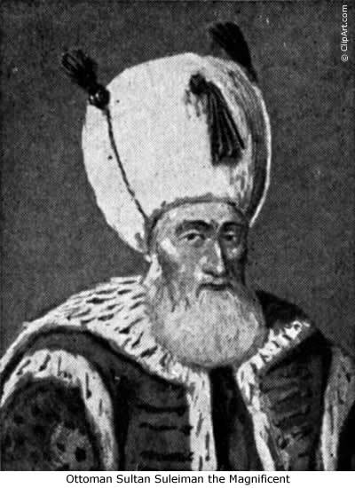
The Scattering Of The Power Of The Holy People
…. In the midst of all this mayhem Jerusalem was taken from the Ottoman Turks by True Israel marking the fullness of the true Israel nations – from now on it was decline for these nations.
Ottoman Sultan Suleiman The Magnificent

Slide 6
Gog – Schemes To Take Possession Of The Holy Land
Here we see General Allenby taking control of Jerusalem, after it surrendered in 1917, walking on foot through the Jaffa Gate as a sign of respect for the holy city.
Has the right significance been put on this event by the mainstream church and BI in particular?
Notes:
Here we present an historic image of Palestine - Jerusalem. General Allenby's entrance into Jerusalem. It was taken in 1917. General Allenby, a famed cavalry officer, dismounted and walked on foot into Jerusalem, as a sign of respect for the Holy City. The image shows Military procession entering Jerusalem through Jaffa Gate.

Slide 7
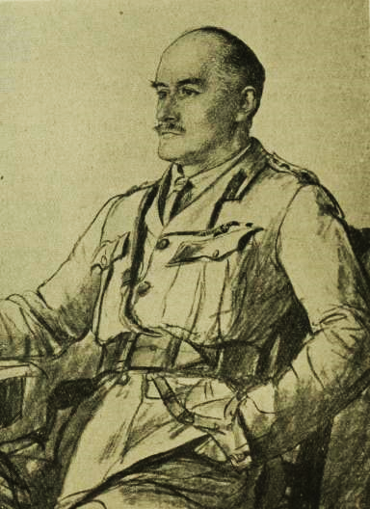
Gog – Schemes To Take Possession Of The Holy Land
In reality the taking of Jerusalem by General Allenby, was a key event, marking the setting up of the abomination of desolation accompanied by the rapid decline of the true Israelite nations.

Slide 8
Gog – Schemes To Take Possession Of The Holy Land
General Allenby entered Jerusalem on December 9, 1917, as World War I neared its end, unknowingly as a proxy for the Zionists, to take control of the Holy Land so Gog could disguise himself as God’s chosen!
General Allenby addressing the inhabitants of Jerusalem

Slide 9
1917 – Scattering The Power Of The Holy People
Romans 11:25-26 For I do not desire, brethren, that you should be ignorant of this mystery, lest you should be wise in your own opinion, that blindness in part has happened to Israel until the fullness of the Gentiles has come in.

Slide 10
True Israel Trodden Down By The Beast System
Luke 8:5 A sower went out to sow his seed: and as he sowed, some fell by the way side; and it was trodden down, and the fowls of the air devoured it.

Slide 11
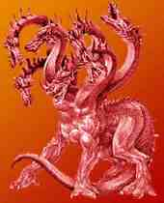
True Israel Trodden Down By The Beast System
The nations of true Israel trodden down by the beast system of Babylon – represented by the 10 toes of Daniel’s image and the 10 horns of the beast of revelation.

Slide 12
True Israel Trodden Down By The Beast System
But Southall – West London
This is not Bombay
Here we see the fowls of the air (Bible symbolism for the heathen non-Israelite nations) coming to feed on the carcases of the declining Israelite nations.

Slide 13
True Israel Trodden Down By The Beast System
Luke 21:24 And they shall fall by the edge of the sword, and shall be led away captive into all nations: and Jerusalem shall be trodden down of the Gentiles, until the times of the Gentiles be fulfilled.

Slide 14
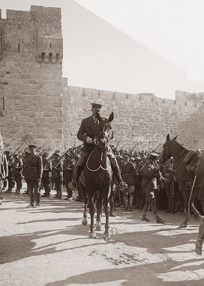
True Israel Trodden Down By The Beast System
The taking of Old Jerusalem by true Israel, in the person of General Allenby, was the prophetic gong that the time had come for scattering the power of the holy people.
General Allenby

Slide 15
The Ottoman Empire
The overt reason for attacking the Ottoman Empire was to free the Arabs from oppression – but in reality it was to rearrange the Middle East to Gog’s design and obtain Palestine for the Zionists.

Slide 16
Gog – Preconditions Christians To Accept The Zionist State
Gog’s agents have, since the publishing of the King James Bible in 1601, been gradually changing it to remove pointers to our identity – removing the translator’s preface, the Apocrypha and substituting Jew for Judah or Judean, to name but a few.
The Scriptures have been tampered with.

Slide 17
Gog – Preconditions Christians To Accept The Zionist State
Scofield did perhaps more than anyone else by his notes and commentaries to the King James Bible (The Scofield edition) to get Christians focused on Zion in the Middle East and the regathering of the Jews “God’s Holy People” to Palestine. Even after Scofield’s death the Oxford University press added and expanded on his notes.
C. I. Scofield (Jew)

Slide 18
Gog – Preconditions Christians To Accept The Zionist State
Another important factor was the growing awareness in Anglo-Saxon countries of their identity as true Israel. However, the original exponents of BI such as Hine saw the Jews as the other house i.e. Judah.
The BIWF Logo

Slide 19
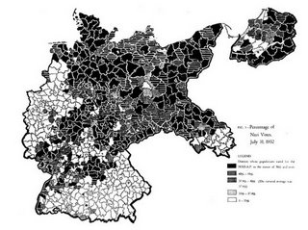
Gog – Preconditions Christians To Accept The Zionist State
This would later play into the Zionists’ hands with regard to redrawing the map of Europe and the destruction of Germany through WWI & 2.
Pre-war Germany

Slide 20
Gog – Preconditions Christians To Accept The Zionist State
During the late 1800’s and early 1900’s there was a turning back to God of the people in the UK and other Anglo-Saxon countries, particularly in S. Wales by preachers who could pack the largest halls, foremost among these was George Jefferies, who also preached the Identity message.
Principal George Jeffreys

Slide 21
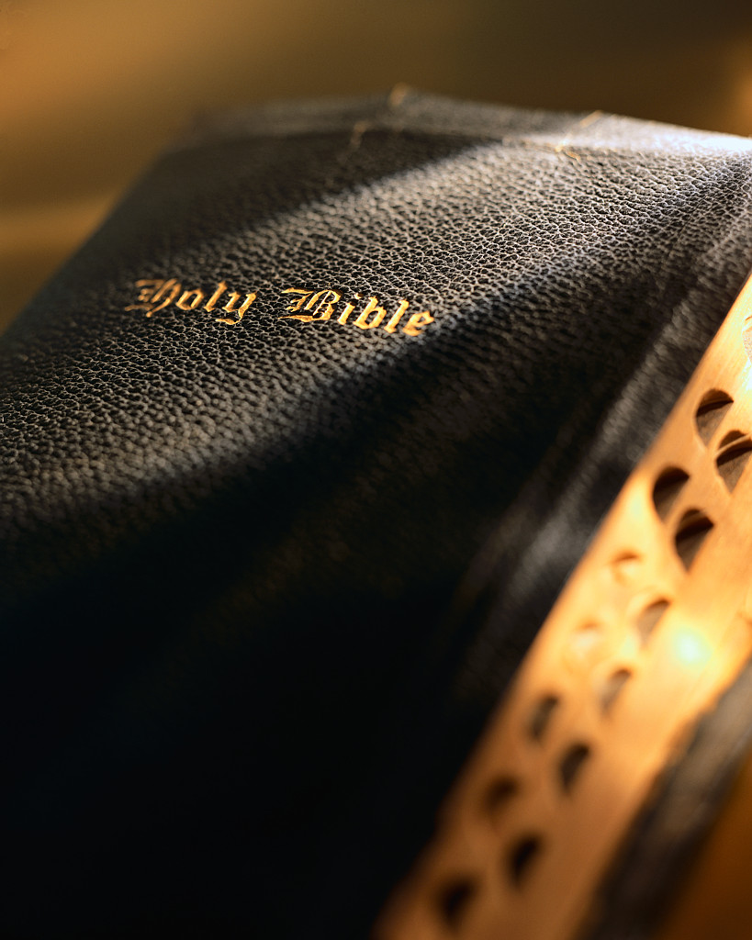
Gog – Preconditions Christians To Accept The Zionist State
Romans 11:25
For I do not desire, brethren, that you should be ignorant of this mystery, lest you should be wise in your own opinion, that blindness in part has happened to Israel until the fullness of the Gentiles has come in.

Slide 22
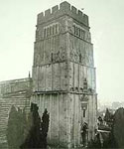
Gog – Preconditions Christians To Accept The Zionist State
It is interesting that at this prophetical time point the Israel Identity message was being disseminated throughout the Germanic-Anglo-Saxon World.

Slide 23
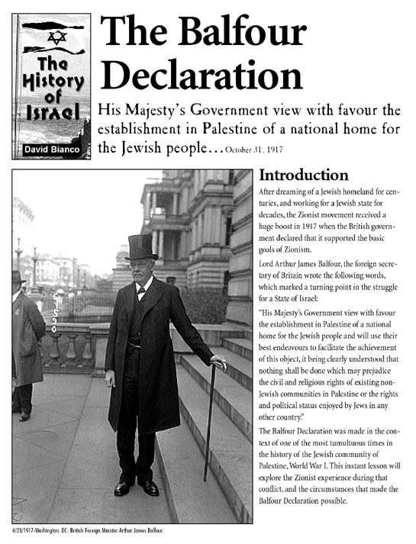
Gog – Preconditions Christians To Accept The Zionist State
The focus was heavily on the British being Israel, with the continent of Europe and its Israelites being ignored, this would play into the hands of the Zionists.

Slide 24
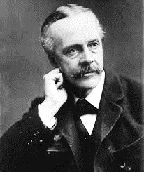
Gog – Preconditions Christians To Accept The Zionist State
Especially helpful would be the fact that the Jews were held up as the House of Judah and would sway public opinion on permitting a homeland for the Jews in Palestine.
Lord Balfour

Slide 25
Gog – Preconditions Christians To Accept The Zionist State
David Davidson (well known for his works on the great pyramid and prophecy) was Taken to task in 1941 for declaring that the Jews were Edom, which would indicate that Zionists had infiltrated this organisation.
The Great Pyramid
Notes:
Stough Papers – Letter from David Davidson 4006
A, R, Heaver, Esq., 4,Buckingham Gate
6, Buckingham Gate, London S.W.1.
London, S.W.1.
24th February, 1941.
Dear A.R.H.,
Is Edom Turkey ? If not, who is ?
I think you have always conceded that my mind operates along logical channels and that I can break away from those channels to explore unknown territory by empirical methods. In this case I propose to explore territory which, I am inclined to believe, may have been wrongly mapped, and I therefore have to follow ‑ or deviate from ‑ the channels of thought of others. I have no bias In the matter, to what I may have to say can be left open for discussion by others within our movement. But let us be logical:
It has been my opinion for thirty‑nine years, ever mince I accepted the general tenets of British­-Israel Truth,
(1) That it has been definitely proved that Britain is Israel; and
(2) That it has never been definitely proved ‑ or oven provisionally or tentatively shown to be a feasible theory ‑ that Turkey is Edom.
My reason for writing you is that I believe we are liable shortly to make some very serious mistakes in the interpretation of prophecy if Turkey is not Edom. If the Turks are not Edomites, we would be in a better position as interpreters if we could identify the race which is in the place of Edom in current times.
Now what are the grounds upon which Turkey is identified with Edom?
I follow H. Herbert Pain's book, Englishmen Israelites: Turks Edomites(1896). In the
light of what we know to‑day this makes out a very strong case for Britain being Israel, but, at the same time, and in the light of the same knowledge, makes out a very poor cams for Turkey being Edom.
Two of Esau's grandchildren were Teman and Omar. From this it is conjectured (Pain, page 106), that Teman in the name Othman or Ottoman, and therefore that Otbman (born in 1258 A.D.), and Omar ( who built the Mosque at Jerusalem around 639.A.D.) were Edomites A previous Othman, however, succeeded the latter Omar as Caliph in 644 A.D., and neither rulers, were Turks, a race not yet in contact with the Early Caliphs.
It is easy to understand how the ancient Edomite names Teman and Omar could persist in Arabia as Othman and Omar, but not no easy to see how either name could be brought into Asia Minor from Khorasan by the 400 Turkish followers of Ertoghrul (the father at the founder of the Ottoman Dynasty) in the middle of the 13th century. An a matter of fact the name Othman ‑ but significantly pronounced Osman by the Turks ‑ was given to the son of Ertoghrul, born in Asia Minor,, after the Turks had settled there. From him, the first Otbman of the Ottoman Dynasty, the Ottoman or Osmanii Turks derive their name.
The intrusion of the Turks under Ertoghrul was due to their displacement from Western Asia Asia by the invading Mongol hordes of Ghengiz Khan. The Turkish language is neither Semitic Aryan in either origin or form both of which are purely Asiatic. At the time of the Caliph Omar ( A.D. 634 ‑ 644) the Turks had no contact with the Middle East.
Of Esau, in Gen. xxvii, 40, it in said, "By the sword thou shalt live". This,
it is conjectured, identifies Turkey with Edom. But would not the same identification apply to all those of the sword of islam? Are therefore all those under the banner of Islam to be identified with Edom?
Pain (page 108) states that Ezekiel, (chap. xxxvi), foretelling the Restoration of the Chosen People, declares that at that time the people who are in possession of the land, is none other than Edom". Turkey is not now in possession of the land, nor has the Chosen People yet been restored according to the tome of Ezekiel’s prophecy. A Mandate to govern the land on behalf of a mixed populace of Ashkenazim Jews and Arabs is not the promised Restoration.
Lest there be any doubt that the reference to Idumea (Edom) in Ezekiel xxxvi, 5, refers to the time of the Final Restoration of Israel, the prophecy of Obadiah verses 15 ‑ 21) makes it clear that, at that time, the house of Esau is in possession of the land, and, (obviously, as a consequence of some act of treachery, not specified and still unknown as to its nature) is utterly destroyed by the house of Jacob. You have recently referred to the "people terrible from their beginning" in re my own special favourite xviith chapter of Isaiah, and I agree with all you have said. To be terrible, according to the meaning which the prophet Isaiah intended to convey, is to be terrible with the righteousness which in over behind the "Weapons of God's indignation”. Even William Penn, the potential peacemaker had to act righteously as the terrible executioner which history proves: Even Jesus, in a parable without words, scourged the money‑changers from the Temple:
Consider, then, what enlightenment there is in the words of II Eadras vi, 7 and 9 -
“What shall be the parting asunder of the times ? or when shall be the and of the first, and the beginning of it that followeth”.
“…………Esau is the end of the world$ and Jacob is the beginning of it that followeth".
But to return to Pain’s book, I have to confess that in the light of the events of the 45 years which have elapsed since the book was published, I can find no identification marks ‑ other than those I have considered equating Turkey with Edom. If you read the book for yourself, I venture to say you will find none.
So let us now consider briefly as to what modern race may reasonably or tentatively be identified with Edom.I emphasize reasonably or tentatively. because the question will be decisively answered only at the time of the Restoration – which obviously, to most of us, must happen shortly.
Here I must refer you to Antiquities, XIII, ix, 1, where Josephus says that the Idumeans, after adopting the Jewish religion in the second century B.C., became "hereafter no other than Jews”.
Re this and other passages in Josephus Antiquities and Wars), the Encyleopaidia Biblica, Vol.II col. 1187, states:-
"And yet many of the Jews, it would seem, must have had Edomite blood in their veins; for we may reasonably assume not only that the Edomites, after they had adopted Judaism, intermarried largely with their co‑religionists, but also that those Edomites, who survived the final catastrophe (A.D. 70), whether in the conditions of slaves or otherwise, were regarded as Jews both by themselves and by the outer world."
Previously, in the same paragraph. It is stated re the rebellion against Rome (A.D. 66 ‑ 70):­-
"Considering themselves Jews in the fullest sense, the fierce and turbulent inhabitants of Idumea eagerly joined in the rebellion against the Romans, and played a prominent part both in the intestine struggles and in the heroic but altogether hopeless resistance to the enemy. Thus Edom was laid waste with fire and sword, and the nation as such ceased to be".
The only seed of Edom then remaining, according to The Encyclopaedia Biblica on the authority of the eye‑witness Josephus, is to be sought in modern Jewry. What an ironical circumstance it will prove to be should Esau, claiming to be of Jacob in modern Jewry, be now seeking to claim the inheritance that was bartered for "a mess of pottage". For Edom must yet “cease to be” at the hands of the House of Jacob.
"Behold, I will make them of the synagogue of Satan, which say they are Jews, and are not, but do lie; behold, I will make them to come and worship before thy feet, and to know that I have loved thee".(Rev* iii, 9).
Here I would bring forward the witness of the Great Pyramid. The prophecy of the latter shows:-­
(1) By the symbolism of the Queen's Chamber, that the "Jews" remain in the "womb of the Second Birth" from A.D. 30 to A.D. 1936, refusing to be spiritually reborn;
(2) By the symbolism of the Queen% Chamber, that the "Jewish" diversion or "rounding‑up" extends from January 18th, 1918 to September 16th, 1936 ‑‑ beginning at January 18th, 1918, upon the date at which the Bolshevists usurped power in Russia;
(3) By the symbolism of the Queen's Chamber and by that of the King's Chamber, that the "Jewish" rounding‑up, ‑ ending at September 16th. 1936, when the 70th Jubilee period began the year of release from usury and all servitude, ‑ finished the twilight of one age to enter the dawn of the next age, the age of the ascension of "Jacob" through tribulation to become "Israel"; and
(4) By the symbolism of the King's Chamber that the period during which "Jacob" (the "supplanter" of Esau) is to become, through "Jacob's trouble", truly Israel, "a prince with God".
For “……… Esau is the end of the world , and Jacob is the beginning of it that followeth". The Pyramid therefore seems to portray the exact end of the age of the power of Esau in Jewry, In this connection kindly refer to say recent précis‑report of a typical lecture, foot of page 5, and top of page 6 of my communication of 18th Instant; and also to MY article for The National Message, “The Feet of the Image of Daniel II", typescript foot of page 4.
The latter article was written at your request per Mr. Grant for further information on the background, of the collapse of France.
The Pyramid indications, as outlined above, were first developed in Pyramid Prophecy and Current Events (July 1925). The Pyramid’s Index Datings, as I termed them,
Were shown to reveal the undermining influence of international finance an operating through France. The self‑planned destiny of the Jews was also dealt with from the standpoint, of pyramid symbolism as being related.
Until then (July 1925) my work had appeared to be entirely favourable to the restoration of the Jews to Palestine, and from autumn 1924 to l925, The Great Pyramid: Its Divine Message had been enthusiastically discussed in League of Nations circles at Geneva, and an eminent journalist representing a powerful ring of newspapers had applied to my publishers for a copy of the work to review it In all the journals of the rings. Then came Pyramid Prophecy and Current Events, (July 1925) and all "international enthusiasm” ceased, and no more was heard of the promised series of reviews. Two or three years later I met another eminent journalist in the same ring referred to. He told me he had long wished to meat me to tell me something privately. He informed me that he had approached his principals and had asked them why they did not take up the popularisation of my works. They replied that they dared not do so because of the powerful opposition from certain international financial elements. I will pass on privately to you the names of the two eminent journalists should you wish to know them.
The Pyramid's prophecy indicates ‑ both by the Queen's Chamber symbolism ending and by the King's Chamber symbolism beginning on the some date -- that September 18th, 1936 is the date for the coming into operation of the Divine Edict for the winding‑up of the affairs of international finance in preparation for the coming new age. This therefore is the beginning of the Divine Assessment preparatory to Jacob's Trouble and then the full Judgment of the Nations. The date began the Jubilee year of release from usury and all servitude as I have pointed out in The Judgment of the Nations, and the actual date from which release was to take effect was 10th Tisri the feast of Atonement (or Expiation, which word the Jews prefer). The latter date fell on September 26th, 1936, when in an effort to save the franc, the Tripartite Monetary Agreement was signed between Britain, the U.S.A. and France. This indicated the end of the attack, projected through French policy, by International Finance upon the financial basis of the economic world order of the British Empire and the U.S.A., an attack which began upon May 30th, 19280 as I have proved from French admissions and Toynbeel's diagnosis. Surely the disaster which is to overtake Edom at the Restoration of Israel will be as a consequence of the poison injected into world affairs by the False Prophet in Edomite Jewry. Here please refer to The Domination of Babylon pagan 34 and 35.
But it will be said; Esau shall live by‑the sword. Well has not international Finance in Jewry lived by the sword, by stimulating the competition in armaments and, by the manipulation of the world’s markets and exchanges, setting nation against nation? And
the whole of Jewry has partaken of the stigma acquired by those who have thus operated from within Jewry.
So of Edom it is said in Obadiah's prophecy:
"Behold I have made thee small among the nations: thou art greatly despised".
"All the men of thy confederacy have driven thee out, over to the border".
"Shall I not in that day, saith the Lord, destroy the wise men out of Edom, and understanding out of the Mount of Esau?". (For wise and understanding Moffatt gives astute and shrewd men.
"For the day of the Lord In near upon all the nations; as thou hast done, it shall be done unto thee: tby dealing shall return upon thine own head". Yet as God has sifted Israel out of the nations so can God sift Esau out of Jewry.
With all this at the back of my mind, can you realise the restraint I have had to exercise in all my interpretations when dealing with the question of the Jews. Understanding that there must be Jews of Israel, Edomite Jews, and Edomites all being shaken through the sieve, I had to be cautious to avoid any semblance of bias against the Jews as such. Any bias that personal contacts may have given me was counterbalanced by the knowledge of the persecutions that the Jews had suffered through history, and by the remembrance of our Lord's words on the Cross ‑
"Father forgive them, for they know what they do".
Indeed so much did I make of this other side of the question in Pyramid Prophecy and Current Events in 19250 that I was accused in many B.‑I. circles (rotating around General Blakeney) of being pro­ Jewish.
Going further back, to 1922, 1 took the lead, as President of the Leeds B.‑I.Association, in opposing what many of us deemed to be, in 1922, the Anti‑Jewish views of Dr. Pascoe Goard and, in particular, Merton Smith.
I cannot therefore now be accused of being anti‑Jewish and therefore, by implication, pro­-Fascist. As I have said in beginning, I have no bias. It is simply the logical interpretation of the prophecies which hat dictated my writing you now. And there I leave the matter.
Here, however, I must express what I have longed to do for some years, which, indeed, I have done extemporary from the platform - namely to say how much I appreciate your editorials and your "Week by Week" articles. How you can accommodate your long view of history ahead with the short view requirements of the majority without landing yourself into major errors of interpretation in regard to prophecy is something which has always astonished me. May I, for my own satisfaction. portray you as -
a statesman‑journalist who employs the "news‑value* of the moment to carry us forward in successive and progressive stages towards the goal which we are all vaguely seeking - namely, understanding of the full meaning of the destiny of Israel‑Britain in the coming Commonwealth of all English­speaking peoples.
With kindest regards,
Yours sincerely.
David Davidson

Slide 26
Gog – Preconditions Christians To Accept The Zionist State
The BIWF would be helpful to the Zionist cause, by assisting in the demonising of Germany and through the holocaust propaganda, would ensure maximum support for the setting up of the Zionist state in Palestine.
Old Map of Germany
Notes:
Stough Papers – Letter from David Davidson 4006
A, R, Heaver, Esq., 4,Buckingham Gate
6, Buckingham Gate, London S.W.1.
London, S.W.1.
24th February, 1941.
Dear A.R.H.,
Is Edom Turkey ? If not, who is ?
I think you have always conceded that my mind operates along logical channels and that I can break away from those channels to explore unknown territory by empirical methods. In this case I propose to explore territory which, I am inclined to believe, may have been wrongly mapped, and I therefore have to follow ‑ or deviate from ‑ the channels of thought of others. I have no bias In the matter, to what I may have to say can be left open for discussion by others within our movement. But let us be logical:
It has been my opinion for thirty‑nine years, ever mince I accepted the general tenets of British­-Israel Truth,
(1) That it has been definitely proved that Britain is Israel; and
(2) That it has never been definitely proved ‑ or oven provisionally or tentatively shown to be a feasible theory ‑ that Turkey is Edom.
My reason for writing you is that I believe we are liable shortly to make some very serious mistakes in the interpretation of prophecy if Turkey is not Edom. If the Turks are not Edomites, we would be in a better position as interpreters if we could identify the race which is in the place of Edom in current times.
Now what are the grounds upon which Turkey is identified with Edom?
I follow H. Herbert Pain's book, Englishmen Israelites: Turks Edomites(1896). In the
light of what we know to‑day this makes out a very strong case for Britain being Israel, but, at the same time, and in the light of the same knowledge, makes out a very poor cams for Turkey being Edom.
Two of Esau's grandchildren were Teman and Omar. From this it is conjectured (Pain, page 106), that Teman in the name Othman or Ottoman, and therefore that Otbman (born in 1258 A.D.), and Omar ( who built the Mosque at Jerusalem around 639.A.D.) were Edomites A previous Othman, however, succeeded the latter Omar as Caliph in 644 A.D., and neither rulers, were Turks, a race not yet in contact with the Early Caliphs.
It is easy to understand how the ancient Edomite names Teman and Omar could persist in Arabia as Othman and Omar, but not no easy to see how either name could be brought into Asia Minor from Khorasan by the 400 Turkish followers of Ertoghrul (the father at the founder of the Ottoman Dynasty) in the middle of the 13th century. An a matter of fact the name Othman ‑ but significantly pronounced Osman by the Turks ‑ was given to the son of Ertoghrul, born in Asia Minor,, after the Turks had settled there. From him, the first Otbman of the Ottoman Dynasty, the Ottoman or Osmanii Turks derive their name.
The intrusion of the Turks under Ertoghrul was due to their displacement from Western Asia Asia by the invading Mongol hordes of Ghengiz Khan. The Turkish language is neither Semitic Aryan in either origin or form both of which are purely Asiatic. At the time of the Caliph Omar ( A.D. 634 ‑ 644) the Turks had no contact with the Middle East.
Of Esau, in Gen. xxvii, 40, it in said, "By the sword thou shalt live". This,
it is conjectured, identifies Turkey with Edom. But would not the same identification apply to all those of the sword of islam? Are therefore all those under the banner of Islam to be identified with Edom?
Pain (page 108) states that Ezekiel, (chap. xxxvi), foretelling the Restoration of the Chosen People, declares that at that time the people who are in possession of the land, is none other than Edom". Turkey is not now in possession of the land, nor has the Chosen People yet been restored according to the tome of Ezekiel’s prophecy. A Mandate to govern the land on behalf of a mixed populace of Ashkenazim Jews and Arabs is not the promised Restoration.
Lest there be any doubt that the reference to Idumea (Edom) in Ezekiel xxxvi, 5, refers to the time of the Final Restoration of Israel, the prophecy of Obadiah verses 15 ‑ 21) makes it clear that, at that time, the house of Esau is in possession of the land, and, (obviously, as a consequence of some act of treachery, not specified and still unknown as to its nature) is utterly destroyed by the house of Jacob. You have recently referred to the "people terrible from their beginning" in re my own special favourite xviith chapter of Isaiah, and I agree with all you have said. To be terrible, according to the meaning which the prophet Isaiah intended to convey, is to be terrible with the righteousness which in over behind the "Weapons of God's indignation”. Even William Penn, the potential peacemaker had to act righteously as the terrible executioner which history proves: Even Jesus, in a parable without words, scourged the money‑changers from the Temple:
Consider, then, what enlightenment there is in the words of II Eadras vi, 7 and 9 -
“What shall be the parting asunder of the times ? or when shall be the and of the first, and the beginning of it that followeth”.
“…………Esau is the end of the world$ and Jacob is the beginning of it that followeth".
But to return to Pain’s book, I have to confess that in the light of the events of the 45 years which have elapsed since the book was published, I can find no identification marks ‑ other than those I have considered equating Turkey with Edom. If you read the book for yourself, I venture to say you will find none.
So let us now consider briefly as to what modern race may reasonably or tentatively be identified with Edom.I emphasize reasonably or tentatively. because the question will be decisively answered only at the time of the Restoration – which obviously, to most of us, must happen shortly.
Here I must refer you to Antiquities, XIII, ix, 1, where Josephus says that the Idumeans, after adopting the Jewish religion in the second century B.C., became "hereafter no other than Jews”.
Re this and other passages in Josephus Antiquities and Wars), the Encyleopaidia Biblica, Vol.II col. 1187, states:-
"And yet many of the Jews, it would seem, must have had Edomite blood in their veins; for we may reasonably assume not only that the Edomites, after they had adopted Judaism, intermarried largely with their co‑religionists, but also that those Edomites, who survived the final catastrophe (A.D. 70), whether in the conditions of slaves or otherwise, were regarded as Jews both by themselves and by the outer world."
Previously, in the same paragraph. It is stated re the rebellion against Rome (A.D. 66 ‑ 70):­-
"Considering themselves Jews in the fullest sense, the fierce and turbulent inhabitants of Idumea eagerly joined in the rebellion against the Romans, and played a prominent part both in the intestine struggles and in the heroic but altogether hopeless resistance to the enemy. Thus Edom was laid waste with fire and sword, and the nation as such ceased to be".
The only seed of Edom then remaining, according to The Encyclopaedia Biblica on the authority of the eye‑witness Josephus, is to be sought in modern Jewry. What an ironical circumstance it will prove to be should Esau, claiming to be of Jacob in modern Jewry, be now seeking to claim the inheritance that was bartered for "a mess of pottage". For Edom must yet “cease to be” at the hands of the House of Jacob.
"Behold, I will make them of the synagogue of Satan, which say they are Jews, and are not, but do lie; behold, I will make them to come and worship before thy feet, and to know that I have loved thee".(Rev* iii, 9).
Here I would bring forward the witness of the Great Pyramid. The prophecy of the latter shows:-­
(1) By the symbolism of the Queen's Chamber, that the "Jews" remain in the "womb of the Second Birth" from A.D. 30 to A.D. 1936, refusing to be spiritually reborn;
(2) By the symbolism of the Queen% Chamber, that the "Jewish" diversion or "rounding‑up" extends from January 18th, 1918 to September 16th, 1936 ‑‑ beginning at January 18th, 1918, upon the date at which the Bolshevists usurped power in Russia;
(3) By the symbolism of the Queen's Chamber and by that of the King's Chamber, that the "Jewish" rounding‑up, ‑ ending at September 16th. 1936, when the 70th Jubilee period began the year of release from usury and all servitude, ‑ finished the twilight of one age to enter the dawn of the next age, the age of the ascension of "Jacob" through tribulation to become "Israel"; and
(4) By the symbolism of the King's Chamber that the period during which "Jacob" (the "supplanter" of Esau) is to become, through "Jacob's trouble", truly Israel, "a prince with God".
For “……… Esau is the end of the world , and Jacob is the beginning of it that followeth". The Pyramid therefore seems to portray the exact end of the age of the power of Esau in Jewry, In this connection kindly refer to say recent précis‑report of a typical lecture, foot of page 5, and top of page 6 of my communication of 18th Instant; and also to MY article for The National Message, “The Feet of the Image of Daniel II", typescript foot of page 4.
The latter article was written at your request per Mr. Grant for further information on the background, of the collapse of France.
The Pyramid indications, as outlined above, were first developed in Pyramid Prophecy and Current Events (July 1925). The Pyramid’s Index Datings, as I termed them,
Were shown to reveal the undermining influence of international finance an operating through France. The self‑planned destiny of the Jews was also dealt with from the standpoint, of pyramid symbolism as being related.
Until then (July 1925) my work had appeared to be entirely favourable to the restoration of the Jews to Palestine, and from autumn 1924 to l925, The Great Pyramid: Its Divine Message had been enthusiastically discussed in League of Nations circles at Geneva, and an eminent journalist representing a powerful ring of newspapers had applied to my publishers for a copy of the work to review it In all the journals of the rings. Then came Pyramid Prophecy and Current Events, (July 1925) and all "international enthusiasm” ceased, and no more was heard of the promised series of reviews. Two or three years later I met another eminent journalist in the same ring referred to. He told me he had long wished to meat me to tell me something privately. He informed me that he had approached his principals and had asked them why they did not take up the popularisation of my works. They replied that they dared not do so because of the powerful opposition from certain international financial elements. I will pass on privately to you the names of the two eminent journalists should you wish to know them.
The Pyramid's prophecy indicates ‑ both by the Queen's Chamber symbolism ending and by the King's Chamber symbolism beginning on the some date -- that September 18th, 1936 is the date for the coming into operation of the Divine Edict for the winding‑up of the affairs of international finance in preparation for the coming new age. This therefore is the beginning of the Divine Assessment preparatory to Jacob's Trouble and then the full Judgment of the Nations. The date began the Jubilee year of release from usury and all servitude as I have pointed out in The Judgment of the Nations, and the actual date from which release was to take effect was 10th Tisri the feast of Atonement (or Expiation, which word the Jews prefer). The latter date fell on September 26th, 1936, when in an effort to save the franc, the Tripartite Monetary Agreement was signed between Britain, the U.S.A. and France. This indicated the end of the attack, projected through French policy, by International Finance upon the financial basis of the economic world order of the British Empire and the U.S.A., an attack which began upon May 30th, 19280 as I have proved from French admissions and Toynbeel's diagnosis. Surely the disaster which is to overtake Edom at the Restoration of Israel will be as a consequence of the poison injected into world affairs by the False Prophet in Edomite Jewry. Here please refer to The Domination of Babylon pagan 34 and 35.
But it will be said; Esau shall live by‑the sword. Well has not international Finance in Jewry lived by the sword, by stimulating the competition in armaments and, by the manipulation of the world’s markets and exchanges, setting nation against nation? And
the whole of Jewry has partaken of the stigma acquired by those who have thus operated from within Jewry.
So of Edom it is said in Obadiah's prophecy:
"Behold I have made thee small among the nations: thou art greatly despised".
"All the men of thy confederacy have driven thee out, over to the border".
"Shall I not in that day, saith the Lord, destroy the wise men out of Edom, and understanding out of the Mount of Esau?". (For wise and understanding Moffatt gives astute and shrewd men.
"For the day of the Lord In near upon all the nations; as thou hast done, it shall be done unto thee: tby dealing shall return upon thine own head". Yet as God has sifted Israel out of the nations so can God sift Esau out of Jewry.
With all this at the back of my mind, can you realise the restraint I have had to exercise in all my interpretations when dealing with the question of the Jews. Understanding that there must be Jews of Israel, Edomite Jews, and Edomites all being shaken through the sieve, I had to be cautious to avoid any semblance of bias against the Jews as such. Any bias that personal contacts may have given me was counterbalanced by the knowledge of the persecutions that the Jews had suffered through history, and by the remembrance of our Lord's words on the Cross ‑
"Father forgive them, for they know what they do".
Indeed so much did I make of this other side of the question in Pyramid Prophecy and Current Events in 19250 that I was accused in many B.‑I. circles (rotating around General Blakeney) of being pro­ Jewish.
Going further back, to 1922, 1 took the lead, as President of the Leeds B.‑I.Association, in opposing what many of us deemed to be, in 1922, the Anti‑Jewish views of Dr. Pascoe Goard and, in particular, Merton Smith.
I cannot therefore now be accused of being anti‑Jewish and therefore, by implication, pro­-Fascist. As I have said in beginning, I have no bias. It is simply the logical interpretation of the prophecies which hat dictated my writing you now. And there I leave the matter.
Here, however, I must express what I have longed to do for some years, which, indeed, I have done extemporary from the platform - namely to say how much I appreciate your editorials and your "Week by Week" articles. How you can accommodate your long view of history ahead with the short view requirements of the majority without landing yourself into major errors of interpretation in regard to prophecy is something which has always astonished me. May I, for my own satisfaction. portray you as -
a statesman‑journalist who employs the "news‑value* of the moment to carry us forward in successive and progressive stages towards the goal which we are all vaguely seeking - namely, understanding of the full meaning of the destiny of Israel‑Britain in the coming Commonwealth of all English­speaking peoples.
With kindest regards,
Yours sincerely.
David Davidson

Slide 27
Gog – Preconditions Christians To Accept The Zionist State
Edward Hine, whose features are those of an Armenian Jew, would be helpful to the Zionist because he taught that the Jews were Judah. However, Bishop Titchcombe included the Germanic peoples within the family of true Israel. Needless to say, the London money power backed Edward Hine.
Edward Hine

Slide 28
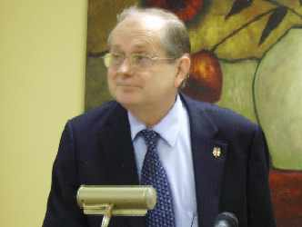
Gog – Preconditions Christians To Accept The Zionist State
The BIWF, once these aims had been achieved, agents within, would ensure the quick decline of this organisation, which had earlier absorbed other independent groups proclaiming the identity message within the UK.
Present BIWF Secretary 2009
Notes:
Stough Papers – Letter from David Davidson 4006
A, R, Heaver, Esq., 4,Buckingham Gate
6, Buckingham Gate, London S.W.1.
London, S.W.1.
24th February, 1941.
Dear A.R.H.,
Is Edom Turkey ? If not, who is ?
I think you have always conceded that my mind operates along logical channels and that I can break away from those channels to explore unknown territory by empirical methods. In this case I propose to explore territory which, I am inclined to believe, may have been wrongly mapped, and I therefore have to follow ‑ or deviate from ‑ the channels of thought of others. I have no bias In the matter, to what I may have to say can be left open for discussion by others within our movement. But let us be logical:
It has been my opinion for thirty‑nine years, ever mince I accepted the general tenets of British­-Israel Truth,
(1) That it has been definitely proved that Britain is Israel; and
(2) That it has never been definitely proved ‑ or oven provisionally or tentatively shown to be a feasible theory ‑ that Turkey is Edom.
My reason for writing you is that I believe we are liable shortly to make some very serious mistakes in the interpretation of prophecy if Turkey is not Edom. If the Turks are not Edomites, we would be in a better position as interpreters if we could identify the race which is in the place of Edom in current times.
Now what are the grounds upon which Turkey is identified with Edom?
I follow H. Herbert Pain's book, Englishmen Israelites: Turks Edomites(1896). In the
light of what we know to‑day this makes out a very strong case for Britain being Israel, but, at the same time, and in the light of the same knowledge, makes out a very poor cams for Turkey being Edom.
Two of Esau's grandchildren were Teman and Omar. From this it is conjectured (Pain, page 106), that Teman in the name Othman or Ottoman, and therefore that Otbman (born in 1258 A.D.), and Omar ( who built the Mosque at Jerusalem around 639.A.D.) were Edomites A previous Othman, however, succeeded the latter Omar as Caliph in 644 A.D., and neither rulers, were Turks, a race not yet in contact with the Early Caliphs.
It is easy to understand how the ancient Edomite names Teman and Omar could persist in Arabia as Othman and Omar, but not no easy to see how either name could be brought into Asia Minor from Khorasan by the 400 Turkish followers of Ertoghrul (the father at the founder of the Ottoman Dynasty) in the middle of the 13th century. An a matter of fact the name Othman ‑ but significantly pronounced Osman by the Turks ‑ was given to the son of Ertoghrul, born in Asia Minor,, after the Turks had settled there. From him, the first Otbman of the Ottoman Dynasty, the Ottoman or Osmanii Turks derive their name.
The intrusion of the Turks under Ertoghrul was due to their displacement from Western Asia Asia by the invading Mongol hordes of Ghengiz Khan. The Turkish language is neither Semitic Aryan in either origin or form both of which are purely Asiatic. At the time of the Caliph Omar ( A.D. 634 ‑ 644) the Turks had no contact with the Middle East.
Of Esau, in Gen. xxvii, 40, it in said, "By the sword thou shalt live". This,
it is conjectured, identifies Turkey with Edom. But would not the same identification apply to all those of the sword of islam? Are therefore all those under the banner of Islam to be identified with Edom?
Pain (page 108) states that Ezekiel, (chap. xxxvi), foretelling the Restoration of the Chosen People, declares that at that time the people who are in possession of the land, is none other than Edom". Turkey is not now in possession of the land, nor has the Chosen People yet been restored according to the tome of Ezekiel’s prophecy. A Mandate to govern the land on behalf of a mixed populace of Ashkenazim Jews and Arabs is not the promised Restoration.
Lest there be any doubt that the reference to Idumea (Edom) in Ezekiel xxxvi, 5, refers to the time of the Final Restoration of Israel, the prophecy of Obadiah verses 15 ‑ 21) makes it clear that, at that time, the house of Esau is in possession of the land, and, (obviously, as a consequence of some act of treachery, not specified and still unknown as to its nature) is utterly destroyed by the house of Jacob. You have recently referred to the "people terrible from their beginning" in re my own special favourite xviith chapter of Isaiah, and I agree with all you have said. To be terrible, according to the meaning which the prophet Isaiah intended to convey, is to be terrible with the righteousness which in over behind the "Weapons of God's indignation”. Even William Penn, the potential peacemaker had to act righteously as the terrible executioner which history proves: Even Jesus, in a parable without words, scourged the money‑changers from the Temple:
Consider, then, what enlightenment there is in the words of II Eadras vi, 7 and 9 -
“What shall be the parting asunder of the times ? or when shall be the and of the first, and the beginning of it that followeth”.
“…………Esau is the end of the world$ and Jacob is the beginning of it that followeth".
But to return to Pain’s book, I have to confess that in the light of the events of the 45 years which have elapsed since the book was published, I can find no identification marks ‑ other than those I have considered equating Turkey with Edom. If you read the book for yourself, I venture to say you will find none.
So let us now consider briefly as to what modern race may reasonably or tentatively be identified with Edom.I emphasize reasonably or tentatively. because the question will be decisively answered only at the time of the Restoration – which obviously, to most of us, must happen shortly.
Here I must refer you to Antiquities, XIII, ix, 1, where Josephus says that the Idumeans, after adopting the Jewish religion in the second century B.C., became "hereafter no other than Jews”.
Re this and other passages in Josephus Antiquities and Wars), the Encyleopaidia Biblica, Vol.II col. 1187, states:-
"And yet many of the Jews, it would seem, must have had Edomite blood in their veins; for we may reasonably assume not only that the Edomites, after they had adopted Judaism, intermarried largely with their co‑religionists, but also that those Edomites, who survived the final catastrophe (A.D. 70), whether in the conditions of slaves or otherwise, were regarded as Jews both by themselves and by the outer world."
Previously, in the same paragraph. It is stated re the rebellion against Rome (A.D. 66 ‑ 70):­-
"Considering themselves Jews in the fullest sense, the fierce and turbulent inhabitants of Idumea eagerly joined in the rebellion against the Romans, and played a prominent part both in the intestine struggles and in the heroic but altogether hopeless resistance to the enemy. Thus Edom was laid waste with fire and sword, and the nation as such ceased to be".
The only seed of Edom then remaining, according to The Encyclopaedia Biblica on the authority of the eye‑witness Josephus, is to be sought in modern Jewry. What an ironical circumstance it will prove to be should Esau, claiming to be of Jacob in modern Jewry, be now seeking to claim the inheritance that was bartered for "a mess of pottage". For Edom must yet “cease to be” at the hands of the House of Jacob.
"Behold, I will make them of the synagogue of Satan, which say they are Jews, and are not, but do lie; behold, I will make them to come and worship before thy feet, and to know that I have loved thee".(Rev* iii, 9).
Here I would bring forward the witness of the Great Pyramid. The prophecy of the latter shows:-­
(1) By the symbolism of the Queen's Chamber, that the "Jews" remain in the "womb of the Second Birth" from A.D. 30 to A.D. 1936, refusing to be spiritually reborn;
(2) By the symbolism of the Queen% Chamber, that the "Jewish" diversion or "rounding‑up" extends from January 18th, 1918 to September 16th, 1936 ‑‑ beginning at January 18th, 1918, upon the date at which the Bolshevists usurped power in Russia;
(3) By the symbolism of the Queen's Chamber and by that of the King's Chamber, that the "Jewish" rounding‑up, ‑ ending at September 16th. 1936, when the 70th Jubilee period began the year of release from usury and all servitude, ‑ finished the twilight of one age to enter the dawn of the next age, the age of the ascension of "Jacob" through tribulation to become "Israel"; and
(4) By the symbolism of the King's Chamber that the period during which "Jacob" (the "supplanter" of Esau) is to become, through "Jacob's trouble", truly Israel, "a prince with God".
For “……… Esau is the end of the world , and Jacob is the beginning of it that followeth". The Pyramid therefore seems to portray the exact end of the age of the power of Esau in Jewry, In this connection kindly refer to say recent précis‑report of a typical lecture, foot of page 5, and top of page 6 of my communication of 18th Instant; and also to MY article for The National Message, “The Feet of the Image of Daniel II", typescript foot of page 4.
The latter article was written at your request per Mr. Grant for further information on the background, of the collapse of France.
The Pyramid indications, as outlined above, were first developed in Pyramid Prophecy and Current Events (July 1925). The Pyramid’s Index Datings, as I termed them,
Were shown to reveal the undermining influence of international finance an operating through France. The self‑planned destiny of the Jews was also dealt with from the standpoint, of pyramid symbolism as being related.
Until then (July 1925) my work had appeared to be entirely favourable to the restoration of the Jews to Palestine, and from autumn 1924 to l925, The Great Pyramid: Its Divine Message had been enthusiastically discussed in League of Nations circles at Geneva, and an eminent journalist representing a powerful ring of newspapers had applied to my publishers for a copy of the work to review it In all the journals of the rings. Then came Pyramid Prophecy and Current Events, (July 1925) and all "international enthusiasm” ceased, and no more was heard of the promised series of reviews. Two or three years later I met another eminent journalist in the same ring referred to. He told me he had long wished to meat me to tell me something privately. He informed me that he had approached his principals and had asked them why they did not take up the popularisation of my works. They replied that they dared not do so because of the powerful opposition from certain international financial elements. I will pass on privately to you the names of the two eminent journalists should you wish to know them.
The Pyramid's prophecy indicates ‑ both by the Queen's Chamber symbolism ending and by the King's Chamber symbolism beginning on the some date -- that September 18th, 1936 is the date for the coming into operation of the Divine Edict for the winding‑up of the affairs of international finance in preparation for the coming new age. This therefore is the beginning of the Divine Assessment preparatory to Jacob's Trouble and then the full Judgment of the Nations. The date began the Jubilee year of release from usury and all servitude as I have pointed out in The Judgment of the Nations, and the actual date from which release was to take effect was 10th Tisri the feast of Atonement (or Expiation, which word the Jews prefer). The latter date fell on September 26th, 1936, when in an effort to save the franc, the Tripartite Monetary Agreement was signed between Britain, the U.S.A. and France. This indicated the end of the attack, projected through French policy, by International Finance upon the financial basis of the economic world order of the British Empire and the U.S.A., an attack which began upon May 30th, 19280 as I have proved from French admissions and Toynbeel's diagnosis. Surely the disaster which is to overtake Edom at the Restoration of Israel will be as a consequence of the poison injected into world affairs by the False Prophet in Edomite Jewry. Here please refer to The Domination of Babylon pagan 34 and 35.
But it will be said; Esau shall live by‑the sword. Well has not international Finance in Jewry lived by the sword, by stimulating the competition in armaments and, by the manipulation of the world’s markets and exchanges, setting nation against nation? And
the whole of Jewry has partaken of the stigma acquired by those who have thus operated from within Jewry.
So of Edom it is said in Obadiah's prophecy:
"Behold I have made thee small among the nations: thou art greatly despised".
"All the men of thy confederacy have driven thee out, over to the border".
"Shall I not in that day, saith the Lord, destroy the wise men out of Edom, and understanding out of the Mount of Esau?". (For wise and understanding Moffatt gives astute and shrewd men.
"For the day of the Lord In near upon all the nations; as thou hast done, it shall be done unto thee: tby dealing shall return upon thine own head". Yet as God has sifted Israel out of the nations so can God sift Esau out of Jewry.
With all this at the back of my mind, can you realise the restraint I have had to exercise in all my interpretations when dealing with the question of the Jews. Understanding that there must be Jews of Israel, Edomite Jews, and Edomites all being shaken through the sieve, I had to be cautious to avoid any semblance of bias against the Jews as such. Any bias that personal contacts may have given me was counterbalanced by the knowledge of the persecutions that the Jews had suffered through history, and by the remembrance of our Lord's words on the Cross ‑
"Father forgive them, for they know what they do".
Indeed so much did I make of this other side of the question in Pyramid Prophecy and Current Events in 19250 that I was accused in many B.‑I. circles (rotating around General Blakeney) of being pro­ Jewish.
Going further back, to 1922, 1 took the lead, as President of the Leeds B.‑I.Association, in opposing what many of us deemed to be, in 1922, the Anti‑Jewish views of Dr. Pascoe Goard and, in particular, Merton Smith.
I cannot therefore now be accused of being anti‑Jewish and therefore, by implication, pro­-Fascist. As I have said in beginning, I have no bias. It is simply the logical interpretation of the prophecies which hat dictated my writing you now. And there I leave the matter.
Here, however, I must express what I have longed to do for some years, which, indeed, I have done extemporary from the platform - namely to say how much I appreciate your editorials and your "Week by Week" articles. How you can accommodate your long view of history ahead with the short view requirements of the majority without landing yourself into major errors of interpretation in regard to prophecy is something which has always astonished me. May I, for my own satisfaction. portray you as -
a statesman‑journalist who employs the "news‑value* of the moment to carry us forward in successive and progressive stages towards the goal which we are all vaguely seeking - namely, understanding of the full meaning of the destiny of Israel‑Britain in the coming Commonwealth of all English­speaking peoples.
With kindest regards,
Yours sincerely.
David Davidson

Slide 29
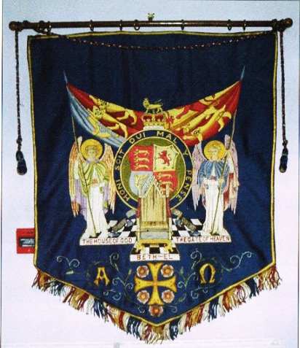
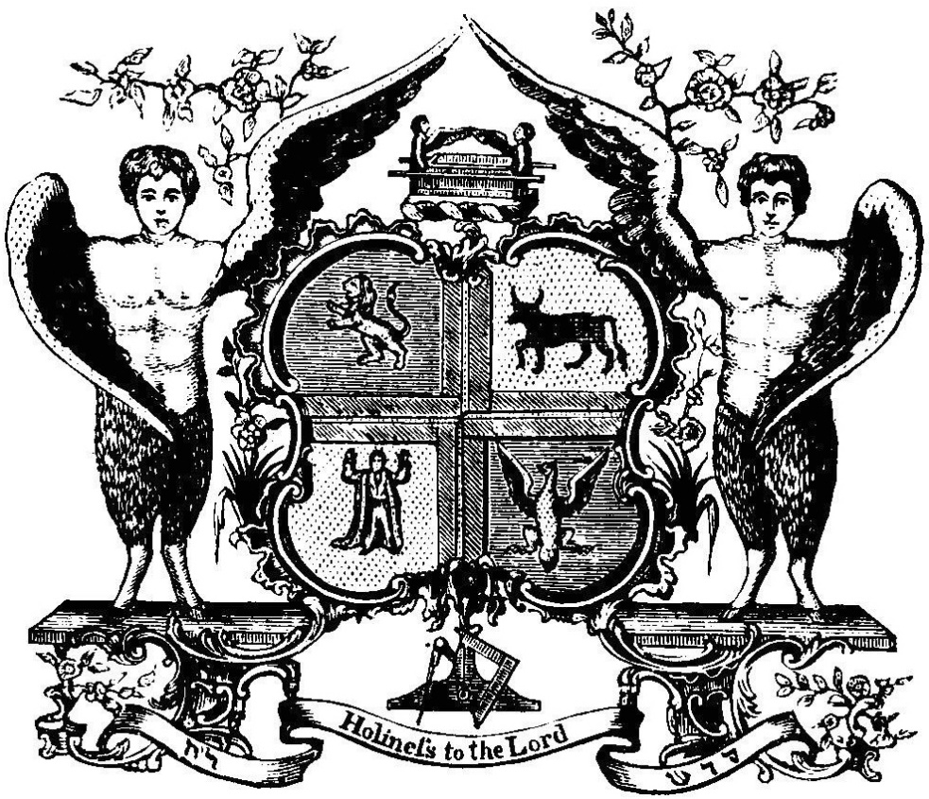
Gog – Preconditions Christians To Accept The Zionist State
Left: The BIWF Coat of Arms Right: The Masonic Coat of Arms – Notice a similarity?
Notes:
Stough Papers – Letter from David Davidson 4006
A, R, Heaver, Esq., 4,Buckingham Gate
6, Buckingham Gate, London S.W.1.
London, S.W.1.
24th February, 1941.
Dear A.R.H.,
Is Edom Turkey ? If not, who is ?
I think you have always conceded that my mind operates along logical channels and that I can break away from those channels to explore unknown territory by empirical methods. In this case I propose to explore territory which, I am inclined to believe, may have been wrongly mapped, and I therefore have to follow ‑ or deviate from ‑ the channels of thought of others. I have no bias In the matter, to what I may have to say can be left open for discussion by others within our movement. But let us be logical:
It has been my opinion for thirty‑nine years, ever mince I accepted the general tenets of British­-Israel Truth,
(1) That it has been definitely proved that Britain is Israel; and
(2) That it has never been definitely proved ‑ or oven provisionally or tentatively shown to be a feasible theory ‑ that Turkey is Edom.
My reason for writing you is that I believe we are liable shortly to make some very serious mistakes in the interpretation of prophecy if Turkey is not Edom. If the Turks are not Edomites, we would be in a better position as interpreters if we could identify the race which is in the place of Edom in current times.
Now what are the grounds upon which Turkey is identified with Edom?
I follow H. Herbert Pain's book, Englishmen Israelites: Turks Edomites(1896). In the
light of what we know to‑day this makes out a very strong case for Britain being Israel, but, at the same time, and in the light of the same knowledge, makes out a very poor cams for Turkey being Edom.
Two of Esau's grandchildren were Teman and Omar. From this it is conjectured (Pain, page 106), that Teman in the name Othman or Ottoman, and therefore that Otbman (born in 1258 A.D.), and Omar ( who built the Mosque at Jerusalem around 639.A.D.) were Edomites A previous Othman, however, succeeded the latter Omar as Caliph in 644 A.D., and neither rulers, were Turks, a race not yet in contact with the Early Caliphs.
It is easy to understand how the ancient Edomite names Teman and Omar could persist in Arabia as Othman and Omar, but not no easy to see how either name could be brought into Asia Minor from Khorasan by the 400 Turkish followers of Ertoghrul (the father at the founder of the Ottoman Dynasty) in the middle of the 13th century. An a matter of fact the name Othman ‑ but significantly pronounced Osman by the Turks ‑ was given to the son of Ertoghrul, born in Asia Minor,, after the Turks had settled there. From him, the first Otbman of the Ottoman Dynasty, the Ottoman or Osmanii Turks derive their name.
The intrusion of the Turks under Ertoghrul was due to their displacement from Western Asia Asia by the invading Mongol hordes of Ghengiz Khan. The Turkish language is neither Semitic Aryan in either origin or form both of which are purely Asiatic. At the time of the Caliph Omar ( A.D. 634 ‑ 644) the Turks had no contact with the Middle East.
Of Esau, in Gen. xxvii, 40, it in said, "By the sword thou shalt live". This,
it is conjectured, identifies Turkey with Edom. But would not the same identification apply to all those of the sword of islam? Are therefore all those under the banner of Islam to be identified with Edom?
Pain (page 108) states that Ezekiel, (chap. xxxvi), foretelling the Restoration of the Chosen People, declares that at that time the people who are in possession of the land, is none other than Edom". Turkey is not now in possession of the land, nor has the Chosen People yet been restored according to the tome of Ezekiel’s prophecy. A Mandate to govern the land on behalf of a mixed populace of Ashkenazim Jews and Arabs is not the promised Restoration.
Lest there be any doubt that the reference to Idumea (Edom) in Ezekiel xxxvi, 5, refers to the time of the Final Restoration of Israel, the prophecy of Obadiah verses 15 ‑ 21) makes it clear that, at that time, the house of Esau is in possession of the land, and, (obviously, as a consequence of some act of treachery, not specified and still unknown as to its nature) is utterly destroyed by the house of Jacob. You have recently referred to the "people terrible from their beginning" in re my own special favourite xviith chapter of Isaiah, and I agree with all you have said. To be terrible, according to the meaning which the prophet Isaiah intended to convey, is to be terrible with the righteousness which in over behind the "Weapons of God's indignation”. Even William Penn, the potential peacemaker had to act righteously as the terrible executioner which history proves: Even Jesus, in a parable without words, scourged the money‑changers from the Temple:
Consider, then, what enlightenment there is in the words of II Eadras vi, 7 and 9 -
“What shall be the parting asunder of the times ? or when shall be the and of the first, and the beginning of it that followeth”.
“…………Esau is the end of the world$ and Jacob is the beginning of it that followeth".
But to return to Pain’s book, I have to confess that in the light of the events of the 45 years which have elapsed since the book was published, I can find no identification marks ‑ other than those I have considered equating Turkey with Edom. If you read the book for yourself, I venture to say you will find none.
So let us now consider briefly as to what modern race may reasonably or tentatively be identified with Edom.I emphasize reasonably or tentatively. because the question will be decisively answered only at the time of the Restoration – which obviously, to most of us, must happen shortly.
Here I must refer you to Antiquities, XIII, ix, 1, where Josephus says that the Idumeans, after adopting the Jewish religion in the second century B.C., became "hereafter no other than Jews”.
Re this and other passages in Josephus Antiquities and Wars), the Encyleopaidia Biblica, Vol.II col. 1187, states:-
"And yet many of the Jews, it would seem, must have had Edomite blood in their veins; for we may reasonably assume not only that the Edomites, after they had adopted Judaism, intermarried largely with their co‑religionists, but also that those Edomites, who survived the final catastrophe (A.D. 70), whether in the conditions of slaves or otherwise, were regarded as Jews both by themselves and by the outer world."
Previously, in the same paragraph. It is stated re the rebellion against Rome (A.D. 66 ‑ 70):­-
"Considering themselves Jews in the fullest sense, the fierce and turbulent inhabitants of Idumea eagerly joined in the rebellion against the Romans, and played a prominent part both in the intestine struggles and in the heroic but altogether hopeless resistance to the enemy. Thus Edom was laid waste with fire and sword, and the nation as such ceased to be".
The only seed of Edom then remaining, according to The Encyclopaedia Biblica on the authority of the eye‑witness Josephus, is to be sought in modern Jewry. What an ironical circumstance it will prove to be should Esau, claiming to be of Jacob in modern Jewry, be now seeking to claim the inheritance that was bartered for "a mess of pottage". For Edom must yet “cease to be” at the hands of the House of Jacob.
"Behold, I will make them of the synagogue of Satan, which say they are Jews, and are not, but do lie; behold, I will make them to come and worship before thy feet, and to know that I have loved thee".(Rev* iii, 9).
Here I would bring forward the witness of the Great Pyramid. The prophecy of the latter shows:-­
(1) By the symbolism of the Queen's Chamber, that the "Jews" remain in the "womb of the Second Birth" from A.D. 30 to A.D. 1936, refusing to be spiritually reborn;
(2) By the symbolism of the Queen% Chamber, that the "Jewish" diversion or "rounding‑up" extends from January 18th, 1918 to September 16th, 1936 ‑‑ beginning at January 18th, 1918, upon the date at which the Bolshevists usurped power in Russia;
(3) By the symbolism of the Queen's Chamber and by that of the King's Chamber, that the "Jewish" rounding‑up, ‑ ending at September 16th. 1936, when the 70th Jubilee period began the year of release from usury and all servitude, ‑ finished the twilight of one age to enter the dawn of the next age, the age of the ascension of "Jacob" through tribulation to become "Israel"; and
(4) By the symbolism of the King's Chamber that the period during which "Jacob" (the "supplanter" of Esau) is to become, through "Jacob's trouble", truly Israel, "a prince with God".
For “……… Esau is the end of the world , and Jacob is the beginning of it that followeth". The Pyramid therefore seems to portray the exact end of the age of the power of Esau in Jewry, In this connection kindly refer to say recent précis‑report of a typical lecture, foot of page 5, and top of page 6 of my communication of 18th Instant; and also to MY article for The National Message, “The Feet of the Image of Daniel II", typescript foot of page 4.
The latter article was written at your request per Mr. Grant for further information on the background, of the collapse of France.
The Pyramid indications, as outlined above, were first developed in Pyramid Prophecy and Current Events (July 1925). The Pyramid’s Index Datings, as I termed them,
Were shown to reveal the undermining influence of international finance an operating through France. The self‑planned destiny of the Jews was also dealt with from the standpoint, of pyramid symbolism as being related.
Until then (July 1925) my work had appeared to be entirely favourable to the restoration of the Jews to Palestine, and from autumn 1924 to l925, The Great Pyramid: Its Divine Message had been enthusiastically discussed in League of Nations circles at Geneva, and an eminent journalist representing a powerful ring of newspapers had applied to my publishers for a copy of the work to review it In all the journals of the rings. Then came Pyramid Prophecy and Current Events, (July 1925) and all "international enthusiasm” ceased, and no more was heard of the promised series of reviews. Two or three years later I met another eminent journalist in the same ring referred to. He told me he had long wished to meat me to tell me something privately. He informed me that he had approached his principals and had asked them why they did not take up the popularisation of my works. They replied that they dared not do so because of the powerful opposition from certain international financial elements. I will pass on privately to you the names of the two eminent journalists should you wish to know them.
The Pyramid's prophecy indicates ‑ both by the Queen's Chamber symbolism ending and by the King's Chamber symbolism beginning on the some date -- that September 18th, 1936 is the date for the coming into operation of the Divine Edict for the winding‑up of the affairs of international finance in preparation for the coming new age. This therefore is the beginning of the Divine Assessment preparatory to Jacob's Trouble and then the full Judgment of the Nations. The date began the Jubilee year of release from usury and all servitude as I have pointed out in The Judgment of the Nations, and the actual date from which release was to take effect was 10th Tisri the feast of Atonement (or Expiation, which word the Jews prefer). The latter date fell on September 26th, 1936, when in an effort to save the franc, the Tripartite Monetary Agreement was signed between Britain, the U.S.A. and France. This indicated the end of the attack, projected through French policy, by International Finance upon the financial basis of the economic world order of the British Empire and the U.S.A., an attack which began upon May 30th, 19280 as I have proved from French admissions and Toynbeel's diagnosis. Surely the disaster which is to overtake Edom at the Restoration of Israel will be as a consequence of the poison injected into world affairs by the False Prophet in Edomite Jewry. Here please refer to The Domination of Babylon pagan 34 and 35.
But it will be said; Esau shall live by‑the sword. Well has not international Finance in Jewry lived by the sword, by stimulating the competition in armaments and, by the manipulation of the world’s markets and exchanges, setting nation against nation? And
the whole of Jewry has partaken of the stigma acquired by those who have thus operated from within Jewry.
So of Edom it is said in Obadiah's prophecy:
"Behold I have made thee small among the nations: thou art greatly despised".
"All the men of thy confederacy have driven thee out, over to the border".
"Shall I not in that day, saith the Lord, destroy the wise men out of Edom, and understanding out of the Mount of Esau?". (For wise and understanding Moffatt gives astute and shrewd men.
"For the day of the Lord In near upon all the nations; as thou hast done, it shall be done unto thee: tby dealing shall return upon thine own head". Yet as God has sifted Israel out of the nations so can God sift Esau out of Jewry.
With all this at the back of my mind, can you realise the restraint I have had to exercise in all my interpretations when dealing with the question of the Jews. Understanding that there must be Jews of Israel, Edomite Jews, and Edomites all being shaken through the sieve, I had to be cautious to avoid any semblance of bias against the Jews as such. Any bias that personal contacts may have given me was counterbalanced by the knowledge of the persecutions that the Jews had suffered through history, and by the remembrance of our Lord's words on the Cross ‑
"Father forgive them, for they know what they do".
Indeed so much did I make of this other side of the question in Pyramid Prophecy and Current Events in 19250 that I was accused in many B.‑I. circles (rotating around General Blakeney) of being pro­ Jewish.
Going further back, to 1922, 1 took the lead, as President of the Leeds B.‑I.Association, in opposing what many of us deemed to be, in 1922, the Anti‑Jewish views of Dr. Pascoe Goard and, in particular, Merton Smith.
I cannot therefore now be accused of being anti‑Jewish and therefore, by implication, pro­-Fascist. As I have said in beginning, I have no bias. It is simply the logical interpretation of the prophecies which hat dictated my writing you now. And there I leave the matter.
Here, however, I must express what I have longed to do for some years, which, indeed, I have done extemporary from the platform - namely to say how much I appreciate your editorials and your "Week by Week" articles. How you can accommodate your long view of history ahead with the short view requirements of the majority without landing yourself into major errors of interpretation in regard to prophecy is something which has always astonished me. May I, for my own satisfaction. portray you as -
a statesman‑journalist who employs the "news‑value* of the moment to carry us forward in successive and progressive stages towards the goal which we are all vaguely seeking - namely, understanding of the full meaning of the destiny of Israel‑Britain in the coming Commonwealth of all English­speaking peoples.
With kindest regards,
Yours sincerely.
David Davidson

Slide 30
Gog – Preconditions Christians To Accept The Zionist State
Left: Notice the checker board indicating city of London Control – 3 x 6 squares = 666 under each angel.
Notes:
Stough Papers – Letter from David Davidson 4006
A, R, Heaver, Esq., 4,Buckingham Gate
6, Buckingham Gate, London S.W.1.
London, S.W.1.
24th February, 1941.
Dear A.R.H.,
Is Edom Turkey ? If not, who is ?
I think you have always conceded that my mind operates along logical channels and that I can break away from those channels to explore unknown territory by empirical methods. In this case I propose to explore territory which, I am inclined to believe, may have been wrongly mapped, and I therefore have to follow ‑ or deviate from ‑ the channels of thought of others. I have no bias In the matter, to what I may have to say can be left open for discussion by others within our movement. But let us be logical:
It has been my opinion for thirty‑nine years, ever mince I accepted the general tenets of British­-Israel Truth,
(1) That it has been definitely proved that Britain is Israel; and
(2) That it has never been definitely proved ‑ or oven provisionally or tentatively shown to be a feasible theory ‑ that Turkey is Edom.
My reason for writing you is that I believe we are liable shortly to make some very serious mistakes in the interpretation of prophecy if Turkey is not Edom. If the Turks are not Edomites, we would be in a better position as interpreters if we could identify the race which is in the place of Edom in current times.
Now what are the grounds upon which Turkey is identified with Edom?
I follow H. Herbert Pain's book, Englishmen Israelites: Turks Edomites(1896). In the
light of what we know to‑day this makes out a very strong case for Britain being Israel, but, at the same time, and in the light of the same knowledge, makes out a very poor cams for Turkey being Edom.
Two of Esau's grandchildren were Teman and Omar. From this it is conjectured (Pain, page 106), that Teman in the name Othman or Ottoman, and therefore that Otbman (born in 1258 A.D.), and Omar ( who built the Mosque at Jerusalem around 639.A.D.) were Edomites A previous Othman, however, succeeded the latter Omar as Caliph in 644 A.D., and neither rulers, were Turks, a race not yet in contact with the Early Caliphs.
It is easy to understand how the ancient Edomite names Teman and Omar could persist in Arabia as Othman and Omar, but not no easy to see how either name could be brought into Asia Minor from Khorasan by the 400 Turkish followers of Ertoghrul (the father at the founder of the Ottoman Dynasty) in the middle of the 13th century. An a matter of fact the name Othman ‑ but significantly pronounced Osman by the Turks ‑ was given to the son of Ertoghrul, born in Asia Minor,, after the Turks had settled there. From him, the first Otbman of the Ottoman Dynasty, the Ottoman or Osmanii Turks derive their name.
The intrusion of the Turks under Ertoghrul was due to their displacement from Western Asia Asia by the invading Mongol hordes of Ghengiz Khan. The Turkish language is neither Semitic Aryan in either origin or form both of which are purely Asiatic. At the time of the Caliph Omar ( A.D. 634 ‑ 644) the Turks had no contact with the Middle East.
Of Esau, in Gen. xxvii, 40, it in said, "By the sword thou shalt live". This,
it is conjectured, identifies Turkey with Edom. But would not the same identification apply to all those of the sword of islam? Are therefore all those under the banner of Islam to be identified with Edom?
Pain (page 108) states that Ezekiel, (chap. xxxvi), foretelling the Restoration of the Chosen People, declares that at that time the people who are in possession of the land, is none other than Edom". Turkey is not now in possession of the land, nor has the Chosen People yet been restored according to the tome of Ezekiel’s prophecy. A Mandate to govern the land on behalf of a mixed populace of Ashkenazim Jews and Arabs is not the promised Restoration.
Lest there be any doubt that the reference to Idumea (Edom) in Ezekiel xxxvi, 5, refers to the time of the Final Restoration of Israel, the prophecy of Obadiah verses 15 ‑ 21) makes it clear that, at that time, the house of Esau is in possession of the land, and, (obviously, as a consequence of some act of treachery, not specified and still unknown as to its nature) is utterly destroyed by the house of Jacob. You have recently referred to the "people terrible from their beginning" in re my own special favourite xviith chapter of Isaiah, and I agree with all you have said. To be terrible, according to the meaning which the prophet Isaiah intended to convey, is to be terrible with the righteousness which in over behind the "Weapons of God's indignation”. Even William Penn, the potential peacemaker had to act righteously as the terrible executioner which history proves: Even Jesus, in a parable without words, scourged the money‑changers from the Temple:
Consider, then, what enlightenment there is in the words of II Eadras vi, 7 and 9 -
“What shall be the parting asunder of the times ? or when shall be the and of the first, and the beginning of it that followeth”.
“…………Esau is the end of the world$ and Jacob is the beginning of it that followeth".
But to return to Pain’s book, I have to confess that in the light of the events of the 45 years which have elapsed since the book was published, I can find no identification marks ‑ other than those I have considered equating Turkey with Edom. If you read the book for yourself, I venture to say you will find none.
So let us now consider briefly as to what modern race may reasonably or tentatively be identified with Edom.I emphasize reasonably or tentatively. because the question will be decisively answered only at the time of the Restoration – which obviously, to most of us, must happen shortly.
Here I must refer you to Antiquities, XIII, ix, 1, where Josephus says that the Idumeans, after adopting the Jewish religion in the second century B.C., became "hereafter no other than Jews”.
Re this and other passages in Josephus Antiquities and Wars), the Encyleopaidia Biblica, Vol.II col. 1187, states:-
"And yet many of the Jews, it would seem, must have had Edomite blood in their veins; for we may reasonably assume not only that the Edomites, after they had adopted Judaism, intermarried largely with their co‑religionists, but also that those Edomites, who survived the final catastrophe (A.D. 70), whether in the conditions of slaves or otherwise, were regarded as Jews both by themselves and by the outer world."
Previously, in the same paragraph. It is stated re the rebellion against Rome (A.D. 66 ‑ 70):­-
"Considering themselves Jews in the fullest sense, the fierce and turbulent inhabitants of Idumea eagerly joined in the rebellion against the Romans, and played a prominent part both in the intestine struggles and in the heroic but altogether hopeless resistance to the enemy. Thus Edom was laid waste with fire and sword, and the nation as such ceased to be".
The only seed of Edom then remaining, according to The Encyclopaedia Biblica on the authority of the eye‑witness Josephus, is to be sought in modern Jewry. What an ironical circumstance it will prove to be should Esau, claiming to be of Jacob in modern Jewry, be now seeking to claim the inheritance that was bartered for "a mess of pottage". For Edom must yet “cease to be” at the hands of the House of Jacob.
"Behold, I will make them of the synagogue of Satan, which say they are Jews, and are not, but do lie; behold, I will make them to come and worship before thy feet, and to know that I have loved thee".(Rev* iii, 9).
Here I would bring forward the witness of the Great Pyramid. The prophecy of the latter shows:-­
(1) By the symbolism of the Queen's Chamber, that the "Jews" remain in the "womb of the Second Birth" from A.D. 30 to A.D. 1936, refusing to be spiritually reborn;
(2) By the symbolism of the Queen% Chamber, that the "Jewish" diversion or "rounding‑up" extends from January 18th, 1918 to September 16th, 1936 ‑‑ beginning at January 18th, 1918, upon the date at which the Bolshevists usurped power in Russia;
(3) By the symbolism of the Queen's Chamber and by that of the King's Chamber, that the "Jewish" rounding‑up, ‑ ending at September 16th. 1936, when the 70th Jubilee period began the year of release from usury and all servitude, ‑ finished the twilight of one age to enter the dawn of the next age, the age of the ascension of "Jacob" through tribulation to become "Israel"; and
(4) By the symbolism of the King's Chamber that the period during which "Jacob" (the "supplanter" of Esau) is to become, through "Jacob's trouble", truly Israel, "a prince with God".
For “……… Esau is the end of the world , and Jacob is the beginning of it that followeth". The Pyramid therefore seems to portray the exact end of the age of the power of Esau in Jewry, In this connection kindly refer to say recent précis‑report of a typical lecture, foot of page 5, and top of page 6 of my communication of 18th Instant; and also to MY article for The National Message, “The Feet of the Image of Daniel II", typescript foot of page 4.
The latter article was written at your request per Mr. Grant for further information on the background, of the collapse of France.
The Pyramid indications, as outlined above, were first developed in Pyramid Prophecy and Current Events (July 1925). The Pyramid’s Index Datings, as I termed them,
Were shown to reveal the undermining influence of international finance an operating through France. The self‑planned destiny of the Jews was also dealt with from the standpoint, of pyramid symbolism as being related.
Until then (July 1925) my work had appeared to be entirely favourable to the restoration of the Jews to Palestine, and from autumn 1924 to l925, The Great Pyramid: Its Divine Message had been enthusiastically discussed in League of Nations circles at Geneva, and an eminent journalist representing a powerful ring of newspapers had applied to my publishers for a copy of the work to review it In all the journals of the rings. Then came Pyramid Prophecy and Current Events, (July 1925) and all "international enthusiasm” ceased, and no more was heard of the promised series of reviews. Two or three years later I met another eminent journalist in the same ring referred to. He told me he had long wished to meat me to tell me something privately. He informed me that he had approached his principals and had asked them why they did not take up the popularisation of my works. They replied that they dared not do so because of the powerful opposition from certain international financial elements. I will pass on privately to you the names of the two eminent journalists should you wish to know them.
The Pyramid's prophecy indicates ‑ both by the Queen's Chamber symbolism ending and by the King's Chamber symbolism beginning on the some date -- that September 18th, 1936 is the date for the coming into operation of the Divine Edict for the winding‑up of the affairs of international finance in preparation for the coming new age. This therefore is the beginning of the Divine Assessment preparatory to Jacob's Trouble and then the full Judgment of the Nations. The date began the Jubilee year of release from usury and all servitude as I have pointed out in The Judgment of the Nations, and the actual date from which release was to take effect was 10th Tisri the feast of Atonement (or Expiation, which word the Jews prefer). The latter date fell on September 26th, 1936, when in an effort to save the franc, the Tripartite Monetary Agreement was signed between Britain, the U.S.A. and France. This indicated the end of the attack, projected through French policy, by International Finance upon the financial basis of the economic world order of the British Empire and the U.S.A., an attack which began upon May 30th, 19280 as I have proved from French admissions and Toynbeel's diagnosis. Surely the disaster which is to overtake Edom at the Restoration of Israel will be as a consequence of the poison injected into world affairs by the False Prophet in Edomite Jewry. Here please refer to The Domination of Babylon pagan 34 and 35.
But it will be said; Esau shall live by‑the sword. Well has not international Finance in Jewry lived by the sword, by stimulating the competition in armaments and, by the manipulation of the world’s markets and exchanges, setting nation against nation? And
the whole of Jewry has partaken of the stigma acquired by those who have thus operated from within Jewry.
So of Edom it is said in Obadiah's prophecy:
"Behold I have made thee small among the nations: thou art greatly despised".
"All the men of thy confederacy have driven thee out, over to the border".
"Shall I not in that day, saith the Lord, destroy the wise men out of Edom, and understanding out of the Mount of Esau?". (For wise and understanding Moffatt gives astute and shrewd men.
"For the day of the Lord In near upon all the nations; as thou hast done, it shall be done unto thee: tby dealing shall return upon thine own head". Yet as God has sifted Israel out of the nations so can God sift Esau out of Jewry.
With all this at the back of my mind, can you realise the restraint I have had to exercise in all my interpretations when dealing with the question of the Jews. Understanding that there must be Jews of Israel, Edomite Jews, and Edomites all being shaken through the sieve, I had to be cautious to avoid any semblance of bias against the Jews as such. Any bias that personal contacts may have given me was counterbalanced by the knowledge of the persecutions that the Jews had suffered through history, and by the remembrance of our Lord's words on the Cross ‑
"Father forgive them, for they know what they do".
Indeed so much did I make of this other side of the question in Pyramid Prophecy and Current Events in 19250 that I was accused in many B.‑I. circles (rotating around General Blakeney) of being pro­ Jewish.
Going further back, to 1922, 1 took the lead, as President of the Leeds B.‑I.Association, in opposing what many of us deemed to be, in 1922, the Anti‑Jewish views of Dr. Pascoe Goard and, in particular, Merton Smith.
I cannot therefore now be accused of being anti‑Jewish and therefore, by implication, pro­-Fascist. As I have said in beginning, I have no bias. It is simply the logical interpretation of the prophecies which hat dictated my writing you now. And there I leave the matter.
Here, however, I must express what I have longed to do for some years, which, indeed, I have done extemporary from the platform - namely to say how much I appreciate your editorials and your "Week by Week" articles. How you can accommodate your long view of history ahead with the short view requirements of the majority without landing yourself into major errors of interpretation in regard to prophecy is something which has always astonished me. May I, for my own satisfaction. portray you as -
a statesman‑journalist who employs the "news‑value* of the moment to carry us forward in successive and progressive stages towards the goal which we are all vaguely seeking - namely, understanding of the full meaning of the destiny of Israel‑Britain in the coming Commonwealth of all English­speaking peoples.
With kindest regards,
Yours sincerely.
David Davidson

Slide 31
Gog – Preconditions Christians To Accept The Zionist State
Up to the 60’s & 70’s there were hundreds of groups meeting under the BIWF banner, but then this collapsed to a point when groups can now be counted on one hand. The decline was marked by the removal of its flagship magazine – “The National Message”….

Slide 32
Gog – Preconditions Christians To Accept The Zionist State
… by the BIWF politically correct brigade as being too nationalistic and a concern that they might be associated with the National Front!!

Slide 33
Gog – Preconditions Christians To Accept The Zionist State
Interestingly the amalgamation of the various British identity groups took place in 1919, a good
Illuminati number containing 11 & 99 (911?) but the digits also add up to 20 indicating a conflict between good and evil.
The National Message, the official periodical of the group was started in 1922 and published weekly and latterly monthly until ….

Slide 34
Gog – Preconditions Christians To Accept The Zionist State
The National Message finally ceased in 1987 after 65 years (6+5=11) another good Illuminati number and was incorporated into the Wake Up magazine and now only published quarterly.

Slide 35
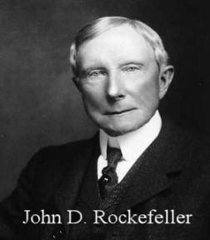
Gog – Preconditions Christians To Accept The Zionist State
Dr. Wesley Swift stated in his Bible study on 29th May, 1968 that the Rockefellers backed the British Israel organization. I don't know how much they backed it with but several thousand dollars over a period of time.

Slide 36
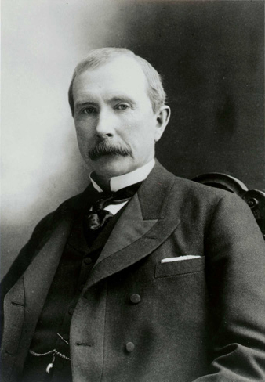
Gog – Preconditions Christians To Accept The Zionist State
… and remember that one year after the organization of British Israel was established the Jews entered it and declared they were Judah and the British organization still says that at least some of the Jews are Israel, of Judah
John D. Rockefeller

Slide 37
Gog – Preconditions Christians To Accept The Zionist State
Even today, those that actively denounce the Zionists are shunned within certain BI circles, this has happened in recent years to a former secretary and well known preacher, but of course they are careful to have another reason for such actions so that it cannot be attributed to anti-Semitism.

Slide 38
Gog – Preconditions Christians To Accept The Zionist State
This collapse may have been a blessing in disguise, as there are now several groups in the UK proclaiming the identity message and an intermingling and exchange of views amongst the members. The Babylonian monopoly has been broken and this bodes well for the future.
The Logo of The Illuminati

Slide 39
Gog’s Asset – The Suez Canal
Another reason for defeating the Ottoman Empire, was one of Gog’s asset, namely, the recently constructed Suez Canal, although paid for by the French and British governments the money to do so was obtained on loan from Gog’s bankers.
The Suez Canal from Space

Slide 40
Gog – The Abomination Of Desolation
Matthew 24:15 has certainly arrived.
“When ye therefore shall see the abomination of desolation, spoken of by Daniel the prophet, stand in the holy place, (whoso readeth, let him understand:)”
The Abomination of Desolation and Anti-Christ standing in the Holy Place.

Slide 41
Gog’s Dark Forces Hard At Work Prior To 1917
The Rothschilds had been buying up land in Palestine during the middle and late 1800’s.
While the Zionist headquarters in No. 77 Russell Street, London, were busy plotting to gain control of the “Holy Land”.
The House of Rothschild

Slide 42
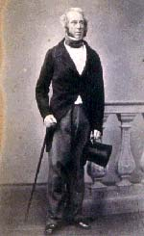
Gog’s Dark Forces Hard At Work Prior To 1917
Viscount Palmerston, was a close Rothschild family associate and patriarch of European Freemasonry. He mixed with all the major Illuminati names of his era. As early as 1840, he wrote:---
Viscount Palmerston

Slide 43
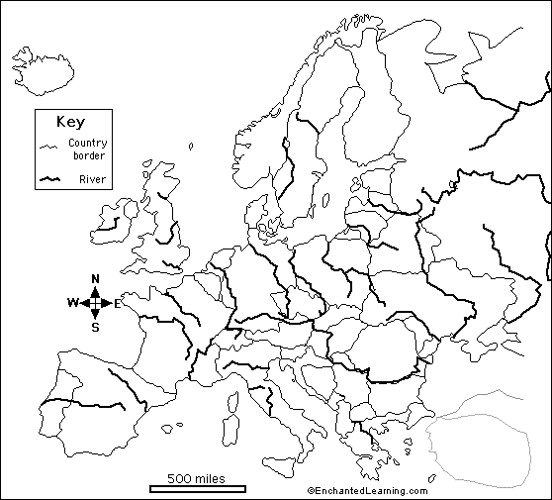
Gog’s Dark Forces Hard At Work Prior To 1917
….“There exists at the present time among the, Jews dispersed over Europe, a strong notion that the time is approaching when their nation is to return to Palestine.”

Slide 44
Gog’s Dark Forces Hard At Work Prior To 1917
It would be of manifest importance to the Sultan to encourage the Jews to return and settle in Palestine, because the wealth that they would bring with them would increase the resources of the Sultan's dominions,
Viscount Palmerston

Slide 45
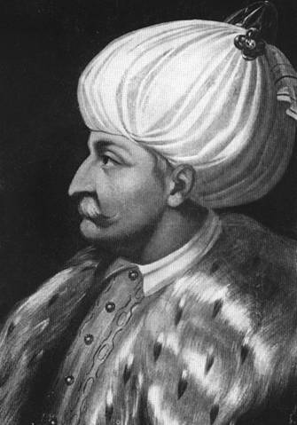
Gog’s Dark Forces Hard At Work Prior To 1917
… and the Jewish people if returning under the sanction and protection at the invitation of the Sultan would be a check upon any future evil designs of Egypt or its neighbours.
Sultan Suleiman

Slide 46
Gog’s Dark Forces Hard At Work Prior To 1917
I wish to instruct your Excellency strongly to recommend to the Turkish government to hold out every just encouragement to the Jews of Europe to return to Palestine.'
Foreign Secretary 1830-1841 and 1846-1851 and he so annoyed Queen Victoria, that she had him sacked
Queen Victoria

Slide 47
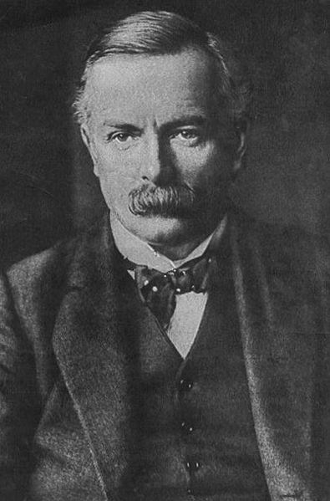
Gog’s Dark Forces Hard At Work Prior To 1917
David Lloyd George, British prime minister 1916-1922
It should be remembered that the Prime Minister, Lloyd George, when a young man, had been solicitor to the Zionist organisation.
Lloyd George

Slide 48
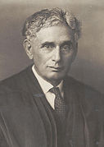
Gog’s Dark Forces Hard At Work Prior To 1917
In the American Government Zionism was even more influential. President Wilson's right-hand man was the leader of American Zionism — Mr. Justice Brandeis.
Justice Louis Dembitz Brandeis

Slide 49
Gog’s Dark Forces Hard At Work Prior To 1917
The Masonic Secret Society worked with the Zionist to get control of the Middle East.
Many are enticed into Gog’s secret society, the Masons, because they believe that it is a patriotic organisation, Christian and of course as a means to better themselves.
A Masonic Secret Society
Notes:
With time, some of the members (but far from everyone) will enter higher and higher grades within the secret society, until they reach the upper, significant levels. But up there, a very careful selection is taken place. Before entering the upper grades in the cult, a Brother of a higher level asks the apprentice to spit on the Christian cross. If the person refuses due to his Christian belief, the higher initiated Brother tells him he did the right thing and has showed his loyalty to his religion. But that person will never be admitted into the highest grades. He will always be met with excuses from the council why he can't continue. On the other hand, if the person does spit on the cross, he is showing his loyalty to the Brotherhood instead, and is considered trustworthy enough to be admitted to continue up the grade chart. He will now have access to the "secret libraries", where the wisdom from long gone ages are gathered, and he is allowed to take part of it and the magic rituals. He will be more and more involved in Black Magic/Satanism and prepared for the "Big secrets", which among others are the following:

Slide 50
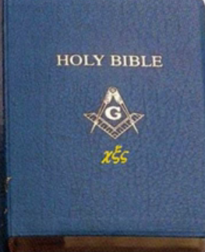
Gog’s Dark Forces Hard At Work Prior To 1917
The lower levels are encouraged to believe that it is a Christian organisation by circulating the Masonic Bible to new recruits. However, there are some subtle clues, that this is not the case in its preface, which refers to the great light which of course is Lucifer – The Shinning One.

Slide 51
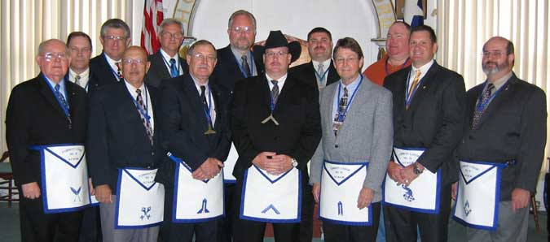
Gog’s Secret Societies - Masons
Forrest Masonic Lodge
Before entering the upper grades in the cult, with time, some of the members (but far from everyone) will enter higher and higher grades within the secret society, until they reach the upper, significant levels. But up there, a very careful selection is made.
Notes:
With time, some of the members (but far from everyone) will enter higher and higher grades within the secret society, until they reach the upper, significant levels. But up there, a very careful selection is taken place. Before entering the upper grades in the cult, a Brother of a higher level asks the apprentice to spit on the Christian cross. If the person refuses due to his Christian belief, the higher initiated Brother tells him he did the right thing and has showed his loyalty to his religion. But that person will never be admitted into the highest grades. He will always be met with excuses from the council why he can't continue. On the other hand, if the person does spit on the cross, he is showing his loyalty to the Brotherhood instead, and is considered trustworthy enough to be admitted to continue up the grade chart. He will now have access to the "secret libraries", where the wisdom from long gone ages are gathered, and he is allowed to take part of it and the magic rituals. He will be more and more involved in Black Magic/Satanism and prepared for the "Big secrets", which among others are the following:

Slide 52
Gog’s Secret Societies - Masons
Before entering the upper grades in the cult, a Brother of a higher level asks the apprentice to spit on the Christian cross. If the person refuses due to his Christian belief, the higher initiated Brother tells him he did the right thing and has showed his loyalty to his religion. But that person will never be admitted into the highest grades.
The Masonic Logo
Notes:
With time, some of the members (but far from everyone) will enter higher and higher grades within the secret society, until they reach the upper, significant levels. But up there, a very careful selection is taken place. Before entering the upper grades in the cult, a Brother of a higher level asks the apprentice to spit on the Christian cross. If the person refuses due to his Christian belief, the higher initiated Brother tells him he did the right thing and has showed his loyalty to his religion. But that person will never be admitted into the highest grades. He will always be met with excuses from the council why he can't continue. On the other hand, if the person does spit on the cross, he is showing his loyalty to the Brotherhood instead, and is considered trustworthy enough to be admitted to continue up the grade chart. He will now have access to the "secret libraries", where the wisdom from long gone ages are gathered, and he is allowed to take part of it and the magic rituals. He will be more and more involved in Black Magic/Satanism and prepared for the "Big secrets", which among others are the following:

Slide 53
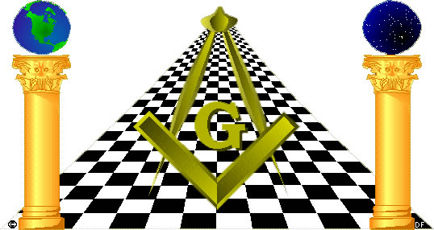
Gog’s Secret Societies - Masons
The Masonic string pullers made sure that Palestine would come under British then Zionist control

Slide 54
Gog’s Dark Forces Hard At Work Prior To 1917
Oil was, as always in modern politics, major factor in the final outcome – Here Arabs laying a pipeline for the British
The British had won their military victory in the area by promising support for Arab independence. But from the beginning, the UK Zionist controllers never intended to honour their pledge.

Slide 55
Gog’s Agent Lord Balfour
By the summer of 1917, the leaders of Zionism, which prior to the War had been an obscure Utopian movement, had so impressed the Foreign Secretary (Lord Balfour ) and other Cabinet Ministers with the world power of their organisation,
Lord Balfour

Slide 56
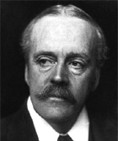
Gog’s Agent Lord Balfour
…. that they felt that they could ask for the British Government's public blessing for a homeland for the Jews in Palestine.
Lord Balfour

Slide 57
Gog’s Dark Forces Hard At Work Prior To 1917
It was Lionel Walter Rothschild, 2nd Baron Rothschild (Lord Balfour’s controller), who formulated with others this British government 'declaration' in support of a Jewish homeland. What became known as the 'Balfour Declaration' was actually a letter from Balfour to Lord Rothschild.
Lord Lionel Walter Rothschild.

Slide 58
Gog – Eliminates Those Who Would Thwart The Zionist Plans
Opposition to Zionism sprang from many prominent Jews themselves, mainly in Britain. Men like Lucien Wolf, Claude Montefiore, Sir Matthew Nathan, Edwin Montague and Sir Philip Magnus had not been consulted,
Claude Montefiore

Slide 59
Gog – Eliminates Those Who Would Thwart The Zionist Plans
… but they began a struggle, which proved a greater set-back to Zionism than the representations on the part of Lord Allenby or Colonel T. E. Lawrence. As a result of their "representations antagonistic to, Zionism" which they sent to the Cabinet, a new formula was drafted, as follows:
Sir Matthew Nathan

Slide 60
Gog’s Dark Forces Hard At Work Prior To 1917
Left: the infamous document that allowed the Zionists to gain control of Palestine while betraying the British promises to the Arabs, the French and the Italians.

Slide 61
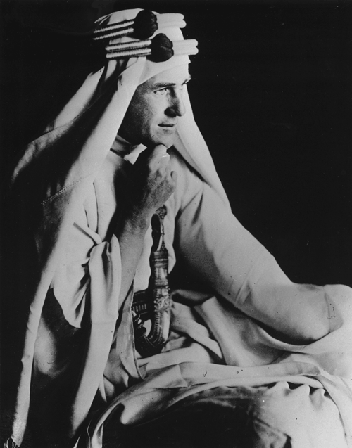
Gog – Eliminates Those Who Would Thwart The Zionist Plans
The Great Betrayal
Because of the opposition by many prominent people such as Lawrence of Arabia and General Allenby, the document known as the Balfour declaration was amended several times.
Lawrence of Arabia

Slide 62
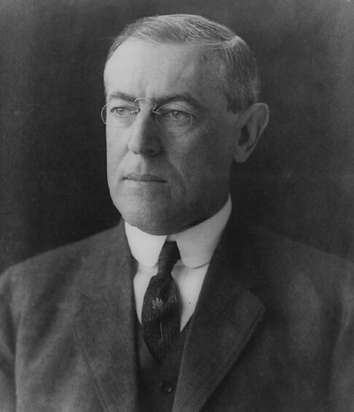
Gog’s Dark Forces Hard At Work Prior To 1917
The American ascendancy in the War Councils led the British to ask for President Wilson's consent and approval of the terminology of the declaration before its issuance.
President Wilson

Slide 63
Gog’s Dark Forces Hard At Work Prior To 1917
Mandel House
Bernard Baruch
Edward Mandel House and Bernard Baruch were British agents in the USA to ensure that the Rothschilds’ plans for the setting up of a Zionist state in Palestine laid in the last century, weren’t put at risk.

Slide 64
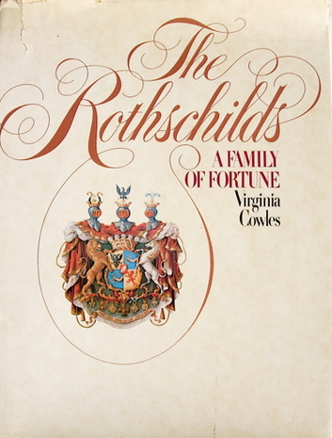
Gog’s Dark Forces Hard At Work Prior To 1917
No doubt they made sure that any amendments were purely cosmetic, but that the amendments would look as though the President was in charge and not an employee of the Rothschilds.

Slide 65
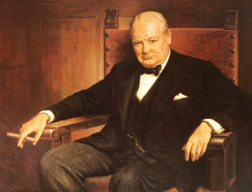
Gog – Eliminates Those Who Would Thwart The Zionist Plans
After the war Lawrence worked in support of independence for the Arab states at the Versailles Peace Conference. He also served as adviser to Winston Churchill at the Colonial Office on Middle Eastern affairs.
Winston Churchill

Slide 66
Gog – Eliminates Those Who Would Thwart The Zionist Plans
Because of this opposition to the Zionist plans and increasing popularity and fame – he had to be eliminated.
Lawrence of Arabia

Slide 67
Gog – Eliminates Those Who Would Thwart The Zionist Plans
In March 1923 he joined the Royal Tank Corps as a private. Shortly after this he rejoined the Royal Air Force where he remained as Aircraftsman Shaw until he retired from the service in February 1935, at the age of forty-six. He retired to his country cottage, Clouds Hill at Bovington, Dorset.
Lawrence's retirement home

Slide 68
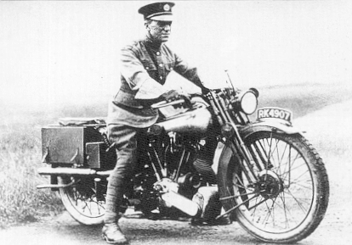
Gog – Eliminates Those Who Would Thwart The Zionist Plans
Just a few months into his retirement he was involved in a motorcycle accident, when he swerved to avoid two boys on bicycles, and died some days later on 19th May 1935 from head injuries. (This is the official story)

Slide 69
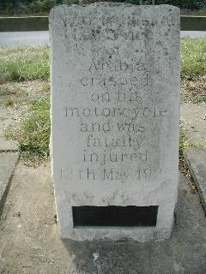
Gog – Eliminates Those Who Would Thwart The Zionist Plans
Witnesses say that an army lorry was involved and a rope placed between 2 trees, which caused Lawrence to crash.
A memorial at the site of the crash

Slide 70
Gog’s Dark Forces Hard At Work Prior To 1917
The draft was reworded several times to find a version that didn't offend English Jews, many of whom opposed Zionism. The largest Jewish organization in England strongly protested against the declaration because it
Above: Palestinians protest the reading of the Balfour Declaration in Jerusalem, 1919.

Slide 71
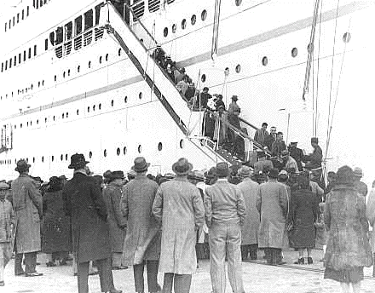
Gog’s Dark Forces Hard At Work Prior To 1917
"must have the effect throughout the world of stamping the Jews as strangers in their native lands."
Above: Jewish refugees boarding a ship for Palestine

Slide 72
Gog’s Dark Forces Hard At Work Prior To 1917
Chaim Azriel Weizmann who worked for the Rothschilds to prepare the way for a Jewish state in Arab Palestine. He was to become President of the World Zionist Organization and the first President of Israel.
Chaim Azriel Weizmann

Slide 73
The Division Of The Middle East Following Allenby’s Victory

Slide 74
Gog’s Dark Forces – The Round Table
What official history does not tell you is that a major Illuminati grouping is called the Round Table and this spawned organisations like the Royal Institute of International Affairs in London and both the Council on Foreign Relations and the Trilateral Commission in the United States.

Slide 75
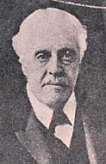
Gog’s Dark Forces – The Round Table
Lord Balfour was an inner-circle member of the Round Table, Lord Rothschild was its funder, and the 'Balfour Declaration' was a letter between the two!
Lord Balfour

Slide 76
Gog’s Other Dark Reason For Defeating The Ottoman Empire
This was the ritual murder that happened at Damascus in February of the year 1840, to the elderly Capuchin Father Thomas, who had come to Damascus in 1807 and had worked there for 33 years as benefactor of the people, and likewise to his servant Ibrahim Amara.
Father Thomas & servant Ibrahim Amara

Slide 77
Gog’s Other Dark Reason For Defeating The Ottoman Empire
A Jewish barber Soliman, had a notice, like the one the Father had attached to the synagogue door. This excited suspicion. The barber was questioned about how he came into possession of this official form. His performance seemed so unbelievable and contrived.
Damascus 1800’s

Slide 78
Gog’s Other Dark Reason For Defeating The Ottoman Empire
Brought from the Jewish Quarter, he subsequently confessed and implicated other Jews in the crime: the Rabbis Moses Saloniki and Moses Abu-el-Afieh, the three brothers David, Isaak and Aaron Harari, their uncle Joseph Harari and a Joseph Laniado.
The Jewish Quarter

Slide 79
Gog’s Other Dark Reason For Defeating The Ottoman Empire
Soliman then went on to describe how the bones and the skull of the victim were crushed on the floor with a pestle. The Jews who stood around gave instructions at the dismemberment of the body.

Slide 80
Gog’s Other Dark Reason For Defeating The Ottoman Empire
At the end of April 1840 – two -and-a-half months, the trial could be considered concluded. This date is to be kept in mind, as it is important re the events following. Sixteen Jews had taken part in the double-murder, four were pardoned, ten were condemned to death.
Awaiting Trial

Slide 81
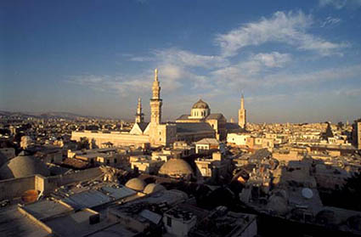
Gog’s Other Dark Reason For Defeating The Ottoman Empire
….four were pardoned, ten were condemned to death. In Damascus the population awaited the execution of the blood-murderers

Slide 82
Gog’s Other Dark Reason For Defeating The Ottoman Empire
There had been attempts to corrupt. These had failed. The Jewish negotiators attempted to attack Count Ratti Menton by means of another consulate: this time 500,000 Piasters were "bid.” When enquiries were made as to where this money was coming from, it was found to be from the Gentile poor boxes given to the Rabbis for safe keeping!
A Report on the affair

Slide 83
Gog’s Other Dark Reason For Defeating The Ottoman Empire
The trial and subsequent bribery attracted a backlash from the Zionist controlled media in Europe, alleging terrible tales of torture; sadistic licentious acts, of a kind which can originate only in Jewish minds.
The Court Building

Slide 84
Gog’s Other Dark Reason For Defeating The Ottoman Empire
The stir caused by the media on the ritual murder trial in Damascus as being an anti-Semitic attack, caused prominent Jews to lobby their respective governments. the Head Jew, of the Central In Paris Consistory of the French Israelites Isaac Adolphe Crémieux –
Adolf Crémieux (geb. Smeerkopp)

Slide 85
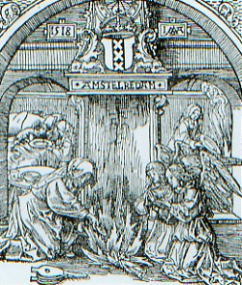
Gog’s Other Dark Reason For Defeating The Ottoman Empire
…. don’t be fooled by the fine-sounding name -- he, too, once had a different name; his origin was in an old Amsterdam Jewish family of swindlers named Smeerkopp, lobbied the French Government.
Old Amsterdam

Slide 86
Gog’s Other Dark Reason For Defeating The Ottoman Empire
While Adolphe Crémieux was applying pressure in Paris, the Italian-English Jew "residing" in London, son-in-law of Nathan Meyer Rothschild, "Sir" Moses Montefiore, would apply pressure in London. From 1835 until 1874 he was President of the "Board of Deputies of the British Jews“ in 77, Russell St. This is another connection to the London bombings in 2007
"Sir" Moses Montefiore

Slide 87
Gog’s Other Dark Reason For Defeating The Ottoman Empire
On the bidding of London, Adolf Crémieux, Moses Montefiore and others went as a delegation to persuade the Pasha to appeal the trial. This caused such an outrage amongst Christians and Moslems, that the Viceroy of Egypt Mehemed Ali, dispatched 800 troops to Damascus to keep order.
Old Damascus

Slide 88
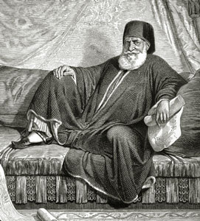
Gog’s Other Dark Reason For Defeating The Ottoman Empire
… that the Viceroy of Egypt Mehemed Ali, dispatched 800 troops to Damascus to keep order.
Left: Viceroy Mehemed Ali

Slide 89
Gog’s Other Dark Reason For Defeating The Ottoman Empire
The French Consul in Damascus, Count Ratti-Menton, who through his conduct caused the Turkish authorities to use coercion, might at last be dismissed". . .This was all the more urgent, since the "unrest among the Gentile population very easily could get out of hand and turn into a regular persecution of the Jews in Palestine.”

Slide 90
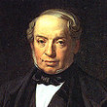
Gog’s Other Dark Reason For Defeating The Ottoman Empire
In fact, Jakob Rothschild, the brother of Salomon Rothschild, in Paris, had attempted to push through the immediate dismissal of the inconvenient Consul with King Louis Philipp.
Jakob Rothschild

Slide 91
Gog’s Other Dark Reason For Defeating The Ottoman Empire
Further trouble - a 12 year old boy was ritually murdered in Rhodes and the Jewish area where the crime occurred was cordoned off by the Pasha. The most respected Jews of London, Rothschild at their head,” ….
Governor of Rhodes

Slide 92
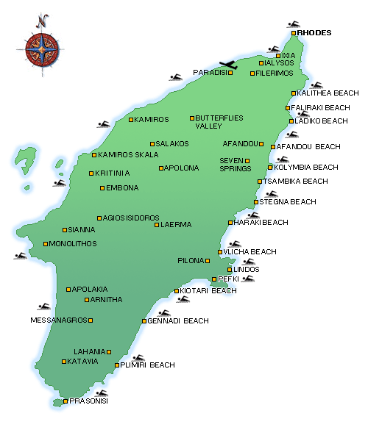
Gog’s Other Dark Reason For Defeating The Ottoman Empire
… promptly presented to the English government a memorandum, "in which he asked it for protection against the acts of violence and arbitrary whims" to which the Jews in Rhodes had been exposed,
Rhodes

Slide 93
Gog’s Other Dark Reason For Defeating The Ottoman Empire
The English envoy in Constantinople received the order delivered through Lord Palmerston, "to take care of the distressed Jews”. The Turkish judges, at the instigation of the English legation in Constantinople, the secret directive went out, to issue a "report of acquittal”
Lord Palmerston

Slide 94
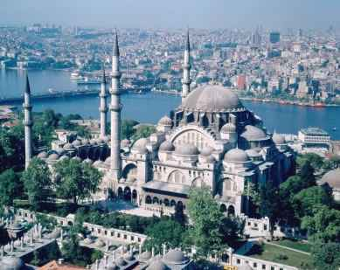
Gog’s Other Dark Reason For Defeating The Ottoman Empire
…. although the mother of the missing child and the plaintiffs had given the same incriminating facts to the protocol before the Turkish authorities as they had on Rhodes.
Istanbul - Turkey

Slide 95
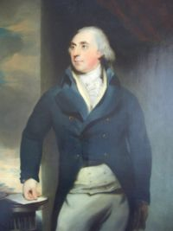
Gog’s Other Dark Reason For Defeating The Ottoman Empire
Lord Ponsonby "presented to the assembled Divan through his representative the written declaration of innocence of the Jews. The Highest Court at Constantinople then announced, too, the "Innocence of the Jews at Rhodes" in a public declaration.
Lord Ponsonby

Slide 96
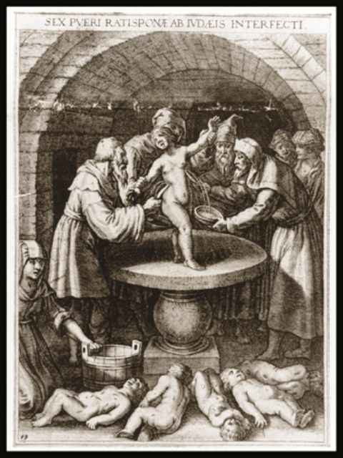
Gog’s Other Dark Reason For Defeating The Ottoman Empire
The Jews were "totally acquitted of the accusations of kidnapping a child and of child-murder, and as compensation were entitled to some benefits.

Slide 97
Gog’s Other Dark Reason For Defeating The Ottoman Empire
James Rothschild: was instrumental in obtaining donations from the gullible public to finance a delegation to Constantinople. The weight of the British and other European governments was behind it to persuade
James Rothschild

Slide 98
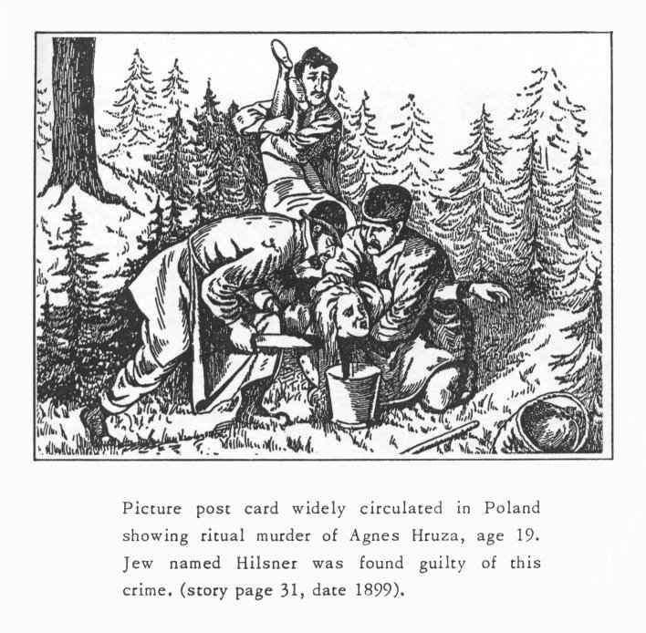
Gog’s Other Dark Reason For Defeating The Ottoman Empire
…. the Ottoman authorities to help the “persecuted” Jews prosecuted for ritual murder that was rife in the empire. Crémieux and Montefiore led the delegation.

Slide 99
Gog’s Other Dark Reason For Defeating The Ottoman Empire
This delegation was necessary, because of previous bribery of officials by Jews resulting in the culprits found guilty of ritual murder being released, thereby causing a seething hatred of the Jews.

Slide 100
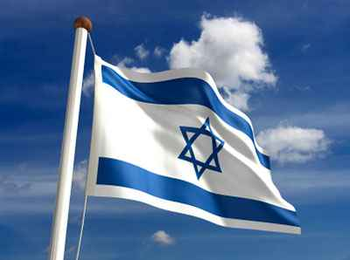
Gog’s Other Dark Reason For Defeating The Ottoman Empire
The Zionists could not afford these facts to become known in Europe as this would jeopardise their plans for creating the state of Israel
Israeli Zionist Flag

Slide 101
Gog’s Other Dark Reason For Defeating The Ottoman Empire
After touring parts of the Ottoman Empire, such as Damascus and Rhodes where anger against the Jews was rife, and getting local officials replaced with their nominees. The uprisings were quelled.
The Flag of the Ottoman Empire

Slide 102
Gog’s Other Dark Reason For Defeating The Ottoman Empire
For Sir Moses Montefiore’s work there occurred for him the honour unattainable for the ordinary Englishman, of being received personally by the Queen.
Sir Moses Montefiore

Slide 103
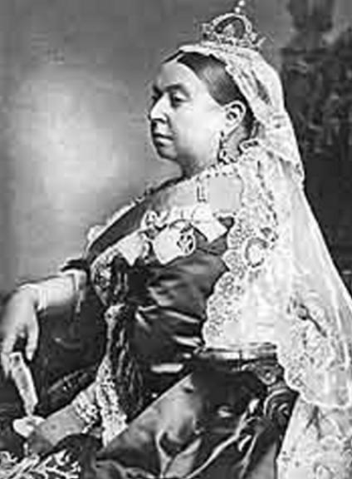
Gog’s Other Dark Reason For Defeating The Ottoman Empire
That Montefiore was given special distinctions, when he returned home from Egypt after a happily concluded mission in this affair. Queen Victoria of England received him personally

Slide 104
Gog’s Other Dark Reason For Defeating The Ottoman Empire
… and as a special sign of her favour recognition of his position and his success in Alexandria, bestowed upon him the privilege of bearing “supporters to his arms.”
Sir Moses Montefiore’s Arms

Slide 105
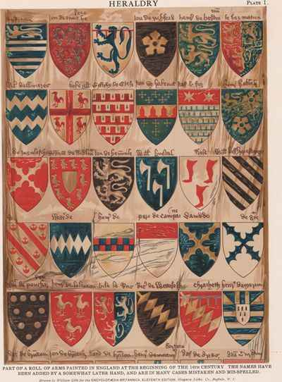
Gog’s Other Dark Reason For Defeating The Ottoman Empire
… In heraldry, this consists of (usually) human figures which are displayed outside of the escutcheon proper and signify an enhancement of the family's distinction.

Slide 106
Armenian Genocide Holocaust Another Factor
The plans of the 1915-23 Armenian Genocide, where a million and half Armenians perished in a barbaric way in their ancestral lands in modern Turkey, actually were drawn up and were in place by the year 1910 or 1912 .
The Armenian genocide – The Forgotten Holocaust

Slide 107
Armenian Genocide Holocaust Another Factor
The participation of the Sephardic Jews together with the Young Turks (Zionist Jews) and their Moslem lackeys …..
Djavid Bey (Rothschild agent) in charge of the Ottoman Finances

Slide 108
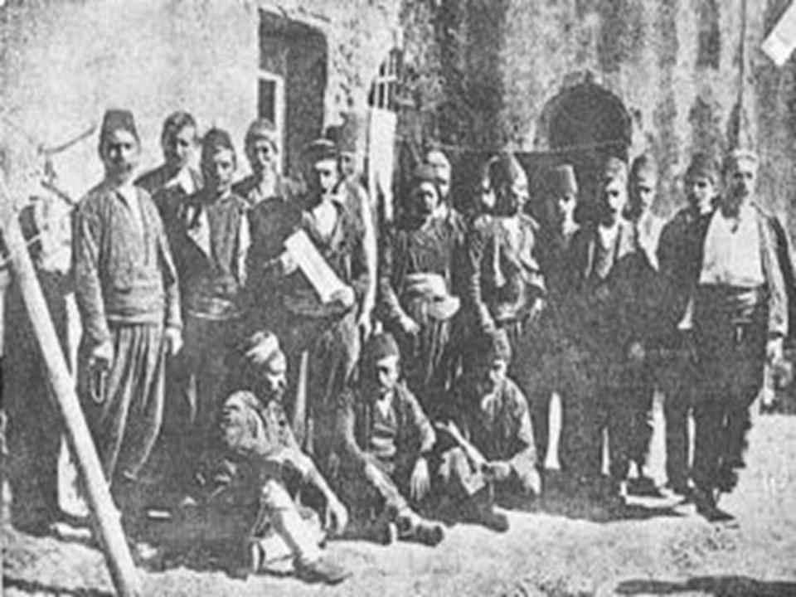
Armenian Genocide Holocaust Another Factor
… in the first massacre of the Armenians in Constantinople in 1895, was no doubt one of the factors for justifying the war against the Ottoman Empire.

Slide 109
Armenian Genocide Holocaust Another Factor
The Armenian genocide was decided in August 1910 and October 1911, by a Young Turk committee composed entirely of displaced Balkan Jews in the format of a syncretist Jewish-Muslim sect Salonika.
Old Salonika

Slide 110
Armenian Genocide Holocaust Another Factor
….which included Talaat, Enver, Behaeddin Shakir, Jemal, and Nizam posing as Muslims. It met in the Rothschild-funded Grand Orient lodge/hotel of Salonika.
Logo of The Grand Orient Lodge

Slide 111
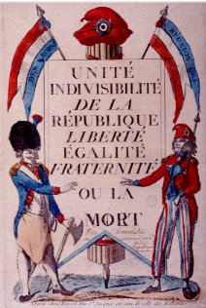
Armenian Genocide Holocaust Another Factor
Syncretism means a combination of different forms of belief or practice; masonism fits that description. As the masons started the 1897 revolution in France with the cry "liberty, fraternity, equality," Young Turks used the same slogan in their revolution of 1908.

Slide 112
Armenian Genocide Holocaust Another Factor
Lord Palmerson launches Young Turks to permanently control Middle East "claims the founder of the Young Turks to be a certain Jew by the name of Emmanuel Carasso.” He states: Carasso set up the Young Turk secret society in the 1890s in Salonika, then part of Turkey, and now part of Greece.
Lord John Russell Palmerston

Slide 113
Armenian Genocide Holocaust Another Factor
The Jew, Emmanuel Carasso met with the sultan, to tell him that he was overthrown. He was in charge of putting the sultan under house arrest. He ran the Young Turk intelligence network in the Balkans. And he was in charge of all food supplies in the empire (Ottoman) during World War I.
Emmanuel Carasso

Slide 114
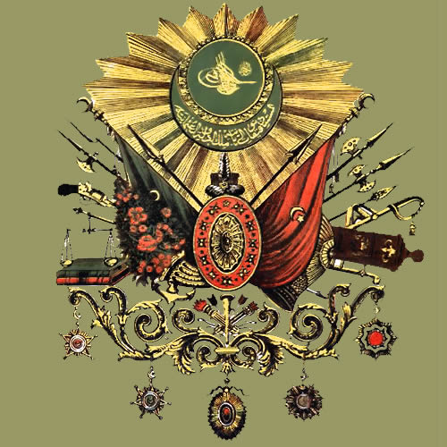
Armenian Genocide Holocaust Another Factor
It is ironic that four centuries after the Turkish sultans welcomed the expelled European Jews into Turkey, certain Jews belonging to secret societies and to Zionism will kick the sultan out of power early in 20th century, …..

Slide 115
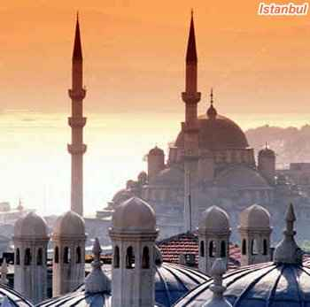
Armenian Genocide Holocaust Another Factor
…. destroy the Ottoman Empire, and celebrated their victory by massacring by proxy almost the whole Christian Armenian people, one million and half Armenians; half million Greeks; and half million Christian Assyrians & Arameans.
Istanbul

Slide 116
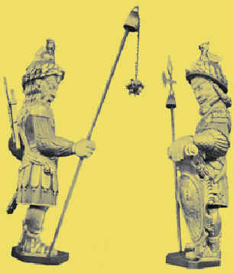
Armenian Genocide Holocaust Another Factor
Gog has always repaid nations that gave the Jews shelter with treachery, in Spain they let the Moors in and in Germany and Poland they destroyed these nations from within.

Slide 117
Armenian Genocide Holocaust Another Factor
All this according to the precepts of the Talmud, the Satanic Bible of the Jews, which encourages Jews to kill, directly or indirectly, by sayings like:

Slide 118
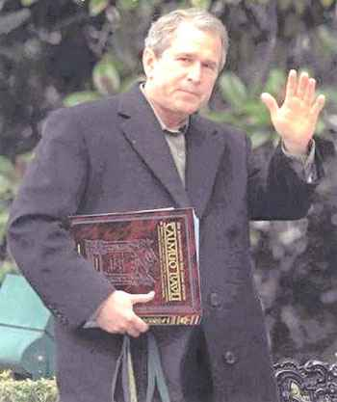
Armenian Genocide Holocaust Another Factor
… "Every Jew who spills the blood of the godless, is doing the same as making a sacrifice to God." Talmud: Bammidber Raba c21 & Jalkut 772. In the eyes of Talmudists all non-Jews are godless.
George Bush Carrying The Talmud

Slide 119
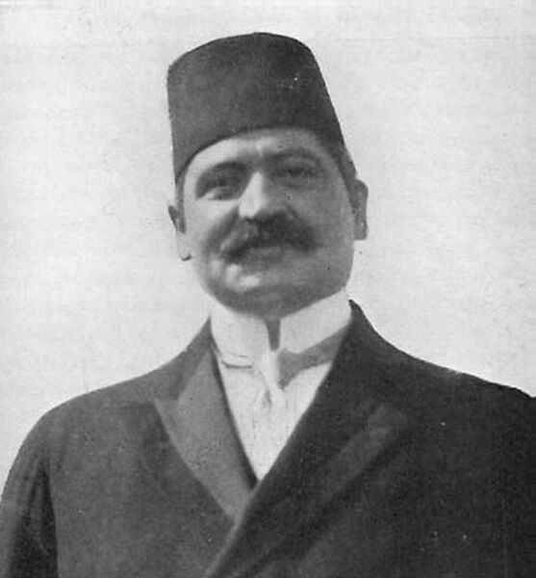
Armenian Genocide Holocaust Another Factor
Some Turks who helped lead the Young Turk movement. For example, Talaat Pasha. Talaat was the interior minister and dictator of the regime during WW1.
Talat Pasha

Slide 120
Armenian Genocide Holocaust Another Factor
He had been a member of Carasso's Italian Masonic lodge in Salonika. One year prior to the 1908 coup, Talaat became the grand master of the Scottish Rite Masons in the Ottoman Empire.
A Scottish Rite Lodge

Slide 121
Armenian Genocide Holocaust Another Factor
The Russian Zionist leader Vladimir Jabotinsky. Jabotinsky arrived in Turkey shortly after the Young Turks seized power, to take over the “The Young Turk and other papers”. The paper was owned by a member of the Turkish cabinet, but it was funded by the Russian Zionist federation,
Vladimir Jabotinsky

Slide 122
Armenian Genocide Holocaust Another Factor
…. and managed by B'nai B'rith. The editorial policy of the paper was overseen by a Dutch Zionist named Jacob Kann, who was the personal banker of the king and queen of the Netherlands.
B'nai B'rith.

Slide 123
Armenian Genocide Holocaust Another Factor
Vladimir Jabotinsky would be instrumental in whipping up Moslem hatred against the Armenians egged on by the Zionists, like they have done in previous wars. The Zionists unbeknown to the general public had already taken over the Ottoman Empire, a few years before its formal defeat by Allenby.

Slide 124
Armenian Genocide Holocaust Another Factor
The Rothschilds saw the Armenians as a threat to their oil interests as they occupied land in the area of the wells. The Armenians being clever traders and business men, being white and Christian, they would be more difficult to control than the mongrelised Turks.
The Rothschilds Paris Home

Slide 125
Summary Of Motives For Gog’s War Against The Ottoman Empire
Secure Palestine for a Zionist Israeli State
Secure the Suez canal
Secure Zionist oil assets in the Middle East
Stop foul deeds of Jews, such as ritual murder becoming known to the European public.
A cover for the Armenian Holocaust
A cover for the take over of Russia and the murder of the Tzar

Slide 126
Gog Takes Control Of Turkey
In Istanbul, which was the capital and the power centre of the Ottoman Empire, there were only few thousands (less than 10,000) Jews and some 200,000 Armenians and Greeks who controlled the trade, finances and arts of the Empire. Jews and Christians were in strong competition through hundreds of years of the life of the empire.
Armenians contributed to the Prosperity of Turkey

Slide 127
Gog Takes Control Of Turkey
… finances and arts of the Empire. Jews and Christians were in strong competition through hundreds of years of the life of the empire.
A Turkish Bazaar

Slide 128
Gog Takes Control Of Turkey
Jews were the losers and Christians were the winners always because the Sultans ( there were very few bad sultans who killed Christians) listened to and favoured the Christians.
The Thirtieth Ottoman Sultan

Slide 129
Gog Takes Control Of Turkey
…. For the Zionist Jews to take over Turkey, its Christians had to be eliminated; and that is another ugly facade of the first Genocide of the 20th Century in Turkey.

Slide 130
Gog Takes Control Of Turkey
Are the Turks finally waking up and realizing that their Sultan's refusal to grant Palestine to the Zionist Jews as a homeland had cost them their centuries-old empire? And are the subjugated Turks about to discover who their real rulers are?
Istanbul – Modern Turkey

Slide 131
Gog Takes Control Of Turkey
There are claims that the blue-eyed founder of modern Turkey, Kemal Ataturk had Jewish origins. And it is known that at least two presidents of modern Turkey (Inonu and Bayar) were Jewish.
Kemal Ataturk

Slide 132
Gog’s Call To Terrorism
A leaflet circulated by the Irgun a terrorist organisation that helped to spawn Israel by calling for the removal of the British administration and Palestinians by murder.

Slide 133
The Israeli State Born In Terrorism
Irgun, led by later Prime Minister, Menachem Begin, was responsible for the bombing of the British headquarters at the King David Hotel in Jerusalem. It killed 91 Britons, Arabs and Jews, injuring many more, and this was only one of a stream of terrorist outrages and assassinations that ended in the creation of Israel.
King David Hotel

Slide 134
The Israeli State Born In Terrorism
On the 29th November, 1947, the United Nations General Assembly passed a resolution calling for the establishment of a Jewish State in Eretz-Israel; the General Assembly required the inhabitants of Eretz-Israel ….
UN General Assembly

Slide 135
The Israeli State Born In Terrorism
…. to take such steps as were necessary on their part for the implementation of that resolution. This recognition by the United Nations of the right of the Jewish people to establish their State is irrevocable.
Demonstration against Israel

Slide 136
The Israeli State Born In Terrorism
Notice that the independence statement of the UN referred to Eretz-Israel being given independence i.e. greater Israel as shown on the map. Notice also that the are 11 letters in the name Eretz-Israel – an Illuminati/Gog number.
Israel’s borders according to Gog

Slide 137
The Israeli State Born In Terrorism
Obviously the Israeli state had no intention of complying with Balfour agreement.
Begin and Shamir ... terrorists who became Prime Ministers of the Israeli State (The Abomination of Desolation) and condemned terrorism!

Slide 138
The Israeli State Born In Terrorism
As Golda Meir, another Israeli Prime Minister, said in Le Monde in 1971: 'This country exists as the fulfilment of a promise made by God Himself. It would be ridiculous to ask it to account for its legitimacy.'
Golda Meir

Slide 139
The Israeli State Born In Terrorism
Left: Retired KGB agent Kissinger in the guise of USA Secretary of State with Golda Meir, no doubt being thanked for his work in making available the resources of the USA to the Israeli State.
Notes:
Henry Kissinger, a war criminal of astonishing proportions, was United States National Security Advisor and Secretary of State from 1969 to1977 and responsible for the death and suffering of extraordinary numbers of people around the world. But his prime role was to represent the interests of Israel and the Illuminati plan for the Middle East that I will describe shortly. Especially after the emergence of Kissinger, the Illuminati-Israel grip on American foreign and domestic policy began to tighten ever more obviously.

Slide 140
The Israeli State Born In Terrorism
The 'Jewish homeland' was from the start a Rothschild fiefdom orchestrated through a global secret society network of interbreeding families known as the Illuminati. The goal of these families is domination of the planet through a world government dictatorship, a world army.
David Ben-Gurion

Slide 141
The Israeli State Born In Terrorism
It is interesting to note that a mere eleven minutes after the Zionist declaration of the Palestinian partition and independence on May 14, 1948, President Truman recognized Israel as an independent Jewish State.
President Truman wearing his Masonic regalia

Slide 142
The Israeli State Born In Terrorism
11 is a good Illuminati number and the number of Gog in the scriptures – Gog is mentioned exactly 11 times in the Bible.

Slide 143
Gog – Takes Possession Of “My Land”
David Ben-Gurion reads the declaration of independence on May 14th 1948 which claimed Palestine as a Jewish state
Notes:
18263

Slide 144
Gog Takes Possession Of The US Congress As Well
In answer to a reporter …. We have the best congress money can buy!
George W. Bush flaunting the Israeli connection!

Slide 145
Gog – Continuously Attacks Palestinians
In contravention of the Balfour agreement, a photograph released by the Israeli army shows an Israeli navy vessel shelling a beach in the northern Gaza Strip on June 9th 2006

Slide 146
Gog – Continuously Attacks Palestinians
Huda Ghalya screaming alongside the body of her father after the Israeli attack. Huda lost seven members of her family - across three generations - on that Gaza beach.

Slide 147
Gog’s Media Control
Wolf Blitzer, who leads the CNN team covering the Middle East conflict, is a Jewish former employee of the American Israel Public Affairs Committee. How can that be seen to be fair? How many Arabic anchors are covering the conflict for CNN?
Wolf Blitzer

Slide 148
The Abomination Of Desolation At Work
Israeli State has and is creating havoc in the Lebanon – a once prosperous and well run country

Slide 149
The Abomination Of Desolation At Work
Children of Gog in the Israeli State are conditioned from an early age to hate their neighbours

Slide 150
Israeli State’s Satanic Holy Book
The Israelis are the people whose holy book is the Talmud. Peter Schaefer, of Princeton's Judaic studies program, has analyzed all the passages in the Talmud that refer to the founder of Christianity, texts that were previously censored from Talmud editions for centuries.

Slide 151
Israeli State’s Satanic Holy Book
… In his book he argues—against other scholars—that the scandalous passages indeed refer not to some other figure of ancient times but to the famous Jesus of Nazareth.
Peter Schaefer

Slide 152
Christendom Is Under A Curse For Supporting The Israeli State
Exodus 17:16 For he said, Because the LORD hath sworn that the LORD will have war with Amalek (Gog) from generation to generation.

Slide 153
Christendom Is Under A Curse For Supporting The Israeli State
The scriptures warn us not to support Yahweh’s enemies:
2 John 1:10 If there come any unto you, and bring not this doctrine, receive him not into your house, neither bid him God speed:
11 For he that biddeth him God speed is partaker of his evil deeds.

Slide 154
Christendom Is Under A Curse For Supporting The Israeli State
The scriptures warn us not to support Yahweh’s enemies:
2 Chronicles 19:2 And Jehu the son of Hanani the seer went out to meet him, and said to king Jehoshaphat, Shouldest thou help the ungodly, and love them that hate the LORD? therefore is wrath upon thee from before the LORD.
King Jehoshaphat

Slide 155
Christendom Is Under A Curse For Supporting The Israeli State
Since the independence of the Israeli state and its recognition by the Western Israelite powers, we have witnessed a rapid decline in Christendom both secular and spiritual - not the blessing promised by most church leaders for supporting the Zionist state!

Slide 156
Christendom Is Under A Curse For Supporting The Israeli State
The London Bombings of 2005 are linked to 1917 and the setting up of the Zionist state of Israel

Slide 157
The London Bombings Linked To The Setting Up Of The Zionist State
The London bombing outrage on 7th July 2005, when several bombs went off on the Underground only one bus was bombed and as it just so happened was blown up in Tavistock Sq.

Slide 158
The London Bombings Linked To The Setting Up Of The Zionist State
… just a stones throw from No. 77 Great Russell St. where the Balfour declaration was drafted and re-drafted. The digits of the date when this happened – 7th July 2005, can be expressed as 777.
Great Russell St. London

Slide 159
The London Bombings Linked To The Setting Up Of The Zionist State
The Bomb went off exactly on the 88th year after the taking of Jerusalem by Allenby in 1917 – God’s warning to the Jerusalem in the west that time is running out! 8 (God) x 11 (Gog/11th Hour) of judgment to come for supporting God’s enemies.
General Allenby entering Jerusalem

Slide 160
The London Bombings Linked To The Setting Up Of The Zionist State
Malachi 1:3 And I hated Esau, and laid his mountains and his heritage waste for the dragons of the wilderness.
Helping God’s Enemies brings punishment

Slide 161
The London Bombings Linked To The Setting Up Of The Zionist State
4 Whereas Edom saith, We are impoverished, but we will return and build the desolate places; thus saith the LORD of hosts, They shall build, but I will throw down; and they shall call them, The border of wickedness, and, The people against whom the LORD hath indignation for ever.

Slide 162
The Abomination Of Desolation At Work
Zionist front organisations such AIPAC, are continuously lobbying for congress and the public to support the Abomination of Desolation known as the Israeli state.

Slide 163
The Abomination Of Desolation At Work
… Supporting God’s enemies in such a blatant way, explains why since the taking of old Jerusalem and the granting of independence to Palestine 30 years later, has seen from that moment on a steady downward decline of true Israel in the west.

Slide 164
The London Bombings Linked To The Setting Up Of The Zionist State
Dr. Grattan Guinness, revealed the date of the release of Jerusalem by the double application of his “1260” years, which added up to 2,500 years, terminating in 1917/18.
Dr. H. Grattan Guinness

Slide 165
The London Bombings Linked To The Setting Up Of The Zionist State
His next time frame, applicable to the revealing of the “abomination of desolation” referred to by our Lord Jesus Christ Himself, was 1290 years, or 30 years further on than the termination of the 1260 period.
The “Abomination of Desolation”

Slide 166
The London Bombings Linked To The Setting Up Of The Zionist State
The Zionist State came into being following a Zionist resolution in the UN exactly 30 years after Allenby took Jerusalem – 88 years on - London in the New Jerusalem is
the New Jerusalem is bombed by the Zionists with blame being placed on the Moslems.

Slide 167
The London Bombings Linked To The Setting Up Of The Zionist State
The Jewish Israeli state came into being through terrorism and betrayal. Here we see on the left one of the many instances of terror on the British – one of the 2 British policemen killed by Jewish terrorists on May 12th 1947.

Slide 168
The London Bombings Linked To The Setting Up Of The Zionist State
It is very appropriate the time factor of 30 years from the taking of Jerusalem to independence, as 30 symbolises betrayal (Arab guarantees) – Judas was paid 30 pieces of silver to betray our Lord.
Judas Iscariot

Slide 169
Was the London bombing part of a plot to rid an obstacle to the Zionist plans for rebuilding the temple in Jerusalem all part of the futurist indoctrination?
Notes:
Built atop the earlier location of the Temple, the Dome of the Rock was erected by the Muslim ruler Abd el-Malik in 688-691. Because of its situation on bedrock, the numerous earthquakes over the centuries have not caused significant damage to the structure (unlike its neighbor Al Aqsa mosque). This shrine was covered by a lead dome from 691 until it was replaced with a gold-colored covering in 1965. Because of rust, the anodized aluminum cover was again replaced in 1993 with a gold covering.

Slide 170
The London Bombings Linked To The Setting Up Of The Zionist State
The Zionists have been working hard to raise the animosity of white people towards the Moslems by false flag operations such as 911 and 777,

Slide 171
The London Bombings Linked To The Setting Up Of The Zionist State
… while at the same time they have been raising the anger of the Moslems towards the west to fever pitch by Zionist caused atrocities in the Moslem populations of Iraq, Afghanistan, Palestine and elsewhere.

Slide 172
The London Bombings Linked To The Setting Up Of The Zionist State
Our Chickens are coming home to roost for our support of that terrorist state in the Middle East known as Israel

Slide 173
The London Bombings Linked To The Setting Up Of The Zionist State
– the reference No. of this bus 17758 the digits of which add up to 28 (4 x7) and have an embedded 77 also linking this incident to the Balfour agreement and Gog.

Slide 174
The London Bombings Linked To The Setting Up Of The Zionist State
Since the London Bombings our freedoms have been further curtailed together with increased surveillance of our communications and movements

Slide 175
The London Bombings Linked To The Setting Up Of The Zionist State
In hindsight, there can now be no doubt that the event of evicting the Turks from Jerusalem in 1917 did not mark the renaissance of Israel,

Slide 176
The London Bombings Linked To The Setting Up Of The Zionist State
…. but the decline of true Israel in the west. The European empires have now crumbled to the point where even their own infrastructures are now falling apart.

Slide 177
Gog’s World Wars
The next 2 chapters of this presentation will go on to look at the 2 World Wars and how Gog was manipulating the combatants on both sides in order to rearrange the map of Europe and the world into a Global empire, first with the League of Nations and then the United Nations

Slide 178
The Story Of Gog And Magog
A thought to leave you with
Meyer Amschel Rothschild said: "Permit me to issue and control the money of a nation, and I care not who makes its laws . . . enforced unemployment and hunger, imposed on the masses because of the power we have to create shortages of food, will create the RIGHT of Capital to rule more surely than it was given to the real aristocracy“.
Howbeit no man spake openly of him for fear of the Jews. (John 7:13)

Slide 179
The Story Of Gog And Magog
The End Of Part Six - Chapter One
To be continued ………… Gog’s World Wars – Chapter 2

