Slide 1
The Story Of Gog And Magog
Part Nine
Chapter B
False Flag Operations

Slide 2
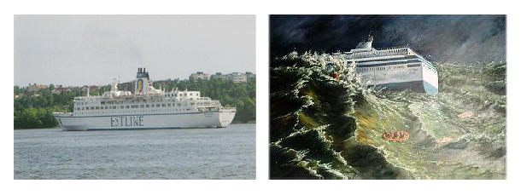
The Estonia Was Sabotaged
852 lives lost that night
28 September 1994

Slide 3
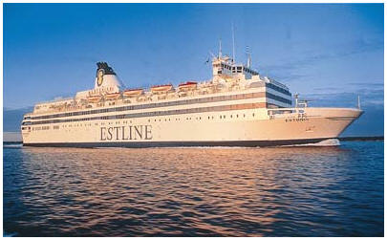
The Estonia Was Sabotaged
This Was A Large Ocean Going Ship
The story goes the bow broke off

Slide 4
The Estonia Was Sabotaged
The Route From Estonia To Sweden

Slide 5
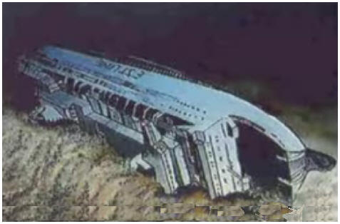
The Estonia Was Sabotaged
This Ship Only Got A Thirty Second SOS Off

Slide 6
The Estonia Was Sabotaged
It Was Flooded In Minutes

Slide 7
The Estonia Was Sabotaged
The Bow Has Three Watertight Layers

Slide 8
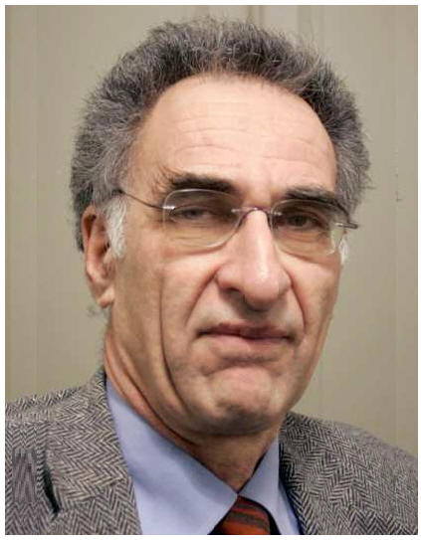
The Estonia Was Sabotaged
Judge Johan Hirschfeldt Keeps An Eye On Estonia Investigation
For Once Israel Doesn't Want The Limelight Israel pushed Estonia, Sweden, Britain, and Egypt into outlawing exploration of a wreck in international waters by passing the 1995 Estonia agreement. The story that a 600 ft ocean liner went down in 6’ seas is just silly.

Slide 9
The Estonia Was Sabotaged
Judge Johan Hirschfeldt Keeps An Eye On Estonia Investigation
The country of Estonia was involved in smuggling arms, and nuclear material, to Iran/Egypt, and Israel sent them a message. Anyone in the intelligence community immediately recognized that convoluted story of arms smuggling as a signal Israel was behind the disaster.

Slide 10
The Estonia Was Sabotaged
00:55 Attachments on the 50-ton bow door, or visor, snap.
1:05 Visor flaps in the raging sea, sawing through steel plating behind it
1:10 Inner door now jarred slightly open, water seeps in
TIME LINE

Slide 11
The Estonia Was Sabotaged
1:15 Bow door now rips off, bouncing off the ship's bulbous bow
1:17 Ship lists by 15 degrees
1:20 Engines have stopped,
1:22 A 30 Second SOS1:35Listing almost 90 degrees.
1:50 Estonia sinks
TIME LINE

Slide 12
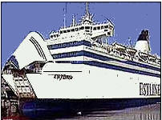
The Estonia Was Sabotaged
Total Fabrication
You need to believe the entire bow of the ship was flapping for twenty minutes. Picture driving the turnpike with your car hood flapping for twenty minutes.
Whatever happened, it occurred within minutes. The majority of passengers died In their cabins.
The Estonia

Slide 13
The Estonia Was Sabotaged
A Bow Falls Off?
If you build a ship with a pivoting bow, you will make it stronger than a one piece bow. You have locking hinge pins, that are pennies compared to the overall cost.
The shipyard said it had to be explosives.

Slide 14
The Estonia Was Sabotaged
You Had Two Backups
If the bow fell off, there were doors behind it. After the doors was the ramp.

Slide 15
The Estonia Was Sabotaged
Other Disasters
There was always a logical explanation. The Titanic hit an iceberg, the Edmund Fitzgerald was a rogue wave, etc.
This Estonia is identical to the Manila disaster and the Egyptian sinking, both of which were Mossad operations.

Slide 16
The Estonia Was Sabotaged
Bemis, during an investigative dive in September 2000, obtained evidence of foul play, a massive hole below the waterline. Bemis said, “if the accident had actually happened as described in the official report,
Underwater Explorer Gregg Bemis

Slide 17
The Estonia Was Sabotaged
… why would certain governments be so obsessively opposed to private resources doing legitimate and highly professional research on the sinking?” The Estonia Agreement of 1995, prohibits diving on the wreck.
Underwater Explorer Gregg Bemis

Slide 18
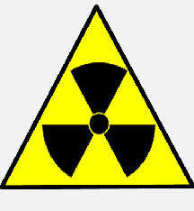
The Estonia Was Sabotaged
What Was The Motive?
What has been leaked is that Estonia was involved in an agreement with Egypt/Iran with regards to nuclear materials.

Slide 19
The Estonia Was Sabotaged
Lars Göran Farm, then marine engineer with Nordström and Thulin, Swedish co-owners of Estonia, confirmed to Anér that the ship owner had ordered a special escort from Vägverket, the Swedish highway authority, for a sensitive cargo on September 28, 1994.

Slide 20
The Estonia Was Sabotaged
Who Did It?
Israel, and it's Mossad. It's their style to send a very public high profile message.

Slide 21
The Estonia Was Sabotaged
How Was It Done?
During a maintenance stop their agents placed thermite charge low in the hull. Next there was a series of charges on all the main bow structures.
An aircraft engineer could take down a 747 with a cigarette pack of C-4

Slide 22
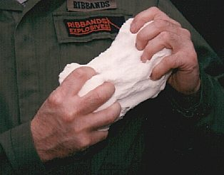
The Estonia Was Sabotaged
If you took a naval architect and asked him where to place some small C-4 explosives to make it look like an accident,
C-4 explosive

Slide 23
The Estonia Was Sabotaged
Placing Charges
… he would stick them here. The official story is the bow slide off and hit the bow tip below the water line, and that is exactly where you would place C-4 explosives.

Slide 24
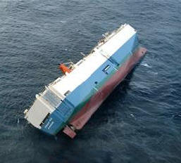
The Estonia Was Sabotaged
The Ship Rolled 40 Degrees
Within minutes of the explosion the ship listed 40 degrees. Short of being hit with a nuclear tip torpedo, ships don't go down that fast.

Slide 25
The Estonia Was Sabotaged
The Estonia Maritime Commission
If you believe the 'bow fell off theory', that meant the higher decks flooded, and the ship would roll over….

Slide 26
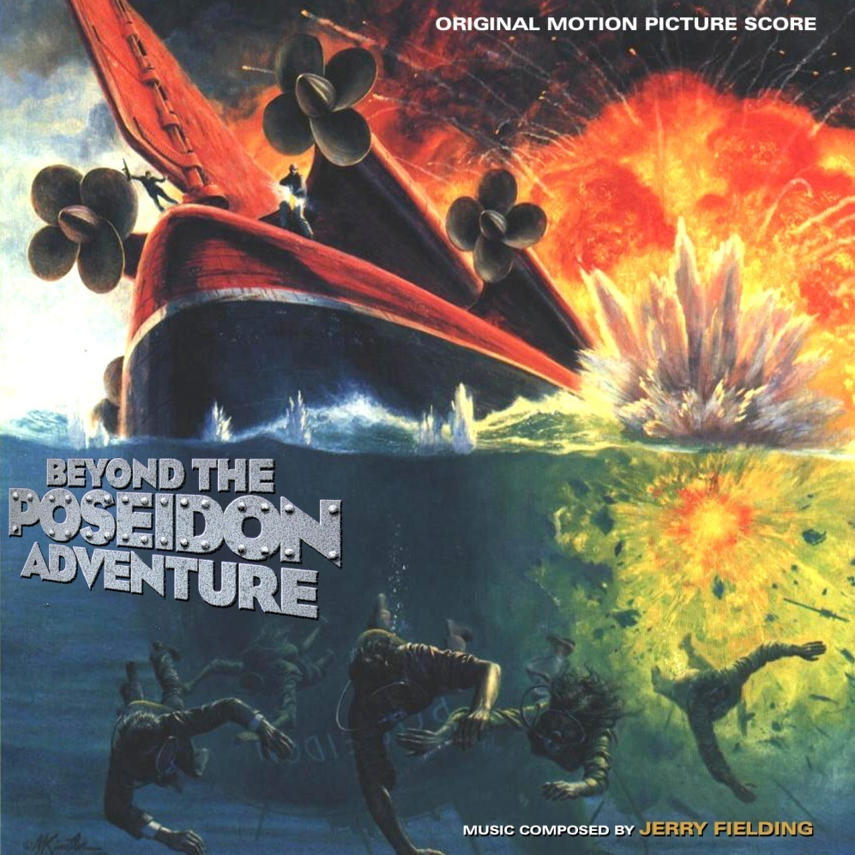
The Estonia Was Sabotaged
… like the Posiden Adventure. But the ship would still float, because the lower decks have watertight bulkheads.

Slide 27
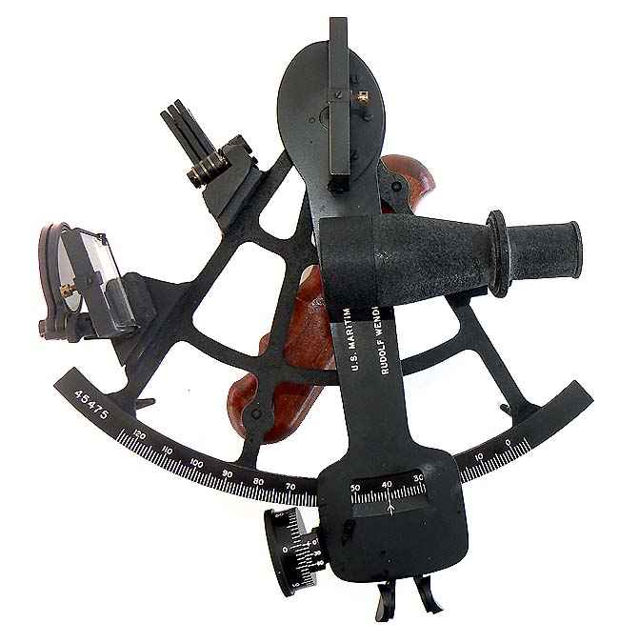
The Estonia Was Sabotaged
When a $200 million dollar ship goes down, everyone from the shipyard, the insurers, maritime commissions, the owners, etc.,

Slide 28
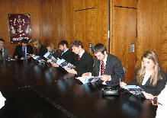
The Estonia Was Sabotaged
The Owners And The Insurers
… all get involved. The ship was owned by a conglomerate, and the insurance companies paid off the owners with a minimal investigation.

Slide 29
The Estonia Was Sabotaged
Protection Of The Wreck
Five nations signed the Estonia Agreement that says no one can explore it. The victims' families, who are pressing for a criminal investigation because parts of the wreck recovered showed explosives.

Slide 30
The Estonia Was Sabotaged
Israel's Only Regret Is They Can't Show The Films
Zionists are filled with unexplainable glee when they pull off a WTC, Beirut Bombing,

Slide 31
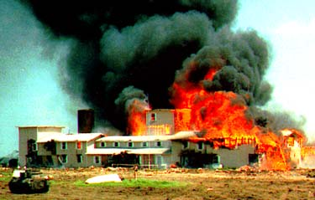
The Estonia Was Sabotaged
…. a Waco, Madrid train attack, etc. This type of manipulation reinforces their superiority, they see themselves as 'Gods' walking among mere mortals.

Slide 32
The Estonia Was Sabotaged
If people woke up to these vampires, and took back control of America, it would be a renaissance. The porn, drugs, family disintegration,

Slide 33
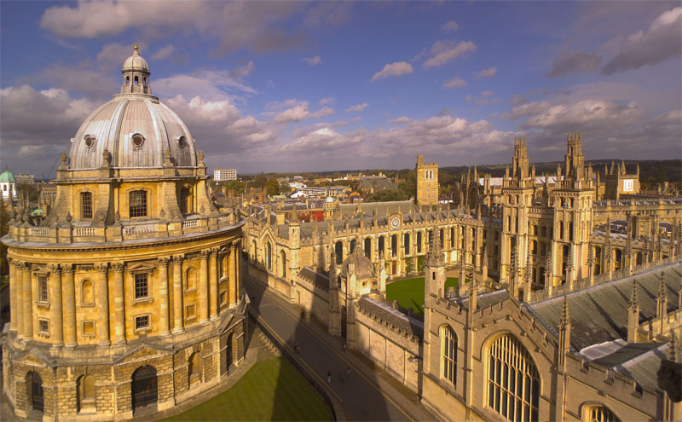
The Estonia Was Sabotaged
… control of the universities, legal system, etc would end. If school kids wanted to get a look at a Zionist, they would have to take a field trip to the local ghetto.

Slide 34
The Hindenburg Disaster
Another Gog attack on western civilisation

Slide 35
The Hindenburg Disaster
Observation deck of the Hindenburg flying over the pyramids of Egypt

Slide 36
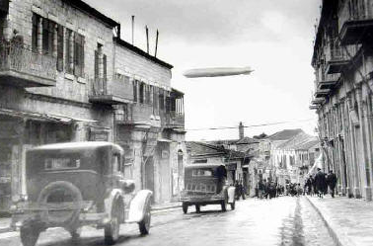
The Hindenburg Disaster
The Hindenburg flying over Jerusalem

Slide 37
The Hindenburg Disaster
The Starboard Dinning Room

Slide 38
The Hindenburg Disaster
The Starboard Dinning Room

Slide 39
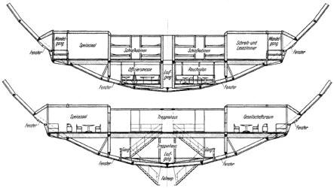
The Hindenburg Disaster
The Hindenburg had 2 decks the width of a ship

Slide 40
The Hindenburg Disaster
The Hindenburg at its home port in Germany

Slide 41
The Hindenburg Disaster
The destruction of the Hindenburg was no accident

Slide 42
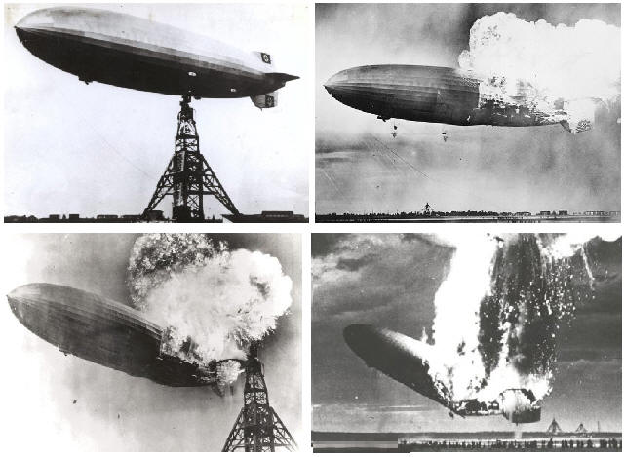
The Hindenburg Disaster
This happened in 32 seconds

Slide 43
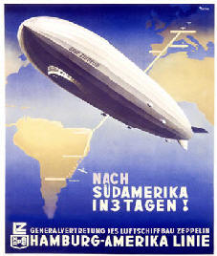
The Hindenburg Disaster
The dirigible is a semi rigid airship, referred to as Zeppelins, after Count Ferdinand von Zeppelin. The ship is a rigid aluminium framework containing separate gas bags.

Slide 44
The Hindenburg Disaster
In 1910 the rigid Deutschland became the world's first commercial airship. Between 1910 and 1914, German zeppelins flew 107,208 miles
and carried 34,028 passengers without injury.

Slide 45
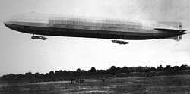
The Hindenburg Disaster
The Graf Zeppelin, flew from 1927 to 1937, carrying thousands. In 1929 it flew around the world.

Slide 46
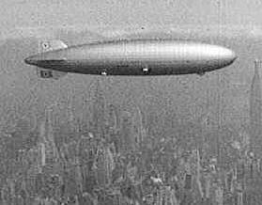
The Hindenburg Disaster
The Hindenburg Was The Pride Of Germany
In 1925 these airships flew around the world. They would fly over the beaches of Rio Janeiro, the rain forests of Amazon, Europe, the Mideast.
This was Germany's greatest ambassador.

Slide 47
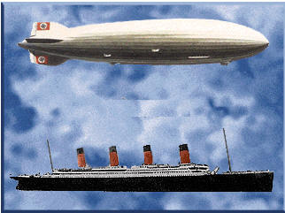
The Hindenburg Disaster
This Air Ship Was Enormous
It was the size of the Queen Mary. Today's Goodyear blimp is approximately 22% of it's size.

Slide 48
The Hindenburg Disaster
World Zionists Orchestrated This Disaster
World Jewry had declared war on Germany in 1934.
& Trotsky

Slide 49
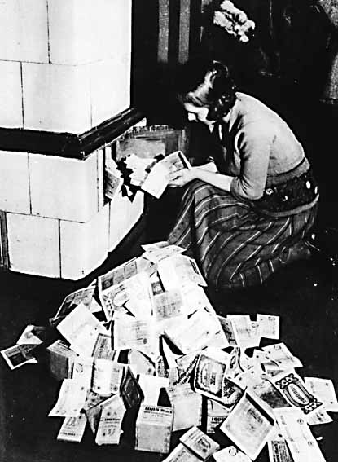
The Hindenburg Disaster
After the Weimar swindle, Germany was feed up with them, so Hitler passed the Nurenberg Laws, and gave them their walking papers.

Slide 50
The Hindenburg Disaster
An Economic War
In June of 1933 there was a worldwide Jewish boycott of German goods.

Slide 51
The Hindenburg Disaster
Hitler Protects The Fatherland
By 1935 the Zionists controlled the judicial, educational, and most of the professions.

Slide 52
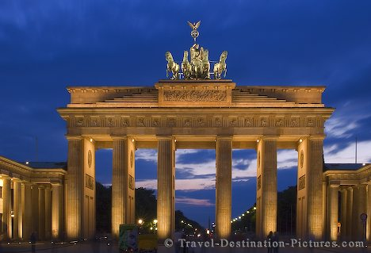
The Hindenburg Disaster
Berlin was a sewer of depravity that Germany passed the Nurenberg Laws. Sexual harassment was so intense that Zionists were actually forbidden to hire a German Frauline under 45 as domestic help.
The Brandenberg Gate

Slide 53
The Hindenburg Disaster
How Was It Done The generally accepted theory is a female communist, Esther Lieblinsky, became romantically involved with one of the Hindenburg's crew.
Esther Lieblinsky

Slide 54
The Hindenburg Disaster
Eric Sphel
According to Arthur Hoehling, Sphel planted a bomb in "Gas Cell 4," the location of the initial explosion. The bomb broke the airship's back, a bottle of oxygen mixed with the Hydrogen, and the ship was gone in 32 seconds.
Eric Sphel

Slide 55
The Hindenburg Disaster
Hydrogen Is Flammable
Some blamed the canvas covering and the hydrogen mix, but recreations showed a two minute burn time. The only way to match the burn was the use of compressed oxygen as an accelerant.

Slide 56
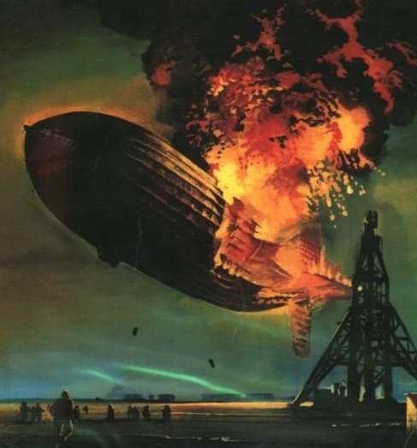
The Hindenburg Disaster
The Hindenburg was the combination of a bomb, an oxygen bottle, and the hydrogen gas. Left: From the movie of H-2 burn.

Slide 57
The Hindenburg Disaster
Germany's Finest Pilots
Captain Max Pruss (left), and Ernst Lehmann (Right), were the Zeppelin Company’s most experienced pilots, with hundreds of flights. Both said a bomb took the ship down.

Slide 58
The Hindenburg Disaster
Dr. Hugo Eckener
Eckener was the head of the Zeppelin airship company, and he blamed it on sabotage.

Slide 59
Gog Tourists Upset The Poles

Slide 60
Rabble Rousing Israelis Are Troublemakers

Slide 61
Gog Tourists Upset The Poles
They are Always Accompanied By Shin Bet Thugs

Slide 62
Gog Tourists Upset The Poles
Jewish Teens Terrorizing Oswiecim
Israeli hatchlings are so rude that the people of Oswiecim, who run the hotels, restaurants, and shops would love to ban them.

Slide 63
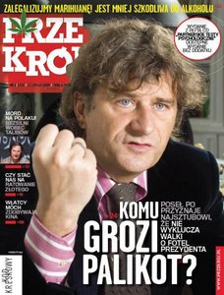
Gog Tourists Upset The Poles
Przekroj weekly, which accused Israeli teens of damaging hotel rooms and traumatizing locals during visits to Poland.

Slide 64
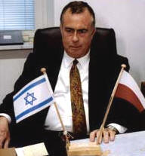
Gog Tourists Upset The Poles
Israel's Ambassador Had To Get Involved
The relationship between Israel and Poland is in danger, according to Israel’s Ambassador to Poland, David Peleg.
David Peleg

Slide 65
Gog Tourists Upset The Poles
Flight Attendants Repulsed
Jewish teens were accused of sexually harassing, and humiliated flight attendants, while flying with the Polish Lot Airlines.

Slide 66
Gog Tourists Upset The Poles
The young Jews travel with Shin Bet, who are armed and belligerent.

Slide 67
Gog Tourists Upset The Poles
Hotels Repulsed
The article published in Przekroj, titled “Young Israeli’s run amok in Poland”, describes incidents of Israeli teens burning carpets, breaking furniture, and defecating in their beds and sinks.

Slide 68
Gog Tourists Upset The Poles
Hotel Maids
They go to make up the bed and there will be a fresh stool under the covers. They wind up throwing the mattress away.

Slide 69
Gog Tourists Upset The Poles
Nobody Wants These Israelis
The hotels, the bars, the restaurants, and the local shops protest to the mayor. Whether it's leaving no tip, or shoplifting, or just plain ignorance.

Slide 70
Gog Tourists Upset The Poles
Israel Savages Beat Townspeople
This Zionists hatchlings parade through downtown Ociewn and hassle the local population, blaming them for the 4,000,000 Jews killed at Auschwitz.

Slide 71
Gog Tourists Upset The Poles
Poles Didn't Care
“The Israeli youth sees Poles as second-class humans, and treat them as potential enemies”, said Professor Moshe Zimmerman of the Hebrew University’s History Department.

Slide 72
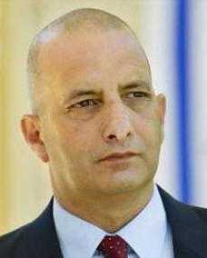
Gog Tourists Upset The Poles
Here Is How They Get Away With It
The article also criticized Shin Bet guards, and featured quotes by locals claiming that the guards beat them and forced them to undergo humiliating security checks.
A Shin Bet Guard

Slide 73
Gog Tourists Upset The Poles
A Polish Teacher Comments
Israeli teens in general are mean, rude, impolite, and uncivilized, add that to their immaturity and age. It's the way their parents have bought them up, with the superiority complex and distaste for the Goyim.

Slide 74
Gog’s Ritual Murders
Meet Mendel Beilis
A fiend who stalked children in 1912
Mendel Beilis

Slide 75
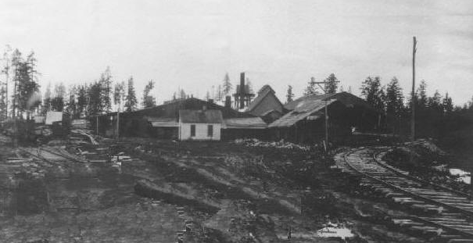
Gog’s Ritual Murders
Beilis was a supervisor at this brick factory outside Kiev

Slide 76
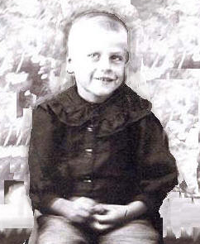
Gog’s Ritual Murders
Meet Andrei Yustschinsky
A Young Boy Murdered for a Purim Sacrifice

Slide 77
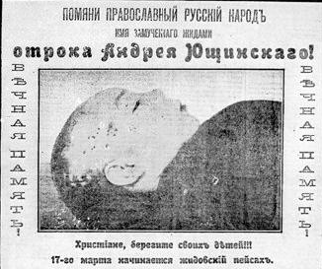
Gog’s Ritual Murders
The Marks of Purim Blood Letting

Slide 78
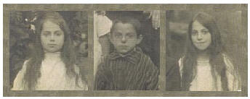
Gog’s Ritual Murders
These children saw who did it.

Slide 79
Gog’s Ritual Murders
1911 Kiev

Slide 80
Gog’s Ritual Murders
Kiev had a population of 452,000

Slide 81
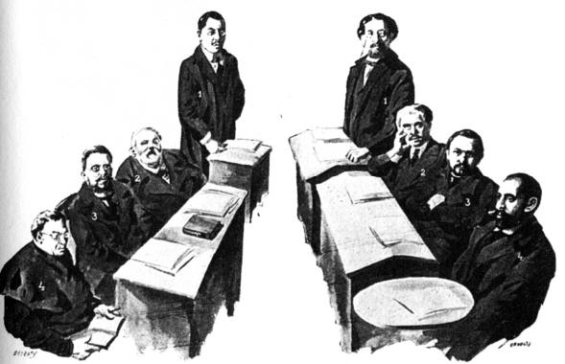
Gog’s Ritual Murders
The 1912 Trial of Ritual Murder
International Jewry Was In A Total Panic Over This Case

Slide 82
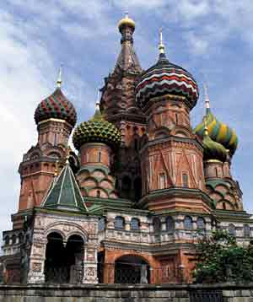
Gog’s Ritual Murders
A Brutal Ritual Murder
In March of 1911 a boy was brutally murdered by Beilis the Jew. Russia exploded, and the case went as far as to the Czar. There was intense Jewish pressure used to block investigators, and the courts.

Slide 83
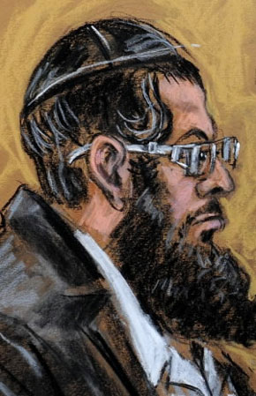
Gog’s Ritual Murders
At the time of the murder, Beilis (Left) had a Hassidic Jew, Faivel Schneerson, whose family had a history of Purim murders, staying with him. All of International Jewry came out to prevent a trial.

Slide 84
Gog’s Ritual Murders
The case of Beilis kept Russia in turmoil for almost three years, and stirred up the whole civilized world. Jews had gotten away with these Purim sacrifices for years, but this was 1912, and the world was focused on this one trial.

Slide 85
Gog’s Ritual Murders
This Kiev Jew had been stalking the child for months, and finally made his move on 20 March, 1911. The one surviving witness, another child, said there were other accomplices with Bielis. A member of the Schneerson family was with him.
Faivel Schneerson

Slide 86
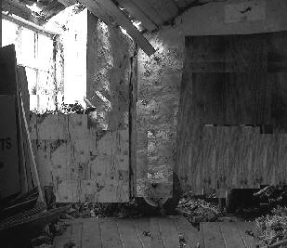
Gog’s Ritual Murders
The investigators concluded that the child was brought to a shed / chamber, and tortured to death. He was stripped naked, tortured and drained of all his blood, in a ritual manner. There were 36 puncture wounds, most on the head, and the blood letting occurred at the carotid artery.
The Child Was Butchered Here

Slide 87
Gog’s Ritual Murders
Body Is Moved was found in a semi rural area of Kiev in a clay pit. The body had rigor mortis, it was in half-sitting position, the hands were tied together behind the back.

Slide 88
Gog’s Ritual Murders
The body was dressed merely with a shirt, underpants, and a single stocking. His face was dark blue and covered with blood. Medical examiners determined he was alive, and naked, while he was tortured.

Slide 89
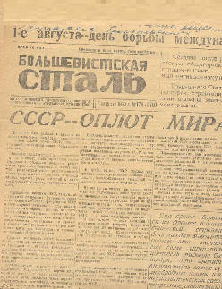
Gog’s Ritual Murders
Russia's Jewish Newspapers Panicked
International Jewry realized they were sitting on a time bomb. The implications of Purim's 'Blood libel' was on all their minds. The Kiev Jewish paper Kievskaya Mysl immediately wrote articles implicating the child's mother.

Slide 90
Gog’s Ritual Murders
A newspaper editor, Borchevsky, bribed police chief Mischtschuk, who then arrested the boy's mother. She wasn't allowed out of jail for the burial of her child! Next they accused the step father, and the police chief brought all the relatives in for questioning.
Borchevsky

Slide 91
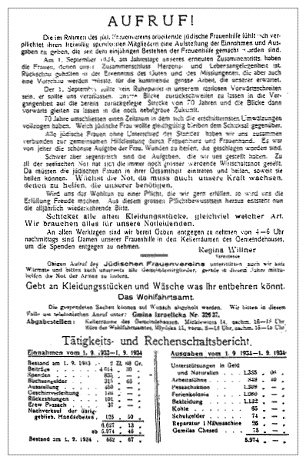
Gog’s Ritual Murders
Jewish newspapers were advocating violence and the governor had to arrest some editors, and close down papers. Jews organized street riots.

Slide 92
Gog’s Ritual Murders
Detective Mishchuk
The Ministry appointed Mishchuk who arrested the mother and step father. For two months he took the case nowhere. He was charged with accepting bribes and imprisoned.

Slide 93
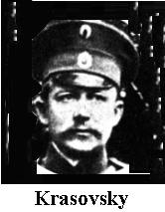
Gog’s Ritual Murders
Inspector Krasovsky
He took over from Mishchuk, and tried to blame one of the witness's mother. He was relieved, but there was enough evidence to charge him with accepting money. This is now four months after the murder.

Slide 94
Gog’s Ritual Murders
Alexandra Prichodko
She was the child's mother. Jews had her arrested, and she couldn't see her boy's funeral.

Slide 95
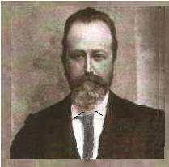
Gog’s Ritual Murders
Police Chief Is replaced By Commissar Kunzevitch;
The police were replaced by Kunzevitch, who preferred to stay in the Grand hotel of Kiev and to place his name merely among press reports.

Slide 96
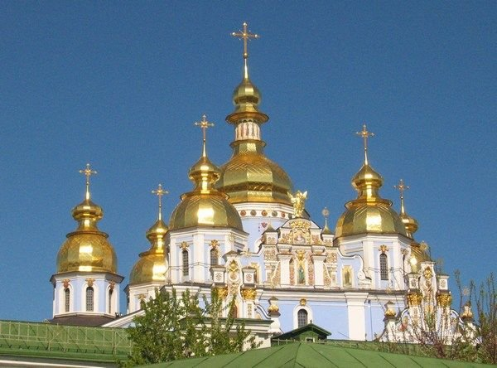
Gog’s Ritual Murders
The people of Kiev said he was bought off. Next was the "secret policeman" Krazovski", "secret policeman" Krazovski", an extremely confident man, who had a sudden change of heart.

Slide 97
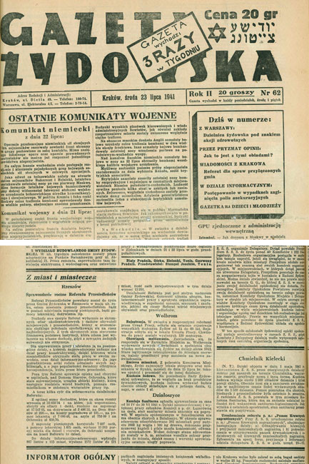
Gog’s Ritual Murders
The investigation went nowhere, but Krazovski became wealthy. His reports always conformed to the Jewish newspapers.

Slide 98
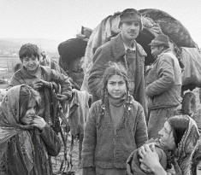
Gog’s Ritual Murders
Gypsies Are Accused
Solomon Breitmann, the publisher of the Jewish paper Poslyednich novostyey, accused a band of travelling gypsies who passed nearby.

Slide 99
Gog’s Ritual Murders
Golub The Investigator
The Jewish press had pretty much buried the story, and the police were paid off to drop it. Golub starting piecing the crime together, gathering witnesses, and took it to regular policemen, who finally had Beilis arrested.

Slide 100
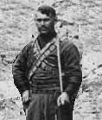
Gog’s Ritual Murders
The Lamp Lighter
A lamplighter testified that on March 12, the day Yushchinsky disappeared, he had seen him playing with two other boys on the premises of the brick factory. He alleged that a Jew had suddenly appeared and kidnapped Yushchinsky, pulling him toward the brick kiln.

Slide 101
Gog’s Ritual Murders
Witnesses Come Forward Four months after the murder, an investigator has three children confirm they were playing with the victim. They had been threatened with death if they talked.

Slide 102
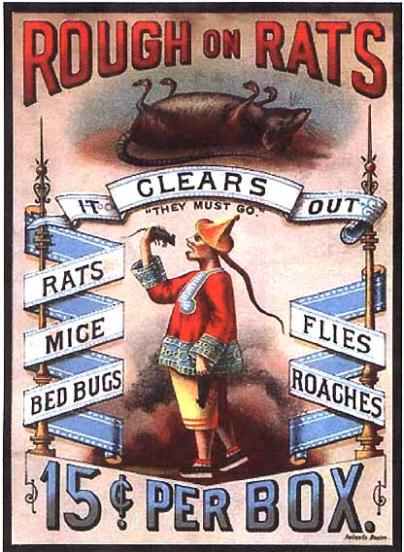
Gog’s Ritual Murders
Children Are Poisoned:
After one week the little ones fell critically ill with symptoms of poisoning, after the "secret Jew commissar" Krasovski had "visited" them and brought them "pies"!

Slide 103
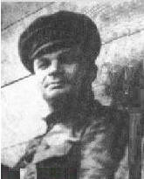
Gog’s Ritual Murders
Two children, Zhenya and Valva, died in quick succession, while Ludmilla slowly recovered only after many weeks. The Jewish newspapers reported the children died of "dysentery"!
Krasovski

Slide 104
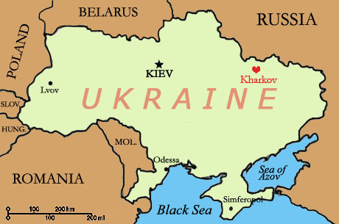
Gog’s Ritual Murders
The Witnesses’ Mother Is Sent To Kharkov. where she is put in the finest hotel of the city.

Slide 105
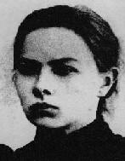
Gog’s Ritual Murders
She was told her other daughter would be killed, and the Jew Margolin, the later defence counsel of Mendel Beilis offered her the round sum of 40,000 Roubles. She was asked to confess to the murder of Andrusha.

Slide 106
Gog’s Ritual Murders
Beilis is Arrested
On 22 July 1911, Beilis was finally arrested together with Mrs. Cheberkov. The mother was soon released. Menahem Beilis spent more than two years in prison awaiting trial. Because of Austrian Jews visiting with him, it was thought to be a ceremony.

Slide 107
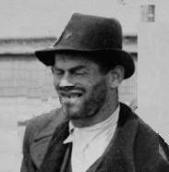
Gog’s Ritual Murders
Local Vagabond Found Strangled
Tartakovski (Left) a part time worker at the brick factory was said to have knowledge of the murder. He was found strangled!

Slide 108
Gog’s Ritual Murders
Beilis Accomplices
Between 1853 and 1860, the Schneerson, a family of Hasidics had been convicted of blood libel in Russia, and were imprisoned in Siberia. The nephew, Faivel Schneerson, of this famous family was staying with Beilis.
Faivel Schneerson

Slide 109
Gog’s Ritual Murders
Dr Sikorsky On Blood libel
This trial revolved around the Jewish ritual of killing Gentile children for a Purim sacrifice. Dr Sikorsky was an expert witness.
Dr Sikorsky

Slide 110
Gog’s Ritual Murders
Father Justin Pranaitis
He was the Catholic’s Church’s expert on Ritual Sacrifice. He produced scriptures that described the filthy Purim act of blood letting. He was executed by the 1919 Bolsheviks.
Father Justin Pranaitis

Slide 111
Gog’s Ritual Murders
Trial Lasted Twenty Days- Sept 25 through Oct 28, 1913
Not fewer than 219 witnesses, mostly Jews, were available during the 20 days of the trial. There were 44 newspapers there, and 95% were Jewish controlled.
Kiev Court of Justice,

Slide 112
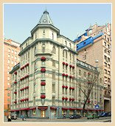
Gog’s Ritual Murders
Trial Lasted Twenty Days- Sept 25 through Oct 28, 1913
The high point of these 20 days of testimony, however, was shaped by the testimony of the little ten-year-old Ludmilla Cheberyakov.
Kiev Court

Slide 113
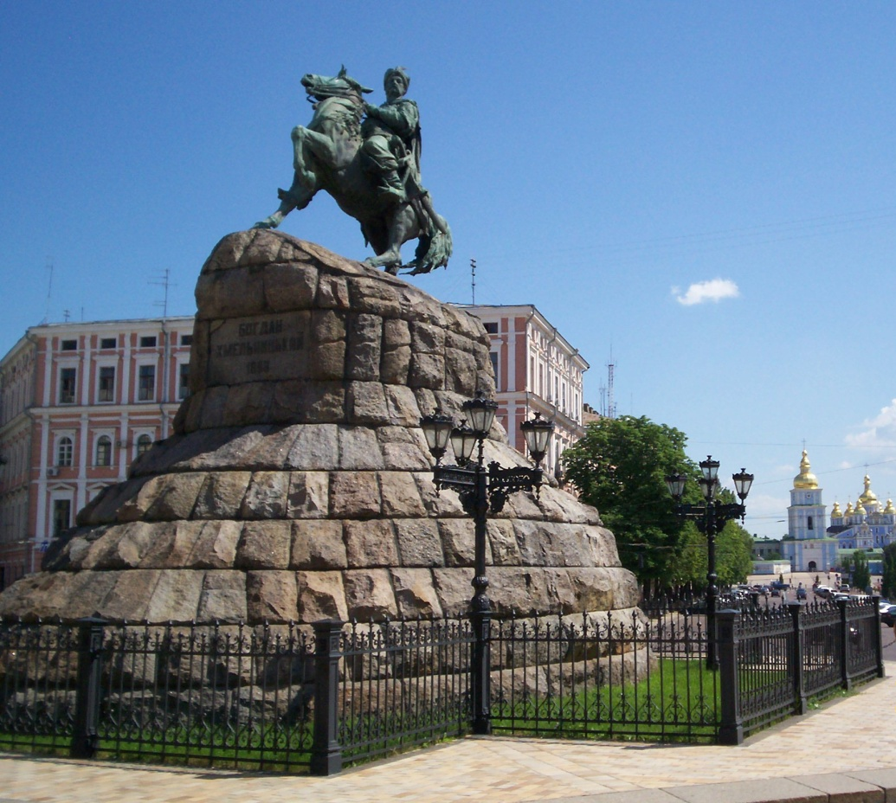
Gog’s Ritual Murders
The court was loaded with Jews, and she was afraid for her life. International Jewry provided five lawyers, and the Beilis trial is supposed to have cost the Jews 17 million Roubles. Beilis is acquitted on a jury vote of six guilty, and six innocent.
Kiev

Slide 114
Gog’s Ritual Murders
…. two chief witnesses against Beilis (both the children of Cheberyakova) died a sudden deaths, and the day the judge was to examine the murder shed, it mysteriously burnt down. In the trial it has been shown that several witnesses, intimidated by threats, did not dare to directly testify.
Theodor Fritsch

Slide 115
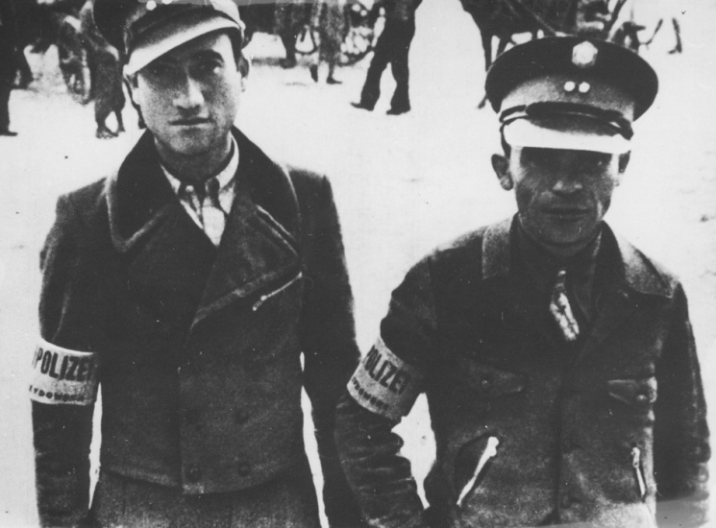
Gog’s Ritual Murders
Theodor Fritsch Comments: I expected anything after watching this trial. A five month investigation by two police chiefs turned up nothing. Next, two examining judges were bribed, and charged. When the third one finally arrested Beilis, remarkable things happened:

Slide 116
Gog’s Ritual Murders
American Consulate
This case was serious enough where the American Consulate kept Washington informed.
American Consulate

Slide 117
Gog’s Ritual Murders
Beilis's Life Afterwards
Beilis leaves for Israel to escape any murder attempts. Soon he moves to New York where Israelites present him with $400,000 Gold Marks. He died in 1932, at 60 yrs old, in New York. He wrote this book.
Beilis

Slide 118
Gog’s Ritual Murders
The Book Beilis wrote under a pseudo name

Slide 119
Gog’s Ritual Murders
The Bolsheviks Take Revenge On The Judges And Witnesses
When the Bolsheviks took over in 1917, all the witnesses, expert witnesses, prosecutors, judges, etc were put on trial, and then executed. Anyone that spoke out during the Beilis trial against Jewry, fell as victims to the Jewish-Bolshevist Terror.

Slide 120
Gog’s Ritual Murders
Professor of Psychiatry, J. Sikorski, and the student Golubov were shot, under martial law in Kiev, together with other witnesses. Professor Kossorotov; murdered by poison. Vera Cheberyak was shot. The ones siding with the Jews, like Bechterev, received a leading scientific administrative posts.
Vera Cheberyak

Slide 121
Gog’s Ritual Murders
Why The Panic Over One Child's Murder?
This trial was international news from 1911-1913. If this piece of human (?) garbage was convicted of Purim Sacrifice, than all of Jewry would be under a cloud.

Slide 122
Gog’s Ritual Murders
They spent 17 million roubles on this single trial, they killed at least three witnesses, and bribed countless police, judges, and prosecutors.

Slide 123
The 1996 Dunblane School Massacre
Twenty-eight children shot

Slide 124
The 1996 Dunblane School Massacre
The School Where The Killings Took Place

Slide 125
The 1996 Dunblane School Massacre
Aerial view of the school and surroundings

Slide 126
The 1996 Dunblane School Massacre
Dunblane is a remote Scottish town

Slide 127
The 1996 Dunblane School Massacre
Dunblane Is A Town Of 10,000, Forty Miles From Edinburgh

Slide 128
The 1996 Dunblane School Massacre
Thomas Hamilton, The Shooter
Dunblane Was Another Odd Massacre. This came on the heels of the Port Arthur Massacre, and had the same MO. Both Dunblane and Port Arthur were remote, both shooters had no motive, and they were horrific massacres.

Slide 129
The 1996 Dunblane School Massacre
What Happened
On March 13, 1996, at 9:30 a.m., Thomas Hamilton, 43, went to the Dunblane Primary School with four handguns and more than 700 rounds of ammunition. Once there, he cut the telephone wires on a nearby pole, then proceeded to the assembly hall.

Slide 130
The 1996 Dunblane School Massacre
What Happened
He shot several teachers, and then started shooting 5 year-old students. Next, he went into the classrooms and shot several more. He then returns to the gym, put a gun into his mouth, and pulled the trigger.
Hamilton in the Morgue

Slide 131
The 1996 Dunblane School Massacre
What Happened
The brutal rampage left 17 people murdered, including one teacher and 16 children. Twelve more students, and three teachers, were wounded.

Slide 132
The 1996 Dunblane School Massacre
Hamilton (nee Watt) ran a series of boy scout camps. He was a nobody from a small village. A key may lay in Edinburgh, 40 miles from Dunblane, and a key financial centre.
Psychiatrists are confused as to why these weren't his targets.
Hamilton Was A Loner

Slide 133
The 1996 Dunblane School Massacre
His three adversaries were a gun club (rejected membership), the police who investigated him, a paedophilia type complaint, and the boy scouts who refused him a position.
A Scout Camp

Slide 134
The 1996 Dunblane School Massacre
Psychiatrists are confused as to why these weren't his targets.
A Group of Scouts

Slide 135
The 1996 Dunblane School Massacre
Central Scotland Police
These police patrol a series of small villages. Scotland is caught up in a wave of political correctness, which appears to be the police's biggest interest.
The force has the correct percentage of women, minority, and gay.

Slide 136
The 1996 Dunblane School Massacre
It was an odd Inquiry which contained a lot of busy work and minutiae, but no real answers. Hamilton walked in and killed 17, but the real questions should be why, and who was he in contact with for the last few years. Rumours floated he was seeing an Edinburgh psychiatrist. Cullen sealed the evidence for 100 years.
Lord Cullen leads Inquiry

Slide 137
The 1996 Dunblane School Massacre
Gun Legislation
Within six weeks after the shooting, a mysterious group had an anti-gun petition with 705,000 signatures. By 1997, Tony Blair, at the urging of Zionists, passed a gun law effectively eliminating all private ownership of handguns in the UK.

Slide 138
The 1996 Dunblane School Massacre
Dunblane's conspiracy centers around a theory that Hamilton was a part of a paedophile ring, that included major politicians, and they put on the 100 yr ban to protect themselves.
A silly smokescreen like that, points to a deeper conspiracy.
Conspiracy Crowds

Slide 139
The 1996 Dunblane School Massacre
A contingent of various people contest the official findings. Ms Uttley wrote a book questioning the Crown's 100-year seal on the Dunblane evidence.
Similarities to the Port Arthur massacre also question the validity of the inquiry, and the possibility of official involvement.
The Questions Begin

Slide 140
The 1996 Dunblane School Massacre
The people (MacGregor, Scurry, Beattie Uttley) questioning the massacres are eyewitnesses, and ex-policeman.
Stewart Beattie, who worked closely with the eyewitnesses, found discrepancies in the suicide account, and believes there was another person involved.
Stewart Beattie

Slide 141
The 1996 Dunblane School Massacre
The investigations of the massacres are all tightly controlled, Columbine was Fuselier, Port Arthur was Tasmanian police, and this was Central Scotland Police.
Central Scotland Police.

Slide 142
The 1996 Dunblane School Massacre
Most occur at schools, in small towns, and the immediate aftermath are the Zionists with their gun control laws coming forth to take advantage.
Coincidences With Other Massacres

Slide 143
The 1996 Dunblane School Massacre
What Really Happened
Hamilton was spotted by a Sayanim, probably a Doctor. He was supposedly taking prozac was troubled, which would make him a ripe Manchurian Candidate. He just didn't explode.

Slide 144
The 1996 Dunblane School Massacre
What Really Happened
Instead he was nurtured along. For months leading up to the massacre, he had been visited by strange Mid-Eastern men, who could have very well been Israeli. He was turned by the use of psychotropic drugs into a mindless moron.

Slide 145
The 1996 Dunblane School Massacre
The Port Arthur Massacre
Memmorial
Both Port Arthur, and Dunblane, had paramilitary overtones, where phone lines are cut, and police are sent on decoy missions.

Slide 146
The 1996 Dunblane School Massacre
Why?
We are close to a world revolution and catastrophic econominc collapse, and the last thing the Zionist elite want is a bunch of patriots with guns.

Slide 147
The 1996 Dunblane School Massacre
His Suicide
The Cullen report said he was shot four times.
How Was He Turned?
Mossad agents used a psychiatric profile on Hamilton, whereby they befriended him, then dropped him down into a mental abyss. In the end, the profile would point to something at that school.

Slide 148
The 1996 Dunblane School Massacre
I have studied this shooting massacre along with many that you have worked on.
At Dunblane I suspect that the controller would have had the following requirements:
Stewart Beattie

Slide 149
The 1996 Dunblane School Massacre
A good working first hand knowledge of Central Scotland's police methodology and politics.
Spoke English with an English accent.
Did not reside in the area of Dunblane.
Had a previous record of assassination success A person such as "Joe" Otho Jewell Vialls for instance.
Stewart Beattie

Slide 150
The 1996 Dunblane School Massacre
Thomas Hamilton did not commit suicide – as it is difficult to shoot yourself TWICE through the roof of your mouth; one shot to exit just above the left ear, the other to lift the brain out the top of the head and be found lying just behind the prostrate body.

Slide 151
The 1996 Dunblane School Massacre
Crime scene examiner falsely claimed Hamilton was standing when he fired the fatal shot as he claims evidence of two shots was found in the ceiling! But his brain was lying just behind his head indicating it had – skidded along the floor to that spot.

Slide 152
The 1996 Dunblane School Massacre
Eye Witnesses
An off duty policeman who entered the Gym very shortly after the shooting saw the janitor remove a semi-auto pistol from the hand of Hamilton and he instructed the janitor to "Put it down!".

Slide 153
The 1996 Dunblane School Massacre
He also noted that there was just one other pistol and again noted "not a revolver" beside the prostate and still gurgling body of Hamilton.

Slide 154
The 1996 Dunblane School Massacre
But the Crime Scene Examiner claimed Hamilton had "4 hand guns in holsters"

Slide 155
The 1996 Dunblane School Massacre
… and that he had his thumb on the hammer of a 9mm Browning with no magazine and one round up the spout – and all this after he was alleged to have fired two rounds from a 357 S&W Magnum revolver to kill himself!
Investigators

Slide 156
The 1996 Dunblane School Massacre
A Professional Assassin
Then there is further compelling evidence that will be revealed to the public shortly which indicates very clearly that (Watt) Hamilton - the hated paedophile, did not murder the children either; a professional assassin like "Joe" did the job.

Slide 157
The 1996 Dunblane School Massacre
Why Did He Do It, And Who Benefits?
Hamilton had no relationship to that school, so what brought him there? Who guns down 28 five year-old kids? His likely targets would have been the Boy Scout administrators, the police, or the members of the gun club that turned him down.

Slide 158
The 1996 Dunblane School Massacre
Why Did He Do It, And Who Benefits?
The beneficiary is the Zionist Gun Control Lobby. And the reason Hamilton did it, is because he was psychologically programmed, and probably cooked on drugs.

Slide 159
The Story Of Gog And Magog
A thought to leave you with
"The modern banking system manufactures money out of nothing. The process is perhaps the most astoundng piece of sleight of hand that was every invented. Banking was conceived in inequity and born in sin . Bankers own the earth. Take it away from them but leave them the power to create money, and with a flick of a pen, they will create enough money to buy it back again.
Howbeit no man spake openly of him for fear of the Jews. (John 7:13)

Slide 160
The Story Of Gog And Magog
A thought to leave you with
"You must conceal all the crimes of your brother Masons... and should you be summoned as a witness against a brother Mason be always sure to shield him.. It may be perjury to do this, it is true, but you are keeping your obligations."
[ Ronayne, "Handbook of Masonry" p. 183 ]
Howbeit no man spake openly of him for fear of the Jews. (John 7:13)

Slide 161
The Story Of Gog And Magog
The End Of Part Nine
Chapter B
To be continued ………… The Conclusion

