Slide 1
The Story Of Gog And Magog
Part Nine
False Flag Operations

Slide 2
The Story of Gog & Magog Will be covered in a series of 10 parts
Attila, The Rise of Islam and the Khazars
Genghis Khan, The Russians & the 3 frogs of Revelation
The Spanish Armada & Inquisition + the English revolution
The rise of the House of Rothschilds & the Armenian Holocaust
The French Revolution &The Victorian Era
WW1 & WW2
Post War Situation

Slide 3
The Story of Gog & Magog Will be covered in a series of 10 parts
Gog’s covert attack on western culture, education, legal system, health, art & education.
False flag operations
Conclusion

Slide 4
False Flag Operations
Some Examples of False Flag Operations:
The Italian Mafia
The Mob – USA
The Russian Mafia

Slide 5
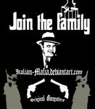
False Flag Operations
Gog’s criminal gangs are assigned with the label of the nation in which they are operating so that their misdeeds are seen as acts by nationals of that country and so blacken its reputation while that of the Jews remains lilywhite in the eyes of the sheeple

Slide 6
False Flag Operations Are Not New!
We have all heard the story about Nero fiddling while Rome burnt, whether this is true or not does not matter, but we do know that it was Nero’s Jewish wife who persuaded Nero to arrange for Rome to be set on fire so that it could be blamed on the Christians and thereby ensure that the citizens supported Rome’s pogrom against them.

Slide 7
The Reichstag Fire
Like the twin towers the “terrorist attack” on the Reichstag was faked to make the population accept a draconian “security” clamp down

Slide 8
False Flag – Black Ops
What is the Mossad?
Mossad is a shell organization for Jewish / Israeli terrorism all over the world.
Right: Mossad’s emblem whose motto is – By deception we shall make war.

Slide 9
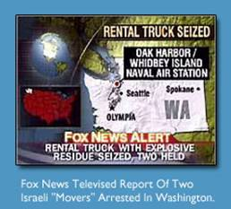
False Flag – Black Ops
Men were intercepted after being caught filming 9-11 from the top of a tall building and were reported as cheering the event.
Left: a report that appeared on Fox News stating they were arrested in a Moving Systems van.

Slide 10
False Flag – Black Ops
The name of their “moving company” actually contained the word MOSSAD embedded inside. Moving Systems Incorporated…
MOving SyStems
IncorporAteD…….
MOSSAD

Slide 11
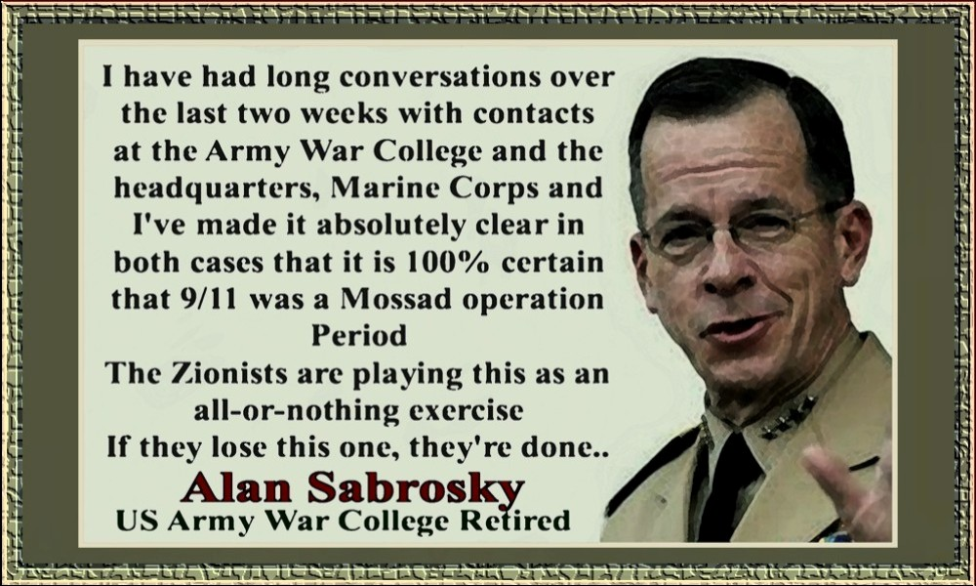

Slide 12
False Flag – Black Ops
What is a False Flag Operation?
Committing an atrocious act, and blaming another party or nation for it. The point is to turn public opinion against an entity, and have someone else fight your battles for you.
Oklahoma

Slide 13
False Flag – Black Ops
The Lusitania
Churchill who was 1/2 Jewish, leaked intelligence to Germany that Lusitania carried munitions, and then it was sent in a U-boat infested area. The ship was supposedly torpedoed, and a massive bomb exploded, killing 1200.

Slide 14
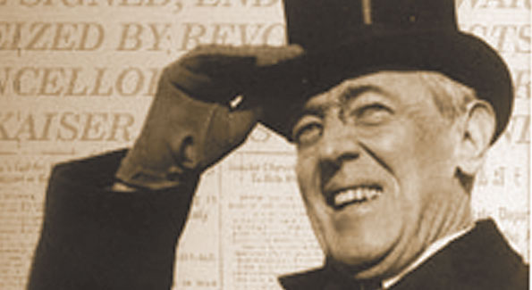
False Flag – Black Ops
This set the stage for Wilson to bring the USA into WW2, at a later date as seen in an earlier presentation.

Slide 15
False Flag – Black Ops
Kristallnacht
When government officials were away, Jewish-paid thugs went on a rampage in Berlin and some border towns.
Nazis were blamed, and world opinion favoured the Jews

Slide 16
False Flag – Black Ops
Bromberg Massacre
An estimated 58,000 German civilians lost their lives in the massacres carried out prior to the 1939 invasion. The Polish Bolshevik Jews massacred 5,500 Germans, on one 'Bloody Sunday, in 1939.
This was the flashpoint for the Polish invasion.

Slide 17
False Flag – Black Ops
The King David Massacre
July 22, 1946
Jewish terrorists blew up a hotel, and killed 91 British soldiers, and blamed the atrocity on Arabs….

Slide 18
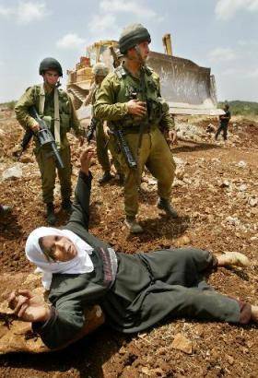
False Flag – Black Ops
… When later caught, they said the British had a list of their Arab spies and were going to turn them over to the Palestinians.
The goal of the False Flag was to pit the British against the .

Slide 19
False Flag – Black Ops
Lavon affair
In 1954, Israeli agents working in Egypt planted bombs in several buildings, and left evidence behind implicincluding a United States diplomatic facility, ating Arabs as the culprits.

Slide 20
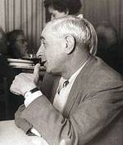
False Flag – Black Ops
The ruse would have worked, had not one of the bombs detonated prematurely, allowing the Egyptians to capture and identify one of the bombers, which in turn led to the round up of an Israeli spy ring.
Israeli's Defence Minister Pinhas Lavon was brought down by the scandal

Slide 21
False Flag – Black Ops
JFK Assassination
Because Kennedy was working against the interests of the NWO and the Israeli state.

Slide 22
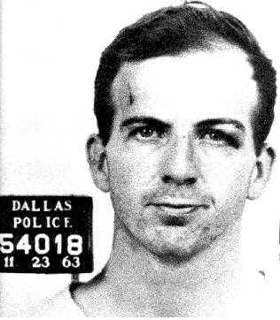
False Flag – Black Ops
Patsy Lee Harvey Oswald was set up so as to make it look as though it was carried out by the USSR. So that MOSSAD was not suspected.

Slide 23
The Most Revealing Wink
Congressman Albert Thomas winks back at a quickly-smiling LBJ

Slide 24
The Most Revealing Wink
… as he is being sworn in to be the next President of the United States on Air Force One while the grief-stricken Jackie Kennedy stands next to him. Notice also the smirk on LBJ’s Jewish wife

Slide 25
False Flag – Black Ops
June 1968 – Robert Kennedy
Robert Kennedy is shot by a PLO bus-boy named Sirhan Sirhan. Kennedy was running for President, and would have sought revenge over the Israeli killing of his brother.
The use of a Palestinian was a little too 'Hollywood'.

Slide 26
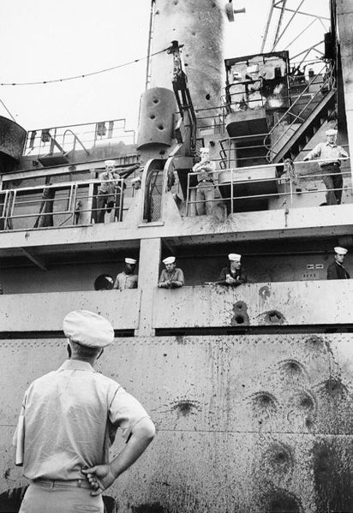
False Flag – Black Ops
Six fighters, three torpedo boats and two assault helicopters attacked the USS LIBERTY There were 24 dead and 177 maimed. F-4 phantoms were enroute when President Johnson stopped the rescue.

Slide 27
False Flag – Black Ops
USS Liberty ....June 6th, 1967
Israel's plan was to blame Egypt, and have the US retaliate against Egypt.

Slide 28
False Flag – Black Ops
September 5, 1972
Eight Palestinian "Black September" terrorists seized 11 Israeli athletes in the Olympic Village in Munich, West Germany. In the rescue attempt by West German authorities.

Slide 29
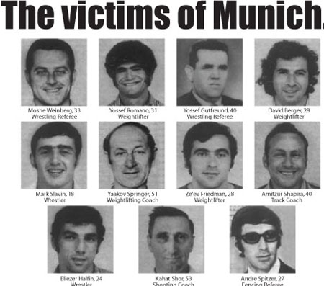
False Flag – Black Ops
September 5, 1972
…. nine of the hostages, and five terrorists were killed.
Israel, and it's Jews, are once again the victim, and the Palestinians are demons.

Slide 30
False Flag – Black Ops
1976 ...Entebbe
Israel faked a hijacking to Kenya (Idi Imin was an Israeli puppet), and then pulled a rescue, portraying themselves as elite commandos.

Slide 31
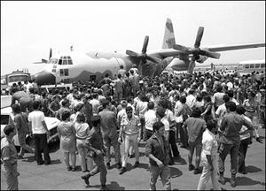
False Flag – Black Ops
1976 ...Entebbe
Arabs looked like monsters and the Israelis, having suffered countless persecutions, have decided to fight back.

Slide 32
False Flag – Black Ops
1982 Abu Nidal, who was an Israeli Black Ops agent, attacked the Jewish Goldenberg's delicatessen in Paris. 6 were killed, and 20 were wounded, of which 2 were Jewish.

Slide 33
False Flag – Black Ops
Pan Am Flight 73
A 747 was enroute from Karachi, to Frankfurt, to its final destination of New York.
Four hijackers took control of the airplane, and for the next 16 hours, ….

Slide 34
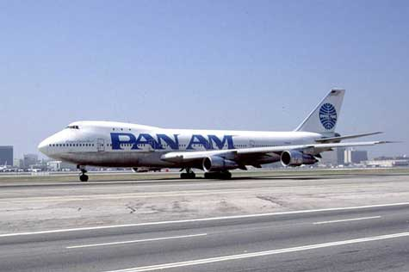
False Flag – Black Ops
Pan Am Flight 73
… they held 379 passengers at gunpoint, while the pilots escaped. The plane was stormed and 20 died.

Slide 35
False Flag – Black Ops
Beirut Marine barracks ...October 23,1983
241 Marines died when a truck packed with explosives blew up a Marine barracks at Beirut International Airport
Another MOSSAD operation

Slide 36
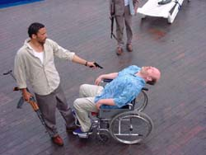
False Flag – Black Ops
Achille Lauro...1985
Abu Abbas, and 15 Arabs, took over a cruise ship and threw a Leon Klinghoffer overboard. After two days of negotiations,

Slide 37
False Flag – Black Ops
Achille Lauro...1985
… the seajackers abandoned the ship.
In this False Flag, the Israelis turned world opinion against the Arabs, while once again portraying themselves as victims.
The Achille Lauro

Slide 38
False Flag – Black Ops
English policewoman shot....1984
In 1984, Zionist Jews staged a protest outside the Libyan embassy in London. Approximately 25 English Bobbies were used for crowd control. During the middle of the demonstration, a shot rang out and a female Bobby named Yvonne Fletcher was hit and killed.

Slide 39
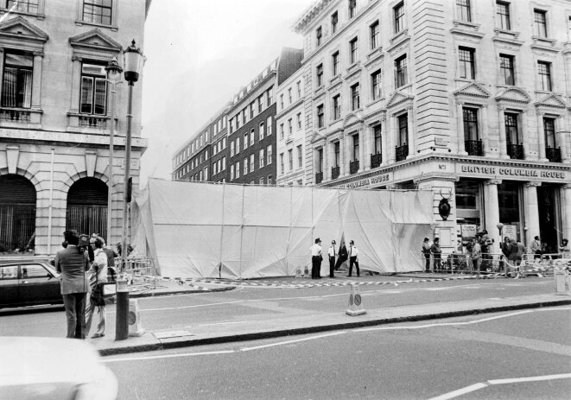
False Flag – Black Ops
English policewoman shot....1984
The shot came from a building used by the Mossad to spy on the Libyan embassy, but the newspapers overlooked that and blamed Libya. .

Slide 40
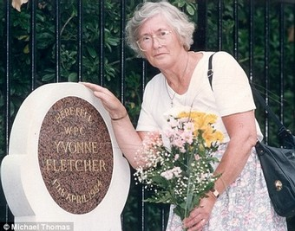
False Flag – Black Ops
English policewoman shot....1984
Israel used this false flag murder of Policewoman Fletcher, to turn world opinion against Libya.

Slide 41
False Flag – Black Ops
Alia airliner...1985
Nidal's Black September group hit a jet with an SAM as it took off from Athens airport. Although the rocket did not explode, it left a hole in the fuselage.

Slide 42
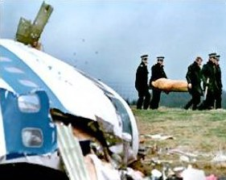
False Flag – Black Ops
Lockerbie ....Dec 1988
Mossad blew up Pan AM 103 and blamed it on Libya. Unfortunately, the plane was late and blew up overland, and all the evidence pointed towards Israel.
Israel's goal was to demonize the Muslims, and lay the groundwork for 9/11.

Slide 43
False Flag – Black Ops
AMIA ....1992
Mossad blew up AMIA and the Israeli Embassy in Argentina. Over 100 killed, and practically all of them were Argentineans.

Slide 44
False Flag – Black Ops
Luxor, Egypt ... 1992
An attack on Luxor, by militants, in which 58 foreigners, most of them Swiss, were killed. Arabs blamed the Mossad.
Israel destroyed Egyptian tourism, and turned world opinion against Muslims.

Slide 45
False Flag – Black Ops
Khobar Towers ...1996
Khobar Towers were bombed. It housed an F-15 unit.
Israel said it was done by Hezbollah, but US military investigators linked it to Mossad.
Khobar Towers

Slide 46
False Flag – Black Ops
Karin-A...... 2000
Israel intercepted a ship, the Karin-A, in the Red Sea. The ship contained massive weapons, which Israel claimed were destined for the PLO. A Jewish arms dealer set it all up.
SS Karin-A

Slide 47
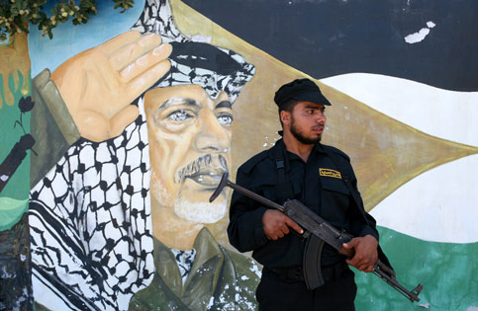
False Flag – Black Ops
As a result, world opinion turned on the PLO, and Israel's slaughter of rock throwing Arab children wasn't questioned.

Slide 48
False Flag – Black Ops
Two airports attacked .....1985
Terrorists from Mossad disguised as Abu Nidal's Black Sept. struck at the Rome and Vienna airports. Nineteen were killed at Schwechat Airport and three at the Rome airport.

Slide 49
False Flag – Black Ops
LaBelle Disco ......1986
As part of a Libya False flag, the Mossad sent a series of false messages out of Tripoli, talking of an impending attack. The Mossad then bombed a German Disco, the Labelle Club,

Slide 50
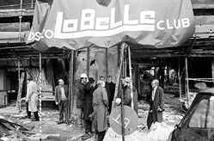
False Flag – Black Ops
LaBelle Disco ......1986
… killing three and wounding 230. President Reagan was convinced it was a Libyan attack, and retaliated by bombing Libya. World opinion turned against Libya

Slide 51
False Flag – Black Ops
OKC Murrah Building ….1993
One of the Mossad's American arms, the Southern Poverty Law Centre (SPLC), was concerned about the growth of Patriot movements

Slide 52
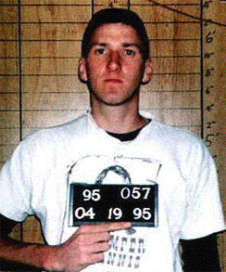
False Flag – Black Ops
OKC Murrah Building ….1993
... such as Militias, so an attack was staged using a Timothy McVeigh patsy, who was out of Elohim City (Jewish-sponsored terror Mecca).

Slide 53
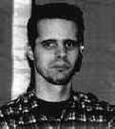
False Flag – Black Ops
OKC Murrah Building ….1993
The real brains behind the OKC bombing were Andreas Strassmeir and Daniel Spiegelman, who were/are both Jewish. The Zionists destroyed the Militia movement's credibility, and brought the FBI down on them.
Andreas Strassmeir

Slide 54
False Flag – Black Ops
Flight 840
TWA's Flight 840, a Boeing 727 flying from Rome to Athens with 115 passengers and seven crew members aboard, had already begun its descent toward the Athens international airport.
Flight 840

Slide 55
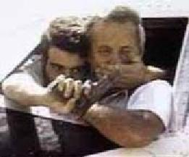
False Flag – Black Ops
Flight 840
Twenty minutes before landing, as it flew at 15,000 ft. over Argos, a town near the ancient site of Mycenae, an explosion shook the aircraft. Four were killed but 111 lived.
Once again, Israel planted the seed of "Arab" terrorism.
Flight 840

Slide 56
False Flag – Black Ops
World Trade Centre.... 1993
In Dec. 1992, an Israeli soldier, Nissim Toledano was kidnapped and killed. The Israeli government rounded up 1600 members of Hamas, and deported 415 of them to the no-mans land between the Israeli and Lebanese borders. In the brutally inhospitable weather, …
WTC Dec.1993

Slide 57
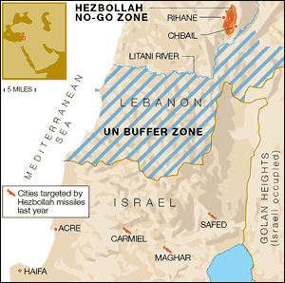
False Flag – Black Ops
World Trade Centre.... 1993
… and deported 415 of them to the no-mans land between the Israeli and Lebanese borders. In the brutally inhospitable weather,

Slide 58
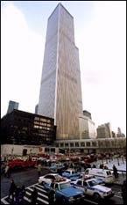
False Flag – Black Ops
World Trade Centre.... 1993
… these 415 Hamas members were stranded without food and shelter. Furthermore, the Israeli authorities stopped any humanitarian aid from reaching these people.
WTC Dec.1993

Slide 59
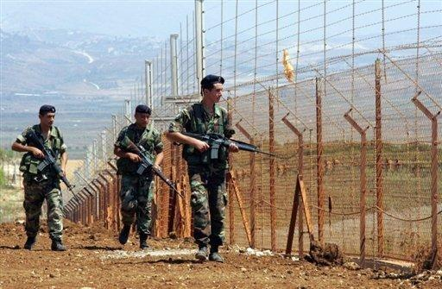
False Flag – Black Ops
World Trade Centre.... 1993
With media focus on the deportees, it triggered international outrage against Israel, which was followed by international pressure on Israel that refused to go away.
Israeli Soldiers Patrolling the Border

Slide 60
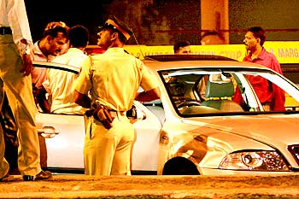
False Flag – Black Ops
World Trade Centre.... 1993
This time, Israel had bitten off more than it could chew. It was time to ‘deflect’ pressure off Israel. Israeli intelligence services went into action.
WTC Dec.1993

Slide 61
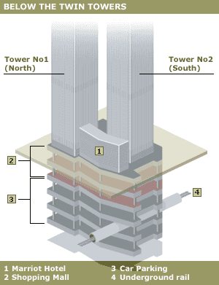
False Flag – Black Ops
World Trade Centre.... 1993
A detailed process that is too long to elaborate here, hatched a plan. In the third week of February 1993, a truck bomb exploded in the basement of the World Trade Centre building.

Slide 62
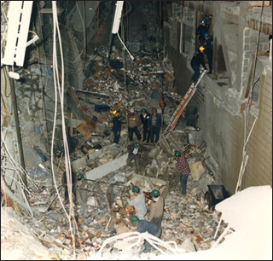
False Flag – Black Ops
World Trade Centre.... 1993
Muslims used as scapegoats took the blame for it, while the real culprits were safely back in Israel. Thus world opinion and pressure was shifted away from Israel
WTC Dec.1993

Slide 63
False Flag – Black Ops
Port Arthur Massacre .....1996
A 2-man Israeli Counter-Terrorism team killed 35 at a remote tourist centre at Port Arthur, Tasmania.
Port Arthur

Slide 64
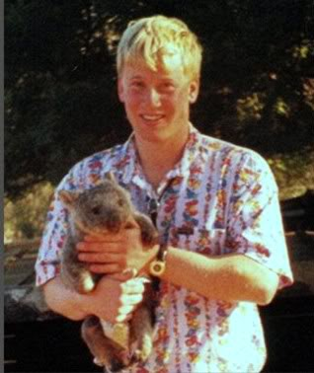
False Flag – Black Ops
Port Arthur Massacre .....1996
The blame fell on a mentally challenged man named Martin Bryant, who has served as the designated patsy for this crime ever since.
Martin Bryant

Slide 65
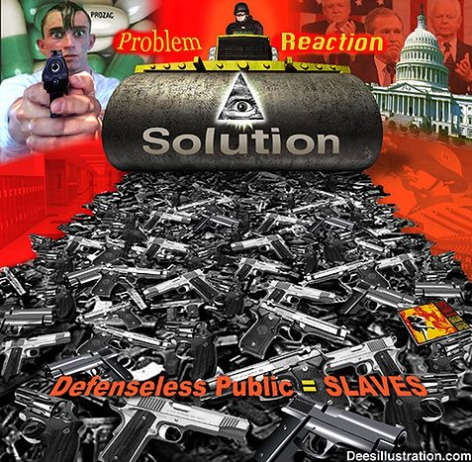
False Flag – Black Ops
Port Arthur Massacre .....1996
Zionists got their long-awaited draconian gun control laws passed in Australia as a result of this massacre.

Slide 66
False Flag – Black Ops
Birmingham USA ....1998
Birmingham abortion clinic bombed and two people killed.
As a result of the bombing, abortion opponents were portrayed as lunatics, while for the Jewish-dominated abortion industry special laws were passed to protect their trade.

Slide 67
False Flag – Black Ops
Egyptair 990.....1999
Israel planted a thermite bomb in the aircraft tail.

Slide 68
False Flag – Black Ops
USS Cole
Sayanims in the Pentagon had the Cole directed to a part in Yemen, where Israeli agents had Arab patsies approach the Cole with a small boat, in order to be seen by crewmen, while they attacked it with a shape charge.

Slide 69
False Flag – Black Ops
Sept 11 .....2001
The most brazen of all Israeli attacks
Time does not permit in this presentation to go into all the sordid details on the attack on the twin towers,
The 911 attack on the twin towers of the World Trade Centre

Slide 70
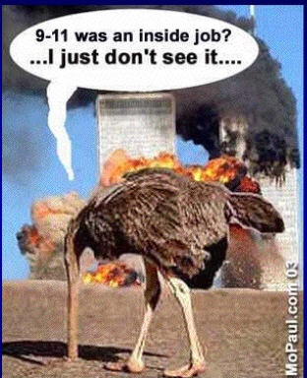
False Flag – Black Ops
Sept 11 .....2001
… save to say this was a landmark event on Gog’s downward spiral to destruction.

Slide 71
911 – Gog Strikes America
A False Flag Operation to achieve the following:-
To facilitate Legislation through Congress and other western Parliaments to curtail freedoms.

Slide 72
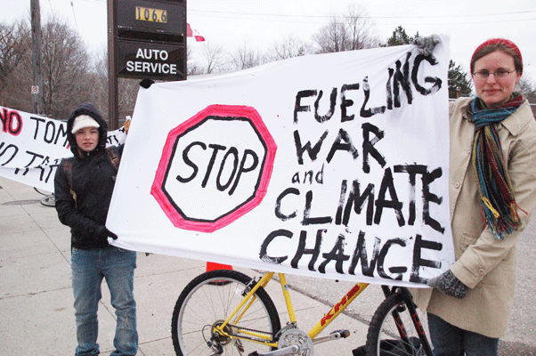
911 – Gog Strikes
To facilitate the dispatch of “Peace Keeping Forces” to overthrow Afghanistan & Iraq.
To facilitate the setting up of a police state.
To inflame relations between Christians and Moslems.

Slide 73
False Flag – Black Ops
Larry (lucky) Silverstein is the New York property tycoon who purchased the entire WTC complex just 6 months prior to the 9/11 attacks. That was the first time in its 33-year history the complex had EVER changed ownership. - You’ve got to be lucky to make $4 Billion killing on a 6-month investment of $124 Million

Slide 74
False Flag – Black Ops
The Security Company he hired was Securacom (now Stratasec). George W. Bush's brother, Marvin Bush, was on its board of directors, and Marvin’s cousin, Wirt Walker III, was its CEO. According to public records, …..

Slide 75
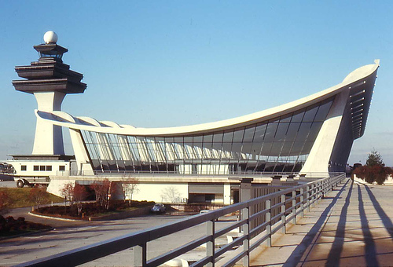
False Flag – Black Ops
… not only did Securacom provide electronic security for the World Trade Center, it also covered Dulles International Airport and United Airlines — two key players in the 9/11 attacks.
Dulles International Airport

Slide 76
False Flag – Black Ops
Now that many US citizens recognise that 911 wasn’t a Moslem attack, the controlled media are diverting the blame onto the puppets rather than the puppeteers!

Slide 77
False Flag – Black Ops
Flight 587....2001
Mossad blows up a F1587 out of NY, and it crashes in Rockaway.

Slide 78
Gog – Seizes Iraq’s Oil
American Troops guarding Iraq’s Ministry of Oil
The phoney war on terror used to seize other countries oil resources.

Slide 79
Gog Uses Terror to Cower The People Into Accepting Military Adventures In Support of The State of Israel

Slide 80
Gog's Most Infamous Serial Killer
One Of History's Most Hushed Up Events
Why did the most diabolical mass murder in history get so little coverage? The simple fact is that Harold Shipman appears to be Jewish
Harold Shipman

Slide 81
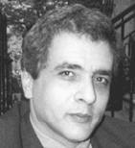
Gog's Most Infamous Serial Killer
Background:
Shipman's career starts in 1974 as a GP in Yorkshire.
He is considered arrogant, and soon found to be selling pain pills, he was fined £600 for forgery and prescription fraud. From 1975 till 1993 he had partners, he left and went on his own in 1993.
HAROLD SHIPMAN

Slide 82
Gog's Most Infamous Serial Killer
What Did Shipman Do?
He used opium to kill 260 patients, and the reason was for money. His victims were mainly elderly ladies who had substantial assets, but few relatives. …
One of Shipman’s victims

Slide 83
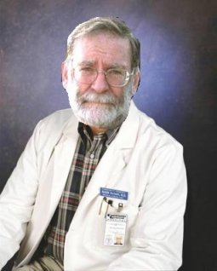
Gog's Most Infamous Serial Killer
.. Shipman would forge their wills, steal their jewels, take their cash and bonds. He even got a kickback from the cremation facilities.

Slide 84
Gog's Most Infamous Serial Killer
Dr Shipman's surgery in Hyde, Greater Manchester - This was a pill mill, and one his many schemes.

Slide 85
Gog's Most Infamous Serial Killer
He had a staff of five, but it was Dr Reynolds that first suspected him.

Slide 86
Gog's Most Infamous Serial Killer
Mrs Brant, a Jewish woman, who managed Battersby’s Chemist near Shipman’s Market Street practice in Hyde, was said to have handed out massive amounts of diamorphine to Shipman without question.
Ghislaine Brant

Slide 87
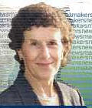
Gog's Most Infamous Serial Killer
Dr. Reynolds
Angela Woodruff
Dr Reynolds suspected him, and Angela Woodruff Caught Him. Shipman killed her 83 yr old mother, and forged the will.

Slide 88
Gog's Most Infamous Serial Killer
Shipman was tried on fifteen deaths in a two week trial. They said the motive was he had to watch his sick mother suffer, and thought he was helping the elderly woman. He was convicted and sentenced to life.
Mr. Justice Forbes

Slide 89
Gog's Most Infamous Serial Killer
Shipman hung himself on Jan 13, 2004. Shipman confessed to a temporary cellmate that he killed 508 patients. The truth is, he was murdered to make this whole incident vanish.
Shipman's Convenient Suicide

Slide 90
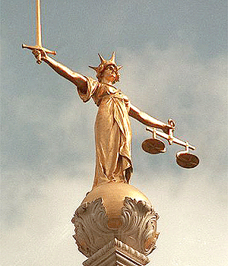
Gog's Most Infamous Serial Killer
The English legal system is destroying all his artefacts, so they don't wind up with another “Jack the Ripper” in a wax museum.

Slide 91
Gog's Most Infamous Serial Killer
It is Certainly Odd How This Monster Was Forgotten
Everything from the quickie trial, to silly motives, to no investigation of his partners, his staff, and so on. Where are the books, and movies?
Harold Shipman

Slide 92
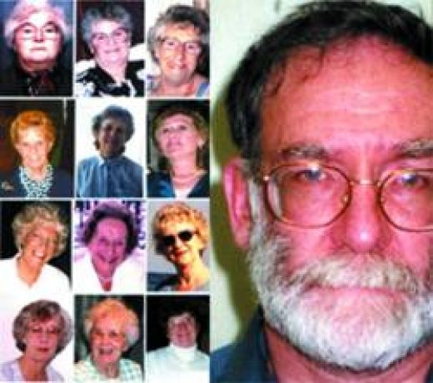
Gog's Most Infamous Serial Killer
The silence on this guy is deafening.

Slide 93
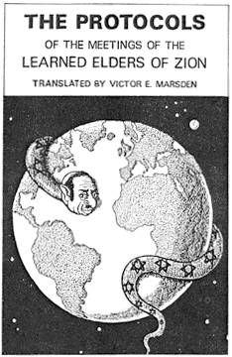
Gog's Most Infamous Serial Killer
We should not be surprised – as clause 3 of the Grand Edict of the Grand Satrap at Constantinople in 1492 was:-

Slide 94
Gog's Most Infamous Serial Killer
Become doctors and apothecaries and kill Christians medically
Harold Shipman

Slide 95
Gog Behind London Bombings
The London Red Bus known throughout the world

Slide 96
Gog Behind London Bombings
We shall see in the following slides that there are many aspects of the 7/7 bombing which don’t square with the official government line and what we have been told in the controlled media.

Slide 97
Gog Behind London Bombings
MI5 Headquarters - London
There can be no public inquiry because any such investigation would reveal a plethora of smoking guns that would prove beyond any shadow of doubt that high-level government officials along with corrupt elements within the intelligence 'services‘ ….

Slide 98
Gog Behind London Bombings
… were complicit in the planning, execution and subsequent cover-up of the bombings. The evidence available incriminates not only key elements within the British government and its intelligence services, the evidence also directly implicates Mossad too.

Slide 99
Gog Behind London Bombings
The British government has been caught red-handed as well. Members of Vladimir Putin's FSB were caught planting bombs in a Russian apartment building in 1999 by the Moscow police.
Moscow apartment bomb
Notes:
15855

Slide 100
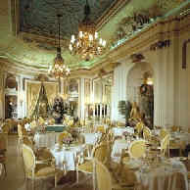
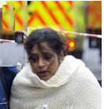
Gog Behind London Bombings
If This Were A Real Islamic Attack
Arab victim right:
Jewish Restaurant Left:
If these attacks were Muslim, the targets would be Jews. 'Rich and powerful Jews', to be more exact. A Jewish conference, or an exclusive Jewish restaurant and Jewish banks, etc.

Slide 101
Gog Behind London Bombings
If This Were A Real Islamic Attack
… The Muslims would want the world to know that Jews are the Muslim's real enemies. Who benefits from bombing a bus-load of working immigrants?

Slide 102
Gog Behind London Bombings
Bush and Blair ... Two Israeli Poodles!
Now these two have a green light to retaliate against all Muslims. People now accept the inevitability of an attack on Iran.
Bush & Blair at the summit

Slide 103
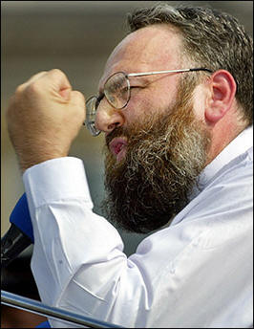
Gog Behind London Bombings
Radical London Muslim Cleric of Jewish Lineage MI-5 put it around that they believe he was involved in the London bombings. Possibly instrumental in setting up the 4 Muslim Patsies.
Sheikh Omar Bakri Muhammad

Slide 104
Gog Behind London Bombings
Bakri Laughs At America & Britain
Bakri initially established terror training camps in Afghanistan, but he claimed, there was too much surveillance. He told reporters: ~ "We will train in America, where they call us tourists".
Sheik Omar Bakri

Slide 105
Gog Behind London Bombings
Sheik Omar Bakri Mohammed, a firebrand Islamic leader in London, and who is also a founder of the fundamentalist al-Muhajiroun organization,
One of Sheik Omar’s “training” sites

Slide 106
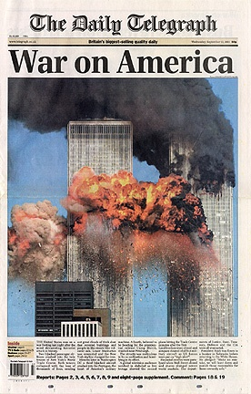
Gog Behind London Bombings
…. told the Telegraph last year that between 1,800 and 2,000 British Muslims were going abroad each year for "military training“.
Bakri has said: ~ I will use domestic Muslims as 'Sleeper Cells‘.

Slide 107
Gog Behind London Bombings
Benjamin Netanyahu, who just happened to be in London, escaped unharmed (he was also in NY at the time of the 911 tragedy . Netanyahu, who was an Israeli assassin / commando, will soon lecture the world on evil Arabs.
Benjamin Netanyahu

Slide 108
Gog Behind London Bombings
Despite Israel's ban on commenting Ex-Mossad chief praises 'Muslim' expertise.
Ex-Mossad Chief Calls For World War 3 After London Attack. - Headline in the Jerusalem Post 7/7/05
Efraim Halevi

Slide 109
Gog Behind London Bombings
We know that Mossad led the coordination for the 911 event, so naturally they should be directing this one as well.
Time of attack on London Bombing 8:49 am Time of attack on New York 911 8:49 am = 11 minutes to 9 or 911!

Slide 110
Gog Behind London Bombings
Scene at Tavistock Square on the morning of the 7th July 2005

Slide 111
Gog Behind London Bombings
CCTV on the No30 bus was not working
The only bus to be diverted off route – led by two unidentified cars (CTV footage conveniently not found)
London symbolically destroyed by the Illuminati

Slide 112
Gog Behind London Bombings
Notice the white van – with Illuminati 5 pointed star (MI5?) logo. Parked close to the bus that was blown up.
Could it have been part of the bombing operation?
Tavistock Square

Slide 113
Gog Behind London Bombings
Bombing linked to the Israeli state
It was at 77 Great Russell Street, a stones throw from where the bus blew up, that Dr. Chaim Weizmann, presided over the effort that culminated in the issuing of the Balfour Declaration (2/11/1917), the instrument making it possible for the Jews to settle in Palestine.
Notice that it was at No. 77 and signed on 2/11/17 – 115 days prior to the anniversary – 1 + 1 + 5 = 7 = 777

Slide 114
Gog Behind London Bombings
Security Connected To Israeli Company
London's underground rail system uses this contractor for transportation security.

Slide 115
Gog Behind London Bombings
The Israeli Security Company
A security company was running a 1000 man drill when the explosions took place. Of course it was just a coincidence that the Company just happened to be having a training exercise where the LUG trains were bombed!

Slide 116
Gog Behind London Bombings
Interestingly the firm in charge of security on the London Underground when the attack took place has its head office in Tavistock House, Tavistock Square!
Tavistock House

Slide 117
Gog Behind London Bombings
Fortressgb’s Address
South Block, Tavistock House Tavistock Square London WC1H 9LG Tel +44 (0) 20 7874 7595
Note the Illuminati embedded in the tel. No.! i.e. 777 – the remaining numbers add up to 33
Tavistock House
Spattered with body parts from the bus bomb

Slide 118
Gog Behind London Bombings
Synchronized timing devices
2. Bombs with a high 'level of sophistication‘
3. Military grade explosives
4. Closely coordinated bombings down to a minute
The bombed underground train at Aldgate Station

Slide 119
Gog Behind London Bombings
Early BBC reports claimed there were 7 explosions, but this has now been revised to 4. Early reports also claimed 11 buses, 7 tunnels and 33 dead, but these have of course now been revised.
Medics attending at Edgware Rd. Tube Station.

Slide 120
Gog Behind London Bombings
It was like a huge electricity surge which knocked us out and burst our eardrums. "The policeman said 'mind that hole, that's where the bomb was'. …
Bruce Lait – Receiving a Royal visit

Slide 121
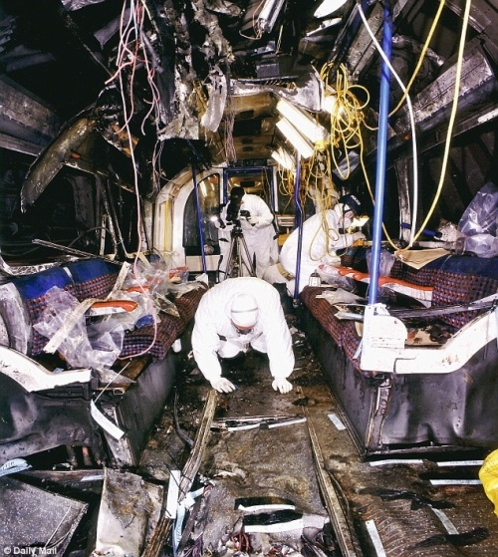
Gog Behind London Bombings
… The metal was pushed upwards as if the bomb was underneath the train. They seem to think the bomb was left in a bag, but I don't remember anybody being where the bomb was, or any bag," he said.

Slide 122
Gog Behind London Bombings
One strange aspect of this event is how the authorities homed in on the Luton station cameras, when one thinks of all the possible destinations the bombers could have come from involving literally thousands of cameras. Could it be anything to do with the fact the Israeli security firm has an office in Luton hospital close by?
A CCTV Camera

Slide 123
Gog Behind London Bombings
Inside of the bombed underground carriage

Slide 124
Gog Behind London Bombings
Photograph from CCTV camera appears to be “doctored” – notice the railing in front of the man’s left arm and the puddles.
Metropolitan Police handout photo shows a CCTV image alleged bombers

Slide 125
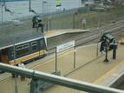
Gog Behind London Bombings
Luton was dry on the day of the bombing but according to the puddles on the official photo it had been recently raining!

Slide 126
Gog Behind London Bombings
The suspect photo in more detail – give away faults circled in red
A further analysis clearly shows the railing continuously running visible through the man's head. There is also a noticeable outline above the bomber's cap and around his head, indicating the image has been "cut out" and superimposed onto the original.

Slide 127
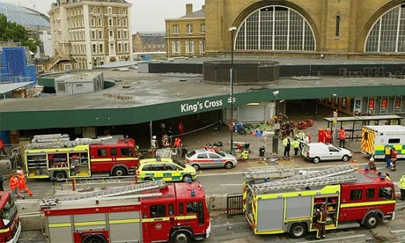
Gog Behind London Bombings
The July 07.05 : 07.40 Luton to London train was cancelled. The next train to London, the 07.48, arrived at London King's Cross at 08.42:

Slide 128
Gog Behind London Bombings
… seven minutes before, and miles away from, the detonations of the first explosives. See the correspondence between Nick Kollerstrom and Mr. C. Hudson Communications Manager, Thameslink Ltd. for the damning evidence.
The Train the alleged Bombers caught

Slide 129
Gog Behind London Bombings
As the cancellation could not have been foreseen and with it being far too late to alter the plans, the police released the pre-prepared 'four suicide bombers took the 07.40 train etc' statement.
The Route of The Luton Train

Slide 130
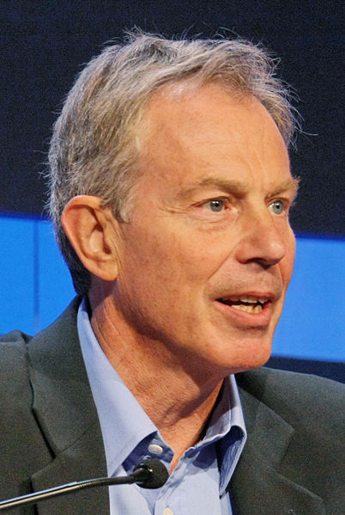
Gog Behind London Bombings
Tony Blair, with remarkable speed, announced that there would be no public enquiry.

Slide 131
Gog Behind London Bombings
Whoever synchronized bombs to go off simultaneously on three separate tubes traveling through tunnels, between platforms,
Aldgate Station

Slide 132
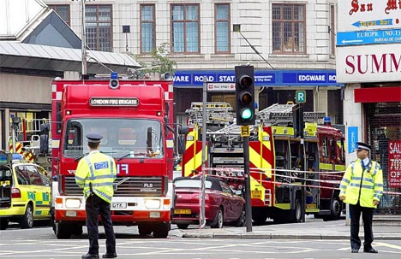
Gog Behind London Bombings
… must have had knowledge of the schedule or the luck of the Devil. Either that or the devices were located inside the tunnels themselves,

Slide 133
Gog Behind London Bombings
which only underground workers and cleaners can enter during the night when no services are running.
But others had access to the network on July 7th,
Edgware Station

Slide 134
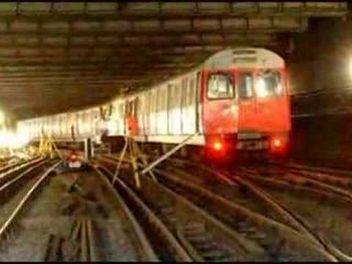
Gog Behind London Bombings
… the firm staging a ‘terror drill’ at the same stations where the actual attacks took place, Aldgate, Edgware Rd, King’s Cross and Liverpool St.

Slide 135
Gog Behind London Bombings
Something else which was suspicious; it took a week to recover bodies trapped under the wreckage on the Piccadilly Line, which suggests the blast came from below the carriage.
The Piccadilly Line

Slide 136
Gog Behind London Bombings
An eyewitness at the Aldgate incident has confirmed that “the metal was pushed upwards as if the bomb was underneath the train” and he has no recollection of a bag.
Aldgate

Slide 137
Gog Behind London Bombings
Illuminati use Big Ben to signal London Bombings
1. The clock stopped at 22.07 = 11.
2. It stopped again at 22.20 = 6 or looked at another way 111 x 2.
3. The duration of the first stoppage was 13 mins - 22.20 minus 22.07.
4. The duration of the second stoppage was 90 mins or 3 x 3.
Big Ben
Notes:
Further Illuminati Signatures on London 15920
An email posted exactly as received from a subscriber in Australia - further food for thought:
It also happens to be 11 months after the London atrocities that they plan to release The Beast movie on 6/6/06.
Remember the Big Ben clock stoppage in London that the news media made so much fuss about?
Here are the interesting numbers plus the stoppage’s relationship to the 7/7 attacks.
1. The clock stopped at 22.07 = 11.
2. It stopped again at 22.20 = 6 or looked at another way 111 x 2.
3. The duration of the first stoppage was 13 mins - 22.20 minus 22.07.
4. The duration of the second stoppage was 90 mins or 3 x 3.
5. The date it stopped was 5/27/2005 and when added together = 39 or 3 x 13.
The number of days between 5/27 and 7/7 including only one date is 41 or 1 month and 10 days or an 11.
Including both dates the time span is 42 days or 1 month and 11 days or a 111.
Also the 41 day method yields a 5 and the 42 day method yields a 6 and so, added together 5 and 6 yields 11.
So, they get multiple 11’s using either method.
11 is the number for their christ or the biblical Antichrist.
Add these numerical features to the ones already posted and it would tend to support the contention that it has all the hallmarks of being orchestrated by devotees of the evil one.
--------------------
London Explosions: 777
Of course there are many conspiracy buffs all over the Internet that recognize the 777 signature of the London blasts (2+0+0+5=7: 7-7-7), but there are far more sinister ‘signatures’ on the event.
If you are not yet familiar with the significance of the Illuminati signature on major world events, see the Numerology Category in this blog, or download the Occult Report.
Early BBC reports claimed there were 7 explosions, but this has now been revised to 4. Early reports also claimed 11 buses, 7 tunnels and 33 dead, but these have of course now been revised.
So what other signatures are evident in this event?
Before I get on to them, I believe this incident was also engineered to justify an imminent invasion of Iran and/or Syria, which is no doubt currently being discussed by the G8 leaders meeting in Scotland. Their excuse will be the fictitious ‘War on Terror’.
First, let’s analyze some of the dates of previous events.
Exactly 1 year 1 month and 1 day after September 11, 2001 we had the Bali Bombings on October 2, 2002.
June 30th, 2004 was declared Iraq’s “independence day”, which is 111 days after the Madrid train bombing on March 11, 2004.
1 year 1 month and 1 day after the London Bombings takes us to August 8, 2006.
111 days after the London Bombings takes us to October 26, 2005.
11 months and 1 day after the London Bombings takes us to June 8, 2006 (it might have been even more interesting if it took us to June 6, 2006 (6-6-6).
Now let’s look at the July 7th date.
London Explosions on July 7, 2005 – Elapsed Time From Other Events 15 Days (or 360 hours) to go till July 22, 2005. 193 Days (0 Years, 6 Months, and 11 Days) since the SE Asian Tsunami on December 26, 2004. 444 Days (1 Year, 2 Months, and 18 Days) since the aborted attack on Chicago’s Sears Towers. (Also see Dirty Bomb Plot on Sears Tower Foiled.) This attack would have been 911 hours after the Madrid Bombings). 483 Days (1 Year, 3 Months, and 26 Days) since the Madrid bomb blast on March 11, 2004. 517 Days (1 Year, 5 Months, and 1 Day) since the Moscow Metro bombing on February 6, 2004. 840 Days (2 Years, 3 Months, and 17 Days) since the invasion of Baghdad on March 20, 2003. 1009 Days (2 Years, 9 Months, and 5 Days) since the Bali bombings on October 2, 2002. 1396 Days (3 Years, 9 Months (3x3), and 27 Days (3x3x3)) since September 11, 2001. (Note that this calculation - 1396 days - is only valid if you take the time difference between the UK and US into account, otherwise the difference is 1395 days). 6042 Days (16 Years, 6 Months, and 16 Days) since the bombing of Pan Am Flight 103 which took place on 21 December 1988 over Lockerbie, Scotland. At 1333 (BST) US President George W Bush, speaking at the Gleneagles summit in Scotland, condemns the attacks, saying that the blasts show the war on terror must continue.
So there certainly appears to be a strong ‘signature’ on this event.
Other Links:
For the usual controlled media spin on events, see BBC News
The Apparent Al Qaeda website which has claimed responsibility. (There was still the matter of the fake al Qaeda website. The DNS was still POINTING TO AN INTERNET SERVICE PROVIDER IN MARYLAND, AMERICA. The Israeli intern had, according to one duty officer who speaks fluent Farsi and classic Arabic, done a poor job of the grammar and had even misquoted the ayahs selected from the Koran. MSNBC TV translator Jacob Keryakes was already saying that al Qaeda would never have posted a statement on a secular website and that the claim of responsibility contained give-away errors. The whole thing is phoney, he scoffed. “This is not something al-Qaeda would do,” he said. From rense.com.)

Slide 138
Gog Behind London Bombings
Illuminati use Big Ben to signal London Bombings
5. The date it stopped was 5/27/2005 and when added together = 39 or 3 x 13.
The number of days between 5/27 and 7/7 including only one date is 41 or 1 month and 10 days or an 11.
When one adds the 2 to the 5 of 5/27/2005 – one gets 7/7/2005 – the date of the bombing.
Big Ben

Slide 139
Gog Behind London Bombings
Illuminati use Big Ben to signal London Bombings
6. It also happens to be 11 months after the London atrocities that they plan to release The Beast movie on 6/6/06
Big Ben

Slide 140
Gog Behind London Bombings
Illuminati use Big Ben to signal London Bombings
7. 1396 Days (3 Years, 9 Months (3x3), and 27 Days (3x3x3)) since September 11, 2001. (Note that this calculation - 1396 days - is only valid if you take the time difference between the UK and US into account, otherwise the difference is 1395 days).
Big Ben

Slide 141
Gog Behind London Bombings
Illuminati use Big Ben to signal London Bombings
8. 6042 Days (16 Years, 6 Months, and 16 Days) since the bombing of Pan Am Flight 103 which took place on 21 December 1988 over Lockerbie, Scotland.
Big Ben

Slide 142
Gog Behind London Bombings
Illuminati use Big Ben to signal London Bombings
8. 7/7/2005: At 1333 (BST) US President George W Bush, speaking at the Gleneagles summit in Scotland, condemns the attacks, saying that the blasts show the war on terror must continue.
Big Ben

Slide 143
Gog Behind London Bombings
Illuminati use Big Ben to signal London Bombings
It is interesting to note that the firm which made Big Ben also made the clock in the Tower of David in Jerusalem which was E. Dent and Co., Ltd.
Big Ben

Slide 144
Gog Behind London Bombings
While London was under attack world leaders were safely tucked up in Gleneagles Scotland – A good day to stage the bombing while security resources were tied up in Scotland!

Slide 145
Gog Behind London Bombings
Peter Power, Managing Director of Visor Consultants was a former Scotland Yard official, working at one time with the Anti Terrorist Branch.
Peter Power

Slide 146
Gog Behind London Bombings
Power told BBC Radio 5 that at the exact same time that the London bombings were taking place, his company was running a 1,000 person strong exercise which drilled the London Underground being bombed at the exact same locations, at the exact same times, as happened in real life.

Slide 147
Gog Behind London Bombings
The three bombs went off nearly simultaneously at about 8:50 a.m. Thursday, said Deputy Assistant Commissioner Brian Paddick, revising earlier accounts that they occurred within a 26-minute span.
Deputy Assistant Commissioner Brian Paddick

Slide 148
Gog Behind London Bombings
"It is high explosive," Paddick said. "That would tend to suggest that it is not homemade explosive, but whether it is military explosive, whether it's commercial explosive, whether it's plastic explosive, we don't want to say at this stage."
Army and Police investigating

Slide 149
Gog Behind London Bombings
Police identify bombers ..All British born ... No reason to die Shehzad Tanweer, 22, a university graduate. Hasib Mir Hussain 18, happily married with a 8 month old baby…
Forensic police

Slide 150
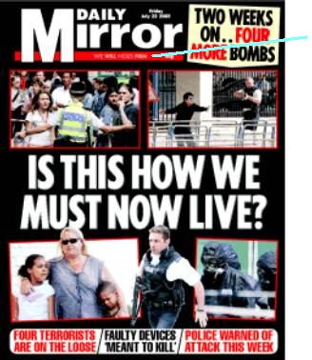
Gog Behind London Bombings
Mohammed Sadique Khan, 30, a teacher for disabled children, has 14 month old, and wife is pregnant. Jermaine Lindsay has a one-year-old son, is expecting her second baby within days.
They all had two way tickets.

Slide 151
Gog Behind London Bombings
Police, despite repeated requests from the families of the alleged bombers, the police have been unable to produce any remains of the bombers or show them photos.
Which leads one to believe that the 4 patsies were exterminated and their bodies disposed of elsewhere.
Alleged Suicide Bomber

Slide 152
Gog Behind London Bombings
The Government was rattled by the large portion of public sceptical of their version of events.
It was therefore necessary to stage another “event” to reinforce the Muslim factor of the recent outrages.
A Protester

Slide 153
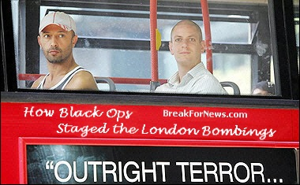
Gog Behind London Bombings
This was the foiled bus bombings on 21/7/2005 only 7 days later – notice the Illuminati time stamp of 7 again on this further assault on London.

Slide 154
Gog Behind London Bombings
Where is the DNA evidence that proves those four moslem boys were at the crime scenes? There is none because they weren’t there
Growing public suspicion of the Police’s involvement regarding the London bombings.

Slide 155
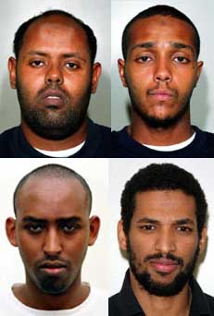
Gog Behind London Bombings
Where are the CCTV images of the four moslem boys on the trains, the bus, or anywhere within the Underground system? There aren’t any because they weren’t there! There were no bombers!

Slide 156
Gog Behind London Bombings
The papers today said that would-be “suicide bomber” Muktar Said Ibrahim of Eritrea, wished to kill every Briton, so why did he plant his bomb on a bus with no passengers?
Muktar Said Ibrahim

Slide 157
Gog Behind London Bombings
The failed detonation on the empty No.26 bus in Hackney Road occurred half an hour after Muktar had disembarked; I guess he wasn’t feeling too suicidal on that day!

Slide 158
Gog Behind London Bombings
Worried Passengers - another stage managed attack on the Red Buses - symbolic of London

Slide 159
Gog Behind London Bombings
Illuminati use Big Ben to signal London Bombings
The hands of Big Ben jammed at 22:07 - an occult signature. (This is how Londoners write the date: 22/07/2005
Big Ben

Slide 160
Gog Behind London Bombings
The shooting dead of suspect suicide bomber, a young Brazilian, Jean Charles de Menezer was signalled by the Big Ben stoppage as well as the Egyptian bombing on the same day!

Slide 161
Gog Behind London Bombings
Why would police allow a bus/tube suicide bombing "suspect" to leave the area, board a bus, then board the tube before confronting him?
At his press conference Sir Ian told reporters: "This operation was directly linked to the ongoing terrorist investigation.”

Slide 162
Gog Behind London Bombings
This may not have been untrue. On top of all the other supposed "botch ups" concerning De Menezes, are we really to believe over and over that the police and special forces are this incompetent?

Slide 163
Gog Behind London Bombings
Did De Menezes know or see something he was not supposed to? On 7/7 there was contradiction between the statements of the Transport Police, Metronet and the National Grid.
De Menezes Demo

Slide 164
Gog Behind London Bombings
The former two declared there WAS a power surge which "caused the explosions". The latter - the National Grid, DENIED there was ever a power surge. Menezes was a contract electrician. Could he have been involved in some sort of work on the London underground?
The National Grid Network

Slide 165
Gog Behind London Bombings
…before the explosions themselves. We may never know the real facts, but one thing is clear, Special forces do not go around in public killing people considered not to be an immediate threat without a good reason. With the reports of the bombs UNDER the trains or ON the rails, .

Slide 166
Gog Behind London Bombings
… is it possible that they were detonated by a calculated & engineered power surge?
That would explain reports of a power surge along with survivors' reports of an "electrical like discharge"

Slide 167
Gog Behind London Bombings
With this photo they may have shot themselves in the foot, as it gives lie to the fact that he was heavily clad for the time of year and therefore suspect!

Slide 168
Gog Behind London Bombings
The subliminal aspect of the shooting of Jean Charles de Menezer is reinforced by the fact that his body lying dead in the tube carriage was published widely in the controlled media – this is what will happen if you do not do as we say!

Slide 169
Gog Behind London Bombings
The Illuminati ever mindful of getting maximum payback from its black ops – this was the case in the shooting dead of Jean Charles de Menezer under the guise of a suicide bomber suspect: Firstly; they removed a witness with dangerous knowledge of how the black op was staged.

Slide 170
Gog Behind London Bombings
Secondly; it sent a subliminal message that if you don’t obey US you will end up like Jean Charles de Menezer. Thirdly; people are conditioned to seeing armed police round every street corner – so when the totalitarian state emerges people will hardly notice.

Slide 171
Gog Behind London Bombings
Police officers and station managers were at odds over the existence of CCTV-footage of the shooting. Police documents submitted to the IPCC stated that:

Slide 172
Gog Behind London Bombings
"None of the cameras at the scene of the shooting of Jean Charles de Menezes at Stockwell Tube station on 22 July were working“. Firstly, if that is the case then how can they explain this?

Slide 173
Gog Behind London Bombings
Blair gave an interview on August 21st. in which he admitted he did not know his officers had killed an innocent man until a day after Jean Charles de Menezes was shot dead at Stockwell Tube station.

Slide 174
Gog Behind London Bombings
Lies, Lies So Many Lies
Sir Ian Blair has lied so many times he has contradicted himself over the issue of the shooting.
Sir Ian Blair

Slide 175
Gog Behind London Bombings
Yet THREE DAYS EARLIER on August 18th, it emerged that Blair himself "tried to halt an independent inquiry into the shooting of Jean Charles de Menezes just hours after the innocent Brazilian's death".
Sir Ian Blair
In a funny hat!

Slide 177
Gog Behind London Bombings
Nothing Makes Sense
How did a good Jewish boy turn into a mad Muslim cleric? Why has Britain let 4,000,000 Muslims immigrate to the UK? What is this Mad Cleric doing in Alabama recruiting?
Skokie, Illinois
This reminds me of that ‘Nasty Nazi’ Frank Collins, who held a rally in Skokie, Illinois (home to the largest single community of Holocaust survivors), …

Slide 178
Gog Behind London Bombings
… and caused untold painful memories. Oddly, it turns out he was Jewish boy named Joseph Cohen. Or maybe one should think of. Wolfgang Hawke. Could this be more phony AL-Quada or Abu Nidal. The deeper one digs, the more it seems that Zionists may have been behind the London terror bombings.
Sheikh Omar Bakri Muhammad

Slide 179
Gog Behind London Bombings
Countless news reports have told the world that Arabs have bombed Israeli buses, killing hundreds. Bush and Blair continue screeching about the 'Axis of Evil'.
Bush and Blair

Slide 180
Gog Behind London Bombings
What Can The World Expect?
But the final payoff will be Iran. Israel wants the Mideast states destroyed. Israel also wants the land of the Arabs, and hoodwinks church people into thinking that the Israeli nation is God's "special group".

Slide 181
Gog Behind London Bombings
The world will gather behind Israel as it attacks Iran. The fact that all the Mideast oil will be pumped through Haifa will be incidental.
Iran

Slide 182
Gog Behind London Bombings
The London attacks will only be a minor part of a series of Israeli false-flag terror attacks. To generate and harness maximum anger against the Arab world, Israel will probably use a tactical nuke to destroy a city in the American Midwest.

Slide 183
London Bombing - Sequel
Daniel Obachike, the man who was on the lower deck of the number thirty bus that exploded in Tavistock Square in London on 7/7/05

Slide 184
London Bombing - Sequel
… and witnessed the bus being diverted off route by 2 unmarked cars – He is circled in red on the above photo.

Slide 185
London Bombing - Sequel
On leaving the bus the witness was surprised to see a man already with a bandage round his head and no signs of blood or injury – he was quickly escorted away by 2 “agents” seen here on the left.

Slide 186
London Bombing - Sequel
He was also surprised to see police and other agents were there already to marshal the people although the emergency services hadn’t arrived yet.

Slide 187
London Bombing - Sequel
The family of Jean Charles de Menezes, the innocent man who was gunned down by British police in the wake of the London bombings, has today accused the BBC
of aiding a cover up after plans to film a politically sensitive docu-drama about his murder were unceremoniously dropped. The filming of a docu-drama about the 7/7 London bombers has also been suddenly abandoned.

Slide 188
London Bombing - Sequel
It is also telling that MI5 is currently bracing itself for further disclosures over tube bombing intelligence "failures" linked to 7/7. These revelations have seemingly forced Dame Eliza Manningham-Buller, the director-general of MI5, to step down in April, a move some suggest is a pre-emptive attempt by the security services to avoid embarrassment.
Dame Eliza Manningham-Buller

Slide 189
London Bombing - Sequel
Jean Charles de Menezes
In December last year the Menezes family lost their High Court battle over a decision not to charge any police officers in connection with the shooting. Indeed, some of the officers involved have since been promoted and have killed again.

Slide 190
London Bombing - Sequel
There has been a catalogue of cover ups concerning the Menezes shooting, including the fact that the officers knew he was not a bomber, the faking of tube logs, lying about the existence of cctv footage and even erasing some parts of it, as well as putting out all manner of false information.
Jean Charles de Menezes

Slide 191
London Bombing - Sequel
Despite having knowingly lied about the events and further attempted to misdirect the public and cover up the incident, Met chief Ian Blair has also escaped any punishment.

Slide 192
London Bombing - Sequel
The government does not want any further disclosure on this issue because it is happy to let the public believe that targeted assassinations on British soil by Israeli trained death squads are now the norm and there's not a damn thing we can do about it apart from sit down and shut up.

Slide 193
London Bombing - Sequel
Otherwise we just might become the next target of her Majesty's secret death squad.

Slide 194
Gog Behind London Bombings
Implicating Muslims in the London Bombing may well have dealt Gog’s multicultural objectives a fatal wound
Notes:
Economist - Tuesday January 2nd 2007
Economist - Tuesday January 2nd 2007

Slide 195
Fear Is
False Evidence Appearing Real

Slide 196
Another of Gog’s London headquarters linked numerically to the London Bombings - is the Kingsway Masonic Lodge

Slide 197
On top of the tower in a most prominent position we see the 5 pointed star of Ameleck (Gog) as also appeared on the flag of the former Soviet Union.

Slide 198
The Freemason’s arms as depicted on the building – notice the 2 “angels” have cloven feet!!

Slide 199
Here we can see in clearer detail - the Masonic coat of arms on the pub opposite the Masonic hall – again notice the cloven feet

Slide 200
Here we see the numerical link to the London bombings i.e. 1717 = 11 & 77 and this again gives us a clue as to who the real culprits of the London Bombings were!!

Slide 201
7/7/7
9/11
Iraq
Congratulations Missions Accomplished

Slide 202
Gog A Wolf In Sheep’s Clothing
It is very apt the analogy used by scripture to describe Satan’s attack on God’s people as a wolf, because many prominent politicians both past and present have been members of the Fabian Society, whose logo is as a above.

Slide 203
The Story Of Gog And Magog
A thought to leave you with
"In death as in life, I defy the Jews who caused this last war [WW II], and I defy the powers of darkness which they represent. I am proud to die for my ideals

Slide 204
The Story Of Gog And Magog
.. and I am sorry for the sons of Britain who have died without knowing why." (William Joyce's [Lord Haw Haw] last words just before Britain executed him for anti‑war activism in WW II)
Howbeit no man spake openly of him for fear of the Jews. (John 7:13)

Slide 205
The Story Of Gog And Magog
The End Of Part Nine
To be continued ……Chapter B – Part 9

