Slide 1
The Story Of Gog And Magog
Part Eight
Gog’s Covert Attack

Slide 2
The Story of Gog & Magog Will be covered in a series of 10 parts
Attila, The Rise of Islam and the Khazars
Genghis Khan, The Russians & the 3 frogs of Revelation
The Spanish Armada & Inquisition + the English revolution
The rise of the House of Rothschilds & the Armenian Holocaust
Satan Bound – The French & American Revolutions
WW1 & WW2
WW3 – The secret War

Slide 3
The Story of Gog & Magog Will be covered in a series of 10 parts
Gog’s covert attack on western culture, education, legal system, health, art & education.
False flag operations
Conclusion

Slide 4
Gog – Recap – Previous Presentations
1) Ezekiel 38:15 Had important Key Words and That This Key Verse Covered Most Of The AD Period to the present day.
2) Magog=Equals Mongol.
3) Gog = Khazar = Askenazim Jew
Gog’s three major frontal attacks – Attila, Genghis Khan and the Moors
The rise of the 3 evil spirit (on the banner of Clovis King of the Franks) Portended Jacob’s trouble

Slide 5
Gog – Recap – Previous Presentations
6) That the Spanish Armada, the great fire of London and the English Revolution were related.
7) That Satan (Gog) is already loosed from the bottomless Pit
8) Gog was behind both World Wars
9) Immediately after WW2, Gog engages in the Quiet War WW3

Slide 6
Gog of The Land of Magog
The Story of
Analysis of Ezekiel 38 : 15
First half of verse
And Thou (Attila/Genghis Khan) Shalt Come From Thy Place Out Of The North Parts, Thou And Many People With Thee All Of Them Riding Upon Horses, A Great Company, And A Mighty Army

Slide 7
Thou And Many People With Thee All Of Them Riding Upon Horses, A Great Company, And A Mighty Army
The horse cavalries of Genghis Khan

Slide 8
Gog of The Land of Magog
The Story of
Second half of verse
And Thou Shalt Come Up Against My People of Israel, As A Cloud To Cover The Land: It Shall Be In The Latter Days, And I Will Bring Thee Against My Land That The Heathen May Know Me, When I Shall Be Sanctified In Thee, O Gog, Before Their Eyes.

Slide 9
A reminder that an important event took place in Constantinople in 1492 AD as we saw in part one

Slide 10
Gog – Grand Edict of 1492
1). Convert to Christianity;
2). Become merchants and take the Christians' property from them;
3). Become doctors and apothecaries and kill Christians medically;
4). Become priests and destroy the Church from within;
Grand Satrap

Slide 11
Gog – Grand Edict of 1492
5). Become lawyers, mix in affairs of State and by putting Christians under your yoke you may dominate the world and be avenged;
6). Do not swerve from this order and you will reach the actuality of power.
Grand Satrap

Slide 12
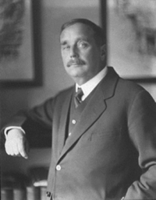
H. G. Wells – Prediction - 1933
The Shape of Things to Come by H.G. Wells - predicts a second world war around 1940, originating from a German‑Polish dispute. After 1945 there would be an increasing lack of public safety in "criminally infected" areas. The plan for the "Modern World‑State"
H. G. Wells 1866-1946

Slide 13
H. G. Wells – Prediction - 1933
would succeed on its third attempt (about 1980), and come out of something that occurred in Basra, Iraq. Also stated, "Although world government had been plainly coming for some years, although it had been endlessly feared and murmured against, it found no opposition prepared anywhere."
H. G. Wells 1866-1946

Slide 14
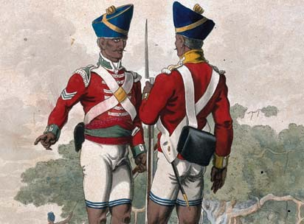
The Socialist Wolves In Sheep’s Clothing
We saw also how when the East India Company came to an end, The London Money Power sought to regain influence through covert means – this would be achieved by setting up the Fabian Society with their very appropriate logo of a wolf in sheep’s clothing
Soldiers of The East India Company

Slide 15
The Socialist Wolves In Sheep’s Clothing
The founding of the London School of Economics was one of its primary achievements which would go on to train Khazars from Eastern Europe and to infiltrate them into all important and not so important establishments in order to bring about a communist revolution under the guise of socialism / Liberalism and New Conservatism
The Logo of The Fabian Society

Slide 16
The “Fall” Of Communism
The great conjuring trick of disappearing communism was performed by the Illuminati in the late 80’s – with the collapse of Communist Russia and the re-unification of Germany.
Breaking-down-Berlin-Wall-1989.

Slide 17
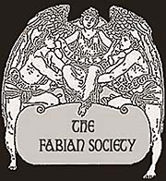
The “Fall” Of Communism
The Fabians had been quietly infiltrating their agents into positions of power since the late 1800’s, but now with the peoples guard down, believing that communism was finished, the Fabians would accelerate

Slide 18
Replaced By The War On Terrorism
Isaiah 21:9 And, behold, here cometh a chariot of men, with a couple of horsemen. And he answered and said, Babylon is fallen, is fallen; and all the graven images of her gods he hath broken unto the ground.
The destruction of the twin towers portend the destruction of Babylon

Slide 19
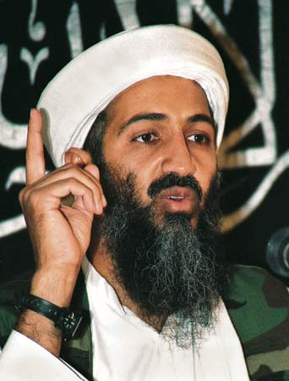
Replaced By The War On Terrorism
Gog always needs a “bogey man” so with the Russians no longer seen as a perceived threat – it was necessary to invent another i.e. “Osama Bin Laden”

Slide 20
Replaced By The War On Terrorism
… which under the guise of protecting us would bring in draconian security laws and remove many liberties (for our good!), particularly as the people were fooled into believing that is was the Moslems

Slide 21
The Moon Turns to Blood
The sun shall be turned into darkness, and the moon into blood, before the great and notable day of the Lord come: Acts; 2:20
911 would also intensify wars going on in the Moslem world (The Moon God worshipping nations) thus fulfilling prophecy and heralding the nearness of the Second Coming.

Slide 22
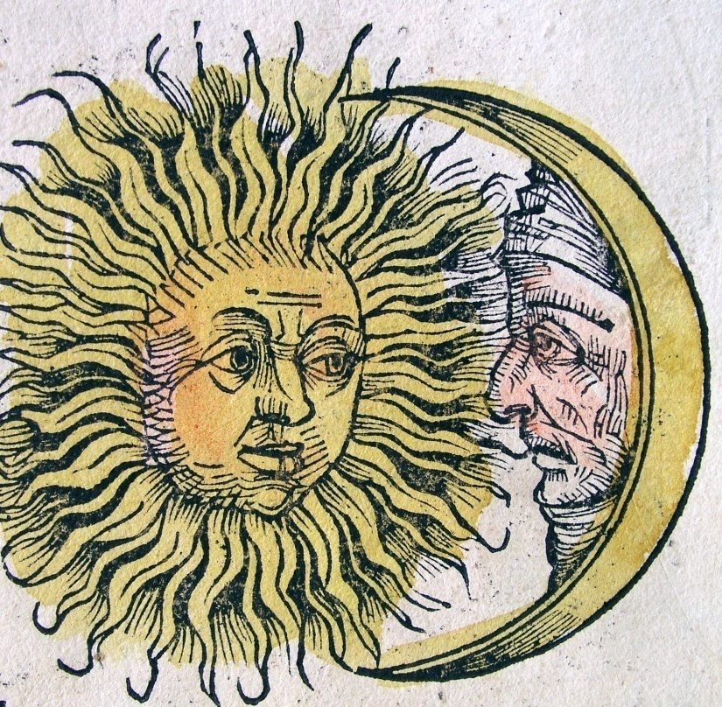
The Moon Turns to Blood
The Symbols of the Sun and the Moon are doubly significant, in that they were representative of true Israel, as well as the Moslem and Catholic powers, indicating that Israel's light and influence in the world was waning.

Slide 23
The Moon Turns to Blood
The sun shall be turned into darkness, and the moon into blood, before the great and notable day of the Lord come: Acts; 2:20
Devastated Grozny - Chechnya

Slide 24
The Moon Turns to Blood
The sun shall be turned into darkness, and the moon into blood, before the great and notable day of the Lord come: Acts; 2:20
India & Pakistan fight for control of Kashmir

Slide 25
The Moon Turns to Blood
The sun shall be turned into darkness, and the moon into blood, before the great and notable day of the Lord come: Acts; 2:20
In April 1986, President Reagan ordered the bombing of two cities in Libya, including the country's capital, Tripoli. Dozens of civilians were killed, including Gadhafi's two-year-old adopted daughter.

Slide 26
The Moon Turns to Blood
The sun shall be turned into darkness, and the moon into blood, before the great and notable day of the Lord come: Acts; 2:20
Kosovo – 1999
Gog uses the Albanian Moslems to stir up trouble with their Christian Serb neighbours – more bloodshed

Slide 27
The Moon Turns to Blood
The sun shall be turned into darkness, and the moon into blood, before the great and notable day of the Lord come: Acts; 2:20
Iraq War still on going

Slide 28
The Moon Turns to Blood
The sun shall be turned into darkness, and the moon into blood, before the great and notable day of the Lord come: Acts; 2:20
So the list goes on – Afghanistan, Iran, The Lebanon, Sudan, Nigeria, Somalia, Indonesia and many more – time does not permit a more detailed study

Slide 29
The Sun Turned To Darkness
The sun shall be turned into darkness, and the moon into blood, before the great and notable day of the Lord come: Acts; 2:20
With the tightening grip of Gog on the RC Church (Baal or Sun worship) it is fast loosing its influence, at least in the Israel nations, following numerous sordid sexual scandals exposed in the media

Slide 30
The Sun Turned To Darkness
Chicago Reader - Priest Scandal Many papers are full of Priests involved in sexual scandals and as a consequence the power of the Catholic Church is waning i.e. not giving its light of influence

Slide 31
The Sun Turned To Darkness
Pope protects paedophile clerics London, 08:24
Pope Benedict XVI is said to have led a systemic cover-up child sex abuse by Catholic priests. The shocking allegations in a television program that the Pontiff helped protect paedophile clerics.

Slide 32
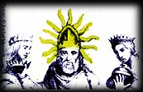
The Sun Turned To Darkness
The Pope represented as the sun
Note: the moon and the sun were also symbolic of Israel and usurped by the Catholic church and was also a symbol of Reuben the eldest sun. So the darkening of the sun can as well be symbolic of the scattering the power of the Holy People.

Slide 33
Bound In Red Tape
In Part 2 we saw that the former Soviet insignia had a biblical message.
One was the binding of the wheat (Israel) shown here in red tape – very appropriate – as it represents thousands of petty restrictions put on God’s people though legislation.

Slide 34
Bound In Red Tape
Hence the expression red tape – many a true word is spoken in jest

Slide 35
Gog & Magog WW3 Against God’s People
WW 1 & 2 were against God’s people, but also involved infrastructure as well. WW3 would concentrate on destroying, subduing and making them impotent.
This would be achieved through supranational bodies such as the UN and the World Bank.
Notes:
Heinrich von Neustadt, around 1300, wrote of them as the "terrifying people of Gog and Magog." 18

Slide 36
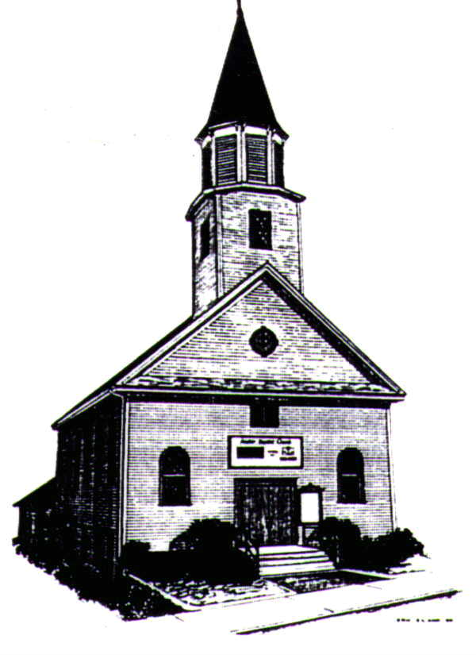
Destruction Of The Nation’s Culture
Church – Replacing the Gospel with Communist Multi-Culturalism / Socialism

Slide 37
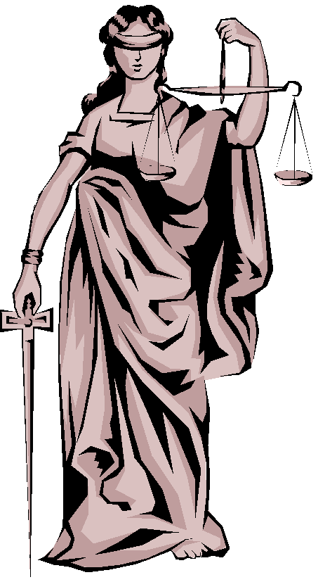
Destruction Of The Nation’s Culture
State – replace Common Law with Talmudic law

Slide 38
Destruction Of The Nation’s Culture
Music - Rock and Roll, Jazz and Rap

Slide 39
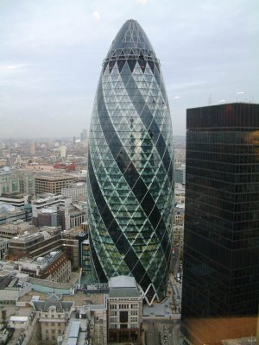
Destruction Of The Nation’s Culture
Architecture - Ugly Buildings

Slide 40
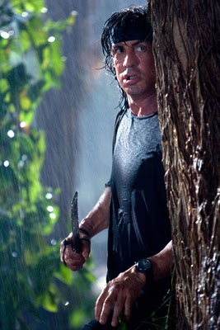
Destruction Of The Nation’s Culture
Theatre/Cinema – Depraved and anti-Christian

Slide 41
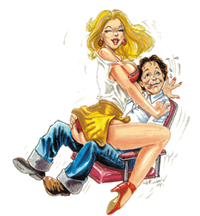
Destruction Of The Nation’s Culture
Dance – Degenerated into a type familiar to jungle tribes

Slide 42
Destruction Of The Nation’s Culture
Education – Indoctrination to become good slaves of the NWO

Slide 43
Destruction Of The Nation’s Culture
Health – A money making bonanza for the Pharmaceutical Industry

Slide 44
Destruction Of The Nation’s Culture
Monuments – Meaningless shapes
The Angel of the North – or crashed plane!!

Slide 45
The Church
We saw in part one how Gog had removed the sacred name from the scriptures and substituted titles such as God and Lord to enable the church to be infiltrated as it was not permitted for Jews on pain of death to utter the holy name Yahweh.
Edomite Jews (Gog) put Christ to death for daring to utter the sacred name in the Temple

Slide 46
The Church
Gog by penetrating among the true Israelites (In Christians' guise or otherwise), has gradually undermined the church via remnants of paganism. Such penetration has
been affected in great measure by crypto‑Jews, who have permeated Christianity and spoken through the mouth of Christianity.
Notes:
Hucknall Parish Church

Slide 47
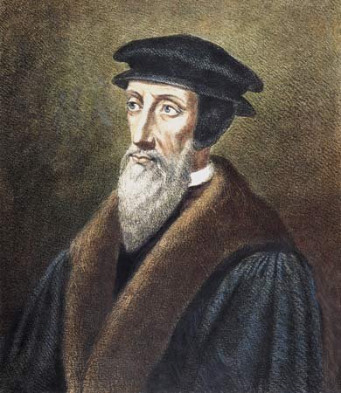
The Church
Even though they are called by great Gentile names, of Democracy, of Socialism, and of Communism. All this achievement ...has come about chiefly through unknown anonymous Jews who have stood behind the scenes; or through Jewish teachers and scholars from the time of the Middle Ages.
John Calvin – A Jew

Slide 48
The Church
War is now being waged against us, however, this is unknown to most of Christianity. Because God's People refuse to accept knowledge and recognize the enemy, but instead elevate God’s enemy to a superior position of being God’s chosen!
Notes:
Croydon Parish Church

Slide 49
Gog Plots To Abolish Christendom
While the protestant churches were being led to Rome under the banner of Ecumenism – Rome was joining forces with Moslems, Buddhists, Hindus and African witch Doctors to bring about a universal Satan worshiping religion.
Canterbury Cathedral

Slide 50
Gog’s Agents Tamper With The Bible
NIV and other new versions of the Bible facilitates the NWO’s plans for a single world religion.

Slide 51
Gog – Accelerates The Destruction Of The Roman Church
Predictably, his first act was to begin to remove the element of Divine Revelation from Catholic teaching, and to embrace naturalism, materialism and Communism. These steps were taken at the Ecumenical Council in 1962 and Vatican Two in 1965.
Pope Paul VI with bent Pagan Crucifix

Slide 52
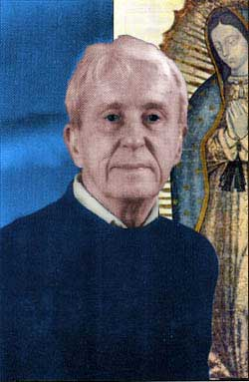
Gog – Accelerates The Destruction Of The Roman Church
As a result, , a former Jesuit, predicted the Roman Catholic Church would no longer be recognizable by the year 2000. "There will be no centralized, control, no uniformity in teaching, no universality in practice and worship, prayer, sacrifice and priesthood."

Slide 53
Pope Paul VI – With Pagan Cross
The late Paul VI also embraced a sinister symbol used by Satanists in the Sixth Century, which had been revived by Vatican Two.
This was a bent or broken cross….
Notes:
According to Piers Compton, a former Catholic priest, the Papacy was actually subverted by the Illuminati in 1958 when John XXIII became Pope. This was the culmination of a 200-year campaign to infiltrate and destroy the Catholic Church.
Piers Compton was the Literary Editor of the Catholic Weekly "The Universe" for 14 years. He documents his claims in "The Broken Cross," (1981) a book that is almost impossible to find because it was mysteriously withdrawn a few weeks after its release.
Compton traces the modern phase of the Luciferian Conspiracy to AdamWeishaupt who established the Illuminati on May 1, 1776. "[Weishhaupt] was backed financially, as are most if not all anarchistic leaders, by a group of bankers under the House of Rothschild.
In 1783, the Illuminati assumed control of much of Freemasonry, which secretly coordinated the revolutionary movement (Liberalism, Socialism, and Communism.) According to David Bay, "secret societies like the "Skull and Bones" have always functioned as Satan's church, as the only way to pass the baton from generation to generation." http://www.cuttingedge.org/ce1089.html
The Illuminati regarded the Catholic Church as their chief obstacle and marked it for ruin. In 1818, their Italian lodge issued a set of "Permanent Instructions" that included: "We require a Pope for ourselves...to march more securely to the storming of the church...." The goal was "the complete annihilation of the Catholicism and even ultimately of Christianity. If Christianity were to revive, even upon the ruins of Rome, it would, a little late revive and live." (13-14)
Paul VI also embraced a sinister symbol used by Satanists in the Sixth Century, which had been revived by Vatican Two.
This was a bent or broken cross on which was displayed a repulsive and distorted figure of Christ. Black magicians and sorcerers in the Middle Ages had used it for occult purposes. It represented the "Mark of the Beast."

Slide 54
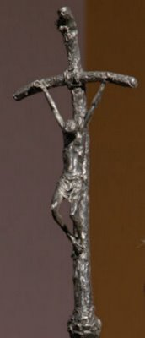
Pope Paul VI – With Pagan Cross
.. on which was displayed a repulsive and distorted figure of Christ. Black magicians and sorcerers in the Middle Ages had used it for occult purposes. It represented the "Mark of the Beast."

Slide 55
Pope Kissing Koran
Pope Paul VI been most active in drawing Catholics closer to other pagan religions

Slide 56
George Bush Being A Good Catholic
In July 2001, President Bush met with the Pope. The Pope reminded him that time was running out to fulfil Fatima!! (The conversion of Russia to Catholicism)

Slide 57
Gog Infiltrates The Churches
Jews, posing as Christian teachers ‑ such as Mike Evans, Billy Graham, Jack Van Impe, and the Jews’ lackeys ‑ such as Pat Robertson, Jerry Falwell, Jimmy Swaggert, Oral Roberts and almost all, if not all television evangelists deceive true Israel
Trinity Broadcasting
Oral Roberts

Slide 58
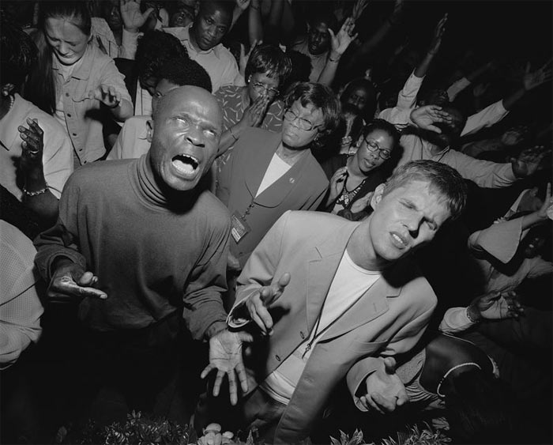
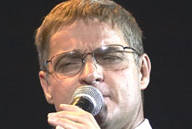
Many Churches Conform To NWO
Formerly a staunch protestant church founded by George Jefferys
Now A multi-cultural cesspit
Kensington Temple London
Rev. Colin Dye, Senior Pastor.

Slide 59
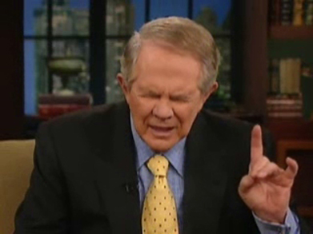
Gog Works From Within To Destroy The Church
Avid supporter of the Israeli State.
In April 2001 Robertson supported China's brutal policy of forced abortion
In 2005, Robertson caused waves when he advocated the assassination of Venezuelan populist president Hugo Chavez.
Pat Robertson Making Satanic Hand Signal

Slide 60
Gog Works From Within To Destroy The Church
Robertson has been caught on numerous occasions flashing El Diablo Satanic hand signals. Robertson is pro Skull and Bones, Bohemian Grove, Bush, pro war, and pro government. He is a modern day Judas Iscariot.
Pat Robertson

Slide 61
Holy Smokescreens—Papal Pat Robertson!!
On Oct, 7, 1995, televangelist Pat Robertson joined Pope John Paul II in a Mass in St. Patrick's Cathedral in New York City. At that time, Robertson handed the Pope a letter urging closer relations between Catholic and Protestant denominations.
Pat Robertson

Slide 62
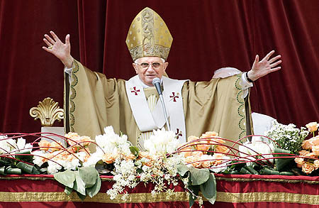
Holy Smokescreens—Papal Pat Robertson!!
Papal Pat met with the Pope in New York City in 1995!!

Slide 63
Food Control – Growing & Distribution Of
Regulation of food production – Family run farms being forced out of business

Slide 64
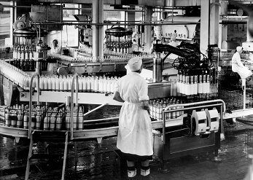
Food Control – Growing & Distribution Of
Regulation of food marketing and distribution – To make sure our food reaches us in a contaminated condition.

Slide 65
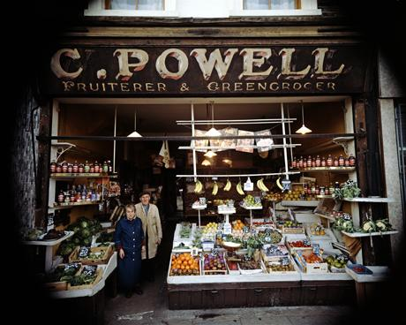
Food Control – Growing & Distribution Of
Driving the small shop keepers out of business - by undercutting prices

Slide 66
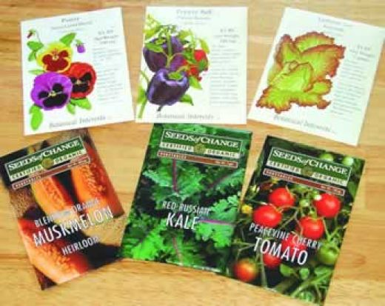
Food Control – Growing & Distribution Of
Regulation of seed varieties – Old favourite varieties will no longer be available.

Slide 67
Food Control – Growing & Distribution Of
Reducing the amount of land available for food production – House building, reservoirs, airports etc.

Slide 68
The De-Nutrition Of Our Food Started A Long Time Ago
Israel was promised a land flowing with milk and honey – It is therefore not surprising that milk would be the first target of Gog in removing true Israel’s food blessing.

Slide 69
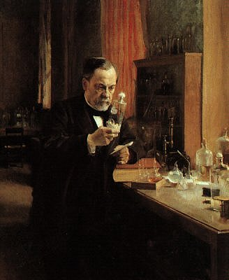
Gog – Destroys Our Milk
Pasteurization of milk is named after Pasteur. This process involved heating milk until ALL the nutrients are boiled away. We are not allowed to drink real milk but the medical mafia lets us be vaccinated with diseased calf lymph.
Louis Pasteur

Slide 70
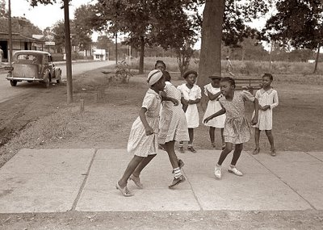
Gog – Destroys Our Milk
Non-Caucasian races are unable to assimilate milk – was this another reason for milk being the first food that Gog attacked so as to facilitate the settlement of hordes of aliens in the Israelite nations??

Slide 71
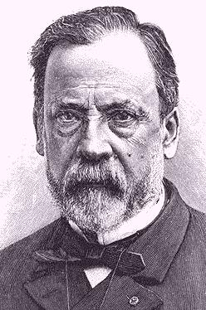
Gog – Destroys Our Milk
(1822 – 1895)
Is the man who destroyed our milk & health

Slide 72
Gog Persuades - That Butter Is Bad For Us
Prior to WW2 butter was the only spread used on bread and for baking etc.
However, during WW2 a substitute was introduced made from hydrogenated oils and other dubious ingredients.

Slide 73
Gog Persuades - That Butter Is Bad For Us
Through constant media brain washing the public were persuaded that butter was very unhealthy, because it blocked up the arteries causing heart attacks. However they did not tell the public that the substitute spreads were far more dangerous to one’s health.

Slide 74
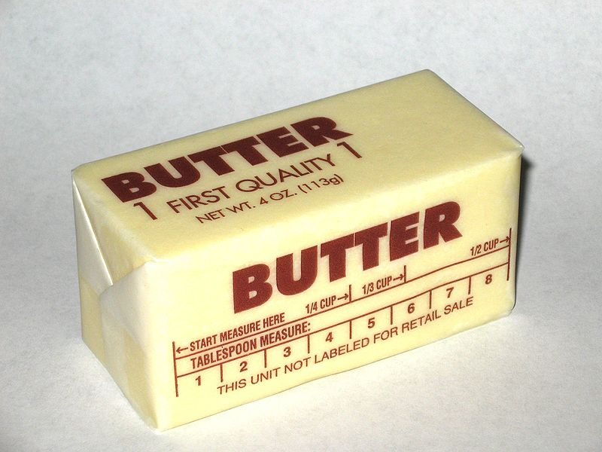
Gog Persuades - That Butter Is Bad For Us
Eating butter increases the absorption of many other nutrients in other foods. Butter has many nutritional benefits where margarine has a few only because they are added!

Slide 75
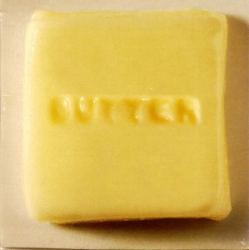
Gog Persuades - That Butter Is Bad For Us
Butter is slightly higher in saturated fats at 8 grams compared to 5 grams. Eating margarine can increase heart disease in women by 53% over eating the same amount of butter, according to a recent Harvard Medical Study.

Slide 76
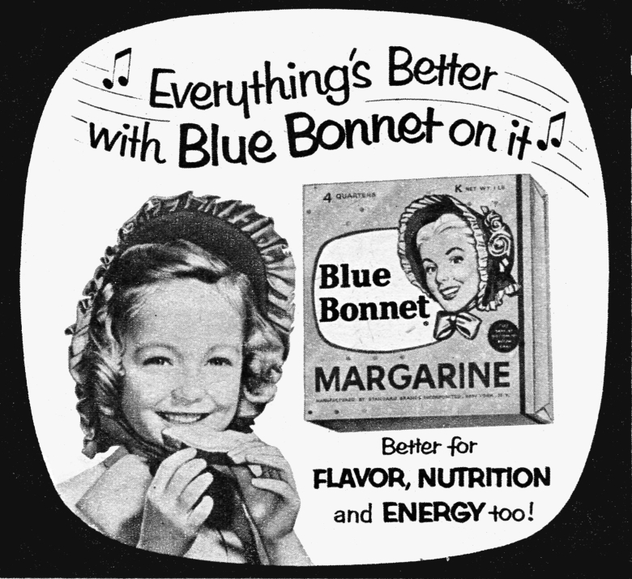

Slide 77
Gog Persuades - That Margarine Is Better For Us
Margarine is in reality a spreadable form of plastic and like plastic it is not attacked by pests.
Margarine is very high in Trans fatty acids. Triple risk of coronary heart disease.

Slide 78
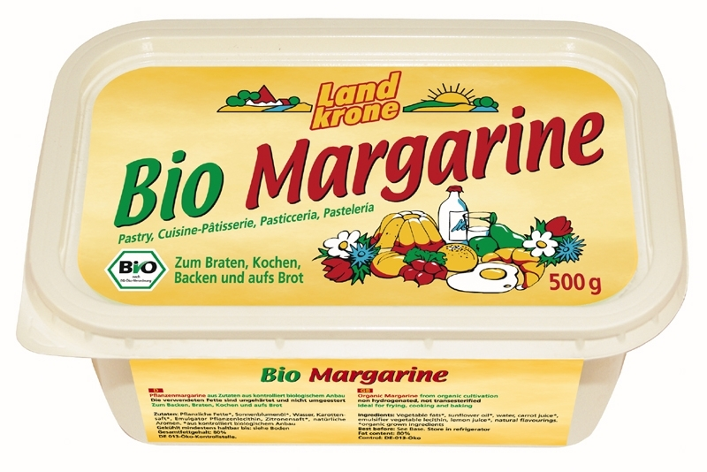
Gog Persuades - That Butter Is Bad For Us
Margarine increases total cholesterol and LDL (this is the bad cholesterol) and lowers HDL cholesterol, (the good cholesterol). Increases the risk of cancers up to five fold.

Slide 79
Gog Persuades - That Margarine Is Better For Us
Margarine was originally manufactured to fatten turkeys. When it killed the turkeys, the people who had put all the money into the research wanted a payback so they put their heads together to figure out what to do with this product to get their money back.
Purchase a tub of margarine and leave it in your garage or shaded area. Within a couple of days you will note a couple of things: no flies, not even those pesky fruit flies will go near it (that should tell you something)

Slide 80
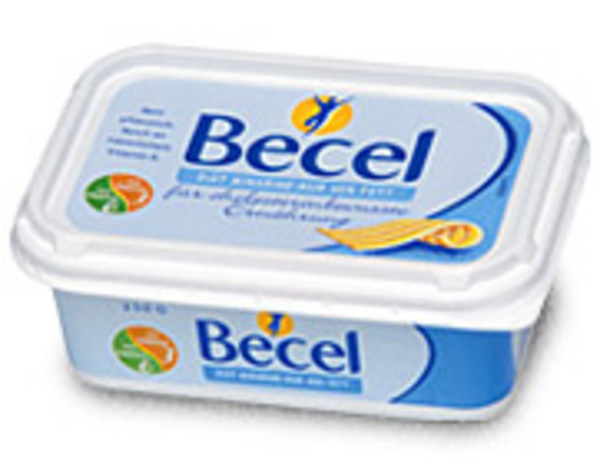
Gog Persuades - That Margarine Is Better For Us
Purchase a tub of margarine and leave it in your garage or shaded area. Within a couple of days you will note a couple of things: no flies, not even those pesky fruit flies will go near it (that should tell you something)

Slide 81
Gog’s Kosher Food Racket
Colossal sums of money are extracted from the unsuspecting public for the privilege of being stamped Kosher by the K or U mark not only on food but other products.

Slide 82
Most Artificial Sweeteners Are Slow Acting Poisons
The deadly toxin Aspartame which is included in more than 6,000 food and drink products
The Government says it is good for you!

Slide 83
Gog Approves Poison – Bans Beneficial Substances
Stevia is safe and NOT approved... Aspartame is poisonous and IS approved!

Slide 84
Rumbled – Gog Substitutes Another Poison!
The alternative is another poison! Splenda's Sour Side Effects

Slide 85
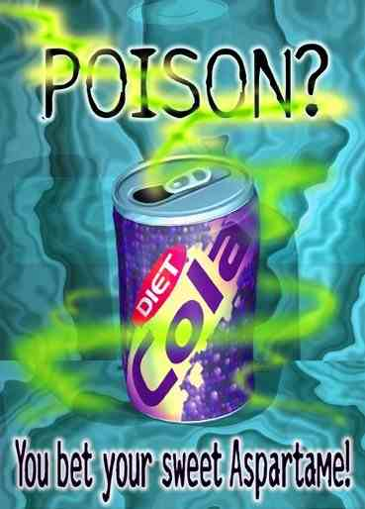
Rumbled – Gog Substitutes Another Poison!
Shrunken thymus glands (up to 40 percent shrinkage) Enlarged liver and kidneys Atrophy of lymph follicles in the spleen and thymus, Reduced growth rate, Decreased red blood cell count, Diarrhea

Slide 86
Most Artificial Sweeteners Are Slow Acting Poisons
Donald Rumsfeld became the chief executive officer of a worldwide pharmaceutical G.D. Searle & Company
Donald Rumsfeld

Slide 87
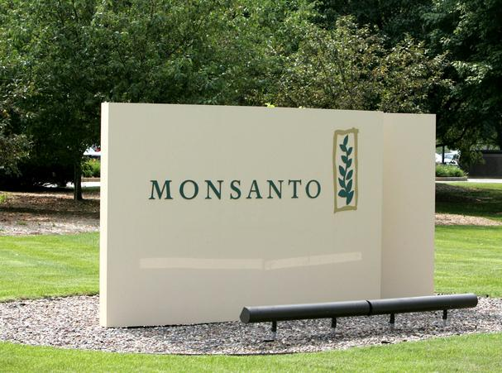
Most Artificial Sweeteners Are Slow Acting Poisons
(later bought out by Monsanto) and therefore the main benefactor of the huge profits generated from the poisons sold to the unaware public

Slide 88
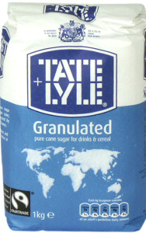
The Sweetest Poison of All
Gog’s Refined Sugar
Consumption of refined sugar zoomed in the 1700’s resulting in large numbers of people being sent to asylums and many more suffering from ill health.

Slide 89
The Sweetest Poison of All
While the body is digesting sugar, the immune system is disabled leading to a wide range of illnesses

Slide 90
The Sweetest Poison of All
Another affect of increased sugar consumption was a deterioration in peoples teeth.
This would have another knock on affect by worsening peoples health - because dentists would fill teeth with a mercury amalgam – which when removed is classed as a hazardous waste.

Slide 91
Microwave Ovens Destroy Health
Microwave ovens are banned in Russia because of their harmful affects by rearranging food molecules so as to be harmful to the human body

Slide 92
Microwave Ovens Damage Your Health
Here we see the result of comparing 2 identical plants – 1 watered with micro- waved water and the other boiled water on a normal oven (after cooling)

Slide 93
Chemical Assault
Chemical Fertilizers – Soil Impoverishment

Slide 94
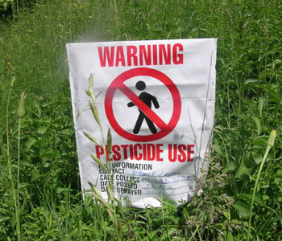
Chemical Assault
Chemical Pesticides On Food, In The Air and Household Cleaners

Slide 95
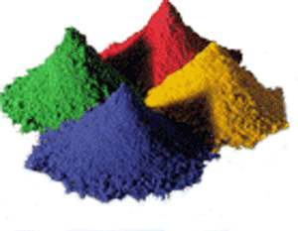
Chemical Assault
Chemical Dyes On Clothes – many absorbed through the skin causing health problems

Slide 96
Chemical Assault
Chemicals In Cosmetics - causing health problem

Slide 97
Chemical Assault
Chemicals In Cleaners – cancer causing

Slide 98
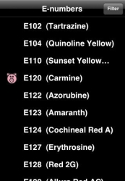
Chemical Assault
Chemicals Additives In Our Food (E Numbers) – Causing ill health

Slide 99
Gog – shortens our lifespan with dangerous chemicals
Teflon coated non-stick surfaces give off cancerous chemicals – the higher the temperature the greater the risk!

Slide 100
Chemical Assault
Tooth Paste – The main ingredient (98%) is low grade aluminium bauxite.

Slide 101
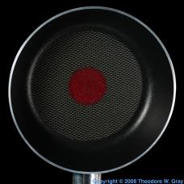
Chemical Assault
Teflon Non-Stick Pans – reacts with fats at high temperatures to produce toxic chemicals.

Slide 102
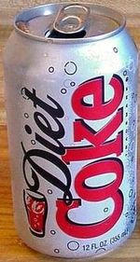
Chemical Assault
Diet Soft Drinks – Contains Aspartame (NutraSweet) that turns to Menthol and causes brain tumours, multiple-sclerosis like symptoms and strokes.

Slide 103
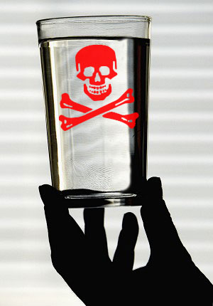
Chemical Assault
1) Fluoridation – to keep the population docile and susceptible. Also a cause of cancer.
2) Chlorination – a poison used in mustard gas in WW1.
3) Aluminium silicate – cause of Alzheimer's

Slide 104
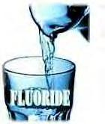
Mass Medication Lies To Make It Acceptable
Fluoride - “to improve one’s teeth”
Chlorine - “to kill germs”
Aluminium silicate – “to assist filtration”
Others? – that we are not told about.
It is very difficult if not almost impossible to get pure drinking water – Many public artesian sources of water have been closed down for “hygiene reasons”

Slide 105
This Cartoon says it all with regard to fluoride in the Public Water Supply

Slide 106
"Fluoridation is the greatest fraud that has ever been perpetrated and it has been perpetrated on more people than any other fraud has" Professor Albert Schatz Ph.D. Nobel Prize Winner 1952

Slide 107
Coca-Cola Corp. Withdraw Bottled Tap Water
Britain's burgeoning bottled water market, is worth more than £1bn a year and growing by 20 per cent annually (2004).
Notes:
Published on Saturday, March 20, 2004 by the lndependent/UK Pure? Coke's Attempt to Sell Tap Water Backfires in Cancer Scare by Michael Mccarthy

Slide 108
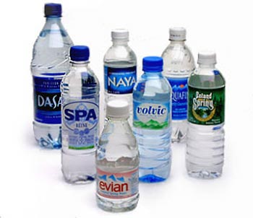
Coca-Cola Corp. Withdraw Bottled Tap Water
An advertising slogan - "as pure as bottled water gets", was found to have illegally high levels of bromate, a chemical which the Food Standards Agency said could lead to an increased risk of cancer.

Slide 109
Using Antibacterial Soap May Disrupt Your Hormones
Triclosan, a chemical used in antibacterial soaps and toothpastes, has been shown to hasten the transformation of tadpoles into adult frogs.

Slide 110
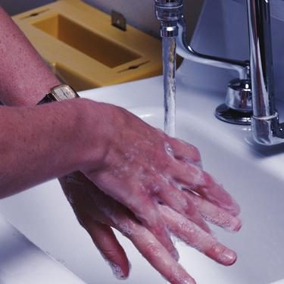
Using Antibacterial Soap May Disrupt Your Hormones
… This means that
Triclosan can act as an endocrine disrupter, upsetting the delicate hormone balance of animals. Triclosan has already been shown to bio-accumulate in fish and contaminate human breast milk.

Slide 111
Gog Causes True Israel To Ignore The Food Laws
Through Gog’s Television propaganda media we have been encouraged to be more “venturous” in cooking which includes disease causing shell fish, pork and eels etc. which are prohibited foods.

Slide 112
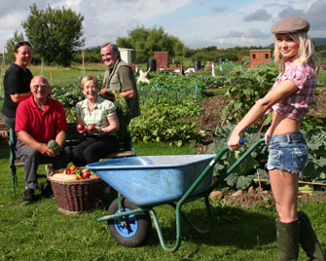
Gog Causes True Israel To Ignore The Food Laws
Programmes are now few and far between which encourage people to grow their own food, but there are plenty on other garden maintenance topics!

Slide 113
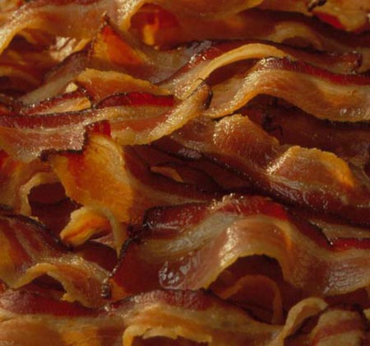
Gog Causes True Israel To Ignore The Food Laws
The Cancer-Causing Breakfast Meat Strikes Again - Research that looked at more than 135,000 people over the course of 22 years has indicated that people who eat bacon five times a week or more are almost 60 percent more likely to develop bladder cancer

Slide 114
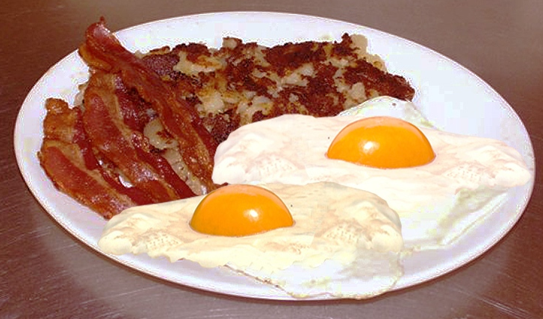
Gog Causes True Israel To Ignore The Food Laws
"Bacon is the worst of all meats to eat and it is not fit for human consumption, period.”

Slide 115
Gog Causes True Israel To Ignore The Food Laws
High-cooking temperatures create ideal carcinogenic conditions. Barbecues, for instance. The black stuff that's unavoidable in the barbecue process is deadly over time. And the frying pan over a high flame."

Slide 116
Toothpaste Has Dangerous Side Effects Too
The main ingredient of toothpaste is Aluminium dioxide to which is added a sudsing agent to make the bubbles, a flavouring agent to make it palatable, perhaps a food colouring agent, some water, and presto - toothpaste Details of the added agents are shown – but not the bulk ingredient!

Slide 117
Toothpaste Has Dangerous Side Effects Too
Aluminium is a suspected cause of Alzheimer's disease

Slide 118
Gog Modifies Our Grapes
Beneficial to health - seeded grapes are now extremely difficult to find as the market is being swamped with the seedless variety as illustrated.
A bunch of seedless grapes

Slide 119
Gog Modifies Our Grapes
The grape seed has chemicals that are beneficial in fighting cancer, eye cataracts and negating junk food poisons – hence the reason for Gog wanting to eliminate natures grapes.

Slide 120
Gog’s Cancer Research Con
Having caused true Israel to be afflicted with cancer through control of the food supply, Gog set up a cleverly conceived plan to ensure that no cure would come on to the market,

Slide 121
Gog’s Cancer Research Con
… but would supply a steady flow funds to produce even more sophisticated drugs with which to gradually destroy God’s true Israel and other Adamites.

Slide 122
Gog’s Cancer Research Con
It is in the Cancer Research’s constitution that upon a cure being found the institute will disband – so obviously its not in their interest to find a cure and lose their big salaries

Slide 123
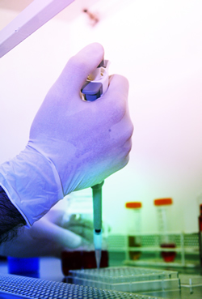
Gog’s Cancer Research Con
A large portion of money donated to cancer research by the public is spent on animal research which has, since its inception, been widely condemned as a waste of time and resources.

Slide 124
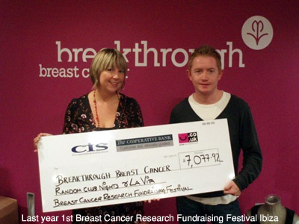
Gog’s Cancer Research Con
The next time you are asked to donate to a cancer organisation, bear in mind that your money will be used to sustain an industry which has been deemed by many eminent scientists as a qualified failure and by others, as a complete fraud.

Slide 125
Porton Down Sarin Experiment Under Guise Of Finding A Cure For The Common Cold
Handling dangerous chemicals at Porton
Entrance to Porton Down
Gog’s Deception responsible for thousands of volunteers being incapacitated by chemical warfare experiments.

Slide 126
Porton Down Sarin Experiment
Wiltshire police say they have "clear evidence" that Ministry of Defence scientists broke the law during chemical weapons tests at Porton Down.

Slide 127
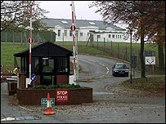
Porton Down Sarin Experiment
Dozens of volunteers, exposed to nerve gas and other chemical and biological agents, said they had believed they were helping find a cure for the common cold!
Entrance to Porton Down

Slide 128
Porton Down Sarin Experiment
Porton Down scientists 'broke law’
'Deceit used'
And DS Luckett, who is heading the police inquiry, said that officers had also found "clear evidence" that deceit was used in getting volunteers to Porton Down.

Slide 129
Aids Manufactured By Gog
Dr. Theodore A. Strecker is the courageous doctor who unravelled the AIDS conundrum, the greatest murder mystery of all time. He should get the Nobel prize but he'll be lucky not to get "suicided".

Slide 130
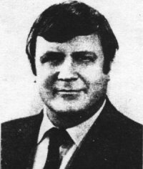
Aids Manufactured By Gog
("Prominent California doctor ties his hands behind his back and, hangs himself, and jumps from the 20th floor. There was no evidence of foul play.")
Dr. Robert Strecker

Slide 131
Aids Manufactured By Gog
The Controlled Media would have you believe that AIDS came via monkeys and homosexuals.
Here we see a researcher infecting a monkey to prove they are susceptible to the disease although none have been found in the wild.

Slide 132
Aids Manufactured By Gog
Because Gallo, Montagnier and those other virologists know that the AIDS virus doesn't occur naturally in monkeys. In fact it doesn't occur naturally in any animal.
The AIDS Virus

Slide 133
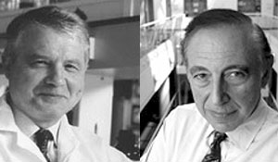
Aids Manufactured By Gog
Some of the best virologists in the world and many of those directly involved in AIDS research, such as Dr. Robert Gallo (Right) of the National Cancer Institute in Washington. and Luc Montagnier of the Pasteur Institute in Paris (Left) say; There is a fatal flaw here. It is very strange.

Slide 134
Aids Manufactured By Gog
WHO, the World Health Organisation, murdered Africa with the AIDS virus. That's a provocative statement isn't it?
The World Health Organisation in published articles, called for scientists to work with these deadly agents and attempt to make a hybrid virus that would be deadly to humans.
Mosquitoes Transmit AIDS

Slide 135
Aids Manufactured By Gog
(Reported in the bulletin of the World Health Organisation WHO), Volume 47, p.259, 1972 If you believe the government propaganda that AIDS is hard to catch then you are going to die even sooner than the rest of us.
Note the serpent on the WHO Logo

Slide 136
Chem-Trails – Another Means Of Attack
The technologies identified in ChemTrails are crude, poisonous and lethal.

Slide 137
Chem-Trails – Another Means Of Attack
The Natural Earth's biological systems are slowly beginning to fail. Rhizobacteria-endomycorrhizae, (on the left) a critical microbial organism, …..

Slide 138
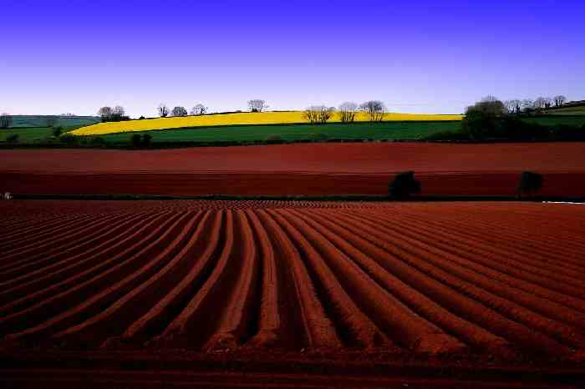
Chem-Trails – Another Means Of Attack
…. s slowly becoming extinct in soils due to Barium and Aluminum heavy-metal toxicities accumulating due to Chem-Trail spraying.

Slide 139
Chem Trails – Spot The Difference

Slide 140
Chem Trails – Nowadays A Frequent Sight
Noxious chemicals and diseases spread by aircraft – these cause more illness than the so-called “Environmental Factors” trotted out by the controlled media.

Slide 141
Gog’s Chem-Trails
The cartoon left illustrates the devastating affect chem-trails have on the population – all part of the plan to eliminate the white race.

Slide 142
Capital Building – Dome Of The Rotunda - Washington
Painting shows an angelic creature Bearing the medical insignia (with snakes!) in her right hand and a bag full of money in her left. She is placing a bag full of money as a bribe upon the desk of politicians in the act of writing legislation.
Painted by Constantino Brumidi

Slide 143
Gog – Murders With Drugs
Eli Lilly Knowlingly Committing Murder, downloadable Company Documents Show
Ted Chabasinksi, commented that, "I'm an attorney, and I think the reason Lilly is panicking is that these documents literally show a conspiracy to commit murder. People talk about how these documents show that Lilly committed fraud.

Slide 144
Gog – Murders With Drugs
… They do. But more importantly, if someone deliberately does something that they know will cause the death of another person, they have committed a homicide -- murder. Lying about the effects of Zyprexa has led to the deaths of many people."

Slide 145
Gog Outlaws One Of The Most Beneficial Plants Known To Man
And I will raise up for them a plant of renown, and they shall be no more consumed with hunger in the land. - - Ezekiel 34/29
Cannabis sativa - Hemp

Slide 146
Gog Outlaws One Of The Most Beneficial Plants Known To Man
During the reign of Queen Elizabeth I farmers were fined for not growing hemp, however, under Queen Elizabeth II farmers are fined for growing it

Slide 147
Gog Outlaws One Of The Most Beneficial Plants Known To Man
Hemp was the raw material for many commodities and as versatile as plastic is to day – providing rope, clothes, paper, food, fuel and medicine.

Slide 148
Gog Outlaws One Of The Most Beneficial Plants Known To Man
An acre of hemp can provide a similar amount of paper pulp in one season that 4 acres of trees do, but take a lifetime to develop to maturity.

Slide 149
Gog Outlaws One Of The Most Beneficial Plants Known To Man
Henry Ford's first Model-T was built to run on hemp gasoline and the CAR ITSELF WAS CONTRUCTED FROM HEMP! On his large estate,
Ford Model-T

Slide 150
Gog Outlaws One Of The Most Beneficial Plants Known To Man
Ford was photographed among his hemp fields. The car, 'grown from the soil,' had hemp plastic panels whose impact strength was 10 times stronger than steel; Popular Mechanics, 1941.

Slide 151
Gog Outlaws One Of The Most Beneficial Plants Known To Man
HEMP SEED: THE MOST NUTRITIONALLY COMPLETE FOOD SOURCE IN THE WORLD
Hemp seed, contain all the essential amino acids and essential fatty acids necessary to maintain healthy human life.
Seeds of the plant cannabis sativa

Slide 152
Gog Outlaws One Of The Most Beneficial Plants Known To Man
No other single plant source has the essential amino acids in such an easily digestible form, nor has the essential fatty acids in as perfect a ratio to meet human nutritional needs

Slide 153
Gog Outlaws One Of The Most Beneficial Plants Known To Man
Left: Illustration depicts all the uses of hemp – no wonder Gog had to ban this plant.

Slide 154
Driver Frustration – All Part Of Gog’s Plan
Under the guise of improving safety – Traffic lights, speed humps, speed cameras, have multiplied galore over recent years, …

Slide 155
Driver Frustration – All Part Of Gog’s Plan
…. all help to divert the driving public away from real issues and in fact rather than reducing accidents cause more accidents to occur!

Slide 156
Driver Frustration – All Part Of Gog’s Plan
However in Drachten in Holland traffic lights and signs (save for a few) have all been removed resulting in reduced accidents as a result of less frustration
Drachten - Holland
Even the UK’s docile population is beginning to revolt against Gog’s ever tightening grip on the motorist

Slide 157
Control Through Drugs
Drugs – Street and Medical
“Cancer Research” – Ensuring no Cures get into the Public Domain
Vaccination Programmes
Creating New Diseases – AIDS & Sars
Regulating Natural Remedies

Slide 158
Control Through Drugs
The Medical Profession operates under the sign of the 2 Snakes protected by a dragon – How appropriate!!

Slide 159
"Codex Alimentarius” Gog’s Pharmaceutical Cartel
If eradication therapies for diseases are discovered and developed, the industry has a basic interest to suppress, discredit and obstruct these medical breakthroughs …..

Slide 160
"Codex Alimentarius” Gog’s Pharmaceutical Cartel
…. in order to make sure that diseases continue as the very basis for a lucrative prescription drug market.

Slide 161
"Codex Alimentarius” Gog’s Pharmaceutical Cartel
For the same economic reasons the pharmaceutical industry has now formed an international cartel by the code name "Codex Alimentarius"

Slide 162
"Codex Alimentarius” Gog’s Pharmaceutical Cartel
… with the aim to outlaw any health information in connection with vitamins and to limit free access to natural therapies on a worldwide scale.

Slide 163
Gog – Regulates Alternative Medicines
By not issuing a Licence until the alternative is proved “safe”.
By publicising any perceived adverse effects while covering up fatalities and deaths caused by drugs.

Slide 164
Gog – Regulates Alternative Medicines
Controlling peoples access to wild herbs by making it an offence to pick them without the owners permission.

Slide 166
Gog – Regulates Alternative Medicines
The FDA is aiming to ban Colloidal Silver, safe alternative to antibiotics.
Bacteria have no resistance to colloidal silver like they do with standard antibiotics, and colloidal silver is dirt cheap and incredibly safe compared to drugs.

Slide 167
Dangerous Side Effects Of Drugs
Tamiflu is just one example. It has also been linked to neuropsychiatric incidents in children, including seizures, loss of consciousness, and delirium.

Slide 168
Dangerous Side Effects Of Drugs
A 14-year-old boy with flu took a dose of Tamiflu and two hours later fell from the ninth floor of his apartment building.

Slide 169
Dangerous Side Effects Of Drugs
Another child, hours after taking a dose of Tamiflu, jumped from the second floor of his house into deep snow

Slide 170
Vaccines Have Dangerous Side Effects Too
In 1871-2, England, with 98% of the population aged between 2 and 50 vaccinated against smallpox, experienced its worst ever smallpox outbreak with 45,000 deaths. During the same period in Germany, with a vaccination rate of 96%, there were over 125,000 deaths from smallpox.

Slide 171
Vaccines Have Dangerous Side Effects Too
In Germany, compulsory mass vaccination against diphtheria commenced in 1940 and by 1945 diphtheria cases were up from 40,000 to 250,000

Slide 172
Gog – Disablement / Death by
Vaccination
If not aborted our children are vaccinated with an array of substances that cause long term illness, disablement and even death

Slide 173
Gog Accelerates The Attack On Our Children
Multiple vaccines are now given to our children – causing disabling problems such as altruism and many other handicaps.

Slide 174
Gog – The Slaughter of Young and Old By Abortion , Euthanasia & Vaccination
Of a nation that has rejected God's laws in favour of killing its own children it was prophesied, "The Lord shall bring a nation against you from afar, from the ends of the earth, as swift as the eagle that flies; ….

Slide 175
Gog – The Slaughter of Young and Old By Abortion , Euthanasia & Vaccination
… a nation whose language you do not understand (Yiddish); a people of fierce countenance, who shall not regard the person of the old [Euthanasia], nor show mercy to the young." [Aborticide]

Slide 176
Gog – The Slaughter of Young and Old By Abortion , Euthanasia & Vaccination
What makes this statement pertinent is the time frame.
"And in the latter time of their kingdom, when the transgressions are come to the full, a king of fierce countenance and understanding riddles shall arise. And his power shall be mighty, but not by his own power; and he shall cause terrible destruction....

Slide 177
Gog – The Slaughter of Young and Old By Abortion , Euthanasia & Vaccination
And through his craft and treachery his dominion shall prosper and he shall magnify himself in his heart, and suddenly he shall destroy many; and he shall rise up against the prince of princes; but he shall be defeated easily." Deut 28:49,50; Daniel 8:23-25.

Slide 178
Mad Cow/Foot & Mouth – Gog’s Means Of Destroying Our Agriculture Industry
Prior to the outbreak the government was making inquiries of timber merchants and sign makers (before closing public footpaths),
Animal Rights activists were supposed to have stolen the virus from Porton Down which is protected by armed guards
Notes:
Coupled with reports of the government making inquiries to timber merchants and sign makers (before closing public footpaths), it is inconceivable that an animal rights activist, as we are led to believe, could have penetrated a level 4 bio-weapons facility that also houses anthrax and ebola and is protected by armed guards of the Ministry of Defence Police and the Military Provost Guard Service. The individual who stole the vial must have had full security clearance to enter the facility. Why would an animal rights activist release a virus that would kill four million animals?

Slide 179
Bird Flu – Another Gog Con
Obviously, other organizations like the RSPCA and farming groups would have no knowledge of what the drill is really intended to achieve and at this stage it is just a coincidence. However,

Slide 180
Bird Flu – Another Gog Con
if the crisis were to escalate causing Blair's government to start restricting the movement of people then more serious questions would need to be asked. If the next three cases of bird flu popped up in Norfolk, south Wales and northern England, the same places as in the drill, then this would turn into a smoking gun.

Slide 181
Bird Flu – Another Gog Con
Britain's bird flu scare that officials are now warning could spread to other areas of Scotland coincided with an exercise that drilled a response to an avian flu outbreak.

Slide 182
Bird Flu – Another Gog Con
The drill included the involvement of Downing Street and the Ministry of Defence.
The BBC report that the exercise was cancelled as soon as the discovery of the H5 virus in the dead swan in Fife was made.

Slide 183
Bird Flu – Another Gog Con
Staged-managed manufactured crises are always paralleled by drills of the same nature. This provides culpable deniability if any government agent is caught.

Slide 184
Mobiles – Gog’s Means Of Control
Gog kept the price of mobile phones artificially low so as to encourage a high “take-up”.
As well as means to track & trace – harmful radio transmissions was yet another means of attacking God’s elect.

Slide 185
Ground Wave Emergency Network (GWEN)
Most are aware of a plethora of Radio transmission masts popping up. While it is true that they transmit radio/telephone signals,
A GWEN Tower

Slide 186
Ground Wave Emergency Network (GWEN)
…. but this acts as a cover for a more sinister objective – monitoring ones whereabouts, thought control and disablement of individuals or whole populations.

Slide 187
Ground Wave Emergency Network (GWEN)
Russian satellites, controlled by advanced computers, can send voices in one's own language interweaving into natural thoughts to the population of choice…..
A Russian Satellite

Slide 188
Ground Wave Emergency Network (GWEN)
…. to form diffused artificial thought. The chemistry and electricity of the human brain can be manipulated by satellite and even suicide can be induced.

Slide 189
Ground Wave Emergency Network (GWEN)
Through ferocious anti-humanitarian means, the extremist groups are fabricated, the troubles and bloody disturbances are instigated….

Slide 190
Ground Wave Emergency Network (GWEN)
…. by advanced tele-means via Russian satellites, in many countries in Asia, Africa, Europe and Latin America."
A GWEN Transmitter Hub

Slide 191
GWEN is a superb system, in combination with cyclotron resonance, for producing behavioural alterations in the civilian population.

Slide 193
Ground Wave Emergency Network (GWEN)
Therefore, if one wished to resonate a specific ion in living things in a specific locality, one would require a specific frequency for that location. The spacing of GWEN transmitters 200 miles apart across the United States would allow such specific frequencies to be 'tailored' to the geomagnetic-field strength in each GWEN area."

Slide 194
Gog Bans Lead Paint To Enable Electronic Eavesdropping
One problem that had to be overcome was that many houses were painted with lead paint which acts as a barrier to electronic transmissions …

Slide 195
Gog Bans Lead Paint To Enable Electronic Eavesdropping
… so the story was put around that lead was dangerous and subsequently banned by legislation – although no one knows of anybody who has died from the lead paint!!

Slide 196
Gog Bans Lead Paint To Enable Electronic Eavesdropping
As a consequence paints are now not so long lasting and the lead substitutes are probably far more dangerous than lead ever was!!

Slide 197
ELF – Electronic Low Frequency Waves
So they found out that the little towers, by the tens of thousands, they could literally aim any energy like a gun to a single home, a given range area, and so forth. FEMA/NORAD run it all from computers. But they can also go remote, with the proper clearance and hook-up.
An ELF Tower

Slide 198
ELF – Electronic Low Frequency Waves
They found out they didn't need to get the guns (that's why the push and schoolyard shootings stopped; they no longer needed that scare op that worked so well in England, Australia, Germany, ....)

Slide 199
ELF – Electronic Low Frequency Waves
How can you fire a gun or load it, if you are crawling on the ground begging for mercy? If you can imagine the worst abominable pain there is, then you know how debilitating it is -

Slide 200
ELF – Electronic Low Frequency Waves
… you simply can't do anything, but lie on the ground and pray for relief.
These low frequency transmitters come in various guises as seen on the left
Caveat Lector from Nexus magazine Vol. 3, No. 3 April, May 1996

Slide 201
ECHELON intercept station at Menwith Hill, Yorkshire.
Big Brother is watching you!!
Designed to Automatically screen the world’s Phone, Fax, E-mail and Wireless Traffic
Notes:
Rumors have abounded for several years of a massive system designed to intercept virtually all email and fax traffic in the world and subject it to automated analysis, despite laws in many nations (including this one) barring such activity. The laws were circumvented by a mutual pact among five nations. It's illegal for the United States to spy on it's citizens. Likewise the same for Great Britain. But under the terms of the UKUSA agreement, Britain spies on Americans and America spies on British citizens and the two groups trade data. Technically, it may be legal, but the intent to evade the spirit of the laws protecting the citizens of those two nations is clear.
The system is called ECHELON, and had been rumored to be in development since 1947, the result of the UKUSA treaty signed by the governments of the United States, the United Kingdom, Canada, Australia and New Zealand.

Slide 202
Gog’s Speed Cameras
Gog’s speed cameras are a symptom of the gradually tightening screw in respect of fines applied to the plethora of regulations – like the thumbscrew the pressure is at first light and then excruciatingly painful as it is turned further.
A typical speed camera

Slide 203
Gog’s Speed Cameras
Furthermore it is all part of doing away with our court procedures and substituting arbitrary justice instead!
This indicates we are well on the way to a totalitarian government.

Slide 204
Gog Actively Promotes Race Mixing
Gerry Cohen, London District Organiser of the Communist Party, leading an "anti-racialist" march in Hackney, North London, circa 1976. Locals pelted the march with eggs and vegetables.

Slide 205
The Thought Police Are Now Going Into Overdrive
This is in order to accelerate the mongrelisation of the Anglo-Saxon-Celtic peoples

Slide 206
The White Race Is In Decline Following Gog’s Latter Day Attacks
Whites from Spain to the Urals, from Iceland to Greece, from America to Australia, are part of one great and endangered family.
Three Russian Girls

Slide 207
"The message to African women is that white is beautiful"
Notes:
TSAR NICHOLAS II LAST Emperor of the Third Rome First cousin to King George V of England First cousin to Kaiser Wilhelm II of Germany TSAR NICHOLAS II LAST Emperor of the Third Rome First cousin to King George V of England First cousin to Kaiser Wilhelm II of Germany TSAR NICHOLAS II LAST Emperor of the Third Rome First cousin to King George V of England First cousin to Kaiser Wilhelm II of Germany

Slide 208
"The Message to White Race is that Brown is beautiful"

Slide 209
Gog takes a great spoil by stealth
The list is endless all the great industries of the Israelite nations have been systematically asset stripped with the spoil being transferred to Gog’s relative in the far east such as China.
By asset stripping and then going bankrupt
Notes:
17223

Slide 210
Gog Gains Control Of The Food Supply
To control a population you must first control their food – this is precisely what Gog has done by driving out the small shop.
A typical Gog supermarket

Slide 211
Gog Gains Control Of The Food Supply
Gog knows that the people are fooled by cheap prices and little do they know that they will pay dearly for it later!!

Slide 212
Gog Gains Control Of The Food Supply
While the corner shop has been disappearing, of late there has been a revival of new ones opening up, but these are Trojan horses as they are operated by the big multi-nationals.
A typical corner shop

Slide 213
Gog – Takes Over our Shops
Exeter High St. in the 1920’s
Notes:
Gigantic Jewish globalists and world criminals like Mikhail Khodorkovsky (photo) in a cage whilst standing trial in Moscow.
The three oil executives living in Israel Leonid Nevzlin, Mikhail Brudno and Vladimir Dubov are former partners of Khodorkovsky and all are wanted by Russia on fraud charges. The men, all of whom appeared on the Forbes list of the world's billionaires in 2004, are now directors of Group Menatep, a holding company that owns 60 percent of what remains of the dismantled Yukos empire. First cousin to King George V of England First cousin to Kaiser Wilhelm II of Germany TSAR NICHOLAS II LAST Emperor of the Third Rome First cousin to King George V of England First cousin to Kaiser Wilhelm II of Germany TSAR NICHOLAS II LAST Emperor of the Third Rome First cousin to King George V of England First cousin to Kaiser Wilhelm II of Germany

Slide 214
Gog – Takes Over our Shops
Exeter High St. in 2005
Notes:
Gigantic Jewish globalists and world criminals like Mikhail Khodorkovsky (photo) in a cage whilst standing trial in Moscow.
The three oil executives living in Israel Leonid Nevzlin, Mikhail Brudno and Vladimir Dubov are former partners of Khodorkovsky and all are wanted by Russia on fraud charges. The men, all of whom appeared on the Forbes list of the world's billionaires in 2004, are now directors of Group Menatep, a holding company that owns 60 percent of what remains of the dismantled Yukos empire. First cousin to King George V of England First cousin to Kaiser Wilhelm II of Germany TSAR NICHOLAS II LAST Emperor of the Third Rome First cousin to King George V of England First cousin to Kaiser Wilhelm II of Germany TSAR NICHOLAS II LAST Emperor of the Third Rome First cousin to King George V of England First cousin to Kaiser Wilhelm II of Germany

Slide 215
Protocol 5 – Become lawyers
Mix in affairs of State and by putting Christians under your yoke you may dominate the world and be avenged;
Jack Straw (Jew) – black/gold gown

Slide 216
Protocol 5 – Become lawyers, mix in affairs of State and by putting Christians under your yoke you may dominate the world and be avenged;
Since our legislators are primarily lawyers, lawyers make the majority of our laws and write them in “legalese”. In doing so, they’ve made this nation increasingly dependent on their trade.
Many people involved in disputes have turned to the legal system for help only to find themselves in an endless morass of legal manoeuvring that ends only when their money is gone.

Slide 217
Protocol 5 – Become lawyers
Since our legislators are primarily lawyers, lawyers make the majority of our laws and write them in “legalese”. In doing so, they’ve made this nation increasingly dependent on their trade.

Slide 218
Protocol 5 – Become lawyers
Many people involved in disputes have turned to the legal system for help only to find themselves in an endless morass of legal manoeuvring that ends only when their money is gone.

Slide 219
Wolfgang Amadeus Mozart Was Murdered By Gog
Wolfgang Amadeus Mozart was murdered. The powers of the brain-wash-machinery try hard to blame Mozart's friend, Court Composer Salieri, for his murder, which was a lie.

Slide 220
Wolfgang Amadeus Mozart Was Murdered By Gog
This was one of the first steps in destroying the music of Israelite nations and substituting their jungle music of “Rock & Roll”

Slide 221
Gog’s Attack On Education
Gog is proceeding apace in dumbing down the peoples of Israel through its control of all education faculties.

Slide 222
Gog’s Attack On Education
This is achieved by encouraging students to take up useless courses that don’t benefit the well being of the nation. Education instead concentrates on making the student a good citizen of the NWO

Slide 223
1933 – Germany Took Education Control Back From Gog
Pre-war Germany took action to root out this insidious influence in its classrooms as depicted by the cartoon on the left.

Slide 224
1933 – Germany Took Education Control Back From Gog
Schools and all departments of education are infested with Gog agents pushing their politically correct multicultural atheistic line.

Slide 225
Gog – Controls The Media
The Mind-Bending Power of The Masters of The Media A power greater than government?
“Today the film makers are the people who control the most powerful medium in the world, and art that can create ideals, change language or topple governments.”
John Baxter in the Daily Mail (28th December 1995)
Lew & Michael Grade

Slide 226
Controlled Media Under Occult Control
Notice the Owl (Bohemian Grove Symbol) and the snake the emblem of the Yehudan on the National Press Club

Slide 227
Gog – Controls The Media
TV has been and is one of Gog’s tools in taking control and subverting Christendom and as we shall see in the next slide was instrumental in making it acceptable to go to war with our Christian brethren in Serbia on the side of Moslem Albania.
Alan Yentob – Director of BBC Broadcasts

Slide 228
Gog – Controls The Media
TV has been and is one of Gog’s tools in taking control and subverting Christendom and as we shall see in the next slide was instrumental in making it acceptable to go to war with our Christian brethren in Serbia on the side of Moslem Albania.
Alan Yentob – Director of BBC Broadcasts

Slide 229
Media Lies / Distortions
The illegal Clinton-NATO bombing of Serbia was fuelled in part by a staged ITN news report purporting to show evidence of a Bosnian Serb death camp.

Slide 230
Media Lies / Distortions
Pictures of emaciated 'prisoners' behind a barbed wire fence were used to claim the Serbians were running internment camps. In reality the emaciated
man was a tuberculosis victim and the film’s crew were the ones inside the barbed wire enclosure, filming out to refugees who had willingly entered the refugee camp.

Slide 231
Media Failed To Get The Better Of Milosevic
After the Initial fanfare of being placed on trial, little was heard of the trial thereafter as Milosevic being a lawyer himself consistently got the better of the judges and prosecuting counsel.
Milosevic on trial in the Hague

Slide 232
ADL & ANL Are Gog’s Enforcers
The ADL & ANL are part of the B’nai B’rith – which in turn is operated by MOSSAD the Israeli Intelligence Service.
Both the ADL & ANL are used to discredit patriots & patriotic organisations by causing fights and punch-ups.

Slide 233
ADL & ANL Are Gog’s Enforcers
…. to discredit them and of course their allies the controlled media are always there to record such events by labelling them Nazis, Fascists etc. Hence the public is given a false picture of the nature of these organisations.

Slide 234
Intelligence Services Act Against True Israel
We have seen in previous parts how the Secret Services of the Western Powers have been subverted by Gog and these play a major roll in man made & “natural” crises ensuring that the finger of blame does not point to the real perpetrators.

Slide 235
Foreign Troops are Already Being Used in The USA
Mexican Troops arriving in Louisiana following the 2005 Hurricane

Slide 236
Fed Help Sent To New Orleans
Notice the lightning symbol on the Fed. Agent’s T shirt which we will see is now appearing on some British Police Uniforms.

Slide 237
UK Police Adorn Satanic Insignia
British police have been photographed wearing bizarre Lightning insignia on their uniforms as the attire of Tony Blair's enforcers begins to compliment ….
Uniforms begin to befit fascist policies abolishing freedom of speech

Slide 238
UK Police Adorn Satanic Insignia
…. the totalitarian society the Prime Minister is creating by openly abolishing freedom of speech and freedom of assembly under draconian crime and terror laws.
Tony Blair

Slide 239
UK Police Adorn Satanic Insignia
…. I beheld Satan as lightning fall from heaven. Behold I give you power to tread on serpents and scorpions, and over all the power of the enemy: and nothing shall by any means hurt you. Luke 10:18-19

Slide 240
UK Police Adorn Satanic Insignia
Lightning has long been a supreme symbol of Lucifer, whom the Illuminati deem to be their “enlightener”.
Scriptures state that Lucifer is called “prince of the power of the air”. (Ephesians2:2)
Zeus

Slide 241
Gog Clamps Down On Holocaust Deniers in 2005
BRITISH HISTORIAN DAVID IRVING was ambushed by eight Austrian Staatspolizei (Stapo) officers at gunpoint on November 11, 2005 when visiting Vienna.
David Irving Outside The Court House

Slide 242
Gog Clamps Down On Holocaust Deniers in 2005
The arrest warrant had been issued 16 years earlier, November, 1989, at the written demand of a Communist-front body,
David Irving Arrested

Slide 243
Gog Clamps Down On Holocaust Deniers in 2005
The Dokumentationszentrum des Österreichischen Widerstands (Document Center of the Austrian Resistance), issued the day before, as court records revealed. Mr. Irving was charged under Austria's 1945 "Verbotsgesetz" (Banning Law)

Slide 244
Gog Clamps Down On Holocaust Deniers in 2005
… with having uttered illegal opinions on history at a 1989 talk, and on February 20, 2006 at a show trial staged in Austria's largest criminal courtroom with 200 spectators, he was sentenced to three years in jail. His lawyers have given notice of Appeal
David Irving

Slide 245
The Scriptures Proved Right Again!
Matthew 24:22 And except those days should be shortened, there should no flesh be saved: but for the elect's sake those days shall be shortened.

Slide 246
A Thought To Leave You With
"Our job is to give people not what they want, but what we decide they ought to have."
--- Richard Salant, Former President of CBS News
Richard Salant

Slide 247
The Story Of Gog And Magog
The End Of Part Eight
To be continued ….. False Flag Operations

