Slide 1
The Story Of Gog And Magog
Part Seven
The secret war – World War 3

Slide 2
The Story of Gog & Magog
Will be covered in a series of 10 parts
Attila, The Rise of Islam and the Khazars
Genghis Khan, The Russians & the 3 frogs of Revelation
The Spanish Armada & Inquisition + the English revolution
The rise of the Rothschilds & the Armenian Holocaust
The Victorian Era
WW1 & WW2
WW3 – The secret war

Slide 3
The Story of Gog & Magog
Will be covered in a series of 10 parts
Gog’s covert attack on western culture, education, legal system, health, art & education.
False flag operations
Conclusion

Slide 4
Gog – Recap – Previous Presentations
1) Ezekiel 38:15 Had important Key Words and That This Key Verse Covered Most Of The AD Period to the present day.
2) Magog=Equals Mongol.
3) Gog = Khazar = Askenazim Jew
Gog’s three major frontal attacks – Attila, Genghis Khan and the Moors
The rise of the 3 evil spirit (on the banner of Clovis King of the Franks) Portended Jacob’s trouble

Slide 5
Gog – Recap – Previous Presentations
6) That the Spanish Armada, the great fire of London and the English Revolution were related.
7) That Satan (Gog) is already loosed from the bottomless Pit
8) Gog was behind both World Wars

Slide 6
Gog of The Land of Magog
The Story of
Analysis of Ezekiel 38 : 15-16
First half of verse
And Thou (Attila/Genghis Khan) Shalt Come From Thy Place Out Of The North Parts, Thou And Many People With Thee All Of Them Riding Upon Horses, A Great Company, And A Mighty Army

Slide 7
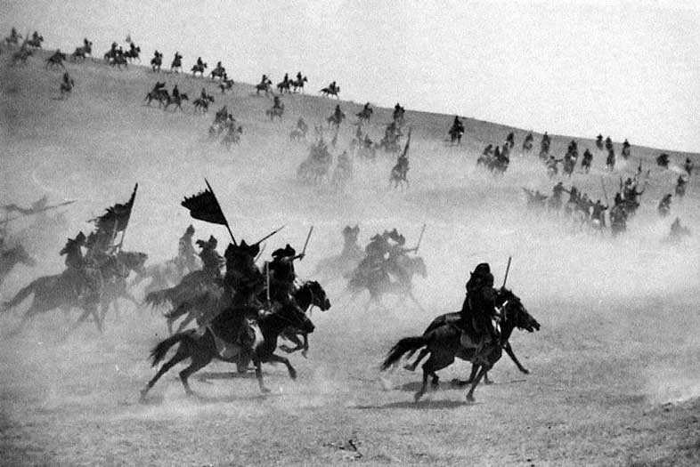
Thou And Many People With Thee All Of Them Riding Upon Horses, A Great Company, And A Mighty Army
The horse cavalries of Genghis Khan

Slide 8
Gog of The Land of Magog
The Story of
Second half of verse
And Thou Shalt Come Up Against My People of Israel, As A Cloud To Cover The Land: It Shall Be In The Latter Days, And I Will Bring Thee Against My Land That The Heathen May Know Me, When I Shall Be Sanctified In Thee, O Gog, Before Their Eyes.

Slide 9
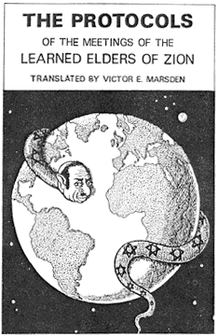
Gog Takes A Great Spoil
The 38th, chapter of Ezekiel: “Thus saith the Yahweh: It shall come to pass, that AT THE SAME TIME shall things come into thy mind, and thou shalt think an evil thought: And thou shalt say, ‘I will go up to the land of unwalled villages; I will go to them that are at rest.
An Evil Thought

Slide 10
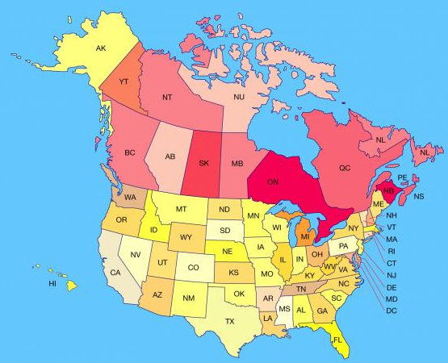
Gog Takes A Great Spoil
….. that dwell safely, all of them dwelling without walls, and having neither bars nor gates, to take a spoil, and to take a prey:’ to turn thine hand upon the desolate places that are now inhabited, and upon the
people that are gathered out of the nations, which have gotten cattle and goods, that dwell in the midst of the land.”

Slide 11
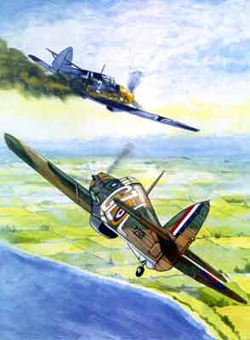
WW2 – War To End All Wars!
This was the war that was supposed to have ended all wars heralding in an era of non ending peace.
Since the end of WW2 the world has been in a continuing state of turmoil – with wars or uprisings ever since.

Slide 12

WW2 – War To End All Wars!
We shall see that there has been a secret war (WW3) going on ever since whose aim is the extermination of the White Race and Christendom in particular

Slide 13
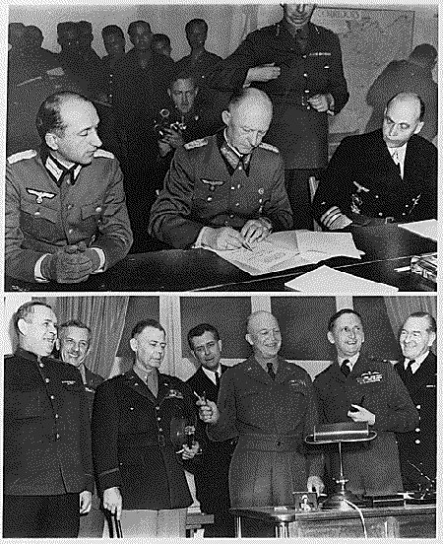
1945 May 05 Germany Surrenders
The only winner was Gog who now had full control of Europe and could now proceed apace with plans for the NWO.
(Top Left) - German officers sign unconditional surrender in Reims, France. (Bottom Left) - Allied force leaders (Eisenhower in middle) at the signing.

Slide 14
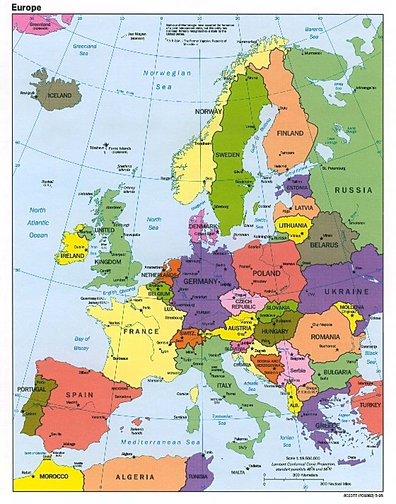
1945 May 05 Germany Surrenders
The Surrender to Allied forces by Germany that would lead not only to the division of that great Israelite nation but the whole of Europe (the New Jerusalem of western Christendom) and the erection of the “Iron Curtain” from the Baltic to the Aegean Seas.

Slide 15
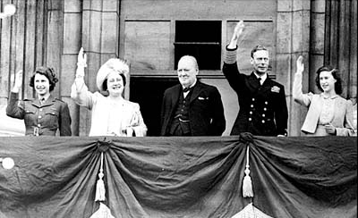
V. E. Day
British Prime Minister Winston Churchill looks on as King George VI, Queen Elizabeth, Princess Elizabeth and Princess Margaret, wave to crowds gathered below from the balcony of Buckingham Palace on VE-Day. (AP Photo)

Slide 16
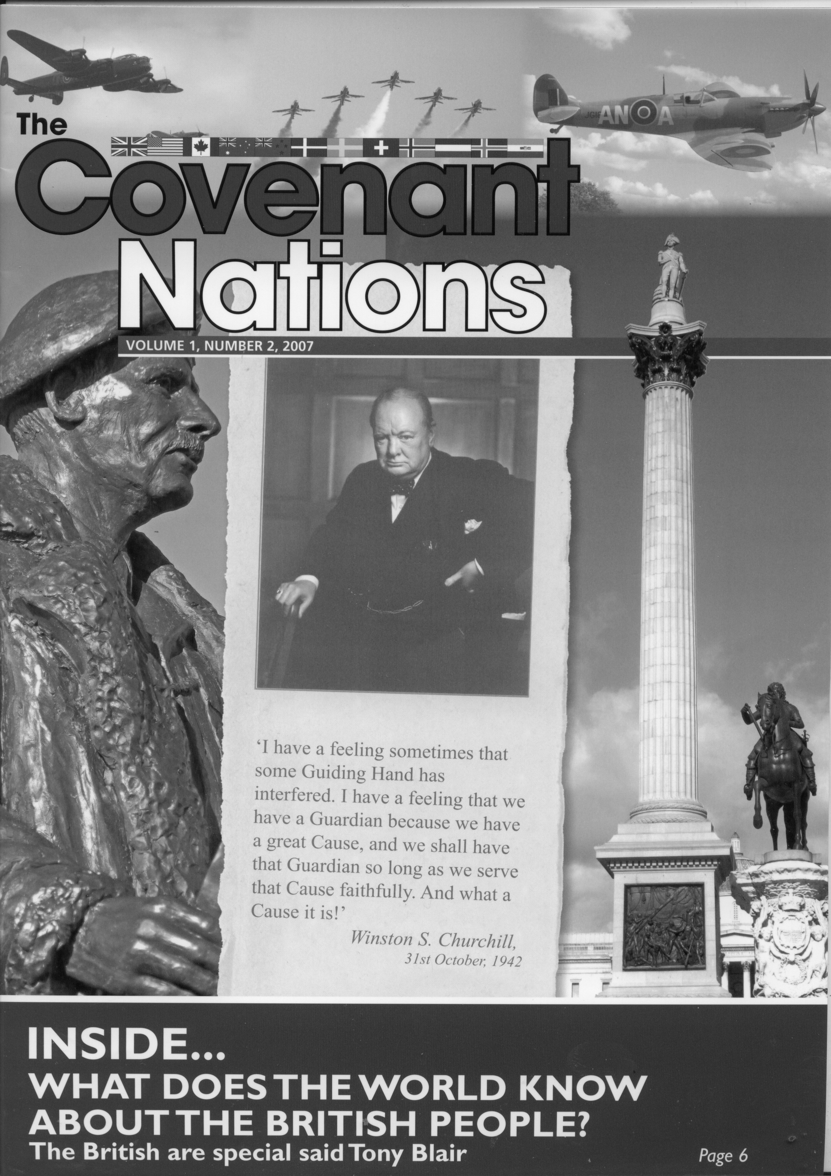
Gog’s Agent – Double Speak
What Winston Churchill Was Really Saying In Code
`I have a feeling sometimes that some Guiding Hand (The Illuminati) has interfered. I have a feeling that we have a Guardian (The House of Rothschild)

Slide 17
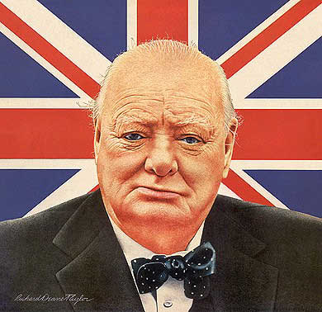
Gog’s Agent – Double Speak
… because we have a great (Zionist) Cause, and we shall have that Guardian (The House of Rothschild) so long as we serve that (Zionist) Cause faithfully. And what a Cause (Zionism) is!'
Winston S. Churchill,
31st October, 1942

Slide 18
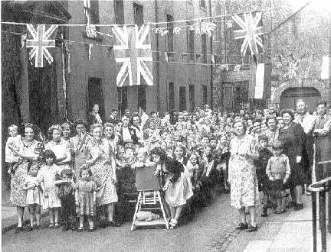
V. E. Day
Little did the Eastenders, seen here celebrating VE Day, realise that a secret war against them and the rest of the country had already started and they would soon lose their docks and their homes to aliens let in by the enemy (Gog)

Slide 19
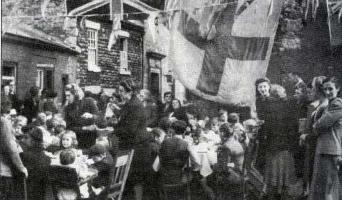
V. E. Day
The nation’s industries such as manufacturing, shipping, fishing, farming and mining would be decimated – indeed Gog would take a great spoil without anyone noticing!!

Slide 20
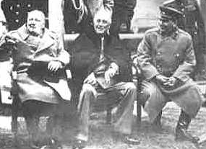
Yalta – Gog Divides The Spoil
The victorious allies (The 3 frogs of Revelation) meet at Yalta to divide the spoil
Churchill, Roosevelt and Stalin at Yalta

Slide 21
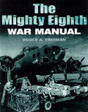
The Quiet War
Like all well planned wars there is a manual issued to officers in command giving strategy and rules of engagement to those taking part on how to take the levers of power and wage war on the indigenous population

Slide 22
Gog’s Secret War Manual
This manual was found in a second hand Xerox machine – which is displayed below
Silent Weapons for Quiet Wars
An Introduction Programming Manual
Operations Research Technical Manual
TW-SW7905.1
We shall go on to examine its implications

Slide 23
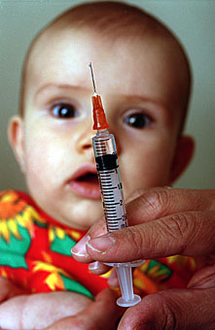
Gog’s Secret War Manual
This presentation will look at the general strategy of this secret war. Part 8 will cover the covert attack in its various aspects in more detail.

Slide 24
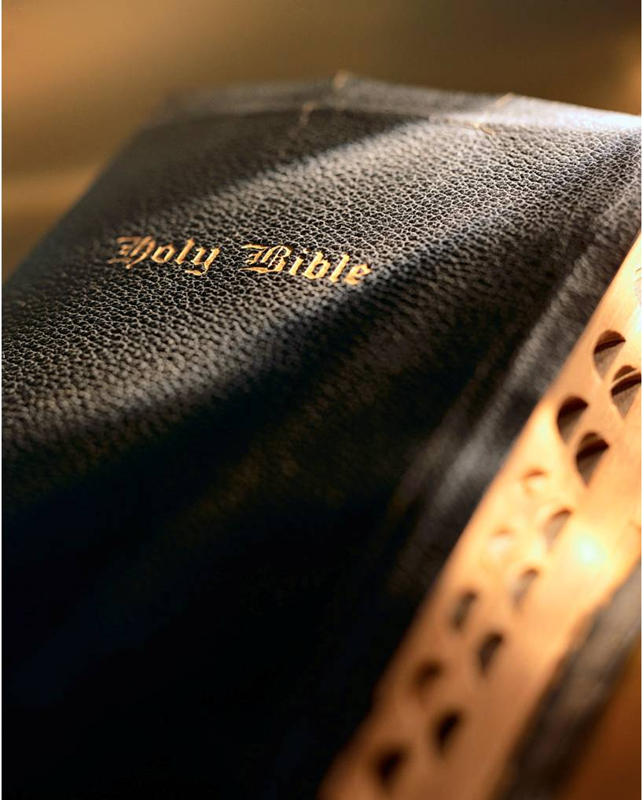
Gog – The Slaughter of Young and Old By Abortion, Euthanasia & Vaccination
Of a nation that has rejected God's laws in favour of killing its own children it was prophesied,

Slide 25
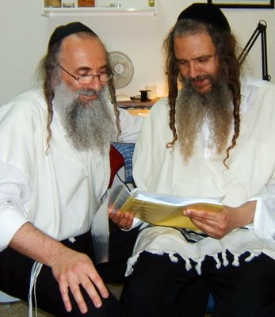
Gog – The Slaughter of Young and Old By Abortion, Euthanasia & Vaccination
"The Lord shall bring a nation against you from afar, from the ends of the earth, as swift as the eagle that flies; a nation whose language you do not understand [Yiddish]; a people of fierce countenance, who shall not regard the person of the old [Euthanasia], nor show mercy to the young." [Aborticide]
Khazars
Notes:
Of a world that has rejected God's laws in favor of killing its children it was prophesied, "The Lord shall bring a nation against you from afar, from the ends of the earth, as swift as the eagle that flies; a nation whose language you do not understand; a people of fierce countenance, who shall not regard the person of the old [Euthanasia], nor show mercy to the young." [Aborticide] What makes this statement pertinent is the time frame. "And in the latter time of their kingdom, when the transgressions are come to the full, a king of fierce countenance and understanding riddles shall arise. And his power shall be mighty, but not by his own power; and he shall cause terrible destruction.... And through his craft and treachery his dominion shall prosper and he shall magnify himself in his heart, and suddenly he shall destroy many; and he shall rise up against the prince of princes; but he shall be defeated easily." Deut 28:49,50; Daniel 8:23-25.

Slide 26
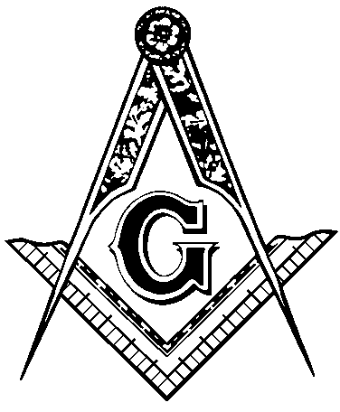
Gog – The Slaughter of Young and Old By Abortion, Euthanasia & Vaccination
What makes this statement pertinent is the time frame. "And in the latter time of their kingdom, when the transgressions are come to the full, a king of fierce countenance and understanding riddles shall arise.

Slide 27
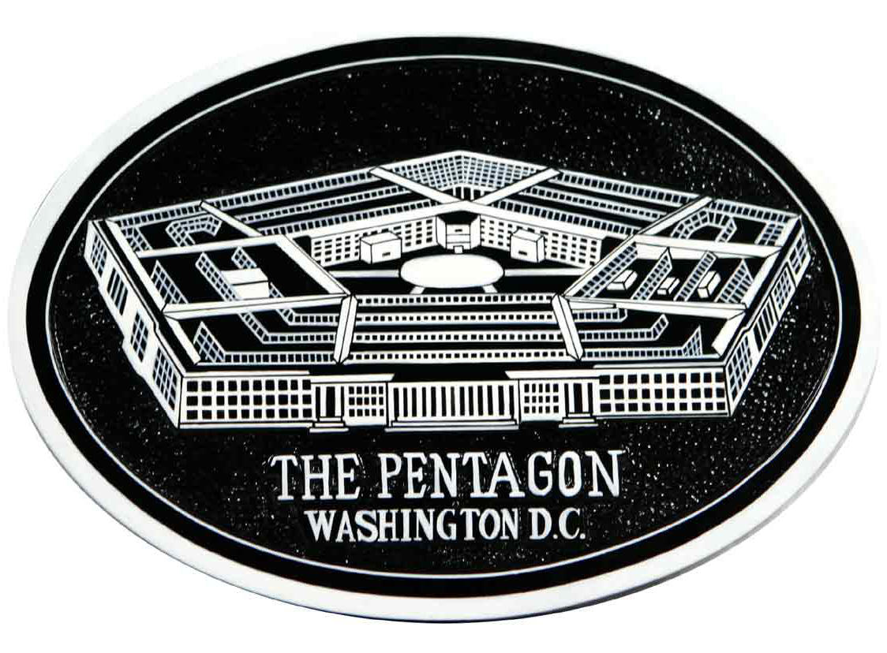
Gog – The Slaughter of Young and Old By Abortion, Euthanasia & Vaccination
And his power shall be mighty, but not by his own power; and he shall cause terrible destruction.... And through his craft and treachery his dominion shall prosper and he shall magnify himself in his heart,

Slide 28

Gog – The Slaughter of Young and Old By Abortion, Euthanasia & Vaccination
… and suddenly he shall destroy many; and he shall rise up against the prince of princes; but he shall be defeated easily." Deut 28:49,50; Daniel 8:23-25

Slide 29
Yehudin = Serpent
And I can take you out there and show you the Serpent woven into a star and this is the symbol and the evidence of ancient Jewry. I can take you to the British Museum and show you the heads of the Cahilla,

Slide 30
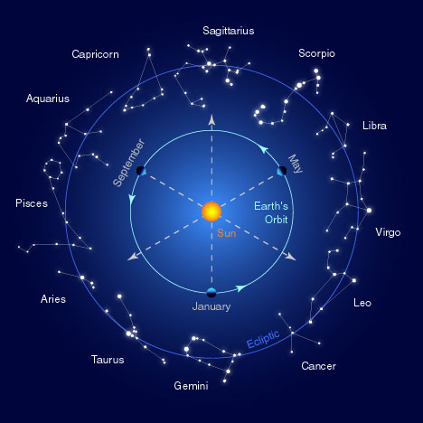
Yehudin = Serpent
… and show you the people marked as Yehudin, marked as the priests of their religion and they are featured as Dragons way back in the days before Adam was even thought of --- as far as the world was concerned. ---- Dr. Wesley Swift

Slide 31
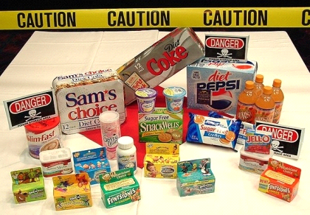
Gog’s Secret War Manual
In part 8 we shall see many more examples of this secret war, besides food – thought control through the media, attacks via the medical profession, education etc

Slide 32
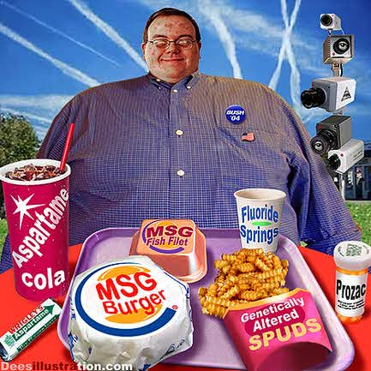
Gog’s Secret War Manual
This Cartoon is a good summary of the Quiet War technologies – Chemicals being sprayed on us from the sky; big brother surveillance cameras plus contaminated food and drinks spiked with deadly long term poison
Killing us off slowly

Slide 33
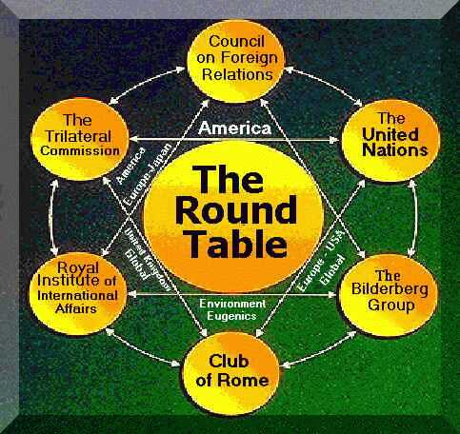
Gog’s Control Structure
This secret war would be conducted through national and international bodies headed up by The United Nations interlocking with these would be well known “charities” and behind whom would be the Illuminati controlled secret societies.
These shall be looked at in more detail later

Slide 34
Gogs Power Structure
Lucifer the Devil
|
Council of 13 Billionaire Bankers (Rothschilds etc.)
|
Council of 33 Top Financiers & Advisers
|
Council of 300 Top Jewish Rabbis and Industrialists, etc.
|
Sanhedrin
|

Slide 35
Gogs Power Structure
|
"The principal inspiration and B'nai B'rith driving power comes from the Grand Orient
|
Jewish Leaders
|
Trilateral Commission
|
Council of Foreign Relations, Bilderbergers, Council of Rome and others
|
Communism
|

Slide 36
Gogs Power Structure
Scottish Rite and York Rite Freemasonry
|
Rotary, Elks, YMCA, Buffaloes etc. Pro Masons - Masons without apron
|
Politicians
|
The top echelon totally controls politics, the media, the military, education, the judiciary, civil service, banks and everything else of consequence on the planet. They control your thinking for you.

Slide 37
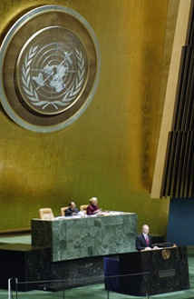
The United Nations
The United Nations came into being as a consequence of war torn populations being in shock following the carnage of WW2 who then readily agreed to hand over certain sovereign powers to this body – exactly what Gog’s world wars had been designed to achieve!

Slide 38
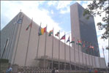
The United Nations
The UN would go on to divide the world into administrative areas such as the EU, NAFTA, SEATO etc. with powerful standing armies to deal with any local unrest or insurrection.
While some dissident voices may be calling for withdrawal from the EU or NAFTA – not a whimper is heard about the UN or the possibility of withdrawing from it!

Slide 39
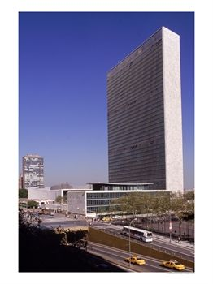
The United Nations
The Wall Of Untempered Mortar
Ezekiel 10-11
Because, even because they have seduced my people, saying, Peace; and there was no peace; and one built up a wall, and, lo, others daubed it with untempered mortar:

Slide 40
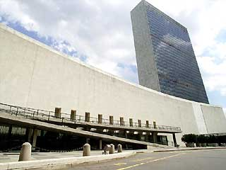
The United Nations
Say unto them which daub it with untempered mortar, that it shall fall: there shall be an overflowing shower; and ye, O great hailstones, shall fall; and a stormy wind shall rend it.
The UN Building

Slide 41
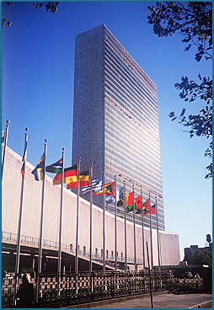
The United Nations
Lo, when the wall is fallen, shall it not be said unto you, Where is the daubing
wherewith ye have daubed it?
Therefore thus saith the Lord GOD; I will even rend it with a stormy wind in my
fury; and there shall be an overflowing shower in mine anger, and great hailstones in my fury to consume it.

Slide 42
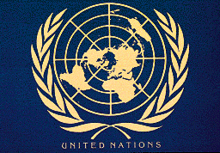
Gog & Magog – Gathering the Nations From The Whole Earth
And shall go out to deceive the nations which are in the four quarters of the earth, Gog and Magog, to gather them together to battle the number of whom is as the sand of the sea (Israel).
Notes:
Heinrich von Neustadt, around 1300, wrote of them as the "terrifying people of Gog and Magog." 18

Slide 43
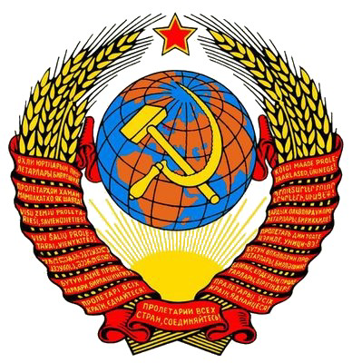
Gog & Magog – Gathering the Nations From The Whole Earth
Here we see that the emblems for the USSR and the UN are similar as are their constitutions – The UN constitution having been written by the Soviet Ambassador to Washington - Andrei Gromyko,
Notes:
Heinrich von Neustadt, around 1300, wrote of them as the "terrifying people of Gog and Magog." 18

Slide 44
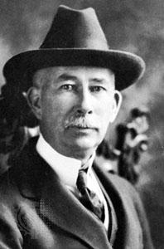
Edward Mandel House
(1858-1938)
Rothschild’s Agent – The power behind Woodrow Wilson and whose objective was the peaceful re-subjugation of the American Colonies to the “Crown” like Alger Hiss in WW2 Mandel House controlled WW1.
Edward M. House
Notes:
LAST Emperor of the Third Rome
First cousin to King George V of England
First cousin to Kaiser Wilhelm II of Germany
TSAR NICHOLAS II
LAST Emperor of the Third Rome
First cousin to King George V of England
First cousin to Kaiser Wilhelm II of Germany
TSAR NICHOLAS II
LAST Emperor of the Third Rome
First cousin to King George V of England
First cousin to Kaiser Wilhelm II of Germany

Slide 45
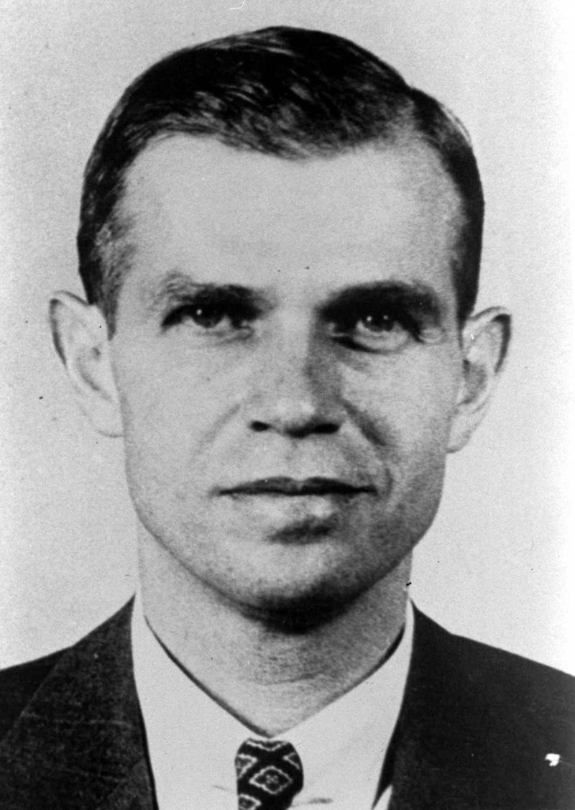
Gog’s Agent – WW2
Alger Hiss (an appropriate name for a viper) was an agent of the Rothschilds and Rockefellers coordinating WW2 to their advantage and writing the constitution of the UN almost identical to that of the USSR
Notes:
Alger Hiss, formerly a high official in the U.S. Department of Justice, denies charges that he engaged in espionage. In 1948 in testimony before the House Committee on Un-American Activities, which investigated Communism in the United States, magazine editor Whittaker Chambers accused Hiss of transmitting secret government information to the Union of Soviet Socialist Republics (USSR). Although Hiss denied the charge, he was convicted of perjury (lying under oath) and sentenced to a five-year prison term.

Slide 46
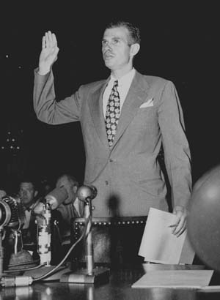
Gog’s Agent – WW2
Alger Hiss here on trial for espionage in 1948 – who was found guilty and sentenced to 5 years imprisonment.

Slide 47
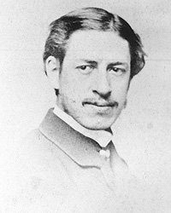
This Attack On The White Race Was Foreseen
Lothrop Stoddard - Left (June 29, 1883-May 1, 1950), born Theodore Lothrop Stoddard, was an American political theorist, eugenicist, and anti-immigration advocate who wrote a number of prominent books of early 20th-century scientific racism.

Slide 48
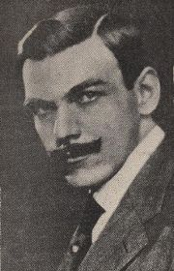
This Attack On The White Race Was Foreseen
Professor Stoddard was a prophet ahead of his time. He wrote books warning the White Adamic people of the impending worldwide war against them by the third world and urged them to take action for their racial survival.

Slide 49
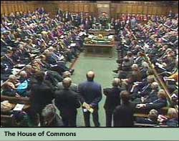
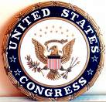
Parliament & Congress
The UK Parliament, US Congress and other western parliaments would become mere debating houses, with the real decisions being made behind closed doors through

Slide 50
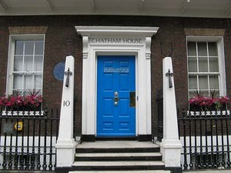
Parliament & Congress
The Royal Institute For Foreign Affairs and its American counter part – The Council on Foreign relations and many other shadowy organisations such as the Bilderbergers, The World Bank and The G8 to name just a few.
Chatham House
The Royal Institute For Foreign Affairs

Slide 51
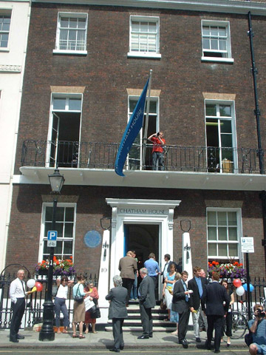
Chatham House
It was here under auspices of the Royal Institute for International Affairs that white rule in Rhodesia and Ian Smith, then Prime Minister was replaced with the Communist Dictator Mugabe resulting in the Murder and Rape of Thousands of white farmers who were also dispossessed of their estates.
Chatham House

Slide 52
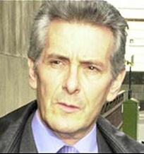
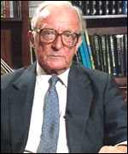
Chatham House
Thanks to Lord Carrington (Right)
and
Van Hougstraten (Left)

Slide 53
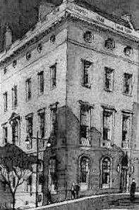
The Council on Foreign Relations (CFR)
The Council on Foreign Relations, housed in the Harold Pratt House on East 68th Street in New York City, was founded in 1921. In 1922, it began publishing a journal called Foreign Affairs

Slide 54

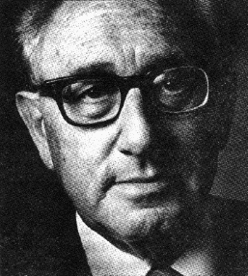
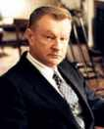
The Council on Foreign Relations (CFR)
David Rockefeller
Henry Kissinger
Zbigniew Brzezinski

Slide 55
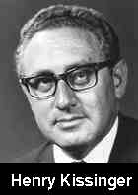
CFR Chief Coordinator
Henry Kissinger despite being a former KGB agent in WW2 was promoted to high office in the USA through the influence of the Rockefeller / Rothschild connection and was the main architect of the Vietnam Debacle.

Slide 56
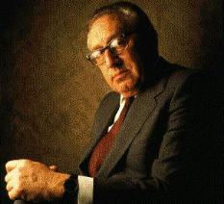
CFR Chief Coordinator
Henry Kissinger, first and foremost a lifelong employee of the Rockefeller Trusts

Slide 57
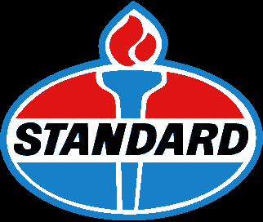
Rockefellers Grab The Wealth Of The USA
…. Rockefeller trusts. The amalgamation of Standard Oil of Texas and Standard Oil of California, resulted in the formation of Caltex. Think of some others, the National Bank, Winthrop, General Motors, General Electric, Kellogg's, Mitsubishi, ….

Slide 58
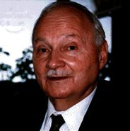
Rockefellers Grab The Wealth Of The USA
United States Nuclear, Coca Cola; they control it all and much more. If it's not in their name, one of their banks will lend the money to someone to buy it, and the Rockefeller's will own the mortgage.
(Top Left) Maurice Strong the Chairman for everything.
Financier and Enviormental planning.

Slide 59
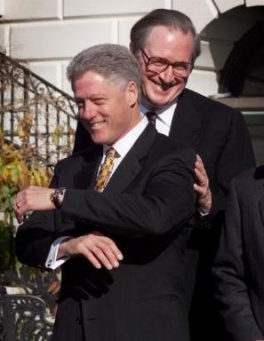
Bill Clinton & His Boss
Draft dodger Bill with his good friend Senator Rockefeller
Bill Clinton was the NWO’s agent for destroying Christian Serbia and bringing to heel Milosevic who had the audacity to issue his own currency by-passing the Rothschild Central Banks.

Slide 60
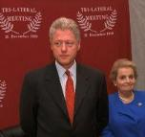
The Trilateral Meeting – Conspiring To Destroy Serbia
Check out the Trilateralist logo on the wall behind Clinton and Allbright as they turn up to receive their latest instructions
Notice the red (Edom/Gog) Overwhelming the 2 houses of Israel denoted by the two olive branches

Slide 61
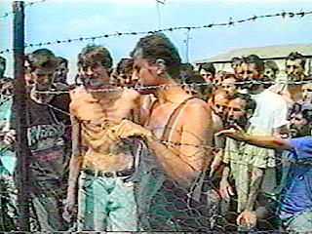
Media Lies About Serbia
The illegal Clinton-NATO bombing of Serbia was fuelled in part by a staged ITN news report purporting to show evidence of a Bosnian Serb death
camp. Pictures of emaciated 'prisoners' behind a barbed wire fence were used to claim the Serbians were running internment camps.

Slide 62
Media Lies About Serbia
In reality the emaciated man was a tuberculosis victim and the film’s crew were the ones inside the barbed wire enclosure, filming out to refugees who had willingly entered the refugee camp.

Slide 63

Kosovo Still Burns
Although we do not hear much about Kosovo in the controlled media now – Christian Serbian homesteads and churches are still being attacked..
Another Serbian homestead is attacked
Notes:
16901

Slide 64

Serbs Protest
Protests by Serbs over their treatment at the hands of the NWO go unreported to any large extent in the controlled Western media outlets.
Protesting Serbs
Notes:
1901

Slide 65

Milosevic On Trial In The Hague
Here on trial for “war Crimes” but in reality for daring to stand up to the NWO.
Being a Lawyer he got the better of the judges so little was mentioned in the mass media.
In the end, they had to resort to murdering him - disguising it as suicide

Slide 66

Russia Warns Gog
"Russia will not remain indifferent to what's going on in Kosovo", announced Vladimir Putin on 20.03.2004.
Tidings from the East & North worry Gog

Slide 67

Russia Warns Gog
….“and hundreds of homes burned and looted, along with dozens of Orthodox churches and monasteries under UNESCO protection", announced Russian Foreign Ministry representative Alexander Yakovenko on 24.03.2004.
Alexander Yakovenko
Notes:
1901

Slide 68

Russia Warns Gog
"NATO-led multi-national forces charged with maintaining security in Kosovo assured us that life there is returning to normal. In fact we're seeing a manifestation of medieval barbarity -- in recent days dozens of people have been killed,

Slide 69

Russians Erect Memorial (2005) To Victory Over The Khazars
Jews complain about a statue, in the southern Russian city of Belgorod, depicting victory over the Khazars by Svyatoslav a mediaeval prince trampling on a Star of David.
Report from The Russian Jewish telegraph 28/11/05 where the they admit the Khazars were Jews.
Statue by Vyacheslav Klykov
Notes:
16976

Slide 70

Russians Erect Memorial (2005) To Victory Over The Khazars
Here is another reason for Gog to be troubled – it is loosing control of Russia!

Slide 71


This Alien Rule is Signalled By Subtle Changes to National Insignias
We Shall now look at some of these changes

Slide 72


The Crown’s & Gog’s Coat of Arms
Spot the Difference!!
The Genuine Arms
The “Counterfeit” Arms

Slide 73

The Crown’s & Gog’s Coat of Arms
Spot the Difference!!
The Genuine Arms
The “Deception” Arms

Slide 74

Deception
Downing Street Perpetuates the lie (Gog’s) that the coat of arms shown here and on government stationery is the true Royal Coat of Arms.
This is obviously a major weapon in Gog’s Armoury of deceiving the people as to who is really in control!!

Slide 75

Gog Signals His Control
This is obviously a major weapon in Gog’s Armoury of deceiving the people as to who is really in control!!

Slide 76

Gog Signals His Control
Obadiah Verse 4
Though thou exalt thyself as the eagle, and though thou set thy nest amongst the stars, thence will I bring thee down, saith the Lord.
33
32
York Rite = 9
Here we see Gog nested as an eagle amongst the stars on the great seal of the USA – Note the 33 degree Scottish rite and the 32 degree York rite of Masonry are represented by the wings of the eagle with 33 feathers and 32 respectively
Note the Zionist “Star of David” above the eagle’s head.

Slide 77
Gog & Magog – Covert Control Signalled By Flags
The US Military Flag is Displayed Prominently in All US Courts To Indicate that the Proceedings Therein are Conducted Under Military Law (British Admiralty Law)
US Military Flag
US Civil Flag
Notes:
Heinrich von Neustadt, around 1300, wrote of them as the "terrifying people of Gog and Magog." 18
The U.S. government hasn't flown the civil flag since the Civil War, as that war is still going on. Peace has never been declared, nor have hostilities against the people ended. The government is still operating under quasi-military rule.
You movie buffs may recall this: In the old Westerns, "Old Glory" has her stripes running sideways and a military yellow fringe. Most of these films are historically accurate about that; their stories usually took place in the territories still under military law and not yet states. Before WWII, no U.S. flag, civil or military, flew within the forty-eight states (except in federal settings); only state flags did. Since then, the U.S. government seems to have decided the supposedly sovereign states are its territories too, so it asserts its military power over them under the "law of the flag."

Slide 78

Gog Signals His Control
The US Government hasn’t flown the civil flag since the Civil War, as that war is still going on.
Before WWII no US flag whether, civil or military, flew within the 48 states (except federal settings). Since then the US Government has decided that the supposedly sovereign states are its territories too!

Slide 79

Old Glory – Sister Of The Civil Flag 1779
Old Glory went through a number of changes before being withdrawn by stealth – to be replaced by the Military Stars & Stripes

Slide 80

The Customs Civil Flag
By 1951 The Civil Flag Flown by US Customs was completely phased out.

Slide 81

1919 – Another Version Of Old Glory Appears
Civilian Merchant Appraisers from 1919

Slide 82
By 1980, nearly all documentation of the Civil Flag had been omitted in school text books and it's existence left as a mystery in a few old photographs, such as the one above, and a rare mention in classic books.

Slide 83

Gog’s Agents In The Secret War
We shall now go on to look at a few of the front men who were agents of the Illuminati in Government and other institutions of influence both in the UK and the USA

Slide 84

Gog’s Agents
Dean Acheson, Secretary of State, who not only defended Alger Hiss when confronted with proof that Hiss was a spy but then promoted Hiss to a higher position within the State Department!

Slide 85

Gog’s Agents
Harry Dexter White, Treasury department at very high level. Gave to the Soviet Union the printing plates for the dollar! Wrote agreements on behalf of the United States

Slide 86

Gog’s Agents
…. which materially damaged the financial interests of the United States and enriched the Soviet Union. He Wrote Much of The Morgenthau Plan, which will surrender a large portion of Europe to Communist/Jewish/leftist rule.

Slide 87

Gog’s Agents
In Britain too – alien forces were at work – here we see Atlee (the “lee” part of his name was from Chinese ancestry) who would be one of Gog’s agents on this side of the Atlantic.
Clement Atlee was Prime Minister between July 1945 and October 1951

Slide 88

Gog’s Agents
Shinwell – a Khazar Jew would with Atlee further the Communist agenda under the guise of Socialism.

Slide 89

Gog’s Agents
Harold Macmillan – Famous for his “Winds of Change” speech and doing the ground work for our entry into the Common Market. He is also remembered for “Operation Keelhaul” – the forcible return of anti-communist refugees to Russia in WW2

Slide 90

Gog’s Agents
Edward Heath – Took the UK into the Common Market and sacked Enoch Powell (said to have been the best PM Britain never had) for daring to point out the folly of allowing mass coloured immigration into the British Isles
Edward Heath

Slide 91

Edward Heath Signs Britain Into EU Bondage
Treason never prospers, what's the reason? For if it does None dare call it treason.

Slide 92

Edward Heath Signs Britain Into EU Bondage
Many groups are now campaigning to get Britain out of the EU

Slide 93

Gog’s Agents
Harold Wilson – advanced Socialism in the UK and set in train mechanisms to end White Adamic rule in South Africa & Rhodesia
MI5 had Harold Wilson under surveillance
Harold Wilson

Slide 94

Harold Wilson Labour PM
Wilson took over the leadership of the Labour Party with the sudden and unex­pected death of Hugh Gaitskell on January 18th 1963, aged 56. Wilson became Prime Minister in 1964-1970 and 1974-1976.
In her book Enemies of the Queen the late Dr. Kitty Little revealed that from the very beginning Harold Wilson was a communist agent

Slide 95

Gog’s Angents
John Major – famous for ERM monetary debacle, signing the UK up to the Maastricht Treaty and having the Stone of Scone returned to Scotland
John Major

Slide 96
Gog’s Agents Moulding US Opinion To Accord With Their Agenda
Richard Clark – Zionist Mole & Inventor of 'al Qaeda‘ in 1998

Slide 97

Gog’s Grand Deception
Ezekiel 16:1-3:- "Son of man, cause Jerusalem to know her abominations, and say, thus saith Yahweh unto Jerusalem: Thy birth and nativity is of the land of Canaan: thy father was an Amorite, and thy mother an Hittite."
Notes:
In Ezekiel 16:1-3 Yahweh says to the people of Jerusalem, "Son of man, cause Jerusalem to know her abominations, and say, thus saith Yahweh unto Jerusalem: Thy birth and nativity is of the land of Canaan: thy father was an Amorite, and thy mother an Hittite."
Ezekiel 11:14-15 where we read, "Again the word of Yahweh came unto me saying, Son of man, thy brethren, even thy brethren, the men of thy kindred, and all the house of Israel wholly, are they unto whom the inhabitants of Jerusalem have said, Get you far from Yahweh unto us is this land given in possession."

Slide 98

Gog’s Grand Deception
Ezekiel 11:14-15 where we read, "Again the word of Yahweh came unto me saying, Son of man, thy brethren, even thy brethren, the men of thy kindred, and all the house of Israel wholly, are they unto whom the inhabitants of Jerusalem have said, Get you far from Yahweh unto us is this land given in possession."
Emblems of The Tribes of Israel
Notes:
In Ezekiel 16:1-3 Yahweh says to the people of Jerusalem, "Son of man, cause Jerusalem to know her abominations, and say, thus saith Yahweh unto Jerusalem: Thy birth and nativity is of the land of Canaan: thy father was an Amorite, and thy mother an Hittite."
Ezekiel 11:14-15 where we read, "Again the word of Yahweh came unto me saying, Son of man, thy brethren, even thy brethren, the men of thy kindred, and all the house of Israel wholly, are they unto whom the inhabitants of Jerusalem have said, Get you far from Yahweh unto us is this land given in possession."

Slide 99

The Power Behind The Throne (1)
Gentile Home Secretary Roy Jenkins gets his latest set of instructions from Lord Fisher and Maurice Orbach."Published with this caption in Let My People Go!” c. 1976

Slide 100

The Power Behind The Throne (2)
The real power in Britain is represented on the right, wearing a silly hat
Tony Blair and Lord Levy

Slide 101

Police Chief Reports To His Political Masters
Sir Paul Condon at yet another Jewish function - an AJEX meeting, Autumn 1995. Note his nervous smile and the scowl on the face of the chief Jew trying to drum up a round of applause.

Slide 102

Police Chief Reports To His Political Masters
The reason for the tension was because Sir Paul (Left) had tried to explain why he had not locked up all "racists" (especially "anti-semites"!). "The police must operate within the law as it is, not as we would like it to be" he whined. His audience was unimpressed.

Slide 103

Lester Pearson Canadian PM
1963-1968
Lester Pearson provided confidential information to Russian Military Intelligence GRU (Insignia Left) while serving in Washington DC from 1942-1946, in his capacity ultimately as Canadian Ambassador.

Slide 104

Lester Pearson Canadian PM
1963-1968
Lester Pearson was probably recruited while a student at Oxford University in 1923. From 1935-1941, he served at the Canadian High Commission in London and rubbed shoulders with the leaders of the world government plot. He helped to establish the North Atlantic Treaty Organization (NATO), and was the UN's point man during the Suez Crisis of 1957.

Slide 105

Another Of Gog’s Agents In The West
Armand Hammer Head of Occidental Petroleum
His father was from Odessa and one of the founders of the American Communist Party.
Named his son “Arm and Hammer” after the Hammer and Sickle
Armand Hammer
Notes:
was Armand Hammer, the head of the major oil company "Occidental Petroleum".
His father Julius, a native of Odessa, moved to the New World, becoming by turns a doctor, entrepreneur, millionaire, and ... one of the founders of the American Communist Party (whose headquarters were located in his New York villa) and trade consultant to the Soviet mission headed by L. Martens. His Marxist sympathies even had a role in the naming of his offspring, Armand. (Arm and Hammer was his interpretation of the hammer and sickle. He had the emblem painted on the side of his yacht.)
His personal airplane with American markings was allowed to take off and land at Moscow's Sheremetevo Airport at any time, without visas or other required documents. What's more, the airplane's crew was Soviet (selected, of course, by the Lubyanka).

Slide 106

Another Of Gog’s Agents In The West
Armand Hammer’s personal airplane with American markings was allowed to land and take off from Moscow Airport at any time.
Also A Confident of Prince Charles

Slide 107

Robert Maxwell (Ludwig Hoch) – “Captain Bob”
Captain Bob Double or Triple Agent for Mossad – To whom he transferred stolen Pension funds
Notes:
Another of the Kremlin's proteges, Robert Maxwell, presents a curious picture too. Maxwell (real name Ludwig Hoch) was born in a Jewish village in the Carpathians. As a naturalized English citizen, he served as a captain in British intelligence during the war. (He later liked to be called "Captain Bob".) He went on to occupy a high post in the Press Ministry, became a deputy from the Labour Party, Secretary of the Fabian Society, publisher and owner of dozens of newspapers and magazines throughout the world, owner of the CBS television network, billionaire
The Israeli prime minister Shimon Perez said to Maxwell and Hammer upon Gorbachev's ascent to the Kremlin: "The matter of restoring Soviet-Israeli relations is in your hands". Later, at Maxwell's grandiose funeral in Jerusalem it was announced that the carrying out of this delicate matter, as well as the liberalization of Soviet emigration policy for Jews in the 1970's, was one of the main services rendered by this "outstanding citizen of Israel".
Western intelligence agencies suspected that Maxwell's money was Soviet in origin. Indeed, he was lovingly referred to in Moscow as "First Secretary of the London Oblast Committee". The major publisher "Pergamon Press", which he owned, engaged in the strange policy of mass printings of the works of Brezhnev and other Soviet leaders.
By the way, Gorbachev's first books in the West were all published by Maxwell, who did much to develop "Gorby-mania" in the "democratic" countries and the personal megalomania of the "marked General Secretary" himself. By the way, as I. Bunich asserts in his book The Gold of the Party, a significant part of the magnate's publishing activities were a cover for the personal enrichment of the Soviet
As it turns out, Maxwell was a double agent: he worked for the Mossad as well. He took part in the enormous "K.K. Mountain" operation worked out by the Israeli secret service (with the participation of the CIA, which allotted more than a billion dollars on it) to develop a network of agents in "third world" countries and the USSR. Maxwell worked more loyally for Israeli intelligence than for Moscow, managing to steal the pension fund of his workers in England (more than 30 million dollars), which he turned over to the Mossad (which, according to former Mossad agent Victor Ostrovsky, used the money for spying in the U.K.). What's more, while demonstrating to the whole world his friendship with Gorbachev, "Captain Bob" helped Yeltsin to victory in 1991, on orders from Jerusalem.
But his political passions betrayed him in the end: His financial affairs fell into disarray. He turned to the Mossad for help, supposing that he deserved help for his great services to Israel. Upon being refused he began to blackmail his co-religionists in Israeli intelligence, threatening to publish the truth about the dark side of their activities, including the latest events in the USSR.
What's more, while demonstrating to the whole world his friendship with Gorbachev, "Captain Bob" helped Yeltsin to victory in 1991, on orders from Jerusalem.

Slide 108

Robert Maxwell (Ludwig Hoch) – “Captain Bob”
Right: "Lady Gislen" Bob’s Luxury yacht - murdered by Mossad after blackmailing them into handing over money because of his financial plight.

Slide 109

The McPherson Report A Plot to Speed The Takeover of The Police

Slide 110

Gog’s Equality!

Slide 111

The Masonic Lodges
Gog’s Masonic lodges with its tentacles well imbedded into all areas of society would be Gog’s chief instrument in waging a secret war against Christendom

Slide 112

Gog In The United States
Here we see that the “Star of David” picks out on the Great Seal of the USA – The word MASON

Slide 113

Gog In The United States

Slide 114

George Bush President of?
Is there significance in the fact of President George Bush’s close proximity to the Israeli flag in the White House to remember those who died in the 911 atrocity?

Slide 115

Christian President?
Here we see President Bush at the Wailing Wall – obviously wishing to proclaim his Jewishness

Slide 116

Christian President?
"Bush celebrates Christmas by lighting the "White House menorah." Where is the 'White House nativity'?"

Slide 117

George Bush At The Simon Weisenthal Centre
Rabbi Marvin Hier (Left), dean and founder of the Simon Wiesenthal Centre, describes President Bush thus: "I have never heard any American president, from Reagan to Clinton, ally himself so closely with the Israeli position."

Slide 118

George Bush At The Simon Weisenthal Centre
So while Berg focuses on the private wallet in Bush's pocket, he ignores the very public yarmulke on Bush's head. See actual unretouched photo from Simon Wiesenthal Centre, taken during Bush's presidential campaign.
George W. Bush with Rabbi Marvin Hier. Note yarmulke on Bush's head.

Slide 119

George Bush – Signalling his true allegiance
The horns of Baphomet (Satan)
Notes:
the national convention of the Knights of Columbus
and instead of being jeered and chased out of the convention center in
Dallas on Aug. 3, was given repeated standing ovations and chants of
"Four More Years! from thousands of Catholics, among whom were two
ranking cardinals, Edward M. Egan, archbishop of New York, and Theodore
E. McCarrick, archbishop of Washington.

Slide 120

George Bush Visits A Mosque

Slide 121

Californian Governor Also Gog’s Agent
The Californian Governor also demonstrates his Jewishness by holding the Menorah
California Governor Arnold Schwarzenegger.

Slide 122



Gog’s Secret War - Charities
Gog would also fight his secret war through many well known Charities

Slide 123

The Red Cross (Rose Croix)
The Red Cross is another arm of the NWO and is in fact the “Rose Croix” of the Rosicrucian emblem of the Prieuré de Sion on the right

Slide 124

The Red Cross (Rose Croix)
The Red Cross was founded by a famous Freemason, “Jean” “Henri” Dunant, whose name also happens to be the address of the Prieuré de Sion in Paris: “110 Rue Henri Dunant, 92700 COLOMBES.”
Jean Henri Dunant
1828 - 1910
Little wonder the funds collected by the Red Cross for disasters such as hurricanes fail to reach the victims.

Slide 125

The Red Cross (Rose Croix)
In 1875, Henri Dunant also founded the Palestine Colonization Society in London (see Zionist Conspiracy), but it was Dunant's Red Cross that would operate globally as a humanitarian cover for the diabolical schemes of the House of Rothschild:
Jean Henri Dunant
1828 - 1910

Slide 126

The Red Cross (Rose Croix)
In 1860, Baron James de Rothschild founded the Alliance Israelite Universalle, the central Cabal of world Jewry, the purpose of which, according to its president, Adolph Crimeaux, was “to penetrate into all the religions as it has penetrated into all countries.”
Baron James de Rothschild

Slide 127

The Red Cross (Rose Croix)
It was Crimeaux who invited Henri Dunant, a friend of Baron Rothschild, to a board meeting of the Alliance Israelite Universelle to speak about what would eventually become the Red Cross.

Slide 128

The Red Cross (Rose Croix)
According to news found in a Turkish Hasidic journal, dated 1865, Rothschild himself managed the early French version of the Red Cross:
Baron James de Rothschild

Slide 129

The Red Cross (Rose Croix)
The Red Cross Mission to Russia was a reconnaissance cover for the conspiracy to overthrow the Czar and his family

Slide 130

The Red Cross (Rose Croix
George Kennan (Left) was well aware that 'this mission' was an act of war by his fanatical friends at 120 Broadway, NY. In his book ... Russia Leaves the War - - the Red Cross complexion of the mission was nothing but a mask.' Kennan was right ... the Red Cross was a con.

Slide 131

The Red Cross (Rose Croix)
Thompson who was the first full-time director of the Federal Reserve in NY had given $250,000 to the Red Cross for the preparation of the Red Revolution. Remember it was Raymond Robins who claimed he was 'Thompson's servant' and 'I'm here to capture Russia for Wall Street.'”
Colonel William Boyce Thompson

Slide 132

The Red Cross (Rose Croix
According to Bruce Lockhart's book British Agent, Colonel William Boyce Thompson of the Red Cross Mission ... 'had denounced in blunt language the folly of the Allies in not opening up negotiations with the Bolsheviks.
Bruce Lockhart

Slide 133

A Power Greater Than Government – The Media!
"Those in control are exactly the same kind and type who ruled the former USSR; and if there is any difference, it is in refinement in the method of procedure. This refinement is evidenced in the manner in which avenues of communication are controlled by the invisible government.

Slide 134

A Power Greater Than Government – The Media!
As to learning the actual truth, we are no better off than we were before we had the telephone, telegraph, radio, and high‑speed presses, for today we are allowed to read and hear only those things which are prepared for us by the subsidized power now in control.

Slide 135

A Power Greater Than Government – The Media!
"Today the film makers are the people who control the most powerful medium in the world, and art that can create ideals, change language or topple governments.” the Daily Mail (28th December 1995)

Slide 136

Gog Censors The News
All major media outlets – Newspapers, television & radio are censored

Slide 137

Censorship of Books
With Gog’s strengthening grip on the media after WW2, many book plates were destroyed so that it would no longer be possible to reprint books distasteful to the Jews
A Bookplate

Slide 138

Censorship
One such example is the prioress from Chaucer’s Canterbury Tales referred to Jews kidnapping a young boy to be ritually sacrificed so that they could consume his blood.
The Prioress from Chaucer's Canterbury Tales. Illustrated by Agnus MacDonall

Slide 139

Censorship of Books
From the 13th edition onwards the Encyclopaedia Britannica comes under the control of Gog – all previous references to vaccines being dangerous are expunged

Slide 140

Fiction Altered To Suit Gog’s Agenda
The book "Gone With The Wind" is cleverly altered when made into a movie by Jewish producers Louis Mayer and David O. Selznick, who now have a White man trying to rape Scarlett, instead of the original Black male rapist in the book.

Slide 141

Fiction Altered To Suit Gog’s Agenda
Another aspect of the book not found in the movie is its noble portrayal of the as patriotic saviours in the anti‑white Klu Klux Klan reconstruction‑era south. [Feeling a little lied to?]
The Klu Klux Klan

Slide 142

Gog Controls Radio & Bulk Mail
1938 The Jewish People's Committee announces, in an advertisement in the Jewish Examiner newspaper, a concerted, country‑wide effort to mobilize public opinion in America against "Radio Priest" Father Coughlin, including the push for "local ordinances" (laws) to curb Coughlin's free speech.
Father Charles Coughlin

Slide 143

Gog Controls Radio & Bulk Mail
The Jewish People's Committee said that it had received a letter from Assistant Attorney General O. John Rogge that the Department of Justice would investigate charges against Father Charles E.Coughlin of Detroit.
O. John Rogge

Slide 144

Gog Controls Radio & Bulk Mail
1940 Arthur Coughlin is forced off the radio, but still publishes his newsletter.
1942 Father Coughlin loses his bulk‑mailing permit, by order of part‑Jewish Roosevelt.

Slide 145

Media Makes Imbeciles Into Geniuses
Albert Einstein was held up by the Jewish liars as a rare genius who drastically changed the field of theoretical physics. The truth, however, is very different.

Slide 146

Media Makes Imbeciles Into Geniuses
The reality is that Einstein was an inept, moronic Jew who could not even tie his own shoelaces; he contributed nothing original to the field of quantum mechanics or any other science, but on the contrary he stole the ideas of other men.

Slide 147

UK Police State, Surveillance
Photos as well as video records are now being taken at UK airports together with increased security measures at railway stations.

Slide 148

UK Police State, Surveillance
Part of the brainwashing is constant announcements about unattended luggage – this keeps in peoples mind that there is an ever present threat of terrorism which makes it acceptable to take away peoples freedoms.

Slide 149

UK Police State, Surveillance
To keep us all safe!
The poster headline reads simply "Watching over you 24/7" and features giant eyes set into the landscape of the Houses of Parliament in London.
Of course we are kept under surveillance constantly for our "safety and security"

Slide 150

UK Police State, Surveillance
Britain is acknowledged as the world leader of Orwellian surveillance. An estimated 4.2 million closed-circuit TV cameras observe people going about their everyday business, from getting on a bus to lining up at the bank to driving around London. It's widely estimated that the average Briton is scrutinized by 300 cameras a day.

Slide 151

UK Police State, Surveillance
How ironic or coincidental that the iconic London red bus would shortly down the line once more appear, this time blown to smithereens,

Slide 152

UK Police State, Surveillance
…. despite the helpful and loving watchful eyes. Even more farcical was the fact that the CCTV cameras on the bus that blew up were not working.

Slide 153

London Bus Blown Up In Tavistock Square 7/7/2005 (777)
Vehicle No. of Bus 17758 = 28 = 4 x 7
Treated in 7 Hospitals
49 Dead & 700 Injured
First explosion reported 8.49 =911

Slide 154

Headlines Designed To Keep The Population fearful

Slide 155

Gog’s Agents of Deception
Mossad Have Penetrated The Western Intelligence Agencies Including CIA, FBI, MI5, MI6 and KGB
Many of those convicted of betraying US and UK Atomic secrets to the USSR were of Khazar descent.

Slide 156

Gog’s Agents of Deception
3 Mossad can call on the services of any Jew within the country within which it is operating, without fear of being reported to the authorities.
Top left The Insignia Of Mossad – The Israeli Intelligence Service

Slide 157

GOG Changing The Face of London
A Map of the distribution of white Britons in our own capital, London. Note that as non-white immigrants have poured into the city,

Slide 158

GOG Changing The Face of London
…. white Britons have either been pushed or driven out by murder, rape and street crime (despite the drivel in the controlled media highlighting the rare white-on-black violence), or bred out because white couples are taxed….
Southall London

Slide 159

GOG Changing The Face of London
(partly to support the employment of low-IQ immigrants and other useless paper-shufflers at huge salaries by local and national government, usually retiring at 50 due to exhaustion on inflation-proof pensions); now they are non-existent in many parts of London.
Lambeth Town Hall

Slide 160

GOG Changing The Face of London
A similar pattern is occurring in major cities all over Britain. Once the cities are completely taken over, then it will be the meadows, vales, valleys and mountains .
Bristol City

Slide 161

Gog Changing The Face of Britain
Typical tranquil villages such as this Wiltshire village will be the next target.

Slide 162

Gog’s Moon Landing Deception
Knowledgeable people have shown that the moon landing was a hoax on a grand scale – here we see the astronaut holding the US flag so that it does not flutter in the breeze from the hot studio lights – Probably taken in Walt Disney studios
NASA would use the “successful” moon landing to generate support for funding in order to produce weapons of mass destruction

Slide 163

911 - 2001
False flag op – to set in train Gog’s NWO plans and Justify a War on Terror now that the Russian Communist Bogey Man has been removed.

Slide 164

Ground Zero 2001
911 – designed to numb the people into accepting drastic reductions in their liberty and binging in draconian laws to suppress freedom of speech and travel.

Slide 165

911 – Connection To The Middle East Is Different To What One Is Led To Believe
The British Mandate in Palestine was proclaimed on September 11, 1922. And the groundbreaking ceremony for the Pentagon took place on September 11, 1941.
Britain & America are cursed for their support of the Jews & not the blessings the tele-evangelists would have you to believe

Slide 166


Slide 167

The New War –The War On Terror
Dov Zakheim – a shadowy figure working in the Pentagon & a Jewish Rabbi – just like one of the frogs described in Revelation
Dov Zakheim—A Key 9/11 Conspirator?

Slide 168


Slide 169

War On Terror Ops Gather Momentum
Further erosion of our freedom to travel engineered by Gog
Heathrow Bomb Plot – 10/8/06

Slide 170

War On Terror Ops Gather Momentum
Heathrow Bomb Plot – 10/8/06

Slide 171

War On Terror Ops Gather Momentum
Only 20% Of Britons Believe Blair On Terror Threats
Perhaps people are waking up to who is really behind terrorism!

Slide 172

Former KGB Recruited Engaged By George Bush
On March 17, 2003 Bush hired "the former head of the KGB (the secret police of the former Soviet Union), General Yevgeni Primakov," as a consultant to the US Department of Homeland Security.
General Yevgeni Primakov
Notes:
16985

Slide 173

Former KGB Recruited Engaged By George Bush
Primakov joined another Russian, Oleg Kalugin, KGB (Ret) with the Department of State Security, also as a part of Homeland Security
Oleg Kalugin
Notes:
16985

Slide 174

Former KGB Recruited Engaged By George Bush
There were no photographs available of Wolf until after the German Reunification, which means neither the CIA nor British Intelligence knew what this man looked like. Quite an accomplishment!

Slide 175

Former KGB Recruited Engaged By George Bush
On January 1, 2005 Kalugin was replaced with the infamous and sinister Silver Fox himself (his former CIA code name), Gen. Markus Wolf. "Wolf was the head of the international intelligence gathering arm (HVA) of East Germany's Ministry for State Security, or Stasi."

Slide 176

Former KGB Recruited Engaged By George Bush
The recruitment of these “former” Communists went a long way toward perfecting the spying and wiretapping of the entire USA, and insured that Americans would become the next victims of State Terrorism ala the USSR and Communist East Germany.
Notes:
16985

Slide 177
How The New World Order Deals With Those Who Deny The Holocaust
Before
After
Professor Robert Faurisson
Gog has ways and means of dealing with those who question its lies
Notes:
TSAR NICHOLAS II
LAST Emperor of the Third Rome
First cousin to King George V of England
First cousin to Kaiser Wilhelm II of Germany
TSAR NICHOLAS II
LAST Emperor of the Third Rome
First cousin to King George V of England
First cousin to Kaiser Wilhelm II of Germany
TSAR NICHOLAS II
LAST Emperor of the Third Rome
First cousin to King George V of England
First cousin to Kaiser Wilhelm II of Germany

Slide 178

Illuminati Have Agents In Most Organisations Including The BNP & French NLF
Frenchman Jean-Marie le Pen (member of Paris Grand Orient Lodge warmly welcomes Masonic brother Nick Griffin, leader of the BNP

Slide 179

Illuminati Have Agents In Most Organisations Including The BNP & French NLF
Gog infiltrates all organisations especially those that wish to undermine its objectives

Slide 180

Total Destruction of Beautiful, Historic Iraq by Gog

Slide 181

USA Builds New Embassy In Iraq
The new embassy is a size of a small city in its self – so Gog intends to be here for a long stay!

Slide 182

Whose War Are We Fighting In Iraq?

Slide 183

The Iraq Invasion – A Middle East Perspective

Slide 184

Protests Against The NWO – Ruthlessly Put Down
1999-Dec-1, Seattle, Washington, environs of the WTO meeting: peaceful protesters are doused with chemical weapons

Slide 185

Protests Against The NWO – Ruthlessly Put Down
1999-Dec-1, Seattle, Washington, environs of the WTO meeting: officer fires less lethal weapon at peaceful protesters at close range

Slide 186

We See Through A Glass Darkly
The Bars are difficult to see these days, but the economic and propaganda controls are so sophisticated that most have learned to love them

Slide 187

The Story Of Gog And Magog
A thought to leave you with
"[The Masons] are the invisible powers behind the thrones of earth, and men are but marionettes, dancing while the invisible ones pull the strings. We see the dancer, but the master mind that does the work remains concealed by the cloak of silence". Manley P. Hall.
Howbeit no man spake openly of him for fear of the Jews. (John 7:13)

Slide 188
The Story Of Gog And Magog
The End Of Part Seven
To be continued ……Part 8 Gog’s Covert Attack on Western Culture

