Slide 1
The Story Of Gog And Magog
Part Six - Chapter Three
Gog’s World Wars

Slide 2
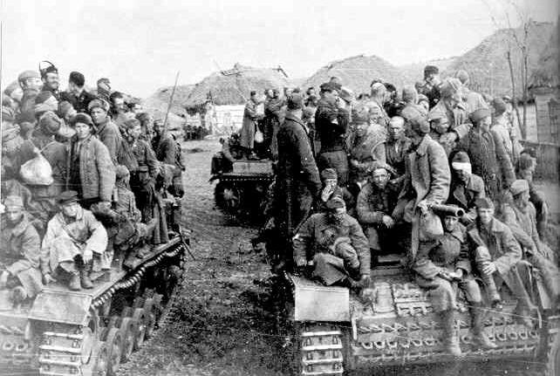
Operation Barbarrosa
Barbarrosa prisoners of war
The invasion of Russia was to pre-empt Stalin’s planned invasion of the west – a vast army of tanks and supply vehicles had been assembled to invade
the west – so we have Hitler to thank that this plan of the NWO never came to fruition!

Slide 3
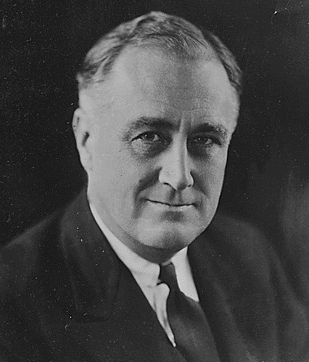
Roosevelt’s Ancestry
The ‘Jewish ancestry' of President Roosevelt
He is a descendent of the Rossocampo family expelled from Spain in 1620. Seeking safety in Germany, Holland and other countries, members of the family, changed their name to Rosenberg, Rosenbaum, Rosenblum, Rosenvelt and Rosenthal. The Rosenvelts in North Holland
Franklin Delano Roosevelt

Slide 4
Roosevelt’s Ancestry
finally became Roosevelt, soon becoming apostates with the first generation and other following suit until, in the fourth generation, a little storekeeper by the name of Jacobus Roosevelt was the only one who remained true to his Jewish Faith. (Chase S. Osborn, 1934 at St. Petersburg, Florida, The Times Newspaper)
Franklin Delano Roosevelt

Slide 6
Roosevelt’s Jewish Mother
The Family Delano (mother of President Roosevelt) belonged to those Jews whom the Dutch Governor of NY did not want.

Slide 7
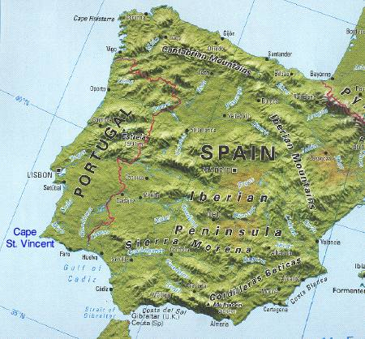
Roosevelt’s Jewish Mother
It is known that the Sephardic Jewish families which came from Spain and Portugal always inter‑married; and the assumption exists that the Family Delano, despite Christian‑confession, remained purely Jewish so far as religion is concerned.

Slide 8
Pearl Harbour – Contrived To Bring USA Into Gog’s War

Slide 9
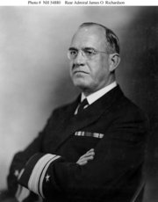
Pearl Harbour – Contrived To Bring USA Into Gog’s War
FDR ordered the fleet from the West Coast to its exposed position in Hawaii and ordered it to remain at Pearl Harbour despite complaints by its commander Admiral Richardson that there was inadequate protection from air attack and no protection from torpedo attack.
Admiral James O. Richardson

Slide 10
Pearl Harbour – Contrived To Bring USA Into Gog’s War
He felt so strongly that he twice disobeyed orders to berth his fleet there and he raised the issue personally with FDR in October. He was soon after replaced. His successor, Admiral Kimmel, also brought up the same issues with FDR in June 1941.
Adm. H.E. Kimmel

Slide 11
Pearl Harbour – Contrived To Bring USA Into Gog’s War
Japan was goaded into war with the west by the cutting off of oil supplies by the British, US and Dutch.
Roosevelt – “a small price to pay to bring the US public into a war mood”!

Slide 12
Pearl Harbour – Contrived To Bring USA Into Gog’s War
Here we see a newspaper report on the Pearl Harbour Attack

Slide 13
Gog Whips Germany Into A War Frenzy
The Protestant as well as the catholic church because of Gog’s influence in these organisations did not oppose the rise of evil forces
which were operating on both sides of the channel to goad us into fighting our brethren.

Slide 14
Roosevelt Puts The USA On A War Footing By-Passing Congress
In 1941 Roosevelt signed the Lend-Lease bill into law, permitting increased deliveries of military aid to Britain in violation of U.S. neutrality and international law.
Notes:
17015

Slide 15
Roosevelt Orders US Troops To Occupy Greenland
In April Roosevelt illegally sent U.S. troops to occupy Greenland. On 27 May he proclaimed a state of "unlimited national emergency," a kind of presidential declaration of war that circumvented a power constitutionally reserved to Congress.

Slide 16
Roosevelt Orders US Troops To Occupy Iceland
Following the Axis attack against the USSR in June, the Roosevelt administration began delivering enormous quantities of military aid to the beleaguered Soviets. These shipments also blatantly violated international law. In July Roosevelt illegally sent American troops to occupy Iceland.

Slide 17
Roosevelt Ensured That The Japanese Raid Was Successful
President Roosevelt put Powell, Knox and Forrestal (Under Secretary For The Navy) under armed Marine guard until after the Pearl Harbour attack. He sent a message to Lt. Col. Clifford M. Andrew, Intelligence officer at Army Intelligence in Hawaii, which read: "The Japanese will attack, do not prepare defences, we need the full support of the American Nation in a war time effort by an unprovoked attack upon the Nation."
1933-1945 Franklin D. Roosevelt, 32nd. President of the U.S.A

Slide 18
Gog – Eliminates Witnesses
On May 22, 1949, James V. Forrestal, former Defence Secretary, fell or was pushed to his death from a 16th story window of Bethesda Naval Hospital. The official verdict was "suicide" but President Truman came, unwittingly perhaps,
James V. Forrestal

Slide 19
Gog – Eliminates Witnesses
nearer to the truth when he declared that Forrestal was "a victim of the Cold War." For, like Sen. Joseph McCarthy eight years later, Forrestal was hounded to a premature death because of his anti‑Communist views.
Bethesda Naval Hospital

Slide 20
Gog – Eliminates Witnesses
Besides James Forrestal others involved in the Pearl Harbour conspiracy were eliminated - on May 15, 1966, Lt. Col. Clifford M. Andrew, who had received FDR's stand down order at Military Intelligence in Hawaii, was murdered in his home in Tigard, Oregon, by a bullet in the back of the head.

Slide 21
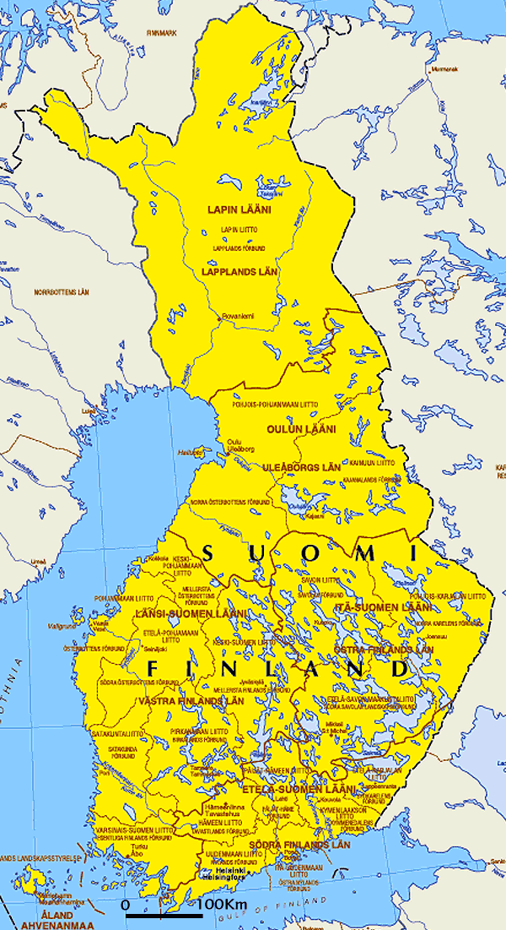
Finland Nearly Defeats The USSR
The USSR under Stalin's rule, was so shaky that the Russian Army was on the verge of being defeated by tiny Finland;

Slide 22
Finland Nearly Defeats The USSR
And with the diversion of just a tiny fraction of the millions of tons of war equipment being shipped to Europe daily, America could have saved Finland and dealt a death blow to Stalin and to Communism.
Carl Gustaf Emil Mannerheim, the Commander-in-Chief of the Finnish army

Slide 23
US Saves Russia From Collapse
Just two years later, when the German Army had cleared Eastern Europe of the Bolshevik plague;
German Soldiers at the battle of Stalingrad

Slide 24
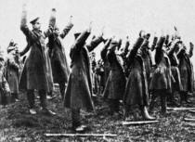
US Saves Russia From Collapse
… and had accepted the eager surrender of millions of Russian soldiers; was knocking at the door of Moscow Russia's Communist rule was once again on the verge of collapse.

Slide 25
US Saves Russia From Collapse
Thus, America, at the cost of thousands of dead and wounded American Troops, through orders of the Great Traitor Roosevelt, in an unheard of frenzy, rushed billions in military aid to Russia. Saving Stalin and with one monstrous Satanic Act, saved the entire Jewish‑Communist‑Zionist World offensive from extinction.

Slide 26
Major Jordan
From Major Jordan’s Diaries:
The man who was in charge of shipping U.S. War materials to Russia during World War II tells how he was instructed by officials in the White House and State Department to deliver critical parts for the atomic bomb – at the same time the government was pretending to be worried about Russia stealing America’s A-bomb secrets.
Major Jordan

Slide 27
Churchill, Truman & Stalin Should Have been hanged At Nurenburg for their war crimes

Slide 28
1940-41 London Blitz
Unbeknown to Londoners, he had rejected Hitler's proposal to spare civilian targets. Quite the opposite, he goaded Hitler into bombing London by hitting Berlin and other civilian targets first.

Slide 29
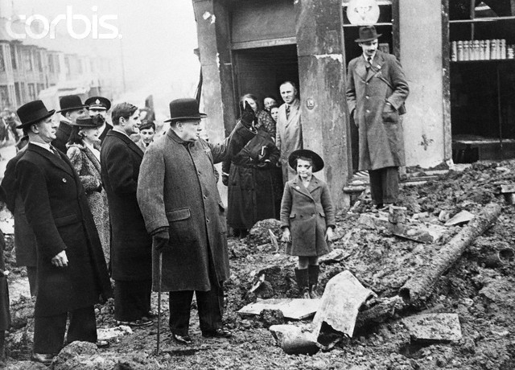
1940-41 London Blitz
After touring the ruins, Winston Churchill remarked, "They cheered me as if I'd given them victory, instead of getting their houses bombed to bits."
Churchill was telling the truth.

Slide 30
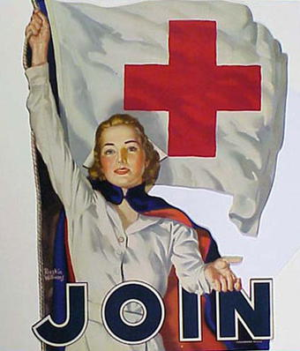
1940-41 London Blitz
Churchill told his Air Marshall: "Never mistreat an enemy by halves" and instructed his cabinet, "bombing of military objectives, increasingly widely interpreted, seems our best road home at present." He blocked the Red Cross from monitoring civilian casualties.

Slide 31
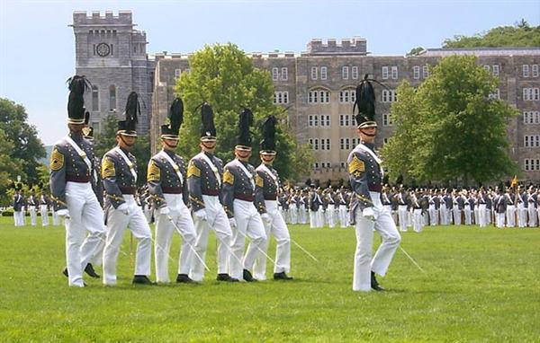
General Eisenhower
Eisenhower's West Point Military Academy graduating class yearbook, published in 1915, Eisenhower is identified as a "terrible Swedish Jew."

Slide 32
General Eisenhower
In 1943, Washington not only transferred Col. Eisenhower to Europe but promoted him over more than 30 more experienced senior officers to five star general and placed him in charge of all the US forces in Europe.
Eisenhower

Slide 33
General Eisenhower
Wherever Eisenhower went during his military career, Eisenhower's Jewish background and secondary manifesting behaviour was a concern to his fellow officers.

Slide 34
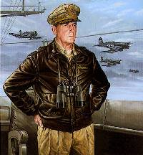
General Eisenhower
During World War II when Col. Eisenhower was working for Gen. Douglas McArthur in the South Pacific, McArthur protested to his superiors in Washington (DC) that Eisenhower was incompetent and that he did not want Eisenhower on his staff.
Gen. Douglas McArthur

Slide 35
David Jacob Eisenhower
In 1945 Eisenhower threw 1.7 million Germans in open fields which killed approx 1.2 million.

Slide 36
General Eisenhower
Eisenhower’s military promotions on the eve of WWII and during the war are curious to say the least. Zionists found an Army officer who had been a military failure until Bernard Baruch (Left) promoted him to General.
Bernard Baruch

Slide 37
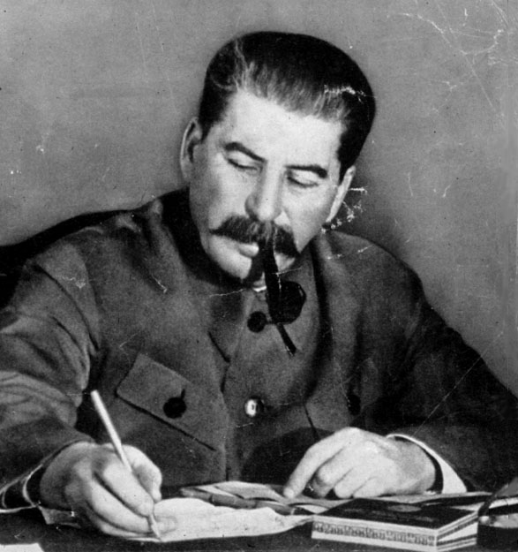
General Eisenhower
His actions and responsibilities during and after the war: direct, personal negotiations with Stalin on the placements of the armies (and the surrender of territory won by Americans, with the ceding of that territory to the Russians).

Slide 38
GOG – Decimates Our German Cousins
General Eisenhower was responsible for starving to death thousands of Germans who had surrendered in camps far worse than the so-called German death camps! One month before the end of WW2, General Eisenhower issued special orders re the treatment of - “prison enclosures are to provide no shelter or other comforts”
General Dwight D. Eisenhower

Slide 39
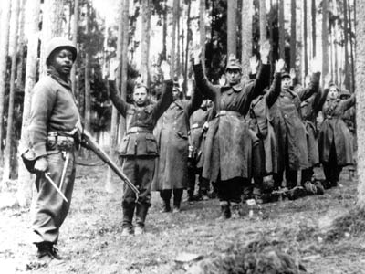
GOG – Decimates Our German Cousins
General Eisenhower issued special orders re the treatment of - “prison enclosures are to provide no shelter or other comforts”
The public was unaware of the German genocide because of the brainwashing re the Jewish Holocaust
Captured Germans

Slide 40
Operation Keelhaul
At the end of World War II, General Dwight D. Eisenhower, who commanded our military in the European Theatre of Operations (but who had never seen a battle outside the movies), ……

Slide 41
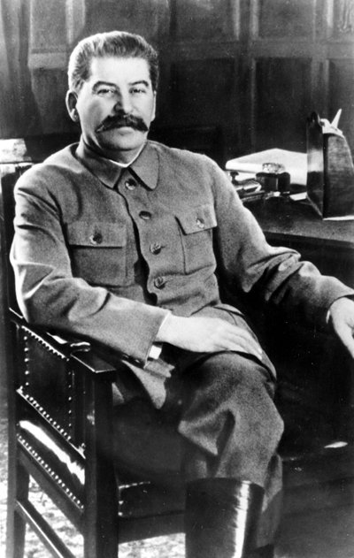
Operation Keelhaul
…. ran Operation Keelhaul. Literally millions of victims who had escaped from Communist dictator Joe Stalin during the war were forcibly returned to him in boxcars like Jews on their way to Auschwitz.

Slide 42
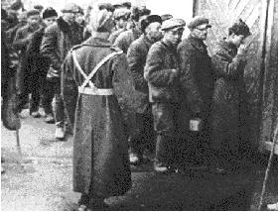
Operation Keelhaul
In Operation Keelhaul what we see follows “During World War II, some 2.5 million Soviet citizens found themselves in Germany and the occupied countries as prisoners of war, slave labourers, or refugees. From 1944 to 1947……..
Soviet citizens being rounded up

Slide 43
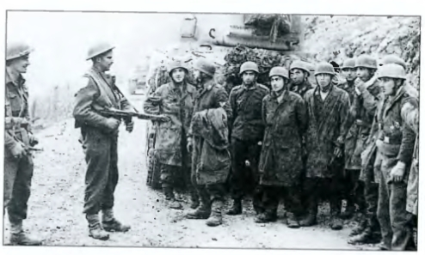
Operation Keelhaul
These people were forcibly repatriated in a number of operations, the best known of which was Operation Keelhaul in 1946-7. Many committed suicide rather than return to Soviet slavery

Slide 44
Operation Keelhaul
Before the addition of those countries and peoples, at the end of the war, Russia had a population of about 160 million people and controlled a land area smaller than the Russia of the Czars. Soviet industry had been almost totally destroyed by the Nazi war machine.
Some of the countless thousands of displaced persons

Slide 45
Operation Keelhaul
Communism was a third rate power, militarily, industrially and economically. There was, literally, no reason for Eastern Europe to be handed over to the Communists other than the influence of the Communist agents in OUR Foreign Office & US State Department.
Memorial to one of the Russians sent back to the USSR

Slide 46
Operation Keelhaul
Almost a million anti-Communist Russian soldiers under Russian General Vlasov had defected to the Germans in hopes of freeing Russia from Stalin’s grasp.
General Vlasov

Slide 47
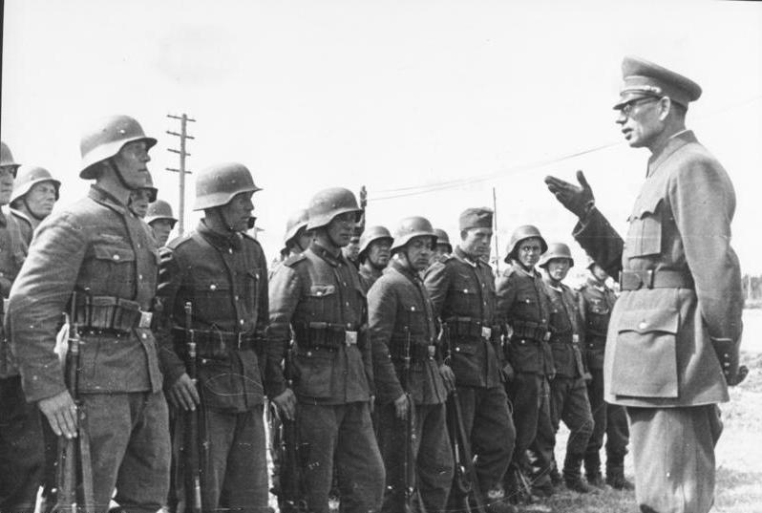
Operation Keelhaul
General Vlasov – Talking to troops to be returned under Operation Keelhaul
The Jewish controlled American Press did not report this genocide, and the American People did not learn of "Operation Keelhaul" until almost 20 years after the war.

Slide 48
Operation Keelhaul
The world went to war to "save" Poland and the other countries of Eastern Europe. Yet, at Yalta, before the war was over, the United States State Department AGREED that the Soviet Union would be allowed to add Estonia, Latvia, Lithuania, Poland, half of Germany, Hungary, Czechoslovakia, Rumania, and Bulgaria to its territory in Europe. Before the addition of those countries and peoples, at the end of the war,
Boundaries of post-war Poland

Slide 49
Operation Keelhaul
these people were rounded up at bayonet point, forced into freight cars and shipped off to a terrible fate. There was no accurate count kept but the MINIMUM figure was 2,000,000 people and a maximum of 5,000,000. The elimination of all these anti-Communist people made the Communist domination of Eastern Europe MUCH easier.
Many were forced onto freight trains

Slide 50
Operation Keelhaul
And the American people were kept blissfully unaware of this action which Eisenhower enforced rigidly, even though it violated international law, the laws of his own country and laws of humanity.
Worn by gullible Americans

Slide 51
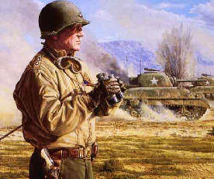
Operation Keelhaul
Patton Was Repulsed By Stalin.
Patton, who was 6', considered Stalin a 5' 6" squinty eyed Bolshevik. He was infuriated over operation Keelhaul, and Eisenhower's death camps.
General Patton

Slide 52
Operation Keelhaul
A painting depicting the horrors of “Operation KeelHaul”

Slide 53
Operation Keelhaul
The Communists often machine-gunned these people as they arrived in Soviet territory - sometimes while still on the trains. Most of these people were nothing more than White Christian refugees, who didn’t want to live in a communist tyranny.
Eisenhower Leaving A Synagogue

Slide 54
Operation Keelhaul
In 1945, General Dwight Eisenhower ordered that "Operation Keelhaul" be put into effect. This involved rounding up and shipping back to "their countries of origin" ALL the refugees from communism: men, women and children, soldier or civilian, male or female — even though many of them had been fighting on OUR side during the war.
General Eisenhower

Slide 55
Operation Keelhaul
Since all of Eastern Europe was then under Communist domination, sending these people back was, quite literally, a sentence of death, some by immediate execution and the rest by slow extermination from overwork and malnutrition in the Soviet slave labor camps in Siberia.
General Eisenhower

Slide 56
Another Of Gog’s Agents
Former PM Harold Macmillan, complicit in “Operation Keelhaul” was responsible for the fact that Tens of thousands Russians and ethnic Germans were liquidated by Stalin as 'traitors' at the end of the war as, having been POWs, they were returned to Russia from Germany.
Harold Macmillan

Slide 57
Another Of Gog’s Agents
Many were forced back to Russia by British officers at the point of guns, a war-crime scandal that at one time besmirched the reputation of Harold Macmillan. Macmillan was also responsible for setting in train Britain’s application to join the Common Market
Harold Macmillan

Slide 58
World War - Controllers
It is hard for people to grasp that the Illuminati controlled Russia, Great Britian, Germany and France during World War II, but they did. Churchill, Roosevelt, and Stalin were all Masons.
Joseph Goebbels

Slide 59
World War - Controllers
DeGaulle of France was closely linked with several esoteric groups, and the Priere de Sion and Grand Orient Masons helped him to power in the 50s. Churchill was a Zionist and pro-Fabian Socialist. Stalin was a closet Satanist. Roosevelt was a Zionist, pro-communist and socialist.
General de Gaulle

Slide 60
Gog Thwarts Germany’s Peace Overture
Rudolf Hess was a German Christian, second in command to the legal head of State, and an Officer of the legal armed forces of a Sovereign nation, Germany.

Slide 61
Gog Thwarts Germany’s Peace Overture
Hess’s Plane crashes on Eaglesham Moor Renfrewshire, Scotland, while on the way to meet the Duke of Hamilton.

Slide 62
Gog Thwarts Germany’s Peace Overture
Rudolf Hess was taken to Buchanan Castle, which was a hospital at the time, to have his wounds treated.

Slide 63
Gog Incarcerates Hess For Life
Spandau Prison – Berlin Germany

Slide 64
Patriot - William Joyce (Lord Haw-Haw)
Joyce inherited the title "Lord Haw-Haw" from the traitorous Englishmen who had been doing the broadcast before him.

Slide 65
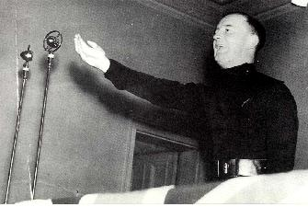
Patriot - William Joyce
(Lord Haw-Haw)
“Thus, a typically Jewish greed not only kept the coal-fields idle and the miners unemployed but left England gravely unprepared for the war that Jews themselves were continually urging her to wage against Germany”.

Slide 66
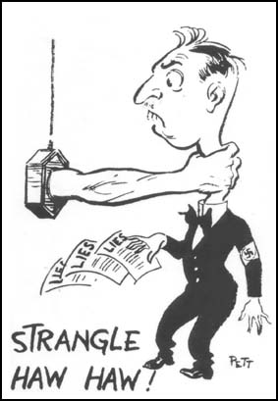
Patriot - William Joyce
Such statements would ensure Gog’s propaganda machine would go into overdrive to denounce him as a traitor.

Slide 67
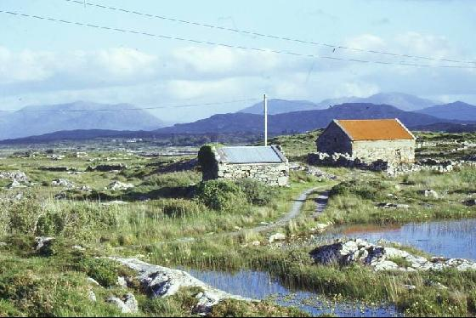
Patriot - William Joyce
Contrary to what official history says, he was a patriot from Galway Ireland who did well at university. He moved to New York for a time and later returned to the UK where he campaigned relentlessly against the partition of Ireland,

Slide 68
Patriot - William Joyce (Lord Haw-Haw)
…. although a Catholic. He also needled the authorities for warning the people that war preparations were being driven by Zionists
William Joyce, who had fought so tenaciously for the racial security and Christian integrity of Europe

Slide 69
Patriot - William Joyce (Lord Haw-Haw)
Before he could reply, Perry drew and fired his revolver. It was never felt necessary to explain why such a standard response to a simple request should have resulted in Joyce being shot down. The bullet entered Joyce's right thigh and then through his left leg, causing four wounds.

Slide 70
Patriot - William Joyce (Lord Haw-Haw)
Captain Alexander Adrian Lickorish of the Reconnaissance Regiment, and Lieutenant Perry, an interpreter, followed and overtook the limping man. "You wouldn't happen to be William Joyce, would you?" Perry asked.
Captain Alexander Adrian Lickorish

Slide 71
Patriot - William Joyce (Lord Haw-Haw)
The grim irony is that the "officer" who shot Joyce, Lieutenant Perry, was no Englishman, nor was he a soldier. Perry was not his real name; the Lieutenant was an armed German‑Jew serving with the British forces.
William Joyce’s Passport

Slide 72
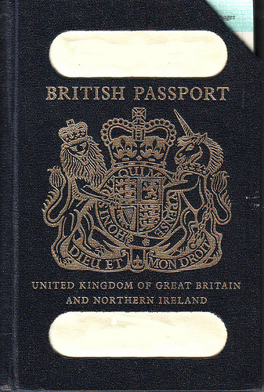
Patriot - William Joyce (Lord Haw-Haw)
The irony was that although in the pre-war years he was refused a British Passport, the authorities now claimed he was British and subject to British jurisdiction and therefore could not escape the death penalty by claiming asylum.

Slide 73
Patriot - William Joyce (Lord Haw-Haw)
Lord Haw Haw - whose real name was William Joyce - was hanged at Wandsworth Prison in 1946 for broadcasting Nazi propaganda.
The family grave

Slide 74
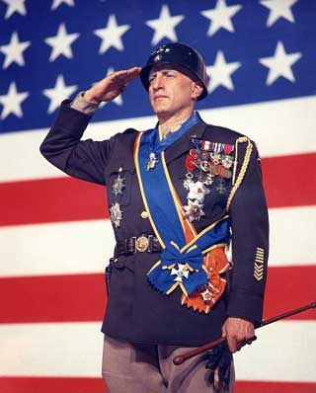
The Murder Of General Patton
One of the few with political potential George Patton Was A High Profile War Hero.
Who Benefits From His Death?
Eisenhower and his backers

Slide 75
General Patton
There Are Too Many Rumours
There is a real possibility that Patton was assassinated. As far as the official story goes, who really knows how true it was.
General Eisenhower

Slide 76
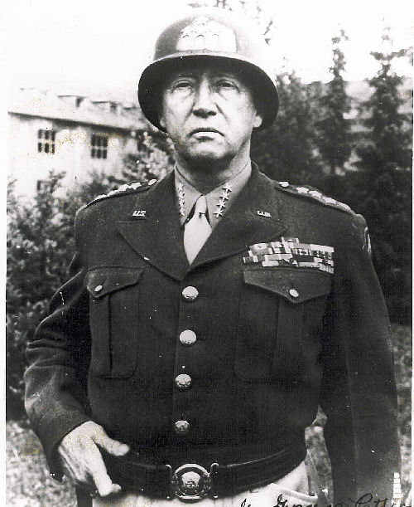
General Patton
You can be sure there were a few deaths that had to be reinvented or altered, , why would you assassinate a four star general?
General Patton

Slide 77
General Patton
Eisenhower Had A Lot Of Baggage.
Eisenhower was promoted by Bernard Baruch, over 356 more qualified commanders.
Bernard Baruch

Slide 78
General Patton
Eisenhower The Soldier. His first assignment was to London, where he lived in the palatial Dorchester hotel. He was assigned a driver / companion, Kay Somersby, a married 26 yr old model.
Ike at a press conference in the Dorchester Hotel

Slide 79
General Patton
Churchill was a debaucherous drunkard, whose mother was a Jewess. He ran the show, with Eisenhower playing the sycophant. Patton made his distaste of Churchill public.
Eisenhower And Churchill

Slide 80
General Patton
Eisenhower's First Battle Command Was Operation Torch
In the North Africa campaign, Eisenhower went to Gibraltar, built a fortified bunker, threw tantrums, and blamed his generals, and his soldiers, for his battle fiascos.
800 Miles From The Front

Slide 81
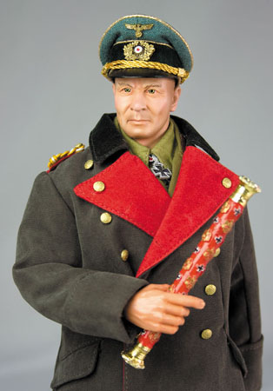
General Patton
Rommel annihilated a US battalion at Kasserine Pass, because Eisenhower didn't use reconnaissance, or provide air cover.
Eisenhower's incompetence, his remote headquarters, and his flaunting of Kay Summersby, infuriated the commanders.
Rommel The Desert Fox

Slide 82
General Patton
Satellite photo of the theatre of Eisenhower’s botched operations

Slide 83
General Patton
Patton Brought To Africa
Patton arrived and cleaned up Eisenhower's mess.
Other Generals Wanted Eisenhower Removed
Eisenhower botched everything, blaming his generals, and US soldiers. Roosevelt had to fly over to Tunis, and stop a mutiny over his Kasserine Pass debacle.
General Patton

Slide 84
General Patton
Eisenhower Goes Back To London
Eisenhower lives at Telegraph Cottage, a ten acre Country Estate, outside of London. He attends dinner parties, and is an embarrassment, whipping around London in his staff car, flags flying, with his British Mistress at the wheel.
US Surrender to Germans - Kasserine Pass debacle

Slide 85
General Patton
Eisenhower's Fashion Model Companion
After North Africa, and Sicily, he returns with his 26 yr old mistress. In 1943 Eisenhower is the Supreme Commander of the Allied forces in Europe. Gen. Montgomery considered Eisenhower a clown.

Slide 86
General Patton
Left: Ike And Kay's Love Nest
Right: Arguing In Public
Long horse rides, card games, and snuggles - She got hammered at a party, and told an aide about 'Ikie' and his bed habits

Slide 87
General Patton
He was in practically every major battle, even the Germans respected him.
Patton Invades Sicily He drove up the coast and took Messina
General Patton

Slide 88
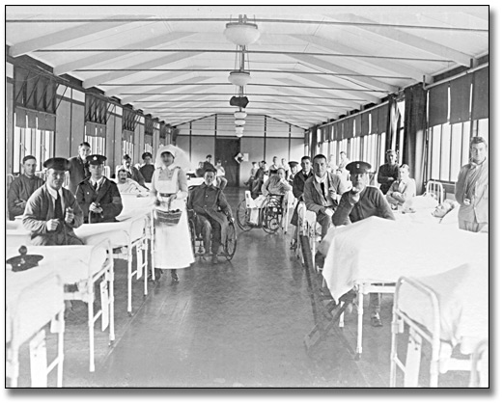
General Patton
While visiting an army hospital he slapped a Charles H. Kuhl, calling him a ‘Yellow Belly Jew Coward. A reporter, David Katz, broke the story and Patton was relieved of duty.
Military Hospital

Slide 89
General Patton
Battle Of The Bulge -Eisenhower's Blunder
Hitler built a massive offensive, hid it in the Ardennes forest, while Eisenhower was at Telegraph cottage, with Summersby, and his dog 'Telek'.
Battle of The Bulge

Slide 90
General Patton
Patton warned Eisenhower about the possibility of a German attack. Patton took Bastogne, and saved Eisenhower from a real catastrophe.
Battle of The Bulge

Slide 91
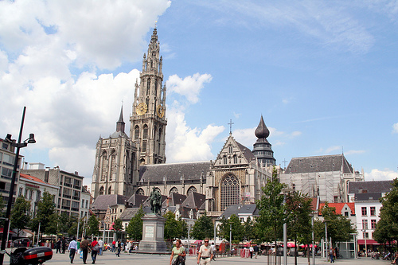
General Patton
If Hitler had captured Antwerp, it could have cost 200,000 American lives, and resulted in a negotiated surrender. As it was, there were 81,000 US casualties, with 18,000 dead.
Antwerp

Slide 92
General Patton
----Eisenhower told Patton to throw Germans out of their houses, and jobs, and install Jews. Paton refused and was demoted.
Back In America - The Jewish interests pushed the ‘Morgenthau plan’, which wanted Germans sterilized, their industries wrecked, and the country divided into three parts.
Henry Morgenthau

Slide 93
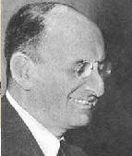
General Patton
Patton despised Jews, and would have blocked the creation of Israel.
There was a movement, ‘America First’ that was looking for a candidate, and there were others.
Henry Morgenthau

Slide 94
General Patton
Neuschwanstein Castle Bavaria
Patton Fought Eisenhower Over Denazification
He was the military governor of Bavaria, and used Nazis to run the country. He opposed Eisenhower's orders to push ordinary Germans out of their houses for Jews.

Slide 95
General Patton
It was common for Polish Jews to appear at an upper class German house and expect Patton's soldiers to remove the tenant Germans.
Patton saw the Jews as instigators of WW2, non-combatants who refused to serve, and jackals who preyed on Germany's corpse.
In late 1945 Eisenhower removed him from command of the Third Army and transferred him to the Fifteenth Army.
General Patton

Slide 96
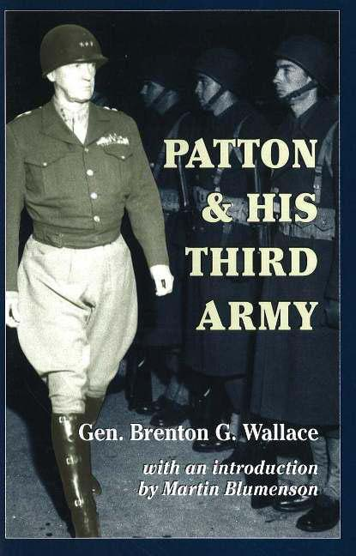
General Patton
Patton saw the Jews as instigators of WW2, non-combatants who refused to serve, and jackals who preyed on Germany's corpse.
In late 1945 Eisenhower removed him from command of the Third Army and transferred him to the Fifteenth Army.

Slide 97
General Patton
Eisenhower wasn’t liked as can be seen from these election posters

Slide 98
General Patton
There was widespread talk at home of Patton for President. This was bad news for the Democrats, because they had no comparable opponent. It was not good news for the Republicans though, ….

Slide 99
General Patton
… because Patton was considered too stubborn and iron-willed to take orders from Wall Street and professional politicians. Thus, many factions viewed Patton as a threat.

Slide 100
General Patton
The Main Suspect
Patton died of heart failure. Most feel his murder was orchestrated by Roosevelt’s hand picked OSS agent, Patton's wife was so suspicious that she hired private investigators.
Roosevelt’s OSS Agent

Slide 101
General Patton
Who Are The Suspects In The Death of General Patton? The Russians were in great dread of Patton, wondering whether he would continue to wage war and cross through their lines. They remained on "alert status" until his death.

Slide 102
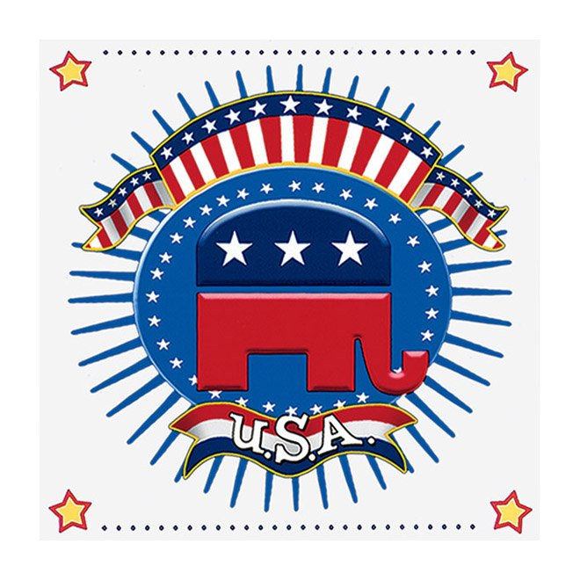
General Patton
Patton wrote to his wife and others that when he returned to the US he was planning to retire from the Army and try his hand a politics as a Republican.

Slide 103
General Patton
No doubt he would have reported the Russian kidnapping of 25,000 American troops, and would have taken action. The full story of these lost men only started to emerge in the 1970s, and has been documented since the fall of the USSR.

Slide 104
General Patton
A year later Patton's wife Beatrice died one week after announcing she would release hundreds of Patton's personal papers regarding the war. An accomplished rider, she reportedly fell from her horse and died of a broken neck. Patton remains buried in Germany. The remains of this American hero were never brought to the US, and no autopsy was ever performed.
Home of the Pattons in Idaho

Slide 105
General Patton
Patton said to a malinger - " You are going to the front lines - you 'Yellow belly Jew' "
When President Truman ordered Eisenhower to improve treatment of the DPs, a furious Patton wrote in his diary: "Harrison and his ilk believe that the displaced person is a human being, which he is not, and this applies particularly to the Jews, who are lower than animals."
General Patton

Slide 106
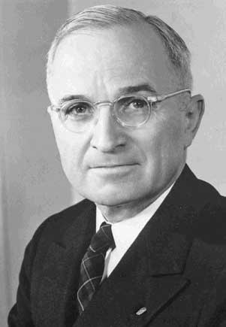
General Patton
When President Truman (Left) ordered Eisenhower to improve treatment of the DPs, a furious Patton wrote in his diary: "Harrison and his ilk believe that the displaced person is a human being, which he is not, and this applies particularly to the Jews, who are lower than animals.“

Slide 107
General Patton
The Mysterious Death:
Patton was seriouly injured on December 9th, 1945. He was riding in a jeep when it was apparently struck by another Army vehicle. Details of the driver of the large truck that hit Patton were never disclosed. Patton did survive the crash.
US Army Truck

Slide 108
General Patton
On the way to the hospital, Patton's vehicle was then struck again by another two-ton Army truck. This time he was injured much more seriously, but still clung to life. Neither of these two truck drivers were arrested or even had their names disclosed.
General Patton’s Staff Car

Slide 109
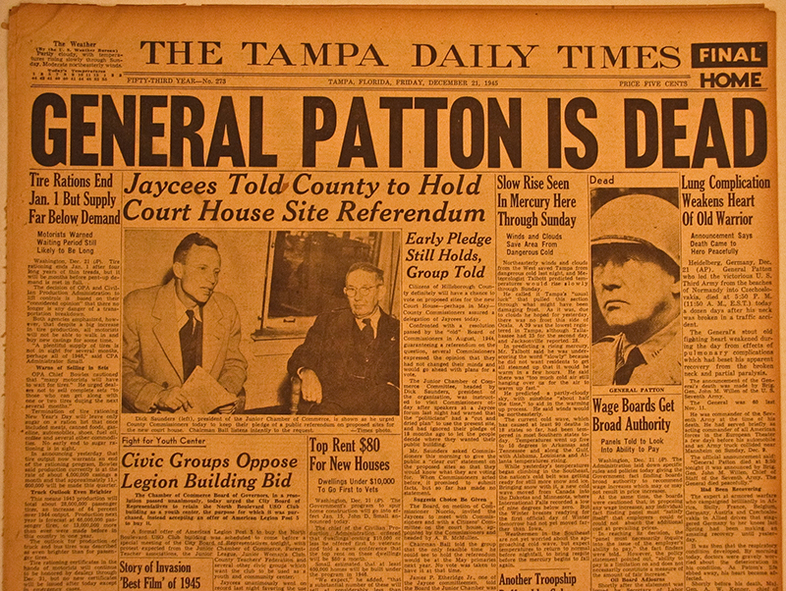
General Patton
In June 1998, an elderly veteran came forward and claimed that he had witnessed the second accident The old soldier recalled that after the vehicles collided, Patton stumbled out. When the truck driver saw Patton still alive, he struck him several times with a 2 foot long pipe wrench.

Slide 110
General Patton
The cause of death is officially listed in Army medical records as embolism and heart failure. Reportedly, he asked his wife to remove him from the hospital because "They're going to kill me here".
Chief suspect - Bill Donovan - Crypto Jew - Goes from a NY lawyer to a 3 star General
Bill Donovan

Slide 111
General Patton
Donovan was a New Yorker, he went to Columbia Law, was a classmate of Roosevelt, became a NY lawyer. In 1939 Roosevelt uses him for special assignments, in 1941 he becomes head of the OSS, where he works hand in hand with Jewish Communist / Partisans. In 1946 he joins the Jewish prosecutors at Nuremberg.
General W. Donovan

Slide 112
General Patton
Militant Zionists: Although nowadays we see the Israelis most often as victims of terrorism, there were Israeli terrorists in those days who agitated for a homeland. Patton was in 1945 their most powerful enemy in the Allied camp, by virtue of the respect he had in the US and abroad.

Slide 113
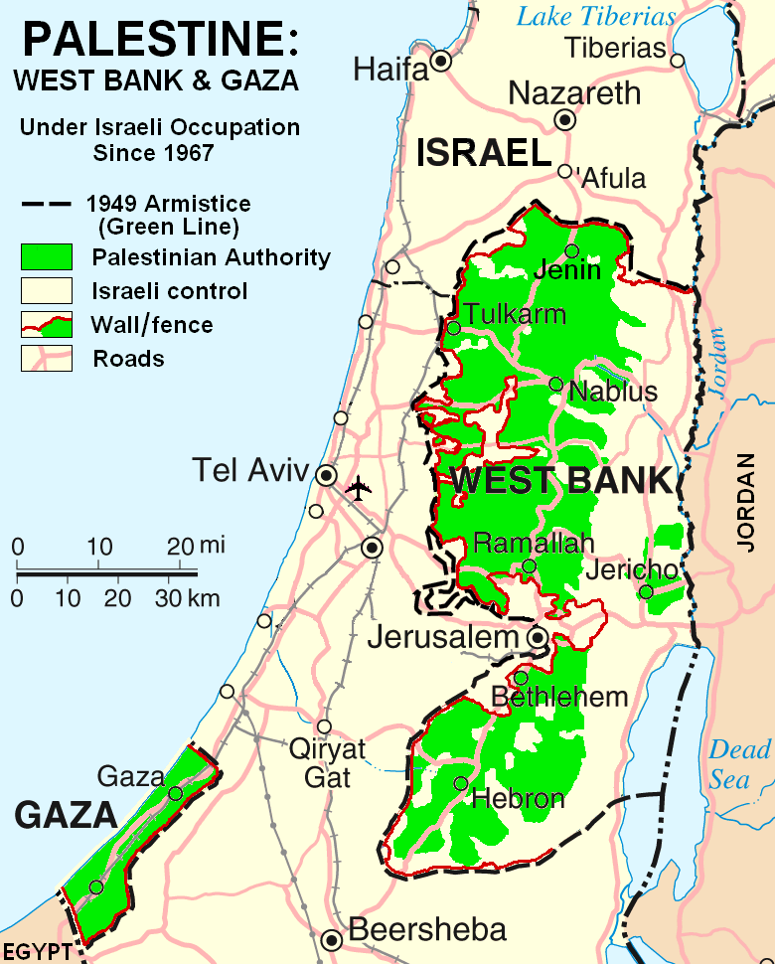
General Patton
The Jewish people had faced horrible atrocities in the war, and claimed to be a nation without a homeland. Patton argued that the Jewish people hadn't been a country for two thousand years and were no longer a nationality, but a religion. This view was extremely unpopular in Washington as well.

Slide 114
General Patton
Patton wasn't just a soldier, he was an actor, and a political candidate. He saw himself as the ancient Roman conquering hero, another Caesar.
Patton detested Eisenhower, he saw the Soviets as the real enemy, and would have entered the race. Maybe a Patton-Lindberg ticket, backed by Henry Ford's crowd.

Slide 115
France In WW2
France was a very safe place in WW2
German troops entering Paris

Slide 116
Headquarters of Paris SS - 1942

Slide 117
Did Smart Jews Just Move South To Unoccupied France ?

Slide 118
French Jews in WW2
During the German occupation there were approximately 390,000 Jews in France. Approximately 75,000 Jews were killed. (According to Jewish folk tales).
The Truth
Out of 390,000 Jews in France maybe 40,000 died – some in fighting but the majority to old age and natural causes.

Slide 119
France In WW2
He drove around in an open car with no escort

Slide 120
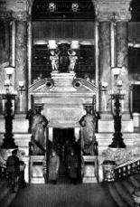
France In WW2
One day after France signed an armistice with Germany in June 1940, Adolf Hitler celebrated the German victory over France with a tour of Paris.
Hitler at the Paris Art Gallery

Slide 121
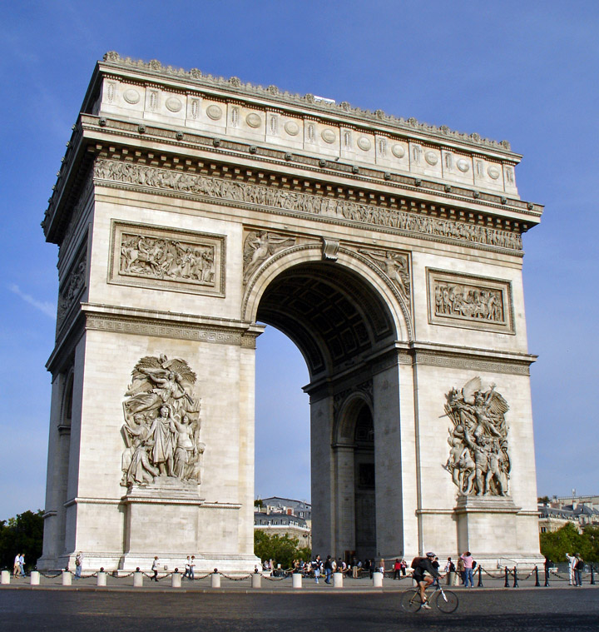
France In WW2
Here, Hitler arrived by train and his tour included the Paris opera, the Champs-Elysees, the Arc de Triomphe, and the Eiffel Tower. After visiting Napoleon's tomb and the Sacre Coeur, Hitler left Paris
Arc de Triomphe

Slide 122
The German Army Was Welcomed

Slide 123
Resistance Is Jewish/Hollywood Fairy Tale
The claim that thousands of Parisians were members of the anti-Nazi "Resistance is an aspect of the Second World War that has come under increasing scrutiny in recent years.
As British historian David Pryce-Jones explains in his study of Paris in the Third Reich, there was little actual resistance activity in the French capital.
Indeed, during the German occupation life in Paris went on much as it had before the war.

Slide 124
Resistance Is Jewish/Hollywood Fairy Tale
As British historian David Pryce-Jones explains in his study of Paris in the Third Reich, there was little actual resistance activity in the French capital.
Indeed, during the German occupation life in Paris went on much as it had before the war.
David Pryce-Jones

Slide 125
Resistance Is Jewish/Hollywood Fairy Tale
Germany occupied France so Britain couldn't launch an invasion from there.

Slide 126
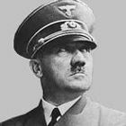
France In WW2
The French mass circulation weekly L'Illustration described the German soldiers as "handsome boys, decent, helpful, above all correct."
Hitler even cancelled a huge victory parade that had been planned by the military, so as not to alienate the Parisians.
Adolph Hitler

Slide 127
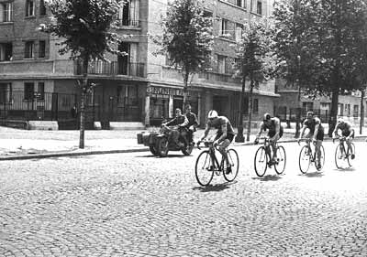
France In WW2
Within a few days after the onset of the German occupation, the schools, restaurants, theatres, trains, newspapers, and other public services were back in operation on a near-normal basis. The Paris police, who outnumbered the Germans, remained on duty throughout the occupation
Paris during the occupation

Slide 128
France In WW2
The Paris police, who outnumbered the Germans, remained on duty throughout the occupation

Slide 129
The French Jews Were Never Touched
Parisians getting permits to work for the Wehrmacht
The next logical step is what is the truth on the Jewish French Underground? Does anyone believe a Parisian Jew is going to run around blowing up Nazis in French restaurants? The Jews existed hand in hand with Germans on a daily basis.

Slide 130
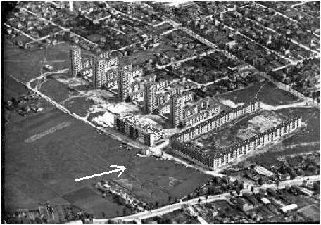
Only 60 yrs later did Jews discover death camps in Paris
The U-shaped building was a camp! Where are the fences and guard towers?

Slide 131
Death Camps in Paris
The making of a ‘Holocaust theme park’ Take a cute city outside of Paris – build some statues and park a railway car and ‘Wa Laa’ your can start building your dream.

Slide 132
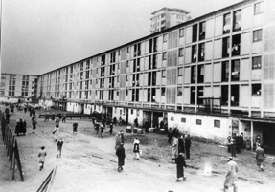
Death Camps in Paris
Drancy, according to the Jewish legends. served as a transit camp for French Jews arrested by the French Police and German occupation forces. The principal departure point for Auschwitz where 77,000 French Jews were deported, including 11,204 children and they were all gassed.
Drancy - France

Slide 133
Death Camps in Paris
The French Apologise for the silence about the Jews and erect a Holocaust memorial on the alleged site of the concentration camp

Slide 134
Death Camps in Paris
The truth
This was a low income housing area which has been owned Groupe Grisel Immobilier (Jewish family).

Slide 135
Death Camps in Paris
There wasn't a RR track within 5 miles 75,000 Jews were shipped from here ??

Slide 136
Gog’s Holocaust Conundrum
Jews claim 6 Million Jews perished as a result of WWII. Therefore, World‑wide Jewish population should be 2‑3,000,000+, given the previous "loss" of 6MM in 1919. The Jews supposedly had 16.5 in 1945, so ‑ ignoring their 1919 claim of 6MM losses, but

Slide 137
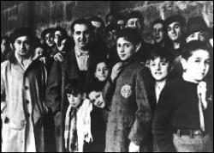
Gog’s Holocaust Conundrum
…. considering their claim of a loss of 6MM; the remainder being 10MM, they would have had to experience a live‑birth growth rate of 23% yearly to get to 16.5MM in 1945.
Drancy Jews

Slide 138
Gog’s HoloHoax
This Plaque Says About 1½ Million Died!

Slide 139
Gog’s HoloHoax
This Plaque Says About 4 Million Died!

Slide 140
Gog’s HoloHoax
Because of increasing evidence that the official facts regarding the so-called Jewish holocaust are lies – it is now a crime to dispute these facts in many countries such as Canada and Germany
Lies not truth needs to be protected by draconian laws!

Slide 141
Gog’s HoloHoax
Bruno Gollnisch Germar Rudolf Ernst Zündel
David Irving Siegried Verbeke
The above most prominent modern day heretics are blackened by the heretical Jewish magazine FORWARD
All the above have been or are in Jail for disputing the facts about the Holocaust – If the holocaust were true why is it a crime to dispute the facts?

Slide 142
The Name Changers
The portraits at left are of the same man but in two different incarnations. On the far left we see Martin "Gray" in retirement after a successful career peddling fake antiques to gullible collectors. He is holding
his mass market paperback For Those I Loved, which is filled with his exploits as a saintly "Holocaust Survivor"

Slide 143
The Name Changers
The earlier portrait is of the youthful Gray as a highly-decorated officer in the Soviet NKVD (the savage forerunner of the KGB, responsible for the murder of millions of Christians in Russia and Eastern
Europe). Even Establishment researchers have had to admit that Gray's book is as phoney as the antiques he peddled.
Notes:
The portraits at left are of the same man but in two different incarnations. On the far left we see Martin "Gray" in retirement after a successful career peddling fake antiques to gullible collectors. He is holding his mass market paperback, For Those I Loved, which is filled with his exploits as a saintly "Holocaust Survivor" who was supposedly forced to help clear bodies out of the Treblinka "gas chamber." The earlier portrait is of the youthful Gray as a highly-decorated officer in the Soviet NKVD (the savage forerunner of the KGB, responsible for the murder of millions of Christians in Russia and Eastern Europe). Even Establishment researchers have had to admit that Gray's book is as phony as the antiques he peddled. But Gray's scam is symbolic of countless other Communist ghouls who have managed to land on their feet in the West, disguised as poor, persecuted "Survivors of the Holocaust" and feted as the saints and martyrs of the universe. Meanwhile the holocaust they perpetrated against millions of Christians slips further down the dark environs of Orwell's memory hole.
(In chapter 13 of Charles Dickens' Oliver Twist, Dickens notes that the Jew Fagin has an inexhaustible supply of props and disguises.)

Slide 144
The Name Changers
But Gray's scam is symbolic of countless other Communist ghouls who have managed to land on their feet in the West, disguised as poor, persecuted "Survivors of the Holocaust" and feted as the saints and martyrs of the universe.
Notes:
The portraits at left are of the same man but in two different incarnations. On the far left we see Martin "Gray" in retirement after a successful career peddling fake antiques to gullible collectors. He is holding his mass market paperback, For Those I Loved, which is filled with his exploits as a saintly "Holocaust Survivor" who was supposedly forced to help clear bodies out of the Treblinka "gas chamber." The earlier portrait is of the youthful Gray as a highly-decorated officer in the Soviet NKVD (the savage forerunner of the KGB, responsible for the murder of millions of Christians in Russia and Eastern Europe). Even Establishment researchers have had to admit that Gray's book is as phony as the antiques he peddled. But Gray's scam is symbolic of countless other Communist ghouls who have managed to land on their feet in the West, disguised as poor, persecuted "Survivors of the Holocaust" and feted as the saints and martyrs of the universe. Meanwhile the holocaust they perpetrated against millions of Christians slips further down the dark environs of Orwell's memory hole.
(In chapter 13 of Charles Dickens' Oliver Twist, Dickens notes that the Jew Fagin has an inexhaustible supply of props and disguises.)

Slide 145
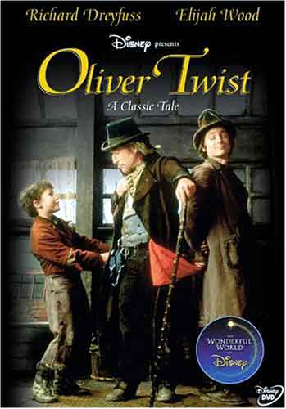
The Name Changers
Meanwhile the holocaust they perpetrated against millions of Christians slips further down the dark environs of Orwell's memory hole. (In chapter 13 of Charles Dickens' Oliver Twist, Dickens notes that the Jew Fagin has an inexhaustible supply of props and disguises.)

Slide 146
GOG – Destroys Dresden Another Christian Stronghold Obliterated
250,000 defenceless German women & children killed through saturation bombing – even though it was no threat to the Allies

Slide 147
Dresden
Dresden was a protestant city and a city of refuge for those displaced by bombing and advancing allies.
Dresden as it used to be – but all would change on 13th Feb. 1945 when the allies (Gog) carpet bombed the city even though the Germans were in retreat and Dresden had no military targets not even anti-aircraft guns.

Slide 148
Another view of the beautiful city of Dresden

Slide 149
Dresden 1945
Dresden after that fateful day
Following orders given by President Roosevelt, Churchill and Eisenhower

Slide 150
Dresden 1945
Even those in underground shelters did not escape because all available oxygen was consumed by the fire

Slide 151
Bodies Recovered From An Underground Shelter
This photo of dead Germans was used by Gog as depicting dead Jews to perpetuate the Holocaust myth.

Slide 152
Gog Attacks Hamburg’s Civilian Population
The Battle of Hamburg. A thermal column of wind generated heat in excess of 1,400 degrees Fahrenheit, melting trolley windows and the asphalt in streets, the wind uprooting trees. When people crossed a street, their feet stuck in the melted asphalt; they tried to extricate themselves with their hands, only to find them stuck as well.
Hamburg

Slide 153
Gog Attacks Hamburg’s Civilian Population
They remained on all fours screaming. Small children lay like "fried eels" on the pavement. The firestorm sucked all the oxygen out of the city; a 15 year-old girl said that the brains of people in shelters "tumbled from their burst temples and their insides [extruded] from the soft parts under the ribs."
Hamburg
Aftermath of Hamburg bombing July 1943

Slide 154
World War 2 D-Day Landing
The D-Day toll was a lot higher than it should have been because of infighting between the Generals

Slide 155
The Federal Republic of Germany is illegal
It does not exist in real constitutional terms. It isn't even recognised by international institutions as the legitimate nation state of Germany.
On 5 June 1945, the Supreme Headquarters Allied Expeditionary Force (SHAEF) accepted Germany's declaration of defeat and quickly moved to recognise the legitimacy of the Zweite Deutsche Reich (Second German Reich), which had been illegally displaced by Hitler's Third Reich.

Slide 156
WW2 – German Surrender
On 31 July 1973, the Bundesverfassungsgericht (Federal Constitutional Court) was forced to concede the following ruling in regard to an upcoming treaty between the BRD and the communist DDR: "It remains the case that the German Reich survived the collapse of 1945 and did not cease to exist, neither through capitulation nor the exercise of foreign power in
Germany on the part of the allies; it possesses today, as it always has, legal and judicial sovereignty, although as a State it is lacking in organisation. The BRD is not the legal successor of the German Reich."
Notes:
File 16543
On 31 July 1973, the Bundesverfassungsgericht (Federal Constitutional Court) was forced to concede the following ruling in regard to an upcoming treaty between the BRD and the communist DDR: "It remains the case that the German Reich survived the collapse of 1945 and did not cease to exist, neither through capitulation nor the exercise of foreign power in Germany on the part of the allies; it possesses today, as it always has, legal and judicial sovereignty, although as a State it is lacking in organisation. The BRD is not the legal successor of the German Reich."

Slide 157
Partitioning Of Germany
The BRD was assigned to the Western block

Slide 158
Partitioning Of Germany
The DDR was assigned to the Communist Eastern block

Slide 159
German Reunification
On the unification of the 2 Germanys --- The BDR (Bundes Republic Deutschlands) and The DDR (Deutsche Democratic Republic) – BDR seized control of the Reichstag.
THE BRD IS NOT THE LEGAL SUCCESSOR OF THE GERMAN REICH.

Slide 161
The Zweite Reich Exists
Although not as well organised as the BDR, The Zweite Reich does issue Passports and driving licences.
The legitimate Chancellor Dr Wolfgang Gerhard Guenter Ebel.

Slide 162
Unlawful Occupation of The Reichstag
The former governments of the BDR & DDR were Gog’s occupied territory administrations – not the Government of the German people – The administration of the Zweite Reich should now be occupying the Reichstag

Slide 163
Supreme Headquarters Allied Expeditionary Force (SHAEF)
The SHAEF laws underpinned a treaty between the occupation authorities and the Second German Reich, in which the latter was invested with full administrative rights and governmental sovereignty throughout most of Berlin and in all of the German states.

Slide 164
Federal Republic of Germany (BRD),
A parallel state, founded by ambitious lawyers and Zionist activists and still known as the Federal Republic of Germany (BRD), competed with the Second German Reich for legitimacy but officially lost its right to grant citizenship and issue passports in 1954, just as was the case with East Germany (DDR) thirty-six years later. Technically, any German with a passport issued by the BRD is now stateless: around 70 million of them.

Slide 165
Gog’s monument to world control – built on Land donated by Nelson D. Rockefeller.
The United Nations’ Building
Gog’s WW2 victory monument to implement global control

Slide 166
Gog & Magog – Gathering the Nations From The Whole Earth
The map of the world represents the gathering of the nations
The 2 surrounding Olive Branches represent the two Houses of Israel
Rev. 20, 8: And shall go out to deceive the nations which are in the four quarters of the earth, Gog and Magog, to gather them together to battle the number of whom is as the sand of the sea (Israel).
Notes:
Heinrich von Neustadt, around 1300, wrote of them as the "terrifying people of Gog and Magog." 18

Slide 167
Gog’s Wars
"Even if we Jews are not bodily with you in the trenches, we are nevertheless morally with you. This is OUR WAR, and you are fighting it for us." (Les Nouvelles Litteraires, February 10, 1940)

Slide 168
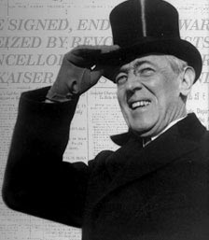
A Thought To Leave You With
Some of the biggest men in the U.S., in the field of commerce and manufacturing, are afraid of something. They know that there is a power somewhere so organized, so subtle, so watchful, so interlocked, so complete, so pervasive, that they had better not speak above their breath when they speak in condemnation of it." The New Freedom. Woodrow Wilson, 1913
Woodrow Wilson (1913-1921)

Slide 169
The Story Of Gog And Magog
The End Of Part Six
To be continued ………WW3 – The Secret War

