Slide 1
The Story Of Gog And Magog
Part Six
The Dresden Holocaust
Appendix One

Slide 2
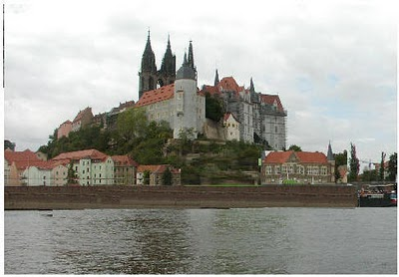
The Dresden Holocaust
International Jewry ordered Eisenhower, and Churchill, to firebomb Dresden, where at least 500,000 died

Slide 3
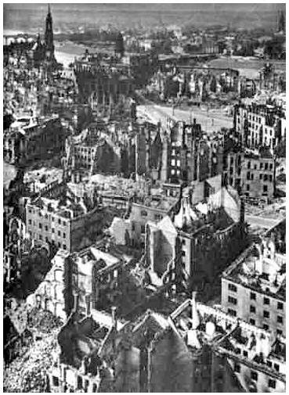
The Dresden Holocaust
Dresden, After Churchill And Roosevelt Ordered The Fire Bombing

Slide 4
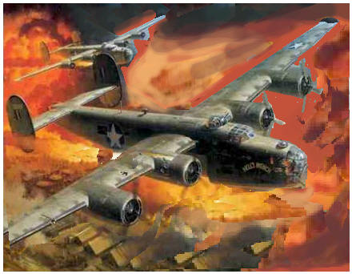
The Dresden Holocaust
The Allied Raid on Dresden - February 13, 1945

Slide 5
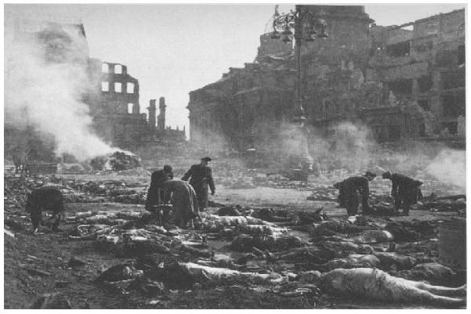
The Dresden Holocaust
At Least 500,000 Dead In An Act Of Jewish Savagery

Slide 6
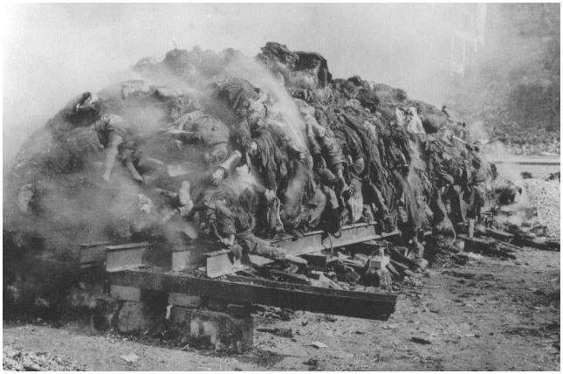
The Dresden Holocaust
Victims Were Cremated 500 At A Time On The Altmark square - Most were just ash or turned to mush

Slide 7
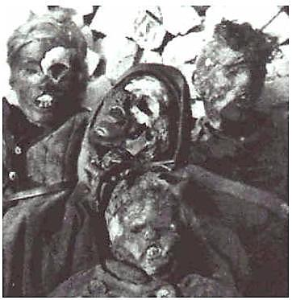
The Dresden Holocaust
Entire Families Cremated

Slide 8
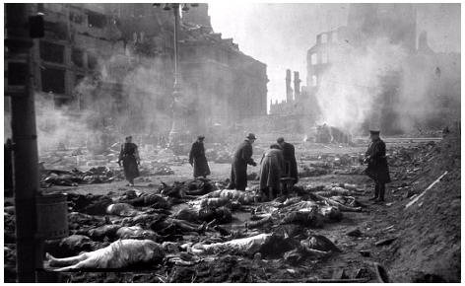
The Dresden Holocaust
There Were Bodies In The Streets, Apartments, And Bomb Shelters

Slide 9
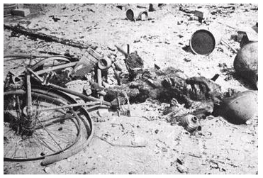
The Dresden Holocaust
No One Escaped

Slide 10
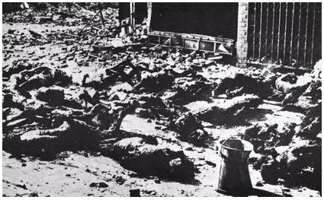
The Dresden Holocaust
Jewish Savagery

Slide 11
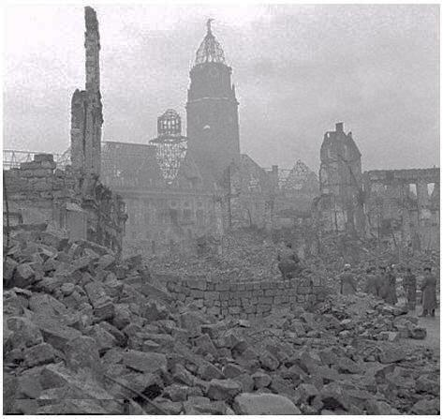
The Dresden Holocaust
Germany's Premier Cultural Center Destroyed

Slide 12
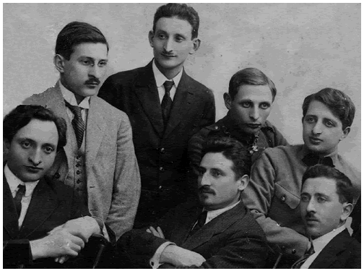
The Dresden Holocaust
The Warsaw Ghetto Is Said To Be The Reason For The Raid
Above: Alleged Jewish Instigators Dragged Out Of The Ghetto And Forced To Work In War Factories

Slide 13
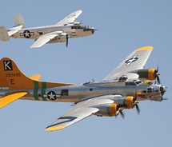
The Dresden Holocaust
Greatest Single Act Of Barbarism In History. The only true Holocaust, death by fire, is the unforgivable and militarily completely unnecessary raid on Dresden. The blood was, at least partly, on Britain's hands..

Slide 14
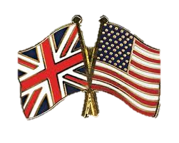
The Dresden Holocaust
The Dresden Holocaust was committed not by the awful Germans, nor even by brutal Reds, but by the so-called democratic, freedom-loving allies, Britain and the USA.

Slide 15
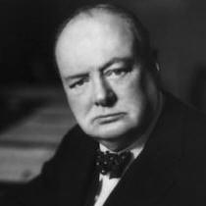
The Dresden Holocaust
One of the instigators of the Dresden Holocaust - Churchill was a Jew, his mother was Jewish.

Slide 16
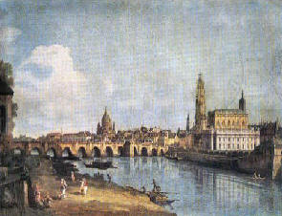
The Dresden Holocaust
Over sixty years ago, on the evening of February 13, 1945, an orgy of genocide and barbarism began against a defenceless German city, famed as one of the greatest cultural centres of Europe.
Dresden - One Of The Greatest Cultural Centers Of Europe

Slide 17
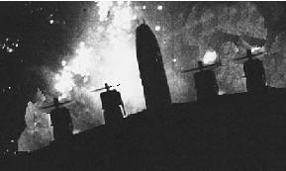
The Dresden Holocaust
Within less than 14 hours, not only was this city reduced to flaming ruins but an estimated quarter of its inhabitants, estimates range from 125,000 up to 300,000, had perished in what was one of the worst massacres of all time.
14 Hours Of Terror

Slide 18
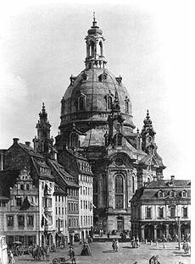
The Dresden Holocaust
Dresden Was Considered An Open City
Toward the end of World War II, as Allied planes rained death and destruction over Germany, the old Saxon city of Dresden lay like an island of tranquility amid an ocean of desolation.

Slide 19
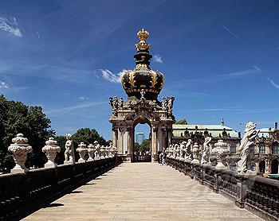
The Dresden Holocaust
Famous mainly for its art and Baroque architecture and possessing no military value, Dresden had been spared the terror that descended from the skies over the rest of the country.
The Crown Gate Dresden

Slide 20
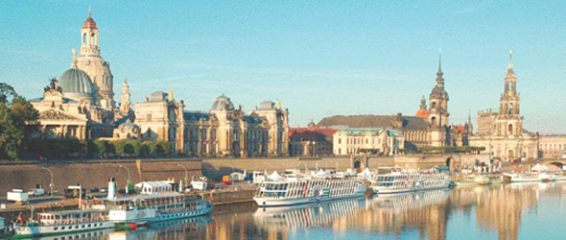
The Dresden Holocaust
The ancient city of artists and craftsmen didn't have any anti-aircraft defences. A gentleman's agreement seemed to prevail, designating Dresden an 'open city'

Slide 21
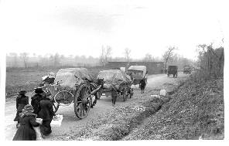
The Dresden Holocaust
Germans Fleeing as Stalin's Bolsheviks Flooded Dresden
For months the flood of refugees fleeing the Red Army, just 60 miles away, had swollen the city's population to well over a million. With them came accounts of Soviet horrors and atrocities, but Dresden topped it all.

Slide 22
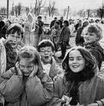
The Dresden Holocaust
Children Were At A Circus Just Hours Before

Slide 23
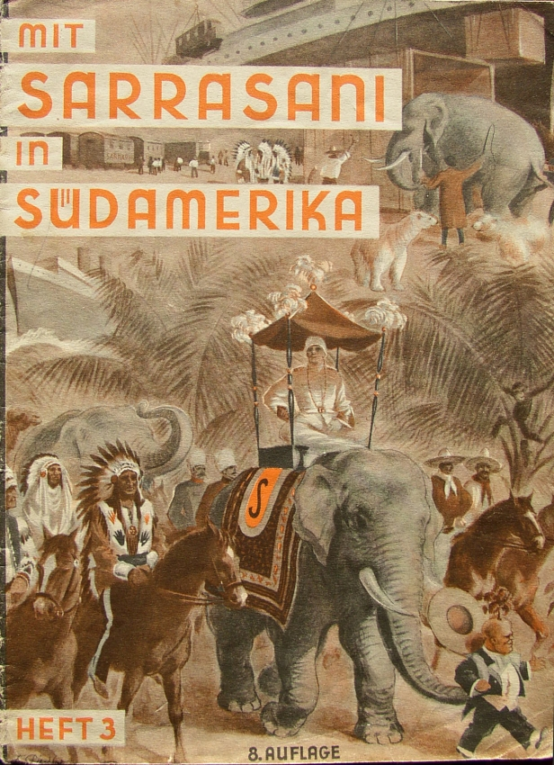
The Dresden Holocaust
However, the people felt relatively safe; and although the mood was grim, the circus played to a full house that night as thousands came to forget for a moment the horrors of war.

Slide 24
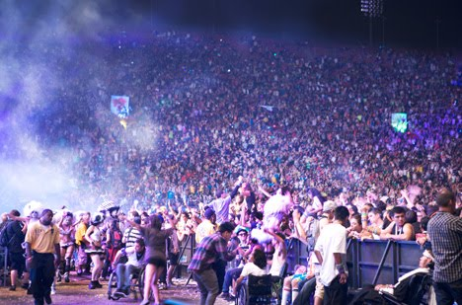
The Dresden Holocaust
Bands of little girls paraded about in carnival dress in an effort to bolster waning spirits. Half-sad smiles greeted the laughing girls, but spirits were lifted.

Slide 25
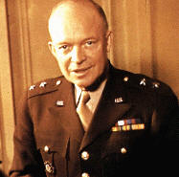
The Dresden Holocaust
No one realized that in less than 24 hours many of those same innocent children would die screaming in Churchill's firestorm.
Eisenhower Had Jewish Blood

Slide 26
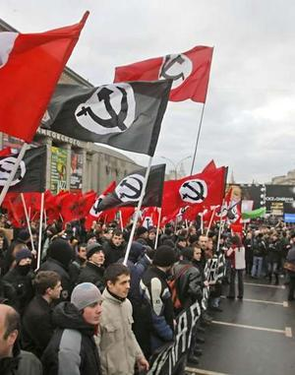
The Dresden Holocaust
Everyone knew the Russian Bolsheviks were savages, but they felt that Britain and America were civilized. If they had considered that Eisenhower, Churchill, and Roosevelt had Jewish blood, they would see the terrible revenge coming

Slide 27
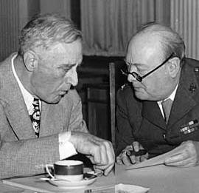
The Dresden Holocaust
So, when those first alarms signalled the start of 14 hours of hell, Dresden's people streamed dutifully into their shelters. But they did so without much enthusiasm, believing the alarms to be false, since their city had never been threatened from the air.
Roosevelt Wanted Dresden Obliterated

Slide 28
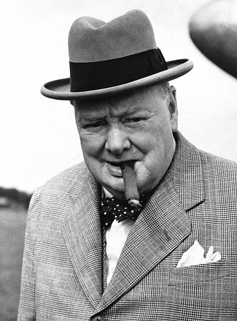
The Dresden Holocaust
Political Motives What where Churchill's motives? They appear to have been political rather than military. Historians unanimously agree that Dresden had no military value whatsoever.

Slide 29
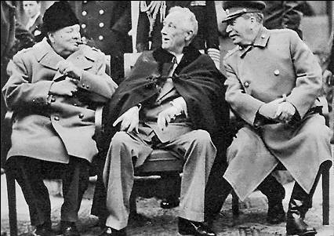
The Dresden Holocaust
What industry it did have produced only cigarettes and china. But the Yalta Conference was coming up, in which the Soviets and their Western allies would sit down like ghouls to carve up the shattered corpse of Europe.

Slide 30
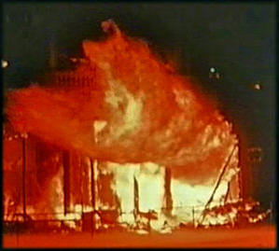
The Dresden Holocaust
Dresden's citizens barely had time to reach their shelters. The first bomb fell at 10:09 pm. The attack lasted 24 minutes, leaving the inner city a raging sea of fire.
The Firestorm

Slide 31
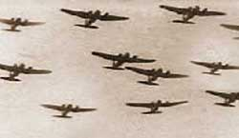
The Dresden Holocaust
Precision saturation bombing had created the desired firestorm. A firestorm is caused when hundreds of smaller fires join in one vast conflagration

Slide 32
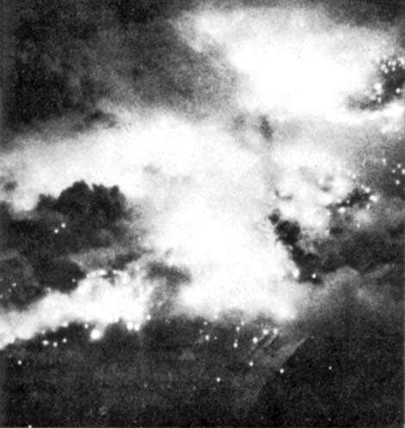
The Dresden Holocaust
Tornado-Like Winds
Huge masses of air are sucked in to feed the inferno, causing an artificial tornado.

Slide 33
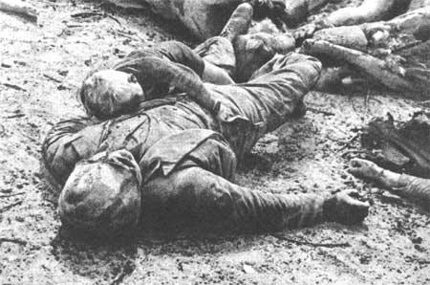
The Dresden Holocaust
Those persons unlucky enough to be caught in the rush of wind are hurled down entire streets into the flames.

Slide 34
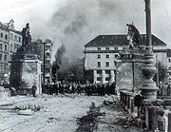
The Dresden Holocaust
Those who seek refuge underground often suffocate, as oxygen is pulled from the air to feed the blaze, or they perish in a blast of white heat - heat intense enough to melt human flesh.

Slide 35
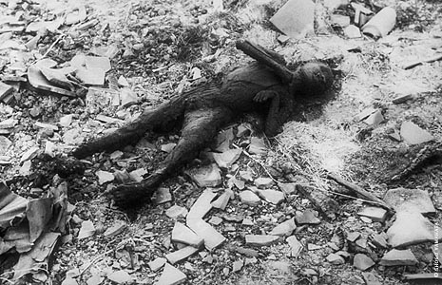
The Dresden Holocaust
Cut Down In The Streets One eyewitness who survived told of seeing "young women carrying babies running up and down the streets, their dresses and hair on fire, screaming until they fell down, or the collapsing buildings fell on top of them."

Slide 36
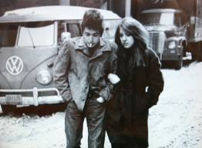
The Dresden Holocaust
The Pause There was a three-hour pause between the first and second raids. The lull had been calculated to lure civilians from their shelters into the open again. To escape the flames, tens of thousands of civilians had crowded into the Grosser Garten,

Slide 37
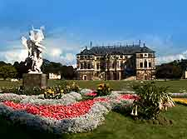
The Dresden Holocaust
….. a magnificent park nearly one and a half miles square. The second raid came at 1:22 a.m., with no warning. Twice as many bombers returned, with a massive load of incendiary bombs. The second wave was designed to spread the raging firestorm into the Grosser Garten.
The Grosser Garten.

Slide 38
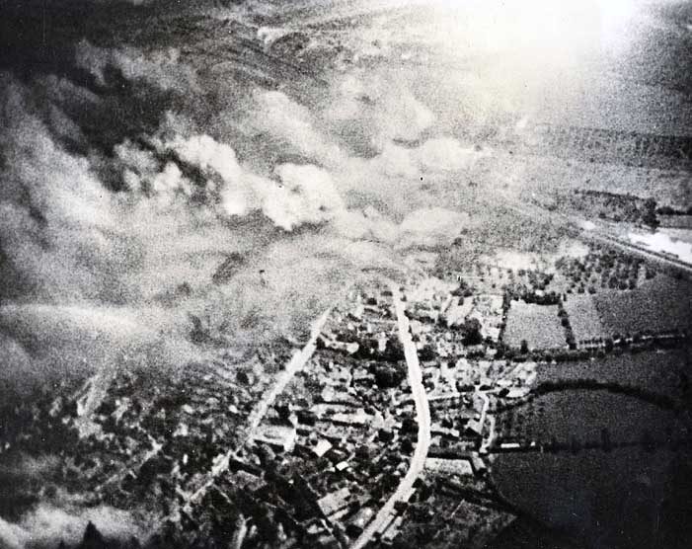
The Dresden Holocaust
It was a complete 'success'. Within a few minutes, a sheet of flame ripped across the grass, uprooting trees and littering the branches of others with everything from bicycles to human limbs
150 MPH Winds

Slide 39
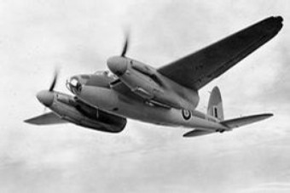
The Dresden Holocaust
At the start of the second air assault, many were still huddled in tunnels and cellars, waiting for the fires of the first attack to die down.

Slide 40
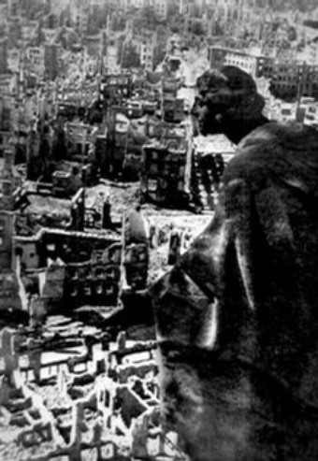
The Dresden Holocaust
At 1:30 am an ominous rumble reached the ears of the commander of a Labour Service convoy sent into the city on a rescue mission.
He described it this way:

Slide 41
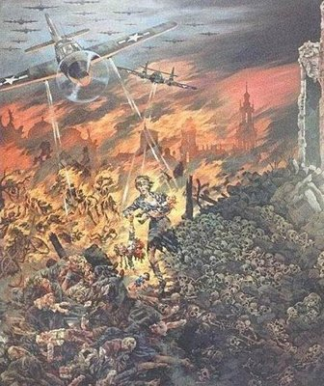
The Dresden Holocaust
"The detonation shook the cellar walls. The sound of the explosions mingled with a new, stranger sound which seemed to come closer and closer, the sound of a thundering waterfall; it was the sound of the mighty tornado howling in the inner city.

Slide 42
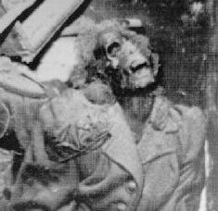
The Dresden Holocaust
Others, hiding below ground, died. But they died painlessly. They simply glowed bright orange and blue in the darkness. As the heat intensified, they either disintegrated into cinders or melted into a thick liquid often three or four feet deep in spot
Melting Human Flesh

Slide 43
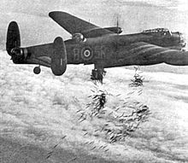
The Dresden Holocaust
On February 14th, the Americans flew the last raid swept over the city. Their bombers pounded the rubble that had been Dresden for a steady 38 minutes with cold-blooded ruthlessness.

Slide 44
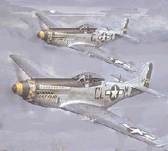
The Dresden Holocaust
US Mustangs appeared low over the city, strafing anything that moved, including a column of rescue vehicles rushing to the city to evacuate survivors. One strafing assault/massacre was aimed at the banks of the Elbe River, where refugees had huddled during the horrible night.
The Next Morning

Slide 45
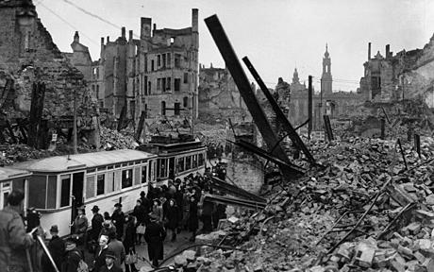
The Dresden Holocaust
Dresden had become a hospital town, and nurses brought the wounded to Elbe river. The low-flying Mustangs machine-gunned those helpless patients, as well as thousands of old men, women and children who had escaped the city inferno.

Slide 46
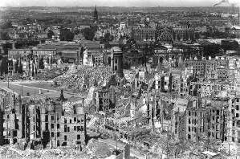
The Dresden Holocaust
At Least 500,000 Dead When the last plane left the sky, Dresden was a scorched ruin, its blackened streets filled with corpses.

Slide 47
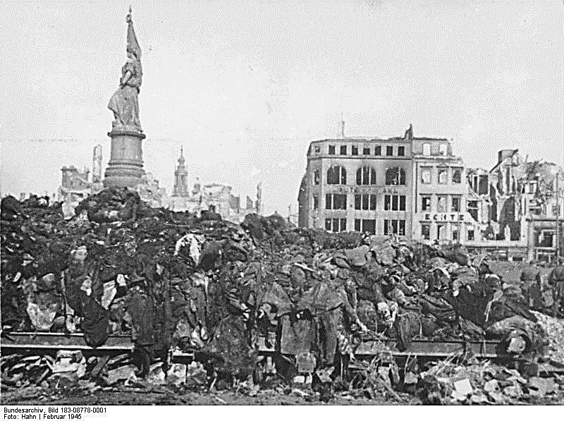
The Dresden Holocaust
A flock of vultures escaped from the zoo and fattened on the carnage. Rats swarmed over the piles of the dead.

Slide 48
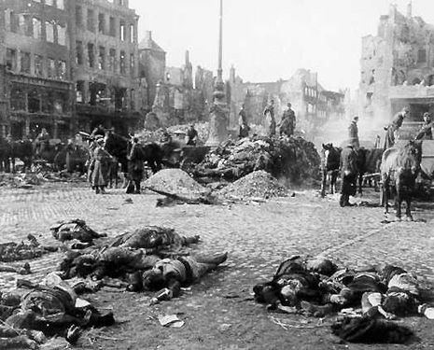
The Dresden Holocaust
A Swiss citizen described his visit to Dresden two weeks after the raid: "I could see torn-off arms and legs, mutilated torsos and heads which had been wrenched from their bodies and rolled away."

Slide 49
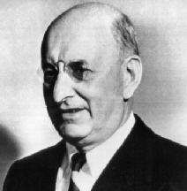
The Dresden Holocaust
Allied apologists compared Dresden to Coventry, where a mere 380 died.
Left Henry Morganthau, who hated Germany and one of the banking cartel who financed the war.
Henry Morgenthau a Zionist

Slide 50
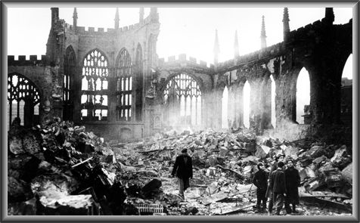
The Dresden Holocaust
Coventry was a centre of the motor and munitions industries and definitely a legitimate military target.

Slide 51
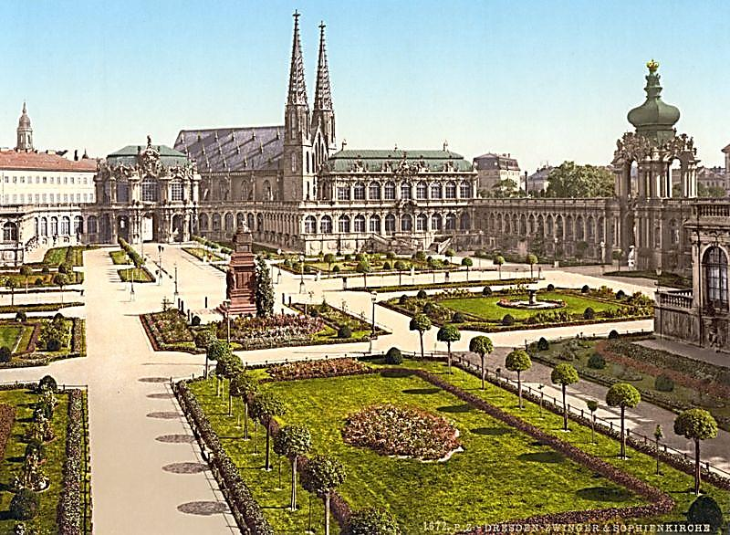
The Dresden Holocaust
Dresden, on the other hand, produced nothing in those categories. Dresden was the center of German culture, a culture Jews always have hated. This is the real reason for the destruction of Dresden.

Slide 52
The Dresden Holocaust
As a comparison with the London Blitz - which we all acknowledge was bad and did demonstrate the bravery of the people of London

Slide 53
The Dresden Holocaust
…… it should still be considered in the light of the destruction visited upon Dresden. In just one night, 16,000 acres of land were destroyed in the Dresden massacre, whereas London escaped with damage to only 600 acres during the entire war.
London

Slide 54
The Dresden Holocaust
Hollywood Won't Touch This Subject If ever there was a war crime, then certainly the Dresden Holocaust ranks as one of the most sordid of all time.
Spielberg – Hollywood Jew

Slide 55
The Dresden Holocaust
Yet there are no movies made today condemning this fiendish slaughter; nor did any Allied airman - or Sir Winston - sit in the dock at Nuremberg.

Slide 56
The Dresden Holocaust
The official story is that Churchill ordered the Dresden slaughter to appease Stalin. The cold-blooded sadism of the massacre, however, is brushed aside by Churchill's biographers, a madman who order a slaughter of many thousands of innocent civilians.
Who Ordered It?

Slide 57
The Dresden Holocaust
Jews started WWII, but sat it out in their comfy ghettos. When Hitler needed manpower for his armament machine, he dragged the Polish Jews out of their ghettos.
The Warsaw Ghetto Was The Reason

Slide 58
The Dresden Holocaust
It should be noted that years before the publication of Hitler's War, Irving had already raised the possibility that Jewish pressure had been one of the main factors behind the Allied decision to bomb and devastate German cities.
The War Didn't Effect Their Ghettos

Slide 59
The Dresden Holocaust
In 1961, during his research "into the causation of the bombing of Dresden," Irving (left) wrote provocative letters concerning alleged Jewish involvement in this operation to the curator of the Wiener Library.

Slide 60
The Dresden Holocaust
Wealthy Jews Sat Out The War In Their Country Estates They visited Paris, Switzerland, Italy or wherever the war wasn't.

Slide 61
The Dresden Holocaust
The Supposed 'Ghetto' The area comprised 35% of Warsaw, was no slum and actually featured rather high-priced shops.

Slide 62
The Dresden Holocaust
The War Didn't Include Them The Jewish population refused to serve in the Polish army and when Germans occupied Warsaw they participated in Fifth Column and Black Marketeering activities.

Slide 63
The Dresden Holocaust
Based on dubious German testimony, Irving requested confirmation of the claim that the World Jewish Congress had demanded the liquidation of Dresden in reprisal for the crushing of the Warsaw Ghetto uprising and the destruction of the ghetto
World Jewish Congress

Slide 64
The Dresden Holocaust
Actual Testimony February 13/14 1945: Dresden was a hospital city for wounded soldiers.

Slide 65
The Dresden Holocaust
Together with the 600.000 refugees from Breslau, Dresden was filled with nearly 1.2 million people. More than 700.000 phosphorus bombs were dropped on 1.2 million people.

Slide 66
The Dresden Holocaust
More than 700.000 phosphorus bombs were dropped on 1.2 million people. One bomb for every 2 people. The temperature in the centre of the city reached 1600 centigrade.
One of the bombers

Slide 67
The Dresden Holocaust
But those who perished in the centre of the city can't be traced, their ashes were gone with the winds of fire. Approximately 125.000 children, women, the elderly, wounded soldiers and the animals of the zoo were eradicated in only one night.

Slide 68
The Story Of Gog And Magog
A thought to leave you with
“Meddle not with those people called Jews; for no man ever touched them and prospered!” Frederick the Great
Howbeit no man spake openly of him for fear of the Jews. (John 7:13)

Slide 69
The Story Of Gog And Magog
The End Of Part Six – Appendix One
To be continued ………… The secret war – World War 3

