Slide 1
The Story Of Gog And Magog
Part Six
Gog’s World Wars 1 & 2 Chapter Two

Slide 2
The Story of Gog & Magog Will be covered in a series of 10 parts
Attila, The Rise of Islam and the Khazars
Genghis Khan, The Russians & the 3 frogs of Revelation
The Spanish Armada & Inquisition + the English revolution
The rise of the Rothschilds & the Armenian Holocaust
Satan bound for a 1000 years and French and American Revolutions
WW1 & WW2
WW3 – The secret war

Slide 3
The Story of Gog & Magog Will be covered in a series of 10 parts
Gog’s covert attack on western culture, education, legal system, health, art & education.
False flag operations
Conclusion

Slide 4
Gog – Recap Part One
1) Ezekiel 38:15 Had important Key Words and That This Key Verse Covered Most Of The AD Period to the present day.
2) Magog=Equals Mongol.
3) Gog = Khazar = Askenazim Jew
4) Gog’s Involvement With The Rise Of Islam.
5) Khazaria Original Homeland of 92% of today’s Jews
Notes:
Three world wars would enable the plan to work. The hammer would be constructed and then given a homeland, a secure base in Russia . It is what we call communism. The first anvil would be created out of economic chaos in Germany. It would be called National Socialism. That anvil would be destroyed in a Second World War, but another anvil would replace it called democracy. The first two world wars accomplished exactly what they were intended to accomplish. Out of the first world war came: (1) A secure Satanic dictatorship in Russia, a secure base to carry out further world subversion. (2) The Satanic family of Rothschilds gained partial control over Palestine, preparing the way for Satan to rule from Jerusalem some day (3) Weapons of mass destruction and terror. (4) The League of Nations.
Out of the second world war came
(1) The enlargement of their secure base in Russia into a world power. (2) complete control over Palestine by the Rothschilds. (3) airpower, including long range missiles, jets, secret flying saucers, and powerful submarines, all items that individuals could not produce . Those in control of production would therefore control all air and sea ways of the earth. (4) The cold war and an era of terror to convince the people of the need for Satan’s One World Order.(5) the United Nations.
Out of the third world war would emerge a new religious system . The third world war would have to be tailored to be like the Bible’s Armaggeddon, Satan told his highest slaves, because- if it resembled Armaggeddon, then the people would believe he was the Messiah when he came after its end . It would have to be terrible, so that he could step in and bring miraculous order out of a world beaten into chaos by the worst war in history. Again it would be “Order out of chaos”, as the Masonic documents repeatedly proclaim. The third world war would come during a period of seven years of tribulation starting in 1992 and running until 1999. Just like the Second World War emerged out of the great world-wide depression. Satan told his followers this 1992-99 tribulation would repeat on a larger scale the plagues of Egypt, for he would wreck revenge for what was done to Egypt by God (and Moses) by giving back in a bigger way to the world what happened to ancient Egypt . To a demonic controlled mind it makes sense to wreck such revenge, especially when the end result is held out to be the salvation of the world by the Lightbearer, the Morning Star, also known as Lucifer.

Slide 5
Gog of The Land of Magog
The Story of
Analysis of Ezekiel 38 : 15
First half of verse
And Thou (Attila/Genghis Khan) Shalt Come From Thy Place Out Of The North Parts, Thou And Many People With Thee All Of Them Riding Upon Horses, A Great Company, And A Mighty Army

Slide 6
Thou And Many People With Thee All Of Them Riding Upon Horses, A Great Company, And A Mighty Army
The horse cavalries of Genghis Khan

Slide 7
Gog of The Land of Magog
The Story of
Second half of verse
And Thou Shalt Come Up Against My People of Israel, As A Cloud To Cover The Land: It Shall Be In The Latter Days, And I Will Bring Thee Against My Land That The Heathen May Know Me, When I Shall Be Sanctified In Thee, O Gog, Before Their Eyes.

Slide 8
The 20th Century
The opening of the 20th Century sees the death of Queen Victoria.
The redrawing of the European Political map and the fall of many monarchies.
Gog’s attack on the Israelite/Adamite Nations accelerates
The Funeral of Queen Victoria

Slide 9
Gog Planned 3 World Wars
Three world wars would enable the plan to enslave the world to work. The hammer would be constructed and then given a homeland, a secure base in Russia. It is what we call communism. The first anvil would be created out of economic chaos in Germany
This hammer is depicted on the old Soviet flag

Slide 10
Jacob Schiff – Plotter In Chief Against Tsarist Russia
Jacob Schiff waged a virtual private war against Czarist Russia from the 1890’s until 1917. Many believe he financed the Bolshevik Revolution that ended Czarist rule. Ford singled him out as a perfect example of a malevolent Jewish financier in the pages of the Dearborn Independent.
Jacob Schiff

Slide 11
Gog Gets Revenge On The Tsar
On March 29th 1919 - The Times of London reports on the Bolsheviks in Russia, “One of the curious features of the Bolshevist movement is the high percentage of non Russian elements among its leaders. Of the twenty or thirty commissaries,

Slide 12
Gog Gets Revenge On The Tsar
… or leaders, who provide the central machinery of the Bolshevist movement, not less than 75% were Jews.” It is reported that the Rothschilds were angry with the Russians because they were not prepared to allow them to form a central bank within their nation.
Lenin raising the rabble

Slide 13
Gog Gets Revenge On The Tsar
They therefore gathered groups of Jewish spies and sent them into Russia to drum up a revolution for the benefit of the common man, which was actually a takeover of Russia by a Rothschild controlled satanic elite.
Trotsky

Slide 14
Gog Takes Revenge On The Czar Of Russia
1917: The Rothschilds order the execution, by the Bolsheviks they control, of Tsar Nicholas II and his entire family in Russia. This is the Rothschilds revenge for Tsar Alexander II siding with President Abraham Lincoln in 1864.

Slide 15
Gog Takes Revenge On The Czar Of Russia
Tzar Nicholas II & Tsarina Alexandra of Russia at their Coronation during less turbulent times.
It is extremely important for them to slaughter the entire family including women and children in order to show the world, this is what happens if you ever attempt to cross the Rothschilds.

Slide 16
Christian Russia Falls to Gog
Here we see a Communist demonstration in front of St. Isaac’s Cathedral in St. Petersburg (renamed Petrograd)
This was symbolic of Gog’s plan to exterminate the seed of Isaac that was in Russia

Slide 17
Gog Slaughters Russian Christians
These Jewish, Rothschild funded Bolsheviks would go on in the course of history to slaughter 60 million Christians and Non-Jews in Soviet controlled territory.
A Soviet Gulag

Slide 18
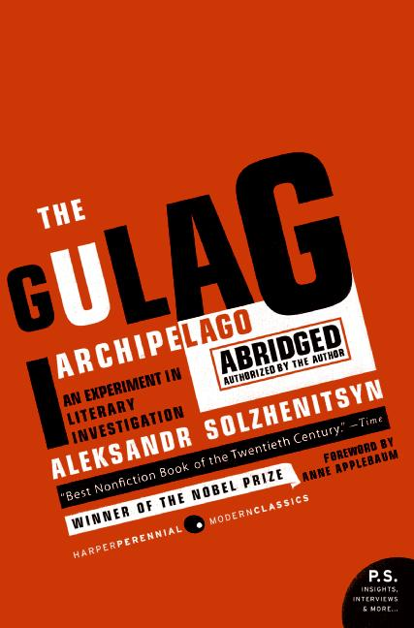
Gog Slaughters Russian Christians
Indeed the author Aleksandr Solzhenitsyn in his work, “Gulag Archipelago, Vol 2,” affirms that Zionist Jews created and administered the organized Soviet concentration camp system in which these tens of millions of Christians and Non-Jews died.

Slide 19
Gog Slaughters Russian Christians
On page 79 of his book he even names the administrators of this the greatest killing machine in the history of the world. They are Aron Solts, Yakov Rappoport, Lazar Kogan, Matvei Berman,
The inmates of a Soviet

Slide 20
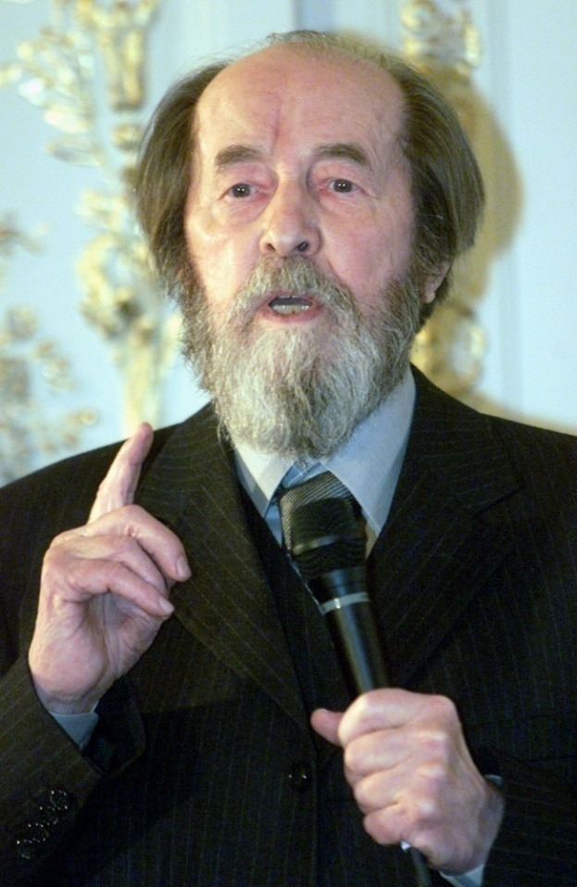
Gog Slaughters Russian Christians
They are Aron Solts, Yakov Rappoport, Lazar Kogan, Matvei Berman,
Genrikh Yagoda, and Naftaly Frenkel. All six are Zionist Jews. In 1970 Solzhenitsyn would be awarded the Nobel Peace Prize for literature.
Alexander Solzhenitsyn

Slide 21
The Tsar's Relatives With Their Troops In WW1
Grand Duke Alexander was commander-in-chief of the Russian Air Force during WW I.
Grand Duke Alexander during his exile in New York in 1932.
Notes:
Kilkenny 12627

Slide 22
Gog’s World War 1 Objectives
(1) A secure Satanic dictatorship in Russia, a secure base to carry out further world subversion.
(2) The Satanic family of Rothschilds gained partial control over Palestine, preparing the way for Satan to rule from Jerusalem some day.

Slide 23
Gog’s World War 1 Objectives
(3) Weapons of mass destruction and terror.
(4) The League of Nations.
(5) The Europeans would be prevented from intervening in the Russian revolution and attention would be diverted from what was happening in Russia.

Slide 24
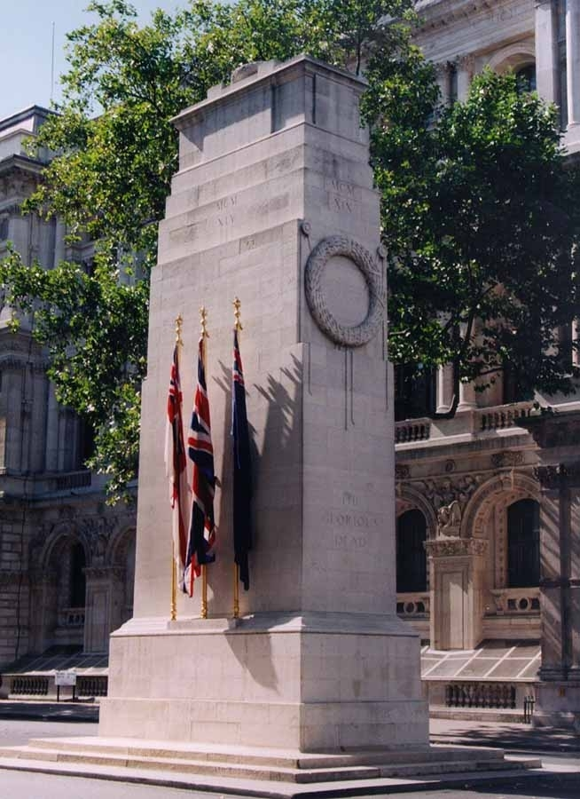
Gog’s World War 2 Objectives
6) The enlargement of their secure base in Russia into a world power.
(7) complete control over Palestine by the Rothschilds.

Slide 25
Gog’s World War 2 Objectives
(8) airpower, including long range missiles, jets, and powerful submarines, all items that individuals could not produce . Those in control of production would therefore control all air and sea ways of the earth.
(9) The cold war and an era of terror to convince the people of the need for Satan’s One World Order.
(10) the United Nations.

Slide 26
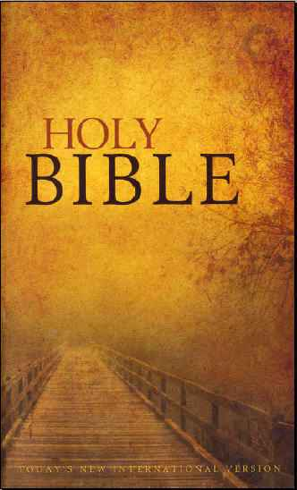
Gog Gathers The Nations To Battle
Rev. 20, 8: And he (Satan) shall go out to deceive the nations which are in the four quarters of the earth, Gog and Magog, (Jews & Mongols) to gather them together to battle the number of whom is as the sand of the sea (Israel).
Note this verse defines Satan as Gog & Magog - who are the Jews and Mongols

Slide 27
War – Gog’s Harvest
"Wars are the Jews harvest, for with them we kill off Christians and take control of their gold. We have already killed 100 million of them and the end is not yet in sight." This statement was made in Prague, Austria, in 1857, by a Jewish Rabbi named Reichorn.
Notes:
From who am I

Slide 28
The Rothschilds Bankroll WWI
Rothschild connections to the first world war are an excellent example of controlled conflict. On the Allied side the British and French Houses financially supported their countries battles.

Slide 29
The Rothschilds Bankroll WWI
During this turbulent period in European history Amschel Rothschild finances the Bolsheviks who would overthrow the Czar and go on to murder millions of Christians.
Amschel Rothschild

Slide 30
Gog – Buys Up Major European News Agencies To Further Its Plans
1914: The Rothschilds have control of the three European news agencies, Wolff (est. 1849) in Germany, Reuters (est. 1851) in England, and Havas (est. 1835) in France.

Slide 31
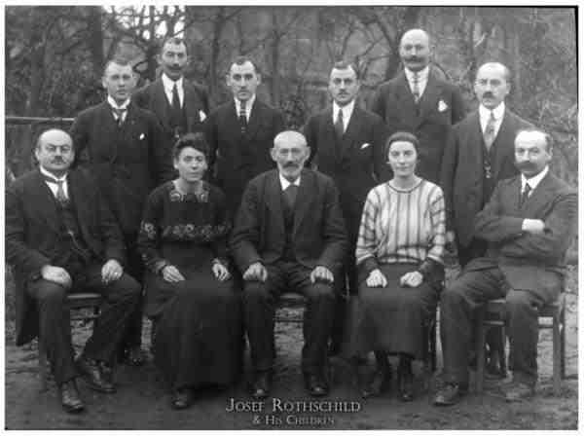
Gog – Buys Up Major European News Agencies To Further Its Plans
The Rothschilds use Wolff to manipulate the German people into a fervour for war. From now on the Rothschilds are rarely reported in the media, because they own the media.
Some of The Rothschild Family

Slide 32
The Round Table – Gog’s Internal Intelligence Network Set Up Prior To WW1
Secret Satanists, Rhodes and Stead created a secret society which had a "circle of initiates". This circle included such names as Albert (Lord) Grey, Arthur (Lord) Balfour, Sir Harry Johnston, and Lord Rothschild. Milner was on the executive committee of this secret group.
Cecil Rhodes

Slide 33
The Round Table – Gog’s Internal Intelligence Network Set Up Prior To WW1
Carroll Quigley dates the start of the group as March 1891. Apparently, the Rothschilds helped finance this secret society. In 1909-1913, this secret society in turn formed Round Table groups in British dependencies and the U.S.
Professor Carroll Quigley

Slide 34
The Fed. – Gogs Central Bank Set Up
The Federal Reserve bill was sneakily passed through congress in the winter of 1913 and President Woodrow Wilson signed the bill into law. The Illuminati, particularly the Rockefellers and Rothschilds, had usurped the financial power of the United States.
The Federal Reserve Bank

Slide 35
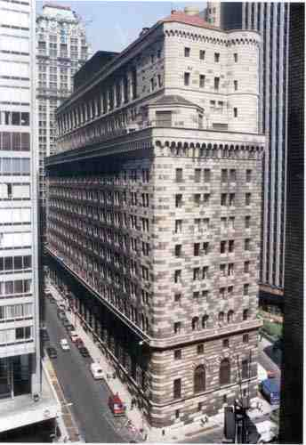
The Fed. – Gogs Central Bank Set Up
This Communistic central private Bank was essential for Gog’s war and global control plans

Slide 36
Gog Destroys The Reichsmark
The German Reichsmark
1923: International Jewish Banks in NY cause the German Reichsmark to crash, bankrupting the country within weeks.

Slide 37
Gog Calls The World To War
1923: Stalin said in a speech that, in order for Communism to be instilled in ALL of Europe, Germany must first be destroyed
Left: Joseph Stalin

Slide 38
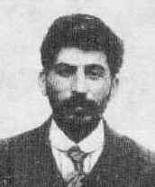
Stalin Was A Jewish Moscow Coffee House Radical
In the Georgian language "shvili" means son of, or son, as in Johnson. "Djuga" means Jew. Therefore Djugashvili means Jewison.
So Joe Stalin's real name, before he changed it, was Joe Jewison. It gets better, his name was Joseph David Djugashvili, a typical Jewish name.
Joseph Stalin

Slide 39
Stalin Was A Jewish Moscow Coffee House Radical
During his revolutionary days he changed his name to "Kochba", the leader of the Jews during one of the anti-Roman uprisings of the Jews. Russians don't change their names. Georgians don't change their names. Jews change their names.
Joseph Stalin

Slide 40
Stalin Was A Jewish Moscow Coffee House Radical
Stalin had three wives, all of them Jewesses.
The first was Ekaterina Svanidze who bore him one son, Jacob.

Slide 41
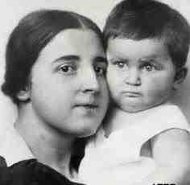
Stalin Was A Jewish Moscow Coffee House Radical
His second wife was Kadya Allevijah. She bore him a son Vassili, and a daughter Svetlana. His second wife died in mysterious circumstances, either by committing suicide, or murdered by Stalin.
Kadya Allevijah

Slide 42
Stalin Was A Jewish Moscow Coffee House Radical
His third wife was Rosa Kaganovich, the sister of Lazar Kaganovich, who was the head of Soviet industry.
Stalin's daughter (who in 1967 fled to the USA) then married Lazar's son Mihail i.e. her step-mother's nephew. Svetlana Stalin had a total of four husbands, three of them Jewish.

Slide 43
Stalin Was A Jewish Moscow Coffee House Radical
Stalin's vice-president Molotov was also married to a Jewess, whose brother, Sam Karp, runs an export business in Connecticut. Just to complicate things even more ….
Vyacheslav Mikhailovich Molotov (1890-1986)

Slide 44
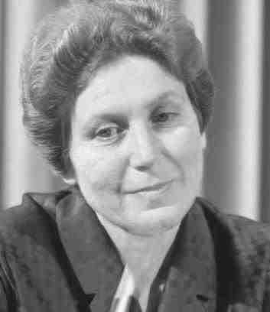
Stalin Was A Jewish Moscow Coffee House Radical
Molotov's (half-Jewish) daughter also called Svetlana was engaged to be married to Stalin's son Vassili.
Svetlana

Slide 45
GOG – Decimates Our Russian Cousins
Stalin responsible for starving to death many millions of Ukrainians was deemed a suitable ally against the war with Germany!
Joseph Stalin

Slide 46
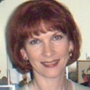
GOG – Decimates Our Russian Cousins
Estonian writer Jyri Lina claims that the USSR was ruled by Jewish gangsters. Soviet "anti-Semitism" was the spin they put on their gang wars. Marxist ideology was a smokescreen.
Jyri Lina

Slide 47
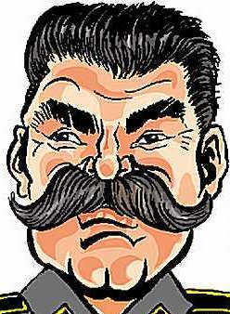
GOG – Decimates Our Russian Cousins
Josef Stalin was a Jew who spoke Yiddish and married Jewish women. He was diagnosed as a "paranoid hysteric" by a doctor he murdered for revealing this. He had an inferiority complex due to being only five foot one inch tall and employed a stand-in for public appearances.

Slide 48
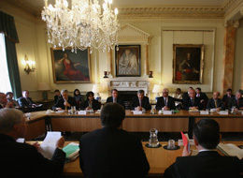
GOG – Decimates Our Russian Cousins
He murdered his second wife in 1932 when she accused him of genocide. Like Lenin, another Jew (who died of syphilis) Stalin was also bisexual. (pp. 284-286). These are the freaks the Illuminati bankers put in power.
The London and other Illuminati Banker in conference

Slide 49
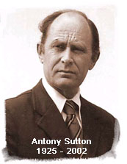
GOG – Decimates Our Russian Cousins
Anthony Sutton found that 95% per cent of Soviet technology came from the US or their allies. He said the Communists couldn't have lasted "one day" without Western aid.

Slide 50
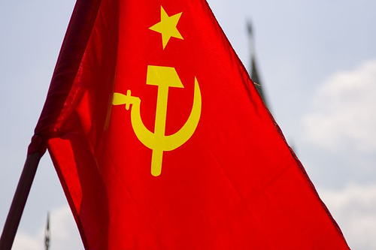
GOG – Decimates Our Russian Cousins
While pretending to be engaged in a "Cold War," the West actually provided billions in direct military and economic aid to the Soviets. How else have a war?
The Soviet Flag

Slide 51
Gog’s WW1 Precludes Intervention In The “Russian” Revolution
Because Israelite powers in Europe were busy fighting each other it would not be possible for them to intervene on behalf of their Russian cousins.
The Somme
The “Russian” Revolution

Slide 52
Churchill Gog’s Agent To Instigate War
The method by which the United Kingdom and the United States were drawn into WW1 started on October 25, 1911, when Winston Churchill was appointed the First Lord of the Admiralty in England.
Winston Churchill

Slide 53
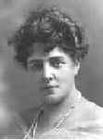
Churchill's Jewish Ancestry
Jenny Jacobson Churchill's mother was Jenny Jerome. Her father was involved in theatre investment and changed his name from Jacobson to Jerome.
‘Cunning, no doubt, came to Churchill in the Jewish genes transmitted by his mother Lady Randolph Churchill, née Jenny Jacobson/Jerome.’ Moshe Kohn, Jerusalem Post
Jenny Jacobson

Slide 54
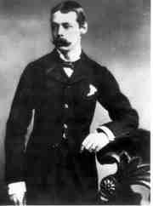
Churchill's Jewish Ancestry
To cover-up his Jewish ancestry, the story was spread that his mother had American Indian ancestry – hence referred to her as “Sitting Bull”
Randolph Churchill

Slide 55
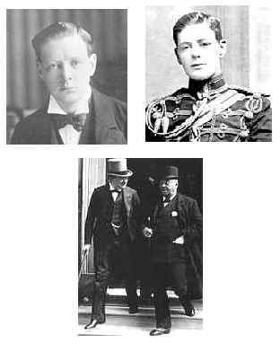
Churchill's Jewish Ancestry
In the company of members of the English aristocracy and establishment Winston’s ‘night on the town’ often ended at fringe homosexual private shows in which every depravity known to man was indulged.

Slide 56
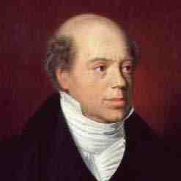
Churchill's Jewish Ancestry
It is believed that Churchill is a son of Nathan Rothschild from one of Jenny’s many affairs
Nathan Rothschild

Slide 57
Gog’s Call To Britain
The famous poster of Lord Kitchener calling Britons to war.

Slide 58
Assassination of Archduke Francis Ferdinand
Gog Triggers WW1 through the “Black hand” of Serbia

Slide 59
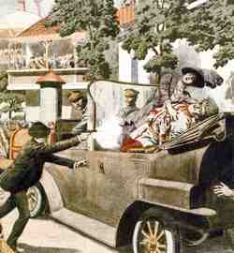
Assassination of Archduke Francis Ferdinand
Ferdinand and his wife had arrived to watch army manoeuvres near Sarajevo, the capital of Bosnia where he was assassinated on June 28, 1914. by a nineteen year-old member of the Black Hand, Gavrilo Princip

Slide 60
Gog’s Agents In Control Of WW1
Lloyd George, who was counsel for the Zionists in England, was made premier of the English Government and chosen to "perform" during World War I.
David Lloyd George

Slide 61
Gog’s Agents In Control Of WW1
Lloyd George’s secretary (Boss) during World War I. was Sir Philip Sasson Rothschild. (American Mercury, KNOW, December 1958)
Sir Philip Sasson

Slide 62
Viscount James Bryce Demonises The Germans
False reports of German atrocities were falsely authenticated by James Bryce, and not a single witness was identified by name.
The Bryce Report unquestionably helped England win the war. It convinced millions of Americans and other neutrals -- it was translated into 27 languages.
Viscount James Bryce

Slide 63
Viscount James Bryce Demonises The Germans
The Bryce Report has obvious connections to the British decision to maintain the blockade of Germany for seven months after the armistice in 1918, causing the starvation deaths of an estimated 600,000 elderly and very young Germans.
Viscount James Bryce
Notes:
16917 May 13, 1915

Slide 64
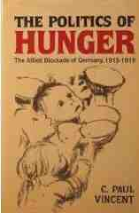
Viscount James Bryce Demonises The Germans
This was far and away the greatest atrocity of World war I and it made every German man and woman hunger for revenge. By creating blind hatred of Germany, Bryce sowed the dragons teeth of World War II.

Slide 65
Gog’s Call To The USA
Poster of Uncle Sam calling the people of the United States of America to war based on Lord Kitchener’s poster.
Notice Only one star is prominent on the top hat – a Single 5 pointed star was the emblem on the flag of Amaleck.

Slide 66
Sinking Of The Lusitainia
A call to war

Slide 68
Gog’s Crime Blamed On The Germans
Rothschild agent Colonel House probably knew of this plot, records point to a discussion of it between him and Sir Edward Grey of England. Historian Colin Simpson called the sinking of the Lusitainia the “foulest act of wilful murder ever committed on the seas.’

Slide 69
Gog’s Crime Blamed On The Germans
A knowledgeable American State Department failed to warn the US. citizens aboard the ship of the voyage's definite danger. Churchill ordered the Lusitainia’s naval escort to return to port, and the fated ship was left unprotected, to be sunk.

Slide 70
Gog’s Crime Blamed On The Germans
Following 2 inquiries, the conclusions were the same: torpedoes and not exploding ammunition sank the Lusitainia, because there was no ammunition aboard. The cover-up was now official.

Slide 71
Gog’s Lusitainia Ploy
The Lusitainia was a ploy. It was packed with some Morgan owned ammunition and had been given over to England as a member of the navy, and despite the warnings of the Germans was sent into a naval war zone, specifically to be a target - the catalyst for America’s entrance into the war.
Winston Churchill

Slide 72
World War One
WW1 as well as a manoeuvre to consolidate power in Christian Russia, another objective would be achieved – that of killing of the cream of Israelite youth in the combatant countries under the cover of war.
The Somme 1916

Slide 73
Battle of the Somme 1st July 1916

Slide 74
Armistice 11-11-11
The date and time of cessation of hostilities indicates the power of the Illuminati to do precisely as they please!

Slide 75
Armistice 11-11-11
Sergeant T. Grady, USA Army, diary entry (11th November, 1918)
Cold and raining. Runner in at 10.30 with order to cease firing at 11.00 a.m. Firing continued and we stood by. 306th Machine-Gun Company on my right lost twelve men at 10.55, when a high explosive landed in their position.
Troops Ordered to cease fire

Slide 76
Armistice 11-11-11
At 11.00 sharp the shelling ceased on both sides and we don't know what to say. Captain came up and told us the war was over. We were dumbfounded and finally came to and cheered - and it went down the line like wildfire. I reported Jones' death and marked his grave. Captain conducted a prayer and cried like a baby.
Troops Ordered to cease fire

Slide 77
The Armistice Did Not Stop The Killing
Mention must be made of the name of Benjamin Cohen (Bela Kun) who was sent to Hungary by Chaim Goldman (Lenin). In 1919, he is credited with the killing of 120,000 innocent Christian people, 30,000 of whom were murdered within 3 months.
Bela Kun (1886-1937)

Slide 78
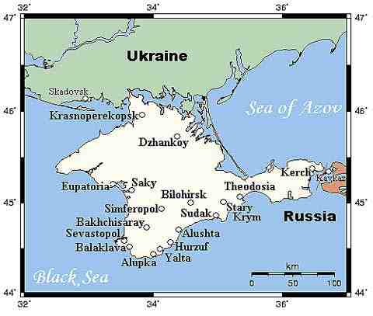
The Armistice Did Not Stop The Killing
Later, after returning to Soviet Russia, 40,000 white Russians were killed in the vicinity of the Crimean Peninsula. Records of this are authenticated by various investigating committees.
The Crimea

Slide 79
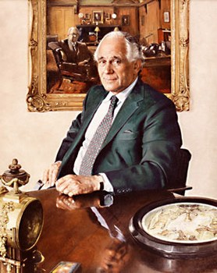
The Illuminati 11 Signature On The World Wars
When Germany fell in WWI, not only did Rothschild agents draft the treaty, prepare the idea of the League of Nations, but Max Rothschild was one of 11 men who took control over Bavaria. Max Rothschild was a Freemason in Lodge No. 11, Munich, Germany.
Max Rothschild

Slide 80
The League Of Nations
1920 January 10th: Entry into force of the Versailles Peace Treaty and of the Covenant of the League of Nations.
This was Gog’s first attempt in constructing a global government following WW1.

Slide 81
Gog Inadvertently Reveals One Of The Reasons For WWI
The real reason for the War was slowly emerging. One of the first revelations occurred on May 27, 1916, when President Wilson proposed at the League of Nations in a speech before the League to Enforce Peace. Wilson argued that what the world needed to prevent the recurrence of a similar war was a world government.
President Wilson

Slide 82
The Rockefellers Bankrolled By The Rothchilds
One of the families who reaped the exorbitant profits were "the Rockefellers, who were very eager for the United States to enter World War I, [and who] made far more than $200,000,000 from that conflict."
The Rockefeller Family

Slide 83
Gog – Infiltrates Agents Into The West
Between the two world wars a great number of English speaking Eastern Europeans with odd sounding names, many with University degrees, came in from Central and Eastern Europe. They were Marxist atheists (Khazars).
Oxford

Slide 84
Gog – Infiltrates Agents Into The West
Oxford
They took up teaching posts in the new faculties and began the indoctrination of the younger generation of the British people.
They poured scorn on the Christian Faith, Christian Ethics, Christian culture and Patriotism so that sound Philosophy, theology and history were supplanted by false teachings.

Slide 85
General Allenby Takes Jerusalem 1917
General Allenby attacked the Ottomans in Palestine. The high point in the British assault was the capture of Jerusalem in December 1917

Slide 86
Palestine A British Protectorate
Palestine becomes a British protectorate. However in the meanwhile Gog schemes to get possession

Slide 87
Churchill & Dr. Weismann
"He received me not only cordially, but he was also full of confidence with respect to the war. His first words, after he had welcomed me, were as follows: ‘Well, Dr. Weismann, we have as good as beaten them already.' I...thanked him for his constant support for the Zionist cause. ‘You were standing at the cradle of this enterprise.'
Winston Churchill

Slide 88
Churchill & Dr. Weismann
I said to him, ‘and hopefully you will live to see that we have succeeded.' Adding that after the war we would build up a state of three to four million Jews in Palestine, whereupon he replied: ‘Yes, go ahead, I am full in agreement with this idea.'" (Conversation between Chaim Weismann and Winston Churchill)
Dr. Chaim Weismann

Slide 89
Gog Assassinates Lawrence of Arabia
Lawrence of Arabia objected to the Government’s reneging on its promise to give the Arabs independence – so he was assassinated - disguised as an accident

Slide 90
Gog’s Versailles (Non)-Peace Conference
1919: Following the end of the First World War, the Versailles peace conference is held to decide reparations that the Germans need to pay to the victors.

Slide 91
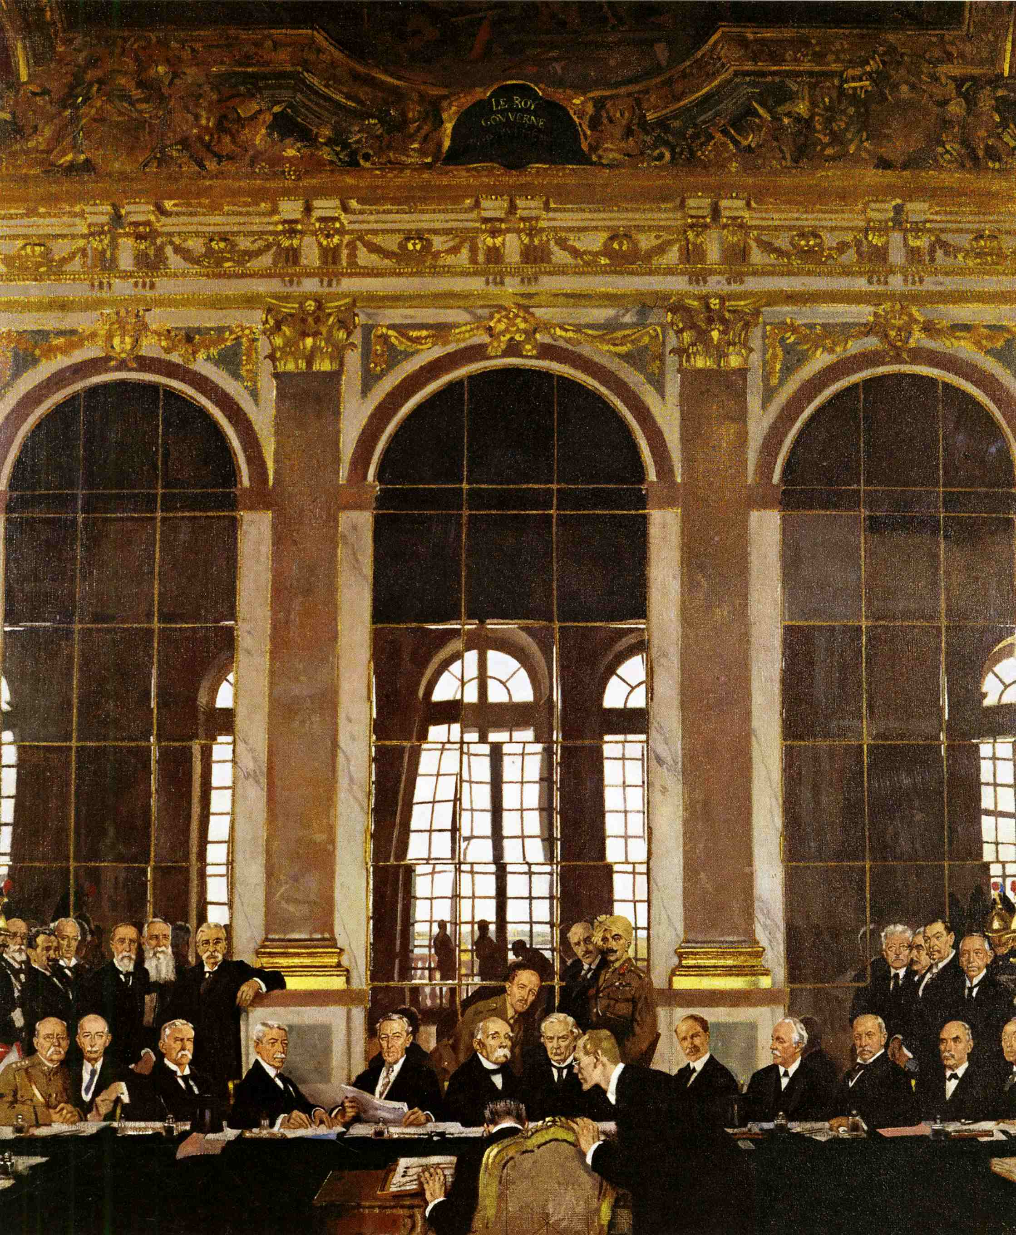
Gog’s Versailles (Non)-Peace Conference
Also decided at this conference is the confirmation of Israel as a Jewish homeland, with the control of Palestine being given to Britain (Britain rules Palestine, and the Rothschilds rule Britain) …..

Slide 92
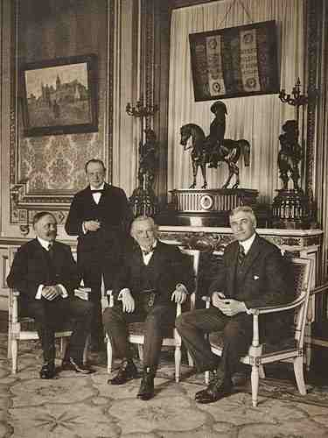
Gog’s Versailles (Non)-Peace Conference
….. whilst this handover takes place.
At that time less than one percent of the population of Palestine was Jewish. The host of this conference is its boss, Baron Edmond de Rothschild.

Slide 93
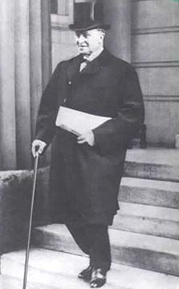
The Outrageous Treaty of Versailles
Lord Curzon of England, the British Foreign Secretary, saw through what the actual intent was and declared: "This is no peace; this is only a truce for twenty years." Lord Curzon felt that the terms of the Treaty were setting the stage for a second world war, and he correctly predicted the year it would start: 1939.
Lord Curzon

Slide 94
Gog’s Great Depression USA 29th October 1929
Gog causes depression and starvation in the midst of plenty to make the people ready to accept socialism and compliant to its war aims

Slide 95
Hitler's Rise To Power
Hitler began his rise to power in 1919, but he had a long and stormy road ahead, until he became Chancellor of Germany in 1933. During this time, he expended a tremendous amount of money, most of it coming from non‑German sources,
Adolf Hitler

Slide 96
Hitler's Rise To Power
although many wealthy German ladies, intrigued by the little moustached man, sent him their family jewels. It is also rather interesting to note that Hitler sold his idea of anti‑Semitism through the help of very powerful and wealthy Jews.
Adolf Hitler

Slide 97
Hitler's Rise To Power
Hitler today is the world’s No. 1 hate figure, but as we shall see he was held in high esteem by a number of world leaders.
While in the most part he acted in German interests, he was nevertheless a tool of the Zionists.
Adolf Hitler

Slide 98
Hitler's Rise To Power
While being interviewed on a morning show (Haaretz 22/12/10) of Greece's largest television station, Mega TV, the Metropolite of Piraeus Seraphim said of Hitler …….

Slide 99
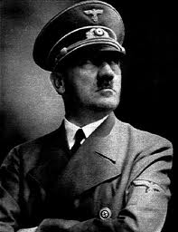
Hitler's Rise To Power
…."Adolf Hitler was an instrument of world Zionism and was financed from the renowned Rothschild family with the sole purpose of convincing the Jews to leave the shores of Europe and go to Israel to establish the new Empire."

Slide 100
Churchill On Hitler
"In fifteen years that have followed this resolve, he (Hitler) has succeeded in restoring Germany to the most powerful position in Europe, and not only has he restored the position of his country, but he has even, to a very great extent, reversed the results of the Great War ... whatever else may be thought about these exploits they are certainly among the most remarkable in the whole history of the world."
Winston Churchill

Slide 101
J. F. Kennedy On Hitler
"Hitler will emerge from the hatred that surrounds him now as one of the most significant figures who ever lived... he had a mystery about him in the way that he lived and in the manner of his death that will live and grow after him. He had in him the stuff of which legends are made."
John F. Kennedy President of the United States of America

Slide 102
Hitler's Rise To Power
"In [pre‑WW II] Berlin, for example, when the Nazis came to power, 50.2% of the lawyers were Jews...48% of the doctors were Jews. The Jews owned the largest and most important Berlin newspapers, and made great inroads on the educational system." (The House That Hitler Built, by Stephen Roberts, 1937)
Berlin

Slide 103
Jewish Leaders Promote Anti‑Semitism - Keeping The Lesser Jews In Fear
The International Zionists were anxious for a European War, so they could enforce the Balfour Treaty and gain control of Palestine. Financial arrangements for aid to Hitler came via the Jewish bank of Mendelsohn and Co., in Amsterdam. In 1933, they advanced Hitler another $7‑million.

Slide 104
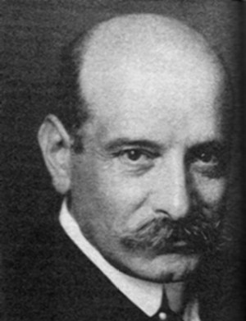
Jewish Leaders Promote Anti‑Semitism - Keeping The Lesser Jews In Fear
When this Warburg Manuscript was published, there was an immediate drive underway to put into effect a ban of the Protocols of Zion. This was carried out by world Jewry and the German Secret Police. Many publishers, out of fear, recalled as many copies as they could.
Paul Warburg

Slide 105
Gog Kills Many Of Those In the Know About Hitler’s Zionist Support
Some Jews used the excuse that they financed Hitler so that they could control him, but it is a known fact, that they made billions of dollars profit by financing both sides in World War II, just as they did in World War I. The Jews who financed Hitler are as much to blame for any Jewish deaths in Germany,
Adolph Hitler

Slide 106
Gog Kills Many Of Those In the Know About Hitler’s Zionist Support
as the German people, yet we never hear anything about this in the constant wailing over the so‑called Holocaust. Most of the men who knew about these transactions between Hitler and the Zionists, met with untimely deaths.
Adolph Hitler

Slide 107
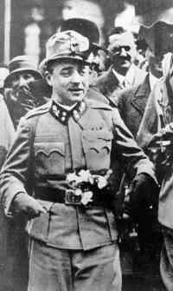
Gog Kills Many - In the Know About Hitler’s Zionist Support
One of the most prominent of these was Dollfuss, Chancellor of Austria. He was assaulted in his office by Nazi thugs, who wounded him mortally and then was left to bleed to death.
Fritz Thyseen, writing in a book - I Paid Hitler! described the Dolfuss murder - the reason the Chancellor was killed was that he had received a copy of the Warburg document and one exposing Hitler's Jewish ancestry.
Dollfuss

Slide 108
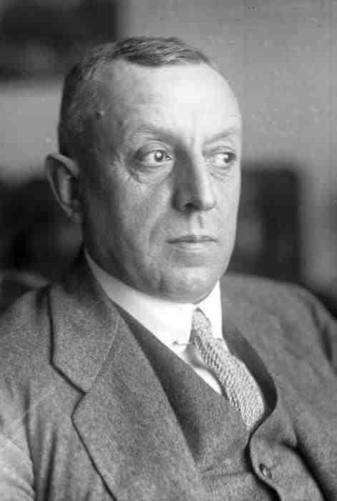
Gog Kills Many - In the Know About Hitler’s Zionist Support
Fritz Thyssen, writing in a book - I Paid Hitler! described the Dolfuss murder - the reason the Chancellor was killed was that he had received a copy of the Warburg document and one exposing Hitler's Jewish ancestry.
Fritz Thyssen

Slide 109
Eichmann Meets Zionist Leaders In Palestine - 1934
Returns with 3 point plan:-
1) Wealthiest German Zionist Jews to be sent to Palestine immediately.
2) Upper‑middle‑class Zionist Jews to be sent to Romania until after the war.
Adolf Otto Eichmann (1906-1962)

Slide 110
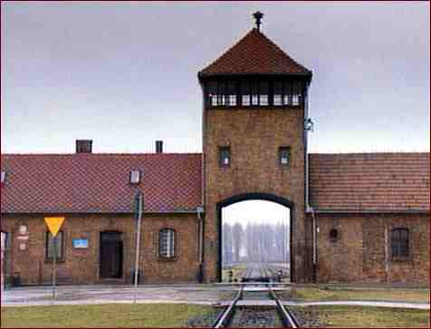
Eichmann Meets Zionist Leaders In Palestine - 1934
3) Poor and Non‑Zionist Jews to be sent to Auschwitz ‑ for further disposition. (Remember... this is not long after Zionist organizations declare war on Germany; 24 March1933, and 5 years before Britain declares war on Germany, starting WWII.)
Auschwitz

Slide 111
Hitler – Gog’s Agent
If Hitler was such an anti‑Semite, be honest enough to ask yourself this simple question:
* "Why did Hitler keep the war going when he knew Germany was defeated and it would only result in hundred of thousands of German casualties?"
General Rommel

Slide 112
Hitler – Gog’s Agent
* "Why was it that during the conduct of the war, on many occasions, he refused to accept the advice of his top admirals and generals on how to conduct the war?"
* "Why was it in North Africa, when General Rommel had the Americans and British forces in retreat, that Hitler refused to send Rommel the supplies he needed to complete a victorious campaign?"
General Rommel

Slide 113
Hitler – Gog’s Agent
If Hitler was an anti‑Communist as some claim, why did he allow the top Communist propagandist to attend the Reichstag Fire Trial in 1933, where he was allowed to harangue the German people in favour of Communism. Why was this man allowed a safe return to Russia?
The Reichstag

Slide 114
Gog’s Bankers Hired Hitler To Start WW2
Like the other war leaders Hitler was a Gog Hired agent, but probably broke his contract, and so had to be eliminated as was the case with Stalin during the post war period.

Slide 115
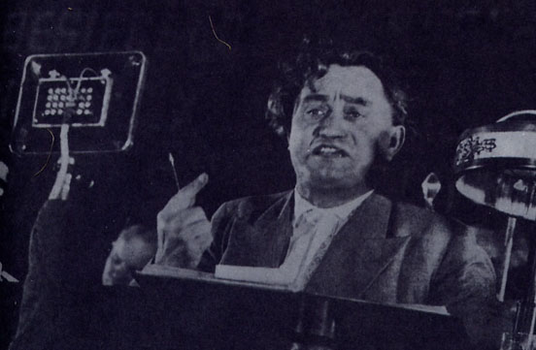
Hitler – Gog’s Agent
During this period, German Nationals were being shot down in cold blood in Germany's streets for the smallest misdemeanor against the Nazis. But here we have a powerful Communist allowed to publicize Communism and get away with it. It doesn't make very much sense. This man, Dimitroff, later became the President of the Communist World International
Georgi Dimitroff

Slide 116
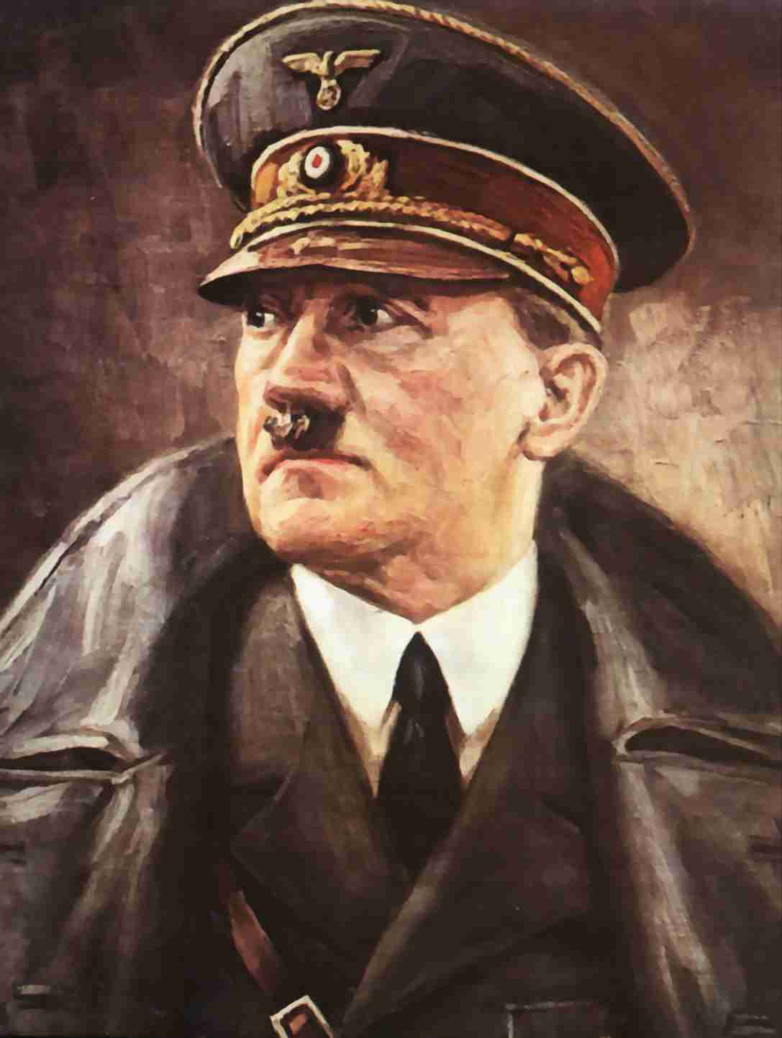
Hitler – Gog’s Agent
From 1933 to 1938 Hitler turned from being a creature of the generals and International Jews, into a radical totalitarian dictator. Many of those who were close to him were dismayed by what they saw.

Slide 117
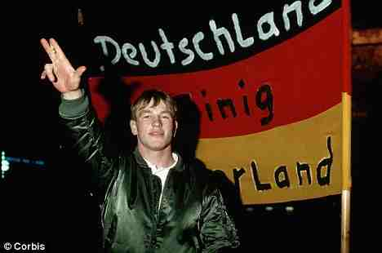
Hitler – Gog’s Agent
These were "dyed in the wool" German patriots who loved their country with a passionate love. They were true Germans who felt it necessary to stop the madman which was destroying the country they loved. Nearly every one of them that broke with Hitler met a terrible death.

Slide 118
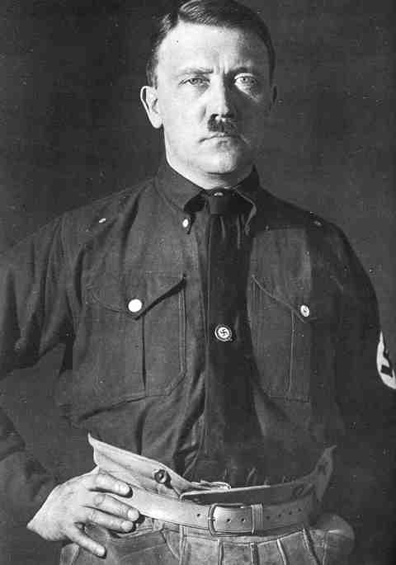
Hitler – Gog’s Agent
These were "dyed in the wool" German patriots who loved their country with a passionate love. They were true Germans who felt it necessary to stop the madman which was destroying the country they loved. Nearly every one of them that broke with Hitler met a terrible death.

Slide 119
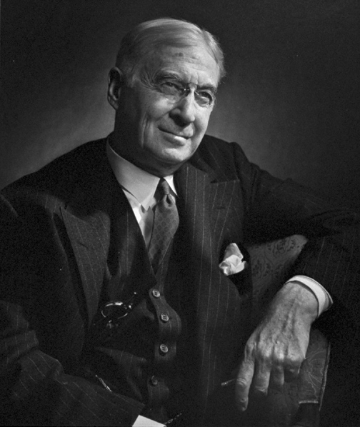
WW2 To Bolster Stalin
Bernard Baruch writes to Adolf Hitler that there must be war; in order to install Josef Stalin in a position of power over all of Europe, Germany must be crushed.
Bernard M Baruch

Slide 120
Hitler – Gog’s Agent
Field Marshall Von Sitzleden
Admiral Canaris
General Rommell
Admiral Canaris was slowly strangled to death; General Rommell, the Desert Fox of North Africa was forced to commit suicide; Field Marshall Von Sitzleden was killed and his body was exhibited hanging from a meat hook.

Slide 121
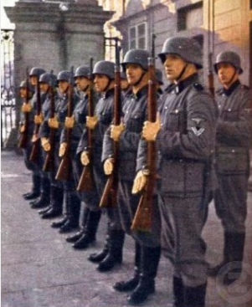
Jews In Hitler’s Army
Thousands of men of Jewish descent and hundreds of what the Nazis called "full Jews" served in the German Military with Adolf Hitler's knowledge and approval.

Slide 122
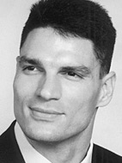
Jews In Hitler’s Army
Cambridge University researcher Bryan Rigg has traced the Jewish ancestry of more than 1200 of Hitler's soldiers, including two field marshals and fifteen generals (two full generals, eight lieutenant generals, five major generals), "men commanding up to 100,000 troops."
BRYAN MARK RIGG Professor of History, American Military University & Southern Methodist University

Slide 123
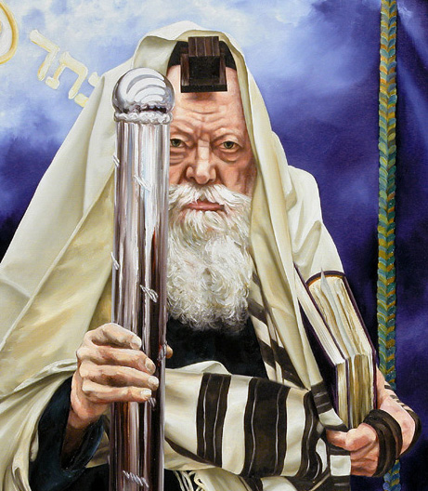
Jews In Hitler’s Army
Rigg's research also shed light on stories surrounding the rescue by German soldiers of the Lubavitcher grand rabbi of that time, who was in Warsaw when the war broke out in 1939. Joseph Isaac Schneerson was spirited to safety after an appeal to Germany from the United States.
Grand Rabbi Lubavitcher

Slide 124
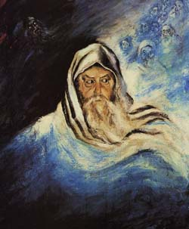
Jews In Hitler’s Army
Schneerson was assisted by a German officer who Rigg has identified as the highly decorated Maj. Ernst Bloch, whose father was a Jew. Jews also served in the Nazi police and security forces as ghetto police (Ordnungdienst) and concentration camp guards (kapos).
Joseph Isaac Schneerson

Slide 125
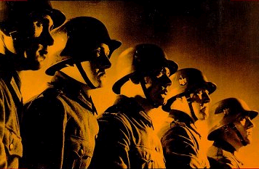
Jews In Hitler’s Army
So what happens to the claim that Hitler sought to exterminate all Jews, when he allowed some of them to join in his struggle against Bolshevism and International finance capitalism?

Slide 126
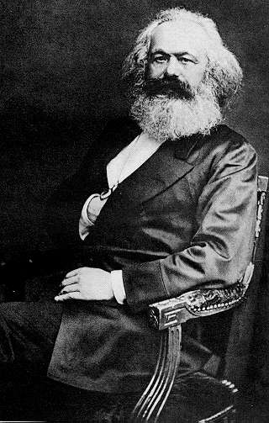
Jews In Hitler’s Army
Marx: "It was disciples of Jewish teachers who headed the Protestant movements. These dogs, these haters of the Jews have a keen nose. In truth, Jewish influence in Germany is powerful. It is impossible to ignore it.
Karl Marx

Slide 127
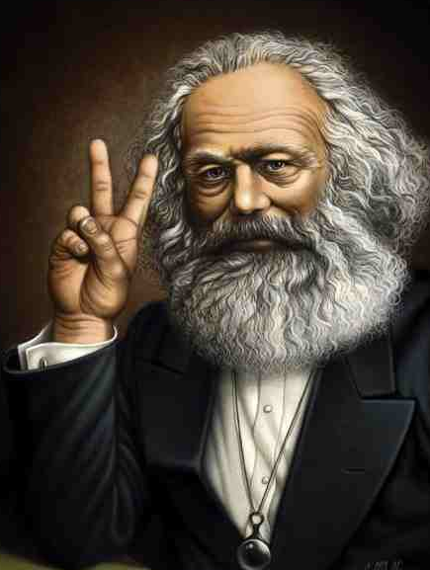
Jews In Hitler’s Army
The Gentiles have at last realized this secret, that Judaism has gradually penetrated them like a drug.” Marx was a Jew.
Karl Marx Making Churchill’s “V” Sign!

Slide 128
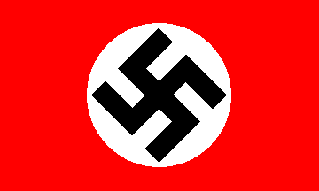
Hitler – Gog’s Agent
On March 21, 1939 Representative Jacob Thorkelson of Montana, stated: “The Communist, to camouflage his own activities, shouts ‘Naziism and fascism.' He waves the swastika to cover the hammer and the sickle. These red‑dancing dervishes ought to be exported to go as part of the war materials shipped out of the United States”
The Nazi Flag

Slide 129
Rothschilds – Gestapo/SS
A little known fact is that the dreaded Gestapo & SS were staffed mainly by the security service staff of I.G. Farben – a German industrial giant owned by the Rothschilds.
Demonstrating against I. G. Farben’s involvement
The Gestapo flag

Slide 130
Ukrainians Starved To Death
1932‑1933:How could it happen that about 10 million people were starved to death in Europe, in the 20th century ‑ almost unnoticed, "unregistered," as Robert Conquest says, in Western public consciousness?
Nobody remembers the Christian Ukrainians – Nobody is allowed to forget the 6 Million Jews!

Slide 131
Gog Calls For A Boycott Of German Goods And Services
Samuel Untermeyer, who arranged for the “International Boycott Conference” in Amsterdam, Holland July 1933, stated:
Samuel Untermeyer

Slide 132
Gog Calls For A Boycott Of German Goods And Services
“This holy war …this boycott must be against all German goods, shipping and services …we will drive the last nail in the German Coffin” And this was before Hitler began any move to rid his country of these parasites!

Slide 133
A Headline Says It All!
Blatant lies – the headline if truthful should have read – “Edom declares war on true Judah”

Slide 134
Hitler Will Be Forced Into War
"Hitler will have no war, but he will be forced into it, not this year but later..." (The Jewish Emil Ludwig, Les Annales, June, 1934)
Emil Ludwig

Slide 135
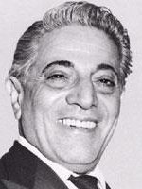
The Oil Cartel Prepares For War
Onassis, Rockefeller and the Seven Sisters (major oil companies) signed an agreement, outlined in an oil cartel memo: Screw the Arabs out of their oil, ship it on Onassis' ships; Rockefeller and the Seven Sisters to get rich. All this was done. Roberts, learned those things via personal contacts.
Aristotele Onassis

Slide 136
War Leaders Jewish & Related To The Rothschilds
As we saw in part 4 of this series Churchill, Stalin and Hitler were related to the Rothschilds through illegitimate liaisons.

Slide 137
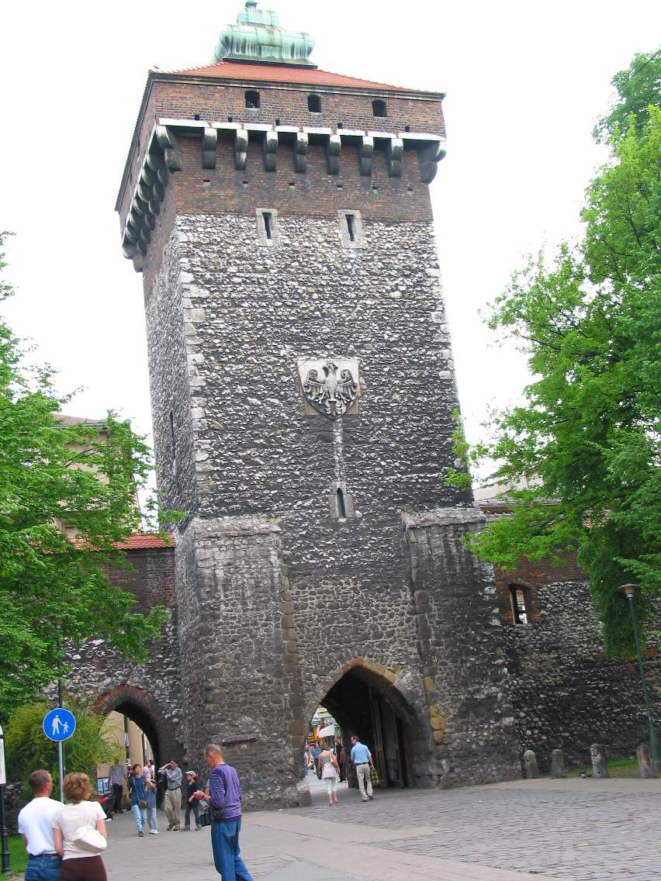
Poland Triggers WW2
We saw in parts 1 & 3 how many Khazars on being defeated by Sviatoslav, duke of Kiev moved to Krakow in Poland and were joined by others after their expulsion from Spain. Also with many German nationals settled in Poland, Poland would be the ideal trigger for WW2.
Krakow City Gate

Slide 138
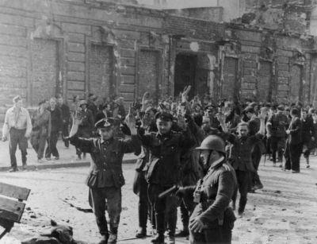
Poland Triggers WW2
Gog would shoot dead many Germans dressed in Polish uniform, so that their Zionist ally Hitler would have an excuse to mobilise the German Army to invade.

Slide 139
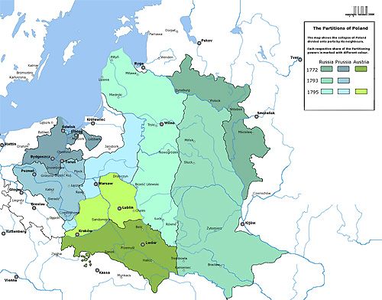
Poland Triggers WW2
It was with Hitler's knowledge and consent which gave the Soviets 70,000 square miles of Polish territory without a fight.

Slide 140
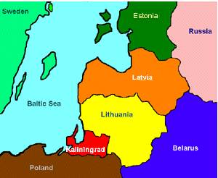
Poland Triggers WW2
By 1940, with German help, the little countries of Lithuania, Latvia and Estonia were safely in the Soviet fold. Then Rumania, Northern Bukovania, and portions of Bessarabia fell to the Communists.
Lithuania, Latvia and Estonia

Slide 141
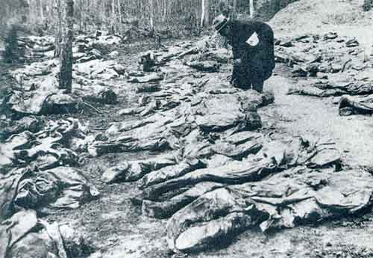
Poland Triggers WW2
When the German armies moved into Poland it gave the Communists the opportunity to do the same from the east and allowed the Soviets to wipe out the cream of the Polish Army Officers Corps at Katyn Forest.
Katyn Forest Massacre

Slide 142
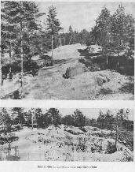
Poland Triggers WW2
This atrocity was used by the Communists to further hatred against Germany, who in this case was not guilty. It might be interesting to note here, that while both Germany and Russia invaded Poland, England and France only found Germany guilty. Stalin admitted they were using the Germans, saying:
Katyn Forest.

Slide 143
Poland Triggers WW2
"We shall assist the Germans in an European War so that they can offer prolonged resistance to the British and French, and in this way exhaust the Capitalist nations...In this way we will control the decision."

Slide 144
Poland Triggers WW2
1st Sept 1939 Midnight, Poland Declares war on Germany. Radio Warsaw claims that Polish troops would be in Berlin by the end of the week.

Slide 145
Poland Triggers WW2
(Poland had 40 Infantry Divisions up against 35 German divisions and were on home ground). 5 hours later Hitler moved his troops into Poland.
This is the true version of events not recorded in official history
Germany responds to Poland’s threat

Slide 146
Why Did Hitler Invade Poland?
WW 2 was started over the Danzig corridor which was part of Germany until the Versailles treaty gave it to Poland

Slide 147
Why Did Hitler Invade Poland?

Slide 148
Why Did Hitler Invade Poland?
The post WW 1 Treaty decimated Germany - causing a depression enabling Jews to buy up vast amounts of German industry and left Germans bitter.

Slide 149
Why Did Hitler Invade Poland?
Versailles
International Jewry, who represented 80% of those attending the Versailles treaty forced Germany to give a portion of their country ( Danzig Corridor ) to Poland.

Slide 150
Why Did Hitler Invade Poland?
Edward House ( left ) was Jewry's lead man a Rothschild employee who previously helped form the Fed Res. And behind the scenes man who would set in train events leading to WW”

Slide 151
Why Did Hitler Invade Poland?
1937 Hitler was pleading with Poland to give Germany a 1 mile wide access to their province of East Prussia. Both parties were in agreement when in 1939 Poland suddenly broke off all negotiations.
Adolph Hitler

Slide 152
Why Did Hitler Invade Poland?
1938 Roosevelt gave Churchill assurances that the USA would be brought into war against Germany

Slide 153
Why Did Hitler Invade Poland?
March 31,1939 Britain and France guarantee Poland's defence (Anglo French Assurance Pact)
They secretly made a pact with Poland to come to their defence if Germany attacked
Winston Churchill

Slide 154
Why Did Hitler Invade Poland?
Poland Threatens War
Emboldened by Roosevelt and Churchill guarantees Rydz Smigly (Bottom left) and Ignacy Moscicki (Top left), the head of Poland's army and it's president were sabre rattling.
Smigly said -- "Poland wants war with Germany and Germany will not be able to avoid it even if she wants to." He threatened to overrun Germany in three days.

Slide 155
The 1939 Danzig Massacres
In the months leading up to the German invasion the Polish Army and independent Bolshevik units had been slaughtering German nationals in the Danzig corridor. Mass killings of thousands of civilian ethnic Germans (Volksdeutsche) by
Another Bolshevik Crime

Slide 156
The 1939 Danzig Massacres
… both civilian and Russian NDVK Jews, who were confident that Poland would quickly defeat Germany. Many apparently expected to take possession of
German farms and businesses. An estimated 58,000 German civilians lost their lives in the massacres carried out prior to the 1939 invasion.

Slide 157
Why Did Hitler Invade Poland?
Poles had been merrily slaughtering anything or anybody German since at least as early as April 1939, with smaller incidents stretching back to the close of WW I -- you haven't been told that by the Mass Media,
Bromberg

Slide 158
Why Did Hitler Invade Poland?
…. or the fact that these atrocities were one of the main causes for the German invasion of Poland.
Germany had been protesting in writing to the League of Nations literally dozens of times with no results.

Slide 159
Bromberg Bloody Sunday
On one day alone - Polish Jews, under the protection of the Polish Army, attack a small German town and viciously kill 5500 Germans

Slide 160
Bromberg Bloody Sunday
On 'Bloody Sunday' 5500 Germans were murdered:
The "Bromberg Bloody Sunday" is perhaps best known. Polish Jews were confident they would win against Germany and went on a rampage of 'Blood Lust' that was unmatched.

Slide 161
Bromberg Bloody Sunday
Groups of Bolsheviks attacked from Ponz, Lotz and Warsaw approached the town and started killing the farmers on the outskirts. Children were nailed to barns, women were raped and hacked to death with axes men were executed where they stood.

Slide 162
Bolshevik leaders of the Ponz, Warsaw and Lodz Jewish groups
Ladovitch
Karpinski
Weis
On Bromberg Bloody Sunday, thousands of ethnic Germans were slaughtered like pigs in an alley because the majority "poles" (the "slavic", non-Teutonic types,

Slide 163
Bolshevik leaders of the Ponz, Warsaw and Lodz Jewish groups
Ladovitch
Karpinski
Weis
…. really Turco-Ugaric, Hunnic, Tartar and Mongoloid residue from the old "Dark Age" invasions) knew they could do so with total impunity.

Slide 164
Bromberg Bloody Sunday
328 killed in church burning

Slide 165
Bromberg Bloody Sunday
Who Benefits?

Slide 166
Why Did Hitler Invade Poland?
The 5 ' 6 " Jewish Stalin and Bolsheviks now have their war and British, French, American, Canadian, etc blood will be spilt all over Europe to decimate Germany and open the world to the Jewish swindle called communism. Also to blame the traitorous actions of those members of western governments acting in the interests Zionists rather than their own nations.
Joseph Stalin

Slide 167
Chamberlain Signs His Death Warrant
September 3, 1939 - Neville Chamberlain. "The Americans and world Jewry have forced me into this war.“
Within a few months he would be dead – Murdered?
Neville Chamberlain 1869 -1940

Slide 168
Dunkirk
Then on May 24, 1940, the Germany Army was in a position to defeat the British at Dunkirk and very possibly end the war. It was then that Hitler gave his famous order that the left wing of the German assault be halted. Gen. Heinz Guderin in his book "The Panzer Leader," said that when this command came, the German military leaders were utterly speechless.
Allied Forces retreating to the beaches of Dunkirk

Slide 169
Dunkirk
Thanks to King George VI calling the nation to prayer – Hitler was minded to preserve the Britsih & French as a bulwark against Communism.

Slide 170
Dunkirk
338,226 French and British soldiers allowed to escape from Dunkirk, France

Slide 171
Dunkirk
"He (Hitler) then astonished us by speaking with admiration of the British Empire, of the necessity for its existence, and of the civilization that Britain had brought into the world.
General Günther von Blumentritt

Slide 172
Dunkirk
He remarked, with a shrug of the shoulders, “that the creation of its Empire had been achieved by means that were often harsh, but ‘where there is planning, there are shavings flying’."

Slide 173
Dunkirk
It went against everything the military stood for. Yet they obeyed and the British were able to make it back to their fortress. Here we see Hitler, with one command, destroy everything the Germany Army had accomplished by their blood, sweat and tears.

Slide 174
Dunkirk
Dr. Walter Dornberger, German expert on the development of the flying bombs and the brains behind the V‑1 and V‑2, stated that Hitler could have won the war in early 1944, but he held back on development of this new and terrifying means of waging war.

Slide 175
Dunkirk
By ensuring that the British were not defeated at Dunkirk, Gog was ensuring that war would not be ended too soon and that the 2 great Israelite nations would continue to slaughter each other while maximising the profits to the benefit of the international bankers who were bankrolling both sides.
Evacuating Dunkirk

Slide 176
Dunkirk – Then Russia
Then to make things even worse, with Britain in his grasp, he turned away and attacked his ally, Russia. Many military experts have tried to figure out the thinking of this devious man. Had he become so drunk with power that he decided he could conquer the world?
The Russian front

Slide 177
Dunkirk – Then Russia
Or was their a deeper purpose behind it? He was never on the battle front, so did not have to face the hardships of his people. While they were suffering and dying, he was living in Sybarite splendour in Berlin.
The Russian front

Slide 178
Hitler’s Russian Front Not A Mistake
"Icebreaker" by Russian military historian Viktor Suvorov exposes this picture as nonsense. This extensively researched piece of historical revisionism provides compelling evidence……
Viktor Suvorov

Slide 179
Hitler’s Russian Front Not A Mistake
… that Operation Barbarossa was a reluctant pre‑emptive strike against a massive Soviet military machine poised to invade not just Germany but the whole of Western Europe.

Slide 180
Operation Barbarrosa

Slide 181
A Thought To Leave You With
“We'll know our disinformation program is complete when everything the American and European public believes is false.”
William Casey, CIA Director (from first staff meeting, 1981)

Slide 182
The Story Of Gog And Magog
End Of Chapter Two Part Six
To be continued ……… Gog’s World Wars – Chapter Two

