Slide 1
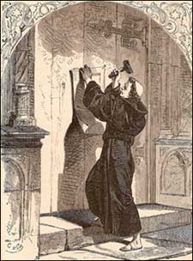
The Story Of Gog And Magog
Part Sixteen
THE REFORMATION AND GOG

Slide 2
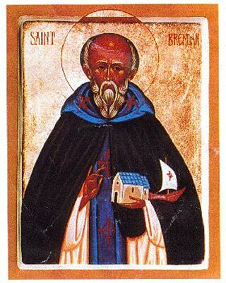
The Story Of Gog And Magog The Reformation
Europe, with its vast populations of pagan Hebrews, was rapidly converting to Christianity in the early centuries AD, following the preaching of the apostles, especially St. Paul very early in this period and later by the Culdees from Britain.

Slide 3
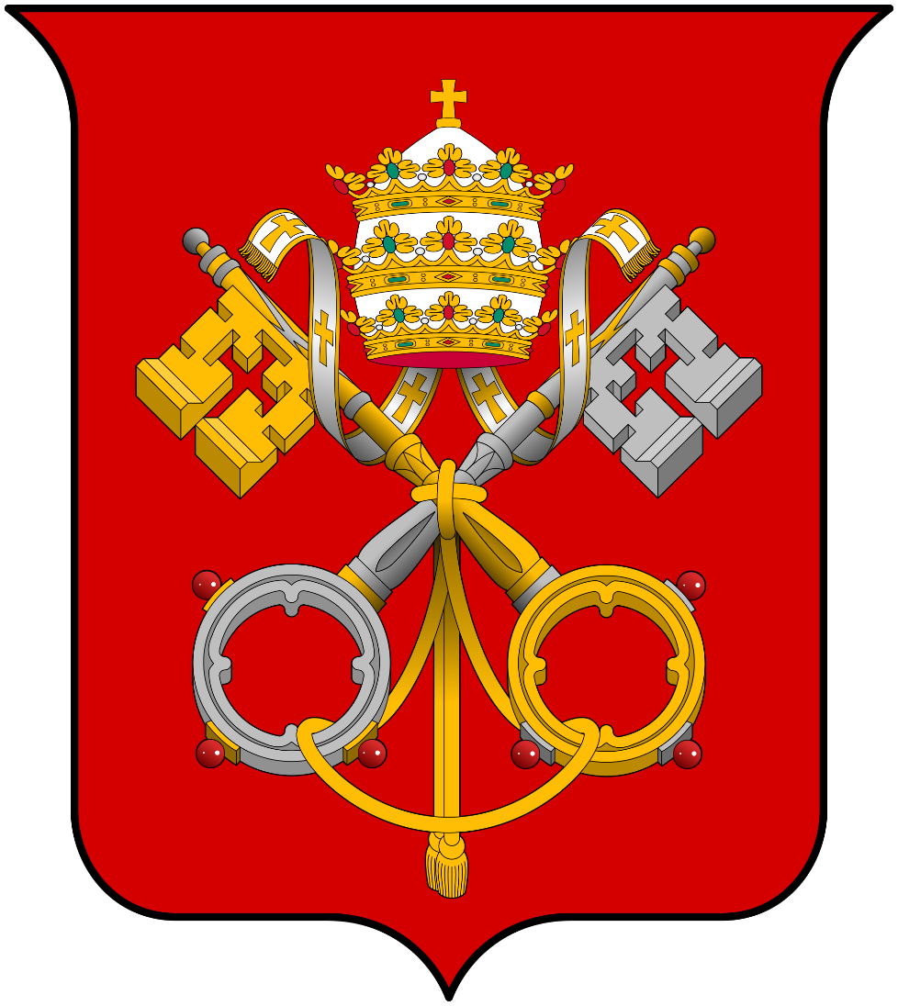
The Story Of Gog And Magog The Reformation
Yahweh’s enemies were now under threat, with his people returning to keeping the law. The enemy would now do all in its power to destroy Christendom and true Israel – this would be achieved by setting one group of his people against another and splitting them into various religious labels and sects. But first they had to be united into one organisation – The Catholic Church

Slide 4
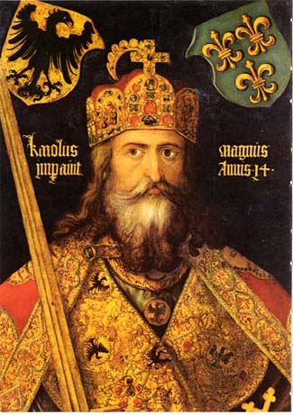
The Story Of Gog And Magog The Reformation
Charlemagne, or Charles the Great (742-847), to the Frankish throne in 768 – Instigated eighty-eight years of Carolingian fanatical Christian war upon the pagan peoples of Europe. In 782, Charlemagne ordered the forced baptism of all Saxons within lands captured by the Carolingian armies.

Slide 5
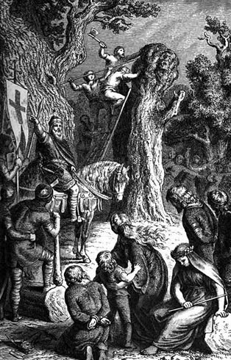
The Story Of Gog And Magog The Reformation
…nearly five thousand Saxons who were captured at Verden - close to present day Denmark - refused to convert, Charlemagne had them all put to death. The massacre sent shock waves around Europe and especially into Scandinavia. It was designed to do just that and divide Yahweh’s People.

Slide 6
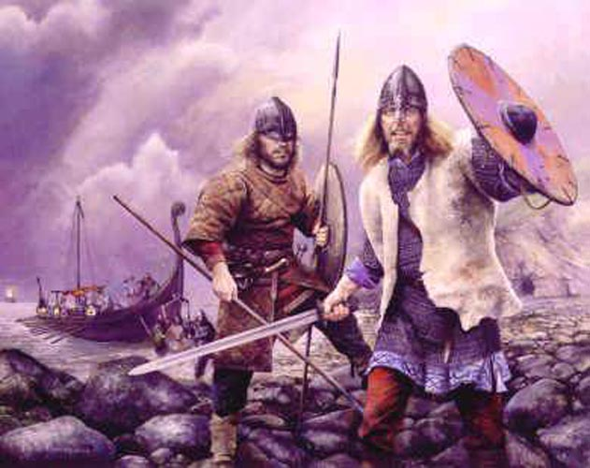
The Story Of Gog And Magog The Reformation
With this single, brutal act of wholesale religious and cultural genocide, panic flared within Northern Europe as fleeing Saxon refugees reported to Vikings communities, of the atrocities they had been subjected to by the sword of Christendom in the hands of Charlemagne's missionaries.

Slide 7
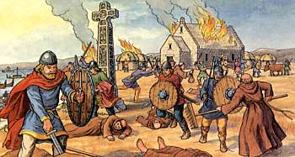
The Story Of Gog And Magog The Reformation
The Vikings would seek revenge and so attacked Christian communities in the UK and elsewhere, such as the massacre at Bangor, in County Down which was raided in AD 824. Around AD 832 there was a naval engagement between Vikings and Irish coracle fleet in Lough Neagh and Armagh.

Slide 8
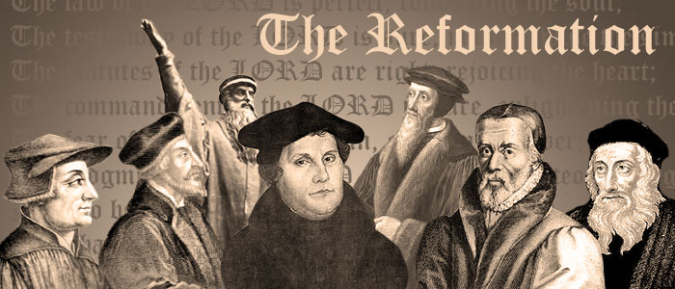
The Story Of Gog And Magog The Reformation
Charlemagne's massacre was one of the first of many that would occur, up to the present day, to keep Yahweh’s people divided and thereby controllable. We now jump to the “Reformation” a traumatic event lasting many centuries.

Slide 9
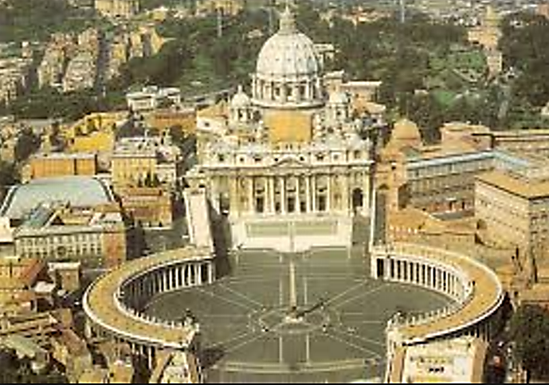
The Story Of Gog And Magog The Reformation
The Roman Catholic Church, founded in 500 AD, when the Bishop of Rome became the senior Bishop in Christendom, would start to decline after 1500 AD with the “reformation”, which would cause another split.

Slide 10
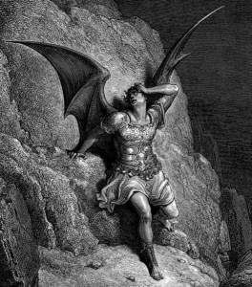
The Story Of Gog And Magog The Reformation
The Hey Day of The Roman Catholic Church, of 500 AD, to 1500 AD, was the 1000 years of chaining Satan (God’s adversaries the Jews) where their ability practice the evil of lending on usury was severely curbed. As in most prophetic time periods there can be several start and terminal dates, as there is with the thousand year chaining of the Devil! – But this is for another presentation

Slide 11
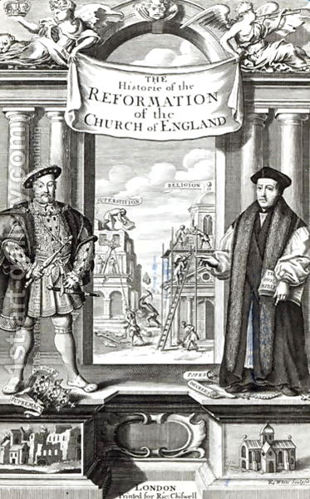
The Story Of Gog And Magog The Reformation
Most are unaware or only have a vague idea of the underlying forces driving the reformation, this presentation is an endeavour to show a more realistic history of it, which is not just a question of white against black i.e. Protestants against Catholics – it will be seen that there are muddy waters and undercurrents on both sides.

Slide 12
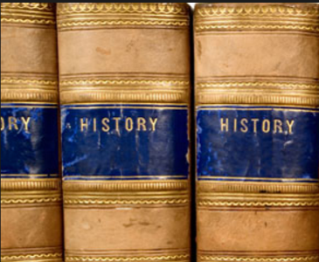
The Story Of Gog And Magog The Reformation
Those histories books we read, rarely mention the hidden hands moving potentates and armies as though they were chess pieces. With careful study we can, and by reading between the lines, we can see the hidden hand of Satan (the Jews), but the if we look even more carefully, we can see the hidden hand of Yahweh, who is all powerful and over-riding all!

Slide 13
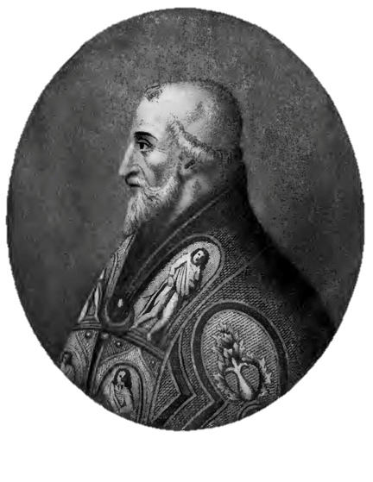
The Story Of Gog And Magog The Reformation
The Reformation was the second shock to befall the Roman Catholic Church, the first being the split with Constantinople and the rise of the Greek Orthodox Church, when Pope Leo IX (left) excommunicated the patriarch of Constantinople in 1054 AD – splitting the Great City of Revelation into 3 parts as foretold therein.
Notes:
These various factors finally came to a head in 1054 AD, when Pope Leo IX excommunicated the patriarch of Constantinople (the leader of the Eastern church). In response, the patriarch anathematized (condemned) the Pope, and the Christian church has been divided into West ("Roman Catholic") and East ("Greek Orthodox") ever since

Slide 14
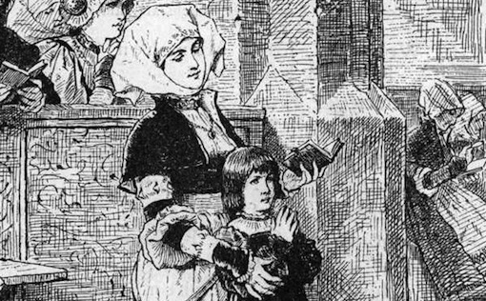
The Story Of Gog And Magog The Reformation
The enemy’s method of attacking the Church (congregation – ecclesia) has not changed since its inception. That is, to corrupt the church from within to such an extent that members keeping the faith are forced to leave, because of the leadership’s failure to effect reforms. This is basically how the “Reformation” came about.

Slide 15
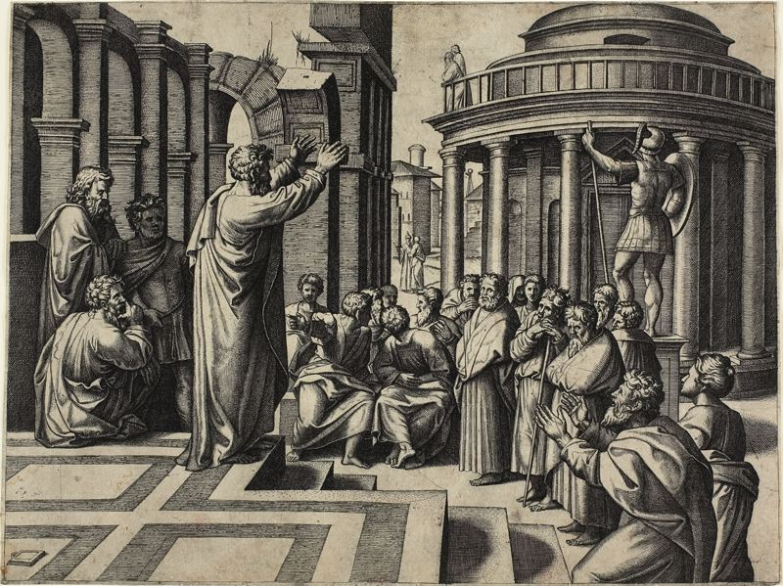
The Story Of Gog And Magog The Reformation
Even during the time of the apostles, the Scriptures record that certain people crept in unawares: “For there are certain men crept in unawares, who were before of old ordained to this condemnation, ungodly men, turning the grace of our God into lasciviousness, and denying the only Lord God, and our Lord Jesus Christ.” Jude 1:4

Slide 16
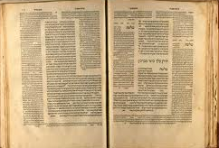
The Story Of Gog And Magog The Reformation
The Scriptures were obviously referring to the satanic seedline, whose communistic thought process requires uniformity in everything. This is contrary to nature as designed by Yahweh to have infinite variety! So they would try and apply it to the Church in the image of the Talmud (tradition of the Elders)

Slide 17
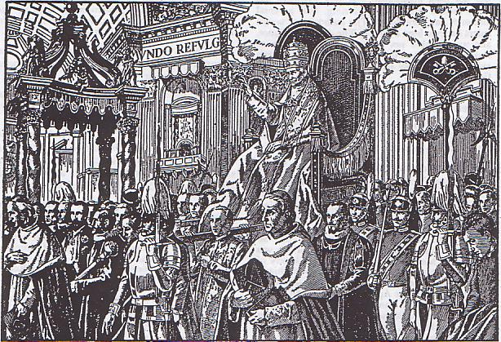
The Story Of Gog And Magog The Reformation
Originally Christendom consisted of many independent churches or congregations, with no overall leader, just local bishops. The enemy loves large organisations, because they are easy to infiltrate and control – to this end, the adversary worked feverishly to unite the churches under the Bishop of Rome (and it wasn’t Peter!).

Slide 18
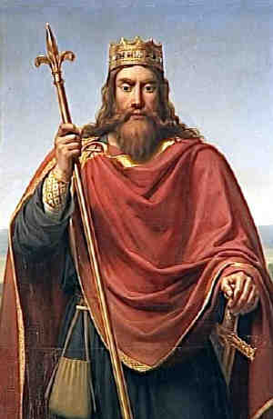
The Story Of Gog And Magog The Reformation
In 496 AD year Clovis, king of the Salian or Merovingian Franks, became the first of the pagan barbarians to adopt Catholicism. The Anglo-Saxons were still pagan, but all the other Germanic kingdoms had accepted the Arian form of Christianity. In the conversion of Clovis, the Catholic Church acquired a champion upon whose military might would hang the theological future of Europe.

Slide 19
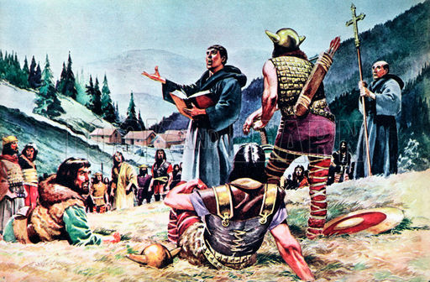
The Story Of Gog And Magog The Reformation
However, there was strong opposition to this centralising force. It arose in the East amongst the Goths who had been joined by some of their brethren from Galilee, as a result of the political upheavals following the destruction of the Temple in Jerusalem. That person was Ulfilas.

Slide 20
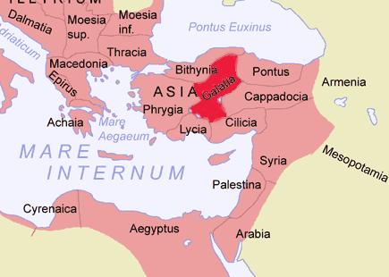
The Story Of Gog And Magog The Reformation
Since his ancestors were from Asia Minor (Galatia where the apostle Peter had been especially instructed by God to plant the gospel), Ulfilas was undoubtedly influenced by the doctrines of the apostles to the Hebrews;

Slide 21
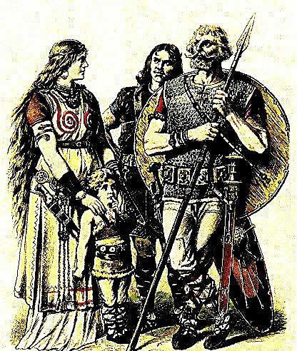
The Story Of Gog And Magog The Reformation
….as he rejected the liberal and unscriptural teachings which had flooded many western churches. He believed in the divine revelation of the Old Testament, as well as the New Testament. He impressed upon the Gothic people a simple, Christianity.

Slide 22
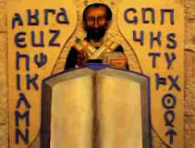

The Story Of Gog And Magog The Reformation
Ulfilas, Gothic Wulfila (born c. 311 —died c. 382, Constantinople [now Istanbul, Turkey]), Christian bishop and missionary who evangelized the Goths, reputedly created the Gothic alphabet, and translated the Bible into a Germanic language. Fragments of his life have come from 4th- and 5th-century ecclesiastical historians.

Slide 23
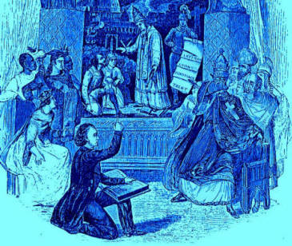
The Story Of Gog And Magog The Reformation
The Goths refused to believe as the church of Rome did. Consequently they have been branded as Arians, Romanism meant little to them. In fact, it meant little to Ulfilas, their great leader. The Goths refused to go along with the innovations being introduced into the church of the caesars, which church quickly branded any competitor as Arian." Benjamin Wilkinson, Truth Triumphant,

Slide 24
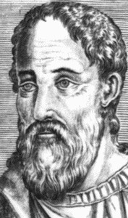
The Story Of Gog And Magog The Reformation
It was this Ulfilas who led the exodus of the pious ones. He was appointed and sent with others by the ruler of the Goths on an embassy in the time of Constantius II, they owed allegiance to the emperor, Ulfilas was elected by Eusebius (of Nicomedia - left) and the bishops of his party (the Arians) as bishop of the Christians in the Getic land.

Slide 25
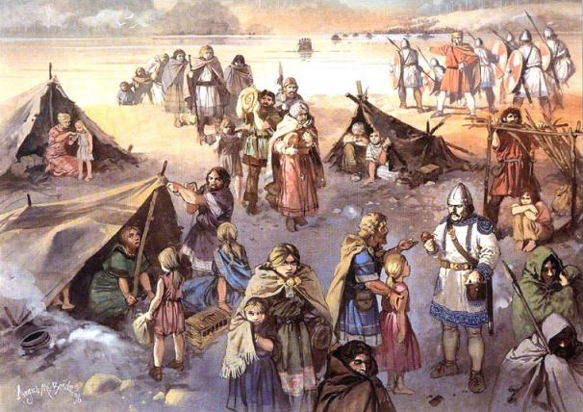
The Story Of Gog And Magog The Reformation
The Goths strong loathing of the papal paganising of Christianity was the main reason for their fierce opposition to the centralisation of Christendom under the Bishop of Rome (Pope)

Slide 26
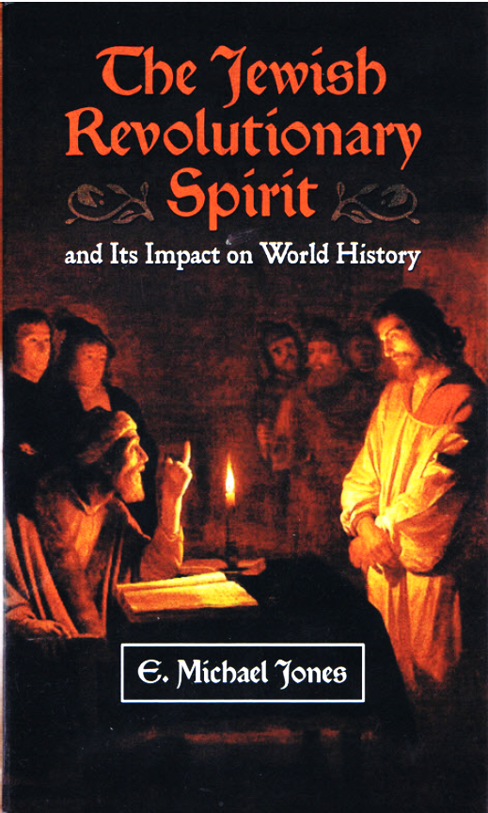
The Story Of Gog And Magog The Reformation
The church prohibited usuary, which prevented Jews from obtaining power, so it was necessary to destroy the church in its present form.
The following extract from a book by E. Michael Jones, “The Jewish Revoluntionary Spirit”, gives a clue as to how this was achieved church was to corrupt the church by subversive infiltration.

Slide 27
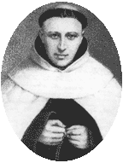
The Story Of Gog And Magog The Reformation
As well as the infiltration referred to in the Scriptures as previously mentioned, others confirm indeed this was the case, but this time going under the name of Jews in latter centuries. Those already entrenched would facilitate further infiltration by banning priests of the church from marrying….
Hermann Cohen – A Catholic Jewish Priest

Slide 28
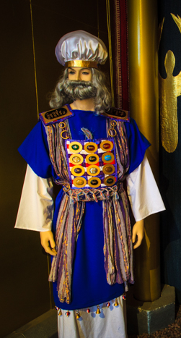
The Story Of Gog And Magog The Reformation
… the reason for this was to break the Levite hold over the church, as it would seem that there was a seamless transfer from Hebrew to the Christian form of worship. Because church leadership tended to run in families, banning of marriage would break the link.

Slide 29
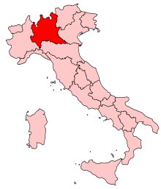
The Story Of Gog And Magog The Reformation
The area of north Italy known as Lombardy, gets its name from the Levites who settled there during tribal migrations – Lombardy is derived from Long Beards that were typical of the levites. Their removal from the church would pave the way for the false Israelites to take control.

Slide 30
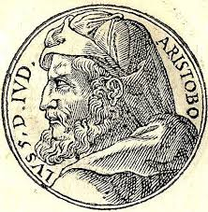
The Story Of Gog And Magog The Reformation
Those supplanting the Levites in Italy would be the Edomites, which was facilitated by the sacking of Jerusalem. The formidable Aristobulus was sent to Rome with his son Antigonus and a horde of Jewish (Edomite) prisoners….

Slide 31
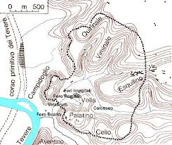
The Story Of Gog And Magog The Reformation
….whose descendants, known as libertini, or the emancipated, settled on the right bank of the Tiber on the slopes of the Vatican hill. The bridge across
the Tiber was known as the Pons Judaeorum, indicating the race of the settlers, and that they had been there for a long time.

Slide 32
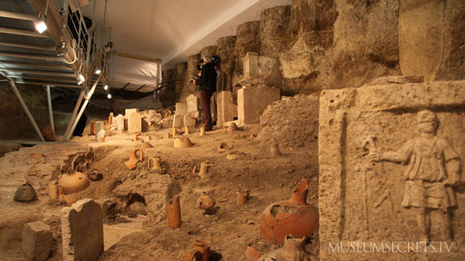
The Story Of Gog And Magog The Reformation
Old graves in the Vatican and Rome testify to the fact that celibacy of priests was not in force during the early years of the Roman church.

Slide 33
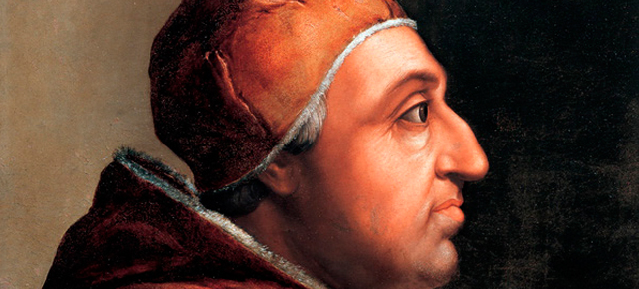
The Story Of Gog And Magog The Reformation
The Borgias and the Mediciis families were Jewish and some became Popes. Mrs Hayning writing in 'Woman's Voice', November 25, 1953, claimed there had been at least 20 up to her day and we known there have been more since.

Slide 34
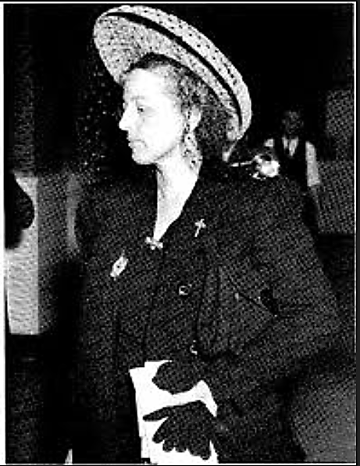
The Story Of Gog And Magog The Reformation
"Mrs. Van Hyning (left), I am surprised at your surprise. You are a student of history -- and you know that both the Borgias and the Mediciis are Jewish families of Italy. Surely you know that there have been Popes from both of these houses”.

Slide 35
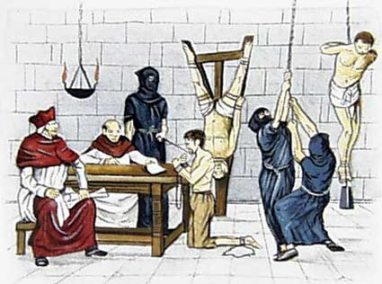
The Story Of Gog And Magog The Reformation
Mrs Van Hyning went on to say: “Perhaps it will surprise you to know that we have had 20 Jewish Popes, and when you have sufficient time, which may coincide with my free time, I can show you these names and dates. You will learn from these that: The crimes committed in the name of the Catholic Church were under Jewish Popes. The leaders of the inquisition was one: De Torquemada, a Jew.".

Slide 36
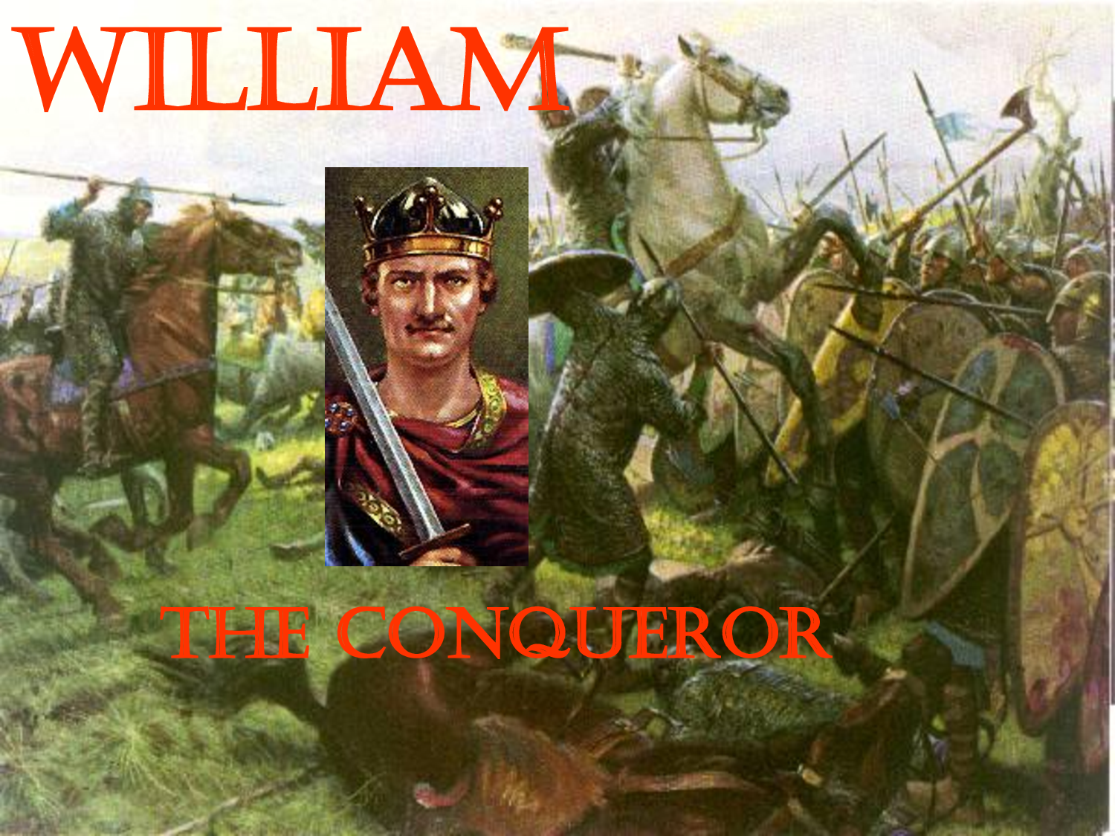
The Story Of Gog And Magog The Reformation
William the Conqueror’s invasion of England was a another stepping stone towards putting in place conditions that would facilitate the reformation, however it was not the kind of true Christianity envisaged – but a licence to loan money on usury!

Slide 37
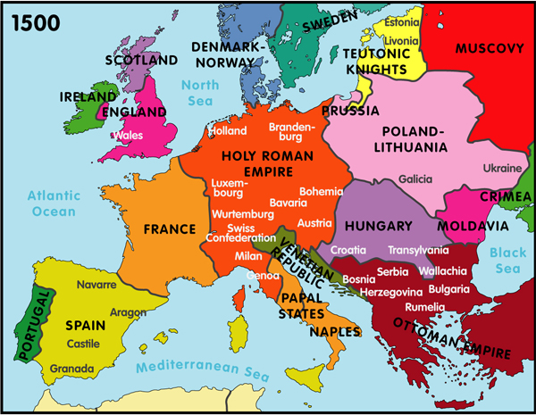
The Story Of Gog And Magog The Reformation
Events would occur as the 16th Century approached which would anger the Jews – elements within the Catholic Church were instigating measures to reverse the damage caused by infiltration in to European Christian society. This would result in a Jewish backlash known as the REFORMATION.

Slide 38
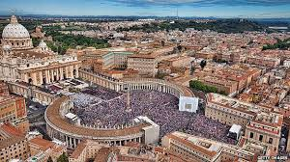
The Story Of Gog And Magog The Reformation
The Venetian Connection
The softening up of the Vatican would be by finance causing increasing corruption, plus other factors to be mentioned, thus making it ripe for attack and the further splitting of Christendom!

Slide 39
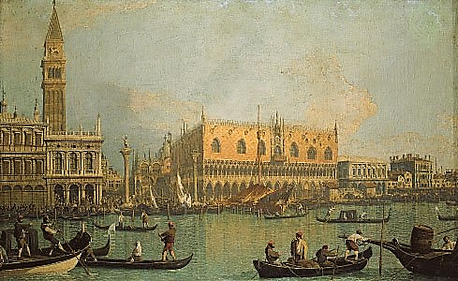
The Story Of Gog And Magog The Reformation
The Venetian Connection
The Venetian Bankers and Merchants through one of their Agents in Germany, would be the catalyst to hasten the planned split up of the Church of Rome. Additionally, they would conspire to get their agents into the Vatican, in order to speedily progress their plans. Thus fulfilling the prophecy that, that great city would split into three.
Venice

Slide 40
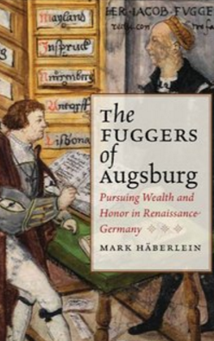
The Story Of Gog And Magog The Reformation
The Venetian Connection
That agent would be Jacob Fugger the wealthiest man who ever lived—Jacob Fugger (Until The Rothschilds)—the Renaissance banker, who revolutionized the art of making money and established the radical idea of pursuing wealth for its own sake.

Slide 41
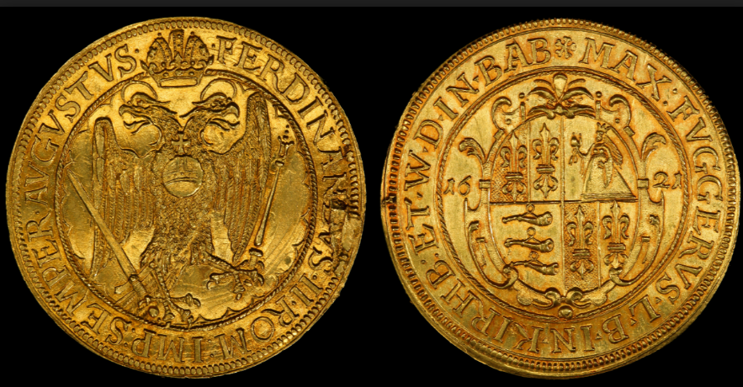
The Story Of Gog And Magog The Reformation
The Venetian Connection
Before Fugger came along it was illegal under church law to charge interest on loans, but he got the Pope to change that. He also helped trigger the Reformation and likely funded Magellan’s circumnavigation of the globe.
10 Ducats (1621) minted as circulating currency by the Fugger Family

Slide 42
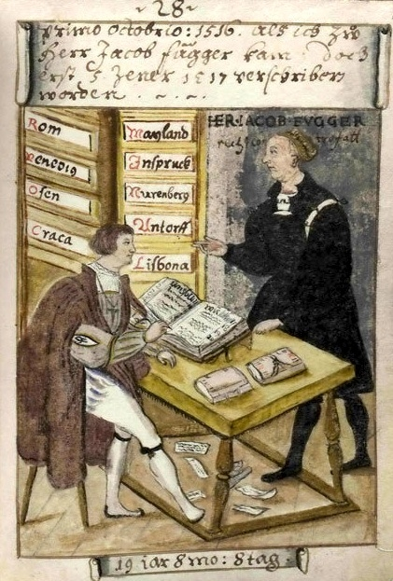
The Story Of Gog And Magog The Reformation
The Venetian Connection
Fugger created a news service, which gave him an information edge over his rivals and customers, knowledge and information is power – just like the Money Power today they were financing both sides!

Slide 43
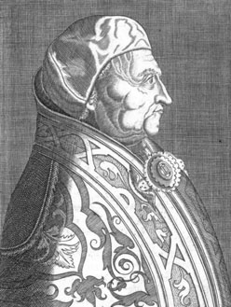
The Story Of Gog And Magog The Reformation
The Venetian Connection
Aeneas Silvius Piccolomini, Pope Pius II (left). Through their cooperation with the best representatives of Medici Florence in the time of the Council of Florence of 1439, Nicolaus and Aeneas Silvius saved western civilization from the Dark Age that had begun with the defeat of Frederick II of Hohenstaufen at the hands of the Black Guelph oligarchs.

Slide 44
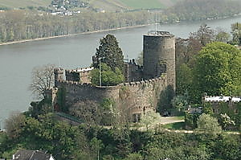
The Story Of Gog And Magog The Reformation
The Venetian Connection
Gregory of Heimburg, an eminent German doctor, was the thug and agent provocateur who attempted to sabotage the work of Pius II, Cusanus, and Bessarion. Thus a prominent representative of the anti-papal, anti-imperial current among the electors and other princes (Fűrsten) of the Holy Roman Empire.
Heimburg

Slide 45
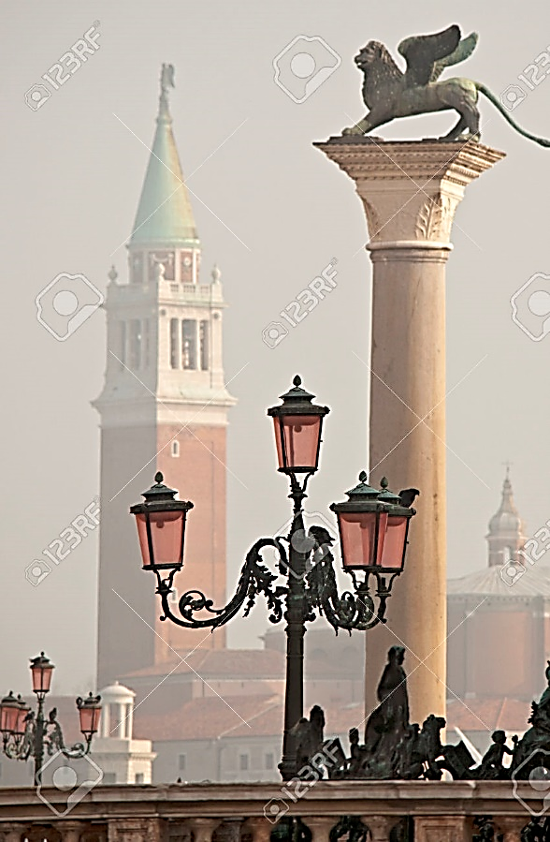
The Story Of Gog And Magog The Reformation
The Venetian Connection
The Venetians had been at war against the Italian renaissance of the Quattrocento or Renaissance, namely, the Conciliar Movement was a Christian reform movement in the 14th and 15th centuries in the Roman Catholic Church, which held that final authority in spiritual matters resided with the Church as a corporation of Christians, embodied by a general church council, not with the Pope.

Slide 46
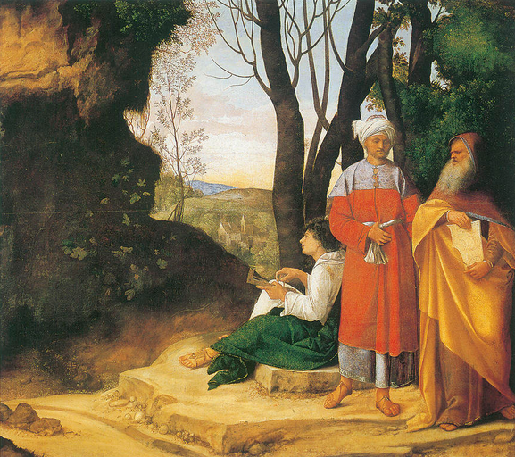
The Story Of Gog And Magog The Reformation
The Venetian Connection
The painting The “Three Philosophers'' hints at an important feature of Venetian methods, namely the strategy of dominating culture, religion, and politics through the expedient of concocting a series of Aristotelian cults or schools which then contend among each other.
The “Three Philosophers''

Slide 47
The Story Of Gog And Magog The Reformation
The Venetian Connection
There were other pressing reasons why the Venetians had to split and conquer the church – The Vatican Armies had almost succeeded in conquering Venice and its usurious bankers

Slide 48
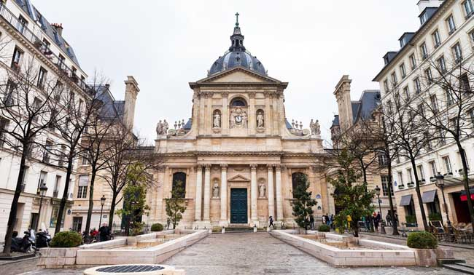
The Story Of Gog And Magog The Reformation
The Venetian Connection
In the 1400's the Aristotelian school-men of the Sorbonne were a formidable force in theology. But the Venetian oligarchs Giustinian and Quirini, in their pioneering 1513 reform proposals addressed to Pope Leo X attacked the decadent scholasticism of the Sorbonne.
The Sorbonne

Slide 49
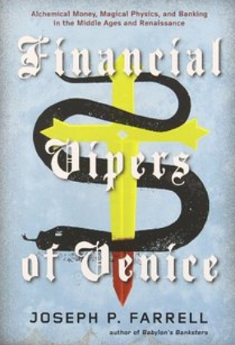
The Story Of Gog And Magog The Reformation
The Venetian Connection
What the Aristotelian school-men of the Sorbonne were trying to do through their theology, was to stamp out the corruption that had been creeping into the Church. However, that would not suit the Venetian Money Power, as it was first necessary to corrupt the Church, in order to split it.

Slide 50
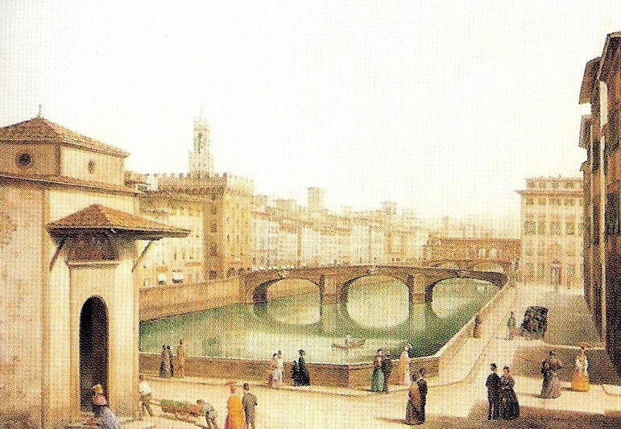
The Story Of Gog And Magog The Reformation
The Venetian Connection
The Christian church which this oligarchy (of Edomite infiltrators) sought then, and still today, to divide and conquer. These usurers and slave-traders hated most fiercely the 1439-1440 Council of Florence, which had reunited the church temporarily
Florence

Slide 51
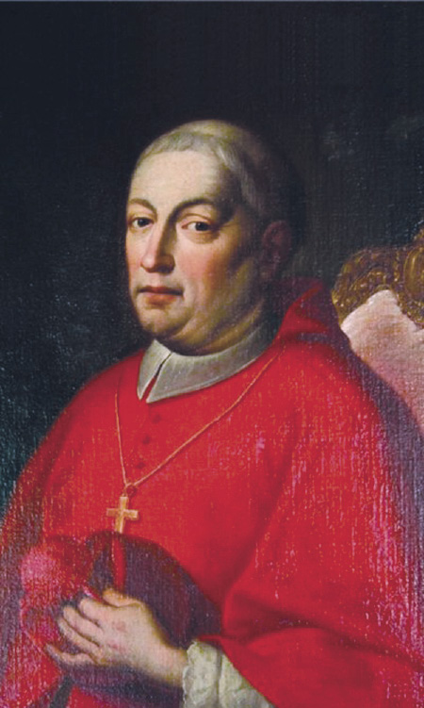
The Story Of Gog And Magog The Reformation
The Venetian Connection
They hated in the highest degree that Cardinal Nicolaus of Cusa, who had played a crucial role in bringing about that reunification. Having split off the Eastern branch (Orthodox) they were determined to further split the Church!
Cardinal Nicolaus of Cusa

Slide 52

The Story Of Gog And Magog The Reformation
The Venetian Connection
French conquest of Milan in 1494 and the sack of Rome in 1527, Italy was indeed devastated by these rival armies. But the entry of the new great powers into Italy also prepared the greatest shock in Venetian history: the War of the League of Cambrai. Fighting began in 1509.
War – The League Cambrai

Slide 53

The Story Of Gog And Magog The Reformation
The Venetian Connection
The League of Cambrai – Against Venice. It included just about all of Europe: the France of Louis XII, the Holy Roman Empire of Maximilan I, Spain, Pope Julius II, the King of Hungary, the Duke of Savoy, the King of Cyprus, the Dukes of Ferrara, Milan, Florence, Mantova. Some accounts include England

Slide 54

The Story Of Gog And Magog The Reformation
The Venetian Connection
Pope Julius II (left) was induced to drop out of the League of Cambrai, but between 1509 and 1513 the French forces, with Florentine money, kept the Venetians on the brink of doom. The state was close to bankruptcy, and had to borrow from the Chigi of Siena. It was also at this time that the Jewish community of Venice came into existence.

Slide 55

The Story Of Gog And Magog The Reformation
It will be shown that the REFORMATION was a plot to split the Catholic Church, in order to create another church in opposition, that would be a counterweight to Rome, but at the same time being an ally of the Jews and a vehicle to gain control.

Slide 56

The Story Of Gog And Magog The Reformation
First Shock: In I492 Spanish Jews were given 3 months to accept Christianity or leave Spain. This was a bad mistake, as the Spanish were to find out later. Jews pretended to be Christian, but carried on with their Talmudic plans to subvert Church in secret.

Slide 57

The Story Of Gog And Magog The Reformation
Second Shock: The Jews were further enraged when in 1509 Maximilian I, Emperor of Holy Roman Empire, gives permission for a converted Jew, Johann Pfefferkorn, to confiscate and destroy all Jew­ish books, especially the Talmud!

Slide 58

The Story Of Gog And Magog The Reformation
To do this took skilled artists like Michelangelo and lots of money. And what better place for Leo to get money than from Jakob Fugger (left). So it turned out that Jakob Fugger financed the building of what we know of as Vatican City, this was the beginning of a major financial crisis for the Catholic Church.

Slide 59

The Story Of Gog And Magog The Reformation
The first question is why is a very wealthy banker involved in religion at all? It turns out that in the year 1500 the city of Rome and its Holy Places were in disrepair. This effected many things including the Papacy that was highly dependent of Pilgrims expenditures and donations for support. That is, in modern terms, Rome was highly dependent on religious tourism.

Slide 60

The Story Of Gog And Magog The Reformation
Pope Leo X had expensive tastes. A true Renaissance man, he built up the Vatican Library (left), accelerated the construction of St. Peter's Basilica and poured lavish funds into the arts. But his efforts to renew Rome's position as a cultural centre took money. So much money, in fact, that within two years he had drained the papal treasury completely.

Slide 61

The Story Of Gog And Magog The Reformation
Pope Leo’s expensive tastes was the most immediate cause of the reformation, resulting his decision to grant indulgences, to all those who donate money for his massive reconstruction project for St. Peter's Basilica.

Slide 62

The Story Of Gog And Magog The Reformation
Dominican Friar Tetzel (left) was the best known of the indulgence sellers. The Friar's most famous jingle was "As soon as the coin in the coffer rings, a soul from Purgatory upward springs."

Slide 63

The Story Of Gog And Magog The Reformation
Another way Leo used to raise funds was to sell high church offices to Princes, who could pay the necessary money, (between 1495 and 1520 88 of 110 bishoprics in Germany, Hungary, Poland and Scandinavia were appointed by Rome on the basis of Fugger money transfers.

Slide 64

The Story Of Gog And Magog The Reformation
Pope Leo X has been listed in the top 10 most controversial Popes: Born Giovanni di Lorenzo de' Medici in Florence, he was the last non-priest to ever be elected to the papacy. Leo X was also pope when Martin Luther initiated the Protestant Reformation.

Slide 65

The Story Of Gog And Magog The Reformation
It was probably no coincidence that at the time of the Reformation, the reigning Pope was from the powerful Jewish banking family, the Medici’s of Venice who were to borrow from the Powerful Jewish Fugger Family. The Hidden Hand had calculated well the consequences that would lead to the breaking of the Roman Church’s stranglehold on the Christian religion, where usury was prohibited.
A medici Coat of Arms

Slide 66
The Story Of Gog And Magog The Reformation
Jakob Fugger as well as Pope Leo X played important roles in the unfolding of the protestant reformation.

Slide 67

The Story Of Gog And Magog The Reformation
Fugger [foog´ur] German family of merchant princes. The foundation of their wealth was laid by Hans Fugger, allegedly a weaver, who moved to Augsburg in 1367. His descendants built up the family fortune by trade and banking.

Slide 68

The Story Of Gog And Magog The Reformation
With Jacob Fugger II, 1459-1525, called Jacob the Rich, the house entered its zenith. The Fugger family owned extensive real estate, merchant fleets, and palatial establishments throughout Europe.
Fugger’s Castle in Kirchheim, Swabia

Slide 69

The Story Of Gog And Magog The Reformation
Jacob's fortune was largely built on a virtual monopoly in the mining and trading of silver, copper, and mercury. Jacob Fugger II lent immense sums to Holy Roman Emperor Maximilian I (left) and helped secure the election (1519) of Charles V as Holy Roman emperor by bribing the electors.

Slide 70

The Story Of Gog And Magog The Reformation
It can now be seen that there were far greater forces at play in triggering the reformation. Martin Luther was the leader. The powers that be had miscalculated the outcome of Martin Luther’s stance – that is, the Scriptures would become available in the vernacular tongue, exposing the unrighteousness of the church establishment!

Slide 71

The Story Of Gog And Magog The Reformation
The corrupt Roman Catholic Church had until the reformation, kept the Scriptures from being read by their adherents, allowing them to paganise and change over a long period the light spread amongst Yahweh’s true Israel now dispersed through Europe. This was a great shock to the establishment, so harsh measures were called for!

Slide 72

The Story Of Gog And Magog The Reformation
Confirmation that the “Reformation” was engineered can be gleaned from the following sources Firstly: We can boast of being the Creators of the Reformation! Calvin (Phillip II, by William Thomas Walsh, p. 248: ‘The origin of Calvin (whose real name was Chauvin)

Slide 73

The Story Of Gog And Magog The Reformation
Secondly: Lucin Wolf, in Transactions, Jewish Historical Society of England, Vol. XI, p. 8; Goris, Les Colonies Marchandes Meridionales Ö Anvers; Lea, History of the Inquisition of Spain, III, 413) Calvin was one of our Children; he was of Jewish descent, and was entrusted by Jewish authority and encouraged with Jewish finance to draft his scheme in the Reformation.

Slide 74

The Story Of Gog And Magog The Reformation
From The Masonic Handbook: Martin Luther yielded to the influence of his Jewish friends unknowingly, and again, by Jewish authority, and with Jewish finance, his plot against the Catholic Church met with success. But fortunately he discovered the deception, and became a threat to us, so we disposed of him as we have so many others who dare to oppose us...

Slide 75

The Story Of Gog And Magog The Reformation
Martin Luther initially was tied to the Jews because of their financial help and protection. He saw them as allies in his fight against corruption. He did not want to divide the Church (Contrary to the Jews wishes), but to reform it from within. This was not to be as he was outmanoeuvred by the Jews.

Slide 76

The Story Of Gog And Magog The Reformation
Martin Luther soon discovered the Jews’ real intent, namely that of eradicating Christianity from off the face of the earth and bring in the reign of anti-christ my means of usury. Soon after he wrote his book “On The Jews and Their Lies”, he met an untimely death!

Slide 77

The Story Of Gog And Magog The Reformation
Great efforts were made to “airbrush” Martin Luther out of the Reformation history without fully succeeding, although there are far more books in circulation written by Calvin, the Jew. So people now tend to think he was the major player in the reformation! However, Calvin (left) was responsible for steering the reformation back onto the path planned by the Jews!!

Slide 78

The Story Of Gog And Magog The Reformation
Today, Luther’s own church worship the anti-christ Edomite Jews, the murders’ of Christ and Martin Luther, which just goes to show how effective the enemies’ brainwashing has been! Left is a picture of an Estonian Lutheran church.

Slide 79

The Story Of Gog And Magog The Reformation
Another casualty of the “Reformation” was Pope Leo X himself, who died suddenly in Rome Dec. 1st 1521. He hadn't been ill and his death came so quickly that no one is able to administer last rites to him.

Slide 80

The Story Of Gog And Magog The Reformation
Some believed he had been poisoned, a fate not uncommon to members of the Medici family. We can only surmise it was because of his failure to deal with Martin Luther or perhaps he had reneged on the terms of the loan to the Vatican.

Slide 81

The Story Of Gog And Magog The Reformation
The influence of the Fuggers in the outcome of the meeting is born out by the fact that a meeting, called by the Pope to get Martin Luther to recant, held in October 1518, was held the Fuggers newly constructed house in Augsburg, no doubt from his profits from his loan to the Vatican!
The same Fugger House today

Slide 82

The Story Of Gog And Magog The Reformation
Cardinal Cajetan told Luther to recant his many statements at odds with the Papacy's positions. It was at Jakob Fugger's house where Luther refused to recant.
An inner courtyard in Fugger’s new house

Slide 83

The Story Of Gog And Magog The Reformation
That all this involved the Rem(us) / Fugger family in addition to the reforming Bishop Remus mentioned earlier, only goes to further confirm that it was the Jewish money power which was behind the Reformation.

Slide 84

The Story Of Gog And Magog The Reformation
Wilhelm Rem, the well-known Augsburg chronicler, was a contemporary of Jakob and married Jakob's sister Wallburga Fugger. While Jakob sided with the Pope Leo X, Wilhelm did not side with Pope Leo X (I wonder what Wallburga though of all this).

Slide 85

The Story Of Gog And Magog The Reformation
Georg Remus, the great grandson of Wilhelm Rem and Wallburga Fugger, became Vice Chancellor of the newly established Protestant Altdorf University and helped to codify the law in protestant Germany.

Slide 86

The Story Of Gog And Magog The Reformation
No doubt the Fuggers involvement with the Protestant University of Altdorf, would be a means of influencing Christians into accepting Jewish lending on usury.
Altdorf University Herb Garden

Slide 87

The Story Of Gog And Magog The Reformation
The German Peasants' War was Europe's largest and most widespread popular uprising prior to the French Revolution of 1789. The fighting was at its height in the spring and summer of 1525.

Slide 88

The Story Of Gog And Magog The Reformation
Around 1520 there were many people both inside and outside the church concerned about financial and moral corruption of the church and her clergy. Bishop Rem of Augsburg and Cardinal Lang of Salzburg were two such concerned insider reformers. Martin Luther was an insider too (he was an Augustinian monk) and was concerned about all of the above too but especially about indulgences for future sins.

Slide 89

The Story Of Gog And Magog The Reformation
Aegridus Rem(us) of Augsburg was a man of great learning and skills. He had an outstanding education. He was an important advisor to Cardinal Lang of Salzburg on matters of religion and Catholic Church reform.
Lookout Tower on the wall of the ancient city of Augsburg

Slide 90

The Story Of Gog And Magog The Reformation
He served the last ten years of his life as the Bishop of Chiemsee (a diocese about half way between Munich and Salzburg), within the realm of the Archbishop of Salzburg, Cardinal Mattaus Lang. He was intimately involved in efforts to reform the Catholic Church at the time of the Reformation.
The Chiemsee

Slide 91

The Story Of Gog And Magog The Reformation
A conference was held in Mühldorf (Der Mühldorfer Reformkonvent) in 1522 in order to reform the Catholic church to prevent a split. The learned Bishop Rem was a major voice. A reform was not in the interests of the “Hidden Hand”!
Mühldorf

Slide 92

The Story Of Gog And Magog The Reformation
With the recent death of Pope Leo X, those intent on removing corruption from the church saw an opportunity to effect their aims while at the same time, implementing Martin Luther’s 95 conditions he nailed to the Wittenberg church in 1517. Sadly, this was not to be.

Slide 93

The Story Of Gog And Magog The Reformation
Because the Vatican was in debt to the money power it was possible for trading monopolies to be established in Germany and because of the Emperor's debts to Jakob Fugger 9left in his office). (At this point the Fugger family seems to be to the Holy Roman Empire what Rothschilds were to Europe in 1800's and 1900's, the "money power ruling State and Church"

Slide 94

The Story Of Gog And Magog The Reformation
The sucking money out of the economy to pay the Vatican’s Debt to Fugger had other consequences, not least was the peasants revolt of 1526, caused by decrease of incomes.

Slide 95

The Story Of Gog And Magog The Reformation
Still seven years later the annual incomes were only 80,000 guldens instead of 100,000 guldens in former times. In addition the rebellious farmer's losses were substantial. The farmers were blamed for the problem rather than the financiers

Slide 96

The Story Of Gog And Magog The Reformation
The German Peasants' War, Great Peasants' War or Great Peasants' Revolt (German: Deutscher Bauernkrieg) was a widespread popular revolt in the German-speaking areas of Central Europe, 1524–1525. It failed because of the intense opposition of the aristocracy, who slaughtered up to 100,000 of the 300,000 poorly armed peasants and farmers.
Map showing the locations of the peasant uprisings and major battles

Slide 97

The Story Of Gog And Magog The Reformation
We can see that the Jews are satisfied that the Protestant Church is fully allied to the Anti-Christ by this statement in: (F. Marsoudon (left): Le Temple, September / October. 1946, p. 34) “We have no problems with the Protestant Churches; our existing relationship is the same as that existing between Free Masonry and the Synagogue; the only problem we have is the opposition of the Roman Catholic Church”

Slide 98

The Story Of Gog And Magog The Reformation
The untimely death of Pope Leo X paved the way for Jew Ignatius of Loyola (left) who founded the Society of Jesus, after being wounded in battle and experiencing a religious “conversion”. This religious order formed of “conversos” (Catholic Jews) became known as the Jesuits and has remained the Jewish arm of the Catholic Church to the present time.

Slide 99

The Story Of Gog And Magog The Reformation
John Calvin, born Jehan Cauvin: 10 July 1509 – 27 May 1564), was an influential French theologian during the Protestant Reformation and would be a counter weight to Martin Luther, charged with steering the Reformation in accordance with the Jews plans which were primarily - 1. Ingratiating the Jews as “God’s Chosen” with the Protestants and 2. Making usury acceptable to Protestants.

Slide 100

The Story Of Gog And Magog The Reformation
John Calvin played a major role in the “Reformation”, supplanting Martin Luther as its leader. The subject of Martin Luther is too extensive to be covered in this presentation, but is covered in Part 14 of this series.

Slide 101

The Story Of Gog And Magog The Reformation
The early 1550’s saw great changes that were to have profound affects on true Israel gathered in Europe, with the ending of the 1000 reign of Yahweh’s people albeit imperfect setting the scene for the rise of the 8th beast and the Anti-Christ Jews wresting power from Jacob Israel. During this period, a wonderful church was constructed in the German town of Rostock (left):

Slide 102

The Story Of Gog And Magog The Reformation
Rostock is a wonderful medieval town with some very impressive buildings. One being the Kirche (St Mary’s Church) built in the 1550’s with a magnificent organ of 5700 pipes, original Astronomical clock from 1472 that has a zodiac, an eternal calendar and a chime where the apostles rotate and are blessed by a central Jesus (which we hear and see at 12.00pm). Was this a warning of the momentous events that were to shortly take place?

Slide 103

The Story Of Gog And Magog The Reformation
Yahweh’s Church would come under massive attack. The Jesuits would corrupt the Catholic Church still further as well as infiltrating protestant churches. This attack would later spawn many other characters, such as Voltaire, Weishaupt, Darwin, and many others would promote atheism and undo the good work of Martin Luther.

Slide 104

The Story Of Gog And Magog The Reformation
Another blow to the Catholic Church during this period was the divorce of King Henry VIII, and subsequent declaration, that he was defender of the faith, with papal influence banished from his realm in 1533. The Pope at this time was too weakened to override this decision.

Slide 105

The Story Of Gog And Magog The Reformation
Yet another disaster to befall the papacy, was the sack of Rome by Emperor Charles 1st of Spain’s troops and holding Pope Clement VII prisoner on 6th May 1527. It was for this reason that he was unable to grant King Henry VIII a divorce, as he did not want to offend Emperor Charles.
The Sack of Rome AD 1527

Slide 106

The Story Of Gog And Magog The Reformation
Emperor Charles 1st of Spain’s was also Charles V (left), Emperor of The Holy Roman Empire. Charles is best known for his role in opposing the Protestant Reformation. However, he may have been tricked into sacking Rome and taking the Pope prisoner.

Slide 107

The Story Of Gog And Magog The Reformation
Emperor Charles V was financed by a "Rabbi" named Josel of Rosheim. "Jew" Josel of Rosheim (left) was even more determined than the emperor to stop the awakening of true Israel. It may be that Charles was told that the Pope was not a safe pair of hands, and feared that he might capitulate to Luther's demands. A united church was to be avoided at all costs!

Slide 108

The Story Of Gog And Magog The Reformation
Maximilian I appointed Josel as governor of all Jews in Germany, a position confirmed after his death by his grandson, Charles V. The Kabbalah "Rabbi" also financed the huge Muslim army that attempted to invade Germany in 1529 via Vienna

Slide 109

The Story Of Gog And Magog The Reformation
The Jewish financed Turkish invasion from money extracted from the Germans by usury was halted at the gates of Vienna. The spring and summer of 1529 saw the worst torrential downpours in the history of Europe. The incessant rain delayed the Muslim army, and the roads became impassable, so the massive siege cannon had to be abandoned.
The 1529 siege of Vienna

Slide 110

The Story Of Gog And Magog The Reformation
The Tribunal of the Holy Office of the Inquisition (Spanish: Tribunal del Santo Oficio de la Inquisición), known as the Spanish Inquisition (Inquisición española), Established in 1478 by Ferdinand II of Aragon and Isabella I of Castile, for the purpose to root out Jewish & Muslim corruption of Church & State.
Ferdinand II of Aragon and Isabella I of Castile

Slide 111

The Story Of Gog And Magog The Reformation
During Luther’s 30-plus years as a fearless Reformer, Saint Martin had to contend with no less than 4 Popes. It was a dangerous time to be a Pope! The hidden hand within the Catholic Church, had to prevent at all costs the reforms demanded by Luther from being implemented as they wanted a divided church!

Slide 112

The Story Of Gog And Magog The Reformation
The Spanish Inquisition instigated in 1478 only ended on15 July 1834. It was under the control of the monarchy and not the papacy as can be seen from the inquisition seal (left). Its purpose to root out Jews who had corrupted state and church institutions. No doubt the monarchy were aware the Papacy itself was corrupt, hence the inquisition being under their control.

Slide 113

The Story Of Gog And Magog The Reformation
The birth period of the Reformation was a dangerous time for both Popes and the reformers, as the “powers that be” struggled to stop the spread of the Scriptures in the vernacular tongue. The reason being that people would come to realise how they had been duped by formal religion.
Wittenberg

Slide 114

The Story Of Gog And Magog The Reformation
The name “Reformation” is a misnomer as the Roman Catholic Church never did reform, instead the dissenters separated and divided the Church. This is precisely what the Jews wanted!

Slide 115

The Story Of Gog And Magog The Reformation
Telemachus Thomas Timayenis (left), in his book, “The Original Mr. Jacobs” says, Protestantism however, was profitable to the Jew. It gave him the opportunity to enfranchise himself, and permitted him to remain in Germany, where he again exercised his usurious nature, from which the Church, with a maternal solicitude, during many a century protected the Aryan.

Slide 116
The Story Of Gog And Magog The Reformation

Slide 117
The Story Of Gog And Magog The Reformation

Slide 118

The Story Of Gog And Magog The Reformation
That On June 16, 1701 King William III issue a charter forming an organisation known as Society for the Propagation of the Gospel in Foreign Parts, also known as SPG, also known as “Society”, now known as The United Society for the Propagation of the Gospel, also now known as USPG. Notice the snake disguised as a banner between the ship and land, replete with forked tongue

Slide 119

The Story Of Gog And Magog The Reformation
----also now known as USPG. That this organisation was established for the purpose of criminal enterprise, specifically, the unlawful kidnap, detainment, transport and sale of individuals for the purpose of international slavery.

Slide 120

The Story Of Gog And Magog The Reformation
---This organisation did become one of the largest and most infamous slave trading enterprises in human history, including the deliberate “branding” of human beings with the word “society” to denote them as the property of SPG,

Slide 121

The Story Of Gog And Magog The Reformation
---slaves were literally worked to death on the plantations, of the Anglican Church and SPG, and that little to no care was taken for their well being, safety, nor spiritual education.

Slide 122

The Story Of Gog And Magog The Reformation
Under the infamous pretence of treason that the tyrant Thomas Cromwell, hanged and ripped up and quartered the Abbot of the famous Abbey of Glastonbury, whose body was mangled by the executioner, and whose head and limbs were hung up on what is called the Torre which overlooks the abbey.

Slide 123

The Story Of Gog And Magog The Reformation
Executed 1540 Thomas Cromwell served as the king's main advisor from 1532 to 1540. He was the one who finally succeeded in getting the king his divorce. It's possible that Cromwell was the mastermind behind the whole English Reformation and agent for the money lenders.

Slide 124

The Story Of Gog And Magog The Reformation
Before four years had passed over his head, Henry VIII found himself as poor as if he had never confiscated a single convent, so sharp-set were the pious reformers (no doubt Jews), and so eager to "please Almighty God“!!! When complaining to Thomas Cromwell (left) – he said “By our Lady, the cormorants, when they have got the garbage, will devour the dish”

Slide 125

The Story Of Gog And Magog The Reformation
The Act of Reformation allowed the plunder of church property to go the King or to his assigns. Initially only the smaller properties were looted as the larger estates might prove more difficult.

Slide 126

The Story Of Gog And Magog The Reformation
The King had soon to stop his plundering, due to clamour from his assignees wanting part of the booty. But though we are not told who these assignees were, one can be sure that they were "God's chosen", because as always they work behind the scenes.

Slide 127

The Story Of Gog And Magog The Reformation
Until the plunder of the wealth of the Church, there was no need for a poor relief act, or the work house, for over 900 years prier to the “Reformation” there was no need, as the wealth of the country was generally generated locally and expended locally!

Slide 128

The Story Of Gog And Magog The Reformation
An Act of Parliament was passed, in March, 1536, the same year that saw the end of Anne Boylen, for the suppression, that is to say, confiscation, of three hundred and seventy-six Monasteries, and for granting their estates, real and personal, to the King and his heirs!

Slide 129

The Story Of Gog And Magog The Reformation
However, the Act to plunder the monasteries languished in the Lower House – it was not passed until pressure was applied, namely:- the King commanded the Commons to attend him in the forenoon in his gallery, where he let them wait till late in the afternoon,…

Slide 130

The Story Of Gog And Magog The Reformation
---- then, coming out of his chamber, walking amongst them at last he said, looking angrily on them, he at last said, “I hear that my bill will not, pass; but I will have it pass, or I will have some of your heads; and, without other rhetoric, returned to his chamber. Enough was said; the bill passed, and all was given him as he "desired."

Slide 131

The Story Of Gog And Magog The Reformation
He took plate, jewels, gold and silver images and ornaments. This act of monstrous tyranny was, however, base as the Parliament was, and full as it was of greedy plunderers, not passed without some opposition.
Glastonbury Abbey today after the Plunder Henry VIII

Slide 132

The Story Of Gog And Magog The Reformation
The men at this leading the Reformation were, in fact, fit to be the subalterns of such a chief. Some of the very worst men in all England; men of notoriously infamous characters; men who had been convicted of heinous crimes, some who had actually been branded; Just like today.
Cranmer

Slide 133

The Story Of Gog And Magog The Reformation
Thomas Cromwell, whose first name, along with that of Cranmer, ought to stand for, aye accursed in the calendar. This Cromwell was the son of a blacksmith of Putney, in Surrey. He had been an underling of some sort in the family of Cardinal Wolsey and had recommended himself to the king by his sycophancy to him, and his treachery to his old master.

Slide 134

The Story Of Gog And Magog The Reformation
William Cobbett (1825) …Even in our own times we see the people of Spain rising in defence of their monasteries; and we hear the Scotch "feelosofers" abuse them, because they do not like to see the property of those monasteries transferred to English Jews
Tintern Abbey

Slide 135

The Story Of Gog And Magog The Reformation
A number of sources refer to corruption creeping (Gog) into the Church during the 13th Century as commented upon by Du Pin’s voluminous ecclesiastical History written at the turn of 17th century

Slide 136

The Story Of Gog And Magog The Reformation
It has been observed by Monsieur Du Pin and others, That School-Divinity was corrupted in the 13th Century, by introducing into it the Principles of Aristotle's Philosophy, whereby all Matters of Doctrine were resolved into a great many curious and useless Questions----

Slide 137

The Story Of Gog And Magog The Reformation
----and decided by the Maxims of that Philosophy (which yet was learned not from the Greek Originals, but the corrupt Versions of the Arabians) as if they were of equal Authority with the Scriptures: And as this mixture corrupted the Simplicity of the ancient Christian Faith, so it was the cause of many Mischiefs.

Slide 138
The Story Of Gog And Magog
Part Sixteen – Section Elizabeth I
THE REFORMATION AND GOG

Slide 139
The Story Of Gog And Magog The Reformation – Elizabeth I
SAINT BARTHOLOMEW’S DAY MASSACRE OF THE HUGUENOTS
More Killing of True Israelites Under The Guise of “The Reformation” and The Plunder of Wealth by Gog

Slide 140
The Story Of Gog And Magog The Reformation – Elizabeth I
Please note other sections from the start of the Reformation and after this section will be added as and when they are ready.

Slide 141

The Story Of Gog And Magog The Reformation
SAINT BARTHOLOMEW’S DAY MASSACRE OF THE HUGUENOTS
The infamous massacre of the French Huguenots is not what we have been led to believe, it was a devilish plan to divide and create division between the peoples of Europe, on religious grounds through the machinations of the treacherous Gaspard de Coligny – leader of the Huguenots in France and “Good Queen Bess of England”

Slide 142

The Story Of Gog And Magog The Reformation
SAINT BARTHOLOMEW’S DAY MASSACRE OF THE HUGUENOTS
This massacre took place at Paris, in the year 1572, and in the 14th year of Elizabeth's reign; and, as it belongs to the history of that day. It was, in fact, in part, produced by her own incessant and most mischievous intrigues. As such it has been put to good effect in opening a great chasm between Europeans and stigmatising the Catholics, even to this day.

Slide 143

The Story Of Gog And Magog The Reformation
SAINT BARTHOLOMEW’S DAY MASSACRE OF THE HUGUENOTS
If one looks carefully, the similarity between the St. Bartholomew's Day massacre and the Holocaust of World War II can be seen. In both instances, the number killed were vastly overstated….

Slide 144

The Story Of Gog And Magog The Reformation
SAINT BARTHOLOMEW’S DAY MASSACRE OF THE HUGUENOTS
…..both served to cover up an even greater massacre. The massacre of the Huguenots would cover up the vast number of both Catholics and Protestants, put to death in England while good Queen Bess was on the throne!

Slide 145

The Story Of Gog And Magog The Reformation
SAINT BARTHOLOMEW’S DAY MASSACRE OF THE HUGUENOTS
Like all Gog’s Traitorous agents, Gaspard de Coligny, is remembered by this fine monument in Paris.
Before going into the background, we shall first look at the falsity of the numbers of Huguenots claimed to have been massacred.

Slide 146

The Story Of Gog And Magog The Reformation
SAINT BARTHOLOMEW’S DAY MASSACRE OF THE HUGUENOTS
By some Protestant writers, the whole number of people killed has been made to amount to a hundred thousand by an account, published in 1582, But as with the modern holocaust the numbers kept dropping - 100,000; then fell to 70,000; then to 30,000; then to 20,000; then to 15,000; and, at last, to 10,000!
A Picture Depicting The Massacre in Paris

Slide 147

The Story Of Gog And Magog The Reformation
SAINT BARTHOLOMEW’S DAY MASSACRE OF THE HUGUENOTS
The real number made up from accounts, collected from the ministers in the different towns, made; the number, for all France, amount to only 786 persons! Dr. Lingard (left) with his usual fairness, says, "if we double this number, we shall not be far from the real amount”

Slide 148

The Story Of Gog And Magog The Reformation
SAINT BARTHOLOMEW’S DAY MASSACRE OF THE HUGUENOTS
Even this number truly horrible to think of; but not half so great as that of those English Catholics whom "good Queen Bess" had, at this time (the 14th year of her reign), caused to be ripped up, racked till the blood came out of their sockets, or caused to be dispatched, or die, in prison, or in exile.

Slide 149

The Story Of Gog And Magog The Reformation
SAINT BARTHOLOMEW’S DAY MASSACRE OF THE HUGUENOTS
---and this, too, observe, not for rebellions, treasons, robberies and assassinations, like those of Coligni and his followers; but, simply and solely by adhering to the religion of their and her fathers, which religion she had openly practised for years, and to which religion she had most solemnly sworn that she sincerely belonged!

Slide 150

The Story Of Gog And Magog The Reformation
SAINT BARTHOLOMEW’S DAY MASSACRE OF THE HUGUENOTS
To discover the cause of the massacre we go back to reign of Mary, whose days were, "Few and full of sorrow“, and the war with France

Slide 151

The Story Of Gog And Magog The Reformation
SAINT BARTHOLOMEW’S DAY MASSACRE OF THE HUGUENOTS
Under Queen Mary, Calais was an English possession, but towards the end of her reign it came under threat. She was ill advised by her counsel who told her that the 500 soldiers would be sufficient to deal with the danger. Of course it wasn't! Calais fell to the French.
The Siege of Calais

Slide 152

The Story Of Gog And Magog The Reformation
SAINT BARTHOLOMEW’S DAY MASSACRE OF THE HUGUENOTS
Further, Doctor Heylin tells us, that Philip, seeing that danger might arise to Calais, advised the Queen of it, and freely offered his assistance for the defence of it; but, the English Council, jealous of Philip, neglected both his advice and proffer.
Doctor Heylin

Slide 153

The Story Of Gog And Magog The Reformation
SAINT BARTHOLOMEW’S DAY MASSACRE OF THE HUGUENOTS
In 1558 Philip and the King of France began negotiations for peace; one of the conditions of Philip was, that Calais should be restored to England; and this unquestionably would have been adhered to by Philip; but, in the midst of these negotiations, Mary died.
King Philip

Slide 154

The Story Of Gog And Magog The Reformation
SAINT BARTHOLOMEW’S DAY MASSACRE OF THE HUGUENOTS
Elizabeth, during the reign of her brother, had been a Protestant, and during the reign of her sister, a Catholic. At the time of her sister's death, she not only went to mass publicly; but, she had a Catholic chapel in her house, and also a confessor. These appearances had not, however, deceived her sister,
Queen Mary

Slide 155

The Story Of Gog And Magog The Reformation
SAINT BARTHOLOMEW’S DAY MASSACRE OF THE HUGUENOTS
On her death bed, honest and sincere Mary required from her a frank avowal of her opinions as to religion. Elizabeth, in answer, prayed God that the earth might open and swallow her, if she were not a true Roman Catholic.
Queen Mary’s Death

Slide 156

The Story Of Gog And Magog The Reformation
SAINT BARTHOLOMEW’S DAY MASSACRE OF THE HUGUENOTS
She made the same declaration to the Duke of Feria, the Spanish envoy, whom she so completely
deceived, that he wrote to Philip, that the accession of Elizabeth would make no alteration in matters of religion.
Duke of Feria

Slide 157

The Story Of Gog And Magog The Reformation
SAINT BARTHOLOMEW’S DAY MASSACRE OF THE HUGUENOTS
In spite of all this, it was not long before she began ripping up the bowels of her unhappy subjects, because they were Roman Catholics.
An Elizabethan Execution

Slide 158

The Story Of Gog And Magog The Reformation
SAINT BARTHOLOMEW’S DAY MASSACRE OF THE HUGUENOTS
Elizabeth was a bastard by law. The marriage of her mother had been, by law, which yet remained un-repealed, declared to be null and void. Her accession having been, in the usual way, notified to foreign powers, that is, that she had succeeded to the throne by hereditary right and the consent of the nation.
The Coronation

Slide 159

The Story Of Gog And Magog The Reformation
SAINT BARTHOLOMEW’S DAY MASSACRE OF THE HUGUENOTS
---The Pope answered, that he did not understand the hereditary right of a person not born in lawful wedlock. So that he, of course, could not acknowledge her hereditary right. This was, of itself, a pretty strong inducement for a lady of so flexible a conscience as she had, to resolve to be a Protestant.
Pope Pius V

Slide 160

The Story Of Gog And Magog The Reformation
SAINT BARTHOLOMEW’S DAY MASSACRE OF THE HUGUENOTS
There was another and even a stronger motive. Mary, Queen of Scotland, wife of Dauphin of France, claimed the crown of England, as the nearest legitimate descendant of Henry VII. So that Elizabeth ran a risk of losing the crown, unless she became a Protestant, and crammed CRANMER'S creed down the throats of her people.
Cranmer

Slide 161

The Story Of Gog And Magog The Reformation
SAINT BARTHOLOMEW’S DAY MASSACRE OF THE HUGUENOTS
If she remained a Catholic, she must yield submission to the decrees from Rome: the Pope could have made it a duty with her people to abandon her; or, at the very least, he could have greatly embarrassed her. In short, she saw clearly, that, if her people remained Catholics, she could never reign in perfect safety.
Pope Pius V

Slide 162

The Story Of Gog And Magog The Reformation
SAINT BARTHOLOMEW’S DAY MASSACRE OF THE HUGUENOTS
If Elizabeth were set aside, or, if she died without issue before Mary, England must become an appendage of France. The loss of Calais and of Boulogne had mortified the nation enough; but, for England herself to be transferred to France, was what no Englishman could think of with patience.
Mary Queen of Scots

Slide 163

The Story Of Gog And Magog The Reformation
SAINT BARTHOLOMEW’S DAY MASSACRE OF THE HUGUENOTS
Those who eulogise Henry IV of France, who became a Catholic expressly and avowedly for the purpose of possessing and keeping the throne of that country, cannot very consistently blame Elizabeth for becoming a Protestant for an exactly similar reason.
King Henry IV

Slide 164

The Story Of Gog And Magog The Reformation
SAINT BARTHOLOMEW’S DAY MASSACRE OF THE HUGUENOTS
Despite Elizabeth’s professed sadness at the loss of Calais, she immediately made peace with France, and that, too, without getting Calais back, as she might have done, if she had not preferred her own private interest to the interest and honour of England.
Calais

Slide 165

The Story Of Gog And Magog The Reformation
SAINT BARTHOLOMEW’S DAY MASSACRE OF THE HUGUENOTS
… Spain was still at war with France over Spanish territory in the Low Countries. However, Negotiations for peace (England, Spain, and France being the parties) were started at Chateau Cambresis, in France.

Slide 166

The Story Of Gog And Magog The Reformation
SAINT BARTHOLOMEW’S DAY MASSACRE OF THE HUGUENOTS
All was soon settled with regard to Spain and France; but Philip, (Mary's husband, remember,) faithful to his engagements, refused to sign the treaty, until the new Queen of England should be satisfied with regard to Calais; and he even offered to continue the war for six years, unless Calais were restored,
Chateau Cambrésis Treaty

Slide 167

The Story Of Gog And Magog The Reformation
SAINT BARTHOLOMEW’S DAY MASSACRE OF THE HUGUENOTS
….provided Elizabeth would bind herself not to make a separate peace during that period. She declined this generous offer, in the meantime she had begun to rip up her subjects, and was afraid of war.
Drawing & Quatering

Slide 168

The Story Of Gog And Magog The Reformation
SAINT BARTHOLOMEW’S DAY MASSACRE OF THE HUGUENOTS
….she, therefore, clandestinely entered into negotiations with France, and it was agreed that the latter should keep Calais for eight years, or pay to England 500,000 crowns!
Calais

Slide 169

The Story Of Gog And Magog The Reformation
SAINT BARTHOLOMEW’S DAY MASSACRE OF THE HUGUENOTS
This treaty further postulated that if France committed any act of aggression against England, during the eight years, or if England committed any act of aggression against France, during that time, the treaty should be void, and that the former should lose the right of retaining, and the latter the claim to the restoration, of this valuable town and territory.
Calais

Slide 170

The Story Of Gog And Magog The Reformation
SAINT BARTHOLOMEW’S DAY MASSACRE OF THE HUGUENOTS
Before three years out of the eight had passed, "good Queen Bess” out of pure hatred and fear of the Catholics; from a pure desire to make her tyrannical sway secure; from the sole desire of being still able to imprison, and rip up her unfortunate subjects, forfeited all claim to the restoration of Calais.

Slide 171

The Story Of Gog And Magog The Reformation
SAINT BARTHOLOMEW’S DAY MASSACRE OF THE HUGUENOTS
Elizabeth’s breach of treaty was more flagrant and more base than, perhaps, had ever before been witnessed in the world.

Slide 172

The Story Of Gog And Magog The Reformation
SAINT BARTHOLOMEW’S DAY MASSACRE OF THE HUGUENOTS
Condè and Coligni, by stirring up the Huguenots, had caused a formidable civil war in France. "Good Queen Bess's" ambassador to the French Court assisted the rebels to the utmost of his power, also Condè and Coligni’s, agent Vidame, came, secretly, over to England to negotiate for military, naval, and pecuniary assistance. They succeeded with "good Bess”
Court of Elizabeth I

Slide 173

The Story Of Gog And Magog The Reformation
SAINT BARTHOLOMEW’S DAY MASSACRE OF THE HUGUENOTS
“Good Bess” who, wholly disregarding the solemn treaties by which she was bound to Charles IX, King of France, entered into a formal treaty with the French rebels to send them an army and money, for the purpose of carrying on war against their sovereign, of whom she was an ally…
Charles IX

Slide 174

The Story Of Gog And Magog The Reformation
SAINT BARTHOLOMEW’S DAY MASSACRE OF THE HUGUENOTS
…having bound herself, in that character, by a solemn oath on the Evangelists! By this treaty she engaged to furnish men, ships, and money; and the traitors, on their part, engaged to put Havre de Grace at once into her hands, as a pledge, not only for the repayment of the money to be advanced, but for the restoration of Calais!
Havre de Grace

Slide 175

The Story Of Gog And Magog The Reformation
SAINT BARTHOLOMEW’S DAY MASSACRE OF THE HUGUENOTS
This infamous compact richly deserves the consequences that followed. The French ambassador in London, when he discovered an intercourse was going on between the Queen and the agents of the rebels, went to Cecil (Jewish), the secretary of state…
William Cecil, Secretary of State

Slide 176

The Story Of Gog And Magog The Reformation
SAINT BARTHOLOMEW’S DAY MASSACRE OF THE HUGUENOTS
…carrying the treaty of CHATEAU CAMBRESIS in his hand, and demanded, agreeably to the stipulations of that treaty, that the agent of the rebels should be delivered up as traitors to their sovereign; and he warned the English government, that any act of aggression on its part, would annihilate its claim to the recovery of Calais
CHATEAU CAMBRESIS

Slide 177

The Story Of Gog And Magog The Reformation
SAINT BARTHOLOMEW’S DAY MASSACRE OF THE HUGUENOTS
"Good Bess" had caused the civil wars in France; she had, by her bribes, and other underhand means, stirred them up, which she believed were necessary to her own security on her throne of doubtful right; and, as she hoped to get Calais in this perfidious way.

Slide 178

The Story Of Gog And Magog The Reformation
SAINT BARTHOLOMEW’S DAY MASSACRE OF THE HUGUENOTS
The rebels took possession of Dieppe, Rouen, Havre de Grace, and a considerable part of Normandy. They put Havre and Dieppe into the hands of the English.
Ancient Rouen

Slide 179

The Story Of Gog And Magog The Reformation
SAINT BARTHOLOMEW’S DAY MASSACRE OF THE HUGUENOTS
So infamous and treacherous a proceeding roused the Catholics of France, who now became ashamed of that inactivity, which had suffered a sect, less than a hundredth part of the population, to sell their country under the blasphemous plea of a love of the Gospel.

Slide 180

The Story Of Gog And Magog The Reformation
SAINT BARTHOLOMEW’S DAY MASSACRE OF THE HUGUENOTS
"Good Bess” with her usual mixture of hypocrisy and effrontery, sent her proclamations into Normandy, declaring, that she meant no hostility against her "good brother" the King of France (left);

Slide 181

The Story Of Gog And Magog The Reformation
SAINT BARTHOLOMEW’S DAY MASSACRE OF THE HUGUENOTS
This cool and hypocritical insolence added fury to the flame. All France could but recollect, that it was the skilful, the gallant, the patriotic Duke of Guise, who had, only five years before, ejected the English from Calais,
The Duke of Guise

Slide 182

The Story Of Gog And Magog The Reformation
SAINT BARTHOLOMEW’S DAY MASSACRE OF THE HUGUENOTS
France; now saw these "sons of the Gospel," as they had the audacity to call themselves, bring those same English back again, and put two French sea-ports into their hands at once! Are we to wonder at the inextinguishable hatred of the people of France against this traitorous sect?
The Huguenots

Slide 183

The Story Of Gog And Magog The Reformation
SAINT BARTHOLOMEW’S DAY MASSACRE OF THE HUGUENOTS
Are we to wonder, that they felt a desire to extirpate the whole of such an infamous sect, who had already sold their country to the utmost of their power?
The Huguenots

Slide 184

The Story Of Gog And Magog The Reformation
SAINT BARTHOLOMEW’S DAY MASSACRE OF THE HUGUENOTS
The real blame must lie with Coligni, Condè and Calvin (Cohen), who deceived the Huguenots into accepting a Judaeo form of Christianity, where loyalty to one’s country is a sin.
Calvin (Cohen)

Slide 185

The Story Of Gog And Magog The Reformation
SAINT BARTHOLOMEW’S DAY MASSACRE OF THE HUGUENOTS
The French nobility, from every province and corner of France, flew to the aid of their sovereign, whose army was commanded by the Constable, Montmorency, with the Duke of Guise under him.
Constable of Montmorency

Slide 186

The Story Of Gog And Magog The Reformation
SAINT BARTHOLOMEW’S DAY MASSACRE OF THE HUGUENOTS
Condè was. at the head of the rebel army, having Coligni as a sort of partner in the concern, and having been joined by the English troops under the Earl of Warwick, nephew of "good Bess's” paramour, and Dudley,
Earl of Warwick

Slide 187

The Story Of Gog And Magog The Reformation
SAINT BARTHOLOMEW’S DAY MASSACRE OF THE HUGUENOTS
The King’s forces finally took the town by assault, and put the whole of the garrison to the sword, including the English reinforcement sent by "good Queen Bess."
Siege of Rouen

Slide 188

The Story Of Gog And Magog The Reformation
SAINT BARTHOLOMEW’S DAY MASSACRE OF THE HUGUENOTS
Coligni kept the field, and pillaged Normandy pretty severely. "Good Bess" sent him some money, and more, if he could get any merchants (that is, Jews) to lend it him; but, she sent him no troops; those, under the Earl of Warwick, being kept safe and sound in the strong fortress of Havre de Grace.
Coligni

Slide 189

The Story Of Gog And Magog The Reformation
SAINT BARTHOLOMEW’S DAY MASSACRE OF THE HUGUENOTS
The Catholics, now under the Duke of Guise, laid siege to Orleans. While this siege was going on, one Poltrot, a Huguenot, in the pay of Coligni, went, under the guise of being a deserter from that inveterate rebel chief, and entered into the service of the army under the Duke of Guise.
Orleans

Slide 190

The Story Of Gog And Magog The Reformation
SAINT BARTHOLOMEW’S DAY MASSACRE OF THE HUGUENOTS
…the Queen-Mother (Catherine de Medici), her son the young King, Charles (now twelve years of age), and the King of Navarre, were present at the siege. The latter was mortally wounded in the attack;
Charles

Slide 191

The Story Of Gog And Magog The Reformation
SAINT BARTHOLOMEW’S DAY MASSACRE OF THE HUGUENOTS
In a short time this miscreant found the means to assassinate that gallant nobleman and distinguished patriot, instigated, and, indeed, employed for the express purpose by Coligni, and urged on by Beza, the "famous preacher," as Hume calls him, but really one of the most infamous of all the "reforming" preachers,

Slide 192

The Story Of Gog And Magog The Reformation
SAINT BARTHOLOMEW’S DAY MASSACRE OF THE HUGUENOTS
This atrocious deed met, afterwards, with retaliation in the massacre of St. Bartholomew, when on Coligni’s mangled body there might have been placarded the name of Poltrot.

Slide 193

The Story Of Gog And Magog The Reformation
SAINT BARTHOLOMEW’S DAY MASSACRE OF THE HUGUENOTS
This wretch had been paid by Coligni, and the money had come from honest and sincere "good Queen Bess” whom we shall hereafter find plainly accused by Whitaker (left: a clergyman of the Church of England) of plotting the assassination of her own cousin,

Slide 194

The Story Of Gog And Magog The Reformation
SAINT BARTHOLOMEW’S DAY MASSACRE OF THE HUGUENOTS
In the meanwhile the brother of Coligni had, by the money of "good Bess," collected together a body of German mercenary Gospellers, and had got them to Orleans, which was then the main hold of the Huguenots;

Slide 195

The Story Of Gog And Magog The Reformation
SAINT BARTHOLOMEW’S DAY MASSACRE OF THE HUGUENOTS
The base traitors, Condè and Coligni, first made a feint on the side of Paris; but, finding themselves too weak on that side, they took their way towards Normandy, in the hope of there having the aid of the English forces.
Henri I de Bourbon
2nd Prince de Conde

Slide 196

The Story Of Gog And Magog The Reformation
SAINT BARTHOLOMEW’S DAY MASSACRE OF THE HUGUENOTS
An amnesty. The King granted to the Huguenots permission to practice their worship in one town in every bailiwick; and thus were all matters settled between the King and his rebellious subject. Sad tidings for "good Queen Bess,"

Slide 197

The Story Of Gog And Magog The Reformation
SAINT BARTHOLOMEW’S DAY MASSACRE OF THE HUGUENOTS
The French King, wishing to get her troops quietly out of Havre de Grace, and finding that she now pretended to hold it as a pledge for the surrender of Calais, at the end of the eight years, offered to renew the treaty of Chateau Cambresis, by which Calais was to be restored to England in 1567.
Le Harve de Grace

Slide 198
The Story Of Gog And Magog The Reformation
SAINT BARTHOLOMEW’S DAY MASSACRE OF THE HUGUENOTS
Elizabeth rejected this fair and reasonable proposal. She had got Havre; no matter how; and she said, that, “a bird in hand was worth two in the bush," snapping her fingers at the same time…
Court of Elizabeth I

Slide 199

The Story Of Gog And Magog The Reformation
SAINT BARTHOLOMEW’S DAY MASSACRE OF THE HUGUENOTS
Finding, however, that all parties in France were now united for the expulsion of the English, she reluctantly gave way. She authorized her ambassadors to present a new project of treaty;

Slide 200

The Story Of Gog And Magog The Reformation
SAINT BARTHOLOMEW’S DAY MASSACRE OF THE HUGUENOTS
"Good Bess's" late friend and ally being serving in the army, was on its way to regain le Havre by force of arms, the King of France being well convinced, that treaty with “Good Betsy" were things perfectly vain.
Recapturing Le Harve

Slide 201

The Story Of Gog And Magog The Reformation
SAINT BARTHOLOMEW’S DAY MASSACRE OF THE HUGUENOTS
The Earl of Warwick, instead of sending troops to assist Bess's allies, had kept his army at Havre. He expelled all the French people from Havre, to their utter ruin, and in direct breach of Bess's treaty with Condè and Coligni.
The Earl of Warwick

Slide 202

The Story Of Gog And Magog The Reformation
SAINT BARTHOLOMEW’S DAY MASSACRE OF THE HUGUENOTS
The Queen-Mother (left) and the King were present in the camp, where they had the indescribable pleasure to see, "Good Queen Bess's" general humbly propose to surrender the place to the rightful sovereign, without any mention of Calais and territory, and on no condition whatever, but that of being permitted to return to England with the miserable remains of his army;

Slide 203

The Story Of Gog And Magog The Reformation
SAINT BARTHOLOMEW’S DAY MASSACRE OF THE HUGUENOTS
“Good Bess" (left) had now to sue for peace, and with that King, with whose rebel subjects she had so recently cooperated. Her ambassadors, going with due passports, were arrested and imprisoned. She stamped and swore, but she swallowed the affront, and took the regular steps to cause them to be received at the French court.

Slide 204

The Story Of Gog And Magog The Reformation
SAINT BARTHOLOMEW’S DAY MASSACRE OF THE HUGUENOTS
The French on their part, treated her pressing applications with a contemptuous sneer, and suffered many months to pass away, before they would listen to any terms of peace. Smith was one of her envoys, and the other was that same THROCKMORTON (left) who had been her ambassador at Paris, and who had been her agent in stirring up Condè and Coligni.

Slide 205

The Story Of Gog And Magog The Reformation
SAINT BARTHOLOMEW’S DAY MASSACRE OF THE HUGUENOTS
The treaty of Chateau Cambresis, which stipulated for the restoration of Calais in eight years, or the forfeiture of 500,000 crowns by the French, contained a stipulation, that four French noblemen should be held by "good Bess," as hostages for fulfilment of the treaty on the part of France.

Slide 206

The Story Of Gog And Magog The Reformation
SAINT BARTHOLOMEW’S DAY MASSACRE OF THE HUGUENOTS
"Good Bess” (left) by aiding of the French rebels, had broken this treaty, had lost all just claim to Calais, and ought to have released the hostages; but, as "good Bess" very seldom did what she ought to; as she might, almost every day of her mischievous life, have, with perfect truth, repeated afflicted with war, afflicted with pestilence….,

Slide 207

The Story Of Gog And Magog The Reformation
SAINT BARTHOLOMEW’S DAY MASSACRE OF THE HUGUENOTS
…..thus were thousands upon thousands of English people destroyed, or ruined, or rendered miserable, merely to this proud and malignant woman, who thought she could never be safe until all the world joined in her apostasy.
An Elizabethan Prison

Slide 208

The Story Of Gog And Magog The Reformation
SAINT BARTHOLOMEW’S DAY MASSACRE OF THE HUGUENOTS
"Good Bess” by her aiding of the French rebels, had broken the treaty, had lost all just claim to Calais…
Calais To-Day

Slide 209

The Story Of Gog And Magog The Reformation
SAINT BARTHOLOMEW’S DAY MASSACRE OF THE HUGUENOTS
Now, however, the French had got a "bird in hand" too. They had got THROCKMORTON, their old enemy, and he had got a large quantity of “good Bess's" horrible secrets locked up in his breast!
Throckmorton

Slide 210

The Story Of Gog And Magog The Reformation
SAINT BARTHOLOMEW’S DAY MASSACRE OF THE HUGUENOTS
So that, after long discussions, during which, Throckmorton gave very significant signs of his determination not to end his days in prison without taking revenge, of some sort, on his fearless employer, the "good" woman agreed to exchange the four French noblemen for him.
A French Prison

Slide 211

The Story Of Gog And Magog The Reformation
SAINT BARTHOLOMEW’S DAY MASSACRE OF THE HUGUENOTS
the "good" woman agreed to exchange the four French noblemen for him; and, as a quarter of a loaf was better than no bread to take 125,000 crowns for the relinquishment of Calais to France in perpetuity!
Elizabeth Receiving Payment

Slide 212

The Story Of Gog And Magog The Reformation
SAINT BARTHOLOMEW’S DAY MASSACRE OF THE HUGUENOTS
Divine punishment: the plague, which had got into the garrison of Havre de Grace, which had left Warwick with only about two thousand out of seven thousand men; this dreadful disease was brought, by that miserable remnant of infected beings, to England.
A French Prison

Slide 213

The Story Of Gog And Magog The Reformation
SAINT BARTHOLOMEW’S DAY MASSACRE OF THE HUGUENOTS
Hume records, that the plague swept off great multitudes especially in London, where above twenty thousand sons died of it in one year..
Plague in London

Slide 214

The Story Of Gog And Magog The Reformation
SAINT BARTHOLOMEW’S DAY MASSACRE OF THE HUGUENOTS
The king was making a progress through the kingdom about four years after the pacification; a plot was formed by Coligni and his associates to kill or seize him; but, by riding fourteen hours, without getting off his horse, and without food or drink, he escaped, and got safe to Paris.

Slide 215

The Story Of Gog And Magog The Reformation
SAINT BARTHOLOMEW’S DAY MASSACRE OF THE HUGUENOTS
During this pacification Coligni, endeavoured to worm himself into favour with the King, and was invited to Paris, while there, someone shot at him with a blunderbuss, his partisans ascribed it to the Duke of Guise and threatened revenge.
The Duke of Guise

Slide 216

The Story Of Gog And Magog The Reformation
SAINT BARTHOLOMEW’S DAY MASSACRE OF THE HUGUENOTS
The court decided to pre-empt the blow, so on the 24th August, St. Bartholomew’s day, they instigated their plan, the King was reluctant, but was convinced by the entreaties by those of the Duke of Anjon, his brother, and those of the Duke of Guise,
Duke of Anjon

Slide 217

The Story Of Gog And Magog The Reformation
SAINT BARTHOLOMEW’S DAY MASSACRE OF THE HUGUENOTS
The dreadful orders were given; at the appointed moment the signal was made; the Duke of Guise, with his band of followers rushed to and broke open the house of Coligni, whose dead body was soon thrown out of the window into the street.

Slide 218
The Story Of Gog And Magog The Reformation
SAINT BARTHOLOMEW’S DAY MASSACRE OF THE HUGUENOTS
The treacherous works of Coligni, this pretended Saint, was basely involved in the assassination of that gallant Patriotic nobleman, the Duke of Guise. His son took to avenge the father, and the just vengeance of this son on the treacherous Coligni, and his supporters the Huguenots!
Duke of Guise Takes Revenge

Slide 219

The Story Of Gog And Magog The Reformation
SAINT BARTHOLOMEW’S DAY MASSACRE OF THE HUGUENOTS
Thus was the heavily taxed, afflicted with war, afflicted with pestilence, thus were thousands upon thousands of English people destroyed, or ruined, or rendered miserable, merely to this proud and malignant woman, who thought she could never be safe until all the world joined in her apostasy. Thus, and merely for this same reason Calais was surrendered for ever;

Slide 220

The Story Of Gog And Magog The Reformation
SAINT BARTHOLOMEW’S DAY MASSACRE OF THE HUGUENOTS
Thus we can now see how the Huguenots came to be marked out for the harsh treatment, known today as the St. Bartholomew’s Day Massacre! Prior to the assassination of the Duke of Guise, the King of France had permitted them to worship freely, provided they did not have more than one church in each Bailiwick.

Slide 221

The Story Of Gog And Magog The Reformation
SAINT BARTHOLOMEW’S DAY MASSACRE OF THE HUGUENOTS
To sum up the causes of the massacre:
A. Elizabeth broke her treaty with France.
B. Elizabeth aided Coligy with money and arms to use the Huguenots to overthrow the French Government.
C. She used her armed forces to seize Le Harve, Rouen and Dieppe.
D. The Assassination of the Duke of Guise – Heir to the French Throne

Slide 222

The Story Of Gog And Magog The Reformation
SAINT BARTHOLOMEW’S DAY MASSACRE OF THE HUGUENOTS
In the Middle Ages, it was difficult to identify Jews in high positions, because unlike today, people generally detested the Jews as Christ murderers and crooked money lenders.
Burning The Talmud

Slide 223

The Story Of Gog And Magog The Reformation
SAINT BARTHOLOMEW’S DAY MASSACRE OF THE HUGUENOTS
…However the Jews acts and physiognomy betray them, and being cowardly they stay in the background and get others to do their work. There is good circumstantial evidence that Cecil, who was Elizabeth’s Secretary of State, was a Jew.
William Cecil

Slide 224

The Story Of Gog And Magog The Reformation
SAINT BARTHOLOMEW’S DAY MASSACRE OF THE HUGUENOTS
Philip II was faced with a rebellion in the Netherlands: Calvinist subversive beliefs had spread in its northern provinces, and even the Catholic South feared that Philip would suppress local autonomy.
The Dutch Revolt

Slide 225

The Story Of Gog And Magog The Reformation
SAINT BARTHOLOMEW’S DAY MASSACRE OF THE HUGUENOTS
In 1567, Philip sent an army there to prevent an uprising, but Elizabeth was afraid that the army would be used against England. In 1568, she seized a shipment of bullion sent by Genoese bankers to pay the Spanish troops garrisoned in the Netherlands. Philip was furious, particularly as he was also suffering losses in the New World from English privateers.
Genoese Bankers

Slide 226

The Story Of Gog And Magog The Reformation
SAINT BARTHOLOMEW’S DAY MASSACRE OF THE HUGUENOTS
Good Queen Bess’s troubles are not over, for having upset King Philip of Spain, there was another crisis looming on the horizon for Elizabeth – but that is another story!

Slide 227
The Story Of Gog And Magog The Reformation
SAINT BARTHOLOMEW’S DAY MASSACRE OF THE HUGUENOTS
A thought to leave you with
One Can Ignore Reality….
But One Cannot Ignore The
Consequences of Ignoring Reality
Howbeit no man spake openly of him for fear of the Jews. (John 7:13)

Slide 228
The Story of Gog and Magog The Reformation
SAINT BARTHOLOMEW’S DAY MASSACRE OF THE HUGUENOTS
The End Of This Section
To be continued – Gog and The Reformation

Slide 229
The Story Of Gog And Magog The Reformation
9 page 7 para 270
the "good" woman agreed to exchange the four French noblemen for him; and, as a quarter of a loaf was better than no bread to take 125,000 crowns for the relinquishment of Calais to France in perpetuity!

Slide 230
The Story Of Gog And Magog The Reformation
Philip II was faced with the rebellion in the Netherlands: Calvinist beliefs had spread in its northern provinces, and even the Catholic South feared that Philip would suppress local autonomy.
In 1567, Philip sent an army there to prevent an uprising, but Elizabeth was afraid that the army would be used against England. In 1568, she seized a shipment of bullion sent by Genoese bankers to pay the Spanish troops garrisoned in the Netherlands. Philip was furious, particularly as he was also suffering losses in the New World from English privateers.

Slide 231
The Story Of Gog And Magog The Reformation

Slide 232
The Story Of Gog And Magog The Reformation

Slide 233

The Story Of Gog And Magog The Reformation
In 1520, Martin Luther published a book, “Von der babylonischen Gefengknuss der Kirchen“ (On the Babylonian Captivity of the Church). This caused consternation at Rome. Luther was given 60 days to disown the book or face a fiery death at the stake!! Henry VIII of England was also outraged by the book.

Slide 234
The Story Of Gog And Magog The Reformation
With the publishing of Martin Luther’s book, the Jews saw the opportunity to have Christians focused on Rome as the enemy, while they were busy infiltrating the Reformation and ingratiating themselves as “God’s chosen”, instead of being ostracised as the murderer’s of Christ!!
“When you see a cross, think about the gruesome murder perpetuated by the Jews at Golgotha.”

Slide 235
The Story Of Gog And Magog The Reformation
“We shall unleash the Nihilists and Atheists and we shall provoke a formidable social cataclysm which in all its horror will show clearly to the nations the effects of absolute atheism, origin of savagery and of the most bloody turmoil. (Mason Albert Pike’s, letter to Guiseppe Mazzini, (left) in Italy, August 15th, 1871 preserved in archives of the British Museum)

Slide 236
The Story Of Gog And Magog The Reformation
The true definition of Judeo-Christian: A religion created for the purpose of destroying Christianity by watering down Christian ideals and neutralizing Christians. Also, designed to promote and protect Jews and Judaism in the Zionist sense of the definition of those misused and created terms.

Slide 237

The Story Of Gog And Magog The Reformation
The word “Jew” originated during the 1700’s to label the Canaanite Khazars! (Hatonn: p3, 17) Counterfeit Blessings - The Anti-Chritst by Any Name: Khazars by G.C. Hatonn, exposes that the Khazars are the real “anti-Semites” who have labelled themselves as Zionists and “Jews” to deceive the world in furthering their own plans for global & political conquest.

