Slide 1
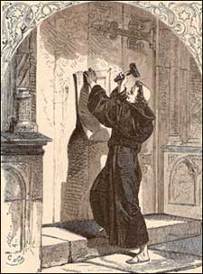
The Story Of Gog And Magog
Part Sixteen – Section Elizabeth I
THE REFORMATION AND GOG

Slide 2
The Story Of Gog And Magog The Reformation – Elizabeth I
SAINT BARTHOLOMEW’S DAY MASSACRE OF THE HUGUENOTS
More Killing of True Israelites Under The Guise of “The Reformation” and The Plunder of Wealth by Gog

Slide 3
The Story Of Gog And Magog The Reformation – Elizabeth I
Please note other sections from the start of the Reformation and after this section will be added as and when they are ready.

Slide 4
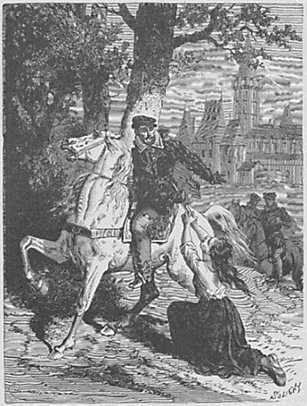
The Story Of Gog And Magog The Reformation
SAINT BARTHOLOMEW’S DAY MASSACRE OF THE HUGUENOTS
The infamous massacre of the French Huguenots is not what we have been led to believe, it was a devilish plan to divide and create division between the peoples of Europe, on religious grounds through the machinations of the treacherous Gaspard de Coligny – leader of the Huguenots in France and “Good Queen Bess of England”

Slide 5
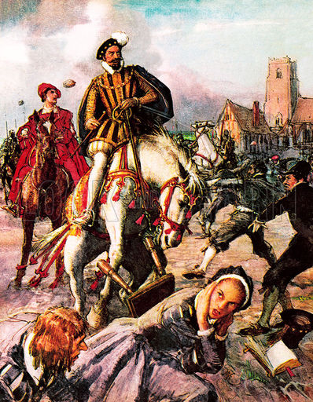
The Story Of Gog And Magog The Reformation
SAINT BARTHOLOMEW’S DAY MASSACRE OF THE HUGUENOTS
This massacre took place at Paris, in the year 1572, and in the 14th year of Elizabeth's reign; and, as it belongs to the history of that day. It was, in fact, in part, produced by her own incessant and most mischievous intrigues. As such it has been put to good effect in opening a great chasm between Europeans and stigmatising the Catholics, even to this day.

Slide 6
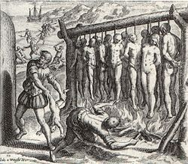
The Story Of Gog And Magog The Reformation
SAINT BARTHOLOMEW’S DAY MASSACRE OF THE HUGUENOTS
If one looks carefully, the similarity between the St. Bartholomew's Day massacre and the Holocaust of World War II can be seen. In both instances, the number killed were vastly overstated….

Slide 7
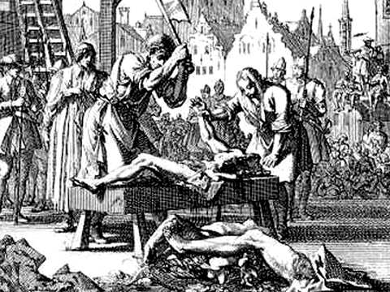
The Story Of Gog And Magog The Reformation
SAINT BARTHOLOMEW’S DAY MASSACRE OF THE HUGUENOTS
…..both served to cover up an even greater massacre. The massacre of the Huguenots would cover up the vast number of both Catholics and Protestants, put to death in England while good Queen Bess was on the throne!

Slide 8
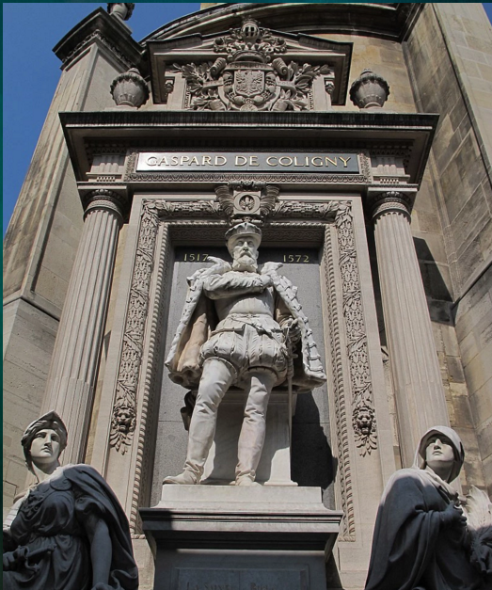
The Story Of Gog And Magog The Reformation
SAINT BARTHOLOMEW’S DAY MASSACRE OF THE HUGUENOTS
Like all Gog’s Traitorous agents, Gaspard de Coligny, is remembered by this fine monument in Paris.
Before going into the background, we shall first look at the falsity of the numbers of Huguenots claimed to have been massacred.

Slide 9
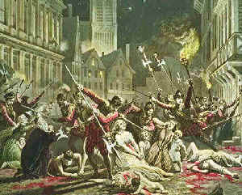
The Story Of Gog And Magog The Reformation
SAINT BARTHOLOMEW’S DAY MASSACRE OF THE HUGUENOTS
By some Protestant writers, the whole number of people killed has been made to amount to a hundred thousand by an account, published in 1582, But as with the modern holocaust the numbers kept dropping - 100,000; then fell to 70,000; then to 30,000; then to 20,000; then to 15,000; and, at last, to 10,000!
A Picture Depicting The Massacre in Paris

Slide 10
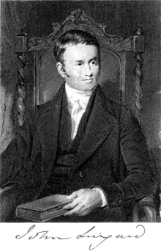
The Story Of Gog And Magog The Reformation
SAINT BARTHOLOMEW’S DAY MASSACRE OF THE HUGUENOTS
The real number made up from accounts, collected from the ministers in the different towns, made; the number, for all France, amount to only 786 persons! Dr. Lingard (left) with his usual fairness, says, "if we double this number, we shall not be far from the real amount”

Slide 11
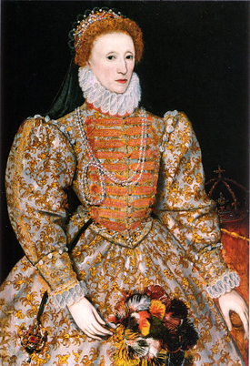
The Story Of Gog And Magog The Reformation
SAINT BARTHOLOMEW’S DAY MASSACRE OF THE HUGUENOTS
Even this number truly horrible to think of; but not half so great as that of those English Catholics whom "good Queen Bess" had, at this time (the 14th year of her reign), caused to be ripped up, racked till the blood came out of their sockets, or caused to be dispatched, or die, in prison, or in exile.

Slide 12
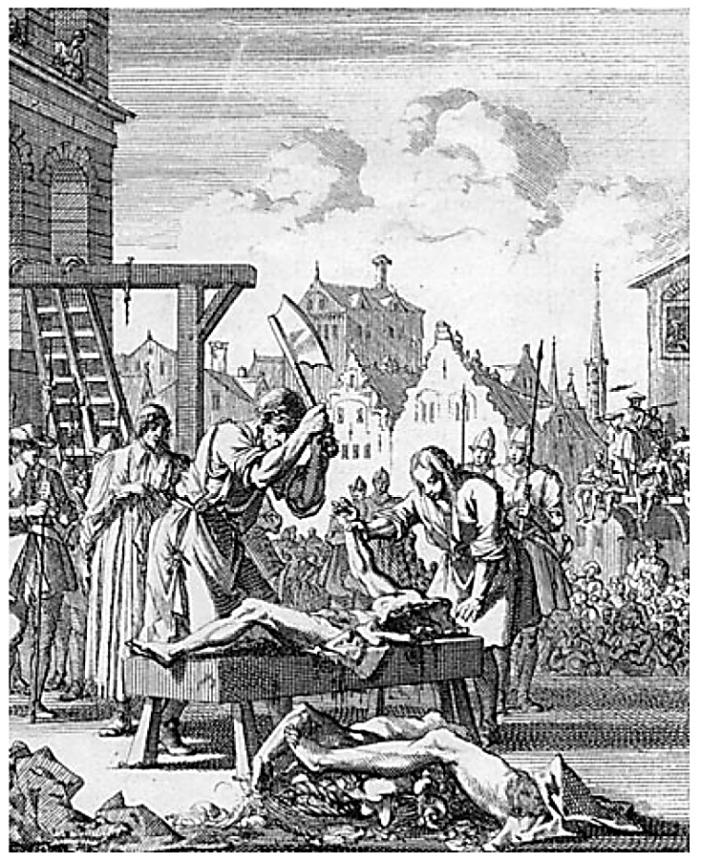
The Story Of Gog And Magog The Reformation
SAINT BARTHOLOMEW’S DAY MASSACRE OF THE HUGUENOTS
---and this, too, observe, not for rebellions, treasons, robberies and assassinations, like those of Coligni and his followers; but, simply and solely by adhering to the religion of their and her fathers, which religion she had openly practised for years, and to which religion she had most solemnly sworn that she sincerely belonged!

Slide 13
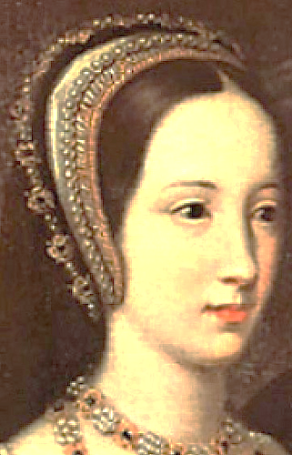
The Story Of Gog And Magog The Reformation
SAINT BARTHOLOMEW’S DAY MASSACRE OF THE HUGUENOTS
To discover the cause of the massacre we go back to reign of Mary, whose days were, "Few and full of sorrow“, and the war with France

Slide 14
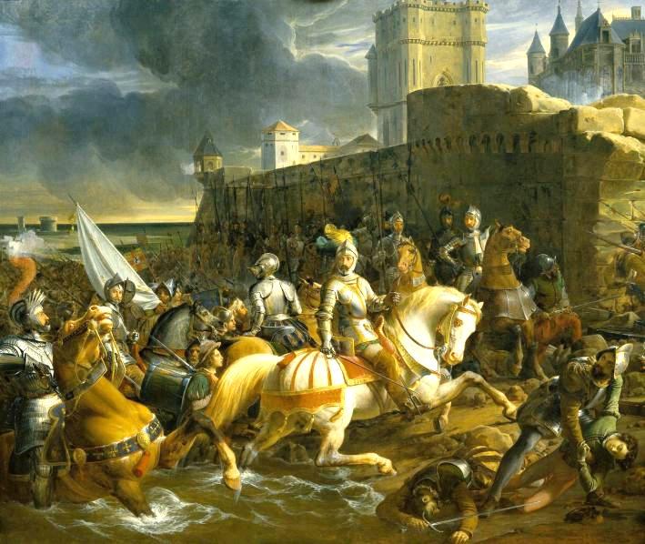
The Story Of Gog And Magog The Reformation
SAINT BARTHOLOMEW’S DAY MASSACRE OF THE HUGUENOTS
Under Queen Mary, Calais was an English possession, but towards the end of her reign it came under threat. She was ill advised by her counsel who told her that the 500 soldiers would be sufficient to deal with the danger. Of course it wasn't! Calais fell to the French.
The Siege of Calais

Slide 15
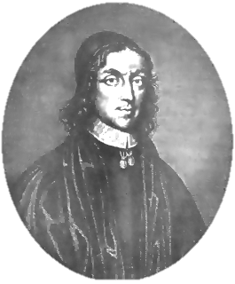
The Story Of Gog And Magog The Reformation
SAINT BARTHOLOMEW’S DAY MASSACRE OF THE HUGUENOTS
Further, Doctor Heylin tells us, that Philip, seeing that danger might arise to Calais, advised the Queen of it, and freely offered his assistance for the defence of it; but, the English Council, jealous of Philip, neglected both his advice and proffer.
Doctor Heylin

Slide 16
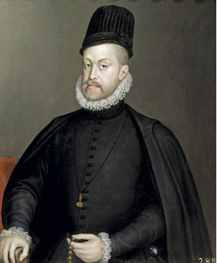
The Story Of Gog And Magog The Reformation
SAINT BARTHOLOMEW’S DAY MASSACRE OF THE HUGUENOTS
In 1558 Philip and the King of France began negotiations for peace; one of the conditions of Philip was, that Calais should be restored to England; and this unquestionably would have been adhered to by Philip; but, in the midst of these negotiations, Mary died.
King Philip

Slide 17
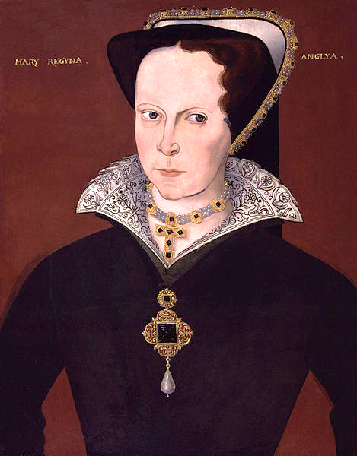
The Story Of Gog And Magog The Reformation
SAINT BARTHOLOMEW’S DAY MASSACRE OF THE HUGUENOTS
Elizabeth, during the reign of her brother, had been a Protestant, and during the reign of her sister, a Catholic. At the time of her sister's death, she not only went to mass publicly; but, she had a Catholic chapel in her house, and also a confessor. These appearances had not, however, deceived her sister,
Queen Mary

Slide 18
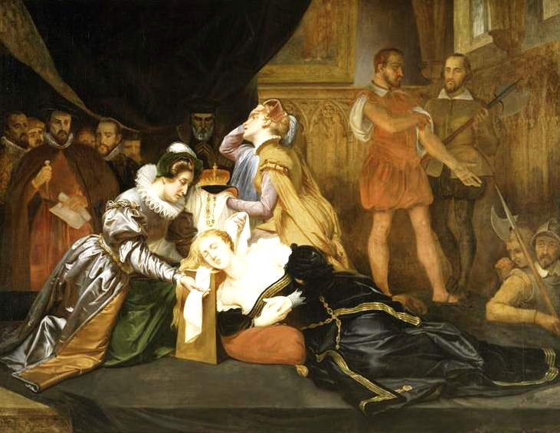
The Story Of Gog And Magog The Reformation
SAINT BARTHOLOMEW’S DAY MASSACRE OF THE HUGUENOTS
On her death bed, honest and sincere Mary required from her a frank avowal of her opinions as to religion. Elizabeth, in answer, prayed God that the earth might open and swallow her, if she were not a true Roman Catholic.
Queen Mary’s Death

Slide 19
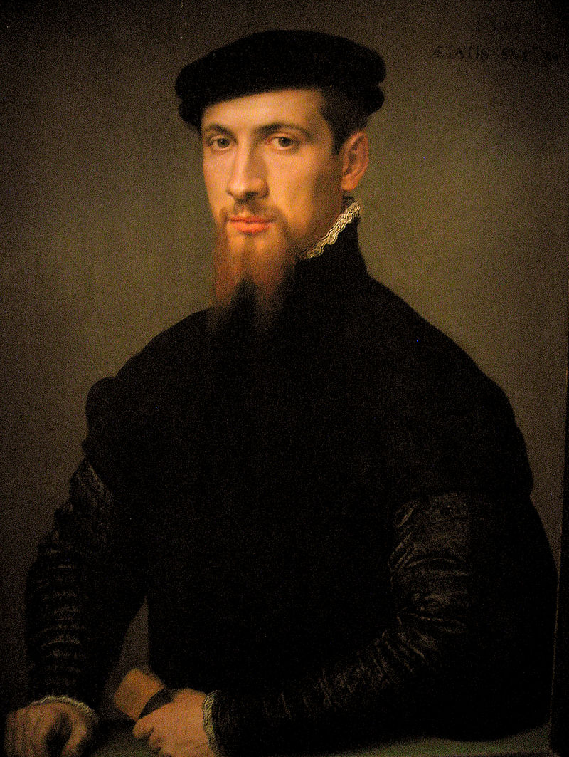
The Story Of Gog And Magog The Reformation
SAINT BARTHOLOMEW’S DAY MASSACRE OF THE HUGUENOTS
She made the same declaration to the Duke of Feria, the Spanish envoy, whom she so completely
deceived, that he wrote to Philip, that the accession of Elizabeth would make no alteration in matters of religion.
Duke of Feria

Slide 20
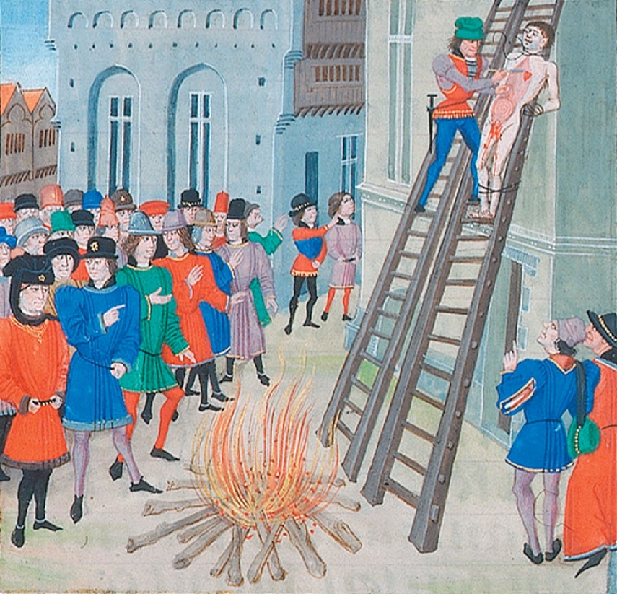
The Story Of Gog And Magog The Reformation
SAINT BARTHOLOMEW’S DAY MASSACRE OF THE HUGUENOTS
In spite of all this, it was not long before she began ripping up the bowels of her unhappy subjects, because they were Roman Catholics.
An Elizabethan Execution

Slide 21
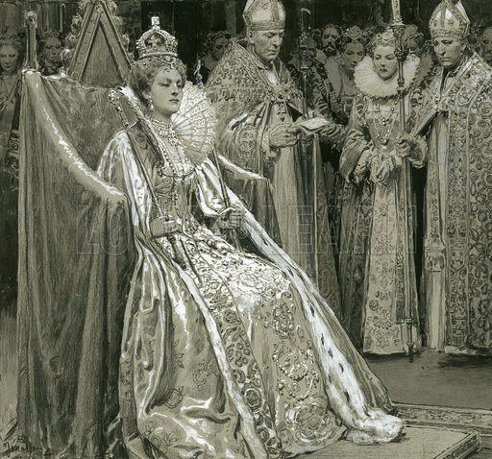
The Story Of Gog And Magog The Reformation
SAINT BARTHOLOMEW’S DAY MASSACRE OF THE HUGUENOTS
Elizabeth was a bastard by law. The marriage of her mother had been, by law, which yet remained un-repealed, declared to be null and void. Her accession having been, in the usual way, notified to foreign powers, that is, that she had succeeded to the throne by hereditary right and the consent of the nation.
The Coronation

Slide 22
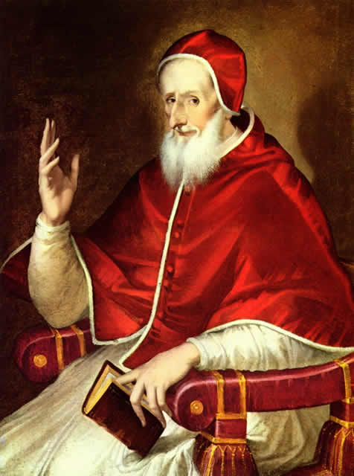
The Story Of Gog And Magog The Reformation
SAINT BARTHOLOMEW’S DAY MASSACRE OF THE HUGUENOTS
---The Pope answered, that he did not understand the hereditary right of a person not born in lawful wedlock. So that he, of course, could not acknowledge her hereditary right. This was, of itself, a pretty strong inducement for a lady of so flexible a conscience as she had, to resolve to be a Protestant.
Pope Pius V

Slide 23
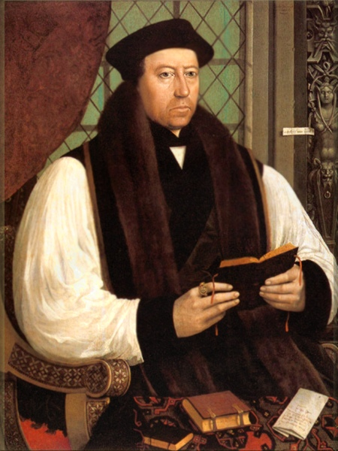
The Story Of Gog And Magog The Reformation
SAINT BARTHOLOMEW’S DAY MASSACRE OF THE HUGUENOTS
There was another and even a stronger motive. Mary, Queen of Scotland, wife of Dauphin of France, claimed the crown of England, as the nearest legitimate descendant of Henry VII. So that Elizabeth ran a risk of losing the crown, unless she became a Protestant, and crammed CRANMER'S creed down the throats of her people.
Cranmer

Slide 24
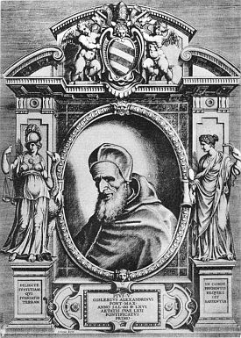
The Story Of Gog And Magog The Reformation
SAINT BARTHOLOMEW’S DAY MASSACRE OF THE HUGUENOTS
If she remained a Catholic, she must yield submission to the decrees from Rome: the Pope could have made it a duty with her people to abandon her; or, at the very least, he could have greatly embarrassed her. In short, she saw clearly, that, if her people remained Catholics, she could never reign in perfect safety.
Pope Pius V

Slide 25
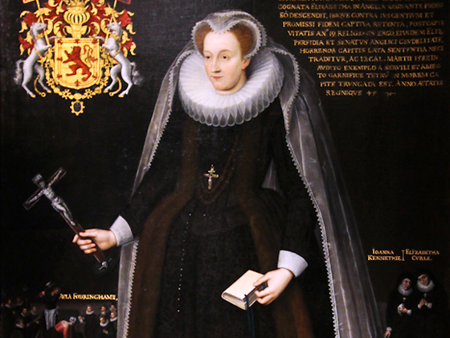
The Story Of Gog And Magog The Reformation
SAINT BARTHOLOMEW’S DAY MASSACRE OF THE HUGUENOTS
If Elizabeth were set aside, or, if she died without issue before Mary, England must become an appendage of France. The loss of Calais and of Boulogne had mortified the nation enough; but, for England herself to be transferred to France, was what no Englishman could think of with patience.
Mary Queen of Scots

Slide 26
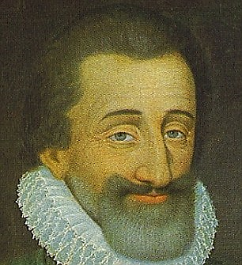
The Story Of Gog And Magog The Reformation
SAINT BARTHOLOMEW’S DAY MASSACRE OF THE HUGUENOTS
Those who eulogise Henry IV of France, who became a Catholic expressly and avowedly for the purpose of possessing and keeping the throne of that country, cannot very consistently blame Elizabeth for becoming a Protestant for an exactly similar reason.
King Henry IV

Slide 27
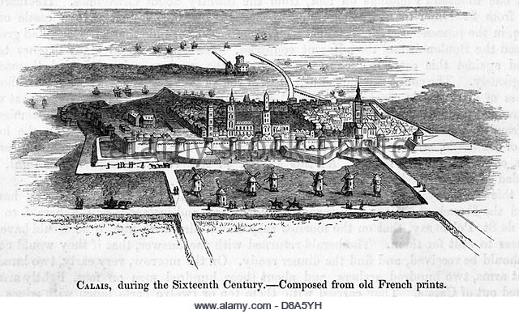
The Story Of Gog And Magog The Reformation
SAINT BARTHOLOMEW’S DAY MASSACRE OF THE HUGUENOTS
Despite Elizabeth’s professed sadness at the loss of Calais, she immediately made peace with France, and that, too, without getting Calais back, as she might have done, if she had not preferred her own private interest to the interest and honour of England.
Calais

Slide 28
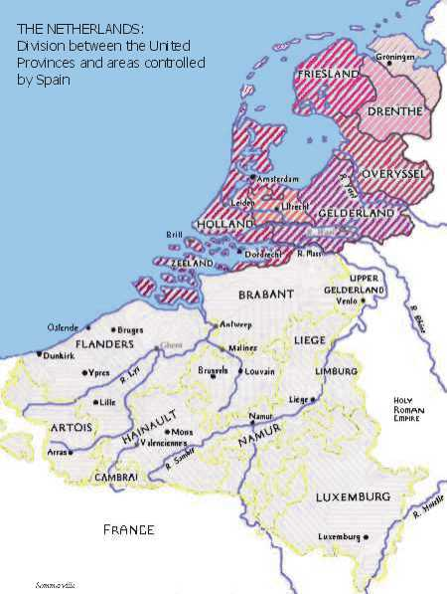
The Story Of Gog And Magog The Reformation
SAINT BARTHOLOMEW’S DAY MASSACRE OF THE HUGUENOTS
… Spain was still at war with France over Spanish territory in the Low Countries. However, Negotiations for peace (England, Spain, and France being the parties) were started at Chateau Cambresis, in France.

Slide 29
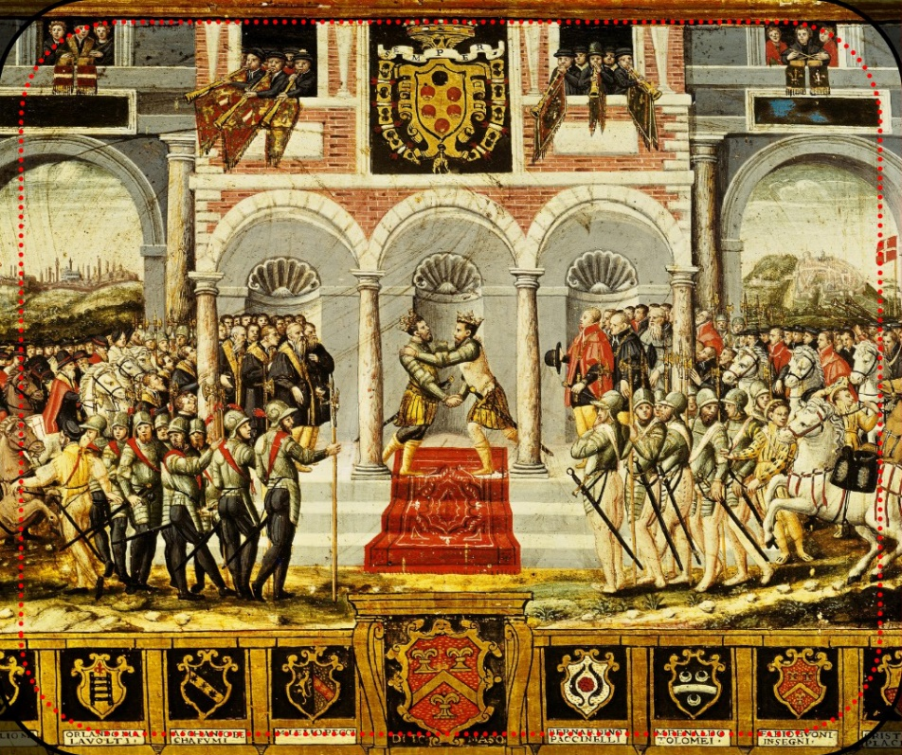
The Story Of Gog And Magog The Reformation
SAINT BARTHOLOMEW’S DAY MASSACRE OF THE HUGUENOTS
All was soon settled with regard to Spain and France; but Philip, (Mary's husband, remember,) faithful to his engagements, refused to sign the treaty, until the new Queen of England should be satisfied with regard to Calais; and he even offered to continue the war for six years, unless Calais were restored,
Chateau Cambrésis Treaty

Slide 30
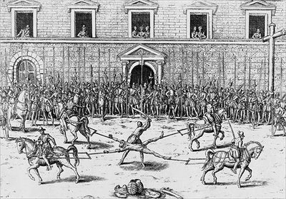
The Story Of Gog And Magog The Reformation
SAINT BARTHOLOMEW’S DAY MASSACRE OF THE HUGUENOTS
….provided Elizabeth would bind herself not to make a separate peace during that period. She declined this generous offer, in the meantime she had begun to rip up her subjects, and was afraid of war.
Drawing & Quatering

Slide 31
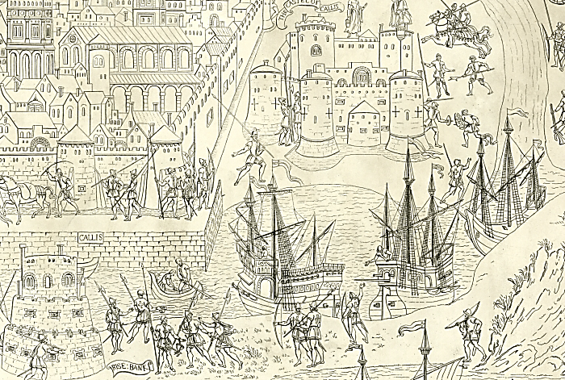
The Story Of Gog And Magog The Reformation
SAINT BARTHOLOMEW’S DAY MASSACRE OF THE HUGUENOTS
….she, therefore, clandestinely entered into negotiations with France, and it was agreed that the latter should keep Calais for eight years, or pay to England 500,000 crowns!
Calais

Slide 32
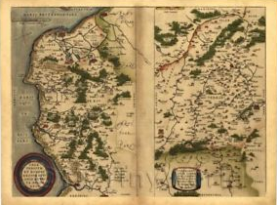
The Story Of Gog And Magog The Reformation
SAINT BARTHOLOMEW’S DAY MASSACRE OF THE HUGUENOTS
This treaty further postulated that if France committed any act of aggression against England, during the eight years, or if England committed any act of aggression against France, during that time, the treaty should be void, and that the former should lose the right of retaining, and the latter the claim to the restoration, of this valuable town and territory.
Calais

Slide 33
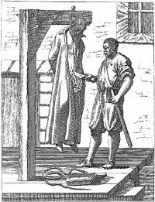
The Story Of Gog And Magog The Reformation
SAINT BARTHOLOMEW’S DAY MASSACRE OF THE HUGUENOTS
Before three years out of the eight had passed, "good Queen Bess” out of pure hatred and fear of the Catholics; from a pure desire to make her tyrannical sway secure; from the sole desire of being still able to imprison, and rip up her unfortunate subjects, forfeited all claim to the restoration of Calais.

Slide 34
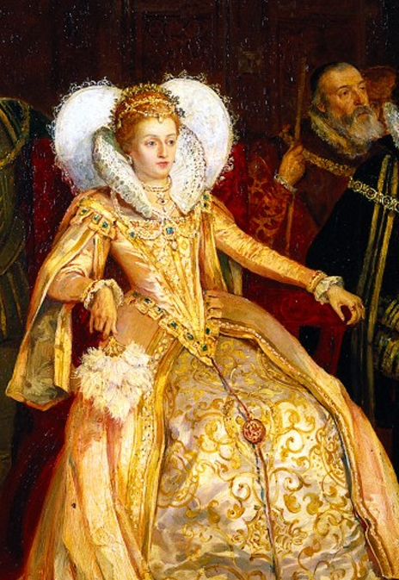
The Story Of Gog And Magog The Reformation
SAINT BARTHOLOMEW’S DAY MASSACRE OF THE HUGUENOTS
Elizabeth’s breach of treaty was more flagrant and more base than, perhaps, had ever before been witnessed in the world.

Slide 35
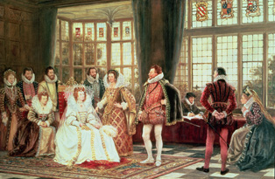
The Story Of Gog And Magog The Reformation
SAINT BARTHOLOMEW’S DAY MASSACRE OF THE HUGUENOTS
Condè and Coligni, by stirring up the Huguenots, had caused a formidable civil war in France. "Good Queen Bess's" ambassador to the French Court assisted the rebels to the utmost of his power, also Condè and Coligni’s, agent Vidame, came, secretly, over to England to negotiate for military, naval, and pecuniary assistance. They succeeded with "good Bess”
Court of Elizabeth I

Slide 36
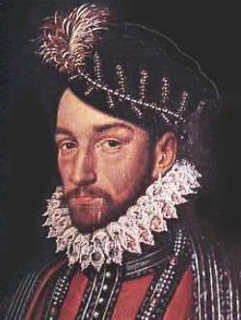
The Story Of Gog And Magog The Reformation
SAINT BARTHOLOMEW’S DAY MASSACRE OF THE HUGUENOTS
“Good Bess” who, wholly disregarding the solemn treaties by which she was bound to Charles IX, King of France, entered into a formal treaty with the French rebels to send them an army and money, for the purpose of carrying on war against their sovereign, of whom she was an ally…
Charles IX

Slide 37
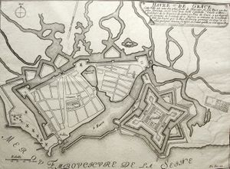
The Story Of Gog And Magog The Reformation
SAINT BARTHOLOMEW’S DAY MASSACRE OF THE HUGUENOTS
…having bound herself, in that character, by a solemn oath on the Evangelists! By this treaty she engaged to furnish men, ships, and money; and the traitors, on their part, engaged to put Havre de Grace at once into her hands, as a pledge, not only for the repayment of the money to be advanced, but for the restoration of Calais!
Havre de Grace

Slide 38
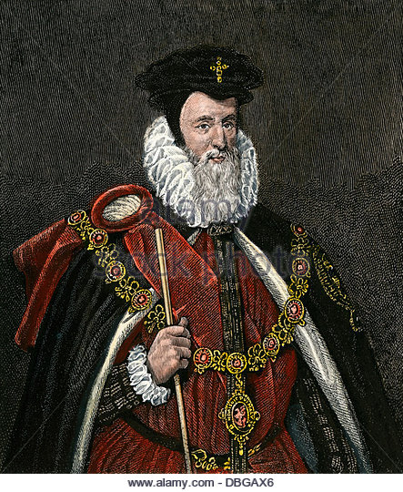
The Story Of Gog And Magog The Reformation
SAINT BARTHOLOMEW’S DAY MASSACRE OF THE HUGUENOTS
This infamous compact richly deserves the consequences that followed. The French ambassador in London, when he discovered an intercourse was going on between the Queen and the agents of the rebels, went to Cecil (Jewish), the secretary of state…
William Cecil, Secretary of State

Slide 39
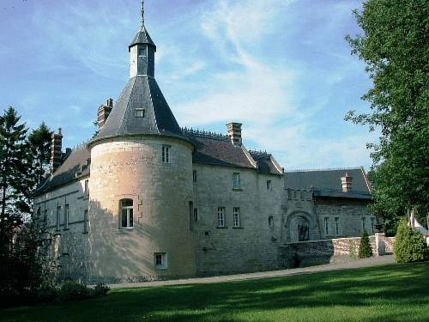
The Story Of Gog And Magog The Reformation
SAINT BARTHOLOMEW’S DAY MASSACRE OF THE HUGUENOTS
…carrying the treaty of CHATEAU CAMBRESIS in his hand, and demanded, agreeably to the stipulations of that treaty, that the agent of the rebels should be delivered up as traitors to their sovereign; and he warned the English government, that any act of aggression on its part, would annihilate its claim to the recovery of Calais
CHATEAU CAMBRESIS

Slide 40
The Story Of Gog And Magog The Reformation
SAINT BARTHOLOMEW’S DAY MASSACRE OF THE HUGUENOTS
"Good Bess" had caused the civil wars in France; she had, by her bribes, and other underhand means, stirred them up, which she believed were necessary to her own security on her throne of doubtful right; and, as she hoped to get Calais in this perfidious way.

Slide 41
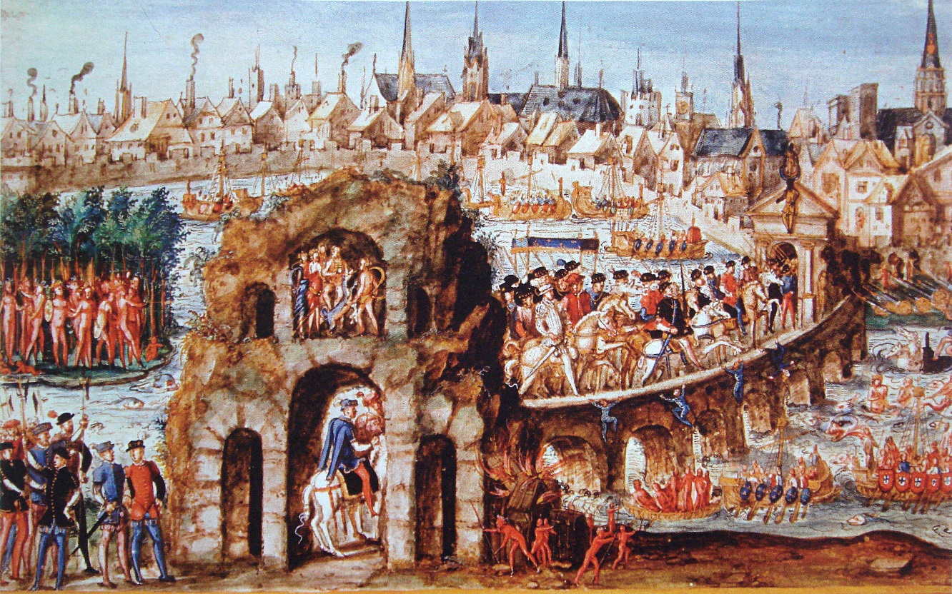
The Story Of Gog And Magog The Reformation
SAINT BARTHOLOMEW’S DAY MASSACRE OF THE HUGUENOTS
The rebels took possession of Dieppe, Rouen, Havre de Grace, and a considerable part of Normandy. They put Havre and Dieppe into the hands of the English.
Ancient Rouen

Slide 42
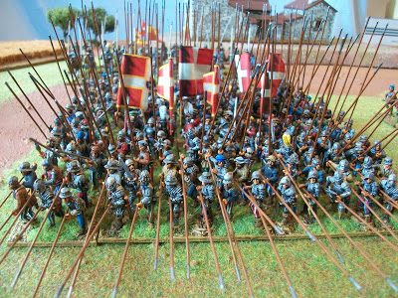
The Story Of Gog And Magog The Reformation
SAINT BARTHOLOMEW’S DAY MASSACRE OF THE HUGUENOTS
So infamous and treacherous a proceeding roused the Catholics of France, who now became ashamed of that inactivity, which had suffered a sect, less than a hundredth part of the population, to sell their country under the blasphemous plea of a love of the Gospel.

Slide 43
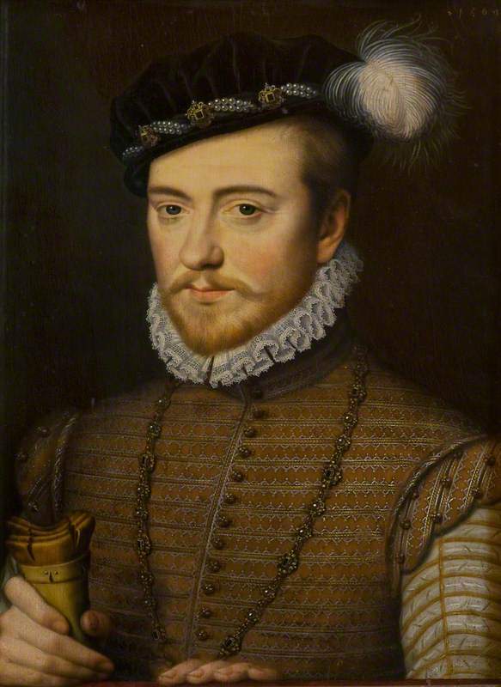
The Story Of Gog And Magog The Reformation
SAINT BARTHOLOMEW’S DAY MASSACRE OF THE HUGUENOTS
"Good Bess” with her usual mixture of hypocrisy and effrontery, sent her proclamations into Normandy, declaring, that she meant no hostility against her "good brother" the King of France (left);

Slide 44
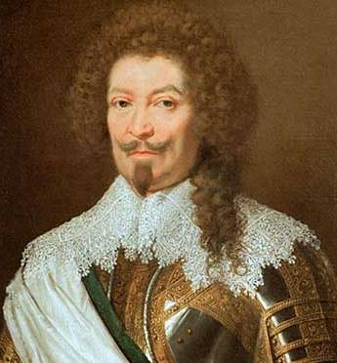
The Story Of Gog And Magog The Reformation
SAINT BARTHOLOMEW’S DAY MASSACRE OF THE HUGUENOTS
This cool and hypocritical insolence added fury to the flame. All France could but recollect, that it was the skilful, the gallant, the patriotic Duke of Guise, who had, only five years before, ejected the English from Calais,
The Duke of Guise

Slide 45
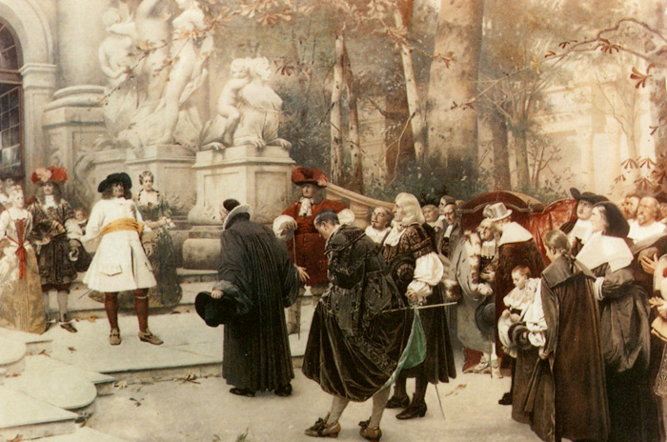
The Story Of Gog And Magog The Reformation
SAINT BARTHOLOMEW’S DAY MASSACRE OF THE HUGUENOTS
France; now saw these "sons of the Gospel," as they had the audacity to call themselves, bring those same English back again, and put two French sea-ports into their hands at once! Are we to wonder at the inextinguishable hatred of the people of France against this traitorous sect?
The Huguenots

Slide 46
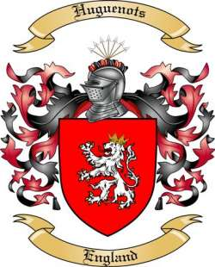
The Story Of Gog And Magog The Reformation
SAINT BARTHOLOMEW’S DAY MASSACRE OF THE HUGUENOTS
Are we to wonder, that they felt a desire to extirpate the whole of such an infamous sect, who had already sold their country to the utmost of their power?
The Huguenots

Slide 47
The Story Of Gog And Magog The Reformation
SAINT BARTHOLOMEW’S DAY MASSACRE OF THE HUGUENOTS
The real blame must lie with Coligni, Condè and Calvin (Cohen), who deceived the Huguenots into accepting a Judaeo form of Christianity, where loyalty to one’s country is a sin.
Calvin (Cohen)

Slide 48
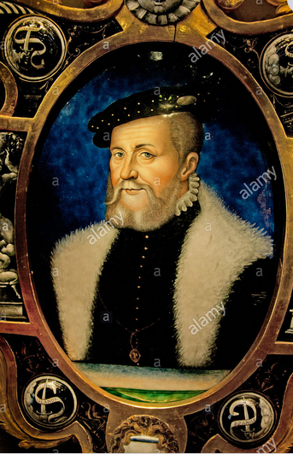
The Story Of Gog And Magog The Reformation
SAINT BARTHOLOMEW’S DAY MASSACRE OF THE HUGUENOTS
The French nobility, from every province and corner of France, flew to the aid of their sovereign, whose army was commanded by the Constable, Montmorency, with the Duke of Guise under him.
Constable of Montmorency

Slide 49
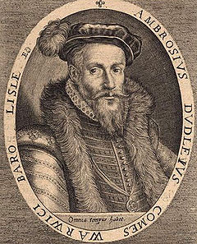
The Story Of Gog And Magog The Reformation
SAINT BARTHOLOMEW’S DAY MASSACRE OF THE HUGUENOTS
Condè was. at the head of the rebel army, having Coligni as a sort of partner in the concern, and having been joined by the English troops under the Earl of Warwick, nephew of "good Bess's” paramour, and Dudley,
Earl of Warwick

Slide 50
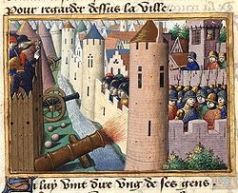
The Story Of Gog And Magog The Reformation
SAINT BARTHOLOMEW’S DAY MASSACRE OF THE HUGUENOTS
The King’s forces finally took the town by assault, and put the whole of the garrison to the sword, including the English reinforcement sent by "good Queen Bess."
Siege of Rouen

Slide 51
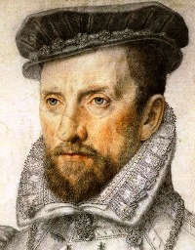
The Story Of Gog And Magog The Reformation
SAINT BARTHOLOMEW’S DAY MASSACRE OF THE HUGUENOTS
Coligni kept the field, and pillaged Normandy pretty severely. "Good Bess" sent him some money, and more, if he could get any merchants (that is, Jews) to lend it him; but, she sent him no troops; those, under the Earl of Warwick, being kept safe and sound in the strong fortress of Havre de Grace.
Coligni

Slide 52
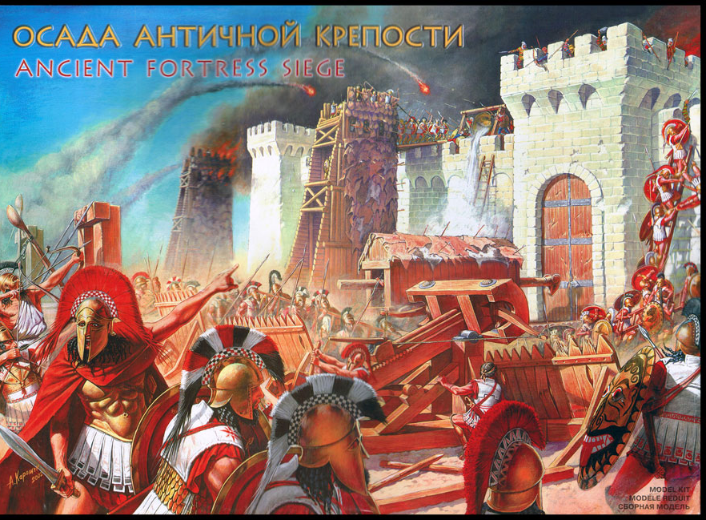
The Story Of Gog And Magog The Reformation
SAINT BARTHOLOMEW’S DAY MASSACRE OF THE HUGUENOTS
The Catholics, now under the Duke of Guise, laid siege to Orleans. While this siege was going on, one Poltrot, a Huguenot, in the pay of Coligni, went, under the guise of being a deserter from that inveterate rebel chief, and entered into the service of the army under the Duke of Guise.
Orleans

Slide 53
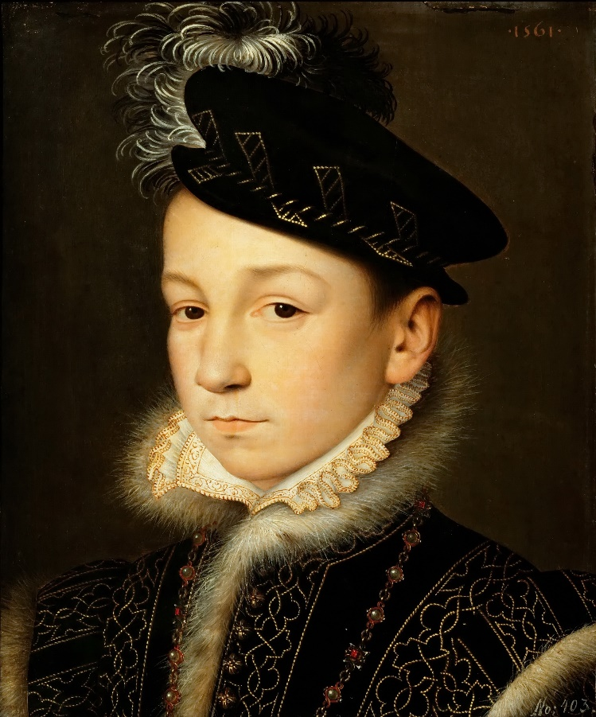
The Story Of Gog And Magog The Reformation
SAINT BARTHOLOMEW’S DAY MASSACRE OF THE HUGUENOTS
…the Queen-Mother (Catherine de Medici), her son the young King, Charles (now twelve years of age), and the King of Navarre, were present at the siege. The latter was mortally wounded in the attack;
Charles

Slide 54
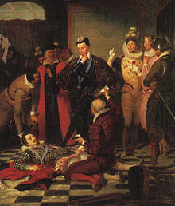
The Story Of Gog And Magog The Reformation
SAINT BARTHOLOMEW’S DAY MASSACRE OF THE HUGUENOTS
In a short time this miscreant found the means to assassinate that gallant nobleman and distinguished patriot, instigated, and, indeed, employed for the express purpose by Coligni, and urged on by Beza, the "famous preacher," as Hume calls him, but really one of the most infamous of all the "reforming" preachers,

Slide 55
The Story Of Gog And Magog The Reformation
SAINT BARTHOLOMEW’S DAY MASSACRE OF THE HUGUENOTS
This atrocious deed met, afterwards, with retaliation in the massacre of St. Bartholomew, when on Coligni’s mangled body there might have been placarded the name of Poltrot.

Slide 56
The Story Of Gog And Magog The Reformation
SAINT BARTHOLOMEW’S DAY MASSACRE OF THE HUGUENOTS
This wretch had been paid by Coligni, and the money had come from honest and sincere "good Queen Bess” whom we shall hereafter find plainly accused by Whitaker (left: a clergyman of the Church of England) of plotting the assassination of her own cousin,

Slide 57
The Story Of Gog And Magog The Reformation
SAINT BARTHOLOMEW’S DAY MASSACRE OF THE HUGUENOTS
In the meanwhile the brother of Coligni had, by the money of "good Bess," collected together a body of German mercenary Gospellers, and had got them to Orleans, which was then the main hold of the Huguenots;

Slide 58
The Story Of Gog And Magog The Reformation
SAINT BARTHOLOMEW’S DAY MASSACRE OF THE HUGUENOTS
The base traitors, Condè and Coligni, first made a feint on the side of Paris; but, finding themselves too weak on that side, they took their way towards Normandy, in the hope of there having the aid of the English forces.
Henri I de Bourbon
2nd Prince de Conde

Slide 59
The Story Of Gog And Magog The Reformation
SAINT BARTHOLOMEW’S DAY MASSACRE OF THE HUGUENOTS
An amnesty. The King granted to the Huguenots permission to practice their worship in one town in every bailiwick; and thus were all matters settled between the King and his rebellious subject. Sad tidings for "good Queen Bess,"

Slide 60
The Story Of Gog And Magog The Reformation
SAINT BARTHOLOMEW’S DAY MASSACRE OF THE HUGUENOTS
The French King, wishing to get her troops quietly out of Havre de Grace, and finding that she now pretended to hold it as a pledge for the surrender of Calais, at the end of the eight years, offered to renew the treaty of Chateau Cambresis, by which Calais was to be restored to England in 1567.
Le Harve de Grace

Slide 61
The Story Of Gog And Magog The Reformation
SAINT BARTHOLOMEW’S DAY MASSACRE OF THE HUGUENOTS
Elizabeth rejected this fair and reasonable proposal. She had got Havre; no matter how; and she said, that, “a bird in hand was worth two in the bush," snapping her fingers at the same time…
Court of Elizabeth I

Slide 62
The Story Of Gog And Magog The Reformation
SAINT BARTHOLOMEW’S DAY MASSACRE OF THE HUGUENOTS
Finding, however, that all parties in France were now united for the expulsion of the English, she reluctantly gave way. She authorized her ambassadors to present a new project of treaty;

Slide 63
The Story Of Gog And Magog The Reformation
SAINT BARTHOLOMEW’S DAY MASSACRE OF THE HUGUENOTS
"Good Bess's" late friend and ally being serving in the army, was on its way to regain le Havre by force of arms, the King of France being well convinced, that treaty with “Good Betsy" were things perfectly vain.
Recapturing Le Harve

Slide 64
The Story Of Gog And Magog The Reformation
SAINT BARTHOLOMEW’S DAY MASSACRE OF THE HUGUENOTS
The Earl of Warwick, instead of sending troops to assist Bess's allies, had kept his army at Havre. He expelled all the French people from Havre, to their utter ruin, and in direct breach of Bess's treaty with Condè and Coligni.
The Earl of Warwick

Slide 65
The Story Of Gog And Magog The Reformation
SAINT BARTHOLOMEW’S DAY MASSACRE OF THE HUGUENOTS
The Queen-Mother (left) and the King were present in the camp, where they had the indescribable pleasure to see, "Good Queen Bess's" general humbly propose to surrender the place to the rightful sovereign, without any mention of Calais and territory, and on no condition whatever, but that of being permitted to return to England with the miserable remains of his army;

Slide 66
The Story Of Gog And Magog The Reformation
SAINT BARTHOLOMEW’S DAY MASSACRE OF THE HUGUENOTS
“Good Bess" (left) had now to sue for peace, and with that King, with whose rebel subjects she had so recently cooperated. Her ambassadors, going with due passports, were arrested and imprisoned. She stamped and swore, but she swallowed the affront, and took the regular steps to cause them to be received at the French court.

Slide 67
The Story Of Gog And Magog The Reformation
SAINT BARTHOLOMEW’S DAY MASSACRE OF THE HUGUENOTS
The French on their part, treated her pressing applications with a contemptuous sneer, and suffered many months to pass away, before they would listen to any terms of peace. Smith was one of her envoys, and the other was that same THROCKMORTON (left) who had been her ambassador at Paris, and who had been her agent in stirring up Condè and Coligni.

Slide 68
The Story Of Gog And Magog The Reformation
SAINT BARTHOLOMEW’S DAY MASSACRE OF THE HUGUENOTS
The treaty of Chateau Cambresis, which stipulated for the restoration of Calais in eight years, or the forfeiture of 500,000 crowns by the French, contained a stipulation, that four French noblemen should be held by "good Bess," as hostages for fulfilment of the treaty on the part of France.

Slide 69
The Story Of Gog And Magog The Reformation
SAINT BARTHOLOMEW’S DAY MASSACRE OF THE HUGUENOTS
"Good Bess” (left) by aiding of the French rebels, had broken this treaty, had lost all just claim to Calais, and ought to have released the hostages; but, as "good Bess" very seldom did what she ought to; as she might, almost every day of her mischievous life, have, with perfect truth, repeated afflicted with war, afflicted with pestilence….,

Slide 70
The Story Of Gog And Magog The Reformation
SAINT BARTHOLOMEW’S DAY MASSACRE OF THE HUGUENOTS
…..thus were thousands upon thousands of English people destroyed, or ruined, or rendered miserable, merely to this proud and malignant woman, who thought she could never be safe until all the world joined in her apostasy.
An Elizabethan Prison

Slide 71
The Story Of Gog And Magog The Reformation
SAINT BARTHOLOMEW’S DAY MASSACRE OF THE HUGUENOTS
"Good Bess” by her aiding of the French rebels, had broken the treaty, had lost all just claim to Calais…
Calais To-Day

Slide 72
The Story Of Gog And Magog The Reformation
SAINT BARTHOLOMEW’S DAY MASSACRE OF THE HUGUENOTS
Now, however, the French had got a "bird in hand" too. They had got THROCKMORTON, their old enemy, and he had got a large quantity of “good Bess's" horrible secrets locked up in his breast!
Throckmorton

Slide 73
The Story Of Gog And Magog The Reformation
SAINT BARTHOLOMEW’S DAY MASSACRE OF THE HUGUENOTS
So that, after long discussions, during which, Throckmorton gave very significant signs of his determination not to end his days in prison without taking revenge, of some sort, on his fearless employer, the "good" woman agreed to exchange the four French noblemen for him.
A French Prison

Slide 74
The Story Of Gog And Magog The Reformation
SAINT BARTHOLOMEW’S DAY MASSACRE OF THE HUGUENOTS
the "good" woman agreed to exchange the four French noblemen for him; and, as a quarter of a loaf was better than no bread to take 125,000 crowns for the relinquishment of Calais to France in perpetuity!
Elizabeth Receiving Payment

Slide 75
The Story Of Gog And Magog The Reformation
SAINT BARTHOLOMEW’S DAY MASSACRE OF THE HUGUENOTS
Divine punishment: the plague, which had got into the garrison of Havre de Grace, which had left Warwick with only about two thousand out of seven thousand men; this dreadful disease was brought, by that miserable remnant of infected beings, to England.
A French Prison

Slide 76
The Story Of Gog And Magog The Reformation
SAINT BARTHOLOMEW’S DAY MASSACRE OF THE HUGUENOTS
Hume records, that the plague swept off great multitudes especially in London, where above twenty thousand sons died of it in one year..
Plague in London

Slide 77
The Story Of Gog And Magog The Reformation
SAINT BARTHOLOMEW’S DAY MASSACRE OF THE HUGUENOTS
The king was making a progress through the kingdom about four years after the pacification; a plot was formed by Coligni and his associates to kill or seize him; but, by riding fourteen hours, without getting off his horse, and without food or drink, he escaped, and got safe to Paris.

Slide 78
The Story Of Gog And Magog The Reformation
SAINT BARTHOLOMEW’S DAY MASSACRE OF THE HUGUENOTS
During this pacification Coligni, endeavoured to worm himself into favour with the King, and was invited to Paris, while there, someone shot at him with a blunderbuss, his partisans ascribed it to the Duke of Guise and threatened revenge.
The Duke of Guise

Slide 79
The Story Of Gog And Magog The Reformation
SAINT BARTHOLOMEW’S DAY MASSACRE OF THE HUGUENOTS
The court decided to pre-empt the blow, so on the 24th August, St. Bartholomew’s day, they instigated their plan, the King was reluctant, but was convinced by the entreaties by those of the Duke of Anjon, his brother, and those of the Duke of Guise,
Duke of Anjon

Slide 80
The Story Of Gog And Magog The Reformation
SAINT BARTHOLOMEW’S DAY MASSACRE OF THE HUGUENOTS
The dreadful orders were given; at the appointed moment the signal was made; the Duke of Guise, with his band of followers rushed to and broke open the house of Coligni, whose dead body was soon thrown out of the window into the street.

Slide 81
The Story Of Gog And Magog The Reformation
SAINT BARTHOLOMEW’S DAY MASSACRE OF THE HUGUENOTS
The treacherous works of Coligni, this pretended Saint, was basely involved in the assassination of that gallant Patriotic nobleman, the Duke of Guise. His son took to avenge the father, and the just vengeance of this son on the treacherous Coligni, and his supporters the Huguenots!
Duke of Guise Takes Revenge

Slide 82
The Story Of Gog And Magog The Reformation
SAINT BARTHOLOMEW’S DAY MASSACRE OF THE HUGUENOTS
Thus was the heavily taxed, afflicted with war, afflicted with pestilence, thus were thousands upon thousands of English people destroyed, or ruined, or rendered miserable, merely to this proud and malignant woman, who thought she could never be safe until all the world joined in her apostasy. Thus, and merely for this same reason Calais was surrendered for ever;

Slide 83
The Story Of Gog And Magog The Reformation
SAINT BARTHOLOMEW’S DAY MASSACRE OF THE HUGUENOTS
Thus we can now see how the Huguenots came to be marked out for the harsh treatment, known today as the St. Bartholomew’s Day Massacre! Prior to the assassination of the Duke of Guise, the King of France had permitted them to worship freely, provided they did not have more than one church in each Bailiwick.

Slide 84
The Story Of Gog And Magog The Reformation
SAINT BARTHOLOMEW’S DAY MASSACRE OF THE HUGUENOTS
To sum up the causes of the massacre:
A. Elizabeth broke her treaty with France.
B. Elizabeth aided Coligy with money and arms to use the Huguenots to overthrow the French Government.
C. She used her armed forces to seize Le Harve, Rouen and Dieppe.
D. The Assassination of the Duke of Guise – Heir to the French Throne

Slide 85
The Story Of Gog And Magog The Reformation
SAINT BARTHOLOMEW’S DAY MASSACRE OF THE HUGUENOTS
In the Middle Ages, it was difficult to identify Jews in high positions, because unlike today, people generally detested the Jews as Christ murderers and crooked money lenders.
Burning The Talmud

Slide 86
The Story Of Gog And Magog The Reformation
SAINT BARTHOLOMEW’S DAY MASSACRE OF THE HUGUENOTS
…However the Jews acts and physiognomy betray them, and being cowardly they stay in the background and get others to do their work. There is good circumstantial evidence that Cecil, who was Elizabeth’s Secretary of State, was a Jew.
William Cecil

Slide 87
The Story Of Gog And Magog The Reformation
SAINT BARTHOLOMEW’S DAY MASSACRE OF THE HUGUENOTS
Philip II was faced with a rebellion in the Netherlands: Calvinist subversive beliefs had spread in its northern provinces, and even the Catholic South feared that Philip would suppress local autonomy.
The Dutch Revolt

Slide 88
The Story Of Gog And Magog The Reformation
SAINT BARTHOLOMEW’S DAY MASSACRE OF THE HUGUENOTS
In 1567, Philip sent an army there to prevent an uprising, but Elizabeth was afraid that the army would be used against England. In 1568, she seized a shipment of bullion sent by Genoese bankers to pay the Spanish troops garrisoned in the Netherlands. Philip was furious, particularly as he was also suffering losses in the New World from English privateers.
Genoese Bankers

Slide 89
The Story Of Gog And Magog The Reformation
SAINT BARTHOLOMEW’S DAY MASSACRE OF THE HUGUENOTS
Good Queen Bess’s troubles are not over, for having upset King Philip of Spain, there was another crisis looming on the horizon for Elizabeth – but that is another story!

Slide 90
The Story Of Gog And Magog The Reformation
SAINT BARTHOLOMEW’S DAY MASSACRE OF THE HUGUENOTS
A thought to leave you with
One Can Ignore Reality…. But One Cannot Ignore The Consequences of Ignoring Reality
Howbeit no man spake openly of him for fear of the Jews. (John 7:13)

Slide 91
The Story of Gog and Magog The Reformation
SAINT BARTHOLOMEW’S DAY MASSACRE OF THE HUGUENOTS
e
The End Of This Section
To be continued – Gog and The Reformation

