Slide 1
The Story Of Gog And Magog
Part Fifteen
The City of London
&
Magna Carta

Slide 2
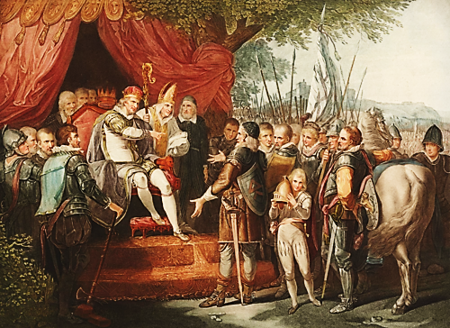
The City Of London & Magna Carta
Few are aware of the impact of Magna Carta in relation to the City of London and how it was an important stepping stone to it achieving world dominance, and to become one of the very few sovereign states remaining today!

Slide 3
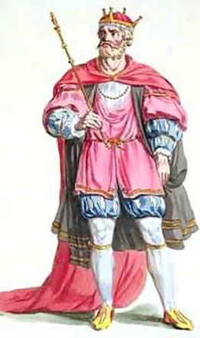
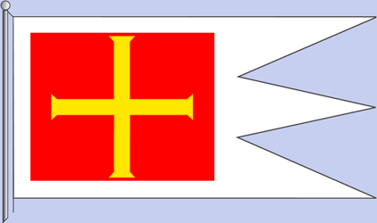
The City of London & Magna Carta
While laying waste to the rest of the country, William the Conqueror (left) “came friendly” to London, recognised the liberties of its citizens. London’s special status within the constitution was upheld by a stream of charters and privileges that protected the City of London from external interference.
Above – The Standard of William The Conqueror

Slide 4
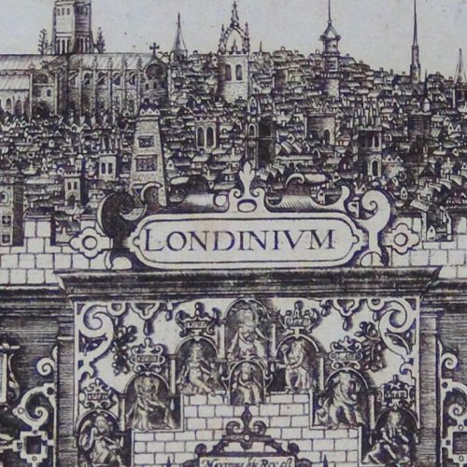
The City of London & Magna Carta
William the Conqueror's friendliness towards the city of London, was due to the fact that the descendants of the Khazar's still lived in London from the days when London was the northern terminus of the silk route which they controlled. For they were relatives of the Jews who financed William’s expedition to conquer England, so no doubt this was part of the price he had to pay!

Slide 5
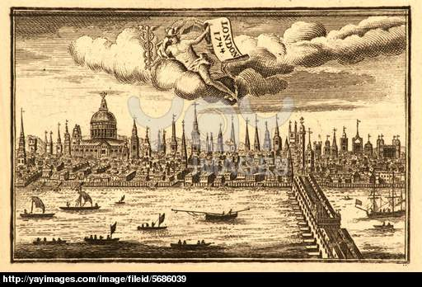
The City of London & Magna Carta
The Corporation of London, which announced itself as a “commune” in 1191, (notice the 911 –Gog’s favourite number) was recognised as one of the great institutions of the Ancient Constitution, with a place only one step below the sovereign.
The Ancient City of London – Early 1700’s

Slide 6
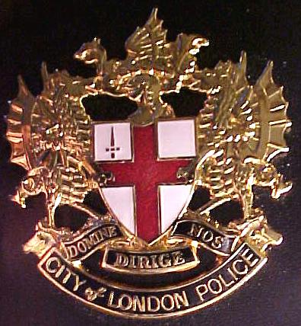
The City of London & Magna Carta
The combination of wealth, functioning democratic and legal institutions, and an effective system of civic militias meant the Crown could never subordinate the City of London to its rule. London taxed itself, judged itself and governed itself.

Slide 7
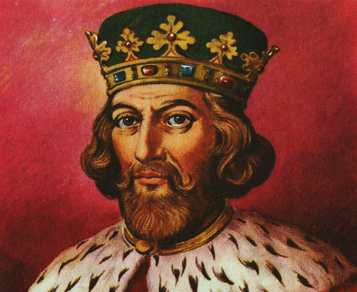
The City Of London & Magna Carta
John became king in 1199, but by 1215 he was faced with a major rebellion. Hoping to win the Londoners to his side, he granted them the right to choose annually a City mayor. In doing this, he was confirming a custom that had already developed.
King John

Slide 8
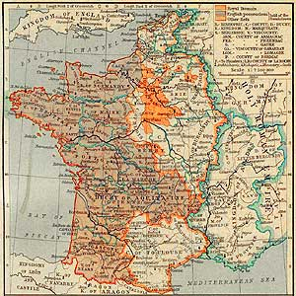
The City Of London & Magna Carta
John was keen to retain his possessions in France, which were in revolt due to heavy taxation to pay for the Crusades to Jerusalem and the Holy Land. He had also continued Henry II’s policy of reducing the influence of the Pope in England.

Slide 9
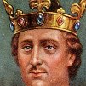
The City Of London & Magna Carta
We need to look back to the reign of Henry II, to see why the Realm of England was not flavour of the month with the Papacy.

Slide 10
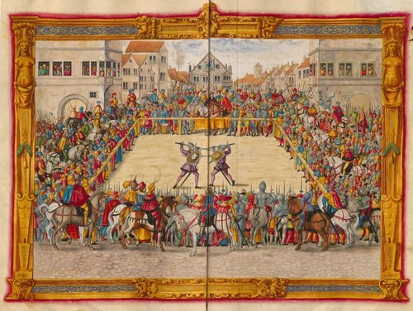
The City Of London & Magna Carta
Most important, he had created a new law through the Assize of Clarendon (1164) which arranged for regular court visits to settle disputes, particularly land disputes.
Clarendon Assize – trial by ordeal

Slide 11
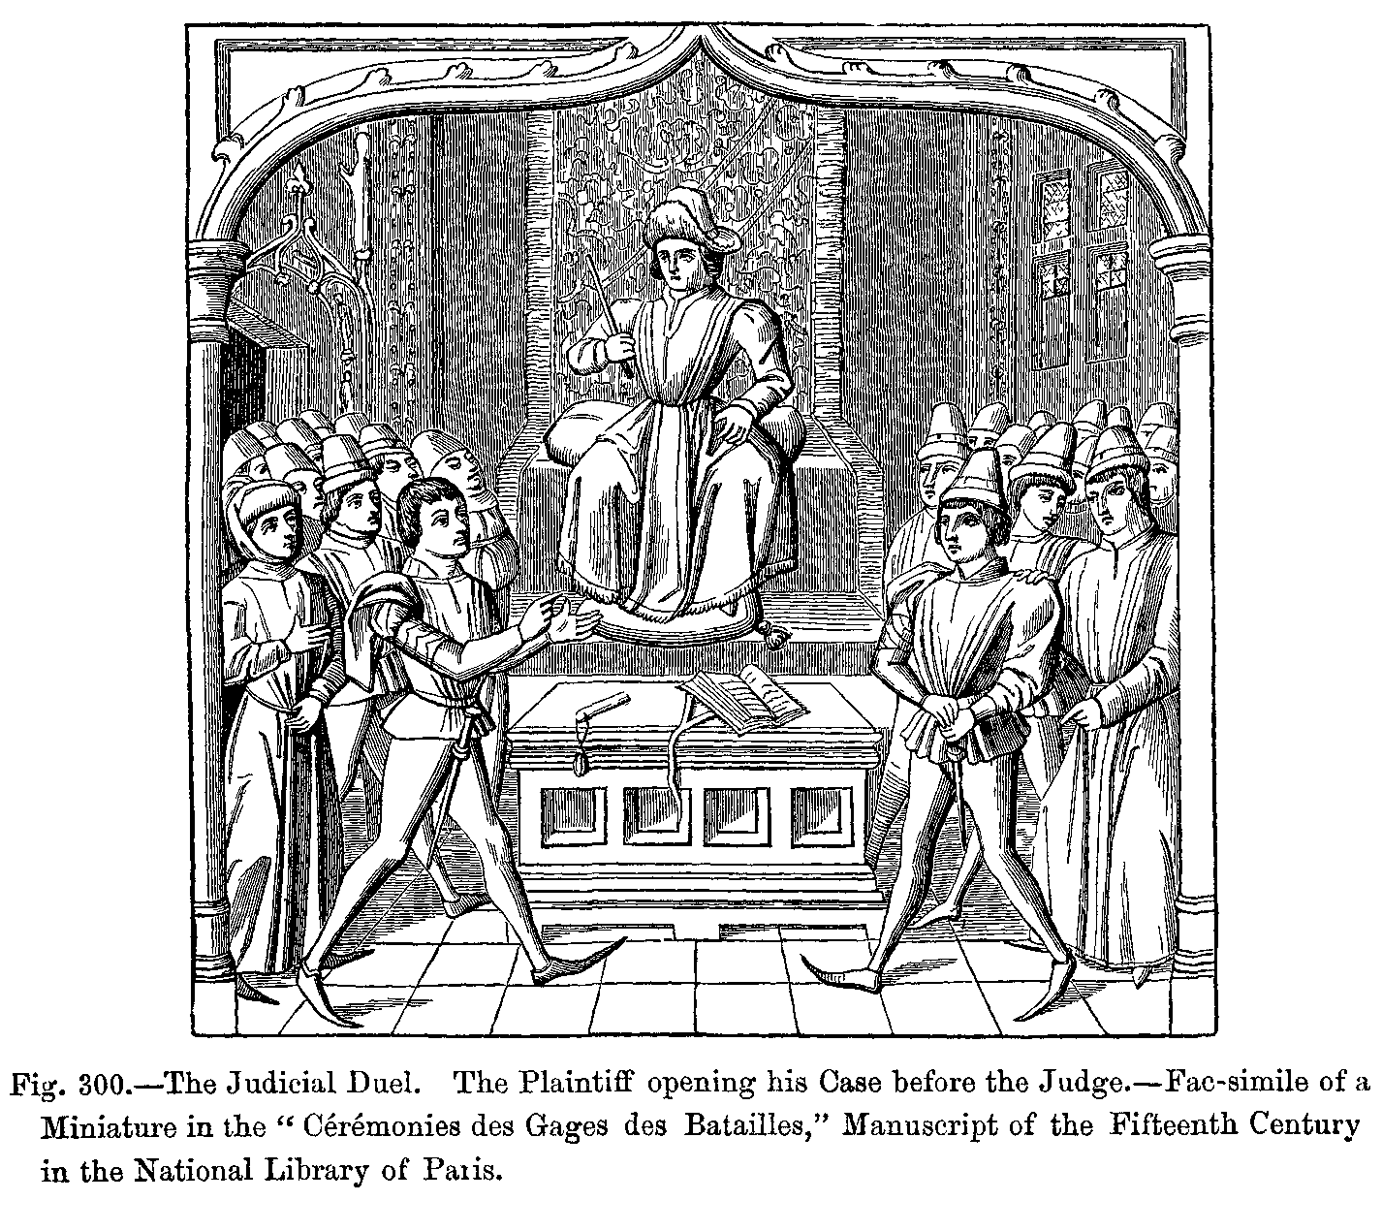
The City Of London & Magna Carta
Judges were appointed who had the power of the crown behind them. They travelled around England holding assizes, what would be called a circuit judge. They replaced the courts controlled by the Catholic Church.

Slide 12
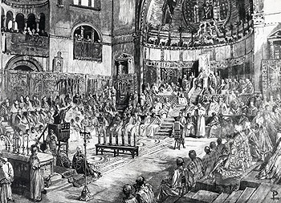
The City Of London & Magna Carta
Based on this act, many proceedings did much to transfer power out of the hands of local barons and into the hands of the royal court and its judges. In 1215, moreover, the Fourth Lateran Council forbade clergymen of the Church from participating in trial by ordeal. After this date, trials after accusation by the grand jury were conducted by juries as well.
The Lateran Council 1215

Slide 13
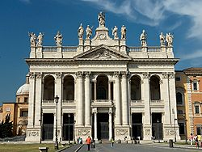
The City Of London & Magna Carta
Also on 11 November 1215, the Fourth Lateran Council Condemns Jewish Christians – “they upset the decorum of the Christian religion by such a mixing”. They were becoming wise to the fact that Jews can’t be converted and such of those that became Christians were corrupting the church from within!!
The Lateran Palace Rome

Slide 14
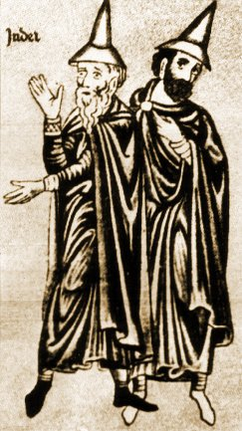
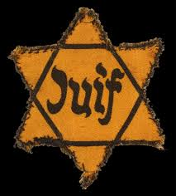
The City Of London & Magna Carta
The meeting marked the zenith of Papal power. Old anti-Jewish decrees were expanded and Jews were compelled to wear the Yellow Patch, the “Badge of Shame”, to distinguish them from Christians. It was enforced in France, England, Germany and later in Hungary.

Slide 15
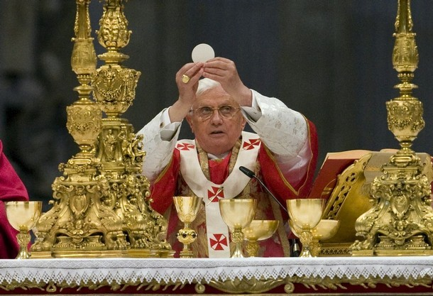
The City Of London & Magna Carta
The Pope also at this time instigated the Doctrine of Transubstantiation, in which the wafer (Host) and wine in the Eucharist are believed to become the blood and flesh of Jesus. It is probably no coincidence that it was this act that led to the demise of the Roman Catholic Church.

Slide 16
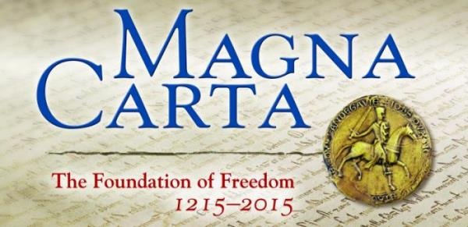
The City Of London & Magna Carta
Celebrations are afoot in 2015 to mark the 800th Anniversary of Magna Carta. However, one can be sure not much mention will be made of it being also the 800th anniversary of the fourth Lateran Council, where severe restrictions were placed on the Jews.

Slide 17
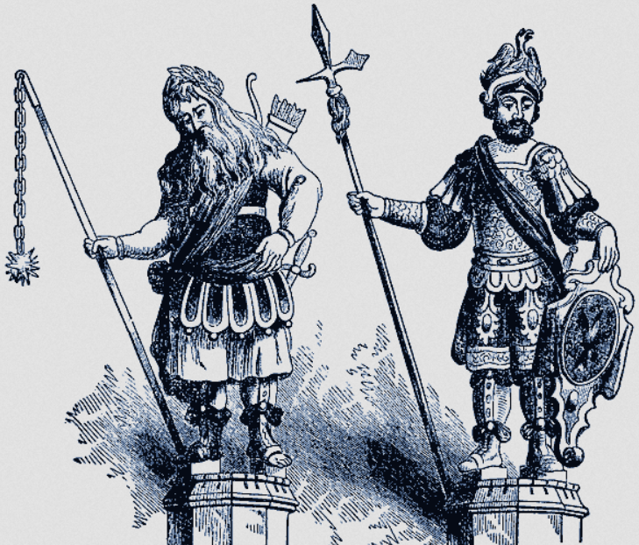
The City Of London & Magna Carta
Note: that the Lateran Council’s edict prohibiting Jews from becoming involved in state affairs and requiring Jews to identify themselves by wearing the yellow badge of shame, was on the 11th November 1215:-- 11 being the number of Gog.
Gog & Magog in Guild Hall City of London

Slide 18
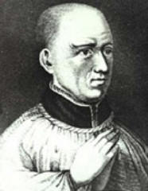
The City Of London & Magna Carta
King Henry had the power to appoint archbishops. To make sure that he had someone who would support his new reforms, he appointed one of his best friends, Thomas Becket (who would be called Thomas à Becket after his death). Thomas was not in the clergy, he was the Chancellor. To correct this minor problem, he was ordained as a priest, the following day was made a bishop, and by evening, became the Archbishop of Canterbury.

Slide 19
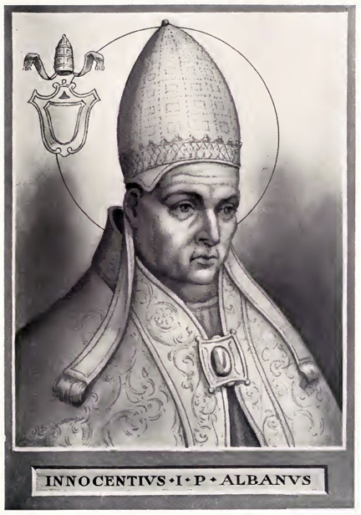
The City Of London & Magna Carta
King Henry II appointment of Thomas Becket as Archbishop would further alienate the Pope against England and would add to King John’s woes.

Slide 20
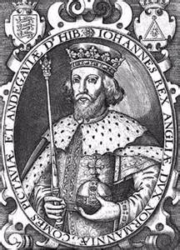
The City of London & Magna Carta
Now to return to King John and Magna Carta. Because of John’s ventures in France, including supporting the crusades financially, he was at the limit of what he could raise through taxation, particularly with regard to the Barons becoming restless.

Slide 21
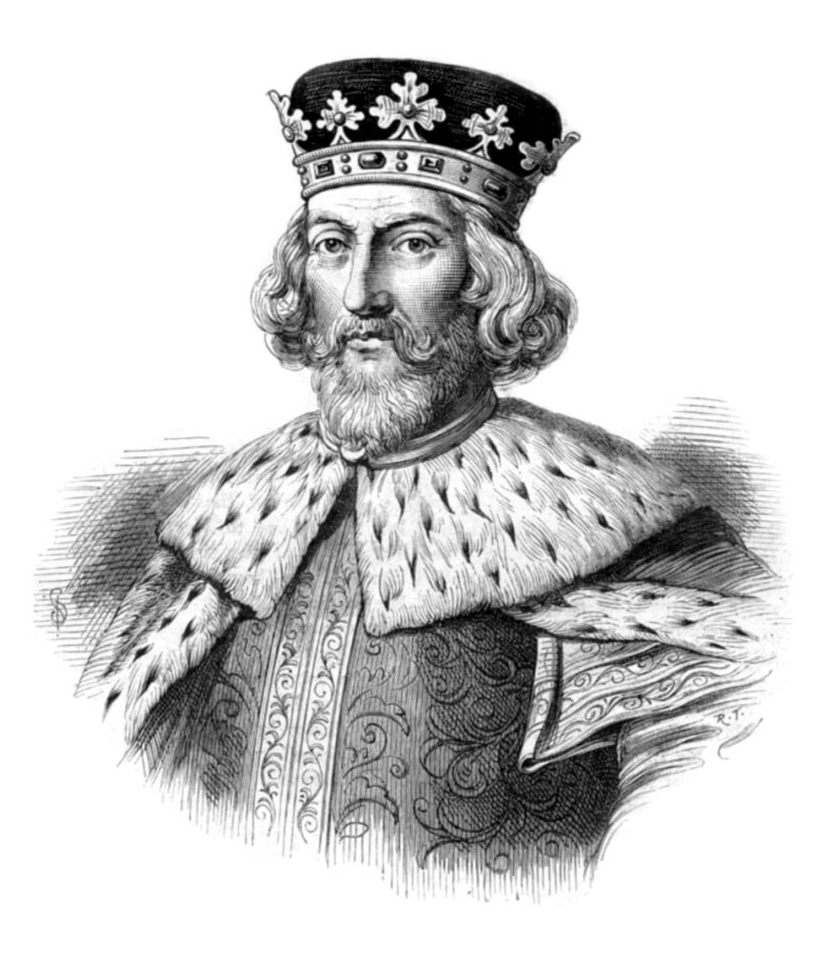
The City of London & Magna Carta
The struggle over church and state had not ended with Henry II. The pope was intent on maintaining power, so was John. Things came to a head when John tried to appoint a new Archbishop of Canterbury in 1205 and the monks wanted someone else.

Slide 22
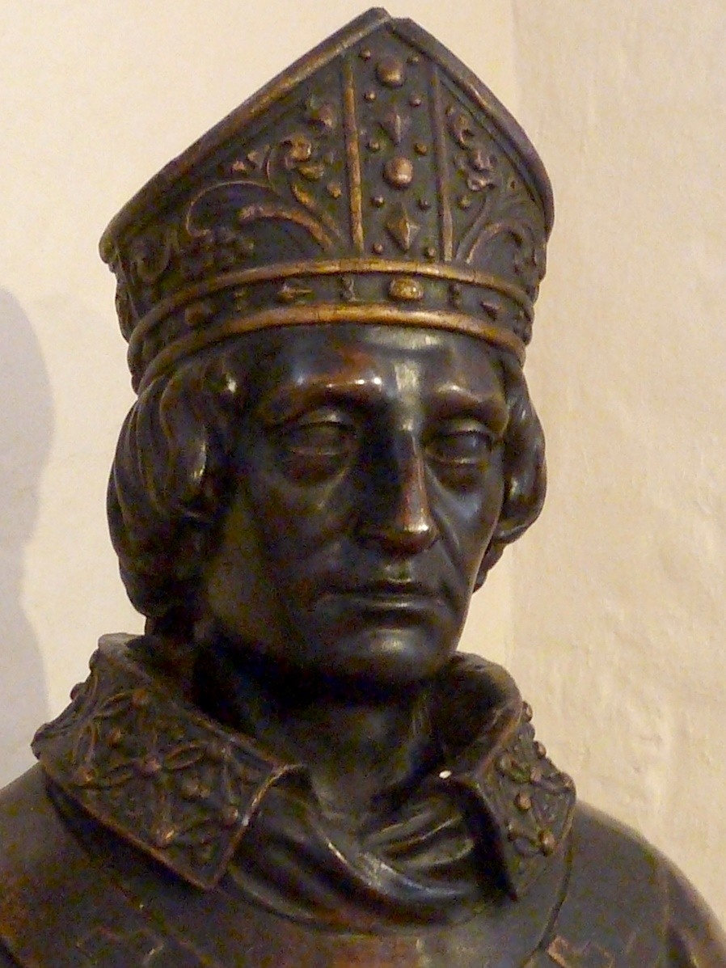
The City of London & Magna Carta
When the dispute was appealed to Pope Innocent III, the pope took the opportunity to appoint his own man; he chose Stephen Langton (left). John would not accept Langton and by 1207 the pope threatened interdiction unless Langton was received.

Slide 23
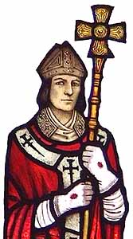
The City of London & Magna Carta
Remember that Henry II had been able to create Thomas Becket as Archbishop (left) in two days. The argument was about the power over the Church and who controlled the clergy and the lands and wealth of the Church.

Slide 24
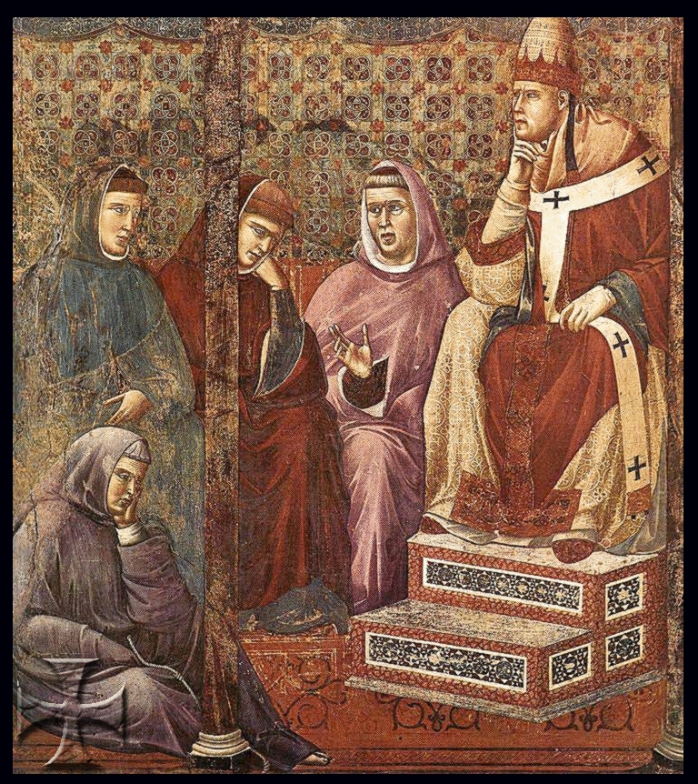
The City of London & Magna Carta
In 1208 the pope (Innocent III – left) activated the interdiction on England and John retaliated by confiscating Church property. In 1209, Langton actually came to England but John would still not receive him and the pope responded by excommunicating John.

Slide 25
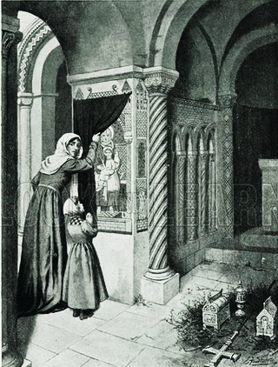
The City of London & Magna Carta
Essentially, the pope had taken away the right to rule, not just his religious salvation. Throughout the country, the priests would not perform the sacraments other than baptism and confession due to the interdiction
A scene during the Papal Interdict

Slide 26
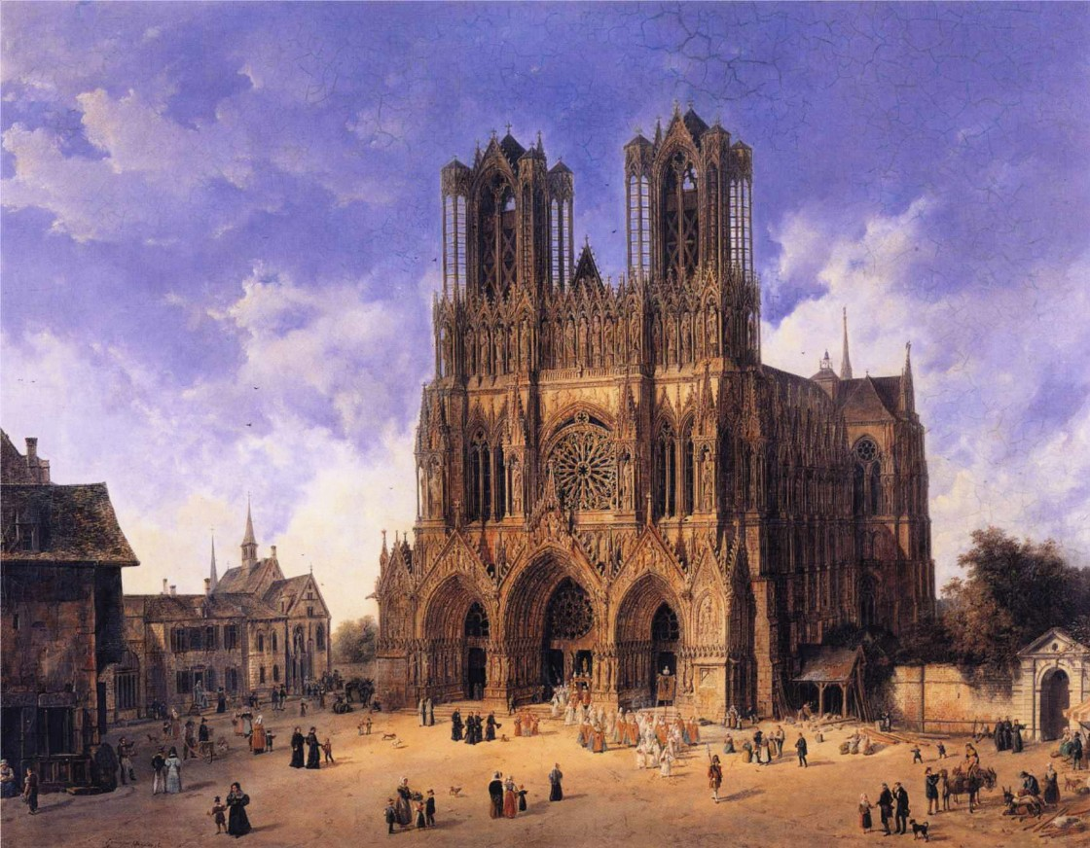
The City of London & Magna Carta
The excommunication of John meant that he no longer had the divine right to rule and had lost the support of the Church. The Church then swung their support to the French.
Reims Cathederal

Slide 27
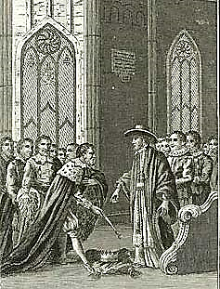
The City of London & Magna Carta
In 1212, John surrendered and sent a mission to the pope. As a result, he had to accept Langton, pay 100,000 marks to the Church (more money), and swear allegiance to the pope. Essentially he pledged England to the pope and ruled it as a fiefdom. In 1214 the interdiction was lifted.
"The Crown resigned to the Pope's Legate by King John" (in 1213)

Slide 28
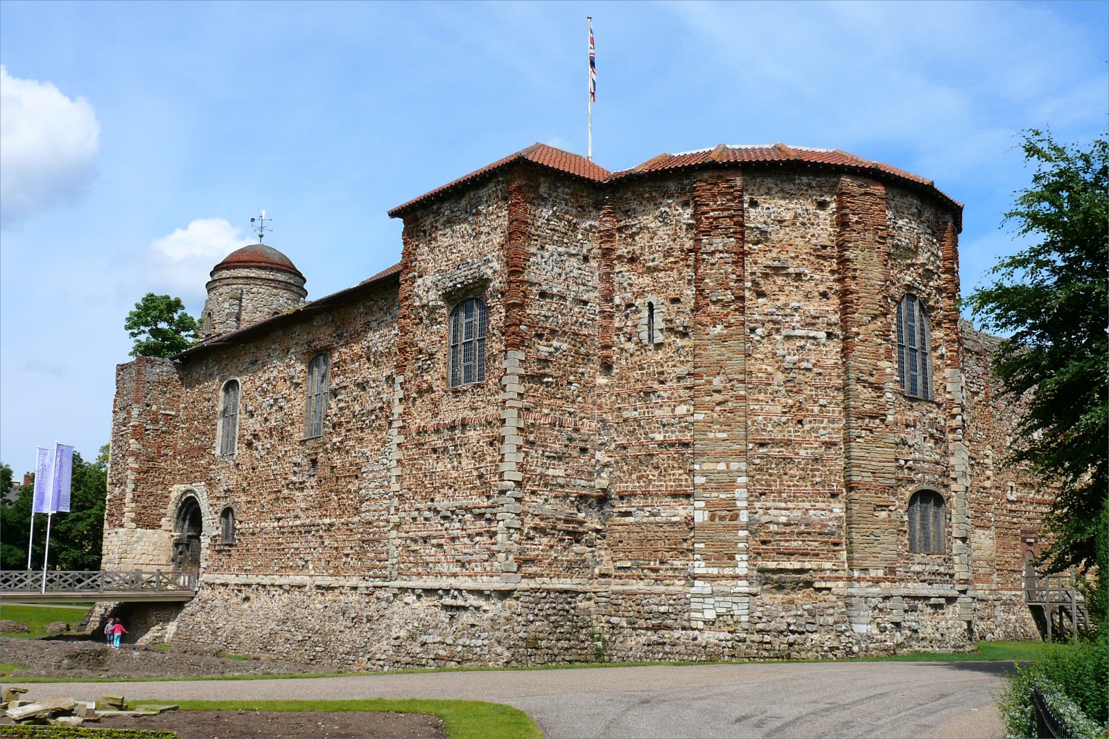
The City of London & Magna Carta
In 1214 the interdiction was lifted. At that point, John again went to war with France but was defeated at the battle of Bouvines. The French under Philip II capitalized on their win and invaded England, taking Colchester Castle.

Slide 29
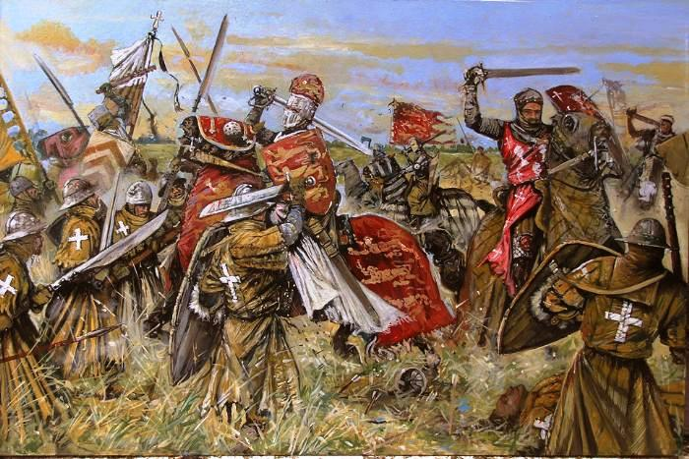
The City of London & Magna Carta
Had this not been yet another emergency in a 15 year series of emergencies, John might have been able to repel them. As it was, the Barons had had enough.

Slide 30
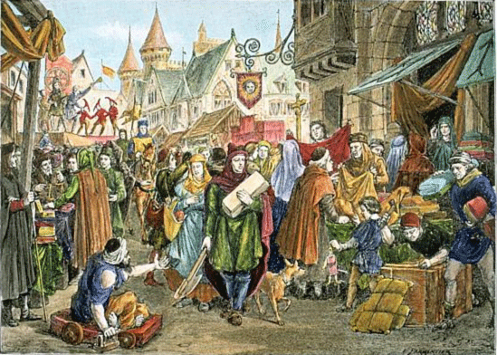
The City of London & Magna Carta
They began to rebel and looked to form alliances with France – probably betting that would be the future. There wasn't a lot of faith in John's military talent and the French had landed.

Slide 31
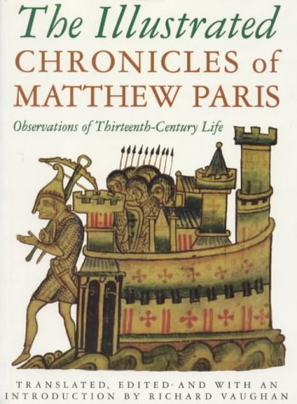
The City of London & Magna Carta
The City of London, however, was to play crucial role in the events leading up to the granting of the Charter in 1215. The rebel barons are not named in the Charter, but we have their identity from the Chronicle of Matthew Paris.

Slide 32
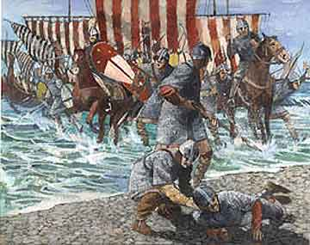
The City of London & Magna Carta
They were of Norman descent (we have to remember that a lot of Jews came in with the Normans). The Charter records that the King made the grant on the advice of certain barons and senior clergy. These are the supporters of the King and their names were Norman.

Slide 33
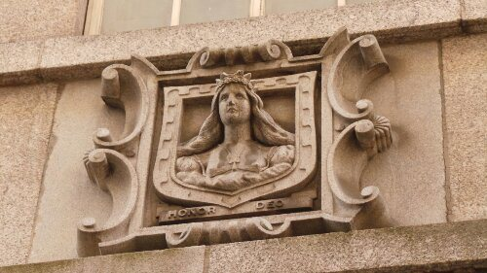
The City of London & Magna Carta
There was one exception – the list included the Mayor of London who had sided with the rebels. He was probably Serlo the mercer. He was succeeded in the course of 1215 by Thomas Hardel – both Anglo Saxon names, but they may well have been Khazars who had changed their names.
The Mercers Maiden is the symbol of the guild and can be seen in many places

Slide 34
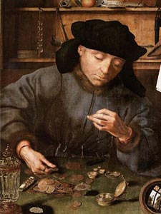
The City of London & Magna Carta
At the time, only Jews could legally be moneylenders due to Church laws against usury; charging interest for a loan. There was a great anti-Semitic sentiment at the time, in part due to the extreme taxes levied which required many to borrow money.

Slide 35
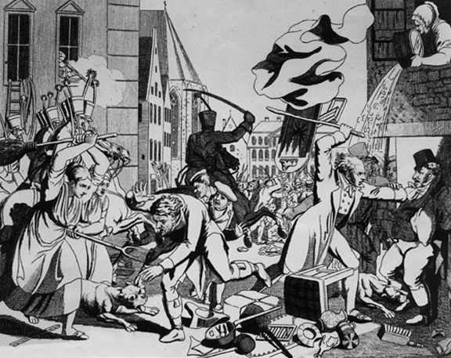
The City of London & Magna Carta
In fact, on their way to Runnymede, the Barons had ransacked Jewish homes. Archbishop Stephen Langton, who was present advising the king, but who had supported the Barons,

Slide 36
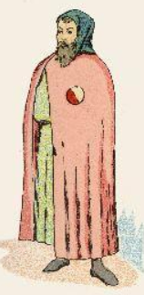
The City of London & Magna Carta
Later a law was instituted requiring Jews to wear identifying badges in 1222, in common with many other countries in Europe. These clauses are not found in the version sent by Henry III to Ireland nor in subsequent versions.

Slide 37
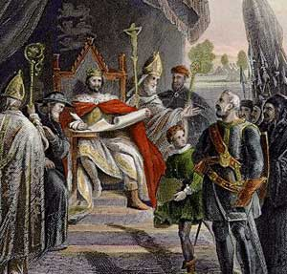
The City of London & Magna Carta
On June 15th, 1215 John's seal was placed on the articles which became known as Magna Carta. John was confident that the pope would never support the provisions of Magna Carta because it severely challenged the feudal rights of the king.

Slide 38
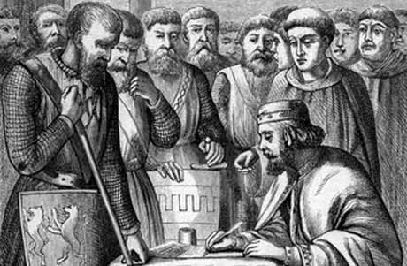
The City of London & Magna Carta
It was by accumulating individual rights that the common law began to be able to be used as a set of guidelines for the limitation of power and a definition of the basic rights of people. During the initial negotiations with King John, the language referred to the Barons, but in the final copy, the word "freemen" was used. This small change would impact the unique character of government under the English Kings.

Slide 39
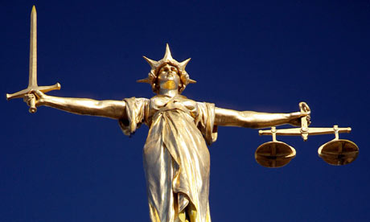
The City of London & Magna Carta
Magna Carta was an important step in a number of ways. It established limits on the king's power. It didn't matter what limits, the idea that there were limits set the stage for the future. It strengthened the rights to private property. It strengthened the system of courts to enforce an equal law throughout the country.

Slide 40
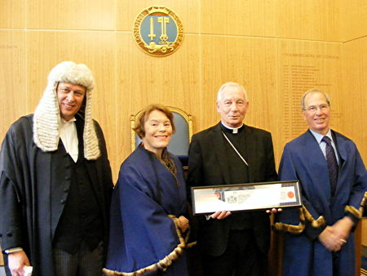
The City of London & Magna Carta
Very little of the provisions of Magna Carta would apply to London, as Magna Carta gave the City the right to govern and judge itself and to this day employs a Remembrancer to sit in parliament, whose sole purpose is to ensure that no laws are passed that would impinge on the City’s independence.
The City of London Remembrancer with wig on the left

Slide 41
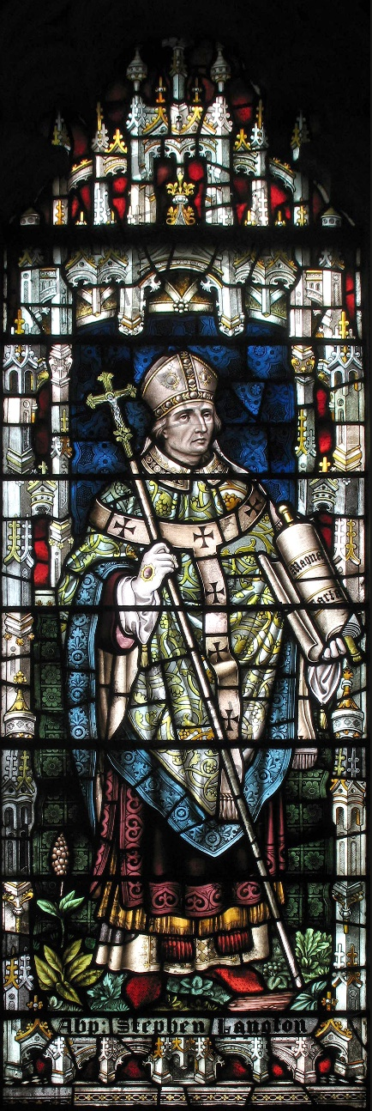
The City of London & Magna Carta
The inclusion of the article promising independence to the Catholic Church in the first position, shows the power the Church had regained in the confrontation over Langton's appointment. It's of interest to note the number of clergy cited as witnesses in Magna Carta:

Slide 42
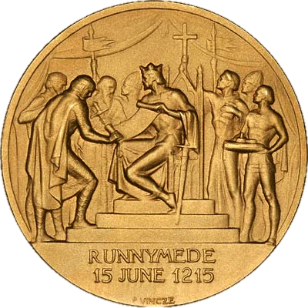
The City of London & Magna Carta
The clergy mentioned at the beginning of Magna Carta: Stephen, archbishop of Canterbury, Henry archbishop of Dublin, William bishop of London, Peter bishop of Winchester, Jocelin bishop of Bath and Glastonbury, Hugh bishop of Lincoln, Walter Bishop of Worcester, William bishop of Coventry, Benedict bishop of Rochester, Master Pandulf subdeacon and member of the papal household, Brother Aymeric master of the knighthood of the Temple in England. That makes a grand total of eleven (The number of Gog)

Slide 43
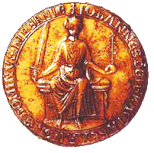
The City of London & Magna Carta
The Barons and laymen mentioned at the beginning of Magna Carta: William Marshal earl of Pembroke, William earl of Salisbury, William earl of Warren, William earl of Arundel, Alan de Galloway constable of Scotland, Warin Fitz Gerald, Peter Fitz Herbert, Hubert de Burgh seneschal of Poitou, Hugh de Neville, Matthew Fitz Herbert, Thomas Basset, Alan Basset, Philip Daubeny, Robert de Roppeley, John Marshal, and John Fitz Hugh. That makes a grand total of sixteen

Slide 44
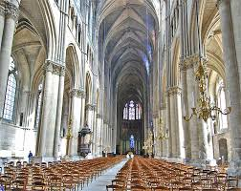
The City of London & Magna Carta
Although the Barons had mounted the rebellion, the Church saw the possibility of stemming the process started by Henry II to restrict its power and influence in England.

Slide 45
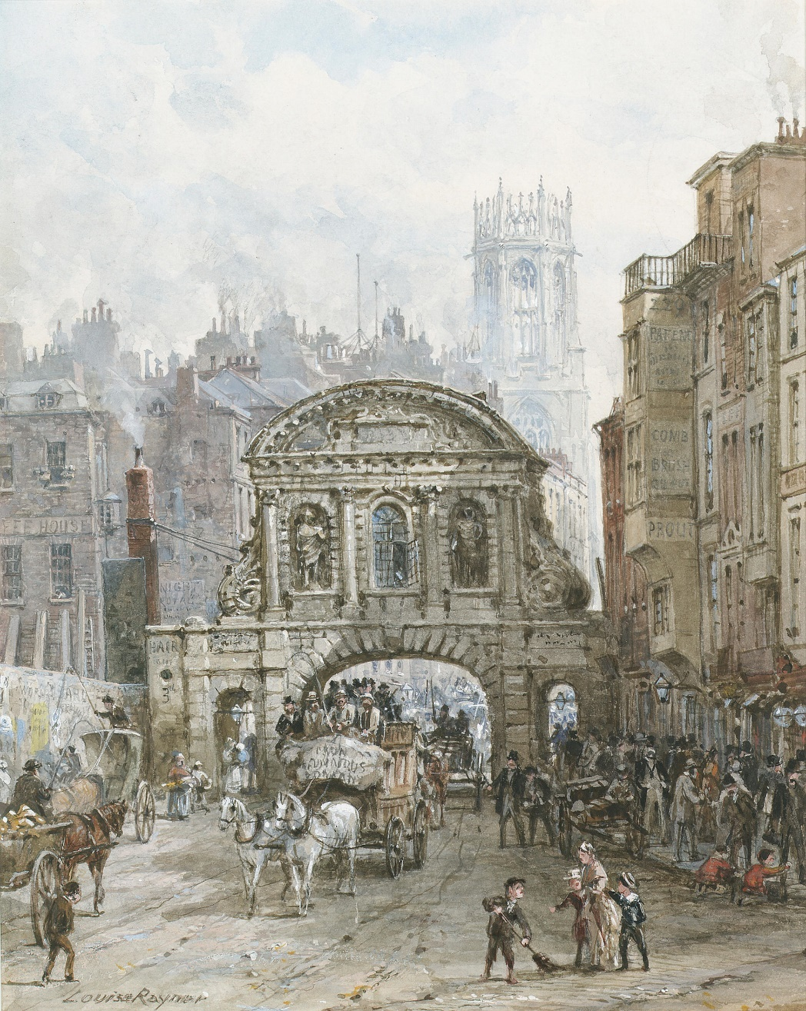
The City of London & Magna Carta
Although Magna Carta provided guarantees of liberty through the Barons of the respective areas in the Kingdom. However, the main benefactor was the City of London, which exempted it from taxation and right to have its own army – thus making it a virtually independent state.

Slide 46
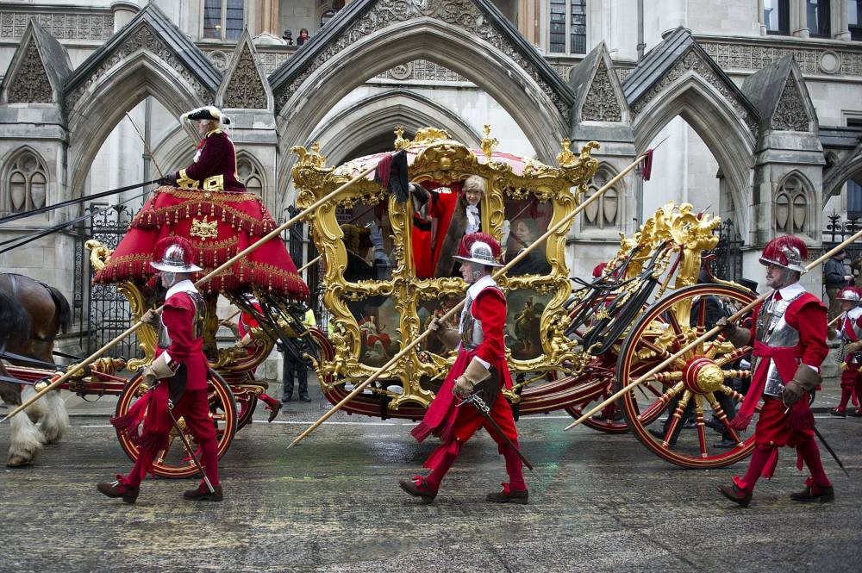
The City of London & Magna Carta
The Baron of The City of London was the most important person in the land next to the King. The Baron title later became Lord Mayor with all the trapping of a monarch.

Slide 47
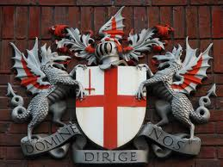
The City of London & Magna Carta
In Magna Carta, the 1215 charter of rights between King John and the barons, not only are the rights of the “whole body” of citizens respected, but the mayor of the City of London was designated as one of two guarantors charged with ensuring that the Crown kept its side of the bargain.

Slide 48
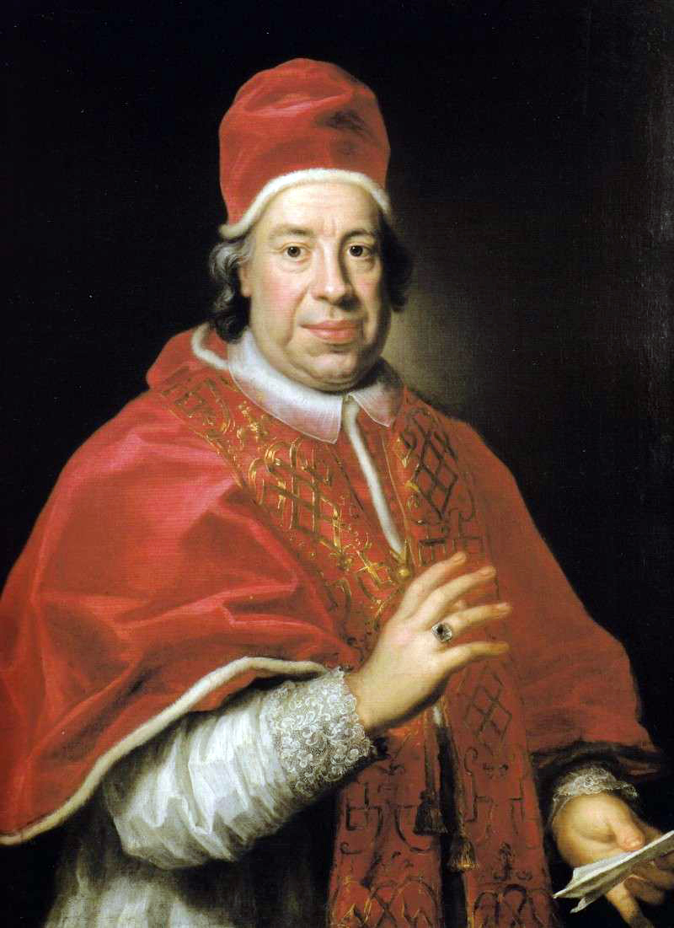
The City of London & Magna Carta
John wrote to Pope Innocent III (Left) who set aside Magna Carta saying that it had been extracted by force and it had been agreed to without his permission.

Slide 49
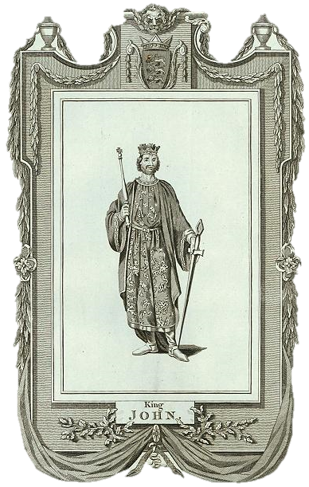
The City of London & Magna Carta
However under the Common Law of England, it was not in King John’s Power to give the realm of England away to a foreign power, as he represented the sovereignty of the People of England.

Slide 50
The City of London & Magna Carta
Magna Carta (left) gave the Barons the right to challenge the king and withhold allegiance if they disagreed. John had placed England under the protection of the pope so that the Church was actually the feudal power.

Slide 51
The City of London & Magna Carta
The Barons saw this as a betrayal and justification for removing John. They offered the crown to the dauphin, Prince Louis of France, son of Philip II. By September John was moving through the country trying to regain territory.

Slide 52
The City of London & Magna Carta
In February, 1216 he regained the territory in East Anglia, but the Barons held onto London and a small French fleet joined them there. A storm wrecked many of John's ships, weakening his defences against France.

Slide 53
The City of London & Magna Carta
This led to the First Barons' War, After John's death, the regency government of his young son, Henry III, reissued the document in 1216, stripped of some of its more radical content, in an unsuccessful bid to build political support for their cause. At the end of the war in 1217, it formed part of the peace treaty agreed at Lambeth.
The First Barons' War (1215–17)

Slide 54
The City of London & Magna Carta
He had to return to East Anglia to put down fresh revolts and then travel north to Scotland to attack Berwick to expel the Scots. Celebrating his victory there, he either ate too much and contracted dysentery, or he was poisoned by a monk. It really depends on which story you like, either way, he died.
The Tomb of King John in Worcester Cathedral

Slide 55
The City of London & Magna Carta
His son, Henry III, inherited the throne at the age of ten. William Marshal and Hubert de Burgh were appointed regents. The south was still held by the Barons and the French and it wasn't until 1219 that they were forced to leave.

Slide 56
The City of London & Magna Carta
Within a month, Magna Carta had been reissued in his name, this time with the agreement of Pope Innocent III. It's interesting to note that an amended copy of Magna Carta was sent to Ireland in the name of Henry III by his regents.

Slide 57
The City of London & Magna Carta
Presumably this was to ensure their loyalty, and remove one threat so that energy could be targeted on regaining the English lands. Magna Carta was used in this way repeatedly through history.

Slide 58
The City of London & Magna Carta
In 1297 the Barons again rose in rebellion against Edward I (left) who was increasing taxes on wool and forcing the Barons to grant aid to support campaigns in Flanders and Gascony. To quell the rebellion, Edward I reissued a revised Magna Carta. This one forbade the king from raising taxes without the consent of the country

Slide 59
The City of London & Magna Carta
This heralded in the period known as “Merry England” when most people needed only work about 3 months in the year, due in main to the lifting of heavy taxation. Also during Edward I’s reign the Jews were expelled from England, some going to France, but many to Wales, which at that time was not part of the English realm. Hence to this day South Wales is a hot bed of socialism. The edict expelling the Jews has never been revoked.

Slide 60
The City of London & Magna Carta
From the 1580s, London became home to 10,000 internal refugees a year, most displaced by enclosure in the north and Midlands. By 1625 it had 400,000 inhabitants – 20 times more than any other English city. This beginning of the Jews plan to corral people into the cities where they could be better controlled and manipulated.

Slide 61
The City of London & Magna Carta
In 1632 the crown asked the Corporation to extend its privileges and institutions to the new areas of London, but the Corporation refused. Instead of expanding and extending its democratic practices and legal protections to the new inhabitants living without civic status in the suburbs of Westminster, Clerkenwell, Whitechapel and Southwark.

Slide 62
The City of London & Magna Carta
Of course there was a good reason for the City of London not to extend its boundaries. This was because Gog, having set London on fire in 1666, it was rebuilt to its precise Masonic plans. It had been designed to exactly cover 677 acres of land. For 677 = 666 (the number of the beast) + 11 (the number of Gog)

Slide 63
The City of London & Magna Carta
The City of London turned its back on London (outer London) as a city. The “great refusal” of 1637 defined the modern history of London. Instead of seeking to integrate the new arrivals, the Corporation put large resources into transferring its unwanted excess population.

Slide 64
The City of London & Magna Carta
This the City of London did by moving them to the Ulster Plantation and the Corporation of Londonderry, which were established for that purpose. The bowler hats and umbrellas of the Orange Orders derive from their sponsorship by the Corporation of London.

Slide 65
The City of London & Magna Carta
Throughout the mid-19th century, the bowler hat occupied the status of work-wear for London labourers, until it was adopted by Edward VII, who made it fashionable. Throughout the 20th century, the hat’s popularity grew until it almost entirely lost its association with the working class and became synonymous with civil servants and bankers.

Slide 66
The City of London & Magna Carta
Here we see the Orange Order parading in their City of London Uniform. Notice the 6 pointed star (Badge of Gog or mark of the beast) indicating that they are now in control of the land of Zarah Judah, having acquired 6 of the 9 counties, since their original purchase of LONDON-Derry!

Slide 67
The City of London & Magna Carta
The Bank of England has its own Masonic Lodge (No. 263 – 2 + 6 + 3 = 11 = The number of Gog). There is good circumstantial evidence, that the Orange Order was instigated by the City of London through connections with the bank of England’s Masonic lodge.

Slide 68
The City of London & Magna Carta
Many good and patriotic people are members of the Orange Order, but little do they know how the enemy is using them directly for the purpose of keeping the Kingdom divided, for the same enemy controls the IRA and other terrorist organisations, together with all the major intelligence services.

Slide 69
The City of London & Magna Carta
The Stuarts made two serious attempts at London reform. One led to the execution of the king, the other – an attempt by Charles II to establish that the monarchy was the source of the Corporation’s authority – led to the Stuarts’ replacement by William and Mary

Slide 70
The City of London & Magna Carta
William and Mary, whose Second Charter in 1690 leaves no doubt as to who were the greatest beneficiaries of the Glorious Revolution.

Slide 71
The City of London & Magna Carta
Nester Webster comments, referring to William of Orange: So a Jewish writer is able to boast that, “a Monarch reigned who was indebted to Jewish gold for his diadem.” Eric Jon Phelps Jews called Amsterdam the ‘New Jerusalem’.

Slide 72
The City of London & Magna Carta
The ‘new’ aristocratic (Jewish financial) Houses acted much like the established royal Houses that they had largely displaced, only more covertly, their strategy being that of master chess players. Therefore, it is difficult to distinguish the white from the black, the ‘good’ from the ‘bad’.
First Central Bank – Wissel Bank Amsterdam

Slide 73
The City of London & Magna Carta
It declared: “That the mayor, commonalty and citizens of London shall for ever hereafter remain, continue and be, and prescribe to be, a body politic, in re, facto, et nomine … and shall have and enjoy all their rights, gifts, charters, grants, liberties, privileges, franchises, customs, usages, constitutions, prescriptions, immunities, markets, duties, tolls, lands, tenements, estates and hereditaments whatsoever.”

Slide 74
The City of London & Magna Carta
The Name William is special because it is made up of two ‘V’s, indicative the name being in relationship to ‘twins’. Many connotations can be applied to William’s name; for instance, the first letter is ‘W’ and the last ‘M’ being its reverse image, in fact twins.

Slide 75
The City of London & Magna Carta
Within the name we find ‘.illi..’; once again, twins. Finally the ‘A’ is a Baconian secret signature. William Henry associates William with the word Elohim (Illi-am), the plural of ‘El’ the mighty one, and speculates it is the ‘mysterious root of such words as Illuminati’.

Slide 76
The City of London & Magna Carta
The Name WILLIAM
V V I (11) l l (The Twin Towers) (11) I (1) a (secret signature)
M = W upside down
V V
(11)
In The Name William we have using Roman numerals No. 11 (Gog) x 3 = 33 Degree Mason and 2 ll = the Twin Towers of the Masons.

Slide 77
The City of London & Magna Carta
3 Great National Disasters are associated with the name ‘WILLIAM’
William The Conqueror
Cromwell (real name Williams)
William of Orange
William The Conqueror

Slide 78
The City of London & Magna Carta
William of Orange, the money power’s proxy, upon his ascendancy to the British throne, marked the loss of real power to the Commons and City of London Crown.
This was ratified through the act of settlement. According to Eustace Mullins, from this time, the monarch that ascends the throne must first be approved by Chancellery.

Slide 79
The City of London & Magna Carta
The ascension of William & Mary, proxies of the Money Power (Gog) to the Throne of David, was a spectacle to be observed in a Masonic ritual of “Crossing over The Nile”; the similarity to Nile and Brù-na-Bóinne will be seen later or the Battle of The Boyne

Slide 80
The City of London & Magna Carta
The Battle of the Boyne - The historical significance of Brù-na-Bóinne and the ritual battle, have been so cunningly divorced from each other that the fables are naïvely accepted.

Slide 81
The City of London & Magna Carta
The Great Masonic Significance of The Battle of The Boyne
Comparison of the course of the Boyne with that of the Milky Way Coincidence?

Slide 82
The City of London & Magna Carta
The Great Masonic Significance of The Battle of The Boyne
Comparison of the course of the Boyne with that of the Nile Coincidence?

Slide 83
The City of London & Magna Carta
Obelisk at the Boyne erected at the spot where William III, Prince of Orange was shot and wounded (1690). The monument stood until 1923 AD when blown up by an early act of terrorism. The base of the Obelisk remains to this day with several stones still scattered around.

Slide 84
The City of London & Magna Carta
Right: William on his ‘white charger’ (Unicorn). Note the X symbol on the horse’s rump. X represents, according to Laurence Gardner, the Saltire (Cross of St. Andrew) and the sign of male female unity.

Slide 85
The City of London & Magna Carta
Left: How Monoceros and Canis Minor were portrayed in the 18th century. Right: Representation of William as Horus the Sun King on his white horse. Note the similarity of posture between the images of the dogs in both illustrations. This represents the Jew riding on the back of true Israel!

Slide 86
The City of London & Magna Carta
There were 2,000 casualties reported, but no individual graves! Although, there is a mound nearby with a plaque on it. Una Sheehan of the ‘Obelisk Centre’ at the Boyne River, surmises that some dead were taken back to their own counties, but is this likely? Finally, there is a theory that they mostly sank into the soft ground. For whatever reasons there are no individual graves on the ‘battle’ site!

Slide 87
The City of London & Magna Carta
This brings us to the artefacts; cannon balls, buttons, bullets and such like. There must be something left as evidence of the conflict since there was a cannonade that lasted for more than a day. There was also the fierce fighting taking place in the river and on both banks.

Slide 88
The City of London & Magna Carta
A John Smith an experienced metal detecting club member, whose main interest was searching ancient battlefield sites for artefacts. Plenty of items had been found at the site of the battle at Benburb, in the year 1646, a full 44 years before the historical events at the Boyne, but nothing was found at the Boyne site!

Slide 89
The City of London & Magna Carta
The 18th century was a glorious epoch for the City and its Corporation. Conflict, however, remained between the Corporation and the Crown, and two different concepts of state and empire developed, one based on “free trade” and championed by the Corporation, the other based on prerogative rule and the sovereignty of the Crown.
The True Royal Crown
The City of London Crown

Slide 90
The City of London & Magna Carta
The City of London supported George Washington and provided funds and men for the cause. The citizens of London reminded the king, to the point of treason, that it was they and not he who had won the civil war.

Slide 91
The City of London & Magna Carta
President Washington lays cornerstone of U.S. Capitol 222 years ago today (1793)

Slide 92
The City of London & Magna Carta
Even as Parliament displaced the Crown as the fundamental unit of sovereignty and democracy displaced the Divine Right of Kings as the principle of legitimacy, the state still refused to subordinate the Corporation of London to national laws and practices. Its assets and its ancient privileges remained untouched

Slide 93
The City of London & Magna Carta
Of course, the crown without the lion on top is covertly signalling control by the City of London. This is very convenient as the Royal crown takes the blame for the misdeeds of the City.

Slide 94
The City of London & Magna Carta
It has been shown that the City of London, was a major beneficiary of Magna Carta, but since achieving its goal of becoming an independent state, it has used its influence in the UK Parliament and government to strip away the rights of Freemen granted by the Charta.

Slide 95
The City of London & Magna Carta
According to a BBC Publication, only three of the 63 clauses in the Magna Carta are still in law. One defends the freedom and rights of the English Church, another relates to the privileges enjoyed by the City of London and the third - the most famous - is generally held to have established the right to trial by jury.

Slide 96
The City of London & Magna Carta
Parliament was up to skulduggery while London burned (a great opportunity to bury their treason). They said, if you do not tell us that you are not dead, then you must be dead so we’re to have to legally look after all your property until it is either claimed or sold. In other words, it’s the legislation that allowed governments to create Legal Title over the publics’ property by a swish of their pens.

Slide 97
The City of London & Magna Carta
The state (City of London) took custody of everybody and their property into a trust. The state became the trustee/husband holding all titles to the people and property, until a living man comes back to reclaim those titles, he can also claim damages.

Slide 98
The City of London & Magna Carta
After the great fire, then operating in Admiralty law, the law of the sea, so lost at sea. Everybody’s were held in trust by the state (City of London). Now that the City controls virtually the whole world the law goes under the name of UCC – Universal Contact Law. The Lord Mayor of The City of London is also Lord High Admiral, so is the fount of this law.

Slide 99
The City of London & Magna Carta
The UK Government is becoming very concerned, as more and more people throw off their strawman status and exert their rights as freemen – so they are planning to reset Magna Carta under the guise of improving our rights (according Cameron), but one can be sure the opposite will be the case.

Slide 100
The City of London & Magna Carta
CONCLUSION: The more one studies Magna Carta, the more questions keep arising, for example were subsequent modifications or re-issues lawful? Was Magna Carta (Charta) itself unlawful because it was granted under duress?
No doubt the debate will continue until the end of the age!

Slide 101
The City of London & Magna Carta
The author of this presentation would like to acknowledge information gleaned from Andrew Power’s book “Ireland Land of The Pharaohs”, particularly in relation to the Battle of the Boyne, William of Orange, and the Orange Order.

Slide 102
A thought to leave you with
One Can Ignore Reality…. But One Cannot Ignore The Consequences of Ignoring Reality
Howbeit no man spake openly of him for fear of the Jews. (John 7:13)

Slide 103
The Story Of Gog And Magog
The End Of Part Fifteen
To be continued – Gog and The Reformation

