Slide 1
The Story Of Gog And Magog
Part Fourteen
Gog’s Infiltration of The Reformation - Calvin

Slide 2
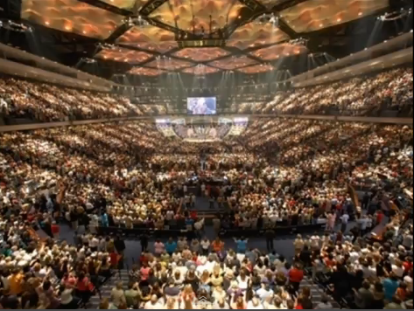
Calvin And The Reformation
You are about learn about an important part of church history from the Reformation period that has been so concealed in our day that very few people know the facts. Brace yourself for a shock.
The Judeo-Christian Church has not told the truth about Calvin

Slide 3
Calvin And The Reformation
It will be shown that Calvin was a Jew and an agent of the Prieuré de Sion.
“Contrary to general belief, Calvinism is of Jewish origin. It was deliberately conceived to split the adherents of the Christian religions and divide the people. Calvin's real name was Cohen.

Slide 4
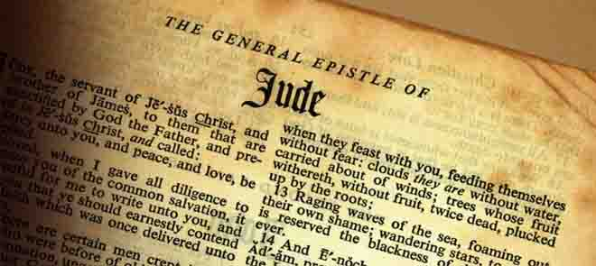
Calvin And The Reformation
Jude 1:4: “For there are certain men crept in unawares, who were before of old ordained to this condemnation, ungodly men, turning the grace of our God into lasciviousness, and denying the only Lord God, and our Lord Jesus Christ.”

Slide 5
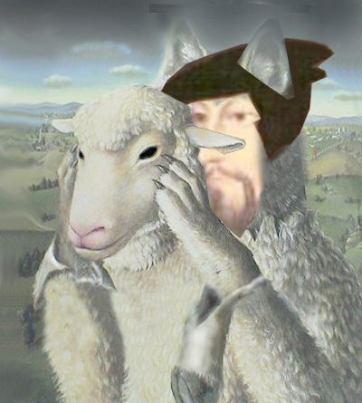
Calvin And The Reformation
The facts presented in this session, will show that there is good evidence that Calvin, was an enemy agent charged to steer the Reformation, in a direction favourable to the planned takeover of Christianity and Western Governments by the Edomite Jews.

Slide 6
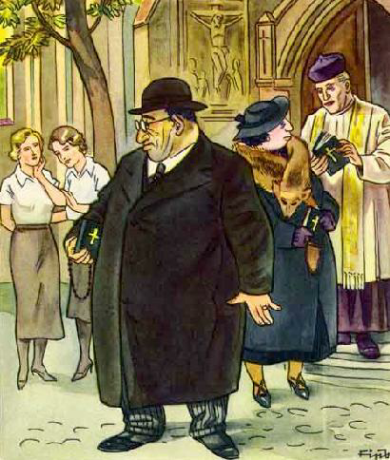
Calvin And The Reformation
That is easily understood by realizing that European Jews were under order of chief Rabbis to infiltrate "gentile" institutions to gain power. because of harsh sentiments toward Jews on the part of Christians who had become aware of the money manipulations of the "goldsmiths" in those days

Slide 7
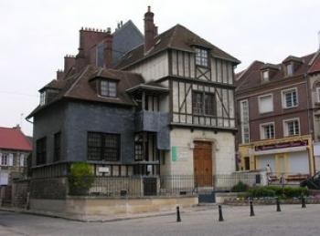
Calvin And The Reformation
CALVIN, John (1509 - 1564) was born at Noyon, in Picardy, July 10 1509. Christened Jean Cauvin – His French letters – Signed as Jean Calvin.
Noyon

Slide 8
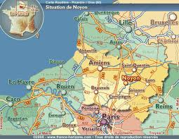
Calvin And The Reformation
Noyon is in NE France, which in times gone by was a very important city. It was here that Charlemagne had his capital before moving to Aachen in Germany.

Slide 9
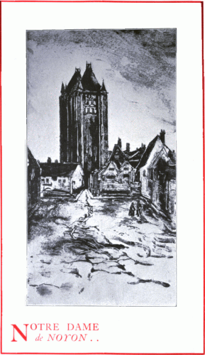
Calvin And The Reformation
"John Calvin's" father Gerard Cohen was an attorney in the French Catholic Church taking care of the Noyon diocese finances. This is our first clue as Jews go where the money is.

Slide 10
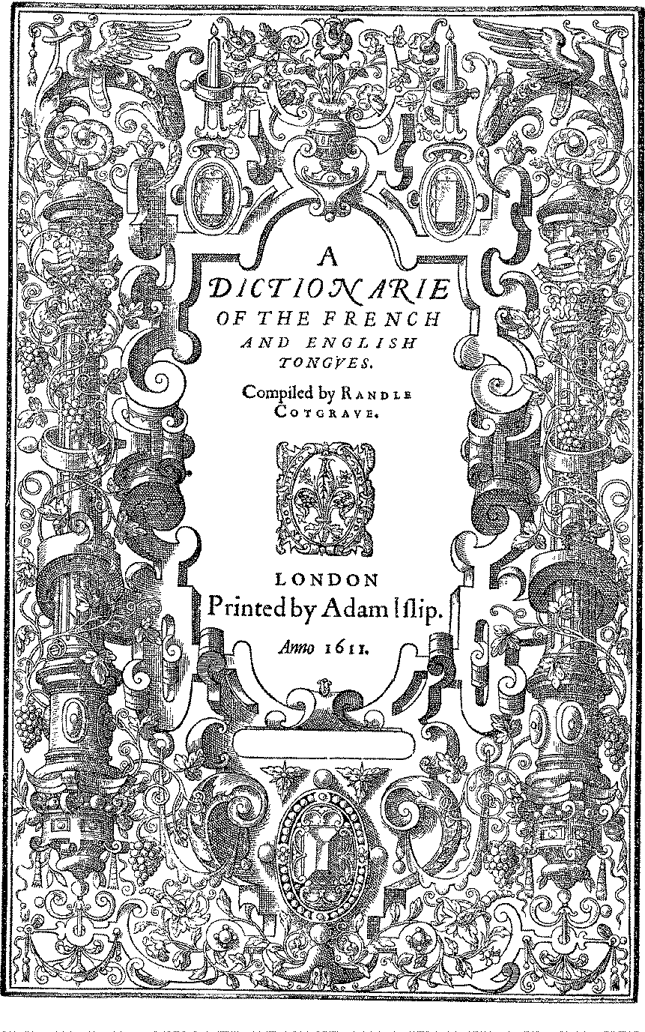
Calvin And The Reformation
From French Dictionary: the name "CAUVIN" 15-1600's French language.
Note the "vowels" a-e-i-o-v ( "v" = uuw, as in "lute")
Note the diphthong au (au = o, as in "aux - oh")
"CAUVIN" in French = The English "C - oh - uwh - in“ Same as English "Cohen”

Slide 11
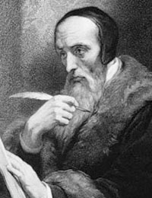
Calvin And The Reformation
Gerard Cohen, Calvin’s father was involved in a great scandal over the Noyon Diocese’s accounts and was excommunicated. His father was denied burial on consecrated ground until security was given for the payment of their father’s debts and other obligations the Roman Church required.

Slide 12
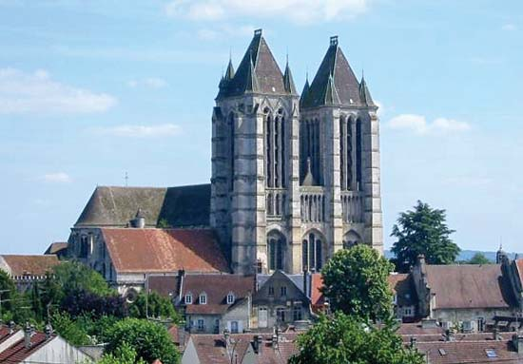
Calvin And The Reformation
Calvin was particularly precocious; by age 12, he was employed by the bishop as a clerk and received the tonsure, cutting his hair to symbolise his dedication to the Church.

Slide 13
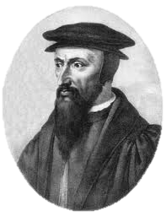
Calvin And The Reformation
He was educated at the College du Montagu, where Loyola, founder of the Jesuit [Roman Catholic] sect, had studied. Cauin later moved to Paris, where he continued his studies with the Humanists from 1531-32. During his stay in Paris he was known as Cauin.

Slide 14
Calvin And The Reformation
Circumstantial evidence and in particular the way Calvin behaved would indicate that he was indeed a Jesuit (a Jewish secret society within the Catholic Church), although we will never know for sure.
The Jesuit Logo

Slide 15
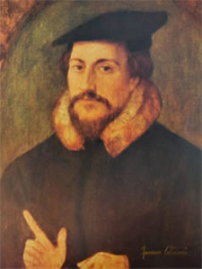
Calvin And The Reformation
His studies on humanities at the College du Montagu, would help mould his doctrine that enabled settlement of Jews in other parts of Europe fleeing the Spanish Inquisition. He also sowed the seeds of ecumenicalism.

Slide 16
Calvin And The Reformation
Calvin was an ecumenist. In a memorandum probably in December 1560, he described the 'Free and Universal Council' that was needed 'to put an end to the existing divisions in Christianity'.

Slide 17
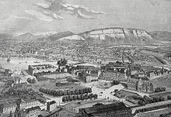
Calvin And The Reformation
It is not surprising, the League of Nations, forerunner of the UN, had its headquarters in Geneva (above) being the home city of Calvin, the preacher of universalism and ecumenism.

Slide 18
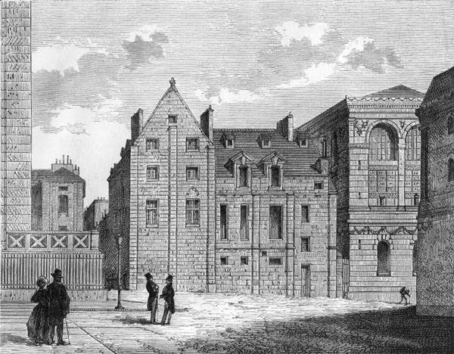
Calvin And The Reformation
The Collège de Montaigu was one of the colleges of the Faculty of Arts of the University of Paris.
It was originally called Collège des Aicelins, founded in 1314 by Gilles I Aycelin de Montaigu, Archbishop of Narbonne and Archbishop of Rouen.
Remains of the Montaigu College, c.1850

Slide 19
Calvin And The Reformation
The University of Paris (French: Université de Paris) was a university in Paris, France, and one of the earliest to be established in Europe. It was founded in the middle of the 12th century and was officially recognized as a university from between 1160 and 1250 approximately.

Slide 20
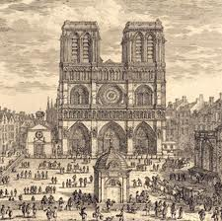
Calvin And The Reformation
On All Saints Day in 1533, Calvin delivered an address in Paris which clearly defended the doctrine of "justification by faith alone." Renouncing his Catholicism.
Old Paris – Notre Dame

Slide 21
Calvin And The Reformation
The core of what became known as Calvinism, was that man was a helpless being before an all-powerful God. He concluded that there was no such thing as free will, that man was predestined for either Heaven or Hell.

Slide 22
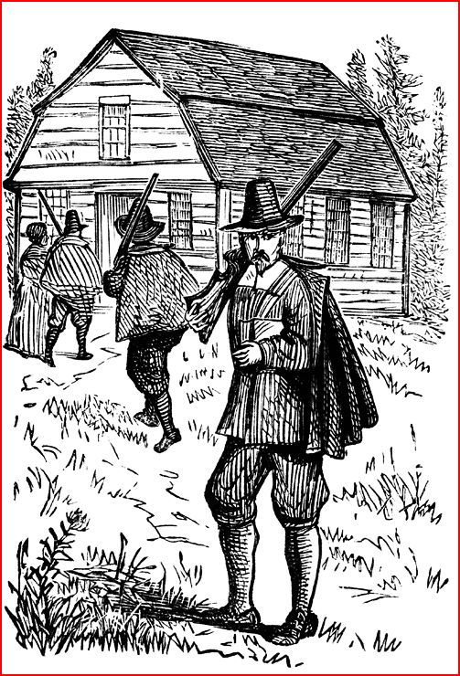
Calvin And The Reformation
Calvinism was clearly the doctrine of predestination, that is, the idea that all of mankind is assigned to either Heaven or Hell at birth. There is nothing you can do that would change your destiny since it was in the hands of all-powerful God. Such an opinion logically leads to anxiety.

Slide 23
Calvin And The Reformation
Adherence to God through a zeal for work and an ascetic lifestyle (main cause of the development of the capitalist economic system) are the main professions of the Calvinist faith, whose impact on society are plain to see.

Slide 24
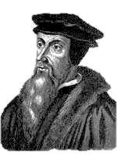
Calvin And The Reformation
It was the Reformation and Calvin in particular, that forced people to make a choice -- to be Catholic or Protestant, where previously they just considered themselves to be Christian.

Slide 25
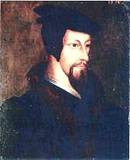
Calvin And The Reformation
Calvin had to flee Noyon after being exposed as a Homosexual – he went to Basle in Switzerland to join his friend Nicolas Cop.

Slide 26
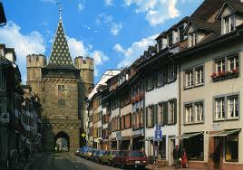
Calvin And The Reformation
Basel
It was not long before the French Church chased him and his father out of town. Calvin settled in Basel, Switzerland, where he worked on and published his famous Institutes of the Christian Religion..

Slide 27
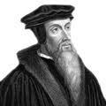
Calvin And The Reformation
Later he moved to Geneva where he formulated his philosophy known as Calvinism. At first known in Geneva as Cohen (the usual pronunciation of Cauin), he Anglicized his name to John Calvin”.

Slide 28
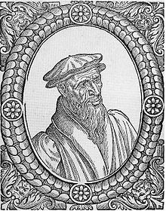
Calvin And The Reformation
During 1536, Farel drafted a confession of faith while Calvin wrote separate articles on reorganising the church in Geneva. It was Farel who persuaded him to move to Geneva.
William Farel

Slide 29
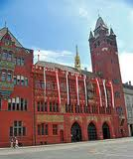
Calvin And The Reformation
The council also refused to grant Calvin and Farel the power to excommunicate, an authority they had demanded because it was critical to insure that their plans could be enforced.
Basel Rathaus (Town Hall)

Slide 30
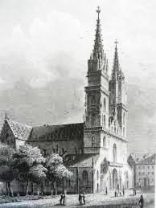
Calvin And The Reformation
Calvin retaliated by denying the Lord’s Supper to all Genevans at the Easter services that soon followed, saying the entire city was too debased to be worthy of communion.

Slide 31
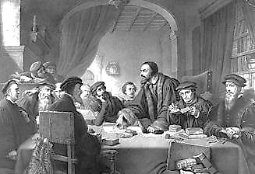
Calvin And The Reformation
John Calvin speaking at the Council Meeting
Consequently, the City Council kicked Calvin and Farel both out of Geneva literally on their arses, calling Calvin a would-be “Pope.”

Slide 32
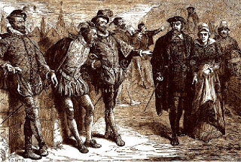
Calvin And The Reformation
In the picture above we Calvin and his wife being jeered on his forced departure from Geneva.

Slide 33
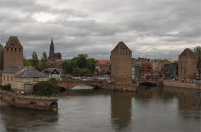
Calvin And The Reformation
Strasbourg
Calvin hid out in Strasbourg Switzerland and found some financial support there. He engaged in a travelling lecture series. He secured a modest position as a pastor and began to build a reputation there as a speaker.

Slide 34
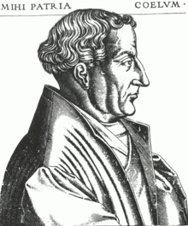
Calvin And The Reformation
Martin Bucer invited Calvin to Strasbourg after he was expelled from Geneva. He was a consecrated acolyte in the Strasbourg church of the Williamites, and he took his vows as a full Dominican friar. In 1510, he was consecrated as a deacon.

Slide 35
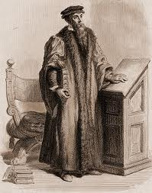
Calvin And The Reformation
Eventually in 1540 somebody still supporting him in Geneva, remembered his polemic skills and invited him to author the city’s written response to a new Papal Bull demanding Geneva’s return to Vatican rule.

Slide 36
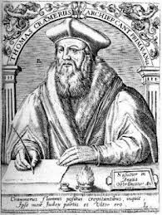
Calvin And The Reformation
Calvin (with Jewish cunning) wrote such a great refusal that he was invited back almost immediately to come help run the Reformation in Geneva, but Calvin didn’t trust Geneva’s government and Church councils enough to risk his life right away.

Slide 37
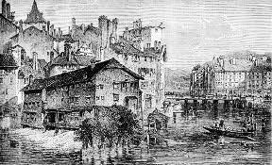
Calvin And The Reformation
There had been a genuine turnover in these social and political powers however, and Calvin’s supporters had indeed taken full charge of the city.

Slide 38
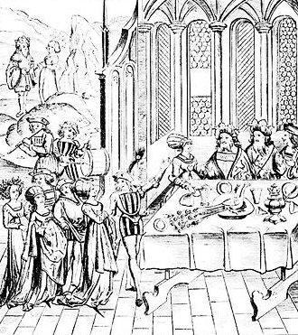
Calvin And The Reformation
After a year of negotiations that reassured him his authority would never again be questioned, Calvin returned triumphantly in 1541 to a huge banquet in his honour and piles of booty as a reward

Slide 39
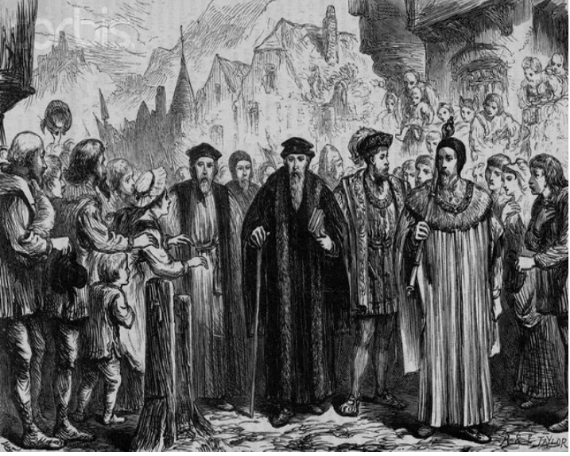
Calvin And The Reformation
Calvin Enters Geneva Again In Triumph

Slide 40
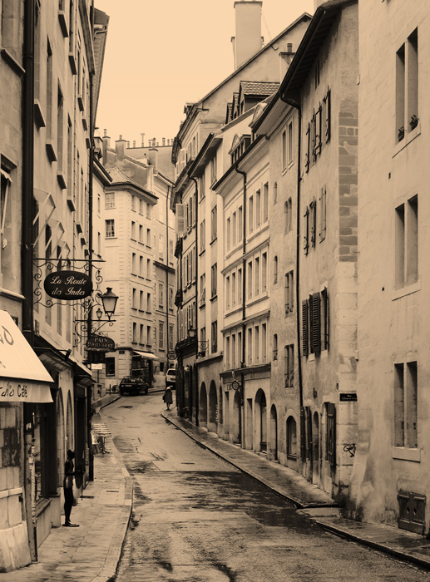
Calvin And The Reformation
Calvin’s triumphant return to Geneva and welcome by the citizens would be short lived. The parishioners soon began to grumble about Calvin's harsh regime and plots were afoot to have him removed. As we shall see Calvin dealt ruthlessly with those who would oppose him.

Slide 41
Calvin And The Reformation
In 1555, under Ami Perrin, a revolt was attempted. No blood was shed, but Perrin lost the day, and Calvin's theocracy triumphed. John Calvin had secured his grip on Geneva by defeating the very man who had invited him there, Ami Perrin, commissioner of Geneva.

Slide 42
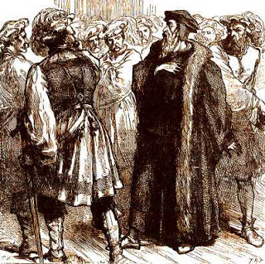
Calvin And The Reformation
To many, even those who helped John Calvin initially to power in Geneva, like Ami Perrin, Calvin became a despot, a bully and hypocrite, the founder of a personality cult, not a Christian hero.

Slide 43
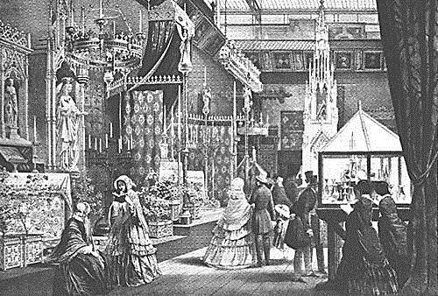
Calvin And The Reformation
In the end, Calvin imprisoned Perrin’s wife for the crime of dancing. His father-in-law was prosecuted in connection with his wife’s dancing for accusing Calvin of being the “Bishop of Geneva”.

Slide 44
Calvin And The Reformation
Perrin had originally hailed Calvin as a component of Guillaume Farel’s Reformation battle against Rome, but Farel soon came to be known as an appendage of Calvin’s Reformation Empire, and Perrin eventually lost all belief in Calvin’s mission in Geneva.

Slide 45
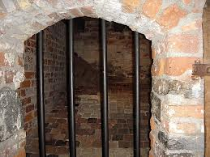
Calvin And The Reformation
I understand that you are considering imprisoning my father-in-law and my wife. My said father-in-law is old, my wife is ill; by imprisoning them you will shorten their days, to my great regret, which I have not deserved, and which would be to give me poor recompense for the services I have done you.

Slide 46
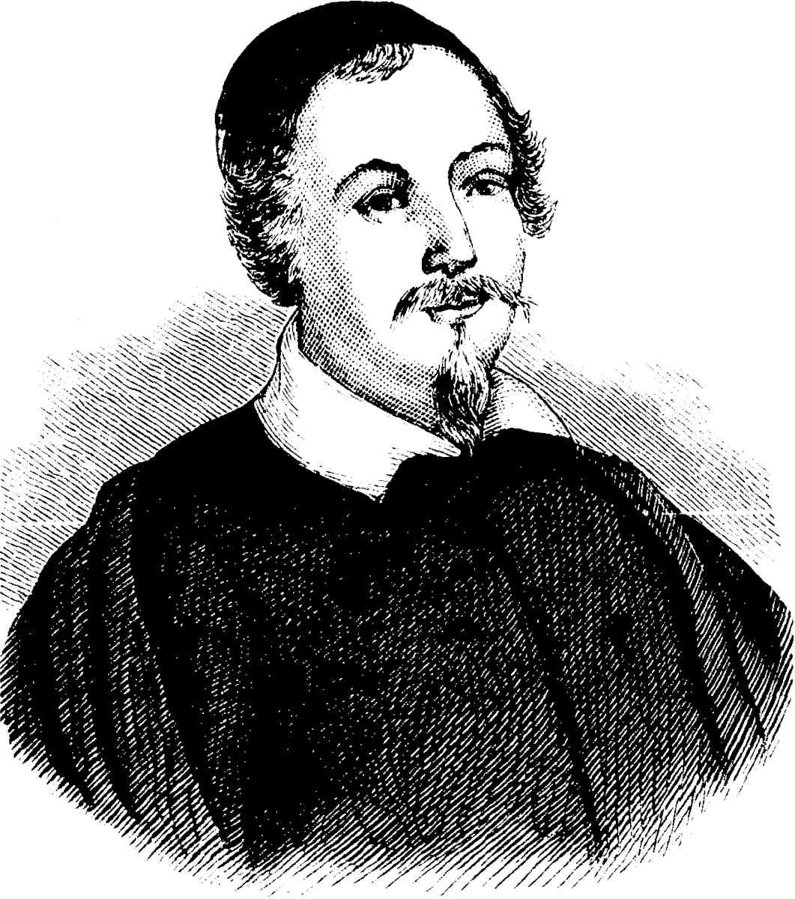
Calvin And The Reformation
….Therefore I beg you not to imprison them. If they have done wrong, I will bring them here to make such amends that you will have reason to be content. I pray you to grant me this, since if you put them in prison, God will aid me to avenge myself for it.
Ami Perrin, quoted by François Bonivard (above)

Slide 47
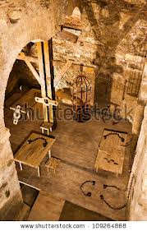
Calvin And The Reformation
I don’t know what made Perrin think this plea would have any effect on Calvin. In 1548, Calvin imprisoned his own brother’s wife for suspected adultery but couldn’t prove the charge.

Slide 48
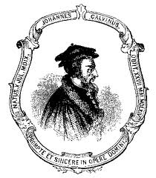
Calvin And The Reformation
….Calvin dogged her down for nine years and in 1557 finally convicted her of adultery with one of his own servants.

Slide 49
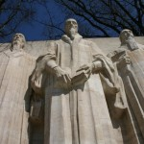
Calvin And The Reformation
If Calvin’s own blood, family, and household wasn’t immune to his deadly piety, Perrin’s begging for mercy wasn’t going to have any influence at all on the “Pope of Geneva.” Not only was Perrin’s petition refused but Perrin was accused of treason.

Slide 50
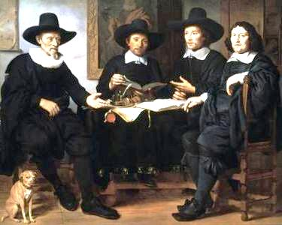
Calvin And The Reformation
In Geneva Calvin founded his own form of Protestantism known as Puritanism in England. Calvinism spread to the Netherlands, where its humanism helped establish a refuge for Spanish and Portuguese Jews.

Slide 51
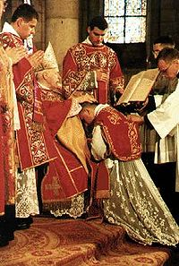
Calvin And The Reformation
Many were attracted to Calvin’s Puritans because, despite the Reformation many churches were still adhering to the Catholic ritual, but did not realise the seeds of Talmudism had been sown that would eventually Judaise most of Western Christianity.

Slide 52
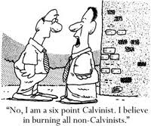
Calvin And The Reformation
Calvin’s brand of Protestantism which led to Puritanism in England. Calvinism spread to the Netherlands, where its humanism helped establish a refuge for Spanish and Portuguese Jews

Slide 53
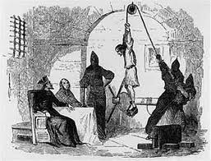
Calvin And The Reformation
Calvinism facilitated the settlement of Jews fleeing the Spanish Inquisition, as the indigenous people of Europe in the time of Calvin shunned Jews as the murderers of Christ – Hence Calvin’s name change from Cohen!

Slide 54
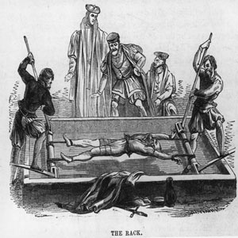
Calvin And The Reformation
While paving the way for his Jewish brethren to escape the Spanish Inquisition, at the same time, Calvin would bring terror to other parts of Christendom just as was going on in Spain.

Slide 55
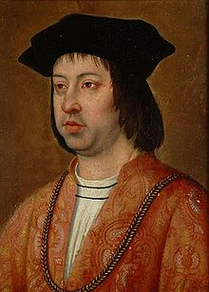
Calvin And The Reformation
We know that the Spanish Inquisition under the Catholic Monarchs, Ferdinand II of Aragon and Isabella I of Castile was to root out those Jews who had infiltrated the Church. Could it be that Calvin was the Jews’ agent to exact revenge on the Christians?
King of Aragon, Sicily, Naples, and Valencia

Slide 56
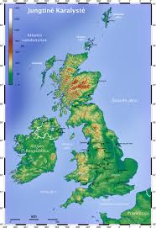
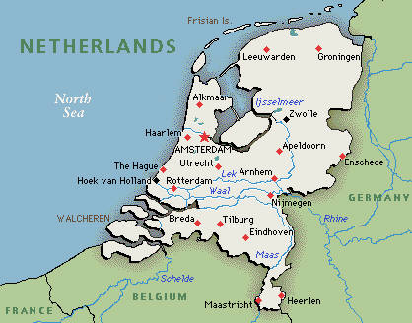
Calvin And The Reformation
Calvin sent huge numbers “missionaries” to the UK (to convert people to Puritanism) and to the Low Countries to convert them to Calvinism – there were some converts in other countries such as Germany and France.

Slide 57
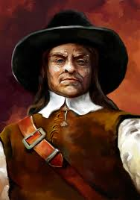
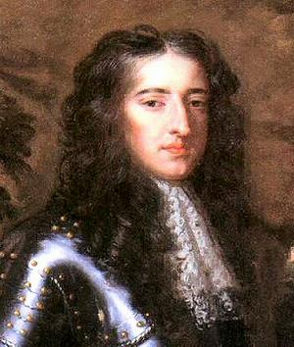
Calvin And The Reformation
Left: Oliver Cromwell
Right: William of Orange
Consequently it was to these countries that many of the Jews fled: first to Holland, then to the UK through the machinations of Cromwell and William of Orange.

Slide 58
Calvin And The Reformation
By Stealth Calvin paved the way for lending on usury, which previously was prohibited by the Roman Catholic Church – So he took the opportunity the Reformation afforded by preaching that a small amount was no sin. Some examples will follow.

Slide 59
Calvin And The Reformation
The Roman Catholic Church obtained great wealth from tribute obtained from European Monarchies, by the sale of indulgencies and pardons. For this reason there was no need to be involved in usury.
A Pardoner

Slide 60
Calvin And The Reformation
Even the Catholic and Church of England preachers at this time warned of the evils of the merchants and their commercial schemes.

Slide 61
Calvin And The Reformation
Few people know that there was a thriving economy during the Middle Ages, when the greatest displays of European wealth, its cathedrals were built.
Milan Cathedral

Slide 62
Calvin And The Reformation
In the middle of the 19th Century, Oxford Professor of Political History, Thorold Rogers wrote of that earlier era: “At that time a labourer could provide all the necessities for his family for a year by working fourteen weeks.”

Slide 63
Calvin And The Reformation
Of course the Jews through their control of publishing have labelled this era as the Dark Ages in our history books! – Because they were restricted from lending with usury.

Slide 64
Calvin And The Reformation
(Calvin's Commentary on Psalm 15:5). “Whence it follows, that the gain which he who lends his money upon interest acquires, without doing injury to any one, is not to be included under the head of unlawful usury"

Slide 65
Calvin And The Reformation
However, though he condemned interest to the poor, he opened the door to it for those who weren't poor. In his sermon on Deut., 23:18-20; he expressed that the interest should be moderate, and never allowed within the Christian fellowship.

Slide 66
Calvin And The Reformation
Aristotle: "He who takes usury for a loan of money acts unjustly for he sells what does not exist." For lack of knowledge the whole of the Western World has been delivered into the hands of the global ‘money changers’ otherwise referred to the Central Bankers with the help of Calvin
Aristotle

Slide 67
Calvin And The Reformation
Captain A.H.M. Ramsay (left), spoke about the ominous rumblings of Calvinism. Calvin organized great numbers of revolutionary orators, not a few of whom were inflicted upon England, Scotland and the Low Countries.
Captain A.H.M. Ramsay

Slide 68
Calvin And The Reformation
Thus Calvin laid the groundwork for revolution under a cloak of religious fervour. On both sides of the Tweed these demagogues contracted all religion into rigid observance of the "Sabbath."
A Puritan Couple

Slide 69
Calvin And The Reformation
Thus To use the words of Isaac Disraeli, "the nation was artfully divided into Sabbatarians and Sabbath breakers." "Calvin," states Disraeli, "deemed the Sabbath to have been a Jewish ordinance, limited to the sacred people."
Benjamin Disraeli

Slide 70
Calvin And The Reformation
He goes on to say that when these Calvinists held the country in their power, "it seemed that religion chiefly consisted of Sabbatarian rigours; and that a British senate had been transformed into a company of Judaised Rabbis":

Slide 71
Calvin And The Reformation
The Talmudisation of Christianity, by making strict rules and severe penalties for breaking the Sabbath is another indication of Calvin’s Jewish ancestry – they even took Christ to task for breaking the Sabbath!
The Talmud

Slide 72
Calvin And The Reformation
Quote by Spurgeon "The old truth that Calvin preached, that Augustine preached, that Paul preached, is the truth that I must preach to-day, or else be false to my conscience and my God.

Slide 73
Calvin And The Reformation
I cannot shape the truth; I know of no such thing as paring off the rough edges of a doctrine. John Knox's gospel is my gospel. That which thundered through Scotland must thunder through England again."—C. H. Spurgeon
John Knox (1514-1572)

Slide 74
Calvin And The Reformation
John Knox (1514-1572) was one of John Calvin’s most inspired students. A rough-and-tumble Scotsman, Knox’s fate would be forever entwined with the romance and mystery of the tragic Mary, Queen of Scots, whom he helped push into exile.

Slide 75
Calvin And The Reformation
John Knox fled England where he had been living, after Mary Tudor (Mary I / Bloody Mary – left) ascended the English throne in 1533. He travelled to Geneva, where he met the zealous Protestant reformer, John Calvin.

Slide 76
Calvin And The Reformation
"In 1650, after the execution of the King Charles I by Puritan Oliver Cromwell, an Act was passed inflicting penalties for a breach of the Sabbath."

Slide 77
Calvin And The Reformation
The passing of the Sabbath Law made it possible for the Puritans to persecute, humiliate and torture other Christians.

Slide 78
Calvin And The Reformation
Captain Maul Ramsay, in his Nameless War, states Calvinist, or Cohenist, Conspirators began to reveal themselves, during the English rising and their focus was the City of London.

Slide 79
Calvin And The Reformation
Earl of Bedford - a Jewish wine merchant named Roussel was the founder of this family in Tudor times, when they changed their name. It was Bedford who led the faction who wanted the King removed and was one of the powers behind Cromwell.

Slide 80
Calvin And The Reformation
At this time there suddenly began to appear from the City armed mobs of "Operatives" (the medieval equivalent for "workers" no doubt). Let me quote Disraeli: "They were said to amount to ten thousand ... with war-like weapons. It was a militia for insurgency at all seasons, and might be depended upon for any work of destruction at the cheapest rate.

Slide 81
Calvin And The Reformation
The Whigs and Tories were the first political parties in the world. The Whigs were Calvin’s Puritans, who were all for reducing the power of the Monarch.

Slide 82
Calvin And The Reformation
The Whigs were fervent supporters of the setting up of a Central bank, namely the Bank of England, against fierce opposition.
The Bank of England

Slide 83
Calvin And The Reformation
Bank of Amsterdam
The Federal Reserve
Bank of England
It is the followers of Calvin, namely the Puritans, that we have to thank for today’s modern oppressive banking system

Slide 84
Calvin And The Reformation
Today's Switzerland - and its cherished bank secrecy - still reflect the influence of church reformer Jean Calvin, an economic think tank director tells Swiss info
Banking secrecy has its roots in Calvinism

Slide 85
Calvin And The Reformation
How did Calvin stamp the mark of the Reformation and the image of Switzerland on the world?

Slide 86
Calvin And The Reformation
Banker replies: I know most about his influence on the United States. There Calvinism is very pronounced with around 15 million Calvinists – called Presbyterians in Anglo-Saxon countries.
A Presbyterian Church USA

Slide 87
Calvin And The Reformation
What was Calvin's influence on the economy and banking? Banker replies: As a reaction to the papal selling of indulgences as a means of raising money for Rome, Calvin was one of the first church leaders to permit the granting of loans with interest – albeit tied to high moral standards.

Slide 88
Calvin And The Reformation
On a worldwide scale, there are few features of the modern-day bourgeois, liberal and capitalist ideology that did not take root in Calvinism Equal rights for all citizens (crucible of liberalism), for example.

Slide 89
Calvin And The Reformation
Calvin and Freemasonary
John Calvin, was probably a Free Mason for in his Institutes of the Christian Religion (published in 1536), he repeatedly calls the Christian God 'the Architect of the Universe',

Slide 90
Calvin And The Reformation
Calvin and Freemasonary
---also referring to his works as 'Architecture of the Universe', and in his commentary on Psalm 19 refers to the Christian God

Slide 91
Calvin And The Reformation
"‘One of the many triumphs of our Freemasonry is that those Gentiles who become members of our Lodges, should never suspect that we are using them to build their own jails,-----

Slide 92
Calvin And The Reformation
-----upon whose terraces we shall erect the throne of our Universal King of the Jews; and should never know that we are commanding them to forge the chains of their own servility to our future King of the World...

Slide 93
Calvin And The Reformation
“Let us remember that as long as there still remain active enemies of the Christian Church, we may hope to become Master of the World ...And let us remember always that the future Jewish King will never reign in the world before Christianity is overthrown...

Slide 94
Calvin And The Reformation
---We have induced some of our children to join the Christian Body, with the explicit intimation that they should work in a still more efficient way for the disintegration of the Christian Church, by creating scandals within her.

Slide 95
Calvin And The Reformation
We have thus followed the advice of our Prince of the Jews, who so wisely said: 'Let some of your children become canons, so that they may destroy the Church.'

Slide 96
Calvin And The Reformation
When he couldn’t find any conventional sinners to persecute, Calvin had an obsession with ferreting out witches. Most of his victims in this sport were women who wouldn’t submit to his will or the will of their husbands.

Slide 97
Calvin And The Reformation
Calvin forced the citizens of Geneva to attend church services under a heavy threat of punishment. Since Calvinism falsely teaches that God forces the elect to believe.

Slide 98
Calvin And The Reformation
it is no wonder that Calvin thought he could also force the citizens of Geneva to all become the elect. Not becoming one of the elect was punishable by death or expulsion from Geneva

Slide 99
Calvin And The Reformation
Calvin exercised forced regeneration (or in modern church parlance to become saved) on the citizens of Geneva, because that is what his theology teaches.

Slide 100
Calvin And The Reformation
Calvin had so re-arranged his new Geneva government that he had absolute power. He literally ran a theocracy. He controlled the police, the courts, the media, and every church in town.
Those who cared to oppose or even debate him were swiftly dispatched one way or another, sometimes fatally, often brutally.

Slide 101
Calvin And The Reformation
It was, for example, routine for Calvinist city supervisors to do spot checks of people’s homes in Geneva, searching them for such things as dissenting religious books.

Slide 102
Calvin And The Reformation
In short, John Calvin’s world was an authoritarian world, and his religion was an authoritarian religion.

Slide 103
Calvin And The Reformation
Here, for example, is a 16th century depiction of iconoclastic Calvinists taking it upon themselves, in the name of Jesus (of all people!), to trash and “cleanse” a Catholic church:

Slide 104
Calvin And The Reformation
Perrin still maintained tremendous influence in Geneva however. There was a lengthy trial and acquittal, and Perrin began to openly move against his former comrade Calvin.

Slide 105
Calvin And The Reformation
Eventually Perrin led an attempted coup against Calvin’s government, based mainly on the promise to expel the hordes of French Protestant refugees like Calvin who were flocking to Geneva to escape the Inquisition or Roman Church in general

Slide 106
Calvin And The Reformation
Perrin’s rebellion failed and he was sentenced in absentia to have his right hand cut off

Slide 107
Calvin And The Reformation
Perrin’s revolt was the last time anyone dared quibble with John Calvin about anything on any level on any subject in Geneva. Calvin dismissed Perrin’s defeat as God’s justice and described Perrin as “our comic Caesar.”

Slide 108
Calvin And The Reformation
The Huguenots like Calvin who were flocking to Geneva to escape the Inquisition, and Roman Church in general (see map on left). These had all but taken over the Swiss city.
The Flight of The Huguenots to safer areas

Slide 109
Calvin And The Reformation
The Huguenots had no option but to accept Calvin’s brand of strict Christianity, otherwise Calvin would have them expelled or worse.

Slide 110
Calvin And The Reformation
Consequential upon the harsh treatment of those who rejected his Doctrine, or broke the rules which he had laid down, was a green light to the Vatican for the planned massacre of the French Huguenots, since most of Calvin’s immediate congregation were Huguenots.

Slide 111
Calvin And The Reformation
The Huguenots however, Calvin’s French friends, and many other refugee foreigners seemed to embrace Calvin’s pious, unilaterally oppressive and uniformly prosecuted religion.

Slide 112
Calvin And The Reformation
This has to be evaluated of course, in light of the alternative, which was for most going back to France or Spain or elsewhere in the Holy Roman Empire, and that of being tortured and burned by the Inquisition.

Slide 113
Calvin And The Reformation
In the years 1558-59, there were 414 prosecutions for moral offences, between 1542 and 1564 there were 76 banishments and 58 executions – just within Geneva – Population 20,000, in those days.

Slide 114
Calvin And The Reformation
A Judeo-Christian church picture (above), depicts Calvin as a caring considerate pastor visiting a home of one of his parishioners and being warmly received.

Slide 115
Calvin And The Reformation
But the extant records indicate otherwise. The picture in the previous slide was doctored to take away Calvin’s Jewish features.

Slide 116
Calvin And The Reformation
Calvin’s officials checked on homes, to make sure they did not have more than the certain amount of clothes, and women were taken to task if their hair style was not as approved.

Slide 117
Calvin And The Reformation
Not only that, in the more affluent houses that he had inspected, any books or pamphlets that were not approved by him were confiscated and burnt – a trait of the Jewish Bolsheviks!

Slide 118
Calvin And The Reformation
Calvin’s control over the city of Geneva was so absolute, that when he was not well, he would order the city council men to come to his house for the meeting.

Slide 119
Calvin And The Reformation
Because of Calvin’s inquisitorial reign in Geneva, he became known as the Protestant Pope, who is on record as having 58 people executed, but it is generally believed that this figure was far higher.
Calvin Characterised as Pope

Slide 120
Calvin And The Reformation
Not only that, Geneva became to be known as the Rome of Protestantism. "Under his rule Geneva, formerly so happy, became like a city of death, where all citizens went about as if in mourning." (Progress of Calvinism - In Switzerland.)

Slide 121
Calvin And The Reformation
Perhaps the most infamous execution, ordered by Calvin, was that of the Spanish Physician and Theologian, Michael Servetus, who left Spain to work in Lyon, France. He wrote a number of books on Theology and Medicinal subjects.
Michael Servetus

Slide 122
Calvin And The Reformation
Michael Servetus, embraces the reformation and corresponds with Calvin; regarding his manuscript of Christianismi Resitutio, but like many people who had befriended him, Calvin would turn against Servetus

Slide 123
Calvin And The Reformation
Servetus discovered the circulation of the blood because understanding this sensitive world, helped him to better grasp the relationship between God and mankind. For Servetus, the man can aspire to communicate with God following the example of God.

Slide 124
Calvin And The Reformation
Michael Servetus fled Spain because of the Inquisition. He wrote a paper condemning the horrors of the Zaragoza Inquisition and because of this had to leave Spain and settle in France.

Slide 125
Calvin And The Reformation
Michael Servetus , Restitution of Christianity was sent to Calvin; Calvin corresponded with Farel, Calvin's long time friend, advisor, and first Reformer in Geneva concerning Servetus' writings including his later one, Christianismi Restitutio that was printed in Lyon.

Slide 126
Calvin And The Reformation
When some of Servetus’ letters to Calvin fell into the hands of Guillaume de Trie, a former citizen of Lyon, he exposed Servetus to the inquisitor general at Lyon. Servetus and his printers were seized. During the trial, however, Servetus escaped, and the Catholic authorities had to be content with burning him in effigy.

Slide 127
Calvin And The Reformation
After fleeing France, he spent some time in Basel. He hoped to meet Erasmus, but the latter had left Basel more than a year earlier. Johannes Oecolampadius was now the chief reformer of Basle; and Servetus stayed in his house as a guest.
Basle

Slide 128
Calvin And The Reformation
According to Servetus, in God there is one single person. Servetus was clearly opposed to the splitting up of the divine essence, and contended that the persons of the Trinity are rather “forms” that God has chosen to manifest Himself.

Slide 129
Calvin And The Reformation
This unorthodox interpretation of the dogma of Trinity, led to a common desire on the part of both Roman Catholics and Protestants alike to jail Servetus, to put him to death, and to destroy his writings.

Slide 130
Calvin And The Reformation
Michael Servetus exchanged many letters with Calvin until Calvin decided he was a heretic.

Slide 131
Calvin And The Reformation
Calvin, who developed an intense dislike of Servetus during their correspondence, refused to return any of the incriminating material. This dislike arose because Michael Servetus took issue with Calvin on aspects of his doctrine.

Slide 132
Calvin And The Reformation
To rescue Servetus from his heresies, Calvin replied with the latest edition of his 'Institutes of the Christian Religion (Institutio Christianae religionis),' which Servetus promptly returned with marginal comments, which Calvin considered insulting.

Slide 133
Calvin And The Reformation
Despite his intense Biblicism and his wholly Christocentric view of the universe, Servetus would be found guilty of heresy, mainly on his views of the Trinity and Baptism. The site of his execution would be Champel near Geneva.

Slide 134
Calvin And The Reformation
Murdering a doctrinal heretic without Scriptural justification. This event was something Calvin had considered long before Servetus was even captured, for Calvin wrote his friend, Farel, on February 13, 1546 (seven years prior to Servetus' arrest) and went on record as saying:
William Farel

Slide 135
Calvin And The Reformation
"If he [Servetus] comes [to Geneva], I shall never let him go out alive if my authority has weight." - “Whosoever hateth his brother is a murderer and ye know that no murderer hath eternal life abiding in him” 1 John 3-15

Slide 136
Calvin And The Reformation
Servetus returned to France remaining out of sight for four months and then decided to go to Italy. He chose the route that passed through Geneva, where on 13 August he was recognized and denounced by Calvin to the magistrates.

Slide 137
Calvin And The Reformation
"As an 'obstinate heretic' he had all his property confiscated without more ado. He was badly treated in prison. It is understandable, therefore, that Servetus was rude and insulting at his confrontation with Calvin. Unfortunately for him, at this time Calvin was fighting to maintain his weakening power in Geneva.

Slide 138
Calvin And The Reformation
“Upon Michael Servetus’ arrest, trial and until executed he was held in an atrocious dungeon with no light or heat, little food, and no sanitary facilities."

Slide 139
Calvin And The Reformation
"Farel walked beside the condemned man, and kept up a constant barrage of words, in complete insensitivity to what Servetus might be feeling. All he had in mind was to extort from the prisoner an acknowledgement of his theological error

Slide 140
Calvin And The Reformation
-- a shocking example of the soulless cure of souls. After some minutes of this, Servetus ceased making any reply and prayed quietly to himself.

Slide 141
Calvin And The Reformation
When the executioner began his work, Servetus whispered with trembling voice: 'Oh God, Oh God!' The thwarted Farel snapped at him: 'Have you nothing else to say?' This time Servetus replied to him: 'What else might I do, but speak of God!'

Slide 142
Calvin And The Reformation
Thereupon he was lifted onto the pyre and chained to the stake. A wreath strewn with sulfur was placed on his head. When the faggots were ignited, a piercing cry of horror broke from him. 'Mercy, mercy!' he cried.

Slide 143
Calvin And The Reformation
For more than half an hour the horrible agony continued, for the pyre had been made of half-green wood, which burned slowly. 'Jesus, Son of the eternal God, have mercy on me,' the tormented man cried from the midst of the flames.

Slide 144
Calvin And The Reformation
"Ironically, the execution of Servetus did not really bolster the strength of Calvin or the Geneva Reformation. On the contrary, as Fritz Barth indicated, it 'gravely compromised Calvinism and put into the hands of the Catholics----

Slide 145
Calvin And The Reformation
---to whom Calvin wanted to demonstrate his Christian orthodoxy, the very best weapon for the persecution of the Huguenots, who were nothing but heretics in their eyes.' The procedure against Servetus served as a model of a Protestant heretic trial----

Slide 146
Calvin And The Reformation
.... it differed in no respect from the methods of the medieval Inquisition .... The victorious Reformation, too, was unable to resist the temptations of power."

Slide 147
Calvin And The Reformation
In just over 10 years from the execution of Michael Servetus Calvin himself would be dead, one of his legacies was to give the “green light” for the Catholics’ to massacre their own Huguenot heretics!

Slide 148
Calvin And The Reformation
Looking back, we can see how Gog (Edomite/Canaanite Jews infiltrated the Church and by corrupting it, split the Church to gain more control until today it is almost absolute. The Spanish found out too late that a Jew could not be converted. Hence the Inquisition to root out the Jews from the body politic.

Slide 149
Calvin And The Reformation
The murder and torture of the Huguenots in Geneva and not long after the Huguenots in France, was Gog’s revenge for being driven out of Spain, which at the time was the most prosperous nation in Europe.

Slide 150
Calvin And The Reformation
The St. Bartholomew's Day massacre (Massacre de la Saint-Barthélemy in French) in 1572 was a targeted group of assassinations, followed by a wave of Roman Catholic mob violence, directed against the Huguenots (French Calvinist Protestants),

Slide 151
Calvin And The Reformation
That the religious bloodshed down the centuries has been caused by the Jews is confirmed in the following statement: “Across the centuries, our brother Abel has lain in blood which we drew, and shed tears we caused by forgetting Thy love.” —Pope John XXIII, A Prayer (1960), cited in VICARS OF CHRIST

Slide 152
Calvin And The Reformation
"In autumn 1558, Calvin became ill with a fever ... Shortly after he recovered, he strained his voice while preaching, which brought on a violent fit of coughing. He burst a blood-vessel in his lungs, and his health steadily declined. He preached his final sermon in St. Pierre on 6 February 1564.

Slide 153
Calvin And The Reformation
For there was no one to take the place of Calvin, who was sick and unable longer to bear the burden resting on him. Calvin and Beza arranged to perform their duties jointly in alternate weeks, but the death of Calvin occurred soon afterward (May 27, 1564).

Slide 154
Calvin And The Reformation
For twenty-two months Beza had been absent from Geneva, and the interests of school and Church there and especially the condition of Calvin made it necessary for him to return.

Slide 155
Calvin And The Reformation
Theodore Beza (June 24, 1519 – October 13, 1605) was a French Protestant Christian theologian who played an important role in the Reformation. A member of the monarchomaque movement who opposed absolute monarchy, he was a disciple of John Calvin and lived most of his life in Switzerland.

Slide 156
Calvin And The Reformation
Calvin on his death bed
As a theocratic dictator, Calvin displayed characteristics every bit as evil as the very worst Popes of history. He ruthlessly dispatched any intellect he considered a threat to his absolute rule and the plan to create a lasting theocratic dynasty of Calvin

Slide 157
Calvin And The Reformation
Soon After Beza’s return the death of Calvin occurred on May 27, 1564. As a matter of course Beza became his successor. By his request Calvin was buried in an unmarked grave.

Slide 158
Calvin And The Reformation
So all there is, is a commemorative grave of Calvin in the Cimetière de Plainpalais in Geneva; the exact location of his grave is unknown. Was the real location kept secret because he knew that it would be desecrated?

Slide 159
Calvin And The Reformation
The Dominionists adhere tenaciously to the tenets of Calvinism or Reformed theology, which maintains that all of the end-time Bible prophecies were fulfilled by 70 A.D., with the destruction of Jerusalem.

Slide 160
Calvin And The Reformation
Therefore, it only remains for the Christian Church to set up the Kingdom of God on earth before the Second Coming of Jesus Christ. The spiritual father of the Dominionists is Protestant Reformer John Calvin, who aspired to set up the “Kingdom of God” in Geneva.
Geneva

Slide 161
Calvin And The Reformation
And yet, for all it’s blatantly despotic nature, today’s Calvinist apologists go so far as to claim Calvin’s Geneva is the pattern upon which the US Constitution was modelled.

Slide 162
Calvin And The Reformation
Even in Calvin’s Bible, the Geneva Bible, Jude 1:4; “For there are certain men crept in unawares, who were before of old ordained to this condemnation, ungodly men, turning the grace of our God into lasciviousness, and denying the only Lord God, and our Lord Jesus Christ”

Slide 163
Calvin And The Reformation
From the evidence given it can be seen that Calvin was of the Evil Fig variety – one of the ones to be bundled up with the tares and burnt..

Slide 164
Calvin And The Reformation
Calvin’s dark past has been carefully hidden from the Protestant Church goers by focusing on the evil’s of the Catholic Inquisition. Thanks to the internet the true history of Calvin is becoming more and more widely available, such as the book illustrated on the left.

Slide 165
Calvin And The Reformation
Despite the enemies machinations of the reformation to divide Christendom, Yahweh’s word was now able to be read in the vernacular tongue in Western Europe, it had always been in the vernacular tongue in Eastern Europe.

Slide 166
Calvin And The Reformation
It is interesting to note that Calvin’s Geneva Bible followed the Pilgrims to the USA, upon which the KJ Bible was based – was it the Edomite Calvin, who caused most of the Western Bibles to be based on the corrupt Masoretic text?

Slide 167
Calvin And The Reformation
“At B'nai B'rith celebrations held in Paris, France, in 1936 Cohen, Cauvin, or Calvin, whatever his name may have been, was enthusiastically acclaimed to have been of Jewish descent (The Catholic Gazette, February, 1936).
B'nai B'rith Logo

Slide 168
Calvin And The Reformation
The Tombstone of Michael Servetus, bears witness to the tyranny of Calvin’s despotic rule as Protestant Pope in Geneva.

Slide 169
Calvin And The Reformation
Calvin’s works are in every theological library; the books of Servetus are among the greatest rarities. Calvin’s influence is felt to this day in the whole Protestant world; Servetus passed away like a meteor, without a sect, without a pupil; yet he still eloquently denounces from his funeral pile the crime and folly of religious persecution.

Slide 170
Calvin And The Reformation
Calvin’s errant theology sowed the seeds, that would further split the church into a multitude of denominations and sects, which leaves the church powerless to resist the relentless onslaught of the enemy. But they have reckoned without Yahweh!

Slide 171
Calvin And The Reformation
It was Calvin, and not Luther, who gave to the Swiss and French reformers of this time a rallying point for Church reform. So, it was almost natural that when a few men were trying to convert the town of Geneva to their reformed doctrines that they called upon Calvin's help.
Geneva Coat of Arms

Slide 172
Calvin And The Reformation
In the next 6 slides, after studying the previous record of Calvin’s life and works, it is now possible to relate Nostradamus’ coded Quatrain, IX 44 to Calvin…

Slide 173
Calvin And The Reformation
Michel de Nostredame (14 or 21 December 1503[1] – 2 July 1566), usually Latinised as Nostradamus, was a French apothecary and reputed seer who published collections of prophecies that have since become famous worldwide. He is best known for his book Les Propheties (The Prophecies – where it is believed that Calvin is mentioned)
Nostradamus

Slide 174
Calvin And The Reformation
Quatrain, IX 44: on Calvin
Leave, leave Geneva everyone.
Saturn of gold will change into iron.
The contrary RAYPOZ will exterminate all.
Before the coming, the heavens will make a sign

Slide 175
Calvin And The Reformation
Pastor Eli’s interpretation of the four lines of the verse:
1.) Flee from Geneva for there is a great danger.

Slide 176
Calvin And The Reformation
2.) the pure gold (Sun) of doctrine will be debased into rusty iron (Mars, the god of war), symbolizing sedition against the True Reformation. Calvin was actually the leader of the counter-Reformation, by Judaizing Christianity

Slide 177
Calvin And The Reformation
3.) The "Protestant Pope" (Raypoz) of Geneva will also martyr his adversaries, hence the religious liberty gained by Martin Luther was subverted by Calvin

Slide 178
Calvin And The Reformation
4.) This could be a reference to Calvin's conversion.
During the autumn of 1533 Calvin experienced a religious conversion, claiming to be inspired of God!. This account can be found in his Commentary on the Book of Psalms:

Slide 179
Calvin And The Reformation
Calvin: "God by a sudden conversion subdued and brought my mind to a teachable frame, which was more hardened in such matters than might have been expected from one at my early period of life…..

Slide 180
Calvin And The Reformation
…..Having thus received some taste and knowledge of true godliness, I was immediately inflamed with so intense a desire to make progress therein, that although I did not altogether leave off other studies, yet I pursued them with less ardour.”

Slide 181
Calvin And The Reformation
With these words, Calvin claimed direct inspiration of God. But there is another inhabitant of the "heavens." His name is Satan, "prince of the air."

Slide 182
The Story Of Gog And Magog
A thought to leave you with From George Orwell
"The most effective way to destroy people is to deny and obliterate their own understanding of their history."
Howbeit no man spake openly of him for fear of the Jews. (John 7:13)

Slide 183
The Story Of Gog And Magog
The End Of Part Fourteen
To be continued …..

