Slide 1
The Story Of Gog And Magog
Part Thirteen
London – Gog’s Capital or Babylon The Great
The Rise of The City of London to Secret Ruler of Almost The Whole World

Slide 2
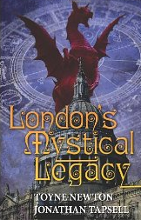
The Story Of Gog And Magog
Some information in this presentation has been gleaned from “London’s Mystical Legacy”, by Toyne Newton and Jonathan Tapsell. Those of you keen to further your knowledge of the dark occult origins and hidden secrets of the City of London would be well advised to purchase a copy of this reasonably priced book.

Slide 3

The Story Of Gog And Magog
Another book amongst many from which information for this presentation was gleaned, is “The New Jerusalem” by Adrian Gilbert, published in 2002. This book goes into great detail, especially on the esoteric aspect of rebuilding London after the great fire of 1666 into a New Jerusalem.

Slide 4
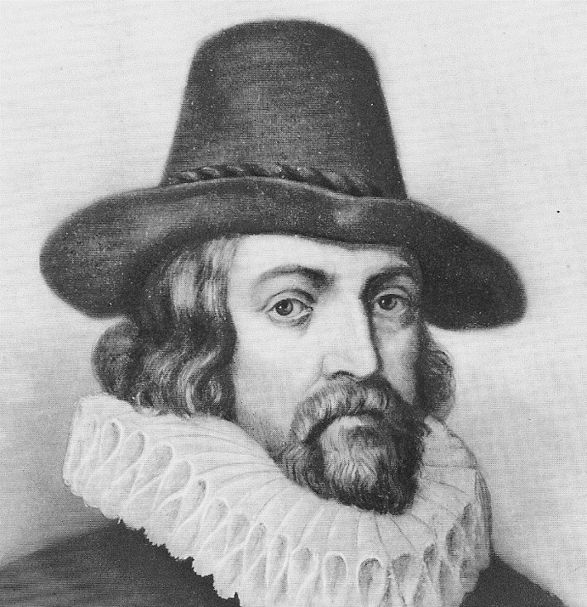
The Story Of Gog And Magog
"Read not to contradict and confute, nor to believe
and take for granted, but to weigh and consider. . . .
Histories make men wise."
FRANCIS BACON

Slide 5
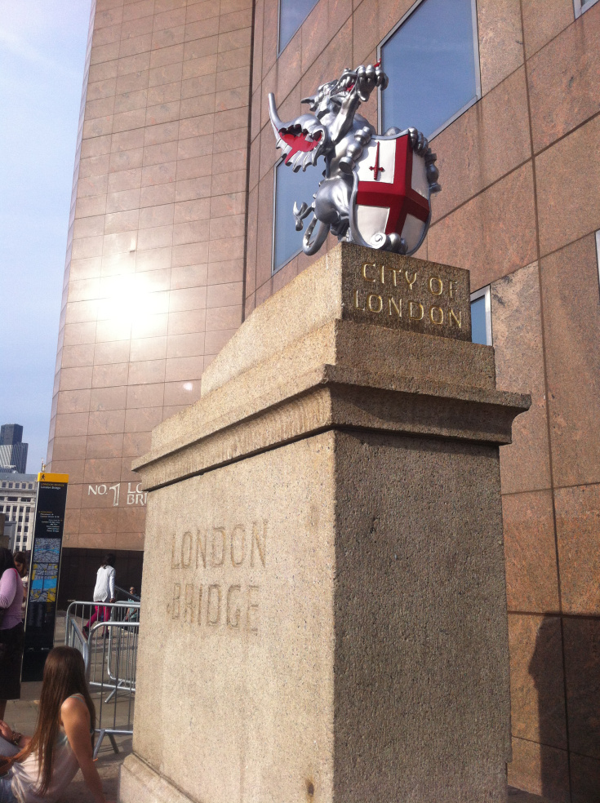
The Story Of Gog And Magog
One may be surprised to learn that the City of London, is the smallest city in England. It is within the centre of a more familiar city known as London, for which it is often mistaken. Despite that, as will be seen, although small in size its power is immense!

Slide 6
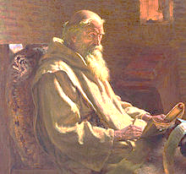
The Story Of Gog And Magog
Its plum trading position - at the mouth of the Thames and the heart of a network of Roman roads – makes London quite a prize. No wonder then it was so fiercely fought over throughout the Anglo-Saxon age.
London: - “A mart of many nations who visit by land and sea.” - The Venerable Bede (Above)

Slide 7
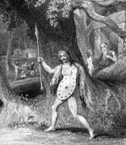
The Story Of Gog And Magog
London (under its previous names) was a thriving important City long before the invasion of the Romans and probably much older than Rome itself, contrary to the establishment’s stance that the Brits were painted savages prior to the civilising influence of the Romans.

Slide 8
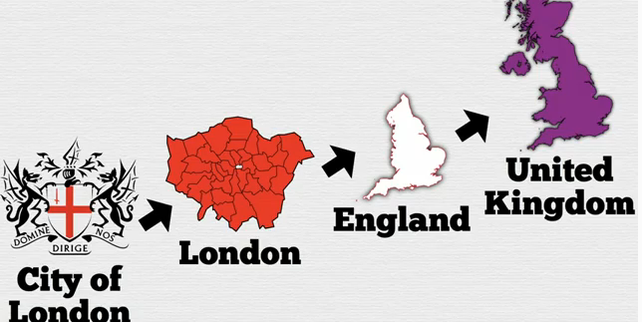
The Story Of Gog And Magog
The City of London is a city within a city (London) which is in a country (England) within a country – The United Kingdom.

Slide 9
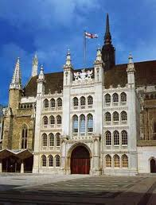
The Story Of Gog And Magog
Some Facts In Brief
The City of London Corporation predates the UK Parliament.
The City of London is the only place in the UK where businesses can vote in local elections

Slide 10
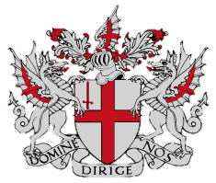
The Story Of Gog And Magog
The City of London will remain outside the authority of parliament. Domestic and foreign banks will be permitted to vote as if they were human beings, and their votes will outnumber those cast by real people. Its elected officials will be chosen from people deemed acceptable by a group of medieval guilds ….
Motto: 'DOMINE DIRIGE NOS' – Lord (Baal), direct us

Slide 11
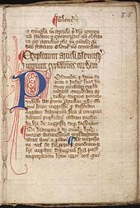
The Story Of Gog And Magog
The Corporation’s privileges could not withstand such public scrutiny. This, perhaps, is one of the reasons why the written constitutional documents of the United Kingdom remains a distant dream.

Slide 12
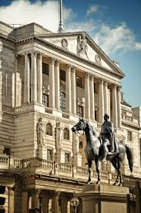
The Story Of Gog And Magog
Its power also helps to explain why regulation of the banks is scarcely better than it was before the crash, why there are no effective curbs on executive pay and bonuses and why successive governments fail to act against the UK’s dependent tax havens.

Slide 13
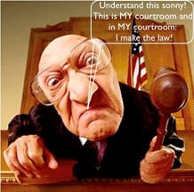
The Story Of Gog And Magog
“We (the City of London) just arbitrarily decide what laws we choose to enforce” Posted in Law, Political History, Politics by earthlinggb on February 23, 2011.
Oops, wrong again you pompous old bastard. The court belongs to the people and within such YOUR oath is “under God, so help me God”. “Understand Sonny”

Slide 14
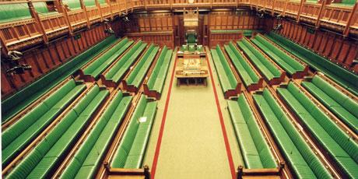
The Story Of Gog And Magog
You may note, that parliament was divided into Government and Opposition (“a house divided cannot stand”). Therefore, many parliamentarians didn’t consider the strict abidance to law STILL ON STATUTE as important.

Slide 15
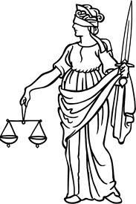
The Story Of Gog And Magog
… EXACTLY what we have today. Their ignorance of their own law with respect to Constitutional issues will be based upon their arbitrary decisions. You see the bottom line is: WE HAVE NO LAW! It’s a joke and it’s on us.

Slide 16
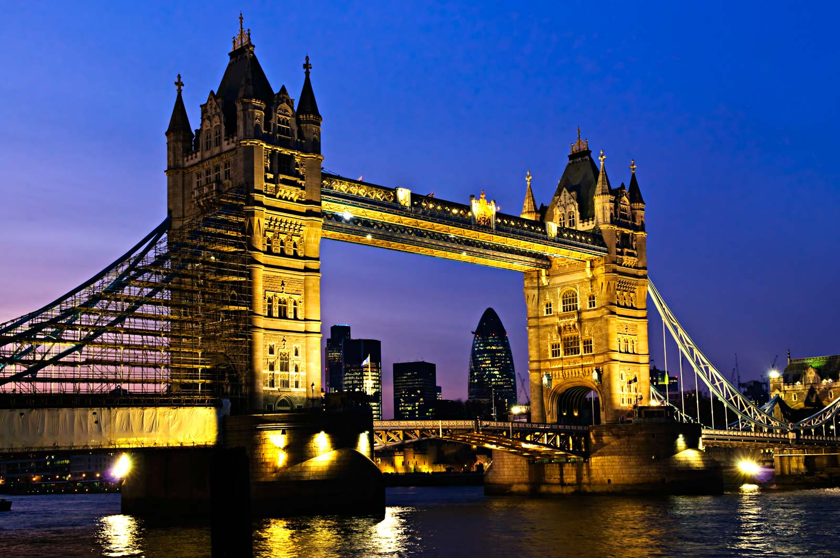
The Story Of Gog And Magog
The colossal political and financial organization centred in the centre of London, known as "The City," operates as a super-government of the world; and no incident occurs in any part of the world without its participation in some form.

Slide 17
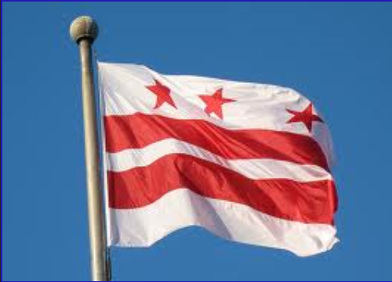
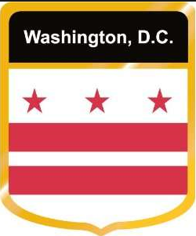
The Story Of Gog And Magog
The City of London with its 2 other subordinate independent city states – The Vatican and Washington DC form the “trinity of evil” that rules the world. This relationship is signalled on the Washington DC flag.

Slide 18
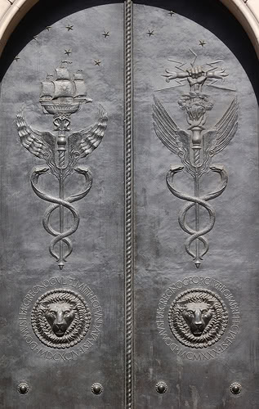
The Story Of Gog And Magog
City of London, known as the richest square mile in the whole of the world. The Golden Rule – he who has the gold rules!! The Bank of England custodian of its ill gotten gains – left: The doors of the Bank of England indicating trade and Admiralty Law and trade, while the other with Neptune's sceptre with bolts of lightening indicating Satanic control and both with 2 snakes representing the serpent race.

Slide 19
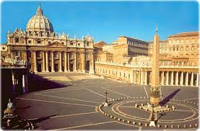
The Story Of Gog And Magog
The Vatican is the religious arm of the “Evil Trinity”, involved in subverting Christianity in order to merge it with other faiths, to create a universal Talmudic devil worshiping religion

Slide 20
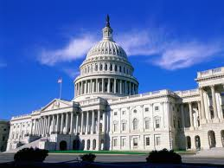
The Story Of Gog And Magog
Washington DC is the enforcement arm of the City of London, used to plunder those countries who would dare not to pay their dues or if they try to extract themselves from the Rothschild banking cartel – those not within the cartel are labelled the axis of evil

Slide 21
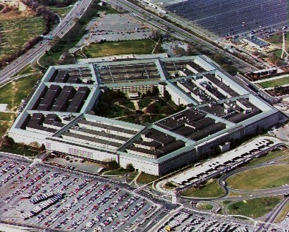
The Story Of Gog And Magog
The Pentagon is the nerve centre of Gog’s Military arm with directives coming not from Congress but the City of London Crown. The 5 pointed star was the emblem of the Amalekites – a Canaanite tribe, who had a king called Agag, or Gog.

Slide 22

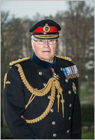
The Story Of Gog And Magog
General Sir Peter Wall is head of the British Army and he is also head of the Pentagon and NATO. Pentagon chief general Dempsey reports directly to him.
General Martin Dempsey (b. 1952). Chairman of the Joint Chiefs of Staff
General Sir Peter Wall
(b. 1955)

Slide 23
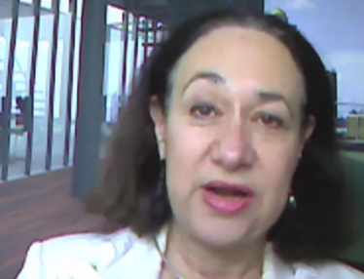
The Story Of Gog And Magog
World Bank whistle blower Karen Hudes, confirmed that all the major banks are controlled from the City of London, and that the Banks control most of the major corporations through their nominee directors on their boards who move from company to company.
Karen Hudes

Slide 24
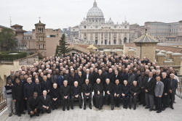
The Story Of Gog And Magog
35th Jesuit general congregation at the Vatican in 2008
Karen Hudes also confirmed that all the USA tax dollars are forwarded to the Federal Reserve Bank, who then send it to the City of London, who then deduct 40% and the balance of 60% is then forwarded to the Vatican.

Slide 25
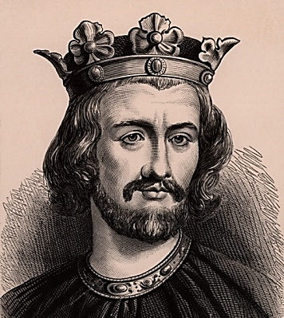
The Story Of Gog And Magog
England is still repaying the Vatican interest on money borrowed by King John of England (24 December 1166 – 18 October 1216) – The repressive taxation imposed by John in order to repay his debt to the Pope, caused a revolt that ultimately led to the Magna Charta.

Slide 26
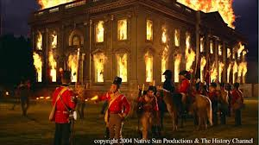
The Story Of Gog And Magog
The USA is still paying reparations for the sacking of the Capitol to the Crown, which is of course is the City of London Crown. The reparations have to be paid even though it was British forces that burn it down.

Slide 27

The Story Of Gog And Magog
If all the USA tax receipts are sent abroad, how does the USA finance itself? One may be surprised to learn that it is from the proceeds of drugs, both the street and pharmaceutical variety.

Slide 28
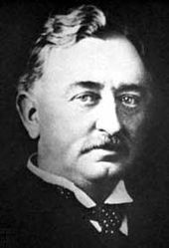
The Story Of Gog And Magog
Its pretensions are supported in the United States by the secret International Pilgrim Society, sponsor of the Cecil Rhodes "One World" ideology which was launched about 1897.

Slide 29
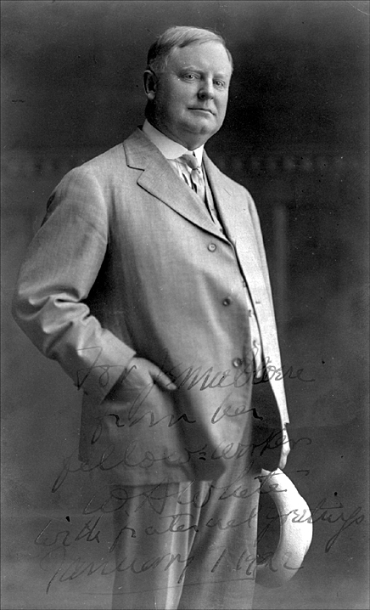
The Story Of Gog And Magog
The ultimate objective of this camarilla was defined by one of its noted propagandists, the late William Allen White, as: "It is the destiny of the pure Aryan Anglo-Saxon race to dominate the world and kill off or else reduce to a servile status all other inferior races."

Slide 30
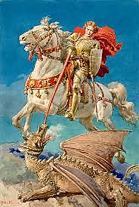
The Story Of Gog And Magog
This is of course the usual elite double speak because the exact opposite was the plan, which was to exterminate the Anglo-Saxons – TRUE ISRAEL by mongrelising them out of existence.

Slide 31
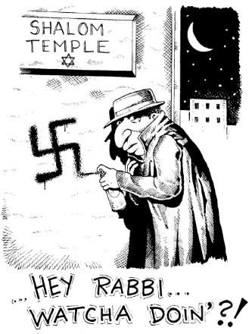
The Story Of Gog And Magog
St. George was of course a serpent killer and we know who, the serpent race is. That is why they are desperate to kill us off before we wake up as a race to our true identity!

Slide 32
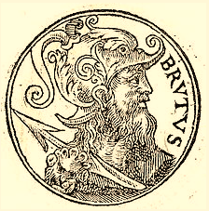
The Story Of Gog And Magog
London is believed to have been founded by Brutus the Trojan – the Trojans were descendants of Zarah Judah. Some Trojans settled in Italy where they became known as Romans. It was then called Troia Nova ("New Troy"), which gradually corrupted to Trinovantum

Slide 33
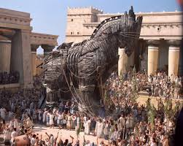
The Story Of Gog And Magog
The Trojans were aware of their ancestry and destiny to rule as descendants of sceptre tribe Judah – this is testified to by an inscription placed on one of the City’s entrances:

Slide 34
The Story Of Gog And Magog
Found in a book called “London Burning” By John Bedford.
When London was a walled city, one of its gates was Aldersgate, and over the arch of this gate was inscribed:
“Then shall there enter into the gate of this City, Kings and princes sitting upon the Throne of David, riding in chariots and on horses, they and their princes the sons of Judah. And this City shall remain forever.” Jeremiah 17:25

Slide 35
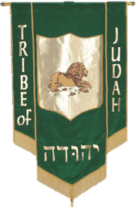
The Story Of Gog And Magog
The Royal line of Judah would eventually be ousted from the City, as foretold in the Scriptures, when Gog (the Serpent race masquerading as “God’s chosen”) would come and take a great spoil – this has been achieved gradually since Gog became ensconced in London when it was a Silk Route terminal controlled by Gog.

Slide 36
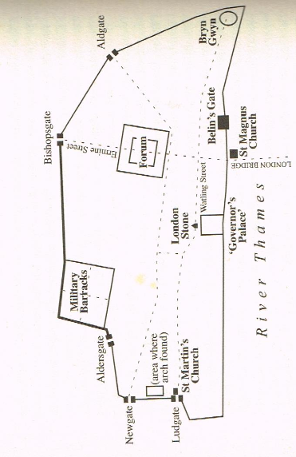
The Story Of Gog And Magog
The map above shows how London would look during the Roman period – the boundaries of the modern City of London have changed little since those times!

Slide 37
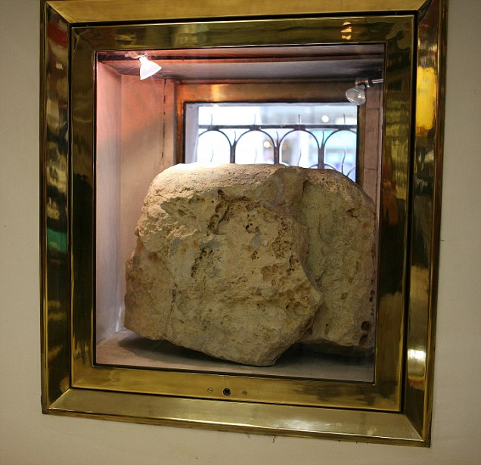
The Story Of Gog And Magog
The London Stone
This map also shows the “London Stone”. A Menhir believed to have been erected by Brutus – Not to do with Dick Wittington as we have been led to believe!

Slide 38
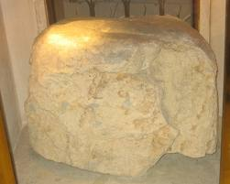
The Story Of Gog And Magog
Until fairly recently, distances to and from London were measured from this stone, but was shifted westward to the Charing cross monument, just a short distance from Nelson’s monument at Trafalgar Square.

Slide 39
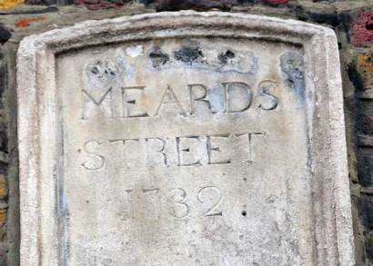
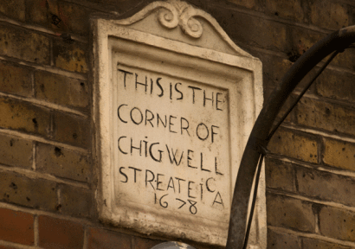
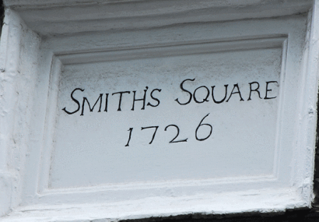
The Story Of Gog And Magog
Many of the City of London street name plates are very ancient as can be seen from the above pictures

Slide 40

The Story Of Gog And Magog
Until very recently there were no roads in The City of London (there is Goswell road running along the boundary) - they were "street", "lane", "gate", "wall" or some other word. The reason is that – as the old definition of a road was “a way between places” and the City is at the heart of the capital (and the globalist world) – it is not "between" anywhere but is at the start or end of any journey.

Slide 41
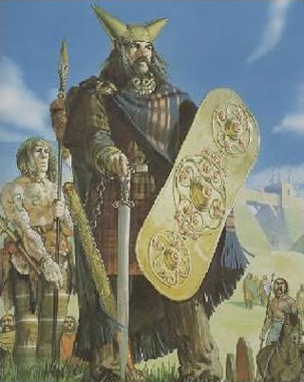
The Story Of Gog And Magog
The area marked Governor's Palace, is believed to be where King Lud’s Palace was – to the north of the London Stone is where The Rothschilds have their London Headquarters at St. Swithin’s Lane.

Slide 42
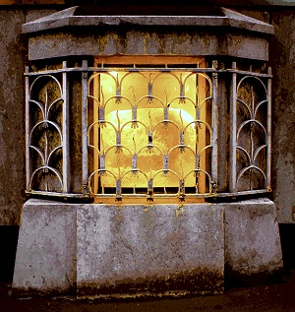
The Story Of Gog And Magog
The ancient London stone is regarded as one of London’s greatest relics yet its history and purpose are still shrouded in mystery. It is widely believed to be the point from which the Romans measured all routes across Britain;

Slide 43
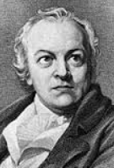
The Story Of Gog And Magog
…..it has associations with the Druids and is featured in works by Shakespeare, William Blake and Charles Dickens. However, it is probably best known for the myth that is attached to it.
William Blake

Slide 44
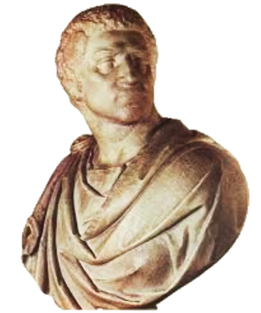
The Story Of Gog And Magog
"So long as the stone of Brutus is safe, so long shall London flourish," says the proverb. Brutus (the Trojan) was the legendary founder of London and the stone is thought to be part of an altar built by him.

Slide 45
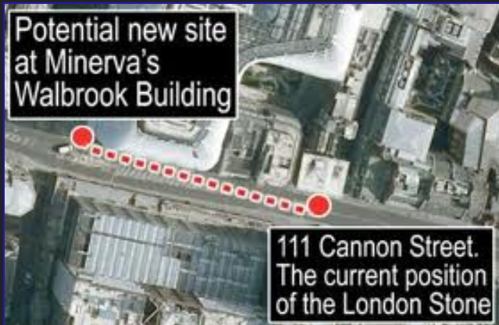
The Story Of Gog And Magog
The stone is caged in a wall at foot level at 111 Cannon Street EC4, opposite Cannon Street station. It is probably no accident the building number where the stone is displayed is 111 as this is the number of Gog ( The Bank of China which owns the building has 11 letters in its name!)

Slide 46
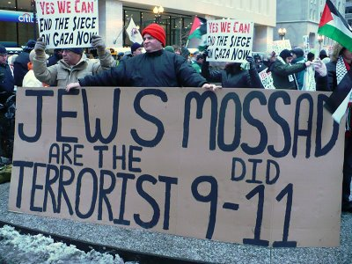
The Story Of Gog And Magog
That the Jews are Gog can be demonstrated by numerology. First the scriptures need to be consulted to discover the number of Gog. We have 3 main indications in scripture:

Slide 47
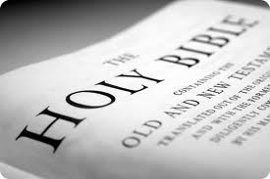
The Story Of Gog And Magog
1) Gog is mentioned exactly 11 times in the scriptures – 10 times in the Old Testament and once in the New Testament, reflecting 10 horns plus 1 little horn.

Slide 48
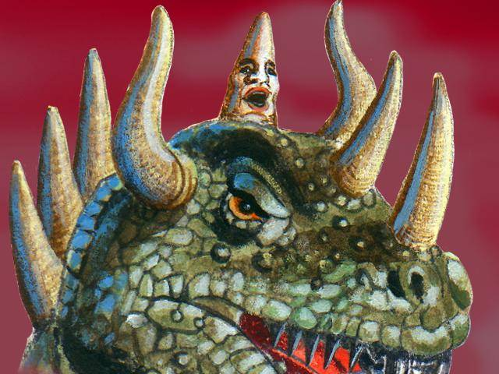
The Story Of Gog And Magog
2) The little horn coming up in the midst of the 10 horns 10+1=11

Slide 49
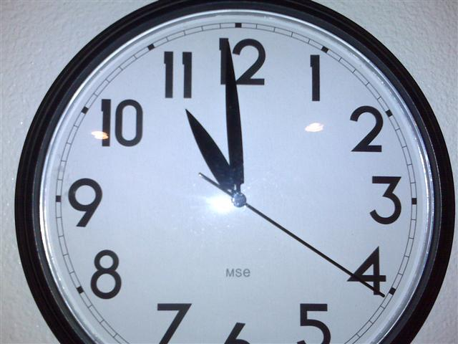
The Story Of Gog And Magog
3) The Bible refers to the eleventh hour as a time of foreboding or the latter day when Gog would come against Israel.

Slide 50
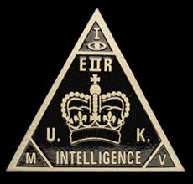

The Story Of Gog And Magog
Left: MI5 Logo
Right: MI6 Logo
Note: MI5 + MI6 = MI11 – There is no MI 1,2,3 nor 4! – 11 is number of Gog and the Little Horn of prophecy

Slide 51
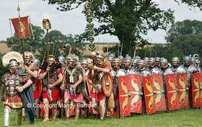
The Story Of Gog And Magog
It is likely that King Lud’s palace is shown as a Roman Governor’s house, for politically correct reasons, to support the error that it was the Romans that brought civilisation to Britain.

Slide 52
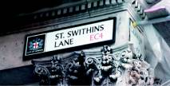
St. Swithins Lane – Global Headquarters
Who would have guessed that St. Swithins Lane, a very narrow and unassuming thoroughfare of Cannon Street, is the headquarters of the Rothschild global empire! Also situated in the Global Capital – The City

Slide 53

The Story Of Gog And Magog
Officially though, the Rothchild’s banking head office is at 1 King William St. in the City. This street is named in honour of Prince William of Orange, proxy of the Amsterdam Khazarian bankers, who authorised the setting up for the first time in the UK of a central bank, known as the Bank of England.

Slide 54

The Story Of Gog And Magog
The Rothschilds, just like their Edomite ancestors prefer to live in the clefts of the rocks as they did in Petra (Mount Seir), so the very narrow St. Swithin’s Lane would make it very difficult for a mob to assault their real headquarters.

Slide 55

St. Swithins Lane – Global Headquarters
Five Arrows House, is No. 18 St. Swithin’s Lane, which for those in the know is signalling 666 as 3 sixes equals 18. Being less than a stones throw from the London Stone they are right at the omphalus of the City and the world empire which it rules.
A Close up of the No. 18, St. Swithin’s Lane

Slide 56

St. Swithins Lane – Global Headquarters
Appropriately the window ledge of Five Arrows House are supported by rams’ heads – one of them is seen on the left. This represents the deluded sheep of true Israel holding up and supporting the beast’s (Rothschilds) edifice.

Slide 57

The Story Of Gog And Magog
This is the only clue that this building is the Rothschild headquarters! (They keep a low public profile)

Slide 58

The Story Of Gog And Magog
By 2014 the Rothschilds had moved a few yards down St Swithins Lane, to a massive new Headquarters – instead of the plain Five Arrows name plate a very ornate coat of arms with the 5 arrows, motto below and initials above.

Slide 59

The Story Of Gog And Magog
They are now even more brazen with a gigantic mural of the five sons of Amschel Mayer, the founder of the Rothschild dynasty, who very appropriately are depicted dressed in black. This is displayed at the side of one of the main entrances to their HQ.

Slide 60

The Story Of Gog And Magog
Nathan Rothschild, who founded the London branch of the Rothschilds’ European Empire. He was one of the 5 sons of Amschel Bower the founder of the dynasty. The picture on the left is depicted on their new London HQ.

Slide 61

The Story Of Gog And Magog
I care not what puppet is placed on the throne of England to rule the Empire on which the sun never sets.
The man who controls the money supply controls the British Empire, and I control the British money supply. – Nathan Rothschild (left)

Slide 62

The Story Of Gog And Magog
Another mural on the outside of their new building is, Moses striking the rock to bring forth water while the Israelites were in the wilderness – is this to beef up the Jewish claim to be Israelites, or does it have some other sinister meaning?

Slide 63

The Story Of Gog And Magog
The dark & evil side of the City of London is reflected by the dark sun clock on Bracken House. In the centre is the darkened face of Winston Churchill, very appropriate considering the evil deeds he perpetrated during his lifetime.

Slide 64

The Story Of Gog And Magog
Bracken House, is named after Bernard Bracken, founder of the Financial Times and a close associate of Winston Churchill, who appointed him his (dis) information minister. It was also rumoured that he was Churchill’s illegitimate son – neither denied this!

Slide 65

The Story Of Gog And Magog
Bracken was born 15 February, 1901 at Templemore, Ireland. His mother moved the family to Dublin, but Brendan because of truancy, in 1915, his mother placed him with the Jesuits at Mungret. This would place him in a good position for his service to the “Crown” as editor of the financial times and minister in the proxy government.

Slide 66

The Story Of Gog And Magog
After the war he was without a job, but managed to engineer a merger between the Financial Times and The Financial News. They remained in separate buildings until his death, when they were located to a new premises named Bracken House in honour of the founder – It is therefore appropriate that the dark deeds of Bracken and Churchill are remembered appropriately.
Bernard Bracken

Slide 67



The Story Of Gog And Magog
Bracken died on 8 August 1958, aged 57 and, according to his wishes, there was no funeral service, or memorial service. All his papers were burnt in the fireplace of 8 Lord North Street, his London home. It can be seen from the checker board pattern on his door step, signal his allegiance to the “Crown”, no doubt that is why his papers were burnt.

Slide 68

The Story Of Gog And Magog
1 Thessalonians 5:5--- “Ye are all the children of light, and the children of the day: we are not of the night, nor of darkness”. The children of darkness were the Edomite Jews who went by the Lunar Calendar while the Hebrews used the Solar Calendar.

Slide 69

The Story Of Gog And Magog
Some Facts In Brief
The City of London is the world’s leading Global Financial Centre according to ZYen (2012)
The London Bullion Market deals with £14bn of gold every day.

Slide 70

The Story Of Gog And Magog
Some Facts In Brief
The City of London accounts for 37% of $4tr global foreign exchange trading, with the USA in second-place at 17.9%

Slide 71

The Story Of Gog And Magog
London is now the City of Dragons – but this has not always been so!

Slide 72

The Story Of Gog And Magog
It is necessary to bear in mind that the Serpent or snake was also a symbol of Dan – alluding to the fact that Dan would be in advance of other Hebrew tribes in their westward migrations into Europe. Dan was a maritime tribe and would ply up and down the great rivers of Europe, after which many are named to this day such as the Danube.
The banner of the tribe of Dan

Slide 73

The Story Of Gog And Magog
One can see from how a river curls around itself just like a snake, that the snake symbolised Dan travelling up the great rivers in their boats. To the ancients they were know as the Tuatha-de-Danann
The River Danube

Slide 74

The Story Of Gog And Magog
We have to try and distinguish between the snake symbol of Dan and the serpent race of Cain, known as Satan (in the Bible generally means adversary not Lucifer the fallen archangel) and referred to as devils. Both have left their mark in London and now that the serpent race is in the ascendancy, the dragon has become more prominent within the City of London.

Slide 75

The Story Of Gog And Magog
Dragons of antiquity were guardians of treasure, as they breathed fire which consumed any attacker, and were the collectors of large red gemstones. How very appropriate for Gog controlled London!

Slide 76

The Story Of Gog And Magog
Another dragon guarding the city

Slide 77

The Story Of Gog And Magog
And there appeared another wonder in heaven; and behold a great red dragon, having seven heads and ten horns, and seven crowns upon his heads.

Slide 78

The Story Of Gog And Magog
A depiction of the City of London Dragons holding a moot on Ludgate Hill – by Matt Bannister

Slide 79

The Story Of Gog And Magog
Confirmation that dragons have been around a long time in the City of London is confirmed by this group of 4 carved dragons' heads, probably C16 Limestone in grotesque style with an oriental influence. Now to be found in Wallington Hall Northumbria
THE WALLINGTON HALL DRAGON HEADS
Notes:
WALLINGTON DEMESNE WALLINGTON HALL
NZ 0384 NZ 03028424
21/222 4 stone dragons' heads
on lawn east of Hall
GV II*
Group of 4 carved dragons' heads, probably C16. Limestone. Grotesque style with
oriental influence. Brought 1760 from Bishopsgate, London, as ballast in one of
Sir Walter Blackett's colliers; moved to present position in 1928.
Listing NGR: NZ0301984246

Slide 80

The Story Of Gog And Magog
These were Brought to Wallington Hall in 1760 from Bishopsgate, London, as ballast in one of Sir Walter Blackett's colliers and moved to their present position in 1928. The dragons now in London marking the boundaries are much fiercer looking and appropriate to the nature of that great City.
Notes:
WALLINGTON DEMESNE WALLINGTON HALL
NZ 0384 NZ 03028424
21/222 4 stone dragons' heads
on lawn east of Hall
GV II*
Group of 4 carved dragons' heads, probably C16. Limestone. Grotesque style with
oriental influence. Brought 1760 from Bishopsgate, London, as ballast in one of
Sir Walter Blackett's colliers; moved to present position in 1928.
Listing NGR: NZ0301984246

Slide 81
The Story Of Gog And Magog
Up until about late 1600’s the City of London’s coat of arms looked much like the one on the left, with the Helmet of Salvation, surrounded with Oak leaves representing Yahweh and his protection, with the English flag and a sword (believed to be one captured from a Roman general while retreating in defeat after attacking London).

Slide 82

The Story Of Gog And Magog
Starting in the 1700’s, with Gog having become more powerful following the Civil War, his control of the City of London was signalled by placing dragons as supporters with their claws clutching the English, symbolising that England was firmly in his control. The white wings with their red crosses show the Knights Templar connection.

Slide 83

The Story Of Gog And Magog
Interestingly the arms of London have never officially been granted, but have been recorded at the College of Arms, albeit without supporters and crest. The crest and helmet were granted on April 30, 1957. Was this because technically it was never subject to the British Monarch?

Slide 84

The Story Of Gog And Magog
In the middle ages London was the largest, most populous and most important city in England, so it is perhaps not surprising that its seal should be highly elaborate. It displays many elements including saints, heraldry and architectural views. The reverse shows one of its famous sons, Thomas Beckett, who might be associated in most people's minds with the place of his martyrdom and pilgrimage at Canterbury, but London claimed him as it was his place of birth.

Slide 85

The Story Of Gog And Magog
Others will say that the sword on the English flag also symbolises the dagger at Gog’s mortal enemy’s throat, the Saxons (Isaac’s sons) – the blood feud continuing since the Garden of Eden, when the evil seed Cain slew his brother Abel. This battle is now being perpetuated through the City of London “Crown”

Slide 86
The Story Of Gog And Magog
The opening wing on the top of the coat of arms signifies to 'rise above' or 'expansion', in other words growth, above and beyond the rest as with the East India Company and the Virginia Company. This of course has come true as the City of London is now the only truly sovereign state in the world, because it rules all the other states in cohorts with its other 2 subordinate city states, namely, Washington DC and Vatican City. Such states that are not within its control are labelled “the axis of evil”.

Slide 87

The Story Of Gog And Magog
The Latin Motto on the City of London coat of arms is: Domine dirige nos – translates as = Lord, direct us – of course Lord is also a name for Baal

Slide 88

The Story Of Gog And Magog
The red cross on a white background as emblazoned several times on the City’s coat of arms was adopted by the Knights Templar, whose original headquarters were situated at Holborn now an underground station. They later moved their headquarters to a site near Thames embankment, "Barran Novi Templi' or Temple Bar, where now Fleet Street joins the Strand. Here is the most prominent dragon.

Slide 89

The Story Of Gog And Magog
The original Temple Bar was a gateway commissioned by James II and designed by Christopher Wren. It was constructed between 1669 & 1672. Its purpose was to regulate trade between the City and outside. Now it regulates trade throughout most of the world!!

Slide 90

The Story Of Gog And Magog
Shortly after entering London through Temple Bar, one come to the ancient church – St. Dunstans in The West. This was where the great fire of London stopped. This church is interesting as here can be found, Gog and Magog clock striking the hours, Statues of King Lud, his sons which were removed from Lud Gate and a statue of Queen Elizabeth I.

Slide 91

The Story Of Gog And Magog
Parishioners put up St Dunstan's Clock thankful, that the Great Fire of London stopped when it reached the church. The church was rebuilt in the 1830's but the clock is the original. This was the first public clock to have a minute hand.
The Gog and Magog Clock
Notes:
Parishioners put up St Dunstan's Clock thankful that the Great Fire of London stopped when it reached the church. The church was rebuilt in the 1830's but the clock is the original.
The diarist, Samuel Pepys, used to attend services in the church regularly, although he was easily distracted.

Slide 92

The Story Of Gog And Magog
Interesting this Gog & Magog clock was placed in the rebuilt church after the great fire, which is shown in this presentation to have been a false flag operation to gain control of the City – The clock therefore is a monument to the victory of the “Money Power” Gog and Magog! But now they are just referred to as giants striking the time!

Slide 93

The Story Of Gog And Magog
Left: King Lud and his sons now hidden away in the church yard. Since the Khazar (Gog) takeover, they have been busily removing links that are indicative of native British ownership of the great city of London, as indeed they are doing throughout the UK.

Slide 94

The Story Of Gog And Magog
When the Queen of England goes to visit the City she is met by the Lord Mayor at Temple Bar, the symbolic gate of the City. She bows and asks for permission to enter his private sovereign state.

Slide 95

The Story Of Gog And Magog
The Queen must acquiesce to the Lord Mayor on entering the City at Temple Bar. Symbolically St. George surrenders to the dragon!

Slide 96

The Story Of Gog And Magog
During such state visits "the Lord Mayor in his robes and chain, and his entourage in medieval costume, outshine the royal party, which can dress up no further than service uniforms." The Lord Mayor leads the Queen into his City.

Slide 97

The Story Of Gog And Magog
The reason should be clear. The Lord Mayor is the monarch. The Queen is his subject! The monarch always leads the way. The subject always stays a pace or two behind!

Slide 98

The Story Of Gog And Magog
The Pearl Sword
The Queen being arrested at the boundary of the City of London at Temple Bar on her way to St. Pauls. Before being allowed to proceed has submit to the London money power, by symbolically touching the pearl sword offered by the Lord Mayor
The Queen touching the Lord Mayor’s Sword as a gesture of submission.

Slide 99

The Story Of Gog And Magog
Within twelve months there was the spectacle of the King of the British race being arrested twice. On the 6th May, 1935, King George the Fifth was commanded to halt and he did halt. Again, last month, King Edward the Eighth was commanded to halt at the same point, and he, too, did halt.
King George V

Slide 100

The Story Of Gog And Magog
The former was during the passage of the King from Buckingham Palace to St. Paul's Cathedral in connection with the Jubilee celebrations, and the latter was during the journey of the then Prince of Wales to Westminster to be proclaimed King.

Slide 101

The Story Of Gog And Magog
On both occasions, when the King's coach and cavalcade reached Temple Bar, opposite the effigy of a Griffin which marks the boundary of the City of London, they encountered the Lord Mayor with his mace and sword bearers decked out in gold, ermine and crimson, representing Money Power, Legal Power and Military Power. Their progress was definitely blocked..
Lord Mayor of London 2014

Slide 102

The Story Of Gog And Magog
The Pearl Sword is thus no idle symbol, for it is on public record that in 1931 the Governor of the Bank of England (Montagu Norman) told the Prime Minister that "If Snowden goes, the Government goes." That meant that if the King's Government did not do as the Bankers desired then the Government would be dismissed. And Montagu was in earnest when he said it.
Part of The Pearl Sword

Slide 103

The Story Of Gog And Magog
This was a visible demonstration of the super-control to which even the King is subservient. Also a reminder that neither the King's Ministers nor the King himself should tamper with the instruments:---
King George VI

Slide 104

The Story Of Gog And Magog
Left: One of the many doors to the Bank of England
----the financiers of London—i.e., specie, securities, bullion, bonds, and the power to manufacture and control the people‘s money. It shows the supremacy of the dictatorship of Finance.

Slide 105

The Story Of Gog And Magog
This comes as a rude shock to the hundreds of thousands who thought that the King represented the people, and was the head of the power of the Empire, acting only subject to the advice of his publicly elected ministers. Nothing was further from the truth.

Slide 106

The Story Of Gog And Magog
The City of London has as one of its objectives the control of Economic Initiative and Direction in every part of the Empire by the method of suppressing private initiative, whether on the part of individuals or small corporations, and it does this by the use of the Pearl Sword known as taxation.
The Pearl Sword

Slide 107

The Story Of Gog And Magog
All governments have to set and enforce their financial or fiscal policies according to the dictates of "The City." If they fail to do so, they are promptly denied access to what is called "Financial Resources," without which it is not possible for their Budgets to be balanced or for the administration even to function.
George Osborne with the budget

Slide 108

The Story Of Gog And Magog
Left: The Lord Mayor of London, David Wootton carries the pearl sword as Queen Elizabeth II and Prince Philip, Duke of Edinburgh attend a service for the Order of the British Empire at St Paul's Cathedral on March 7, 2012, London

Slide 109

The Story Of Gog And Magog
The monarch should say “Away with you and your cosmopolitan money-mongers who are destituting my subjects throughout the Empire. I am their monarch and they are inheritors of the widest and wealthiest empire the world has ever seen. It is neither necessary nor justifiable that any one of them should be deprived of that which would make them economically secure and mentally content.

Slide 110

The Story Of Gog And Magog
In England, these "resources" are known as the "Ways and Means Account," a name which for generations has disguised the fact that the resources are neither more nor less than bank-created credit, the granting of which, under present conditions, depends on the whim of "The City" – i.e., the Khazar Bankers.
Dividend Day at The Bank of England

Slide 111

The Story Of Gog And Magog
"The City" is represented in the Government by the Treasury, and the Treasury is represented throughout the Empire by Governors-General and Governors who have power to veto any legislation which may get through Parliaments without the approval of the money monopolists.
Peter Cosgrove
Australia, Governor-general

Slide 112

The Story Of Gog And Magog
So you can see how the Pearl Sword of finance, in London, swings over our heads in Australia and many other countries, a land and other lands are being bled white in the interests of "The City" thousands of miles away.

Slide 113

The Story Of Gog And Magog
Corporate power with no country and no conscience! It is represented by the Pearl Sword which overawes the King and which is the symbol of a sort of cosmopolitan lodge of bankers, and financiers whose only allegiance is to High Finance and the worldwide control of the creation of money.

Slide 114

The Story Of Gog And Magog
It is no accident that close to Temple Bar, one finds the Royal Courts of Justice, 2 of the 3 Inns of Court and the Knights Templar Church – The Temple where the Bank of England was set up in secret.

Slide 115

The Story Of Gog And Magog
The Inns of Court are also on the site of Carmelite Monastery – Whitefriars in Whitefriars Street, formerly Thames Street. Interestingly, the City of London has both a Blackfriars and Whitefriars site within its boundaries.

Slide 116

The Story Of Gog And Magog
The Inns of Court are where the City exacts its dues from its fiefdoms through the legal profession operating out of the Inns of Courts. On the left is a picture of the Middle Temple – perhaps it was originally the Knights Templar HQ, morphed into what it is today when they had to go undercover after their corruption was exposed.

Slide 117

The Story Of Gog And Magog
The main Idol of the Knights Templar was Baphomet The white and black moons depicts the white Adamic race, born from above, being mixed and brought down to the level of the black races. This objective is now almost achieved with white nations being flooded with non-white races.

Slide 118

The Story Of Gog And Magog
We shall see how through setting up the Bank of England as a central bank the city would control nearly the whole world through money power and the Bar at the Inns of Court.

Slide 119

The Story Of Gog And Magog
Some of the early inhabitants of Britain, were the scattered remnants of the fallen city of Troy. They founded a city on the Thames and called it "Troia Newydd" (New Troy) which later became "Troynovant" or "Trinovantum

Slide 120

The Story Of Gog And Magog
The Trojans were descendants of Zarah Judah as were the Romans

Slide 121

The Story Of Gog And Magog
In ancient times - The Khazars who controlled the Silk Route extended it northwards to Scandinavia and to London
At important points along the Silk Route were control centres called Kontours, where the Khazars exacted taxes on the goods passing through these points and they had one in London.

Slide 122

The Story Of Gog And Magog
The route marked red was abandoned due to the increasing power of the Kievien Russ
The Blue Blobs indicate Khazar (Gog) Settlements

Slide 123

The Story Of Gog And Magog
Evidence that London was already a great city before the Claudian invasion came to light more recently. Archaeologists carried out extensive excavations at Fenchurch St. near Leadenhall Market. Here they found the remains of 'part of the largest Roman shopping centre in the whole of northern Europe'

Slide 124

The Story Of Gog And Magog
What is not explained was how, given that the Romans did not even begin their conquest of Britain until AD 43, there could have been such a large and flourishing market, of the magnificence they describe, at the time of Boadicea's rebellion in AD 60. Seventeen years is hardly long enough to have built the 'largest shopping centre in northern Europe’.

Slide 125

The Story Of Gog And Magog
This would confirm that even in ancient times London was a large centre of commerce, being it was on one of the terminals of the silk route controlled by the Khazars – Gog.

Slide 126

The Story Of Gog And Magog
After the demise of the Silk Route, the Khazars remained in London, and blended in with the native population, but secretly remained a tight knit community who would later by stealth take control of the City of London

Slide 127

The Story Of Gog And Magog
Even William The Conqueror had the gates of the City slammed shut in his face – no doubt he was dissuaded from using his superior force to overcome the City by his Jewish funders, who were relatives of the Khazars resident in the City.

Slide 128

The Story Of Gog And Magog
Eventually, the City of London and William came to an understanding, and William built the Tower of London on the White Mound (Bryn Gwyn) – It is here that the head of Bran the Blessed was buried facing south so as to protect the City from invaders from across the channel.

Slide 129

The Story Of Gog And Magog
Bran the blessed was also known as Bendigeid Fran or “Blessed Raven” – In Celtic lore the raven was regarded as an oracular bird, which are still today to be seen in the Tower’s grounds – Legend has it that if the Ravens leave, then the Monarchy will perish.

Slide 130

The Story Of Gog And Magog
It is well recorded that one of the worst aspects of the Norman invasion was the number of Jews in his retinue.

Slide 131


The Story Of Gog And Magog
Left A Norman Soldier
Right – The Khazar Jews
Once established in England – it was payback time!

Slide 132

The Doomsday Book The Normans Record Ownership Of All Real Estate Within The Realm
Under Norman Rule It was now possible to seize a person’s house or lands for unpaid debts (Credit agreement – shetar or Starr)
A Payback for financing the invasion?

Slide 133

The Story Of Gog And Magog
For this reason it was necessary to make an inventory of all property with in the Kingdom. Hence the Doomsday Book.
The Doomsday Book indeed sealed our doom!!

Slide 134

The Story Of Gog And Magog
We have William the Conqueror to thank for Council Tax and Property Tax in the USA, due to his diligence in recording all property under the Doomsday Book project..

Slide 135

The Story Of Gog And Magog
William The Conqueror’s Judges enforced the Shetar or Starr Law where both movable and unmovable property could be seized to pay debts for which the Crown received a consideration.

Slide 136

The Story Of Gog And Magog
Knights held land permanently and in return served the king or his lord – this applied also under Norman Law – but all would Change with the introduction of Shetar Law

Slide 137

The Story Of Gog And Magog
This system of holding land in return for service finally disappeared around 1260 when scutage (rent) became payable for land held.
Following this change from service to cash as payment for property the amount paid could be varied by changing the value of money and no longer constant as it used to be.

Slide 138

The Story Of Gog And Magog
Shetar Law would pave the way for purchasing properties through a bank loan - secured by a mortgage (Grip of Death).

Slide 139

The Story Of Gog And Magog
The centralisation of authority in the Duchy of Normandy – would be William’s model for England
William’s Castle at Rouen

Slide 140

The Story Of Gog And Magog
The combination of William the Conqueror’s centralisation policy and the Khazar enclave in the City of London would ensure that all the levers of power would gravitate to London – paving the way for the New World Order.

Slide 141

The Story Of Gog And Magog
The Jews were the property of the Monarch who taxed them up to 30% of their income earned through usury – because of this, the Jews thrived, while the indigenous population came less prosperous.

Slide 142

The Story Of Gog And Magog
While the Monarch was profiting from the Jews, many of the indigenous people were being dispossessed of their property and land, as a consequence of the alien shetar law being added into English Common law.

Slide 143

The Story Of Gog And Magog
The indigenous English were at a disadvantage when in court for debt, as the Jew did not have to produce 2 or more witnesses, unlike the English. In the absence of a witness the Jew need only swear an oath on the Talmud.

Slide 144

The Story Of Gog And Magog
As chattels of the King, the Jews retained their own property at his pleasure. They lived where the King permitted, and when they died, their property vested in the King.

Slide 145

The Story Of Gog And Magog
….This is still remembered in names today such as Jew Lane above in Oxenhope.

Slide 146

The Story Of Gog And Magog
Because the ecclesiastical courts could proceed only against Christians, the Jews operated free of the Church's usury prohibitions. The civil authorities openly permitted the Jews to lend money at interest and enforced their credit contracts, both for principal and interest.

Slide 147

The Story Of Gog And Magog
Because of the large contribution the Jews made to swelling the coffers of the King – it was therefore in the interest of the Monarch to enforce recovery of debts owed to the Jews. We shall see that this evil practice would lead to riots and the eventual expulsion of Jews from England.

Slide 148

The Story Of Gog And Magog
Because of the Jews’ importance to Monarch and through their serpent wiles their status improved and they were able to inherit and hold land in their own right.

Slide 149

The Story Of Gog And Magog
Many scholars have been at a loss to explain the symbols on many of the seals used by Jewish merchants and the residual Khazars from the Silk Route in London.
Biblical scholars will know that the signs symbolise them as descendants of Cain – Edom. The serpent represents Cain while the hand and the all seeing eye the Edomites, who were known for their funny handshakes!

Slide 150

The Story Of Gog And Magog
The descendants from the Khazar community in London of the silk route period – kept a low profile and their Jewishness secret and would not be affected by the later expulsion of Jews from England.

Slide 151

The Story Of Gog And Magog
Alfred the Great well known for codifying the Common Law – established by Brutus which was the law of the land prior to William’s invasion, was based on Biblical law. Following the invasion, Common Law suffered its first dilution – until today when it has been almost eclipsed by the City of London’s Commercial Contract Law based on the Talmudic shetar Law.

Slide 152

The Story Of Gog And Magog
A reconstruction drawing showing the burning of the wooden tower during the massacre of the Jews on the 16th March 1190. During a period of anti-Semitic riots the Jews of York took refuge in the keep.

Slide 153

The Story Of Gog And Magog
Rather than surrender to the mob outside many chose to commit suicide, the mob then burnt down the wooden keep with the Jews inside.
The rebuilt Clifford Tower as it is today

Slide 154

The Story Of Gog And Magog
The 16th century was a very turbulent one, including the plague and the great fire, as was seen in previous presentations, and indeed, in respect to the city of London which will be gone into in more detail here.

Slide 155

The Story Of Gog And Magog
The real cause of the turbulence, was the fight was between the Money Power and Monarchy, with the victory of the Money Power in 1688 when James II (left) was driven off the throne by his son-in-law, William III.,

Slide 156

The Story Of Gog And Magog
The next step towards global control was to remove the Monarch’s money issuing power. This would be achieved by setting up central banks. First Amsterdam, then England followed by the Fed. Reserve of the USA., just to mention a few of the most important.

Slide 157

The Story Of Gog And Magog
The Royalist Counter Reformation
After the Despotic rule of Oliver Cromwell and the short lived reign of his son, the Royalists saw their chance to restore a monarch to the English throne in the person of Charles II. However, as we shall see it was to be short lived.

Slide 158

The Story Of Gog And Magog
The infiltration of the Reformation by Gog, in the person of John Calvin, paved the way for the Jews to re-enter Britain. A full account of this can be seen in part 14 of Gog & Magog presentation.

Slide 159

The Story Of Gog And Magog
Captain A.H.M. Ramsay (left), spoke about the ominous rumblings of Calvinism. Calvin organized great numbers of revolutionary orators, not a few of whom were inflicted upon England, Scotland and the Low Countries.
Captain A.H.M. Ramsay

Slide 160

The Story Of Gog And Magog
Thus Calvin laid the groundwork for revolution under a cloak of religious fervour. On both sides of the Tweed these demagogues contracted all religion into rigid observance of the "Sabbath."
A Puritan Couple

Slide 161

The Story Of Gog And Magog
Thus to use the words of Isaac Disraeli, "the nation was artfully divided into Sabbatarians and Sabbath breakers." "Calvin," states Disraeli, "deemed the Sabbath to have been a Jewish ordinance, limited to the sacred people."
Benjamin Disraeli

Slide 162

The Story Of Gog And Magog
He goes on to say that when these Calvinists held the country in their power, "it seemed that religion chiefly consisted of Sabbatarian rigours; and that a British senate had been transformed into a company of Judaised Rabbis":

Slide 163

The Story Of Gog And Magog
The Talmudisation of Christianity, by making strict rules and severe penalties for breaking the Sabbath is another indication of Calvin’s Jewish ancestry – they even took Christ to task for breaking the Sabbath!
The Talmud

Slide 164

The Story Of Gog And Magog
"In 1650, after the execution of the King Charles I by Puritan Oliver Cromwell, an Act was passed inflicting penalties for a breach of the Sabbath."

Slide 165

The Story Of Gog And Magog
For 300 years this financial oligarchy has been overlaying the peoples of the world with grossness and manifesting ideas of greed and power. The process started in 1649 when an English military oligarchy (led by Lord Fairfax – left), backed by the financial power of the international financiers of Lombard Street, beheaded England's king.
Thomas Fairfax, 3rd Lord Fairfax of Cameron

Slide 166

The Story Of Gog And Magog
You will be aware that they also dealt with Napoleon, King Edward VIII, Australia's Prime Minister Harold Holt, two Tsars and a brace of US Presidents, Saddam Hussein, Col. Gaddafi, et al].
Prime Minister Harold Holt

Slide 167

The Story Of Gog And Magog
The passing of the Sabbath Law made it possible for the Puritans to persecute, humiliate and torture other Christians.

Slide 168

The Story Of Gog And Magog
Captain Maul Ramsay, in his Nameless War, states Calvinist, or Cohenist, Conspirators began to reveal themselves, during the English rising and their focus was the City of London.

Slide 169

The Story Of Gog And Magog
It is interesting to note that in 1630 in a letter to Archbishop Abbot (left), Matthew Brook, the master of Trinity College, Cambridge, wrote: "This doctrine of pre-destination is the root of puritanism, and puritanism is the root of all rebellions... and of all schism and sauciness in the country.

Slide 170

The Story Of Gog And Magog
What Brook really meant was that Calvin had instilled into his Puritan followers the desire to become British Israelites, (not knowing that they were Hebrews and the sons of Isaac) and modelling their life on the Edomite Jews and even dressing in black as the Jews do.

Slide 171

The Story Of Gog And Magog
Nicholas Hagger in book “Secret History of The West” states: The early millenarian Puritans who dressed differently clearly modelled themselves on the Jews.

Slide 172

The Story Of Gog And Magog
….In the Elizabethan time, William Cecil, Walsingham and Bacon all wore black garments instead of doublet and hose, and were dressed in garb similar to that worn by him (picture of 1642 - left) by the Dutch Rabbi Menasseh ben Israel. By wearing it they may have been expressing their sympathy for the internationalist aims of the Family of God, "lovers of truth of all nations."

Slide 173

The Story Of Gog And Magog
We can see that the Jews were using Calvin’s Puritans as a tool to build on the foundation of centralisation initiated by William the Conqueror. This was another stepping stone towards the New World Order. At the same time the Jesuits(Jews) of the Catholic Church would be working towards the same end.

Slide 174

The Story Of Gog And Magog
Puritan dress: Jewish-style skull caps. Marten (left), Owen (centre), Marvell (right)
Shortly before 1654 The Puritan even started to wear Jewish style black skull-caps, so eager were they to become “Israelites” who they wrongly thought were Jews. Little did they realise that they were adopting the uniform of the Tares.

Slide 175

The Story Of Gog And Magog
William Cecil, almost certainly a Marrano Jew and the most powerful person in the land excluding the Queen, did not suppress or discourage the rise of the Puritans and may have privately sympathized with the entry of Jews into England as Marranos.

Slide 176

The Story Of Gog And Magog
The Puritans were funded by the Jews, but most were only aware being neo-Israelites in the sense of awaiting the Second Coming. Puritans had to live purely to be ready to be among the congregation of saints.

Slide 177

The Story Of Gog And Magog
This was the same tactic as is used today, keep people in fear of the unknown. By this method they can be controlled more easily. At the same time keeping people focused away from the dark deeds being perpetuated under their very noses. A conjuring trick!

Slide 178

The Story Of Gog And Magog
To encourage a readmission of the Jews, it is possible that he endorsed the millenarian Jewish dress which Shakespeare (who seems to have despised Lord Burghly) lampooned through Malvolio. According to some very informed opinion, including G. W. Phillips, Shakespeare later satirized Cecil. Shylock.

Slide 179

The Story Of Gog And Magog
The Puritans would be used by the City of London to Talmudise western Christendom, and with their control of the press this has been achieved.

Slide 180


The Story Of Gog And Magog
Earl of Bedford - a Jewish wine merchant named Roussel was the founder of this family in Tudor times, when they changed their name. It was Bedford who led the faction who wanted the King removed and was one of the powers behind Cromwell.

Slide 181

The Story Of Gog And Magog
At this time there suddenly began to appear from the City armed mobs of "Operatives" (the medieval equivalent for "workers" no doubt). Let me quote Disraeli: "They were said to amount to ten thousand ... with war-like weapons. It was a militia for insurgency at all seasons, and might be depended upon for any work of destruction at the cheapest rate.

Slide 182

The Story Of Gog And Magog
In 1655, the Jewish influx under Cromwell started. Cromwell first called Councils to consider the matter, but all were against it. Cromwell dismissed his counsellors and allowed the Amsterdam Jews to enter Britain surreptitiously. The following extracts from "The Jewish Encyclopaedia "are most instructive on this matter:

Slide 183

The Story Of Gog And Magog
“Toward the middle of the seventeenth century a considerable number of Marrano merchants settled in London, and founded there a secret foundation at the head of which was Antonio Fernandez Carvajal”.
Fernandez Carvajal

Slide 184

The Story Of Gog And Magog
Outwardly, they seemed as Spaniards and Catholics, but they held prayer-meetings at Cree Church Lane.
---meanwhile, public opinion in England had become prepared by the Puritanical movement for a sympathetic treatment of any proposal, by the Judaizing sects among the extremists of the Parliamentary Party for the readmission of the Jews into England

Slide 185

The Story Of Gog And Magog
The Puritans, (followers of Calvin) or Whigs were in the forefront of attacking British culture by promoting the banking racket, backed by their mentor Manasseh ben Israel (Left).

Slide 186

The Story Of Gog And Magog
Those trying to get information from the Dutch Information Office, about Spanish and Portuguese Marrano settlers in Holland, escaping from the inquisition in their countries, come up against a wall of silence and closed doors. No doubt they do not want the identities of Asiatic Khazars masquerading as white Europeans in high places to become public knowledge.
Amsterdam City Archives

Slide 187

The Story Of Gog And Magog
Even Cecil Roth (left) writing a book on Manasseh ben Israel, who was himself a Jew, was refused access and more recently, Nicholas Hagger, researching for his book, “The Secret History Of The West”. One suspects that there was concern about the fact that the English revolution was financed by the Amsterdam Jews would become public.

Slide 188

The Story Of Gog And Magog
It would appear that the Amsterdam funding of Cromwell was to secure the reversal of the 1290 expulsion. However, the cunning Jews would see that by taking control of the City of London, it would advance their money power while at the same time allowing revenge to be taken on the Catholic Church for driving them out of Spain.
Old Amsterdam

Slide 189

The Story Of Gog And Magog
Manasseh, who financed Cromwell, had links to the Priory of Sion whose objective was to overthrow the Stuarts. He had links also to the Rosicrucians whose oath was renewed on October 31, 1617 by a convention of seven at Magdeburg, to destroy the church of Jesus Christ? His contacts with this organisation was through Fludd and Andreae.

Slide 190

The Story Of Gog And Magog
Cromwell was first and foremost a Rosicrucian Mason and secondly a Puritan. His revolution seems more Rosicrucian-Masonic than Protestant. How did he become an MP? Was he from the beginning in the pay of Holland through the Mulheim Synagogue. The Puritans was an offshoot of the Jewish Calvinists. Likewise the Jews had infiltrated many Masonic lodges.
The Mulheim Synagogue

Slide 191
The Story Of Gog And Magog
The name "Jew" comes from the Hebrew language it means "the funny users of the hands," a nick-name imposed upon the people who shrug their shoulders and make funny gestures with the hands. The root form of the Hebrew word is "YAD" pronounced "YAWD" meaning the open hand in gestures of direction,….

Slide 192

The Story Of Gog And Magog
…..also meaning broad-handed, closed hand, and has a variety of meanings —like the Communist salute of the clenched fist. From this root word comes the name "Jew" and also "Yiddish."

Slide 193

The Story Of Gog And Magog
One must not mix up and confuse the "Jews" with Shem —the Semitic race and the Hebrews and Israelites of the Old Testament for they are in no way related. The Kingdom of Judah and the Judahites were God's people and of the Semitic race but they were not Jews.

Slide 194

The Story Of Gog And Magog
There is an unconfirmed report from the Venetian Ambassador, that Cromwell came in contact with the Jew Menasseh Ben Israel while travelling in Flanders in his youth. If true, it could be that Cromwell (real name Williams – a common Jewish name) was selected at this point to be the Money Power’s agent for instigating the English revolution.

Slide 195

The Story Of Gog And Magog
Many blame Cromwell’s stance on his mistaken belief that the Jews were Israel. As mentioned his name was changed from Williams, because this is one of the names the Jews adopted after settling in Wales following King Edward’s expulsion of Jews, so he himself might have been a secret Jew. He paved the way for Whig party who would be supportive of the money power.

Slide 196

The Story Of Gog And Magog
"There is certainly in 'Whigism' an inherent propensity to tyranny; and of all the methods which tyranny ever invented for sucking out the essential vitality of free institutions, without appearing materially to touch their forms, this centralising system is the most plausible and the most pernicious…..

Slide 197

The Story Of Gog And Magog
----If it shall be fully carried out, British liberty ... will rest no longer on the possession of constitutional power by the people, but upon the sufferance of a majority of those who, for the time being, may call themselves the people's representatives."

Slide 198

The Story Of Gog And Magog
"Whig" historians tell of the tyrannies of Charles I. & Charles II, and how they reigned without Parliament. However, Parliament in those days was not like to-day. It comprised a group of wealthy men who were not very responsible to the British people.

Slide 199

The Story Of Gog And Magog
Charles Reign would be short lived because he sided with the Jews, issuing a statement assuring the Jews of his protection. He did not know they were supporting the Whig party plotting to remove the money issuing power from the monarchy. When certain Jews were prosecuted for rioting, He honoured his agreement in 1673/4 when he ordered the Attorney General to drop the case.

Slide 200

The Story Of Gog And Magog
Charles II and King Louis XIV signing of the Treaty of Dover in secret, would be used by the Jews to motivate the Whig Protestants to remove him from the Throne, because in return for the support of the French, he agreed to re-join the Catholic Church.

Slide 201

The Story Of Gog And Magog
The Treaty of Dover, also known as the Secret Treaty of Dover, was a treaty between England and France signed at Dover on 1 June 1670. It required France to assist England in the king's aim that it would re-join the Roman Catholic Church, and England to assist France in its war of conquest against the Dutch Republic. The Third Anglo-Dutch War was a direct consequence of this treaty.

Slide 202

The Story Of Gog And Magog
While the Protestants considered signing the treaty of Dover treason as it would undo the reformation, he knew that it was the Dutch Jews who were supporting the Reformation in order to take control of money issuing and thereby control the Realm of England, so the King was between a rock and a hard place.

Slide 203

The Story Of Gog And Magog
For six and a half centuries from the Norman Conquest, until the financiers arrived at the invitation of Cromwell, the Monarchy did exercise its sovereign right of issuing money. There was adequate money for the people's needs.

Slide 204

The Story Of Gog And Magog
Not long after Cromwell had let the Jews in again, Solomon Dormido, a nephew of M. ben Israel, was admitted to the Royal Exchange as duly licensed broker to the City of London without taking the usual oath involving faith in Christianity.

Slide 205

The Story Of Gog And Magog
With the execution of the monarch Charles I, the Jews were free to plot the takeover of the power to issue money. The indigenous merchants in the City were not happy with the situation and made concerted efforts to have the Jews expelled.
King Charles I

Slide 206

The Story Of Gog And Magog
The Great Fire of London in 1666 was a cover for subverting our Common Law with the The CESTUI QUE VIE Act, It went through Parliament before the embers had hardly cooled down – it takes a long time to draft legislation!

Slide 207

The Story Of Gog And Magog
Strange how the fire cleared the land now occupied by the City Of London, just a few years before the building of The City of London, the founding of The Bank Of England, and the launch of the debt/war economy.
The extent of the fire in red

Slide 208

The Story Of Gog And Magog
More important than anything else, it cleared approximately one square mile of old buildings, so that new ones could be established. HELLO....CITY OF LONDON..... Out of the ashes of the innocent and decent hard working people came the CITY of SCUMBAGS who control the world today.

Slide 209

The Story Of Gog And Magog
The Golden Square Mile contains among other things, The Bank of England, London Metal Exchange (LME), Fleet Street (News), F.T.S.E. (Stock Exchange), the Royal Mint and the Old Bailey (court)... are you getting the picture yet?

Slide 210

The Story Of Gog And Magog
Interestingly the area of the City of London is exactly 677 acres, that is, 666 acres (Number of the Beast) and 11 the Number of Gog or the Little Horn – see presentation 12.

Slide 211

The Story Of Gog And Magog
2ND OCT 1666 .....GREAT FIRE OF LONDON...(started at a bakery in Pudding Lane).
3RD OCT 1666 .....2ND DAY...FIRES STILL BURNING
4TH OCT 1666 ......FIRES FINALLY EXTINGUISHED
5TH OCT 1666.......PARLIAMENT PASSES AN ACT ...CESTUI QUE VIE ACT 1666

Slide 212

The Story Of Gog And Magog
The Act declared all men and women dead and lost beyond the seas. The state took every "body" and their property into trust and the state became the trustee husband to both the people and their property---.

Slide 213

The Story Of Gog And Magog
---until living men come back and claim title and can prove they are alive and that their title can be re-vested can claim for damages. You have 7 yrs from birth to claim titles back, otherwise you are dead beyond reasonable doubt and the state takes your body and property into trust...

Slide 214

The Story Of Gog And Magog
Translation of the Act’s Title: CEST = THIS, TUI = KILLED, QUE = THAT, VIE = LIFE. "The person whose life measures the duration of a trust, gift, estate or insurance contract".

Slide 215

The Story Of Gog And Magog
CESTUI QUE TRUST
Definition: Black's Law Dictionary 2nd Edition
He who has a right to a beneficial interest in and out of an estate the legal title to which is vested in another. 2 Waslib. Real Prop. 163. The person who possesses the equitable right to property and receives the rents, issues, and profits thereof, the legal estate of which is vested in a [...] for "cestui" - The Law Dictionary

Slide 216

The Story Of Gog And Magog
Communications between the government, other corporations and the people are addressed in all CAPITAL LETTERS as they are deemed to be DEAD, just as is the case on gravestones! Because they are dead they have to be represented in court!

Slide 217

The Story Of Gog And Magog
The fact that this English Law was disguised within a French term might give credence to under-hand agendas being present, but when the translation to English does not match the Legalese translation, it proves beyond any doubt that another agenda was in play, or has since become a very convenient re-play with new terms being applicable.

Slide 218

The Story Of Gog And Magog
CESTUI QUI VIE ACT 1707 This act was so important because it KILLED EVERYONE... and gave them 7 years to claim back their lives.
(The inception of the STRAWMAN also robbed people of their properties for the same reason).

Slide 219

The Story Of Gog And Magog
The Monument, designed by Sir Christopher Wren to commemorate the Great Fire of London has been welcoming visitors for over 300 years. Today, visitors climb 311 steps to the top of this historic landmark (built 1677) to take in spectacular views of London.

Slide 220

The Story Of Gog And Magog
The original inscription stated that the great fire was started deliberately by Catholics (Jesuits – Catholic Jews) – One by the name of Hubert was hanged for the crime in October 1666.
Notes:
This inscription was set up in 1681 on the site of the Pudding Lane bakery where the Great Fire started. It blames the fire on 'barbarous Papists' and Robert Hubert, the disturbed Frenchman who confessed to starting the fire. Hubert was hung for the crime in October 1666, though it was later revealed that he had only arrived in London after the fire started. In January 1667, the King's Council declared the fire was an accident. However, conspiracy theories of a Catholic plot persisted for years. The slab was taken down after the accession of the Catholic king, James II, but reinstated in 1689 after the Protestant William III and Mary II took the throne. It was finally removed in 1830.

Slide 221

The Story Of Gog And Magog
This inscription was set up in 1681 on the site of the Pudding Lane bakery where the Great Fire started. It blames the fire on 'barbarous Papists' and Robert Hubert, the disturbed Frenchman who confessed to starting the fire. Hubert was hanged for the crime in October 1666, though it was later revealed that he had only arrived in London after the fire started.

Slide 222

The Story Of Gog And Magog
Like today, the authorities had to have a patsy. They chose Robert Hubert who was weak and fed up with life, so he was an ideal candidate. On his execution, justice would have been seen to have be done. Eyes would be directed away from finding the real perpetrators.

Slide 223

The Story Of Gog And Magog
However, after Hubert’s execution the impossibility of him being the culprit was the talk of the town, detailed in the next slide. The decision was taken to change the plaque inscription to indicate the great fire was started accidently.

Slide 224

The Story Of Gog And Magog
1. As the owner of the bakery, Thomas Farynor, testified - the bakery had no windows;
2. Hubert's workmates told authorities that Hubert was clearly 'unbalanced;
3. Hubert was crippled and weak, evidently incapable of tossing a fireball anywhere;

Slide 225

The Story Of Gog And Magog
4. When the authorities made enquiries, they discovered that no Swedish ship had berthed next to the Bridge on September 1st,
5. And that Hubert in fact arrived in London two days after the fire started.

Slide 226

The Story Of Gog And Magog
Following the accession of a Catholic King James II The slab was taken down – like today the establishment changed its story. In January 1667, the King's Council declared the fire was an accident. However, conspiracy theories of a Catholic plot persisted for years.
The Coat of Arms of King James II

Slide 227

The Story Of Gog And Magog
The original Inscription was reinstated in 1689 after the Protestant William III and Mary II took the throne. It was finally removed in 1830.

Slide 228

The Story Of Gog And Magog
Those reading the inscription today, will understand that the great fire of London was an accident, and not the deliberate act to rebuild London in the image of Gog!

Slide 229

The Story Of Gog And Magog
After the great fire of London, Gog would take the opportunity to rebuild it in is own image as a New Jerusalem, and secure its position in one of the principle capitals of true Israel from whence, it would seek to destroy us through infiltration of our institutions and control of the media. One of the men tasked to do this was the well known Freemason – Christopher Wren
Christopher Wren

Slide 230

The Story Of Gog And Magog
Surprisingly, important buildings and monuments in the City of London were erected at a distance of 666 metres apart or multiples of 666, and following the rapid redevelopment of greater London during the industrial revolution in the 1800’s, other buildings were added to the 666 network.

Slide 231

The Story Of Gog And Magog
Even more startling, is the fact that the metre was not in use at the time of the great reconstruction of London. Nor at that time it had not been introduced into Europe. It was not until after the French revolution, and downfall of the French Monarchy, that the metre became the standard unit of measurement on the Continent when the decimal system was adopted on 27 October, 1790.
Dunkirk Tower – Northern end of the meridian arc on which the Metre is defined

Slide 232

The Story Of Gog And Magog
Buckingham Palace - Westminster Cathedral = 666 metres.
Buckingham Palace - Wellington Monument = 666 metres.
Buckingham Palace - Victoria Station = 666 metres.
Buckingham Palace - Houses of Parliament = 1332 metres = 2 x 666.
Buckingham Palace

Slide 233

The Story Of Gog And Magog
Downing Street - St Jame’s Palace = 666 metres.
Downing Street - New Scotland Yard = 666 metres.
Downing Street - National Gallery = 666 metres.
Downing Street

Slide 234

The Story Of Gog And Magog
Bank of England - Cannon Street Station = 666 metres.
Bank of England - Fenchurch Street Station = 666 metres.
Bank of England - Liverpool Street Station = 666 metres.
Bank of England - London Bridge = 666 metres.
The Bank of England

Slide 235

The Story Of Gog And Magog
National Gallery = 666 metres.
St James’s Square = 666 metres.
St James’s Palace = 666 metres.
New Scotland Yard = 666 metres.
Home Office = 666 metres.
The Old County Hall = 666 metres.
Downing Street (home of British Prime Minister David Cameron) equidistant to:

Slide 236

The Story Of Gog And Magog
The old magnificent St. Paul’s Cathedral destroyed in the great fire, with a spire of 498ft, the highest in Europe, would be Christopher Wren’s first priority amongst many other churches and buildings he would design in the image of Gog. It would be a domed building just like the Vatican and Washington DC!

Slide 237

The Story Of Gog And Magog
When it was seen that Sir Christopher Wren’s design for St. Pauls, would be entirely different to the Saxon/ Gothic style of Christian England, it attracted a huge amount of criticism – so much so that the design had to be modified and while under construction had to be hid from public view by the erection of hoardings.

Slide 238

The Story Of Gog And Magog
The Elizabethan antiquarian, William Camden (left), argued that a Roman temple dedicated to the goddess Diana had once stood on the site of the medieval St Paul's cathedral

Slide 239

The Story Of Gog And Magog
Excavations on the site in the 14th century came across more than a 100 ox skulls, evidently used for sacrificing on the temple altar – this practice went on long into the Christian period. There is a record of a Sir William Baud in 1375 being allotted some cathedral land on condition that he provided long horned beasts for sacrifice to Diana.

Slide 240

The Story Of Gog And Magog
This sacrificial tradition is confirmed by the discovery of a relief depicting Mithraic sacrifice found in Walbrook Street. The Hebrews sacrificed animals as a remission of sins, while the Pagans sacrificed humans – the Hebrews were exiled for going after other Gods such as Mithras.

Slide 241


The Story Of Gog And Magog
Temple of Diana
High Clare Castle
A Temple of Diana at High Clare Castle – notice a similarity? Was this the reason for the change from a spire to a domed church? – Secretly reverting back to a pagan building in celebration of Gog’s achievement in taking control of the City of London by stealth!

Slide 242

The Story Of Gog And Magog
In 1981, a royal tradition of marrying in Westminster Abbey spanning many centuries, was broken when Charles and Diana married in St. Pauls’ appropriately – The new temple of Diana! – Note the checkerboard floor.

Slide 243



The Story Of Gog And Magog
Greek Cross Design
The Warrant Design
Final – As Built
Here we see the previous 2 designs and the final design

Slide 244

The Story Of Gog And Magog
The style is in keeping with The Capitol Washington DC
CAPITOL. The temple of Jupiter in Rome, and a fort or castle, on the Mons Capitolinus. In this, the Senate of Rome anciently assembled; and on the same place, is still the city hall or town-house, where the conservators of the Romans hold their meetings. The same name was given to the principal temples of the Romans in their colonies.

Slide 245

The Story Of Gog And Magog
St. Pauls is measured precisely in Egyptian cubits from other monuments – Wren altered the axis of St. Pauls so that the distance between it and Temple Bar is exactly 2000 Egyptian Cubits

Slide 246

The Story Of Gog And Magog
Prior to recent local government reorganisations, the SE part of greater London was within the county of Kent and bordered the City of London – Kent is known as the garden of England. The Kent is derived from the Egyptian word ‘Khent’ meaning garden – Hence the Egyptian connection with St, Pauls’ Cathedral.

Slide 247

The Story Of Gog And Magog
After the destruction of Jerusalem, Aristobulus was ordered back to Rome with his son Antigonus and a horde of Jewish (Edomite) prisoners, whose descendants, known as libertini, or the emancipated, settled on the right bank of the Tiber on the slopes of the Vatican hill. The bridge across the Tiber was known as the Pons Judaeorum, indicating the race of the settlers, and that they had been there for a long time.

Slide 248

The Story Of Gog And Magog
The "pons Fabricius" or the Fabrician Bridge, built in 62 B.C. It was later dubbed the "Pons Judaeorum" or the Jewish bridge. The Vatican hill area was known as a centre of depravity, to be avoided by the good citizens of Rome! Nothing changes!!

Slide 249

The Story Of Gog And Magog
The third St Paul's (known as Old St Paul's), was begun by the Normans after the late Saxon cathedral suffered in a fire of 1087. Work took over two hundred years, and a great deal was lost in a fire in 1136.

Slide 250

The Story Of Gog And Magog
The rebuilding of the City of London under Sir Christopher Wren, marked the gradual decline to morph into the ugly square blocks and skyscrapers we see today, and buildings no longer on a human scale as they once were, when the highest buildings usually being places of worship.
The City’s Ugly Buildings

Slide 251

The Story Of Gog And Magog
Prior to Gog’s rebuilding programme, London was a beautiful city of spires as depicted in this 17th century picture on the left.

Slide 252

The Story Of Gog And Magog
From about 1684 to about 1700, Hawksmoor worked with Christopher Wren on projects including Chelsea Hospital, St. Paul's Cathedral, Hampton Court Palace and Greenwich Hospital. Six London churches were wholly designed by Hawksmoor, causing great controversy because of their esoteric designs.

Slide 253

The Story Of Gog And Magog
Ian Sinclair in his poetic piece “Lud Heat”, connects the Hawksmoor designed churches with some of the darkest crimes committed in London’s
East End, including Jack the Ripper’s and the Ratcliffe Highway crimes.

Slide 254

The Story Of Gog And Magog
The London’s East End Hawksmoor churches contain many design peculiarities, such as pyramids, obelisks and sacrificial altars – Outwardly having a non-Christian appearance. Hawksmoor himself said that his design followed the rule of the ancients (Pagan?)

Slide 255

The Story Of Gog And Magog
ST. ANNE'S LIMEHOUSE is a huge, gleaming white, church. It was built over a lengthy period and was unable to afford a rector until 6 years after it was completed.

Slide 256

The Story Of Gog And Magog
The church was gutted by fire on Good Friday in 1850. A new parish had been created hence a new church – was this done in order to complete gnostic church alignment – many did not take kindly to the division of the parish – was this why it was burnt down?

Slide 257

The Story Of Gog And Magog
Nelson's column also implies an invisible pyramid with a side of 550 feet - large enough to cover the entire square. Throughout the eighteenth and nineteenth centuries, from the vantage point of London, the sun would still be positioned in the sign of Leo the lion..

Slide 258

The Story Of Gog And Magog
….at the time of year when it culminated in the southern sky at an altitude of 51* 51' - the same as the slope of the Great Pyramid. Thus there is a geometrical link between Nelson's Column, the invisible pyramid that it implies, and the sign of Leo in the sky.

Slide 259

The Story Of Gog And Magog
Following the banishment of the Stuart Dynasty, and the massive rebuilding of the square mile, lots of rich financiers began to be attracted to the City of London, among these many of these were of the Jewish faith such as Rothschild, Moccatta and Goldsmith families.

Slide 260

The Story Of Gog And Magog
The Annual Encyclopaedia of 1868 records that at the time of his death in 1868, Jacob Rothschild's fortune was estimated at over $300,000,000.00, and his yearly income at about $40,000,000.00.

Slide 261

The Story Of Gog And Magog
In comparison it may be significant to note that there was at this time no fortune in all America that equaled only one year's income of Jacob Rothschild (Baron James de Rothschild). The fortune of the Rothschild family in 1913 was estimated at over two billion dollars

Slide 262

The Story Of Gog And Magog
There is evidence that an occult NWO plan was envisaged way back in the late 1500’s by Francis Bacon. He became initiated into a secret society known as the “Order of The Helmet”. They worshiped the Greek Goddess Pallas Athena and was referred to by some, as the spear shaker.

Slide 263

The Story Of Gog And Magog
Greeks placed numerous statues of this Goddess on their temples – when the sun’s rays struck, the sword appeared to shake – hence the name Shake Spear. It is said that Francis Bacon wrote most of the Shakespeare plays. It was looked down upon in those days to be involved with the theatre, hence he paid someone with an appropriate name to publish them on his behalf.

Slide 264

The Story Of Gog And Magog
Others accredited with being possible authors of the Shakespeare plays are Marlow and Edward de Vere, the 17th century Earl of Oxford. Not only that Bacon was responsible for supervising the translation of the King James Bible – where he left his secret signature in Psalm 46, being he was 46 at the time – if one counts 46 words from the beginning, the next word is shake, while counting 46 words up from the end, the next word will be spear.

Slide 265

The Story Of Gog And Magog
Undoubtedly, the King James Bible, though one of the best translations, was used to advance the universalistic New World Order’s agenda. The translators were ordered to translate ecclesia as church rather than congregation, so as to maintain power over the people.

Slide 266

The Story Of Gog And Magog
Another was the word ethnos translated as Gentile instead of nation – thereby preparing the way for the Talmudisation of Christianity and the elevation of the Edomite/Jews as God’s “chosen”.

Slide 267

The Story Of Gog And Magog
The King James though an excellent translation, was based on the corrupt masoretic text, where the sacred name of Yahweh had been replaced with titles such as God (dog spelt backwards) and Lord (Baal), by the Edomite Jews – this was essential in order to allow the Jews to infiltrate Christianity and corrupt it from within, as they were not permitted to utter the sacred name.

Slide 268

The Story Of Gog And Magog
Robert Fludd, Grand Master of the Prieure de Sion also monitored the translation of the King James Bible. According to one study in the 19th century, there were a minimum of 36,000 errors. Also Francis Bacon edited out the books of Maccabees, because of the condemnation of a secret society known as the Nazarenes.
Robert Fludd

Slide 269

The Story Of Gog And Magog
Another important factor in the hidden satanic Canaanite / Edomite hand was to reverse the rolls from the time of the Garden of Eden, when they were the subtitle beast deceiving the Adamites. This was achieved by mistranslating the word ethnos (nation) to Gentile as already mentioned, so today the Jews refer to non-Jews as cattle and themselves as Israel.

Slide 270

The Story Of Gog And Magog
The King James Bible was the Bible used throughout the English speaking world, because of its excellent prose, it held the language together and was used as a reading text book in schools. The publishing of the Bible would soon fall into the hands of Gog through the City of London’s control of the printing press.

Slide 271

The Story Of Gog And Magog
Gog would use the reprobate Cyrus Scofield, to build on the foundations laid by Francis Bacon to promote the Zionist agenda of obtaining Palestine as a homeland for the “persecuted” Jews through the popular “Scofield Bible”, gullible Christians and even those in the Identity movement would fall for this ploy.

Slide 272

The Story Of Gog And Magog
Comynes Beaumont in his book “The Virgin Queen” produces evidence from old documents that Elizabeth 1st was married in secret to Robert Dudley, Earl of Leicester (Left) – Francis Bacon was her son, which would account for his rise in prominence. Francis Bacon was also responsible for producing the King James Bible. That is why people say that Shakespeare’s prose reads like the Bible.

Slide 273

The Story Of Gog And Magog
Francis bacon was into Gnostics and acquainted with John Dee, who was Elizabeth 1st’s secret agent and whose code name was 007! There is a record of Bacon, with a Mr. Phillips a leading cryptographer, meeting at John Dee’s house at Mortlake.

Slide 274

The Story Of Gog And Magog
The purpose of the meeting between the top cryptographers, was to discover the truth of one of the oldest cypher systems known, which was the Hebrew method of Gematria dating back to circa 700 BC.

Slide 275

The Story Of Gog And Magog
While many at this time were planning the enlarging and strengthening of the Queen’s realm, the secret Cabal who had secreted themselves away in the City of London, would infiltrate all these societies, to make sure they worked to their advantage.

Slide 276
The Story Of Gog And Magog
One of these was Cecil, whose descendants would later rise in prominence and later ennobled as the Marquis of Salisbury. Evidently he was nicknamed Cecil, because he came from Scilly with the retinue of Jews brought in by William the Conqueror.
Robert Cecil, 1st Earl of Essex

Slide 277

The Story Of Gog And Magog
According to Comyns Beaumont, Cecil poisoned Elizabeth 1st’s drink. It failed to kill her, but left her in a much weakened state and when she was eventually confined to bed, it was alleged that he ordered the doctor not to save her or he strangled her himself – afterwards saying that James was her preferred heir – because the money power saw the possibility of bringing Scotland under their control by uniting the 2 parliaments.

Slide 278

The Story Of Gog And Magog
In those days the Scots in London had made themselves extremely unpopular because James had surrounded himself with greedy courtiers from over the Border, In Parliament and outside, there was powerful opposition to the Union on which the King had set his heart. In this quandary the Government of Robert Cecil, now thoroughly alarmed, offered Francis the post of Solicitor-General if he would support the Bill.

Slide 279

The Story Of Gog And Magog
King Charles II and James II tried to forfeit Livery/City wealth, so William of Orange was placed onto the throne and the City’s Royal Charters were restored. The endeavours of the Stuarts to get back the throne were outmanoeuvred.

Slide 280

The Story Of Gog And Magog
In the end, the money power prevailed and Scotland was united with England. It was not a union of crowns but a union of parliaments – when the monarch is in Scotland, he or she is the Scottish monarch.

Slide 281

The Story Of Gog And Magog
Peter Dawkins in his book, “Francis Bacon Herald of The New Age” says, Bacon was a master of cipher symbol and rhythmic language in all his works in various cryptic ways. He saw mathematics as a vitally mystic science and used it accordingly.

Slide 282

The Story Of Gog And Magog
Today’s secret services are based on the Elizabethan model, through the pioneering efforts of John Dee and Francis Bacon. John Dee for encrypting secret messages and Francis Bacon was Queen Elizabeth’s ears and eyes in foreign courts which he frequented.

Slide 283

The Story Of Gog And Magog
London – Headquarters of Gog’s Worldwide Spy Network
Left: MI5 Domestic Spying Headquarters of which the FBI is a junior branch.
MI5 hdqrs. at Thames House,
Westminster, London.

Slide 284

The Story Of Gog And Magog
While the 2 UK security services, MI5 & MI6, are located outside the City of London, they are nevertheless controlled by the City. During WWII, Winston Churchill, sacked the existing head of MI6 and appointed Victor Rothschild as its director. These 2 services are signalled as being under the control of Gog, by the fact that 5+6 = 11 = the number of Gog. (Note, there is no MI1,2,3, or 4!)

Slide 285

The Story Of Gog And Magog
MI6 – Gog’s Foreign Spy Headquarters and its USA branch the CIA and the Israeli State Mossad – controlled from London through the Rothschild connection.
MI6 Headquarters Vauxhall London

Slide 286

The Story Of Gog And Magog
Left, is the MI6 headquarters by Vauxhall bridge on the south side of the Thames and is 9 stories high with 9 basements below. A person working on the site as it was being built remarked, “the Treblinka in Moscow has 7 basements, so which is the biggest police state?” – London of course!!!

Slide 287

The Story Of Gog And Magog
Downing Street is named after a notorious spy!!
10 Downing Street—the residence of the British Prime Minister. The street is named after a man who spied on the British Christians as they sought to plant the latter days’ Israel in the New World.

Slide 288

The Story Of Gog And Magog
Anglo-Irish Sir George Downing as well as being a notorious spy, who spied on John Winthrop a leader of the Christian settlers in the New World Wilderness. He was responsible for arranging the acquisition of New York from the Dutch, and is remembered there in the name of Downing Street, in Manhattan and Brooklyn, New York.
Sir George Downing
(1623 - 1684)
Notes:
As Treasury Secretary he is credited with instituting major reforms in public finance. His influence was substantial on the passage and substance of the mercantilist Navigation Acts. The Acts strengthened English commercial and Naval power, contributing to the security of the English state and its ability to project its power abroad. More than any other man he was responsible for arranging the acquisition of New York from the Dutch, and is remembered there in the name of Downing Street, in Manhattan and Brooklyn, New York

Slide 289

The Story Of Gog And Magog
Downing later spied for Oliver Cromwell and then he spied against the Dutch.
He was undoubtedly the City’s agent to prepare the ground for taking control of the New World.

Slide 290

The Story Of Gog And Magog
Francis Bacon was credited with laying the foundations of the New World Order in America through the Pilgrim Fathers, who were puritan and supported the money power, so said G. V. Thorpe in his book – Bacon Masonry.

Slide 291

The Story Of Gog And Magog
The City of London is the only part of Britain over which parliament has no authority. In one respect at least the Corporation acts as the superior body:

Slide 292

The Story Of Gog And Magog
it imposes on the House of Commons a figure called the remembrancer: an official lobbyist who sits behind the Speaker’s chair and ensures that, whatever our elected representatives might think, the City’s rights and privileges are protected.

Slide 293

The Story Of Gog And Magog
As head of the City of London, the Lord Mayor presides over its governing bodies – the Court of Aldermen and the Court of Common Council. He is Chief Magistrate of the City of London and not least Admiral of the Port of London!
Notes:
Today Admiralty jurisdiction is exercised by the High Court of England and Wales. The admiralty laws which are applied in this court is based upon the civil law-based Law of the Sea, as well as statutory and common law additions. The Admiralty court is now housed in the Rolls Building.
Historically, there were a number of admiralty courts. From about 1360 the sea coast of England and Wales was divided into 19 districts, and for each there was a Vice Admiral of the Coast, representing the Lord High Admiral. From 1360 to 1875 a Judge served as the "Lieutenant, Official Principal and Commissary General and Special of the High Court of Admiralty, and President and Judge of the High Court of Admiralty". In 1875, the High Court of Admiralty was absorbed into the new Probate, Divorce and Admiralty Division of the High Court. No judges are now appointed for the local courts, and the judicial functions of the Lord High Admiral have been passed to the Queen's Bench Division of the High Court, where they continue to be exercised by the Admiralty Judge and other Commercial Court judges authorised to sit in Admiralty cases.
The sole survivor of the ancient local Courts of Admiralty is the Court of Admiralty for the Cinque Ports, which is presided over by the Judge Official and Commissary of the Court of Admiralty of the Cinque Ports. This office is normally held by a High Court Judge who holds the appointment of Admiralty Judge. The jurisdiction of the Court of Admiralty of the Cinque Ports extends from Shore Beacon, Essex, to Redcliffe, near Seaford, Sussex. It covers all the sea from Seaford to a point five miles off Cape Grisnez on the coast of France, and the coast of Essex (and Birchington, near Margate, Kent). The Court now sits only rarely, and the last full sitting was in 1914. Accordingly to general civilian practice, the registrar can act as deputy to the judge, and the only active role of the judge now is to take part in the installation of a new Lord Warden of the Cinque Ports. Appeal from the court's decisions lies to the Judicial Committee of the Privy Council.

Slide 294

The Story Of Gog And Magog
The King reigns, but he does not rule.
Parliament assembles but it does not control.
Governments are appointed but they do not govern.
It is City that rules, controls and governs, and Britain has become its mere vassal.
The House of Lords

Slide 295

The Story Of Gog And Magog
The Admiral, the Lord Mayor, is therefore, the highest authority for appeal under Admiralty law, whereas, it is the Monarch who is the highest authority under Common Law.
Port of London Coat of Arms

Slide 296

The Story Of Gog And Magog
The City of London Port Authority jurisdiction is along the tidal reach of the Thames to its limit at Staines. The first stone church here was said to have been built by St Ermingeld, abbess of Ely, in 685 A.D. It was at a junction of ley lines and important roads – there was also a stone circle from which Staines derives its name.
The London Stone
How the Staines Stone circle could have looked

Slide 297

The Story Of Gog And Magog
St. Mary’s Church on the site of St Ermingeld’s original church is close to the London Stone and the site of the former stone circle on the opposite side of the river – It is said that on occasions the sound of the sea can be heard within, no doubt because of the ley lines crossing it.

Slide 298

The Story Of Gog And Magog
The City as a maritime port would take advantage of the ‘Black Book of the Admiralty’ It is a compilation of English admiralty law created over the course of several reigns. Its starting point was the Rolls of Oléron, which were promulgated in c. 1160 by Eleanor of Aquitaine, although the Black Book is undoubtedly later. The book itself states that the High Court of Admiralty was established during the reign of Edward I (1272–1307).

Slide 299

The Story Of Gog And Magog
Following dispensing of the French as rivals after the Napoleonic wars, Britannia ruled the waves, which the City used to its advantage to extract tribute from lesser nations.

Slide 300

The Story Of Gog And Magog
William of Orange was the Amsterdam Jews’ proxy for setting up a central bank in England, who married Mary the Duchess of York after the unexpected death of the heir to throne – the Duke of York.

Slide 301

The Story Of Gog And Magog
WILLIAM STADHOLDER, a Dutch army careerist, was a handsome chap with money problems. The Jews saw another opportunity and through their influence arranged for William’s elevation to Captain General of the Dutch Forces.

Slide 302

The Story Of Gog And Magog
The next step up the ladder for William was his elevation by the Jews to the aristocratic title of William, Prince of Orange.

Slide 303

The Story Of Gog And Magog
After James II fled to France, William was asked to take on the administration of the country; However William despised the English, and replaced a number of our senior military and civil servants with Dutchmen.

Slide 304

The Story Of Gog And Magog
The politicians, thinking they had just got rid of one bad King, and it looked like they were about to get another, went and spoke to the Alderman and 50 of the Common Council of the City of London.

Slide 305

The Story Of Gog And Magog
The representatives came to Westminster and met with the Lords, the politicians, and the Aldermen and Common Council of the City of London, at a convention.

Slide 306

The Story Of Gog And Magog
William heard about this, and issued instructions for writs to be sent to every Borough in England. The Boroughs were to send representatives to Westminster, and tell the politicians, and William, how we, the English, wished to be ruled.

Slide 307

The Story Of Gog And Magog
After much discussion the convention produced the Declaration of Rights, which was a restatement of Alfred’s law. This Declaration was shown to William and Mary who were told by the representatives of the people, that if they wanted the Crown they had to accept the terms of the Declaration of Rights.

Slide 308

The Story Of Gog And Magog
The first thing parliament did was to pass the Declaration of Rights into law as the Bill of Rights 1689. Two codicils. Were added to the bill, first any amendments after the 23 September 1689 were void and not lawful, and second, this Bill is for all time.

Slide 309

The Story Of Gog And Magog
The new King William III soon got England involved in costly wars against Catholic France which put England deep into debt. Here was the Jewish bankers’ chance to collect.

Slide 310

The Story Of Gog And Magog
So King William, under orders from the Elders of Zion in Amsterdam, persuaded the British Treasury to borrow 1.25 million pounds sterling from the Jewish bankers who had helped him to the throne.
Bank of Amsterdam – First Central Bank

Slide 311

The Story Of Gog And Magog
The names of the lenders were to be kept secret and that they be granted a Charter to establish a Central Bank of England. Parliament accepted and the Jewish bankers sunk their tentacles into Great Britain.
Bank of England’s interior

Slide 312

The Story Of Gog And Magog
It is the Bank of England which is one of the most important institutions through which the City exerts worldwide control – another being the BAR (British Accredited Registry) operating through the Inns of Court.

Slide 313

The Story Of Gog And Magog
Because of the great power exerted by the Bank of England, we shall now spend a little time looking at its history.

Slide 314

The Story Of Gog And Magog
Sealing the bank of England charter 1694

Slide 315


The Story Of Gog And Magog
The “Money Power” whose headquarters were in Old Jewry, made sure that the New Central Bank, to be known as the Bank of England, would be in close proximity and also near the site of the Great Synagogue.

Slide 316

The Story Of Gog And Magog
The Bank of England is built over the old Walbrook stream and on the site of an ancient Temple of Mithras (God of Contracts)
Excavated Temple of Mythrus

Slide 317


The Story Of Gog And Magog
It is interesting that the 2 major world financial centres, the Bank of England and Wall Street are located on sites with “wall” in their name, for we read in the Scriptures:
Ezekiel 13:15; “Thus will I accomplish My wrath on the wall and on those who have plastered it with un-tempered mortar; and I will say to you, ‘The wall is no more, nor those who plastered it.

Slide 318

The Story Of Gog And Magog
"The bank hath benefit on the interest on all monies which it creates out of nothing." Quote from the Bank of England charter (1694)

Slide 319

The Story Of Gog And Magog
The bank was moved to its permanent location on Threadneedle Street, London, in the 1730s.

Slide 320

The Story Of Gog And Magog
Prior to its listing, the bylaws of the bank were carefully scrutinized by Serjeant Levinz in order to ensure that the bank complied with its hidden purpose, viz. to fleece the English people in perpetuity by allowing the creation of the nation’s money and means of exchange out of nothing.

Slide 321

The Story Of Gog And Magog
The famous Macmillan Commission in 1929: the evidence of Sir Ernest Harvey (left), Deputy Governor of the Bank of England, dealt with this same. point. He said: “The Bank of England is practically free to do whatever it likes. . . . "

Slide 322

The Story Of Gog And Magog
At that time the House of Commons had 512 members, consisting of 243 Tories, 241 Whigs and 28 members whose allegiance was unknown.

Slide 323

The Story Of Gog And Magog
About two-thirds of the members were country gentlemen and it is believed that of the 512 members approximately 20% were illiterate. The bill was debated in July 1694, the high point in summer, when most of the rural members were engaged in summer pursuits and the harvesting of their crops

Slide 324

The Story Of Gog And Magog
On that fateful Friday, July 27, 1694, when the charter of incorporation was granted, only 42 members were present, all of them Whigs as the Tories opposed the bill. All the Whigs voted for it. [This begs the question as to what a quorum consisted of in those days.]

Slide 325

The Story Of Gog And Magog
The Whigs as we have seen earlier, were followers of Calvin, the Jew, who paved the way for Christians to be subject to usurious loans and were very influential in the City of London.

Slide 326

The Story Of Gog And Magog
The title of the bill made no mention of the proposed Bank of England, which is only described or one might say secreted, two-thirds down in the unintelligible verbiage—to the layman that is—of the bill.
Parliament of England
Long title | An Act for the frequent Meeting and calling of Parliaments.^{[2]}
Chapter | 6 & 7 Will & Mary c 2
Status:
Revised text of statute as amended

Slide 327
The Story Of Gog And Magog
The opening sentence of the bill reads as follows: “William and Mary by the grace of God, King and Queen of England, Scotland, France and Ireland, defenders of the faith etc. To all for whom these presents shall come greeting.” The third sentence, which contains 242 words starts:

Slide 328

The Story Of Gog And Magog
Whereas in and by a certain Act lately made in Parliament entitled an Act for granting to their majesties several rates and duties upon TONNAGE OF SHIPS AND VESSELS, and upon beer, ale, and other liquors, for securing certain recompenses and advantages in the said Act mentioned.

Slide 329

The Story Of Gog And Magog
---- to such persons as shall voluntarily advance the sum of fifteen hundred thousand pounds towards carrying on the war with France. It is amongst other things enacted.

Slide 330

The Story Of Gog And Magog
The gist of the first two-thirds of the bill details the necessity to levy a complicated array of new rates, duties and taxes on ships, beer, ale and other liquors. The true purpose of these taxes is that they were needed in order to fund the interest on all future government loans.

Slide 331

The Story Of Gog And Magog
Shortly thereafter further taxes were introduced including a land tax, paper tax, poll tax, salt tax, stamp tax and window tax, which replaced the hearth or chimney tax. Other taxes initiated were a tax on pedlars, a tax on hackney coaches, a tax on births, marriages and deaths and lastly a tax on bachelors.

Slide 332

The Story Of Gog And Magog
However, the most punitive tax introduced was an income tax, levied at a rate of 20%. It was applied not only on companies, but labourers too

Slide 333

The Story Of Gog And Magog
Henceforth a pattern would emerge where unnecessary wars would be embarked upon which simultaneously increased the national debt and the profits of the usurers.

Slide 334

The Story Of Gog And Magog
Significantly, many of these wars were started against countries, which had implemented interest-free state banking systems, as was the case in the North American Colonies and France under Napoleon.

Slide 335

The Story Of Gog And Magog
This pattern of attacking and enforcing the bankers’ system of usury has been deployed widely in the modern era and includes the defeats of Imperial Russia in World War I, Germany, Italy and Japan in World War II and most recently Libya in 2011

Slide 336

The Story Of Gog And Magog
These were all countries that had state banking systems, which distributed the wealth of their respective nations on an equal basis and provided their populations with a standard of living far superior to that of their rivals and contemporaries.

Slide 337

The Story Of Gog And Magog
Within two years of its establishment in 1696 the Bank of England had 1,750,000 worth of bank notes circulating with a gold reserve of only 2% or 36,000 pounds.

Slide 338

The Story Of Gog And Magog
On May 1, 1707 the union between Scotland and England was established, motivated in no small way by the necessity to seize control of the royal mint in Edinburgh, which took place in 1709.

Slide 339

The Story Of Gog And Magog
The war against France lasted from 1792 until 1815. Among the principal objectives of this pointless blood-letting was to destroy Napoleon’s debt and interest-free system of finance.

Slide 340

The Story Of Gog And Magog
On Jan. 18, 1800 Napoleon established the Banque de France as a state bank. As Napoleon detested the bankers, he made himself not only governor of the bank, but also appointed himself first minister of Treasury.

Slide 341
The Story Of Gog And Magog
Every step in the ascent of Gog masquerading as “God’s chosen” in the nation’s affairs has been marked by the increase and multiplication of debt.”
“With inky blots and rotten parchment bonds that England, that was wont to conquer others hath made a shameful conquest of itself.”

Slide 342

The Story Of Gog And Magog
The debt to the Amsterdam Jews and the London Money Power continues to this day, after William III gave the Royal assent to setting up a Central Bank known as – The Bank of England

Slide 343

The Story Of Gog And Magog
William Cobbett (1763-1835), at this time perceived what was afoot and wrote as follows: “I set to read the Act of Parliament by which the Bank of England was created. The investors knew what they were about.

Slide 344

The Story Of Gog And Magog
…Their design was to mortgage by degrees the whole country ... lands ... houses ... property... labour. The scheme has produced what the world never saw before: starvation in the midst of abundance.”

Slide 345

The Story Of Gog And Magog
The affairs of the Bank of England remained secret, and it was not until 1833, 139 years later, that a sanitized version of its accounts was presented to Parliament by means of the Act of 1833.

Slide 346

The Story Of Gog And Magog
The Bank of England would in the 1800’s come under the Rothschilds and their associates (see the presentation on the Rothschilds), through their manipulation of the London Stock Exchange.

Slide 347

The Story Of Gog And Magog
We have a clue to the fact of the Rothschilds’ involvement in the Bank of England through a statement made by Nathan Rothschild (1777 – 1836), namely; “I care not what puppet is placed on the throne of England to rule the Empire. The man who controls the British money supply controls the British Empire and I control the British money supply.”
Nathan Rothschild

Slide 348

The Story Of Gog And Magog
We will take a brief look at Christ’s indirect prophecy to the rise and fate of the London Money Power in the Book of Mark – The parable of the rich man.

Slide 349

The Story Of Gog And Magog
Parable Of The Rich Man
Mark 10:25 - It is easier for a camel to go through the eye of a needle than a rich man to enter into the Kingdom of God

Slide 350



The Story Of Gog And Magog
Parable Of The Rich Man
The Lord in referring to it being easier for a camel to go through an eye of a needle, than a rich man to gain entry into the Kingdom of Heaven - was prophesying the rise of the Rothschilds (rich man) and the Bank of England in Threadneedle Street.

Slide 351

The Story Of Gog And Magog
Parable Of The Rich Man
As we already have seen how that the Bank of England through secret negotiations in a church (London Temple) was set up and whose tentacles would control most of the world’s currencies. Those who are not controlled such as Libya, Syria, Iran and North Korea, were deemed the axis of evil

Slide 352

The Story Of Gog And Magog
Parable Of The Rich Man
The Lord in turning out the money changers from the temple was foretelling that on his return the money changers at the Bank of England in Threadneedle Street would be removed – the needle in Threadneedle street would no longer be threaded!

Slide 353

The Story Of Gog And Magog
Parable Of The Rich Man
Broad is the way that leadeth to destruction …. Here we see Old Broad Street that leads into Threadneedle Street – home to the Bank of England
Old Broad Street

Slide 354

The Story Of Gog And Magog
Broad Is The Way That Leads To Destruction
Note Old Broad Street leads into Threadneedle Street

Slide 355

The Story Of Gog And Magog
Broad Is The Way That Leads To Destruction
We saw earlier how the Temple Church was a replica of the Church in Jerusalem so this gives even more poignancy to the parable of the Rich Man and the money changers in the Temple

Slide 356

The Story Of Gog And Magog
Parable Of The Rich Man
And of course Threadneedle Street leads to the Unholy Temple Church – The Church of The Knights Templar

Slide 357

The Story Of Gog And Magog
Parable Of The Rich Man
Lord Rothschild – The Rich Man
The Bank of England rules the world and the Rothschilds rule the bank of England

Slide 358

The Story Of Gog And Magog
Parable Of The Rich Man
Note The Shield affixed to the Rothschild Mansion gates mimic the Royal Coat of Arms – Only a Rothschild could get away with this!!

Slide 359

The Story Of Gog And Magog
The international bankers led by the House of Rothschild soon acquired an interest in 3 leading European agencies (Reuter, Wolff and Havas). Reuters, whose headquarters were in Old Jewry, the Bank of England was the facilitator.

Slide 360

The Story Of Gog And Magog
Its a staggering presumption of this firm that the news of the world was its own private property, to be withheld, to be discoloured to its own purposes, or to be sold to whom and where they directed

Slide 361

The Story Of Gog And Magog
It was during the late 1800’s and early 1900’s that British and Europeans were being encouraged to emigrate to America and their colonies – the reason given was that the old countries were becoming overcrowded, particularly the UK.

Slide 362

The Story Of Gog And Magog
While the Western European nations were encouraging their populations to emigrate, they were at the same time encouraging immigration of eastern Jews in vast numbers.

Slide 363

The Story Of Gog And Magog
A newspaper reporter attending the laying of the foundation stone of a new Jewish settlement near the Commercial Road, E, by Mr. Bernhard Baron. The huge crowd might have been mistaken, but for its attire, for a gathering in Smyrna or Cairo. Every type of Asiatic alien and Eastern tongue seemed to be represented;

Slide 364

The Story Of Gog And Magog
….some of the former were repulsive in the extreme: others were shading off towards the Central European type. The absorbent power of Britain is great, but we do not believe that this utterly alien population can coalesce with the British Nation without deteriorating the latter; and this is putting it mildly.

Slide 365

The Story Of Gog And Magog
This shows that people even over a hundred ago were concerned at the alien invasions of their homelands (tiny compared today) – the City took note – hence the “hate” speech racism laws.

Slide 366

The Story Of Gog And Magog
These aliens masquerading as “God’s chosen” fanning out across Western Europe soon infiltrated the higher strata of society and their institutions.

Slide 367

The Story Of Gog And Magog
Once Gog had successfully infiltrated his kinsmen into Europe and UK in particular, he would flood the west with coloured people drawn from the City’s Crown Territories for the purpose of destroying the Caucasian Nations.

Slide 368

The Story Of Gog And Magog
Nowadays border controls are primarily in place to prevent white colonials from returning to their homelands, especially the UK!

Slide 369

The Story Of Gog And Magog
J.P. Morgan, a Rothschild associate, operates one of the two largest commercial gold vaults in London (one of only six in the City) and is a member of the London gold clearing system.

Slide 370

The Story Of Gog And Magog
Who owns the other largest commercial gold vault in London? Why HSBC of course: the bank which built its fortune on the Chinese opium trade.

Slide 371

The Story Of Gog And Magog
--- and the bank which has recently been embroiled in virtually every scandal involving global money laundering, also happens to be the custodian for such massive (supposedly) physical gold.

Slide 372

The Story Of Gog And Magog
The HSBC gold vault is also known as "Gold's secret hiding place" as CNBC penned it, when Bob Pisani was allowed to take a look deep inside the vault's bowels but only after he was theatrically blindfolded.

Slide 373

The Story Of Gog And Magog
The bank of England, would then go on to set up a network of central banks in other countries, the most famous of which, is the Federal Reserve Bank of The USA.

Slide 374

The Story Of Gog And Magog
The evolution of the banking system from earliest times has involved not only empirical, accidental modifications but also of a secret, concerted plan to create a financial system of supremely corrupting and corruptible capacity.

Slide 375

The Story Of Gog And Magog
It was not until the 18th century that the secret plan was brought to its perfect form by the creation of banking dynasties, especially the Rothschild, and the perfecting of a vehicle of transmission –central banks. The model for this perfect vehicle is the Bank of England.

Slide 376

The Story Of Gog And Magog
The 1943 edition of the Encyclopaedia Americana (Vol. 13) makes this stunningly significant statement of the Bank of England, that it is a full partner of the American Administration in the conduct of the financial affairs of all the world:

Slide 377

The Story Of Gog And Magog
"... Its weakness is the weakness inherent in a system which has developed with the smallest amount of legislative control ... its capital is held privately, and its management is not in any way directly or indirectly controlled by the state.

Slide 378

The Story Of Gog And Magog
During its whole history, it has been more or less under the protection of the state; its development has been marked by successive loans of its capital to the state in return for the confirmation or extension of its privileges, and it still continues to exercise powers and owe responsibilities delegated by the state ...

Slide 379

The Story Of Gog And Magog
... The bank of England is controlled by a governor, deputy-governor and a court of 24 directors who are elected by the proprietors on the nomination of the directors ..." (This is a description of a privately owned structure of government, sovereign in its own right, and over and above the laws of England…..

Slide 380

The Story Of Gog And Magog
…. A status admittedly attained by bribing dishonest officials of the Government of the British Isles through the years to gradually extinguish the freedom and rights of the people.)

Slide 381

The Story Of Gog And Magog
That the nature of this strange bank is actually that of a secret holding company of colossal size is indicated by a reference in "England's Money Lords”, by Simon Haxey, to (page 158) Lancashire Steel Corporation, subsidiary of the Bank of England.

Slide 382

The Story Of Gog And Magog
The plotting to set up the Bank of England took place at a secret location behind closed doors, believed to be the Knights Templar Church in the City of London, The Temple.

Slide 383

The Story Of Gog And Magog
It was appropriate that the Temple of London was chosen, because of its garrison of knights, its monastic character, and its privilege of sanctuary, became a place in which great lords and even kings deposited their treasure. Queen Berengaria's dower was placed in the hands of the Templars.

Slide 384

The Story Of Gog And Magog
The Temple Church serves both the Inner and Middle Temples and is located between Fleet Street and Victoria Embankment at the Thames River. Its grounds also house the Crown Offices at Crown Office Row. This Temple "Church" is outside any Canonical jurisdiction. The Master of the Temple is appointed and takes his place by sealed (non-public) patent, without induction or institution.

Slide 385

The Story Of Gog And Magog
All licensed Bar Attorneys in the U.S. owe their allegiance to the Crown Temple. In fact all Bar Associations throughout the world are signatories and franchises to the international Bar Association, located at the Inns of Court at Crown Temple, which are physically located at Chancery Lane behind Fleet Street in London.

Slide 386

The Story Of Gog And Magog
The Chancel, or Chancery, of the Crown Inner Temple Court was where King John was, in January 1215, when the English barons demanded that he confirm the rights enshrined in the Magna Charta.

Slide 387

The Story Of Gog And Magog
You will now see why the officials of Government, responsible for accounting for expenditure and budgeting are called chancellors and not treasurers. It is because they are acting on behalf of the crown temple in the chancel of the Temple in the City!!

Slide 388

The Story Of Gog And Magog
"Woe unto you, scribes and Pharisees, hypocrites! for ye are like unto whited sepulchres, which indeed appear beautiful outward, but are within full of dead men's bones, and of all uncleanness." - Matthew 23:27

Slide 389

The Story Of Gog And Magog
The Temple in the City of London has been home to the Knight Templar secret society. It was built and established by the same Temple Knights who were given their Rule and Order by the Roman Pope. It's very important to know how the British Royal Crown was placed into the hands of the Knights Templars, and how the Crown Templars became the fiscal and military agents for the Pope of the Roman Church.

Slide 390

The Story Of Gog And Magog
It's a real eye opener to know that the Middle Inn of the Crown Temple, has publicly acknowledged there were at least five Templar Bar Attornies, under solemn oath only to the Crown, who signed what was alleged to be an American Declaration of Independence.

Slide 391

The Story Of Gog And Magog
This City of London Temple was the headquarters of the Templar Knights in Great Britain where Order and Rule were first made, and became known as Code. Remember all these terms, such as Crown, Temple, Templar, Knight, Chancel, Chancery, Court, Code, Order and Rule as a system of thievery by equity (chancery) contracts.

Slide 392

The Story Of Gog And Magog
After the dissolution of the monasteries, the Temple passed to the monarchy but this proved a drain on royal finances. In 1608, the Crown concocted a deal that gave the land to the lawyers on the condition that they maintained the church
Middle Temple Hall

Slide 393

The Story Of Gog And Magog
The Temple is within the Inns of Court area and modelled on the Knights Templar church in Jerusalem – Christ drove the money changers out of the Temple, but now they have crept back in!!

Slide 394

The Story Of Gog And Magog
The City of London Temple has many secrets and perhaps more still to be discovered

Slide 395

The Story Of Gog And Magog
The dominant feature of the church, the ten statues of knights that lie on their backs on the floor in the centre of the circular nave. These stone effigies of dead Templars are frozen in time.

Slide 396

The Story Of Gog And Magog
…….one, commemorating Geoffrey De Mandeville, is dated 1144 making it older than the church itself; it is said to be here, because no other church would bury him.

Slide 397

The Story Of Gog And Magog
All look like they are covering something, perhaps an opening to a secret chamber. They certainly appear to serve some function greater than mere decoration.

Slide 398

The Story Of Gog And Magog
This great round edifice, the New Temple, was consecrated in 1185. Its circular nave paid direct homage to the Church of the Holy Sepulchre in Jerusalem, the idea being that Londoners could visit Jerusalem without leaving the city.

Slide 399

The Story Of Gog And Magog
Rumours – started by rivals to the Knights Templar in other religious orders and the nobility – began to spread of their nefarious conduct, and of their sacrilegious and obscene initiation ceremonies, ----

Slide 400

The Story Of Gog And Magog
----which took place on sacred ground, in London’s case in the crypt beneath the church. It was said that members spat on the cross, worshipped cats and practiced ‘unnatural vice’ with each together.

Slide 401

The Story Of Gog And Magog
As hostility towards the Templars heightened, the end was inevitable and bloody. Phillip IV of France, who, coincidentally no doubt, was heavily in debt to the order, arrested leading French Templars in 1307 and through torture and imprisonment, gained lurid confessions about their immoral conduct. The order was dissolved in 1312.
Phillip IV of France

Slide 402


The Story Of Gog And Magog
The purge of the Knights Templar in Britain was less severe than it was in France – it is believed that many joined the City of London Livery Companies where they merged into corporate life and strengthened the Templar influence in the City.

Slide 403

The Story Of Gog And Magog
The Knights Templar although disbanded reformed and continued as an underground secret society, assuming other names to deceive an unsuspecting public, they also infiltrated other organisations such as the Masons.

Slide 404

The Story Of Gog And Magog
There are more Freemasons per capita in the City than anywhere else in the world. The Bank of England even has its own Masonic Lodge No. 263 (2+6+3 = 11 = the number of Gog or the Little Horn)

Slide 405

The Story Of Gog And Magog
The Bank of England, is thought of by most people as being England’s bank, but it is in fact a private bank – In legal speak, “of” can mean “without” so in other words it is outside the jurisdiction of England because it is without!!

Slide 406

The Story Of Gog And Magog
The first central bank, the Bank of Amsterdam Established 1609, set a precedent for the Bank of England established during the reign of the Dutch monarch William of Orange

Slide 407

The Story Of Gog And Magog
Bishop Burnet wrote: The fear of centralisation of the money power was indeed the grounds upon which, the Tories and Commons fought so bitterly against the founding of the Bank of England, thinking that the bank would grow to be a monopoly.----
Bishop Burnet
Notes:
"The fear of centralisation of the money power was indeed the grounds upon which the Tories and Commons fought so bitterly against the founding of the Bank of England, thinking that the bank would grow to be a monopoly. All the money in England would come into their hands, and they would, in a few years, become the masters of the stock and wealth of the nation."

Slide 408

The Story Of Gog And Magog
----All the money in England would come into their hands, and they would, in a few years, become the masters of the stock and wealth of the nation.

Slide 409

The Story Of Gog And Magog
The Conservatives fought against it, but needless to say, the majority of the Whigs (Puritans) favoured the establishment of the Bank. The first Governor was Sir John Doublon (left), a Dutchman.

Slide 410

The Story Of Gog And Magog
The formation of the Bank in 1694 was incredibly camouflaged in its authorisation by “The Tonnage Act."

Slide 411
The Story Of Gog And Magog
In 1696 the law laid it down that stock in the Bank might be held by "any and every persons, natives and foreigners, bodies politick and corporate, who may so subscribe.“ It can be guessed who bought up most of the stock!
Rothschild’s Coat of Arms

Slide 412

The Story Of Gog And Magog
There are no publicly available files of the Bank of England. Since it is not a limited company, but operates under Parliamentary charters, it has no registered offices, and, therefore, no place where, by law, its accounts may be examined.

Slide 413
The Story Of Gog And Magog
(1) The list of stockholders published by the Bank is for internal use, and is available to proprietors of Bank Stock only.
(2) The Bank has no Statutes or Articles of Association; the constitution being based upon a Charter of 1694 and various Acts of Parliament, of which the chief is that of 1844.

Slide 414

The Story Of Gog And Magog
In 1919 Britain possessed the greatest industrial machine in the world. She was in the position to give her people the highest standard of living the world has yet seen – But, the City of London, would make sure that did not happen!

Slide 415

The Story Of Gog And Magog
1934: Mr. Norman advised his directors to include Hitler in their plans. There was no opposition, and it was decided that Hitler should get covert help from London's financial section until Mr. Norman had succeeded in putting sufficient pressure on the Government to make it abandon its pro-French policy for a more promising pro-German orientation.

Slide 416

The Story Of Gog And Magog
In the same year English armament firms placed huge advertisements in the Militaerischer Wochenblatt, offering for sale tanks and guns, prohibited by the Versailles Treaty.

Slide 417

The Story Of Gog And Magog
In May, 1934, a private conference took place between Dr. Schacht and Mr. Norman. They met again at a "secret conclave" at Badenweiler, in the Black Forest (right)

Slide 418

The Story Of Gog And Magog
A loan for Germany was being negotiated. A further meeting between the two bankers took place in October of the same year. Towards the end of 1935 Mr. Norman was again in secret discussion with Dr. Schacht.
Left Dr. Schacht. Right Mr. Norman

Slide 419
The Story Of Gog And Magog
Notice the checkerboard pattern above Dr Schacht and Mr Norman - An insigna of the City of London and Bank of England control.
The City of London covert control logo.

Slide 420

The Story Of Gog And Magog
64 acres is the area of the main control centres within the City such as the Bank of England and the Inns of Court. A checker board, so this is why we have the checker board pattern in churches and on policemen’s helmets.

Slide 421

The Story Of Gog And Magog
Here we see the Knights Templar on a checkerboard pattern also note the flag, which is the same as the English Flag, so the red cross on a white background on the City of London coat of arms could well signify Templar control.

Slide 422

The Story Of Gog And Magog
The Checkerboard Pattern Inside St. Pauls

Slide 423


The Story Of Gog And Magog
A Policeman’s Helmet has the checkerboard pattern – indicating City of London Control
We also write a Cheque – Bank of England Money control

Slide 424

The Story Of Gog And Magog
Already the Bank of England had pledged itself to a financial scheme for stabilising the German Government.

Slide 425

The Story Of Gog And Magog
British "Hansard":
"Mr. Parker asked the Chancellor of the Exchequer whether he is aware that, in the report of the Bank of International Settlements,…..

Slide 426

The Story Of Gog And Magog
…..dated May 27, 1940, the names of Mr. Montagu Norman, Governor of the Bank of England, and Dr. Funk, German Economic Minister, are included together amongst the list of directors;

Slide 427

The Story Of Gog And Magog
…and as it is not desirable at the present time Mr. Norman should be listed in a public document as a colleague of a German Cabinet Minister, he will take the necessary steps to terminate this country's connection with the Bank of International Settlements?"
Bank of International Settlements -Basle

Slide 428

The Story Of Gog And Magog
THE BANK of England helped Nazi Germany sell looted Czechoslovakian gold in the early stages of the second world war, historical documents released by the central bank on its website revealed yesterday.

Slide 429

The Story Of Gog And Magog
Senior figures at the institution sanctioned a transfer of stolen Czech gold worth £5.6m at the time to Germany’s Reichsbank on 21 March 1939, the report says – six days after German troops marched into Czechoslovakia.

Slide 430

The Story Of Gog And Magog
The City of London was involved in removing the Czar’s gold by using the Royal Navy to ship it out via Japan and Canada to finance WWI. Russian gold reserves at the time were estimated to be the largest gold deposits in the world, far exceeding those of the British Empire.
The amber room in the Czar’s palace at St. Petersburg.

Slide 431

The Story Of Gog And Magog
Besides the Bank of England, other merchant banks were involved such as Barings. Russian governments have negotiated for its return to no avail, as it can’t be traced!

Slide 432

The Story Of Gog And Magog
When a pretender to Russian Imperial throne and the gold made a claim in a German court, Lord Louis Mountbatten (of Khazarian ancestry) and married to a Jewish wife, paid legal teams to contest the case. Obviously acting on behalf of his bosses in control of the City of London.

Slide 433

The Story Of Gog And Magog
The incident was revealed in a secret history of the bank written in 1950 but until yesterday never published.

Slide 434

The Story Of Gog And Magog
In about 1837 the Births, Deaths and Marriages act was formed in UK and the post of registrar general was established. His job was to collect all the data from the churches which held the records of birth.

Slide 435

The Story Of Gog And Magog
Prior to 1837, births were recorded by the Parish Church, which is quite different to registering a birth, which means that the state owns the person who has a birth certificate. The people then become collateral for the money which the government has borrowed from the City of London banks, so we become the property of City banks.

Slide 436

The Story Of Gog And Magog
With WWI a change happened where money was not backed by gold or silver anymore, it is now based on peoples labour. People are now pledged to the IMF (The City of London Banking Cartel) as the surety to pay back the creditors in the global bankruptcy.

Slide 437

The Story Of Gog And Magog
Jarrow was closed by the Bank of England!
I want the nation to remember that for 20 years we have pursued a policy of restricting and cutting down production, and now we are paying the price for it. I will give one example. What would this nation give today for a shipbuilding yard at Jarrow? Who closed down Jarrow?

Slide 438

The Story Of Gog And Magog
Following the appointment of Lord Catto, Cohn Campbell and Sir B. Hornsby - all bankers - to the British Treasury in 1940 the following appeared in the London Evening Standard of July 3

Slide 439

The Story Of Gog And Magog
----"The Bank of England is now taking over Whitehall. That is the true meaning of appointments to the Treasury in the past few days. The Bank of England today is probably more powerful than it has been for years."

Slide 440

The Story Of Gog And Magog
The Money Power has been trying to undermine the British Monarchy since Cromwell. Prior to the start of the debt system, when the issue of the nation's money supply was one of the Monarchy's greatest prerogatives. Here is an interesting table of comparison of conditions in England: ----

Slide 441

The Story Of Gog And Magog
Thirteenth Century
Debt. Nil.
Meat: ½d. per lb
Fat Goose: 2d
Beer: 1d gallon
Shoes: 4d. Pair
Holidays: 152 a year
Week's Work: Four days
Productive Power: Man and horse
Man's Achievement: Cathedrals, Guildhalls, Art, Literature.

Slide 442

The Story Of Gog And Magog
Twentieth Century Debt:
Debt: £8,000,000,000.(This is considerably more now.)
Meat: 2/- per lb
Fat Goose: 8/6
Beer: 5/4 gallon
Shoes: 12/6 pair.
Holidays: 56 a year.
Week's Work: 6 days
Productive Power: Steam, Electricity, Petrol.
(About a million times greater than the 13th century.)
Man's Achievement: Slums, Crowded Hospitals, Distressed Areas, Public Assistance Committees.

Slide 443

The Story Of Gog And Magog
Until 1928 in Britain, the pretence of the King's sovereignty over the nation's money was maintained by keeping his head upon all Treasury notes. But, as we know, this is only a small portion of the total money supply.

Slide 444

The Story Of Gog And Magog
Mr. Paul Einzig, editor of the London "Financial Review," says: "Another condition on which Mr. Norman and his collaborators insisted was that the central banks should be independent of their governments."

Slide 445

The Story Of Gog And Magog
King George V saw through the chicanery of the money power page 32.
What a reproach to those responsible for the mal-administration of the Empire! King George V died very saddened in spirit, but he left a fitting epitaph in the words I have quoted.

Slide 446

The Story Of Gog And Magog
"I appeal to you to co-operate for the ultimate good of the whole world. It cannot be beyond the power of man so to use the vast resources of the world as to assure the material progress of civilisation. No diminution of these resources has taken place."

Slide 447

The Story Of Gog And Magog
With the news of possible war with Germany, there was a rush to withdraw gold deposits from The Bank of England. This was a cause of great concern to the bank, so in order to finance the war….

Slide 448

The Story Of Gog And Magog
…..it was on the 7th August 1914, in order to avoid a run on the banks, the Treasury issued Treasury Notes signed by John Bradbury - a form of national credit backed only by the credit of the nation.

Slide 449

The Story Of Gog And Magog
It did not take long before the Bank of England realised that the Bradbury pound could not be continued, as there was no profit in it for them, so they were subsequently withdrawn, following pressure put on Lloyd George the then Prime Minister, and replaced with the Bank’s own debt notes.

Slide 450

The Story Of Gog And Magog
The Bank of England would have no problem in persuading Lloyd George to remove the “Bradbury” as his Secretary was David Sassoon. The Sassoons were involved in the Chinese opium trade. The Bank would also know about his affairs with other women.
Sir Philip Albert Gustave David Sassoon, 3rd Baronet

Slide 451

The Story Of Gog And Magog
In 1928 an Act was passed which transferred the King's currency to the Bank of England. In the design of the new Bank of England notes the King's head disappeared!

Slide 452

The Story Of Gog And Magog
The Bank of England could not afford to have another run on its gold reserves, and with the public having become used to paper promissory notes, currencies in the City’s central banking system would over a short space of time no longer be backed by Gold and become fiat currencies.
William McKinley ran for president on the basis of the gold standard.

Slide 453

The Story Of Gog And Magog
However for the bank’s own purpose it decides the value of gold in relation to paper money, So every weekday at 11 a.m. the representatives of five firms of bullion brokers and one firm of refiners meet at the office of Messrs. Rothschild (except on Saturday) and there fix the sterling price of gold.
Gold fixing at NM Rothschild

Slide 454

The Story Of Gog And Magog
The banking houses privileged to meet with the Rothschilds to set the world price of gold are known as “the Club of Five”. In 1958, they were: N.M. Rothschild, Samuel Montagu, Mocatta and Goldsmid, Sharps Pixley, and Johnson, Matthey.

Slide 455

The Story Of Gog And Magog
As of 2013 no country used a gold standard as the basis of its monetary system, although some hold substantial gold reserves. Following the removal of the pound sterling’s gold backing, the monarch’s head was added again onto British notes, in order to fool people into believing that the note was backed by substance.

Slide 456

The Story Of Gog And Magog
In reality; the monarchs of England had little power over the issue of currency since the time of Cromwell, although they tried to take back control after the restoration. Charles 2 and the 2 James were soon chased off the throne, to be replaced by the money power approved hook nosed monarch - William of Orange.

Slide 457

The Story Of Gog And Magog
The people's paper money ceased to have any authority under the Crown, and was now issued to them, very kindly, by the private joint stock concern called 'The Governor and Company of the Bank of England.'
Bank of England Gold Vaults

Slide 458

The Story Of Gog And Magog
After William & Mary and to ensure the Stuarts did not regain the Throne, George Ludwig of the House of Hanover was manoeuvred onto throne. The House of Hanover was supportive of the London Money Power, having previously usurped the House of Brunswick, the senior royal house in Germany.

Slide 459

The Story Of Gog And Magog
The Scottish Jacobite revolution’s aim was to restore James II to the throne and take back the monarch’s right to issue money by removing it from the City of London money power.

Slide 460

The Story Of Gog And Magog
The revolution was only narrowly defeated. Consequently the City of London couldn’t risk this happening again, so they ordered the depopulation of Scotland through their leverage on the lairds of Scotland.

Slide 461

The Story Of Gog And Magog
Tony Benn (left) in the Houses of Parliament not too many years ago as to what the “Crown” was. This is very, very simple: The British people have no idea who this “Crown” is. It acts outside of any parliamentary scrutiny whatsoever. As such, it acts outwith the law yet decides what this thing called “Law” is!

Slide 462

The Story Of Gog And Magog
The central overriding power in the City is the "CROWN" as opposed to the reigning Monarch. Chaired by the Lord Mayor, the "Crown" is a committee of 12 to 14 appointed persons who preside over the City of London Corporation as an independent sovereign state. History has shown that the City held sway over the Monarch and has been responsible for dethroning several Kings who had onerously decided to restrict the City's powers.

Slide 463


The Story Of Gog And Magog
It is important to recognise the fact that two separate empires were operating under the guise of the British Empire. One was the Crown Empire and the other the British Empire.
The True Royal Crown
The City of London Crown

Slide 464

The Story Of Gog And Magog
Of course, the crown without the lion on top is covertly signalling control by the City of London. This is very convenient as the Royal crown takes the blame for the misdeeds of the City.

Slide 465

The Story Of Gog And Magog
As can be seen from a letter from 10 Downing Street, dated 27th July, 1948, government stationery treasonably bears a look alike Royal Coat of Arms, with no lion atop the crown. This state of affairs continues today.

Slide 466

The Story Of Gog And Magog
The colonial possessions that were white were under the sovereign – i.e. under the authority of the British government. Such nations as the Union of South Africa, Australia, New Zealand and Canada were governed under British law.

Slide 467

The Story Of Gog And Magog
These only represented thirteen percent of the people who made up the inhabitants of the British Empire.

Slide 468

The Story Of Gog And Magog
--- other parts of the British Empire – nations like India, Egypt, Bermuda, Malta, Cyprus and colonies in Central Africa, Singapore, Hong Kong and Gibraltar were all Crown Colonies. These were not under British rule. The British parliament had no authority over them.
The City of London Empire or the Crown

Slide 469

The Story Of Gog And Magog
They were privately owned and ruled by a private club in London, England, known as the Crown. The Crown's representative in such areas held the absolute power of life and death over all the people under his jurisdiction.

Slide 470

The Story Of Gog And Magog
There were no courts and no method of appeal or retribution against a decision rendered by the representatives of the Crown.

Slide 471

The Story Of Gog And Magog
Even a British citizen who committed a crime in a Crown colony was subject to the Crown law. He couldn't appeal to British law as it didn't apply.

Slide 472



The Story Of Gog And Magog
As the Crown owned the committee known as the British Government, there was no problem getting the British taxpayer to pay for naval and military forces to maintain the Crown's supremacy in these areas. Any revolts were met with terrible retribution by the British Navy at no cost to the Crown.

Slide 473

The Story Of Gog And Magog
David Lloyd George (left), a future prime minister, emphasized the power of the City and its total contempt for the `wretches' who were not part of the ‘club’. In a 1910 speech he stated: "We do most of the business of the world. We carry more international trade – probably ten times more – than Germany.

Slide 474

The Story Of Gog And Magog
Here we see a Punch cartoon depicting the 2 crowns – Disraeli offering the crown of England in exchange for the Indian Empire crown, which at that time was run by the City of London in the guise of the East India Company.

Slide 475

The Story Of Gog And Magog
This was an astute move by the City of London’s agent, Benjamin Disraeli in making Queen Victoria Empress of India, as it blurred the boundaries of the two crowns, enabling the City by stealth to take control of both.

Slide 476
The Story Of Gog And Magog
This cartoon says it all – “sure Nathaniel you want to buy the Suez Canal, how much do we need to borrow so we can buy it for you”!!

Slide 477


The Story Of Gog And Magog
The East India Company Flag
Does this remind you of another flag?
Continental or Grand Union Flag (right) (1707-1801) of the U.S. was identical to East India Company’s Ensign.

Slide 478

The Story Of Gog And Magog
Of course the East India Company morphed into the familiar Stars and Stripes of the City of London into a corporation known as the United States of America

Slide 479

The Story Of Gog And Magog
Here is a good depiction of how the City of London Crown operates in New Zealand

Slide 480

The Story Of Gog And Magog
London managed to secure the right to elect its own Lord Mayor from King John in 1215, the year of Magna Charta, when royal power was at a particularly low ebb. In 1282 the then mayor, Henry Le Galeys, set out his provision for the ‘safe keeping of the City’.

Slide 481

The Story Of Gog And Magog
The present Queen of England is not the "Crown," as we have been led to believe. Rather, it is the Bankers and Attornies (Attorneys) who are the actual Crown or Crown Temple. The Monarchs of England have not been ruling sovereigns since the reign of King John, circa 1215. All royal sovereignty of the old British Crown since that time has passed to the Crown Temple in Chancery.

Slide 482

The Story Of Gog And Magog
Prior to the installation of the Lord Mayor of London, elected on Michaelmas, 29th September, all present celebrate a pre-reformation mass. Anyone who is not a Liveryman must leave or be imprisoned.
The Honourable Company of Pikemen preceding the Liverymen of the City of London

Slide 483

The Story Of Gog And Magog
The scene of the installation of the Lord Mayor presents us with a model of the coronation of the Monarch of the British empire, as represented by Sovereign, Lords, Commons, and all classes of people. Indeed the Lord Mayor in reality is Emperor of Britain and most of the world.

Slide 484

The Story Of Gog And Magog
The Lord Mayor’s Office displays all the trappings of monarchy including officers of state – Sword Bearer and Mace Bearer – which will now be looked at.

Slide 485

The Story Of Gog And Magog
The Lord Mayor’s Sword Bearer
One of the Mayor’s officers is his sword bearer – notice his hat; which is similar to that worn by the Khazars who would be guarding their London terminal of the ancient Silk Route

Slide 486

The Story Of Gog And Magog
Prince Harry and Kate Middleton attending a service at St. Pauls, where the Lord Mayor’s Sword bearer with the pearl sword and wearing his Khazar military hat!

Slide 487

The Story Of Gog And Magog
Another of the Lord Mayor’s Officers is the Mace Bearer. It is interesting that “Mace” is defined as follows: “The ceremonial mace is a highly ornamented staff of metal or wood, carried before a sovereign or other high official in civic ceremonies by a mace-bearer, intended to represent the official's authority. The mace, as used today, derives from the original mace used as a weapon. Processions often feature maces, as on parliamentary or formal academic occasions”.

Slide 488

The Story Of Gog And Magog
Not only has the Lord Mayor officers of state, but he also has gold coach to rival the Royal Monarchy!!

Slide 489

The Story Of Gog And Magog
Here a 19th centaury depiction of the New Lord Mayor seated on his “throne” with the outgoing Lord Mayor - from the “London Illustrated News”

Slide 490

The Story Of Gog And Magog
The election of the Lord Mayor takes place in Guild Hall under the watchful eyes of Gog and Magog and then the official inauguration, which as we shall see is with all the pomp and ceremony of a Monarch.

Slide 491

The Story Of Gog And Magog
Gog and Magog looking down on the proceedings at Guildhall in the City of London.

Slide 492

The Story Of Gog And Magog
Here illustrated on the left is the “City of London’s Lord Mayor’s Coronation Banquet” in the Guild Hall

Slide 493

The Story Of Gog And Magog
The City of London needed a real crown, Arnold Leese relates from information gleaned during his time in the Middle East, that it instructed an American Lodge to recover Solomon’s Crown and other artefacts:
Arnold Leese

Slide 494

The Story Of Gog And Magog
At the time of Titus’ attack on Jerusalem, the Jews had succeeded in burying the more important items, such as the Tables of the Law of Moses, Aaron’s rod, Solomon’s crown, David’s sceptre, etc. The hiding place was on Mount Moriah,

Slide 495

The Story Of Gog And Magog
Where in the 7th century, Kalif Abdulmelik built a mosque; there they remained until 1909, when a party of American freemasons attacked the watchmen and dug up the treasure.

Slide 496

The Story Of Gog And Magog
In this connection, it is of interest to note that on the 1st April, 1909, the Grand Orient Ottoman, was founded by representatives of 45 Turkish Masonic Lodges; on 27th April, Abdul Hamid was deposed; the Mason Mehmed Djavid Bey became Finance Minister and was therefore in a position to assist his American brethren, as the mosques came under his jurisdiction.

Slide 497

The Story Of Gog And Magog
Only two newspapers, one French and one Russian, mentioned the robbery; the rest, presumably, were silenced by the usual method; Djavid Bey lost his job at the time but was eventually hanged in 1926 by Kemal Pasha for certain crimes of office.

Slide 498

The Story Of Gog And Magog
The Jewish regalia are now to be found in the Grand Lodge at Charleston, South Carolina, U.S.A., which was the scene of the activity of the notorious Masonic Chief of the Scottish Rites, Albert Pike. (The Charleston Lodge was started in 1783 by two Jews, Morin and Dacosta, the site being selected because it was on the 33rd degree Latitude).”

Slide 499

The Story Of Gog And Magog
The titular head of the City of London, the Lord Mayor, is only a figurehead and is appointed on the advice of the Rothschilds – a reward for doing their masters’ bidding.

Slide 500

The Story Of Gog And Magog
The above diagram gives an overview of the City of London government structure and the hoops that have to be gone through to become Mayor.

Slide 501

The Story Of Gog And Magog
There are very important differences between "The Crown Empire" and "The British Empire" -- but not the name of the current ruling Lord Mayor of The City which is a well-kept secret.

Slide 502

The Story Of Gog And Magog
The City of London Crown is administered by a secret Committee of 12 -14 people, one can be almost sure one or more of these will be a Rothschild.

Slide 503

The Story Of Gog And Magog
The City of London sovereign state status is signalled covertly by the crown symbol, which is to most unsuspecting people the Royal crown!

Slide 504
The Story Of Gog And Magog
City of London Corporation is run from Guildhall - 'guildhall' is the Anglo-Saxon 'gild', meaning payment, with a "gild-hall" being where citizens would pay their taxes. This is very appropriate, as almost the entire world has to pay the City vast sums.

Slide 505

The Story Of Gog And Magog
Very appropriately also, Gog and Magog are on prominent display in the Guildhall

Slide 506

The Story Of Gog And Magog
Here we see Gog and Magog being paraded on the Lord Mayor’s Procession in November, the 11th month as 11 is the number of Gog

Slide 507

The Story Of Gog And Magog
Putin is considered a threat to City of London’s plans for the NWO, so Lord Mayor’s parade includes the Russian bear with the traditional Gog & Magog giants, chained and under their control!
Gog & Magog on Parade in The City of London with Russian Bear

Slide 508

The Story Of Gog And Magog
"The international bankers in the City, can well dine sumptuously for they own, probably the major part of the bonded indebtedness of the world…..

Slide 509

The Story Of Gog And Magog
Russia, Turkey, Egypt, India, China, Japan, and South America are probably owned, so far as any nation can be owned, in London or Paris. Payment of interest on these vast sums is secured by the pledging of the public revenues of these countries

Slide 510

The Story Of Gog And Magog
The City of London is one of the very few sovereign states in the world, the others being in thrall mainly unknowingly to the city of London.

Slide 511
The Story Of Gog And Magog
The City of London has all the attributes of a sovereign state – An Army (the pentagon), Money issuing (Bank of England) Law (The Bar – Inns of Court) and Press to control the minds of the Governed (Fleet Street).

Slide 512

The Story Of Gog And Magog
The “Gutter Press” is where the appropriate term for Fleet Street comes from, as the river Fleet runs beneath this street.

Slide 513

The Story Of Gog And Magog
Woe betide a person if he does not listen to the City. The most striking instance of this happened in recent history. In 1956 the then Prime Minister, Sir Anthony Eden, launched a war to regain the Suez Canal.

Slide 514

The Story Of Gog And Magog
….It had scarcely begun when the City let it be known that in a few days he would have no more money to fight it; the Pound would collapse.

Slide 515

The Story Of Gog And Magog
He stopped the war and was turned out of office by his party.

Slide 516

The Story Of Gog And Magog
Diplomats are nowadays no more than office boys, and slow ones at that. The City will know. They will tell the Treasury and the Treasury will tell the Prime Minister.

Slide 517

The Story Of Gog And Magog
UK Civil Service have what they call Permanent Secretaries and it is they, rather than the titular minister who reports to Parliament who are in charge, and as their name implies, they aren’t subject to the minister but to the City via the Treasury.

Slide 518


The Story Of Gog And Magog
The City calls the tune. The “visible and audible leaders” are mere puppets who dance to that tune on command.

Slide 519

The Story Of Gog And Magog
The City reaped fantastic profits from its operations conducted under the protection of the British armed forces. This wasn’t British commerce and British wealth.

Slide 520

The Story Of Gog And Magog
“Loans to foreign countries are organised and arranged by the City of London with no thought whatsoever of the nation’s welfare, but solely in order to increase indebtedness upon which the City thrives and grows rich.”

Slide 521

The Story Of Gog And Magog
In the House of Lords in November 2010, Lord James of Blackheath made a devastating disclosure. It was that the Bank of England had appointed him to deal with problems caused by the laundering of IRA money. His job was to run down companies containing IRA money and liquidise their assets.

Slide 522

The Story Of Gog And Magog
Lord Blackheath went on to say that the IRA account was the largest client, in his dealings with terrorist and funny money accounts. He commented that in laundering money he was cleaning it and implied he had done nothing improper.

Slide 523

The Story Of Gog And Magog
To those who have studied the history of the Bank of England it will be no surprise, that it has been bank-rolling terrorist organisations such as the IRA, as it has been doing this almost from its inception.

Slide 524

The Story Of Gog And Magog
After the civil war, L. B. Woolfolk, an American Baptist preacher, made a point of tracing the tentacles of the banking system cartel in the USA which led him to the City of London. He found that City agents had bought the entire US economy via agents, many years prior to the setting up of the Federal Reserve.

Slide 525

The Story Of Gog And Magog
The Houses of Parliament are not in the City of London, but to the west of it, in the neighbouring city of Westminster. However, the City has firm control over it through its puppets and Permanent Secretaries in Government departments and through the Treasury.

Slide 526

The Story Of Gog And Magog
The first laws were said to have been introduced by the Druids, and emerged where the Houses of Parliament now stand - but not in the buildings themselves. For the land they stand upon was once known as Thorney Island, where a Druidic circle with a college nearby once flourished.
Thorney Island post Roman period

Slide 527

The Story Of Gog And Magog
Thorney Island, as attested by Roman historians, was where one of the major battles occurred during the Roman conquest of England.

Slide 528

The Story Of Gog And Magog
The invasion of England should never have taken place, as the Roman Senate gave Caesar permission to only go as far as Gaul. Caswallon, the British leader had pointed out that both the Britons and the Romans were of noble Trojan stock – but like today the alien Canaanite seed were able to manipulate both sides to go to war as they have done through the ages.

Slide 529

The Story Of Gog And Magog
This was one of the first “pricks” from thorny Island, as there was great loss of life on both sides, but in later times, especially today Yahweh’s people are suffering from the unjust statutes masquerading as laws promulgated from the area of Westminster, once know as Thorny Island!!

Slide 530


The Story Of Gog And Magog
It is appropriate that the Houses of Parliament should have been built on Thorney Island, as we the true Hebrews-Israelites, would be punished for not ridding the promised land of the Canaanites – they would become pricks in our eyes and thorns in our flesh – this is precisely what Edomite-Canaanite controlled parliament is to us today!!

Slide 531

The Story Of Gog And Magog
Numbers 33:55; But if ye will not drive out the inhabitants of the land from before you; then it shall come to pass, that those which ye let remain of them shall be pricks in your eyes and thorns in your side, and shall vex you in the land wherein ye dwell. Moreover, it shall come to pass, that I shall do unto you, as I thought to do unto them.

Slide 532


The Story Of Gog And Magog
Names have now been replaced by groups, capitalists, republicans, democrats, terrorists, corporations, NATO, UNO, NAFTA, EMI, ECB, ASEAN. They are names that are spewed out like confetti in an endless list of anonymity..

Slide 533

The Story Of Gog And Magog
The Bible says repeatedly “woe unto the merchants” – in the original language of the Scriptures, the word merchant was interchangeable with Canaanite. London is the trading centre of the world and the rebuilt Babylon is bang in the centre of the New Jerusalem which encompasses the Northern Hemisphere.

Slide 534

The Story Of Gog And Magog
Soon after the defeat of the Spanish Armada in 1588, City of London merchants presented a petition to Queen Elizabeth I for permission to sail to the Indian Ocean. The permission was granted and on 10 April 1591 three ships sailed from Torbay England around the Cape of Good Hope to the Arabian Sea on one of the earliest English overseas Indian expeditions

Slide 535

The Story Of Gog And Magog
The East India Company was formed on 22nd September, 1599 (The autumn equinox) when 101 investors led by the Lord Mayor of the City of London, Sir Stephen Soame, who raised £30,000, but the Company did not start trading until the following year. (Note the good Illuminati numbers)

Slide 536

The Story Of Gog And Magog
Queen Elizabeth would be unaware that the East India Company would build an Empire under control of the City of London Crown. It would eventually swallow the English Crown and many other crowns. James Lancaster (left) commanded the first East India Company voyage in 1601

Slide 537

The Story Of Gog And Magog
One hundred years later in 1698, King William of Orange was bribed to the tune of £2,000,000, for making bids from rivals of the existing stockholders successful. One hundred years on in 1979, records indicate that 46 out of 49 shareholders live in the London area with names from year to year frequently reappearing viz., Baring and Thornton.

Slide 538

The Story Of Gog And Magog
The East India Company (EIC), originally chartered as the Governor and Company of Merchants of London trading into the East Indies, and more properly called the Honourable East India Company,….
The grand headquarters in London of the East India Company

Slide 539

The Story Of Gog And Magog
….was an English and later (from 1707) British joint-stock (One can be certain that control lay in the hands of the Jewish financiers) company formed for pursuing trade with the East Indies but which ended up trading mainly with the Indian subcontinent, North-West Frontier Province and Baluchistan.

Slide 540

The Story Of Gog And Magog
The committee of 300 who are alleged to rule the world can be traced back to the East India Company’s council of 300, founded in 1727 and was reckoned to be an influential body even in the 18th century.

Slide 541

The Story Of Gog And Magog
A number of other companies domiciled in the City of London would endeavour to profit out of the expanding empire and trade, such as the Hudson Bay Company and the Virginia Company.

Slide 542


The Story Of Gog And Magog
King William III and the City of London money power was not adverse to using privateers to enforce trade and plunder others, to enable plausible denial. There is circumstantial evidence that infamous Captain Kidd had links to the money power.

Slide 543

The Story Of Gog And Magog
Indian policy was influenced by the East India Company from 1757 to 1773, when their power was broken by the 1773 Regulatory Act, and Pitt’s India Act of 1784, finally ending their monopoly in 1813.

Slide 544

The Story Of Gog And Magog
When the East India Company ceased to exist in 1873, many of its shareholders were major financiers. The principals of this group perpetuated their elitist goals by establishing the Fabian Society
The Fabian Society Logo

Slide 545

The 2nd English Revolution 1884!
What Marx would do by force the Fabian Socialists would carry out by stealth by re‑education and propaganda. The Fabian Society was formed in January 1884 after the arrival of the pseudo Jews from Russia.
Karl Marx’s London Grave

Slide 546

The Story Of Gog And Magog
Here we see their present day headquarters at 11 Dartmouth St. London, only a stone’s throw from 10, Downing St. and the Houses of Parliament
Fabian HQ

Slide 547

The Story Of Gog And Magog
Among the early members was George Bernard Shaw, joined in April 1884 by, Edward Carpenter the poet Laureate of British Socialism, Havelock Ellis the apostle of free love also Frank Podmore and Sydney Webb, the founder of the London School of Economics.
George Bernard Shaw

Slide 548

The Story Of Gog And Magog
This unassuming red door is the entrance to the Fabian headquarters in London.
The red painted door signals its Rothschild allegiance as well as 11 the number of Gog. Note also that the address 11, Dartmouth St. contains 11 letters.

Slide 549

The Story Of Gog And Magog
George Orwell (above), Eric Blair (no relation to Tony), wrote his “1984” on becoming disillusioned with the Fabians, hence his insight into the type of society one would be living in, in the future. His title 1984, alludes to what the world would be like 100 years after the founding of the Fabians in 1884, which was 100 years after the East India Company Regulatory Act of 1784!

Slide 550

The Story Of Gog And Magog
On the death of George Orwell’s 2nd wife, his entire estate fell under the control of the Fabian Society. They also sealed up his documents and archive material against public access – What do they want to hide?

Slide 551

The Story Of Gog And Magog
Nothing changes! In the 13th century Richard of Devizes wrote, that he did not like the City of London as all sorts of men gather there from every country under the heavens. It was full of vice, you will meet more braggarts than all of France.

Slide 552


The Story Of Gog And Magog
The vice and depravity of the City of London was confirmed by Sir John Vanbrugh, in his book “The Relapse”, mentions that a float in a procession (The Lord Mayor’s?) had 4 figures seated on it representing the 4 vices of the City – Fraud, Usury, Seeming-sanctity and Hypocrisy!

Slide 553

The Story Of Gog And Magog
In 1014, the Great Danes invaded Britain. They hurled spears and pulled the Bridge down, hence “London Bridge is falling down, falling down, falling down.”
Notes:
London Bridge is broken down,
Broken down, broken down,
London Bridge is broken down,
My fair lady.
Build it up with wood and clay,
Wood and clay, wood and clay,
Build it up with wood and clay,
My fair lady.
Wood and clay will wash away,
Wash away, wash away,
Wood and clay will wash away,
My fair lady.
Build it up with bricks and mortar,
Bricks and mortar, bricks and mortar,
Build it up with bricks and mortar,
My fair lady.
Bricks and mortar will not stay,
Will not stay, will not stay,
Bricks and mortar will not stay,
My fair lady.
Build it up with iron and steel,
Iron and steel, iron and steel,
Build it up with iron and steel,
My fair lady.
Iron and steel will bend and bow,
Bend and bow, bend and bow,
Iron and steel will bend and bow,
My fair lady.
Build it up with silver and gold,
Silver and gold, silver and gold,
Build it up with silver and gold,
My fair lady.
Silver and gold will be stolen away,
Stolen away, stolen away,
Silver and gold will be stolen away,
My fair lady.
Set a man to watch all night,
Watch all night, watch all night,
Set a man to watch all night,
My fair lady.
Suppose the man should fall asleep,
Fall asleep, fall asleep,
Suppose the man should fall asleep,
My fair lady.
Give him a pipe to smoke all night,
Smoke all night, smoke all night,
Give him a pipe to smoke all night,
My fair lady.

Slide 554

The Story Of Gog And Magog
The next bridge was made of stone and had a road 20 feet wide with town houses on to pay the rent, 20 arches, plus a drawbridge.

Slide 555

The Story Of Gog And Magog
The bridge lasted 600 years and would possibly be the best looking bridge in the world at that point. In fact, it would still be the best looking bridge in the world today: a major tourist attraction, a world wonder.

Slide 556

The Story Of Gog And Magog
While this nursery rhyme is purportedly about the Danes destroying the original bridge, it could in fact be referring to the collapse of the City of London’s New World Order, when their hoard of gold will be of no use in that day.

Slide 557

The Story Of Gog And Magog
This is the City of London’s agenda and we pray that its reign of terror may soon be ended and its bridge is indeed broken down!

Slide 558

The Story Of Gog And Magog
There should now be no mystery behind the current abomination of Babylon for those who discern His Truth: And upon her forehead was a name written, MYSTERY, BABYLON THE GREAT, THE MOTHER OF HARLOTS AND ABOMINATIONS OF THE EARTH. - Revelation 17:5

Slide 559

The Story Of Gog And Magog
A thought to leave you with
"A nation...cannot survive treason from within... the traitor ...wears the face of his victims,... and he appeals to the baseness that lies deep in the hearts of all men. He rots the soul of a nation—he works secretly... he infects the body politic so that it can no longer resist. A murderer is less to be feared......." Cicero, 42 B.C.E.
Howbeit no man spake openly of him for fear of the Jews. (John 7:13)

Slide 560
The Story Of Gog And Magog
The End Of Part 13
To be continued …14 Gog’s Infiltration of The Reformation - Calvin

