Slide 1
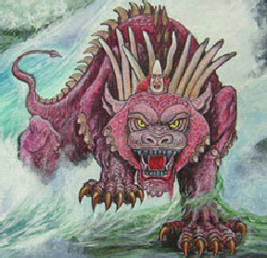
The Numerology Of Gog And The Little Horn
The Story Of Gog And Magog
Part 12

Slide 2
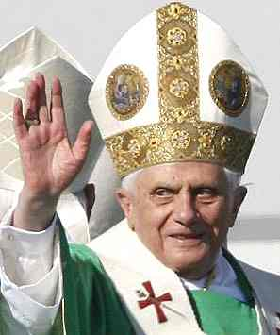
Gog & The Little Horn
It would probably be true to say that 99% of Protestant Christians including theologians believe that the little horn of Daniel is the Papacy.

Slide 3
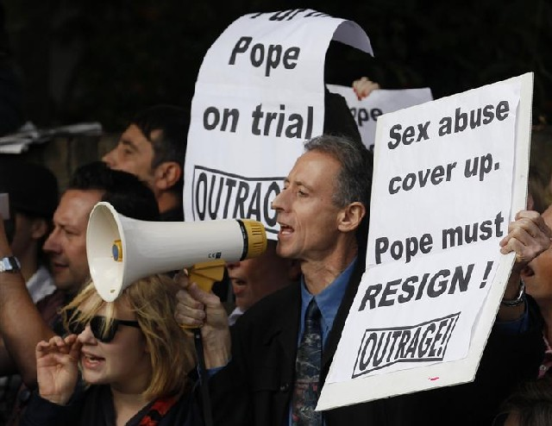
Gog & The Little Horn
However, the scriptures would indicate otherwise, although the Papacy was and is an emanation of the “Little Horn Power”, but only in part’ and acting as an Aunt Sally to take the knocks from those who are not aware that the Papacy was and is a front for a far more sinister power unseen behind the scenes.

Slide 4
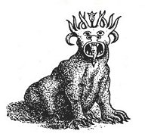
Gog & The Little Horn
Most in Christian Identity will agree that the ten horns of the beast is Israel, representing the 12 tribes of Israel – 10 because the Levites were divided amongst the tribes while Judah was the sceptre tribe which ruled over the other tribes.
The Ten Horned Beast

Slide 5
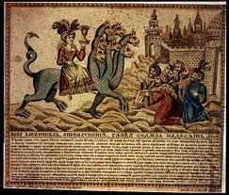
Gog & The Little Horn
Also these horns are known collectively as the whore, because Israel and Judah were put away for going after strange gods hence the term whore.

Slide 6
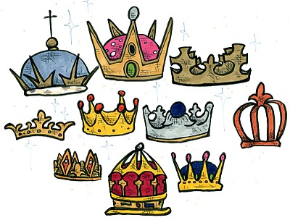
Gog & The Little Horn
We are told each horn is a king, now a king has to have a populace over which to rule.

Slide 7
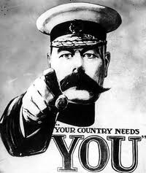
Gog & The Little Horn
Now that is a very good metaphor, because the beast uses the tribes as its proxy war machine to keep other nations in line, and to set one tribe against another in order to keep numbers down, as it knows that it is no match numerically speaking against all the tribes.

Slide 8
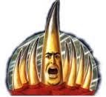
Gog & The Little Horn
Now it stands to reason that the little horn, must be similar to the other horns, but as its name implies, is much smaller.

Slide 9
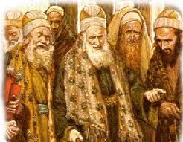
Gog & The Little Horn
The only candidate to fit the description are the Edomites, who go under the name of Jews, originating in the most part from Khazaria or are descendants of the Pharisees and Sadducees of Christ’s day.
Pharisees

Slide 10
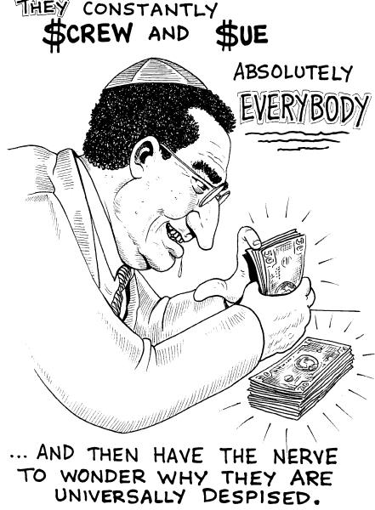
Gog & The Little Horn
Many are aware that the Jews control all western governments, but form barely 2% of the population. Hence the metaphor “little horn”.

Slide 11
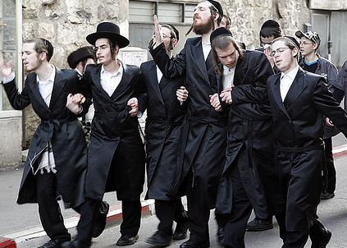
Gog & The Little Horn
Therefore, it is not referring to one person in one place but to an alien race scattered amongst all ten tribes!

Slide 12
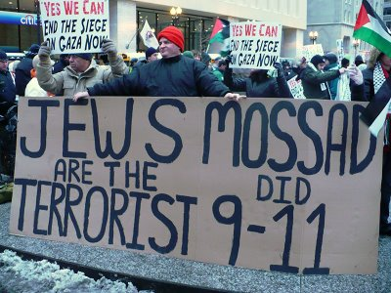
Gog & The Little Horn
That the Jews are Gog can be demonstrated by numerology. First the scriptures need to be consulted to discover the number of Gog. We have 3 main indications in scripture:

Slide 13
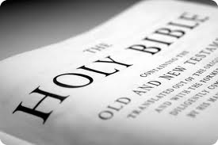
Gog & The Little Horn
1) Gog is mentioned exactly 11 times in the scriptures – 10 times in the Old Testament and once in the New Testament, reflecting 10 horns plus 1 little horn.

Slide 14
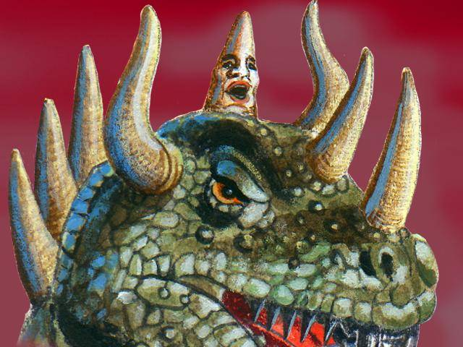
Gog & The Little Horn
2) The little horn coming up in the midst of the 10 horns 10+1=11

Slide 15
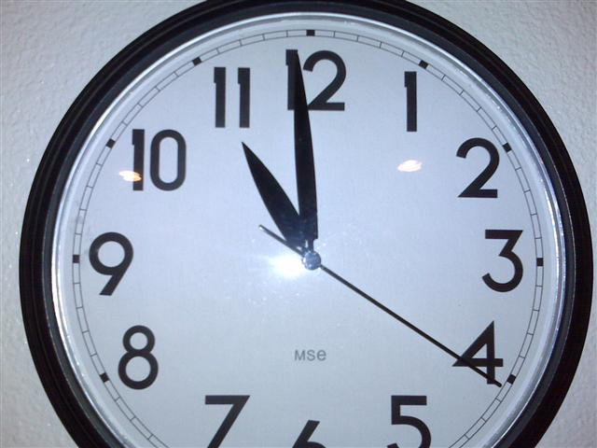
Gog & The Little Horn
3) The Bible refers to the eleventh hour as a time of foreboding or the latter day when Gog would come against Israel.

Slide 16
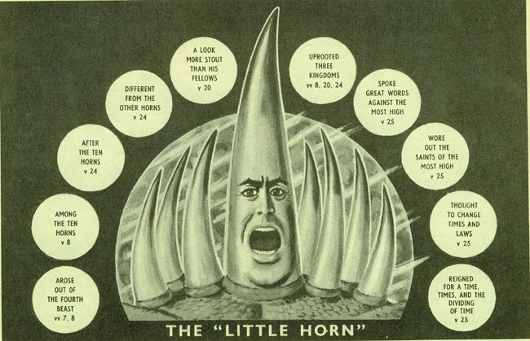
Gog & The Little Horn
The Bible obeys its own rules, namely 2 or 3 witnesses. There is only one verse referring to the little horn coming up amongst the 10 horns

Slide 17
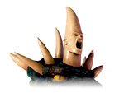
Gog & The Little Horn
However, there is another verse using a different metaphor – the clue is “coming up”. Both the little horn and Gog “come up” amongst the tribes of Israel. “Coming up” is a good description of their modus operandi i.e

Slide 18
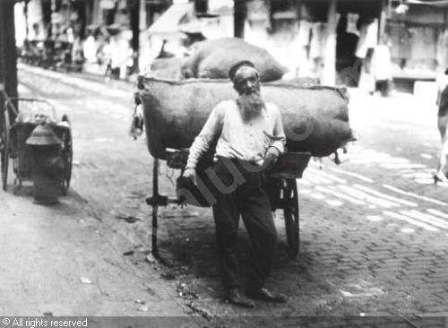
Gog & The Little Horn
….. or in modern parlance worming their way in! First doing very lowly jobs and then working their way up the ladder in the various host nations.

Slide 19
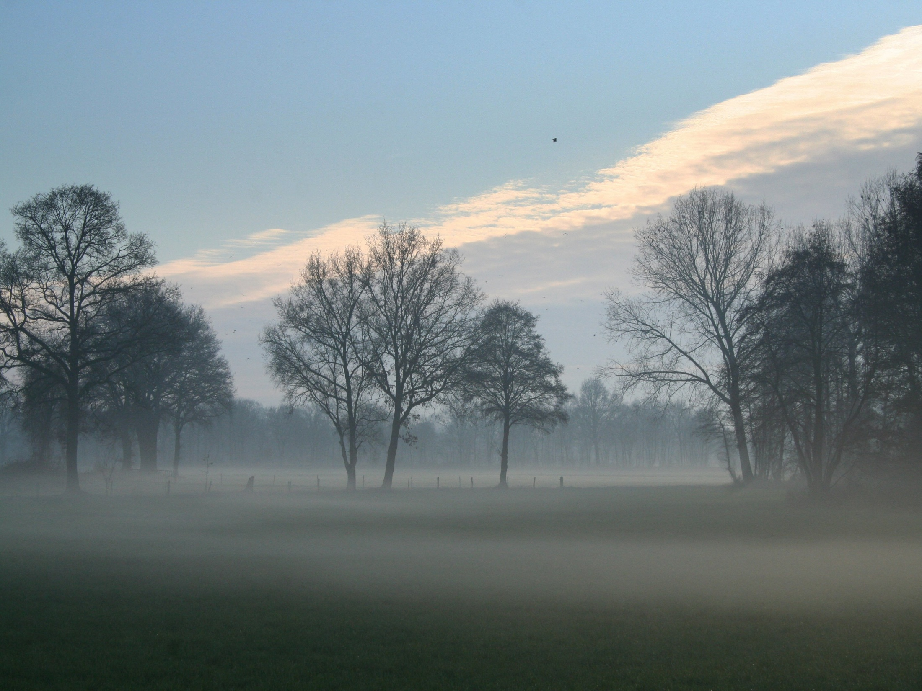
Gog & The Little Horn
Coming up as a cloud covereth the earth is another good metaphor, because like an autumn mist which at first is only a few inches above the ground, but then rises very high and everything is obscured, just like the Jew…..

Slide 20
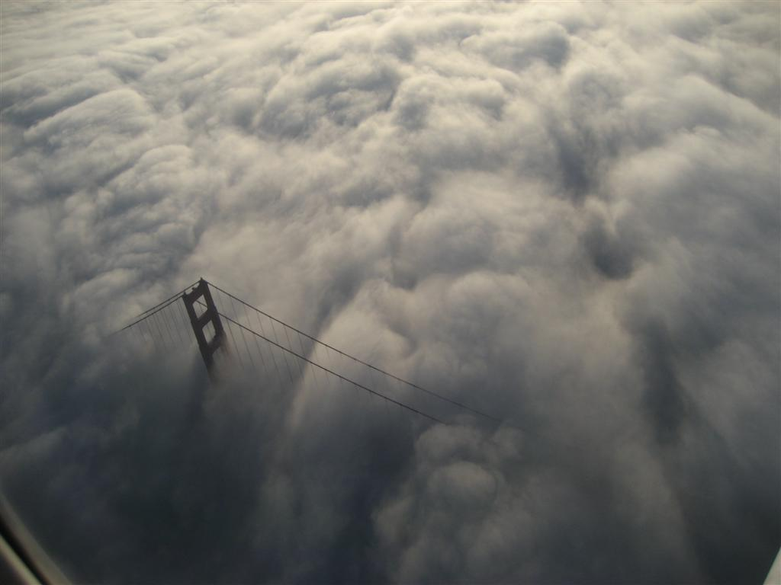
Gog & The Little Horn
….who having reached high office is no longer visible as Jew and has blended in with the indigenous population,

Slide 21
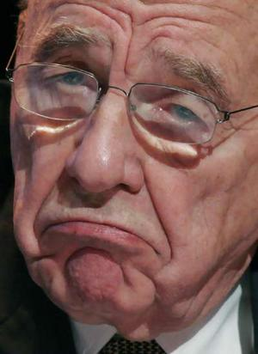
Gog & The Little Horn
….using such tricks as pretending to convert to Christianity or marrying into the aristocracy. However, their allegiance is not to the host state, but to their Zionist satanic agenda.
Rupert Murdoch

Slide 22
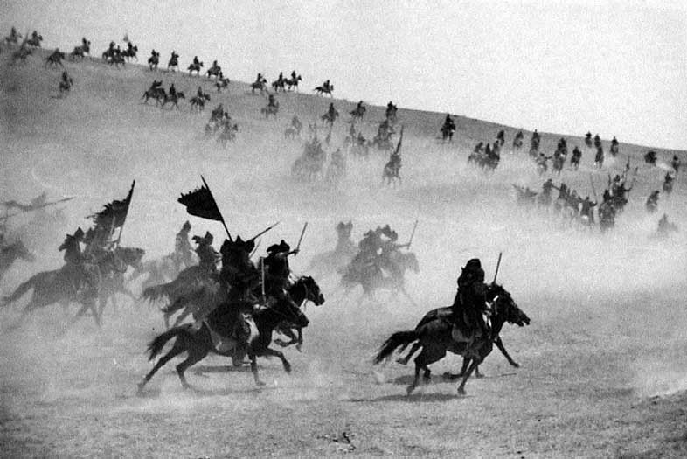
Gog & The Little Horn
Ezekiel 38 15: And thou shalt come from thy place out of the north parts, thou, and many people with thee, all of them riding upon horses, a great company, and a mighty army:
Genghis Khan

Slide 23
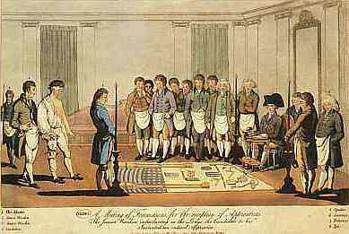
Gog & The Little Horn
16 : And thou shalt come up against my people of Israel, as a cloud to cover the land; it shall be in the latter days, and I will bring thee against my land, that the heathen may know me, when I shall be sanctified in thee, O Gog, before their eyes.
The Covert Attack Masonic & Secret Societies

Slide 24
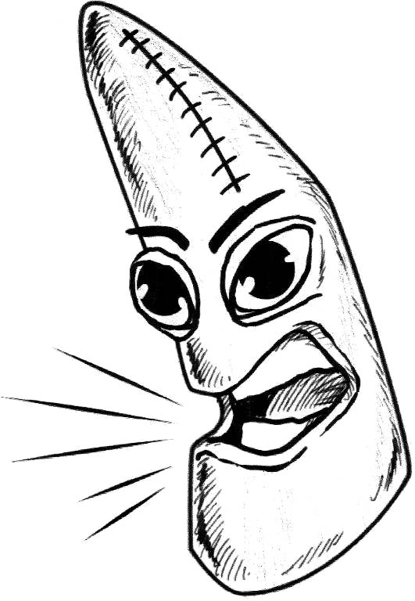
Gog & The Little Horn
Daniel 7:8; I considered the horns, and, behold, there came up among them another little horn, before whom there were three of the first horns plucked up by the roots: and, behold, in this horn were eyes like the eyes of man, and a mouth speaking great things.

Slide 25
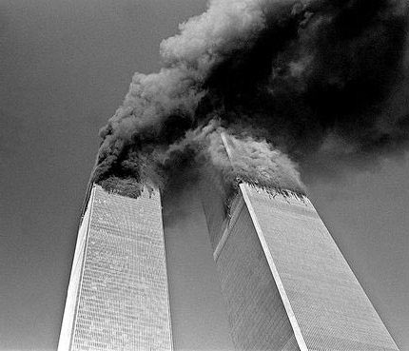
Gog & The Little Horn
Not only that: On the basis of A = 1, B = 2, C = 3 etc,
Khazar = 11 + 8 + 1 + 26 + 1 + 18 = 65 = 6 + 5 = 11
Gog = 7 + 15 + 7 = 29 = 2 + 9 = 11
Jew = 10 + 5 + 23 = 38 = 3 + 8 = 11
The Former Twin Towers Form A Large 11

Slide 26
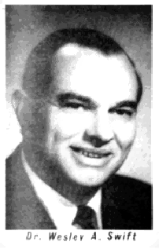
Gog & The Little Horn
This gives us 33 (11+11+11) = The number of Masonic degrees! Dr. Wesley Swift stated that the Edomites were known as the people with funny handshakes!

Slide 27
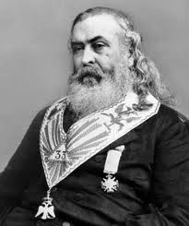
Gog & The Little Horn
Eleven (11) is a sacred number. When eleven is multiplied by the perfect number 3, the number 33 is produced, a number of tremendous occult importance.
Albert Pike 33 Degree Mason

Slide 28
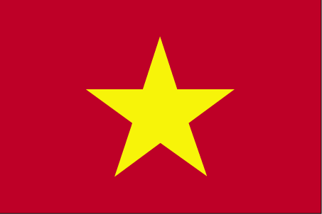
Gog & The Little Horn
The symbol of Amalek (an Edomite race) is a 5 pointed star, hence their military nerve centre the pentagon, is a 5 pointed star in plan.

Slide 29
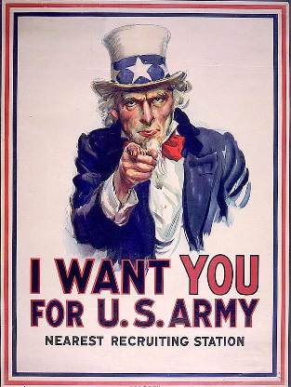
Gog & The Little Horn
The 5 pointed star was prominent on the hat of uncle Sam when calling the Americans to take up arms against their German cousins.

Slide 30
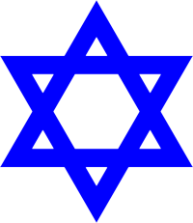
Gog & The Little Horn
The 6 pointed star of Moloch and Astarte, which is an emblem of the Rothschilds and is on the flag of their large real estate area in the Middle East known as the Israeli state.

Slide 31
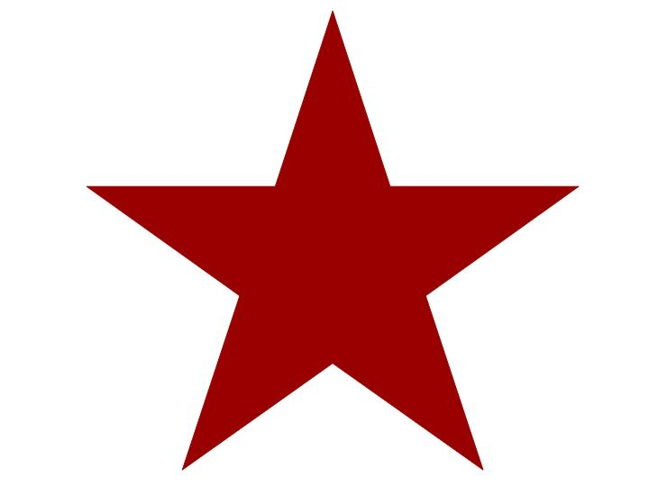
Gog & The Little Horn
Thus again we have 5 + 6 = 11 (the number of Gog)

Slide 32
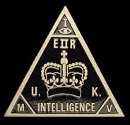
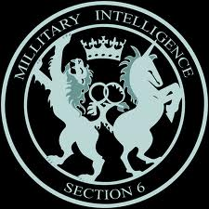
Gog & The Little Horn
Note in The UK (Gog’s Headquarters) we have 2 main intelligence Services MI5 & MI6 (there is no MI1-2-3 or 4) 5 + 6 = the number of Gog

Slide 33
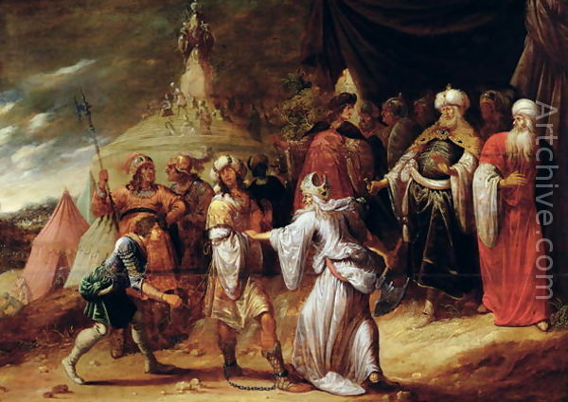
Gog & The Little Horn
Moreover, a number of Bible versions refer to Agag King of the Amalekites as either Agog or Gog
Samuel Killing Agag, King of the Amalekites

Slide 34
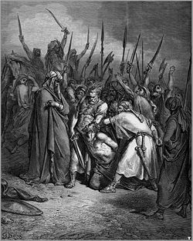
Gog & The Little Horn
…..which further associates the name with Amalek-Edom or modern day Jewry whom Yahweh would have war with from generation to generation. Exodus 17:16
Amalekites

Slide 35
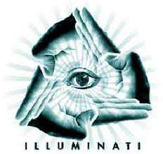
Gog & The Little Horn
The Illuminati reconstituted itself with its occult knowledge having been acquired from ancient Egypt, using the vehicle of the Knights Templar an outwardly very respectable organisation, that assisted pilgrims going to Jerusalem.
The All Seeing Eye

Slide 36
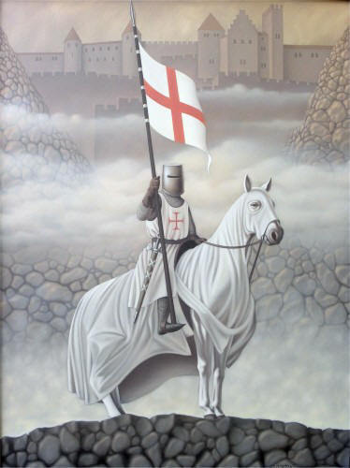
Gog & The Little Horn
It was set up in 1111, but did not become officially recognised until 9 years later. Hence the importance of 9 & 11 for the orchestration of major disasters on September 11th i.e. the great fire of London,

Slide 37
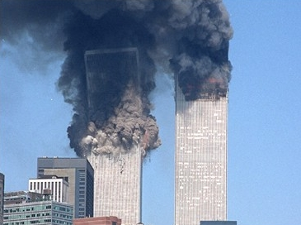
Gog & The Little Horn
…..the twin towers (which themselves form a number eleven!) and the 2009 financial collapse.

Slide 38
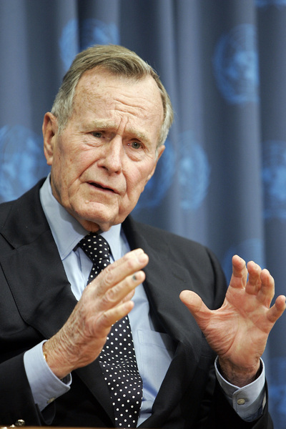
Gog & The Little Horn
Some Other Notable 911 Events
11. 9. 1990: George H. Bush announces the coming of the New World Order (NOW)

Slide 39
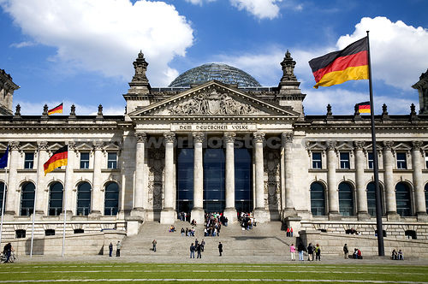
Gog & The Little Horn
Some Other Notable 911 Events
9. 11. 2007: The “Big Brother” Telecommunicati-ons Surveillance Law is passed in the German Bundestag.

Slide 40
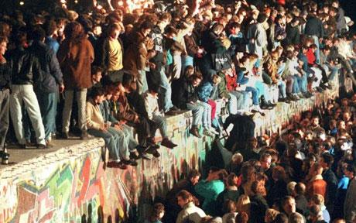
Gog & The Little Horn
Some Other Notable 911 Events
9. 11. 1989: The “Fall of the Berlin Wall”, with disastrous economic consequences for the citizens of the former German Democratic Republic.

Slide 41
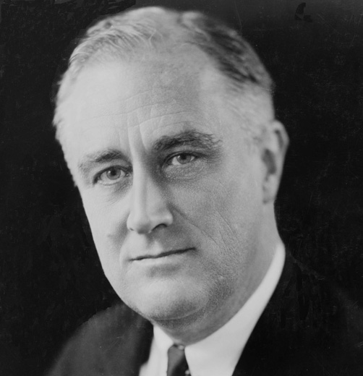
Gog & The Little Horn
Some Other Notable 911 Events
11. 9. 1941: U.S. President Roosevelt, a High-Degree Freemason himself, states publicly that he (without declaring war) gave the order to fire on German militaryVehicles.

Slide 42
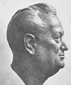
Gog & The Little Horn
Some Other Notable 911 Events
9. 11. 1938: The “Crystal Night” or “Night of the Broken Glass”; the NSDAP attacks Jewish fellow citizens, their synagogues and property – the fruit of the anti-Semitic seeds sown by Freemason and founder of the Thule Society, Rudolf von Sebottendorf (left).

Slide 43
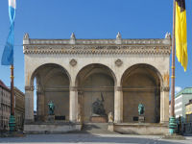
Gog & The Little Horn
Some Other Notable 911 Events
8./9. 11. 1923: “March on the Feldherrnhalle” (Field Marshal’s Hall) – Hitler coup in Munich

Slide 44
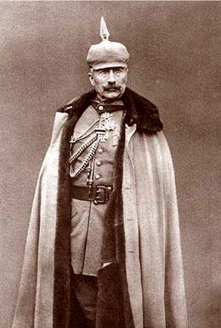
Gog & The Little Horn
Some Other Notable 911 Events
9. 11. 1918: Revolution and overthrow of the Kaiser in Berlin. Prior to this there had been a Communist revolution in Munich (civil war).
German Kaiser Wilhelm II abdicated on November 9th 1918.

Slide 45
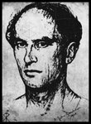
Gog & The Little Horn
Some Other Notable 911 Events
Rudolf von Sebottendorf gave a speech in Berlin which already contained the quintessence of “Third Reich ideology”.

Slide 46
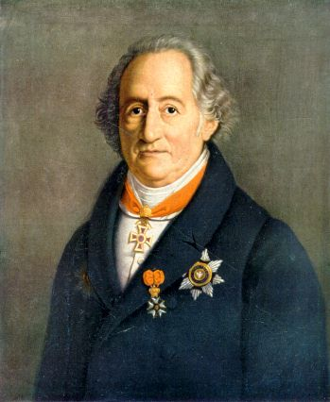
Gog & The Little Horn
Some Other Notable 911 Events
(By way of explanation): “German Reich ideology”, from 1870 or so onwards, was undoubtedly wrong and gave rise to “Hitler mania”. Johann Wolfgang von Goethe (left) warned that: “The German faces no greater danger than trying to improve himself through or with his neighbours.

Slide 47
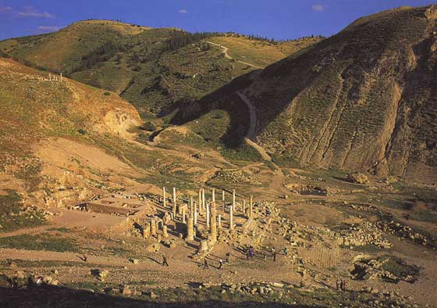
Gog & The Little Horn
The Hebrew word for Gog is “Gowg” means "roof, covering, or mountain." Coming up as a cloud means covert or in secret. Mountain would also tie up with the other biblical name for Edom, that is mount Seir.

Slide 48
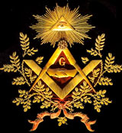
Gog & The Little Horn
Undercover aptly describes freemasons who operate in secret from their Masonic lodges under the symbol of the all seeing eye for the little horn was full of eyes, like the eye of a man,

Slide 49
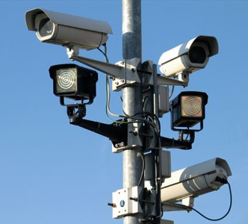
Gog & The Little Horn
….a subliminal warning that we are under surveillance. Being that the UK, is Gog’s headquarters would explain why the UK has more surveillance cameras than any other country.

Slide 50
Gog & The Little Horn
Further, the Masonic symbol with compass and the inverted set square could also represent a roof and the large letter G above it Gog.

Slide 51
Gog & The Little Horn
The City of London is the citadel of the beast and Gog.

Slide 52
Gog & The Little Horn
The area of the City is 677 acres = 666 (No. of the beast) + 11 (No. of Gog) = 677.

Slide 53
Gog & The Little Horn
The city of London is also known as the city of dragons, the most famous being at temple bar.

Slide 54
Gog & The Little Horn
The City of London is an independent state, even the Queen has to seek permission from the Lord Mayor before she can enter.

Slide 55
Gog & The Little Horn
London is also the premier capital of modern Israel where the Prime minister resides at No.10 (ten horns or ten tribes) Downing street,

Slide 56
Gog & The Little Horn
…while the controlling representative of the City of London resides at No.11 again the number of Gog.

Slide 57
Gog & The Little Horn
11 - The subversion and undoing of 10; a flawed addition to that perfect order. 11 - the Antichrist/Prince is known as the 11th Horn. Lucifer = “Light Bearer” has 11 letters!

Slide 58
Gog & The Little Horn
Another interesting fact is that; of the 190 nationalities within the old USSR the 11th in population size was the Jews (Gog).

Slide 59
Gog & The Little Horn
Aquarius is the 11th sign in the Zodiac. We are since August 11, 1999 in the "Age of Aquarius" [Aqua = water = Satan's offspring coming in as a flood] which ended the 2,000 year reign of Pisces [True Christianity].

Slide 60
Gog & The Little Horn
Another astounding fact is that on the August 11th 1999 Solar Eclipse which occurred at precisely 11:11 [over Cornwall, UK].

Slide 61
Gog & The Little Horn
Biblical numerology – 11 = 11th Hour – Nearing Christ’s return. To Britain??

Slide 62
Gog & The Little Horn
Also a warning to the 11th horn your time is nearly up! Mr. Vic. A. Proposch of Australia published an article showing another numerological significance of the eclipse, was that knowledge would be increased, that is of the enemies machinations

Slide 63
Gog & The Little Horn
….since the spread of alternative news on the Internet people are beginning to wake up.

Slide 64
Gog & The Little Horn
It is interesting to note that only a mere eleven minutes after the Zionist declaration of the Palestinian partition and independence of the Israeli State on May 14, 1948,….

Slide 65
Gog & The Little Horn
President Truman (left) recognized Israel as an independent Jewish State.

Slide 66
Gog & The Little Horn
Another point to note is that under the UK bankruptcy Act and when a firm goes into liquidation of its assets, it is said to be under chapter 11 of that act and that is when the bank takes control, which as we know is Gog!!

Slide 67
Gog & The Little Horn
Readers of previous issues of the New Ensign will be aware that Gog has been secretly attacking us through its scalar wave technology via HAARP
HAARP Alaska Complex

Slide 68
Gog & The Little Horn
….and its network of microwave transmitters using ELF (extra low frequency) waves. Those readers who speak German will know that elf is German for number eleven!

Slide 69
Gog & The Little Horn
We must also remember that Gog has been interfering with Scriptures. In the original KJV Bible there were 80 books, a good number (8 God x 10 ten tribes = 80).

Slide 70
Gog & The Little Horn
However when the Jesuit (Jewish) committee called the biblical destruction group was set up in 1776, whose objective was to remove the opiate (Scriptures) of the people.

Slide 71
Gog & The Little Horn
Interestingly, 50 years later in 1826, the committee was disbanded, the same year the apocrypha was removed from the Bible leaving only 66 books (6 man x 11 Gog)

Slide 72
Gog & The Little Horn
11 years after Robert Campbell received Royal assent for his fairs, he led the Campbells against the MacDonalds in the infamous Glencoe massacre, on the orders of William (of Orange) and his (important) Stuart wife, Mary.

Slide 73
Gog & The Little Horn
Finally, Gog ensures that its massacres are remembered on its special day here in the UK on 11/11 at 11am each year

Slide 74
Gog & The Little Horn
……with fittingly the red poppy - red for Esau also the symbol for its covert drug weapon.

Slide 75
Gog & The Little Horn
However, this is not to deprecate our brave men who were deceived into thinking that they were fighting for their country.

Slide 76
The Story Of Gog And Magog
A thought to leave you with
"Whenever the legislators endeavour to take away and destroy the property of the people, or to reduce them to slavery under arbitrary power, they put themselves into a state of war with the people, who are thereupon absolved from any further obedience ... " John Locke (1632-1704),
Howbeit no man spake openly of him for fear of the Jews. (John 7:13)

Slide 77
The Story Of Gog And Magog
The End Of Part 12
To be continued …..

