Slide 1
The Story Of Gog And Magog
APPENDIX ONE
President Truman’s Jewish Origins Father Coughlin - A 1930 Campaigner Against Gog Oliver Cromwell – Gog Agent Churchill’s Mother – Gog Agent Nikola Tesla and Tunkuska

Slide 2
President Truman’s Jewish Origins
It was President Truman who recognised Israel
Harry Solomon Truman

Slide 3
President Truman’s Jewish Origins
Truman, and boyhood pal Jacobson, went from supply clerks to front-line warriors

Slide 4
President Truman’s Jewish Origins
Truman Owned A Haberdashery With Jacobson.
Left: Truman And Eddie Jacobson

Slide 5
President Truman’s Jewish Origins
Truman Recognizes Israel As A Nation – here talking to Chaim Weisman

Slide 6
President Truman’s Jewish Origins
Truman Playing Poker With Abbie Garnof And Pals

Slide 7
President Truman’s Jewish Origins
Abbie Garnof (centre), One Of Truman's Inner Circle

Slide 8
President Truman’s Jewish Origins
Harry S. Truman, 1884-1972
Truman succeeded to the office of President upon the death of Franklin D. Roosevelt. He recognized Israel as a nation, de-segregated the armed forces, and was soft on Communism. Truman was always considered a haggling haberdasher.

Slide 9
President Truman’s Jewish Origins
After the war, they opened The Truman & Jacobson haberdashery on November 28, 1919, at 104 West 12th Street in downtown Kansas City. His maternal and paternal grandparents were Shippe and Solomon.
Truman's Store

Slide 10
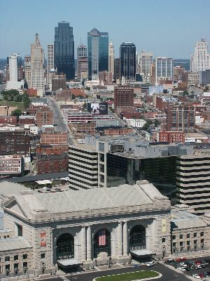
President Truman’s Jewish Origins
Eddie Jacobson and Harry Truman met in Kansas City (left) as young men.

Slide 11
President Truman’s Jewish Origins
Eddie was 28 years old when he enlisted. Sergeant Edward Jacobson and Harry Truman, ran a game at Fort Sill in Oklahoma. The two arrived late in June, and the war ended four months later.
Eddie Jacobson

Slide 12
President Truman’s Jewish Origins
"Today, not tomorrow, we must do all that is humanly possible to provide a haven for all those who can be grasped from the hands of Nazi butchers. Free lands must be opened to them.”
Truman At The 1944 Convention

Slide 13
President Truman’s Jewish Origins
Truman Becomes Vice-President
He was put in as Vice-President in January of 1945 because Zionists realized that Roosevelt wouldn't' last much longer.

Slide 14
President Truman’s Jewish Origins
Truman Recognizes Israel
On March 13, 1948, it was Jacobson who persuaded Truman to meet with Dr. Chaim Weizmann, the leader of the Zionist movement.

Slide 15
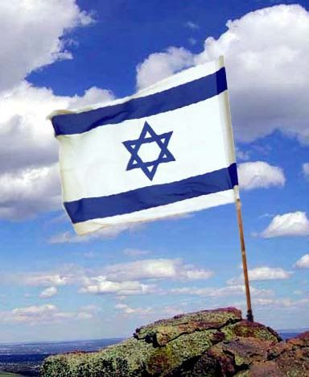
President Truman’s Jewish Origins
Two months later, on May 14, 1948, the United States became the first nation to recognize the new state of Israel

Slide 16
President Truman’s Jewish Origins
Did Truman Aid Israel In Their 1948 Massacres?
That question has haunted Americans for years.

Slide 17
President Truman’s Jewish Origins
1948 Israel Was A Bloodbath
Ariel Sharon was a young ruthless Zionist, and his armies would often massacre a village of women and children.

Slide 18
President Truman’s Jewish Origins
Who Was Harry Truman?
It's a safe bet he had Jewish blood, just like John Kerry, Sen. Allen, Wesley Clarke, etc. The Zionists knew Roosevelt would die in office, and you can rest assured they were going to have another one of theirs follow Roosevelt.

Slide 19
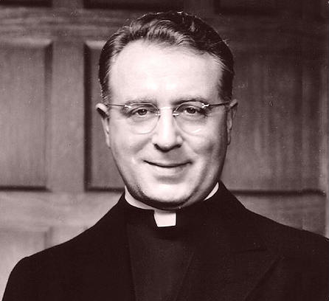
Father Coughlin - A 1930’s Campaigner Against Gog
He Started Out Using The Radio To Broadcast Sermons – Highly critical of Jewish Influence in government.
Father Coughlin

Slide 20
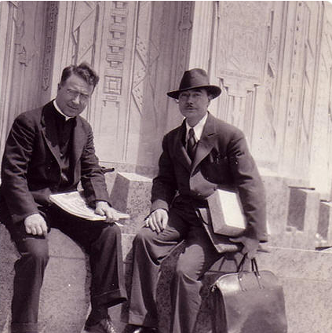
Father Coughlin - A 1930’s Campaigner Against Gog
Father Coughlin was one of the few religious-political activists seen here P. Oliver Rivero

Slide 21
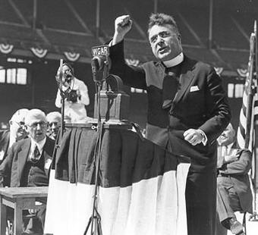
Father Coughlin - A 1930’s Campaigner Against Gog
He drew large crowds

Slide 22
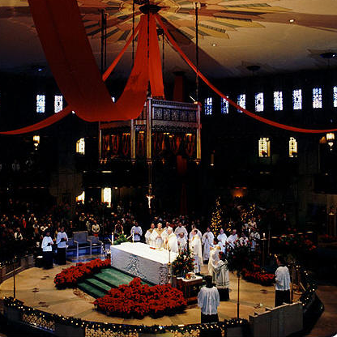
Father Coughlin - A 1930’s Campaigner Against Gog
His Church was to become a shrine.

Slide 23
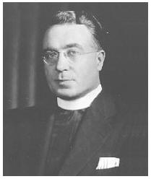
Father Coughlin - A 1930’s Campaigner Against Gog
Father Coughlin Really Was Doing Good Job.
The churches must accept their responsibility to protect their flocks. When a plague ravishes a land, the clergy can't hide in their castles and pray, they have an obligation to roll up their selves and help. You are starting to see the Coughlin spirit as Episcopalians use their pensions to divest from funding Israel.

Slide 24
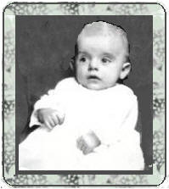
Father Coughlin - A 1930’s Campaigner Against Gog
Father Coughlin Is Born
He was born in Ontario Canada In 1891

Slide 25
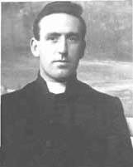
Father Coughlin - A 1930’s Campaigner Against Gog
The Father Is Ordained
Coughlin was ordained in Toronto in 1916. He taught at Assumption College in Windsor, Ontario, before moving to Detroit in 1923

Slide 26
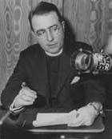
Father Coughlin - A 1930’s Campaigner Against Gog
He Becomes An Activist
In 1926 he broadcasts sermons on Christian radio. In 1931 CBS dropped him, so he raised money to create his own national network, which soon reached millions of listeners.

Slide 27
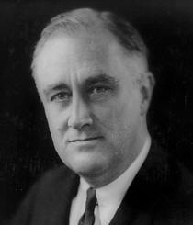
Father Coughlin - A 1930’s Campaigner Against Gog
Initially He Supports Roosevelt
He strongly endorsed Franklin D. Roosevelt during the 1932 Presidential election. He was an early supporter of Roosevelt's New Deal reforms

Slide 28
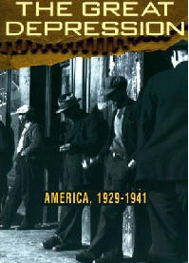
Father Coughlin - A 1930’s Campaigner Against Gog
Coughlin Was Incensed At Jewish Bankers Had Done
In the 1930s as he preached more and more about the negative influence of "international bankers" and of Wall Street on the general welfare and about the need for monetary reform.

Slide 29
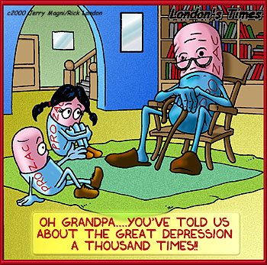
Father Coughlin - A 1930’s Campaigner Against Gog
Coughlin claimed that the Depression was a Jewish created cash famine, as the solution. He blamed the Depression on an "international conspiracy of Jewish bankers” and he proposed monetary reforms, including the elimination of the Federal Reserve System,

Slide 30
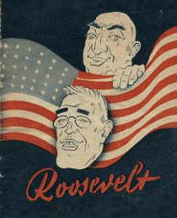
Father Coughlin - A 1930’s Campaigner Against Gog
He Takes A Second Look At Roosevelt
Coughlin began denouncing Roosevelt as a tool of Wall Street.

Slide 31
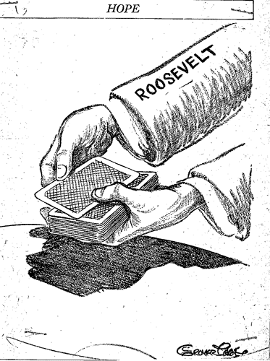
Father Coughlin - A 1930’s Campaigner Against Gog
Thus, as Coughlin became a bitter opponent of the New Deal, his radio talks escalated in vehemence against Roosevelt, capitalists and Jewish conspirators.

Slide 32
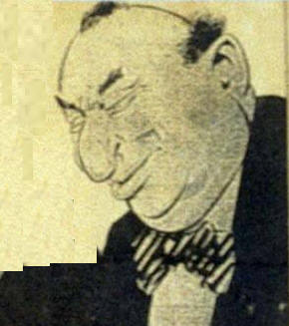
Father Coughlin - A 1930’s Campaigner Against Gog
Coughlin Called The New Deal, The Jew Deal
Roosevelt had surrounded himself with a Jewish Cabal, and the greatest beneficiaries of the "New/Jew Deal" were Jewish businessmen

Slide 33
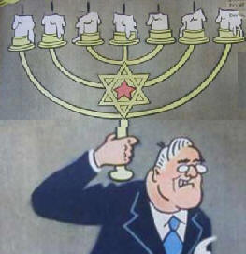
Father Coughlin - A 1930’s Campaigner Against Gog
Roosevelt Was Seen As A Jewish Puppet
When he began criticizing the New Deal, Roosevelt sent Joseph P. Kennedy and Frank Murphy, prominent Irish Catholics, to try to tone him down.

Slide 34
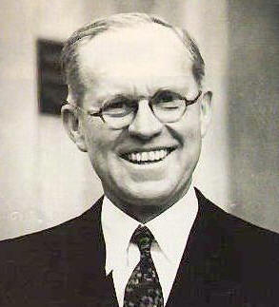
Father Coughlin - A 1930’s Campaigner Against Gog
Kennedy Has No Use For Coughlin
Kennedy, who strongly supported the New Deal, warned as early as 1933 that Coughlin was "becoming a very dangerous proposition" as an opponent of Roosevelt and "an out and out demagogue.”

Slide 35
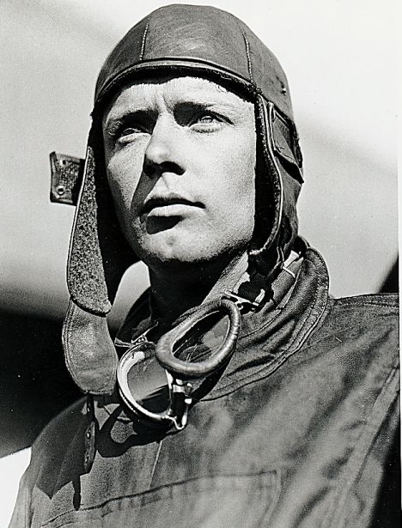
Father Coughlin - A 1930’s Campaigner Against Gog
Kennedy attacked the isolationism of Coughlin, and aviator Charles Lindbergh (left).

Slide 36
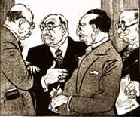
Father Coughlin - A 1930’s Campaigner Against Gog
Coughlin's National Union For Social Justice
Coughlin reached the farm belt, who really was devastated in the 1930's. He had a strong following among nativists and opponents of the Federal Reserve. As Kazin notes, Coughlinites saw Wall Street and Communism as twin faces of Judiaism

Slide 37
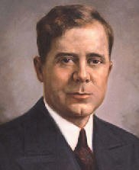
Father Coughlin - A 1930’s Campaigner Against Gog
Coughlin Saw Huey Long As America's Salvation
Coughlin supported Huey Long, and was enraged when he was killed by the Jewish assassin, Jakob Weiss in 1935.
Huey Long

Slide 38
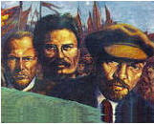
Father Coughlin - A 1930’s Campaigner Against Gog
Germany Was The Dam Restraining Communism
After 1936, Coughlin increasingly expressed sympathy for German policies, as an antidote to Bolshevism. In his 1938 CBS radio broadcasts he exposed Jewish bankers as financing the Russian Revolution.

Slide 39
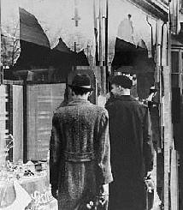
Father Coughlin - A 1930’s Campaigner Against Gog
He Sees Kristallnacht As A Giant Hate Hoax
On November 20, 1938, two weeks after German Jews staged Kristallnacht, Coughlin detailed what really happened, cataloging the the nonsensical exaggerations.

Slide 40
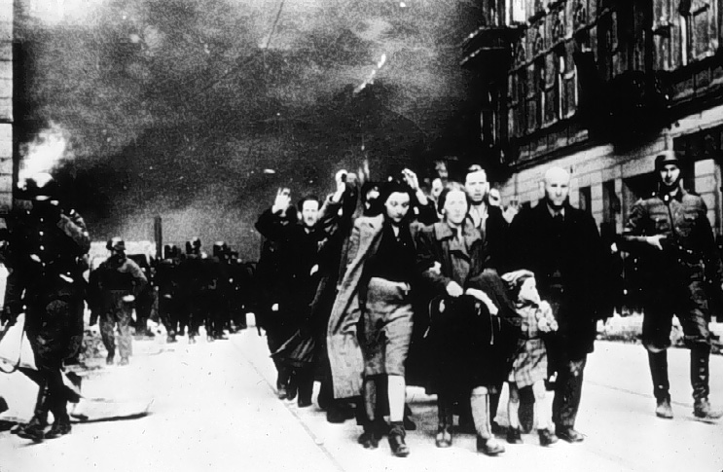
Father Coughlin - A 1930’s Campaigner Against Gog
The Jews claimed that untold numbers were beaten, that a thousand synagogues were burned, and hundreds of Jews died rushing into their synagogues to save books.

Slide 41
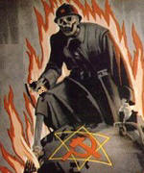
Father Coughlin - A 1930’s Campaigner Against Gog
He Opposed Stalin's Communism
His newspaper, Social Justice, claimed that Marxist atheism in Europe was a Jewish plot. He exposed Stalin's Jewish blood.

Slide 42
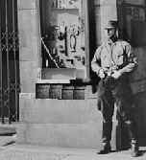
Father Coughlin - A 1930’s Campaigner Against Gog
Coughlin Hit A Nerve With Kristallnacht
After this speech, radio stations in New York and Chicago, began refusing to air his speeches, and he was cancelled by WINS and WMCA. Coughlin continued to broadcast on a small Newark station.

Slide 43
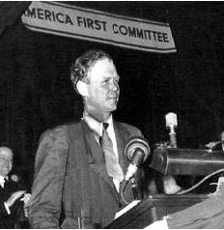
Father Coughlin - A 1930’s Campaigner Against Gog
Coughlin Agreed With Lindbergh
Coughlin, and Lindbergh, wanted no part of WW2. They both referred too it as the Jew's war

Slide 44
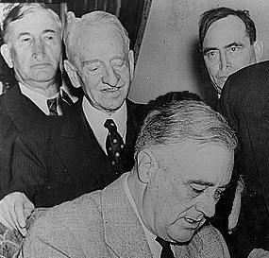
Father Coughlin - A 1930’s Campaigner Against Gog
The Lend Lease Act
Roosevelt supplied weapons to Stalin's communists, who had killed 50 million Christians since 1918.

Slide 45
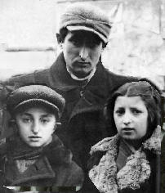
Father Coughlin - A 1930’s Campaigner Against Gog
Stop The Mass Immigration Of Jews
From 1933 on the Jews of Europe realized a war was coming, they weren't about to serve, and they didn't want the inconveniences, and dangers their war would bring. From 1933 to 1941 there was a massive immigration, and Coughlin wanted them to be sent back.

Slide 46
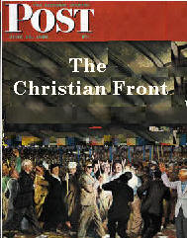
Father Coughlin - A 1930’s Campaigner Against Gog
The FBI Gets Involved
An organization called the Christian Front, who claimed affiliation with Coughlin, starts passing out flyers that it planned to murder Jews, and a dozen congressman. Edgar J Hoover steps in, and declares Coughlin, Hitler's agent.
Coughlin denied any knowledge.

Slide 47
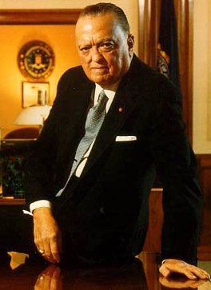
Father Coughlin - A 1930’s Campaigner Against Gog
Edgar J Hoover (left) steps in, and declares Coughlin, Hitler's agent.
Coughlin denied any knowledge.

Slide 48
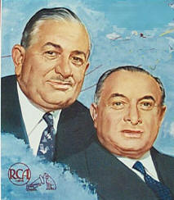
Father Coughlin - A 1930’s Campaigner Against Gog
Coughlin Blames Sarnoff And His Fellow Jews
FDR administration decided to regulate broadcasting, operating permits were required of those who were regular radio broadcasters.

Slide 49
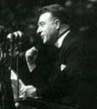
Father Coughlin - A 1930’s Campaigner Against Gog
When Coughlin's permit was denied, he was temporarily silenced.
In 1940 Coughlin had 1/3 of American listening to his broadcasts.

Slide 50
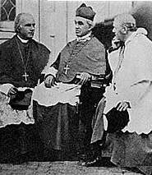
Father Coughlin - A 1930’s Campaigner Against Gog
Coughlin Is Finally Silenced
After the attack on Pearl Harbor and the declaration of war, the peace movement began to sputter out and isolationists like Coughlin were seen as being sympathetic to the enemy.

Slide 51
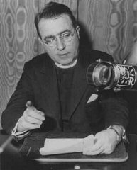
Father Coughlin - A 1930’s Campaigner Against Gog
In 1942, a new bishop of Detroit ordered Coughlin to stop his controversial political activities and to return to his duties as a parish priest.

Slide 52
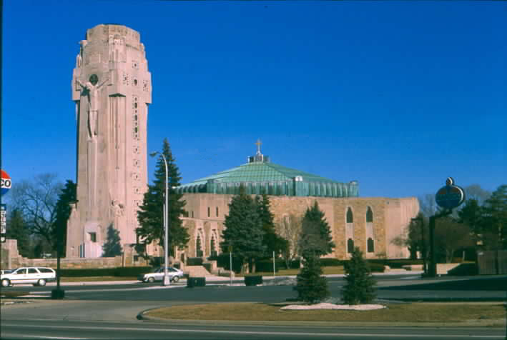
Father Coughlin - A 1930’s Campaigner Against Gog
Coughlin complied and remained the pastor of the Shrine of the Little Flower until retiring in 1966.

Slide 53
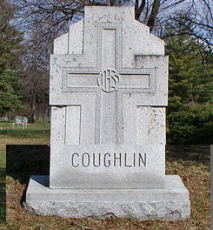
Father Coughlin - A 1930’s Campaigner Against Gog
He refused numerous interview opportunities, and continued to write pamphlets denouncing Communism until his death at Bloomfield Hills, Michigan in 1979, at the age of 88.
Father Coughlin Dies In 1979

Slide 54
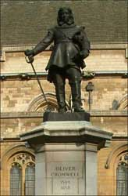
Oliver Cromwell – Gog Agent
This section deals with a bizarre 11 year episode (the number of Gog) in English history when the country was a republic or Commonwealth. It was called an INTERREGNUM and lasted from 1649 to 1660. The last 5 years were called a Protectorate with Oliver Cromwell reigning as Lord Protector.

Slide 55
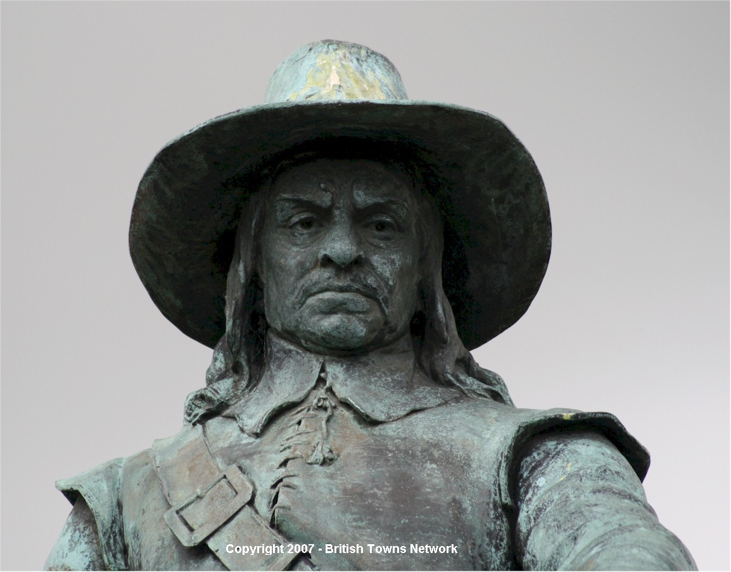
Oliver Cromwell – Gog Agent
For most of his life, Cromwell was an obscure commoner without a drop of royal blood, and stood no chance of inheriting the English throne. Cromwell is considered a HERO in England - but in Ireland he is as HATED as Hernán Cortés in Mexico.

Slide 56
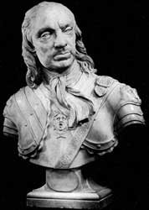
Oliver Cromwell – Gog Agent
The reason for this bizarre episode in English history will be clearly seen when we carefully examine laws that were passed and alliances that were changed during Cromwell's career and the subsequent reign of the restored King Charles II.

Slide 57
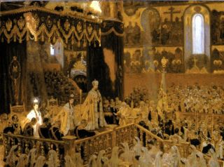
Oliver Cromwell – Gog Agent
Without a drop of royal blood, COMMONER Cromwell almost became king of the 3 kingdoms
The coronation of Oliver Cromwell as Lord Protector of England.

Slide 58
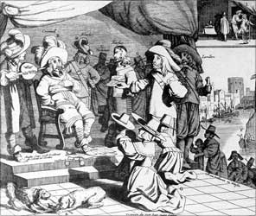
Oliver Cromwell – Gog Agent
Dutch satirical print showing Cromwell thinking about becoming king as his sycophants surround him and grovel at his feet.

Slide 59
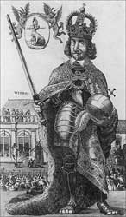
Oliver Cromwell – Gog Agent
Dutch satirical print portrays Cromwell as an arch-hypocrite and a power hungry usurper, for even as Charles I is being beheaded in Whitehall, Cromwell is seizing the power and emblems of monarchy including ermine robe, orb, crown and sword of justice.

Slide 60
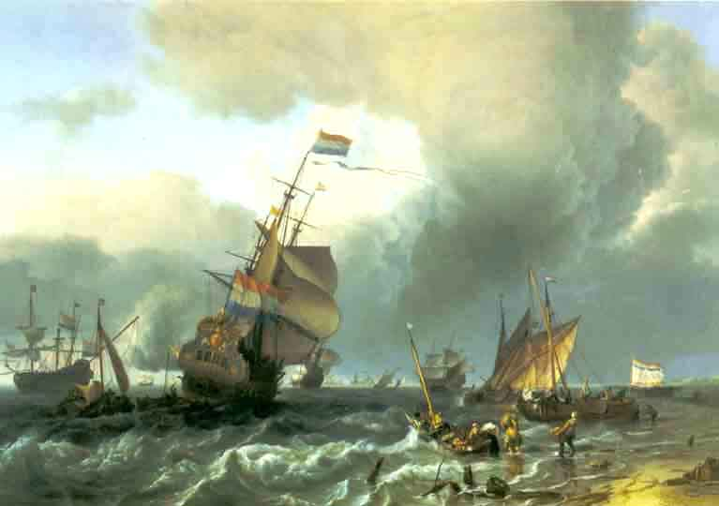
Oliver Cromwell – Gog Agent
The gallant little country of Holland was one of the winners in the Gog instigated 30 Years' War.
Their navy was expanding and they were taking over the decaying Spanish Empire.
Gog tool/fool Cromwell actually got England to declare war on their most faithful ally—Holland.

Slide 61
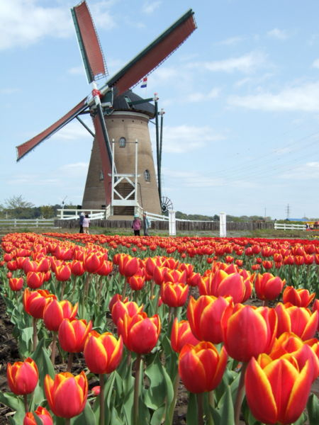
Oliver Cromwell – Gog Agent
England and Holland were faithful allies until the Cromwell regime!!
England and Holland were faithful allies from before the time of the defeat of the "Invincible" Armada until the regime of Cromwell.

Slide 62
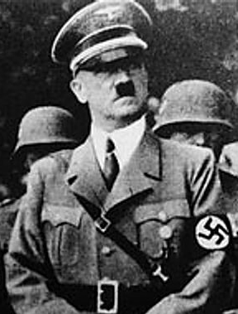
Oliver Cromwell – Gog Agent
It is ironic that the dictatorship of Oliver Cromwell lasted just as long as another Gog tool—Adolf Hitler.

Slide 63
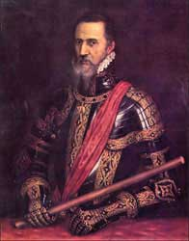
Oliver Cromwell – Gog Agent
This "Iron Duke“ (Gog Agent) as he was called began a 6 year reign of terror in the Netherlands. On August 22, Alba, accompanied by a body of select Spanish troops, made his entry into Brussels. He immediately appointed a council to condemn without trial those suspected of heresy and rebellion.
Duke of Alva (1507-1582).

Slide 64
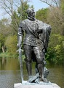
Oliver Cromwell – Gog Agent
On June 1, 1568, Brussels witnessed the simultaneous decapitation of twenty-two noblemen; on 6 June followed the execution of the Counts of Egmont and Horne. The "Council of Blood" was the popular designation of Alba's tribunal.
Count of Egmont

Slide 65
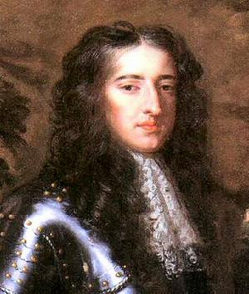
Oliver Cromwell – Gog Agent
Only Protestant England, and the small Dutch Republic under under William of Orange, stood in Spain's way of eventual world conquest. England had a small population of 4 million, and no overseas possessions.

Slide 66
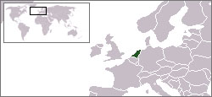
Oliver Cromwell – Gog Agent
The Netherlands was ideally situated for an invasion of England. England and Holland were close allies and both countries contributed to the defeat of the "Invincible" Armada.

Slide 67
Oliver Cromwell – Gog Agent
The Spanish Netherlands.
Gog’s plans to control the world from Spain would change with the successful instigation of the “English Revolution”

Slide 68
Oliver Cromwell – Gog Agent
The Spanish Netherlands.
… and because of the Spanish Inquisition whose purpose was to root the deceitful Jews pretending to be Christians while they were still secretly practising their religion.

Slide 69
Oliver Cromwell – Gog Agent
In 1607, a small congregation of Christians left England bound for Holland. King James I—a Roman Catholic in disguise—refused to grant them freedom of religion.
Replica of the Mayflower in Plymouth, Massachusetts.

Slide 70
Oliver Cromwell – Gog Agent
For the next 13 years they found a refuge and freedom of religion in Holland.
Eventually they decided to leave Holland and obtained a patent to found a colony in the New World.
Replica of the Mayflower

Slide 71
Oliver Cromwell – Gog Agent
In Sept. 1620, 101 men, women, and children of this Leiden congregation left Plymouth, England, in a tiny ship called the Mayflower, bound for the New World.

Slide 72
Oliver Cromwell – Gog Agent
In Nov. 1620, the English finally obtained a beachhead on the coast of the New World when the Pilgrim Fathers landed at Plymouth Rock.

Slide 73
Oliver Cromwell – Gog Agent
They were Protestant Christians who left everything behind in order to worship God according to His Word.

Slide 74
Oliver Cromwell – Gog Agent
Englishman Henry Hudson explored the New York area for the Dutch East India Company in 1609.
The “English” revolution was all part of Gog’s strategy for seizing control of the wealth of the Israelites now colonising the New World.
Henry Hudson (1570-1611)

Slide 75
Oliver Cromwell – Gog Agent
The Dutch founded a settlement in present day New York City called New Amsterdam.
New York City was formerly called New Amsterdam!!
New Amsterdam was founded by the Dutch in 1625.

Slide 76
Oliver Cromwell – Gog Agent
King James II who was overthrown in the Glorious Revolution of 1688 by Dutch king William of Orange was also called the Duke of York and Albany.
New York City was renamed after him in 1664.
King James II (1633-1701). King from 1685 to 1688

Slide 77
Oliver Cromwell – Gog Agent
Aerial view of lower New York City. The city was called New Amsterdam until its conquest by the English.

Slide 78
Oliver Cromwell – Gog Agent
Obviously the king was not cooperating with the Jesuits in destroying the Dutch, navy so he had to be taught a lesson
King Charles I (1600-1649). King from 1625 to 1649

Slide 79
Oliver Cromwell – Gog Agent
Depiction of the beheading of King Charles I in 1649.

Slide 80
Oliver Cromwell – Gog Agent
Cromwell went to war with the Dutch!!
Spain was the FIRST country to recognize the Cromwell regime....Cromwell declared war on England's faithful ally the Dutch.
General Robert Blake (1599-1657) commanded the English navy

Slide 81
Oliver Cromwell – Gog Agent
The first of the Anglo-Dutch wars lasted from 1652 to 1654.....Spain was the FIRST country to recognize the Cromwell regime,
Dutch admiral Maarten Tromp (1598-1653), commanded the Dutch navy.

Slide 82
Oliver Cromwell – Gog Agent
… and of course the Jesuit general was DELIGHTED that the British were fighting for them and destroying the Dutch navy.

Slide 83
Oliver Cromwell – Gog Agent
Cromwell bombards Drogheda before storming the city.

Slide 84
Oliver Cromwell – Gog Agent
Flyer issued by the Jesuits depicting the Sack of Drogheda by Cromwell
"He who would England win, Must in Ireland begin."
Cromwell's regime was a big blow to the Reformation in England, as it produced limitless recruits for the Jesuits in Ireland. There is an old Jesuit saying:

Slide 85
Oliver Cromwell – Gog Agent
The new regime struck a medal to mark its inauguration. It featured a bust of Cromwell and an inscription recording that he was Protector by the grace of God.

Slide 86
Oliver Cromwell – Gog Agent
The reverse shows the Protectoral and Cromwell's family arms with a Latin motto meaning "peace is sought through war."

Slide 87
Oliver Cromwell – Gog Agent
Cromwell died by poisoning in 1658
King Charles II must have learned his lesson well and promised to become a compliant Jesuit tool because he was allowed to regain his throne.
A contemporary engraving showing effigy of Cromwell lying-in-state.

Slide 88
Oliver Cromwell – Gog Agent
Of course Cromwell had to have a hasty demise and Dr. Bate was on standby to give him the eternity powder.
Left: Oliver Cromwell’s Seal

Slide 89
Oliver Cromwell – Gog Agent
Dr. Bate kept a careful diary of his visits to his patient but he omitted the most important of all—Oliver Cromwell.
"Bate's "diary" contains notes for consultations in August 1658 while he also attended the lord protector.

Slide 90
Oliver Cromwell – Gog Agent
He saw "Lord Rich" on the eighth and the tenth, "Sir Thomas Reinall" on the ninth, and "Mrs. Rolles in threadneedlestreet" on the twelfth. These were prominent persons, typical of Bate's patients in general.
Lord Rich

Slide 91
Oliver Cromwell – Gog Agent
The whereabouts of the first two cannot be verified for the days mentioned, but a reasonable inference is that they were with the protector in Hampton Court.
Death mask of Cromwell.

Slide 92
Oliver Cromwell – Gog Agent
The implication for the protector's medical narrative is at least curious, if not ominous. Bate saw the first two patients, doubtlessly at Hampton Court, on 8, 9, and 10 August, days when Cromwell, also at Hampton Court,
Hampton Court Palace

Slide 93
Oliver Cromwell – Gog Agent
..... displayed increasingly debilitating symptoms from a second dose of poison, probably mercury administered on the eighth. On the tenth Cromwell was unable to attend his daughter's burial at Westminster; he was assumed to be near death.

Slide 94
Oliver Cromwell – Gog Agent
King Charles II carried on the policy of Oliver Cromwell
Like the Bourbon dynasty in France after the defeat of Napoleon, a greatly chastened King Charles II was allowed to regain his throne in May 1660.
King Charles II (1630-1685). King from 1660 to 1685

Slide 95
Oliver Cromwell – Gog Agent
Many of the laws enacted during the Cromwell regime were repealed but new navigation acts were enacted aimed at destroying Dutch trade in the New World.

Slide 96
Oliver Cromwell – Gog Agent
Coronation procession of King Charles II.

Slide 97
Oliver Cromwell – Gog Agent
Here lived one, Rabbi Manasseh ben Israel, who saw an opportunity. Two factors made Cromwell susceptible to the scheme of Rabbi ben Israel. First, his Israel identity conviction and secondly, the fact that revolutions cost money.
Rabbi Menasseh Ben Israel
Notes:
EJP looks back on 350 years of history of Jews in the UK 31 October commemorates the petition to readmit Jews to Britain.Updated: 30/Oct/2005 15:33This year, on 31 October, Jews in the UK celebrate 350 years since their re-admittance to the British Isles.
Rabbi Menasseh
Ben IsraelIt was in 1655 that Rabbi Menasseh Ben Israel petitioned the Lord Protector, Oliver Cromwell, to allow Jews to live in a land that was banned to them for more than 350 years. In 1290, Edward I expelled the Jews from all of England, becoming the first European nation to do so. This ended a very dark period for Jews which had seen the first ever blood-libels, massacres and laws meant to subjugate the Jewish population. Cromwell looks for finances The civil war in England in the 17th century had almost destroyed the economy and the new ruler, Lord Protector Oliver Cromwell, looked for answers to satisfy his economic needs.
Lord Protector,
Oliver CromwellAt the same time the Spanish and Portuguese Jewish community had been expelled from Spain, making Amsterdam into one of the most thriving ports in the world. The leader of the Jewish community, Rabbi Menasseh Ben Israel, saw an opportunity across the sea. The rabbi moved to London in September 1655 and on October 31 submitted a seven-point petition to the Council of State calling for the return of Jews to England. Cromwell called the Whitehall Conference of December 4-18, 1655 to discuss Jewish readmission. Many merchants questioned Cromwell’s ideas and Cromwell angrily dismissed the conference, resolving to authorize an unofficial readmission of the Jews into England. Jews receive rights and protection In 1656, Cromwell’s oral guarantee and the approval of the Council of State allowed the Jews of England to practice their faith openly.
Charles IIOther Jews immigrated to England from Holland, Spain and Portugal and opened a synagogue in 1657 called Beavis Marks. In 1664, Charles II issued a formal written promise of protection and, in 1674 and 1685; further royal declarations were made confirming that statement. In 1698, the Act for Suppressing Blasphemy granted recognition to the legality of practicing Judaism in England. 350 years later the Jews of Britain owe much to the conscience and persistence of a Rabbi from Holland and an English ruler who thoroughly believed in the rights of Jew

Slide 98
Oliver Cromwell – Gog Agent
Cromwell's regime was a big blow to the Reformation in England, as it produced limitless recruits for the Jesuits in Ireland. There is an old Jesuit saying:
"He who would England win, Must in Ireland begin."

Slide 99
Churchill’s Mother – Gog Agent
The Life Of Jenny Churchill
Winston Churchill's mother

Slide 100
Churchill’s Mother – Gog Agent
Born In 1854

Slide 101
Churchill’s Mother – Gog Agent
Mother Of Winston And Spencer Churchill

Slide 102
Churchill’s Mother – Gog Agent
A Brooklyn Girl With A Wealthy Father

Slide 103
Churchill’s Mother – Gog Agent
She Marries Royalty And Becomes An English Socialite - Her Affair With King Edward VII Was The Key To Winston's Rise.

Slide 104
Churchill’s Mother – Gog Agent
They were lovers for over twenty years. One of the best kept secrets of World War Two was Churchill's racial heritage. His mother was Jenny Jacobson, daughter of Jerome Jacobson, a multi millionaire from New York.

Slide 105
Churchill’s Mother – Gog Agent
Born In Brooklyn
She was born in 1854, at 197 Amity Street, in the Cobble Hill section of Brooklyn, New York.

Slide 106
Churchill’s Mother – Gog Agent
There Were Three Sisters - Jenny, Clara and Naomi.

Slide 107
Churchill’s Mother – Gog Agent
Jenny's Family
Her father, Leonard Walter Jerome (Left) born November 3, 1817 in Pompey, New York. Leonard Jerome (nee Jacobson) was a Princeton Graduate. He moved to Brooklyn, New York, where he became a notable and flamboyant stock market speculator and promoter.

Slide 108
Churchill’s Mother – Gog Agent
Proprietor, and editor, of the New York Times, who used gattling guns on his striking employees. He was a stock speculator, and a close friend of August Belmont, Sr (nee Schoenberg),

Slide 109
Churchill’s Mother – Gog Agent
Jenny's Family
American representative of the Rothschild family's banking. He had interests in Broadway theaters, race tracks and railroads. He was plagued by scandals such as (Minnie Hauk was believed to be his illegitimate daughter). He changed his name from Jacobson to Jerome.
Minnie Hauk

Slide 110
Churchill’s Mother – Gog Agent
New York High Society
The New York social scene was run by a German named Lady Astor, and under no circumstances were these blue bloods interested in some natty second generation Polish Jews.

Slide 111
Churchill’s Mother – Gog Agent
The Mother Shops Europe
Jennie's teenage years were spent in Paris, where she and her family were mingled with European society. The Jewish trend was to shop Europe for eligible husbands with a proper title.

Slide 112
Churchill’s Mother – Gog Agent
The Iroquois Fabrication
Jenny was so Sephardic looking that the press made up a story that she was an Iroquois Indian.

Slide 113
Churchill’s Mother – Gog Agent
Jennie Meets Lord Churchill
Society had gathered at Cowes for the yachting festival Lord Randolph Churchill among the rest. Mrs. Jerome had brought her two elder daughters to join in the gaieties of the regatta.

Slide 114
Churchill’s Mother – Gog Agent
Randolph Churchill Marries In April 1874
Jenny's father paid Churchill to marry Jenny, who was pregnant at the time. Randolph received $2.5 million in today's money, and assurances his career would take off. It was a private ceremony and even Randolph's parents refuse to attend.
Seven months later, Winston is born.
Randolph Churchill

Slide 115
Churchill’s Mother – Gog Agent
It was a private ceremony and even Randolph's parents refuse to attend.
Seven months later, Winston is born.
The Bride Jenny Jacobson

Slide 116
Churchill’s Mother – Gog Agent
Randolph Is Tossed Out Of England
In 1876 Randolph brother is in trouble, Randolph is afraid for his future, so he attempts to blackmail the Princess of Wales.

Slide 117
Churchill’s Mother – Gog Agent
The Prince finds out and challenges Randolph to a duel, he refuses, and the princess goes to Queen Victoria, who threw Churchill out of England. He is assigned an obscure post in Ireland.

Slide 118
Churchill’s Mother – Gog Agent
Jenny is livid, and spends the next eight years trying to get Randolph (left) back to English society. She slept with the Prince of Wales, Count Kinsky, King Edward VII , and King Milan, to name a few.

Slide 119
Churchill’s Mother – Gog Agent
Rudolph Gains Political Stature
In July 1886 "Randy", age 37, became simultaneously chancellor of the exchequer and leader of the House of Commons, and even discussed as the next Conservative prime minister.

Slide 120
Churchill’s Mother – Gog Agent
Jennie was a social butterfly, who had affair after affair, many say she had 200 lovers.

Slide 121
Churchill’s Mother – Gog Agent
Jenny Has A Second Son
In 1880 she has child named Jack, who was fathered by Col. John Strange Jocelyn .

Slide 122
Churchill’s Mother – Gog Agent
Randolph Dies In 1895 And She Concentrates On Winston
She now concentrates on her social life and promoting Winston. She sought consul from Disraeli and Baruch. Winston was a clown, a heavy drinker who dabbled in bisexuality.

Slide 123
Churchill’s Mother – Gog Agent
The Reason Winston Succeeded
Jenny Churchill meet King Edward VII when she was 19, at the Cowes regatta. She slept with him from 1873 to 1892. The rumour was he was Churchill's father.

Slide 124
Churchill’s Mother – Gog Agent
The Rumour was spread around that King Edward VII was the real father of Winston to cover up the fact that in reality it was most probably the father was a Rothschild through many of her liaisons with that family while in Paris, which if true would make Winston 100% Jewish!!
Baron Rothschild

Slide 125
Churchill’s Mother – Gog Agent
In 1900 She Remarries
She married George Cornwallis

Slide 126
Churchill’s Mother – Gog Agent
In 1908 She Remarries Again
to Montague Phippen Porch

Slide 127
Churchill’s Mother – Gog Agent
Jenny Died In 1921
Jennie died in 1921 at the age of 67 after surgery to remove a gangrenous leg, and is buried in the Churchill plot. Winston stops a book on the mother's heritage.

Slide 128
Churchill’s Mother – Gog Agent
Now History Gets Rewritten
And Jenny is portrayed as Lady Churchill, the beautiful and sophisticated mother of Winston Churchill, the bulldog that faced down Hitler.

Slide 129
Churchill’s Mother – Gog Agent
The truth is she was just a no morals scheming social climber, whose mother married her off to dilettante with a title.

Slide 130
Churchill’s Mother – Gog Agent
International Jewry saw something in Winston and put him under Bernard Baruch's wing (left). Churchill and Roosevelt crushed Germany, the only floodgate to Communism.

Slide 131
Nikola Tesla and Tunguska
About June 30, 1908, just over 100 years ago, a huge explosion destroyed over 1,000 miles of a very remote and sparsely inhabited region of central Siberia.

Slide 132
Nikola Tesla and Tunguska
The exact date of the event is very uncertain because nobody from the outside reached the region until 1927.

Slide 133
Nikola Tesla and Tunguska
This explosion was 1,000 times more powerful than the Hiroshima atomic bomb, and larger than the devastation caused by subsequent nuclear bomb testing by the U.S.

Slide 134
Nikola Tesla and Tunguska
There is an 11 day difference between the Julian calendar then used by the Russians, and the Gregorian calendar, which supplanted the Julian calendar.

Slide 135
Nikola Tesla and Tunguska
In 1582, Pope Gregory XIII massacred the calendar by taking out 11 days in the month of October. The Russians did not convert to the Gregorian calendar until after the 1917.

Slide 136
Nikola Tesla and Tunguska
Because of the remote location, the Russian Revolution and Civil War, an expedition did not reach Tunguska until 1927.

Slide 137
Nikola Tesla and Tunguska
Initial reports said that it was a meteorite because a celestial phenomenon like the northern lights (left) or could be seen as far south as London.

Slide 138
Nikola Tesla and Tunguska
This explosion was not a meteorite (left) or visitors from outer space.... It was the work of the super Serbian scientist named Nikola Tesla.

Slide 139
Nikola Tesla and Tunguska
Super scientist Nikola Tesla was born on July 10, 1856, in Yugoslavia.
He emigrated to the U.S. in 1884 and began to work for Thomas Edison.
Young Nikola Tesla.

Slide 140
Nikola Tesla and Tunguska
One of the greatest days in his life was July 30, 1891, when he became a U.S. citizen.
His AC induction motor electrified and the entire world!!

Slide 141
Nikola Tesla and Tunguska
Nikola Tesla arrived back from Colorado Springs in 1900, and immediately began constructing a transmitting tower to send electricity and communications worldwide without the use of wires.
Nikola Tesla

Slide 142
Nikola Tesla and Tunguska
His wireless transmission tower was located on Long Island, New York, about 1 hour by train east of Manhattan. Tesla commuted every day from his Waldorf Astoria hotel and supervised every facet of the construction.

Slide 143
Nikola Tesla and Tunguska
Tesla began construction of his wireless transmission tower in 1900.
A famous architect named Sanford White was the designer, with Tesla personally supervising every facet of the construction.
Tesla's Wardenclyffe tower

Slide 144
Nikola Tesla and Tunguska
For his role in designing the tower, Sanford White was shot dead in 1906.
Famous architect Sanford White designed the tower.

Slide 145
Nikola Tesla and Tunguska
Tesla had 3 objectives for his tower:
Worldwide wireless communication.
Worldwide transmission of electricity.
A shield to protect the U.S. from foreign invasion.

Slide 146
Nikola Tesla and Tunguska
Tesla's wireless and communications system did not use Hertzian waves to broadcast but rather used the EARTH as a carrier for the electromagnetic and high frequency waves.
The Tesla tower

Slide 147
Nikola Tesla and Tunguska
Tesla was a man of peace and he envisioned using electricity as a SHIELD to protect any nation from an invading force . . . and thus end all wars....To accomplish this he designed a PEACE RAY which the media quickly dubbed a DEATH RAY.

Slide 148
Nikola Tesla and Tunguska
Tesla's tower could produce 100 billion watts of electricity!!
Tesla's magnifying transmitter could produce awesome levels of power by setting up stationary waves in the earth.

Slide 149
Nikola Tesla and Tunguska
The awesome power released by Tesla in a few seconds defies description but it can be proven mathematically: "The difference between a current that can be used to run, say, a sewing machine and a current used as a method of destruction, however, is a matter of timing.

Slide 150
Nikola Tesla and Tunguska
If the amount of electricity used to run a sewing machine for an hour is released in a millionth of a second, it would have a very different, and negative, effect on the sewing machine.

Slide 151
Nikola Tesla and Tunguska
Tesla said his transmitter could produce 100 million volts of pressure with currents up to 1000 amperes which is a power level of 100 billion watts.

Slide 152
Nikola Tesla and Tunguska
If it was resonating at a radio frequency of 2 MHz, then the energy released during one period of its oscillation would be 100,000,000,000,000,000 joules of energy, or roughly the amount of energy released by the explosion of 10 megatons of TNT.

Slide 153
Nikola Tesla and Tunguska
Such a transmitter, would be capable of projecting the energy of a nuclear warhead by radio. Any location in the world could be vapororized at the speed of light" (Smith, HAARP, p. 43).

Slide 154
Nikola Tesla and Tunguska
In order to build the tower, Tesla had to appeal to J.P. Morgan for funds....That was his FATAL MISTAKE.... Morgan had already ruined Tesla financially by taking over the Westinghouse Company and insisting that George Westinghouse stop paying royalties to Tesla.
J.P. Morgan (1837-1913)

Slide 155
Nikola Tesla and Tunguska
Morgan and Thomas Edison also burned down his laboratory which contained many of his electrotherapeutic and life saving devices. The scientific, medical, and financial loss to all mankind was incalculable.
Thomas Edison

Slide 156
Nikola Tesla and Tunguska
J.P. Morgan was called the OCTOPUS because of his control of so many industries.
In 1904, he stopped lending money to Tesla to complete the tower.
He caused a panic on Wall St. in 1905 which was a major financial blow to Tesla.

Slide 157
Nikola Tesla and Tunguska
J.P. Morgan pulled the plug on Wardenclyffe!!
J.P. Morgan and Thomas Edison were generals in the Battle of the Currents which pitted DC against AC. DC was called the rich man's current because only the very rich like Morgan could afford to have the costly dynamos in their homes.
Thomas Edison

Slide 158
Nikola Tesla and Tunguska
The Vatican was totally committed to getting back the lost Papal States and Morgan was duty bound to obey the Syllabus of Errors of Pope Pius IX:
76. The abolition of the temporal power of which the Apostolic See is possessed

Slide 159
Nikola Tesla and Tunguska
.. would contribute in the greatest degree to the liberty and prosperity of the Church. —Allocutions "Quibus quantisque," April 20, 1849, "Si semper antea," May 20, 1850. (Condemned as error).
Morgan knew that getting back the Papal States was impossible without a world war so

Slide 160
Nikola Tesla and Tunguska
Tesla's dream of a world without war was a nightmare to Morgan and his Vatican backers.

Slide 161
Nikola Tesla and Tunguska
Tesla decided to test his "peace ray" at the North Pole!!
With Morgan pulling the plug on his finances and threatening to end free electricity for the world, Tesla was desperate to save his tower and its threefold purpose.

Slide 162
Nikola Tesla and Tunguska
It just so happened that about that time an arctic explorer named Robert Peary was on his way to the North Pole
Real admiral Robert Peary (1856-1920

Slide 163
Nikola Tesla and Tunguska
Admiral Peary was determined to be the first man to reach the North Pole by land.
Tesla contacted Peary before he left New York and asked him to observe any unusual phenomena on his journey to the North Pole.
Peary's destination was the North Pole.

Slide 164
Nikola Tesla and Tunguska
Long Island lay in a direct path between Peary's destination and the North Pole.

Slide 165
Nikola Tesla and Tunguska
Tesla's particle beam missed the North Pole!!

Slide 166
Nikola Tesla and Tunguska
(The Arctic Circle is an imaginary line that circles the globe and indicates the southern border of the frigid zone near the North Pole). Peary's ship,

Slide 167
Nikola Tesla and Tunguska
Peary left New York City on July 6, 1908:
"On July 6, 1908, fifty-two-year-old Robert Edwin Peary, already recognized for his exploration in the area above the Arctic Circle, set sail for the North Pole.

Slide 168
Nikola Tesla and Tunguska
The Roosevelt (left), had been especially designed for breaking through Arctic ice packs. At one o'clock in the afternoon,

Slide 169
Nikola Tesla and Tunguska
Peary's team steamed up New York's East River followed by the private yachts of many supporters." (Warrick, Race for the North Pole, p. 5).

Slide 170
Nikola Tesla and Tunguska
After Tesla fired his particle beam, he waited anxiously for some communication from Peary.
Peary had nothing to report because Tesla overshot the target. This was very unlike the great genius Tesla because he definitely was not a trial and error inventor.

Slide 171
Nikola Tesla and Tunguska
Normally the super genius Tesla (Left) was totally exact in his calculations. His brain was a SUPER COMPUTER and he did all the mathematics in his head without the use of even a slide rule.

Slide 172
Nikola Tesla and Tunguska
When he designed Niagara Falls, it worked perfectly the first time—as did all of his inventions.... For Tesla to miss the North Pole must have been the work of Divine Providence.

Slide 173
Nikola Tesla and Tunguska
By 1928, the Jesuits were in a unique position to dictate to the entire world and demand the return of the Papal States

Slide 174
Nikola Tesla and Tunguska
The 1928 Presidential election and Tesla technology
This could be accomplished by getting Al Smith into the White House and using Tesla's particle beam weapons to conquer the entire world.
Governor Alfred E. Smith (1873-1944)

Slide 175
Nikola Tesla and Tunguska
The Jesuits denigrated Tesla and called him a wizard and a MAD SCIENTIST.
With Al Smith as President and Tesla's particle beam weapons, general Ledochowski and his Jesuits could have dictated to the entire world and demanded the return of the Papal States.
It was their one and only unique opportunity—and they blew it!!
Jesuit general Ledochowski. General from 1915 to 1942.

Slide 176
Nikola Tesla and Tunguska
Unfortunately the Jesuits denigrated Tesla and called him a wizard, a kook, a dangerous experimenter, and a mad scientist.

Slide 177
Nikola Tesla and Tunguska
Even Hollywood got in on the act and reinforced this stereotype by using a Tesla coil in a Frankenstein movie. After stealing millions of dollars in royalties, their agents Rockefeller and Morgan actually bankrupted him and he died penniless!!

Slide 178
Nikola Tesla and Tunguska
The Soviet Union developed Tesla's particle beam weapons!!
To protect themselves from a sneak nuclear attack by the madmen in the Pentagon, the Russians developed defensive weapons based on Tesla's technology.

Slide 179
Nikola Tesla and Tunguska
Beginning in the 1960s, the Soviet Union conducted a substantial research program to develop a defence against ballistic missiles.

Slide 180
Nikola Tesla and Tunguska
The Soviets built, and Russia continues to maintain, the world's only operational anti-ballistic missile system.

Slide 181
Nikola Tesla and Tunguska
The Soviets built, and Russia continues to maintain, the world's only operational anti-ballistic missile system. Additional programs focused on the development of other ground— and space-based weapons using laser, particle beam, and kinetic energy technology.

Slide 182
Nikola Tesla and Tunguska
U.S. satellite reconnaissance photo of suspected Soviet beam weapon installation near Semipalatinsk. Published July 28, 1980. (Courtesy Aviation Week & Space Technology).

Slide 183
Nikola Tesla and Tunguska
To protect themselves from the madmen in the Pentagon, the Soviets began to develop particle beam weapons as early as 1950.

Slide 184
Nikola Tesla and Tunguska
Illustration of a Soviet space based particle beam weapon that could target satellites or intercontinental ballistic missiles with high-velocity particle beams.

Slide 185
Nikola Tesla and Tunguska
Nikola Tessla particle beam plans were used to design today’s PB weapons

Slide 186
The Story Of Gog And Magog
A thought to leave you with
"You must conceal all the crimes of your brother Masons... and should you be summoned as a witness against a brother Mason be always sure to shield him.. It may be perjury to do this, it is true, but you are keeping your obligations." [ Ronayne, "Handbook of Masonry" p. 183 ]
Howbeit no man spake openly of him for fear of the Jews. (John 7:13)

Slide 187
The Story Of Gog And Magog
The End Of Appendix One
To be continued ….. Appendix 2

