Slide 1
The Story Of Gog And Magog
Part Eleven
The 911 Financial Crash

Slide 2
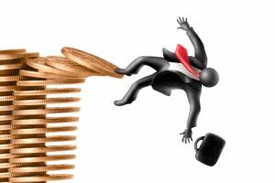
The 911 Financial Crash
Of 2008

Slide 3
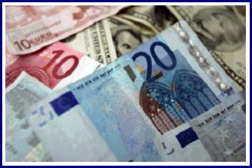
The 911 Financial Crash
The precursor to the 2008 911 crash which occurred nearly one year earlier on 14th September 2007 was
The Northern Rock

Slide 4
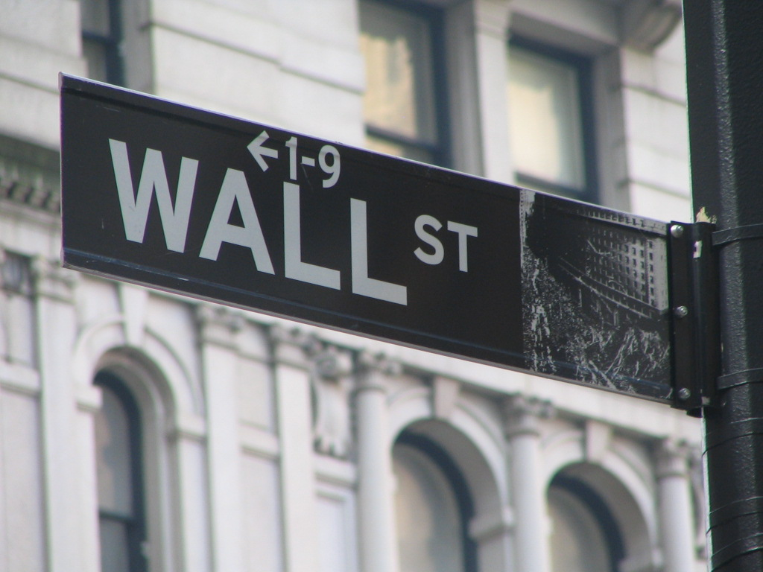
The 911 Financial Crash
This would trigger a full blown crisis culminating with a run on Wall Street and the banks on the 11th September 2008

Slide 5
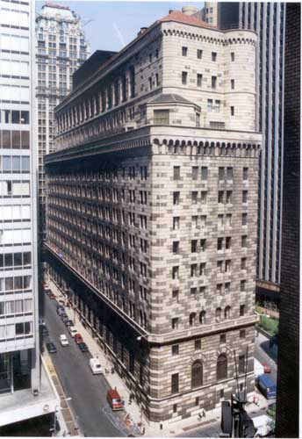
The 911 Financial Crash
The run on securities through the Wall Street exchange, New York, would reverberate through the Federal Reserve (a branch of the Bank of England) to shake an already shaky institution.
Federal Reserve Bank - NY

Slide 6
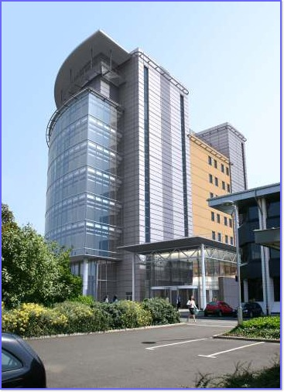
The 911 Financial Crash
Interestingly, the Newcastle headquarters of the Northern Rock at Gosforth is know as the tower – it was the twin towers in New York that were the subject of the last 911 attack – in fact if one looks carefully one can see that the “tower” is also 2 towers joined in the middle to form one building
Northern Rock Headquarters
Notes:
On 14 September 2007, during the financial crisis of 2007–2009, the Bank sought and received a liquidity support facility from the Bank of England,^{[11]} following problems in the credit markets caused by the US subprime mortgage financial crisis.
At 00:01 on 22 February 2008 the bank was taken into state ownership (see the Nationalisation of Northern Rock). The nationalisation was a result of two unsuccessful bids to take over the bank, neither being able to fully commit to repayment of taxpayers' money.^{[12]} The government-appointed Chairman Ron Sandler assumed the position on 18 February.^{[13]}
Northern Rock has recently completed the redevelopment of the Gosforth site, Northern Rock House, which saw the demolition of the original 1960s tower block during Spring 2006. A new tower block, simply known as The Tower,^{[20]} was completed in November 2008, originally intended to create 1500 jobs, and act as the main entrance and focal point of the company headquarters.^{[21]} This will now also likely be sold or leased as the additional space has become surplus to requirements.^{[22]}

Slide 7
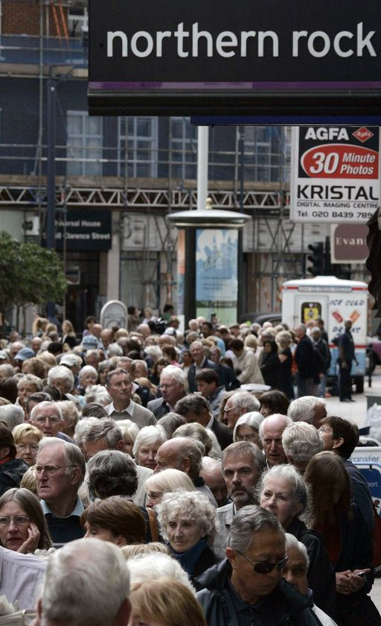
The 911 Financial Crash
Upon news of the Northern Rock’s precarious position, long queues of panicked account holders formed outside of the bank’s various branches hoping to be able to withdraw their money.
Notes:
15/09/07 18:51 Filed in
Address: Northern Rock House Gosforth Newcastle upon Tyne NE3 4PL England Telephone: (44) 0191 285 7191
Former building society Northern Rock plc is one of the United Kingdom's largest retail banks, and the largest financial institution in the UK

Slide 8
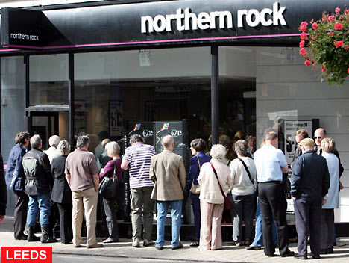
The 911 Financial Crash
Many worried customers would have phoned the head office whose Tel. No. is 0191 285 7191

Slide 9
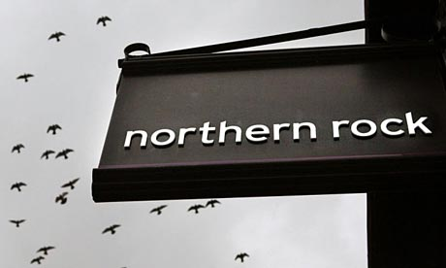
The 911 Financial Crash
The embedded 2 911’s in the Northern Rock telephone number implies that the Illuminati had pre-planned the demise of the Northern Rock for a long time prior to the event!
0191 285 7191

Slide 10
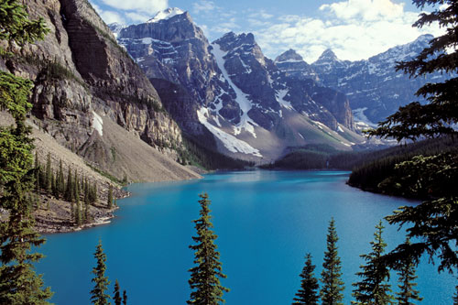
The 911 Financial Crash
The name Northern Rock is symbolic for God’s (Yahweh’s) people who reside in the north and rock symbolic of his Son – Christ the Rock which
would destroy Babylon as we read in Psalm 48:2: Beautiful for situation, the joy of the whole earth, is mount Zion, on the sides of the north, the city of the great King.

Slide 11
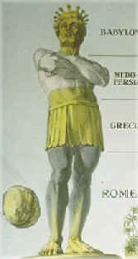
The 911 Financial Crash
It is therefore highly significant that the Northern Rock was the first to fall, just like the last 911 the north tower was hit first – symbolising war against Yahweh and His people who mainly reside in the north, so the Northern Rock debacle made a mockery of the foretold Rock that would destroy the Babylonian system.

Slide 12
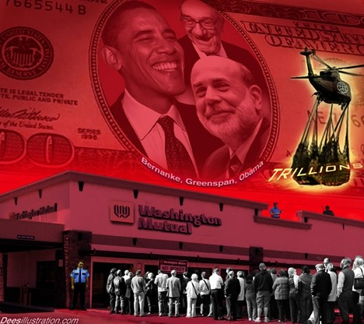
The 911 Financial Crash
Following the demise of the Northern Rock, a new institutional fraud was being reported almost daily, particularly in the UK and USA

Slide 13
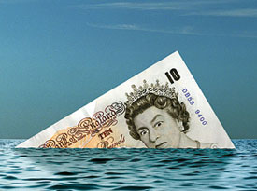
The 911 Financial Crash
The following cartoons say it all!

Slide 14
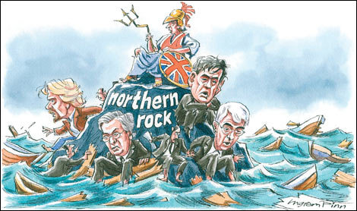
The 911 Financial Crash

Slide 15
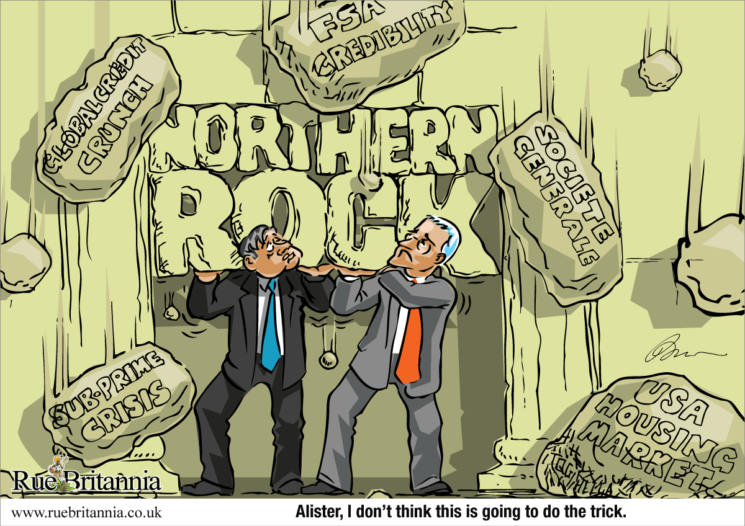

Slide 16
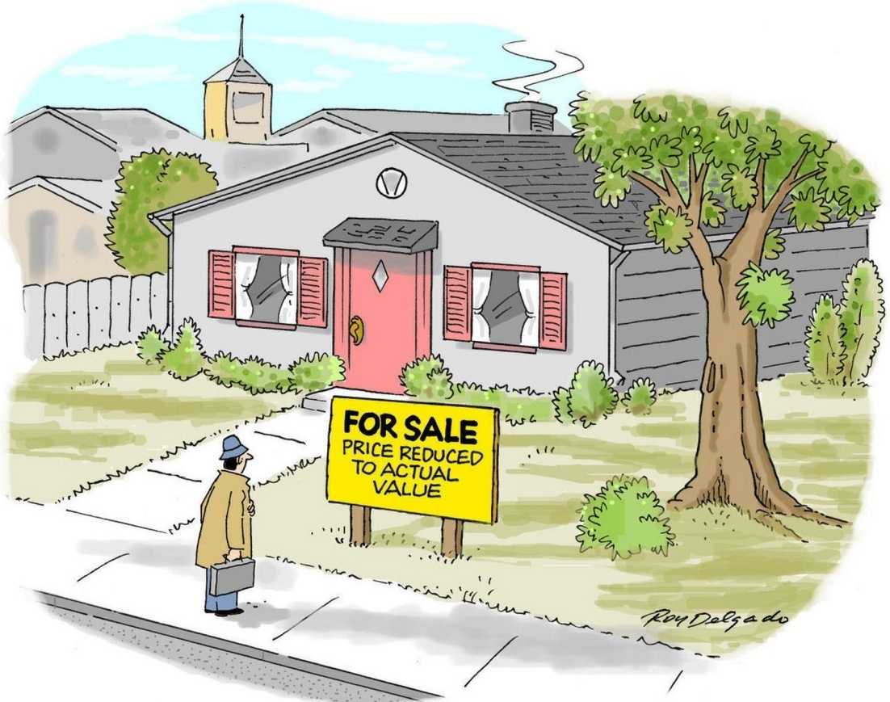
Financial Crash 9/11 2008

Slide 17
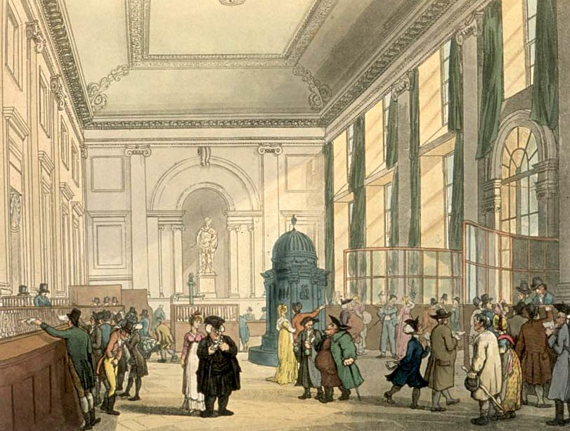
The 911 Financial Crash
The interior of the Bank of England (Global headquarters of Gog’s financial system) from where the worldwide financial collapse was planned.
Notes:
In an admission stunning for its frankness (and particularly given the fact it originated with a politician whose country is held prisoner by foreign, criminal interests) Rep. Paul Kanjorski, (D, Penn) Chairman of the House’s Capitol Markets Subcommittee recently admitted on C-SPAN that the current economic problems faced by–not just the United States, but indeed the entire world–were the result of an "electronic run on the bank" that resulted in the hemorrhaging of $550 billion dollars in just "an hour or 2".
Speaking the last week of January on the Washington DC-based television program, Rep. Kanjorski was verbally accosted by an irate American caller charging that the economic stimulus package currently up for debate in the Congress (as well as the previous $700 billion bank-bailout) is solely for the benefit of fat cats on Wall Street rather than for Joe Six-pack on Mainstreet. With barely-concealed panic in his voice, the Congressman tried explaining the severity of the current financial problem faced by the US with the following comments–
"Why did we do that? We did that because…Look, I was there when the Secretary of the Treasury and Chairman of the Federal Reserve came and talked with members of Congress about what was going on, it was about September the 15th…Here’s the facts and we don’t even talk about these things…"
"On Thursday at about 11 am the Federal Reserve noticed a tremendous drawdown of money market accounts in the United States to the tune of 550 billion dollars, being drawn out in the matter of about an hour or 2. The Treasury opened up its window to help, pumped 105 billion dollars in the system and quickly realized they could not stem the tide…We were having an electronic run on the banks. They decided to close the operation, close down the money accounts and announce a guarantee of $250,000 per account so there wouldn’t be further panic out there. If they had not done this, their estimation was that by 2 o’clock that afternoon, 5.5 trillion dollars would have been drawn out of the money market system of the United States, would have collapsed the entire economy of the United States, and within 24 hours the world economy would have collapsed…"
"We talked about what would happen–it would have been the end of our economic and political system as we know it, and that’s why we had to act and do things quickly. Why? Because if you don’t have a banking system you don’t have an economy, and although we did that it wasn’t enough. The economy has been falling and we’re really no better off today than we were 3 months ago, as other assets are going sour by the moment…Somebody threw us in the middle of the Atlantic ocean without a life raft and we’re trying to determine which is the closest shore and whether there’s any chance in the world to swim that far. We don’t know…"
Put in less "gentle" terms, the 2-hour/half-a trillion dollar/$4.6 billion-per-minute event Kanjorski described was the equivalent of having a major economic artery "Jack-the-Rippered" in a way that threatened the very existence of not only the US but the entire world whose economies and political stability are intrinsically tied to the monetary good mood of the land of the free and home of the brave. According to some of the economic experts interviewed for this piece (who insisted upon anonymity, due to the "sensitive" nature of the topic) it is one of the largest–if not THE largest–singular transfer of money in history in such a short time frame. Furthermore, the general consensus of those interviewed is that had the bloodletting been permitted to run its course–meaning the evaporation of 5.5 trillion dollars–it would have resulted in the elimination of 90% of America’s liquidity (again the "blood" that keeps the economic body alive) in the span of just 5 hours.
In a word, ‘unprecedented’…
Based upon the unnerving words of the Congressman in this very short television exchange, what is known is as follows–
First, that the potentially-apocalyptic events leading up to the bailout of America’s banks are not "talked about", something to remember when President Obama or his monetary magicians are promising "this and that" with regards to curing America’s economic ills. By the very words of Rep. Paul "Vallachi" Kanjorski, a "code of silence" exists amongst the ‘made members’ of the political and financial elite preventing them from telling the truth, the whole truth and nothin’ but the truth, so help them ‘G-d’. The fact that it took close to 5 months for this information concerning a deliberate run on the banks to be made public is proof positive that the Captain and crew of the Titanic have decided to allow the passengers to go about their lives unencumbered while they try and find a way to "deal with" the current situation.
Second, that on September 15, Treasury Secretary Paulson and Chairman of the Federal Reserve Ben Shalom Bernanke testified before Congress that on the previous Thursday, September 11th, an "electronic run" on the US banking system took place between the hours of 9 and 11 am…That had stop-gaps not been executed, by 2 pm that afternoon (again, on September 11th) the hemorrhaging of "5.5 trillion dollars" would have taken place, resulting in the collapse of not only "the entire economy" of the United States but as well of the world within just "24 hours," leading to "the end of our economic and political system as we know it".
And, last but not least, eliminating the possibility that the event was all part of some fluke or "market correction", the honorable Congressman (who one day will doubtless dearly regret his recent "honesty" with the American people on C-SPAN that morning) ended his comments by saying "someone" was responsible for the slashing of that financial jugular that nearly bled America to death, as well as indicating the worries on the part of the power elite in Washington DC as to whether or not at the end of the day America will survive it, despite the unprecedented transfusions she is currently receiving.
Of the many things in Kanjorski’s comments sticking out like the proverbial whore-in-a-red-dress-at-a-1st-communion-ceremony, obviously the most prominent is the date on which the hemorrhaging is said to have taken place, none other than on September 11th, the same date America’s financial headquarters (and by extension, the financial headquarters of the world) were attacked 7 years earlier and the starting gun as it were for the current "war on terror" benefiting a certain ethno-theocratic state in the Middle East. The other thing equally important (and yet hiding in plain sight) is the time frame this monetary hemorrhaging is said to have taken place–between 9 and 11 am, which also coincides closely with the time frame of the terror attacks of September 11, 2001, with the first tower being struck by an airliner shortly before 9 am and the 2nd tower collapsing at roughly 10:30 am.
Realizing in an instant the immense implications in all of this, some of the "see no evil/hear no evil/speak no evil" variety of today’s "freedom-lovin’ ‘merkins" will doubtless prefer to put their landing gear down on "terra firma" in this case, maintaining that the economic crisis faced both by the US and the world is all the result of "market corrections" no more sinister in their nature than a person sneezing when catching a cold.
However, other persons (and particularly those who note the hundreds of "odd" items dealing with 9/11, including but not limited to the arrest of hundreds of Israeli intelligence operatives, some seen cheering as the Twin Towers were crumbling) will see with good reason that the current financial crisis–rather than being an "accident"–may very well be an act of sabotage on the part of certain interested parties who stand to benefit from it all, and that out of all the possible players most likely to pull off an "economic 9/11" such as this–it is none other than Israel that may have done the dirty deed in order to maneuver the US into fighting those deemed "enemies of the Jewish state".
The idea that Israel would do such a thing–whether it be the terror attacks on 9/11/2001 or the financial attacks on 9/11/2008–should be no surprise to those even vaguely familiar with the Jewish state’s well-documented history of false flag attacks in creating certain pre-desired political outcomes. Besides the myriad of bombings, shootings and assassinations throughout the world engineered by Israel and then blamed on "Ahab the Arab" for the last 60+ years, there are events such as her deliberate attack on the USS Liberty June 8, 1967 resulting in the deaths of 34 American servicemen, the Lavon affair and many, many others proving that Israel is more than ready, willing and able to dirty her hands in the dirtiest business imaginable. Anyone still doubting this should sit down and talk with the 5 Mossad agents arrested on 9/11 as they cheered the destruction of the Twin Towers with congratulatory "high-fives", an event they later said on Israeli TV they were sent "to document" after being released by then-Justice Department Official Michael Chertoff.
It is on the basis of these and many more similar instances of blatant terrorism and acts of war against the people of the United States that sane, rational persons can dismiss then the idea that Israel is "incapable" of doing such things as causing total economic meltdown to her bestest buddy in the whole wide world, America. A leopard does not change its spots, and what a criminal has done once he can (and will) do again.
Besides, what must be remembered is that–religiously speaking–doing such a thing can hardly be considered immoral within the Judaism’s "code of ethics" as it is something celebrated annually during the feast of Passover when Jews worldwide recount with great nostalgia how their forefathers looted Egypt of all its gold and silver before high-tailing it to the new "promised land" with Pharaoh and his army in hot pursuit.
When considering the recent remarks of Rep. Kanjorski what must also be kept in mind is the fact that NOTHING has been said in the almost 5 months following this bloodletting as pertains the highly-relevant date and time frame the aforementioned "run on the banks" took place. In a day and age when everything from bad breath to unwanted facial hair is being blamed on Muslim terrorists, where carefully-placed, fifth column agents working throughout Western media loyal to Israel never miss an opportunity in propagandizing Americans into throwing their support behind the current "clash of civilizations" between the Christian West and Muslim Middle East, the fact that a Zionist-dominated media has made NO MENTION of the "coincidental" nature of this date is striking to say the least.
However, one thing mentioned (and quite prominently, by the way) is how the most "persecuted and misunderstood people in history"–the Jews–have suffered as a result of the current crisis, first in the form of all the "old canards" concerning their involvement in banking being resurrected and secondly, the Bernard Madoff affair.
Within days of the now-infamous 9/11 run on the banks, Israel’s domestic branch of the Mossad–the ADL–was feverishly at work doing what it does best–spying on what people say about Jews and doing everything in its power to muddy the waters of current events by twisting facts and figures. Seemingly every other day a new "poll" was commissioned by the spy agency, citing Gentile suspicion that the current financial mess indeed was not part of some accident but rather by design and that those responsible were Jews, how "unfair and unjust" it all was, and, more importantly, how ridiculous and baseless such suspicions were, despite the fact that the western banking system is dominated by a handful of Jewish families with names such as Rothschild, Kuhn Loeb, Mendelsohn, etc, etc, etc.
What is particularly interesting about the ADL getting involved in this situation at the onset is that this is EXACTLY what it did following 9/11 with regards to the various stories (some actually making their way to mainstream news sources) dealing with Israeli foreknowledge of that day’s events. Not only did the spy agency attempt to shout down any discussion of the HUNDREDS of Israeli spies arrested before, during, and after 9/11 (and again, some in circumstances as incriminating as conveniently being at a locale where they had a bird’s eye view of the destruction and cheering) but as well personally visited news headquarters and warned them to stop reporting on Israeli involvement in 9/11, ADL’s "capo-di-tutti capi" Abe Foxman’s words being "What are you doing putting this stuff out there? You’re killing us".
Given that the ADL’s "typical" magic did not work with regards to throwing Americans off track regarding the current financial collapse and the "who dunnit" of it all, Israel then needed something more potent, a stronger anesthetic that would confuse and disorient Americans and dull their sense of smell with regards to all those "old canards" involving Jews and money.
Enter one Bernie Madoff, the financial swindler who literally went from being a nobody’s nobody to OVERNIGHT being more familiar to the average American than Osama Bin Laden himself. Like a bomb going off in the middle of rush hour in Manhattan, suddenly the economic downturn that was a Gentiles-only club now claimed all sorts of new, important victims whose tale of financial woe every soul in America learned about 24/7, and all of them Jewish. Eli Wiesel’s organization, synagogues, yeshivas, charities, all of them suddenly became victims as well, thus throwing water on all those "anti-Semitic" fires and conspiracy theories involving Jews and the current financial meltdown that, at least according to Rep. Kanjorski, began the morning of September 11, 2008. Therefore the stories dealing with Jewish losses as a result of the Madoff affair should be seen as being no different in their use as a diversionary tactic than all the stories that "popped up" dealing with "anti-Semitic hate crimes" taking place in the aftermath of Israel’s holocaust on Gaza in December/January .
What can be inferred about this then is that the recent "economic 9/11" taking place 5 months back was in effect much like other false flag attacks engineered by the Jewish state that went awry, and Israel thus was forced to backtrack into the shadows lest too much attention be paid to her involvement. Recall that in June 1967 the Jewish state "accidentally" attacked a US ship for 2 hours–the USS Liberty–"accidentally" hitting it with 1,000 rockets, tens of thousands of armor-piercing rounds, hundreds of gallons of napalm and 5 torpedoes. Unable to sink her but understanding as well that dead men tell no tales, she then "accidentally" sent a team of machine gun-wielding commandos by helicopter, assassins whose job was to board the ship and kill everyone on board. As the helo hovered above the deck at a distance of barely 12 feet for a minute, Israeli headquarters intercepted an American radio transmission indicating fighter jets were on the way, at which point the flying assassin transport scurried off and Israel donned her most embarrassed, regretful face and said the entire "accidental" attack (lasting as long as the attack on Pearl Harbor) was all a "big mistake". Had things gone as planned and the Liberty sunk as intended, Egypt would have been blamed, and America would have been drawn into the Middle East in exactly the way as took place immediately following 9/11.
It should be recalled that within minutes of the attacks in New York and DC 7 years ago Big Brutha knew EXACTLY and without question that it was none other than Osama Bin Laden and his band of swarthy, Islamo-fascist thugs who carried it out, and with evidence as flimsy as Mohammed Atta’s paper-and-plastic passport that somehow survived the same heat said to be responsible for melting the steel beams that brought down the Twin Towers. And yet, the fact that 5 months after Jack the Ripper slashed the financial throat of America, leaving a gash that has yet to be contained and as of this moment no one is saying a word about the culprit or culprits involved in this recent bloodletting of American wealth speaks volumes, and particularly in a day and age when computers can detect and track down a micro-penny discrepancy tens of thousands of miles away and within seconds.
If there is any player with such capabilities in bringing about such an act of economic sabotage on the American financial system such as occurred on 9/11/2008, it is Israel. Besides the fact that she is the world leader in not only computer technology but as well computer theft, it is also no theory that the economies of America and the entire western world are not dominated by Muslims, Buddhists, Hindus, Druids or any other group, but rather by Jews whose loyalty to their Old Testament-created state takes precedence over anything and everything else in 99 cases out of 100.
Secondly, it is no secret the Jewish state wants certain nations in the Middle East attacked by the US–and not today or tomorrow, but yesterday–Iran obviously being at the top of that list. It is also no secret that for reasons known or unknown the US is not as enthusiastic about such a prospect as she was about attacking Iraq in 2003. Recall that Israel all but busted a vein in her head when the National Intelligence Estimate stated unequivocally in December 2007 that Iran had no nuclear weapons program, which by extension means no US attack on Iran. Since that momentous day, when all appeared lost in getting America to smite Judea’s ancient Persian enemies, it has been a daily spectacle of threats and bluster on the part of the Jewish state. Israeli Defense Minister Ehud Barack recently threatened in coded words that an American east coast city would be devastated by a nuclear weapon if Iran was not stopped, while other media outlets in Israel have predicted a whole smorgasbord of unfortunate events befalling the US, including an American version of the recent Mumbai terrorist attacks in India. So convinced were certain elements within the American power structure of an imminent false flag operation by Israel that persons no less in stature than Chairman of the Joint Chiefs Admiral Mullen personally cut short his trip to Europe in the summer of 2008 to go to Tel Aviv and tell his counterpart Gabi Ashkenazi how vital it was that no "USS Liberty Pt II" takes place.
The idea that America was not warned that an event as apocalyptic as her economy going down in flames was in the making is not accurate. During George Bush’s recent visit to Israel in May 2008 to help celebrate 60 uninterrupted years of good, old-fashioned/Old Testament-type butchery and oppression against the non-Jewish peoples of the Holy Land (Christian and Muslim alike) he was met by rabbis closely-associated with ultra-violent elements of the Israeli right (as opposed to the moderately-violent of the Israeli left) who presented him with a list of demands. The commandments, collectively called ‘Megillat Bush’ and written on a specially-made scroll as if scribed personally by some Old Testament prophet were of the typically haughty, pushy, demanding, threatening, obnoxious and condescending tones universally-known to be part of the Jewish state’s character. The document–in effect a diplomatic message from Israel to America–threatened (again, in coded language) that "God ordained that the role of the nations of the world is to strengthen the nation of Israel" and that if America did not go through with vanquishing Israel’s enemies (namely Iran, Pakistan, Saudi Arabia, Syria, Egypt, and Lebanon) that "certain doom" would result, endangering "all life on earth". The mafia-esque diatribe ended ominously with "Your fate and that of all those with you hangs in the balance of the destiny of our land…’
In sum, the logical explanation as to what took place now resulting in the economic freefall in America and elsewhere is that–much like what took place on 9/11/2001, Israel and her network of assets and intelligence agents working in the American financial infrastructure coordinated an attack on the US banking system on the morning of September 11th, 2008 between the hours of 9 and 11 am for the purpose of destroying the US economy and throwing the world into chaos as a prelude to blaming it on Al Qaeda or some other affiliated organization. The results would have been all-too predicatable–fathers responsible for feeding their families would get calls on Sept 12, telling them not to come to work. Within less than a week, the system would be paralyzed as a result of being bled of its cash, martial law would be declared (exactly as Rep. Brad Sherman, Democrat from California stated on the floor of the House of Representatives recently) Ahab the Arab would get the blame and Israel would get the war she demands.
The fact that the attack was stopped and did not achieve the full intended effect, along with likely warnings to the Jewish state from US intelligence and law enforcement agencies who knew where the money went and what was afoot is the likely reason why for the last 5 months the Zionist media has been as quiet as death and why there has been no blaming of "Islamists" or any other group.
In the meantime, the US is scrambling to get the severed artery and accompanying bleeding under control before it reaches the point of no return, if indeed it has not already.
And while all this takes place, thousands of miles away, Israel sits, stewing as she sees her plans fall apart yet again, inching an itchy, apocalyptic finger towards the "button" in what she considers to be "the final solution" to the problem of "anti-Semitism" in the world Yahweh gave to the Jewish people and to them alone–the Samson Option and accompanying nuclear destruction of all creation. (c) 2009
Mark Glenn, Correspondent, American Free Press Newspaper

Slide 18
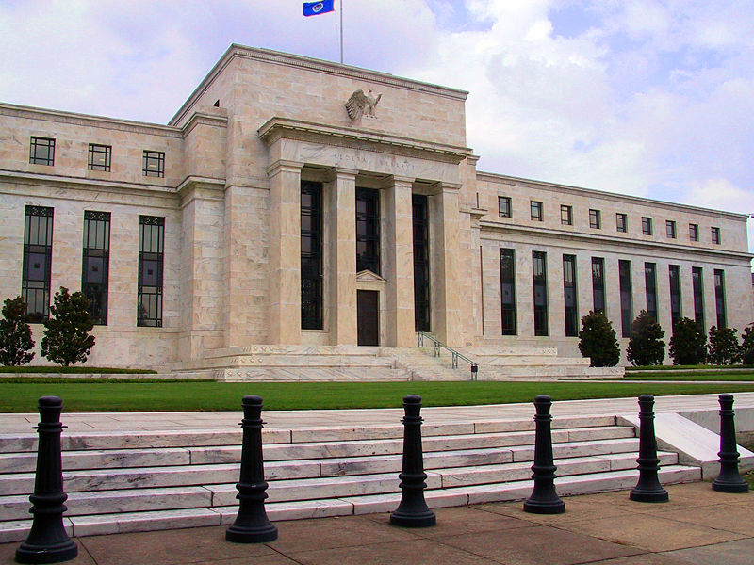
The 911 Financial Crash
The Federal Reserve
On September 15, 2008, Treasury Secretary Paulson and Chairman of the Federal Reserve Ben Shalom Bernanke testified before Congress ….

Slide 19
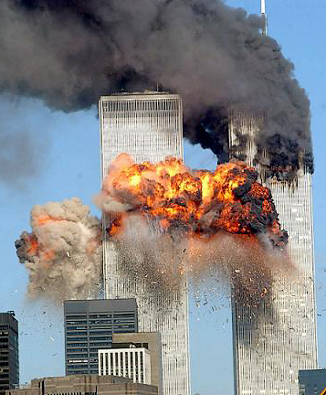
The 911 Financial Crash
…. that on the previous Thursday, September 11th, an "electronic run" on the US banking system took place between the hours of 9 and 11 am

Slide 20
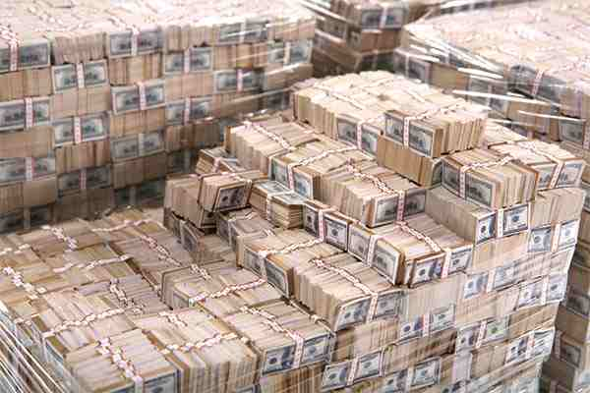
The 911 Financial Crash
The current economic problems faced by – not just the United States and the UK, but indeed the entire world–were the result of an "electronic run on the bank" that resulted in the hemorrhaging of $550 billion dollars in just "an hour or 2”

Slide 21
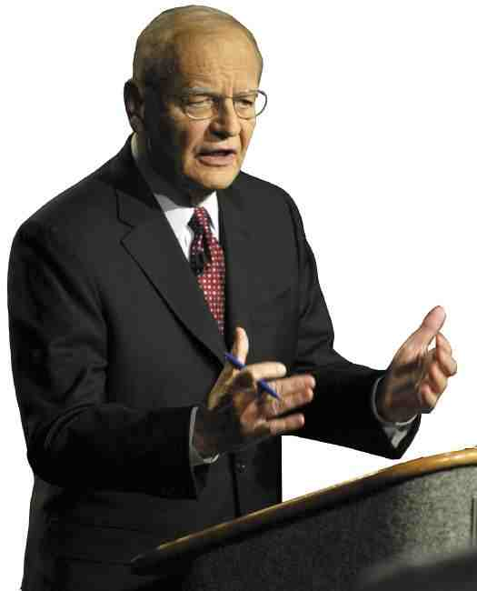
The 911 Financial Crash
Put in less "gentle" terms, the 2-hour/half-a trillion dollar/$4.6 billion-per-minute event described was the equivalent of having a major economic artery "Jack-the-Rippered" in a way that threatened the very existence of not only the US but the entire world.

Slide 22
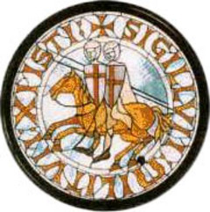
The 911 Financial Crash
A Reminder Of The Importance Of The Number 911
The number 911 is important because this relates to when the Knights Templar were formed. When disbanded they carried on to this day
secretly as the Illuminati, operating through other secret societies such as the Masons. These societies were used by Gog to gain world control.

Slide 23
The 911 Financial Crash
The Templars banded togethger in 1111 and were recognized at Clermont in 1118. 1+1+1+8= 11. The authors of Holy Blood Holy Grail provided the definitive evidence that there were 9 original founding Templars

Slide 24
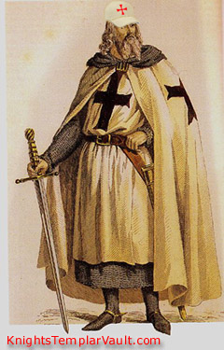
The 911 Financial Crash
They first banded together in 1111 and taking no new members for 9 years. This then was the numerical basis for the 911's in many tragedies.

Slide 25
The 911 Financial Crash
The Knights Templar order was Officially founded in 1118 by the Burgundian knight Yves de Faillon, with the aim of protecting pilgrims traveling to the Holy Places. The order's official name, the "Poor Knights of Christ and of the Temple of Solomon,”
Notes:
The order was founded in 1118 by the Burgundian knight Yves de Faillon, with the aim of protecting pilgrims traveling to the Holy Places. The order's official name, the "Poor Knights of Christ and of the Temple of Solomon," comes from their place of residence - on the Temple Mount, where its members took over the el-Aqsa Mosque, known as the "Temple of Solomon" by the Crusaders.
The Templars enlarged the el-Aqsa Mosque to the west, building a refectory with three long halls there. In addition, they built partitions to divide up the mosque's prayer hall into cells. They used the vaults supporting the Temple Mount structures as stables, as described by John of Wurtzburg (1160-1170): "When you descend to the main street, there is a great gate through which one may enter the great courtyard of the Temple. On the right side, toward the south, is the palace which they say that Solomon built. Within it are stables, so huge that they can hold more than two thousand horses or 1,500 camels, and near this palace the Templar knights have many great houses and there are also the foundations of a great new church which is not yet finished. This order has enormous property and endless revenues in this region and in other places. This allows them to give alms to the poor, though not as a tithe, as the Hospitallers do. The order also has many knights for the defense of the land of the Christians."

Slide 26
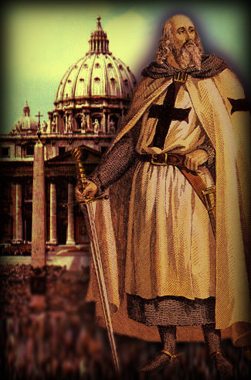
The 911 Financial Crash
… comes from their place of residence - on the Temple Mount, where its members took over the el-Aqsa Mosque, known as the "Temple of Solomon" by the Crusaders.
Notes:
The order was founded in 1118 by the Burgundian knight Yves de Faillon, with the aim of protecting pilgrims traveling to the Holy Places. The order's official name, the "Poor Knights of Christ and of the Temple of Solomon," comes from their place of residence - on the Temple Mount, where its members took over the el-Aqsa Mosque, known as the "Temple of Solomon" by the Crusaders.
The Templars enlarged the el-Aqsa Mosque to the west, building a refectory with three long halls there. In addition, they built partitions to divide up the mosque's prayer hall into cells. They used the vaults supporting the Temple Mount structures as stables, as described by John of Wurtzburg (1160-1170): "When you descend to the main street, there is a great gate through which one may enter the great courtyard of the Temple. On the right side, toward the south, is the palace which they say that Solomon built. Within it are stables, so huge that they can hold more than two thousand horses or 1,500 camels, and near this palace the Templar knights have many great houses and there are also the foundations of a great new church which is not yet finished. This order has enormous property and endless revenues in this region and in other places. This allows them to give alms to the poor, though not as a tithe, as the Hospitallers do. The order also has many knights for the defense of the land of the Christians."

Slide 27
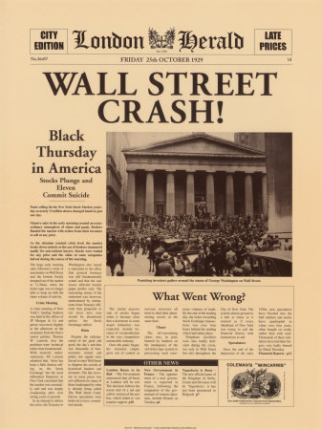
Financial Crash 9/11 2008
Its not surprising that 911 is associated with the latest financial crisis as the Knights Templar were very involved in banking. The King of France, who with the Pope’s help had their leader burnt at the stake for financial chicanery and the order was then subsequently proscribed.

Slide 28
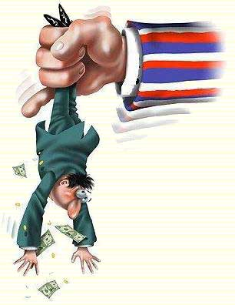
Financial Crash 9/11 2008
The restriction of credit is one of the means by which Gog takes a great spoil by taking back securities (real assets) through foreclosure. However this time it is on a global scale!

Slide 29
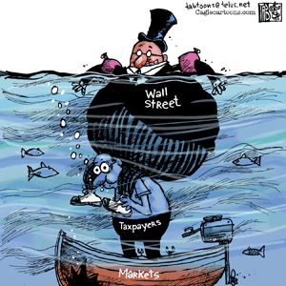
The 911 Financial Crash
Gog has manipulated the financial markets to the disadvantage of the small investor.

Slide 30
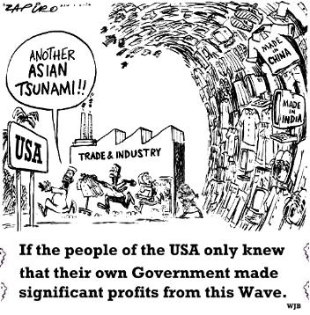

Slide 31
Gordon Brown addressing Congress on the global finanial crisis standing very appropriately between two snakes

Slide 32
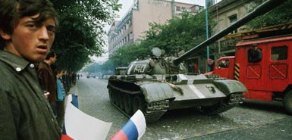
The 911 Financial Crash
The Objective of destabilising society is so as to have an excuse to declare martial law and bring tanks and even foreign armies onto the streets just as they did in 1968 In Prague, Checkcoslovakia.

Slide 33
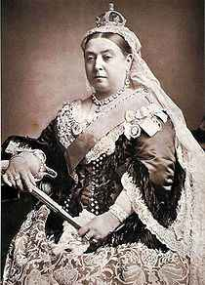
The 911 Financial Crash
The UK became Bankrupt in 1869, evidenced by the “Bankruptcy Act of 1869” and now located and understood, we are in fact in the equivalent to a (Chapter 11) Bankruptcy which is “Debtors in Possession”. 11 being the Illuminati signature, which tells us just who is in possession!
Queen Victoria 20 June 1837 – 22 January 1901

Slide 34
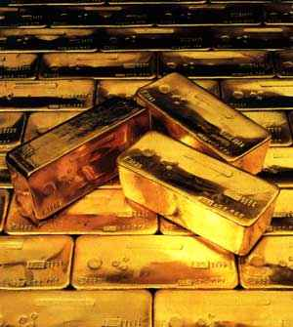
The 911 Financial Crash
The bankrupt state of the UK is confirmed by the Amendment to the “Gold Standards Act 1925” better known as Bill 227 or 277, if “Hansards” have it correct. This dissolved the connection to Gold in our currency when the bill was finally passed on the 21st of September 1931,

Slide 35
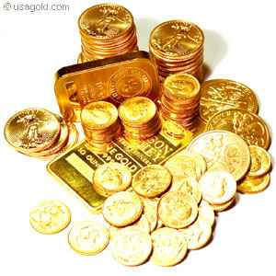
The 911 Financial Crash
The Gold Standard Bill 227 again has the signature of Gog upon it – 2+2+7=11. The Bill was finally passed on the 21st September 1931. Again we have the 911 factor – Bill passed 10 days after 911 = the 10 Horns (Israel). 911 is also embedded in the date 1931. Also we have the 12 tribes trapped in the centre of Gog 3+9=12 i.e. 11 - 1931

Slide 36
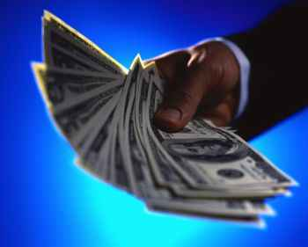
The 911 Financial Crash
Following Bankruptcy our fiat currency came into being – promissory notes that in fact promise nothing of substance.

Slide 37
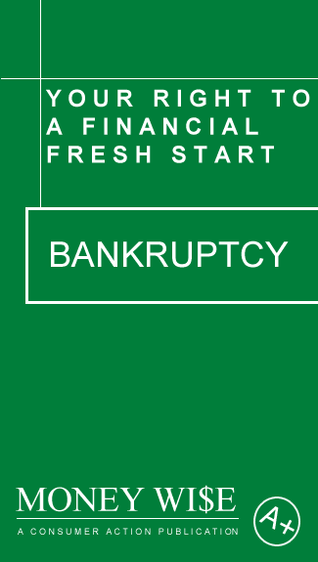
The 911 Financial Crash
The fiat currency is backed by the tax or labour of the citizens, furthermore to back up the Bankruptcy claim there is “double entry bookkeeping” which is just a claim and counter claim balancing exercise.

Slide 38
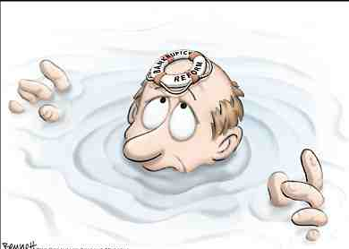
The 911 Financial Crash
Bankruptcy is deemed to last no longer than a lifetime (3 score years and 10) WHAT YEAR ARE WE IN? HOW MANY YEARS HAVE PAST SINCE 1869 + 70 = 1939 + 70 =????

Slide 39
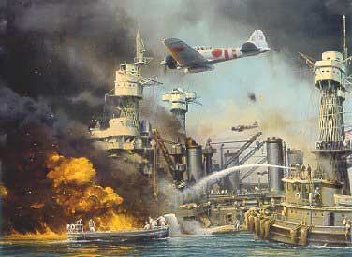
The 911 Financial Crash
World War 2 Occurred at the start of the 2nd Bankruptcy period – Interestingly we remember the slain on the 11th day of the 11th month at 11am – The number of Gog.

Slide 40
Gog Uses Drugs To Subdue
It is no coincidence that the poppy is used to represent the fallen of the last 2 world wars

Slide 41
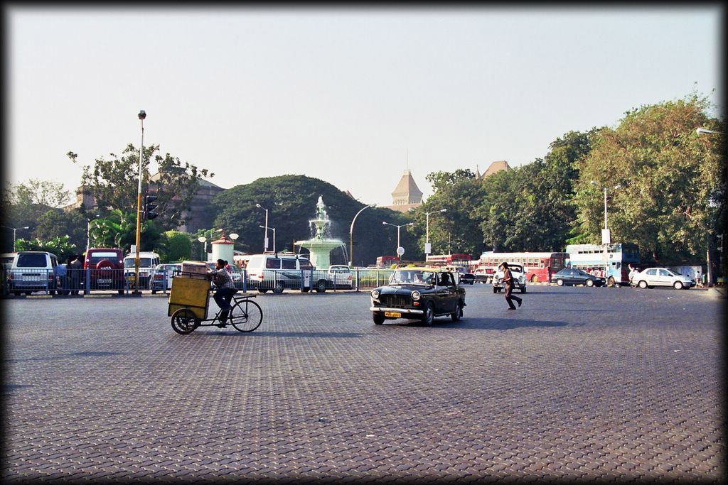
Sassoon - Jewish
It is interesting to note that the Jews of Bombay in India controlled the drug trade and especially the Chinese opium trade, their chiefs took the name Sassoon which was no doubt taken from the pagan Sassonades who ruled Persia

Slide 42
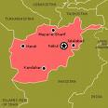
Gog Uses Drugs To Subdue
One of the reasons for the war in Afghanistan was to safeguard the opium trade after the Taliban refused to supply after big pharmacy declined to give them an increase of price. Opium is the basis for many medical drugs as well as street drugs. A small amount of opium is added to tobacco to keep users “hooked”.

Slide 43
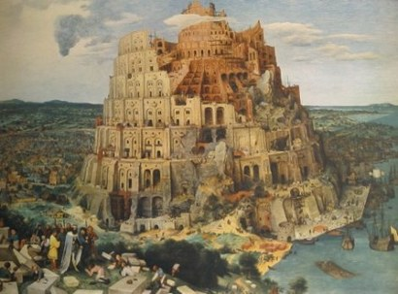
The 911 Financial Crash
The Twin Towers of 911, the Northern Rock’s 2 Towers, 2 periods of Bankruptcy are pointing to the soon to come 2nd fall of Mystery Babylon.

Slide 44
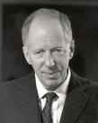
The 911 Financial Crash
The rise and fall of the Babylonian system centred in London was foretold by Christ and that it would all be controlled by one man – Lord Rothschild

Slide 45
Parable Of The Rich Man
Mark 10:25 - It is easier for a camel to go through the eye of a needle than a rich man to enter into the Kingdom of God

Slide 46
Parable Of The Rich Man
The Lord in referring to it being easier for a camel to go through an eye of a needle than a rich man to gain entry into the Kingdom of Heaven was prophesying the rise of the Rothschilds (rich man) and the Bank of England in Threadneedle Street.

Slide 47
Parable Of The Rich Man
As we already have seen how that the Bank of England through secret negotiations in a church (London Temple) was set up and whose tentacles would control most of the world’s currencies. Those who are not controlled such as Libya, Syria, Iran and North Korea, were deemed the axis of evil
The Lord in turning out the money changers from the temple was foretelling that on his return the money changers at the Bank of England in Threadneedle Street would be removed – the needle in Threadneedle street would no longer be threaded!

Slide 48
Parable Of The Rich Man
Broad is the way that leadeth to destruction …. Here we see Old Broad Street that leads into Threadneedle Street – home to the Bank of England
Old Broad Street

Slide 49
Broad Is The Way That Leads To Destruction
Note Old Broad Street leads into Threadneedle Street

Slide 50
Broad Is The Way That Leads To Destruction
We saw earlier how the Temple Church was a replica of the Church in Jerusalem so this gives even more poignancy to the parable of the Rich Man and the money changers in the Temple
And of course Threadneedle Street leads to the Unholy Temple Church – The Church of The Knights Templar

Slide 51
Parable Of The Rich Man
Lord Rothschild
Note The Shield affixed to the Rothschild Mansion gates mimic the Royal Coat of Arms – Only a Rothschild could get away with this!!
The Bank of England rules the world and the Rothschilds rule the bank of England
The Rich Man

Slide 52
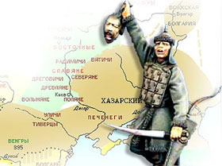
The 911 Financial Crash
This controlling financial power is in the hands of the Canaanite / Edomite Khazars masquerading as God’s chosen. This rise to power within true Israel was foretold using various symbols – One was the little horn.
A Khazar Warrior

Slide 53
Gog Is Identified as The Little Horn
It can be shown from the scriptures and numerical values that the little horn can be identified as the Jews and Khazar Jews in particular

Slide 54
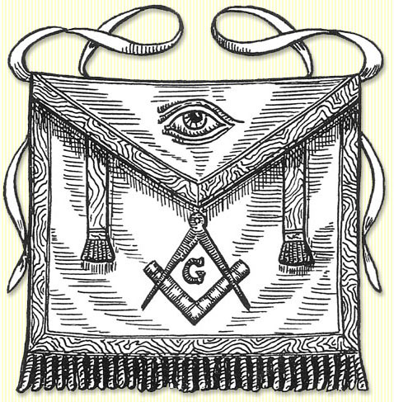
Khazar = Gog = The Little Horn
Daniel 7:8 I considered the horns, and, behold, there Came Up among them another little horn, before whom there were three of the first horns plucked up by the roots: and, behold, in this horn were eyes like the eyes of man, and a mouth speaking great things.
And Thou Shalt Come Up Against My People of Israel, As A Cloud To Cover The Land:
A Masonic Apron

Slide 55
Khazar = Gog = The Little Horn
Daniel 8:9 And out of one of them came forth a little horn, which waxed exceeding great, toward the south, and toward the east, and toward the pleasant land.
A Masonic Apron

Slide 56
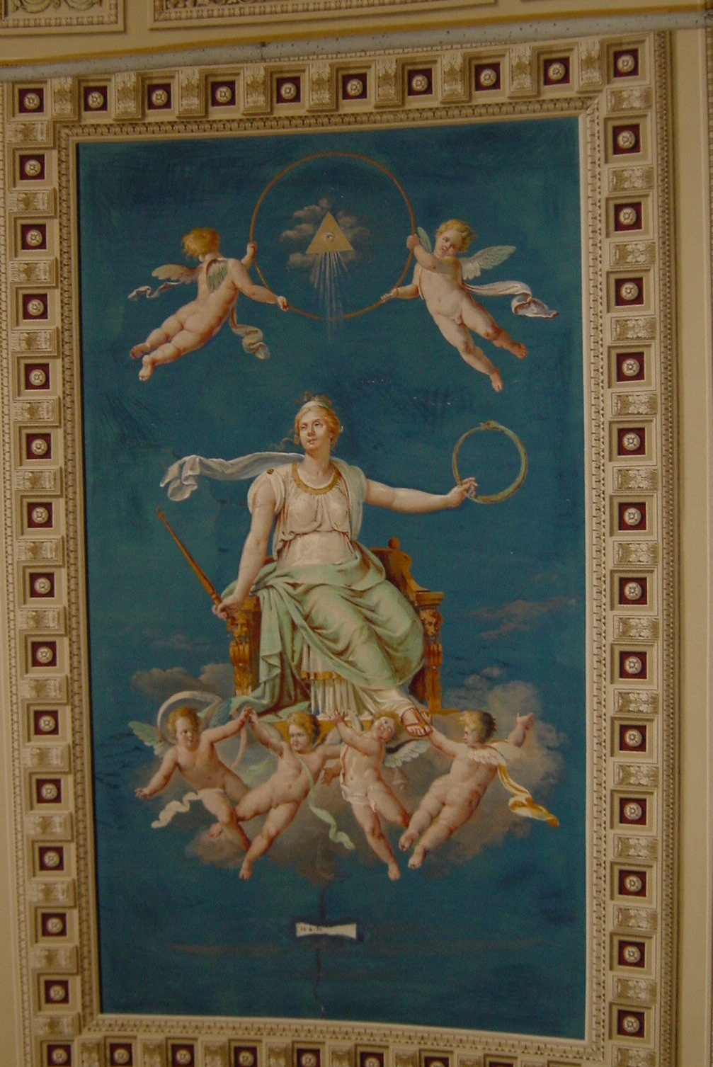
Khazar = Gog = The Little Horn
Tapestry in the Vatican with the all seeing eye
The Vatican is only part of the Little Horn, but is not the Little Horn as some commentators say nor the Pope. The Little Horn was a power (Jewish) like the other 10 horn sovereignties.
The all seeing eye shows that the Vatican was part of the “Little Horn Power”

Slide 57
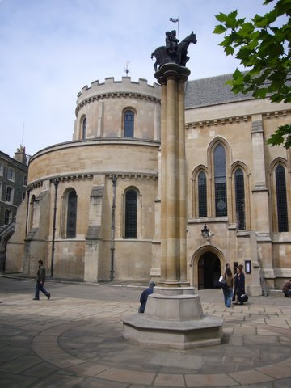
Khazar = Gog = The Little Horn
2 Thessalonians 2:4 Who opposeth and exalteth himself above all that is called God, or that is worshipped; so that he as God sitteth in the temple of God, shewing himself that he is God.
There is a double allegory here. Left we see the church modelled on the temple in Jerusalem and where the plot to set up a central bank was plotted that would eventually enslave the whole world.
The Temple – London & monument to the Knights Templar

Slide 58
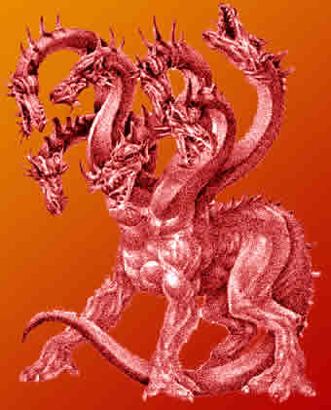
Khazar = Gog = The Little Horn
The presentation (Gog & Magog) will show that Gog has had a foothold in London since ancient times and was one of the control centres for the silk route.
The City of London is full of dragons, on the boundary posts and the coat of arms, even the Queen of England is not sovereign in the City of London.

Slide 59
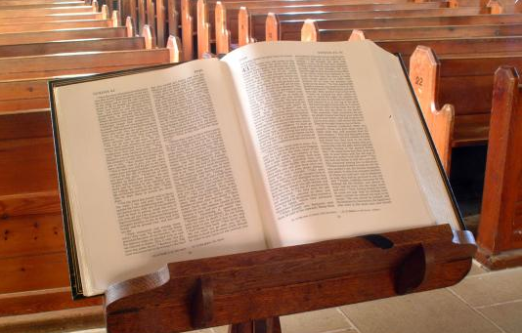
Khazar = Gog = The Little Horn
Notice the similarity of the 2 verses describing this power as coming up in the midst of the Israel nations. Christ said ye (Israel) are the Temple.
The scriptures also say that the Anti_Christ would be in the midst of the Temple (Israel). These references only occur once, but together they fulfil the requirement of being in the mouth of 2 or 3 witnesses!

Slide 60
Khazar = Gog = The Little Horn
The Little Horn has a numerical value of 11 because when the little horn came up amongst the 10 (Israel nations) although 3 were plucked up i.e. lost their sovereignty, there were
now 11 races (Israel + the Jewish Khazars), no longer the perfect government no of 10 (12). 11 making for instability, division and aggression – the addition of 1 to the perfect order.

Slide 61
The Numerology Of The Little Horn
On the basis of A = 1, B = 2 etc.
Khazar = 11 + 8 + 1 + 26 + 1 + 18 = 65 = 6 + 5 = 11
Gog = 7 + 15 + 7 = 29 = 2 + 9 = 11
Jew = 10 + 5 + 23 = 38 = 3 + 8 = 11
This gives us 33 (11+11+11) = The number of Masonic degrees!
One of the secret forces of Gog was the Illuminati and as we shall see was formed, or to be more correct, re-constituted, on a very significant date. The Illuminati would be at the centre of the octopus’s many tentacles that would entrap true Israel.

Slide 62
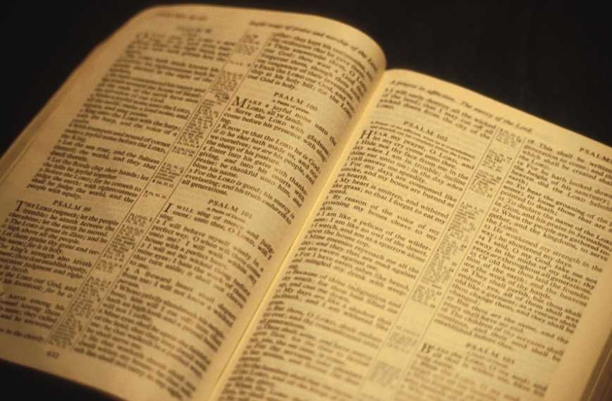
The Numerology Of The Little Horn
The word Gog is mentioned exactly 11 times in the Holy Scriptures

Slide 63
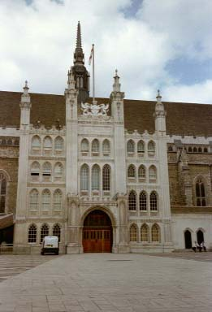
The Numerology Of The Little Horn
The ancient walled City of London covers an area of 677 acres which is the number of the beast (666) plus the number of Gog (11). Which is very appropriate as it is Gog’s headquarters in the administrative and premier capital of the Israel nations
London Guildhall guarded by 2 dragons!

Slide 64
Gog/Babylon - Destroyed
It is therefore appropriate that the leading Israelite tribe of the 10 horns should have its Prime Minister's residence at number ten Downing St.!

Slide 65
Gog/Babylon - Destroyed
It is equally appropriate that the “the great red dragon or the London money power” – that is Gog, whose number is 11, should be occupying 11 Downing Street and exercising control over the affairs of the leading tribe through No. 10 Downing Street by dictating monetary policy via the Treasury.

Slide 66
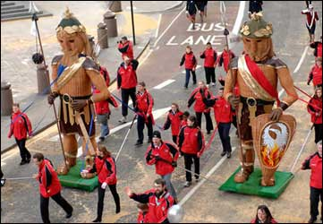
The 911 Financial Crash
Gog and Magog are paraded through The City of London on the occasion of the Lord Mayor’s show in the month of November. (the No. 11 again!) As always their real identity is hidden in public view!

Slide 67
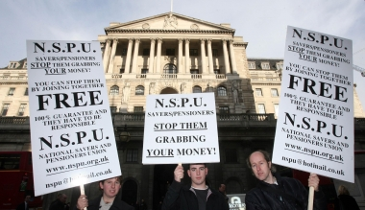
The 911 Financial Crash
Riots outside the Bank of England on the weekend of April 5th 2009, is another sign that Babylon is falling.

Slide 68
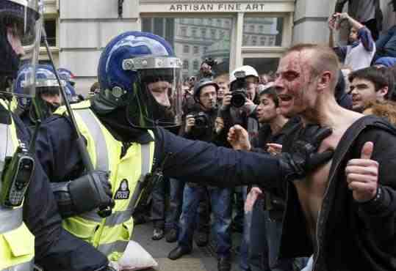
The 911 Financial Crash
People are waking up to the fact that the real power in the real world is not the Queen in Parliament – but the Bank.

Slide 69
The 911 Financial Crash
Revelation 18:2 ... And he cried with a strong voice, saying, Great Babylon has fallen, has fallen, and has become the habitation of demons, and a hold of every unclean spirit …

Slide 70
The 911 Financial Crash
A thought to leave you with:
Mayer Amschel Rothschild said:
"Give me control over a nation's currency, and I care not who makes its laws."
Bank of England
Mayer Amschel Bauer (Rothschild)

Slide 71
The End

