Slide 1
The Story Of Gog And Magog
Part Ten - Chapter 2
Conclusion

Slide 2
This is The Story of Gog Conclusion
We have seen how Gog has been attacking God’s people of Israel over many centuries – first advancing and then retreating as prophesied in the scriptures.
Initially as an open frontal attack then covertly.
Attila – The Hun – Overt attack

Slide 3
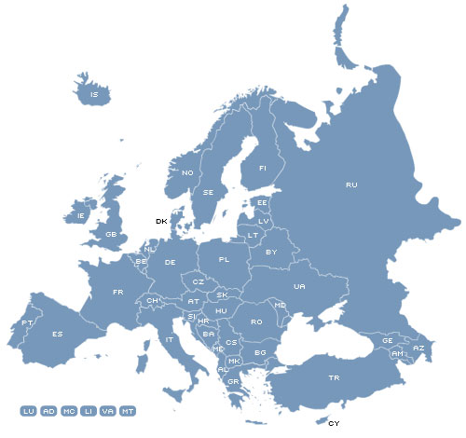
This is The Story of Gog Conclusion
Gog’s control over the Israel nations is now in the order of 95% achieved without hardly anybody having noticed!!

Slide 4
This is The Story of Gog Conclusion
We have seen how a number of key events and heroes of the protestant faith have had a darker side, sowing the seeds of the predicament that we find our selves in the present day.
Oliver Cromwell let the Jews in

Slide 5
This is The Story of Gog Conclusion
We have also seen that as the scriptures foretold, we are fighting powers and principalities of evil (secret societies and an alien race in our midst bent on our destruction)

Slide 6
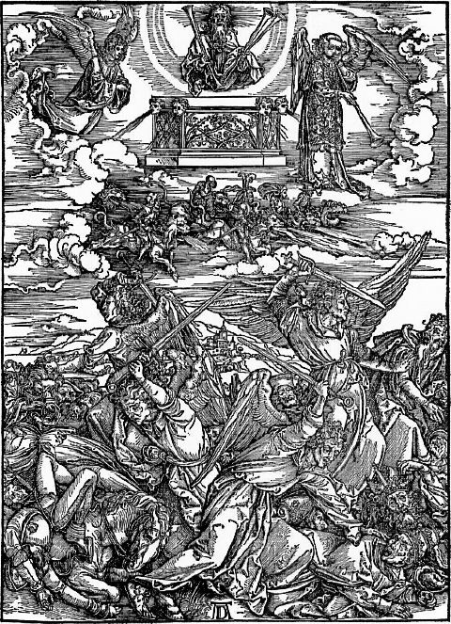
This is The Story of Gog Conclusion
We can only surmise how much further Gog’s iron grip will be strengthened until Armageddon and the Great Day of Yahweh.

Slide 7
Gog’s Iraq War
The Iraq war is all about culling whites (Adamites) and reducing their fighting capabilities and with Mossad agents causing outrages on both sides designed to cause uprisings in the western nations who all have large Moslem populations.

Slide 8
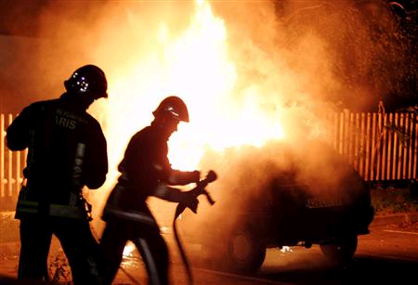
Gog’s Iraq War
Rioting took place last year (2005) in major cities across France – the intensity of which was no doubt triggered by the Iraq war as well as being egged on by Jewish and other leftwing elements.
One of the cars set on fire in Paris

Slide 9
Gog Destroys Mosul (Nineveh)
The Christian communities in Iraq have been subjected to particularly harsh treatment

Slide 10
Modern Nineveh (Mosul) – Iraq - Largely Christian Community – carpet bombed to destruction by Gog using US & UK forces

Slide 11
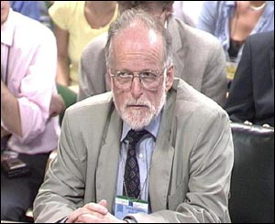
Gog – Ridicules Or Suicides Those Who Oppose The Iraq War
Dr. Kelly it was alleged, was the source for the claim that the government exaggerated intelligence about Iraqi weapons to justify war.
Because of this he had to be eliminated.
Doctor David Kelly, defence expert

Slide 12
David Kelly – Top Germ Warfare Scientist – Conveniently Committed “Suicide”
"a man at the top of his game" before his “suicide”
Blair’s Government almost brought down by Dr. Kelly’s disclosures to Andrew Gilligan, a maverick BBC reporter
Notes:
The suicide in July 2003 of Kelly, a former United Nations weapons inspector and biological weapons adviser to Tony Blair's Government, almost brought down the British prime minister. It did bring down - eventually - the BBC hierarchy. All because Kelly gave a secret briefing to Andrew Gilligan, a maverick BBC reporter who in turn accused Blair's office of "sexing up" intelligence reports about Saddam Hussein's so-called weapons of mass destruction.
Sydney-based filmmaker Susan Lambert wasn't at Kelly's cottage to talk to him about the Iraq war. She knew she would never get Ministry of Defence clearance. Instead, she had been granted permission to talk to Kelly about his pivotal role in the early 1990s in uncovering the then Soviet Union's secret and illegal biological warfare program. Setting up the interview - for Lambert's fascinating documentary Deadly Enemies, a history of germ warfare in the Cold War - took months.
When Lambert finally got to film Kelly she found him "affable, clearly enjoying his job, patriotic, very loyal to the Ministry of Defence, with a huge amount of experience - hardly a Walter Mitty, as he was described".
She spent "five or six hours at his home". Kelly was a man at the top of his game. Not a hint of inner turmoil. No forewarning of the political bomb that was about to explode. It turned out to be Kelly's last interview. And that, of course, made Lambert's documentary hot property.
In Britain, there was a bidding war between the BBC (ironically) and Channel 5. The commercial station won. Chillingly, his last words on camera go to the heart of the weapons of mass destruction debate: "There is no clear delineation between offensive and defensive research [into biological warfare]. It's really a question of intent ... and intent is very difficult to determine."

Slide 13
Zionist have their eyes set on all of the land between the Nile and the Euphrates. The plan for a "Greater Israel" is as old as Zionism itself.
Gog’s planned expansion of the Israeli State – so the Iraqis must be culled

Slide 14
Gog’s Haifa Super Pipeline
Another reason for culling the Iraqis

Slide 15
Gog Needs To Cull Our Armed Forces
Having gained almost total political control of western Israelite nations, the need now is to cull the armed forces and replace them with aliens so when time is decided for the final takeover there will be no possibility of a mutiny.
Another casualty of Gog’s War in Afganistan

Slide 16
Gog Needs To Cull Our Armed Forces
The Gog controlled media keeps quiet on the scale of deaths and injuries

Slide 17
Gog Needs To Cull Our Armed Forces
All the wars after WW2 as well as rearranging the map to suit the NWO, and oil cartels. The primary achievement of Gog would be culling the prime of Israel's manhood – these have been many – Korea, Vietnam, Iraq 1, Serbia, Iraq 2 and Afghanistan.
Kosovo - Serbia

Slide 18
Gog’s Drugs Are Also A Factor In Many Wars
The Taliban in Afghanistan stopped the growing of opium poppies this had a major affect in reducing the flow of heroine to the west.
To rectify the situation George Bush with the help of his pal Tony Blair PM of the UK ordered troops in under the pretext of hunting down Osama Bin Laden!

Slide 19
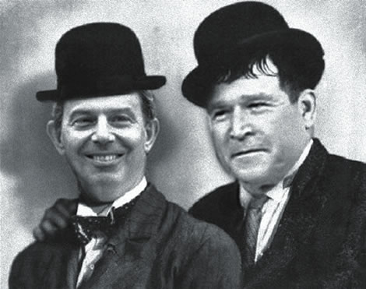
Gog’s Drugs Are Also A Factor In Many Wars
To rectify the situation George Bush with the help of his pal Tony Blair PM of the UK ordered troops in under the pretext of hunting down Osama Bin Laden!

Slide 20
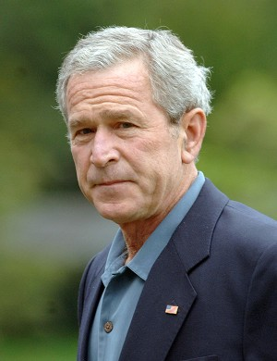
Gog’s Drugs Are Also A Factor In Many Wars
Because of President Bush’s secret involvement in the drug trade, those in the know nick name him “Poppybush”. Needless to say since the troops went in the opium trade is again flourishing in Afghanistan!

Slide 21
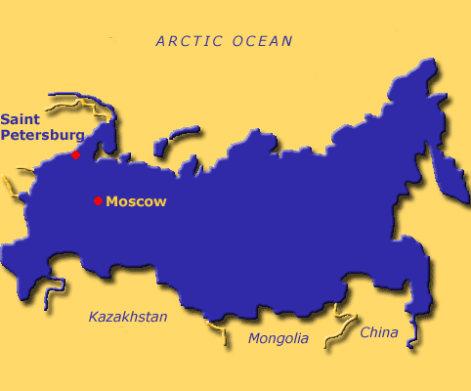
Gog’s Drugs Are Also A Factor In Many Wars
Of course another factor in the Afghanistan war was to put pressure on Russia and Iran with an eye to their vast oil reserves

Slide 22
Large Drug Companies Involved With Legal As Well As Illegal Drugs
Eli Lily was the first company to produce synthetic LSD for the CIA.
Eli Lily is the largest producer of precursor chemical needed to manufacture cocaine and heroin.
Eli Lily Headquarters - Indianapolis

Slide 23
Large Drug Companies Involved With Legal As Well As Illegal Drugs
Eli Lily sends chemicals needed to process the coca leaf directly to Columbia.

Slide 24
Gog’s Suicide Bombers
Many suicide bombing outrages are false flag operations – operatives having been hypnotised and drugged to become robots conditioned to blow up Jewish targets, preferably with a high percentage of foreigners to cause the maximum of international outrage –
A Suicide Bomber

Slide 25
Gog’s Suicide Bombers
– this is so that the murder of Palestinian women and children can proceed apace.
It is remarkable that such bombers are always identified within hours of the atrocity having taken place!
A Suicide Bomber

Slide 26
Gog’s Drugs Killing Our Soldiers
More soldiers have been killed in wars of recent years by the pharmaceutical industry than by enemy bullets – these large numbers of deaths have gone unnoted by the controlled media because the poisons imbibed were slow acting over many years.
Drugs in widespread use in the military

Slide 27
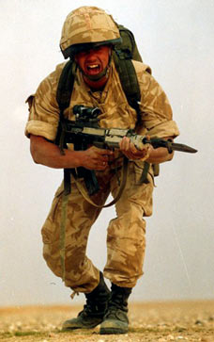
Gog’s Drugs Killing Our Soldiers
These deaths and maiming could not be totally covered up and were alluded to as the Golf War syndrome. Government officials of course denied responsibility or that such a problem existed!

Slide 28
Thousands Of Our Soldiers Severely Disabled Or Dead Through “Gulf War Syndrome”
French Soldiers who were in the first Gulf war were not vaccinated against Anthrax and did not suffer from “Gulf War Syndrome”

Slide 29
The Iraq killing fields – to decimate true Israel’s fighting forces

Slide 30
Gog’s Other Weapon Depleted Uranium
Much of the ammunition used in recent wars has been manufactured with various quantities of depleted uranium under the guise that it has been added for strength.

Slide 31
Gog’s Other Weapon Depleted Uranium
On impact dust particles of this substance are scattered far and wide affecting the soldiers on both sides just as Gog had planned!!

Slide 32
There is no easy escape from this theatre of war

Slide 33
A Picture Not Shown By The Mass Media
Dead US Soldiers Returning from Iraq

Slide 34
Iraq – The War Dead Figures Much Higher Than Stated In The Mass Media

Slide 35
Gog – Uses The Dead Bodies Of The US and Allies
Gog defiled the bodies of US servicemen by stripping out their innards and inserting as much as 50lbs of opium. These are then flown as priority by CIA’s own airline Air America and landed at Norton Airbase in California.
Notes:
Victor Thorn p99 The NOW Illusion.

Slide 36
Gog – Uses The Dead Bodies Of The US and Allies
Not only Iraq, Gog has other wars planned to further decimate the fighting forces of the true nations of Israel.

Slide 37
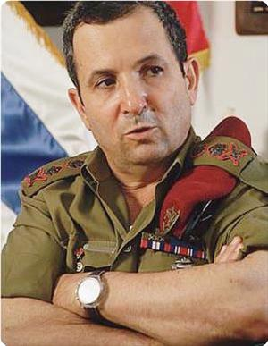
Mass Murderer Sharon
In an interview with General Ouze Merham 1956, Ariel Sharon, former Israeli Prime Minister said:
The Palestinian woman and child is more dangerous than the man, because the Palestinian child’s existence infers that generations will go on, but the man causes limited danger.
General Ouze Merham
Notes:
In an interview with General Ouze Merham 1956, Ariel Sharon, current Israeli Prime Minister said: "I don't know something called International Principles. I vow that I'll burn every Palestinian child (that) will be born in this area. The Palestinian woman and child is more dangerous than the man, because the Palestinian childs existence infers that generations will go on, but the man causes limited danger. I vow that if I was just an Israeli civilian and I met a Palestinian, I would burn him and I would make him suffer before killing him. With one hit I've killed 750 Palestinians (in Rafah in 1956). I wanted to encourage my soldiers by raping Arabic girls as the Palestinian women is a slave for Jews, and we do whatever we want to her and nobody tells us what we shall do but we tell others what they shall do." (1)

Slide 38
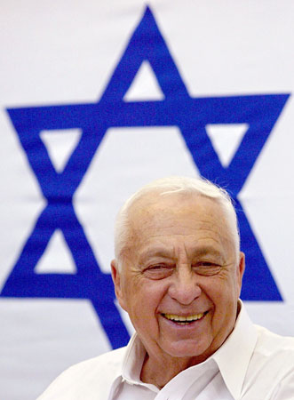
Mass Murderer Sharon
I vow that if I was just an Israeli civilian and I met a Palestinian, I would burn him and I would make him suffer before killing him.

Slide 39
Mass Murderer Sharon
With one hit I've killed 750 Palestinians (in Rafah in 1956). I wanted to encourage my soldiers by raping Arabic girls as the Palestinian women is a slave for Jews, and we do whatever we want to her and nobody tells us what we shall do but we tell others what they shall do.”
Ariel Sharon
Notes:
In an interview with General Ouze Merham 1956, Ariel Sharon, current Israeli Prime Minister said: "I don't know something called International Principles. I vow that I'll burn every Palestinian child (that) will be born in this area. The Palestinian woman and child is more dangerous than the man, because the Palestinian childs existence infers that generations will go on, but the man causes limited danger. I vow that if I was just an Israeli civilian and I met a Palestinian, I would burn him and I would make him suffer before killing him. With one hit I've killed 750 Palestinians (in Rafah in 1956). I wanted to encourage my soldiers by raping Arabic girls as the Palestinian women is a slave for Jews, and we do whatever we want to her and nobody tells us what we shall do but we tell others what they shall do." (1)

Slide 40
Dick Cheney – American Vice President
Dick Cheney – shedding crocodile tears for the dead returning American servicemen
Notes:
Now think about this people, think about it very carefully. Dick Cheney, leader of the Tikrit mega-scam trio, has been an obsequious Zionist doormat for more than two decades, and as Vice President of the United States of America he also has direct access to all strategic and tactical data on Iraq, as do Wolfowitz and Rumsfeld

Slide 41
The US Elite’s Reaction To The Death of GIs In Iraq

Slide 42
Barbara Bush’s Ancestry?
Aleister Crowley, the infamous practitioner of "sex magick" whose motto was "Do What Thou Wilt"
Aleister Crowley

Slide 43
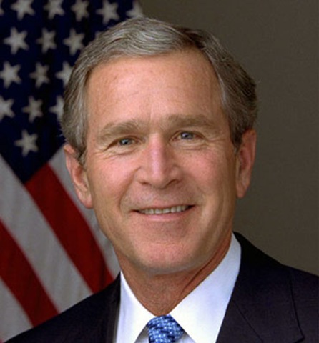
Barbara Bush’s Ancestry?
-- came to know a great many remarkable people, including the maternal grandmother of George W. Bush. "Know," in this case, may be taken in the Biblical sense.

Slide 44
Gog’s Grip Extends To Police Other Law Enforcers
Not only the army, but the police and other law enforcement agencies are being cleansed of Adamites and replaced with non-Adamites….

Slide 45
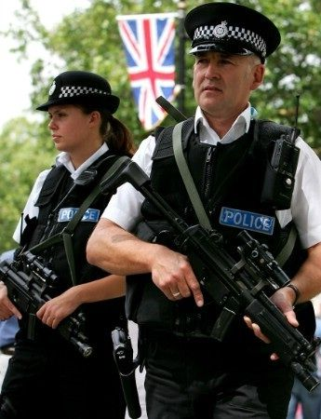
Gog’s Grip Extends To Police Other Law Enforcers
… so when the time is ripe to come into the open and clamp down with a police state USSR style, these ethnics will have no qualms about slaughtering whites.

Slide 46
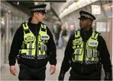
Gog’s Grip Extends To Police Other Law Enforcers
Police officers in London who introduce a recruit from an ethnic minority will be given £350 bonus payment. (BBC News 18/05/03)

Slide 47
Gog – Creates Unemployment
By stealth Gog has been removing the livelihoods of the indigenous population while paying out “benefits” to keep them quite.

Slide 48
Gog – Creates Unemployment
It has now reached a level where 1 in 5 households rely entirely on state handouts. This is true of most of the western nations – This is all to make it easier for the final takeover!

Slide 49
Gog – Uses Diseases To Control Target Populations
insect vectors are used by Gog to spread Man made diseases, such as AIDS, as another means of eliminating the white Israelite nations

Slide 50
A Community Wiped Out
Was Waco a trial run for the final attack on the weakened and depleted white race?

Slide 51
Oklahoma – Gog Further Tightens The Screw
The bombing of the Alfred P Murrah building in Oklahoma in 1995, was to facilitate the forcing through of tough new gun and other legislation thereby continuing the erosion of freedoms in the name of security –
1995 bombing of the Alfred P Murrah building in Oklahoma.

Slide 52
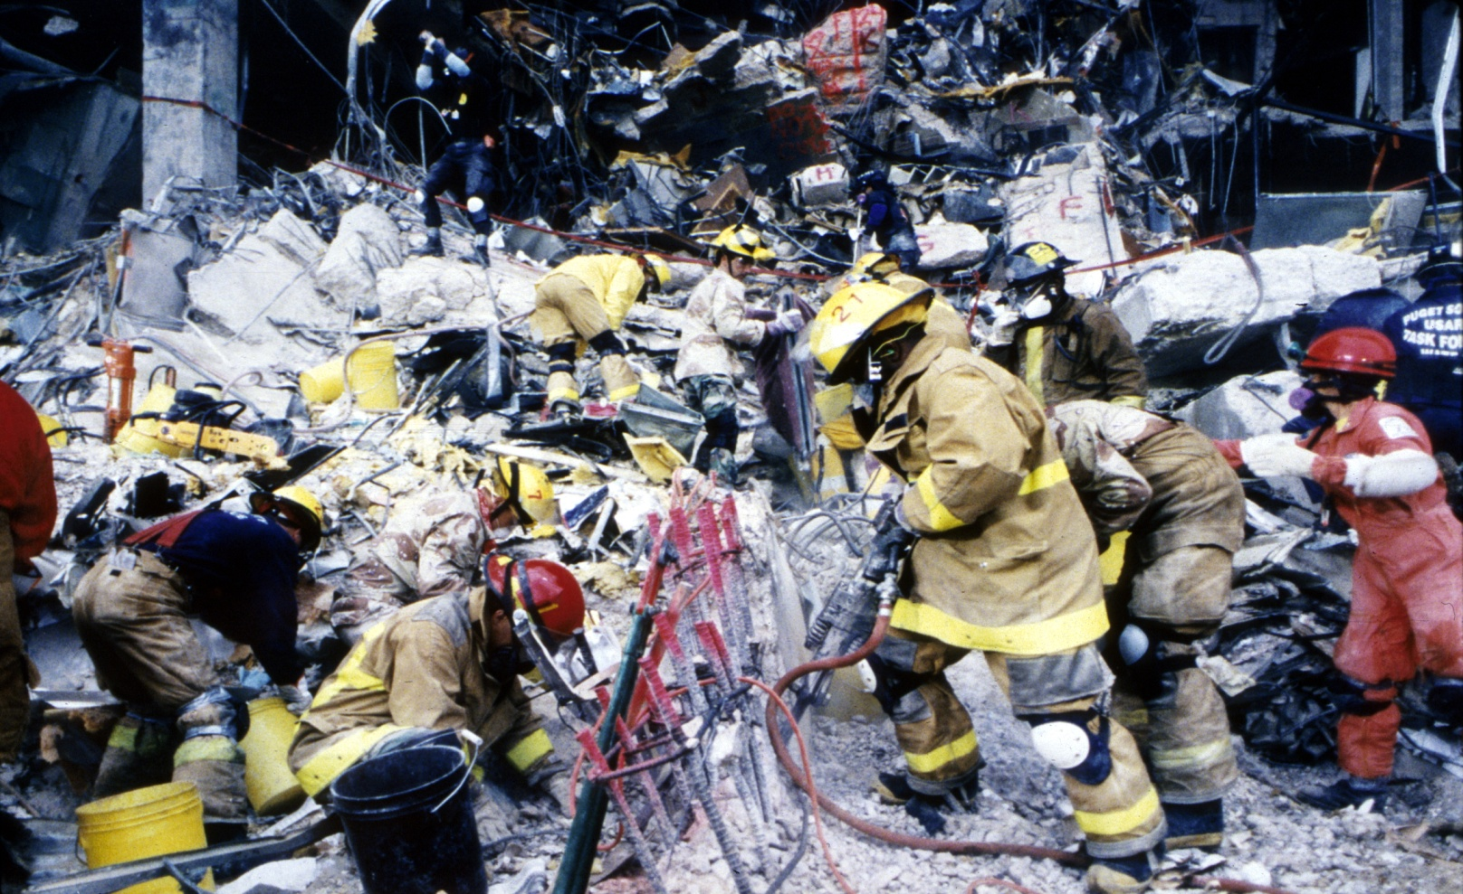
Oklahoma – Gog Further Tightens The Screw
…. as usual Gog had a patsy to take the blame – Timothy McVeigh

Slide 53
Oklahoma – Gog Further Tightens The Screw
Bomb experts state the colossal damage to the A. P. Murrah building and the fact that the blast wave pushed outwards from the building would indicate that it was not a truck bomb as stated by the authorities. Also witnesses heard several explosions.
Timothy McVeigh

Slide 54
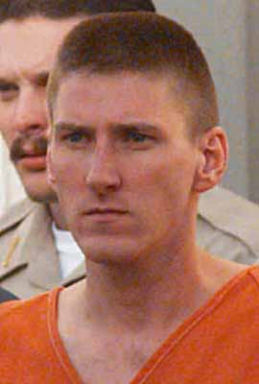
Oklahoma – Gog Further Tightens The Screw
A video shows Oklahoma City bomber Timothy McVeigh (left) at a U.S. military base that specializes in explosives and demolition trainingover a year after he supposedly left the army puts the official story of the April 19 1995 federal building bombing under serious doubt.

Slide 55
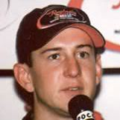
Oklahoma – Gog Further Tightens The Screw
McVeigh who according to the official timeline as endorsed by the FBI, was honourably discharged from the military for the last time in May 1992.

Slide 56
Oklahoma – Gog Further Tightens The Screw
And yet he is seen here on tape at a U.S. military base over a year after that date in August of 1993.

Slide 57
Gog – Quietly Setting Up A Police State
Concentration style interment camps are being quietly set up in the UK, USA and other Israelite nations

Slide 58
Gog – Quietly Setting Up A Police State
Also under the guise of innocuous names such as Homeland Security in the USA and the Counter Terrorism Unit of the UK Home Office headed up by Jews who would not look amiss standing on the podium in Red Square, Moscow, in Stalin's days.

Slide 59
Gog Tightens his Grip Soviet Style
Michael Chertoff, evil Zionist neo-con Bush has appointed as America’s head of Homeland Security.
Notes:
TSAR NICHOLAS II LAST Emperor of the Third Rome First cousin to King George V of England First cousin to Kaiser Wilhelm II of Germany TSAR NICHOLAS II LAST Emperor of the Third Rome First cousin to King George V of England First cousin to Kaiser Wilhelm II of Germany TSAR NICHOLAS II LAST Emperor of the Third Rome First cousin to King George V of England First cousin to Kaiser Wilhelm II of Germany

Slide 60
Gog Tightens His Grip Soviet Style
John Negroponte, brutal Jewish thug responsible for mass killings in Central America, is now America’s Gestapo SS Chief and spy Czar.
Notes:
TSAR NICHOLAS II LAST Emperor of the Third Rome First cousin to King George V of England First cousin to Kaiser Wilhelm II of Germany TSAR NICHOLAS II LAST Emperor of the Third Rome First cousin to King George V of England First cousin to Kaiser Wilhelm II of Germany TSAR NICHOLAS II LAST Emperor of the Third Rome First cousin to King George V of England First cousin to Kaiser Wilhelm II of Germany

Slide 61
The ADL (ANL in UK)
The ADL is another organisation helping to eliminate patriots and to keep these people in power. It is believed that it was created in response to the lynching of Leo Frank, the president of the Atlanta B'nai B'rith?

Slide 62
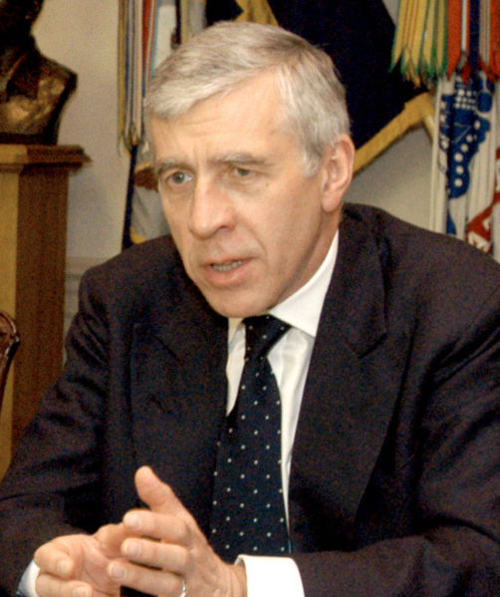
Gog Tightens his Grip Soviet Style
The UK has equally objectionable people like Jack Straw now back in the Home Office again and Peter Hain dealing with Northern Ireland affaires.
Jack Straw - AKA John Whitaker Straw (Jew)

Slide 63
Gog Tightens his Grip Soviet Style
Peter Hain, not content with having been instrumental in bringing the White South African Government down is now interfering in the affaires of Northern Ireland.
Peter Hain (Jew)

Slide 64
Gog Sends A Subliminal Message
This picture was widely publicised in the media throughout the UK, Europe and the rest of the world.
The message being that if you dare cross us this is what will happen to you!
Jean Charles de Menezes

Slide 65
Diana Car Crash Not An Accident
The death of Princess Diana in a car crash was no accident, all part of the secret WW3 to destroy true Israel in the west and would be engineered to weaken the monarchy.
Just a few points about the “accident”:-

Slide 66
Diana Car Crash Not An Accident
Just before the car entered the tunnel every police radio in Paris mysteriously died, preventing a quick response which could have saved Diana's life.
Diana leaving for the fateful car journey

Slide 67
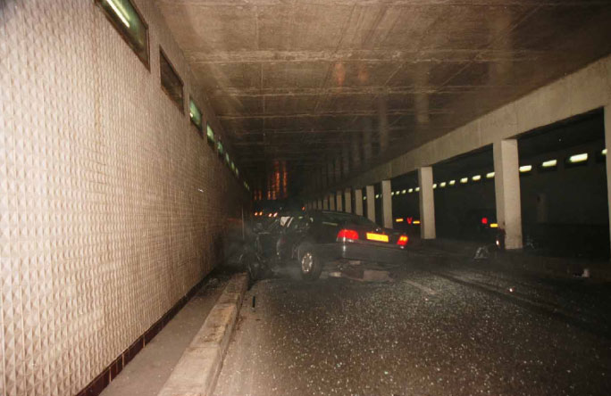
Diana Car Crash Not An Accident
Just before the car entered the tunnel every security camera in the tunnel mysteriously died, preventing us from ever seeing footage of what caused the crash.
The Pont de l’Alma Road Tunnel Crash Site

Slide 68
Diana Car Crash No Accident
The crime scene was completely cleaned within hours of the crash, a policy totally anathema to standard preservation of any crime scene.
The car after the crash

Slide 69
Diana Car Crash Not An Accident
Diana was still alive after the crash. Unexplained delays in getting her to the hospital, caused by the slow speed of the ambulance…..

Slide 70
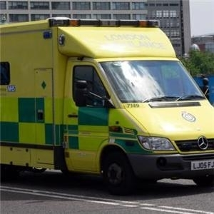
Diana Car Crash Not An Accident
… and the fact that it passed several nearer hospitals before reaching its destination, ensured Diana was dead upon arrival. A faster response could have saved her life.

Slide 71
Diana Car Crash Not An Accident
The Mercedes used to transport Dodi and Diana from the Ritz was mysteriously swapped for a car that had been stolen only weeks earlier.
The Ritz Hotel Paris

Slide 72
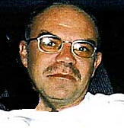
Diana Car Crash Not An Accident
The foremost reason put forward to explain the 'accident' - that driver Henri Paul was dangerously drunk, has been thoroughly debunked by the camera footage of his behaviour before the crash….
Driver Henri Paul

Slide 73
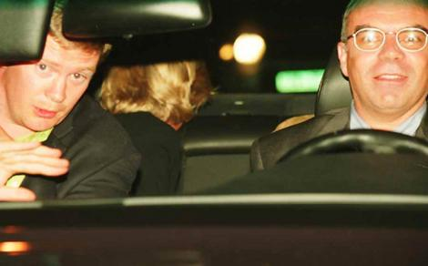
Diana Car Crash Not An Accident
.. and the fact that the tests on Paul's blood were either faked or swapped with the blood of another dead man. Paul's liver showed no sign of alcohol abuse and his close friends and family said he rarely drank alcohol.

Slide 74
Diana Car Crash Not An Accident
The monarchy were humiliated in the controlled press and forced to fly the Royal Standard at half mast, for Diana, when this normally only happens when the monarch dies.

Slide 75
Diana Car Crash Not An Accident
Diana’s funeral service was used by the media to further damage the monarchy by implying that the Queen was responsible for Diana’s death because of the way she had been treated by the royal family

Slide 76
Gog’s Hegelian Dialectic Process
Gog’s rearrangement of the world has been achieved to a large extent by a process known as Hegelian Dialectics. This is basically creating 2 opposites which are both controlled by the same side – such as Communism and Capitalism and then creating the middle way or centre –

Slide 77
Gog’s Hegelian Dialectic Process
However, this centre is not really a middle way as the centre is set to the far left. This is all done through Gog’s absolute control of the media being used to paint a false picture for the gullible people to take in.

Slide 78
The Globalist Elite
| |
Thesis Antithesis
| |
Marxist Russia Nazi Germany
| |
Conflict of World War II
| |
1917 Bolshevik Revolution 1933 Hitler's accession to power
USA Constructs and subsidizes USA constructs and subsidizes
Soviet Union 1920 - present National Socialism
| |
Profit
|
Synthesis Post World War II United Nations, a step towards New World Order

Slide 79
Gog’s Hegelian Dialectic Process
A capitalist
A Communist
People’s image of the 2 extremes

Slide 80
Gog – Gains Control Of Nations Through Drugs
“And the light of a candle shall shine no more at all in thee; and the voice of the bridegroom and of the bride heard no more at all in thee: for thy merchants were the great men of the earth; for by thy sorceries were all nations deceived." Revelation 18:23

Slide 81
Gog – Gains Control Of Nations Through Drugs
The English word "sorceries" is translated from the Greek word "pharmakia" from which we get our word "pharmacy" or "drugs." A literal rendering of that passage would be this charge against Mystery Babylon: "For by thy drugs were all nations deceived” or "by thy drugs were all nations drugged."

Slide 82
Gog’s Banking System Involved In Drugs
The banking system has been complicit in facilitating the drug trade

Slide 83
Global Security Fund – Gog’s Fund For Assassination And Bribery
The New Underworld Order's bank accounts are used for bribery, murder and corruption world wide as private Illuminati-controlled bankers make money out of thin air.
Federal Reserve Bank
Notes:
16842

Slide 84
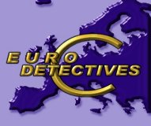
Global Security Fund – Gog’s Fund For Assassination And Bribery
European investigators trying to trace the illegal funds, say the Illuminati's Global Security Fund needs to be stopped and is the difference between freedom and slavery in America

Slide 85
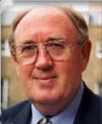
Global Security Fund – Gog’s Fund For Assassination And Bribery
Recently, Ashley Mote of the European Union (EU) asked this volatile question in a public EU meeting, a question never answered, as Mr. Mote merely by asking it was immediately scratched from the White House Christmas card list and placed on its top ten hit list:

Slide 86
CIA Forge Dollars To Fund Covert Operations
The North Koreans were accused of forging high value us Dollars when in fact the CIA using false plates have been producing them to cover their covert operations costs.

Slide 87
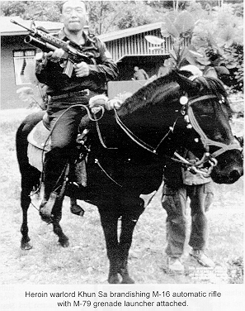
CIA Covert Operations The Largest Drug Trafficker
The CIA is Gog’s agent for importing drugs into the USA. Heroin War Lord in Burma stated on video tape in 1986, that the entire crop of Burmese Heroin, some 900 tons was bought by the US Government.
Heroin War Lord Khun Sa

Slide 88
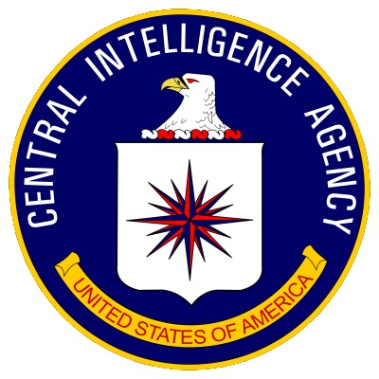
CIA Covert Operations The Largest Drug Trafficker
The CIA drug operations are only to bring to book those who are in competition with the government!

Slide 89
USA Drug Trade
Samuel Russell worked closely with the scotch firm of Jardine-Matheson and were know as the COMBINATION and was co-founder of the Scull and Bones Society. His business was to purchase opium and then smuggle it into China.
William H. Russell (Skull & Bones; co-founder-1833)

Slide 90
USA Drug Trade
Right Warren Delano, Jr. Who was Samuel Russell’s main agent for the purchasing and distribution of Opium – Interestingly he was the grandfather of Frank Delano Roosevelt – The US War Traitor President!!
Many of the intelligence services grew from the private intelligence services operated by the drug running cartels.

Slide 91
NAFTA – Gog’s American EU
The EU, NAFTA and other trading bocks are all parts of Gog’s plan to create a global government and to divide the world into large administrative areas controlled by the UN to be eventually moved from New York to Jerusalem.
The NAFTA Flag

Slide 92
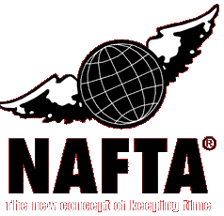
NAFTA – Gog’s American EU
However, Yahweh will bring their plans to nought

Slide 93
NAFTA – Gog’s American EU
On March 23, 2005, heads of government Vincente Fox, George W. Bush, and Paul Martin launched the North American partnership at a meeting in Waco, Texas.

Slide 94
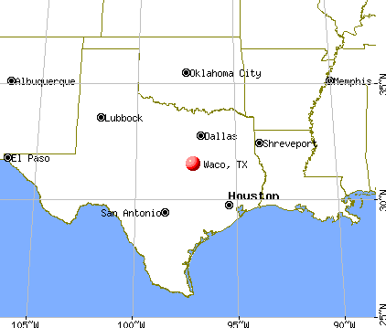
NAFTA – Gog’s American EU
Was the choice of venue symbolic i.e. we will ride rough shod over you using whatever means it may take to achieve our aims!

Slide 95
NAFTA – Gog’s American EU
Massive ULF ‘Blast’ Detected In US Bridge Collapse Catastrophe
Notes:
These reports further state that one of the United States primary research organizations into acoustic weapons research is Augsburg College, and which is located in Minneapolis, Minnesota, and most importantly less than 1 mile from the Interstate 35W Bridge collapse.

Slide 96
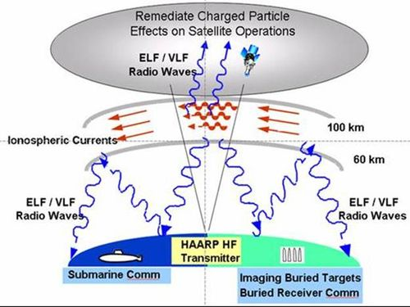
NAFTA – Gog’s American EU
Was Gog using a secret sonic weapon to destroy the Interstate 35W Bridge which spanned the Mississippi River to make way for the super highway between Mexico & Canada especially as the research centre for such weapons, Augsburg College, was less than a mile away?

Slide 97
Gog – Gradually Removing Local Councils By Mergers Into Larger Groups
Small local and County Councils are gradually being removed in the name of efficiency and merged into vast regions with the administrative offices remote from many of their inhabitants.
The members of these regional councils are appointed and not elected.

Slide 98
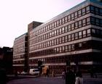
Gog – Gradually Removing Local Councils By Mergers Into Larger Groups
For many people this is one local council reorganisation too many after several decades of local government reorganisation!
.
Lothian Regional Headquarters

Slide 99
Gog – Gradually Removing Local Councils By Mergers Into Larger Groups
People here in the UK are becoming restless as are people in other western nations where similar things are happening as we shall see on the left and the next slide.

Slide 100
Opposition Rising To Gog’s Plans

Slide 101
New types of police forces are being set up across Europe and the USA – are these the precursors to a Gestapo type force?

Slide 102
Territorial Police Headquarters – Vehicle Pound
Met. Police Cars in Strange Colours

Slide 103
Are these Metropolitan Police or European Police in Disguise?

Slide 104
This is The Story of Gog Conclusion
Joe Vialls a retired military analyst – came up with a realistic scenario based on fact through intelligence sources.
I leave you to judge how this account ties in with the prophecies of scriptures!
Joe Vialls – A Private Investigator

Slide 105
Gog’s Retreat To Fortress USA
Having all but killed the goose that lays the golden egg i.e. the USA taxes flowing to keep the abomination of desolation afloat otherwise known as the Israeli state, the Zionists are planning to retreat to fortress America as they know the state of Israel is near to collapse.
A depiction of the Israeli State

Slide 106
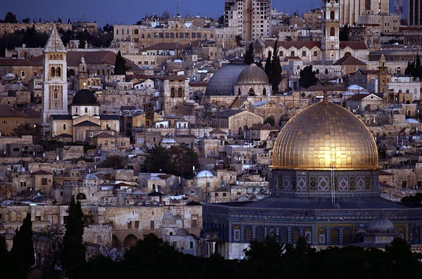
Gog’s Retreat To Fortress USA
Of course Gog always likes to maximise any disaster to his own advantage, so it is quite likely that Gog would be hoping that the destruction of the Israeli state will destroy the Christian faith

Slide 107
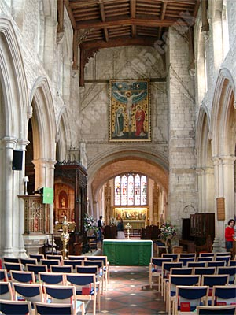
Gog’s Retreat To Fortress USA
because the Christians have been so brain washed into believing that the Jews are God’s people, however, it may have the opposite effect by causing people to look to their roots and discover that they are true Israel!!

Slide 108
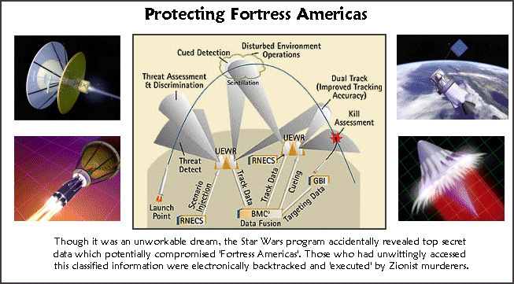
Gog’s Contingency Plans - Fortress America

Slide 109
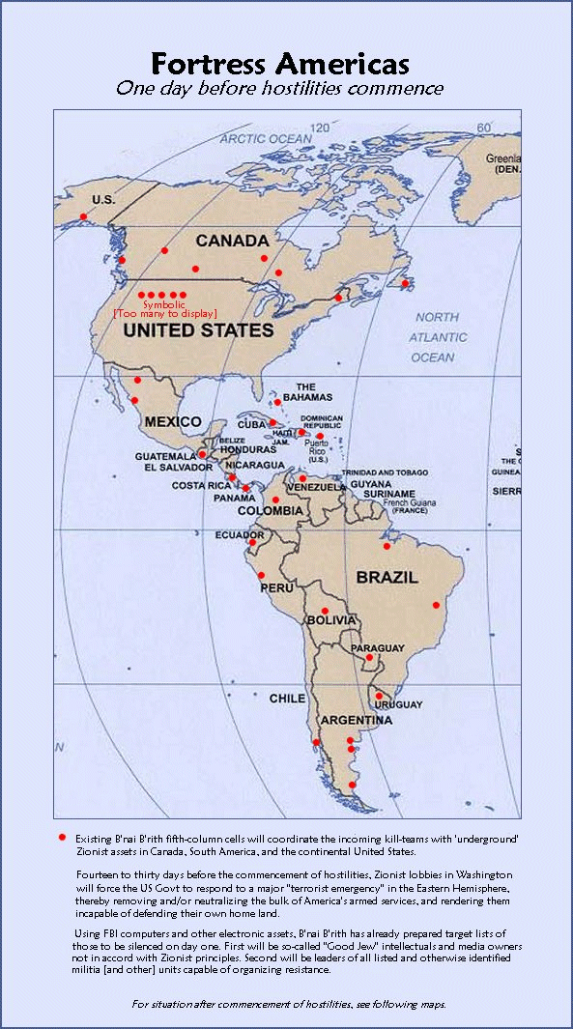
Gog plans a super American state to include both south and north America – a start on this has already begun by the setting up of NAFTA

Slide 110
The Falkland Islands contain huge reserves of oil which have not been exploited yet, as well as closing other oil fields in the States for various reasons, mainly to keep the oil price high, but also to leave Gog with a fall back position in that fortress USA will be self-sufficient in oil.

Slide 111
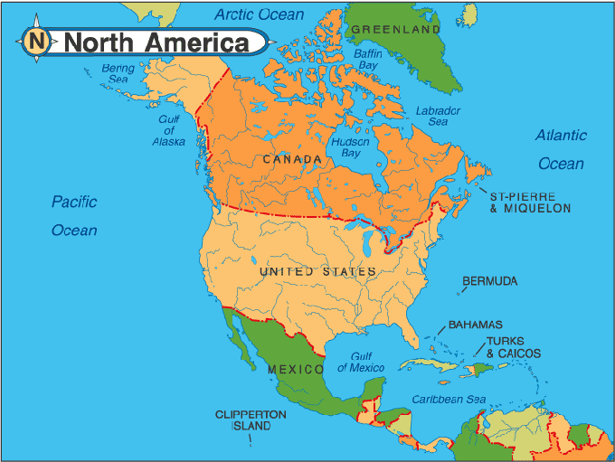
Gog’s Plan B
Zionist Elite Prepares to Desert America
With 'Fortress Americas' now in tatters because of Russia's coalition with Brazil and Venezuela, …

Slide 112
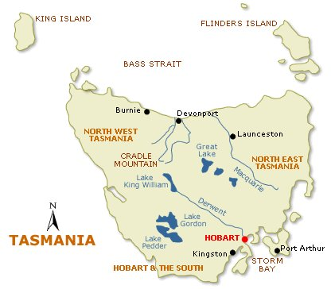
Gog’s Plan B
Wall Street's neocons and other Zionist traitors will desperately try to avoid War Crimes Tribunals and the waiting hangman's noose, by fleeing aboard special jets to a little -known Australian island - Tasmania

Slide 113
Gog’s Plan B
The possibility of armed Tasmanians rising up against this influx of Zionists (backed by armed Mistaravim terrorists from Palestine), laying down the law and requisitioning the best properties on the island.
Notes:
Next came the matter of possibly hostile armed natives in Tasmania, who might object to 1,500 arrogant Zionists (backed by armed Mistaravim terrorists from Palestine), laying down the law and requisitioning the best properties on the island. They would doubtless object even more when they found their wives, daughters, and even sons being forced to sexually gratify the all-male Zionist Elite and its numerous Mistaravim bodyguards. Old Jewish sexual customs die hard, as proved by multiple rapes and sodomy in Russia under the Bolsheviks, and multiple rapes and sodomy in Lebanon and occupied Palestine today.

Slide 114
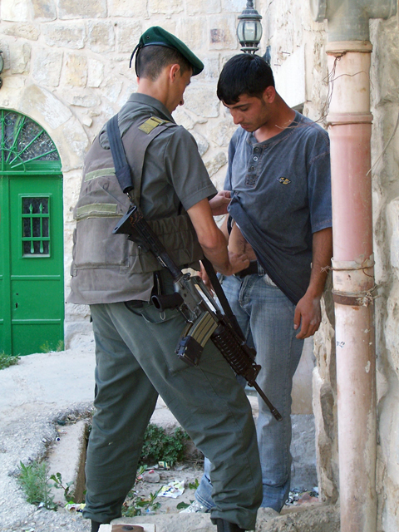
Gog’s Plan B
They would doubtless object even more when they found their wives, daughters, and even sons being forced to sexually gratify the all-male Zionist Elite and its numerous .

Slide 115
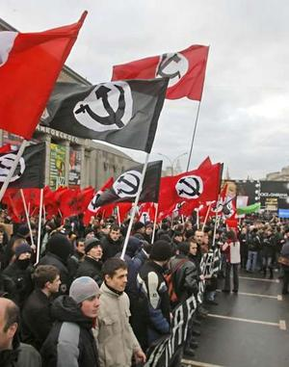
Gog’s Plan B
Old Jewish sexual customs die hard, as proved by multiple rapes and sodomy in Russia under the Bolsheviks, and multiple rapes and sodomy in Lebanon and occupied Palestine today.

Slide 116
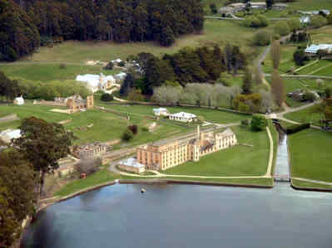
Gog’s Plan B
Top priority was to disarm the Tasmanians. This would be achieved by the Port Arthur massacre.

Slide 117
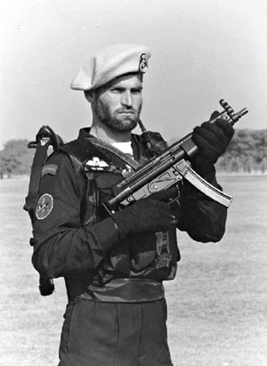
Gog’s Plan B
In April 1996, to reduce the risk of serious resistance, a four-man Jewish (Civilian Special Forces) team carried out a particularly gruesome mass murder at Port Arthur in Tasmania, which resulted in the deaths of 35 tourists, with another 22 seriously injured.

Slide 118
Gog’s Plan B
Intellectually impaired 'Patsy' Martin Bryant (Left) is currently serving 35 consecutive life terms in prison for the Port Arthur mass murder, despite the fact he was not present, and was never allowed a trial. Does this remind you of the Zionist's Guantanamo Bay?
Martin Bryant

Slide 119
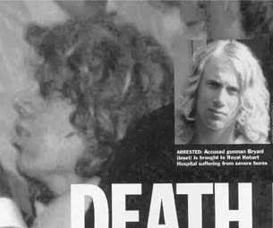
Gog’s Plan B
Using trick television editing, the Zionists 'grafted' Bryant's head onto the left film frame showing a man apparently running away from the Broad Arrow Cafe immediately after the massacre.
The discrepancies pointing to the fact that it couldn’t have been Martin Bryant are too long to be dealt with here.
Martin Bryant

Slide 120
Gog/Babylon – To Be Destroyed
After all the gloom there is good news – Babylon and Gog will soon be destroyed.

Slide 121
Gog Has Closed - London Docks
As all part of destroying the infrastructure of the UK, Gog has closed the London docks, now most of all the commerce coming into London is by lorries, clogging up the roads and further damaging the infrastructure!
Docklands London

Slide 122
London Docks
The London docks were once a hive of industry, with goods being transported efficiently round the country by the rail network and small lorries
Docklands London

Slide 123
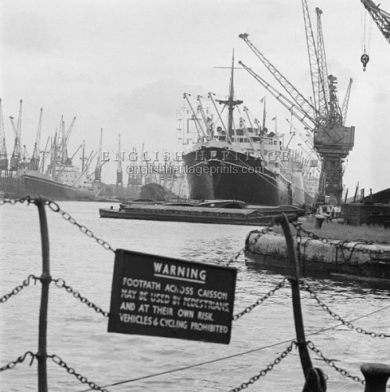
London Docks
– all this has now ceased and Gog has made sure that they can’t be used again by building on them as we shall see in the next slide.

Slide 124
London Docks
Here we see how docklands looks today – Preparing for the day when ships stood afar off and no longer traded with Babylon.

Slide 125
Gog/Babylon – To Be Destroyed
“Therefore shall her plagues come in one day, death, and mourning and famine; and she shall be utterly burned with fire: for strong is the Lord God who judgeth her.” Revelation 18:8
911 – the count down starting for the destruction of Gog and Babylon?

Slide 126
Gog / Babylon – The Beast
The Bible refers to the Babylonian/Gog system as various beasts under its different guises.
To find out why this is we must go back to the book of beginnings – Genesis.

Slide 127
Gog / Babylon – The Beast
Genesis 1:25 And God made the beast of the earth after his kind, and cattle after their kind, and every thing that creepeth upon the earth after his kind: and God saw that it was good.

Slide 128
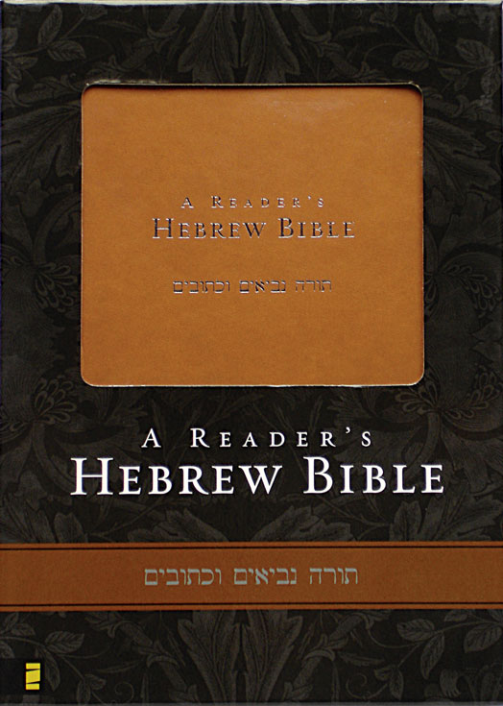
Gog / Babylon – The Beast
The word beast in Hebrew is “Chay” which means a living being and notice the personal pronoun which refers to the different kinds of beast while the others are “things

Slide 129
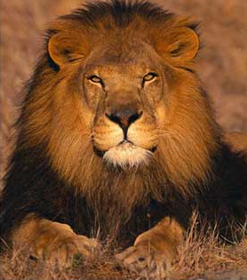
Gog / Babylon – The Beast
The word beast has over many years lost its true sense of meaning and in no way denigrates these other races …

Slide 130
Gog / Babylon – The Beast
Chinaman
Jew
Negro
… such as the Chinese and the black races as all creation was very good. However when Satan and his angels were cast down to earth all this changed.

Slide 131
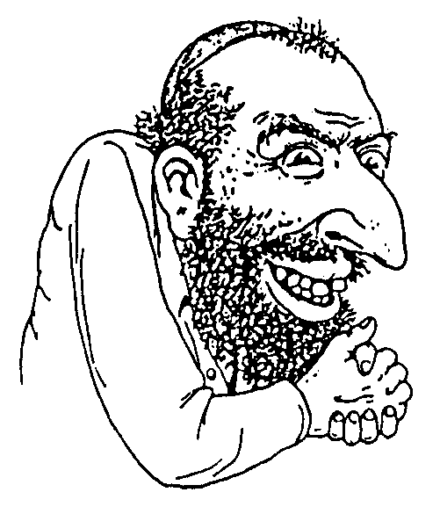
Gog / Babylon – The Beast
Satan and his offspring were on the earth a long time before Adam was formed and went under the name of Jehudyn and had the symbol of the fig leaf and snake, hence the biblical reference to them as snakes, serpents and vipers.

Slide 132
Gog / Babylon – The Beast
The sin in the garden of Eden was not eating an apple but miscegenation with the Serpent race. Ever since Cain slew Able, the serpent race has been trying to destroy God’s sons – the white Adamic race.
A depiction of the Garden of Eden

Slide 133
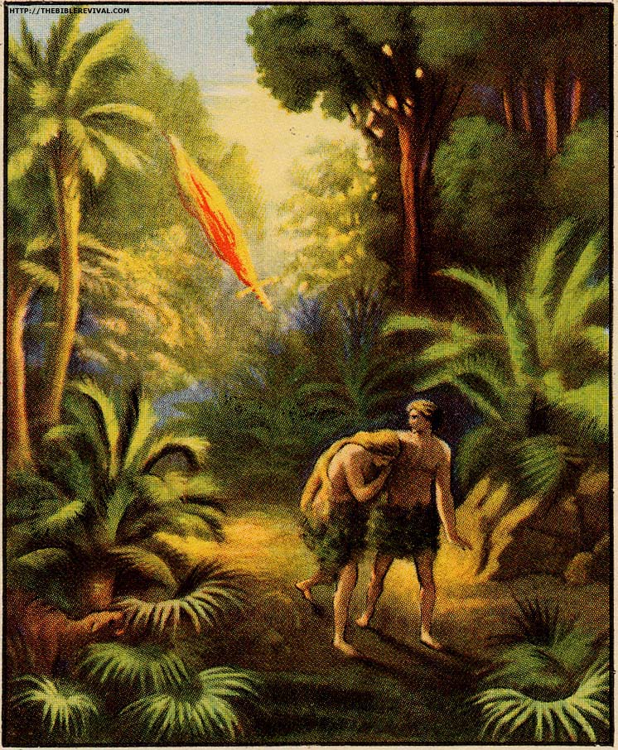
Gog / Babylon – The Beast
What happened in the Garden of Eden is a very extensive study that cannot be covered in this series save to say that the attack of Gog is a continuation of enmity between Satan’s seed and the woman's seed.

Slide 134
Gog / Babylon – The Beast
The Beast reveals its self in Secret Societies which have been present in the history of man for a very long time. It all started thousands of years ago with the "Brotherhood of the Snake", a secret society that refers to Satan (the Great Serpent) back in the Garden of Eden.
Image:France Paris Notre-Dame-Adam and Eve.
Notes:
The Secret Societies have been present in the history of man for a very long time. It all started thousands of years ago with the "Brotherhood of the Snake", a secret society that refers to Satan (the Great Serpent) back in the Garden of Eden. The Illuminati consider Satan being a good God and the Old Testament God to be evil. Their opinion is that Satan gave man knowledge, while God tried to suppress the same. From this viewpoint Satanism was developed and is practiced within the secret societies up until this day.

Slide 135
Gog / Babylon – The Beast
We now know the reason why the various past world empires are sometimes referred to as beasts because a non Adamic element was in secret control just as they are of our western nations at the present time.
Dragons mark the boundary of London

Slide 136
Gog / Babylon – The Beast
In 1922 Lucifer's Trust was created in London, but later changed its name to Luci's Trust, as the first name was too obvious. The Trust is non-governmental and officially recognized by the United Nations. It is also an extension of the Theosophical Society,
Here are the Lucis trust’s 2 logos linking them to the Masons and the UN
Notes:
In 1922 Lucifer's Trust was created in London, but later changed its name to Luci's Trust, as the first name was too obvious. The Trust is non-governmental and officially recognized by the United Nations. It is also an extension of the Theosophical Society, another secret society which influenced Adolf Hitler in developing his doctrine about the Arian Super Race. Luci's Trust is sponsored by among others the Satanist Robert McNamara, former minister of Defence in the USA, president of the World Bank, member of the Rockefeller Foundation, and Thomas Watson (IBM, former ambassador in Moscow). Luci's trust sponsors, among others, are the following front organizations: United Nations, Greenpeace Int., Greenpeace USA, Amnesty Int., UNICEF. Luci's Trust has its only "religious" chapel, the Temple of Understanding, where Satanism is practiced, in the UN headquarter in New York1. Interesting is the fact that Luci's Trust openly declares that a secretive group of illuminated, New Age notables is now running the planet from behind the scene.

Slide 137
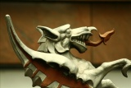
Gog / Babylon – The Beast
These beast symbols can often be seen in the heraldry of the controlling power – often non-Adamite. Here we see the Dragon representing the Corporation of London – the Great Red Dragon of revelation.

Slide 138
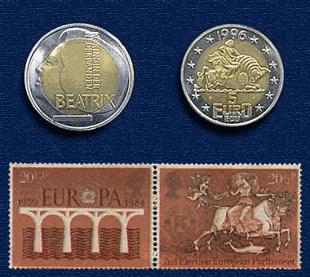
Beast Computer System
It is appropriate that the EU computer system that tracks every person in the world is called the BEAST which assigns an 18 digit
tracking number, which consists of 3 groups of 6 numbers. The first 3 numbers assigned to everyone are 666.

Slide 139
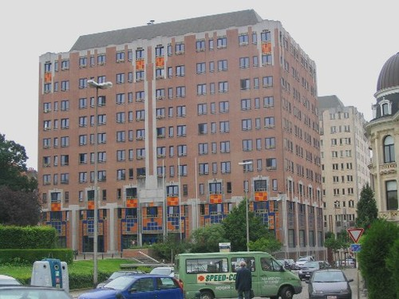
Beast Computer System
The next is one’s national code. The U.S. national code is 110. Then the next 3 numbers are your telephone area code, and then finally your 9 digit Social Security number.
EU Directorate

Slide 140
Gog/Babylon - Destroyed
What is rarely understood is that the horns of the beast represent powers – here there are 10 horns representing the 12 tribes of Israel

Slide 141
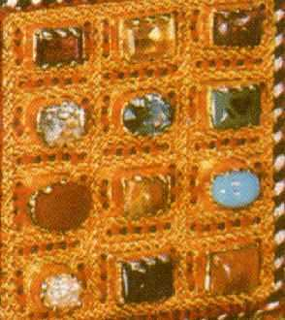
Gog/Babylon - Destroyed
… the tribe of Levi did not have territory and Judah held the sceptre, so this is the reason for there being 10 horns and not 12. The beast is under the horns which is symbolic of the beast manipulating the Israelite nations in secret.
High Priest’s Breastplate

Slide 142
Gog/Babylon - Destroyed
Here we see Daniel’s image another depiction of the world empires again the 10 toes representing the 10 tribes of Israel – without the feet and 10 toes the image would collapse – signifying that the system without the skills of the Israelite nations would be unable to stand.

Slide 143
Gog/Babylon - Destroyed
The 2 legs are an extremely good representation of the Israelite nations and the beast system underlying their governments. Because Europe has been divided in many ways:
Catholic Powers Protestant Powers
Catholic Religion Greek Orthodox Religion

Slide 144
Gog/Babylon - Destroyed
Anglican Church Non Conforming Churches
Germanic Languages Latin Languages
English type Alphabet Cyrillic Alphabet
Eastern Europe Western Europe
EU Members Non EU Members

Slide 145
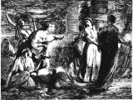
Gog/Babylon - Destroyed
The Parable of The 10 Virgins
It is significant that there were 10 virgins in the parable which again is the number of the Israelite tribes, excluding Levi and Judah.
A depiction of the 5 foolish & the 5 wise virgins

Slide 146
Gog/Babylon - Destroyed
The Parable of The 10 Virgins
The 5 wise virgins had trimmed their lamps and filled them with oil while the foolish virgins had neglected to fill their lamps with oil being symbolic for the word of Yahweh.

Slide 147
Gog/Babylon - Destroyed
The Parable of The 10 Virgins
This parable could be alluding to those Israelite nations who have been active in spreading the Gospel and distributing it in the vernacular tongue such
A depiction of the 5 foolish & the 5 wise virgins

Slide 148
Gog/Babylon - Destroyed
… such as the Germanic-Anglo-Saxon- Celtic nations, while the Latin nations of southern Europe have not done this!
This is another example of the division represented by the 2 legs.
The Parable of The 10 Virgins

Slide 149
Gog/Babylon - Destroyed
Here we see the logo of one of the Rothschild Banks with arrows taken from the coat of arms of the house of Rothschild – Interestingly the large R could refer to the Right Hand and the J & C to judgment coming!

Slide 150
Gog/Babylon - Destroyed
Ezekiel 39:3; And I will smite thy bow out of thy left hand and will cause thine arrows to fall out of thy right hand.
The Rothschilds Headquarters

Slide 151
Gog/Babylon - Destroyed
Malachi 4:1 For, behold, the day cometh, that shall burn as an oven; and all the proud, yea, and all that do wickedly, shall be stubble: ….

Slide 152
Gog/Babylon - Destroyed
….. and the day that cometh shall burn them up, saith the LORD of hosts, that it shall leave them neither root nor branch.

Slide 153
Gog/Babylon - Destroyed
Obadiah 1:18
And the house of Jacob shall be a fire, and the house of Joseph a flame, and the house of Esau for stubble, and they shall kindle in them,
Of course the term House of Jacob is used because all the tribes of Israel will rise up and destroy Gog

Slide 154
Gog/Babylon - Destroyed
… and devour them; and there shall not be any remaining of the house of Esau; for the LORD hath spoken it.

Slide 155
Gog/Babylon - Destroyed
Revelation 17:16
And the ten horns which thou sawest upon the beast, these shall hate the Whore and make her desolate and naked, and shall eat her flesh, and burn her with fire.

Slide 156
Gog/Babylon - Destroyed
The previous 2 slides of bible verses confirm that the horns of the beast are the Israelite nations.

Slide 157
Gog/Babylon - Destroyed
We must also give consideration to the little horn, which of course makes 11 horns – the number of Gog! The other horns are the tribes of Israel, therefore the little horn must be a race small in number, this is of course the Jews.
The little horn makes 11 horns

Slide 158
Gog/Babylon - Destroyed
The crown on the small horn indicates that although numerically inferior to the 10 tribes they exercise power over them!!

Slide 159
Gog/Babylon - Destroyed
It is therefore appropriate that the leading Israelite tribe of the 10 horns should have its Prime Minister's residence at number ten Downing St.!

Slide 160
Gog/Babylon - Destroyed
It is equally appropriate that the “the great red dragon or the London money power” – that is Gog, whose number is 11, should be occupying 11 Downing Street ….

Slide 161
Gog/Babylon - Destroyed
….. and exercising control over the affairs of the leading tribe through No. 10 Downing Street by dictating monetary policy via the Treasury.

Slide 162
Parable Of The Wheat And Tares (Gog)
Matthew 13:30 Let both grow together until the harvest: and in the time of harvest I will say to the reapers, Gather ye together first the tares, and bind them in bundles to burn them: but gather the wheat into my barn.

Slide 163
Parable Of The Wheat And Tares (Gog)
Matthew 13:30 The binding of the tares has already begun, where once evil associations were very secretive, they are now forming open groups and clubs as diverse as Satanists,
LOGO
Gay Police Association UK
Homosexuals, ADL, ANL and even Gay associations in the police force – ready for collecting and burning.

Slide 164
Parable Of The Wheat And Tares (Gog)
Many of the leaders of western nations are crypto Jews and are not ashamed to flaunt it – Left George Bush & Right Tony Blair

Slide 165
Parable Of The Wheat And Tares (Gog)
George W Bush receiving his instructions

Slide 166
Parable Of The Wheat And Tares (Gog)
Matthew 13:30 The tares (Gog/Edom) will be gathered up and burnt. This ties in with other verses, i.e. the horns hating the whore and burning her with fire;
Burning The Tares
… and the house of Jacob shall be a fire, and the house of Joseph a flame, and the house of Esau for stubble.

Slide 167
No Hiding Place For Gog
Jeremiah 49:10 But I have made Esau bare, I have uncovered his secret places and he shall not be able to hide himself. His seed is spoiled and his neighbours and he is not (he is no more)
This means that Gog can no longer hide under the guise of Yahweh’s chosen.

Slide 168
Gog Destroyed By Yahweh’s Return
Yahweh returns to his people the nations of the Olive Branch – true Israel and true Judah – symbolised by him being caught up to heaven from the mount of olives in old Jerusalem to return at his second coming to the New Jerusalem in the sides of the north.
The mount of Olives Jerusalem

Slide 169
Gog Destroyed By Yahweh’s Return
The scriptures refer to the mountain (nation) on which Yahweh returns being split in 2 by a great earthquake, this in symbolic terms means a great political upheaval with the forces of evil (Satan’s offspring being separated from the sons of God (Adam’s offspring).

Slide 170
Gog Destroyed By Yahweh’s Return
The futurists tell us that the holy land will be re-engineered by massive earthquakes to make it habitable for his people, while this is possible the primary purpose would be to destroy the abomination of desolation.

Slide 171
Gog Destroyed By Yahweh’s Return
Matthew 25:33 And he shall set the sheep on his right hand, but the goats on the left.
The sheep of course being Yahweh’s people Israel and the Goats the evil forces of Gog and his associates.
Sheep & Goats grazing together

Slide 172
Gog Destroyed By Yahweh’s Return
The symbol of a goat is appropriate, because this is one of the Illuminati symbols we have seen in an earlier presentation.
Interestingly Goat Heads adorn the Rothschild’s headquarters in St. Swithin’s Lane, London

Slide 173
Gog Destroyed By Yahweh’s Return
The Goat or Baphomet is the cabbalistic symbol of the Illuminati with its hidden meaning of destroying the white race of Shem by mixing this line with the dark races.
So it is appropriate that Yahweh referred to this evil line as goats!

Slide 174
Gog Destroyed By Yahweh’s Return
Matthew 25:33 And he shall set the sheep on his right hand, but the goats on the left.

Slide 175
Gog Destroyed By Yahweh’s Return
It is interesting also that the political forces bent on destroying the work ethic of the Israel nations are labelled left, while those trying to conserve these ideals are labelled right.
A cartoon depiction of left and right

Slide 176
Gog Destroyed By Yahweh’s Return
We have now seen that figurative depictions in the scriptures about the removal of evil from the Kingdom of Yahweh all refer to the destruction of Gog, Amalek and his associates.
LUIKEN, Caspar (Dutch, 1672-1708) Date: Published 1712 Technique: Copper engraving

Slide 177
Gog Destroyed By Yahweh’s Return
LUIKEN, Caspar (Dutch, 1672-1708) Date: Published 1712 Technique: Copper engraving

Slide 178
Gog Destroyed By Yahweh’s Return
A summary follows of the symbolisms used in the scriptures to describe isolation of evil from good prior to the final destruction of evil (Gog-Amalek)
The separation of the wheat (good seed) and tares (evil seed)

Slide 179
Gog Destroyed By Yahweh’s Return
The splitting of the Mount of Olives (nations of Israel)
The gathering of the wheat and tares
The separation of the sheep and goats
4) One shall be taken and one will be left

Slide 180
Gog Destroyed By Yahweh’s Return
The Great Red Dragon – The London money power – Babylon The Great – The Great Whore – Gog – Edom – Amelak and the other guises of Satan are destroyed by fire and the brightness of Yahweh’s second coming

Slide 181
Gog/Babylon – Destroyed Aliens Also Will Be Removed
Isaiah 13:14; …. they shall every man turn to his own people, and flee every one into his own land.
As well as Gog being utterly destroyed, so will the aliens be removed from Israelite lands of the west.

Slide 182
Gog Wailing Over His Destruction Shortly About To Come To Pass

Slide 183
Our Freedoms are Being Lost
Wake up before it is too late

Slide 184
A Thought To Leave You With
The Bush Family America Doesn't Know
In 1992, George Herbert Walker Bush, responding to a question from the late Sarah McClendon about Iraq-gate and Iran contra, stated, “…if the American people ever find out what we have done, they will chase us down the streets and lynch us.”.......

Slide 185
The Story Of Gog And Magog
The End Of Part Ten –
Chapter 2

Slide 186
The Story Of Gog And Magog
The End

