Slide 1
The Story Of Gog And Magog
Part Ten Chapter 1
Conclusion

Slide 2
Gog - A Short Recap
Gog as we have seen is just another (little understood) phase of Satan’s attack through his children the offspring of Cain, the Idumeans (Amalek) and the Edomites (the mongrel offspring of Esau and his Hittite wife.
The fall of Gog & Magog
Notes:
Fall of Gog and Magog, east wall, left lunette, installed 1916 Oil on canvas with Lincrusta-Walton reliefs (1999 photo

Slide 3
Gog - A Short Recap
The scriptures use various names to describe the different manifestations of Satan’s attacks on Israel – the descendants of Cain and the serpent race – hence Man of Sin, Synagogue of Satan and the Anti-christ. These 3 terms are only used once but all 3 refer to Cain’s offspring.
Cain Killing Abel

Slide 4
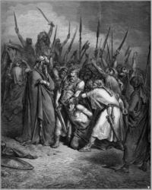
Gog - A Short Recap
Some versions of scriptures refer to Agag, king of the Amelecks, as either Agog or Gog – further linking Gog to Ameleck, the Edomites and Khazars.
The killing of King Agag

Slide 5
We Have Seen That The Russian People Are Not Gog

Slide 6
We Have Seen That The Russian People Are Not Gog
Here we see the Coat of Arms of the Royal House of Russia – Romanov dynasty – The eagle being an Israelite symbol and ruling over Ishmael looks to his brethren in West and to the East.

Slide 7
Archangel Michael Patron Saint Of Russia
Russia and the true Russian people are nominally Christian unlike the Christ hating anti-Christ Ashkenazim ….
Cathedral of Archangel Michael - Moscow

Slide 8
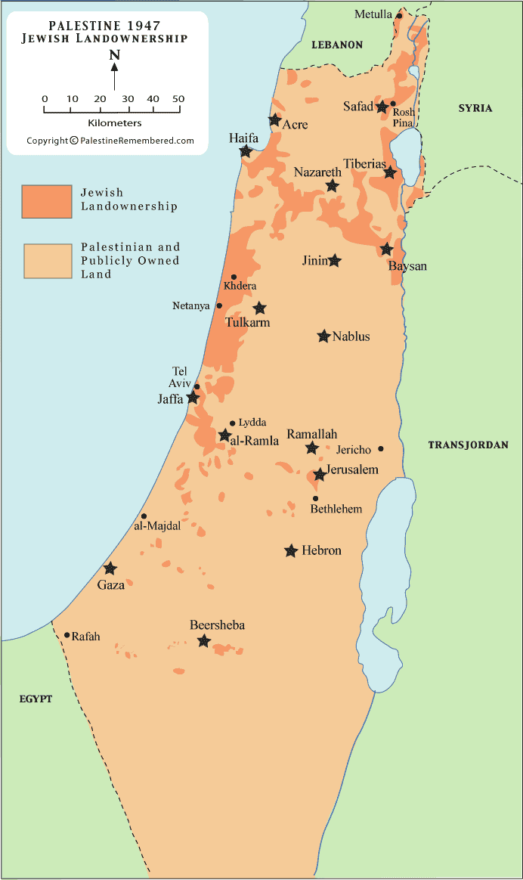
Archangel Michael Patron Saint Of Russia
…. Mongol Jews who hold the levers of power particularly in the Western nations and of course the abomination of desolation the Israeli state in Palestine.

Slide 9
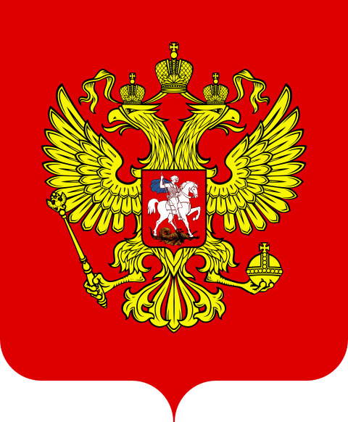
Archangel Michael Patron Saint Of Russia
The Russians like the Christian Germans have been demonised by the Gog controlled media

Slide 10
Russia No Longer Under Absolute Control By Gog
Russia is no longer under the Hammer and Sickle but the old Russian red white and blue tricolour

Slide 11
Futurists – Russia To Attack Israeli State – This May Prove To Be True
But True Israel is elsewhere!!

Slide 12
Gog - A Short Recap Gog’s Attack Was In 2 Phases
Overt
Attila & Genghis Khan
Covert
Secret Societies – The Illuminati, Freemasons etc.

Slide 13
Gog’s Multi-Front Covert Attack
We have seen that the later covert attack by Gog has been a multi-front attack through many secret societies and organisations

Slide 14
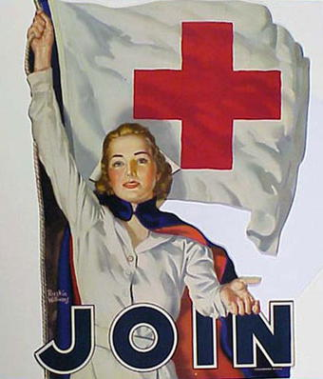
Gog’s Multi-Front Covert Attack
All Societies and organisations with any influence are infiltrated by Gog’s agents.
Gog is careful to maintain an impeccable front (image) to cover his subversive activities

Slide 15
Gog – Conceives An Evil Thought
Ezekiel 38: 10-12; Thus sayeth the Lord God: It shall also come to pass, that at the same time shall things come into thy mind, and thou shalt think (conceive / plan) an evil thought:
The evil plan

Slide 16
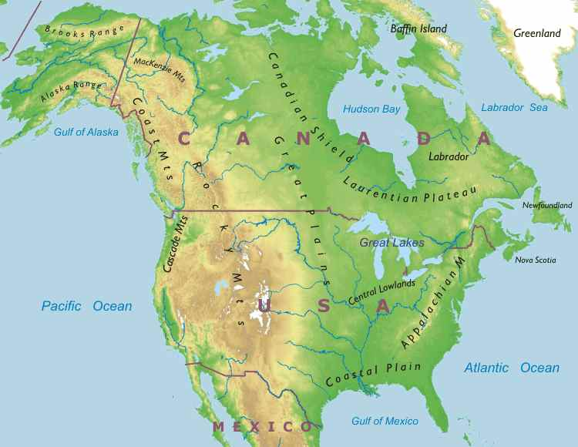
Gog – Conceives An Evil Thought
And thou shalt say, I will go up to the land of unwalled villages: I will go to them that are at rest, that dwell safely, all of them dwelling without walls, and having neither bars nor gates, to take a spoil and to take a prey.

Slide 17
Old Babylon Has Moved!
Here we see a depiction of Babylon in all its former glory – although it was utterly destroyed it now lives on secretly in the City of London

Slide 18
Babylon’s New Headquaters

Slide 19
The City Of London Dragon
Whose tentacles spread across the world
Gog’s Secret Headquarters
We have seen how the City of London is the Babylonian headquarters and seat of the Anti-Christ and not Rome, Moscow, Bruxelles, New York or Washington which are mere subsidiaries and all controlled from London

Slide 20
Gog’s Government Headquaters
The White House – Washington DC

Slide 21
Gog’s Military Headquarters
The pentagram shape represents the 5 pointed star of the Idumeans.
The Pentagon is divided up in to 11 major sections – the Illuminati number.
At the centre are 6 spokes representing the Rothschild’s hexagram.
The Pentagon

Slide 22
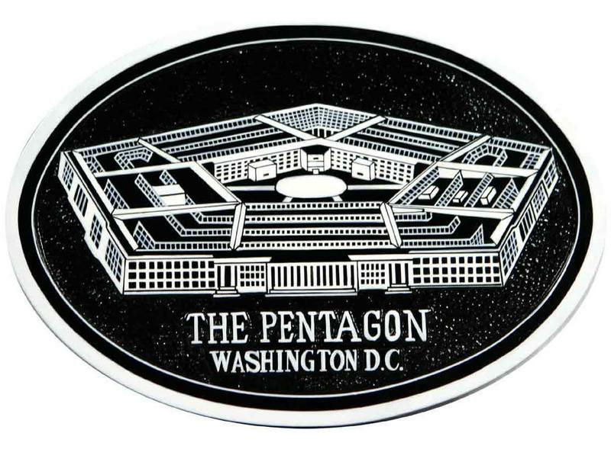
Gog’s Military Headquarters
The pentagram was known to medieval alchemy as the sign of the cloven hoof .... (Hall.. Magic, Los Angeles, CA: Philosophical Research Soc., pg. 46)

Slide 23
Gog’s Headquarters For Subversion Of Christianity And Other Religions
Vatican City

Slide 24
Gog’s Dips Into Our Pockets To Take a Great Spoil
We have seen how the banks led by The Bank of England have been Gog’s instrument in taking a great spoil as foretold by the scriptures, but most are ignorant of this fact!

Slide 25
Coal Industry Destroyed
A Working Coal Colliery Now A Rare Sight
Immediately after WW2 Gog would go all out to make the UK’s huge reserves of coal a non useable asset by manipulating the commodity market in favour of oil –

Slide 26
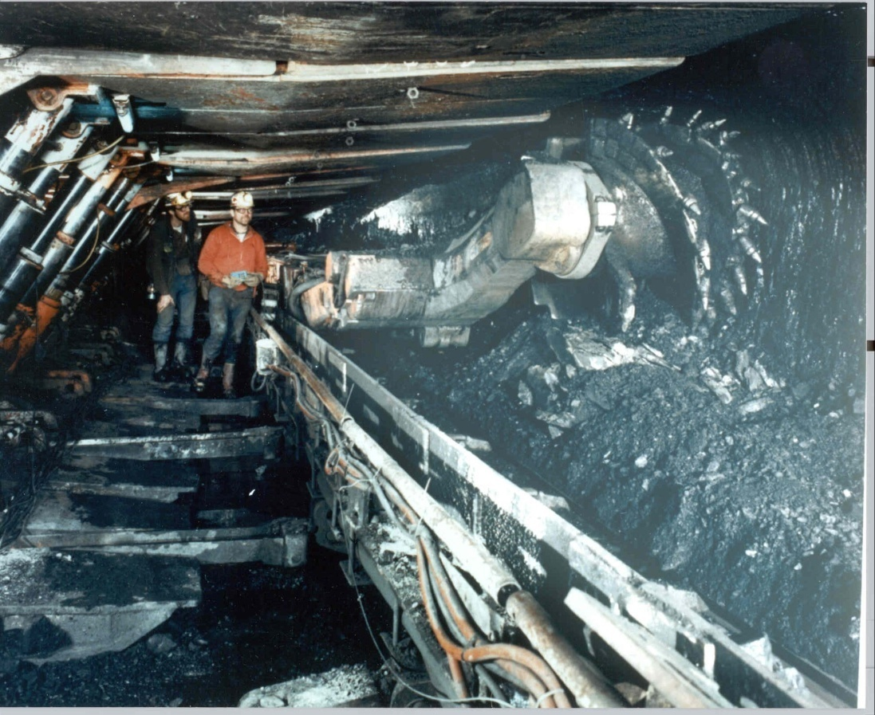
Coal Industry Destroyed
… first by supplying oil very cheaply relative to coal and secondly by causing strife between the miners and their employers.
A working coal mine

Slide 27
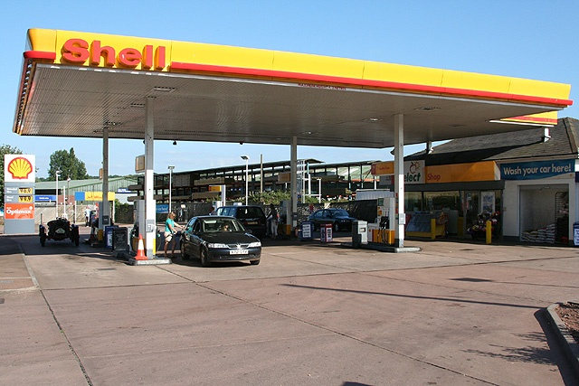
Coal Industry Destroyed
Once hooked on oil, the price would be hiked by artificially engineered crises. Once closed the pits would be prohibitively expensive to reopen.

Slide 28
Brown Coal & Other Inferior Coal Imported
The superior UK coal was exported while at the same time importing inferior brown coal.
This would enable Gog to bring in smoke control regulations thereby making it possible to make ….

Slide 29
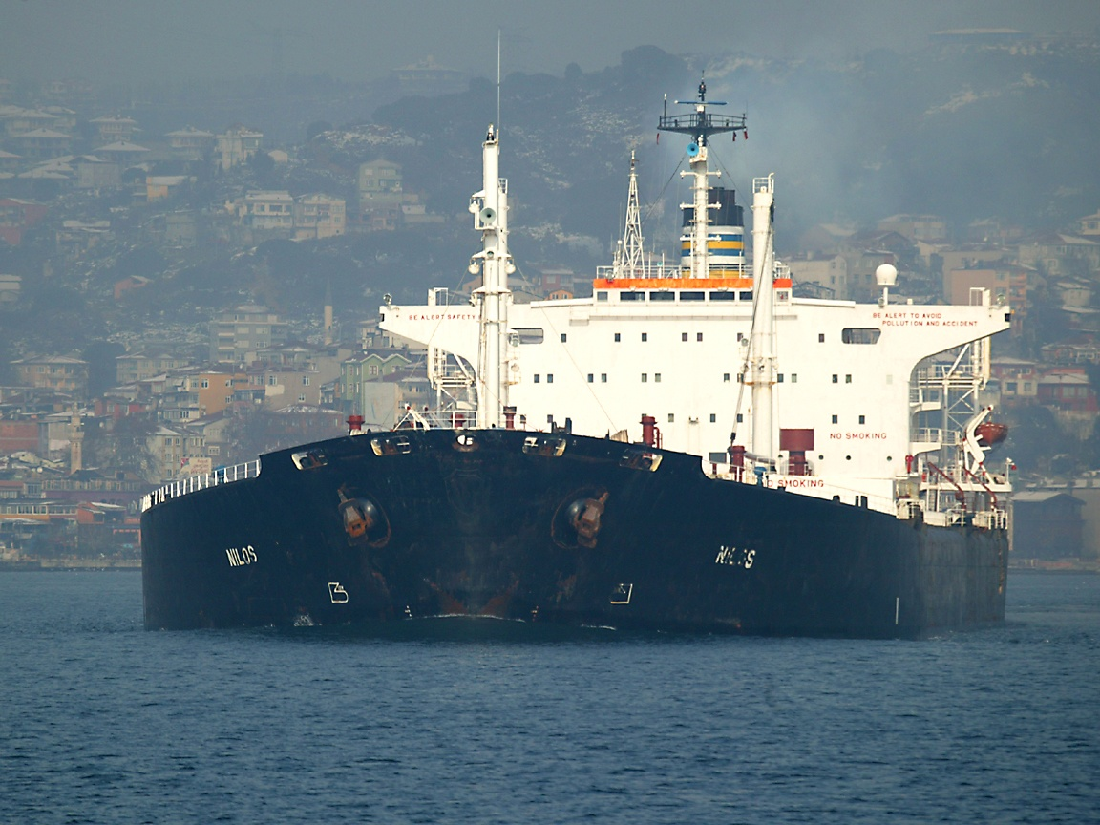
Brown Coal & Other Inferior Coal Imported
… the country dependent on foreign oil imports which would decimate the coal industry while making the UK less self sufficient.

Slide 30
The Great Fog of 1952
This famous fog was to a large extent engineered by Gog. This was done by supplying the domestic market with inferior brown coal with its noxious smoke and fumes, instead of high quality Welsh, English and Scottish coal as formerly.

Slide 31
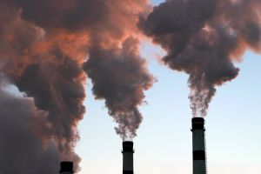
The Great Fog of 1952
This would enable stringent regulations to be brought in as to what fuel could be burnt and would pave the way to making the UK dependent on foreign oil.

Slide 32
The Fishing Industry Destroyed
Under the pretext of conserving fish the UK’s Fishing industry is now but a shadow of its former self. Our once bountiful supplies of fish are no more – yet another example of Gog taking a great spoil
The Grimsby Fishing Fleet

Slide 33
The Fishing Industry Destroyed
The owners of fishing boats that have managed to survive, operate under very difficult conditions, being restricted as to where they can fish, and only being allowed out on certain days
A North Sea Trawler

Slide 34
Ship Building Industry Destroyed & Moved Abroad
Ship building is another great industry that has been seized and destroyed by Gog
Ship building thrived as here in the Clyde

Slide 35
The Steel Industry Destroyed
The Steel Making industries of all the Israelite nations have been decimated – with manufacturing infrastructure having been transferred to 3rd world countries such as India and China.
A Welsh steel making plant

Slide 36
The Steel Industry Destroyed
Now vast quantities of steel are being imported into the UK and other Israelite countries from India and China.
A Steel Warehouse

Slide 37
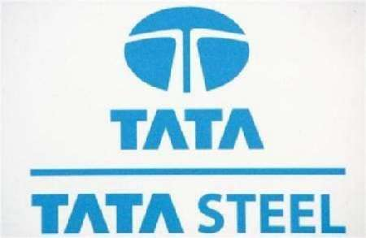
The Steel Industry Destroyed
Much of this steel is inferior and caused the Hertford rail crash – of course those responsible for buying this poor quality steel weren’t prosecuted, instead the blame was conveniently placed on those responsible for maintenance.
Indian Steel Logo

Slide 38
The Car Industry Destroyed
Car manufacturing in Israelite countries is just a mere shadow of what it used to be.

Slide 39
Gog’s Democracies
The people think they elect their governments, but in reality are just electing the puppets.

Slide 40
Gog’s Elected Puppets
Many of these elected puppets turn out to be traitors to their country and people

Slide 41
Gog’s Elected Puppets
Here we see another long-term “sleeper” turned traitor, Rev. Ian Paisley, seen here with IRA terrorist chief Martin McGuiness laughing together,

Slide 42
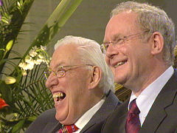
Gog’s Elected Puppets
… no doubt laughing over how they have duped the gullible public and the large reward they will receive from their hidden masters.

Slide 43
Gog’s Elected Puppets
The Gathering of the Northern Ireland traitorous puppets led by Tony Blair and the Rev. Ian Paisley

Slide 44
Gog’s Signals
We have seen how Gogites uses hand signals to recognise each other – The Hebrews referred to the Edomites as those people with the funny handshakes!

Slide 45
Gog’s Signals
Condoleezza Rice giving evidence with fingers crossed so as to be able to lie with impunity to the congressional investigative committee looking into the Iraq fiasco.

Slide 46
Gog’s Signals
Almost all the Western leaders attend elite establishment clubs such as this one – The Bohemian Grove where orgies and even human sacrifices are purported to take place

Slide 47
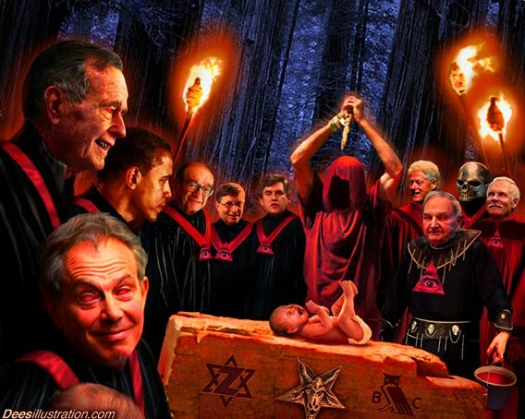

Slide 48
Gog – Destroys Our Cattle
Psalm 50:10
For every beast of the forest is mine, and the cattle upon a thousand hills.
The vast herds of cattle and flocks of sheep are another mark of Israel – so Gog is going all out to destroy these as well as remove our food supply. Just as they removed the plentiful herds of Bison from the USA

Slide 49
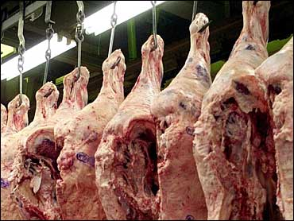
Gog – Destroys Our Cattle
… so Gog is going all out to destroy these as well as remove our food supply. Just as they removed the plentiful herds of Bison from the USA …..

Slide 50
The Land of Magog takes control of the USA’s retail industry as in other Israelite nations

Slide 51
Gog Gains Control Of Food Distribution
Gog has over recent years accelerated the growth of supermarkets at the expense of the small independent businesses.

Slide 52
Gog Gains Control Of Food Distribution
Once Gog has full control of the food supply it will be only a matter of time before food is withheld to cause a holocaust as occurred to the Ukrainians under Stalin.
A typical supermarket

Slide 53
Jerusalem Has Moved Too!
New Jerusalem in the sides of the north

Slide 54
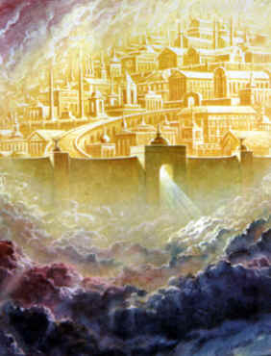
Jerusalem Has Moved Too!
Psalm 48:2
Beautiful for situation, the joy of the whole earth, is mount Zion, on the sides of the north, the city of the great King.
As we see from this verse (New) Jerusalem is in the northern hemisphere
A fanciful depiction of New Jerusalem

Slide 55
Prophetic Jerusalem Not The Old Jerusalem
The North Tower was hit first – symbolising an attack against Yahweh (God) whose offspring resides in the north

Slide 56
Israel Was To Move No More!!
2 Samuel 7:10
Moreover I will appoint a place for my people Israel, and will plant them, that they may dwell in a place of their own, and move no more; neither shall the children of wickedness afflict them any more, as beforetime,
Israel on the move in the wild west
Their capital city moved too!

Slide 57
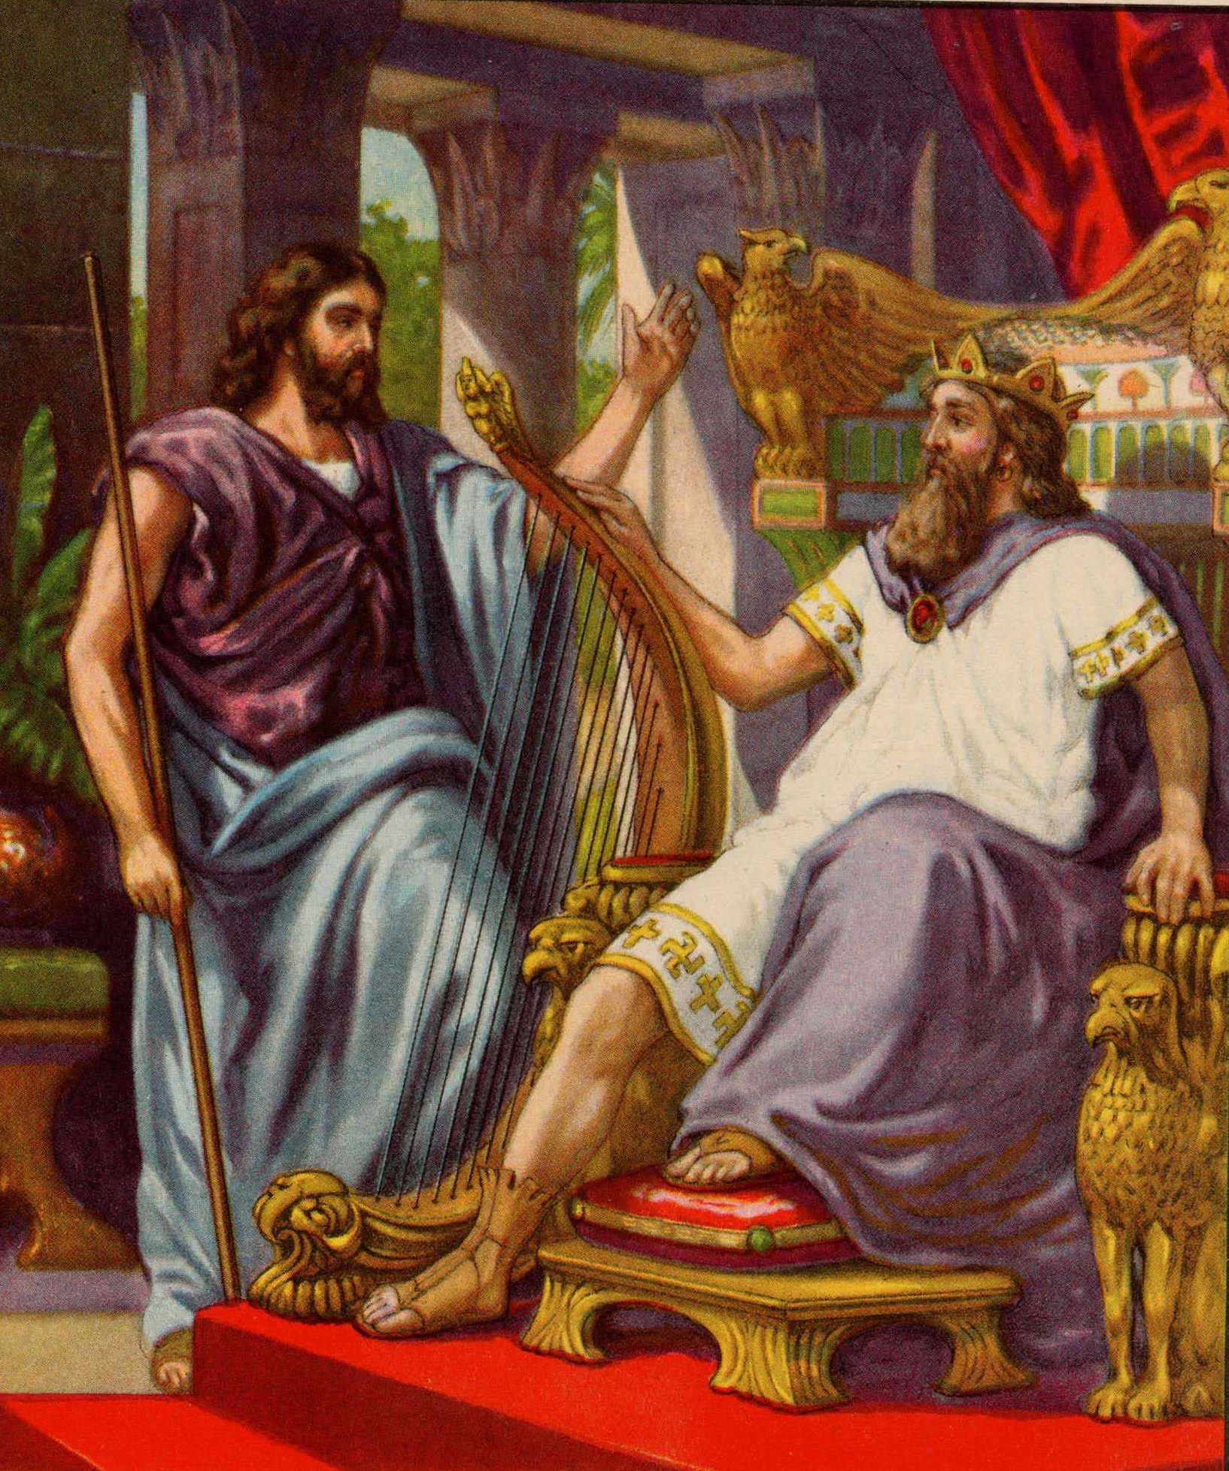
Israel Was To Move No More!!
When Yahweh spoke to David about the appointed place he was already in Palestine, so obviously he was not speaking about the modern state of Israel!
King David

Slide 58
Israel Was To Move No More!!
John 4:21 Jesus saith unto her, Woman, believe me, the hour cometh, when ye shall neither in this mountain, nor yet at Jerusalem, worship the Father.
Woman at the well

Slide 59
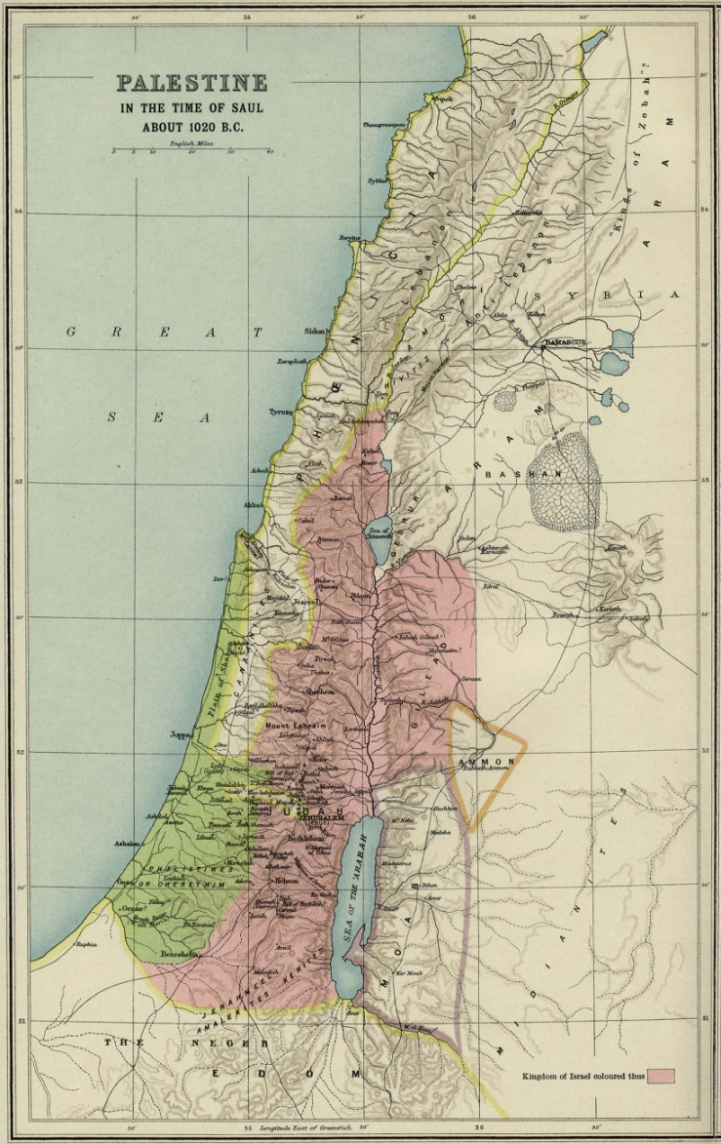
Israel Was To Move No More!!
Jesus was foretelling that the Holy Land and old Jerusalem would no longer worship Yahweh

Slide 60
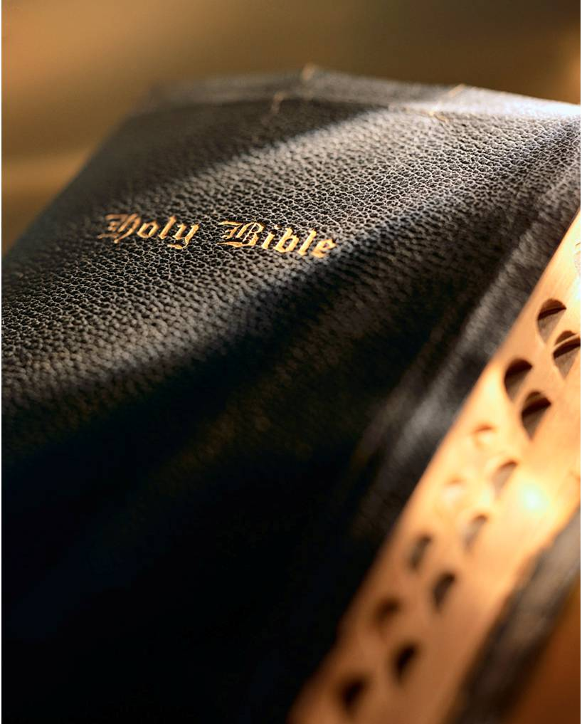
All Nations Against Jerusalem
Zechariah 2:1-4, "I lifted up mine eyes again, and looked and behold a man with a measuring line in his hand. Then said I, Whither goest thou? And he said to me, To measure Jerusalem, to see what is the breadth thereof, and what is the length thereof

Slide 61
All Nations Against Jerusalem
The New Jerusalem was so large that it would take an angel to measure it

Slide 62
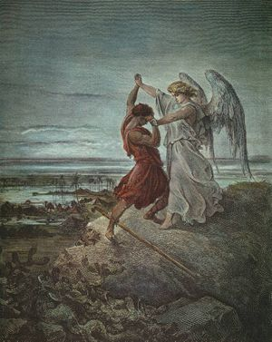
All Nations Against Jerusalem
… And, behold, the angel that talked with me went forth, and another angel went out to meet him. And said unto him, Run, speak to this young man, saying, Jerusalem shall be inhabited as towns without walls for the multitude of men and cattle therein."

Slide 63
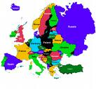
All Nations Against Jerusalem
Here we see that Jerusalem consisted of many towns with a multitude of men and cattle obviously not the old Jerusalem!

Slide 64
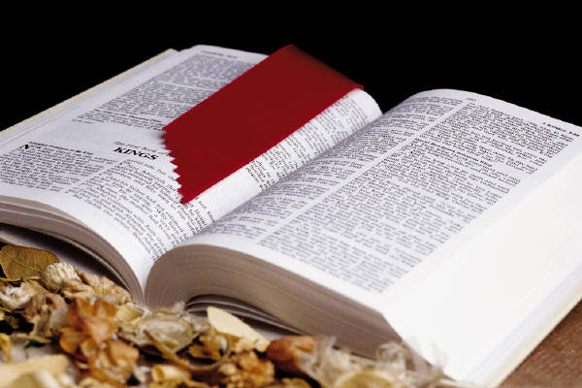
Jerusalem Has Moved To The North
Matthew 10:23 "For verily I say unto you, ye shall not have gone over the cities of Israel, till the Son of man be come."

Slide 65
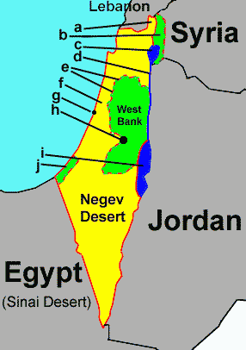
Jerusalem Has Moved To The North
The disciples could have gone over the towns in old Palestine in a matter of weeks, and missionaries still could do so today. But if the cities of Israel were to be "spread abroad" and to be a great number, it could not be done so quickly.
The Israeli State is a small country!

Slide 66
All Nations Against Jerusalem
Zechariah 14:2
For I will gather all nations against Jerusalem to battle; and the city shall be taken, and the houses rifled, and the women ravished; and half of the city shall go forth into captivity, and the residue of the people shall not be cut off from the city.

Slide 67
New Jerusalem Divided
Here we see the New Jerusalem divide as foretold, with half going into slavery as shown coloured red on the map to the left.
The Political Map of Europe 1945

Slide 68
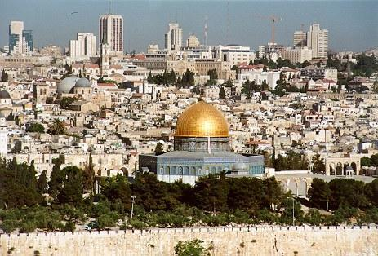
Jerusalem Has Moved To The North
Those who look to the old Jerusalem would say that, that happened when the Israeli state came into being up until the 6 day war when half was held by the Jordanians. They certainly weren’t in slavery!
Old Jerusalem

Slide 69
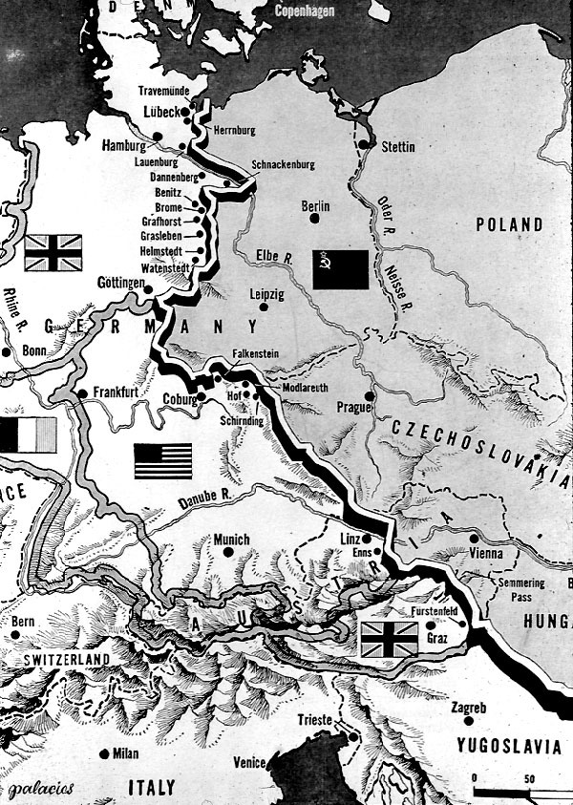
New Jerusalem Divided
From Stettin in the Baltic to Trieste in the Adriatic an "iron curtain" has descended across the Continent. Behind that line lie all the capitals of the ancient states of Central and Eastern Europe. Warsaw, Berlin, Prague, Vienna, Budapest, Belgrade, Bucharest and Sofia.

Slide 70
New Jerusalem Divided
Churchill was responsible for popularising the term Iron Curtain
Sir Winston Churchill

Slide 71
New Jerusalem Divided
Left: Churchill, Roosevelt and Stalin. The 3 war criminals who were responsible for dividing up the spoils of war and sending half of Europe into slavery to be followed by the other half with the rise of the EU.
The Yalta Conference 1945

Slide 72
Prophetic Jerusalem Not The Old Jerusalem
Psalm 48:2 Beautiful for situation, the joy of the whole earth, is mount Zion, on the sides of the north, the city of the great King.
Isaiah 14:13 For thou hast said in thine (Gog) heart, I will ascend into heaven, I will exalt my throne above the stars of God: I will sit also upon the mount of the congregation, in the sides of the north:

Slide 73
Gog – Unbars The Gates To Let In The Worse Of The Heathen
Blacks invade the canary islands to eventually make their way to London.

Slide 74
Gog – Recruits Aliens Into The Armies Of True Israel
The armies of true Israel are gradually by stealth being replaced by aliens, as these will willingly do the bidding of the NWO and not rise up in revolt. It is also another method of diluting the indigenous population.
A US Army Recruiting Centre in Mexico

Slide 75
Gog (Satan) Gathers The Nations To Battle
Having been loosed for a little season – Satan (Khazars) gather the Israel nations to battle under the guise of international organisations particularly the UN

Slide 76
Gog & Magog Have Been Striking Time In Melbourne Since 1992
Here we see Gog & Magog in Australia gathering together those whose number is as the sand of the sea (Israel) to war and the final battle. The Clock here showing the Illuminate's number 11 which is also scripture’s warning that the midnight hour cometh
Melbourne shopping arcade

Slide 77
Gog (Satan) – The Eighth Beast
Rev. 17:10 "the other is not yet come; and when he cometh, he must continue a short space."
Rev. 20: 3. And cast him in to the bottomless pit, and shut him up, and set a seal upon him, that he should deceive the nations no more until the thousand years should be fulfilled and after that he must be loosed a little season.

Slide 78
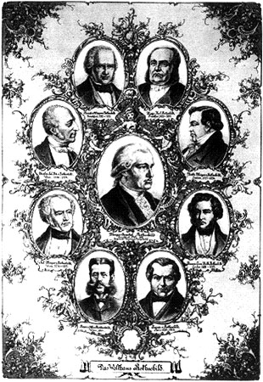
Gog (Satan) – The Eighth Beast
Notice the similarity of the previous 2 verses which would tend to indicate that Satan would be manifest in the eighth beast headed up by the Rothschilds.

Slide 79
Rothschild’s Coat of Arms
Notice the arrows attacking True Judah and Manasseh. The lion and unicorn supporters – which gives poignancy to Satan going round like (disguised) as a roaring lion.

Slide 80
Rothschild’s Burial Place
Rothschild's coat of arms at the entrance to Rothschild's burial place at the Ramat Hanadiv gardens in Israel.

Slide 81
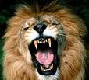
Like A Roaring Lion
The House of Rothschild have usurped the power of Judah – holder of the sceptre and even have had the audacity to have a replica of the Coat of Arms of The Royal House of David assigned to their satanic house. The Lion as we know is the emblem of The True House of Judah.
A roaring lion

Slide 82
Like A Roaring Lion
We have seen over recent years a proliferation of wars under the banner of peace in Kosovo, Iraq, Afghanistan and now with threats directed at Iran.

Slide 83
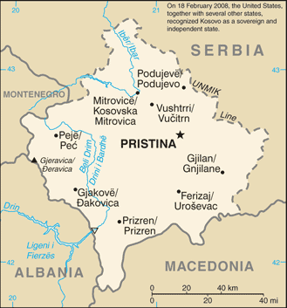
Like A Roaring Lion
These all headed up by the US & UK – Gog disguised as wolves in sheep's clothes – further evidence that we are in the time foretold of the roaring lion.
Kosovo

Slide 84
There Will No Longer Be A Canaanite In The House Of Yahweh
Zechariah 14:21
Yea, every pot in Jerusalem and in Judah shall be holiness unto the LORD of hosts: and all they that sacrifice shall come and take of them, and seethe therein: and in that day there shall be no more the Canaanite in the house of the LORD of hosts
Louis Mountbatten of a Jew corrupted line

Slide 85
There Will No Longer Be A Canaanite In The House Of Yahweh
As well as masquerading as Judah Gog has been by subterfuge marrying into Royalty as occurred with
Prince Alexander of Hesse-Darmstadt with his morganatic wife, Countess Julie von Hauke (Jewess)

Slide 86
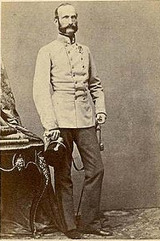
There Will No Longer Be A Canaanite In The House Of Yahweh
… the marriage of Prince Alexander of Hesse-Darmstadt (left) to Jewish lady in waiting promoted to a Countess – Julie von Hauke to whom the Mountbattens are related.

Slide 87
Queen Elizabeth The Last?
One must ask will Queen Elizabeth II be the last monarch to sit on the Throne of David before the return of Yahweh having regard to the corrupted line in her offspring?

Slide 88
Queen Elizabeth The Last?
Under Elizabeth 1 England started to expand into an empire as did other Israelite nations also one could be fined for not growing hemp.

Slide 89
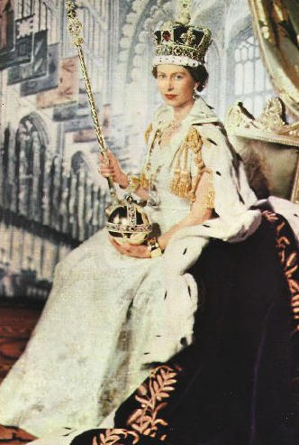
Queen Elizabeth The Last?
However, under Elizabeth II the empire disintegrated as did other Israelite nations, also one could be fined or imprisoned for growing hemp.

Slide 90
Queen Elizabeth The Last?
The coronation stone was taken from Westminster Abbey on November 14, 1996 the day of Prince Charles birthday!
This was a significant event for the House of David and the Israel nations – portending a great event in the near future.

Slide 91
Is Prince Charles a Convert to Islam?
1997 Middle East Quarterly Magazine

Slide 92
Queen Elizabeth The Last?
Prince Charles remarried to a Jewess Camilla Parker Bowles – has this sealed his fate as future heir to the Throne of David.

Slide 93
They Shall Condemn Themselves
Luke 19:22
And he saith unto him, Out of thine own mouth will I judge thee, thou wicked servant.

Slide 94
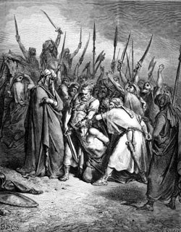
They Shall Condemn Themselves
We shall see from the following slides that is precisely what Gog / Amaleck here in the parable referred to as the wicked servant has been condemning himself.

Slide 95
They Shall Condemn Themselves
Disraeli, speaking at Aylesbury, 20th September, 1873, said:—
"I can assure you, Gentlemen, that those who govern must count with new elements! We have to deal not with Emperors and Cabinets only. We must take into consideration secret societies,
Benjamin Disraeli
Notes:
Arnold Leese 1930

Slide 96
They Shall Condemn Themselves
Disraeli, speaking at Aylesbury, 20th September, 1873, said:—
… who can disconcert all measures at the last moment, who have agents everywhere, determined men, encouraging assassinations, and capable of bringing about a massacre at any moment."
Benjamin Disraeli
Notes:
Arnold Leese 1930

Slide 97
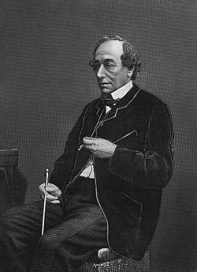
They Shall Condemn Themselves
1852
Jewish, British Prime Minister Benjamin Disraeli warns Europe, in a speech to the House of Commons, that Jewish persons are dangerous to Western, conservative ideas. Few listen.
Benjamin Disraeli

Slide 98
They Shall Condemn Themselves
1935
"You cannot be English Jews. We are a race, and only as a race can we perpetuate. Our mentality is of Edomitish character, and differs from that of an Englishman.

Slide 99
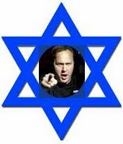
They Shall Condemn Themselves
Enough subterfuges! Let us assert openly that we are International Jews." (From the manifesto of the "World Jewish Federation," January 1, 1935, through its spokesperson, Gerald Soman)

Slide 100
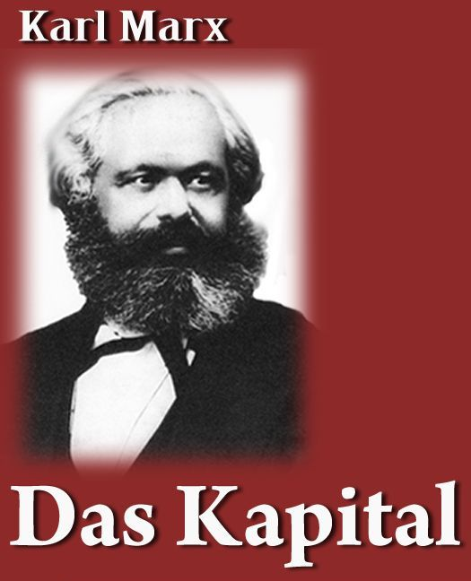
They Shall Condemn Themselves
1936
"Marxism, you say, is the bitterest opponent of capitalism, which is sacred to us. For the simple reason that they are opposite poles, they deliver over to us the two poles of the earth and permit us to be its axis.

Slide 101
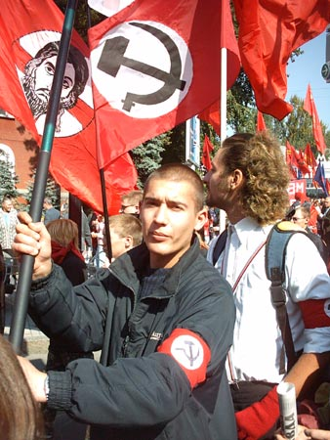
They Shall Condemn Themselves
These two opposites, Bolshevism and ourselves, find ourselves identified in the International. And these two opposites, the doctrine of the two poles of society,

Slide 102
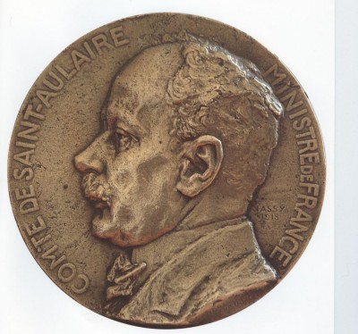
They Shall Condemn Themselves
… meet in their unity of purpose, the renewal of the world from above by the control of wealth, and from below by revolution." (Quotation from a Jewish banker by the Comte de Saint‑Aulaire in Geneve contre la Paix Libraire Plan, Paris, 1936)
Comte de Saint‑Aulaire

Slide 103
They Shall Condemn Themselves
1976
False Prophets Exposed By Arthur Koestler In His Book “The Thirteenth Tribe” showing that 92% of today’s Jews are of Khazar origin whose original home was Asia not Palestine.
Arthur Koestler

Slide 104
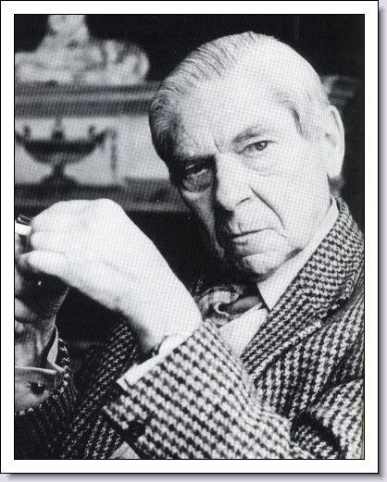
They Shall Condemn Themselves
Born: 3-Sep-1905 Birthplace: Budapest, Hungary Died: 3-Mar-1983 Location of death: London, England Cause of death: Suicide (or so they say)

Slide 105
They Shall Condemn Themselves
THE LATE JACK BERNSTEIN
.. was a rarity—an American Zionist who actually "returned" to Israel.
His ability was to see through the sham and hype to the oppressive, racist, parasitic character of Zionism as practiced in modern Israel, ….

Slide 106
They Shall Condemn Themselves
… and his courage to denounce it with the force and fervour of an Old Testament prophet. This Honest and courageous Jew was assassinated some years ago by the Israeli MOSSAD

Slide 107
They Shall Condemn Themselves
Benjamin H. Freedman in a letter to Dr. David Goldstein exposed the great Jewish deception that they are God’s chosen people - 92% of them are Asiatics with not a drop of Hebrew blood in them and was later published in book form under the title Facts are Facts.

Slide 108
They Shall Condemn Themselves
ARIEL TOAFF Professor of Medieval and Renaissance History at Bar-Ilan University in Israel, Toaff has written the book Pasque di sangue (Bloody Passover) and gives another insight into Jewish ritual sacrifice.
Professor ARIEL TOAFF

Slide 109
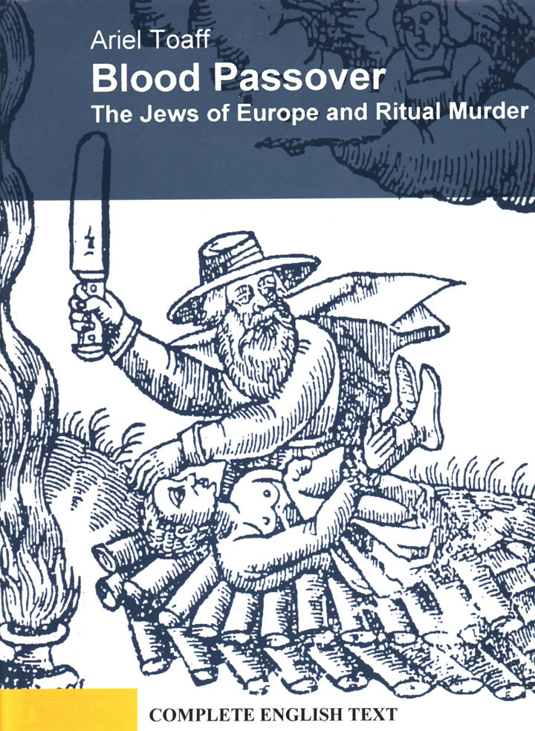
They Shall Condemn Themselves
Although written by a Jew, the Italian version of the book was removed from shops – an English version still exists on the internet.

Slide 110
Gog Reinvents Himself As God’s Chosen
Prior to Gog’s concerted attack on the Anglican Church, people were aware subconsciously that they were God’s Israel through the use of the Book Of Common Prayer, believed to have come down from the disciples,
Book of Common Prayer

Slide 111
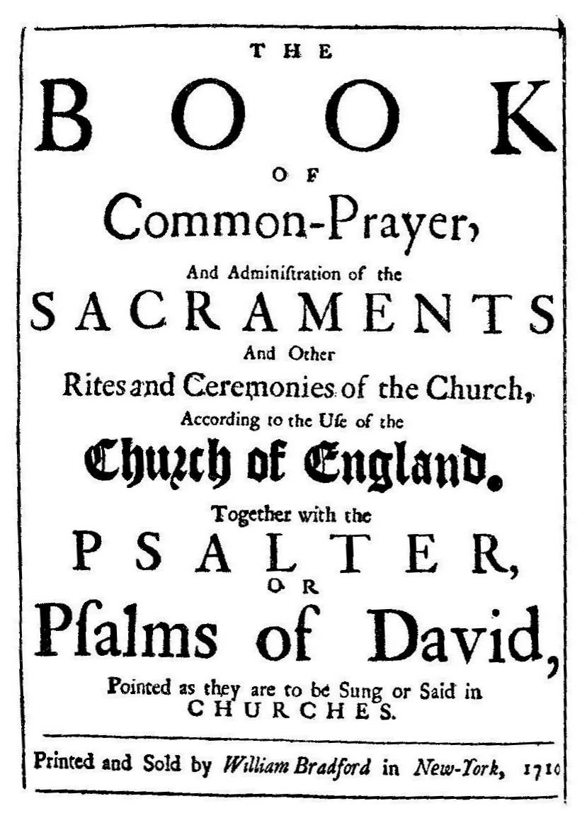
Gog Reinvents Himself As God’s Chosen
… as constant reference is made to the fact that the congregations are Israel.
For this reason the Book of Common Prayer had to be removed from the churches.

Slide 112
The first step necessary in enabling Gog to control the world was to re-invent himself as God’s chosen and in order to give credence to this, it would be necessary to take possession of the Holy Land (“My Land”) as prophesied in Ezekiel.

Slide 113
In order to do this, It would be necessary to change the signposts of prophecy:-

Slide 114
That Israel would be regathered into its chambers in the Middle East and not the appointed place in Europe, USA and other white dominions.

Slide 115
… that Christians see the rise of the NWO as hastening the day when they would be whisked away from all the troubles here on earth,

Slide 116
..
…. and not actively appose the system but instead withdrawing from politics and leaving the enemy a clear field with no opposition.

Slide 117
Gog Taking Yahweh’s Name In Vain
By calling it the Israeli State they are declaring it is their land – the suffix I in Hebrew means “my” and are therefore in effect calling My Land their land.

Slide 118
The Holocaust Myth
Was Another of Gog’s Ingenious Ploys To gain The Sympathy Of The Gullible Christians.

Slide 119
The Holocaust Myth
Covered up the real Holocaust of Germans & Christian Russians and ensured that the dispossessing of Palestinian Arabs proceeded with no objections

Slide 120
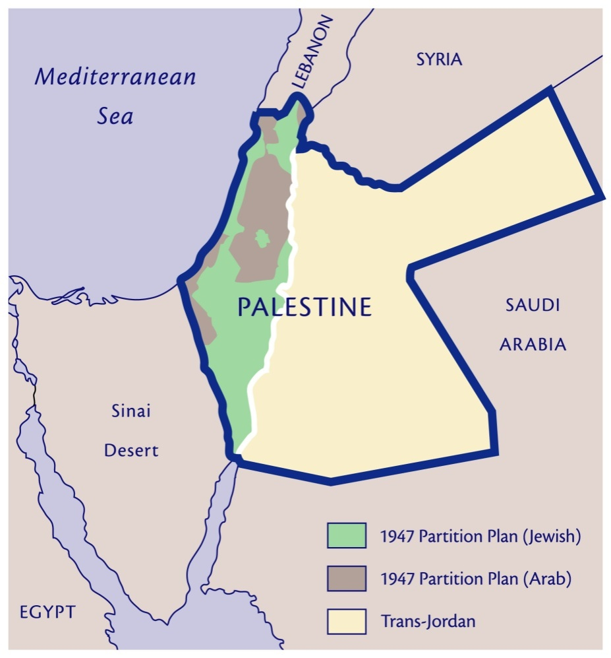
Gog Prepares To Take Over “My Land” - Palestine
The Gog takeover of Palestine was planned long ago just as the world wars and holocaust were.
It required long term conditioning of people in western nations, particularly the UK & US.

Slide 121
Gog Prepares To Take Over “My Land” - Palestine
As we shall see in the following slides it started in the 1600’s as up to then Jews were kept at arms length and were known for what they are i.e. the murderers of Christ.
A Palestinian boy trying to halt the advance of a Jewish Tank

Slide 122
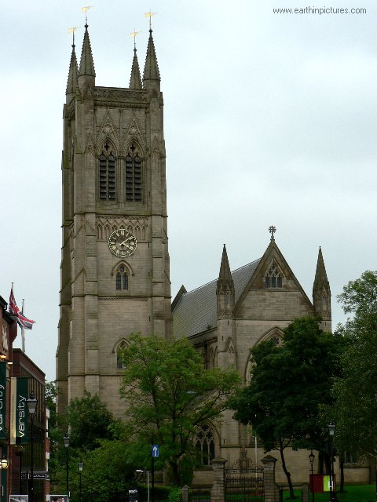
Gog Prepares To Take Over “My Land” - Palestine
This would be achieved by massive infiltration of the Church and associated institutions.

Slide 123
Gog – Gains Control Through The Church
Jude 1:4 For there are certain men crept in unawares, who were before of old ordained to this condemnation, ungodly men, turning the grace of our God into lasciviousness, and denying the only Lord God, and our Lord Jesus Christ.
RHEIMS CATHEDRAL

Slide 124
Gog – Gains Control Through The Church
As we see, the infiltration of the church by Edom is nothing new! In the days of Christ, the priesthood was infested with Canaanites and as Christianity started to take hold, the Jews could see that they had to pretend to be Christians as well in order not to loose their hold on the Israelites.
DRESDEN CATHEDRAL

Slide 125
Gog – Gains Control Through The Church
The church of the apostles’ day would over many centuries be changed by stealth into what we know today as the Catholic Church in the West and the Orthodox Church in the East.
ULM CATHEDRAL

Slide 126
Gog – Gains Control Through The Church
Even following the Reformation, protestant churches have again been infiltrated to the extent that to many it is hard to tell the difference between them and the Catholic Church.
KOLN CATHEDRAL

Slide 127
Gog Reinvents Himself As God’s Chosen
Up until the 1600’s the Jews were regarded as Christ’s enemies and were not absorbed into society – a lord would happily sit down to a meal with one of his lowly estate workers but would never be seen sharing his table with a Jew.
St. Mary’s Church Tidworth

Slide 128
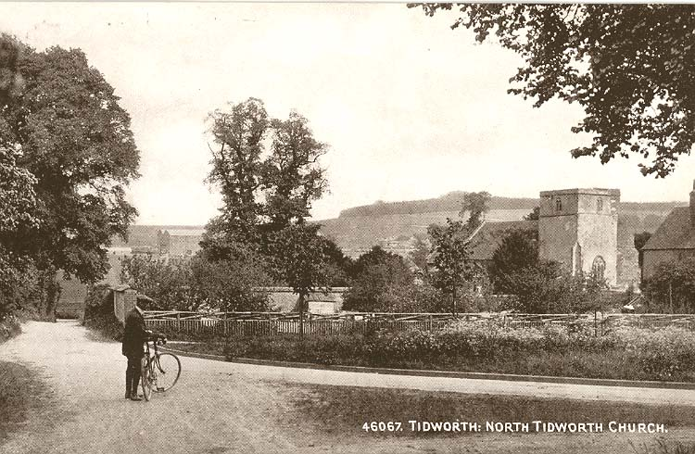
Gog Reinvents Himself As God’s Chosen
All this would change with the birth of Robert Marton in Tidworth Wiltshire in 1607.

Slide 129
Gog Reinvents Himself As God’s Chosen
Interestingly both Robert Maton & Gog’s other agent Christopher Wren were born in Wiltshire and both studied at Wadham College, Oxford Marton published….
Wadham College Oxford

Slide 130
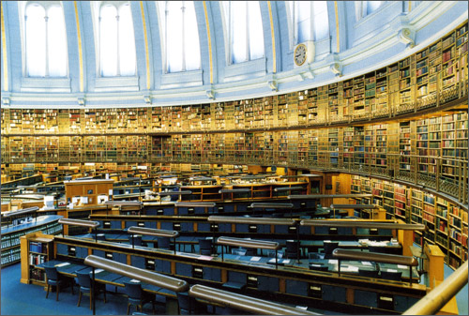
Gog Reinvents Himself As God’s Chosen
… a book entitled Israels Redemption or the Propheticall History of Our Saviours Kingdom on Earth This text was published and bound with the second work, entitled A Discourse of Gog and Magog, The Battle of the Great Day of the Lord Almightie.
These books are long out of print – only to be found in large libraries

Slide 131
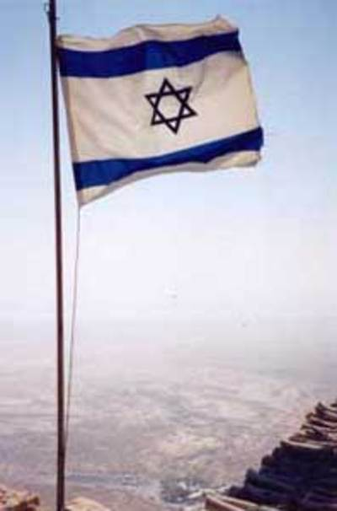
Gog Reinvents Himself As God’s Chosen
His book put forward the thesis that the Jews had to be regathered in Israel (Palestine) and then the Lord’s Millennial reign would be ushered in.

Slide 132
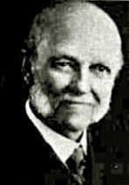
Gog Reinvents Himself As God’s Chosen
1878
Following on from Robert Maton Methodist minister William E. Blackstone publishes Jesus is Coming, an exposition of the widespread "dispensationalist pre‑millennialist“ cause.
William E. Blackstone

Slide 133
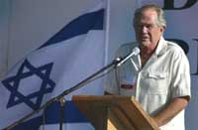
Gog Reinvents Himself As God’s Chosen
Christian teaching that the Jews must return to the Holy Land before Jesus' Second Coming can occur. Christian fundamentalists unwittingly embrace the Zionist cause.
Pat Robinson

Slide 134
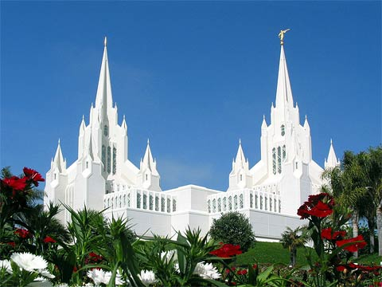
Gog Reinvents Himself As God’s Chosen
It was during this period that Joseph smith had his vision which gave rise to the Mormons.
Mormon Temple – Fort Lauderdale, Florida

Slide 135
Gog Reinvents Himself As God’s Chosen
No mention of the Rapture until 1830 – when a Margaret Macdonald had a vision when she was dangerously ill and near to death, of the elect being caught up to meet the Lord in the air.
Joseph Smith

Slide 136
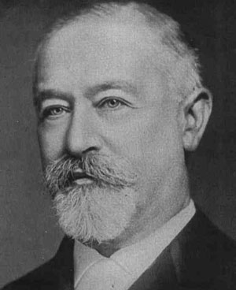
Gog Reinvents Himself As God’s Chosen
When the Mormon Church needed financing in the late 19th century, they went to Kuhn, Loeb Co. who were under the control of Rothschilds. Thus ensuring that Jews would be given due deference as God’s chosen people
Jacob Schiff Of Kuhn Loeb

Slide 137
Gog Reinvents Himself As God’s Chosen
Ellen G. White a Jewess also had a vision in 1847 which gave rise to the Seventh Day Adventists a break away from the Jehovah’s Witnesses and the Church of God – all part of Gog’s plan to sow confusion and split the church.
Ellen G. White

Slide 138
Gog Reinvents Himself As God’s Chosen
J. N. Darby: regarded as the founder of the 'Brethren'. As an Anglican curate Darby attended a number of mysteriously organised meetings on Bible Prophecy at Powerscourt in Ireland, where he learnt about the 'secret rapture’.
J. N. Darby

Slide 139
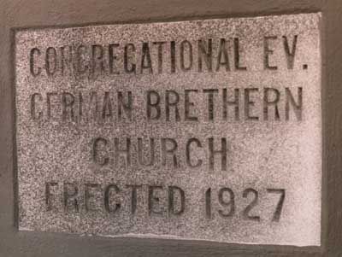
Gog Reinvents Himself As God’s Chosen
He carried the teaching into the Brethren and was one of the main sources that carried the theory into the heart of Evangelicalism. With a new veneer of being scriptural the teaching spread and was later popularised in the notes of the Schofield Reference Bible.

Slide 140
Gog Reinvents Himself As God’s Chosen
John Darby visited Margaret Macdonald and subsequently propounded the Rapture theory through the Brethren denomination following further enhancement of the theory from Scofield
Cyrus Ingerson Scofield 1843 - 1921

Slide 141
Gog’s Aim To Split And Cause Confusion In The Church
Up to the middle of the 1700’s worship was generally uniform throughout the UK and Christendom as whole, each country with its own variety. There wasn’t the plethora of denominations that we see today.

Slide 142
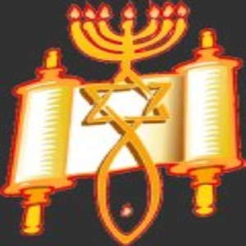
Gog’s Aim To Split And Cause Confusion In The Church
Many of these new denominations (cults) would be initiated directly by Gog’s agents; being of the tree of knowledge of good and evil they would be well able to do this
Jehovah's Witness Symbol

Slide 143
Gog Takes Advantage Of The State Of Church And Country
While Wesley revivals and others were good in the short term causing people to repent and turn to their God. However, Gog looks long-term. With denominations further splitting and holding a variety of different beliefs
John Wesley Preaching c.1766

Slide 144
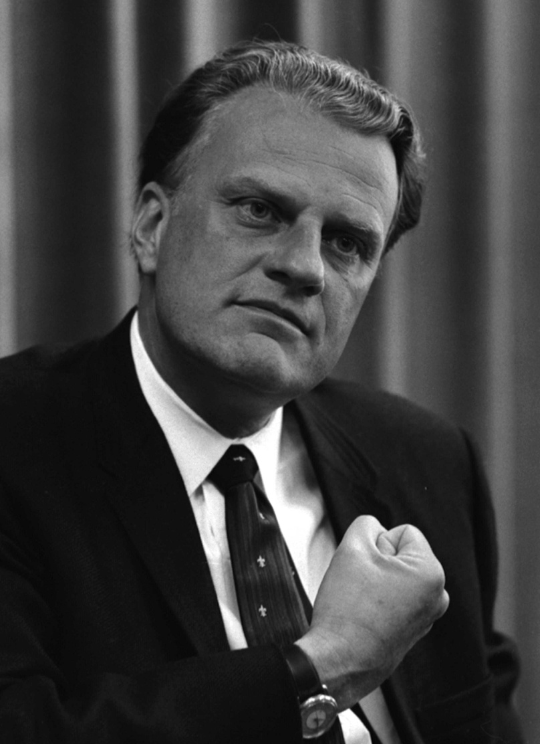
Gog Takes Advantage Of The State Of Church And Country
Gog would infiltrate his agents and then by stealth bring them to a uniform type of worship in the long term. – the universal faith church conforming to the Talmud.

Slide 145
Gog Takes Advantage Of The State Of Church And Country
At the same time people would be encouraged to disassociate from politics as being worldly!
The people would also be conditioned not to discriminate (between good and evil), to love everybody, to mongrelise, not to be patriotic but above all give their allegiance to the NEW WORLD ORDER
John Wesley Preaching c.1766

Slide 146
Gog’s Ecumenical Agent
Billy Graham was the driving force behind the ecumenical movement under various guises such as Churches Together and the Alpha Course or Alpha Curse as some call it.

Slide 147
Gog’s Ecumenical Agent
Little did the people know that they were being moulded to conform to the image of the beast.

Slide 148
Gog’s God Channel Agents
They (Gog) are more wiser than men like Jerry Falwell who run around proclaiming Israel is God’s nation. Men like Falwell are the type that this Author finds reference to repeatedly in Jewish documents that speak of their power within the Fundamentalists.
Jerry Falwell

Slide 149
Gog’s Tax Hold On Churches
The US government grants total tax exemption (other Israelite countries have similar schemes) to the Christian churches. Why? Because they serve the Jewish plan.
Benny Hinn

Slide 150
Gog’s Tax Hold On Churches
Christianity (as practised by most churches today) is an off-shoot of Judaism and a public relations organization that always works for "interfaith" cooperation, meaning Jewish control of Gentile religious thinking.

Slide 151
Gog’s Tax Hold On Churches
The Beatitudes (wrongly applied) are prescriptions for destruction at the hands of the crafters of the universal faith. To become a Christian is to deny yourself your right of survival in the deadliest struggle on earth.
The Beatitudes

Slide 152
Gog’s Tax Hold On Churches
Those whom the Jews would destroy they first make Christian, because it assures the Jew that the enemy will not fight back.

Slide 153
Israel’s Powerful USA Lobby
As well as fundamentalist religious support, Israel enjoys powerful political lobbying groups.
Notes:
American Israel Public Affairs Committee (AIPAC),

Slide 154
Gog – Starts To Merge Catholicism Other Pagan Religions
While the protestants are being drawn to Rome, Islam, Buddhism, Voodoo and many others are merging with Catholicism - to form a one world faith in the image of the NWO.

Slide 155
Gog’s Many Guises
We have seen in previous presentations on Gog – how Satan’s Canaanite offspring have hid themselves from view just like a parasite by burrowing into the host and attacking its vital organs – this they have done by changing their names in order to blend into the host nation and by grovelling very low to curry favour just as foretold by the scriptures
Cain - Giovanni Dupre.1846

Slide 156
Gog’s Many Guises
We have also seen how they have infiltrated the church, disguising themselves as the true Israel, changed the signposts of prophecy so that.

Slide 157
Gog’s Many Guises
God’s people are still looking for Gog to invade and take a great spoil when this has already happened under their very noses.

Slide 158
Gog’s Many Guises
Also They have substituted our Ishmaelite & Israelite cousins in Russia as the feared Gog.

Slide 159
What the Futurists would like
But God has put an obstacle in their way!
Notes:
TSAR NICHOLAS II LAST Emperor of the Third Rome First cousin to King George V of England First cousin to Kaiser Wilhelm II of Germany TSAR NICHOLAS II LAST Emperor of the Third Rome First cousin to King George V of England First cousin to Kaiser Wilhelm II of Germany TSAR NICHOLAS II LAST Emperor of the Third Rome First cousin to King George V of England First cousin to Kaiser Wilhelm II of Germany

Slide 160
Gog – Reinterprets Prophecy
This map showing the Gog/Magog onslaught on Israel sums up the futurist/Jesuit theory of this assault, which of course helps to hide the true identity of Gog.
True Israel is labelled Gog!

Slide 161
Gog – Reinterprets Prophecy
For most of the period when this theory was promulgated Gog was in control of the USSR and the State of Israel and during this time pretended to be enemies. However all this started to change after the so-called fall of communism in 1987.
Red Square Moscow

Slide 162
Land Of The Unwalled Villages?
The Israeli state is building yet more walls to isolate the Palestinians giving lie to those that say Gog will attack the Israeli State – but rather refers to the habitations of true Israel in Europe ….

Slide 163
Land Of The Unwalled Villages
… and particularly North America where there are no walled villages or cities – Canada derives its name from the Eskimo word meaning unwalled villages – which Gog has already seized as foretold in the scriptures

Slide 164
Palestine – The Land of Unwalled Villages?
Here is one of the many walls erected by the Israelis to isolate the Palestinian enclaves – which rival the Berlin wall for shear size and magnitude…
The futurists conveniently overlook the fact that Palestine is bristling with fortifications and walls!

Slide 165
Israeli State Brisling With Weapons Of Mass Destruction
False Israel's program has developed into one that rivals those of larger powers like France and Britain. This map is based on interviews with U.S. intelligence officials and nuclear experts, and is a portrait of Israel's strategic weapons programs.

Slide 166
Gog - Troubled
Daniel 11:44 But tidings out of the east and out of the north shall trouble him: therefore he shall go forth with great fury to destroy, and utterly to make away many

Slide 167
Gog – Reinterprets Prophecy
Since the fall of the USSR things have not gone quite to plan. With Gog’s manpower resources concentrated on the final subversion of the west, particularly the USA.
Gog’s grip on the USSR has weakened as indicated by the reinstatement of the old Russian flag.
St Petersburg Russia

Slide 168
Gog – Reinterprets Prophecy
Another indicator of this – Putin has banished a number of "oligarchs" and seized their assets. According to Rifat, they are all Rothschild fronts.
Vladimir Putin
Notes:
British-based Intelligence analyst Tim Rifat.

Slide 169
Gog – Reinterprets Prophecy
The British government and MI-6 are under Rothschild control and financing Chechen resistance. He predicts Putin will be assassinated within two years.

Slide 170
Gog – Reinterprets Prophecy
In the case of Russia, Rifat says recent Chechen terrorist attacks on two airliners and a school were designed to punish and undermine Vladimir Putin for his interference with Rothschild oil giant Yukos.
Yukos Oil Conglomerate

Slide 171
Gog – Reinterprets Prophecy
Putin refused to let his countries gigantic oil reserves to be handed over to the western oil cartel, known as the 7 sisters.

Slide 172
Gog – Reinterprets Prophecy
This angered the Rothschilds who instigated the Chechnya insurrection and Beslan massacre.

Slide 173
Gog – Reinterprets Prophecy
Obviously, Putin knew who was really responsible for the Beslan massacre.

Slide 174
Gog – Reinterprets Prophecy
While the western media were all reporting that the Moslems were responsible, He referred to getting revenge on the international terrorists!

Slide 175
Gog – Reinterprets Prophecy
In order to further hurt Russia, Gog manipulates elections in the Ukraine so as to bring in into the western camp.

Slide 176
Gog - Troubled
Gog troubled from the east and north because as we have seen Gog’s Babylonian headquarters is in London

Slide 177
Gog - Troubled
It could well be that Yahweh will use Russia to destroy the Israeli State, so the futurists prophecy would be fulfilled but not in the way they expected!

Slide 178
Russia’s Super Weapon Could It Be Turned Against Gog?
Notes:
Though Sunburn can fly 150 kilometers at Mach 2.1 [1,520 mph] at an average altitude of 60 feet, Onyx leaves this performance for dead. Using the same launch tubes as Sunburn, Onyx streaks along its extended 200+ kilometer flight path at a blistering Mach 2.9 [2,100 mph], while hugging the ground even closer at an average altitude of only 45 feet. Onyx is 100% “Fire and Forget”, meaning that once out of the launch tube, flight management is entirely automatic, and you can forget the doomed 93,000-ton aircraft carrier sitting meekly down range, only minutes away from being converted into environmentally-friendly heat and light.

Slide 179
Israeli State Brisling With Weapons Of Mass Destruction
Despite Israel's refusal to acknowledge its nuclear weapons status, its secret arsenal is an open secret that Israeli policy makers don't go out of their way to deny. From its beginnings in the mid-1960’s.
Planes lined up on a runway in Israel by courtesy of western taxpayers ready to attack Iran?

Slide 180
Gog – Makes Preparations To Attack Iran
The media is at the moment at full throttle denigrating Iran and labelling it as part of the axis of evil. All the countries who have this label, of course do not have a Rothschild central bank!

Slide 181
Iran Prepares For An Attack By Gog
Iranians on manoeuvres in preparation for an attack by Gog. The Iranians are more clued up to who the real enemy is compared with the Israelites in the west!
Iranians on manoeuvres

Slide 182
Destruction Of The Israeli State
The shock general churchianity will receive at the destruction of the Israeli state could well be the trigger point in bringing people to a realisation as to who true Israel is and that Yahweh is their God and they are not second class worshipers of a Jewish God.
Jerusalem Bomb – Portent of future judgment?

Slide 183
Gog Troubled
Ezekiel 38 : 16
And Thou Shalt Come Up Against My People of Israel, As A Cloud To Cover The Land: It Shall Be In The Latter Days, And I Will Bring Thee Against My Land That The Heathen May Know Me, When I Shall Be Sanctified In Thee, O Gog, Before Their Eyes.

Slide 184
Zionist State Will Be Destroyed
This verse reminds us that the Israeli state is to be destroyed which will be an astonishment to the heathen and the Judeo-Christian church and Edom’s cover will be broken.
The Israeli state’s weapons of mass destruction will be unable to protect it in the great day of Yahweh.

Slide 185
Gog’s - Numbers
3, 6, 9,11,13,33 & 666
We have seen that Gog places a cabbalistic number stamp on all prearranged events as a signal to those in the higher degrees of knowledge as well as the magical properties Gog places on these numbers.

Slide 186
Gog’s - Numbers
Generally it may be said the more sophisticated and devastating the event is, is reflected in the numbering of such events, i.e. 911, 333 (the Madrid Bombing) and 777 (The London bombing)
Kabala Symbol

Slide 187
911 Masterminded By Mossad With The Help Of Its Allies

Slide 188
Gog – Strikes Again Madrid 11th March 2004
The Madrid attack was exactly 911 days after World Trade Centre Attack

Slide 189
Gog’s - Numbers
The number 911 is of particular significance because the Illuminati regrouped into an organisation in the year 1111 and were recognised in Claremont in 1118 (1+1+1+8=11) and took no new members until 9 years later – hence 911 is reserved for extra special events such as the Great Fire of London, The Twin Towers and the Madrid Bombings.
Public Illuminati Logo

Slide 190
The Story Of Gog And Magog
A thought to leave you with
"You must conceal all the crimes of your brother Masons... and should you be summoned as a witness against a brother Mason be always sure to shield him.. It may be perjury to do this, it is true, but you are keeping your obligations
Howbeit no man spake openly of him for fear of the Jews. (John 7:13)

Slide 191
The Story Of Gog And Magog
The End Of Part Ten Chapter One
To be continued….. Chapter 2 – Iraq War and the destruction of Babylon/Gog

Slide 192
The Story Of Gog And Magog
The End

