Slide 1

Yahweh’s Racially Exclusive Covenant People
By
Pastor Eli James
{ www.anglo-saxonisrael.com }

Slide 2
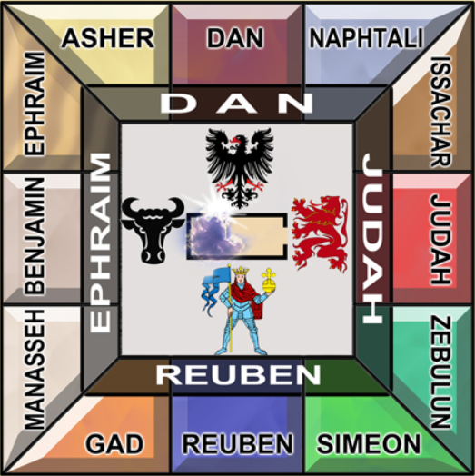
Yahweh’s Racially Exclusive Covenant People
“Behold it [Israel] is a people that shall DWELL ALONE.” - Numbers 23:9.
“For thou art an holy people unto Yahweh, your Elohim: Yahweh your Elohim hath chosen thee to be a special people unto Himself, above all the people that are upon the face of the earth.” – Deut. 7:6.

Slide 3

Yahweh’s Racially Exclusive Covenant People
“ Be ye not unequally yoked together with unbelievers: for what fellowship hath righteousness with unrighteousness? Wherefore come out from among them, and be ye separate, saith the Lord, and touch not the unclean thing; and I will receive you. And will be a Father unto you, and ye shall be my sons and daughters, saith the Lord Almighty.” - 2 Corinthians 6:14-18

Slide 4
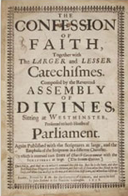
Yahweh’s Racially Exclusive Covenant People
Westminster Confession of Faith
VIII. The Old Testament in Hebrew (which was the native language of the people of God of old), and the New Testament in Greek (which, at the time of the writing of it, was most generally known to the nations), being immediately inspired by God, and, by His singular care and providence, kept pure in all ages, are therefore authentical; so as, in all controversies of religion, the Church is finally to appeal unto them….

Slide 5
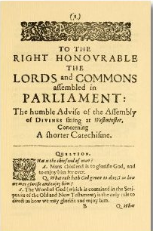
Yahweh’s Racially Exclusive Covenant People
Westminster Confession of Faith
….But, because these original tongues are not known to all the people of God, who have right unto, and interest in the Scriptures, and are commanded, in the fear of God, to read and search them, therefore they are to be translated in to the vulgar language of every nation unto which they come, that, the Word of God dwelling plentifully in all, they may worship Him in an acceptable manner; and, through patience and comfort of the Scriptures, may have hope.

Slide 6

Yahweh’s Racially Exclusive Covenant People
AWDAWM
It must be understood that the Hebrew word, ‘Awdawm,’ means, “to show blood in the face.”
Strong's #119: 'adam (pronounced aw-dam') to show blood (in the face), i.e. flush or turn rosy:--be (dyed, made) red (ruddy). - Bible tools.org
To show blood (in the face), i.e. flush or turn rosy -- be (dyed, made) red (ruddy). – Strong’s #119, from Biblos.com

Slide 7
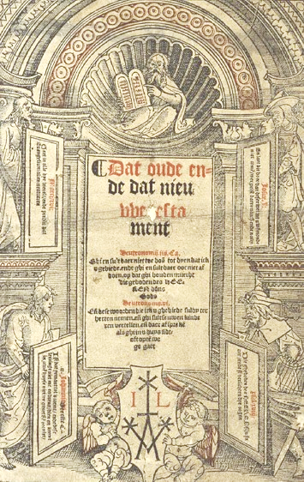
Yahweh’s Racially Exclusive Covenant People
The Bible is written to, by, for and about the descendants of Adam and Eve, exclusively. It is a moral instruction manual for the Adamic species. It is only from this species that the Chosen People can come. Gen. 5:1: “This is the book of the generations (toledaw, family tree, descendants of) Adam. In the day that God created Adamkind, in the likeness of God (elohim) made He him.”

Slide 8
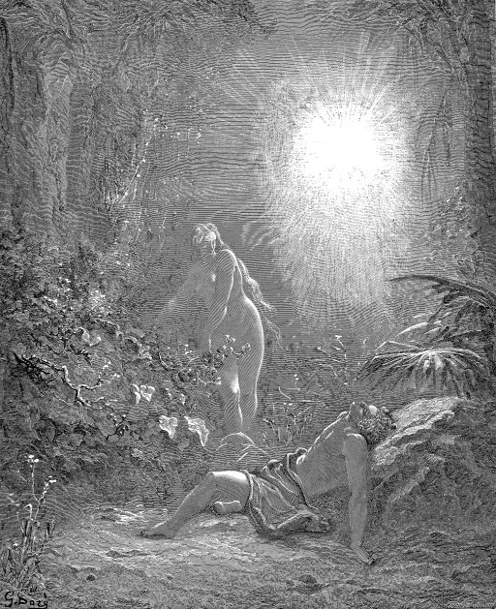
Yahweh’s Racially Exclusive Covenant People
Gen. 1:11 says that all species reproduce after their own kind and have their seed within themselves. Adam is a specific genome, from which only Whites can come. The bible does not teach that all races came from Adam and Eve.

Slide 9
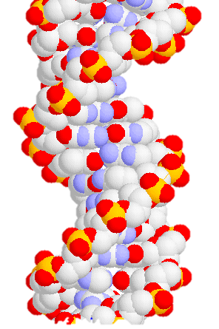
Yahweh’s Racially Exclusive Covenant People
The science of genetics teaches that all DNA is designed to replicate itself. DNA is like a computer program. Any geneticist will tell you that mutations invariably cause disease and death. DNA is exclusive to every species, just as Gen. 1:11 says. DNA replicates its own kind and none other.

Slide 10
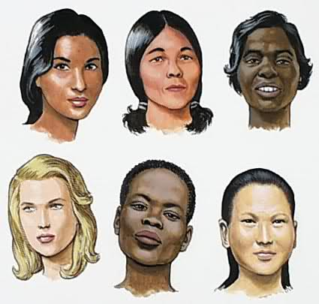
Yahweh’s Racially Exclusive Covenant People
Wheat seed produces wheat. Corn seed produces corn. Adamic seed produces more Adamites. Negro seed produces more Negroes. Oriental seed produces more Orientals. That’s how it works. Every scientist knows this. Only when somebody messes with the genetic programming is there a different result.

Slide 11
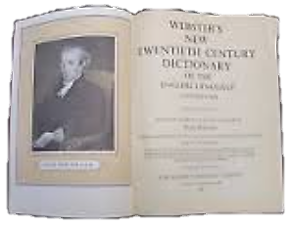
Yahweh’s Racially Exclusive Covenant People
FAIR
Webster’s New Twentieth Century Dictionary Copyright, 1904 – 1966: Fair - “of a light color; not dark or dusky; blond; as a fair complexion, fair hair.”

Slide 12

Yahweh’s Racially Exclusive Covenant People
The word ‘fair’ is translated from two main Hebrew words: #2896 TOWB, meaning “good, pleasant, kindly,” which are attributes of personality, but also “beautiful,” a quality of physical appearance; #3303 YAPHEH, “beautiful, comely, fair,” which are attributes of physical appearance. Both words can refer to physical appearance, but yapheh is almost exclusively used for physical appearance.

Slide 13
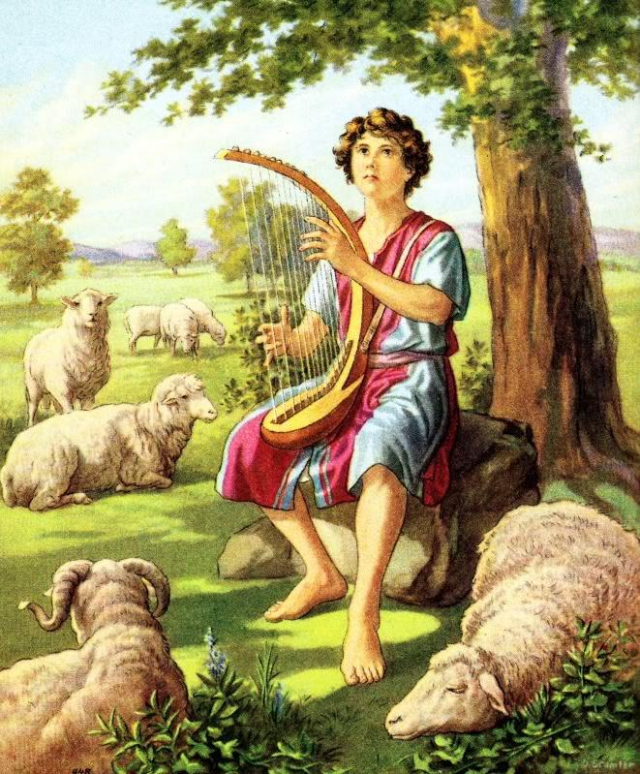
Yahweh’s Racially Exclusive Covenant People
Gen. 6:2. “The sons of God (ben elohim) saw the daughters of men (Adam) that they were fair (white-skinned); and they took them wives…”
And when the Philistine looked about, and saw David, he disdained him: for he was but a youth, and ruddy, and of a fair countenance. – I Samuel 17:42.
As we all should know, David was “fair and ruddy.”

Slide 14
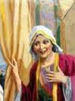
Yahweh’s Racially Exclusive Covenant People
Examples of the word fair, where the context is unmistakably physical appearance.
And it came to pass, when he (Abram) was come near to enter into Egypt, that he said unto Sarah his wife, Behold now, I know that thou art a fair woman to look upon......(Gen. 12: 11)
Sarah

Slide 15
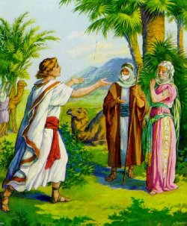
Yahweh’s Racially Exclusive Covenant People
And it came to pass, that when Abram was come into Egypt, the Egyptians beheld the woman (Sarah) that she was very fair.....(Gen. 12: 14)
And the damsel (Rebekah, Isaac's future wife) was very fair to look upon, a virgin, neither had any man known her:.....(Gen. 24: 16)

Slide 16
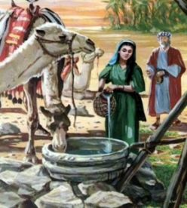
Yahweh’s Racially Exclusive Covenant People
"She is my sister: for he (Isaac) feared to say, She is my wife; lest, said he, the men of the place should kill me for Rebekah; because she was fair to look upon...” (Gen. 26:7)
"And he sent, and brought him (David ) in. Now he was ruddy [showed blood in the face], and withal of a beautiful countenance, and goodly to look at. And the Lord said, Arise anoint him: for this is he...” (1 Sam.16:12)
Rebekah at The Well

Slide 17
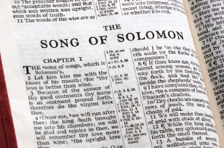
Yahweh’s Racially Exclusive Covenant People
And it came to pass after this, the Absalom the son of David had a fair sister whose name was Tamar; she was a woman of a fair countenance. (2 Sam.13:1)
To bring Vashti the queen before the king ( Ahsauerus) with the crown royal, to shew the people and the princes her beauty: for she was fair to look on..... (Esther 1:11).
"My beloved is white and ruddy, the chiefest among ten thousand." (Song of Solomon 5:10)

Slide 18
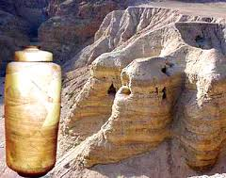
Yahweh’s Racially Exclusive Covenant People
"Her Nazarites were purer than snow, they were whiter than milk, they were more ruddy in body than rubies, their polishing was of sapphire..... (Lam 4:7)
In the Scroll of the Apocryphal Genesis, found in the Dead Sea Scrolls, Abraham’s wife, Sarah, is described as a beautiful White woman:

Slide 19
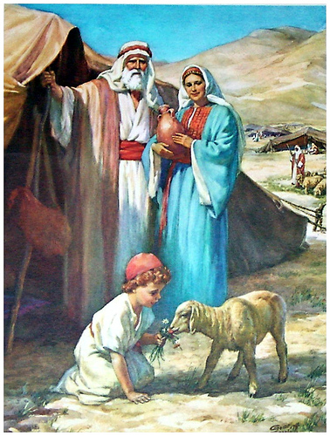
Yahweh’s Racially Exclusive Covenant People
Her skin was pure white; She had long lovely hair;
Her limbs were smooth and rounded (her thighs were shapely)
She had slender legs and small feet;
Her hands were slim and long and so were her fingers

Slide 20
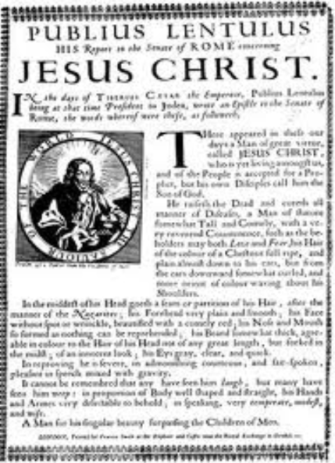
Yahweh’s Racially Exclusive Covenant People
Jesus was also fair and ruddy
Physical descriptions of Jesus from historical sources :
Description of Jesus by Publius Lentulus, Governor of Judea, addressed to Tiberius Caesar, Emperor of Rome. Found in an excavated city written in Aramaic, on stone.

Slide 21
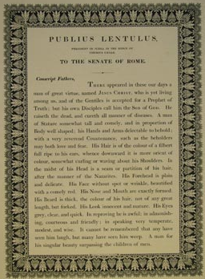
Yahweh’s Racially Exclusive Covenant People
He is a tall man, and well shaped, of an amiable and reverend aspect; his hair of a colour that can hardly be matched, the colour of chestnut full ripe falling in waves about his shoulders. His forehead high, large and imposing; his cheeks without spot or wrinkle, beautiful symmetry; his beard thick and of a colour suitable to his hair, reaching below his chin. His eyes bright blue, clear and serene, look innocent, dignified, manly and mature.

Slide 22
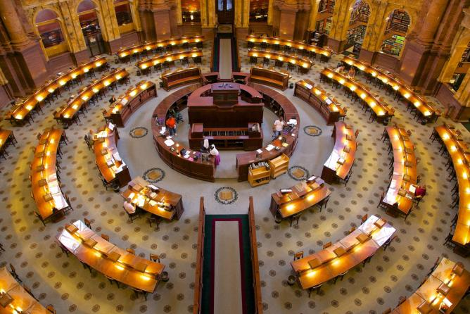
Yahweh’s Racially Exclusive Covenant People
We may also note another source, copies of the following letter appear in the Congressional Library in Washington, D.C (catalog card number # 56-10075), entitled a letter from Pontius Pilate to Tiberius Caesar. This is a reprinting of an apparent letter from Pontius Pilate to Tiberius Caesar describing the physical appearance of Jesus.

Slide 23
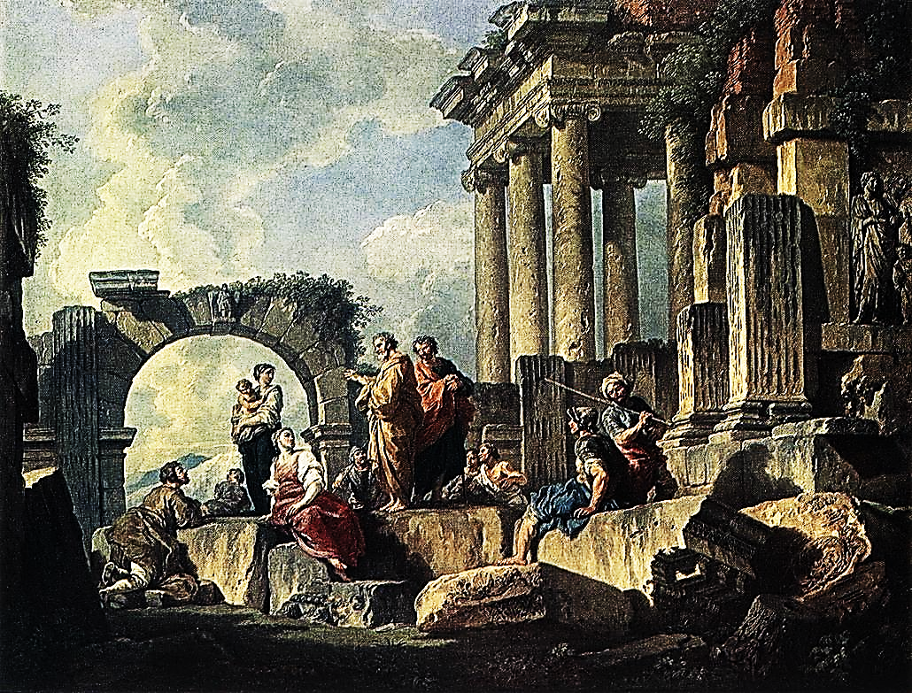
Yahweh’s Racially Exclusive Covenant People
''A young man appeared in Galilee preaching with humble unction, a new law in the Name of the God that had sent Him. At first I was apprehensive that His design was to stir up the people against the Romans, but my fears were soon dispelled. Jesus of Nazareth spoke rather as a friend of the Romans than of the Jews.

Slide 24
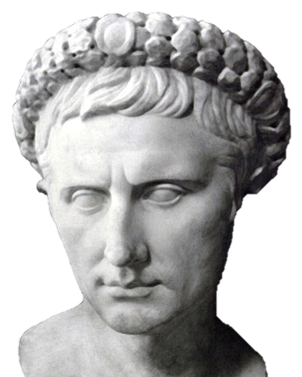
Yahweh’s Racially Exclusive Covenant People
One day I observed in the midst of a group of people a young man who was leaning against a tree, calmly addressing the multitude. I was told it was Jesus. This I could easily have suspected so great was the difference between Him and those who were listening to Him. His golden coloured hair and beard gave to his appearance a celestial aspect. He appeared to be about 30 years of age. Never have I seen a sweeter or more serene countenance.
Pontius Pilate

Slide 25
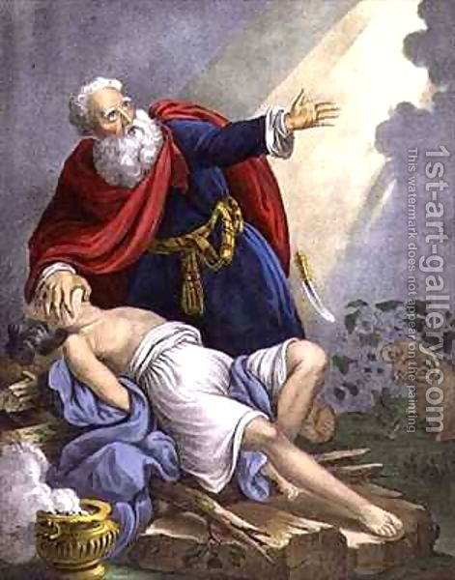
Yahweh’s Racially Exclusive Covenant People
HOLY, SEPARATE, SEVERED
Contrary to the modern usage of the word, ‘holy,’ which typically means “righteous, pious, spiritual, good,” etc., the Hebrew word means “called out, select, special, unique, different from all the rest.” “Holy” means “called out, dedicated,” because our entire seedline was dedicated to Yahweh when Isaac was placed on the altar by Abraham

Slide 26
Yahweh’s Racially Exclusive Covenant People
This special status was bestowed on this seedline exclusively; and no other group of “believers,” no “church,” nor any fictitious “spiritual Israel” can take our place in Yahweh’s plan of restoration. It is only in modern times that the word ‘holy’ has developed the strictly RELIGIOUS meaning of ‘saintly” or “well-mannered.”

Slide 27
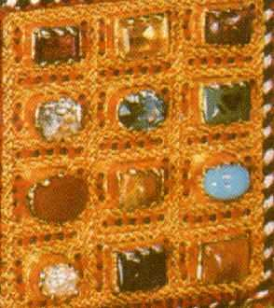
Yahweh’s Racially Exclusive Covenant People
“Even so, these modern meanings are derived from “called out.” Obviously, the Israelites were hardly ever a non-sinful people, so that definition makes no sense at all. Yahweh has constantly struggled with us because of our sinfulness.
Ex. 19:5-6: “Now, therefore, if ye will obey my voice indeed, and keep my covenant, then ye shall be a peculiar treasure unto me above all people: for all the earth is mine. And ye shall be unto me a kingdom of priests, and an holy nation.
The 12 Stones of The Priest’s Breast Plate

Slide 28
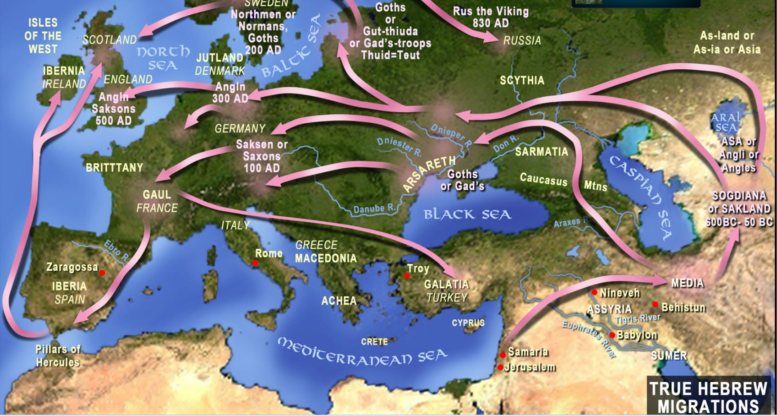
Yahweh’s Racially Exclusive Covenant People
Isa. 6:12-13: “And Yahweh has removed men [#120, AWDAWM] far away [into the wilderness of Europe, which became the regathering place for all White Israelites],…

Slide 29

Yahweh’s Racially Exclusive Covenant People
…..and a great forsaking [of His laws, way back in Palestine and the Great Apostasy today] in the midst of the land. But yet in it shall be a tenth [a remnant], and it [the remnant] shall return [to Me, Yahweh], and shall be eaten: as a teil tree, and as an oak, whose substance is in them, when they cast their leaves: so the HOLY SEED shall be the substance thereof.”
The Teil Tree – German = Linden Baum – English = Lime- Botanical Name = Tilia

Slide 30
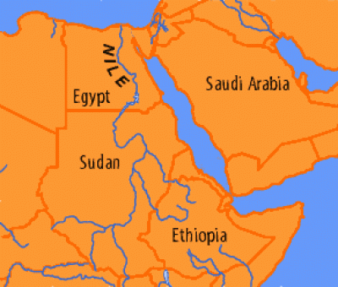
Yahweh’s Racially Exclusive Covenant People
“For I am Yahweh your Elohim, the HOLY ONE OF ISRAEL, your Saviour: I gave Egypt for your ransom, Ethiopia are for you. Since you (Israel) were precious in My sight, you have been [somewhat] honorable, and I have loved you: therefore will I give men for you, and people for your life. Fear not: for I am with you:

Slide 31
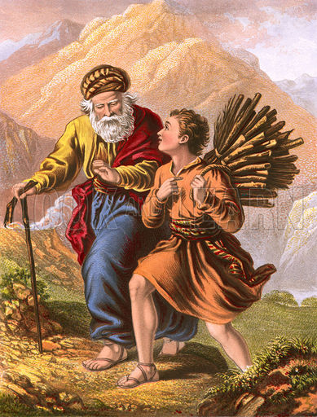
Yahweh’s Racially Exclusive Covenant People
The Hebrew word for ‘holy’ is qadash. More than anything else, it means “appointed, dedicated, consecrated.” The dedication ceremony was the placing of Isaac on the sacrificial altar by Abraham.

Slide 32
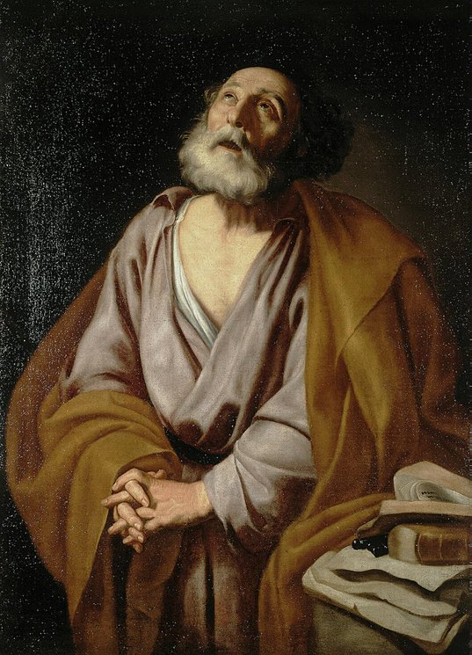
Yahweh’s Racially Exclusive Covenant People
Peter confirms this dedicated state for Israel. I Peter 2:9-10: “Ye are a chosen [selected out of many races] Race, a royal [kingly, above all others] priesthood, a holy [dedicated exclusively to Yahweh] nation, a peculiar [different from all other peoples] people, that ye should show the praises of him [to the rest of the world, as in Gen. 12:3] who hath called you out of darkness in to his marvelous light. Such in time past were not a people, but now are the people of God.”

Slide 33
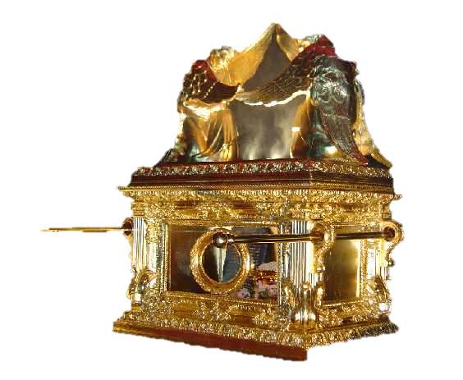
Yahweh’s Racially Exclusive Covenant People
BERITH (COVENANT)
Definition of the term ‘covenant’. Strong’s Hebrew #1285, Berith (in the sense of cutting, cut a covenant, cut a deal) – a compact.. confederacy, covenant, league.

Slide 34
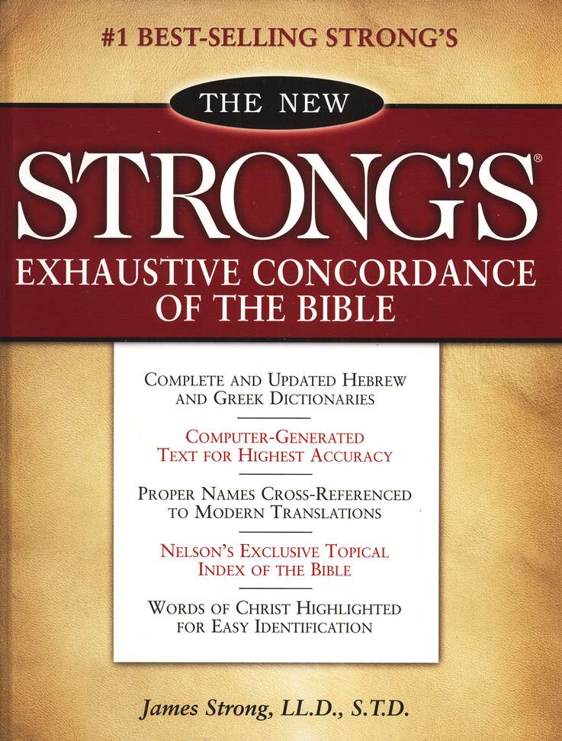
Yahweh’s Racially Exclusive Covenant People
Strong’s Greek #1242, diatheke, a disposition, contract, covenant, testament.
Dictionary Definition: 1. A binding and solemn agreement by two or more persons, parties, etc., to do or keep from doing some specified thing; a contract; compact.

Slide 35
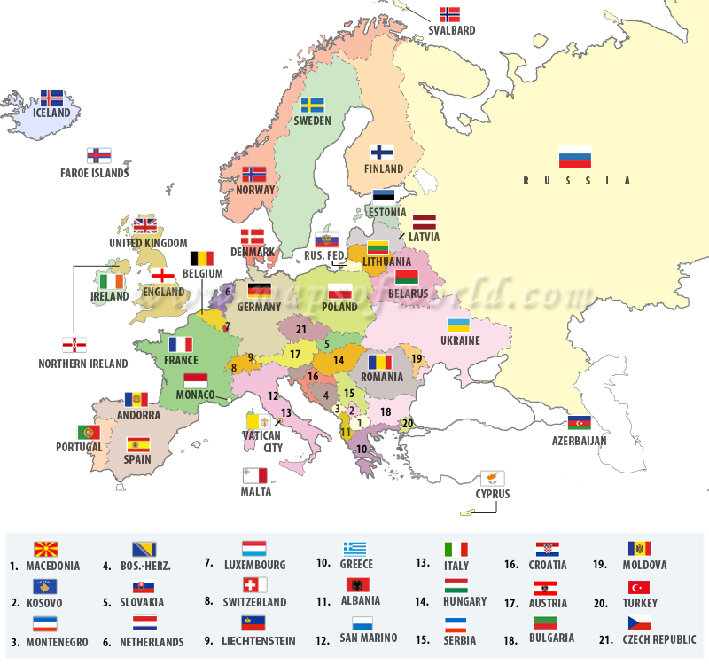
Yahweh’s Racially Exclusive Covenant People
Gen. 17:4: As for me, behold, MY COVENANT is with thee, and thou shalt be a father of many NATIONS.” It does not say ALL nations. Those “many” are, specifically, the Caucasian people and the specific nations we have founded.
Now, let’s take a look at the verses immediately following verse 4:

Slide 36
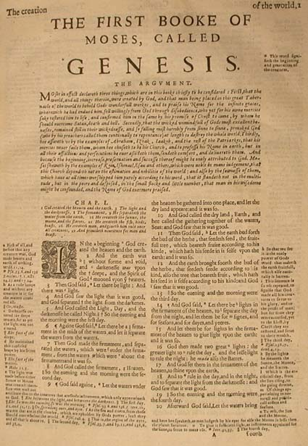
Yahweh’s Racially Exclusive Covenant People
“Neither shall thy name any more be called Abram, but thy name shall be Abraham: for a father of many nations have I made thee. And I will make thee exceedingly fruitful, and I will make nations of thee, and kings shall come out of thee.

Slide 37
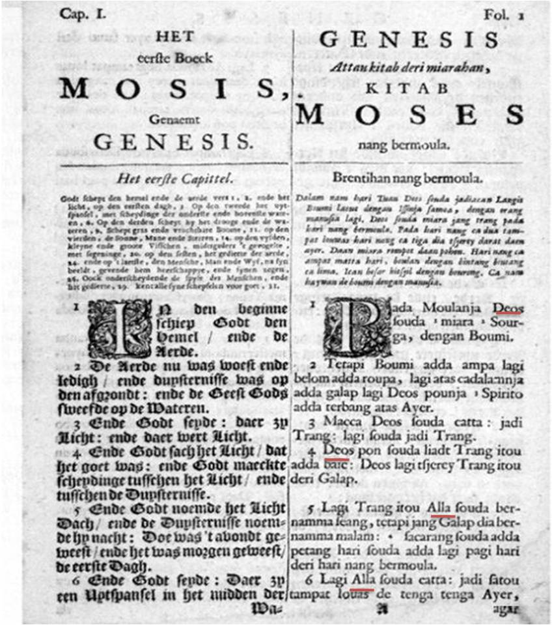
Yahweh’s Racially Exclusive Covenant People
And I will establish my covenant between me and thee and THY SEED AFTER THEE IN THEIR GENERATIONS [which means only those direct descendants who are to come from the lineage AFTER HIM] for an everlasting Covenant.”
Yahweh repeats this promise at verse 9: “And God said unto Abraham, Thou shalt keep my covenant, therefore, thou, and thy SEED after thee in their generations.”

Slide 38
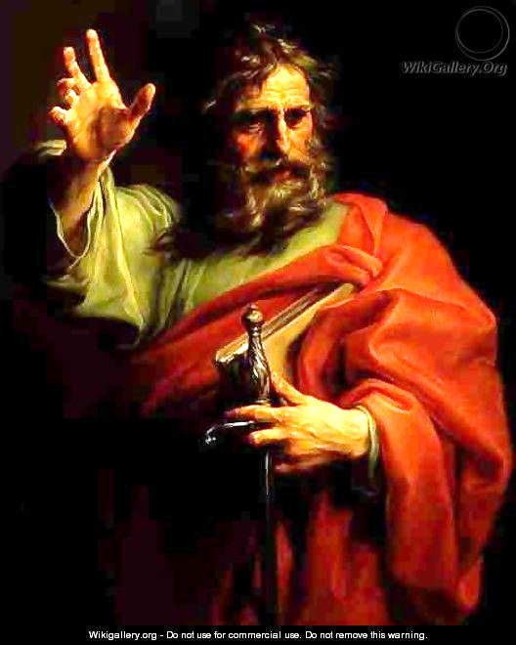
Yahweh’s Racially Exclusive Covenant People
“Endless Genealogies”
What about Paul’s admonition not to be concerned about genealogies? The genealogies that Paul criticizes at I Tim. 1:4 and Titus 3:9 are NOT references to Israelite genealogies. Paul is here criticizing the endless genealogies among the Greeks and other Dispersed Israelites. The Dispersion (James 1:1) consisted of many estranged Israelites. “I am not sent but unto the estranged [or exiled] sheep of the House of Israel.” - Matt. 15:24.
Paul

Slide 39
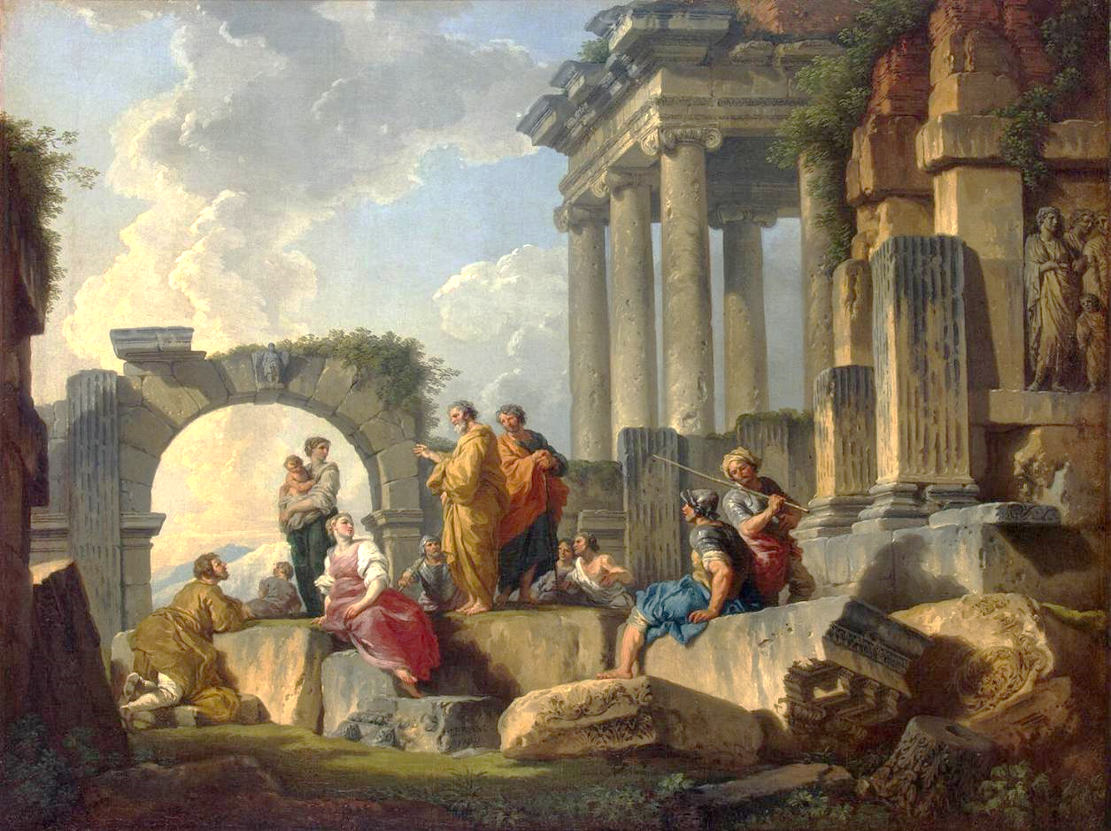
Yahweh’s Racially Exclusive Covenant People
Many of these estranged Israelites had adopted heathen practices and claimed to have descended from the “gods’ of the various nations within which they lived. This is what Paul is criticizing in these passages. He is not challenging the genetic code of True Israel. In fact, Paul goes out of his way to assert that he is an Israelite of the Tribe of Benjamin.
Paul at Mars Hill Greece

Slide 40
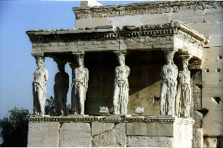
Yahweh’s Racially Exclusive Covenant People
“I say then, Hath God cast away his people? God forbid. For I also am an Israelite, of the seed of Abraham, of the tribe of Benjamin. God hath not cast away his people which he foreknew. (Rom. 11:1-2.)
The subject is not the genealogies of the Israelites, but the genealogies of the pagan Greek Israelites:
Temple of Athena

Slide 41
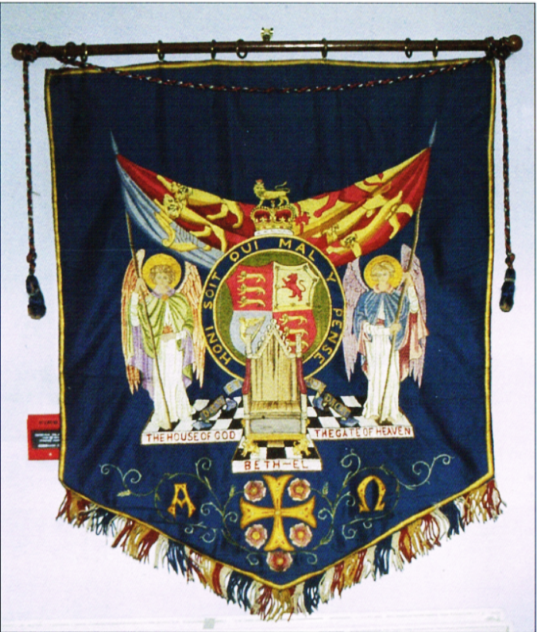
Yahweh’s Racially Exclusive Covenant People
“Some even claim that people who believe in British-Israel “... give heed to fables and endless genealogies, which minister questions, rather than godly edifying which is in faith:” (1 Tim 1:4; Titus 3:9). Is this true?
The British Israel World Federation Banner

Slide 42
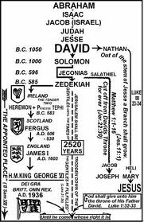
Yahweh’s Racially Exclusive Covenant People
Answer: First, the Bible is loaded with genealogies. All one has to do is look into the books of Genesis, Numbers, 1 Chronicles etc. and even the New Testament Gospels to see all the genealogies of the people of Israel, and the world in Genesis. Doesn’t this contradict what Paul is saying? Absolutely Not!

Slide 43
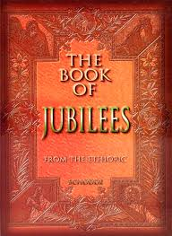
Yahweh’s Racially Exclusive Covenant People
The genealogies that Paul is speaking of are not the Biblical genealogies, but are, “...found in Philo, Josephus and the book of Jubilees, by which the Jews [sic, Judahites and Israelites - Eli] traced the descent from the Patriarchs and their families, and perhaps also to Gnostic ‘genealogies’ and orders of aeons and spirits.

Slide 44
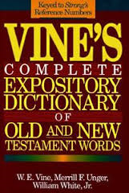
Yahweh’s Racially Exclusive Covenant People
Amongst the Greeks, as well as other nations, mythological stories gathered around the birth and ‘genealogy’ of their heros [hence Paul’s reference to ‘fables’]. Probably Jewish ‘genealogical’ tales crept into the Christian communities” (Vines Expository Dictionary, p.262)

Slide 45
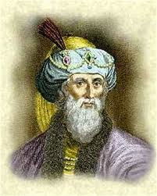
Yahweh’s Racially Exclusive Covenant People
Clearly these are not the Biblical genealogies Paul was speaking of. Josephus “appeals to the priestly registers and is proud of the royal descent of his mother; he shows that even the priests residing in Egypt had their sons registered authentically in Jerusalem, so as to safeguard their priestly prerogatives (C. Apion., I, vii).” (The Catholic Encyclopedia, under article “Genealogy”). Philo, “to the various stories and fables told about Moses and the Patriarchs” (ibid).
Josephus

Slide 46
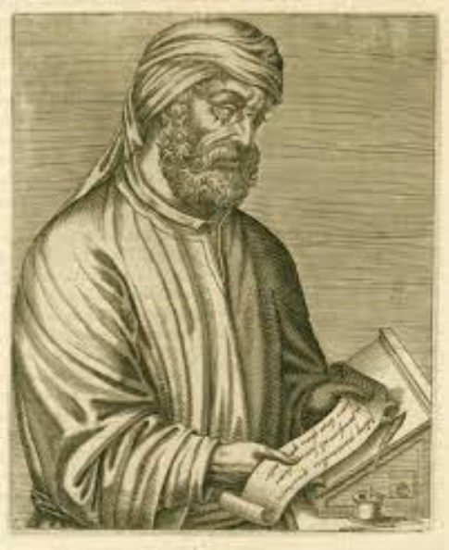
Yahweh’s Racially Exclusive Covenant People
As for the Gnostics, “[These were] genealogies of spirits and aeons, as they called them, “Lists of Gnostic emanations” [ALFORD]. So TERTULLIAN [Against Valentinian, c. 3], and IRENÆUS [Preface]... Endless” refers to the tedious unprofitableness of their lengthy genealogies (compare Tit. 3:9). - Peter Salemi,….
TERTULLIAN
http://www.british-israel.ca/answers.htm

Slide 47
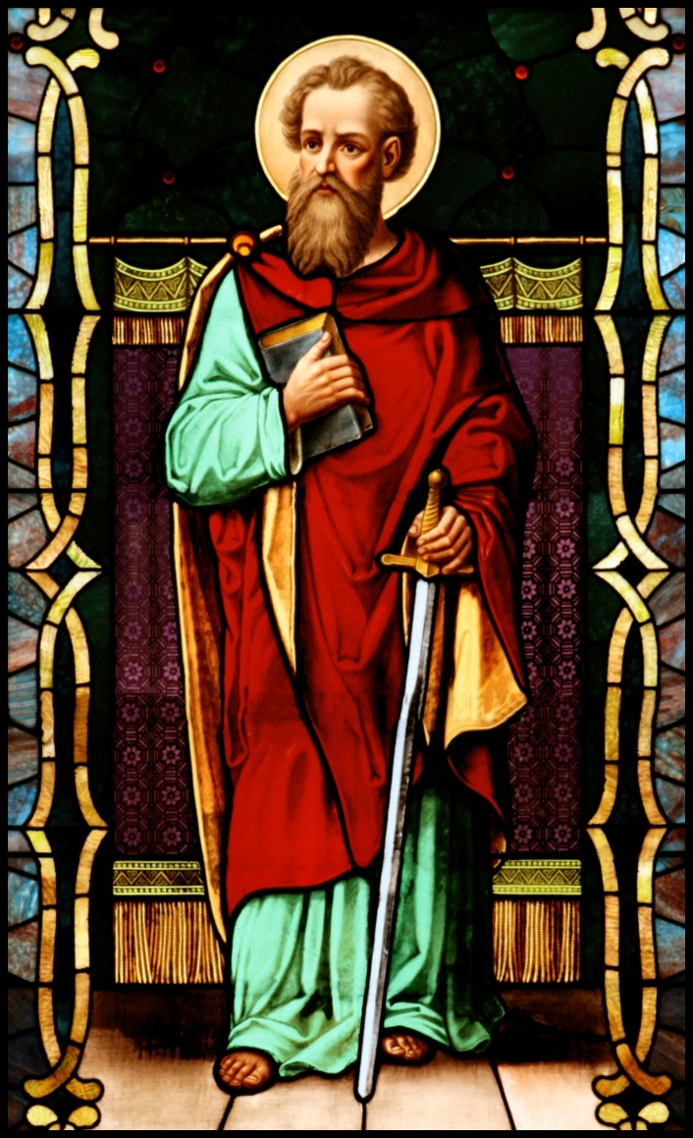
Yahweh’s Racially Exclusive Covenant People
….Hence, Paul’s condemnation of genealogies concerns the existing mythical genealogies of the Dispersion as well as those of the emerging anti-Gospel sects, whose “genealogy” was traced back to the Gnostic aeons, i.e., gods and goddesses.

Slide 48
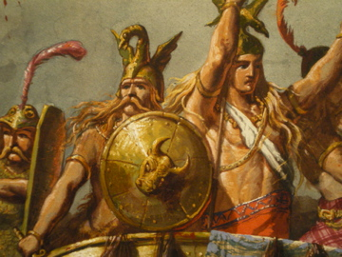
Yahweh’s Racially Exclusive Covenant People
The Saxon Covenant
“In Isaac shall thy seed be called.” - Gen. 21:12.
Abraham is adamant that only a Shemitic woman be selected as Isaac’s wife. Her name is Rebekah. As we will see, Rebekah is a racial exclusivist, with Yahweh’s full approval.
Gen. 17: 1-16. Ishmael blessed, but only Isaac is covenanted.

Slide 49
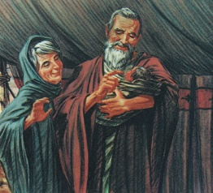
Yahweh’s Racially Exclusive Covenant People
And Abraham said unto God, O that Ishmael might live before thee! And God said, Sarah thy wife shall bear thee a son indeed; and thou shalt call his name Isaac: and I will establish my covenant with him for an everlasting covenant, and with his seed after him.

Slide 50
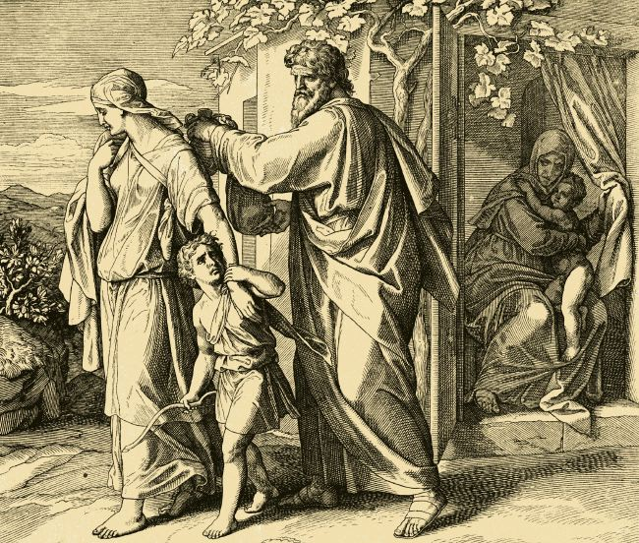
Yahweh’s Racially Exclusive Covenant People
And as for Ishmael, I have heard thee: Behold, I have blessed him, and will make him fruitful, and will multiply him exceedingly; twelve princes shall he beget, and I will make him a great nation. But my covenant will I establish with Isaac, which Sarah shall bear unto thee at this set time in the next year.

Slide 51
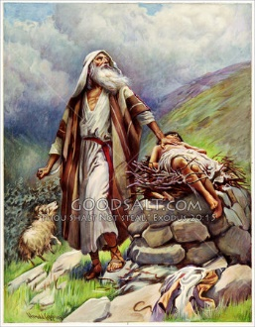
Yahweh’s Racially Exclusive Covenant People
Gen. 17:21 Isaac Covenanted, but not Ishmael.
Gen. 21:12-13: The Covenant with Isaac
Gen. 21: 17-18 – Ishmael blessed but excluded from the covenant, which goes through Isaac.
Isaac Placed Upon the Altar. His Seed is Dedicated to Yahweh

Slide 52
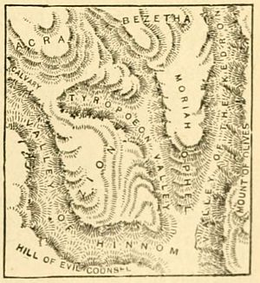
Yahweh’s Racially Exclusive Covenant People
Gen. 22: 1-2: And it came to pass after these things, that God did tempt Abraham, and said unto him, Abraham: and he said, Behold, here I am. And he said, Take now thy son, thine only son Isaac, whom thou lovest, and get thee into the land of Moriah; and offer him there for a burnt offering upon one of the mountains which I will tell thee of. (‘Test,’ not ‘tempt,’ is the proper translation)

Slide 53
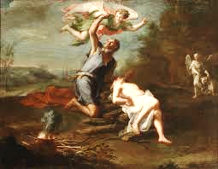
Yahweh’s Racially Exclusive Covenant People
Gen. 22: 15-18. And the angel of the Lord called unto Abraham out of heaven the second time, And said, By myself have I sworn, saith the Lord, for because thou hast done this thing, and hast not withheld thy son, thine only son:

Slide 54
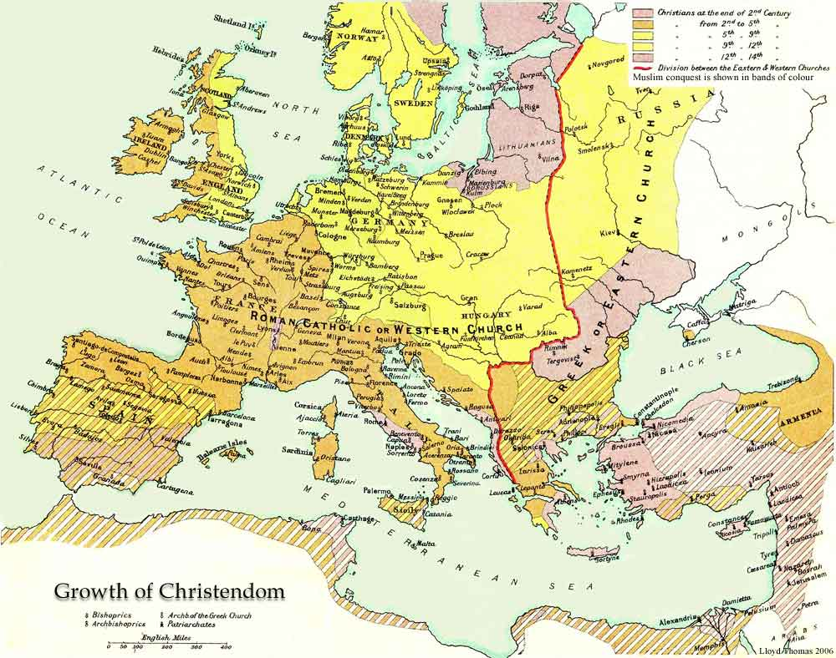
Yahweh’s Racially Exclusive Covenant People
That in blessing I will bless thee, and in multiplying I will multiply thy seed as the stars of the heaven, and as the sand which is upon the sea shore; and thy seed shall possess the gate of his enemies; And in thy seed shall all the nations of the earth be blessed; because thou hast obeyed my voice.”

Slide 55
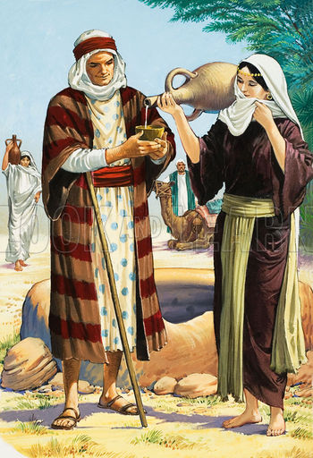
Yahweh’s Racially Exclusive Covenant People
Gen. 24: 2-7. A Pure White Wife to be Chosen for Isaac. Her name is Rebekah. Rebekah is given an extraordinary blessing and prophecy:

Slide 56
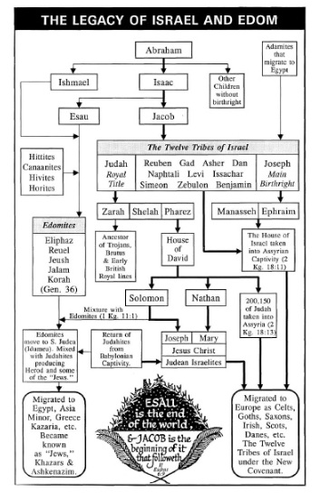
Yahweh’s Racially Exclusive Covenant People
Gen. 26:34-35:
And they called Rebekah, and said unto her, Wilt thou go with this man? And she said, I will go. And they sent away Rebekah their sister, and her nurse, and Abraham's servant, and his men. And they blessed Rebekah, and said unto her, Thou art our sister, be thou the mother of thousands of millions, and let thy seed possess the gate of those which hate them.

Slide 57

Yahweh’s Racially Exclusive Covenant People
Rebekah is a racially conscious Shemite, who condemns Esau for violating the commandments to not intermarry with Canaanites.
Gen. 26:34-35: And Esau was forty years old when he took to wife Judith the daughter of Beeri the Hittite, and Bashemath the daughter of Elon the Hittite: Which were a grief of mind unto Isaac and to Rebekah

Slide 58

Yahweh’s Racially Exclusive Covenant People
She admonishes Jacob not to do as his evil brother Esau has done.
Gen. 27:46 – Gen. 28:1: And Rebekah said to Isaac, I am weary of my life because of the daughters of Heth: if Jacob take a wife of the daughters of Heth, such as these which are of the daughters of the land, what good shall my life do me? And Isaac called Jacob, and blessed him, and charged him, and said unto him, Thou shalt not take a wife of the daughters of Canaan.

Slide 59

Yahweh’s Racially Exclusive Covenant People
Jacob Becomes the Bearer of the Covenant
The famous story of Jacob’s dream, in which he saw a ladder on which angels were ascending and descending, contains an important piece of information, which is ignored by all but those who teach Covenant Theology. It is the story of the Saxon Covenant devolving upon Jacob. It tells us that Yahweh stood above the ladder and spoke to Jacob.

Slide 60

Yahweh’s Racially Exclusive Covenant People
Gen. 28:13-15. And, behold, the Lord stood above it, and said, I am the Lord God of Abraham thy father, and the God of Isaac: the land whereon thou liest, to thee will I give it, and to thy seed; And thy seed shall be as the dust of the earth, and thou shalt spread abroad to the west, and to the east, and to the north, and to the south: and in thee and in thy seed shall all the families of the earth be blessed. And, behold, I am with thee, and will keep thee in all places whither thou goest, and will bring thee again into this land; for I will not leave thee, until I have done that which I have spoken to thee of.

Slide 61

Yahweh’s Racially Exclusive Covenant People
These covenants still hold today, as the Bible nowhere abolishes them. The idea that the covenants established through these three patriarchs have been abandoned and transferred to the “Gentiles” is a cruel hoax.

Slide 62

Yahweh’s Racially Exclusive Covenant People
Contrary to what the Jews and Judeos teach, the whole House of Israel will never be completely destroyed: “I am Yahweh. I change not. Therefore, you sons of Jacob ARE NOT CONSUMED.” – Mal. 3:6.
“And they shall be as though I HAD NOT CAST THEM OFF.’ - Zech. 10:6.

Slide 63

Yahweh’s Racially Exclusive Covenant People
All of the OT prophets confirm the exclusive, unchangeable covenants with Adamic Israel. Anyone who says that these covenants were changed in the NT to include non-Israelites is a liar. This false doctrine is direct contradiction to all of Scripture

Slide 64

Yahweh’s Racially Exclusive Covenant People
This false idea that True Israel has been abandoned by God and replaced by the Church is the central tenet of the doctrine called “Dispensationalism.” Since dispensationalism contradicts every pronouncement of Covenant theology, they make Yahweh to be liar. Who do you think is lying? Yahweh or the false priests?

Slide 65

Yahweh’s Racially Exclusive Covenant People
Isa. 42:1 tells us this: “Behold MY SERVANT (Israel), whom I uphold; MINE ELECT, in whom my soul delighteth; I have put my spirit upon him: he shall bring forth judgment to the nations.”
Isaiah does NOT say that Israel will become the nations. He tells us that we will bring judgment TO the nations.

Slide 66

Yahweh’s Racially Exclusive Covenant People
The Law Was Given Only to Israel
Deut. 27: 9-10: Moses and the priests spoke to all Israel, saying, “Take heed, and hearken, O Israel; this day you are become the people of Yahweh Elohim. You shall therefore obey the voice of Yahweh your Elohim and do His commandments and His statutes, which I command you this day.”

Slide 67

Yahweh’s Racially Exclusive Covenant People
Deut. 4:7-8: “For what [other] nation is there so great, who has El so near to them, as Yahweh Elohim is in all things that we call upon Him? And what nation is there so great, that has statutes and judgments so righteous as all this law, which I set before you this day?” All scholars agree that the Mosaic Law was delivered to Israel and only Israel.

Slide 68

Yahweh’s Racially Exclusive Covenant People
Psalm 147:19-20: “He showeth His word unto Jacob, his statutes and His judgments unto Israel. He hath NOT DEALT SO WITH ANY OTHER NATION

Slide 69

Yahweh’s Racially Exclusive Covenant People
Standing on the Promises
Hearken to me, ye that follow after righteousness, ye that seek the Lord: look unto the rock whence ye are hewn, and to the hole of the pit whence ye are digged. Look unto Abraham your father, and unto Sarah that bare you: for I called him alone, and blessed him, and increased him.

Slide 70

Yahweh’s Racially Exclusive Covenant People
For the Lord shall comfort Zion: he will comfort all her waste places; and he will make her wilderness like Eden, and her desert like the garden of the Lord; joy and gladness shall be found therein, thanksgiving, and the voice of melody. Hearken unto me, my people; and give ear unto me, O my nation: for a law shall proceed from me, and I will make my judgment to rest for a light of the people.

Slide 71

Yahweh’s Racially Exclusive Covenant People
My righteousness is near; my salvation is gone forth, and mine arms shall judge the people; the isles shall wait upon me, and on mine arm shall they trust. Lift up your eyes to the heavens, and look upon the earth beneath:

Slide 72

Yahweh’s Racially Exclusive Covenant People
...for the heavens shall vanish away like smoke, and the earth shall wax old like a garment, and they that dwell therein shall die in like manner: but my salvation shall be for ever, AND MY RIGHTEOUSNESS SHALL NOT BE ABOLISHED. Hearken unto me, ye that know righteousness, the people in whose heart is my law; fear ye not the reproach of men, neither be ye afraid of their reviling's.” - Isa. 51:1-9.

Slide 73

Yahweh’s Racially Exclusive Covenant People
The Promises were made exclusively to Abraham, Isaac and Jacob… and their descendants. No other people have ever been included in these covenants
Yahweh’s specific promise was given to Sarah (Gen. 17:15-16). She will be the mother of a bloodline. Her direct descendants will be kings and nations.

Slide 74

Yahweh’s Racially Exclusive Covenant People
Again, Paul confirms the exclusivity of these promises. Gal. 3:13-19. This covenant cannot be disannulled. “Abraham’s seed will be a blessing to all nations.” Paul confirms the exact terms of Gen. 12:3 at Gal. 4:14. Nothing has been altered, nor can it be altered.

Slide 75

Yahweh’s Racially Exclusive Covenant People
The whole of Chapter 3 is devoted to explaining that the forgiveness of Israel was not dependent upon the Law of Moses. It was promised independently of the Law, even BEFORE the Law, through Abraham. That’s why the Law cannot annul this promise.

Slide 76

Yahweh’s Racially Exclusive Covenant People
“Now to ABRAHAM AND HIS SEED [posterity] were the promises made. He said not “and to posterities [such as those genealogies which have been decidedly excluded from the promises], as of many [posterities]; but as of ONE [posterity], to your seed [posterity], which is anointed. – Gal. 3:16.

Slide 77

Yahweh’s Racially Exclusive Covenant People
The KJV translation of “which is Christ” is absurd, as the promises were NOT made to Jesus Christ. The verse begins by recounting the direct genealogy to which the promises were applied. These promises were made to all of Abraham’s direct descendants, through Isaac and Jacob’s descendants.

Slide 78

Yahweh’s Racially Exclusive Covenant People
The specific promise that the Messiah [Christ] would come to Israel is being affirmed here. Christ did not come to redeem Himself, as this horrible translation implies. Nor were the promises made to Him. He is the Redeemer who was promised to Israel. Gal. 3:16 is speaking of the ANOINTED PEOPLE, ISRAEL.

Slide 79

Yahweh’s Racially Exclusive Covenant People
“I come not but unto the exiled sheep of the House of Israel.” – Matt. 15:24.
He did not come to redeem himself. He was sinless. Such nonsensical translations in the KJV have made absolute mincemeat of the True Gospel.

Slide 80

Yahweh’s Racially Exclusive Covenant People
Paul is confirming that only the anointed people, those to whom the promises were made, are the recipients of the promise that was delivered. Sarah specifically disinherited Ishmael at Gen. 21:10. Esau disinherited his own mixed-race descendants by selling his birthright, and Paul has no authority to change the terms of the covenants and promises.

Slide 81

Yahweh’s Racially Exclusive Covenant People
Nor does he claim to have such authority. He specifically states that no one has the authority to GIVE OUR INHERITANCE TO ANYONE ELSE; but the KJV and the Dispensationalists claim otherwise! This is GRAND THEFT, by mistranslation!

Slide 82

Yahweh’s Racially Exclusive Covenant People
As Paul stated twice already (Gal. 3:15, 17), these covenants CANNOT BE ANNULLED, but the translation committee of King James have done their utmost to rewrite history, deny that these covenants mean what they say, and declare that the promises have been annulled, by CHANGING THE TERMS OF THE PROMISES AND COVENANTS and adding the rest of creation to the redemption.

Slide 83
Yahweh’s Racially Exclusive Covenant People
This doctrine is in total violation of the terms of the covenants, promises, and inheritance. But false priests have no problems with contradictions.
Arnold Kennedy has done the best analysis of the KJV’s poor translation of the book of Galatians. His article, “The Book of Galatians and an Israel Exclusive” is must reading. First, a quotation regarding Gal 3:26 and 3:29:
Arnold Kennedy

Slide 84

Yahweh’s Racially Exclusive Covenant People
In these two critical verses we have something else [not Jesus Christ] which is anointed! What can it be? What is the subject? Is it not the seed of Abraham, in their generations, according to the original promise? Hence, Gal. 3:16 reads ‘and TO THY SEED which is anointed’ and Gal. 3:29 reads ‘and if ye be an anointed (people) then ye are Abraham’s seed. The churches try to spiritualize the matter of Abraham’s seed.

Slide 85

Yahweh’s Racially Exclusive Covenant People
But it is not sufficient to be a physical descendant of the Covenant Race, you must also be obedient, otherwise you will lose the grace which freed us from our past sins.
“Know ye then that those of the faith, these are the sons of Abraham.” – Gal. 3:7.

Slide 86

Yahweh’s Racially Exclusive Covenant People
Paul is saying that those Israelites who accept the undeserved forgiveness at the cross are those who are the true sons and daughters of Abraham. He is NOT saying that non-Israelites become “spiritual Israelites”

Slide 87

Yahweh’s Racially Exclusive Covenant People
“by believing something that we are not even supposed to teach them! Peter confirms the exclusive bloodline when he says, ‘Sarah obeyed Abraham, calling him lord: whose daughters ye are, as long as ye do well, and are not afraid with amazement.” - I Peter 3:6.

Slide 88


Yahweh’s Racially Exclusive Covenant People
Race-Mixing is Absolutely Forbidden by Yahweh
From the above witnesses, it is absolutely verified and established that the covenants are made with a particular line of descent and no other people. For these covenants to exist, all twelve tribes must necessarily exist today and they will always exist, even into the Kingdom. (Rev. 21:12.) And because this is a racial covenant, Israel is commanded to not make marriages with non-Adamic tribes and/or tribes that have made alliances with the enemy.

Slide 89

Yahweh’s Racially Exclusive Covenant People
Deut. 7: 1-10: The Israelites are commanded not to intermarry with the Canaanites.
Deut. 23:2. No mongrels can be accepted into the congregation of Yahweh. The Hebrew word for “bastard” is MAMZER. Strong’s concordance contains a simple, one word definition of “mamzer.” A mamzer is a mongrel.
From Ugarit, A Canaanite City

Slide 90

Yahweh’s Racially Exclusive Covenant People
Deut. 23:3. Ammonites and Moabites are not permitted to enter into the seedline of Covenant Israel.
Deut. 28:1-14. And it shall come to pass, if thou shalt hearken diligently unto the voice of the Lord thy God, to observe and to do all his commandments which I command thee this day, that the Lord thy God will set thee on high above all nations of the earth:

Slide 91

Yahweh’s Racially Exclusive Covenant People
…And all these blessings shall come on thee, and overtake thee, if thou shalt hearken unto the voice of the Lord thy God. Blessed shalt thou be in the city, and blessed shalt thou be in the field. Blessed shall be the fruit of thy body, and the fruit of thy ground, and the fruit of thy cattle, the increase of thy kine, and the flocks of thy sheep. Blessed shall be thy basket and thy store.

Slide 92

Yahweh’s Racially Exclusive Covenant People
Blessed shalt thou be when thou comest in, and blessed shalt thou be when thou goest out. The Lord shall cause thine enemies that rise up against thee to be smitten before thy face: they shall come out against thee one way, and flee before thee seven ways. The Lord shall command the blessing upon thee in thy storehouses, and in all that thou settest thine hand unto; and he shall bless thee in the land which the Lord thy God giveth thee.

Slide 93

Yahweh’s Racially Exclusive Covenant People
The Lord shall establish thee an holy people unto himself, as he hath sworn unto thee, if thou shalt keep the commandments of the Lord thy God, and walk in his ways.

Slide 94

Yahweh’s Racially Exclusive Covenant People
Numbers 22- 25 tell the story of Balak, the king of the Moabites, and Balaam, a Chaldean priest and prophet. Balak tried to get Balaam to curse the Israelites, but Yahweh would always turn these curses into blessings. Finally, Balaam suggested to Balak that the only way the Israelites could be defeated is by causing them to sin against Yahweh’s laws against miscegenation.

Slide 95

Yahweh’s Racially Exclusive Covenant People
Num. 25:1. “And Israel began to commit whoredom with the daughters of Moab.”
This is not just idolatry. This is the sin of racial fornication. When Phinehas, a descendant of Aaron, saw an Israelite man brazenly walk into his tent with a Midianite woman, he barged into the tent and, with a javelin, thrust them both through while they were engaged in the act of sexual intercourse.

Slide 96

Yahweh’s Racially Exclusive Covenant People
Yahweh was so pleased with this act of swift justice on the part of Phinehas that He stopped a plague which had killed 24,000 Israelites. No doubt this was a sexually transmitted disease contracted from the Baal-worshipping Midianites and Moabites.

Slide 97

Yahweh’s Racially Exclusive Covenant People
There are some who say that Jesus, the Son of Yahweh, the God of the Old Testament, would not condone such an action by His Father; but this is also incorrect, because Yahshua Himself said, “The Father and I are One.” (John 10:30.) This means that they are in perfect agreement. Indeed, they always have been and always will be. In fact, when Jesus returns as the Lion of Judah at the Judgment Day, all sinners will receive their just deserts, because the Word clearly says that we will all be judged “according to our works. (Rev. 20:13-14.)

Slide 98

Yahweh’s Racially Exclusive Covenant People
Those who teach that the law has been done away with will not escape this judgment. I advise to stop believing in the heresy of antinomianism. It is part of the Great Apostasy that Paul prophesied would occur just before the Second coming. (II Thess. 2.)

Slide 99

Yahweh’s Racially Exclusive Covenant People
Some multi-culti theologians, who claim to be Christians, say that the sin of Balaam is acceptable to Jesus Christ, as we are supposedly no longer under the law, but “under grace.” This is a false teaching, because we have three witnesses in the New Testament who reference this racial fornication and condemn it.

Slide 100

Yahweh’s Racially Exclusive Covenant People
These three witnesses are II Peter 2:15, Jude 11 and Rev. 2:14. Being under grace does not mean that the law has been done away with. It only means that we can repent and be forgiven. The Bible clearly teaches that only our PAST SINS were forgiven at the Cross.

Slide 101

Yahweh’s Racially Exclusive Covenant People
We have also three witnesses of this fact:
Romans 3:25. Whom God hath set forth to be a propitiation through faith in His blood, to declare His righteousness for the remission of SINS THAT ARE PAST, through the forbearance of God.

Slide 102

Yahweh’s Racially Exclusive Covenant People
Hebrews 9:15. And for this cause He is the Mediator of the New Testament, that by means of death, for the REDEMPTION OF THE TRANSGRESSIONS THAT WERE UNDER THE FIRST TESTAMENT, they which are called MIGHT receive the promise of eternal inheritance.
II Peter 1:9. But he that lacketh these things is blind, and cannot see afar off, and hath forgotten that HE WAS PURGED FROM HIS OLD SINS.

Slide 103

Yahweh’s Racially Exclusive Covenant People
Nowhere does Scripture say that we can keep on sinning and not pay the price for our disobedience. This idea is a dispensationalist heresy. Jesus Himself says that those who teach disobedience to the commandments.

Slide 104

Yahweh’s Racially Exclusive Covenant People
Matt. 5:18-20. “For verily I say unto you, Till heaven and earth pass, one jot or one tittle shall in no wise pass from the law, till all be fulfilled. Whosoever therefore shall break one of these least commandments, and shall teach men so, he shall be called the least in the kingdom of heaven: but whosoever shall do and teach them, the same shall be called great in the kingdom of heaven.

Slide 105

Yahweh’s Racially Exclusive Covenant People
For I say unto you, That except your righteousness shall exceed the righteousness of the scribes and Pharisees, ye shall in no case enter into the kingdom of heaven.”
Being “under grace” does not give us a license to sin; it only gives us the opportunity for forgiveness at the Judgment Day, IF we truly repent.

Slide 106

Yahweh’s Racially Exclusive Covenant People
I John 3: 22-24: And whatsoever we ask, we receive of him, because we keep his commandments, and do those things that are pleasing in his sight. And this is his commandment, That we should believe on the name of his Son Jesus Christ, and love one another, as he gave us commandment.

Slide 107

Yahweh’s Racially Exclusive Covenant People
And he that keepeth his commandments dwelleth in him, and he in him. And hereby we know that he abideth in us, by the Spirit which he hath given us.
What was the sin of Solomon, that caused Yahweh to condemn him in his old age?
King Solomon in his palace

Slide 108

Yahweh’s Racially Exclusive Covenant People
But King Solomon LOVED MANY STRANGE WOMEN, together with the daughter of Pharoah, women of the Moabites, Ammonites, Edomites, Zidonians, and Hittites: of the nations concerning which Yahweh said unto the children of Israel, YE SHALL NOT GO INTO THEM, NEITHER SHALL THEY COME IN UNTO YOU. – I Kings, 11:1-2.
Can it be any clearer what Solomon’s sin was?

Slide 109

Yahweh’s Racially Exclusive Covenant People
Ezra 4: The Judahites, observing Yahweh’s laws of separation, reject the company of the Samaritans. Today, this is called “discrimination” or “racism.”
Ezra 9: Ezra is astounded at the loose morals of those Judahites who have taken foreign wives. The sin of race-mixing is thoroughly condemned.
Neh. 10:28; 13:23. Ditto.
Ezra at the Temple

Slide 110

Yahweh’s Racially Exclusive Covenant People
Psalm 106:34-45. Because the Israelites did not destroy the Canaanite nations, Yahweh punished them by handing the Israelites over to the heathen for punishment. “But they mingled with the nations, so…

Slide 111

Yahweh’s Racially Exclusive Covenant People
….He gave them into the hand of the heathen.” This happens whenever we Israelites mingle with non-Whites. Yahweh uses those nations with whom we race-mix to punish us. This clearly is happening to the White Race today

Slide 112

Yahweh’s Racially Exclusive Covenant People
The New Covenant Prophesied in the Old Testament
Jer. 31:31-37. Behold, the days come, saith YHWH, that I will make a new covenant with the house of Israel, and with the house of Judah: Not according to the covenant that I made with their fathers in the day that I took them by the hand to bring them out of the land of Egypt;

Slide 113

Yahweh’s Racially Exclusive Covenant People
….which my covenant they brake, although I was an husband unto them, saith YHWH: But this shall be the covenant that I will make with the house of Israel; After those days, saith YHWH, I will put my law in their inward parts, and write it in their hearts; and will be their God, and they shall be my people.

Slide 114

Yahweh’s Racially Exclusive Covenant People
And they shall teach no more every man his neighbour, and every man his brother, saying, Know YHWH: for they shall all know me, from the least of them unto the greatest of them, saith YHWH: for I will forgive their iniquity, and I will remember their sin no more.

Slide 115

Yahweh’s Racially Exclusive Covenant People
Thus saith YHWH, which giveth the sun for a light by day, and the ordinances of the moon and of the stars for a light by night, which divideth the sea when the waves thereof roar; YHWH of hosts is his name. If those ordinances depart from before me, saith YHWH, then the seed of Israel also shall cease from being a nation before me for ever.

Slide 116

Yahweh’s Racially Exclusive Covenant People
Jesus Christ Confirms the Exclusivity of Israel and the Prohibitions Against Race-Mixing
“I am Yahweh. I change not. Therefore, you sons of Jacob are NOT consumed.” – Malachi 3:6.
“Has God forsaken His people, Israel? God forbid! For I am an Israelite, of the tribe of Benjamin.”- Romans 11:1.
Benjamin – Zurbaron Painting

Slide 117

Yahweh’s Racially Exclusive Covenant People
“I come not but unto the lost (appolumi [exiled]) sheep of the House of Israel.” - Matt. 15:24.
The Book of James opens with this dedication: “To the TWELVE TRIBES SCATTERED ABROAD, GREETINGS.”

Slide 118

Yahweh’s Racially Exclusive Covenant People
The Great Commission that Yahshuah gave to the Apostles is very exclusive.
Matt. 10:6. These twelve Jesus sent forth, and commanded them, saying, Go not into the way of the Gentiles, and into any city of the Samaritans enter ye not: But go rather to the lost sheep of the house of Israel.

Slide 119

Yahweh’s Racially Exclusive Covenant People
John 7:35. The Pharisees acknowledge that the Lost Tribes still exist and are scattered throughout the Greco-Roman world.
John 8:32-47. The Edomite Jews expose their non-Isaelite sperma. (‘Seed’ comes from the Greek word sperma.) There is no such thing as spiritual sperm. John 8 cannot be spiritualized.

Slide 120
Yahweh’s Racially Exclusive Covenant People
The discussion here is about literal descendants and the false Jewish claim to being the descendants of Abraham. Since these Pharisaic Jews admit that they were “never in bondage to any man,” Christ tricked them into admitting that they are the descendants of Esau.

Slide 121

Yahweh’s Racially Exclusive Covenant People
We are NOT instructed to evangelize unbelievers.
II Cor. 6:14. “Be not unequally yoked with unbelievers.”
Luke 9: 1-5: Then he called his twelve disciples together, and gave them power and authority over all devils, and to cure diseases.

Slide 122

Yahweh’s Racially Exclusive Covenant People
And he sent them to preach the kingdom of God, and to heal the sick. And he said unto them, Take nothing for your journey, neither staves, nor scrip, neither bread, neither money; neither have two coats apiece. And whatsoever house ye enter into, there abide, and thence depart.

Slide 123

Yahweh’s Racially Exclusive Covenant People

Slide 124

Yahweh’s Racially Exclusive Covenant People
Matt. 15:21-28. Then Jesus went thence, and departed into the coasts of Tyre and Sidon. And, behold, a woman of Canaan came out of the same coasts, and cried unto him, saying……

Slide 125

Yahweh’s Racially Exclusive Covenant People
Have mercy on me, O Lord, thou son of David; my daughter is grievously vexed with a devil. But he answered her not a word. And his disciples came and besought him, saying, Send her away; for she crieth after us. But he answered and said, I am not sent but unto the lost sheep of the house of Israel. Then came she and worshipped him, saying, Lord, help me.

Slide 126

Yahweh’s Racially Exclusive Covenant People
But he answered and said, It is not meet to take the children's bread, and to cast it to dogs. And she said, Truth, Lord: yet the dogs eat of the crumbs which fall from their masters' table. Then Jesus answered and said unto her, O woman, great is thy faith: be it unto thee even as thou wilt. And her daughter was made whole from that very hour.

Slide 127

Yahweh’s Racially Exclusive Covenant People
Jesus told the Canaanite woman that it is not right, or proper, or even legal, for Him to give that which belongs to the children of Israel to those who are not part of the covenant. They can receive a blessing, if they bless us, as per Gen. 12:3, but they can never receive what only belongs to Yahweh’s chosen people: Caucasian Israel.

Slide 128

Yahweh’s Racially Exclusive Covenant People
If Jesus refused to give away that special relationship that the Father created with us, what do you think happens when we try to give away our covenant relationship to the other races? Here is what Jesus tells us:

Slide 129

Yahweh’s Racially Exclusive Covenant People
Give not that which is holy unto the dogs, neither cast ye your pearls before swine, lest they trample them under their feet, and turn again and rend you. (Matt. 7:6).
Would Jesus Christ be so crude as to refer to the other races as “dogs.” Well, He did. It’s right there in your KJV. But the multi-culti cult of Apostasy refuses to quote such verses for fear of offending the Jews and the other races, whom we are not to evangelize.

Slide 130

Yahweh’s Racially Exclusive Covenant People
And, finally, Matt. 25: 31-32: When the Son of man shall come in his glory, and all the holy angels with him, then shall he sit upon the throne of his glory: And before him shall be gathered all nations: and he shall separate them one from another, as a shepherd divideth his sheep from the goats.

Slide 131

Yahweh’s Racially Exclusive Covenant People
I would like to repeat the words of a modern humanitarian, who spent his whole life trying to make the lives of Blacks better. Here is what he had to say:
“I have given my life to try to alleviate the sufferings of Africa. There is something that all White men who have lived here like I must learn and know:

Slide 132

Yahweh’s Racially Exclusive Covenant People
….that these individuals are a sub-race. They have neither the intellectual, mental or emotional abilities to equate or to share equally with White men in any function of civilization. I have given my life to try to bring them the advantages which our civilization must offer, but I have become well aware that we must retain this status: the superior and they the inferior.

Slide 133

Yahweh’s Racially Exclusive Covenant People
For whenever a White man seeks to live among them as their equals they will either destroy him or devour him… Never fraternize with them as equals. Never accept them as your social equals or they will devour you. They will destroy you.” -- Albert Schweitzer, African Notebook, 1939, German edition.

Slide 134

Yahweh’s Racially Exclusive Covenant People
“I have no purpose to introduce political and social equality between the white and black races. There is a physical difference between the two which in my judgment, will forever forbid their living together upon the footing of perfect equality;

Slide 135

Yahweh’s Racially Exclusive Covenant People
…and inasmuch as it becomes necessary that there must be a difference, I am in favor of the race to which I belong having the superior position.” - Abraham Lincoln, August 21, 1858, Ottowa, IL. (Lincoln-Douglas Debates.)

Slide 136

Yahweh’s Racially Exclusive Covenant People
"It’s incredible that any white sends aid to Africa when Africans are anti-white racists." - Mfonobong Nsehe (Kenyan journalist)

Slide 137

Yahweh’s Racially Exclusive Covenant People
What is the solution to Israel’s problems?
“If my people, which are called by my name [Ish-ra-el means “People ruling with God”] shall humble themselves and pray and seek My Face and turn from their wicked ways, then I will hear from heaven and will forgive their sin and will heal their land.” - II Chron. 7:14.

Slide 138

Yahweh’s Racially Exclusive Covenant People
For full source notes and web links for this presentation will be found on Pastor Eli James website: www.anglo-saxonisrael.com

Slide 139

Yahweh’s Racially Exclusive Covenant People
“Strange Parallel,” by Helene Koppejan, documenting the connection between the Dutch people and the tribe of Zebulun.

Slide 140

Yahweh’s Racially Exclusive Covenant People
By Pastor Eli James
The End
die Einde
Background Picture – The Pass of Israel

