Slide 1
The Seven Times
Feast Day Calendar
and
The Second Coming
By
Pastor Eli James

Slide 2
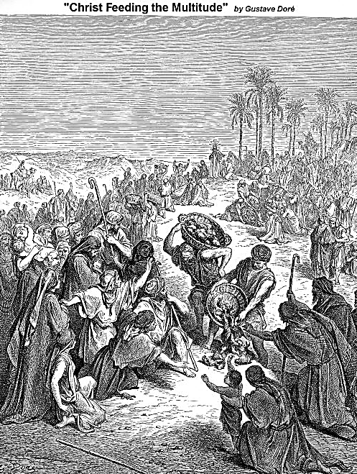
Introduction
At Matt. 14:17, we are told the story of the miracle of the 5 loaves and 2 fishes. The 5 loaves, in my opinion, represent the 5,000 years from Adam to Christ (Septuagint chronology) and the 2,000 years from the First Advent to the Second Advent. Hosea confirms this imagery when he says,

Slide 3
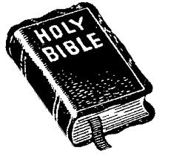
Introduction
After two days will he revive us: in the third day he will raise us up, and we shall live in his sight. - Hos. 6:2. These two "days" actually represent a period of a thousand years each, as per 2 Peter 3:8: “Beloved, be not ignorant of this one thing, that one day with Yahweh is as a thousand years, and a thousand years as one day.”

Slide 4
Introduction
The two fishes represent the 2,000-year Grace Period from the Sacrifice on the Cross to the Judgment Day. As you know, the symbol of the fish has been the symbol of Christianity for these last two thousand years. I will make you fishers of men. (Mark 1:17.)

Slide 5
Introduction
The 7,000 year timeline of God’s plan of salvation looks like this:
Adam | First Advent | Second Advent
5,000 BC | 2 BC – 33 AD | 1998-2033AD

Slide 6
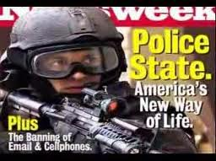
Introduction
But Jesus tells us that the days of Tribulation would be shortened for the elect’s sake (Mark 13:20), so we can expect Him to return some time before 2033. The Lord’s judgment will be brought upon the Last Days Church of Laodecia, which has grown fat and pompous:

Slide 7
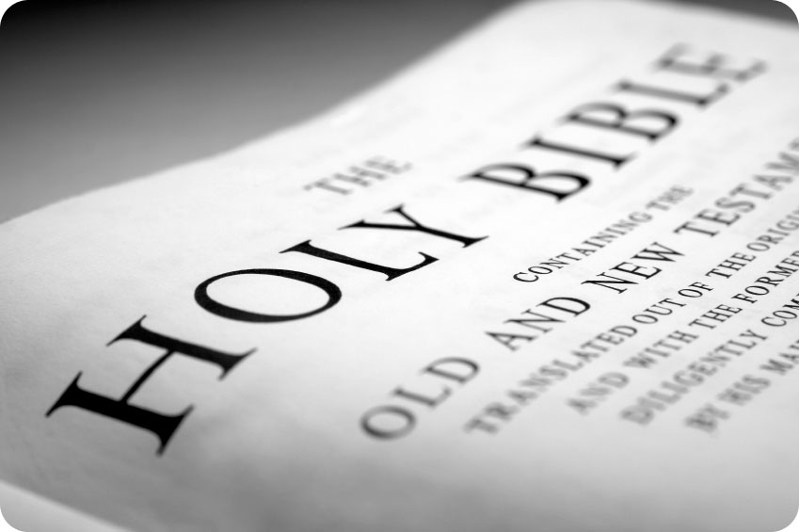
Introduction
And to the angel of the church of Laodicea write: The words of the Amen, the faithful and true witness, the beginning of God's creation: I know your works: you are neither cold nor hot. Would that you were cold or hot! So, because you are lukewarm, and neither cold nor hot, I will spew thee out of my mouth. For you say "I am rich,

Slide 8
Introduction
I have prospered and I need nothing," not knowing that you are wretched, pitiable, poor, blind and naked. Therefore, I counsel you to buy from me gold refined by fire, that you may be rich, and white garments to clothe you and to keep the shame of your nakedness from being seen, and salve to anoint your eyes, that you may see. Those whom I love, I reprove and chasten; so be zealous and repent. - Rev. 3:14-19.

Slide 9
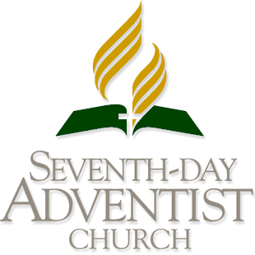
Jesus is Coming Soon
The SDA Church was founded upon the idea that Jesus would return in 1844. Obviously, that did not happen.

Slide 10
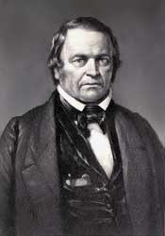
Jesus is Coming Soon
According to Adventists, the 2300 days began in 457 BC and ended in 1844 AD. But William Miller made some mistakes and the Great Disappointment was the result.
One who reads the entire chapter of Daniel 8 will see this interpretation:
William Miller

Slide 11
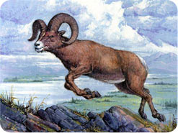
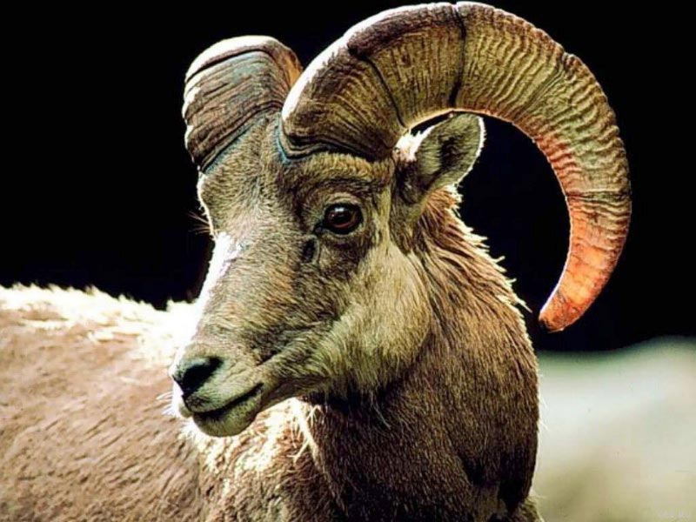
Jesus is Coming Soon
The two-horned ram of verse 3 is the Medes and Persians.
The he-goat of verses 4-7 is Alexander the Great, who conquered the Ram
3. Verse 8 explains that Alexander’s empire, after his death, was broken up into four parts, under four different generals:

Slide 12
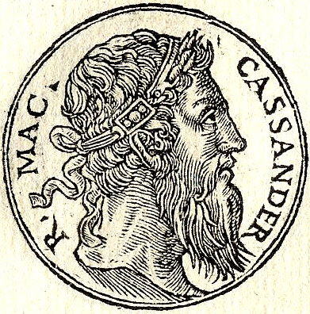
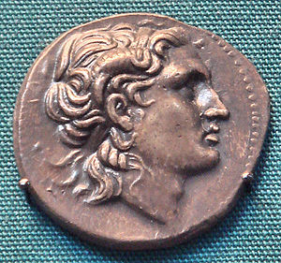
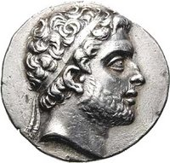
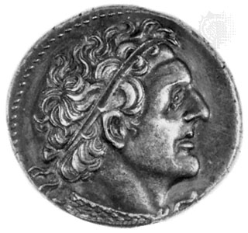
Jesus is Coming Soon
a) Greece, under Cassander,
b.) Thrace, under Lysimachus,
c) Syria, under Antigonus, and
d) Egypt, under Ptolemy

Slide 13
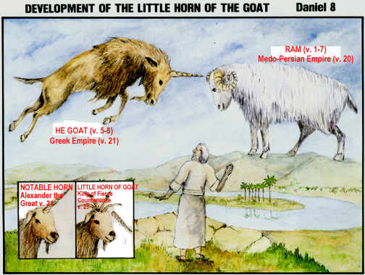
Jesus is Coming Soon
4.) The Little Horn
Daniel 8:9: And out of one of them came forth a little horn, which waxed exceeding great, toward the south, and toward the east, and toward the pleasant land.

Slide 14
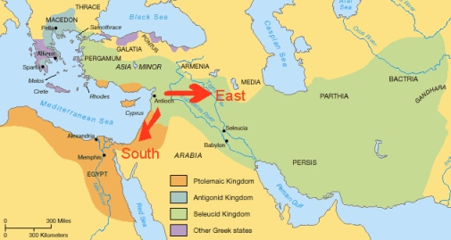
Jesus is Coming Soon
Map of the Territory of Antiochus Epiphanes:
In verse 9, the little horn that attacked the pleasant Land, Palestine, is Antiochus Epiphanes, of the Seleucid (Syrian) Kingdom of Greece.

Slide 15
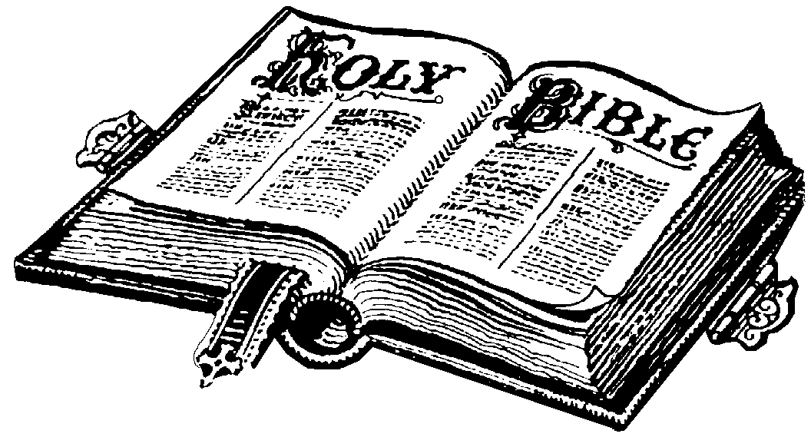
Jesus is Coming Soon
Daniel 4:13 Then I heard one saint speaking, and another saint said unto that certain saint which spake, How long shall be the vision concerning the daily sacrifice, and the transgression of desolation, to give both the sanctuary and the host to be trodden under foot?
Verse 14 is the 2300 days prophecy: “To 2300 days (evenings and mornings), then shall the sanctuary be cleansed.”

Slide 16
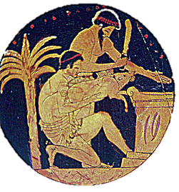
Jesus is Coming Soon
It was Antiochus Epiphanes, who desecrated the altar and slaughtered a pig thereon. Philip Newell makes this case:

Slide 17
Jesus is Coming Soon
"For a duration of time during which 2300 daily sacrifices would ordinarily have been offered, one at evening and one in the morning, as specified in Exodus 29:38-43. Since there are two of these daily, the actual time period involved is 1150 days, or slightly over three years.

Slide 18
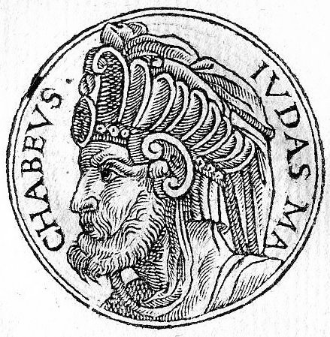
Jesus is Coming Soon
This, in fact, was the time of the Maccabean tribulation, 168-165 b.c., at the end of which the sanctuary was 'cleansed' by Judas Maccabeus in his restoration of the evening and morning sacrifices (210:1-5)."
Judas Maccabeus

Slide 19
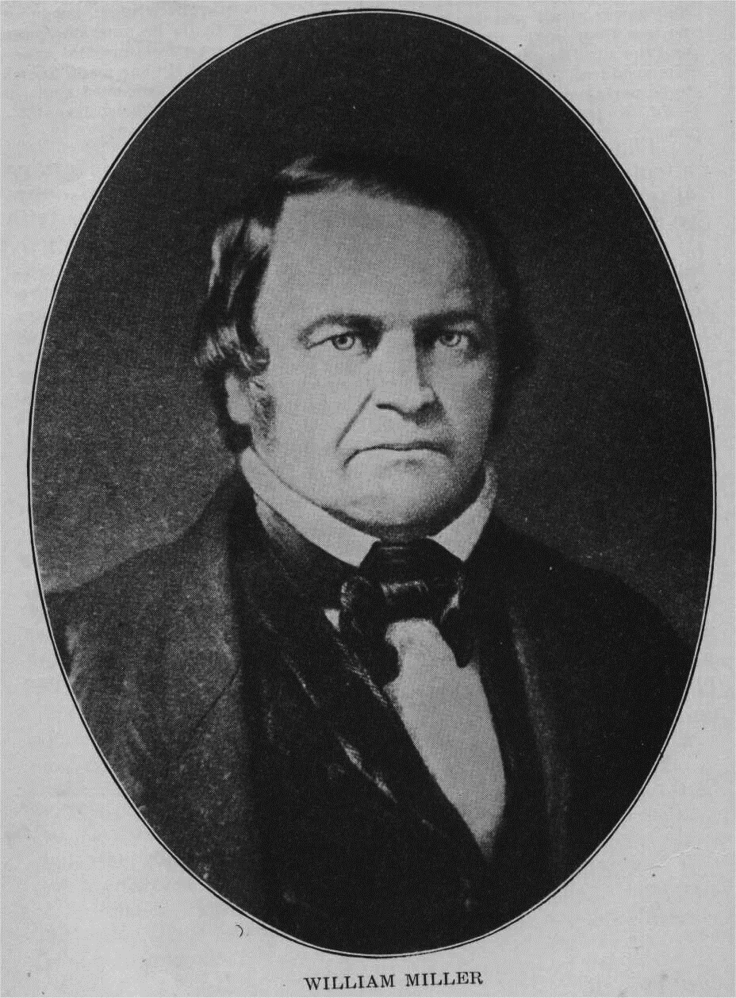
Jesus is Coming Soon
This is the verse that William Miller used for his 2,300 "year-days" to calculate that Jesus would return in 1844 (2,300 years after Cyrus issued the decree to rebuild the temple). His movement ended up giving birth to the Seventh-Day Adventists, Jehovah's Witnesses, and several other movements.

Slide 20
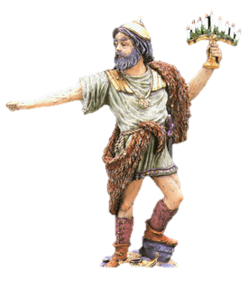
Jesus is Coming Soon
But the actual date of the transgression by Antiochus was 168 BC, not 457 BC, so Miller was wrong on two counts. Is there another way of reckoning the approximate date of the Second Advent?

Slide 21
The Seven Times Prophecy (Lev. 26)
What is a prophetic “time”?
What is a prophetic “time”?

Slide 22
The Seven Times Prophecy (Lev. 26)
If the disciples had the key to understanding prophetic calculation, of determining the length of 'seven times punishment' (as mentioned in Leviticus 26: 18, 21, 24 and 28), then they wouldn't have asked Jesus in Acts 1:6, "Lord, wilt thou at this time restore again the Kingdom of Israel?" The key is found in Revelation. Most judeo-Christian students of the Bible are unaware of the 2,520 year cycle and its importance in Bible prophecy.

Slide 23
The Seven Times Prophecy (Lev. 26)
However, most know about the 1,260 day cycle mentioned in Revelation 11:3 and 12:6 and verse 14, where it's called a time, and times and half a time. 1,260 is half of 2,520. A prophetic year is 360 days, because it's halfway between a solar year (365 days) and a lunar year (354 days). 3 1/2 prophetic years is thus 1,260 days and a full seven year cycle is 2,520 days. In long term prophecy, the days are years.

Slide 24
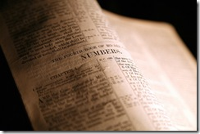
The Seven Times Prophecy (Lev. 26)
We get the confirmation of this conversion in Numbers 14:34, "after the number of the days in which ye searched the land ... each day for a year, shall ye bear your iniquities" and in Ezekiel 4:6, "and thou shalt bear the iniquity ... I have appointed thee each day for a year."

Slide 25
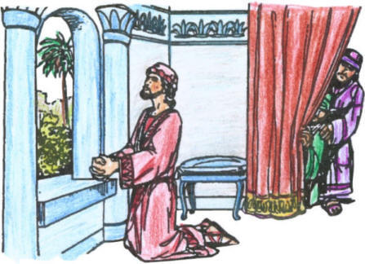
The Seven Times Prophecy (Lev. 26)
Daniel 12:7 repeats the expression 'a time, times and an half'. Although he does not mention 1,260 specifically, it is generally accepted that a 'time' refers to 360 days or years. Therefore, 'times’
would be a doubling, or 720, and 'half a time' would be 180. Add them up: 360+720+180 and you get 1,260.

Slide 26
The Seven Times Prophecy (Lev. 26)
This calculation verifies that a 'time' is indeed 360 years. So, 'seven times' is seven multiplied by 360, which equals 2,520. 'Seven times' is mentioned seven times as such in the Bible, and remarkably the '3 1/2 times' is also referred to seven times. Additional proof that these periods of time are synonymous is found in Revelation 3:2 and 13:5, where it is 42 months (i.e. 1,260).

Slide 27
The Seven Times Prophecy (Lev. 26)
Confirmed in II Samuel 7:10, we read: "Moreover I will appoint a place for my people Israel, and will plant them, that they may dwell in a place of their own, and move no more; neither shall the children of wickedness afflict them anymore, as beforetime.”

Slide 28
The Seven Times Prophecy (Lev. 26)
Because of their national sins, God would drive them out and into a new land. If you look at some good biblical maps, you'll get an idea of the migratory routes that our ancestors took when they left Assyria (modern Syria and Turkey) and traveled north and west. John 7:35 refers to them as 'the dispersed', and Jesus knew where the lost sheep of Israel were and commanded His disciples to go to them.

Slide 29
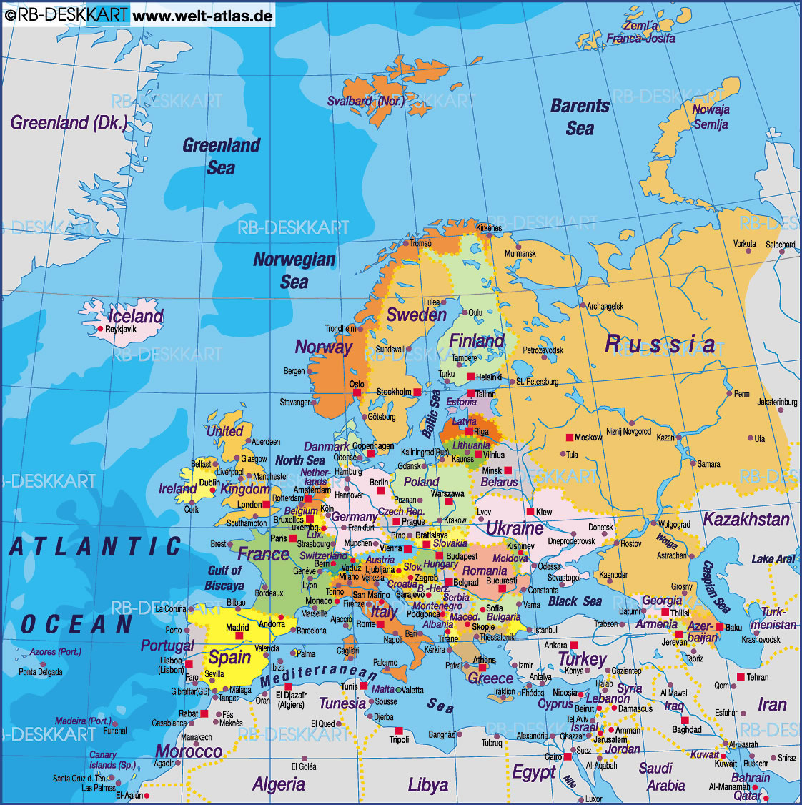
The Seven Times Prophecy (Lev. 26)
What followed was the Christianization of Europe. Israel would occupy Isles or islands, and coastlines, wilderness and uncultivated land their fathers never knew. God was to scatter and sift them among nations, and then would regather the twelve tribes and again, give them a land to possess in the Kingdom Age. It would not be in the old Jerusalem; thus it would be a prophetic new Jerusalem.

Slide 30
The Seven Times Prophecy (Lev. 26)
Let's get to the punch line! The conquest of the ten-tribed northern house of Israel took about 25 years to complete. The logistics were monumental, as some two million people were transported hundreds of miles away from their homeland. As near as can be determined through archaeology, the historical record and the Bible itself, the first campaign against Israel began in 745 BC on the east side of the Jordan River.

Slide 31
The Seven Times Prophecy (Lev. 26)
Precisely 2,520 years from 745 BC is the final date where the 'seven times punishment' expires upon the nation of Israel. On this date, a nation was born in a day, just as Isaiah 66:7-9 had prophesied, which I think also corresponds to Revelation 12, when it speaks of a woman travailing in birth, in pain to deliver, bringing forth a man child. This was speaking of Israel becoming a new nation. Verse 8 in the Ferrar Fenton says,

Slide 32
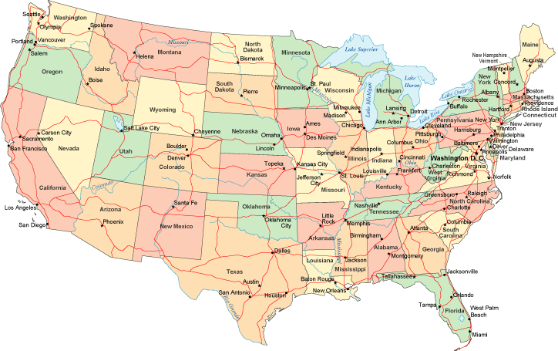
The Seven Times Prophecy (Lev. 26)
"Who has heard such a thing? Who has seen it like that? For the earth to produce in a day! In a moment a nation be born?" And if I can paraphrase God in verse 9, He is saying "should I restrain this birth which I have produced?" This glorious moment in history; the conclusion of the chastisement upon God's Israel people and the restoration of their birthright blessings was none other than July 4, 1776. - Seven Times Punishment, by Pastor Mark Downey

Slide 33
The Seven Times Prophecy (Lev. 26)
From the foregoing, we see that a prophetic time equals 360 years.
In 745 B.C., Tiglath-Pileser, the king of Assyria, began the first invasion against Israel in the reign of Menahem (2 Ki.15:19-20).

Slide 34
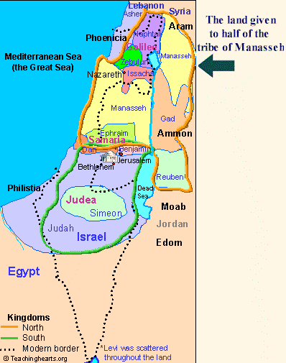
The Seven Times Prophecy (Lev. 26)
In this year, the Assyrians captured and deported half the Tribe of Manasseh, the half which lived on the eastern side of the Jordan River. This event began the process of deporting the ten northern tribes away from Palestine,

Slide 35
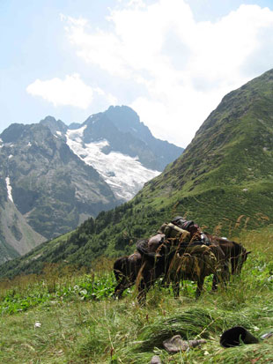
The Seven Times Prophecy (Lev. 26)
who were then resettled in northern Media, just south of the Caucasus Mountain Range. From there, they eventually migrated through these mountains into Europe and became known as the Caucasian People.

Slide 36
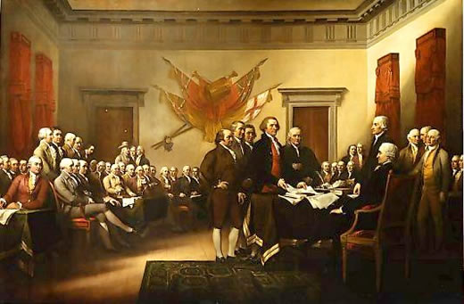
The Seven Times Prophecy (Lev. 26)
Putnam's Dictionary Of Events, copyright 1927, page 6, states, "745, Accession of Tiglath-pileser III of Assyria, who wages war against Chaldea, Syria, and the kingdom of Israel." (Tiglath-Pileser is called "Pul" in the Bible -- 2 Kings 15:19; 1 Chr.5:26). As Pastor Downey explained, from 745 B.C. we add 2520 YEARS (Seven Times) to get 1775 plus one (compensating for the calendrical fact that there is no year "zero") is 1776 A.D., the very year the American Declaration of Independence was signed.

Slide 37
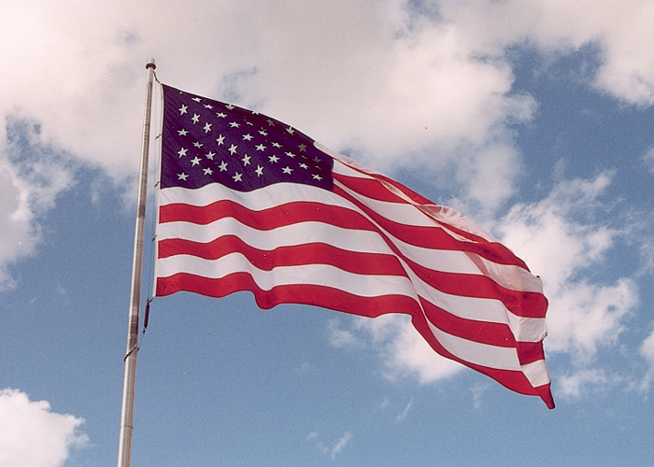
The Seven Times Prophecy (Lev. 26)
From this prophecy, we know that America represents the regathering of the Twelve Tribes of Israel, according to the 7 Times prophecy of Leviticus 26. We, along with our Christian Israelite brethren around the world, are the New JerUSAlem. But America, which is still the world’s only Christian Republic, will be the seat of God’s government, after the Judgment Day.

Slide 38
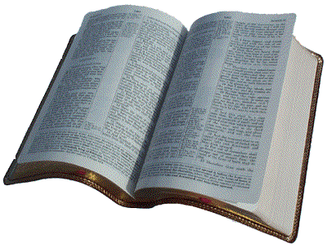
The Significance of the Year, 1982.
“After two days He will revive us. In the third day He will raise us up and we shall live in His sight.” – Hosea 6:2.

Slide 39
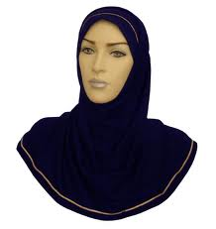
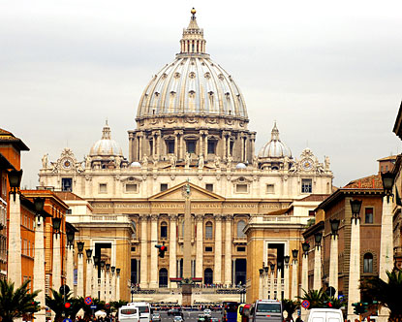
The Significance of the Year, 1982.
In order to understand Bible prophecy, you must be able to identify the Babylonians in the world today; and it’s NOT the Iraqis or the Muslims. Nor is it America. Nor is it the Catholic Church!

Slide 40
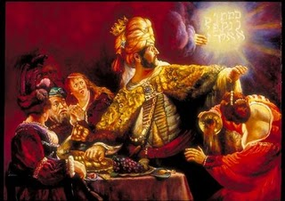
The Significance of the Year, 1982.
Dan. 5:30 tells us that Belshazzar, King of Babylon, was slain by Darius on the very night that the handwriting appeared on the wall.

Slide 41
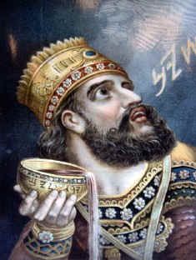
The Significance of the Year, 1982.
The Babylonians had presumed their walls to be impenetrable, so they were busy partying, completely unconcerned with what the Median army might be doing outside the walls of the great city. According to historians, Belshazzar was beheaded by Darius the Mede, using a ceremonial sword. This event occurred in the year, 539 BC.
Belshazzar

Slide 42
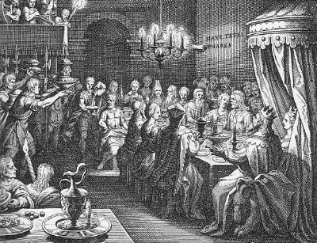
The Significance of the Year, 1982.
Here is William G. Fowler’s account, as given in his book, End Time Revelation: The fifth chapter of Daniel gives an account of what took place in Babylon on the night when the city fell. Belshazzar, the king’s son, and co-regent in Babylon, was holding a feast, blasphemously using the gold and silver vessels taken from the temple of Jerusalem.

Slide 43
The Significance of the Year, 1982.
Suddenly, writing appeared on the wall, “Mene, Mene, Tekel, Upharsim,” which Daniel interpreted, “God hath numbered thy kingdom and finished it. Thou art weighed in the balances and art found wanting.” Thy kingdom is divided and given to the Medes and Persians.” History records that the Medes and Persians gained entrance into the city by diverting the river Euphrates, so that the river bed became dry where it ran through the walls.

Slide 44
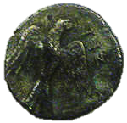
The Significance of the Year, 1982.
Now, it is interesting to note that the four words, written in Chaldaic (Aramaic), when translated into Hebrew, would read “Minah, Minah, Shekel, Peres,” which were Hebrew weights. The gerah was the smallest weight, and the total of the above weights, expressed in gerahs, is 2520.” - p. 125.
Gerah coin = 1/20 of a shekel

Slide 45
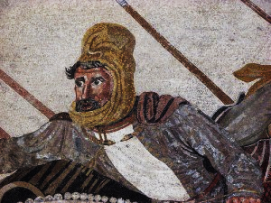
The Significance of the Year, 1982.
Babylon was overthrown by the year, 539 BC. Now, given what we have learned about the prophetic significance of the number 2520, let’s do the math:
539 BC + 2520 = 1982.

Slide 46
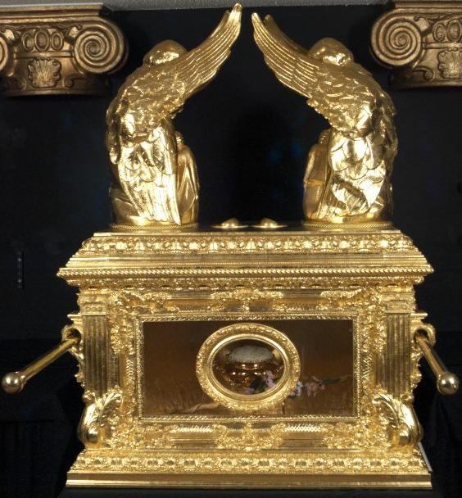
The Significance of the Year, 1982.
I happened to be doing some research on the Hebrew calendar, when the internet search I was doing listed a seemingly unrelated item, something about Ron Wyatt finding the in Jerusalem. I checked it out and the video just blew me away.

Slide 47
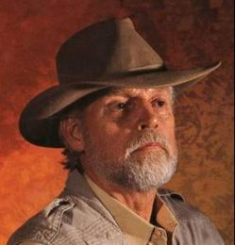
The Significance of the Year, 1982.
Ron Wyatt’s description of how he found the blood on the Mercy Seat and the lab analysis took my breath away. 23 chromosomes from His mother, Mary, plus one y-chromosome provided by the Holy Spirit. The fact that the blood only had 24 chromosomes could only be accounted for by the fact that Jesus had no earthly father:
Ron Wyatt

Slide 48
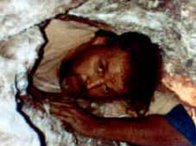
The Significance of the Year, 1982.
This was mind-boggling stuff!! I immediately notified my entire mailing list (of about 1,000 people) to inform them of this remarkable find. The prophetic significance of the year 1982 had finally been revealed; and it relates to the Atoning Blood of Jesus Christ!!

Slide 49
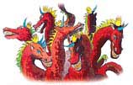
The Beast With Seven Heads And Ten Horns

Slide 50
The Beast With Seven Heads And Ten Horns
Before continuing with the subject of the Atoning Blood, we must understand that, at the Second Coming, Yahshua will accomplish two purposes:

Slide 51
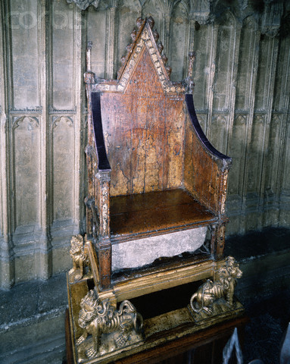
The Beast With Seven Heads And Ten Horns
1.) the destruction of all evil in this world, and
2.) the Restoration of Christian Israel.
#1 must happen before #2 can be accomplished, so let’s analyze some Scriptures relevant to the Judgment Day:

Slide 52
The Beast With Seven Heads And Ten Horns
"And there came one of the seven angels which had the seven vials, and talked with me, saying unto me, Come hither; I will show unto thee the judgment of the great whore that sitteth upon the many waters:... So he carried me away in the spirit into the wilderness: and I saw a woman sit upon a scarlet coloured beast, full of names of blasphemy, having seven heads and ten horns... And upon her head was a name written, Mystery Babylon..." -- Rev. 17:15.

Slide 53
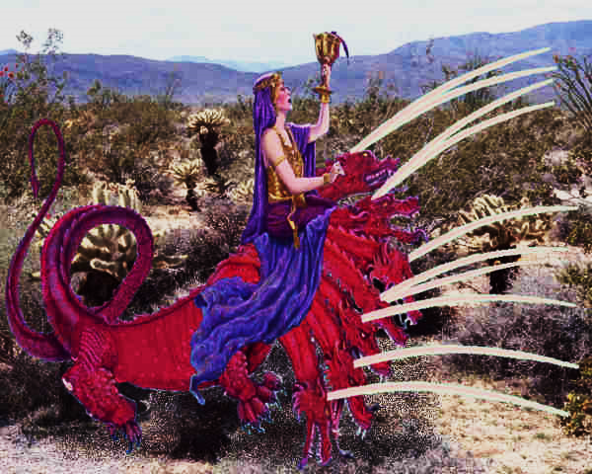
The Beast With Seven Heads And Ten Horns
The angel further explains to John the meaning of the image of the Scarlet Woman: "And here is the mind which hath wisdom. The seven heads are seven mountains, on which the woman sitteth.
And there are seven kings: five are fallen, and one is, and the other is not yet come; and when he cometh, he must continue a short space." -- Rev. 17:9,10.

Slide 54
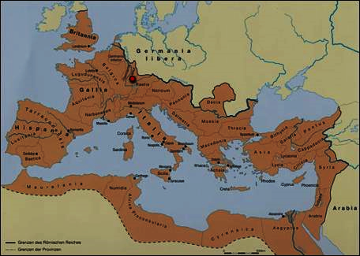
The Beast With Seven Heads And Ten Horns
The image of the Scarlet Woman refers to Seven Kings upon whom she sits, that is, over whom she has power and control. Five are fallen and one is. The one that obviously is the Roman Empire because John, the author of the Book of Revelation (Apocalypse to Catholics) lived in Roman times.
The Roman Empire

Slide 55
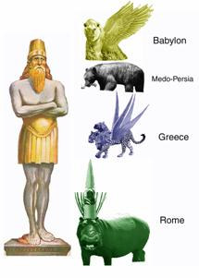
The Beast With Seven Heads And Ten Horns
Tracing backward in time, we know that previous to Rome were Greece, Medo-Persia, and Babylon, three empires which were also mentioned in Daniel as part of Nebuchadnezzar's image.

Slide 56
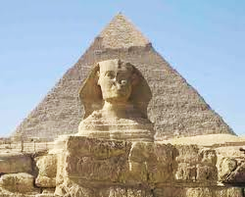
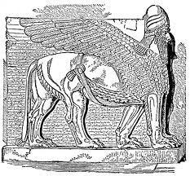
The Beast With Seven Heads And Ten Horns
But there were two empires before Babylon which were also great. These were Egypt and Assyria. So, in chronological order, we have six great empires who are directly under the control of the Scarlet Woman of Revelation. These are:

Slide 57
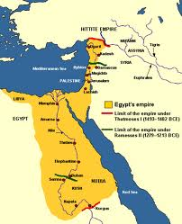
The Beast With Seven Heads And Ten Horns
1: Egypt, dating from approximately 3100 BC, which was conquered by…..

Slide 58
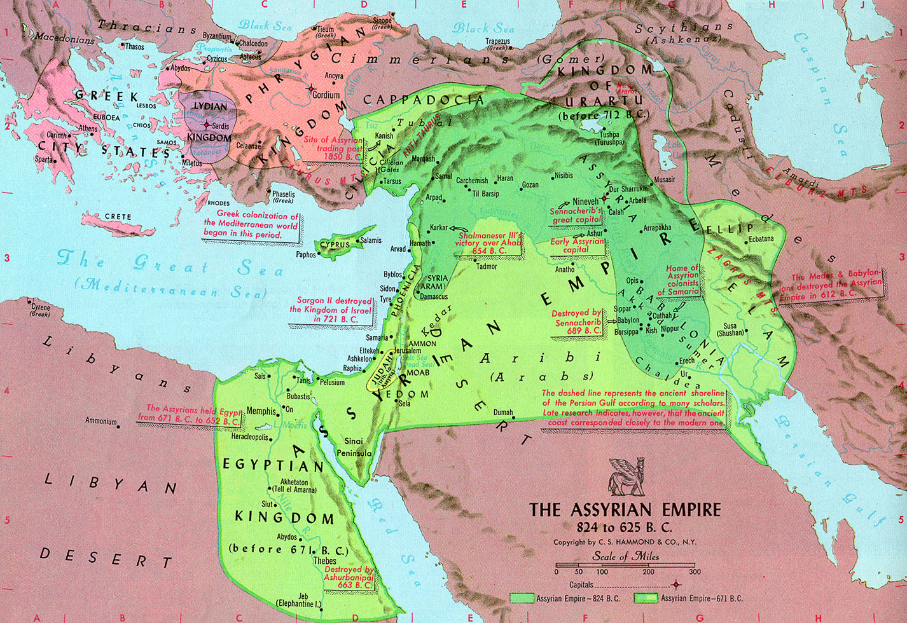
The Beast With Seven Heads And Ten Horns
2: the Assyrian Empire, which was replaced by the

Slide 59
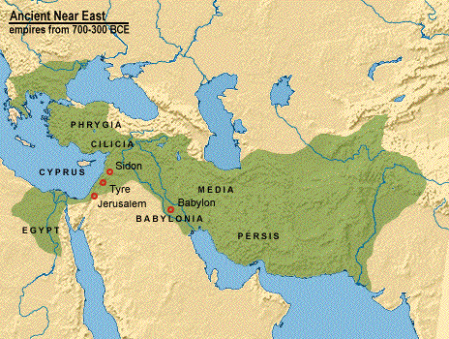
The Beast With Seven Heads And Ten Horns
3: Babylonian Empire in 609 BC. Then,

Slide 60
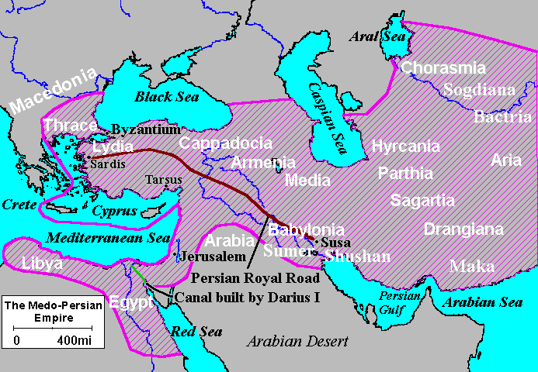
The Beast With Seven Heads And Ten Horns
4: the Medo-Persian Empire, followed by

Slide 61
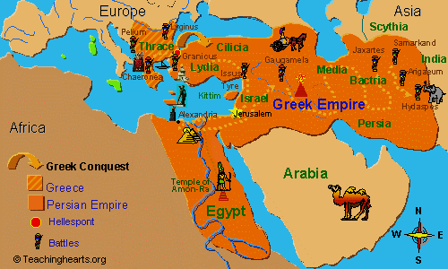
The Beast With Seven Heads And Ten Horns
5: Greece.

Slide 62
The Beast With Seven Heads And Ten Horns
These five had already fallen by the time of John the Revelator who lived in the first century AD.
According to the angel in John’s vision, one "is." That is, one kingdom is contemporary with John. That empire is, obviously,
6. Rome.

Slide 63
The Beast With Seven Heads And Ten Horns
Revelation 17:10 says that "the other is not yet come; and when he cometh, he must continue a short space.”

Slide 64
The Beast With Seven Heads And Ten Horns
Some people might here object and say that Secular Rome and Papal Rome are two different entities which are not to be considered as a continuous empire, so that the Rome of the Caesars should be considered as one empire and the Rome of the Popes another.

Slide 65
The Beast With Seven Heads And Ten Horns
The fact is, however, that Papal Rome was still a secular power. It adopted Christianity merely as a matter of convenience to both placate and deceive the early Christians into thinking that it was becoming "holy".

Slide 66
The Beast With Seven Heads And Ten Horns
Although Constantine put an end to the martyrdom of Christians during his reign when he issued his Edict of Toleration, it is a recorded fact that he did not personally convert to Christianity until he was on his deathbed. Perhaps the then-current Bishop of Rome talked him into an attempt to save his soul.

Slide 67
The Beast With Seven Heads And Ten Horns
In addition, he retained the pagan title of Pontifex Maximus even while he presided over the Council of Nicea, where the books of the Bible were decided upon.

Slide 68
The Beast With Seven Heads And Ten Horns
The title of Pontifex Maximus was used by all of the previous Roman Emperors and it signified the High Priest of Jupiter, the ruling god of the Roman pantheon.

Slide 69
The Beast With Seven Heads And Ten Horns
"And I stood upon the sand of the sea, and saw a beast rise up out of the sea, having seven heads and ten horns, and upon his horns ten crowns, and upon his heads the name of blasphemy." – Rev. 13:1.

Slide 70
The Beast With Seven Heads And Ten Horns
Many Bible prophecy scholars have interpreted the seven heads to be the seven hills upon which the city of Rome is built. But, these seven heads are the same as the seven beasts of Rev. 17. In this particular vision, the beast with seven heads is seen as one entity having seven heads and ten horns.
Map of the seven hills of Rome

Slide 71
The Beast With Seven Heads And Ten Horns
Then, what are the ten horns? Most likely, the ten horns are the ten European nation-states which eventually formed a league with Rome after the city of Rome was sacked by the Germanic tribes.

Slide 72
The Beast With Seven Heads And Ten Horns
These ten nations or tribes were the 1. Franks, 2. Huns, 3. Vandals, 4. Visigoths, 5. Ostrogoths, 6. Alans (and Sueves), 7. Burgundians, 8. Odoacer’s Italian kingdom of several tribes, 9. Saxons, 10. Lombards.

Slide 73
THE HEALING OF THE DEADLY WOUND
"And I saw one of its heads, as it were, wounded to death; and his deadly wound was healed: and all the world wondered after the beast." – Rev. 13:3.

Slide 74
THE HEALING OF THE DEADLY WOUND
The "deadly wound" was the sacking of Rome by the Germanic tribes, which led to the demise of the emperors, who had all taken the title "Pontifex Maximus."

Slide 75
THE HEALING OF THE DEADLY WOUND
After a period of utter turmoil in which leadership was up for grabs, Rome miraculously reappeared as the Holy Roman Empire. While the secular emperors were disappearing, the groundwork was being laid for the emergence of the popes, who claimed to be the "vicars of Christ".

Slide 76
THE NUMBER OF THE BEAST: 666
The title for the Pope, in Latin, is "Vicarius Filii Dei." This title is engraved on the Papal mitre. It means "Vicar of the Son of God." According to the Roman Numeral System, V=5, I=1, C=100, A=0, R=0, I=1, U=5 (U and V have the same value), F=0, I=1, L=50, I=1, I=1, D=500, E=0, I=1.
Adding these numbers, we get: 5+1+100+1+5+1+50+1+1+500+1=

Slide 77
THE NUMBER OF THE BEAST: 666
At some point, the title, Pontifex Maximus, was assumed by the popes, who are still known as "Pontiffs" today. Thus, the deadly wound which was administered to the pagan emperors of Rome was healed and the popes took their place.

Slide 78
THE NUMBER OF THE BEAST: 666
Imperial Rome and Papal Rome are one continuous entity symbolized by the number 666. This combined beast is, therefore, the sixth beast of the Apocalypse.

Slide 79
THE SEVENTH BEAST
The fact is that the sixth beast was dethroned by a seventh beast, just as the Bible prophesied. Papal Rome was ultimately relieved of power by none other than Napoleon Bonaparte in 1798 as commander of the French army. In May of 1804, Napoleon was declared Emperor of France by the French senate.

Slide 80
THE SEVENTH BEAST
In December of the same year, the still acting Pope was to crown him Emperor in an official rite. As a symbol of Rome’s power over all of Europe, the reigning Popes had crowned the kings and queens of the European monarchies for centuries.

Slide 81
THE SEVENTH BEAST
This was an established rite which was begun by Pope Leo III when he crowned Charlemagne in the year 800; and Napoleon, a thousand years later, was expected to adhere to this tradition. The site was the Cathedral of Notre Dame.

Slide 82
THE SEVENTH BEAST
As Pope Pius VII was preparing to crown him, Napoleon grabbed the crown from the Pope’s hands and crowned himself, thus signifying that he, and not the Papacy, was the true power.

Slide 83
THE SEVENTH BEAST
When Napoleon came to power in France, he relieved the Papacy of its real estate holdings in that country, namely the monasteries. This was about 25% of the land in France. In 1809, Napoleon completed the takeover by annexing the Papal States. The Papacy was stripped of both its military and political might, but never its spiritual might.

Slide 84
THE SEVENTH BEAST
At this point, Napoleon’s power was at its height. But in 1815, only six years later, his empire was defeated by Wellington at Waterloo. Regarding the seventh beast, the Bible says:
The Duke of Wellington

Slide 85
THE SEVENTH BEAST
"...and when he cometh, he must continue a short space." Indeed, Napoleon’s reign of 17 years was the shortest of any of the 7 beasts. The last beast of the prophecy, then, is
7: Napoleon

Slide 86
THE SEVENTH BEAST
This brings us up to the year 1815. History records no clear successor to Napoleon, yet the Bible tells us that there is to be another beast, the 8th Beast!
Left: Napoleon’s Deathbed

Slide 87
THE SEVENTH BEAST
Rev.17:11: "And the beast that was, is not, even he is the eighth, and is of the seven, and goeth into perdition." The beast that "was, is not," and yet "is the eighth" is to be one of the five previous to Rome. Why is this true?

Slide 88
THE SEVENTH BEAST
1. It cannot be Rome that is to be resurrected. The angel clearly tells John that it, the 8th beast, "is not," meaning it is not in power at the time of John the Revelator. Logically, therefore, it cannot be Rome because Rome "is."
Roman Coloseum

Slide 89
THE SEVENTH BEAST
2. Although the verse says that the 8th beast is "of the seven," it cannot be number seven because the verse says to John that the 8th beast already "was." That is, the 8th Beast is one which existed previously to Rome but is to be reincarnated later.

Slide 90
THE SEVENTH BEAST
2. So, we have ruled out beasts six and seven as possible candidates for the resurrected eighth beast. Although many Bible prophecy interpreters teach that Rome is to be revived, they are clearly wrong.

Slide 91
THE SEVENTH BEAST
2. The language of the Bible is so clear on this fact that it can be categorically stated that the Papacy is not a candidate for the 8th Beast. The Papacy will, however, fulfill another prophetic role entirely, that of the False Prophet..

Slide 92
THE SEVENTH BEAST
Obviously, the 8th beast is one of the previous five. But which one? Let us go back to the Book of Daniel.

Slide 93
NEBUCHADNEZZAR’S SECOND DREAM
Daniel 4:4,5: "I, Nebuchadnezzar was at rest in mine house, and flourishing in my palace: I saw a dream which made me afraid, and the thoughts upon and the visions of my head troubled me."

Slide 94
NEBUCHADNEZZAR’S SECOND DREAM
As with the previous vision, the Babylonian priests had failed to reveal the meaning of the dream, so Nebuchadnezzar was forced to turn to Daniel again. But before Daniel began his interpretation, the king revealed a few more details of the dream.
Daniel Interprets The Dream

Slide 95
NEBUCHADNEZZAR’S SECOND DREAM
Daniel 4:10-15: "Thus were the visions of my head upon my bed; I saw, and behold, a tree in the midst of the earth... The tree grew, and the height thereof was great... And, behold, a watcher and an holy
one came down from heaven; He cried aloud and said thus, Hew down the tree, and cut off his branches... Nevertheless leave the stump of his roots in the earth, even with a band of iron and brass."

Slide 96
NEBUCHADNEZZAR’S SECOND DREAM
Daniel then told him that the tree is Nebuchadnezzar’s empire, Babylon. The cutting of the tree is the vanquishing of Babylon at the hands of the Medes and Persians, and the banding of the tree stump refers to a future rebirth of Babylon.

Slide 97
NEBUCHADNEZZAR’S SECOND DREAM
"And whereas they commanded to leave the stump of the tree roots, thy kingdom shall be sure unto thee, after that thou shalt have known that the heavens do rule." - Dan. 4:26.

Slide 98
NEBUCHADNEZZAR’S SECOND DREAM
Now this dream had a personal meaning for Nebuchadnezzar in that he was driven insane for seven years, after which he regained his sense and declared the God of Israel to be the One, True God. But in those days, the king and his empire were considered one; so,
Nebuchadnezza - Insane

Slide 99
NEBUCHADNEZZAR’S SECOND DREAM
… there is a secondary meaning which involves the empire, Babylon. As his empire was cut down as a tree, so was the stump of that tree banded. (This banding of a tree stump to prevent the dying of the roots is still practiced today.) And since the stump represents the empire as well as the king, Babylon is to be reborn.

Slide 100
NEBUCHADNEZZAR’S SECOND DREAM
So, in fitting symbolism, Nebuchadnezzar "died" and was reborn after seven years just as the 8th beast, Mystery Babylon, formerly the 3rd beast, is to be reborn after seven kingdoms.

Slide 101
MYSTERY BABYLON: THE 8TH BEAST
Returning to Revelation, we find that Babylon, indeed, has been reborn: "And there were voices, and thunders, and lightnings; and there was a great earthquake, such as not since men were on the earth, so mighty an earthquake, and so great. And the great city was divided into three parts, and the cities of the nations fell; and great Babylon came in remembrance before God, to give unto her the cup of the wine of the fierceness of his wrath." – Chap. 16, vs. 18, 19.

Slide 102
MYSTERY BABYLON: THE 8TH BEAST
This can be a literal earthquake or it can be the final World War, neither of which has happened yet, but it is clear from the prophecy that the world will be divided into three parts just before the Day of Judgment.

Slide 103
MYSTERY BABYLON: THE 8TH BEAST
Observe, however, that Revelation clearly foretells a time during which corporate "global governance" is an established fact.

Slide 104
MYSTERY BABYLON: THE 8TH BEAST
The essence of the prophecy is that the world has entered into a period of global economy in which the nations are ruled by merchants:

Slide 105
MYSTERY BABYLON: THE 8TH BEAST
"For all nations have drunk of the wine of the wrath of her fornication, and the kings of the earth have committed fornication with her, and the merchants of the earth are waxed rich through the abundance of her delicacies." – Rev. 18:3

Slide 106
MYSTERY BABYLON: THE 8TH BEAST
"...for thy merchants were the great men of the earth; for by thy sorceries were all nations deceived." – Rev. 18:23.

Slide 107
MYSTERY BABYLON: THE 8TH BEAST
"And the beast was taken, and with him the false prophet that wrought miracles before him, with which he deceived them that received the mark of the beast, and them that worshipped his image. These both were cast alive into a lake of fire burning with brimstone." – Rev. 19:20.

Slide 108
THE HOUSE OF ROTHSCHILD

Slide 109
THE HOUSE OF ROTHSCHILD
In 1815, the very year in which Napoleon Bonaparte was defeated at Waterloo by a British army financed by the Rothschild banking family, the very first attempt was made to create a One World Government. It was called the Congress of Vienna.

Slide 110
THE HOUSE OF ROTHSCHILD
The Congress was conceived by the Emperor of Austria, but the Rothschilds and other Zionist banking families of Europe co-opted the Congress and turned it to their own ends, with nightly receptions for the delegates held in the homes of prominent Jewish bankers and merchants.
The Congress of Vienna

Slide 111
THE HOUSE OF ROTHSCHILD
These ends were for the long-range goal of overcoming nationhood and establishing a One World Government. The Emperor of Austria (left) wanted to unite Europe in order to prevent another Napoleon from coming to power; but the Rothschilds had bigger motives.

Slide 112
THE HOUSE OF ROTHSCHILD
The Rothschilds had become unimaginably rich – billionaires – during the Napoleonic Wars because they had lent money to all of Napoleon’s enemies. In fact, Nathan Rothschild privately organized the financing for Wellington’s army while he was fighting against Napoleon in Spain for two years before the battle of Waterloo.

Slide 113
THE HOUSE OF ROTHSCHILD
At that time, the British government was reluctant to fund Wellington because they were still reeling from a second military defeat at the hands of the United States on the other side of the Atlantic during the War of 1812.

Slide 114
THE HOUSE OF ROTHSCHILD
At the same time, Napoleon had lost his navy at the Battle of Trafalgar, so the consensus in the government was that Napoleon could never strike across the English Channel to harm Britain.

Slide 115
THE HOUSE OF ROTHSCHILD
Unless things changed dramatically, Napoleon Bonaparte was the mainland’s problem. In addition, Great Britain was selling goods to both sides in the struggle, so she was profiting handsomely from the war and had no incentive to stop it or to commit herself militarily. The more the continental powers battled each other, the stronger Britain would become.

Slide 116
THE HOUSE OF ROTHSCHILD
But the Rothschilds saw that Wellington’s army was their trump card in saving their European economic and political investments.

Slide 117
THE HOUSE OF ROTHSCHILD
Had Napoleon prevailed, they would have lost several fortunes, not to mention all of the influence they had accumulated through their banking and mercantile activities. But the complete story of the Battle of Waterloo is rarely told.

Slide 118
THE HOUSE OF ROTHSCHILD
The fact is that Napoleon had fought Wellington to a stand-off. It wasn’t until the Prussian reinforcements arrived that Napoleon’s fate was sealed. It was the charge of the German cavalry that carried the day!
German Cavalry

Slide 119
THE HOUSE OF ROTHSCHILD
As a result of Wellington’s Victory, the Rothschild family made the first of many huge killings in the British stock market by spreading the rumor the Wellington had been defeated at Waterloo.

Slide 120
THE HOUSE OF ROTHSCHILD
According to popular reports, Nathan Rothschild had already learned by carrier-pigeon message that Wellington had won. According to the book, The Rothschilds, a Family Portrait, by Frederic Morton, here is what actually happened:

Slide 121
THE HOUSE OF ROTHSCHILD
"For thirty hours the fate of Europe hung veiled in cannon smoke. On June 19, 1815, late in the afternoon a Rothschild agent named Rothworth jumped into a boat at Ostend. In his hand he held a Dutch gazette still damp from the printer.

Slide 122
THE HOUSE OF ROTHSCHILD
….. By the dawn light of June 20 Nathan Rothschild stood at Folkstone harbor and let his eye fly over the lead paragraphs. A moment later he was on his way to London (beating Wellington’s envoy by many hours) to tell the government that Napoleon had been crushed. Then he proceeded to the stock exchange.”

Slide 123
THE HOUSE OF ROTHSCHILD
NOTE: By this time, the Rothschilds had central banks located in Frankfurt, London, Vienna, Naples, and even in Paris, with each of Meyer Amschel Rothschild’s five sons in charge of a branch.

Slide 124
THE HOUSE OF ROTHSCHILD
Because of all these spread-out locations, the Rothschilds had developed a system of secret couriers who could deliver messages more quickly than even the military messengers of Europe’s various armies.

Slide 125
THE HOUSE OF ROTHSCHILD
Napoleon had standing orders that these messengers should be detained wherever they might be suspected. Having received news from one of his own couriers of, Nathan Rothschild went and told certain members of the government the truth, but what he did at the stock exchange was a different matter. Read on.

Slide 126
THE HOUSE OF ROTHSCHILD
After Wellington’s Rothschild-financed army defeated Napoleon at Waterloo, Nathan Rothschild had demonstrated his economic might by nearly bankrupting Great Britain so that he could make a huge killing in the stock market, thus further profiting from the war.

Slide 127
THE HOUSE OF ROTHSCHILD
The Rothschild Money Power has secretly and relentlessly conspired to rule over the nations ever since, setting up privately-owned central banks that dictate economic terms to these same nations, although this is a secret only to the public. America’s Federal Reserve System is just such a privately-owned bank,

Slide 128
THE HOUSE OF ROTHSCHILD
… operated for the profit of the bankers, not the good of the nation. The Rothschilds and other international banking families have always been the inspiration for all subsequent attempts to create a One-World-Government.

Slide 129
THE HOUSE OF ROTHSCHILD
As Meyer Amschel Rothschild put it so bluntly: "Give me the power to issue a nation’s currency and I care not who makes its laws."

Slide 130
THE HOUSE OF ROTHSCHILD
The international bankers are the true power behind the United Nations. As the Money Power proceeds with its plans for the New World Order, the United Nations is making plans to take over the world’s various armies, so that no nation can resist the will of the U.N.

Slide 131
THE HOUSE OF ROTHSCHILD
"...and they worshiped the beast, saying, Who is like unto the beast? Who is able to make war with him?" – Rev. 13:4.

Slide 132
The Divine Sacrifice
Daniel 9:20-27: And while I was speaking, and praying, and confessing my sin and the sin of my people Israel, and presenting my supplication before the LORD my God for the holy mountain of my God; Yea, whiles I was speaking in prayer, even the man Gabriel,

Slide 133
The Divine Sacrifice
whom I had seen in the vision at the beginning, being caused to fly swiftly, touched me about the time of the evening oblation. And he informed me, and talked with me, and said, O Daniel, I am now come forth to give thee skill and understanding.

Slide 134
The Divine Sacrifice
At the beginning of thy supplications the commandment came forth, and I am come to shew thee; for thou art greatly beloved: therefore understand the matter, and consider the vision. Seventy weeks are determined upon thy people and upon thy holy city,

Slide 135
The Divine Sacrifice
… to finish the transgression, and to make an end of sins, and to make reconciliation for iniquity, and to bring in everlasting righteousness, and to seal up the vision and prophecy, and to anoint the most Holy.

Slide 136
The Divine Sacrifice
Know therefore and understand, that from the going forth of the commandment to restore and to build Jerusalem unto the Messiah the Prince shall be seven weeks, and threescore and two weeks: the street shall be built again, and the wall, even in troublous times …
The Temple Jerusalem

Slide 137
The Divine Sacrifice
And after threescore and two weeks shall Messiah be cut off, but not for himself: and the people of the prince that shall come shall destroy the city and the sanctuary; and the end thereof shall be with a flood, and unto the end of the war desolations are determined.

Slide 138
The Divine Sacrifice
And he shall confirm the covenant with many for one week: and in the midst of the week he shall cause the sacrifice and the oblation to cease, and for the overspreading of abominations he shall make it desolate, even until the consummation, and that determined shall be poured upon the desolate.

Slide 139
The Divine Sacrifice
Before Ron Wyatt’s discovery of the Holy Blood on the Ark, I had assumed that Daniel’s expression, “to anoint the Most Holy,” was a reference to Jesus Christ being anointed. I think that virtually every Christian scholar is of the same opinion; but now I have a different view.

Slide 140
The Divine Sacrifice
Having researched how the expression is used in the Bible, I realized that the meaning of “most holy” [Hebrew: HaQodashim] in the Old Testament is NEVER used of a person. It is used EXCLUSIVELY for the secret chamber, behind the veil, wherein the Ark and the Mercy Seat lay hidden from the eyes of all the world, with the exception of the High Priest.

Slide 141
The Divine Sacrifice
The very last act of the sacrificial ritual was to sprinkle the sacrificial blood onto the Mercy Seat. If the High Priest did not do this, then there was no atonement.

Slide 142
The Divine Sacrifice
Consequently, this aspect of the ritual, which was mandated by Yahweh, as explained earlier, was crucial to the fulfillment of the Law. The ceremony was NOT COMPLETE until the blood was sprinkled on the Mercy Seat.

Slide 143
The Divine Sacrifice
Here is how one author describes it: Within the Holy Place of the tabernacle, there was an inner room called the Holy of Holies, or the Most Holy Place. Judging from its name,

Slide 144
The Divine Sacrifice
… we can see that it was a most sacred room, a place no ordinary person could enter. It was God’s special dwelling place in the midst of His people. During the Israelites’ wanderings in the wilderness, God appeared as a pillar of cloud or fire in and above the Holy of Holies. The Holy of Holies was a perfect cube — its length, width and height were all equal to 15 feet.

Slide 145
The Divine Sacrifice
A thick curtain separated the Holy of Holies from the Holy Place. This curtain, known as the “veil,” was made of fine linen and blue, purple and scarlet yarn. There were figures of cherubim (angels) embroidered onto it. Cherubim, spirits who serve God,

Slide 146
The Divine Sacrifice
…..were in the presence of God to demonstrate His almighty power and majesty. They also guarded the throne of God. These cherubim were also on the innermost layer of covering of the tent. If one looked upward, they would see the cherubim figures.
Ark of The Covenant

Slide 147
The Divine Sacrifice
The word “veil” in Hebrew means a screen, divider or separator that hides. What was this curtain hiding? Essentially, it was shielding a holy God from sinful man. Whoever entered into the Holy of Holies was entering the very presence of God. In fact,

Slide 148
The Divine Sacrifice
…., anyone except the high priest who entered the Holy of Holies would die. Even the high priest, God’s chosen mediator with His people, could only pass through the veil and enter this sacred dwelling once a year, on a prescribed day called the Day of Atonement..

Slide 149
The Divine Sacrifice
The picture of the veil was that of a barrier between man and God, showing man that the holiness of God could not be trifled with. God’s eyes are too pure to look on evil and He can tolerate no sin (Habakkuk 1:13). The veil was a barrier to make sure that man could not carelessly and irreverently enter into God’s awesome presence.

Slide 150
The Divine Sacrifice
Even as the high priest entered the Holy of Holies on the Day of Atonement, he had to make some meticulous preparations: He had to wash himself, put on special clothing, bring burning incense to let the smoke cover his eyes from a direct view of God, and bring blood with him to make atonement for sins. – “Holy of Holies and the Veil”

Slide 151
The Divine Sacrifice
So, the Holy of Holies, or the Most Holy, is the sacred space, the enclosure, where Yahweh met with the High Priest. And the Mercy Seat was the spot on the lid of the Ark where the blood was sprinkled. The Most Holy is a location, not a person.

Slide 152
The Divine Sacrifice
Secondly, we know that this ritual was performed in Old Testament times as a prefigurement of the Last Sacrifice. The Holy of Holies ritual was instituted as an ongoing practice in preparation for the ONE LAST TIME: the redemption of Israel on the Cross by Yahshua’s own Blood.

Slide 153
The Divine Sacrifice
Thirdly, since the entirety of Christ’s Passion was endured under the terms of the Old Covenant, the atonement could not have been lawfully executed unless His Blood was LITERALLY SPRINKLED ON THE MERCY SEAT!!!!

Slide 154
The Divine Sacrifice
The New Covenant could not go into effect until all of the provisions of the sacrificial law had been met.
Therefore, the expression, “anoint the most holy,” Daniel 9:25, is a reference to the anointing of the Mercy Seat with Christ’s own Blood.

Slide 155
The Divine Sacrifice
Daniel 9:27 is very specific as to the nature of the change in the Law when Messiah is sacrificed: “And in the midst of the week He shall cause the sacrifice and oblation to cease.”

Slide 156
Yahweh's Feast Days And The Female Gestation Cycle, Part 1
One of the most astounding coincidences of the Hebrew Calendar is the apparent fact that the Feast Day Appointments of Yahweh's Calendar correlate with the major developmental stages of the human fetus in the mother's womb.
Seven Thunders Ministry: /

Slide 157
Yahweh's Feast Days And The Female Gestation Cycle, Part 1
Just as Yahweh set up specific days for His feasts, there are also specific cycles of growth for a baby in its mother's womb. It is fascinating to discover the parallels between His feasts days and the development of life in a mother's womb. This study will attempt to demonstrate the amazing similarities, for in God all things have perfect timing!

Slide 158
Yahweh's Feast Days And The Female Gestation Cycle, Part 1
Feast Day Gestation Stage
Passover Fertilization (formation of the zygote)
Unleavened Bread Implantation of Zygote in Uterus Wall
First Fruits (Wave Sheaf) Zygote Becomes an Embryo
Pentecost Embryo Becomes a Fetus
Trumpets Third Trimester Starts
Atonement Baby Begins to Make Its Own Blood
Tabernacles Viability

Slide 159
Yahweh's Feast Days And The Female Gestation Cycle, Part 1
If this correlational table is indeed valid - which it appears to be - then the Biblical Appointments have a hidden significance never before suspected!

Slide 160
Yahweh's Feast Days And The Female Gestation Cycle, Part 1
In the northern hemisphere, Yahweh's Solar Calendar always starts with the Spring Equinox, when the daytime is equal to the nighttime and when life is renewed.

Slide 161
Yahweh's Feast Days And The Female Gestation Cycle, Part 1
Comparing the Feast Day Calendar with the Human Gestation Period:
Day 1 | Spring Equinox | Ovulation
Day 14 | Passover | Maximum Fertility

Slide 162
Yahweh's Feast Days And The Female Gestation Cycle, Part 1
(If fertilized, the egg becomes a zygote within 24 hours, containing the combined DNA of both parents. During the next seven days, the zygote must implant itself into the wall of the uterus, where it will be nourished for development and growth. Passover is always the day before a Sabbath, so the next day (24 hours) is always the Sabbath of Unleavened Bread.)

Slide 163
Yahweh's Feast Days And The Female Gestation Cycle, Part 1
Day 15 | Feast of Unleavened Bread | Formation of the zygote

Slide 164
Yahweh's Feast Days And The Female Gestation Cycle, Part 1
(In this context, "unleavened" means pure, uncorrupted, as Jesus Christ was sinless. Barring complications, the zygote will attach itself to the uterine wall and grow.)

Slide 165
Yahweh's Feast Days And The Female Gestation Cycle, Part 1
Day 16 | First Fruits of barley | Zygote connects with uterus

Slide 166
Yahweh's Feast Days And The Female Gestation Cycle, Part 1
(Also known as Wave Sheaf Day represents the point where the Zygote's outer membrane opens up and physically connects with the mother's uterus, beginning the process of developing the umbilical cord. The umbilical cord provides the necessary exchange of bodily fluids, for the zygote to develop into an embryo.)

Slide 167
Yahweh's Feast Days And The Female Gestation Cycle, Part 1
Day 65 | Pentecost | Embryo becomes a fetus

Slide 168
Yahweh's Feast Days And The Female Gestation Cycle, Part 1
(Forty-nine days after the Wave Sheaf offering, Pentecost (First fruits of wheat) becomes the point where the embryo becomes recognizably human, with appendages, head, eyes, shoulders, etc., all taking shape. This represents the transition from embryo to fetus.

Slide 169
Prophetic Fulfillment of the First Four Feasts
In the Spring of 33 AD, these first four Feast Days were all literally fulfilled by Jesus Christ and the Disciples. Jesus was crucified on Passover Day, redeeming Israel fulfilling the Levitical sacrificial type. His purity was maintained even unto death (Unleavened Bread), and it established the New Covenant (Wave Sheaf Offering).

Slide 170
Prophetic Fulfillment of the First Four Feasts
Finally, on the Day of Pentecost, the Holy Spirit descended on those Disciples who had assembled in Jerusalem, symbolizing the first fruits of wheat, with the final harvest of grapes coming in the Fall.

Slide 171
Prophetic Fulfillment of the First Four Feasts
The delay in time between the Spring Feasts and the Fall Feasts is the difference in time between the First Advent and the Second Advent!!!

Slide 172
Yahweh's Feast Days And The Female Gestation Cycle, Part 2
Day 183 | Feast of Trumpets | Biological functions completed

Slide 173
Yahweh's Feast Days And The Female Gestation Cycle, Part 1
(The Feast of Trumpets (third trimester) represents the point where the fetus has all of its parts fully formed and functioning. The little human being needs now to fully develop and integrate those parts. Notably, its ears are capable of hearing (the trumpets) at this point.)

Slide 174
Yahweh's Feast Days And The Female Gestation Cycle, Part 2
Day 190 | Day of Atonement | Blood Development

Slide 175
Yahweh's Feast Days And The Female Gestation Cycle, Part 2
(The sixth stage (Day of Atonement) is when the fetus starts producing its own blood, in preparation for the day when it will no longer have the mother's blood available for nutrition.)

Slide 176
Yahweh's Feast Days And The Female Gestation Cycle, Part 2
Day 197 | Feast of Tabernacles | Viability

Slide 177
Yahweh's Feast Days And The Female Gestation Cycle, Part 2
(The final stage before birth is the Viability Stage. The Feast of Tabernacles is also called the Feast of Booths, meaning living outside in tents. It represents the baby's ability to live outside of the womb.)

Slide 178
Yahweh's Feast Days And The Female Gestation Cycle, Part 2
Day 204 | Last Great Day | Premature Birth Viable

Slide 179
Yahweh's Feast Days And The Female Gestation Cycle, Part 2
Now, given this truly remarkable parallelism, I would like to carry it one step further. The human gestation period is approximately 9 months, or 270 days.

Slide 180
Yahweh's Feast Days And The Female Gestation Cycle, Part 2
(9 * 30 = 270. With the Solar Calendar of Enoch and Jubilees, we would add the three 91st Days of the three seasons. 270 + 3 = 273 days.) If we begin this process on the First Sabbath after the Spring Equinox, say March 21 (ovulation), then the birth date of the baby would be December 21, the Winter Solstice!!!!

Slide 181
Yahweh's Feast Days And The Female Gestation Cycle, Part 2
The Mayans considered the Great Rift to be the "Birth Canal" of the Milky Way Galaxy. The Great Rift Nebula will be in perfect position (surrounding the Sun/Galactic Center conjunction) on Dec. 21, 2012, in perfect position to "give birth" to a "new heaven and a new earth."

Slide 182
Yahweh's Feast Days And The Female Gestation Cycle, Part 2
Thus the Solar Calendar can be included among the various pointers that focus our attention on Dec. 21, 2012.

Slide 183
Yahweh's Feast Days And The Female Gestation Cycle, Part 2
Fascinating, isn't it? The March, 2008 issue of America's Promise Newsletter also contains an article on this subject, by Mike Vincent. Here is what Pastor Vincent has to say about the Feast of Tabernacles:

Slide 184
Yahweh's Feast Days And The Female Gestation Cycle, Part 2
The Feast of Tabernacles follows on the 15th day of the seventh month. This is the day that the Israelites celebrated God's breathing the breath of life into Adam. Medical Fact: by the 15th day of the 7th month the child is capable of breathing air,

Slide 185
Yahweh's Feast Days And The Female Gestation Cycle, Part 2
…. he or she is a fully developed Tabernacle and can be born. However, to achieve maximum strength the child should continue to grow inside a mother's womb for another 70-80 days.

Slide 186
Yahweh's Feast Days And The Female Gestation Cycle, Part 2
It can thereafter be born and dedicated to God. The feast 80 days later is called the Feast of Dedication. (Dec. 21, although it has been changed to Dec. 25.)

Slide 187
Prophetic Fulfillment of the Last Three Feasts
Since the Spring Feasts were all fulfilled in the same year, I expect that the Fall Feasts will also be fulfilled in the same year, very soon!!! Whatever year this is, it will begin with the Feast of Trumpets,

Slide 188
Prophetic Fulfillment of the Last Three Feasts
…. which will probably be announced by the mysterious Seven Thunders of Rev. 10:3-4. This will probably be a series of great earthquakes, announcing the fulfillment of the Fall Feasts, specifically the Feast of Trumpets.

Slide 189
Prophetic Fulfillment of the Last Three Feasts
Then the Day of Atonement, on which True Christendom, having made herself acceptable, humbles herself by REPENTANCE, PRAYER AND FASTING, will dedicate herself to Jesus Christ has His Bride.

Slide 190
Prophetic Fulfillment of the Last Three Feasts
Finally: The Second Coming!! During the Feast of Tabernacles, Jesus Christ will return (tabernacle with us!) with His army of angels to vanquish the forces of evil and to claim His Bride.
(Rev. 21) On the Last Great Day, the Wedding Feast will occur and the New Jerusalem will descend upon the earth.
(Rev. 21) On the Last Great Day, the Wedding Feast will occur and the New Jerusalem will descend upon the earth.

Slide 191
Prophetic Fulfillment of the Last Three Feasts
I Corinthians 15:52 In a moment, in the twinkling of an eye, at the last trump: for the trumpet shall sound, and the dead shall be raised incorruptible, and we shall be changed.

Slide 192
Prophetic Fulfillment of the Last Three Feasts
Revelation 10:7 But in the days of the voice of the SEVENTH ANGEL, when he shall begin to sound, the mystery of God should be finished, as he hath declared to his servants the prophets.

Slide 193
Prophetic Fulfillment of the Last Three Feasts
Revelation 11:15 And the SEVENTH ANGEL sounded; and there were great voices in heaven, saying, The kingdoms of this world are become the kingdoms of our Lord, and of his Christ; and he shall reign for ever and ever.

Slide 194
Prophetic Fulfillment of the Last Three Feasts
Matthew 24:29 Immediately after the tribulation of those days shall the sun be darkened, and the moon shall not give her light, and the stars shall fall from heaven, and the powers of the heavens shall be shaken:

Slide 195
Prophetic Fulfillment of the Last Three Feasts
Luke 21:26 Men's hearts failing them for fear, and for looking after those things which are coming on the earth: for the powers of heaven shall be shaken.

Slide 196
Prophetic Fulfillment of the Last Three Feasts
Hebrews 12:26 Yet once more I shake not the earth only, but also heaven.

Slide 197
Prophetic Fulfillment of the Last Three Feasts
Isaiah 13:13 Therefore I will shake the heavens, and the earth shall remove out of her place, in the wrath of the LORD of hosts, and in the day of his fierce anger.

Slide 198
The Sprinkling of the Blood in the New Testament
The Sprinkling of the Blood in the New Testament
Until I found out about Ron Wyatt’s discovery of the Holy Blood on the Mercy Seat, I had no idea that Christ’s Blood, in addition to being spilled on the ground, was also sprinkled on the Mercy Seat of the Ark of the Covenant.

Slide 199
The Sprinkling of the Blood in the New Testament
The most sacred sacrifice in the Feast Day calendar was the Day of Atonement. All Israel was required to take that day off, pray and fast. The Feast was not complete unless the sacrificial blood was sprinkled on the Mercy Seat.

Slide 200
The Sprinkling of the Blood in the New Testament
And because so few people are aware of Ron Wyatt’s discovery of the blood on the Mercy Seat, scholars will use expressions like “Christ’s Blood was shed on the Mercy Seat in heaven.” Up until now, no one could have imagined that His Blood was literally sprinkled on the Mercy Seat in Jeremiah’s Cave!!!

Slide 201
The Sprinkling of the Blood in the New Testament
Is there any evidence in the New Testament that recognizes the legal necessity that Christ’s Blood was literally sprinkled on the Mercy Seat? I think there is.
Peter opens his first epistle with these words:

Slide 202
The Sprinkling of the Blood in the New Testament
Peter, an apostle of Jesus Christ, to the strangers scattered throughout Pontus, Galatia, Cappadocia, Asia, and Bithynia, Elect according to the foreknowledge of God the Father, through sanctification of the Spirit,

Slide 203
The Sprinkling of the Blood in the New Testament
… unto obedience and sprinkling of the blood of Jesus Christ: Grace unto you, and peace, be multiplied. Blessed be the God and Father of our Lord Jesus Christ, which according to his abundant mercy hath begotten us again unto a lively hope by the resurrection of Jesus Christ from the dead,

Slide 204
The Sprinkling of the Blood in the New Testament
To an inheritance incorruptible, and undefiled, and that fadeth not away, reserved in heaven for you, Who are kept by the power of God through faith unto salvation ready to be revealed in the last time. – I Peter 1:1-5.

Slide 205
The Sprinkling of the Blood in the New Testament
It is not possible that Peter could have known about the fact that Yahshua’s Blood was sprinkled on the Mercy Seat. Perhaps Peter meant “by the shedding of His blood,” but he uses the word ‘sprinkling’ [Greek: raino], not ‘shedding’ [Greek: haimatekchusia = the shedding of blood]

Slide 206
The Sprinkling of the Blood in the New Testament
Perhaps the Holy Spirit inspired him to use this language, as he, in his own mind, could have been using it metaphorically, or in remembrance of the Old Testament ritual.

Slide 207
The Sprinkling of the Blood in the New Testament
The Sprinkling of the Blood in the New Testament
Paul, in the Ninth Chapter of Hebrews, gives us this detailed account of the transition from the Old Covenant to the New Covenant:

Slide 208
The Sprinkling of the Blood in the New Testament
But Christ being come an high priest of good things to come, by a greater and more perfect tabernacle, not made with hands, that is to say, not of this building; Neither by the blood of goats and calves, but by his own blood he entered in once into the holy place

Slide 209
The Sprinkling of the Blood in the New Testament
… having obtained eternal redemption for us. For if the blood of bulls and of goats, and the ashes of an heifer sprinkling the unclean, sanctifieth to the purifying of the flesh: How much more shall the blood of Christ,

Slide 210
The Sprinkling of the Blood in the New Testament
…. who through the eternal Spirit offered himself without spot to God, purge your conscience from dead works to serve the living God? – Heb. 9:11-14.

Slide 211
The Sprinkling of the Blood in the New Testament
“By His own Blood He entered once into the holy place.” Is this another metaphorical statement? Or did the Holy Spirit inspire him to make a statement that was literally true? The only way that this statement can be taken literally is if it is a reference to the fact that Christ’s blood actually dripped on the Mercy Seat!

Slide 212
The Sprinkling of the Blood in the New Testament
But Paul could not possibly have known about this. The only explanation would be that he was inspired to make this statement by the Holy Spirit – either that, or the statement cannot be taken literally. He would not have known what he was saying, but he said it anyway!

Slide 213
The Sprinkling of the Blood in the New Testament
We know for a fact that Christ bled literal blood. Does mere shedding of blood qualify for “entering into the holy place”? Is it not a requirement, under the sacrificial law, which was still operative under the Old Covenant at His Crucifixion, for the blood to be sprinkled upon the Mercy Seat?

Slide 214
The Sprinkling of the Blood in the New Testament
If His body gave up the ghost at the moment that the first drop of His Blood dripped onto the Mercy Seat, then we have the instantaneous transition from the Old Covenant to the New Covenant.

Slide 215
The Sprinkling of the Blood in the New Testament
But you are come to mount Zion …And to Jesus the mediator of the New Covenant, and to the blood of sprinkling, that speaketh better things than that of Abel. See that ye refuse not him that speaketh. For if they escaped not who refused him that spake on earth, much more shall not we escape, if we turn away from him that speaketh from heaven: - Heb. 12:22-25.

Slide 216
The Sprinkling of the Blood in the New Testament
Again, the word is sprinkling, not shedding. Sprinkling is an act performed by the sprinkler. The shedding of one’s own blood usually happens by accident, or by someone else’s hand; and the one whose blood is being shed is not “sprinkled” by that person.

Slide 217
The Sprinkling of the Blood in the New Testament
If His body gave up the ghost at the moment that the first drop of His Blood dripped onto the Mercy Seat, then we have the instantaneous transition from the Old Covenant to the New Covenant.

Slide 218
The Sprinkling of the Blood in the New Testament
But you are come to mount Zion… And to Jesus the mediator of the New Covenant, and to the blood of sprinkling, that speaketh better things than that of Abel. See that ye refuse not him that speaketh. For if they escaped not who refused him that spake on earth, much more shall not we escape, if we turn away from him that speaketh from heaven: - Heb. 12:22-25.

Slide 219
The Sprinkling of the Blood in the New Testament
Again, the word is sprinkling, not shedding. Sprinkling is an act performed by the sprinkler. The shedding of one’s own blood usually happens by accident, or by someone else’s hand; and the one whose blood is being shed is not “sprinkled” by that person.

Slide 220
The Sprinkling of the Blood in the New Testament
The two concepts, though similar, are not the same. Sprinkling is a ritual act. The blood has to be shed before it can be sprinkled, so the shedding and the sprinkling are not the same act!

Slide 221
The Sprinkling of the Blood in the New Testament
The first thing we think of when our blood is being shed is to stop the bleeding! No one ever says, “OK, now let me sprinkle the blood I have just shed.” Only someone performing a ritual would think that way.

Slide 222
The Sprinkling of the Blood in the New Testament
Peter and Paul could not have been consciously aware that Christ’s blood was literally sprinkled on the Mercy Seat; but this is the language they both chose to use. Only now, in hindsight, can we even consider the possibility that these words can be taken literally, not just figuratively.

Slide 223
The Sprinkling of the Blood in the New Testament
In Acts, Chapter 2, Luke states the following: Now, this is what was spoken by the prophet Joel: 'In the last days, God says, I will pour out my Spirit on all people. Your sons and daughters will prophesy, your young men will see visions, your old men will dream dreams. Even on my servants, both men and women,

Slide 224
The Sprinkling of the Blood in the New Testament
I will pour out my Spirit in those days, and they will prophesy. I will show wonders in the heaven above and signs in the earth below, blood and fire and billows of smoke. The sun will be turned to darkness and the moon to blood before the coming of the great and glorious day of the Lord. And everyone who calls on the name of the Lord will be saved.”

Slide 225
The Sprinkling of the Blood in the New Testament
Ron Wyatt discovered the sign of the Blood beneath the earth. Fire and brimstone will be next.

Slide 226
The Final Revelation
The Blood on the Mercy Seat only contained 24 chromosomes, proving that Jesus had no earthly father, for, if He had had an earthly father, His Blood would have contained the usual 46 chromosomes. It proves that the Y-chromosome could not have come from a human male.

Slide 227
The Final Revelation
It also proves that Mary was still a virgin when His blood was formed. Like the rest of basic Christian doctrine, the virgin birth story is true. Just as amazingly, the Israeli lab told Ron Wyatt that the Blood had come back to life. He was as amazed as the lab technicians at this piece of information.

Slide 228
The Final Revelation
This is just another of the long line of supernatural events that surround the Passion, only this one just happened to occur 2,000 years later. For me, as a Bible scholar specializing in prophecy interpretation, 1982 WAS THE MYSTERY YEAR,
1982

Slide 229
The Final Revelation
…. the year for which I had expected to find a significant development of Israelite prophecy / history. The reason I didn’t know about Ron Wyatt’s discovery of Christ’s Blood on the Mercy Seat before 2009 was because the Jews were covering this story up like the proverbial skeleton in the closet!

Slide 230
The Final Revelation
539 BC + 2520 = 1982
1982 was the year of Ron Wyatt’s discovery of the Blood of Jesus Christ on the Mercy Seat.

Slide 231
The Final Revelation
(The Seven Times count, resulting in the year 1982, is from the overthrow of Babylon by the Medes and Persians in 539 BC.
539BC | + | 2520 | = | 1982

Slide 232
The Final Revelation
Ron Wyatt's discovery of the Holy Blood on the Mercy Seat in 1982 symbolizes the fact that Mystery Babylon will be overthrown by Jesus Christ's Holy Blood at His Second Coming. The reason why the Israelis must suppress this knowledge at all costs is that it proves the virgin birth doctrine.

Slide 233
The Final Revelation
Rev. 21:9-12 states that the New JerUSAlem will descend down to our planet. The Kingdom will be both physical and spiritual. Both Advents play a part in overthrowing Mystery Babylon. Also, both Advents play a part in the Restoration of Israel.

Slide 234
The Final Revelation
The first Advent (the Passover sacrifice) redeemed Israel of the past sins of Adam and Eve, plus the past sins of national Israel. (Romans 3:25 and II Peter 1:9.) The Second Advent, which is typified by the Fall Feasts, will include the Feast of Trumpets, the Day of Atonement, on which True Israel must repent as a nation, and the Feast of Tabernacles.

Slide 235
The Final Revelation
The True “Rapture” of the Saints will occur on the Last Great Day of the Feast of Tabernacles. (This is the glorious day on which True Israel will be fully restored to the immortal bodies that Adam and Eve gave up).

Slide 236
The Completion of the Sacrifice Under the Old Covenant
“At the time of Jesus’ death, even the physical environment reverberated with the effects of that death. The veil in the Temple, a very heavy linen curtain embroidered with spun gold, was torn from top to bottom. This veil formed the entrance to the Holy of Holies, the most sacred and the innermost part of the Temple.

Slide 237
The Completion of the Sacrifice Under the Old Covenant
The Holy of Holies represented the presence of God with Israel. Only once a year could anyone enter it, and that was on the Day of Atonement when the high priest alone, after a period of cleansing, would enter in through the veil. Only he could enter into God’s presence.

Slide 238
The Completion of the Sacrifice Under the Old Covenant
There, he, as the representative of Israel would intercede with God for Israel. For this reason the veil represented the separation between God and Israel. At the moment of Jesus Christ’s death, this separation was done away with.” - Victor Paul Wierwille (left), Jesus Christ Our Passover, p. 256-257.

Slide 239
The Completion of the Sacrifice Under the Old Covenant
In addition to Christ’s blood being shed for our redemption at Passover, His Blood had to have been sprinkled on the Mercy Seat as well, otherwise, the Levitical Type of Atonement ritual could never be literally fulfilled.

Slide 240
The Completion of the Sacrifice Under the Old Covenant
Yahweh would have broken His Own rules had not Christ’s Blood actually been sprinkled on the Mercy Seat! Yahshua’s atoning sacrifice could not have been fulfilled to the letter of the Law unless this sprinkling – the very last element of the atoning sacrifice of the High Priest – was accomplished.

Slide 241
The Completion of the Sacrifice Under the Old Covenant
Therefore, I must consider that Daniel 9:24 is speaking of that very sprinkling, which Yahweh Himself had arranged for on Mt. Calvary that fateful year. In the Spring, Christ’s Passover Blood was shed for our redemption,.

Slide 242
The Completion of the Sacrifice Under the Old Covenant
Some of that Blood washed down into the crack under the cross, just above Jeremiah’s grotto, where Yahweh had arranged to place the Ark of the Covenant.

Slide 243
The Completion of the Sacrifice Under the Old Covenant
According to Ron Wyatt, the earthquake not only split the rock of Mt. Calvary, it also split the stone lid which held the Ark of the Covenant, exposing the Mercy Seat. Then, in the Fall of that year, on the Day of Atonement, when the rainy season begins in Palestine,

Slide 244
The Completion of the Sacrifice Under the Old Covenant
Yahweh sent the rains to wash that Blood down through the rock, to be sprinkled onto the Mercy Seat, so that the Day of Atonement ritual might be fulfilled as well! Again, in the words of the prophet, Daniel:

Slide 245
The Completion of the Sacrifice Under the Old Covenant
Seventy weeks are determined upon your people and upon your holy city, to finish the transgression, and to make an end of sins, and to make reconciliation for iniquity, and to bring in everlasting righteousness, and to seal up the vision and the prophecy, and to anoint the Most Holy. – Daniel 9:24.

Slide 246
The Completion of the Sacrifice Under the Old Covenant
Were it not for Ron Wyatt’s discovery of the Ark of the Covenant in 1982, we would never have known that Christ’s own Blood was sprinkled on the Mercy Seat, thus literally anointing the Most Holy! What an incredible story!

Slide 247
The Completion of the Sacrifice Under the Old Covenant
For those Christians who remain skeptical of this analysis, all I can say is that it is no more improbable than Lazarus being raised from the dead or Yahweh’s angel killing 185,000 of Sennacherib’s Assyrian soldiers in one night!

Slide 248
The Completion of the Sacrifice Under the Old Covenant
The only difference is that the latter two haven’t been deliberately suppressed by all parties: Christians, Jews and atheists alike! The potential of this story to create a Christian revival is enormous; but I also know that none of the existing denominations want to offend the Jews by demanding access to the Ark, if only to have the Blood tested again.

Slide 249
The Completion of the Sacrifice Under the Old Covenant
The last thing the Israeli State wants is to have that Blood tested again, because a DNA test will show that Jesus was NOT a Jew, because Mary’s DNA is purely Adamic, not mixed with Edomite. Jewry cannot afford to have this Blood tested again, because of two factors: 1.) If the Blood is confirmed to have only 24 chromosomes, then this would provide scientific proof of the Virgin Birth.

Slide 250
Conclusion
And there are three that bear witness in earth: the spirit, and the water, and the blood; and these three agree in one… He that believes on the Son of God has the witness in himself: he that believes not God has made him a liar;

Slide 251
Conclusion
…because he believes not the record that God gave of His Son. And this is the record that God has given to us eternal life, and this life is in His Son. He that has the Son has life; he that has not the Son of God has not life.” - I John 5:11-12.

Slide 252
Conclusion
Psalm 85:10: Mercy and truth are met together; righteousness and peace have kissed each other. Truth shall spring out of the earth; and righteousness shall look down from heaven.

Slide 253
Conclusion
“And shall not God avenge His own elect, which cry day and night to Him, though He bear long with them? I tell you that He will avenge them speedily. Nevertheless when the Son of Man comes, shall He find faith in the earth?” - Luke 18:7-8.

Slide 254
Conclusion
Video of Ron Wyatt Describing the Lab Test. At the end, Ron Wyatt says to the Israeli lab technicians, “It’s the blood of YOUR Messiah.”

Slide 255
Feast Day Calendar
and
The Second Coming
By
Pastor Eli James

Slide 256
The End

