Slide 1
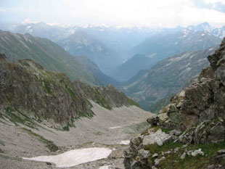
The Chronicles Of The
Migrations Of The
Twelve Tribes Of Israel
From The Caucasus
Mountains Into Europe
By Pastor Eli James

Slide 2
Chapter Six
The Israelites In Europe The Origin Of The Germanic Tribes In The Scythian Israelites
By Pastor Eli James

Slide 3
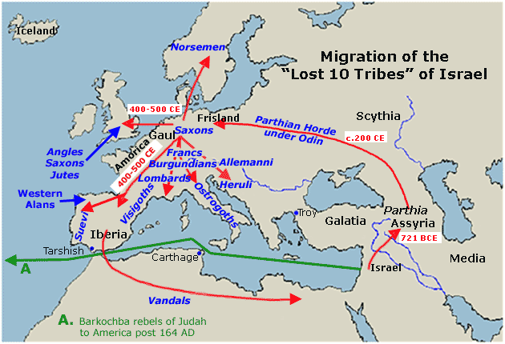
Migrations Of Israel – Chapter 6
In this episode of the Migration Chronicles, we are going to trace the Israelite Scythians across the European Continent.

Slide 4
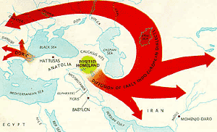
Migrations Of Israel – Chapter 6
This migration began in 745 BC and did not end until Europe was settled by various tribes, most of whom descended from the Twelve Tribes of Israel.

Slide 5
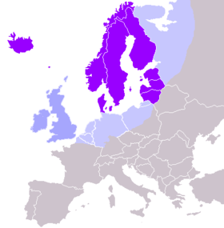
Migrations Of Israel – Chapter 6
We can say that, roughly, this Age of Migrations period lasted close to 2,000 years, with the northernmost parts of Europe
being settled by 1,250 AD.

Slide 6
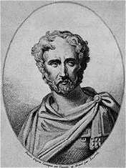
Migrations Of Israel – Chapter 6
Pliny, the Elder, in his Natural History, asserts, “The name of the Scythians is everywhere changed to that of Sarmatae and Germans.”
Pliny The Elder

Slide 7
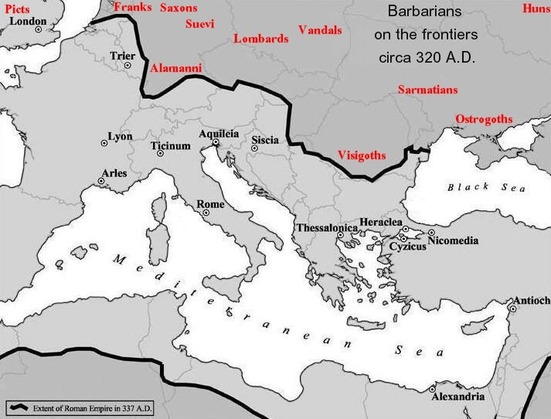
Migrations Of Israel – Chapter 6
Map showing the location of the “barbarian” in Europe circa 320 AD
The word, German, was used by the Romans to refer to all of the “Barbarian” tribes north of Italy. The reality is that none of these tribes called themselves “Germans.”

Slide 8
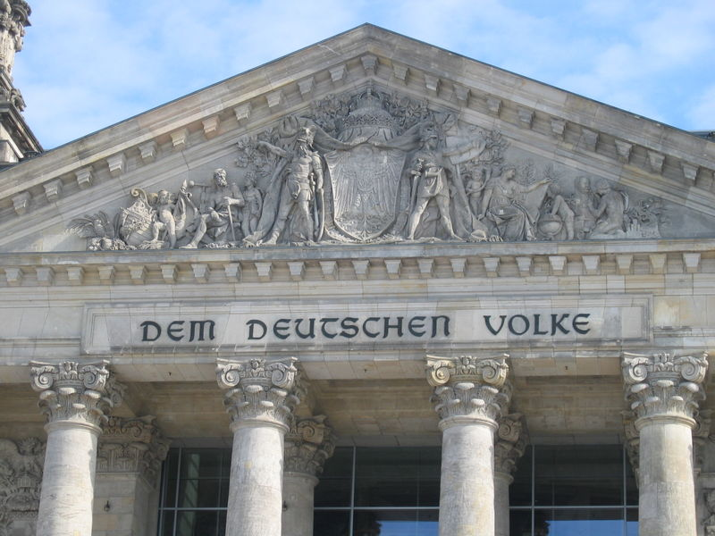
Migrations Of Israel – Chapter 6
For example, the Germans call themselves “Deutsch,” from the root word, “Teut,” meaning “people,” or “folk.”

Slide 9
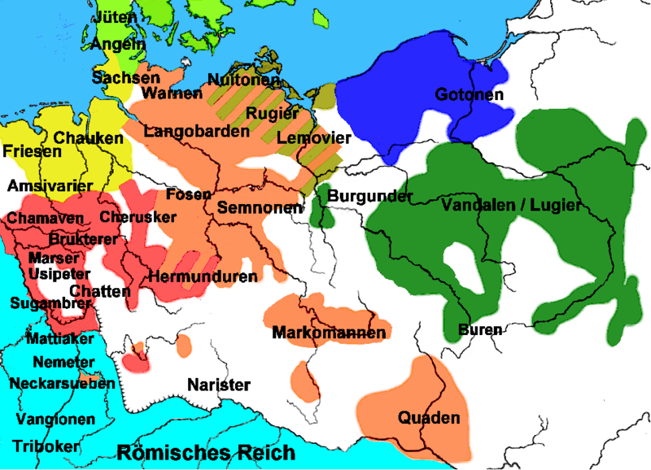
Migrations Of Israel – Chapter 6
As these Scythian/German tribes began settling down, they formed city-states and, eventually, nation-states.

Slide 10
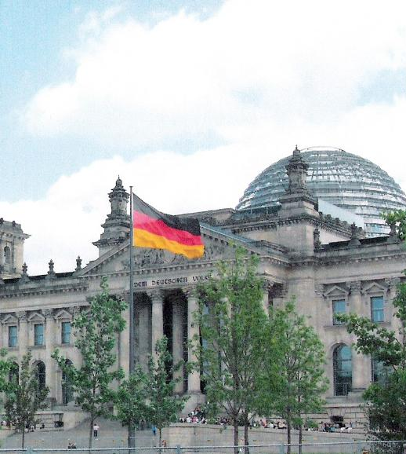
Migrations Of Israel – Chapter 6
It is also possible that the word ‘Teut’ comes from the Latin word, ‘Deus,’ which means “God.” So, the word, Deutschevolk actually means “God’s People,” which is what the Israelites traditionally called themselves.
The Reichstag
(German Parliament)

Slide 11
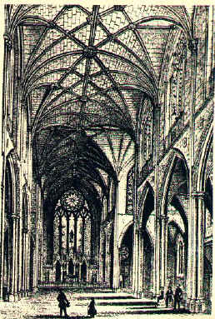
Migrations Of Israel – Chapter 6
The word ‘Goth’ also means “God,” as does the Germanic “Gott.” So, the word “Goth” is also a reference to “God’s people.”
An example of Gothic architecture

Slide 12
Migrations Of Israel – Chapter 6
Historically, only the Israelites ever referred to themselves as “God’s people.” As these migrated north and west through Europe, their tribal names often informed the territories where they settled.

Slide 13
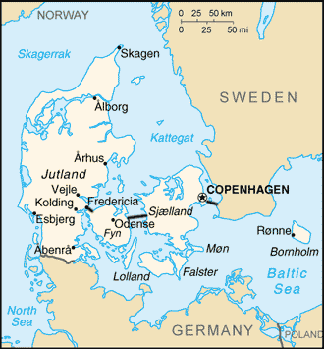
Migrations Of Israel – Chapter 6
Some of these tribal names actually recall their Israelite heritage. Thus Jutland was named after the Jutes (Tribe of Judah).

Slide 14
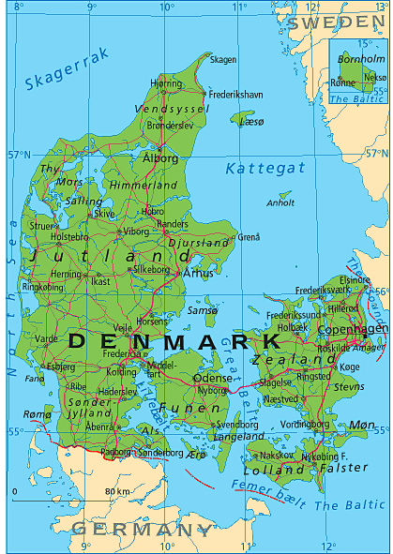
Migrations Of Israel – Chapter 6
Denmark (Dan-Mark) was named after the Tribe of Dan.

Slide 15
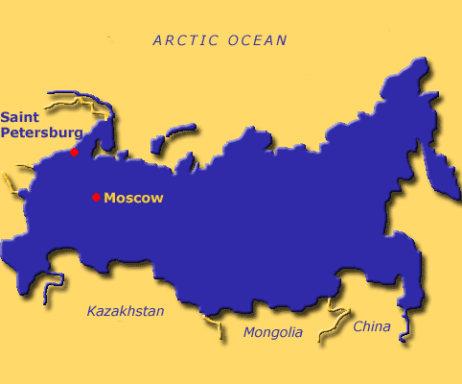
Migrations Of Israel – Chapter 6
Russia is probably named after Rosh, the son of Benjamin. The origin of the word "Russian" is from "Rosh" of Ezekiel 38:2. In Mesopotamia was a valley called "the land of Rashu!”
Russia – coloured blue

Slide 16
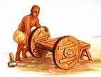
Migrations Of Israel – Chapter 6
The word "Russ" or "Rosh" means blonde. And in ancient Mesopotamia lived the blonde children of Keturah and Abraham mentioned in Genesis 25:1-6. They founded the Kingdom of Mitanni, named after Midian and Medan.
A Mesopotamian Worker

Slide 17
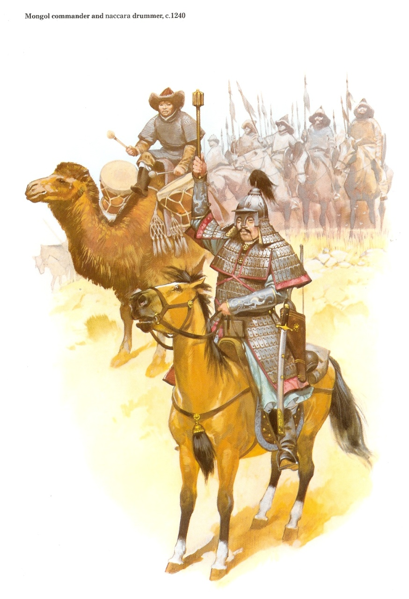
Migrations Of Israel – Chapter 6
Mongol Warriors
These Scythian/Gothic Israelites, mixed with other Aryan descendants of Abraham, were constantly driven north and west by Asiatic tribes, such as the Huns, Avars, Turks, Mongols, and Khazars.

Slide 18
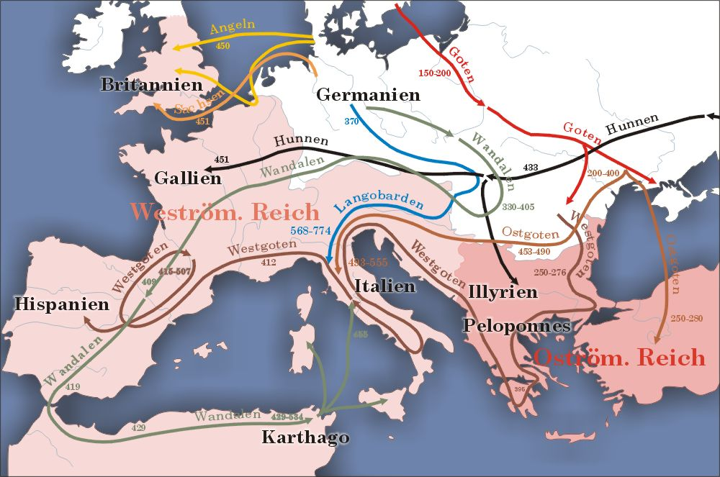
Migrations Of Israel – Chapter 6
The easternmost of the Gothic Tribes had to fight against these invaders, thus preventing them from moving further west. These invasions constantly propelled the Scythian Israelites northward and westward. When these invasions finally ended, central Europe began to thrive.

Slide 19
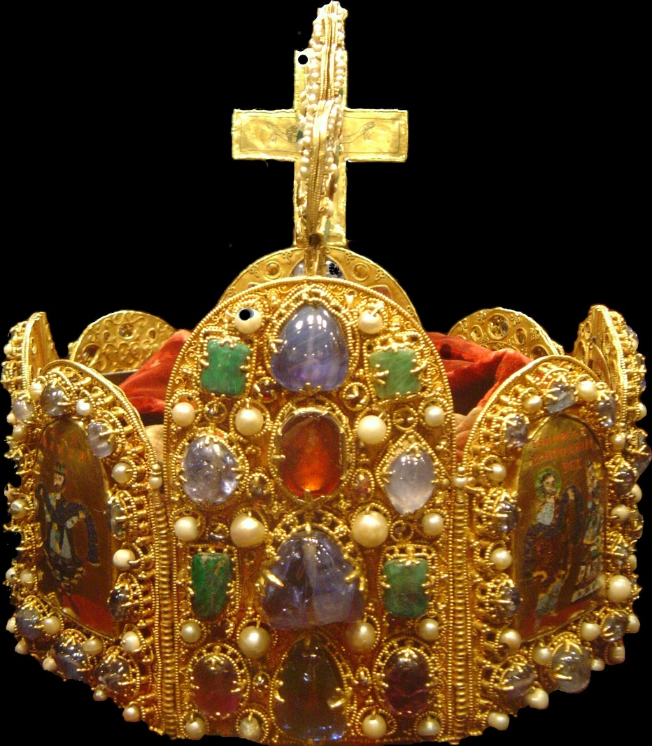
Migrations Of Israel – Chapter 6
A major development occurred in 800 AD, when Charlemagne unified most of the German states into the Holy Roman Empire.
The Holy Roman Empire Crown

Slide 20
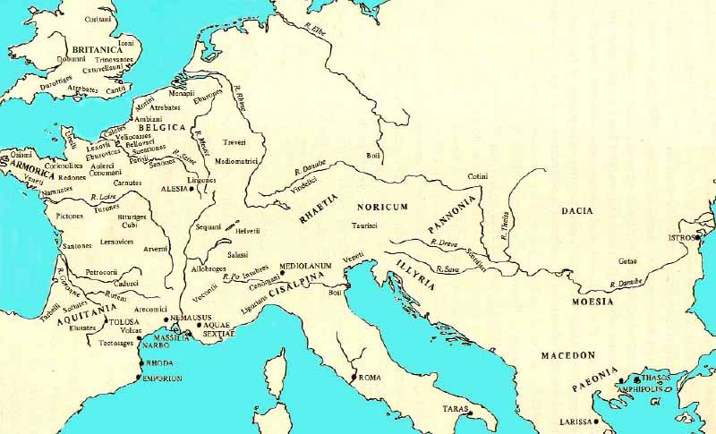
Migrations Of Israel – Chapter 6
Map of early distribution of tribes
The HRE included what was left of the Ostrogoths, Visigoths, Goths, Vandals, Huns, Franks, Angles, Saxons, etc. Ultimately, the Vikings and Normans became the nations of Sweden, Norway, Finland, Estonia, Lithuania, etc.

Slide 21
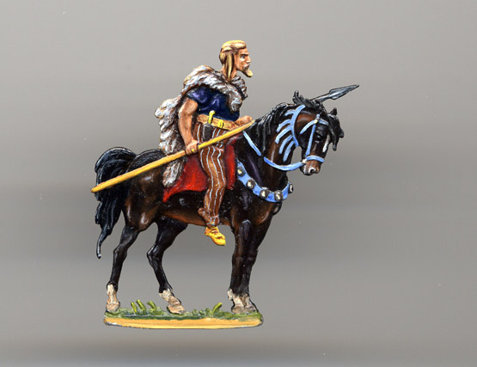
Migrations Of Israel – Chapter 6
Left: German chieftain of the Suebi people
The first mention of the Suebi people occurs in the first century BC.

Slide 22
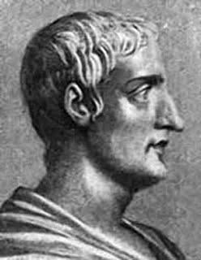
Migrations Of Israel – Chapter 6
According to Tacitus, in his Annales, after 9 BC, Augustus divided the Germans by making a separate peace with the Sugambri and Suebi under their king Maroboduus. This is the first mention of any permanent king of the Suebi.
Tacitus
AD 56 – AD 120

Slide 23
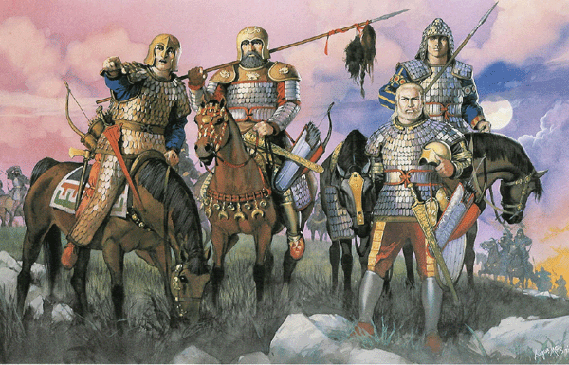
Migrations Of Israel – Chapter 6
Alans and Sueves
Left: The Alans
There is no doubt that the Suebi are a branch of the Germans. The Alans and Sueves, as part of the Migrations of the Twelve Tribes, were known to have traveled together for a good part of their history.

Slide 24
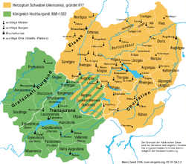
Migrations Of Israel – Chapter 6
Alans and Sueves
Closely related to the Alamanni and often working in concert with them, the Suebi for the most part stayed on the right bank of the Rhine until December 31, 406,
The Alamanni (Coloured buff ) on the right bank of the Rhine

Slide 25
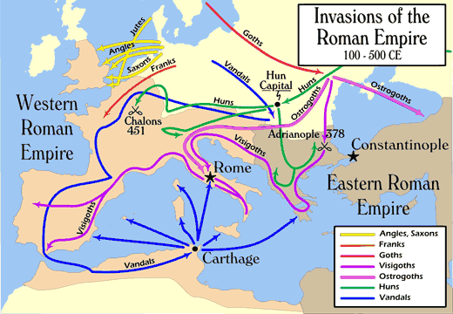
Migrations Of Israel – Chapter 6
…. when much of the tribe joined the Vandals and Alans in breaching the Roman frontier by crossing the Rhine, perhaps at Mainz, thus launching an invasion of northern Gaul.

Slide 26
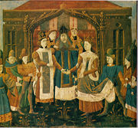
Migrations Of Israel – Chapter 6
Alans and Sueves
The "northern Suebi" were mentioned in 569 under Frankish king Sigebert I in areas of today's Saxony-Anhalt which were known as Schwabengau or Suebengau at least until the 12th century. In connection to the Suebi, Saxons and Lombards, returning from the Italian Peninsula in 573, are also mentioned.
Marriage of Sigebert and Brunhilda

Slide 27
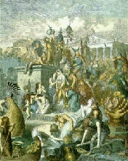
Migrations Of Israel – Chapter 6
Alans and Sueves
While the Vandals and Alans clashed with the Roman-allied Franks for supremacy in Gaul, the Suebi under their king Hermeric worked their way to the south,
The Vandals

Slide 28
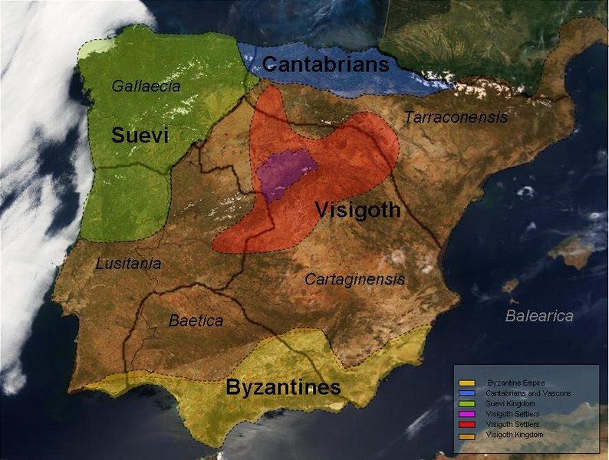
Migrations Of Israel – Chapter 6
Alans and Sueves
…. eventually crossing the Pyrenees and entering the Iberian Peninsula which was out of Imperial rule since the rebellion of Gerontius and Maximus in 409.
The Iberian Peninsular
circa 409

Slide 29
Migrations Of Israel – Chapter 6
Alans and Sueves
The Suebi or Suevi (from Proto-Germanic *swēbaz based on the Proto-Germanic root swē - meaning "one's own" people, from an Indo-European root swe -, the third person reflexive pronoun)

Slide 30
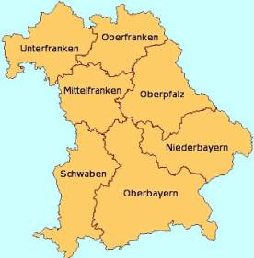
Migrations Of Israel – Chapter 6
Alans and Sueves
The Bavarian province of Swabia (Swaben) formerly an independent principality retains the proto-German swēbaz name of the Suebi or Suevi to this day!

Slide 31
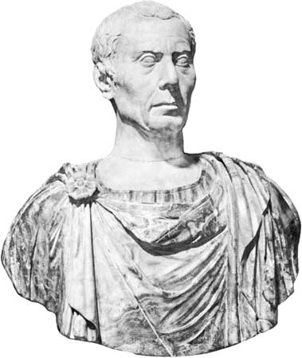
Migrations Of Israel – Chapter 6
Alans and Sueves
…. were a group of Germanic peoples who were first mentioned by Julius Caesar in connection with Ariovistus' campaign, circa 58 BC;
Julius Caesar

Slide 32
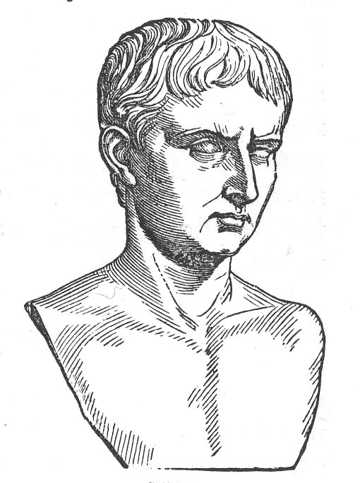
Migrations Of Israel – Chapter 6
Alans and Sueves
Ariovistus was defeated by Caesar. Some Suebi remained a periodic threat against the Romans on the Rhine, until, toward the end of the empire, the Alamanni, including elements of Suebi, brushed aside Roman defenses and occupied Alsace, and from there Bavaria and Switzerland.
Ariovistus

Slide 33
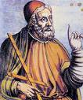
Migrations Of Israel – Chapter 6
Suevi and Angli
Ptolemy in his Geography (2.10) presents a somewhat more complex view. The Saxons are placed around the lower Elbe, which area they could have reached merely by an extension of the Saxon alliance.
Ptolemy

Slide 34
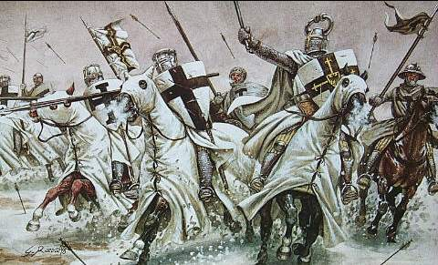
Migrations Of Israel – Chapter 6
Suevi and Angli
East of them are the Teutones and also a dissimilation of them, the Teutonoari, which denotes "men" (wer); i.e., "the Teuton men." These Teutons or Teuton men appear to have been in Angeln and the land around it.

Slide 35
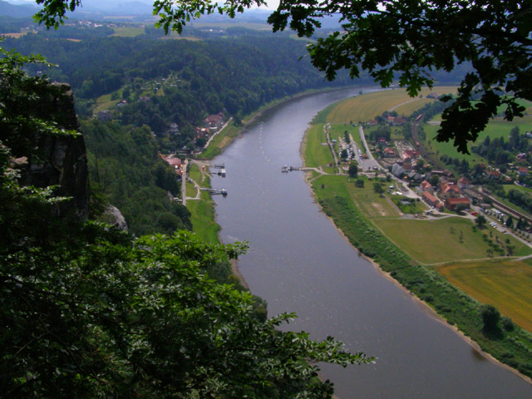
Migrations Of Israel – Chapter 6
Suevi and Angli
The Angles, as such, are not listed at all. Instead there are Syeboi Angeilloi, Latinized to Suevi Angili, located south of the middle Elbe.
The River Elbe - Rathen

Slide 36
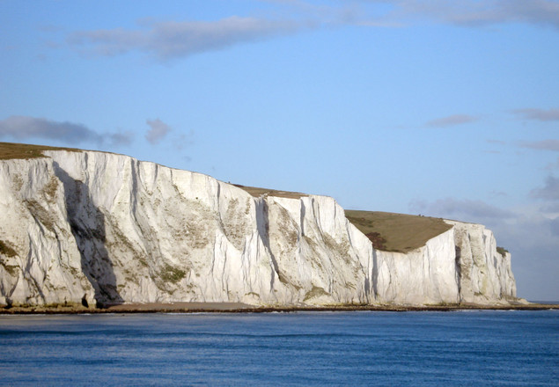
Migrations Of Israel – Chapter 6
Suevi and Angli
There has been much speculation regarding the original home of the Angli, but it appears that the Angli, or Angles, derived from the Suebi. These Angles continued west towards England.
The White Cliffs Of Dover England

Slide 37
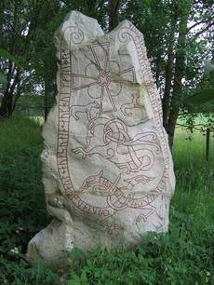
Migrations Of Israel – Chapter 6
Suevi and Alemanni
The name of the Suebi also appears in Norse mythology and in early Scandinavian sources. The earliest attestation is the Proto-Norse name Swabaharjaz ("Suebian warrior") on the and in the place name Svogerslev.

Slide 38
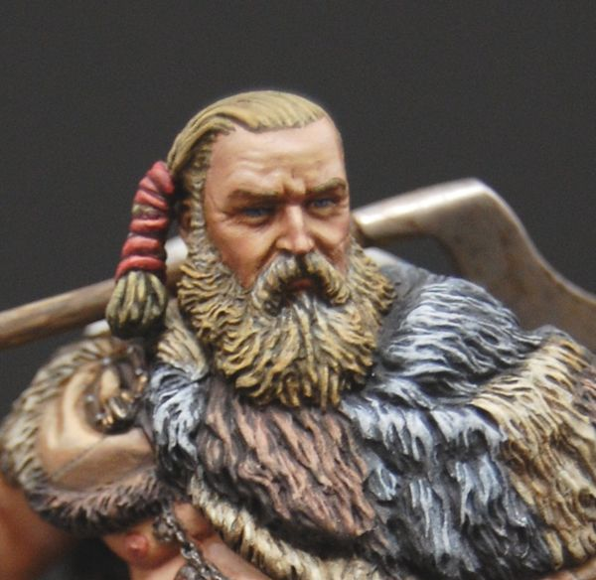
Migrations Of Israel – Chapter 6
Suevi and Alemanni
Sváfa, whose name means "Suebian", was a Valkyrie who appears in the eddic poem Helgakviða Hjörvarðssonar
The Suebian Knott

Slide 39
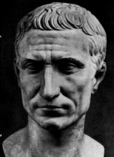
Migrations Of Israel – Chapter 6
Suevi and Alemanni
Ariovistus was a native of the Suebi. He spoke Gaulish fluently. He had two wives, one of whom he had brought from home. The second, who was the sister of King Vocion of Noricum, he acquired in an arranged political marriage.
Ariovistus

Slide 40
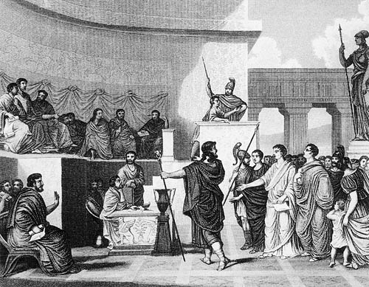
Migrations Of Israel – Chapter 6
Suevi and Alemanni
Ariovistus is described by Caesar as rex Germanorum. It is likely that Ariovistus' authority only extended over those Germans who had settled in Gaul. He was recognized as a king by the Roman Senate.
The Roman Senate

Slide 41
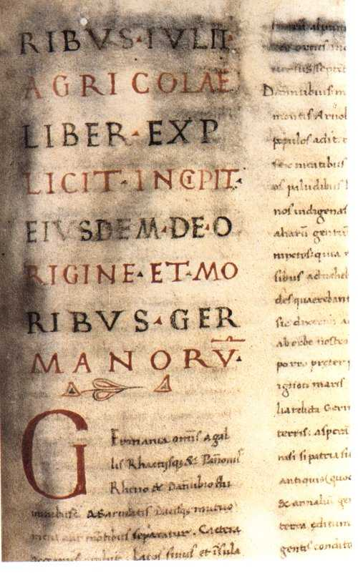
Migrations Of Israel – Chapter 6
Suevi and Alemanni
Tacitus says that the Germans made a distinction between kings, who were chosen by birth, and military leaders, who were chosen by ability, and that kings did not have absolute power.
Example of Tacitus’ writing

Slide 42
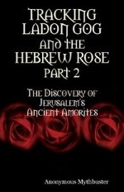
Migrations Of Israel – Chapter 6
Allemanni and Marcomanni
The following slides are quotations form the book, TRACKING LADON GOG AND THE HEBREW ROSE, by John Anonymous Mythbuster

Slide 43
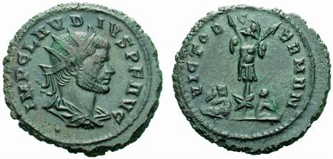
Migrations Of Israel – Chapter 6
Allemanni and Marcomanni
Left: Roman coins depicting victory over the Allemanni
“It is also a good theory to view the Allemanni as the vehicle between the Maeonians and the Meons, with the understanding that it may have been prior to the Allemanni making an alliance with the Allens, at which time they were simply a hypothetical "Manni,”……

Slide 44
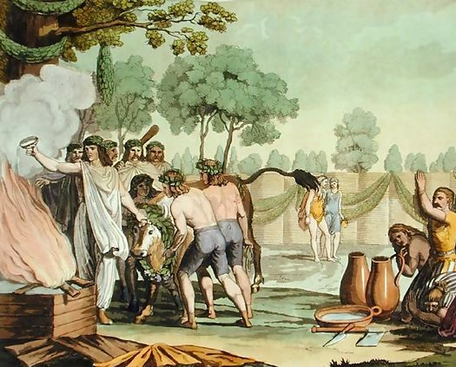
Migrations Of Israel – Chapter 6
Allemanni and Marcomanni
….."but perhaps the historical Marcomanni among whom were the Quadi. The Quadi may then have been the Cati who joined the peoples (Hirpini?) of Abellinum / Avellino in forming the Catuvellauni Celts
Catuvellauni Celts

Slide 45
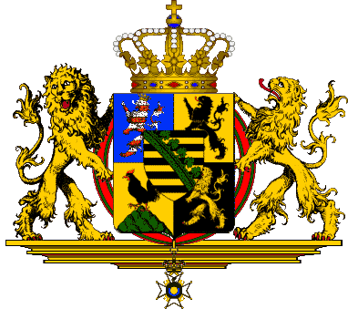
Migrations Of Israel – Chapter 6
Allemanni and Marcomanni
The Wassa clan (which I'm assuming was Saxon) that began in Cornwall may thereby have become a Saxo-Cati mix, a mix smacking of the entity of Thuringia (that put forth the modern British royals).”
Coat of Arms of The Duchy of Saxe-Coburg-Gotha

Slide 46
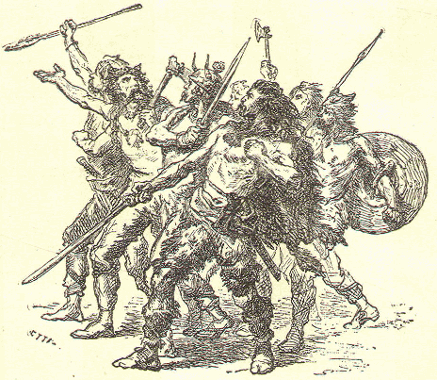
Migrations Of Israel – Chapter 6
Allemanni and Marcomanni
There is no doubt that the “Catti” are the Tribe of Gad. Without a knowledge of our origins in the Twelve Tribes, this connection could not be made.
The Catti

Slide 47
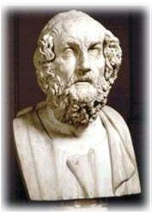
Migrations Of Israel – Chapter 6
Allemanni and Marcomanni
The Suebian writer, , said that the Suebi called themselves, "Sueve," wherefore the Semnones were indeed related to them ...as much as Tacitus placed the Semnones beside the Seuve and claimed their kinship.
Strabo

Slide 48
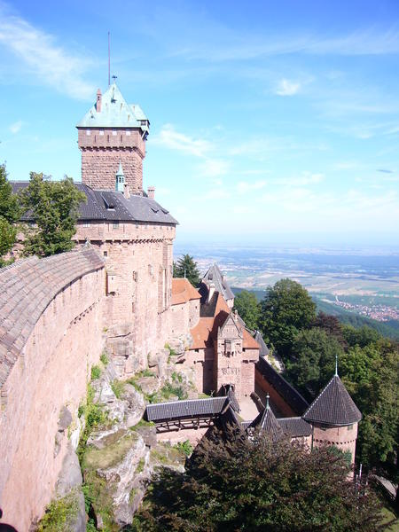
Migrations Of Israel – Chapter 6
Allemanni and Marcomanni
To show that we are dealing with a Molech-like cult, Tacitus wrote: "There by publicly sacrificing a man, [the Semnones] begin the horrible solemnity of their barbarous worship." It is said that the Allemanni moved into and/or founded.
Castle-in-Alsace-France

Slide 49
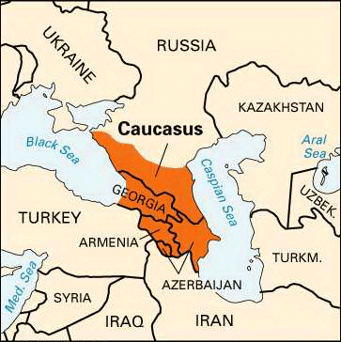
Migrations Of Israel – Chapter 6
Allemanni and Marcomanni
Alsace could be read as Ale-Saka or Ale-Saxon, and who knows but that "Alesacius" could have been the earliest rendering of these peoples, as far back as , Caucasia,
The Caucasus Region

Slide 50
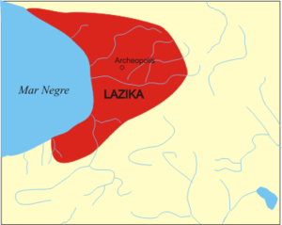
Migrations Of Israel – Chapter 6
Allemanni and Marcomanni
which is to say that the Laz/Lazica of Caucasia may have been named after an Alesacius-like term. After all, Alans were from northern Caucasia, and the Saka were there as well.
Kingdom of Lazica

Slide 51
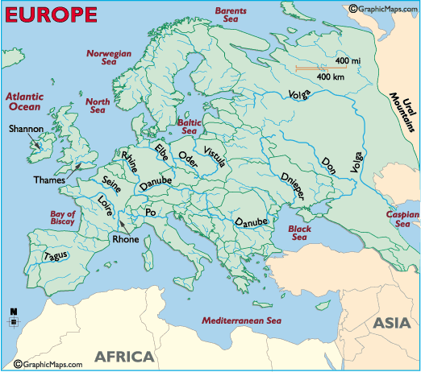
Migrations Of Israel – Chapter 6
From this map of Europe’s rivers, we can see how the Danube penetrates into the very center of Europe

Slide 52
Migrations Of Israel – Chapter 6
The Danube River, named by the Tribe of Dan, was the main transportation route of the westward migrating tribes. The Dnieper, Don and Volga rivers provided the northerly migration routes.

Slide 53
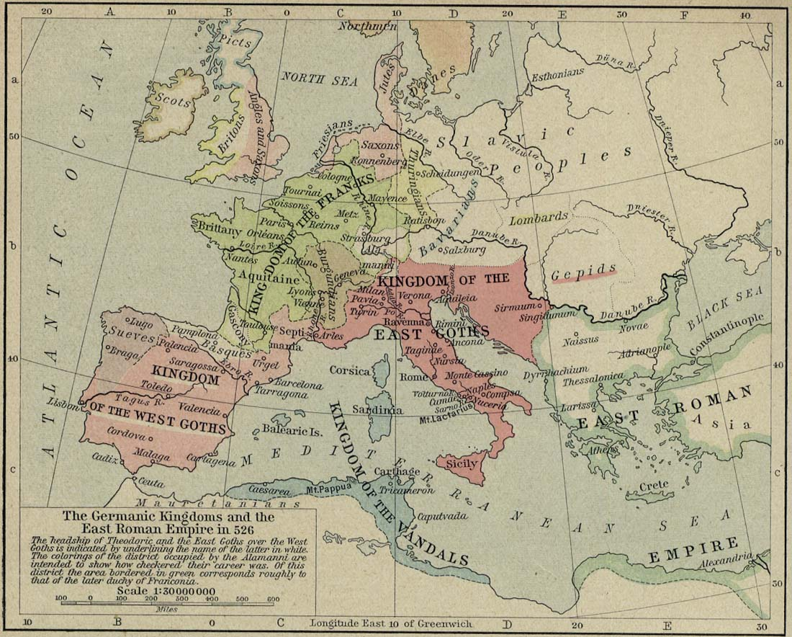
Migrations Of Israel – Chapter 6
Allemanni and Marcomanni
Map of central Europe, showing the Alemanni

Slide 54
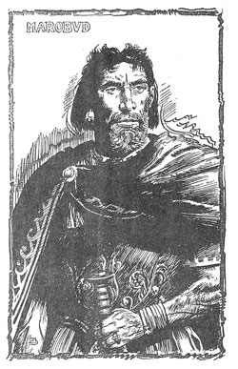
Migrations Of Israel – Chapter 6
Allemanni and Marcomanni
The Marcomanni were immediately north of the Allemanni. are also said to have been a Suebi tribe. Now the oldest term belonging to these Germanics was "Hermunduri," no doubt the root of "German.”
Maroboduus (or Marbod), King of the Marcomanni

Slide 55
Migrations Of Israel – Chapter 6
Allemanni and Marcomanni
The word "duri" is the same as ‘Thuri,’ from which we get the name, ‘Thuringia.’
Both the Allemanni and the Suevi are today called by the name, Germans.
The modern state of Thuringia

Slide 56
Migrations Of Israel – Chapter 6
The Invasion of the Huns
Frederick Haberman:
“For a century the Roman Empire stood against the Gothic invasion, the reason being that Christianity was spreading rapidly at that time in southern Europe. Wulfila spread from Constantinople, where he translated the Bible into Gothic. …..

Slide 57
Migrations Of Israel – Chapter 6
The Invasion of the Huns
…. But many centuries were yet to pass before the northern gothic peoples, the Saxons, Jutes, and the Angles, should hear of Jesus Christ. In Sweden, Odin was deified and the faith in him grew until the 11th Century, AD. …..
Odin on his throne

Slide 58
Migrations Of Israel – Chapter 6
The Invasion of the Huns
…. The reason why northern Europe did not accept Christianity for centuries later was the invasion of the Huns, who drove a wedge between the Gothic nations of the north and south.”

Slide 59
Migrations Of Israel – Chapter 6
The Mongols Finally Defeated
The last of the Eastern hordes were the Mongols under Genghis Kahn. Their presence in Eastern Europe lasted almost 300 years. They reached as far west as Vienna, where they were prepared to invade that city in December, 1241.

Slide 60
Migrations Of Israel – Chapter 6
The Mongols Finally Defeated
But the sudden death of Ogedei Khan, Genghis Khan’s son and successor, put an end to the invasion. Ogedei’s successors fell to fighting amongst themselves; and the White nations of Europe began to drive them back.
Ogedei Khan

Slide 61
Migrations Of Israel – Chapter 6
The Mongols Finally Defeated
The first major White re-conquest of the southern parts of Russia only began in the mid 1500s, when bands of Russian peasants, known as Cossacks, fleeing the autocratic fiefdoms of northern Russia, started settling along the banks of the Don River basin.
A Cossack

Slide 62
Migrations Of Israel – Chapter 6
The Mongols Finally Defeated
…. engaged in a large clearing operation lasting many decades against the Mongols. By the mid-1600s the majority of Mongols had been cleared from central southern Russia

Slide 63
Migrations Of Israel – Chapter 6
The Mongols Finally Defeated
… the remaining minority were for the greatest part absorbed into the new population. – March of the Titans, A History of the White Race, Chapter 32.

Slide 64
Migrations Of Israel – Chapter 6
The Descendants of Abraham
Besides the Israelites, many of their kinsfolk of other tribes decided to flee from their Assyrian captors. These appear to be the “Sarmations,” whom historians distinguish from the Scythians. Abraham came from "Ur of the Chaldees".
The Sarmations

Slide 65
Migrations Of Israel – Chapter 6
The Descendants of Abraham
Ancient Ur was in Mesopotamia. Ur is a shortened name for Urfa. There were once two cities by that name.

Slide 66
Migrations Of Israel – Chapter 6
The Descendants of Abraham
The Apostle, Stephen, tells us that it was the northern Ur in Mesopotamia from which Abram came (Acts 7:2-3). That is where the Chaldeans first dwelt -- over 400 miles northwest of ancient Babylon.
St. Stephen Window Norwich

Slide 67
Migrations Of Israel – Chapter 6
The Descendants of Abraham
The word "Chaldean" comes from the Greek. The original Hebrew word is Chasdim, meaning "the people of Chesed". Notice that Chesed was a common name in the family of Abraham (Gen.22:22).
Abraham

Slide 68
Migrations Of Israel – Chapter 6
The Descendants of Abraham
One area where these people lived was Arphaxad. Most Biblical encyclopaedias will clearly show that the Hebrew form is Arfachesed -----MEANING ARFA OR URFA THE CHALDEAN!
Arphaxad

Slide 69
Migrations Of Israel – Chapter 6
The Descendants of Abraham
The Chaldeans come from Arphaxad. They are his children. Abraham was a branch of this stock! The city of Ur was named after Arfa or Urfa, the Chaldean.’
The Chaldeans

Slide 70
Migrations Of Israel – Chapter 6
The Descendants of Abraham
Sometimes they were referred to as HURRI or Hurrians, after Haran (Gen.11:29; 22:20-24). Sometimes they bore the name GUTI, probably meaning "people of God". ‘Guti’ is the source word for “Goth.’
A Hurrain Charioteer

Slide 71
Migrations Of Israel – Chapter 6
The Descendants of Abraham
The word "Persian" or "Parthian" is derived from the word "Euphrates". Along this river these sons of Abraham first lived. The Hebrews called the Euphrates the Perath or Peres River --- the River of the Persians!

Slide 72
Migrations Of Israel – Chapter 6
The Descendants of Abraham
Perez is actually a form of the Hebrew word, Pharez. Pharez was the son of Judah. It is obvious that the descendants of Pharez, who were taken captive by Sennacherib in 701 BC, when his Assyrian army captured all of the fenced cities of Judea, except for the city of Jerusalem itself. (Isa. 36:1; II Chron. 17:2.)
Judah’s Genealogy

Slide 73
Migrations Of Israel – Chapter 6
The Descendants of Abraham
Left: The Magi
Hence, it is quite possible that the Persians derived their name from Pharez (Perez), the son of Judah. The Parthians were those Israelites who stayed in Mesopotamia until after the days of Christ. Their kings were direct descendants of Pharez. The Magi were the igh priesthood of these Judahite Parthians.

Slide 74
Migrations Of Israel – Chapter 6
The Descendants of Abraham
The Persians named several small rivers in their new land after the Euphrates in Mesopotamia. Cyrus the King, so famous in Bible history, was a Persian.
King Cyrus

Slide 75
Migrations Of Israel – Chapter 6
The Descendants of Abraham
“Travellers still speak of the fair-complexioned, blue eyed populations met with in the Persian highlands", writes Sayce in RACES OF THE OLD TESTAMENT. "Chestnut hair is very common in Persia, as it is among the West European Alpines", says Griffith Taylor in ENVIRONMENT AND RACE, p.186.
Thomas Griffith Taylor

Slide 76
Migrations Of Israel – Chapter 6
The Descendants of Abraham
Closely the Persians related to are the Medes. Pliny in his NATURAL HISTORY, bk. VI, sec. xi. mentions "the river Don, where the inhabitants are . . . said to be descended from the Medes"!
Rostov-on-Don

Slide 77
Migrations Of Israel – Chapter 6
The Descendants of Abraham
I am Dariush, the Great King, the King of Kings The King of many countries and many peoples The King of this expansive land, the son of Wishtasp Achamenia Persian, the son of a Persian, 'Aryan', from the Aryan Race
Dariush's scripture in Naqshe-e-Rostam
King Dariush

Slide 78
Migrations Of Israel – Chapter 6
Conclusion
There is no doubt that the Germanic peoples derive from the overland migration of the Twelve Tribes of Israel. Various waves of these people passed through the Caucasus Mountains, around the Black and Caspian Seas, then north and west into Europe.

Slide 79
Migrations Of Israel – Chapter 6
Conclusion
Isa. 11:16 tells us that these Israelites would pass through the area:
And there shall be an highway for the remnant of his people, which shall be left, from Assyria; like as it was to Israel in the day that he came up out of the land of Egypt.

Slide 80
Migrations Of Israel – Chapter 6
Conclusion
Before migrating, however, these Israelites had to learn the language of the area. The language spoken there was Persian. The historian, Sharon Turner, has collected a number of Persian words, which came into the Anglo-Saxon language from this captivity.

Slide 81
Migrations Of Israel – Chapter 6
The following word study is from Sharon Turner, author of “The History of the Anglo-Saxons.”
PERSIAN, ANGLO-SAXON
Persian | Anglo-Saxon | German
Am | I am
Angel | A Hook
Aw | Water | Wasser
Ende | End | Ende
Berend | Fruitful
Brader | A brother | Bruder
Band | A band, a chain
Bendan | To bind | Binden
Saf | Pure
Mxden | A maiden | Mädchen
Madah | A female
Morth | Death | Mort?

Slide 82
Migrations Of Israel – Chapter 6
PERSIAN, ANGLO-SAXON
Persian | Anglo-Saxon | German
Murda | Death
Morther | Murder
Mus | A Mouse | Maus
Nah | Not
Nun | Now | Nun
Nuh | Nine | Neun
Hol | Health
Dar | A Door
Cu | A Cow | Kuh
Leogan | To tell a Lie | Lügen
Lam | Lame | Lahm
Lust | Delight | Lustig

Slide 83
Migrations Of Israel – Chapter 6
PERSIAN, ANGLO-SAXON
Persian | Anglo-Saxon | German
Thu | Thou
Sorg | Sorrow
Supwah | A shoe | Schuh
Tunder | Thunder | Donner
Faeren | To go | Fahren
Zend/Anglo-Saxon (Zend is a Persian Dialect)
Zend | Anglo-Saxon | German
Dochter | Daughter | Tochter
Dohte | He did

Slide 84
Migrations Of Israel – Chapter 6
Zend/Anglo-Saxon (Zend is a Persian Dialect)
Zend | Anglo-Saxon | German
Frend | A friend | Freund
Feder | Father | Vater
Mid | With | Mit
Meder | Mother | Mutter
Metan | Measure
Maest | Master | Meister
Meze Meso | Great
Mal | More | Mehr
Hera | A lord | Herr
Uppa | Above
Thre | Three | Drei
Thrydde | A third | Dritter

Slide 85
Migrations Of Israel – Chapter 6
Zend/Anglo-Saxon (Zend is a Persian Dialect)
Zend | Anglo-Saxon | German
Thu | Thou | Du
Dreori | Dreary | Düster
Daeth | Death | Tot
Dajed | He is no more
Reswian | Reason
Guast | The spirit | Geist
Mxnde | To mention
Manthre | Words | Wörter
Midda | Middle | Mittle
Meiao | Middle
Morth | Death
Mrete | Mortal

Slide 86
Migrations Of Israel – Chapter 6
Zend/Anglo-Saxon (Zend is a Persian Dialect)
Zend | Anglo-Saxon | German
Yare | Year | Jahr
Starian | To look at
Senghan | A Word
Snid | A cut | Schnitt
Scina Shina | Brilliant
Scheeto | Brilliant
Pehlvi/Anglo-Saxon (Pehlvi is a dialect of Persian)
Pehlvi | Anglo-Saxon | German
Halig | Holy | Heilig
Halae | Pure

Slide 87
Migrations Of Israel – Chapter 6
Pehlvi/Anglo-Saxon (Pehlvi is a dialect of Persian)
Pehlvi | Anglo-Saxon | German
Eahta | Eight | Acht
Ascht | Eight | Acht
Marg | Mortal
A-marg | Immortal
Thu | Thou | Du
Tou | Thou
Sex | Six | Sechs
Besche | Wicked | böse
Cneou | Knee
Djanouh | Knee
Steorran | Stars | Sterne
Cu | Cow | Kuh

Slide 88
Migrations Of Israel – Chapter 6
Pehlvi/Anglo-Saxon (Pehlvi is a dialect of Persian)
z
Pehlvi | Anglo-Saxon | German
Meh | Great | groß
Bar | Bare
Barhene | Naked | Nackt
Morth | Death
Meder | Mother | Mutter
Nafel | The Navel | Nabel
Na | No
Cald | Called
Kala | Crying out
Band | A Joining | Bund
Banda | A Band
Raed | A Road

Slide 89
Migrations Of Israel – Chapter 6
Pehlvi/Anglo-Saxon (Pehlvi is a dialect of Persian)
Pehlvi | Anglo-Saxon | German
Raeh | A way
Eortha | Earth
Arta | Earth (Hebrew eretz) | Erde
The Sibboleth
Another important identifying linguistic mark is the “Sibboleth”, where the Judahites were unable to pronounce the “h” in the “th” sound, whereas the Northern House of Israel could. This language difference between the English and Germans remains to this day!
Notes:
Here is the relevant excerpt from the Book of Judges. The full account is in Chapter 12, verses 1-15.
12, 4 Then Jephthah gathered together all the men of Gilead, and fought with Ephraim: and the men of Gilead smote Ephraim, because they said, Ye Gileadites are fugitives of Ephraim among the Ephraimites, and among the Manassites.
5 And the Gileadites took the passages of Jordan before the Ephraimites: and it was so, that when those Ephraimites which were escaped said, Let me go over; that the men of Gilead said unto him, art thou an Ephraimite? If he say Nay;
6 Then said they unto him, Say now Shibboleth: and he said Sibboleth: for he could not frame to pronounce it right. Then they took him, and slew him at the passages of Jordan: and there fell at that time of the Ephraimites forty and two thousand.

Slide 90
Migrations Of Israel – Chapter 6
The story of sibboleth is given in the Book of Judges, 12: 1-15; where after a battle between the 2 houses, some Judahites tried to pass themselves off as Ephraimites, but were caught when they couldn’t pronounce the word sibboleth correctly.
The Judahites being interogated

Slide 91
Migrations Of Israel – Chapter 6
The Sibboleth
Judges 15:6; Then said they unto him, Say now Shibboleth: and he said Sibboleth: for he could not frame to pronounce it right. Then they took him, and slew him at the passages of Jordan: and there fell at that time of the Ephraimites forty and two thousand.

Slide 92
Migrations Of Israel – Chapter 6
Likewise Germans are unable to pronounce “h” in th such as “the” which becomes “der” and the famous German poet, Johann Wolfgang von Goethe, whose surname is pronounced “gerta” – thus this is another mark of the Hebrew ancestry of the German people and language.
Johann Wolfgang von Goethe

Slide 93
Migrations Of Israel – Chapter 6
According to the experts of the linguistic history of the migrations of the Anglo-Saxon, Celtic and Caucasian people, the English language is of primarily Hebrew syntax (according to Tyndale and others), plus Gaelic (Hamito-Semitic, which is also Hebrew) and Germanic words.

Slide 94
Migrations Of Israel – Chapter 6
In essence, the German descendants of Isaac (Saxons), having stayed in Armenia until they finally escaped through the Caucasus, learned the syntax and words of the ancient Persian language [also called Farsi] and brought those linguistics with them as they migrated across Europe.
Armenia - Khor Virap Monastery
&
Mount Ararat

Slide 95
Migrations Of Israel – Chapter 6
When the Angles and Saxons crossed over to Britain, they adopted the syntax (grammar) of the Brits, but added numerous Germanic words to the native tongue of Britain.

Slide 96
Migrations Of Israel – Chapter 6
This explains the major grammatical differences and word similarities between Germanic and English, both of which languages retain much of their native Hebrew tongue.

Slide 97
Migrations Of The 12 Tribes Of Israel
End Of Chapter Six
BY PASTOR ELI JAMES
To be continued ………… Chapter Seven:

