Slide 1
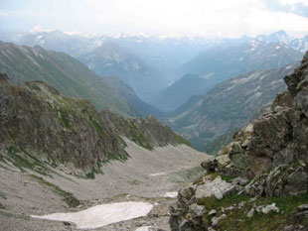
The Chronicles Of The
Migrations Of The
Twelve Tribes Of Israel
From The Caucasus
Mountains Into Europe
By Pastor Eli James

Slide 2
Chapter Five
Messiah
Comes From The House Of Judah
By Pastor Eli James

Slide 3
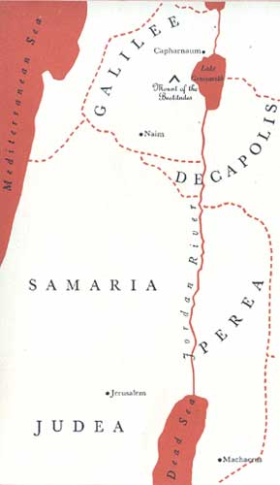
Migrations Of Israel – Chapter 5
While the House of Israel was wandering through Europe and setting up the European nation states, a small portion of the House of Judah remained in Palestine in order to bring forth the Messiah. These were the 42,000 Judahites, Benjamites and Levites who returned from the Babylonian captivity.

Slide 4
Migrations Of Israel – Chapter 5
“And there shall come forth a rod out of the stem of Jesse, and a Branch shall grow out of his roots.” - Isa. 11:1.

Slide 5
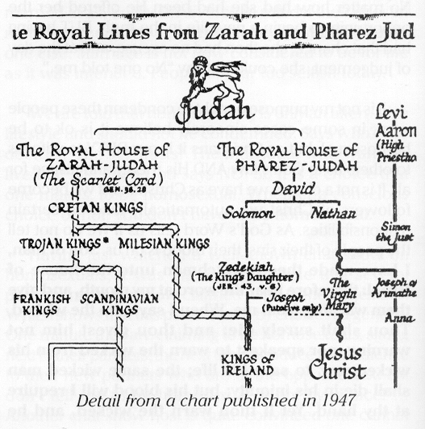
Migrations Of Israel – Chapter 5
Jesse was David’s father (Ruth 4:22; Matt. 1:6). Isaiah is telling us that there will be a “Branch” of the Family Tree, stemming from Jesse, that will result in the Messiah.

Slide 6
Migrations Of Israel – Chapter 5
This is the Royal House of David, descendants of Judah. The House of Judah was to remain in Judea and Palestine until the First Advent.

Slide 7
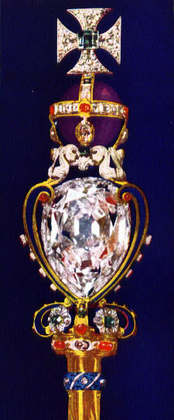
Migrations Of Israel – Chapter 5
“The scepter shall not depart from Judah, nor the ruler’s staff from between his feet, until Shiloh [he to whom it belongs] come; and to him shall be the obedience of the peoples.” - Gen. 49:10 (Revised Standard Version)

Slide 8
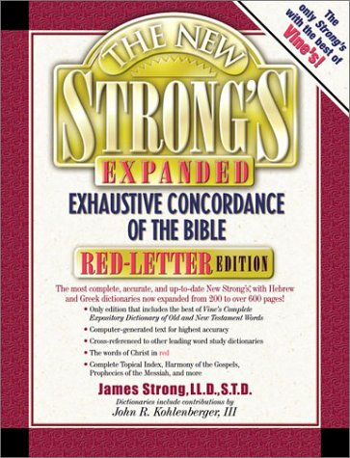
Migrations Of Israel – Chapter 5
“Shiloh, an epithet of the Messiah.” - Strong’s Concordance, #7886.

Slide 9
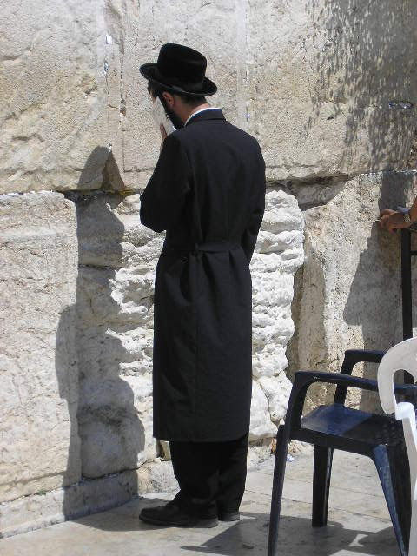
Migrations Of Israel – Chapter 5
The reason why none of the prophecies made to ancient Israel have been fulfilled by the Jewish people is because the Jews are not Israelites. Nor is Judaism the religion of the Old Testament.

Slide 10
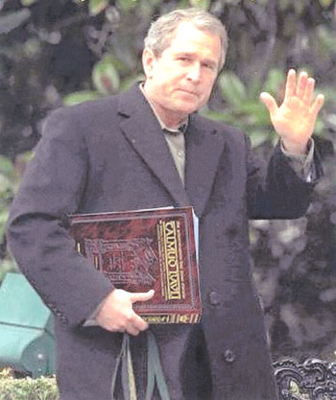
Migrations Of Israel – Chapter 5
Judaism is, in reality, the teachings of the Talmud, which are based on the opinions of the rabbis, not on the Law of Moses. (Deut. 4:1-2 forbids all priests from tampering with the written Law of Moses; but the rabbis have always substituted their “Oral tradition” for the Law of Moses.)
George Bush Carrying
The Talmud

Slide 11
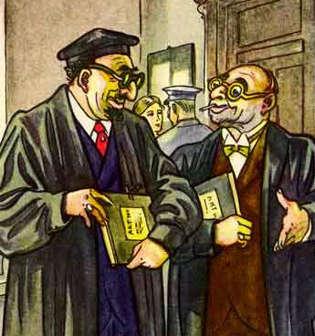
Migrations Of Israel – Chapter 5
Therefore, the Jewish people cannot possibly be either Israel or Judah, because their religion constantly violates the Law of Moses and because they are not a truly Shemitic people. 95% of modern Jews are, in fact, Ashkenazi Khazars, who CONVERTED to Judaism in the 8th Century AD.
Ashkenazi Khazar Jews

Slide 12
Migrations Of Israel – Chapter 5
None of their Ashkenazi ancestors have any Israelite or Shemitic blood. The other 5% of modern Jewry consists of the Sephardic type, who are not Shemites either.
Left: An Iranian Sephardic Jew

Slide 13
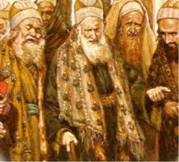
Migrations Of Israel – Chapter 5
As explained earlier, the scribes and Pharisees, whom Jesus repeatedly condemned in all four Gospels, were of Idumean heritage. Neither the Ashkenazim nor the Sephardim are true Israelites.
The Pharisees

Slide 14
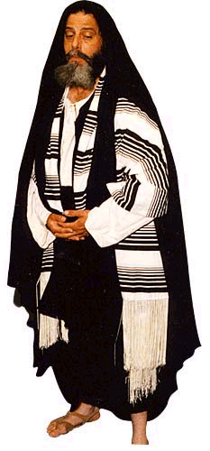
Migrations Of Israel – Chapter 5
This means that Judaism and Jewry are total impostors, who have laid a false claim to the heritage of Israel and Judah, as is stated in Rev. 2:9, 3:9 and 12:9.

Slide 15
Migrations Of Israel – Chapter 5
Speaking to Israel in Rev. 2:9, Jesus, through the Apostle John, tells us:
I know your tribulation and your poverty (but you are rich) and the slander of those who say they are Jews [Judeans] and are not, but are the synagogue of Satan.”

Slide 16
Migrations Of Israel – Chapter 5
Psalms 50:16 and 17 offer an interesting foresight into this development: "But unto the wicked God saith, What hast thou to do to declare my statutes, or that thou shouldest take my covenant in thy mouth? Seeing thou hatest instruction, and castest my words behind thee.”

Slide 17
Migrations Of Israel – Chapter 5
This means that a nation of hypocrites will declare themselves to be “His people,” but they will actually be liars and deceivers! Of course, this statement is also true of the disobedient Israelites; but it is even more true of the wicked nation that is pretending to be Israel!
From The Daily Mail London 2004

Slide 18
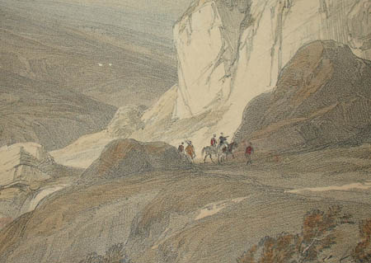
Migrations Of Israel – Chapter 5
Speaking to the Edomites of Idumea, Yahweh declares:
“Thus says Yahweh Elohim: Surely in the fire of my jealousy have I spoken against the against the residue of the heathen,
Idumea

Slide 19
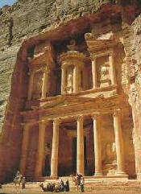
Migrations Of Israel – Chapter 5
…. and against all Idumea, which have appointed my land into their possession with the joy of all their heart, and with despiteful minds, to cast it out for a prey.” – Ezek. 36:5.

Slide 20
Migrations Of Israel – Chapter 5
I have previously explained that it was the Idumeans of Edom who overthrew the House of Judah in Judea, just before the coming of Christ, and that these Idumeans, …

Slide 21
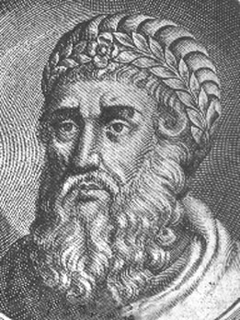
Migrations Of Israel – Chapter 5
…. under Herod the usurper, seized control of the priesthood known as the Pharisees. Under Herod, these Idumeans also took control of the Sanhedrin, the ruling Council of Elders, which ruled on matters of civil, criminal and religious law.
Herod

Slide 22
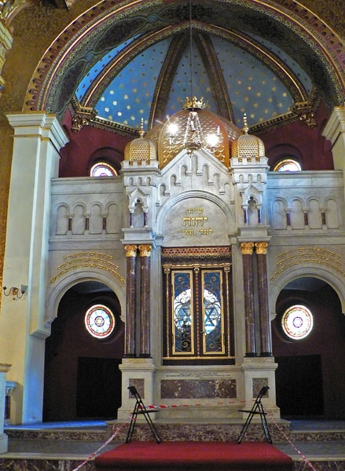
Migrations Of Israel – Chapter 5
The Jewish Encyclopedia even admits that Judaism is the religion of the Pharisees:
“The Jewish religion as it is today traces its descent, without a break, through all the centuries, from the Pharisees.
Krakow Temple Synagogue

Slide 23
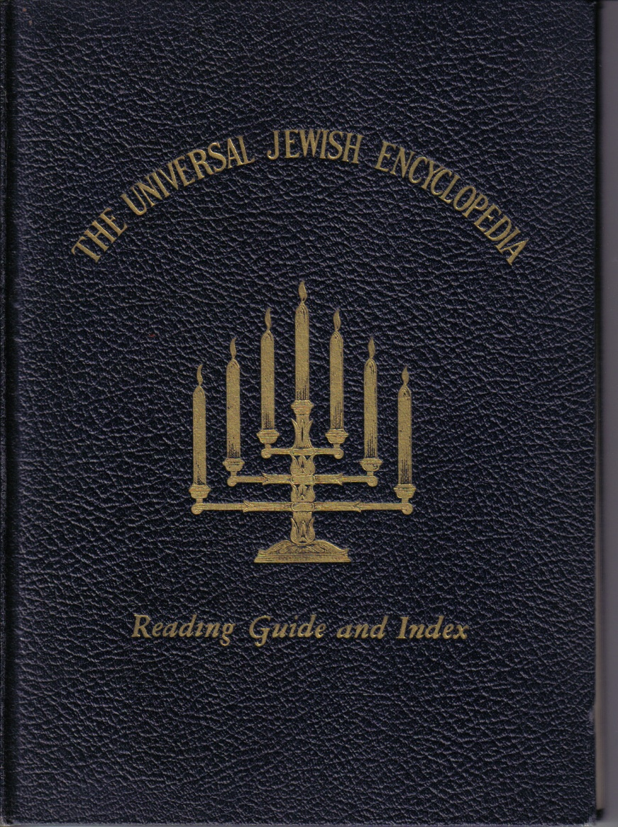
Migrations Of Israel – Chapter 5
Their leading ideas and methods found expression in a literature of enormous extent, of which a very great deal is still in existence. The Talmud is the largest and most important single member of that literature.”
Universal Jewish Encyclopedia, Vol. VIII, p. 474 (1942).

Slide 24
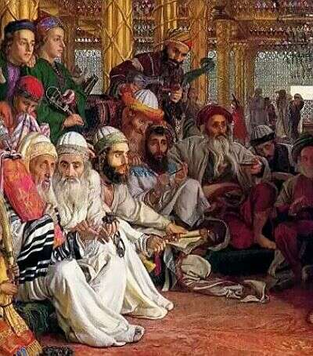
Migrations Of Israel – Chapter 5
Luke 12:1 puts it as plain as it can be: “Beware the leaven of the Pharisees, which is hypocrisy.”
Left: The Pharisees taking Council

Slide 25
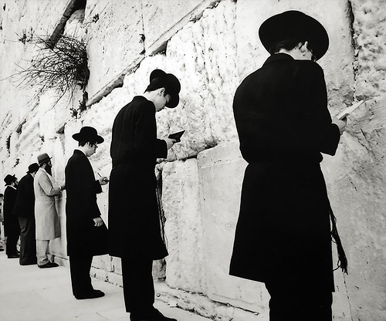
Migrations Of Israel – Chapter 5
Could it be that the REAL REASON that the Jewish people have never accepted Jesus as the Messiah is because they are not Israelites? (Nor was Jesus a Jew. He was a Judahite of the Tribe of Judah!)
The Wailing Wall

Slide 26
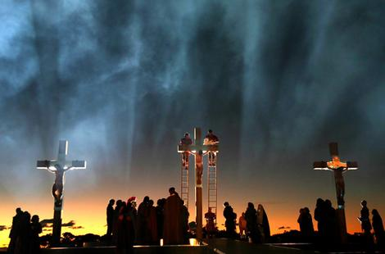
Migrations Of Israel – Chapter 5
Jesus would have become the King of Judah had not the Jews crucified Him. And the Jews DID crucify Him, just as the Bible teaches. Read John 7:1, if you don’t believe me. “Jesus would not walk in Jewry, because the Jews sought to kill him.”
The Crucifixion

Slide 27
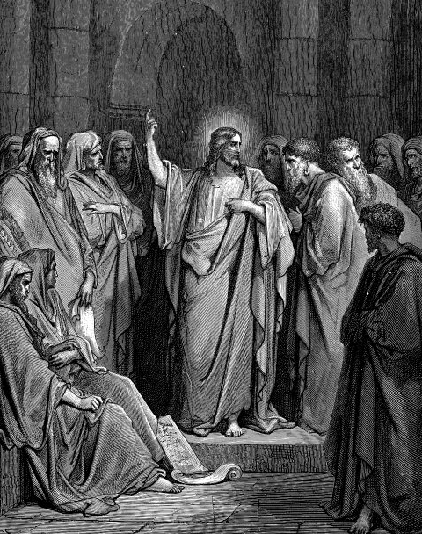
Migrations Of Israel – Chapter 5
This is confirmed in John 5. Speaking to the Pharisees, the originators of the religion called Judaism, Jesus says:

Slide 28
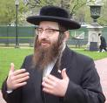
Migrations Of Israel – Chapter 5
“I am come in My Father’s Name, and you receive me not: if another shall come in his own name (“I am Rabbi so-and-so.”), him you will receive. How can you believe, which receive honor of one another [the rabbis are always praising one another], and seek NOT the honor that comes from God only?
A New York Rabbi

Slide 29
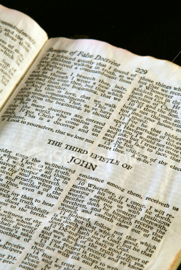
Migrations Of Israel – Chapter 5
Do not think that I will accuse you to the Father: there is one that accuses you, EVEN MOSES, in whom you hope. For had you believed Moses, you would have believed Me. But if you believe not his writings, how shall you believe My words?” - John 5:40-47.

Slide 30
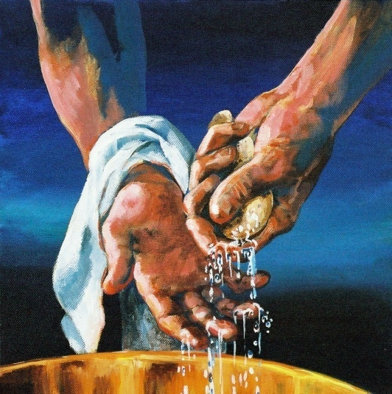
Migrations Of Israel – Chapter 5
When Pontius Pilate washed his hands of the crucifixion affair (Matt. 27:20-25), he officially disclaimed any responsibility, on his own behalf and on Rome’s behalf, for what was to follow.

Slide 31
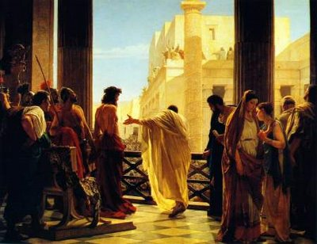
Migrations Of Israel – Chapter 5
This is clearly what the hand washing ceremony meant. It was an official rite that Pilate borrowed from local tradition, which meant that neither Pilate nor Rome was to be responsible for any of the events that followed.
The Trial Of Christ

Slide 32
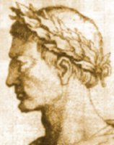
Migrations Of Israel – Chapter 5
Then Pontius Pilate turned Jesus over to the Pharisees, who were the Edomite Jews of Judea. It was these Jews who illegally tried, convicted and executed Jesus Christ, not the Romans.
Pontius Pilate

Slide 33
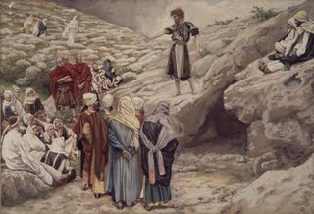
Migrations Of Israel – Chapter 5
Jesus Himself told the scribes and Pharisees that the were a bunch of liars, thieves and murderers. (John 8:33-44.) So, whom are you going to believe? Those who have a tradition of lying, or Jesus Christ?

Slide 34
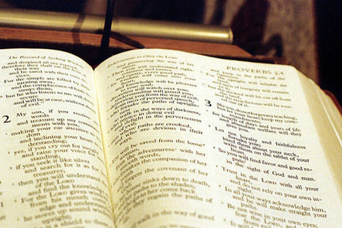
Migrations Of Israel – Chapter 5
The Jews are NOT Israelites or Judahites
The confusion about the Biblical use of the word, Jew, comes from the fact that it is translated from the Greek word Ioudaios, which means JUDEAN. But there were two types of Judeans in those days:

Slide 35
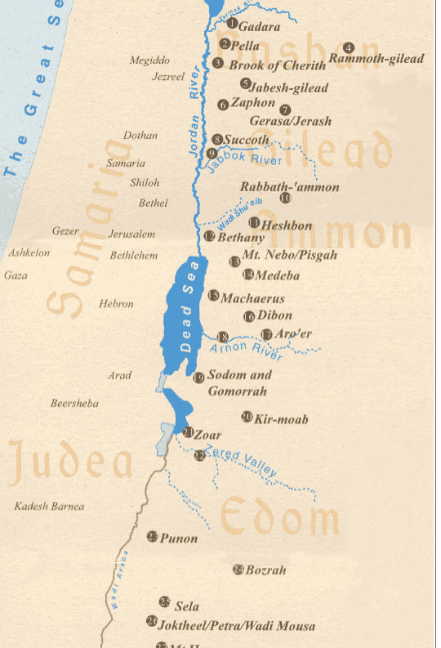
Migrations Of Israel – Chapter 5
The Jews are NOT Israelites or Judahites
1.) The True Judahites who had lived in Judea (the land of Judah) for nearly 2,000 years, and
2.) The recently naturalized Idumeans, who had been citizens of Judea only since 125 BC.

Slide 36
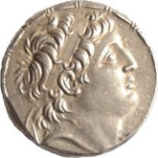
Migrations Of Israel – Chapter 5
The Jews are NOT Israelites or Judahites
Once these Idumeans had come to power, King Herod, an IDUMEAN, murdered the True King, John Hyrcanus, who was the legitimate heir to the throne, as was Jesus Christ, being a descendant of King David through both Mary and Joseph.
Coin - John Hyrcanus

Slide 37
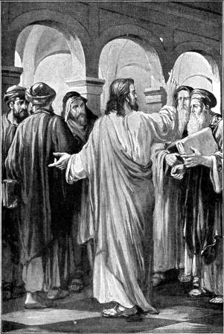
Migrations Of Israel – Chapter 5
The Jews are NOT Israelites or Judahites
Knowing full well that the Herodian scribes and Pharisees were an evil, vile people, verily, the ancient enemies of True Israel, Jesus told them:

Slide 38
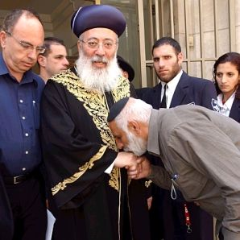
Migrations Of Israel – Chapter 5
The Jews are NOT Israelites or Judahites
“Wherefore ye be witnesses unto yourselves, that ye are the children of them which killed the prophets. Fill ye up then the measure of your fathers. Ye serpents. Ye generation [race] of vipers, how can ye escape the damnation of hell?
Rabbi Shlomo Amar, the Sephardi Chief Rabbi of Israel

Slide 39
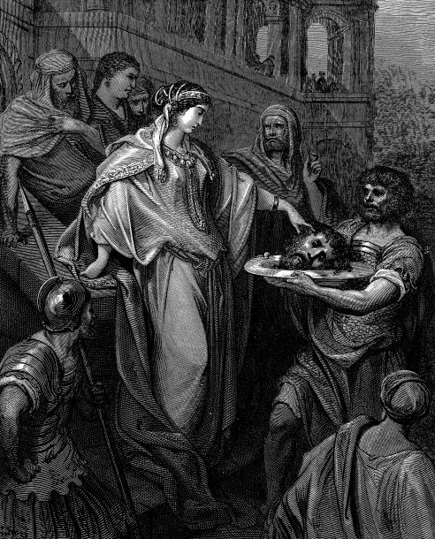
Migrations Of Israel – Chapter 5
The Jews are NOT Israelites or Judahites
Wherefore, behold, I send unto you prophets [the Apostles], and wise men, and [true Judahite] scribes; and some of them ye shall kill and crucify [including Himself]; and some of them shall ye scourge in YOUR synagogues, and persecute them from city to city:
Daughter of Herod receiving the head of John the Baptist

Slide 40
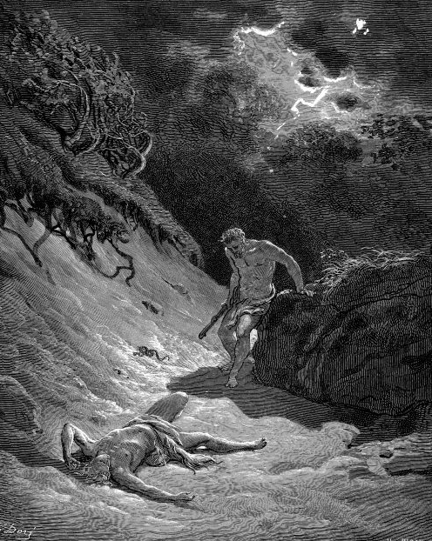
Migrations Of Israel – Chapter 5
The Jews are NOT Israelites or Judahites
That upon you may come all the righteous blood shed upon earth, from the blood of righteous Abel unto the blood of Zacharias, whom ye slew between the temple and the altar.” - Matt. 23: 31-35.
Abel slain by Cain

Slide 41
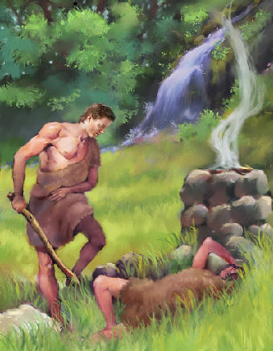
Migrations Of Israel – Chapter 5
The Jews are NOT Israelites or Judahites
This indictment of the Jews goes all the way back to Cain’s murder of Abel. Jesus is telling us that these Jews are the direct lineal descendants of the murderer, Cain. The Old Testament tells us that Cain begat the Kenites.

Slide 42
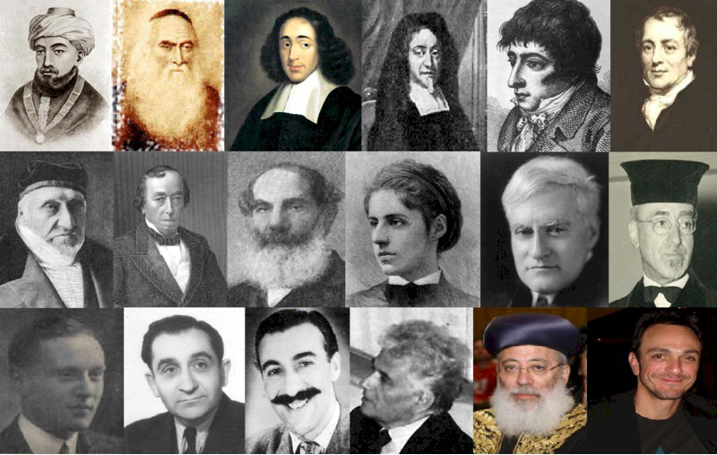
Migrations Of Israel – Chapter 5
The Jews are NOT Israelites or Judahites
Left: Some modern Kenites
The Kenites merged with the Canaanites. Then Esau/Edom merged with the Canaanites, thus the entire nation became known as Edom.
Notes:
1st row: Maimonides•Isaac Abrabanel•Baruch Spinoza•David Nieto•Daniel Mendoza•David Ricardo 2nd row: Moses Montefiore•Benjamin Disraeli•Sabato Morais•Emma Lazarus•Benjamin Cardozo•David de Sola Pool 3rd row: Basil Henriques•Pierre Mendès-France•Sam Costa•Jacques Derrida•Shlomo Amar•Hank Azaria

Slide 43
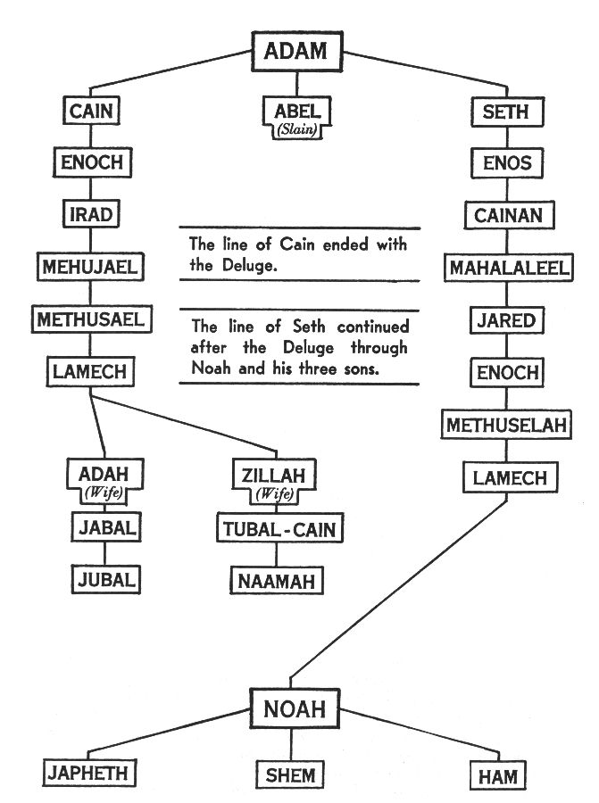
Migrations Of Israel – Chapter 5
The Jews are NOT Israelites or Judahites
And the Greek word for Edom is Idumea. Jesus is telling these Edomite Jews that He knows that they are the descendants of Cain, the murderer, and that they have not changed their ways, nor will they ever!
Genealogy of the line of Cain

Slide 44
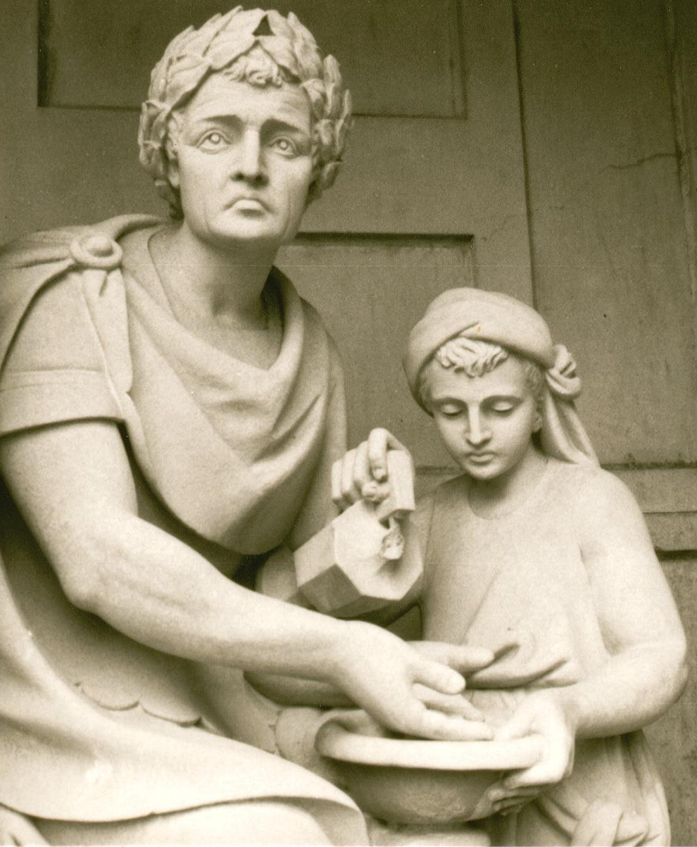
Migrations Of Israel – Chapter 5
The Jews are NOT Israelites or Judahites
Indeed, when Pilate washed his hands of the Crucifixion affair, the Jews (including the mob of people that the scribes and Pharisees had paid to assemble against Pilate) then took this responsibility UPON THEMSELVES, fully understanding that Pilate had disclaimed responsibility!
Pontius Pilate

Slide 45
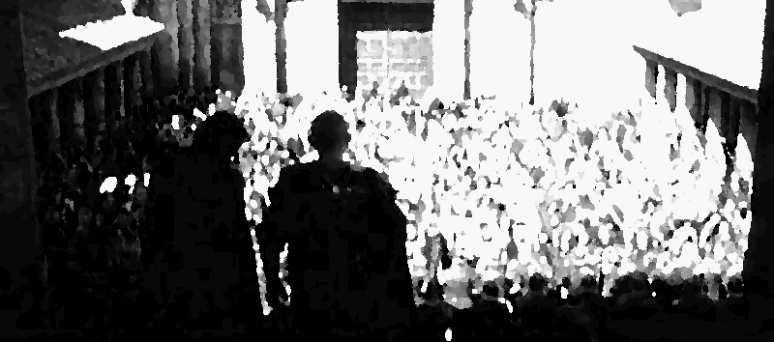
Migrations Of Israel – Chapter 5
The Jews are NOT Israelites or Judahites
“When Pilate saw that he could prevail nothing, but that rather a tumult was made, he took water, and washed his hands before the multitude, saying….

Slide 46
Migrations Of Israel – Chapter 5
The Jews are NOT Israelites or Judahites
‘I AM INNOCENT OF THE BLOOD OF THIS JUST PERSON:’ see ye to it. Then answered all the people [the mob assembled by the Jews], and said, “HIS BLOOD BE UPON US, AND ON OUR CHILDREN.” - Matt. 27:24-25.

Slide 47
Migrations Of Israel – Chapter 5
The Jews are NOT Israelites or Judahites
Now, I ask you again, whom do you believe? The Apostles, who gave us the Word of God, or the Pharisees, who gave us the religion called the Babylonian Talmud?

Slide 48
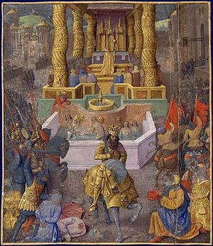
Migrations Of Israel – Chapter 5
The Jews are NOT Israelites or Judahites
Remember, it was this evil King Herod, an Idumean usurper, who tried to murder baby Jesus. Now you know why: because, as an enemy of True Judah, He did not want the Davidic Dynasty to be re-established.
King Herod

Slide 49
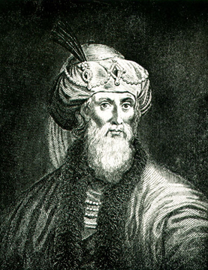
Migrations Of Israel – Chapter 5
The Jews are NOT Israelites or Judahites
Josephus, the JUDAHITE historian, clearly tells us that the Davidic Dynasty ended when the Idumean, Herod the Usurper, had murdered all the true heirs. (Antiquities, Book 15, Chapter 6, Para. 1-2.)

Slide 50
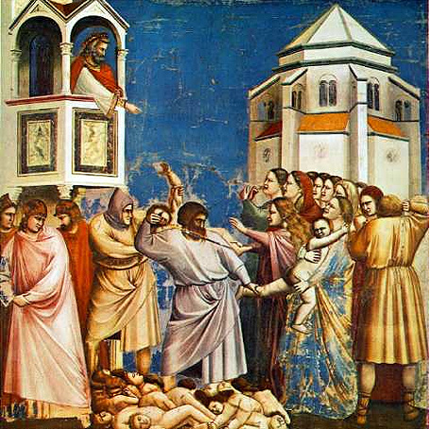
Migrations Of Israel – Chapter 5
The Jews are NOT Israelites or Judahites
When the Parthian Magi came to honor baby Jesus, whom the Magi knew was to be “King of Israel,” Herod’s first instinct was to murder the baby! Why?
Herod – Slaying Babies

Slide 51
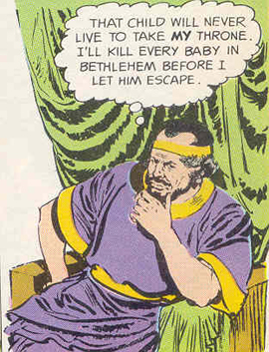
Migrations Of Israel – Chapter 5
The Jews are NOT Israelites or Judahites
If Herod were an Israelite, He would have been overjoyed that the Messiah had come. But since Herod was an Edomite, his first instinct was to eliminate the competition!

Slide 52
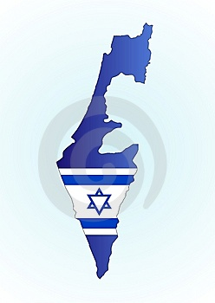
Migrations Of Israel – Chapter 5
The Jews are NOT Israelites or Judahites
Ever since Herod made the Pharisees the official priesthood of Judea, the Jews have been fooling the world with their charade as Israel. The devil’s children have concocted a most convincing story:

Slide 53
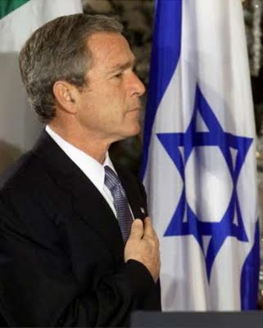
Migrations Of Israel – Chapter 5
The Jews are NOT Israelites or Judahites
“Let’s pretend to be God’s chosen people. We can then pretend that crucifying Christ was just a ‘mistake.’” And the world has been fooled by this ploy ever since!

Slide 54
Migrations Of Israel – Chapter 5
The Jews are NOT Israelites or Judahites
“And the great dragon was cast out, that old serpent, called the Devil and Satan, which deceiveth the whole world: he was cast out into the earth, and his angels were cast out with him.” - Rev. 12:9.

Slide 55
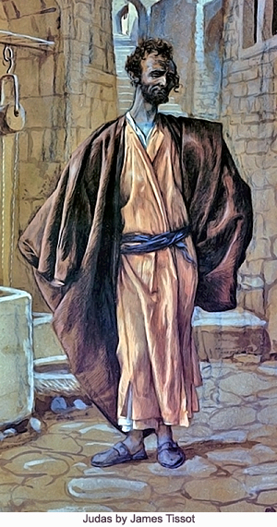
Migrations Of Israel – Chapter 5
The Jews are NOT Israelites or Judahites
All of the Apostles were Galileans of the Tribe of Benjamin, except Judas. Guess which type of Judean he was! Jesus told the assembled Apostles, “One of you is a devil.” (John 6:70.)

Slide 56
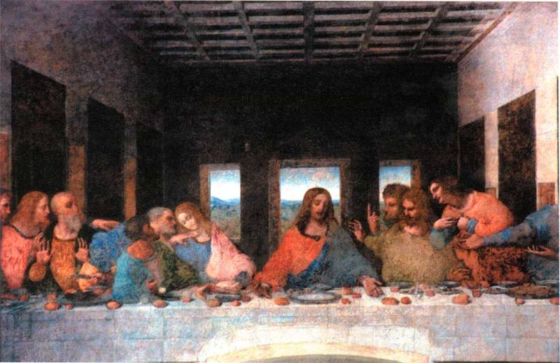
Migrations Of Israel – Chapter 5
The Jews are NOT Israelites or Judahites
To the Twelve Apostles gathered at the Last Supper, John says of Judas, that after Jesus handed Judas a sop (piece of bread for dipping), “Satan entered into him.” (John 13:27.) The Jewish people are still making excuses for Judas, even today!!!!
The Last Supper

Slide 57
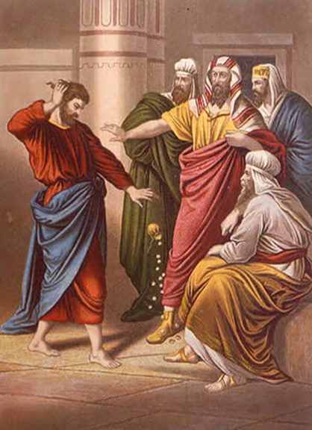
Migrations Of Israel – Chapter 5
The Jews are NOT Israelites or Judahites
By trying to defend Judas, the Jews are actually admitting that he was one of their own!!! (Jews hate criticism!)

Slide 58
Migrations Of Israel – Chapter 5
The Jews are NOT Israelites or Judahites
One author has summarized the Jewish impersonation of Israel so well that I don’t think his words can be improved upon:

Slide 59
Migrations Of Israel – Chapter 5
The Jews are NOT Israelites or Judahites
"Judaism's masquerade as Biblical Judah and, moreover, as all Israel -- which is the basis of Jewish Nationalism -- becomes patently counterfeit when placed in juxtaposition with the historical record of the true Houses of Israel and Judah.

Slide 60
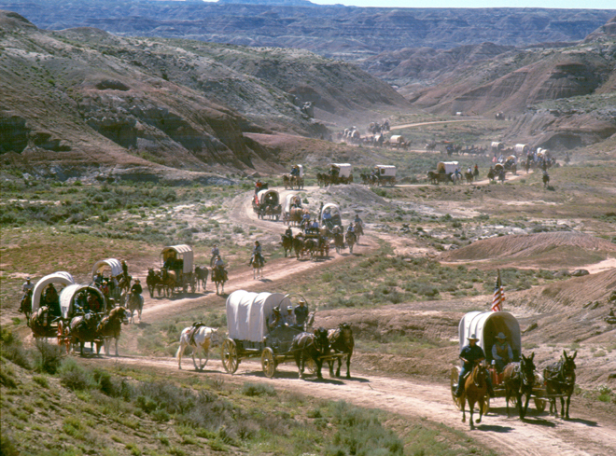
Migrations Of Israel – Chapter 5
The Jews are NOT Israelites or Judahites
Even a brief summary will show the contrast between the descendants of Biblical Jacob-Israel

Slide 61
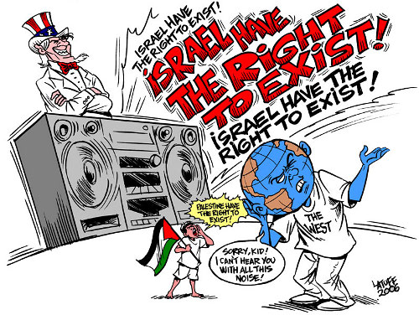
Migrations Of Israel – Chapter 5
The Jews are NOT Israelites or Judahites
.. as opposed to the alien posterity of the cabal which claims for itself not only the Promised Land but the very name and inheritance of Israel." - William Norman Saxon, “The Mask of Edom,” p. 8.

Slide 62
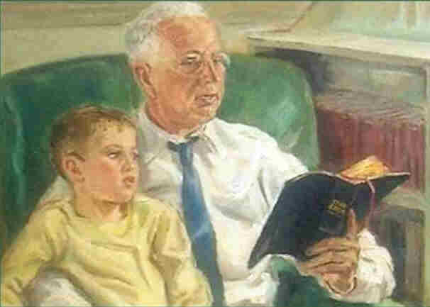
Migrations Of Israel – Chapter 5
The Jews are NOT Israelites or Judahites
Didn’t I tell you that you cannot understand the Bible unless you know the difference between the Two Houses of Jacob-Israel, neither of which are Jews?

Slide 63
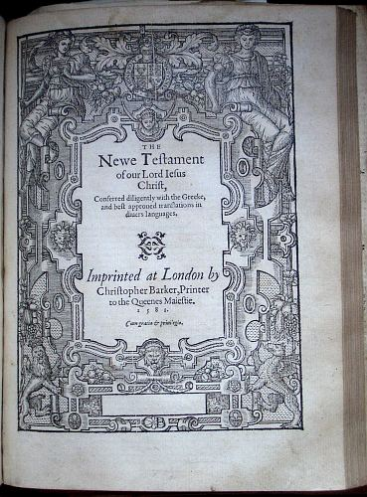
Migrations Of Israel – Chapter 5
For Israelites Only!
When we read the Scriptures carefully, we find that, more often than not, the “Gentiles” being spoken of in the New Testament are the dispersed Israelites of the “Lost Ten Tribes.” Since the true meaning of the Latin word ‘Gentile’ is “kinsman,”

Slide 64
Migrations Of Israel – Chapter 5
For Israelites Only!
… when Paul said he was the “Apostle to the Gentiles,” he meant that he was sent to those 12 Tribes scattered abroad, i.e., his KINSMEN!

Slide 65
Migrations Of Israel – Chapter 5
For Israelites Only!
Who else would have been interested in the Messiah anyway? Only the Israelite people had any idea of what he was talking about; and it is these dispersed Israelites that Paul addresses in each of his Epistles!!! The book of James opens up with the declaration, “To the Twelve Tribes scattered abroad, greetings.”
Greek New Testament

Slide 66
Migrations Of Israel – Chapter 5
For Israelites Only!
From these and many other statements in the New Testament, it is quite obvious that Jesus and the Apostles knew that the “Lost Tribes” still existed and they even corresponded with them.

Slide 67
Migrations Of Israel – Chapter 5
For Israelites Only!
Many of the circumcised Israelites of the House of Judah (some of whom lived in foreign lands) came from all over the Dispersion to the Temple at Jerusalem for Pentecost and other Feast days. Only such Israelites were allowed into the Temple.
Model – Temple in Jerusalem

Slide 68
Migrations Of Israel – Chapter 5
For Israelites Only!
All non-Israelites had to remain in the outer court, upon penalty of death! Archeologists have uncovered the ancient signs placed all around the outer court of the Temple grounds.
Temple – Showing The Outer Court

Slide 69
Migrations Of Israel – Chapter 5
For Israelites Only!
Left: Here is an online photo of one of the actual plaques: And this is the translation:
No outsider shall enter the protective enclosure around the sanctuary. And whoever is caught will ….
… only have himself to blame for the ensuing death.

Slide 70
Migrations Of Israel – Chapter 5
Circumcision Versus Uncircumcision
When Paul speaks to or about the CIRCUMCISION, he is speaking of the House of Judah (Judah and Benjamin), which practiced the sacrificial law until Yahshua’s self-sacrifice on the cross.

Slide 71
Migrations Of Israel – Chapter 5
Circumcision Versus Uncircumcision
The UNCIRCUMCISION is a specific reference to those Israelites who ceased to practice or perhaps never practiced the sacrificial rituals; and these people were the House of Israel scattered abroad!

Slide 72
Migrations Of Israel – Chapter 5
Circumcision Versus Uncircumcision
But Jesus came to redeem ALL ISRAEL, not just the House of Judah. This is why Peter had the vision about clean versus unclean animals. (Acts 10 & 11.)

Slide 73
Migrations Of Israel – Chapter 5
Circumcision Versus Uncircumcision
When Peter understood the meaning of the vision (Acts 10:28), he realized that the vision had nothing to do with literal food. Rather, he understood that the vision meant that the House of Israel, which had been scattered abroad, never to return, had also been forgiven their past sins.
Celts in Europe – part of Israel scattered abroad

Slide 74
Migrations Of Israel – Chapter 5
Circumcision Versus Uncircumcision
And that’s what Paul meant when he said, “There is neither Judean nor Greek,” since both Houses had been redeemed. The Greeks were uncircumcised Israelites of the Dispersion!

Slide 75
Migrations Of Israel – Chapter 5
Circumcision Versus Uncircumcision
Not understanding that Paul was talking about these two Houses (rather than about “Jews” or “Gentiles”), mainstream Christian ministers and theologians have utterly confused the issue. Their ignorance of Bible history is the principal cause of their false claims that Paul’s ministry was to non-Israelites!
Paul preaching to the Thessalonians

Slide 76
Migrations Of Israel – Chapter 5
Circumcision Versus Uncircumcision
In Acts 10, Cornelius, an uncircumcised Israelite of the Dispersion, from Italy, had come to Jerusalem in search of knowledge about Jesus. Peter’s vision was from the Holy Spirit (Acts 10:19), and he began to realize that the uncircumcised Israelites were no longer to be rejected by circumcised Judahites.
Cornelius

Slide 77
Migrations Of Israel – Chapter 5
Circumcision Versus Uncircumcision
From that moment on, the Circumcision of the House of Judah and the Uncircumcision of the House of Israel were to recognize each other as brethren.

Slide 78
Migrations Of Israel – Chapter 5
Circumcision Versus Uncircumcision
Under no circumstances were any of the Apostles told to go out and try to convert the heathen. Their mission was to the Israelites, exclusively, wherever they happened to be in the world.
Apostles preaching

Slide 79
Migrations Of Israel – Chapter 5
Circumcision Versus Uncircumcision
Paul explains this new understanding in these words:
“Hath God cast away HIS People? God forbid! For I also am an Israelite, of the seed of Abraham, of the tribe of Benjamin.
St. Paul

Slide 80
Migrations Of Israel – Chapter 5
Circumcision Versus Uncircumcision
God hath not cast away His People, which he foreknew …And so ALL ISRAEL [both Houses!] shall be saved [not the whole world!]: as it is written,

Slide 81
Migrations Of Israel – Chapter 5
Circumcision Versus Uncircumcision
THERE SHALL COME OUT OF SION THE DELIVERER AND SHALL TURN AWAY UNGODLINESS FROM JACOB.” - Romans 11:1,26-27.
The Magi

Slide 82
Migrations Of Israel – Chapter 5
Circumcision Versus Uncircumcision
Yet, the Judeo-Christian pulpits teach that Israel (falsely identified with the Jews) was “cast away” by God for rejecting the Messiah. (The Jews have indeed been rejected for their iniquity, but not Israel!)
Paul Crouch TBN

Slide 83
Migrations Of Israel – Chapter 5
Circumcision Versus Uncircumcision
Because many of the denominational churches fail to understand this history and the prophecies that go with them, they reject the Old Testament and proclaim that the “Church,” or “spiritual Israel,” has taken the place of TRUE ISRAEL!

Slide 84
Migrations Of Israel – Chapter 5
Circumcision Versus Uncircumcision
But, the Bible teaches NO SUCH THING! And Paul directly contradicts it! Rabbinical deception has led these denominations, full of misplaced good intentions, down the road of Apostasy!
Rabbi-weiss-cohen-and-rosenberg

Slide 85
Migrations Of Israel – Chapter 5
Circumcision Versus Uncircumcision
How can you take stolen property away from one thief (the Edomite Jews, to whom the inheritance never belonged) and justifiably give it another thief (the so-called “Church”)? Especially when the TRUE HEIR is still alive?
Washington National Cathedral

Slide 86
Migrations Of Israel – Chapter 5
Circumcision Versus Uncircumcision
It’s like buying stolen property and pretending that it now belongs to you! Legally, the stolen property still belongs to the true owner; and it must be returned to him!

Slide 87
Migrations Of Israel – Chapter 5
Circumcision Versus Uncircumcision
I guarantee you that the true heirs, and Jesus Christ, will have something to say about this matter before the Judgment Day!!!!

Slide 88
Migrations Of Israel – Chapter 5
Jesus Christ, Redeemer of Israel
With this understanding of the predestinated relationship between God and His People, Israel, we can now look at the life of Jesus Christ (Yahshuah Messiah in Hebrew), during His First Advent.
The Sermon On The Mount

Slide 89
Migrations Of Israel – Chapter 5
Jesus Christ, Redeemer of Israel
Although little is known about His absent years (away from Judea), it is quite probable that Jesus spent at least some time with his great uncle, Joseph of Arimathea, in Britain, where Joseph owned tin mines in Cornwall. Joseph was Mary’s uncle.
A Cornish Tin Mine

Slide 90
Migrations Of Israel – Chapter 5
Jesus Christ, Redeemer of Israel
Upon His return from the missing years, Jesus sought, at the age of thirty, to be baptized by John. The Law in Israel is that an Israelite man has to be at least thirty years of age before he can become a priest. (Numbers 4:43-47.)

Slide 91
Migrations Of Israel – Chapter 5
Jesus Christ, Redeemer of Israel
Jesus had to wait until He achieved this age, for He could not break any of Yahweh’s Laws. He had to be a sacrifice “without blemish.” The baptism by John was the beginning of Christ’s ministry.

Slide 92
Migrations Of Israel – Chapter 5
Jesus Christ, Redeemer of Israel
The Gospel of Matthew opens up with Yahshua’s genealogy. This genealogy proves that Matthew, and those of the House of Judah and Benjamin (including Luke and the other Apostles), ….

Slide 93
Migrations Of Israel – Chapter 5
Jesus Christ, Redeemer of Israel
… who lived in Judah and Galilee, understood that Jesus was a pure-blooded descendant of the Royal House of David, and, therefore, heir to the Throne of David.

Slide 94
Migrations Of Israel – Chapter 5
Jesus Christ, Redeemer of Israel
After being baptized, Jesus went into the desert, where he fasted for forty days. While there, he was tempted by the devil, who promised Him earthly power and riches, if Jesus would submit to his will. The devil was trying to thwart God’s Plan for the restoration of His people, Israel.

Slide 95
Migrations Of Israel – Chapter 5
Jesus Christ, Redeemer of Israel
Of course, Jesus was already Master of the Universe, so such a promise meant nothing to Him; but the devil was hoping that Jesus might fear the pain, suffering and death that were in store for Him at the Cross and thereby agree to the devil’s terms.

Slide 96
Migrations Of Israel – Chapter 5
Jesus Christ, Redeemer of Israel
He knew that if he could eliminate the Messiah’s sacrifice, we Israelites could not be redeemed. The devil’s people would then have free reign forever; or so he hoped! But Jesus did not let us down! Our Kinsman Redeemer came through!
The Empty Tomb

Slide 97
Migrations Of Israel – Chapter 5
The Gospel of the Kingdom of Israel
Few modern Christians understand that Jesus never taught the “Gospel of Personal Salvation.” Although it is true that we can all achieve personal salvation, that is not the focus of the Bible. Rather, Jesus taught about NATIONAL SALVATION:

Slide 98
Migrations Of Israel – Chapter 5
The Gospel of the Kingdom of Israel Jesus Christ, Redeemer of Israel
… that we should keep our people together as a nation, so we could fulfill our Destiny. This is something we Israelites must do TOGETHER, AS A NATION!

Slide 99
Migrations Of Israel – Chapter 5
The Gospel of the Kingdom of Israel
Jesus taught, almost exclusively, the Gospel of the Kingdom. All of His Parables begin with the words, “The Kingdom…” This Kingdom will be established right here on this earth at His Second Coming, right after the Judgment Day. (Rev. 21.)

Slide 100
Migrations Of Israel – Chapter 5
The Gospel of the Kingdom of Israel
In His own words, “Seek first the Kingdom, and all these things (personal blessings) shall be added unto you.” In direct contradiction to this principle, today’s apostate churches teach the exact opposite:
The Scottish Crown Jewels

Slide 101
Migrations Of Israel – Chapter 5
The Gospel of the Kingdom of Israel
Billy Graham
….. “Seek PERSONAL SALVATION in order to get into the Kingdom.” It’s quite amazing how modern Churchianity has got everything backwards!

Slide 102
Migrations Of Israel – Chapter 5
The Gospel of the Kingdom of Israel
Jesus Christ’s ministry was exclusively to the Children of Israel, and to no one else. Jesus came to redeem Israel, so that we might be those descendants of Abraham who were destined to be the “blessing to the world.” (Gen. 12:1-3.)
William Blake composer of Jerusalem ("And did those feet, in ancient time...")

Slide 103
Migrations Of Israel – Chapter 5
The Gospel of the Kingdom of Israel
And, indeed, we have been. Just look at all the blessings, which we Caucasians have delivered to the world: science, technology, art, architecture, classical music, automobiles, ….
Wolfgang Amadeus Mozart

Slide 104
Migrations Of Israel – Chapter 5
The Gospel of the Kingdom of Israel
…. railroads, air travel, space travel, agriculture, indoor plumbing, sanitation, medicine, computers, radios, televisions, the Bible, Christian Jurisprudence, the Magna Carta, the English Bill of Rights, …
Magna Carta

Slide 105
Migrations Of Israel – Chapter 5
The Gospel of the Kingdom of Israel
…. the Declaration of Independence, the Constitution of the United States, etc. It is WE CAUCASIANS (True Israel) who have been the blessing to the world.

Slide 106
Migrations Of Israel – Chapter 5
The Gospel of the Kingdom of Israel
God said to Israel: “You are my witnesses!” (Isa. 43:10.) The Anglo-Saxon Christians have witnessed the Bible, evangelizing the whole world.
A Meeting of the British and Foreign Bible Society in Freemasons Hall

Slide 107
Migrations Of Israel – Chapter 5
The Gospel of the Kingdom of Israel
The Jews have done none of these things! On the contrary, the Jews have never blessed the world in any way!
Notes:
Friday’s inauguration saw rabbis bringing the Torah to the synagogue, in a ceremony witnessed by political leaders and Holocaust survivors from around the world. The synagogue, with a 1,200-person capacity, has been described as one of the jewels of Germany’s Jewish community. Germany’s biggest synagogue, on Rykestrasse in Berlin, has reopened after a lavish restoration.

Slide 108
Migrations Of Israel – Chapter 5
The Gospel of the Kingdom of Israel
The Jews have given the world Zionism, communism, moneylending, international banking, globalism, welfare statism, stock markets, trafficking, giant corporations, organized crime, homosexual rights, feminism, pornography, and a host of other vices and rackets.

Slide 109
Migrations Of Israel – Chapter 5
The Gospel of the Kingdom of Israel
They have NOT had anything to do with bringing the Bible to the world. They have kept their own scriptures to themselves, teaching only that they are “G-d’s chosen people.” This is the extent of their “witness.” Do you still believe that?

Slide 110
Migrations Of Israel – Chapter 5
The Gospel of the Kingdom of Israel
They are STILL the world’s leading moneylenders, just as they were in the days of Jesus, when He drove them out of the Temple with His whip!! And, to our great discredit, we have let the money lenders back into the Temple of Israel!
The US Federal Reserve Bank

Slide 111
Migrations Of Israel – Chapter 5
The Gospel of the Kingdom of Israel
Jesus said, “I am not come but unto the Lost [exiled] Sheep of the House of Israel.” (Matt. 15:24.)

Slide 112
Migrations Of Israel – Chapter 5
The Gospel of the Kingdom of Israel
He came as the Kinsman Redeemer of the Tribes of Israel. Since only True Israel was given the Law at Mt. Sinai by Moses, only the Israelites needed to be redeemed for breaking that Law.
Moses – Mt. Sinai

Slide 113
Migrations Of Israel – Chapter 5
The Gospel of the Kingdom of Israel
Yahshua Messiah had to come and take our sins away from us, so that WE could carry the Gospel to the rest of the world, while always remaining a separate and distinct people.

Slide 114
Migrations Of Israel – Chapter 5
The Gospel of the Kingdom of Israel
This is exactly what our ancestors did in Europe, as Christianity swept through all of the Anglo-Saxon nations, from Russia to Iceland.

Slide 115
Migrations Of Israel – Chapter 5
The Gospel of the Kingdom of Israel
In this manner, we were being prepared for the eventual regathering, which happened in 1776, and for, ultimately, the RESTORATION, which will not happen until the Wedding Feast of the Lamb, which will be after the Judgment Day.

Slide 116
Migrations Of Israel – Chapter 5
Jesus Christ, Redeemer of Israel
Since the Kingdom - God’s Government - will be administered by True Israelites of All Twelve Tribes (Rev. 21:9-12), it behooves us to understand who we are, so that we can prepare ourselves for this day. This is why Jesus told the Apostles at the Great Commission,
Breastplate with jewels of the 12 tribes

Slide 117
Migrations Of Israel – Chapter 5
Jesus Christ, Redeemer of Israel
“Go rather to the Lost Sheep of the House of Israel.” – Matt. 15:24.
This command was taken literally by the Apostles, who went out in search of those Israelites of the Dispersion, which had begun with the House of Israel in 745 BC.
Ludgate Hill where St. Paul preached

Slide 118
Migrations Of Israel – Chapter 5
Jesus Christ, Redeemer of Israel
The Jews never teach about the TRUE DISPERSION OF ISRAEL, because they were never a part of it. Those Israelites had become a great multitude of people, as Josephus attests:

Slide 119
Migrations Of Israel – Chapter 5
Jesus Christ, Redeemer of Israel
"Wherefore there are but two tribes in Asia and Europe subject to the Romans [the House of Judah], while the ten tribes are beyond Euphrates till now, and are an immense multitude, and not to be estimated by numbers [the House of Israel]." - The Antiquities of Judea.
The Roman Empire

Slide 120
Migrations Of Israel – Chapter 5
Appolumi
One of the most misunderstood words in the New Testament is the word ‘lost’ as it used of the “Lost Ten Tribes.” The English lost is translated from the Greek appolumi.

Slide 121
Migrations Of Israel – Chapter 5
Appolumi
Most Christians assume that this word is a general reference to being either spiritually or morally “lost,” or both, and that it can be applied to non-Israelites. This is NOT THE CASE! What the Greek word appolumi means is this: “to put away in punishment.”
Israel being taken into captivity

Slide 122
Migrations Of Israel – Chapter 5
Appolumi
And that is exactly what happened to the EXILED Tribes of Israel. The correct translation of appolumi is “exiled.”

Slide 123
Migrations Of Israel – Chapter 5
Appolumi
As such, it is an exclusive reference to the Dispersion, and also to the Seven Times Punishment of Leviticus 26, of those Israelites who were put away in punishment for their pagan practices.
Book of Leviticus

Slide 124
Migrations Of Israel – Chapter 5
Appolumi
Yahshua did not come to redeem the world. The world still hates Him, even today. He came to redeem His People, Israel, so that we could build His Kingdom here on earth, in spite of all of Satan’s minions, …

Slide 125
Migrations Of Israel – Chapter 5
Appolumi
…. who ferociously battle against having this Kingdom become a reality on planet earth. If you are paying attention, you can see that this battle is heating up to a fever pitch in the early part of this Twenty-First Century.

Slide 126
Migrations Of Israel – Chapter 5
Appolumi
Unfortunately, the mainstream Judeo-Christians have actually joined with the enemies of Christ by siding with the Jews. Paul’s prophecy of the Great Apostasy in II Thess. 2 has been fully realized in modern Churchianity!
Notes:
St. Ives Church

Slide 127
Migrations Of Israel – Chapter 5
The Lamb and the Lion
We can never forget that Yahshua’s ministry requires TWO ADVENTS. The First Advent was to redeem Israel by forgiving our past sins. At that time, He came as the sacrificial lamb.

Slide 128
Migrations Of Israel – Chapter 5
The Lamb and the Lion
The Second Advent will be to establish the never-ending Kingdom. And this will be accomplished for His People, True Israel, the Anglo-Saxon, Celtic and Caucasian people.

Slide 129
Migrations Of Israel – Chapter 5
The Lamb and the Lion
No one else stands to inherit the Kingdom! Yahweh God has told us that He has prepared us for this Kingdom even before the world was created! This is the true meaning of the doctrine of Predestination, as explained by Paul in Romans 8:29-30 and Ephesians 1:5,11.

Slide 130
Migrations Of Israel – Chapter 5
The Lamb and the Lion
At the First Advent, He was Shiloh, the Messiah and Lamb of God. At the Second Advent, we will call Him the Lion of Judah, when He will take His place as King of Kings.

Slide 131
Migrations Of Israel – Chapter 5
The Lamb and the Lion
He never achieved that last time, did He? He was crucified; and the Jews mocked him by putting a sign on His Cross, which said “King of the Judeans.” This time, He will come with vengeance for His enemies; and He will rule with a “rod of iron.” There won’t be any law-breaking anymore!

Slide 132
Migrations Of Israel – Chapter 5
Meanwhile, back in Europe, the Israelites of the Dispersion were becoming a vast multitude of people. Because of hundreds of years of wandering, they eventually forgot who they were and were called by other names!!!

Slide 133
Migrations Of The 12 Tribes Of Israel
End Of Chapter Five
BY PASTOR ELI JAMES
To be continued ………… Chapter Six: The Israelites In Europe - The Origin of the Germanic Tribes In the Scythian Israelites

