Slide 1
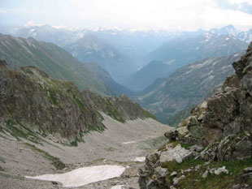
The Chronicles Of The
Migrations Of The
Twelve Tribes Of Israel
From The Caucasus
Mountains Into Europe
By Pastor Eli James

Slide 2
Chapter Four
The House Of Judah
Is Taken Captive To
Babylon
By Pastor Eli James

Slide 3
Migrations Of Israel – Chapter 4
As stated earlier, the House of Judah had a completely separate and distinct destiny, function and history from that of the House of Israel. The House of Judah was to remain in Palestine; but, except for King Josiah, none of the Kings of Judah was righteous.

Slide 4
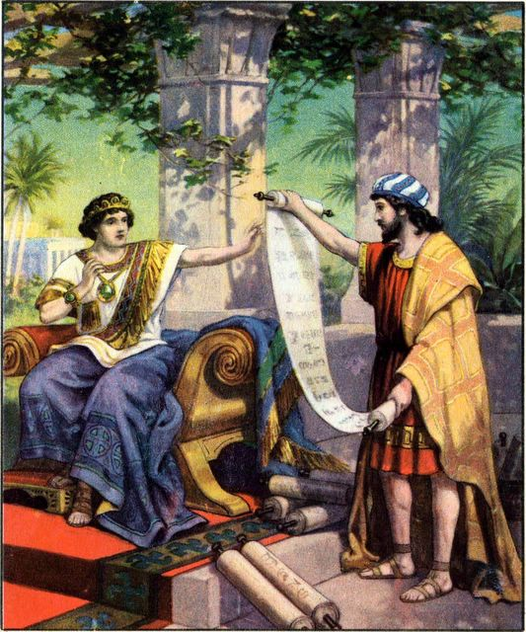
Migrations Of Israel – Chapter 4
Josiah instituted a brief reign of righteousness. Josiah proceeded to clean up the kingdom of Judah, removing all the idols, the groves, the high places, and eliminating all of the other abominations of pagan idol worship.
King Josiah Reads The Law

Slide 5
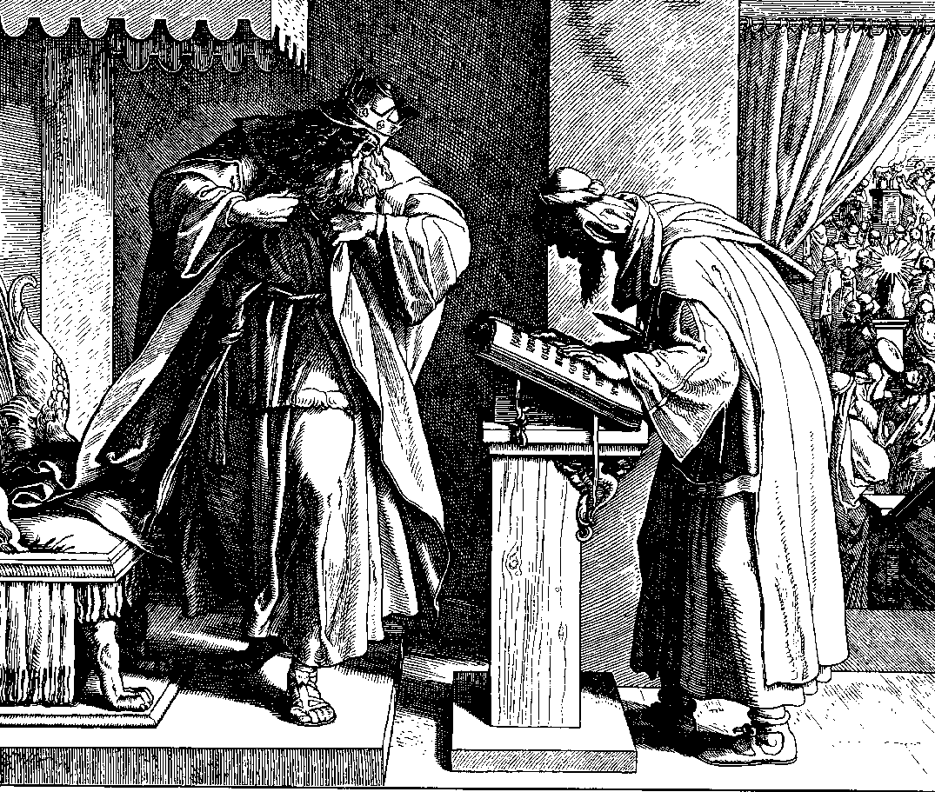
Migrations Of Israel – Chapter 4
II Kings 23:3.
“And the king stood by a pillar, and made a covenant before Yahweh, to walk after Yahweh, and to keep His Commandments and His testimonies and His statutes with all their heart and with all their soul …and all the people stood to the covenant.”

Slide 6
Migrations Of Israel – Chapter 4
Under Josiah, the House of Judah kept the Passover of Moses, which previous kings had neglected.
A Stained Glass Window Depicting King Josiah Keeping The Passover

Slide 7
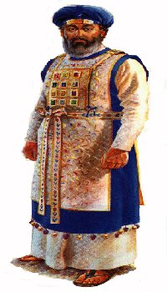
Migrations Of Israel – Chapter 4
II Kings23: 22-25.
“Surely there was not holden such a passover from the days of the judges that judged Israel, nor in all the days of the kings of Israel, nor of the kings of Judah… that he might perform the words of the law which were written in the book that Hilkiah the priest found in the house of the Lord.
Hilkiah The Priest

Slide 8
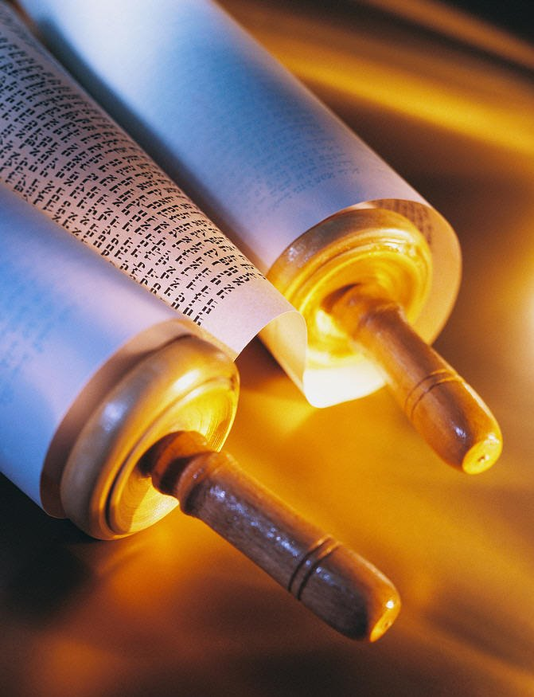
Migrations Of Israel – Chapter 4
II Kings23: 22-25.
And like unto him was there no king before him, that turned to the Lord with all his heart, and with all his soul, and with all his might, according to all the law of Moses; neither after him arose there any like him.”

Slide 9
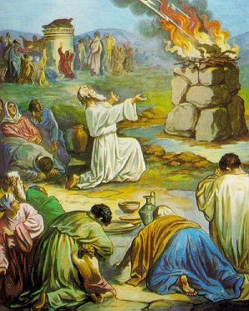
Migrations Of Israel – Chapter 4
After King Josiah, however, the House of Judah became just as wicked as the House of Israel.
Baal Worship

Slide 10
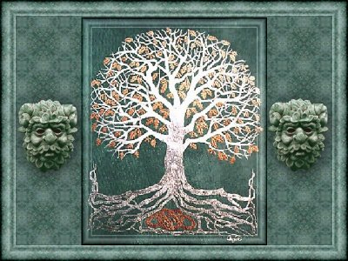
Migrations Of Israel – Chapter 4
Jeremiah 3:6-10.
6 The LORD said also unto me in the days of Josiah the king, Hast thou seen that which backsliding Israel hath done? She is gone up upon every high mountain and under every green tree, and there hath played the harlot.

Slide 11
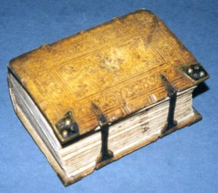
Migrations Of Israel – Chapter 4
Jeremiah 3:6-10.
7 And I said after she had done all these things, Turn thou unto me. But she returned not. And her treacherous sister Judah saw it.

Slide 12
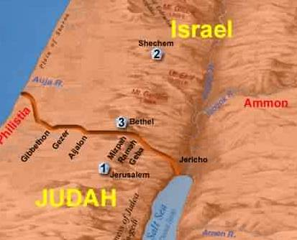
Migrations Of Israel – Chapter 4
Jeremiah 3:6-10.
8 And I saw, when for all the causes whereby backsliding Israel committed adultery I had put her away, and given her a bill of divorce; yet her treacherous sister Judah feared not, but went and played the harlot also.

Slide 13
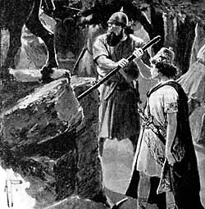
Migrations Of Israel – Chapter 4
Jeremiah 3:6-10.
9 And it came to pass through the lightness of her whoredom, that she defiled the land, and committed adultery with stones and with stocks.

Slide 14
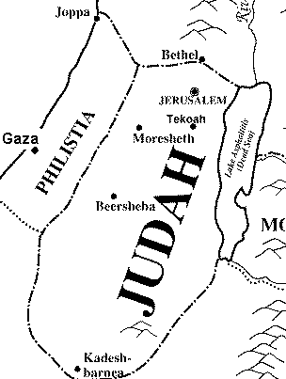
Migrations Of Israel – Chapter 4
Jeremiah 3:6-10.
10 And yet for all this her treacherous sister Judah hath not turned unto me with her whole heart, but feignedly, saith the LORD.

Slide 15
Migrations Of Israel – Chapter 4
This is a pretty sad state of affairs. The House of Judah and the House of Israel are spoken of as treacherous sisters! Neither of these two sisters was willing to obey their Father, Yahweh! They were too busy having fun playing the harlot! Therefore, Yahweh had no choice but to punish Judah also.
Two Olive Branches Representing The Two Houses Of Israel

Slide 16
Migrations Of Israel – Chapter 4
God’s word concerning the House of Judah:
“And Yahweh said, I will remove Judah also out of my sight, as I have removed Israel, and will cast off the city of Jerusalem which I have chosen, and the house of which I have said, My name shall be there.”
II Kings 23:27.

Slide 17
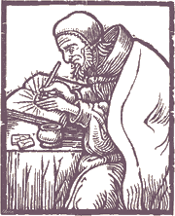
Migrations Of Israel – Chapter 4
The True Name of God is Yahweh (Ex. 3:15), but both rabbinical and priestly traditions have replaced the Name, Yahweh, with the title, God. God’s name is indeed part of the name of Jerusalem,

Slide 18
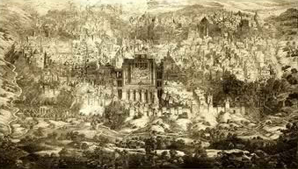
Migrations Of Israel – Chapter 4
ANCIENT JERUSALEM
… but it is well disguised. Breaking it down phonetically, it is Yah-Ru-Salem. Ru is a Hebrew root meaning melody or song. King David was always singing Yah’s praises in Jerusalem.

Slide 19
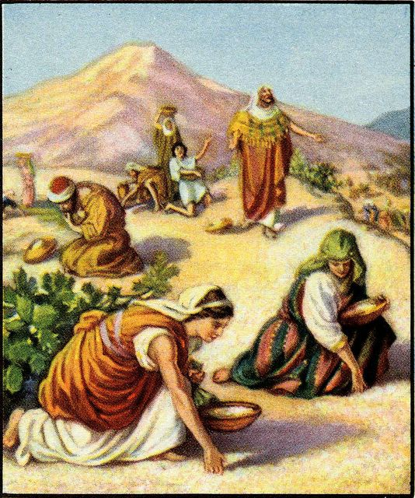
Migrations Of Israel – Chapter 4
The Israelites were known as the “people of Yah” to the surrounding nations.

Slide 20
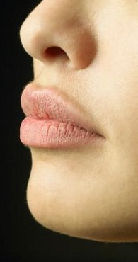
Migrations Of Israel – Chapter 4
Part of the punishment of Israel was that He took His Name from off of our lips, so that we could abuse it no longer. That is why we have forgotten His Name. The reasons for this are stated in I Chr. 22:8, Isa. 48:11 and Jer. 23: 26,27, which states,

Slide 21
Migrations Of Israel – Chapter 4
“How long shall this be in the heart of the prophets that prophesy lies? Yes, they are prophets of the deceit of their own heart; Which think to cause my people to forget my name by their dreams which they tell every man to his neighbour, as their fathers have forgotten my name for Baal.”

Slide 22
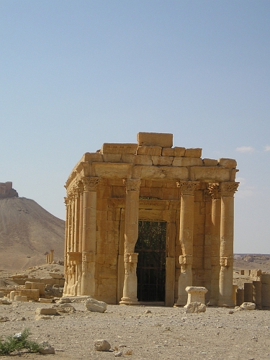
Migrations Of Israel – Chapter 4
Baal is the Hebrew/Chaldean word for Lord. Indeed, our modern Bibles have replaced the name of Yahweh with the title, LORD.
Temple Of Baal – Shamin, Syria

Slide 23
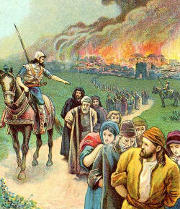
Migrations Of Israel – Chapter 4
Yahweh removed Judah out of His sight in the year 586 BC. This event is recorded, among other places in the Bible, in II Kings 24:
Judah Taken Captive

Slide 24
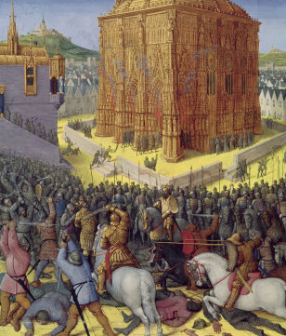
Migrations Of Israel – Chapter 4
II Kings 24:
"And Nebuchadnezzar king of Babylon came against the city [Jerusalem], and his servants did beseige it. And Jehoiachin the king of Judah went out to the king of Babylon,
Siege of Jerusalem by Nebuchadnezzar

Slide 25
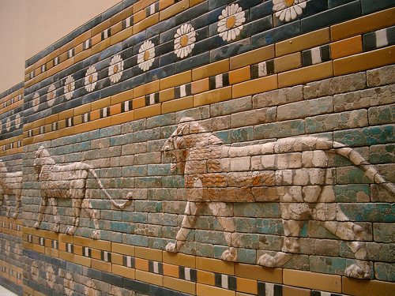
Migrations Of Israel – Chapter 4
II Kings 24:
… he, and his mother, and his servants, and his princes, and his officers: and the king of Babylon took him in the eighth year of his reign...And he carried away all Jerusalem,
Nebuchadnezzar’s Palace

Slide 26
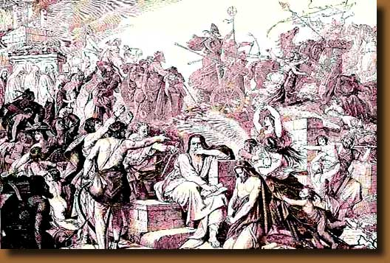
Migrations Of Israel – Chapter 4
II Kings 24:
and all the princes, and all the mighty men of valour, even ten thousand captives, and all the craftsmen and smiths: none remained, save the poorest sort of the people of the land." (Vs. 11,12, 14.)
Nebuchadnezzar conquers Jerusalem

Slide 27
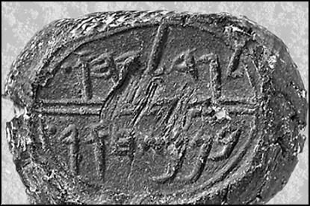
Migrations Of Israel – Chapter 4
Nebuchadnezzar then installed Jehoiachin's uncle, Mattaniah, on the throne of Jerusalem and renamed him Zedekiah. But Zedekiah also rebelled, thus causing Jerusalem to be destroyed. Nebuchadnezzar then tried to install Gedaliah as governor.
The seal of Zedekiah

Slide 28
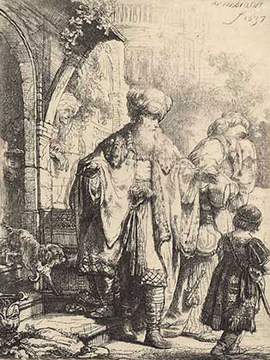
Migrations Of Israel – Chapter 4
(II Kings 24: 25, 26)
"And it came to pass in the seventh month, that Ishmael the son of Nethaniah, the son of Elishama, of the seed royal, came, and ten men with him, and smote Gedaliah, that he died, and the Judahites and the Chaldees “
Ishmael

Slide 29
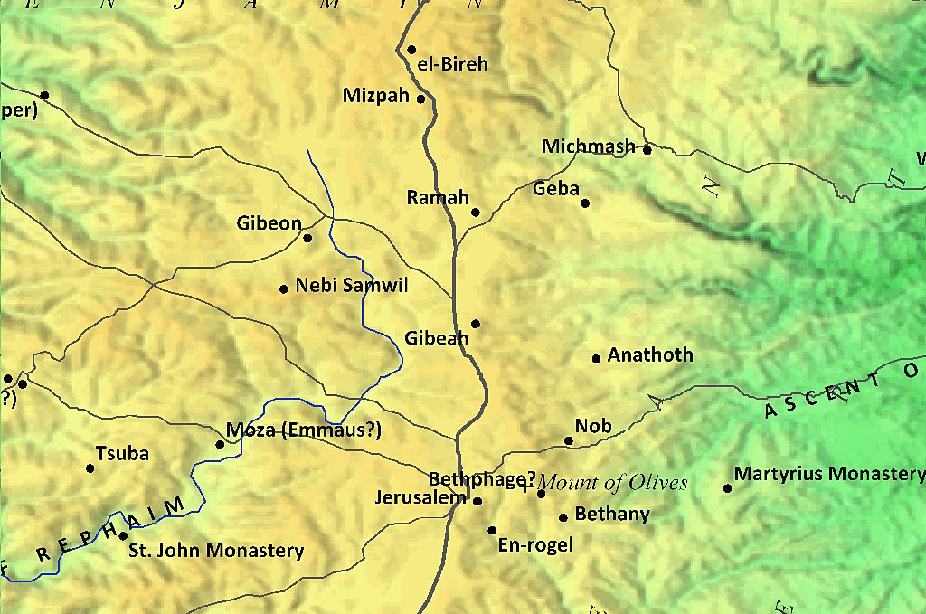
Migrations Of Israel – Chapter 4
…. that were with him at Mizpah. And all the people, both small and great, and the captains of the armies, arose, and came to Egypt: for they were afraid of the Chaldees."
(See also Jer. 40 and 41.)

Slide 30
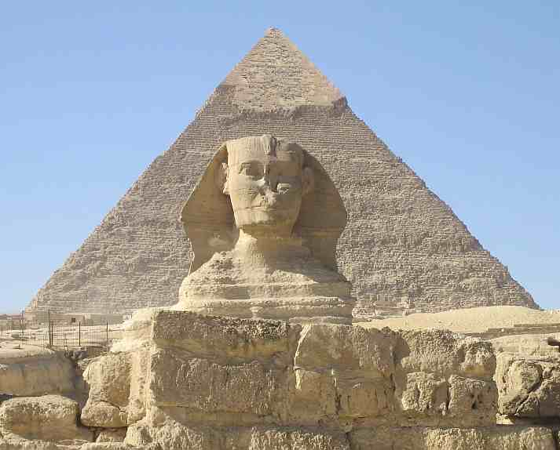
Migrations Of Israel – Chapter 4
Thus there was civil strife within the House of Judah, some siding with the Babylonians (Chaldees) and some with Ishmael, of the “seed royal,” meaning a descendant of King David. These people decided to go to Egypt instead of to Babylon. (Jer. 41:10 and 43:6.)

Slide 31
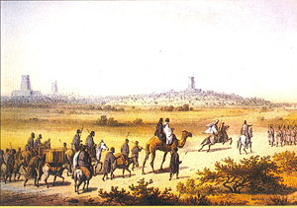
Migrations Of Israel – Chapter 4
This number included "the captains of the armies." (II Kings 24:26.) So, we have evidence that a great number of Judahites, specifically soldiers, shepherds, vinedressers, and the poor, all fled to Egypt for safety.
Judah Fleeing

Slide 32
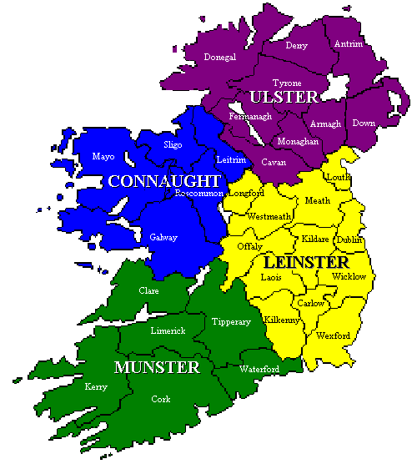
Migrations Of Israel – Chapter 4
There, and possibly even in Ethiopia, Judahites settled but were later destroyed as Jeremiah had prophesied. (Jer. 44). What is not generally known is that Jeremiah’s flight continued from Egypt to Spain, and from Spain to Ireland, where Jeremiah finally settled.

Slide 33
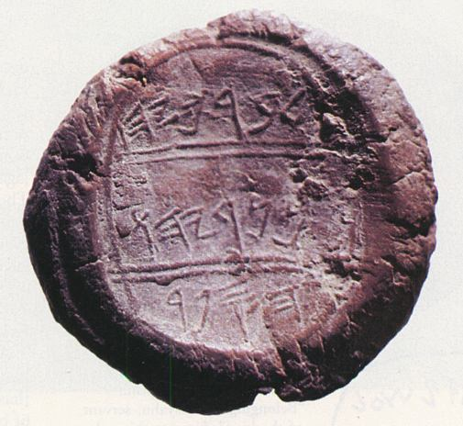
Migrations Of Israel – Chapter 4
(Of very great significance to our story is the fact that Jeremiah took with him Baruch, his scribe, and Zedekiah’s two daughters, who were also of the “seed royal.” …..
The Seal Of Baruch

Slide 34
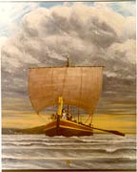
Migrations Of Israel – Chapter 4
… The Bible does not record their names, but from the Irish records, their names were Scota and Tamar, who took the Egyptian name of Tea Tephi. The story of these two daughters will be taken up in Part 6.)
Tea Tephi Sailing To Ireland
Notes:
An archaeological find which verifies the historicity of the book of Jeremiah, is the discovery of the Seal of Baruch in 1975. Baruch was the scribe or emanuensis who wrote down the prophecies of Jeremiah. Read more about the Seal of Baruch at: http://home.att.net/~kmpope/SealofBaruch.html

Slide 35
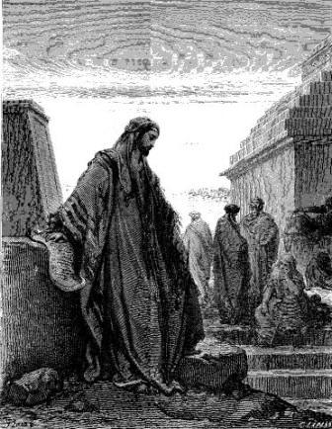
Migrations Of Israel – Chapter 4 The Babylonian Captivity
This was written by Daniel while he was a captive with the other Judahites and Benjaminites in Babylon. This captivity lasted 70 years.
Daniel In Babylon

Slide 36
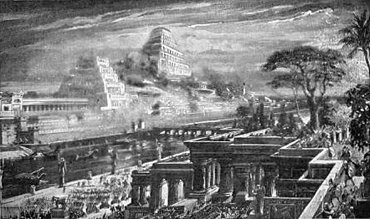
Migrations Of Israel – Chapter 4 The Babylonian Captivity
Babylon where part of Judah were in captivity
This captivity of the House of Judah was also ordained by Yahweh, and for reasons similar to the captivity of the House of Israel.

Slide 37
Migrations Of Israel – Chapter 4 The Babylonian Captivity
Turning to Jeremiah, Chapter 24: 1-7. we read the parable of the good and bad figs:

Slide 38
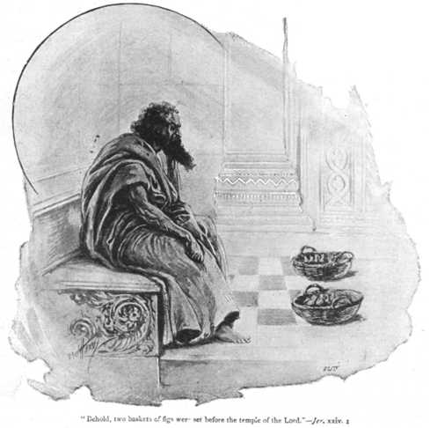
Migrations Of Israel – Chapter 4 The Babylonian Captivity
"The Lord shewed me, and behold, two baskets of figs were set before the temple of the Lord, after that Nebuchadrezzar king of Babylon had carried away captive Jeconiah the son of Jehoiakim king of Judah… One basket had very good figs, even like the figs that are first ripe: and the other basket had very naughty figs,
The Good And Bad Figs

Slide 39
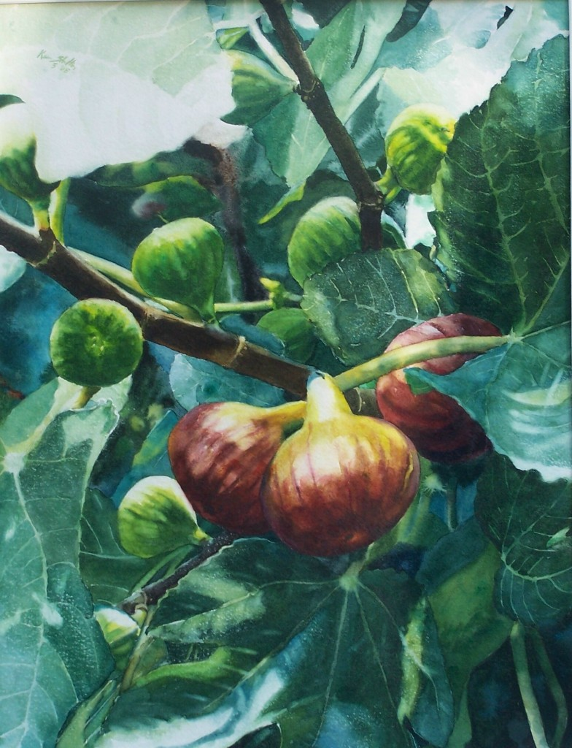
Migrations Of Israel – Chapter 4 The Babylonian Captivity
… which could not be eaten, they were so bad... Thus saith the Lord, the God of Israel; Like these good figs, so will I acknowledge them that are carried away captive of Judah, whom I have sent out of this place into the land of the Chaldeans for their good.

Slide 40
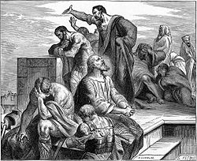
Migrations Of Israel – Chapter 4 The Babylonian Captivity
For I will set mine eyes upon them for good, and I will bring them again to this land: and I will build them, and not pull them down; and I will plant them, and not pluck them up...for they shall return to me with their whole heart.”

Slide 41
Migrations Of Israel – Chapter 4 The Babylonian Captivity
Restating this prophecy, the good figs are to go captive to Babylon for their own good -- to learn a lesson of humility and obedience. They are to return again to the land of Judah, and when they do, they will have been reformed and belong once again to God.

Slide 42
Migrations Of Israel – Chapter 4 The Babylonian Captivity
That is, they will return to His statutes and be His people again. This return from Babylon is a spiritual and moral return as well, and these good figs are to be the progenitors of the Messiah via the descendants of the House of David.
The Harp Of David

Slide 43
Migrations Of Israel – Chapter 4 The Babylonian Captivity
Jeremiah, Chapter 24: 8-9
"And as the evil figs, which cannot be eaten, they are so evil; surely thus saith the Lord, So will I give Zedekiah the king of Judah, and his princes, and the residue of Jerusalem, that remain in this land, and them that dwell in the land of Egypt:
Bad Figs

Slide 44
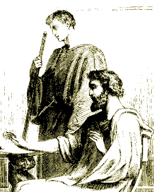
Migrations Of Israel – Chapter 4 The Babylonian Captivity
Jeremiah, Chapter 24: 8-9
And I will deliver them to be removed into all the kingdoms of the earth for their hurt, to be a reproach and a proverb, a taunt and a curse, in all the places whither I shall drive them.
King Zedekiah

Slide 45
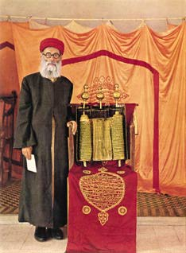
Migrations Of Israel – Chapter 4 The Babylonian Captivity
Those Judahites who refused to be taken captive, and who stayed behind in Judea, are identified as being the evil figs. Those who remained in Judea intermarried with the non-Israelite inhabitants of the land and became known as the Samaritans.
A Samaritan Priest

Slide 46
Migrations Of Israel – Chapter 4 The Babylonian Captivity

Slide 47
Migrations Of Israel – Chapter 4 The Babylonian Captivity

Slide 48
Migrations Of Israel – Chapter 4 The Babylonian Captivity

Slide 49
Migrations Of Israel – Chapter 4 The Babylonian Captivity

Slide 50
Migrations Of Israel – Chapter 4 The Babylonian Captivity

