Slide 1
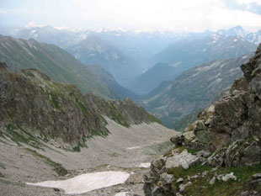
The Chronicles Of The
Migrations Of The
Twelve Tribes Of Israel
From The Caucasus
Mountains Into Europe
By Pastor Eli James

Slide 2
Chapter Three
Tracing the Migrations
From the
Iberian Caucasus
By Pastor Eli James

Slide 3
Moreover I will appoint a place for my people Israel, and will plant them, that they may dwell in a place of their own, and move no more; neither shall the children of wickedness afflict them any more, as beforetime,
I Samuel 7:10.

Slide 4
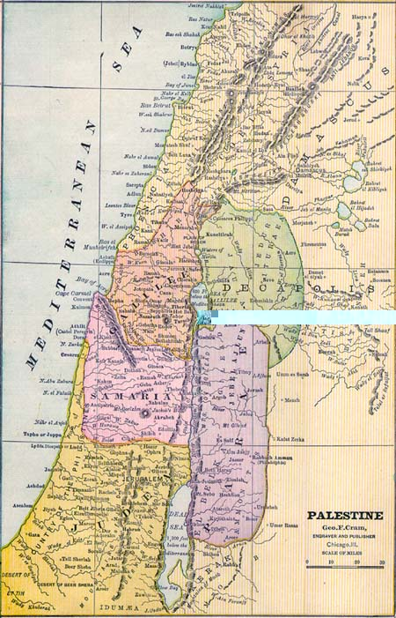
Migrations Of Israel – Chapter 3
All historians agree that the bulk of these people never returned to Palestine

Slide 5
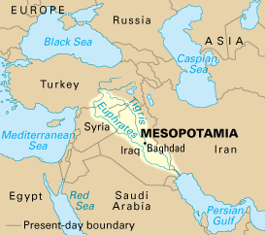
Migrations Of Israel – Chapter 3
but they are wrong in asserting that these people either died off or intermarried with the other peoples of Mesopotamia.

Slide 6
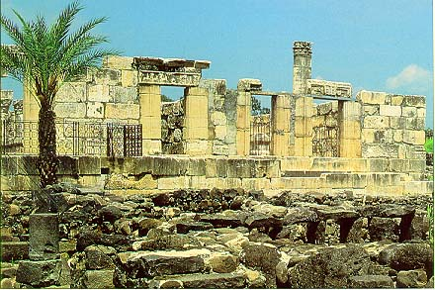
Migrations Of Israel – Chapter 3
Scythopolis
The fact is that one small contingent of them did return later to Palestine, when they were known as “Scythians.” Knowing that they were Israelites, they returned to Palestine and founded a small town called “Scythopolis.” That town still exists today.

Slide 7
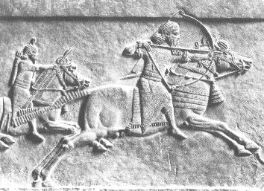
Migrations Of Israel – Chapter 3
What really happened is this: The Israelites, having become a captive people, were being used by the Assyrians to perform slave labor and were also forced to fight battles for them (“Kill or be killed”) as unwilling mercenaries
Assyrian Warriors

Slide 8
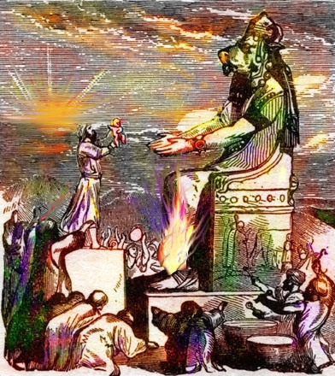
Migrations Of Israel – Chapter 3
Having been evicted from Palestine by Yahweh for their pagan practices, they were without a land of their own for the first time.
Worshipping Baal

Slide 9
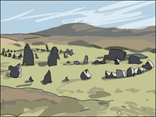
Migrations Of Israel – Chapter 3
Hence, they were referred to by new and different names as they migrated through the territories of other peoples

Slide 10
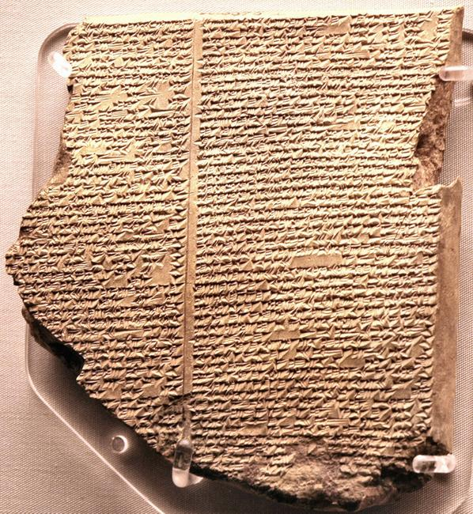
Migrations Of Israel – Chapter 3
These new names were spoken and recorded in the languages of their captors and in the languages of the historians who chronicled their locations and migrations. These new names will be detailed later.

Slide 11
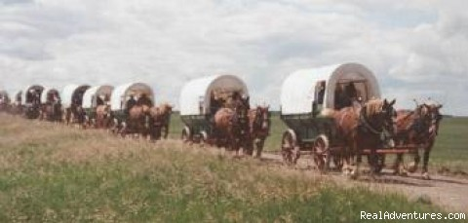
Migrations Of Israel – Chapter 3
Ultimately, these migrating Israelites would become known by a single, new name. This eventuality was prophesied in various places, such as Isa. 62:2, Isa. 65:15, and Hosea 2:1.

Slide 12
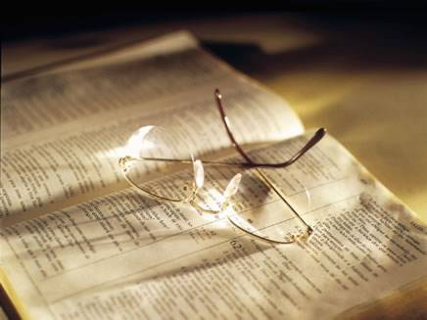
Migrations Of Israel – Chapter 3
These are the exact words of Isa. 62:2: “And the nations shall see thy righteousness, and all kings thy glory: and thou shalt be called by a new name, which the mouth of Yahweh shall name.”

Slide 13
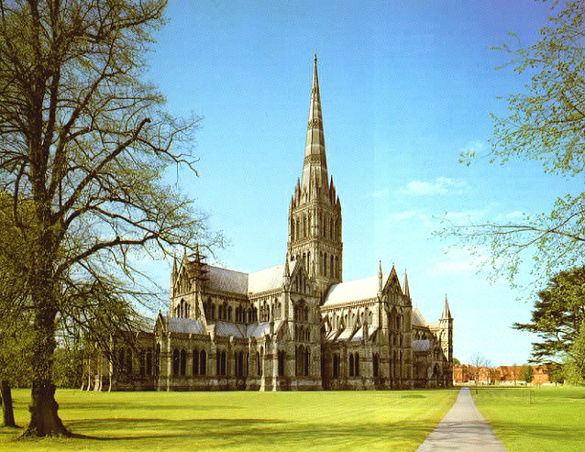
Migrations Of Israel – Chapter 3
That new name, by which we are still called today, is “Christians,” and the “righteousness” being referred to is Christian jurisprudence, which was and is the foundation of Christian civilization.
Salisbury Cathedral - England

Slide 14
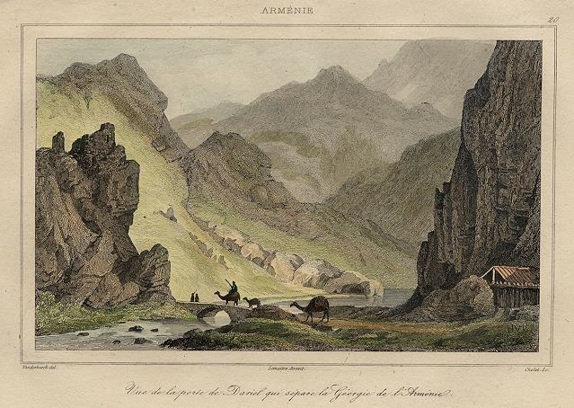
Migrations Of Israel – Chapter 3
A Painting of the Pass of Dariel, Armenia, 1838
Recalling that Isaiah prophesied that the children of Israel would have a second exodus from Assyria, we can now pinpoint that “highway” as the highway that leads through the Dariel Pass.

Slide 15
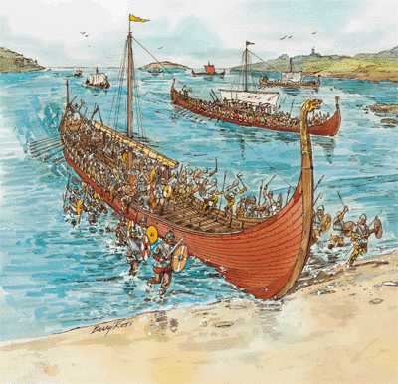
Migrations Of Israel – Chapter 3
There is ample witness from various documents that these tribes maintained their tribal traditions and continued to exist as a people throughout history, but they eventually forgot their Identity as Israel.
The Vikings

Slide 16
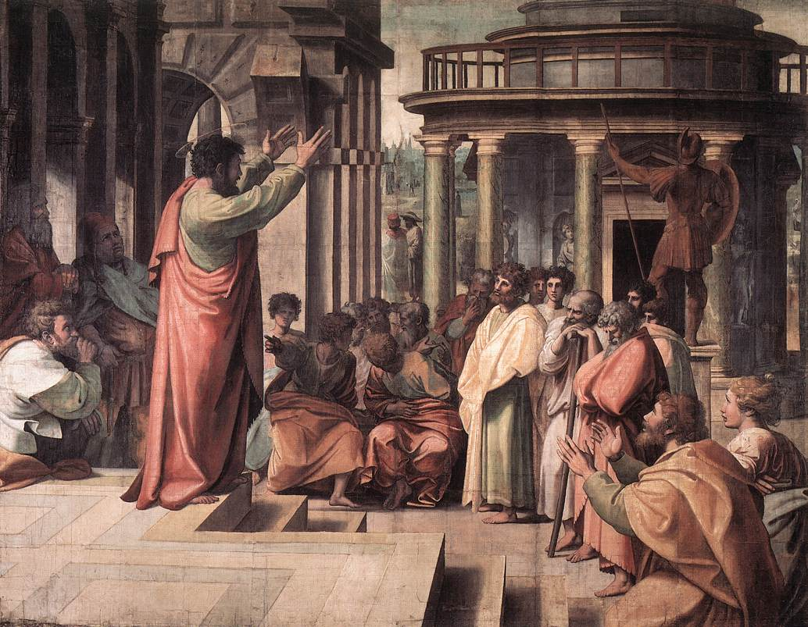
Migrations Of Israel – Chapter 3
This forgetfulness was prophesied in various Scriptures, such as Isa. 29:10-12, 42:16, 19-20; Hos. 1:9-10, 2:7-23, 3:4-5, and verified by Paul at Romans 11:7-8, 25. In the words of Hosea:

Slide 17
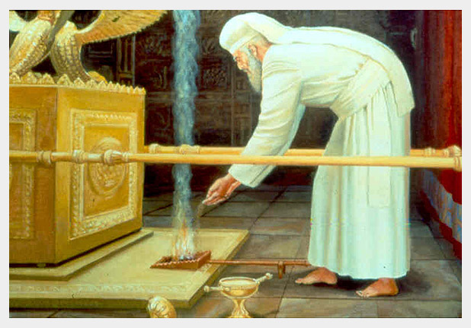
Migrations Of Israel – Chapter 3
“For the children of Israel shall abide many days without a king, and without a prince, and without a sacrifice and without an image, and without an ephod and without a teraphim:

Slide 18
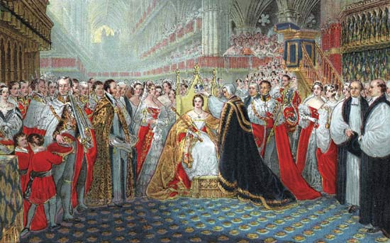
Migrations Of Israel – Chapter 3
Afterward shall the children of Israel return and seek Yahweh their God, and David their King and shall fear Yahweh and His goodness in the latter days.” – Hos. 3:4-5.

Slide 19
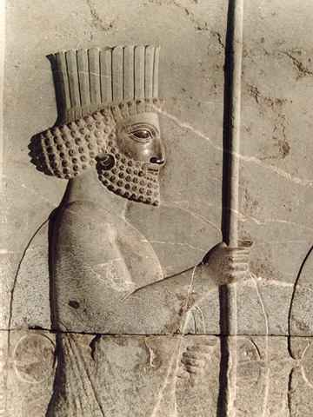
Migrations Of Israel – Chapter 3
“Those are the ten tribes, which were carried away prisoners out of their own land in the time of Osea [Hosea] the king, whom Salmasar the king of Assyria led away captive, and he carried them over the waters, and so they came into another land.” - II Esdras 13:40-45.
Salmasar

Slide 20
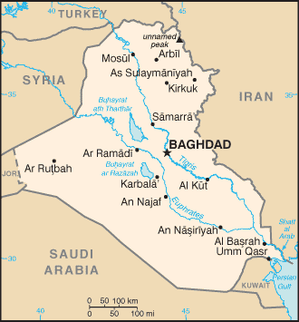
Migrations Of Israel – Chapter 3
The “waters” that are here spoken of are the Tigris and Euphrates Rivers, which still flow out of northern Media today.
Tigris and Euphrates

Slide 21
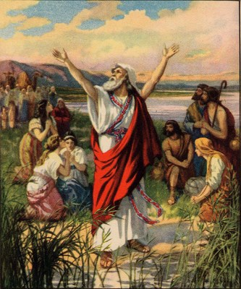
Migrations Of Israel – Chapter 3
Esdras also records their determination to flee their captors by going north:
Esdras

Slide 22
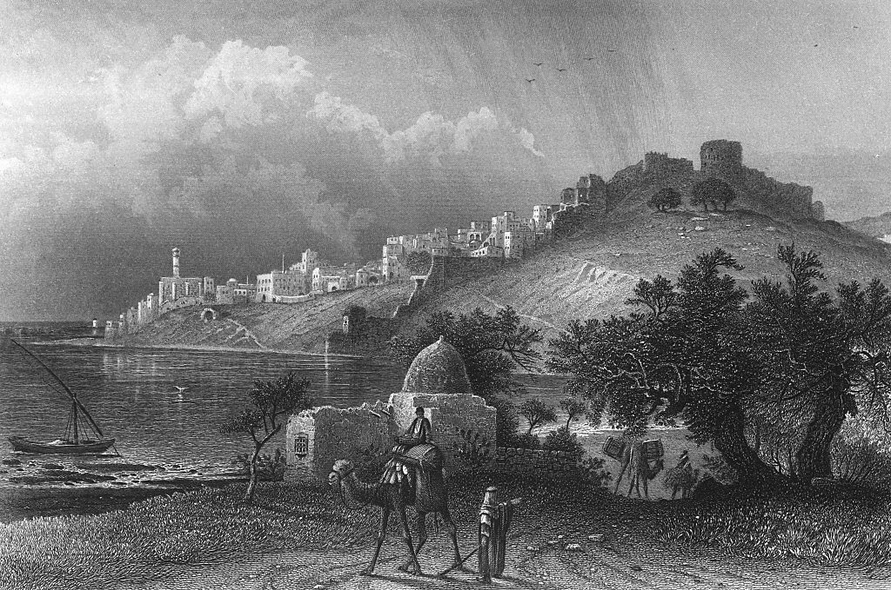
Migrations Of Israel – Chapter 3
“But they took this counsel among themselves, that they would leave the multitude of the heathen, and go forth into a further country, where never mankind dwelt, that they might there keep their statutes, which they never kept in their own land.

Slide 23
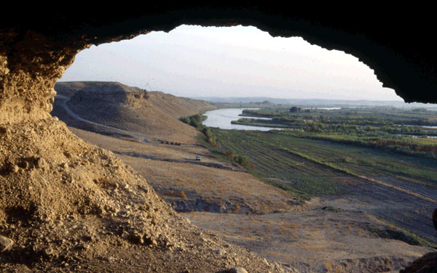
Migrations Of Israel – Chapter 3
And they entered into Euphrates by the narrow passages of the river. For the Most High then showed signs and wonders [as in the days of the Exodus from Egypt] and held still the flood, till they were passed over.

Slide 24
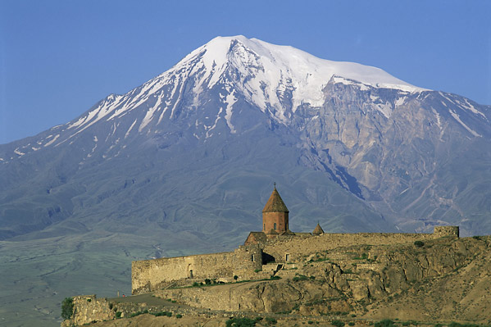
Migrations Of Israel – Chapter 3
For through that country there was a great way to go, namely, of a year and a half: and the same region is called Arsareth.” – II Esdras, 13:40-45.

Slide 25
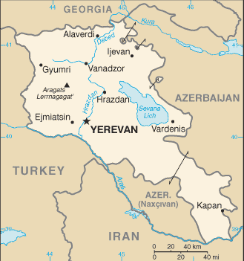
Migrations Of Israel – Chapter 3
Today, it is called Armenia. Note that this passage from the Apocrypha totally verifies Isa. 11:11, which is the “highway” prophecy.
Armenia

Slide 26
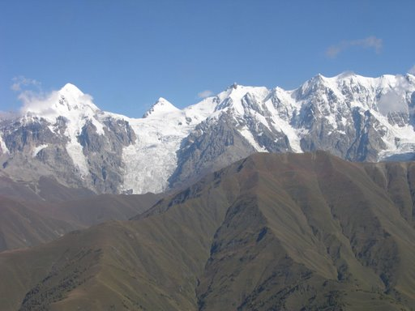
Migrations Of Israel – Chapter 3
So, far from disappearing off the face of the earth, and far from dying out, the so-called “Ten Lost Tribes” are still VERY MUCH ALIVE. We are known as the Caucasian people!!! I like to refer to us as Anglo-Saxon Israel.

Slide 27
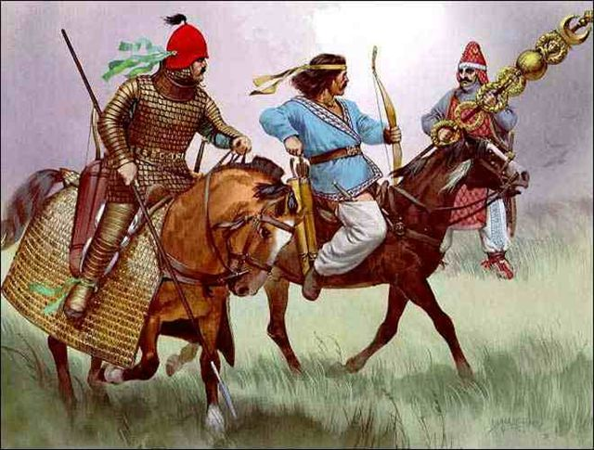
Migrations Of Israel – Chapter 3
Having firmly established the Identity of the Israelites of the Assyrian Captivity with the Caucasian people, we can now traces some of the other names
by which our ancestors called themselves and by which they were called by other people.

Slide 28
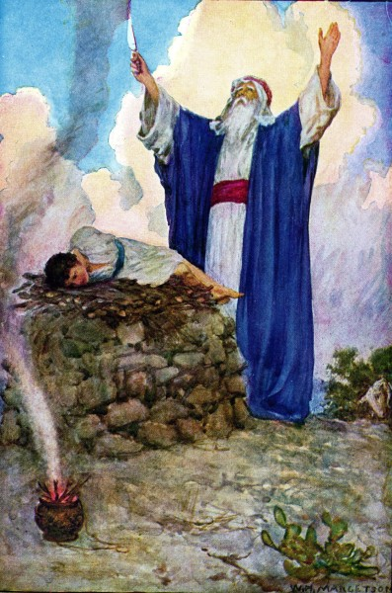
Migrations Of Israel – Chapter 3
Scythians and Saxons
“In Isaac shall thy seed be called.” – Gen. 21:12.
Abraham Making An Offering Of Isaac

Slide 29
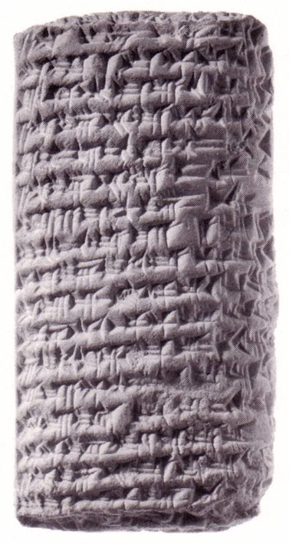
Migrations Of Israel – Chapter 3
Scythians and Saxons
Esarhaddon refers to the Iskuza as being united with the Mannai in battle. One of the names by which the House of Israel was known was as the House of Isaac. Iskuza is the Assyrian version of the Greek Scythian and the Persian Sacae.
Letter To Esarhaddon

Slide 30
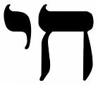
Migrations Of Israel – Chapter 3
Scythians and Saxons
In Hebrew, Isaac is pronounced Ish-Ak, with the accent on the second syllable. The Greeks and Persians dropped the first syllable and retained the second.

Slide 31
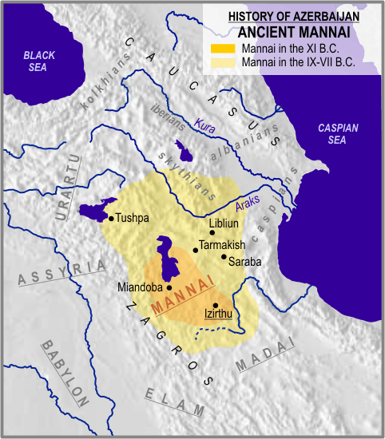
Migrations Of Israel – Chapter 3
Scythians and Saxons
These same Sacae (also called Sacca or Sakka) were driven out of Media later that century along with the Mannai and Gimira (another variation of Cimmerians or Khumru) when Media and Babylon joined forces to overthrow the Assyrian Empire.

Slide 32
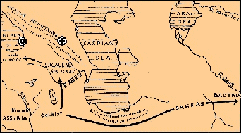
Migrations Of Israel – Chapter 3
Scythians and Saxons
In addition to the Caucasus Mountain route, some of these Israelites went west, migrating along the southern shores of the Black Sea, and some went east, along the southern shores of the Caspian Sea and then north along the eastern shores of that same sea into the steppes of southern Russia.

Slide 33
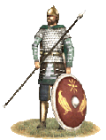
Migrations Of Israel – Chapter 3
Scythians and Saxons
One group of these Sacae stayed in the area of Media, outlasting the Assyrians, Medes and Persians. They became known as the Parthians.
A Parthian Soldier

Slide 34
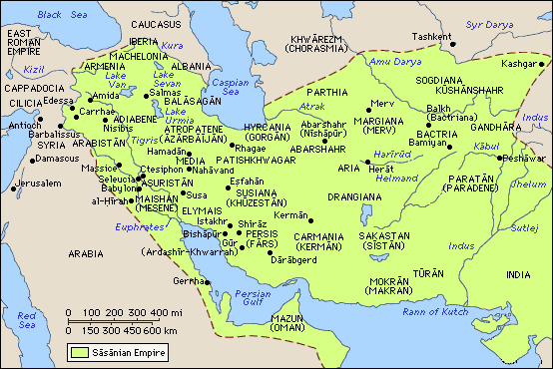
Migrations Of Israel – Chapter 3
Scythians and Saxons
The Parthians became a huge empire, at one point stretching from Armenia all the way down to the Indus Valley. Their empire lasted well beyond the days of Christ.
The Parthian Empire
x

Slide 35
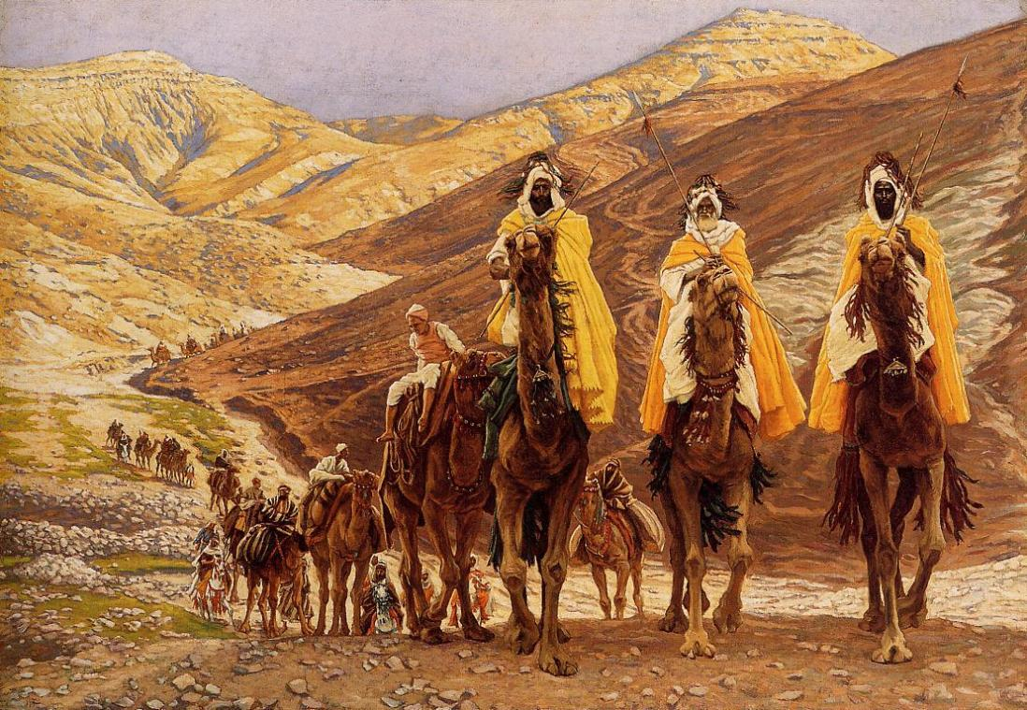
Migrations Of Israel – Chapter 3
Scythians and Saxons
In fact the Magi were Parthians. The Romans were never able to defeat the Parthians; and it was during a truce period, between the Romans and Parthians, that the Magi were able to travel to Judah. .
The Magi

Slide 36
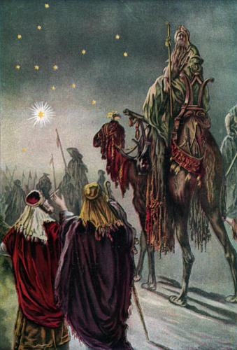
Migrations Of Israel – Chapter 3
Scythians and Saxons
The Magi knew they were the kinsmen of Jesus Christ. That’s why they traveled to Judea when they saw the star.
The Magi & Star

Slide 37
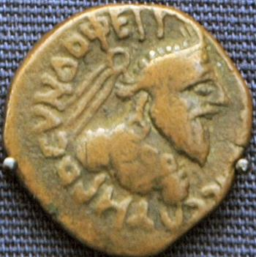
Migrations Of Israel – Chapter 3
Scythians and Saxons
The Sacae were also referred to as the Saka-Suni, which, literally translated, means “Isaac’s sons.” It is easy to see how Saka-Suni would have been shortened to SAXON. The fact that these Israelites were named after Isaac fulfills the prophecy of Gen. 21:12.
A Sacae Coin

Slide 38
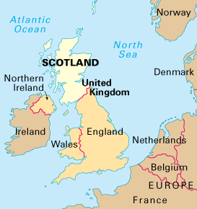
Migrations Of Israel – Chapter 3
Scythians and Saxons
Another variation of Scythian was Scuth, which is the basis of the word Scot, from which the words Scotia and Scotland derive.
Scotland

Slide 39
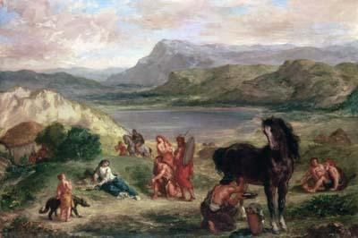
Migrations Of Israel – Chapter 3
Scythians and Saxons
The first historical traces of the Scythians in South Russia are dated around 600 BC, about 145 years after the first deportation.

Slide 40
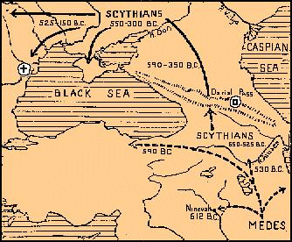
Migrations Of Israel – Chapter 3
Scythians and Saxons
From there, the Scythians moved northwest toward the Baltic and west toward Germany. As the Scythians migrated westward, the various sub-tribes developed names of their own.
Scythian Migration towards Europe

Slide 41
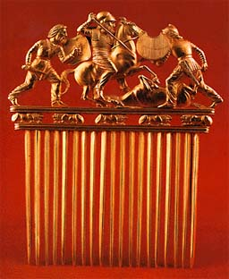
Migrations Of Israel – Chapter 3
Scythians and Saxons
In a tract on the subject of the Lost Tribes entitled "Our Scythian Ancestors", W. E. Filmer traces archeological evidence connecting Scythian artifacts with what is known of Hebrew artifacts.
A Scythian Comb

Slide 42
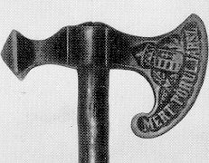
Migrations Of Israel – Chapter 3
Scythians and Saxons
Such objects as the battle-axe, three-edged arrowheads, scabbards and sword handles with a tree-of-life design, etc., all go to show that the Scythians of south Russia migrated from the south and not from the east as many historians have believed. The battle-axe was the favorite weapon of the Israelites.
A Scythian Axe

Slide 43
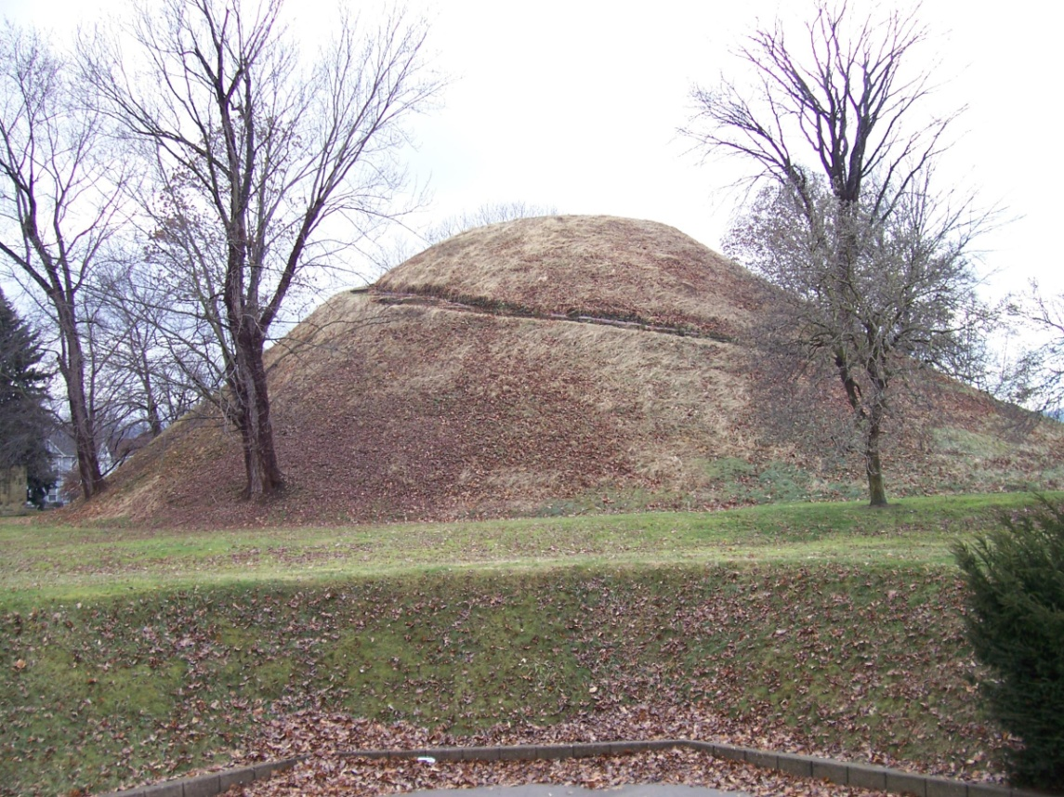
Migrations Of Israel – Chapter 3
Scythians and Saxons
The migrations of the Scythian Israelites is confirmed by the trail of burial grounds of the Scythians and their kings, which lead up the Dnieper River valley as far as Kiev.
A Scythian Burial Mound

Slide 44
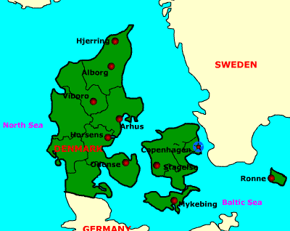
Migrations Of Israel – Chapter 3
Scythians and Saxons
The oldest of these artifacts are those closest to Romania, Armenia, and south Russia. Their burial sites spread as far as the Danish Islands and the Jutland Peninsula.
The Jutland Peninsular

Slide 45
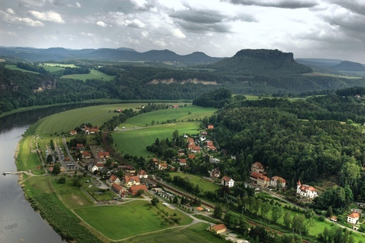
Migrations Of Israel – Chapter 3
Scythians and Saxons
Quoting Filmer, "Now Tacitus and Ptolemy name the region of the River Elbe and the base of the Jutland Peninsula as the places inhabited by the Angles and Saxons before they came to Britain.
The River Elba

Slide 46
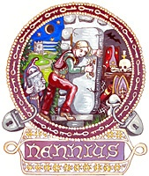
Migrations Of Israel – Chapter 3
Scythians and Saxons
According to Roman terminology, this was `Germany' but it is interesting to note that the British historian, Nennius, in his account of the arrival of the Hengist and Horsa in Thanet, says that `messengers were sent to Scythia for reinforcements.’

Slide 47
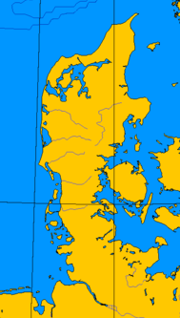
Migrations Of Israel – Chapter 3
Scythians and Saxons
The context shows that these came, in fact, from north Germany, so evidently the ancient name of the `genuine Scythians' persisted long in northern Europe."
The Jutland Peninsula is named after the Jutes, who are of the Tribe of Judah.
Jutland

Slide 48
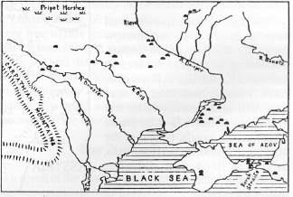
Migrations Of Israel – Chapter 3
Scythians and Saxons
Regarding the northerly migrations of the Scythians, M.I. Rostovtsev, in his Iranians And Greeks In South Russia, says…
The Area Of S. Russia

Slide 49
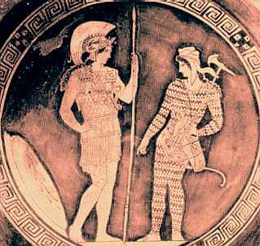
Migrations Of Israel – Chapter 3
Scythians and Saxons
"We cannot but recognize that in the fourth and third centuries [B.C.] the Scythians endeavored to install themselves as a ruling class in the northern regions of their empire,
The Scythians

Slide 50
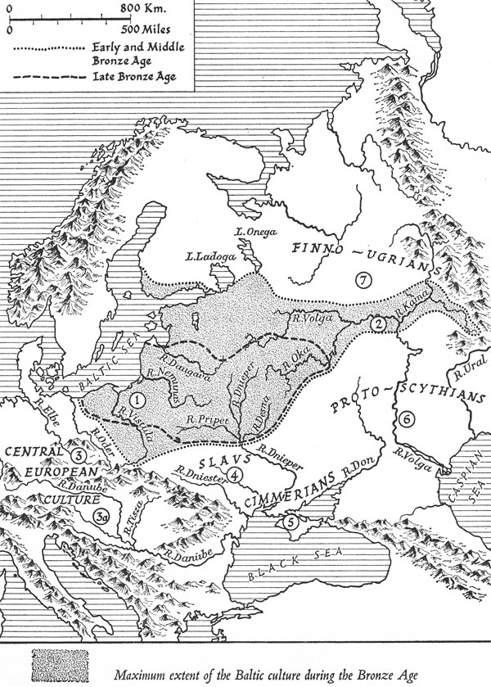
Migrations Of Israel – Chapter 3
Scythians and Saxons
to transform their suzerainty into a real domination, and to extend that domination as far as possible to the north. It will not be denied that this Scythian expansion, hitherto unnoticed, is an historical fact of the first importance." – p. 98.
The Scythians

Slide 51
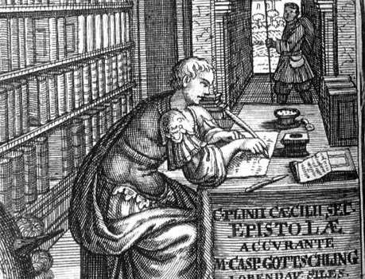
Migrations Of Israel – Chapter 3
Scythians and Saxons
Pliny, the Elder, in his Natural History, asserts, “The name of the Scythians is everywhere changed to that of Sarmatae and Germans.”
Pliny – The Elder

Slide 52
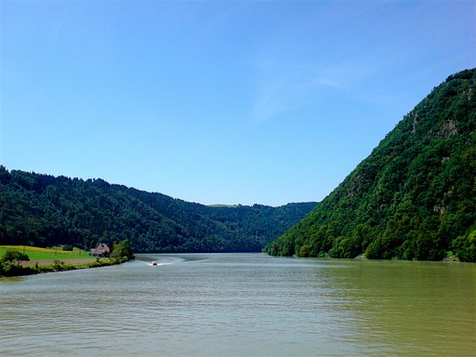
Migrations Of Israel – Chapter 3
Scythians and Saxons
The Tribe of Dan obviously left its name in the Danube River, the Danes of Denmark, the Don River, etc. Scan a map of Europe and you will be struck by the names which can be traced to the Tribes of Israel.
The River Danube

Slide 53
Migrations Of Israel – Chapter 3
Scythians and Saxons
Dan abode in ships and used those ships to travel up the various rivers of Europe. Since, in all probability, the Danites reached these places first, these Danites (today called Danes) named many of the places and rivers.
Dan’s Ships

Slide 54
Migrations Of Israel – Chapter 3
Scythians and Saxons
William Fowler in his book, End Time Revelations, records the migration of the Scythians east of Media into India as well where blond Scythians invaded and stayed for five centuries,
Indo Scythian Kingdom

Slide 55
Migrations Of Israel – Chapter 3
Scythians and Saxons
leaving a tradition among the Jats (Jutes?) and Rajputs that they are of Scythian ancestry. Fowler states, "The Saka were the blond people who carried the Aryan language to India." (p. 100). The similarity of the words Aryan, Aramii, Aramaic (the language spoken by Jesus), and Armenian is self-evident.
The Saka

Slide 56
Migrations Of Israel – Chapter 3
Scythians and Saxons
Strabo, who wrote in the 1st century A.D., says of the Sacae: "Most of the Scythians, beginning from the Caspian Sea are called `Dahae Scythae', and those situated more towards the east,
Strabo

Slide 57
Migrations Of Israel – Chapter 3
Scythians and Saxons
`Massagatae' and `Sacae'; the rest have the common name of `Scythians', but each tribe has its own peculiar name." In rudimentary form, we can trace in Strabo's account the names of Dan, Manasseh, and Isaac, and even Issachar.
Strabo

Slide 58
Migrations Of Israel – Chapter 3
Scythians and Saxons
Of the English people, Bede says, “They had come from the three bravest nations of Germany, namely, from the Saxons, the Angles and the Jutes.
Bede

Slide 59
Migrations Of Israel – Chapter 3
Scythians and Saxons
The Cantuarii (the inhabitants of Kent) are of Jutish origin;

Slide 60
Migrations Of Israel – Chapter 3
Scythians and Saxons
and so are the Victuarii, the tribe which inhabits the Isle of Wight…

Slide 61
Migrations Of Israel – Chapter 3
Scythians and Saxons
The East Saxons, the South Saxons and the West Saxons came from the Saxons, ie, from the country which is now called the country of the Old Saxons

Slide 62
Migrations Of Israel – Chapter 3
Scythians and Saxons
Lastly, the East Angles, the Middle Angles, the Mercians, and the whole population of Northumbria…

Slide 63
Migrations Of Israel – Chapter 3
Scythians and Saxons
are sprung from the Anglii, from a land which is called Angulus…It lies between the territories of the Jutes and those of the Saxons.” - Ecclesiastical History.
Area Now Called Schleswig-Holstein

Slide 64
Migrations Of Israel – Chapter 3
So, here is the historical progression of names: Ishak, Sacae, Scythians, Sarmatians, Germans (Saxons, Angles, and Jutes), English.

Slide 65
Migrations Of Israel – Chapter 3
Celts, Cimmerians and Gaels
The Cimmerians or Celts have also been known as the Keltae, Geltae, Galatae, Galatians, Goidels, Gauls and Gaels. Where did these names come from? The Cimmerians in Armenia were later joined from the southeast by westward-advancing Scythians from Medo-Persia--i.e. Israelites from around Samaria (taken in the second captivity).
The Geltae

Slide 66
Migrations Of Israel – Chapter 3
Celts, Cimmerians and Gaels
However, the Cimmerians were first established as those people who had been carried away in Israel's first Assyrian captivity, known as the "Galilean Captivity," from the northern and eastern regions of the Northern Kingdom--the lands of GALILEE and GILEAD!

Slide 67
Migrations Of Israel – Chapter 3
Celts, Cimmerians and Gaels
(There was a practice of attaching "gilead" as a suffix to places, e.g. Jabesh-gilead and Ramoth-gilead.) In the Trans-Jordan area was also the tribe of GAD.

Slide 68
Migrations Of Israel – Chapter 3
Celts, Cimmerians and Gaels
Just to the east of the Sea of Galilee we still find the GOLAN Heights. The Hebrew Golan means "their captivity" and comes from the word Golah, meaning "captive" or "exile" (Enhanced Strong's Lexicon).

Slide 69
Migrations Of Israel – Chapter 3
Celts, Cimmerians and Gaels
Arthur Spier, Jewish author of A Comprehensive Hebrew Calendar, says that "Golah" referred to those Israelite "communities living beyond the confines of Israel" (p. 62). Galilee, Gilead, Gad, Golan and Golah are all possible etymological roots for Galatae, Goidels or Gauls--the Celtic people!

Slide 70
Migrations Of Israel – Chapter 3
Celts, Cimmerians and Gaels
Remember too that in Spain these people were Celtiberians or just Iberians--as the Israelites living just north of Armenia were also called. Iber-ia is "land of Iber."

Slide 71
Migrations Of Israel – Chapter 3
Celts, Cimmerians and Gaels
Based on what we now know of these people, we can easily see that "Iber" is almost identical with "Eber" or "Heber"--that is, "Hebrew,"
Iberia

Slide 72
Migrations Of Israel – Chapter 3
Celts, Cimmerians and Gaels
which sounds very close to "Ibheriu," the ancient name of Ireland (Heb. Ivri = ancient Gaelic Iveriu). The "Emerald Isle" was also known as Ivernia, Hibernia, Iberon, Ierne, Erin, Eire, Ire-land.
The Emerald Isle

Slide 73
Migrations Of Israel – Chapter 3
Celts, Cimmerians and Gaels
Immediately west of northern Scotland, the Hebrews probably gave their name to the islands called the Hebrides
The Hebrides

Slide 74
Migrations Of Israel – Chapter 3
Celts, Cimmerians and Gaels
In northeast Spain, the Ebro River was most likely named after them. It is probable that Israelite mariners brought the name Hebrew to the Iberian Peninsula.
The River Ebro

Slide 75
Migrations Of Israel – Chapter 3
Celts, Cimmerians and Gaels
And, since the northern Danites dwelling near the Phoenicians lived in the region of Galilee, they may also have brought such Celtic names as Galacia (northwestern Spain) and Portugal ("Port of the Gaels").
Galicia

Slide 76
Migrations Of Israel – Chapter 3
Celts, Cimmerians and Gaels
These names may also have been brought by the transcontinental Celts.
Celtic Settlements In Pink And Yellow

Slide 77
Migrations Of Israel – Chapter 3
Celts, Cimmerians and Gaels
“Israel’s Post-Captivity Names,” from America and Britain in Prophecy, by Raymond F. McNair.
Raymond F. McNair

Slide 78
Migrations Of Israel – Chapter 3
Goths, Visigoths, Ostrogoths
The word Goth derives from the word Getae, which we have encountered as a suffix of Massagetae. Visigoth means West Goth and Ostrogoth means East Goth.
Notes:
Ostrogoths of Italy

Slide 79
Migrations Of Israel – Chapter 3
Goths, Visigoths, Ostrogoths
What is the origin of the Goths?
Notes:
Ostrogoths of Italy

Slide 80
Migrations Of Israel – Chapter 3
Goths, Visigoths, Ostrogoths
Paul Siding begins his history of Scandinavia by saying, "The present inhabitants of Denmark, as well as of Norway and Sweden, are successors of the enormous Gothic tribe formerly dwelling round about the Black Sea" (page 19, Scandinavian Races).
Notes:
Ostrogoths of Italy

Slide 81
Migrations Of Israel – Chapter 3
Goths, Visigoths, Ostrogoths
Notice that both the Svear and the Goths came from the area of the Black Sea. At the mouth of the Danube on the western shore is the area of Getae and Dacia in Roman times.
Notes:
Ostrogoths of Italy

Slide 82
Migrations Of Israel – Chapter 3
Goths, Visigoths, Ostrogoths
According to Procopius, who wrote his history in the fifth century, Romans "say that the Goths are of the Getic race" (Book V.xxiv,30).
Notes:
Ostrogoths of Italy

Slide 83
Migrations Of Israel – Chapter 3
Goths, Visigoths, Ostrogoths
The Getae are mentioned in the history of Herodotus (fifth century B.C.). In the translation by George Rawlinson, his brother Sir Henry gives this footnote: "The identity of the Getae with the Goths of later times is more than a plausible conjecture. It may be regarded as historically certain" (Vol.III, page 84, 1862 edition).
Herodotus
Notes:
Ostrogoths of Italy

Slide 84
Migrations Of Israel – Chapter 3
Goths, Visigoths, Ostrogoths
Jordanes, the best known Gothic historian, always speaks of the Getae and Goths as one people. He also calls them "Scythae."
Notes:
Ostrogoths of Italy

Slide 85
Migrations Of Israel – Chapter 3
Goths, Visigoths, Ostrogoths
We find more evidence in other historical accounts. For example, "The Pictish Chronicle declares that the Scythians and Goths had a common origin" (page 216, The Races of Ireland and Scotland by W. C. Mackenzie).
Notes:
Ostrogoths of Italy

Slide 86
Migrations Of Israel – Chapter 3
Goths, Visigoths, Ostrogoths
The evidence also indicates that the Getae were the same kind of people as the Dacians. They both spoke the same language according to Strabo (7.3.13). Pliny says that the Getae were called Dacians by the Romans (Book IV, xxi, 80).
A Dacian Soldier
Notes:
Ostrogoths of Italy

Slide 87
Migrations Of Israel – Chapter 3
Goths, Visigoths, Ostrogoths
Duchesne, who collected the Norman chronicles in the seventeenth century, has no doubt whatever that the Normans were Dacians and consistently calls them by that name in his preface.
André Duchesne
Notes:
Ostrogoths of Italy

Slide 88
Migrations Of Israel – Chapter 3
Goths, Visigoths, Ostrogoths
Dudo, who wrote the earliest history of the Normans in the tenth century, also had no doubt that they came from Scythia beyond the Danube. He also said they were Dacians.
Scythia
Notes:
Ostrogoths of Italy

Slide 89
Migrations Of Israel – Chapter 3
Goths, Visigoths, Ostrogoths
Uncovering Scandinavian Roots, by Robert C. Boraker.
Scythia
Notes:
Ostrogoths of Italy

Slide 90
Migrations Of Israel – Chapter 3
Goths, Visigoths, Ostrogoths
What about the Teuts, or Teutons?
Teutonic Knights
Notes:
Ostrogoths of Italy

Slide 91
Migrations Of Israel – Chapter 3
Goths, Visigoths, Ostrogoths
At the time the Teutes/Teutons started to be mentioned in documents and books, Teuste/Tjust saw several settlements abandoned, land grow wild again without any shown signs of resettlements within the nearest areas.
Notes:
Ostrogoths of Italy

Slide 92
Migrations Of Israel – Chapter 3
Goths, Visigoths, Ostrogoths
After 200 BC the culture around the Baltic Sea became more or less alike each other. This seems to be the case from Bornholm, West-Prussia, Eastern Pommern to Schlesien as in other areas where the East-Germanic tribes had settled.
Notes:
Ostrogoths of Italy

Slide 93
Migrations Of Israel – Chapter 3
Goths, Visigoths, Ostrogoths
To these tribes belonged the Goths, the Burgunds, the Vandals and other.
Blue Line: Migrations Of The Vandals
Notes:
Ostrogoths of Italy

Slide 94
Migrations Of Israel – Chapter 3
Goths, Visigoths, Ostrogoths
It's during this time, according to some, that the 'Asa-gudar' Norse Gods came wandering up to southern Scandinavia. It's been presumed by some that the 'Asar' (pluralis) were some Gothic God statues,
Thor
Notes:
Ostrogoths of Italy

Slide 95
Migrations Of Israel – Chapter 3
Goths, Visigoths, Ostrogoths
… believed to be the Amals Dynasty's Ancestors among the Gods the Goths who arrived came from the Black Sea region of the Balkan Peninsula and up to Crimea.
Balkan Peninsula
Notes:
Ostrogoths of Italy

Slide 96
Migrations Of Israel – Chapter 3
Goths, Visigoths, Ostrogoths
TEUTONIC TRIBES AND GEATA/GETAE/GOTHS, Johansson Inger E, Gothenburg, October 2005.
Balkan Peninsula
Notes:
Ostrogoths of Italy

Slide 97
Migrations Of Israel – Chapter 3
Goths, Visigoths, Ostrogoths
Recalling that these Israelites had adopted pagan gods and rituals, they carried these traditions with them until they were Christianized.
Golden calves erected by Jeroboam
Notes:
Ostrogoths of Italy

Slide 98
Migrations Of Israel – Chapter 3
Covered Wagons
Ukrainian and Polish archaeologists excavated an intact tomb of an ancient Scythian nobleman near Ryzanovka, Ukraine, 145 km (90 mi) from the capital, Kiev, in the summer of 1996.
Ryzanovka Tomb
Notes:
The Polish-Ukrainian archaeological research
Conducted on the Great Ryzhanovka Kurgan in Ukraine
From 1995 to 1998 excavations were conducted in the Great Ryzhanovka Kurgan in the village of Ryzhanovka in Ukraine (150 km south of Kiev). Among many things, the excavations yielded a sensational discovery of the unlooted tomb of the Scythian Chieftain ("the Prince"), which attracted worldwide interest among several scientific circles and the media. Great interest was portrayed by the New York Times, the New York “Archaeology” and National Geographic magazine as numerous reports and press articles were published commenting on the details of the discovery. The excavations in Ryzhanovka were conducted by the "Polish-Ukrainian Archaeological Expedition" headed by Jan Chochorowski and Sergei Skoryi. The expedition was organized by the power of an agreement signed between the Jagiellonian University’s Institute of Archaeology and the National Ukrainian Academy of Sciences in 1995. This program is currently carried out and shall be concluded in the year 2000 with a publication of a monograph containing the summary of the results of the studies. An exhibition on the discoveries recently opened in the Archaeological Museum of Kraków under the title "Tutankhamen of the Ukrainian Steppe", indeed a result of the effective cooperation between the archaeologists from Kraków and Kiev.
Significant interest in the venture was quite evident as the authorities of Kraków, Malopolska Province and the Ministry of Culture all participated in the opening of the exhibition. Delegations from the leading archaeological institutions of Ukraine and Russia such as the National Ukrainian Academy of Sciences, Ermitage Museum of St. Petersburg and Archaeological Museum in Odessa, headed by Piotr Toloczka, Vice President of the National Ukrainian Academy of Sciences and Member of the Ukrainian Parliament were also among the major participants.
The co-operation between the Jagiellonian University Institute of Archaeology with its Ukrainian partners has not been limited to the research in Ryzhanovka. The overall cooperation already resulted in a great archaeological exhibition "The Nomad of Ukrainian", an exhibition held from 1996 to 1997 in the Silesian Museum in Katowice and co-organized by the Silesian Museum and its partners from Kiev. The exhibition won the great prize in the national contest for the most important event of the year in Poland.
In 1998, the Jagiellonian Institute of Archaeology in cooperation with the Museum of Archaeology in Odessa and the Conservator's Office for the Odessa Oblast launched excavations in a complex of ancient sites (from the fifth to the second century BC) which included the ruins of a settlement site and a big necropolis in Koshary near Odessa on the Black Sea.
The Great Ryzhanovka Kurgan
(the village of Ryzhanovka, Zvinogrodok region, Czerkassy Oblast)
In the light of Polish-Ukrainian research conducted from 1995 to 1998
The Great Ryzhanovka Kurgan became known mankind as early as the end of the 19th century, owing to the discoveries made by Polish researchers. In 1884, Julian Talko-Hryncewicz, a young medical doctor and anthropologist, and later Jagiellonian University professor initiated excavations in that site. In 1887 after an accidental discovery of an underground tomb in the N-W side of the kurgan, Godfryd Ossowski, an archaeologist and geologist conducted studies. The catacomb grave, thus far notoriously looted by the local peasants, was uncovered yielding a lavishly equipped grave of a young woman, a Scythian princess. The discovery was a representative of the nomadic peoples of the Scythians occupying the Black Sea areas from the seventh century BC to the third century BC. The valuable finds are represented by a collection of almost 500 gold and silver artifacts. Among them are gold ornaments of the princess' ceremonial dress and jewelry. In addition, a set of silver, bronze, and clay Greek vessels were discovered. The most interesting artifacts found are a pair of gold, Greek-style earrings and a silver mug bearing an image of racing animals, all masterpieces made by Greek artists. The findings also included two rings made of gold coins issued by the Greek colony of Pantikapaion (today Kerch on the Crimean peninsula) dating back to the years 330-315 BC.
In 1995 studies on the great Ryzhanovka Kurgan were launched by the Polish-Ukrainian archaeological expedition headed by Jan Chochorowski of the Jagiellonian University Institute of Archaeology and Sergei Skoryi of the Institute of Archaeology of the National Ukrainian Academy of Sciences in Kiev (*). As a result, the female's grave located on the side was uncovered again in 1995. 19th century studies were verified and in 1996 the main male's burial place (discovered the year before) located under the central portion of the kurgan was investigated. Moreover, from 1997 to 1998 the architecture of the Great Kurgan and three other smaller graves in the Ryzhanovka cemetery were studied.
The most important realization among the finds was the research conducted on the main burial place of the Scythian Prince. Her body was placed in the niche grave with an entry shaft to it and a spacious grave chamber (i.e., the burial for which a huge mound was raised in the ancient times). It turned out that the grave had been left intact by the looters. This was the first instance since 1830 when the Kul-Oba Kurgan near Kech was discovered by planned investigation of the central grave in the kurgan of Scythian aristocracy, which had not been previously devastated or looted either by ancient or contemporary "treasure hunters". It dates back to mid third century BC and evidences the final stage of the history of the Scythians who at that time (starting in mid fourth century BC) were being pushed away from the Black Sea Steppes by another wave of Iranian nomads, the Sarmatians.
(*) The works were financed by Jagiellonian University, Foundation for Polish Science, Committee for Scientific Research (KBN), Archaeological Museum of Kraków, and Polish Academy of Arts and Letters.
The Great Ryzhanovka Kurgan - The importance of the discovery
The central tomb of the Great Ryzhanovka Kurgan is the first investigated assemblage of that rank since the discovery of the Kul-Oba Kurgan on the Crimean peninsula in 1830, which survived unlooted. Together with the grave on the side of the Kurgan uncovered at the end of the 19th century, it is an exceptional burial place. Its features of grave architecture, monumental mound and richness of assemblage has been ranked among the elitist groups of kurgans of Scythian aristocracy, commonly referred to as "princely" or "royal". The fact that the two grave chambers remained intact gave the archeologists virtually first opportunity to investigate complete burial customs of that rank. This has a great importance for the understanding of the content and sense of religious behavior of the Scythians, the peoples who played a great historic role and developed a wonderful culture. Unfortunately, not a single written record has been left behind. Silent archaeological finds can "speak" for them in a fuller voice only when such global and comprehensive evaluations of different cult expressions are available. The Great Ryzhanovka Kurgan may become the point of reference for the evaluation of many other grave assemblages of Scythian aristocracy, that were not lucky enough to remain intact and serve as a site for complex studies.
The Great Ryzhanovka Kurgan enveloped Scythian burials which were undoubtedly connected with the nomadic environment of the steppe zone and are part of the civilization occurrences in the Great Steppe. However, the Great Ryzhanovka Kurgan is located outside the steppe (it is the north-easternmost burial site of this rank) in the forest-steppe area inhabited in ancient times by settled farming communities. The nomadic element and the aristocracy politically dominated local peoples but, at the same time, their cultural effects influenced them. We are able, therefore, to follow the fascinating phenomena of changes occurring at a point where two different worlds, the nomadic and settled, represent entirely different civilization models, overlap.
The exceptional significance of the finds in the Great Ryzhanovka Kurgan is also highlighted by their sequence. Thus far, the assemblages of this type (including the grave on the side of the Kurgan discovered by Ossowski) were dated to the second half of the fourth century BC. The study on the chronology of the central grave indicates that it dates back to the second quarter of the third century BC Probably, because of these new datings, many other late Scythian sites need to be also re-dated or reevaluated. It this way, the seeming gap in archaeological finds on the steppe areas of Eastern Europe and its outskirts between late Scythian and early Sarmathian assemblages will be bridged. It seems that despite the defeat of Ateas and the onrush of the Sarmathians and other unfavorable factors, the Scythians continued to exist for still a long time in various regions. The so called "Scythia Minor" in Dobrudza were important participants in the ethnic and cultural situation as well. During the Sarmathian domination, many "small Scythias" existed on the steppe fringes. Among them, hitherto unknown, was "Scythia Minor" operating under the reign of the prince from the Great Ryzhanovka Kurgan.
Professor Jan Chochorowski
Director, Institute of Archaeology, JU

Slide 99
Migrations Of Israel – Chapter 3
Covered Wagons
Jan Chochorowski, the director of the Kraków Institute of Archaeology at Jagiellonian University in Poland, and Serhiy Skory, an archaeologist with the Academy of Sciences in Kiev,

Slide 100
Migrations Of Israel – Chapter 3
Covered Wagons
… unearthed the rare 2300-year-old tomb, which contained the remains of a Scythian chief, his servant, a horse, and many gold, silver, and bronze artifacts.

Slide 101
Migrations Of Israel – Chapter 3
Covered Wagons
The Scythians were a nomadic people who raised horses, cattle, and sheep. According to ancient Greek historians, Scythians traveled in tent-covered wagons, spoke a form of Persian, and fought with short bows and arrows from horseback

Slide 102
Migrations Of Israel – Chapter 3
Covered Wagons
Their empire stretched north of the Black Sea to parts of present-day Ukraine, Russia, and Moldova from the 7th century BC to the 4th century BC.
Encarta Yearbook, Oct. 1996

Slide 103
Migrations Of Israel – Chapter 3
What other people do you know of that were famous for traveling in covered wagons? We Americans called them Pioneers. Little did these Pioneers realize that their ancestors were once called Scythians. Even less did these Pioneers realize that their ancestors were once called ISRAEL!

Slide 104
The Chronicles Of The
Migrations Of The
Twelve Tribes Of Israel
From The Caucasus
Mountains Into Europe
By Pastor Eli James

Slide 105
The End

