Slide 1
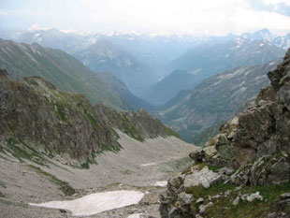
The Chronicles Of The
Migrations Of The
Twelve Tribes Of Israel
From The Caucasus
Mountains Into Europe
By Pastor Eli James

Slide 2
Chapter Two
The House
Of Israel
Rebels
By Pastor Eli James

Slide 3
Migrations Of Israel – Chapter 2
Now that we understand that the expression, “House of Israel,” refers to the Ten Northern Tribes, excluding Judah and Benjamin, we can trace their history and migrations.

Slide 4
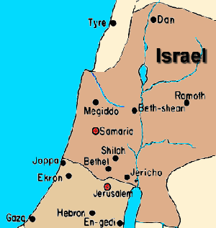
Migrations Of Israel – Chapter 2
The names of these Tribes are Ephraim, Manasseh, Dan, Asher, Zebulun, Reuben, Gad, Naphtali, Issachar, and Simeon. This is the Ten-Nation House of Israel.

Slide 5
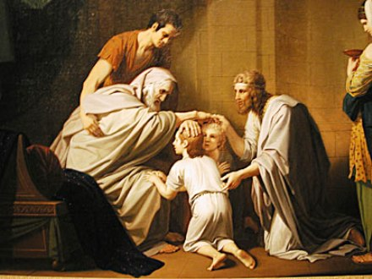
Migrations Of Israel – Chapter 2
Jacob blessing Ephraim
The Bible often refers to this House as “Ephraim,” because Ephraim was the leading tribe; but “Ephraim” is never used to represent the House of Judah..

Slide 6
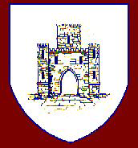
Migrations Of Israel – Chapter 2
The Tribe of Levi had ceased to be a separate Tribe. The Levites were still the main priests, serving all twelve tribes, so some Levites remained with the House of Judah. Other Levites went with the House of Israel.
Banner of the tribe of Levi

Slide 7
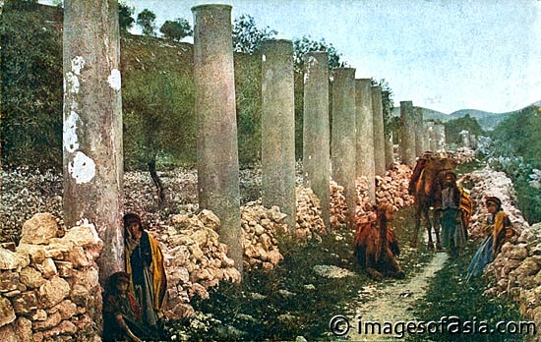
Migrations Of Israel – Chapter 2
I Kings 12 explains how Ahijah’s prophecy to Jeroboam was fulfilled in Samaria. Samaria was the capital city of the Ten Northern Tribes.

Slide 8
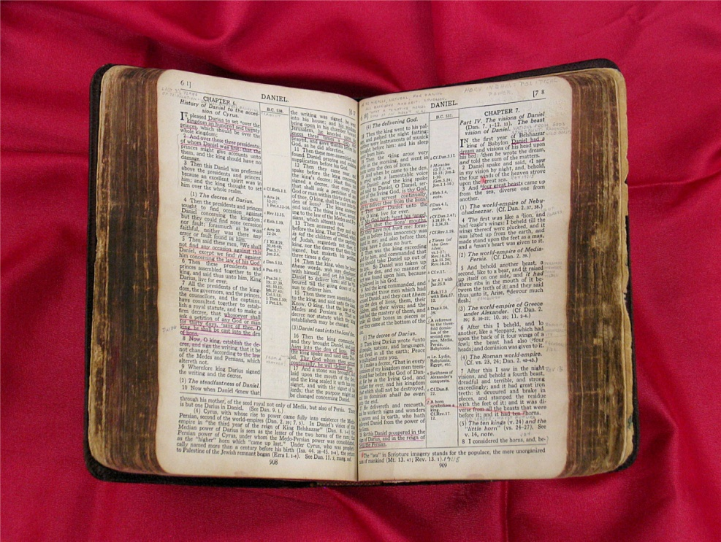
Migrations Of Israel – Chapter 2
The Bible goes into great detail as to how the Ten Northern Tribes became a separate Kingdom.

Slide 9
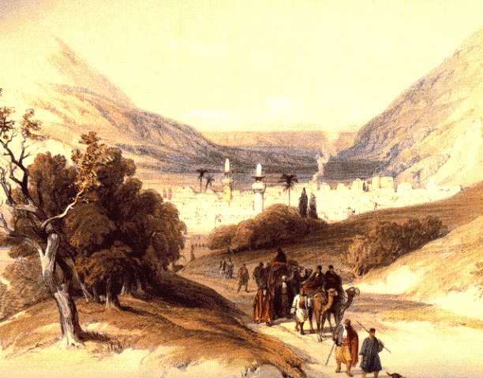
Migrations Of Israel – Chapter 2
I Kings 12
25 Then Jeroboam built Shechem in mount Ephraim, and dwelt therein; and went out from thence, and built Penuel.
26 And Jeroboam said in his heart, Now shall the kingdom return to the house of David:
Shechem

Slide 10
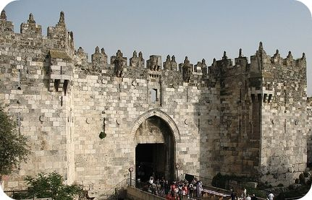
Migrations Of Israel – Chapter 2
I Kings 12
Jerusalem
27 If this people go up to do sacrifice in the house of the LORD at Jerusalem, then shall the heart of this people turn again unto their lord, even unto Rehoboam king of Judah, and they shall kill me, and go again to Rehoboam king of Judah.

Slide 11
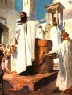
Migrations Of Israel – Chapter 2
I Kings 12
28 Whereupon the king took counsel, and made two calves of gold, and said unto them, It is too much for you to go up to Jerusalem: behold thy gods, O Israel, which brought thee up out of the land of Egypt.

Slide 12
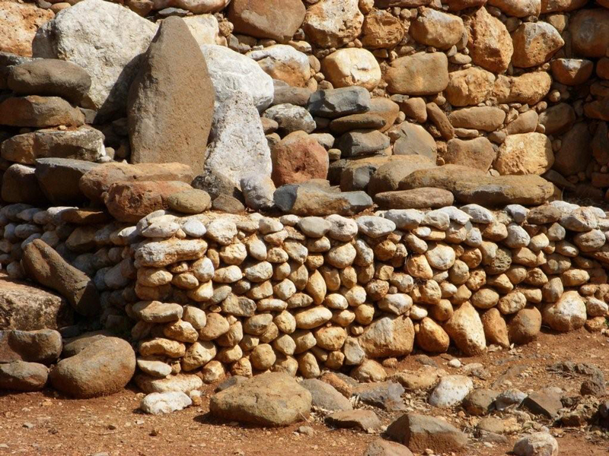
Migrations Of Israel – Chapter 2
I Kings 12
29 And he set the one in Bethel, and the other put he in Dan.
30 And this thing became a sin: for the people went to worship before the one, even unto Dan.
Jeroboam’s Altar In Dan

Slide 13
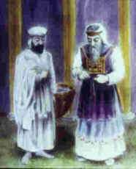
Migrations Of Israel – Chapter 2
I Kings 12
31 And he made an house of high places, and made priests of the lowest of the people, which were not of the sons of Levi.
Levitical Priests

Slide 14
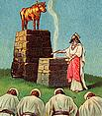
Migrations Of Israel – Chapter 2
I Kings 12
32 And Jeroboam ordained a feast in the eighth month, on the fifteenth day of the month, like unto the feast that is in Judah, and he offered upon the altar. So did he in Bethel, sacrificing unto the calves that he had made: and he placed in Bethel the priests of the high places which he had made.
Jeroboam's idolatry

Slide 15
Migrations Of Israel – Chapter 2
I Kings 12
33 So he offered upon the altar which he had made in Bethel the fifteenth day of the eighth month, even in the month which he had devised of his own heart; and ordained a feast unto the children of Israel: and he offered upon the altar, and burnt incense.

Slide 16
Migrations Of Israel – Chapter 2
I Kings 13:33-35
These verses tell us that the first thing that Jeroboam did was to institute pagan practices instead of Yahweh’s law. He also picked unworthy men as priests.

Slide 17
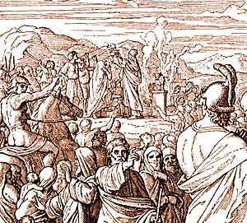
Migrations Of Israel – Chapter 2
I Kings 13:33-35
33 After this thing Jeroboam returned not from his evil way, but made again of the lowest of the people priests of the high places: whosoever would, he consecrated him, and he became one of the priests of the high places.
Jeroboam And Pagan Sacrifices

Slide 18
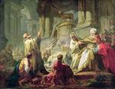
Migrations Of Israel – Chapter 2
I Kings 13:33-35
34 And this thing became sin unto the house of Jeroboam, even to cut it off, and to destroy it from off the face of the earth.
The Sin Of Jeroboam

Slide 19
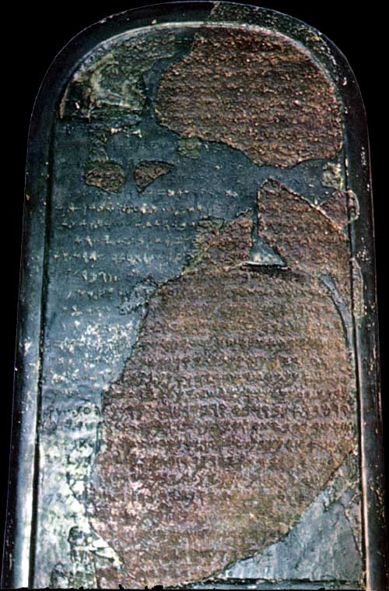
Migrations Of Israel – Chapter 2
Left: The Moabite Stone – mentions King Omri
Unfortunately, this type of disobedience was practiced by all of Jeroboam’s successors.
One of his successors was King Omri. King Omri was known to the Assyrians and other nations as Gomri and Khumri.
Notes:
What is Written on the Stone?
"I am Mesha, son of Chemosh[-yatti], the king of Moab, the Dibonite.
My father (had) reigned over Moab for thirty years, and I reigned
after my father. And I made this high-place for Chemosh in Qarcho . . .
because he has delivered me from all kings, and because he has made me triumph over all my enemies. As for Omri
the king of Israel, and he humbled Moab for many years (days), for Chemosh was angry with his land.
And his son reigned in his place; and he also said, "I will oppress Moab!" In my days he said so.
But I ltriumphed over him and over his house, and Israel has perished; it has perished forever! And Omri took possession of the whole land of Medeba,
and he lived there in his days and half the days of his son (Ahab): forty years.
But Chemosh restored it in my days. And I built Baal Meon, and I built a water reservoir in it. And I built
Qiryaten. And the men of Gad lived in the land of Atarot from ancient times; and the king of Israel
built Atarot for himself, and I fought against the city and captured it. And I killed all the people of
the city as a sacrifice for Chemosh and for Moab. And I brought back the fire-hearth of his uncle from there; and I brought it
before the face of Chemosh in Qerioit, and I made the men of Sharon live there, as well as the men of Maharit.
And Chemosh said to me, "Go, take Nebo from Israel."
And I went in the night and fought against it from the daybreak until midday, and I took it
and I killed the whole population: seven thousand male subjects and aliens, and female subjects, aliens, and servant girls.
For I had devoted them to destruction for (the god) Ashtar Chemosh. And from there I took the
vessels of Yahweh, and I presented them before the face of Chemosh. And the king of Israel had built
Yahaz, and he stayed there throughout his campaign against me; and Chemosh drove him away before my face. And
I took two hundred men of Moab, all first class (warriors), and I led it up to Yahaz. And I have taken it
in order to add it to Dibon. I have built Qarcho, the wall of the woods and the wall of
the citadel; and I have built its gates; and I have built its towers; and
I have built the house of the king; and I have made the double reservoir for the spring in the innermost part of the city.
Now the innermost part of the city had no cistern, in Qarcho, and I said to all the people, "Each one of you shall make
a cistern in his house." And I cut the moat for Qarcho by using Israelite captives.
I have built Aroer, and I constructed the military road in Arnon (valley).
I have built Beth-Bamot, for it had been destroyed. I have built Bezer, for it lay
in ruins. And the men of Dibon stood in battle formation, for all Dibon were in subjection. And I am the king
over the hundreds in the towns which I have added to the land. And I have built
Beth-Medeba and Beth-Diblaten and Beth-Baal-Meon, and I brought there . . .
flocks of the the land. And the House of [Da]vid dwelt in Hauranen, . . .
Chemosh said to me, "Go down, fight against Hauranen!" I went down . . . and Chemosh restored it in my days . .
The Moabite Stone was discovered in 1868 about 20 miles east of the Dead Sea. What is most amazing is that it mentions "Israel," "Yahweh" and the "House of David." It is now in the Louvre Museum in Paris.
Mesha Stele (Moabite Stone) In the Bible it says that Mesha the king of Moab was paying tribute to Israel and that they suddenly stopped: "Mesha, king of Moab rebelled against the king of Israel..." (2 Kings 3:5). Well, Mesha made his own record of this rebellion, and the record has been found. It is known today as "The Mesha Stele" or the more popular designation "The Moabite Stone." It was found in 1868 at Dibon, in Moab. Dibon is located 20 miles east of the Dead Sea. Amazingly enough it was discovered by chance by F.A. Klein, a German missionary who had heard rumors of this stone while visiting the area. It was a bluish basalt stone, about 4 feet high and 2 feet wide, and 14 inches thick, with an inscription from king Mesha. When it was found the Berlin Museum negotiated for it while the French Consulate at Jerusalem offered more money.
The next year some local Arabs, realizing all that was at stake, laboriously hoisted it out of the earth and lit a fire around it, and after pouring cold water on it they chipped away several large pieces which they distributed among a few of them. Later the French re-assembled 669 of the estimated 1100 consonants from the pieces and preserved the inscription. It now remains in the Louvre Museum in Paris.

Slide 20
Migrations Of Israel – Chapter 2
King Khumri was the king that the non-Israelite nations knew best. During the reign of Omri, the House of Israel was known as the House of Omri and these Israelites were called Khumru, or Kimmerians, after King Khumri. The English version of this word is Cimmerians.
King Khumri

Slide 21
Migrations Of Israel – Chapter 2
When it became apparent that the Assyrians were going to invade Israel, a branch of the Khumru people left Israel by sea. They settled in Wales

Slide 22
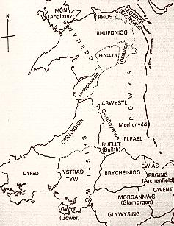
Migrations Of Israel – Chapter 2
The Welsh people still refer to themselves as Khumru today; and the Welsh language is virtually identical to Hebrew, because they brought this language with them directly from Israel.

Slide 23
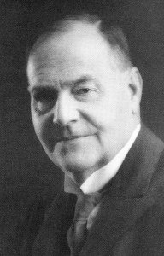
Migrations Of Israel – Chapter 2
This little-known fact is confirmed by many professional linguists, such as Charles Edwards (1675), LGA Roberts (1919), Sir Charles Marston, Professor Stephen Langdon, and many others.
Sir Charles Marston

Slide 24
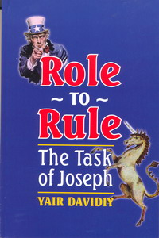
Migrations Of Israel – Chapter 2
From the works of Yair Davidy, a Jewish author who has traced the linguistic connections between Welsh and Hebrew:

Slide 25
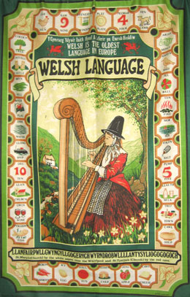
Migrations Of Israel – Chapter 2
A writer who signed his name "Glas" submitted a list of Welsh words with Hebrew origins in 1832. The writer remarked that, But the best proof of the Eastern descent of the ancient British is the close resemblance and connection existing between the Welsh and Hebrew languages, even at this day.

Slide 26
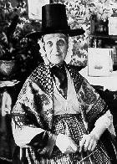
Migrations Of Israel – Chapter 2
As a proof of this we have extracted the following vocabulary of words in both tongues, so closely resembling each other in sound and sense as to leave no doubt whatever on the subject.
A Welsh Lady

Slide 27
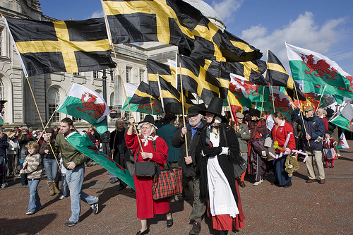
Migrations Of Israel – Chapter 2
Many of these words, it will be found, have been transmitted from the Welsh, through the Anglo-Saxon into our modern English. It would be easy to swell their number.

Slide 28
Migrations Of Israel – Chapter 2
Examples:
Welsh | Meaning | Hebrew | English
Aeth | He went, he is gone | Athah
Aml | Plentiful, ample | Hamale | ample
Ydom | the earth | Adamah

Slide 29
Migrations Of Israel – Chapter 2
Examples:
Welsh | Meaning | Hebrew | English
Awye | air, sky | auor, or | air
bu | it came to pass | bo | be
boten | belly | beten

Slide 30
Migrations Of Israel – Chapter 2
Examples:
Welsh | Meaning | Hebrew | English
brith | bright | barud | bright
cas | hatred | Caas (anger)
dafnu | to drop, or distill by drops | nataph, taph

Slide 31
Migrations Of Israel – Chapter 2
Examples:
Welsh | Meaning | Hebrew | English
Gael hedd | heap of testimony | Galaed
Bagad | A troop cometh | Bagad
Anudon | Without God | Aen Adon

Slide 32
Migrations Of Israel – Chapter 2
One can see in this small sample that many of the words are perfectly identical in the Welsh and Hebrew, with some of these Hebrew words even surviving into English.

Slide 33
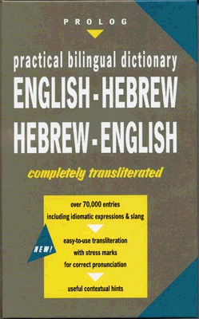
Migrations Of Israel – Chapter 2
In my opinion, fully one quarter of the common English vocabulary in usage today is derived from the Hebrew.

Slide 34
Migrations Of Israel – Chapter 2
“For with stammering lips and ANOTHER TONGUE will he speak to this people.” - Isa. 28:11.

Slide 35
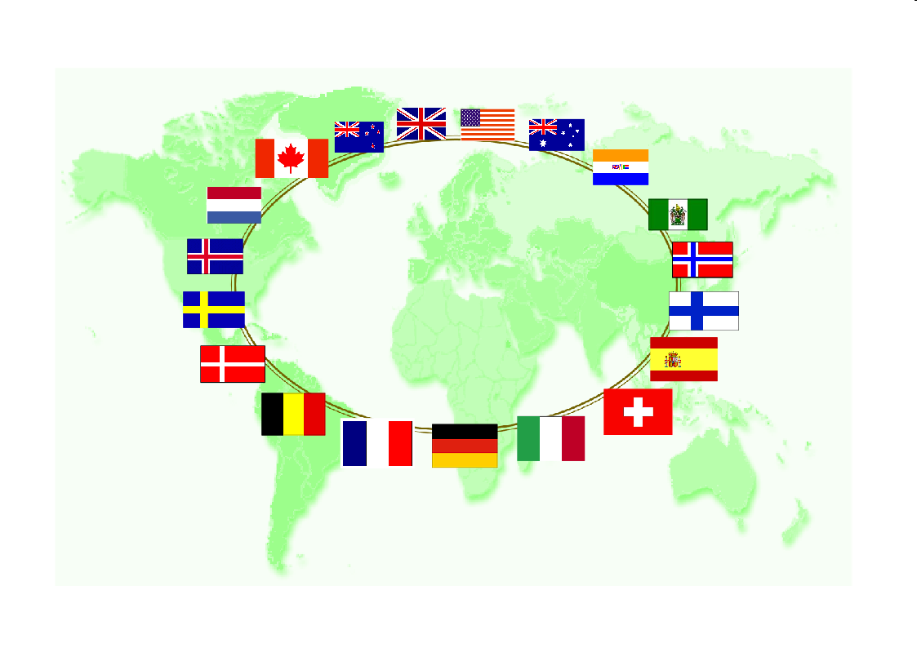
Migrations Of Israel – Chapter 2
Virtually all of the Anglo-Saxon world today speaks English, if not as their first language, then as their second language. This is Yahweh’s doing.

Slide 36
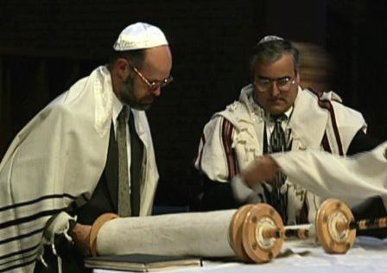
Migrations Of Israel – Chapter 2
The Jewish people had nothing to do with the development of the English language. The common language of the Jewish people is Yiddish.

Slide 37
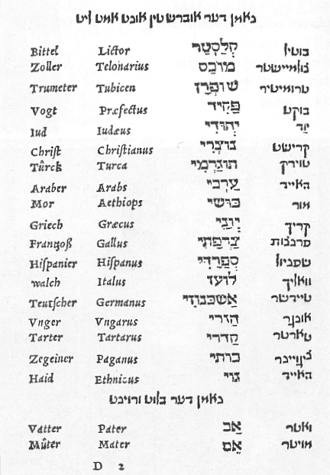
Migrations Of Israel – Chapter 2
Yiddish is primarily German. German is also an Israelite language, as I will show later. The Jews, as a non-Israelite people, speak OUR languages, not vice-versa, which proves that the Anglo-Saxon Israelites are the leaders of civilization.

Slide 38
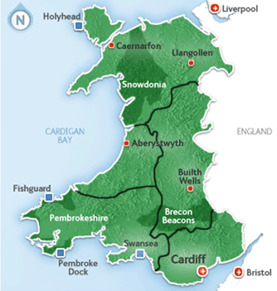
Migrations Of Israel – Chapter 2
But Yahweh has seen fit to preserve Hebrew in the Welsh language.

Slide 39
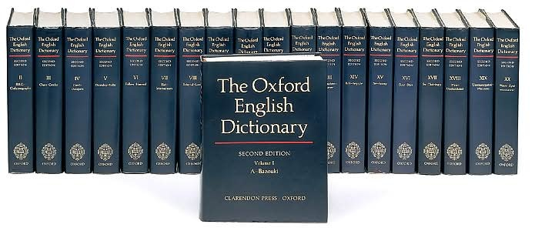
Migrations Of Israel – Chapter 2
From an article entitled, “Was English Derived From Hebrew?”:
The idiomatic likenesses between ENGLISH and HEBREW were noticed by Tyndale when he translated the scriptures. He said, "The properties of the HEBREW tongue agreeth a thousand times more with the ENGLISH than with the LATIN.

Slide 40
Migrations Of Israel – Chapter 2
From an article entitled, “Was English Derived From Hebrew?”:
The manner of speaking is in both one, so that, in a thousand places, there needest not but to translate the HEBREW word for word." Canon Lyson found 5000 HEBREW ROOTS in the ENGLISH language (Our British Ancestors);

Slide 41
Migrations Of Israel – Chapter 2
From an article entitled, “Was English Derived From Hebrew?”:
other authorities put the figure still higher. The Welsh is so much like the Hebrew that the SAME SYNTAX may be used for both. The old SAXON language is said to be eighty percent HEBREW.

Slide 42
Migrations Of Israel – Chapter 2
From an article entitled, “Was English Derived From Hebrew?”:
The oldest poems in the CELTIC language are in the "Book of the Dun Cow" (1106 A.D.) and are "not unlike the poetical passages in the Old Testament" (5:626, Encyc. Brit. 11th).

Slide 43
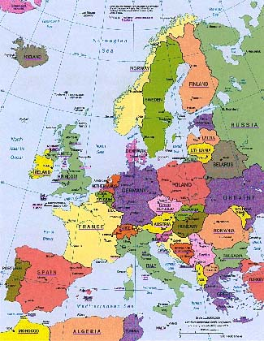
Migrations Of Israel – Chapter 2
Later, we will find that the other Anglo-Saxon languages have remarkable affinities to Hebrew as well. This means that the current academic separation of Hebrew from the “Indo-Aryan” language group is defective.
Europe

Slide 44
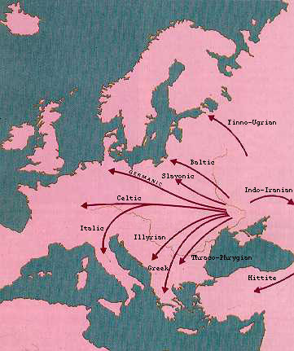
Migrations Of Israel – Chapter 2
The Israelites clearly brought their language with them as they migrated.

Slide 45
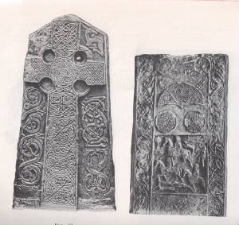
Migrations Of Israel – Chapter 2
Since Welsh and Hebrew are virtually identical, there is no doubt that the Welsh people are Hebrew Israelites. Currently, there is a revival of Welsh and Gaelic occurring in the British Isles. Few of these people realize they are speaking Hebrew
Typical Welsh & Gaelic Stones

Slide 46
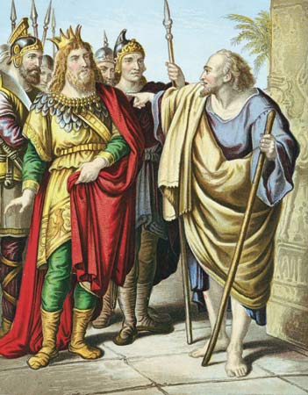
Migrations Of Israel – Chapter 2
Ahab and Jezebel
King Omri’s son was King Ahab. Ahab is more famous to us because he married Jezebel, the daughter of a Sidonian king. The Bible devotes many pages to their story.
King Ahab

Slide 47
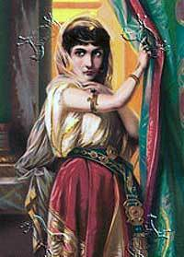
Migrations Of Israel – Chapter 2
Ahab and Jezebel
Jezebel replaced the Israelite priests with the pagan priests from her native country.

Slide 48
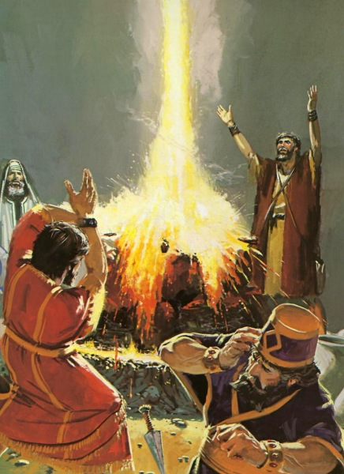
Migrations Of Israel – Chapter 2
Ahab and Jezebel
It was the prophet, Elijah, who challenged these priests to a “duel of the gods.” Yahweh won easily! All of these Baal priests were destroyed by Yahweh,

Slide 49
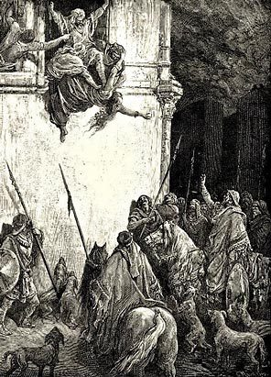
Migrations Of Israel – Chapter 2
Ahab and Jezebel
.. and so was Jezebel, who was thrown out of a window to her death.

Slide 50
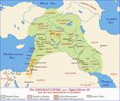
Migrations Of Israel – Chapter 2
Ahab and Jezebel
Life in the House of Israel continued this way, king after king, until Yahweh decided that he had had enough. Thus, He used Assyria to punish the House of Israel for their sins.
The Assyrian Empire

Slide 51
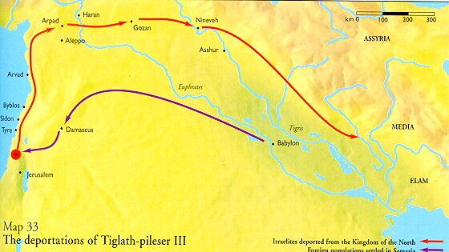
Migrations Of Israel – Chapter 2
Ahab and Jezebel
The first deportations of the Northern Tribes began in the year 745 BC. In 745 B.C., Tiglath-Pileser, king of Assyria, began the first invasion against Israel in the reign of Menahem (2 Ki.15:19-20).

Slide 52
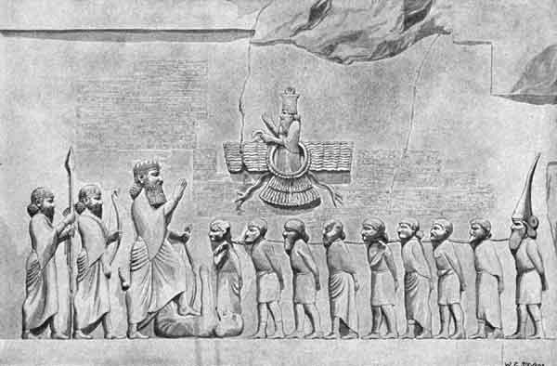
Migrations Of Israel – Chapter 2
Ahab and Jezebel
In this year, the Assyrians captured and deported half the Tribe of Manasseh, the half which lived on the eastern side of the Jordan River. This event began the process of deporting the Ten Northern Tribes away from Palestine,

Slide 53
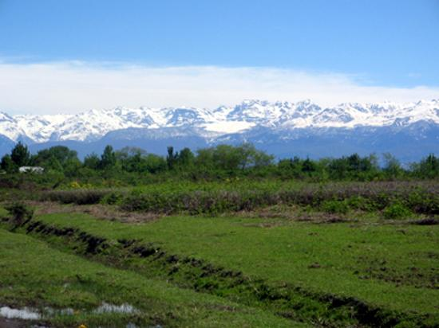
Migrations Of Israel – Chapter 2
Ahab and Jezebel
In this year, the Assyrians captured and deported half the Tribe of Manasseh, the half which lived on the eastern side of the Jordan River. This event began the process of deporting the Ten Northern Tribes away from Palestine, who were then resettled in northern Media, just south of the Caucasus Mountain Range.
Northern Media

Slide 54
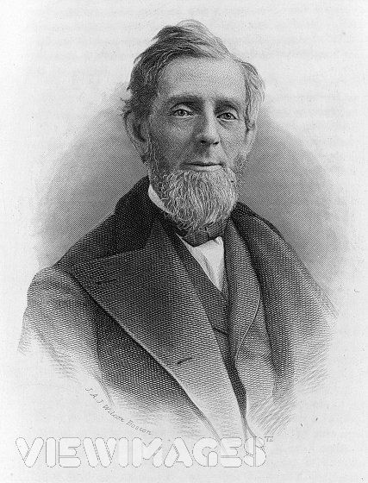
Migrations Of Israel – Chapter 2
Putnam's Dictionary Of Events, copyright 1927, page 6, states, "745, Accession of Tiglath-pileser III of Assyria, who wages war against Chaldea, Syria, and the kingdom of Israel." (Tiglath-Pileser is called "Pul" in the Bible -- 2 Kings 15:19; 1 Chr.5:26).
George Palmer Putnam

Slide 55
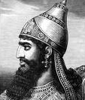
Migrations Of Israel – Chapter 2
These deportations, under various Assyrian kings, continued until about 712 BC. One other very important fact about these deportations is that King Sennacharib of Assyria later attacked and captured all of the cities of Judah,
King Sennacharib

Slide 56
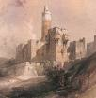
Migrations Of Israel – Chapter 2
except for the city of Jerusalem itself. This story is told in Isaiah 36 and 37. Sennacherib would have defeated the City had not an angel of Yahweh intervened by slaughtering 185,000 of Sennacherib’s men. (Isa. 37:36.)
Jerusalem

Slide 57
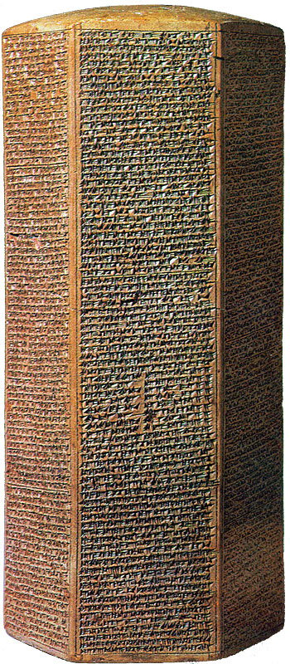
Migrations Of Israel – Chapter 2
The Taylor Prism, which resides in London’s British Museum, states, “As for Hezekiah, the Judahite who did not submit to my yoke, forty-eight of his strong walled cities, as well as the small cities of their neighborhood…by escalade and bringing up siege engines, by attacking and storming on foot, by mines, tunnels and breaches, I took 200,150 people, great and small…”

Slide 58
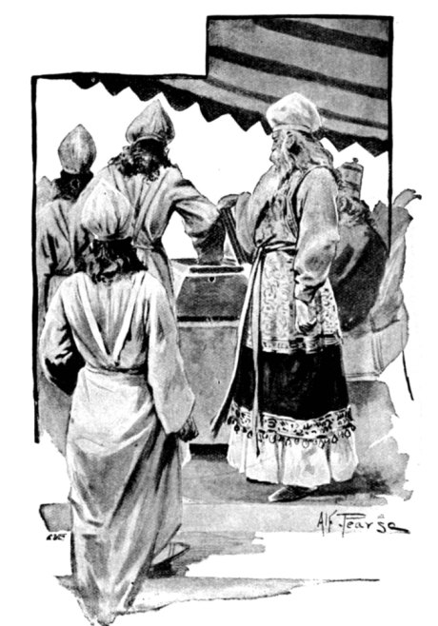
Migrations Of Israel – Chapter 2
Sennacherib also refers to a people called the Mannai, which are probably the Tribe of Manasseh. This archeological evidence confirms that members of all twelve tribes were deported from Palestine and placed in Media, a large area just south of the Caucasus Mountains.
Tribe of Manasseh

Slide 59
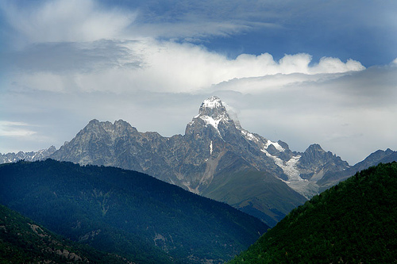
Migrations Of Israel – Chapter 2
History books will tell you that the Caucasian people came from the Caucasus Mountains around 700 BC, but rarely do they pursue the previous history of the Caucasian people to their TRUE SOURCE: the Israelites of Media!!!

Slide 60
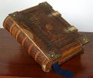
Migrations Of Israel – Chapter 2
There are two reasons for this:
1.) Most academic historians hate the Bible and want to refute its history. Unfortunately for them, modern archeology confirms the vast majority of the Bible’s history. Having no interest in verifying what the Bible teaches, they simply ignore it.

Slide 61
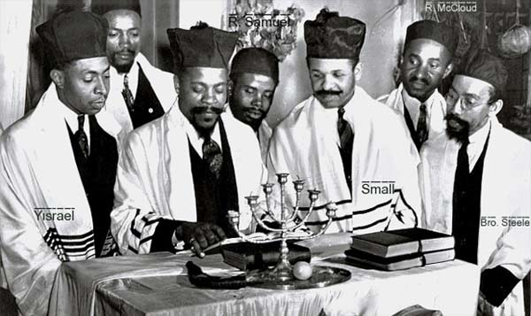
Migrations Of Israel – Chapter 2
There are two reasons for this:
2.) The rabbis of Judaism teach that the House of Israel disappeared into oblivion, never to be heard from again!

Slide 62
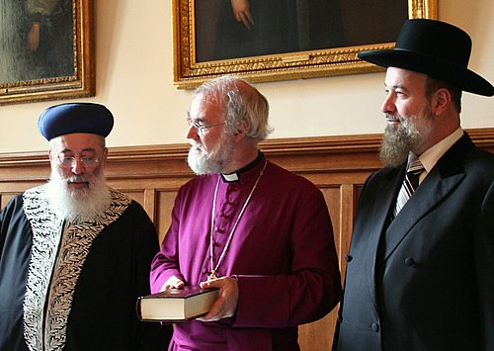
Migrations Of Israel – Chapter 2
There are two reasons for this:
Archbishop Rowan Williams and Chief Rabbis
As you can now see, THEY ARE BOTH WRONG!!!

Slide 63
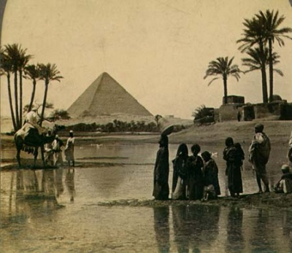
Migrations Of Israel – Chapter 2
The Seven Times Prophecy - Leviticus 26:13-46
13 I am the LORD your God, which brought you forth out of the land of Egypt, that ye should not be their bondmen; and I have broken the bands of your yoke, and made you go upright.
14 But if ye will not hearken unto me, and will not do all these commandments;

Slide 64
Migrations Of Israel – Chapter 2
The Seven Times Prophecy - Leviticus 26:13-46
15 And if ye shall despise my statutes, or if your soul abhor my judgments, so that ye will not do all my commandments, but that ye break my covenant:
23 And if ye will not be reformed by me by these things, but will walk contrary unto me;
24 Then will I also walk contrary unto you, and will punish you yet seven times for your sins.

Slide 65
Migrations Of Israel – Chapter 2
The Seven Times Prophecy - Leviticus 26:13-46
27 And if ye will not for all this hearken unto me, but walk contrary unto me;
28 Then I will walk contrary unto you also in fury; and I, even I, will chastise you seven times for your sins.
33 And I will scatter you among the heathen, and will draw out a sword after you: and your land shall be desolate, and your cities waste.

Slide 66
Migrations Of Israel – Chapter 2
The Seven Times Prophecy - Leviticus 26:13-46
43 The land also shall be left of them, and shall enjoy her sabbaths, while she lieth desolate without them: and they shall accept of the punishment of their iniquity: because, even because they despised my judgments, and because their soul abhorred my statutes.
44 And yet for all that, when they be in the land of their enemies, I will not cast them away, neither will I abhor them, to destroy them utterly, and to break my covenant with them: for I am the LORD their God.

Slide 67
Migrations Of Israel – Chapter 2
The Seven Times Prophecy - Leviticus 26:13-46
45 But I will for their sakes remember the covenant of their ancestors, whom I brought forth out of the land of Egypt in the sight of the heathen, that I might be their God: I am the LORD.
46 These are the statutes and judgments and laws, which the LORD made between him and the children of Israel in mount Sinai by the hand of Moses.

Slide 68
Migrations Of Israel – Chapter 2
The Seven Times Prophecy
Before the Ten Northern Tribes rebelled, Yahweh had issued this warning that, if the Israelites do not obey His Laws, He will cast them away for a period of SEVEN TIMES!

Slide 69
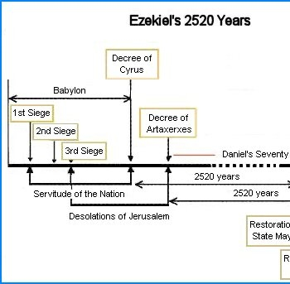
Migrations Of Israel – Chapter 2
What does this mean? Various Bible scholars have concluded from other fulfilled Scriptural prophecies that a “time” equals 360 prophetic years. Thus “7 times” = 7 * 360 = 2520 years.

Slide 70
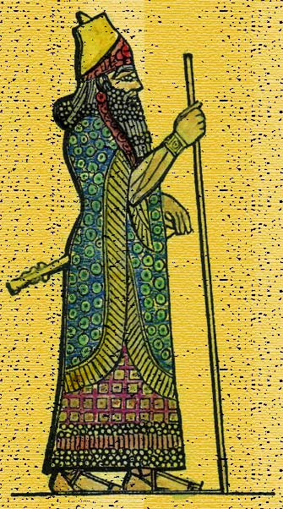
Migrations Of Israel – Chapter 2
Observe very closely and you will see the Divine fulfillment of this prophecy. The deportations of the House of Israel began, as cited earlier, in 745 BC. This is established, historical fact. From 745 B.C. we add 2520 YEARS (Seven Times). Now, 2520 – 745 = 1775. We are very close to the year in which America was founded, aren’t we?
King Sennacherib

Slide 71
Migrations Of Israel – Chapter 2
But, close only counts in horseshoes, right? Wait a minute! There is no such thing as a YEAR ZERO!! The BC calendar goes directly from 1 BC to 1AD! Unlike regular math, there is no zero!
Time Calculator

Slide 72
Migrations Of Israel – Chapter 2
Therefore, in order to account for this lack, we have to add 1 year! Guess what? The correct answer is the Year of Our Lord, 1776, the very year the American Declaration of Independence was signed.

Slide 73
Migrations Of Israel – Chapter 2
America, the world’s FIRST CHRISTIAN REPUBLIC (not a monarchy like Britain) was founded SEVEN TIMES AFTER THE FIRST DEPORTATION in 745 BC! Imagine that! What a coincidence! Not in God’s Plan, it isn’t!

Slide 74
Migrations Of Israel – Chapter 2
There are no coincidences with Yahweh. His hand guides all of prophecy and history. Since all of the European nations were founded by Israelites, and
representatives of all of these nations migrated to America, America is the regathering place of ALL TWELVE TRIBES.

Slide 75
Migrations Of Israel – Chapter 2
This amazing prophecy was fulfilled by the United States of America, the USA, which is destined to be the future headquarters of God’s Kingdom, the New JerUSAlem, right here on earth!
Are you now beginning to understand how important it is to correlate these prophecies with the TRUE HISTORY of the Israelite people?

Slide 76
Migrations Of Israel – Chapter 2
The Gog Prophecy of Ezekiel 38:11 states that Gog’s army would attack a land of unwalled villages. This cannot be Palestine or the Israeli State, for the Jewish State is NOT a land of “unwalled villages.”

Slide 77
Migrations Of Israel – Chapter 2
Far from it! In fact, the Jews are building even more walls around their villages as we speak!! But America has always been a land of unwalled villages.

Slide 78
Migrations Of The 12 Tribes Of Israel
End Of Chapter Two
BY PASTOR ELI JAMES
To be continued ………… Chapter Three: Tracing the Migrations From the Iberian Caucasus

