Slide 1
Migrations Of The 12 Tribes Of Israel
Welcome to the Holy Scriptures, children of Israel. The Story begins with King Solomon.
The Most Holy Place
King Solomon’s Temple

Slide 2
Migrations Of The 12 Tribes Of Israel
End Of Introduction
BY PASTOR ELI JAMES
To be continued ………… Chapter One: A House Divided

Slide 3
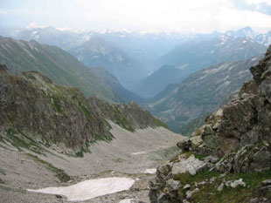
The Chronicles Of The
Migrations Of The
Twelve Tribes Of Israel
From The Caucasus
Mountains Into Europe
By Pastor Eli James

Slide 4
Chapter One
A House Divided
By Pastor Eli James

Slide 5
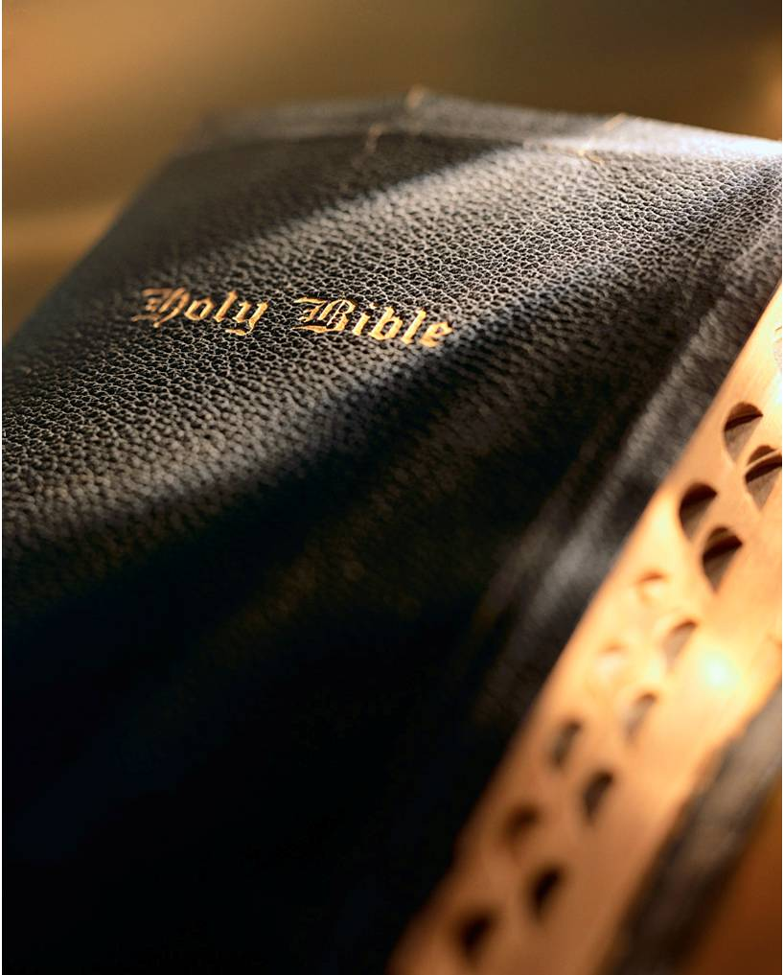
Migrations Of Israel – Chapter 1
I Kings 11:26-42
26 And Jeroboam the son of Nebat, an Ephraimite of Zereda, Solomon’s servant, whose mother’s name was Zeruah, a widow woman, even he lifted up his hand against the king.
27 And this was the cause that he lifted up his hand against the king: Solomon built Millo, and repaired the breaches of the city of David his father.

Slide 6
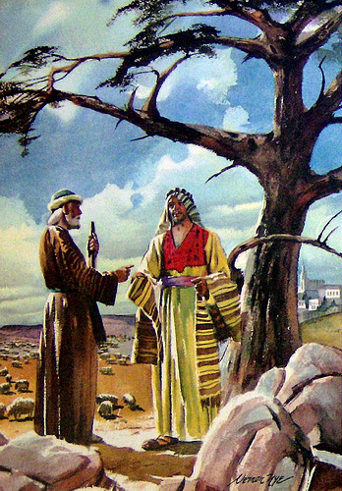
Migrations Of Israel – Chapter 1
I Kings 11:26-42
28 And the man Jeroboam was a mighty man of valor: and Solomon seeing the young man that he was industrious, he made him ruler over all the charge of the house of Joseph.
29 And it came to pass at that time when Jeroboam went out of Jerusalem, that the prophet Ahijah the Shilonite found him in the way; and he had clad himself with a new garment; and they two were alone in the field:

Slide 7
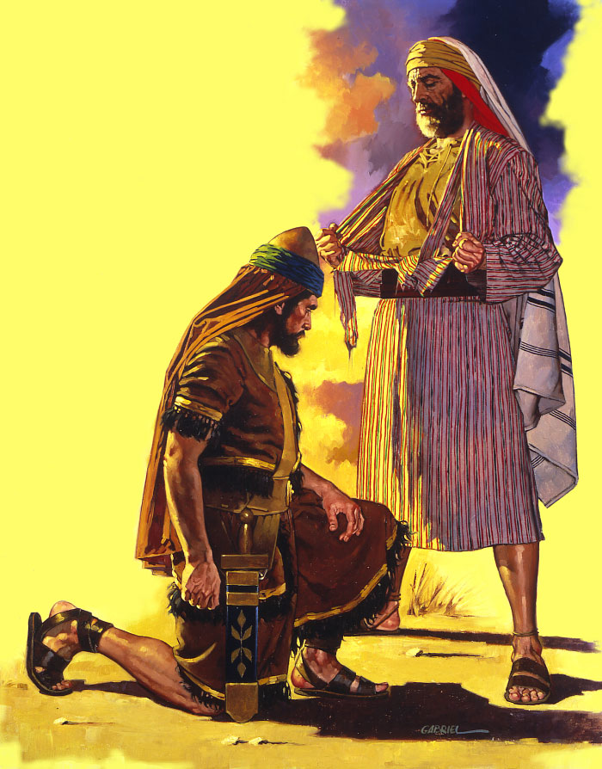
Migrations Of Israel – Chapter 1
I Kings 11:26-42
30 And Ahijah caught the new garment that was on him, and rent it in twelve pieces:
31 And he said to Jeroboam, Take thee ten pieces: for thus saith the LORD, the God of Israel, Behold, I will rend the kingdom out of the hand of Solomon, and will give ten tribes to thee:
The prophet Ahijah rent his garment

Slide 8
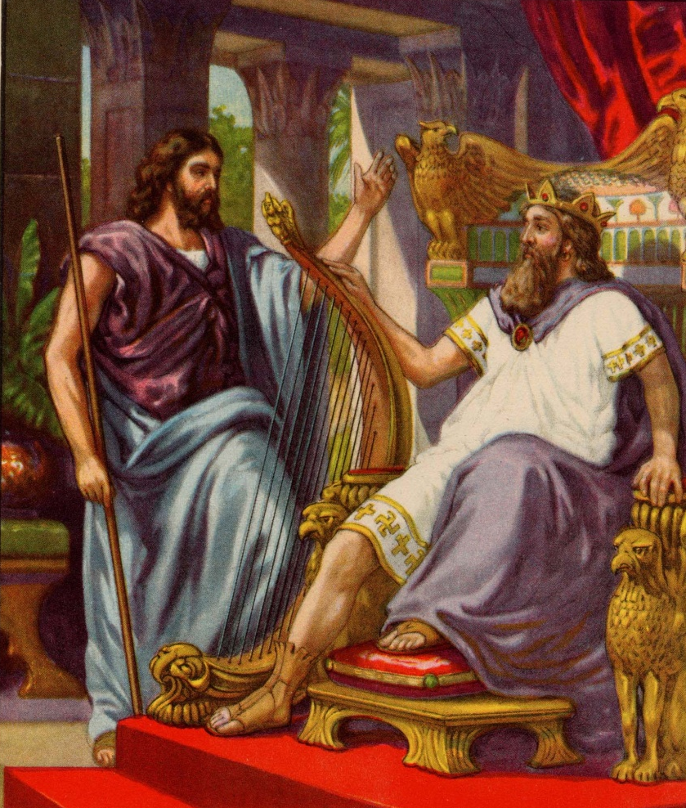
Migrations Of Israel – Chapter 1
I Kings 11:26-42
32 (But he shall have one tribe for my servant David's sake, and for Jerusalem's sake, the city which I have chosen out of all the tribes of Israel:)
King David

Slide 9
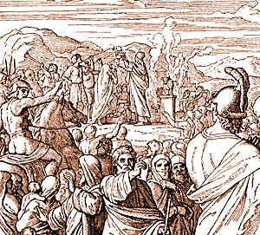
Migrations Of Israel – Chapter 1
I Kings 11:26-42
33 Because that they have forsaken me, and have worshipped Ashtoreth the goddess of the Zidonians, Chemosh the god of the Moabites, and Milcom the god of the children of Ammon, and have not walked in my ways, to do that which is right in mine eyes, and to keep my statutes and my judgments, as did David his father.

Slide 10
Migrations Of Israel – Chapter 1
I Kings 11:26-42
34 Howbeit I will not take the whole kingdom out of his hand: but I will make him prince all the days of his life for David my servant's sake, whom I chose, because he kept my commandments and my statutes:
35 But I will take the kingdom out of his son's hand, and will give it unto thee, even ten tribes.

Slide 11
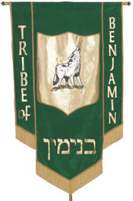
Migrations Of Israel – Chapter 1
I Kings 11:26-42
36 And unto his son will I give one tribe, that David my servant may have a light alway before me in Jerusalem, the city which I have chosen me to put my name there.
37 And I will take thee, and thou shalt reign according to all that thy soul desireth, and shalt be king over Israel

Slide 12
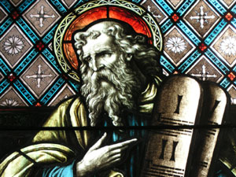
Migrations Of Israel – Chapter 1
I Kings 11:26-42
38 And it shall be, if thou wilt hearken unto all that I command thee, and wilt walk in my ways, and do that is right in my sight, to keep my statutes and my commandments, as David my servant did; that I will be with thee, and build thee a sure house, as I built for David, and will give Israel unto thee.

Slide 13
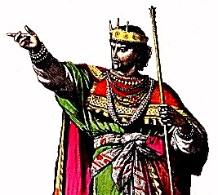
Migrations Of Israel – Chapter 1
I Kings 11:26-42
39 And I will for this afflict the seed of David, but not for ever.
40 Solomon sought therefore to kill Jeroboam. And Jeroboam arose, and fled into Egypt, unto Shishak king of Egypt, and was in Egypt until the death of Solomon.

Slide 14
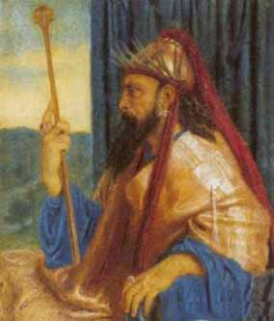
Migrations Of Israel – Chapter 1
I Kings 11:26-42
41 And the rest of the acts of Solomon, and all that he did, and his wisdom, are they not written in the book of the acts of Solomon?
42 And the time that Solomon reigned in Jerusalem over all Israel was forty years.
King Solomon

Slide 15
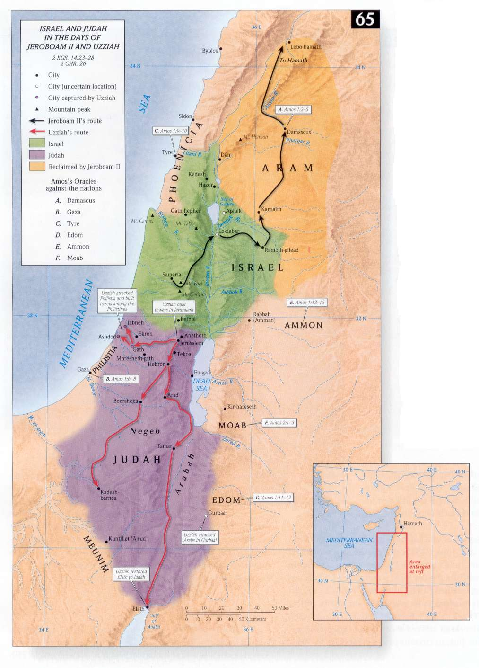
Migrations Of Israel – Chapter 1
Israel
The controversy between Solomon and Jehoboam of Ephraim precipitated the division of All Israel into Two Houses. (The Biblical expression, “All Israel,” always refers to all Twelve Tribes taken as a single nation.)
Judah

Slide 16
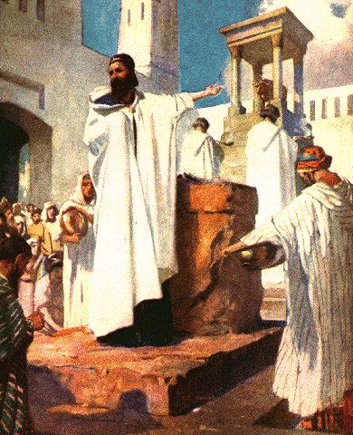
Migrations Of Israel – Chapter 1
Verse 35 tells us that this eventuality is Yahweh’s doing. All of these shortly came to pass, after the prophecy was given.
Jehoboam

Slide 17
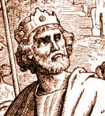
Migrations Of Israel – Chapter 1
I Kings 12 tells the story of Rehoboam, son of Solomon. But Rehoboam refused to accept the elders and advisors that he had inherited from Solomon.
Rehoboam

Slide 18
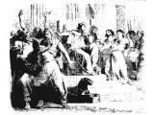
Migrations Of Israel – Chapter 1
Instead, he chose a bunch of “Whiz Kids,” who made new regulations, contrary to God’s Law.
Rehoboam with advisers

Slide 19
Migrations Of Israel – Chapter 1
In order to implement his new policies, he laid a heavy burden of taxation upon All Israel. But these taxes did not benefit the Ten Tribes in the north. They only benefited Rehoboam, his administration and palace.
The Palace

Slide 20
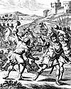
Migrations Of Israel – Chapter 1
When Rehoboam sent a tax collector, Adoram, into the north country, they stoned him to death. Just like people today, the ancient Israelites did not like tax collectors!

Slide 21
Migrations Of Israel – Chapter 1
The rebellion, very similar to America’s Civil War, had begun; but in this case, the North seceded from the South.

Slide 22
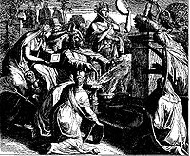
Migrations Of Israel – Chapter 1
When Jeroboam, the Ephraimite, learned that Solomon had died, he returned from Egypt to fulfill Ahijah’s prophecy.

Slide 23
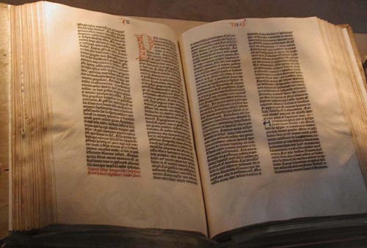
Migrations Of Israel – Chapter 1
II Kings 12:20-21
20; And it came to pass, when all Israel heard that Jeroboam was come again, that they sent and called him unto the congregation, and made him king over all Israel: there was none that followed the house of David, but the tribe of Judah only.

Slide 24
Migrations Of Israel – Chapter 1
II Kings 12:20-21
21 And when Rehoboam was come to Jerusalem, he assembled all the house of Judah, with the tribe of Benjamin, an hundred and fourscore thousand chosen men, which were warriors, to fight against the house of Israel, to bring the kingdom again to Rehoboam the son of Solomon.

Slide 25
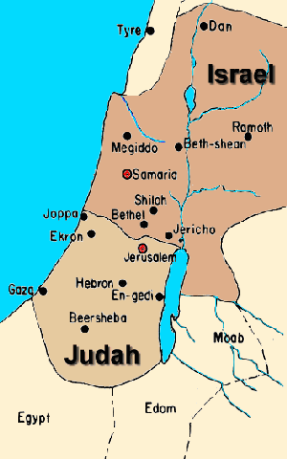
Migrations Of Israel – Chapter 1
These two verses declare the historical breach. They contain the first mention of two different Houses, the House of Judah and the House of Israel.

Slide 26
Migrations Of Israel – Chapter 1
The House of Judah is defined as the two southern Tribes of Judah and Benjamin.
The House of Israel is defined as the Ten Northern Tribes of Israel.

Slide 27
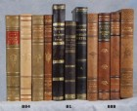
Migrations Of Israel – Chapter 1
They have separate histories and separate destinies, but they will eventually be joined back together into one House.

Slide 28
Migrations Of Israel – Chapter 1
In verse 24, Yahweh declares that this division of Israel into Two Houses is His Will: “For this thing is from me.” So, we had better pay attention.

Slide 29
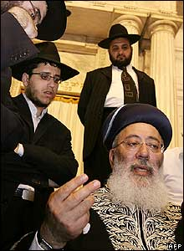
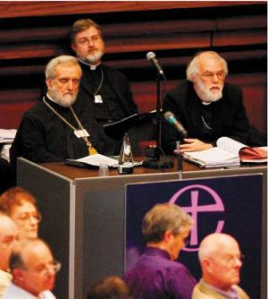
Migrations Of Israel – Chapter 1
Neither the Jewish rabbis nor the Judeo-Christian priesthood teach about the very important distinctions between these two Houses.
Rabbis
C of E Priests

Slide 30
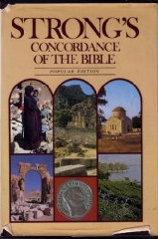
Migrations Of Israel – Chapter 1
Since they are either ignorant of this subject matter or give it short shrift, their usage of such words as ‘Israel,’ ‘Judah,’ ‘Jew,’ and ‘Gentile’ is extremely deficient.
These deficiencies have given rise to mountains of doctrinal error.

Slide 31
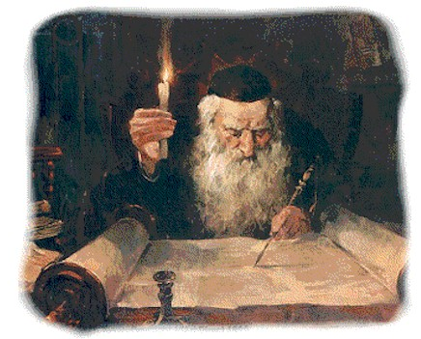
Migrations Of Israel – Chapter 1
Unraveling this mountain of error is an absolute prerequisite to knowing the Truth, for you cannot tell the good guys from the bad guys, unless you understand the language of the Bible.

Slide 32
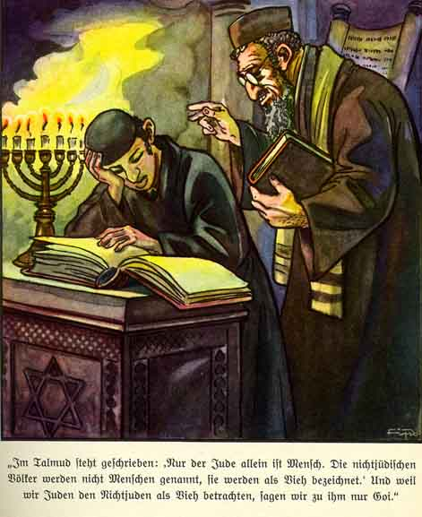
Migrations Of Israel – Chapter 1
For example, the Jews use the word ‘Gentile’ to mean “non-Jew.” But the Latin word ‘gentilis’ means “kinsman,” which is the exact opposite of the sense in which the Jews use it. But, since the Jewish people aren’t Israelites, it doesn’t matter how they use the word.

Slide 33
Migrations Of Israel – Chapter 1
What matters is how the Hebrew prophets and the Israelite writers of the New Testament used the words goy and ethnos. These are the words which have been erroneously translated into the word “Gentiles,” which has no proper place in Scripture.

Slide 34
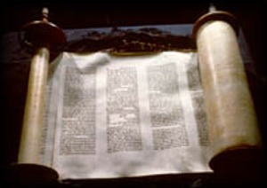
Migrations Of Israel – Chapter 1
It should never have been used to translate these words, for it causes much confusion. Throw that word out and never use it again. None of the Bible writers used it.

Slide 35
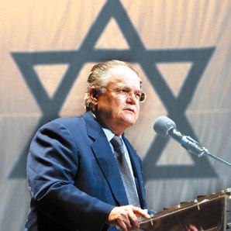
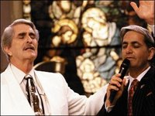
Migrations Of Israel – Chapter 1
Paul Crouch & Benny Hinn
Trinity Broadcasting Corp.
Pastor John Hagee
We must reject the language of the false priests and recognize the proper categories of people, as they are presented to us in the Holy Scriptures.

Slide 36
Migrations Of Israel – Chapter 1
Anything short of this leads to nothing but error and confusion. The reason the Christian world is today completely baffled by the history and prophecies of Scripture is because they have not paid attention to these clear categories of people.

Slide 37
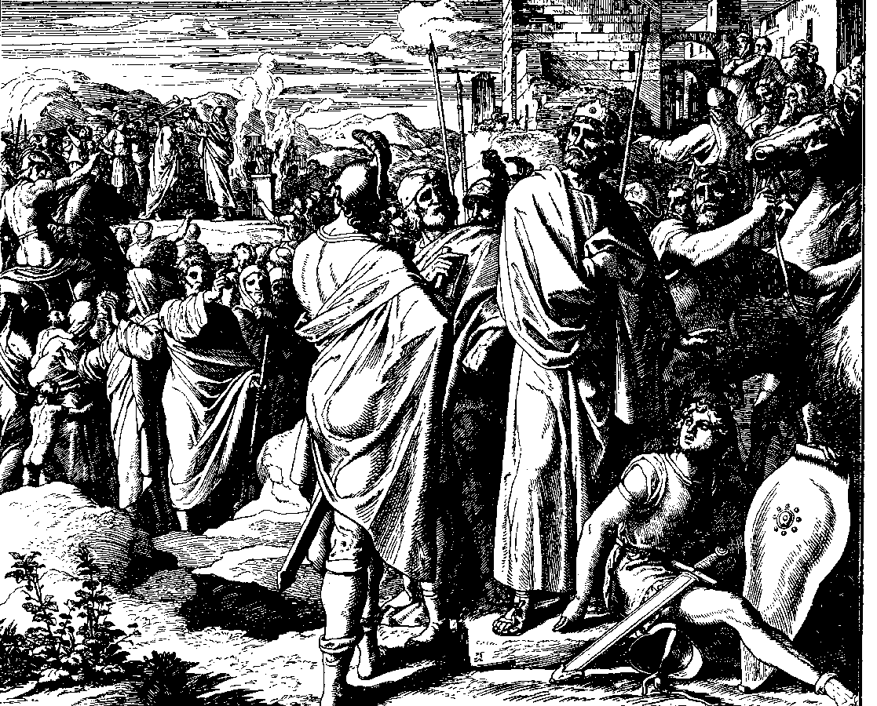
Migrations Of Israel – Chapter 1
Chapters 13 and 14 of I Kings give us more history of those days, culminating with this statement: “And there was war between Rehoboam and Jeroboam in all their days.” (Verse 30.)
Rehoboam and Jeroboam

Slide 38
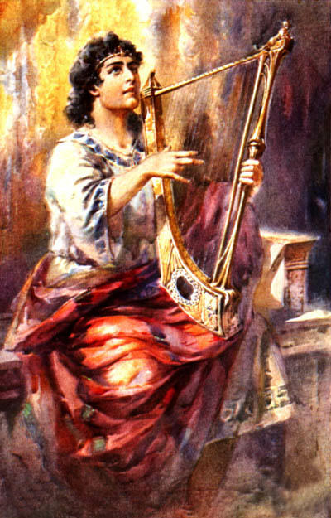
Migrations Of Israel – Chapter 1
Not to be overlooked is the fact that there is also a third House declared by Yahweh. That is the House of David; and that House is the Davidic King line, which Yahweh has declared to reign in Israel as long as there exists a planet called Earth

Slide 39
Migrations Of Israel – Chapter 1
"I have made a covenant with my chosen, I have sworn unto David my servant, thy seed will I establish forever, and build throne to all generations." - Psalm 89:3-4.

Slide 40
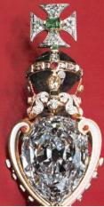
Migrations Of Israel – Chapter 1
"My mercy will I keep for him [David] forevermore, and my covenant shall stand fast with him. His seed also will I make to endure for ever, and his throne as the days of heaven." - Psalm 89:28-29.
Left: The Royal Sceptre

Slide 41
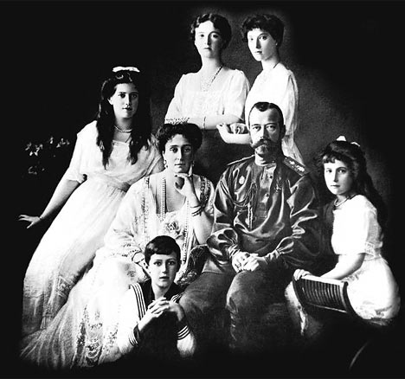
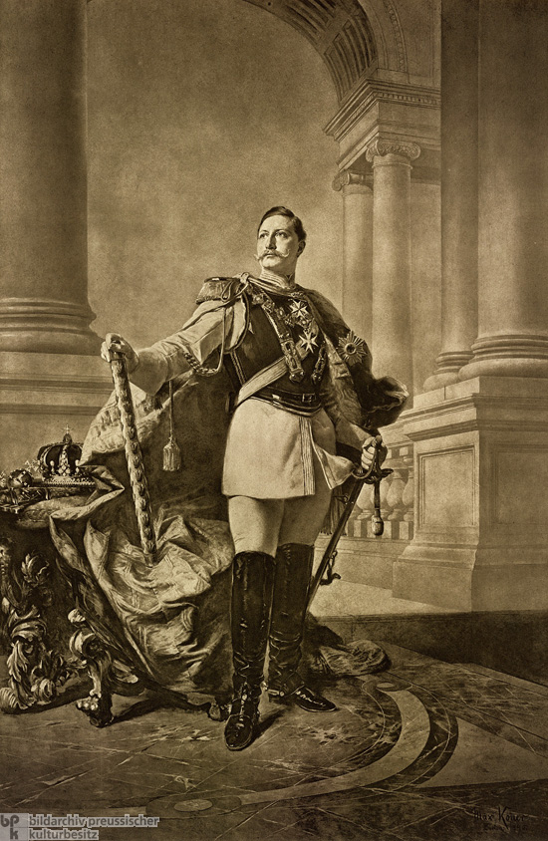
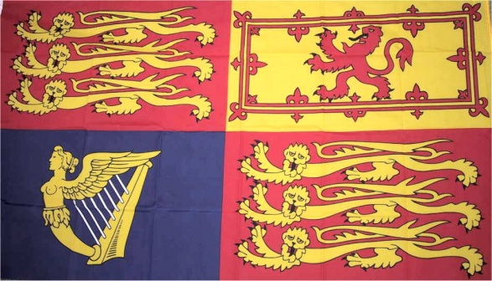
Migrations Of Israel – Chapter 1
UK Royal Standard
The Russian Czar Nicholas II and Family
"My covenant will I not break, nor alter the thing that is gone out of my lips. Once have I sworn by my holiness that I will not lie unto David. His seed shall endure for ever, and his throne as the sun before me." – Psalm 89:34-36.
Kaiser Wilhelm II (1890)

Slide 42
Migrations Of Israel – Chapter 1
Has the sun disappeared? Children of Israel, these prophecies cannot be spiritualized. They clearly teach that the “seed,” or offspring, descendants of Israel – All Twelve Tribes - will exist forever and the Davidic Throne will also last forever

Slide 43
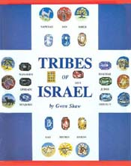
Migrations Of Israel – Chapter 1
The Book of Revelation tells us that, when the Kingdom comes, the Bride of Christ will consist of All Twelve Tribes:

Slide 44
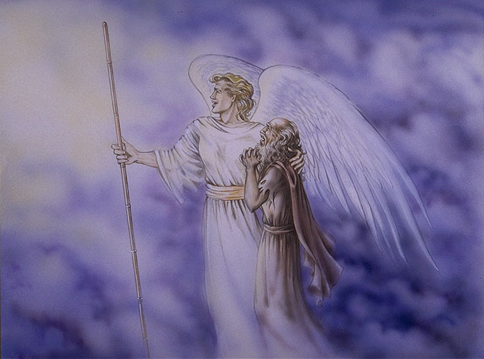
Migrations Of Israel – Chapter 1
“And there came unto me one of the seven angels which had the seven vials full of the seven last plagues and talked with me, saying, Come hither, I will show thee the Bride, the Lamb’s Wife. And he carried me away in the spirit to a great and high mountain, and showed me that great city, the Holy Jerusalem, descending out of heaven from God,

Slide 45
Migrations Of Israel – Chapter 1
having the glory of God, and her light was like unto a stone most precious, even like a jasper stone, clear as a crystal; And had a wall great and high, and had twelve gates, and at the gates twelve angels and the names written thereon, WHICH ARE THE NAMES OF THE TWELVE TRIBES OF THE CHILDREN OF ISRAEL.” - Rev. 21: 9-12.

Slide 46
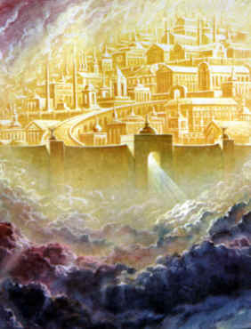
Migrations Of Israel – Chapter 1
Since the “Holy Jerusalem” comes down from heaven, it cannot be the literal city of Jerusalem in Palestine. Rather, it comes down from heaven to rest upon “the twelve tribes of the children of Israel” and upon planet earth, in order to renew it.
A fanciful depiction of New Jerusalem

Slide 47
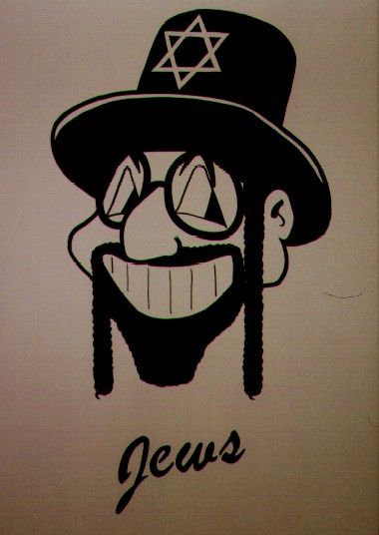
Migrations Of Israel – Chapter 1
If we assume that the Jewish people are the Tribe of Judah, which is what many people teach, then where are the other 11 Tribes?

Slide 48
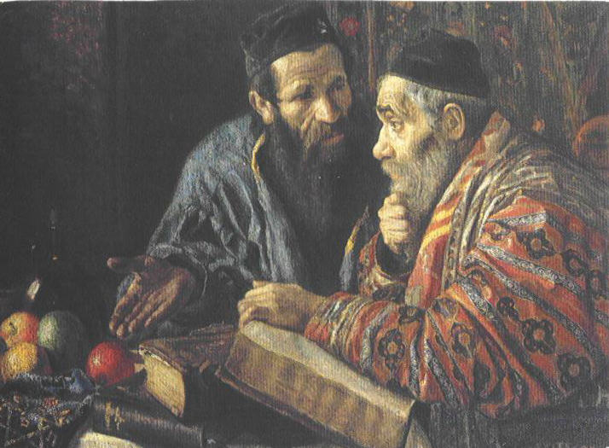
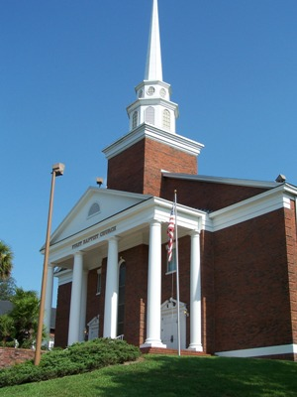
Migrations Of Israel – Chapter 1
Neither Judaism nor Judeo-Christianity can explain these
verses, so they must pretend that the Bible doesn’t mean what it says. I will show you that the Bible means exactly what it says

Slide 49
Migrations Of The 12 Tribes Of Israel
End Of Chapter One
BY PASTOR ELI JAMES
To be continued ………… Chapter Two: The House of Israel Rebels

