Slide 1
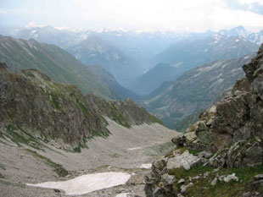
The Chronicles Of The
Migrations Of The
Twelve Tribes Of Israel
From The Caucasus
Mountains Into Europe
By Pastor Eli James

Slide 2
Migrations Of The 12 Tribes Of Israel
Introduction

Slide 3
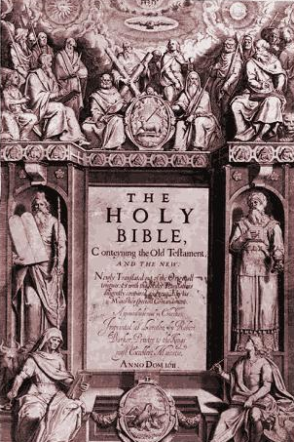
Migrations Of The 12 Tribes Of Israel
Isaiah, Chapter 11 Verse 11
“And it shall come to pass in that day, that the Lord shall set his hand again the second time to recover the remnant of his people, which shall be left, from Assyria, and from Egypt, and from Pathros, and from Cush, and from Elam, and from Shinar, and from Hamath, and from the islands of the sea.”

Slide 4
Migrations Of The 12 Tribes Of Israel
Isaiah, Chapter 11 Verse 12
“And he shall set up an ensign for the nations, and shall assemble the outcasts of Israel, and gather together the dispersed of Judah from the four corners of the earth.”

Slide 5
Migrations Of The 12 Tribes Of Israel
Isaiah, Chapter 11 Verse 13
“The envy also of Ephraim shall depart, and the adversaries of Judah shall be cut off: Ephraim shall not envy Judah, and Judah shall not vex Ephraim.”

Slide 6
Migrations Of The 12 Tribes Of Israel
Isaiah, Chapter 11 Verse 14
“But they shall fly upon the shoulders of the Philistines toward the west; they shall spoil them of the east together: they shall lay their hand upon Edom and Moab; and the children of Ammon shall obey them.”

Slide 7
Migrations Of The 12 Tribes Of Israel
Isaiah, Chapter 11 Verse 15
“And the LORD shall utterly destroy the tongue of the Egyptian sea; and with his mighty wind shall he shake his hand over the river, and shall smite it in the seven streams, and make men go over dry shod.”

Slide 8
Migrations Of The 12 Tribes Of Israel
Isaiah, Chapter 11 Verse 16
“And there shall be an highway for the remnant of his people, which shall be left, from Assyria; like as it was to Israel in the day that he came up out of the land of Egypt.”

Slide 9
Migrations Of The 12 Tribes Of Israel
The Dariel Pass
That highway, in verse 16, is today known as the Dariel Pass.

Slide 10
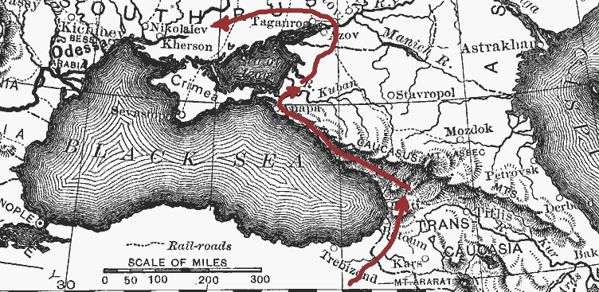
Migrations Of The 12 Tribes Of Israel
It is the pathway the children of Israel took through the Caucasus Mountains, thus becoming known as the Caucasian People.

Slide 11
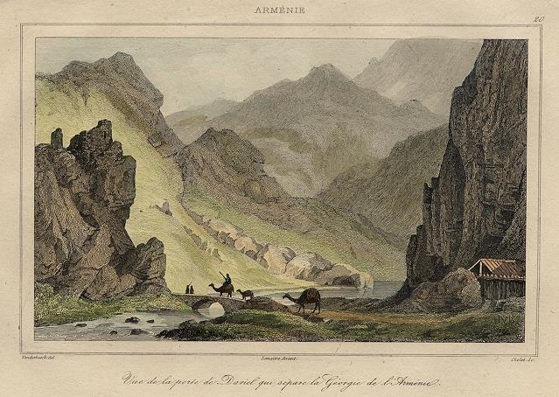
Migrations Of The 12 Tribes Of Israel
A Painting of the Pass of Dariel, Armenia, 1838
In ancient times, and even to today’s local residents of the area, the Dariel Pass is still known as “The Pass of Israel.”

Slide 12
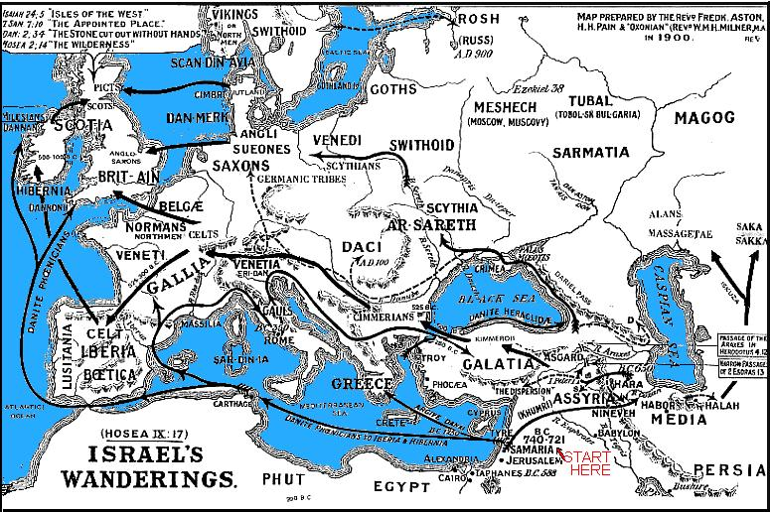
Verse 11 describes how the children of Israel will one day be reassembled from the various places of their dispersion

Slide 13
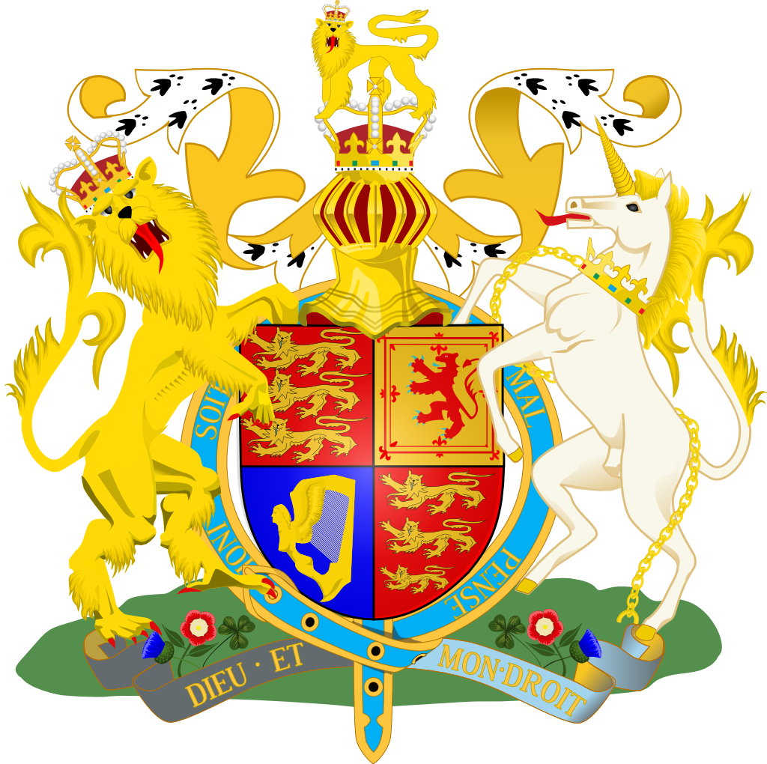
Migrations Of The 12 Tribes Of Israel
Verse 12 says it will be the children of both Houses.
The 2 houses of Israel represented in the Royal Coat of Arms – the lion = House of Judah and the Unicorn (bull) = Ephraim – leading tribe of the House of Israel

Slide 14
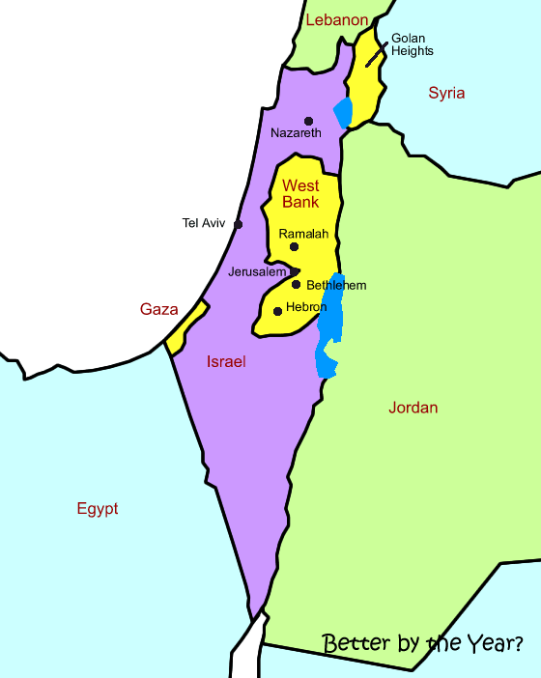
Migrations Of The 12 Tribes Of Israel
It is not possible for that regathering place to be the tiny nation called Palestine. The Bible clearly teaches that the Israelites will be far too numerous to be contained by that small territory.

Slide 15
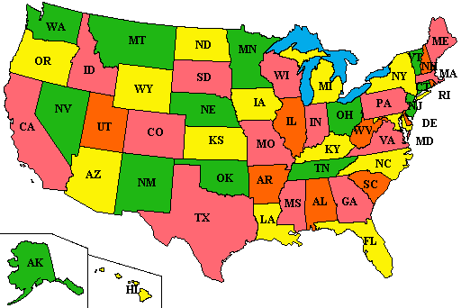
Migrations Of The 12 Tribes Of Israel
No, the main regathering place of the Twelve Tribes of Israel is the USA, the New JerUSAlem of the Holy Scriptures

Slide 16
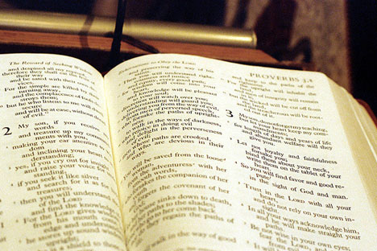
Migrations Of The 12 Tribes Of Israel
The Holy Bible is the most misunderstood book in the world.

Slide 17
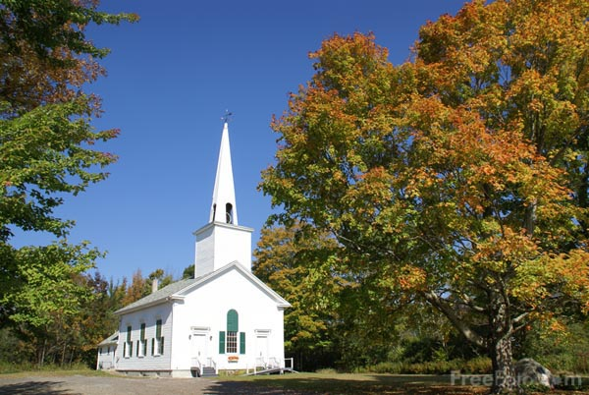
Migrations Of The 12 Tribes Of Israel
More mythology has been taught in the name of both Judaism and Judeo-Christianity than truth.

Slide 18
Migrations Of The 12 Tribes Of Israel
Islam is another religion which has mythologized and distorted the historical facts of the Bible.
Mohamed

Slide 19
Migrations Of The 12 Tribes Of Israel
As a historian for my People, Israel, I have developed a unique perspective about the Israelites versus the Jews. The two people cannot be equated. Contrary to current Judeo-Christian mythology, the Jewish people and the Israelite people are not the same.

Slide 20
Migrations Of The 12 Tribes Of Israel
The Israelites actually were a Nordic looking people.

Slide 21
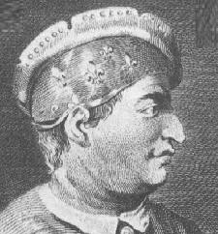
Migrations Of The 12 Tribes Of Israel
The Sephardic Jews actually descend from the Canaanite people of Idumea, who have the classic "hook-nosed" countenance.
A Sephardic Jew

Slide 22
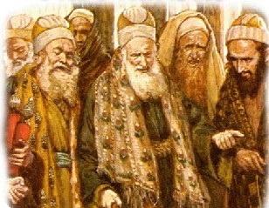
Migrations Of The 12 Tribes Of Israel
It was from this Sephardic group that the Scribes and Pharisees emerged. Jesus repeatedly condemned these Pharisees for their own violations of the Law of Moses."
The Pharisees

Slide 23
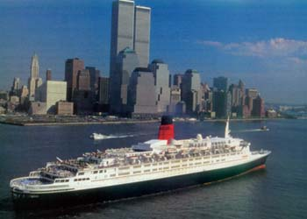
Migrations Of The 12 Tribes Of Israel
The Bible says that the Israelites would be known by another name, that they would be a great sea-faring people,

Slide 24
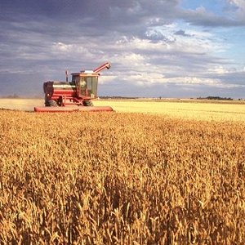
Migrations Of The 12 Tribes Of Israel
a great agricultural people,

Slide 25
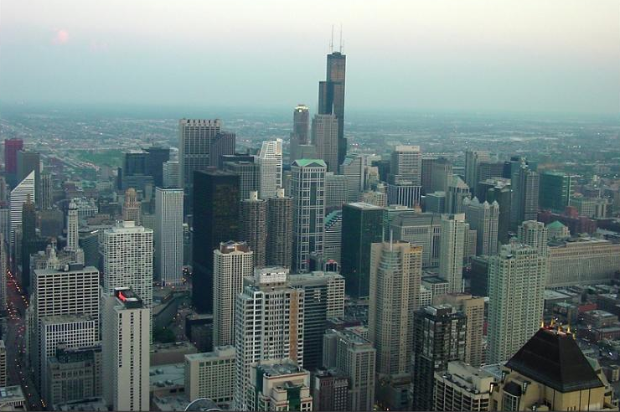
Migrations Of The 12 Tribes Of Israel
and great builders of cities and nations.

Slide 26
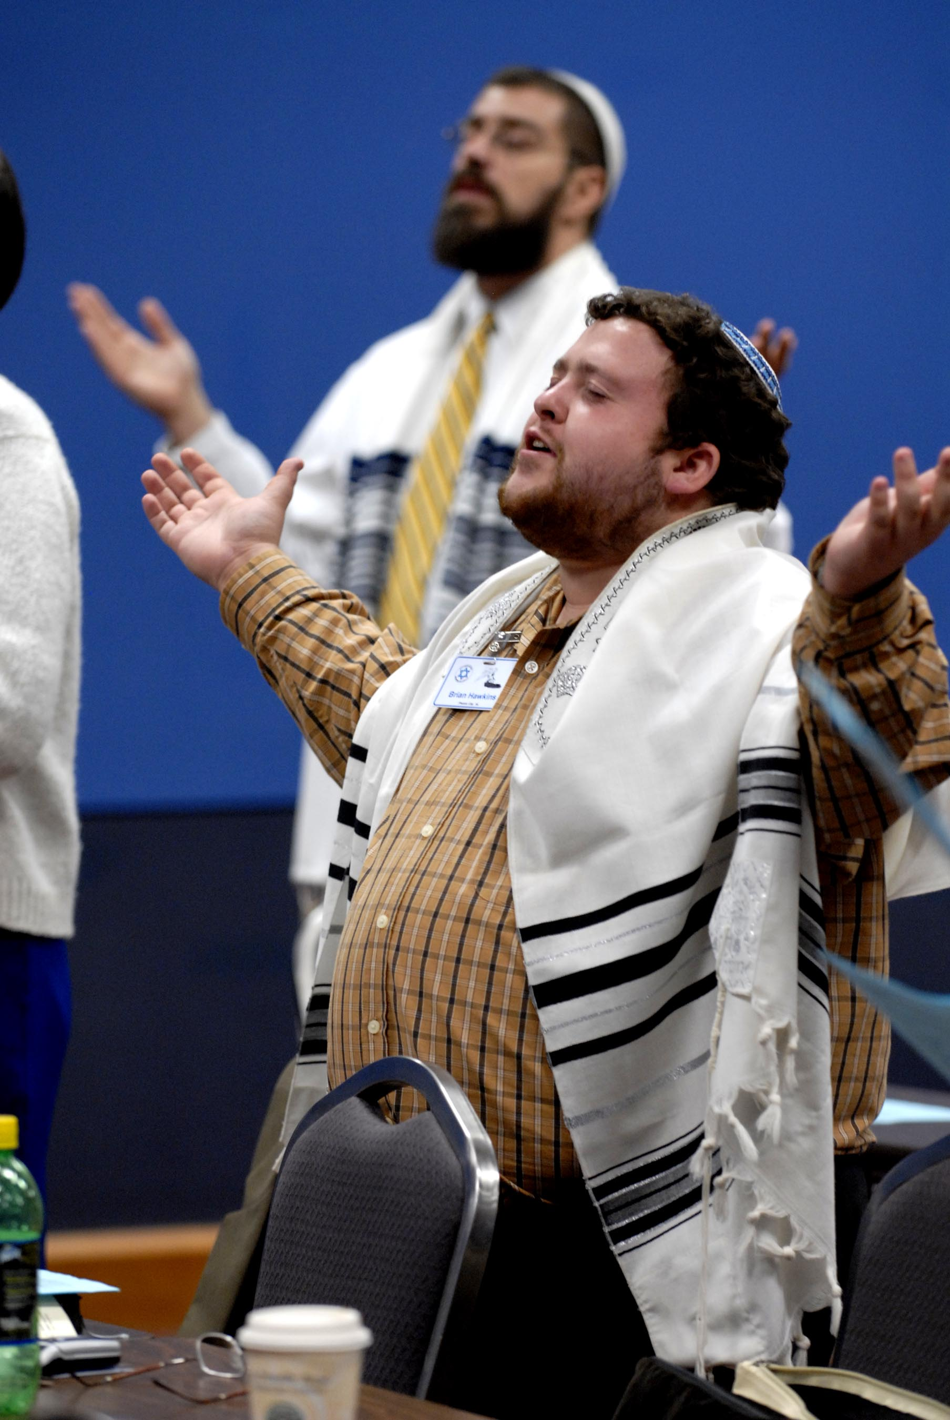
Migrations Of The 12 Tribes Of Israel
None of these things is true of the Jews.

Slide 27
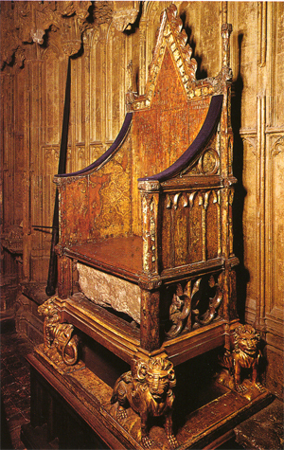
Migrations Of The 12 Tribes Of Israel
The Bible also teaches that King David would always have a literal, physical heir sitting on a throne somewhere on planet earth, as long as the sun, moon and stars rule the skies.

Slide 28
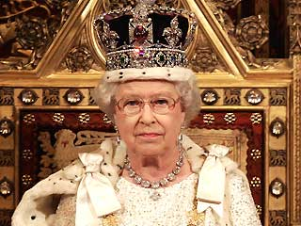
Migrations Of The 12 Tribes Of Israel
Queen Elizabeth II is one of those heirs, and she knows it. Again, this is not true of the Jewish people.

Slide 29
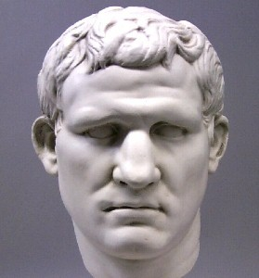
Migrations Of The 12 Tribes Of Israel
The Jews have not had a King since the days of Herod Agrippa II, the last of the Herodian Dynasty; nor have they ever laid claim to the throne of David.
Herod Agrippa II

Slide 30
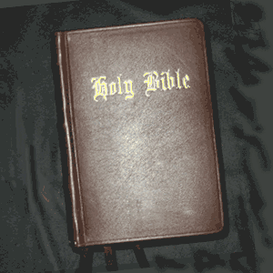
Migrations Of The 12 Tribes Of Israel
What you are about to experience is proof positive that the Bible is, at one and the same time, the world’s most accurate history book and the world’s most astounding book of prophecy,

Slide 31
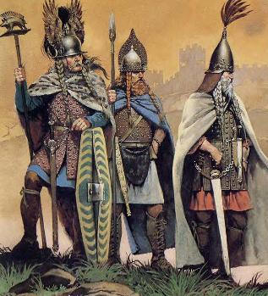
Migrations Of The 12 Tribes Of Israel
… for I will demonstrate how the history and the prophecies have been fulfilled only in one people: the Anglo-Saxon, Celtic and Caucasian People, otherwise known as Germans, British, Danes, Dutch, Vikings, Goths, Alans, Sueves, Canadians, Americans, and many other names.
Celtic Warrior Chieftains

Slide 32
Migrations Of The 12 Tribes Of Israel
What you are about to experience is also proof that the Bible cannot possibly be understood without a thorough knowledge of both history and prophecy.

Slide 33
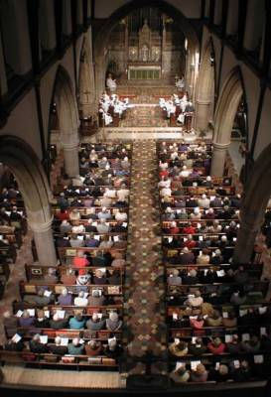
Migrations Of The 12 Tribes Of Israel
Since modern Christianity is totally ignorant of the complementarity of Biblical prophecy and the true history of the Twelve Tribes, there is little understanding in any of its denominations.

Slide 34
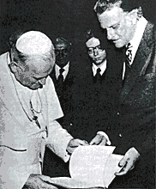
Migrations Of The 12 Tribes Of Israel
They teach error in place of truth. They make wild guesses where the Bible is very clear and sufficient.
Billy Graham with the Pope in Nov. 1982

Slide 35
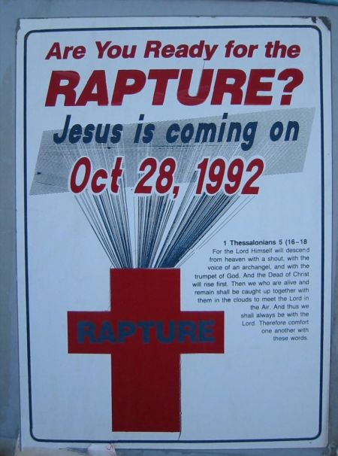
Migrations Of The 12 Tribes Of Israel
They invent far-fetched theories, such as Dispensationalism, Antinomianism and Universalism in order explain away what they do not understand. Millions Of Christians believe these theories, which have no basis in fact and actually deny the meaning of the Holy Scriptures.

Slide 36
Migrations Of The 12 Tribes Of Israel
Foreward
The Plot of the Greatest Drama Ever Staged

Slide 37
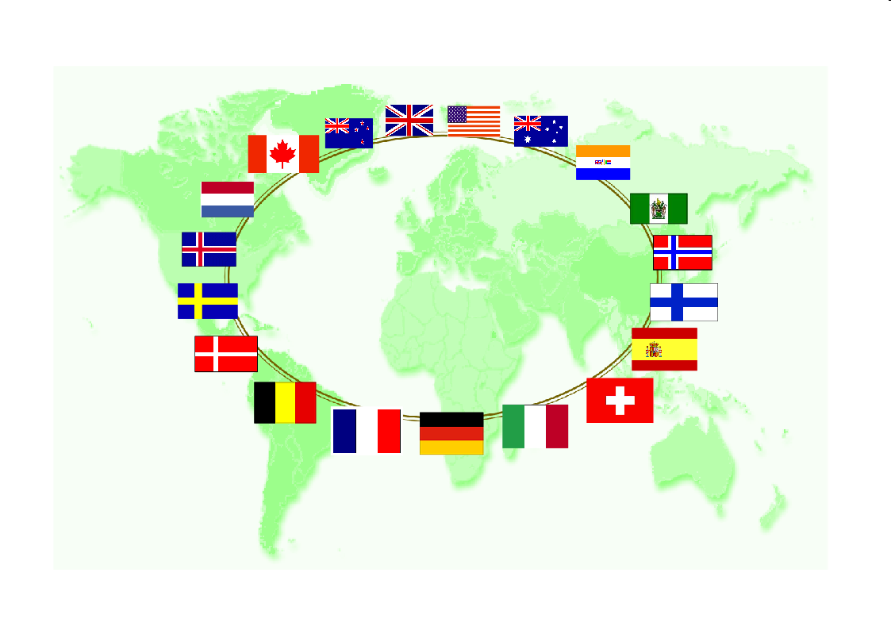
Migrations Of The 12 Tribes Of Israel
Neither Judaism nor Judeo-Christianity teaches those passages of Scripture which identify True Israel.

Slide 38
Migrations Of The 12 Tribes Of Israel
Rather, they ignore those passages and teach self-serving doctrine, which is unrelated to the true identity of Israel.

Slide 39
Migrations Of The 12 Tribes Of Israel
One of the most critical subjects of the Holy Bible, a subject which reveals Israel’s True Identity, is the subject of the division of the Twelve Tribes into Two Houses.

Slide 40
Migrations Of The 12 Tribes Of Israel
The subject of the Two Houses involves much Biblical history, secular history and hundreds of prophetic fulfillments of Scripture.
The 2 Houses of Israel represented by 2 olive branches

Slide 41
Migrations Of The 12 Tribes Of Israel
Yet, modern religion is virtually silent on this subject.

Slide 42
Migrations Of The 12 Tribes Of Israel
Ask a typical Christian what he knows about this subject, and he or she will simply shrug their shoulders. Many will say they have never even heard of the Two Houses.

Slide 43
Migrations Of The 12 Tribes Of Israel
I sincerely hope that this presentation will remove all doubts as to who True Israel is and what the Bible actually teaches about us.
“You must become as a little child.”
Enjoy!

Slide 44
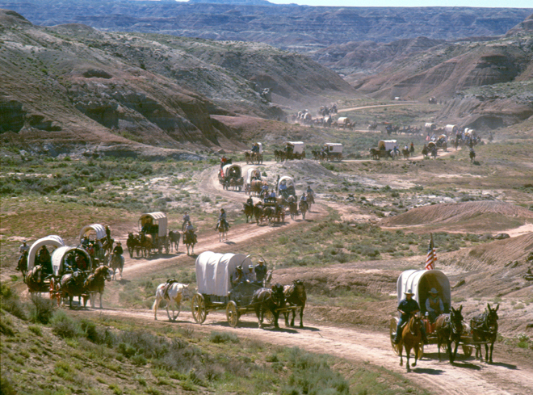
Migrations Of The 12 Tribes Of Israel
A quick synopsis of this story involves the following episodes:
1.) Israel is divided into the Ten-Tribed House of Israel and the Two-Tribed House of Judah.
2.) The House of Israel rebels against God’s Law, adopting pagan practices, and is taken captive by the Assyrians for this rebellion. This episode is called the Assyrian Captivity, or, better, the Assyrian Exile.

Slide 45
Migrations Of The 12 Tribes Of Israel
A quick synopsis of this story involves the following episodes:
3.) Well into the future, these Israelites retain much of their pagan heritage, bringing it with them into Europe until Christianity purges it from them.
4.) The House of Judah is also taken captive, not to Assyria, but to Babylon. This, the Bible says, is also in punishment for their sins. After 70 years of this captivity, a remnant returns to restore Jerusalem to the Law of Moses; and their priest-kings, Ezra and Nehemiah, re-establish the Davidic Dynasty in Judah.

Slide 46
Migrations Of The 12 Tribes Of Israel
A quick synopsis of this story involves the following episodes:
5.) The House of Judah has the distinct mission of bringing forth the Messiah through the lineage of King David. Having fulfilled its mission in the land of Judah, the Judahite dynasty dies out for good, but only in Judea. The Davidic Dynasty is alive and well in Europe. They are known as King Arthur and the British Kings, Charlemagne and the Germanic Kings, such as the Hapsburgs, the Czars, etc. All of the Kings and Queens of Europe are, in fact, descendants of King David!

Slide 47
Migrations Of The 12 Tribes Of Israel
A quick synopsis of this story involves the following episodes:
6.) The various Tribes of Israel would found numerous nations: first in Europe and then all over the world.
7.) These Dispersed Israelites would be redeemed by their Kinsman, Jesus Christ, and be forgiven for their past sins. Having recognized and accepted their Redeemer, they would become known as Christians.

Slide 48
Migrations Of The 12 Tribes Of Israel
A quick synopsis of this story involves the following episodes:
8.) Ultimately, the Two Houses would one day be merged back together, so that they are no longer a House Divided. This re-unification is moral, spiritual and literal, taking place in the physical descendants of the Israelites of Scripture.

Slide 49
Migrations Of The 12 Tribes Of Israel
A quick synopsis of this story involves the following episodes:
9.) The nation where the physical re-unification took place was the United States of America. Simultaneously with their prophesied nation-building, a great period of amnesia would fall upon these same Israelites, whereby all of these things happen under their very noses and yet they are completely ignorant of the fact that they are the subject and object of Scriptural prophecy. The reason for this is that another group of people have stolen their name and have made a habit of pretending to be them. (If this sounds like a melodramatic, tortuous plot, don’t blame me! Blame the Father!)

Slide 50
Migrations Of The 12 Tribes Of Israel
A quick synopsis of this story involves the following episodes:
10.) Just before the Judgment Day, the amnesiac people of Israel will awaken to their true Identity and prepare to fight one last great battle, in order to cast off the parasitic people who are trying to steal their inheritance.
11.) These awakening Israelites will fully come to understand that the Scriptures are about them and not about the people who are impersonating them. And finally,

Slide 51
Migrations Of The 12 Tribes Of Israel
A quick synopsis of this story involves the following episodes:
12.) Their Kinsman Redeemer will come back down from heaven and avenge their enemies during the Battle of Armageddon. At this battle, not only will the devil’s children be vanquished, death itself will be vanquished.

Slide 52
Migrations Of The 12 Tribes Of Israel
Preface
This is the Great Plot of the Holy Scriptures, which cannot be comprehended if you do not know the history and prophecies that concern the Two Houses.

Slide 53
Migrations Of The 12 Tribes Of Israel
As I said earlier, this plot is so important to understanding Scripture that, if you are ignorant of its message, you simply do not understand Scripture.

Slide 54
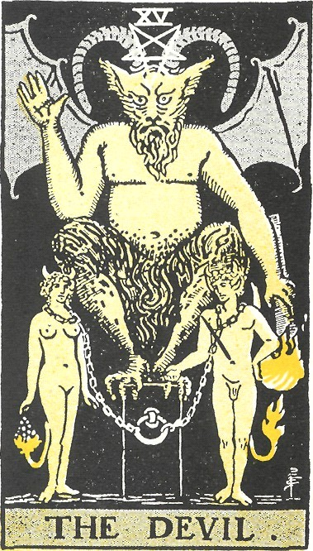
Migrations Of The 12 Tribes Of Israel
You must also understand that the devil himself has been involved in trying to prevent you from knowing this story. He knows how important this story is to the fulfillment of Scripture;

Slide 55
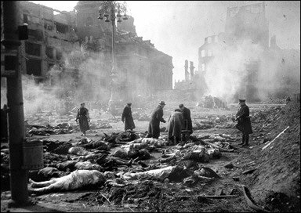
Migrations Of The 12 Tribes Of Israel
… and he has literally massacred millions of Israelite Christians in order to prevent them from regaining the knowing of who they are.
Victims of the Dresden bombing

Slide 56
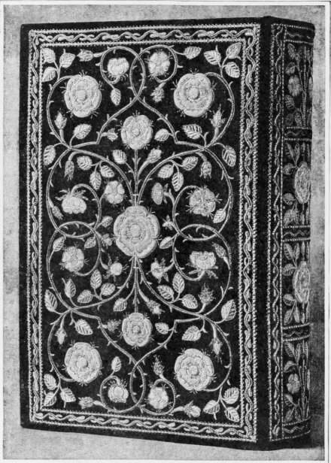
Migrations Of The 12 Tribes Of Israel
The Second Recovery of His People Israel, as prophesied in Isaiah 11:11 has not happened yet
Queen Elizabeth’s Bible

Slide 57
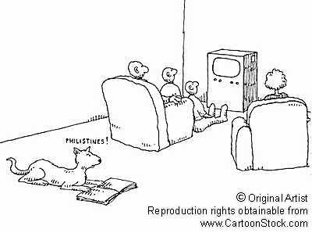
Migrations Of The 12 Tribes Of Israel
It cannot happen until the children of Israel awaken out of their amnesia; but that awakening is happening as we speak!
a

Slide 58
Migrations Of The 12 Tribes Of Israel
Welcome to the Holy Scriptures, children of Israel. The Story begins with King Solomon.
The Most Holy Place
King Solomon’s Temple

Slide 59
Migrations Of The 12 Tribes Of Israel
End Of Introduction
BY PASTOR ELI JAMES
To be continued ………… Chapter One: A House Divided

Slide 60
The Chronicles Of The
Migrations Of The
Twelve Tribes Of Israel
From The Caucasus
Mountains Into Europe
By Pastor Eli James

Slide 61
Chapter One
A House Divided
By Pastor Eli James

