Slide 1
Ensigns of the lost Sheep of True Israel
Matthew 15:24 I was sent ONLY to the lost sheep of the house of Israel.

Slide 2
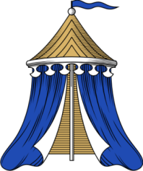
From the God of Abraham
Numbers 2:2
Every man of the children of Israel shall pitch by his own standard with the ensign of their father’s house far off about the tabernacle of the congregation shall they pitch.

Slide 3
Find a Tribe in Today’s World using using the ancient art of Heraldry
There are 12 original Tribes of Israel; one for each son.
Look for Judah’s two sons, Phares and Zara. Phares, the golden lion and Zara, the red hand or red lion.
The tribe of Joseph had their blessing split in half between his two sons, Ephraim and Manasseh. This act by Jacob/Israel of blessing the first and second born created another tribe, making the final total 13.
Resources: Holy Scriptures
Symbols of Our Celto-Saxon Heritage- W. H. Bennett

Slide 4
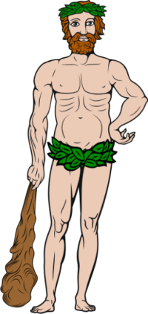
Tribe of Reuben
Genesis 49:3 Reuben, thou art my firstborn, my might, and the beginning of my strength, the excellency of dignity, and the excellency of power:
Genesis 49:4 Unstable as water, thou shalt not excel; because thou wentest up to thy father's bed; then defiledst thou it: he went up to my couch.
His first symbol is a man;
His second is water.

Slide 5
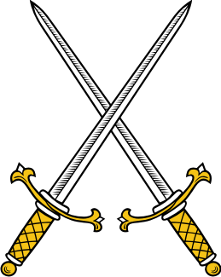
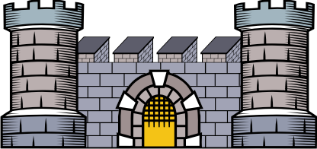
Tribe of Simeon
Genesis 49:5 Simeon and Levi are brethren; instruments of cruelty are in their habitations.
Genesis 49:6 O my soul, come not thou into their secret; unto their assembly, mine honour, be not thou united: for in their anger they slew a man, and in their selfwill they digged down a wall.
His first symbol is a sword; his second is a wall.

Slide 6
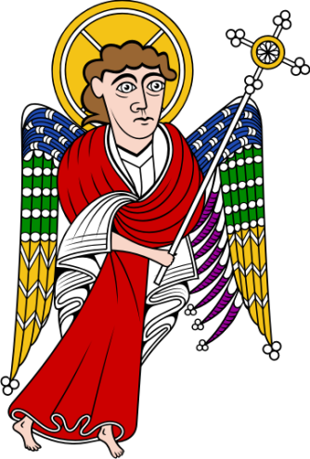
Tribe of Levi
Genesis 49:7 Cursed be their anger, for it was fierce; and their wrath, for it was cruel: I will divide them in Jacob, and scatter them in Israel.
The priesthood was given to Levi.

Slide 7
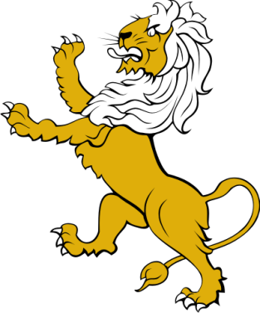
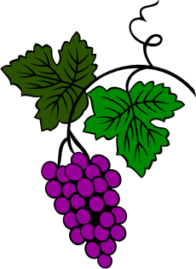
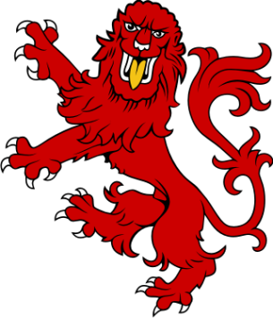
Tribe of Judah
Genesis 49:9 Judah is a lion's whelp: from the prey, my son, thou art gone up: he stooped down, he couched as a lion, and as an old lion; who shall rouse him up?
A lion is the symbol of Judah and of his true sons Phares and Zara. A golden lion, red lion, sceptre, grape vine and a red hand are his symbols.

Slide 8
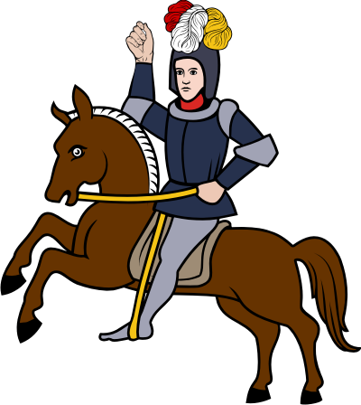
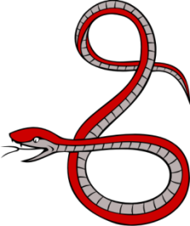
Tribe of Dan
Genesis 49:16 Dan shall judge his people, as one of the tribes of Israel.
17 Dan shall be a serpent by the way, an adder in the path, that biteth the horse heels, so that his rider shall fall backward.
His first symbol is a serpent .
His second is a bucking horse.

Slide 9
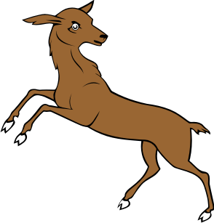
Tribe of Naphtali
Genesis 49:21 Naphtali is a hind let loose: he giveth goodly words.

Slide 10
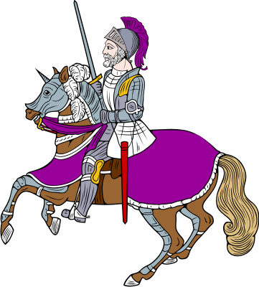
Tribe of Gad
Genesis 49:19 Gad, a troop shall overcome him: but he shall overcome at the last.

Slide 11
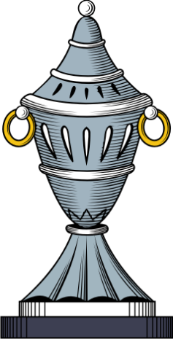
Tribe of Asher
Genesis 49:20 Out of Asher his bread shall be fat, and he shall yield royal dainties.
An container for sweets is his symbol.

Slide 12
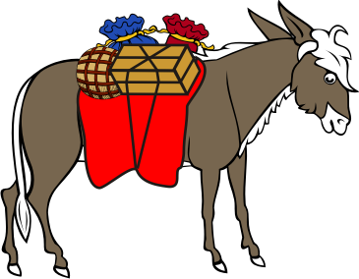
Tribe of Issachar
Genesis 49:14 Issachar is a strong ass couching down between two burdens:
Obvious what his symbol is.

Slide 13
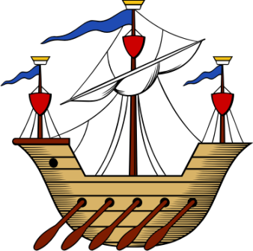
Tribe of Zebulun
Genesis 49:13 Zebulun shall dwell at the haven of the sea; and he shall be for an haven of ships; and his border shall be unto Zidon.
Look for ships of different Navies.

Slide 14
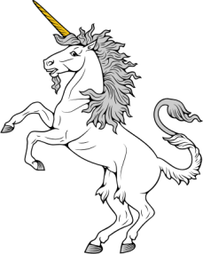
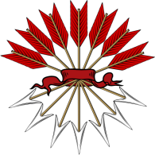
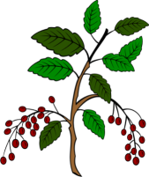
Tribe of Joseph
Genesis 49:22 Joseph is a fruitful bough, even a fruitful bough by a well; whose branches run over the wall:
Genesis 49:23 The archers have sorely grieved him, and shot at him, and hated him:
Genesis 49:24 But his bow abode in strength, and the arms of his hands were made strong by the hands of the mighty God of Jacob; from thence is the shepherd, the stone of Israel.
These are his symbols: A bull, arrows, bough or Unicorn.

Slide 15
Tribe of Benjamin
Genesis 49:27 Benjamin shall ravin as a wolf: in the morning he shall devour the prey, and at night he shall divide the spoil.
All the disciples except Judas came from Benjamin.
Travel the Bible Belt and hear everyone preaching.
Lone wolves, posed, ready for the trumpet blast.

Slide 16
How to do it
Following are four examples.
Notice how the ensigns of the various tribes are incorporated into them.
Look for shields and symbols at least 150 years old as the modern ones are probably corrupted.

Slide 17
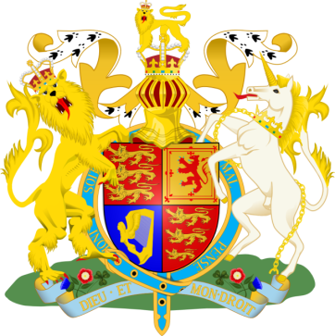
Royal Seal of Great Britain
Golden lion of Judah.
Red lion of Zara.
Harp of David.
Unicorn of Ephraim.

Slide 18
Great Seal of the United States
13 Stars for 13 States and 13 Tribes.
Star matrix is the star of David.
Eagle from the tribe of Dan.
The eagle is also a Brigade Banner.
Bough and Arrows from Manasseh.
Cloud reflects the pillar of cloud.

Slide 19
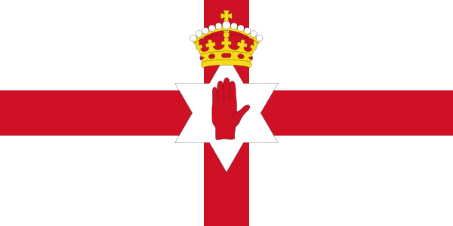
The Flag of Ulster Ireland
On the beautiful Ulster flag there is a "Red Hand" mounted on the "Star of David", under a Royal Crown. Why would symbols of Israel's royalty be on the flag of people who have been taught that they are gentiles? It is because they are NOT gentiles but Israelites who have lost the knowledge of their true identity and the PROOF is on the flag.

Slide 20
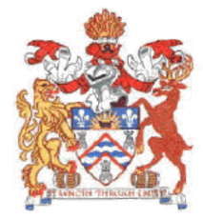
Council of East Staffordshire England
The rampant Stag is from the tribe of Naphtali.
The rampant Lion is from the tribe of Judah.
The wavy blue lines are from the tribe of Reuben.
The castle gate is from the tribe of Simeon.

Slide 21
The End
Interested
Buy H. W. Bennett’s book
Symbols of Our Celto Saxon Heritage

