Slide 1
The Story Of Gog And Magog
Part Five
Satan bound for a 1000 years - The Victorian era – Gog steals South Africa’s wealth

Slide 2
The Story of Gog & Magog Will be covered in a series of 10 parts
Attila, The Rise of Islam and the Khazars
Genghis Khan, The Russians & the 3 frogs of Revelation
The Spanish Armada & Inquisition + the English revolution
The rise of the Rothschilds & the Armenian Revolution
Satan Bound For a 1000 Years - French & American Revolutions & The Victorian Era
WW1 & WW2 - Sections 1 & 2
WW3 – The secret war

Slide 3
The Story of Gog & Magog Will be covered in a series of 10 parts
Gog’s covert attack on western culture, education, legal system, health, art & education.
False flag operations & 7/7 London Bombing
Conclusion

Slide 4
Gog – Recap Parts 1 - 5
6) Gog attack on England via the Spanish Armada fails
7) Gog dispersed by the Spanish Inquisition to Mexico, Sicily and Amsterdam
8) From Amsterdam Gog is successful in gaining control of Britain’s money
9) By knowing the Illuminati’s occult numbering code one can identify false flag operations

Slide 5
Gog of The Land of Magog
Analysis of Ezekiel 38 : 15
First half of verse
And Thou (Attila/Genghis Khan) Shalt Come From Thy Place Out Of The North Parts, Thou And Many People With Thee All Of Them Riding Upon Horses, A Great Company, And A Mighty Army

Slide 6
Thou And Many People With Thee All Of Them Riding Upon Horses, A Great Company, And A Mighty Army
The horse cavalries of Genghis Khan

Slide 7
Gog of The Land of Magog
Second half of verse
And Thou Shalt Come Up Against My People of Israel, As A Cloud To Cover The Land: It Shall Be In The Latter Days, And I Will Bring Thee Against My Land That The Heathen May Know Me, When I Shall Be Sanctified In Thee, O Gog, Before Their Eyes.

Slide 8
Satan Bound For A Thousand Years
Revelation 20:1-3 And I saw an angel come down from heaven, having the key to the bottomless pit and a great chain in his hand.
2. And he laid hold of the dragon, that old serpent, which is the Devil, and Satan, and bound him a thousand years.
Gustave Doré's depiction of Satan from John Milton's Paradise Lost

Slide 9
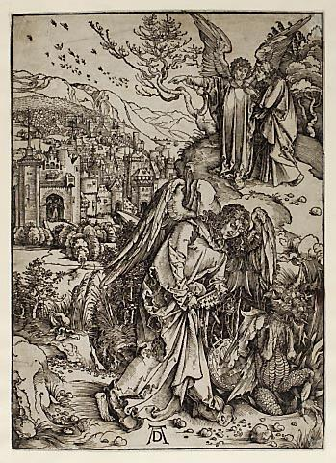
Satan Bound For A Thousand Years
3. And cast him in to the bottomless pit, and shut him up, and set a seal upon him, that he should deceive the nations no more until the thousand years should be fulfilled and after that he must be loosed a little season.
Angel with the key to the bottomless pit

Slide 10
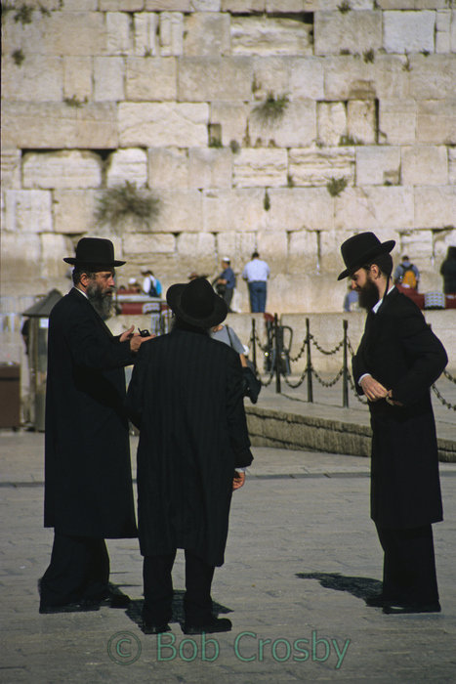
Satan Bound For A Thousand Years
This passage is made up of, or about Satan (the Jews - Gog) being cast into the bottomless pit of non-influence for a symbolic thousand years (actually from the time of (Christ) or Yahshua until 1776).

Slide 11
Satan Bound For 1000 Years
Nowhere do the Scriptures say that the 1000 year binding of Satan is in the same time frame as the millennial reign of Christ.
Further if Satan were able to influence the nations to go to war during Christ’s reign it would imply an imperfect reign!

Slide 12
Satan Bound For 1000 Years
The word Satan here is a collective term referring to his offspring the Yehudin (accursed ones) the Jews.
One can see that this prophecy is being fulfilled by the Gog controlled United Nations and confirmed by its insignia.

Slide 13
Satan Bound For 1000 Years
The Jews (Gog) did not gain any great influence until the time of the Illuminati (1776), and since that time, Satan (the Jews) have regained their control over the nations. It
has developed into the United Nations, which is attempting to control the entire world (“four quarters of the earth”).

Slide 14
Gog & Magog – Gathering the Nations From The Whole Earth
Rev. 20, 8: And shall go out to deceive the nations which are in the four quarters of the earth, Gog and Magog, to gather them together to battle the number of whom is as the sand of the sea (Israel).
The UN Logo
Notes:
Heinrich von Neustadt, around 1300, wrote of them as the "terrifying people of Gog and Magog." 18

Slide 15
Gog & Magog – Gathering the Nations
1) The 2 olive branches represent Israel (2 Houses) being gathered to battle
2) Gog & Magog gathering Israel from the 4 corners of the world represented by the world map.
3) Note that there are 33 sections on the insignia an important Illuminati number!
Notes:
16952

Slide 16
Gog & Magog In English Folklore
There are a number of mentions of Gog and Magog in English legends which will be covered in the next few slides re their importance relating to biblical prophecies.
Gog & Magog giving Paddit a lift out of the mire

Slide 17
Satan Bound For 1000 Years
That Satan was Magog & Gog in the symbolism used in Revelation is confirmed by Old English Lore and legends from the Middle East
The Statues of Magog & Gog housed in the Guild Hall London

Slide 18
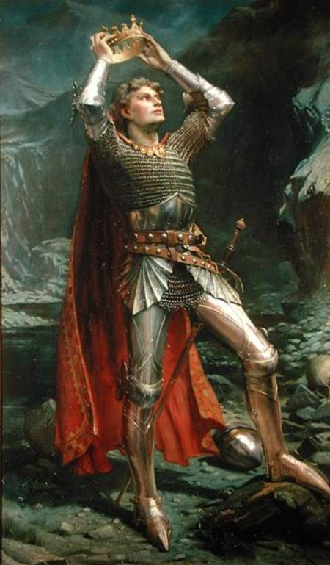
GOG AND MAGOG IN ENGLISH LORE:
In Arthurian lore, King Arthur battled the giant captains of the nations Gog and Magog and with the help of Gargantua who overcame and killed them both. Afterward they built a great wall to contain the monstrous legions until the end of the world.
King Arthur

Slide 19
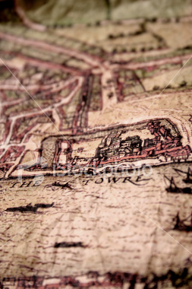
Satan Bound For 1000 Years
We have seen that the khazars from the land of Gog & Magog have had a colony in London since the times of the Silk Route.
Ancient London

Slide 20
GOG AND MAGOG IN ENGLISH LORE:
These nine-foot tall statues of Gog (left) and Magog (right) stand at the Guildhall in London. First erected in the 1400's, they were restored in 1708 following the Great Fire, then again after the end of World War II in 1953.

Slide 21
The Guildhall - London
It is appropriate that the statues of Gog & Magog should be housed in Guildhall, London – which is Gog’s Babylonian world headquarters
The Guildhall London

Slide 22
Gog & Magog Paraded In London
According to the Lord Mayor, the giants Gog and Magog are traditional guardians of the City of London, and images of them have been carried in the Lord Mayor's Show since the days of King Henry V. The Lord Mayor's procession takes place each year on the second Saturday of November.

Slide 23
GOG AND MAGOG IN ENGLISH LORE:
In the Middle Ages it was believed that Gog and Magog were nations that had been confined behind mountains by Alexander the Great, who had used 6,000 bronze-and iron-workers to build a gate to hold them back.

Slide 24
Gog Walled IN
In the Alexander Romance, Alexander chases his enemies to a pass between two peaks in the Caucasus known as the "Breasts of
the World". He decides to imprison the "unclean nations" of the north, which include Gog and Magog, behind a huge wall of steel or adamantine.

Slide 25
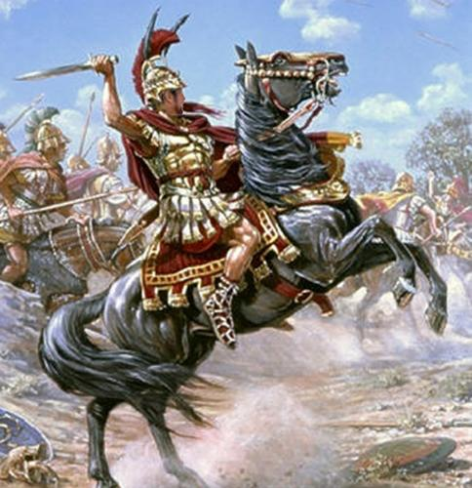
Gog Walled IN
With the aid of God, Alexander and his men close the narrow pass, keeping the uncivilized Gog and Magog from pillaging the peaceful southern lands. The nature of the pass is never very clear; some sources
say it is a pass between mountains, while others say it is a pass between the peaks and the Caspian Sea

Slide 26
Satan Bound For 1000 Years
Here is a painting by Qasim, 16th century, illustrating the building of the wall
Notes:
In the Qur'an, in Surat al-Kahf (83-98), it is written that Dhul-Qarnayn (the one with two horns) — who due ambiquity has been conjectured to refer to various historical figures including Cyrus the Great, and Alexander the Great — travelled in three directions, meeting villagers who complained about Yajooj and Majooj in each. First, to where the twin suns rise (to the east); second, to where the twin suns set (to the west); and a third direction, which is not specified in the Qur'an, between two mountain chains where a folk were living on the foothill, and to the north dwelt Yajooj and Majooj (sometimes transliterated from Arabic as Yajuj and Majuj), who continuously attacked the southern people. They are believed to be two tribes of wild and destructive nature.
When Dhul-Qarnayn arrived at the third location, that folk complained about the tribes and offered Dhul-Qarnayn a tribute to build a wall between them so that Yajooj and Majooj would not bother them anymore. Believing his reward would be from God, Dhul-Qarnayn refused the tribute but agreed to build the wall. He constructed the wall out of iron and then poured melted copper over it, making it difficult to climb or dig under. This stopped Yajooj and Majooj from threatening the people for a certain time. There is an opinion that this wall might be in the Caucasus Mountains at Dariel Pass. According to the Islamic scholar, Mufti Ebrahim Desai, they are situated in a land of ice.
The Yajooj and Majooj attempt to break through the iron wall every day, but when night falls and they are near escape, they stop and say to each other "we will finish it tomorrow". The next day when they wake up, they see that all the work they had done had become undone while they slept. This scenario continues every day until the day they say "we will finish tomorrow, in sha allah" (in sha allah meaning by the will of God) before they sleep, and thus when they awaken, they will finish their work and break out.[citation needed]
They are also mentioned in the sayings of the prophet of Islam, Muhammad, as the sign of the nearness of the Doomsday, and that they will destroy the civilizations (The Books of Sahih Al Bukhari and Sahih Al Muslim).
"But when Ya'jooj and Ma'jooj are let loose and they rush headlong down every height (or advantage)" (Quran 21:97)
They will emerge during the reign of Jesus, and will be vast in number [2] drinking up the waters of the Tigris and Euphrates. It is said that Allah (God) divided mankind into ten parts- nine tenths constitute Ya'jooj and Ma'jooj while the remaining tenth constitutes the rest of mankind. Some Muslim Scholars like Abul kalam Azad, Sayed Moududi and Tibri believe that they were Mongols, who were always raiding and destroying the Persian and Indian civilisations, and finally destroyed the Muslim dynasty of Baghdad and Khwarzam (central Asia).
The conquest and the fate of Ya'jooj and Ma'jooj in the Hadith is quite similar to the Martian invaders' conquest and fate in the fictional story of The War of the Worlds. Both armies are unstoppable by the humans, only to be killed by small creatures. It's unknown if H.G. Wells was inspired by the Hadith or such similar stories for the story.

Slide 27
Satan Bound For 1000 Years
Arab tradition corroborates that the symbolic binding of Satan was Gog & Magog (The Jews) “They did not understand anything, because they were so isolated; they were Gog and Magog. They were spreading corruption through the earth,
Abu'l-Abbas Ahmad ibn Muhammad ibn Kathir al-Farghani
Circa 833-900AD

Slide 28
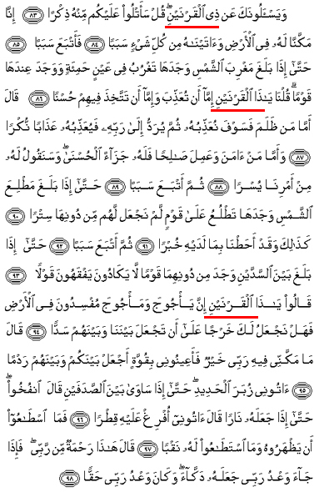
Satan Bound For 1000 Years
.. and harming the people, so the people sought help from Dhu'l Qarnayn. They asked him to build a barrier between them and Gog and Magog. He asked them to help him to build it, so together they built a barrier by mixing iron, copper and tar.”
Dhu'l Qarnayn - Writing

Slide 29
Satan Bound For 1000 Years
From the map on the left, one can see that Gog was hemmed in with no easy access to the civilised world

Slide 30
Khazars – Gog & Magog
This means that it is highly likely that the prophecies in The Bible concerning Gog and Magog, are directly relevant to the activities and destiny of the Khazar Jews. After being released (scattered abroad) from their Khazar Kingdom
Mountains of The Caucuses

Slide 31
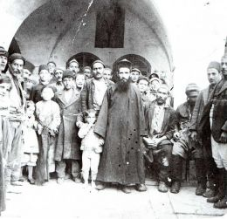
Satan Bound For 1000 Years
– they were further entrapped in the Ghettoes of Poland within the Russian Empire and were not permitted to leave on pain of death – hence the term “beyond the pale”
One of the Polish Ghettoes

Slide 32
Russia Quarantines Gog’s Polish Kahal
"Empress Catherine II (the Great!) established a (Russian) protectorate over Poland through armed force....prior to the Russian victory over Poland, Russia proper did not have a large Jewish population…
Empress Catherine II

Slide 33
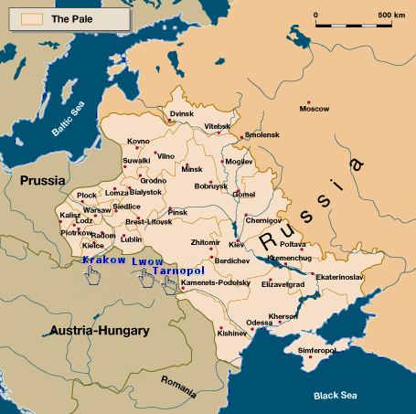
Russia Quarantines Gog’s Polish Kahal
Czarina Catherine the Great established a territory called the Pale of Settlement. The purpose was to restrict the Jewish population to this area and confine the impact of the Jewish population on Russian society." (Above Quotes from "Anti‑Semitism: Causes and Effects")
The Pale

Slide 34
The Ghettos of Poland

Slide 35
Sarkel (Itil) – Khazarian Capital
Left: The ruins of the Khazarian capital now covered by a reservoir – no doubt to prevent excavations!
Sarkel (Itil) Aerial photo of remains of the Khazar capital

Slide 36
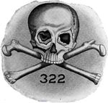
Gog & The Skull & Bones Society
Gog and Magog are two of the traditional monikers taken by newly-inducted members of the Skull and Bones Society.
On an initiate's first day in the Skull and Bones society, they are assigned a name, which they will be known as for the rest of their life.
Skull & Bones Logo

Slide 37
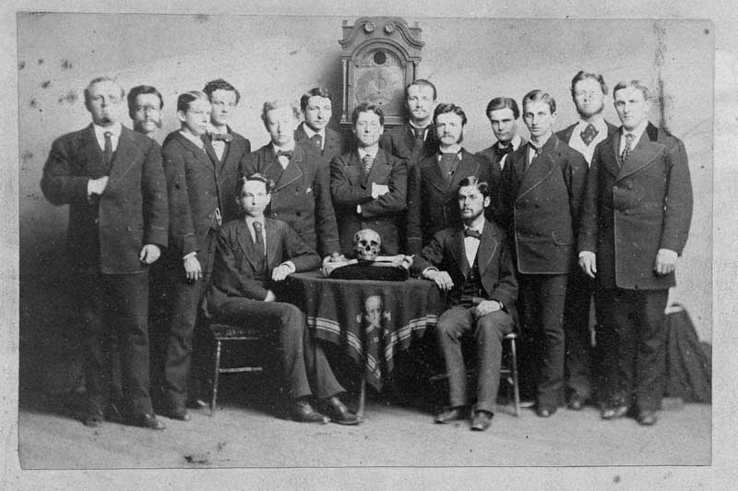
Gog & The Skull & Bones Society
The Order of Skull & Bones -- Yale University Circa 1900
Two of the names that are regularly used are: Magog, which is assigned to the initiate with the most experience with the opposite sex; Gog, which is assigned to the least sexually experienced.

Slide 38
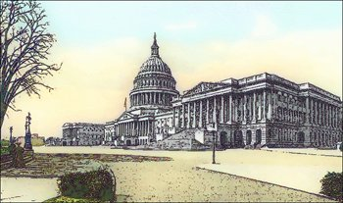
Gog & The Skull & Bones Society
Many USA Presidents have been members of this Illuminati organisation together with many high officials in the administration

Slide 39
The Skull And Cross Bones
America’s wealthiest Families are members of the order:-
The Rockefellers
The Davidsons
The Paynes
The Harrimans
The Bushes
Arthur Sutton Traced The Occult Traditions Of This Organisation To The Illuminati
Notes:
The wealthiest American families are Order members: the Rockefellers, Davidsons, Paynes and Harrimans, who control major financial centers and leading fields of industry. The Order created its own funds and think tanks, its own research, consultative and power structures. In his book The Secret Cult of the Order, Sutton traced the occult traditions of an organization arising (as Rakovsky also asserted) from the Illuminati. It's curious that the symbolry of the "skull and bones", with its connotations of death and destruction, appeared simultaneously on the uniforms of the Nazi SS and in the name of the Order's affiliate at Yale University from which George Bush, future head of the CIA and US President, emerged. The "philosophical" strategy: to bring "thesis" and "antithesis" into conflict to achieve the desired "synthesis", was based on the ancient methodology of secret societies "enriched" by the Hegelian dialectic of the Order's founder, J.P. Morgan. (By the way, this "dialectic" was discussed in The Red Symphony.)

Slide 40
Bohemian Grove
Many of the Skull and Bone Society attend this pagan ceremony – it is purported that Tony Blair was invited to attend (2006) with his pal George Bush.

Slide 41
Satan Loosed From The Bottomless Pit
Satan (the Jews) being cast into the bottomless pit of non-influence for a symbolic thousand years (actually from the time of (Christ) or Yahshua until 1776). And is then released from the period of being rendered impotent politically and monetarily to go about deceiving The Nations
Left: A woodcut depicting an angel having the key to the bottomless pit going to release Satan.

Slide 42
The Thousand Years Bound
The Doomsday Book
The fall of Jerusalem 70AD ---- Doomsday Book started 1066 completed 1086
The Khazars convert en-mass to Judaism 740AD – The Board of Deputies of British Jews formed 1760 / The Illuminati formed 1776 / Congress of Wilhelmsbad 1782

Slide 43
The 1782 Congress of Wilhelmsbad
Louis XVI King of France
Emperor Leopold of Austria.
Gustavus III of Sweden
It was at this conference that the Masons voted to put to death these 3 European Monarchs

Slide 44
The 1782 Congress of Wilhelmsbad
The Wilhemsbad Congress in 1872, under the auspices of Meyer Amschel Rothschild, united continental masonry with the Illuminati.
Few to this day are aware of the importance of this event written about by Nester H. Webster
Meyer Amschel Rothschild's castle in Wilhelmsbad

Slide 45
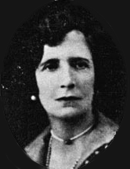
The 1782 Congress of Wilhelmsbad
Nesta H. Webster said "(its) importance to the subsequent history of the world has never been appreciated by historians”. It was held here "at Meyer Amschel Rothschild's castle in Wilhelmsbad" – Following the unification the power and influence of the Illuminati grew by leaps and bounds.
Nesta H. Webster

Slide 46
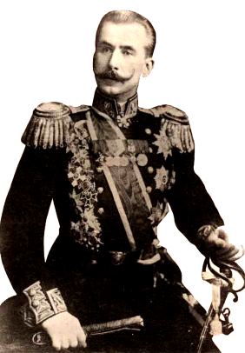
The 1782 Congress of Wilhelmsbad
Maj. General Count Cherep-Spiridovich (left) stated in his book “The Secret World Government or The Hidden Hand” that “The absence of the eight lines (show in next the 3 next slides) Mrs. Webster's book French Revolution most visibly detracts from its great value.”

Slide 47
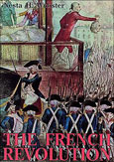
The 1782 Congress of Wilhelmsbad
"At Wilhelmsbad in 1782 it was decided to remove the headquarters of 'Illuminized' (i. e. re-judaized or re-satanized) Free-Masonry to Frankfurt­-am-Main, which 'incidentally' was the stronghold of Jewish Finance,

Slide 48
The 1782 Congress of Wilhelmsbad
….controlled by such leading members of the race as Rothschild, Mayer Amschel (left). At this head lodge of Frankfurt the gigantic plan of world revolution (practically murdering) was carried forward and it was there,

Slide 49
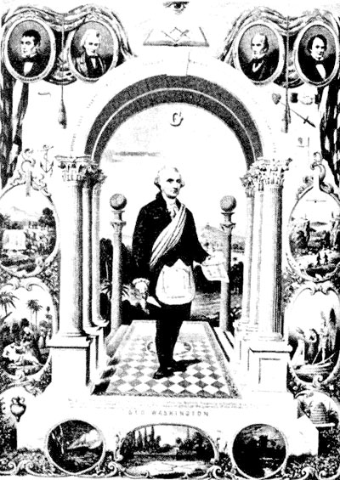
The 1782 Congress of Wilhelmsbad
…. that at a large Masonic Congress in 1786, the deaths of Louis XVI and Gustavus III of Sweden were definitely decreed." (And also of Emperor Joseph II of Austria).

Slide 50
The Thousand Years Bound
It is perhaps not insignificant that after the rise of Illuminati in 1776 – we find 2 Satanic symbols coming into wide use and being venerated by Christians – Namely the so-called “Star of David” and “Santa Claus”

Slide 51
Santa Claus = Satan
Unscramble the cleverly worded - “Santa Claus.” Santa is obviously S a t a n, and Claus is L u c a s, from the Roman name Lucius, meaning “luminous or white,” which is derived from Lucifer or the “bringer of the light.”

Slide 52
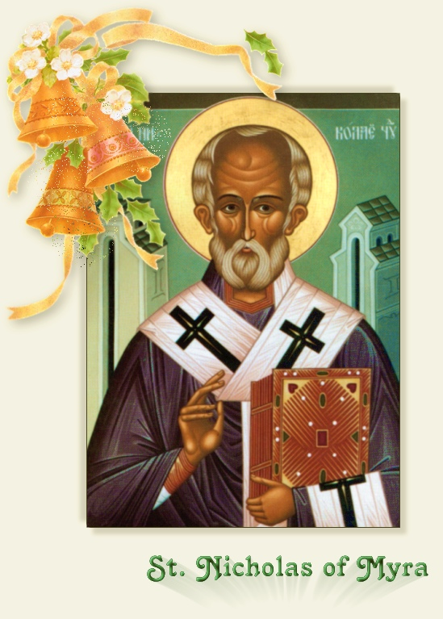
Santa Claus = Satan
Santa Claus is also called “Old Saint Nicholas,” because Nicolaus is the same name as Nicholas, or “Old Nick,” - the Devil himself.

Slide 53
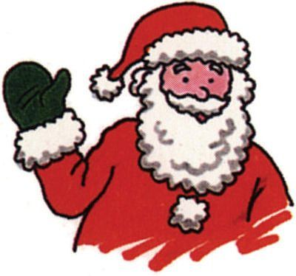
Santa Claus = Satan
If we stretch our imagination even further, every time Santa says “Ho-Ho-Ho”, he is really saying “666.” Each word "HO" has 6 letters between the H and the O, where you get... H i j k l m n O, then HO HO HO here equals 6 6 6.

Slide 54
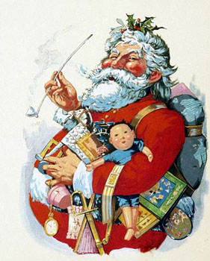
Santa Claus = Satan
Now, using A = 6, B = 12, C = 18, .... etc., the name
S A N T A C L A U S also adds up to 666.

Slide 55
The Star Of “David” The 666 Hexagram
The six-pointed star was the symbol of Moloch and Ashteroth. It certainly was not used by David, but was used by Solomon in the later years of his reign when …..
The hook of 6 points by which Gog would be drawn

Slide 56
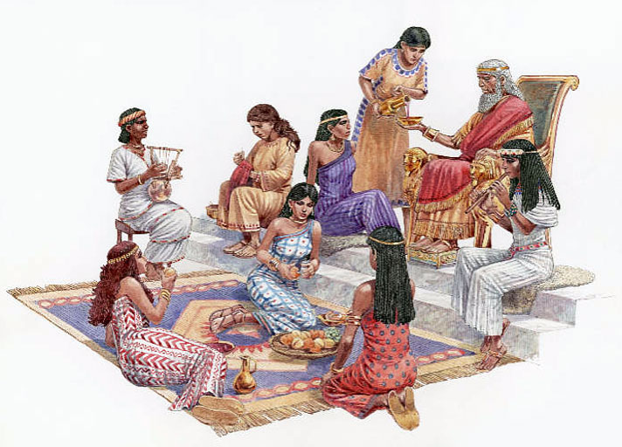
The Star Of “David” The 666 Hexagram
… he went after strange wives and religions causing Yahweh’s wrath and the splinting of the Kingdom.
Few Jews will tolerate a discussion of this subject
Some of King Solomon’s many wives

Slide 57
The Evil Eye
“The Serpent promised Adam and Eve that their eyes would "be opened" (Genesis 3:5)
The most foreboding aspect of this Scripture emerges from the fact that the Hebrew word for "eyes" is not plural, but singular.

Slide 58
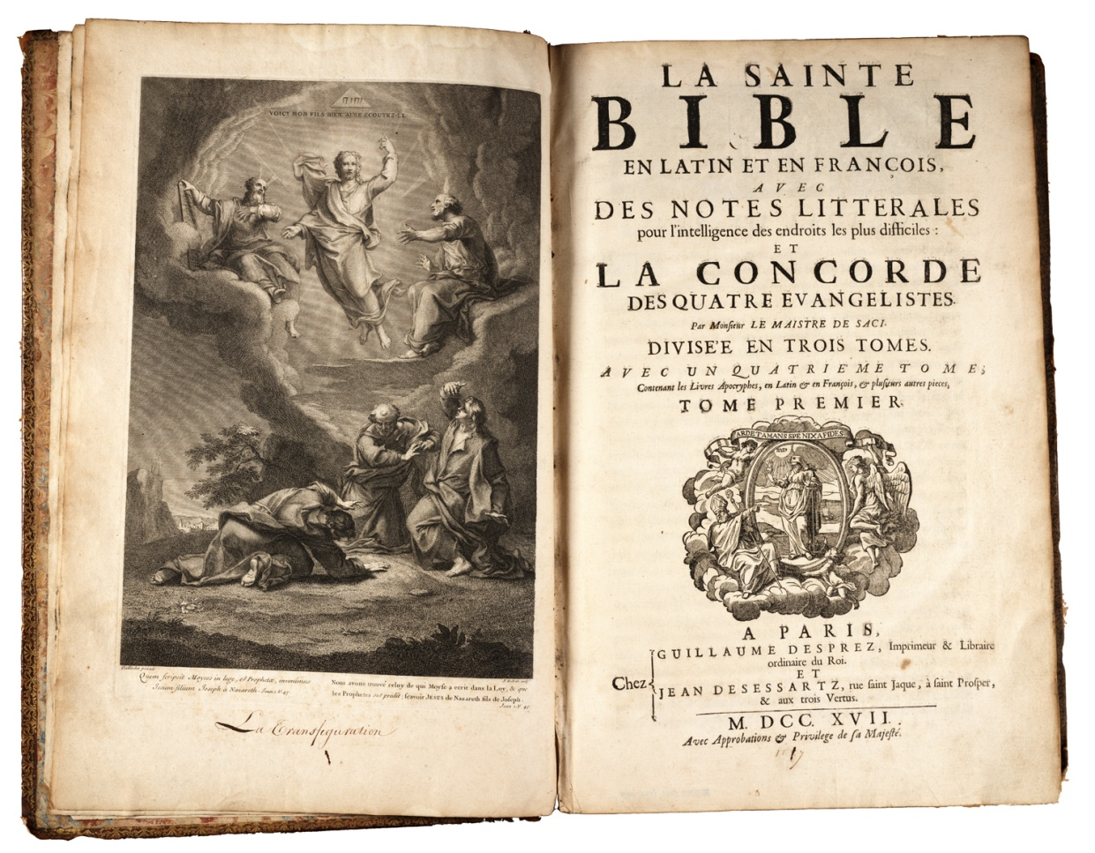
The Evil Eye
The "eye" that Scripture wants us to consider is not the physical organ of sight, but the eye of the mind or soul.

Slide 59
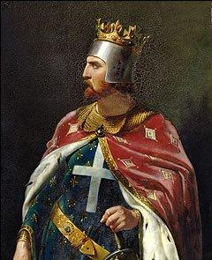
The Evil Eye
The Jews of England were forbidden to attend the coronation of Richard the Lion-heart (1189) for fear that an evil eye might harm the crown
Richard The Lion-Heart

Slide 60
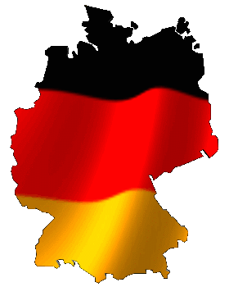
The Evil Eye
So feared was the purported power of the Jew, that the German word for evil eye remains to this day “Judenblick” (Jews glance).”

Slide 61
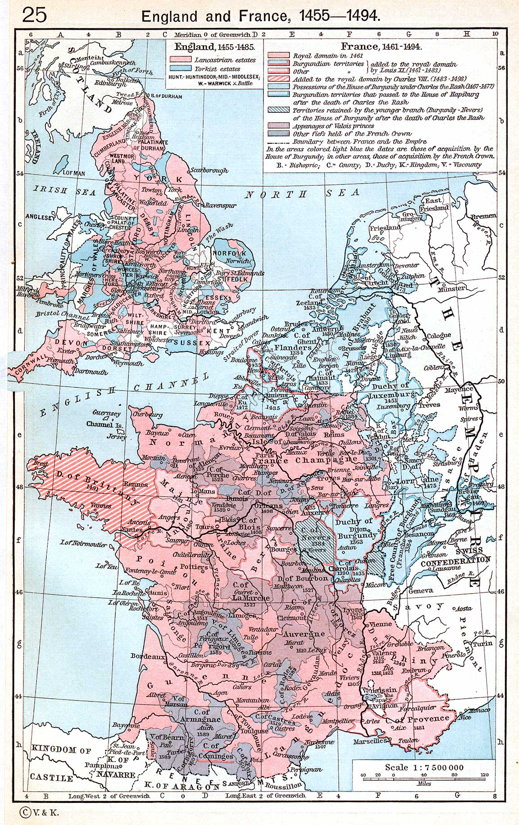
Israel Nations Expanding Trade & Territory
During the 18th & 19th Centuries Britain (Ephraim) & France (Reuben) were the most powerful nations in the world.
Gog would concentrate his attacks on these 2 powerful nations – France (The French Revolution) & Britain (Through its North American Colonies – the Boston “Tea Party” and later on the American Civil War.

Slide 62
The Hanseatic League
A Hanseatic League ship
Gog’s Trading block – The Hanseatic League (A Medieval Common Market) had ceased through the increased power of the Israelite nation states such as England, Holland, France and Spain to name just a few.

Slide 63
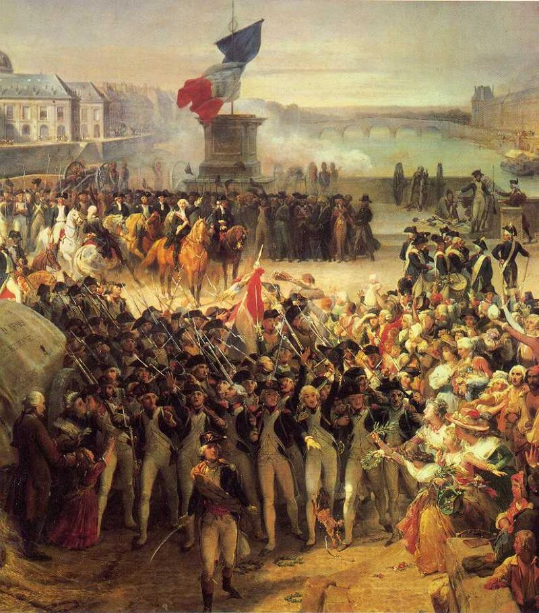
The Hanseatic League
Gog was now looking to reassert its control over trade – the first step towards this goal would be the overthrow of France – through the so-called “French” revolution!

Slide 64
The Hanseatic Trading League

Slide 65
Gog’s Stronghold In Poland
We Have seen in earlier presentations how on the collapse of the Khazar Empire, many Khazars went to Poland with many more joining them as a consequence of the Spanish Inquisition during the 15th century.
Polish (Khazar) Military

Slide 66
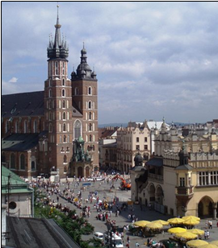
Gog’s Stronghold In Poland
Krakow was the main centre of an almost autonomous region and being a Khazar stronghold was the reason for it being in the Hanseatic League.
For this reason also it would become a pawn in the 2nd World War.
Krakow

Slide 67
Krakow – Poland – in the middle ages

Slide 68
Gog’s Hanseatic League Trading Block
The Hanseatic League was a trading association of German merchants and cities that was active from the middle of the 12th century to the middle of the 17th century. At its largest extent in the mid-1400s, league membership included over 100 cities. Hanseatic merchants maintained permanent enclaves called kontors in other major cities in northern and western Europe. At the height of its power, the Hanseatic League held a virtual monopoly on trade in the North and Baltic seas.

Slide 69
Gog’s Hanseatic League Collapses
With the decline of the Hanseatic League in the early 1700’s Gog would build the foundations of an even more powerful trading blocks as we shall see in the following slides and subsequent presentations.
Hildesheim – a Hanseatic League Trading Centre

Slide 70
Gog Takes Control Of the East India Companies
Gog would use its plunder from the British, French and Dutch East India Companies to finance its attack on the French & British Empires following the demise of The Hanseatic League. We shall now have a brief look at the history of the British East India Company.
A British East India Co. Coin

Slide 71
East India House in Leadenhall Street, London as drawn by Thomas Hosmer Shepherd, c.1817.
The British East India Company was a British commercial and political organization established in India in the late1600’s, which was known as the Governor and Company of Merchants of London. A forerunner of this group was the London Mercers Company

Slide 72
British East India Company
The British East India Company under the direct supervision of Francis Day and Andrew Cogon built it in 1640 AD. This place achieved its name from Saint George, the patron saint of England. The fort houses Saint Mary's Church and fort museum. Saint Mary's Church the oldest Anglican Church built in 1680 and the tombstones in its courtyard are the oldest British tombstones in India.
Chennai, India

Slide 73
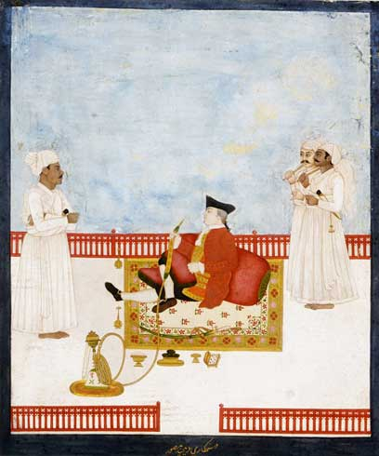
British East India Company
The fort houses Saint Mary's Church and fort museum. Saint Mary's Church the oldest Anglican Church built in 1680 and the tombstones in its courtyard are the oldest
An East Indian Official

Slide 74
British East India Company
1707 - 1 Jan 1801
British East India Company flag
1 Jan 1801 - 2 Aug 1858
British East India Company flag
Notice the similarity to the United States flag – The Stars and Stripes

Slide 75
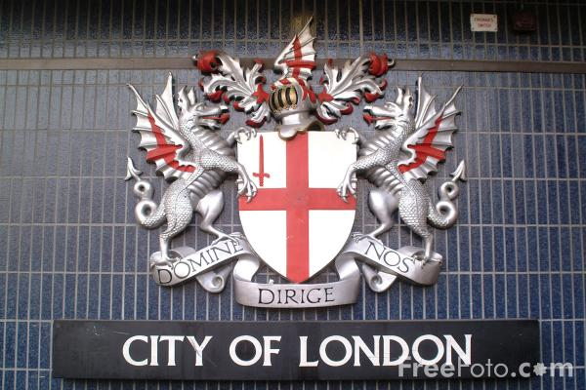
Gog – Would Seize Control Of The British East India Company
This would be achieved by using the City of London’s money power – “the great red dragon” – here we see the dragon supporters of the city’s coat of arms!

Slide 76
Gog’s Ambitions In India Thwarted
Indian policy was influenced by the company from 1757 to 1773, when their power was broken by the 1773 Regulatory Act, and Pitt’s India Act of 1784, finally ending their monopoly in 1813.

Slide 77
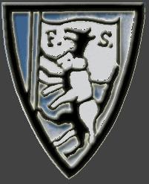
Gog’s Ambitions In India Thwarted
When they ceased to exist in 1873, many of its shareholders were major financiers. The principals of this group perpetuated their elitist goals by establishing the Fabian Society
The Fabian Society Logo

Slide 78
Karl Marx – Writes Gog’s Agenda
Karl Heinrich Marx
(May 5, 1818, Trier, Germany-March 14, 1883, London, England). Chief theoretician of Communism.

Slide 79
Karl Marx – Writes Gog’s Agenda
Philosopher and political economist. Revolutionary. Journalist. Collaborated with Friedrich Engels. Organized International Workingmen's Association. Author of the Communist Manifesto (1848) and Das Kapital.

Slide 80
The 2nd English Revolution 1884!
What Marx would do by force the Fabian Socialists would carry out by stealth by re‑education and propaganda. The Fabian Society was formed in January 1884 after the arrival of the pseudo Jews from Russia.
The Fabian Society Logo

Slide 81
The Fabian Society
Here we see their present day headquaters at 11 Dartmouth St. London only a stone’s throw from 10, Downing St. and the Houses of Parliament
Fabian HQ

Slide 82
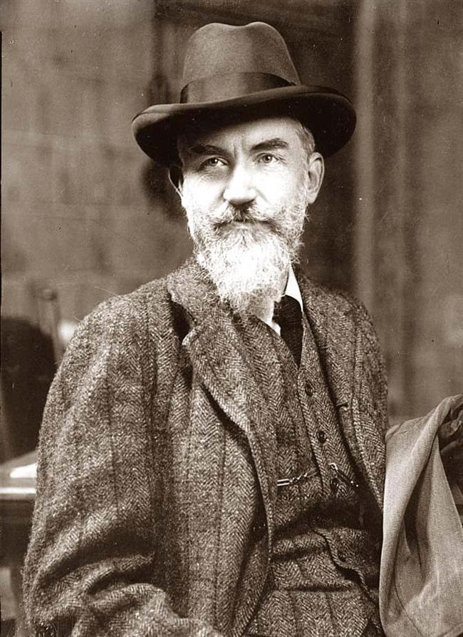
The Fabian Society
Among the early members was George Bernard Shaw, joined in April 1884 by, Edward Carpenter the poet Laureate of British Socialism, Havelock Ellis the apostle of free love also Frank Podmore and Sydney Webb, the founder of the London School of Economics.
George Bernard Shaw

Slide 83
The Fabian Society
This unassuming red door is the entrance to the Fabian headquarters in London.
The red painted door signals its Rothschild allegiance as well as the Illuminati sacred No. 11. Note also that the address 11, Dartmouth St. contains 11 letters

Slide 84
The East India Company & Virginia Company Have A Common Origin
A forerunner of this group (The British East India Company) was the London Mercers Company, and earlier than that, the London Staplers. The organization traced their lineage back to the ancient commercial groups involved in trading between the Mediterranean and India.

Slide 85
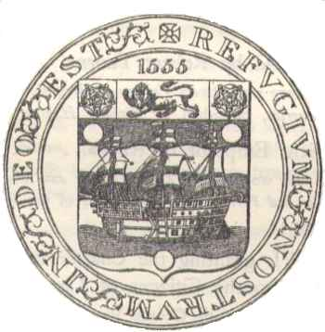
The East India Company & Virginia Company Have A Common Origin
They were closely related to the Levant Company, and the Anglo-Muscovy Company, and spawned the London Company, which was chartered in 1606 by King James I, to establish the Virginia Plantation on a communistic basis, and the Plymouth Colony in 1621.
Seal of Anglo-Muscovy Company

Slide 86
Gog Puts Pressure on King George III
Gog put the squeeze on King George and said they wouldn’t loan him any money unless pressure was put on the colonies by taxes. This was started and it kept increasing --- taxation without representation, and the Revolutionary war was a direct result of this squeeze on King George by the Jews. It was a plan by the international Jews to break the financial structure of the USA.
King George III

Slide 88
The 13 Colonies Gain Their Independence
1783 – Treaty of Independence signed between the 13 colonies and Great Britain

Slide 89
Gog’s Agents On Both Sides Of The Peace Treaty Signing
What the people of the United States didn’t know was that the peace treaty only gave independence superficially – because they were still tied to the “Crown” – not the Royal Crown but the legal crown in the inns of court in London and the London money power or the Great Red Dragon of Revelation.
The Knights Templars

Slide 90
Gog Establishes A Central Bank In The USA
1791: The Rothschilds through Alexander Hamilton (their agent in George Washington’s cabinet) set up a central bank in the USA called the Bank of the United States. This was established with a 20 year charter.
Alexander Hamilton

Slide 91
Gog – Starts To Eliminate & Control European (Israelite) Powers
1806: Napoleon states that it is his, “object to remove the house of Hess-Cassel from rulership and to strike it out of the list of powers.” On hearing this, Prince William IX of Hesse-Hanau, flees Germany, goes to Denmark and entrusts his fortune valued at $3,000,000 at that time to Mayer Amschel Rothschild for safekeeping.

Slide 92
Gog’s Plans For The USA Thwarted
1811: The charter for the Rothschilds Bank of the United States runs out and Congress votes against its renewal. At the time Andrew Jackson (who would become the 7th President of the United States from 1829 to 1837) says, …..
Andrew Jackson

Slide 93
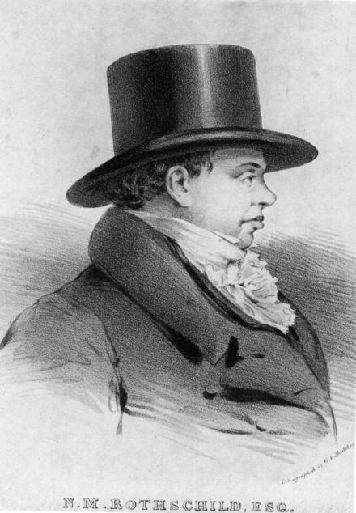
Gog’s Plans For The USA Thwarted
“If Congress has a right under the Constitution to issue paper money, it was given them to use by themselves, not to be delegated to individuals or corporations.”
Nathan Mayer Rothschild is not amused and he stated,

Slide 94
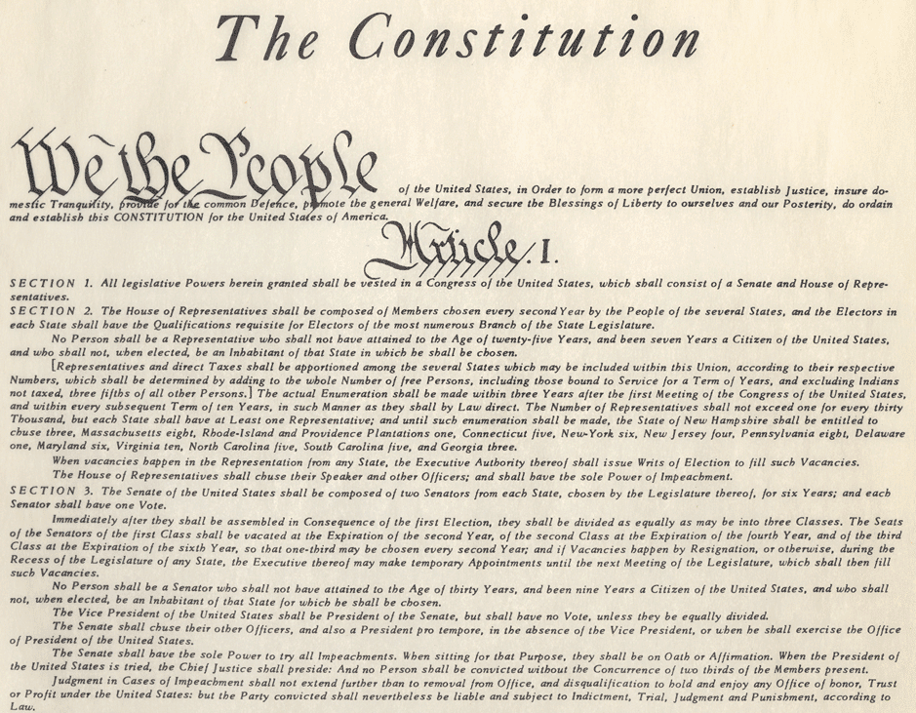
Gog’s Plans For The USA Thwarted
“Either the application for renewal of the charter is granted, or the United States will find itself involved in a most disastrous war.”
“Teach those impudent Americans a lesson. Bring them back to colonial status.”
The US Constitution

Slide 95
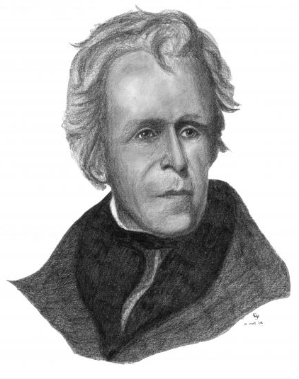
Gog’s Plans For The USA Thwarted
US President Andrew Jackson, the only US President (1839/47) to totally abolish the National Debt, condemned the international bankers as "A den of vipers,"
Andrew Jackson

Slide 96
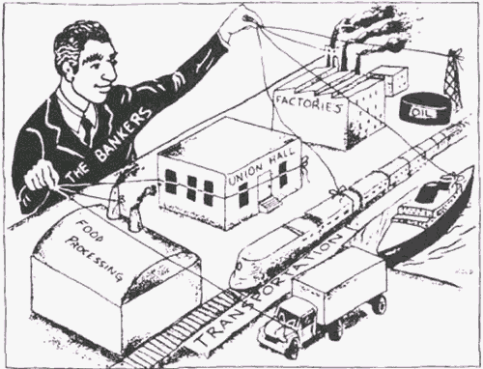
President Jackson & The Money Power
… one which he was determined to root out of American life. Jackson claimed that if the American people only understood how these "snakes" operate, . . "There would be a revolution before morning”

Slide 97
Bank Of The United States
1812: Backed by Rothschild money, the British declare war on the United States. The Rothschilds plan was to cause the United States to build up such a debt in fighting this war that they would have to surrender to the Rothschilds and allow the charter for the Rothschild owned Bank of the United States to be renewed.

Slide 98
The London Money Power
“I care not what puppet is placed upon the throne of England to rule the Empire on which the sun never sets. The man who controls Britain's money supply controls the British Empire, and I control the British money supply.”
Nathan Mayer Rothschild 1815

Slide 99
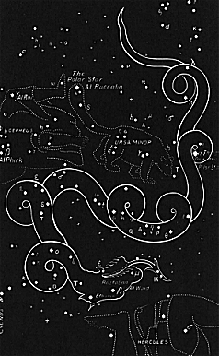
Louisiana Part Of Gog’s Plot To Control The USA
Revelation 12:4
And his tail drew the third part of the stars of heaven, and did cast them to the earth: and the dragon stood before the woman which was ready to be delivered, for to devour her child as soon as it was born. This would be re-enacted in the Stars of the American Heaven – as we shall see.
DRACO (The Dragon)

Slide 100
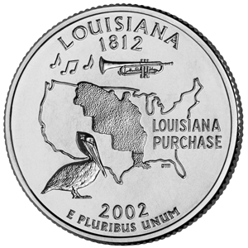
Gog Wanted To Split The USA Into 2 Parts
The Louisiana Territory was just purchased from France by the United States. This Territory was initially claimed by France but France secretly ceded it to Spain in 1762.
A Louisiana Territory

Slide 101
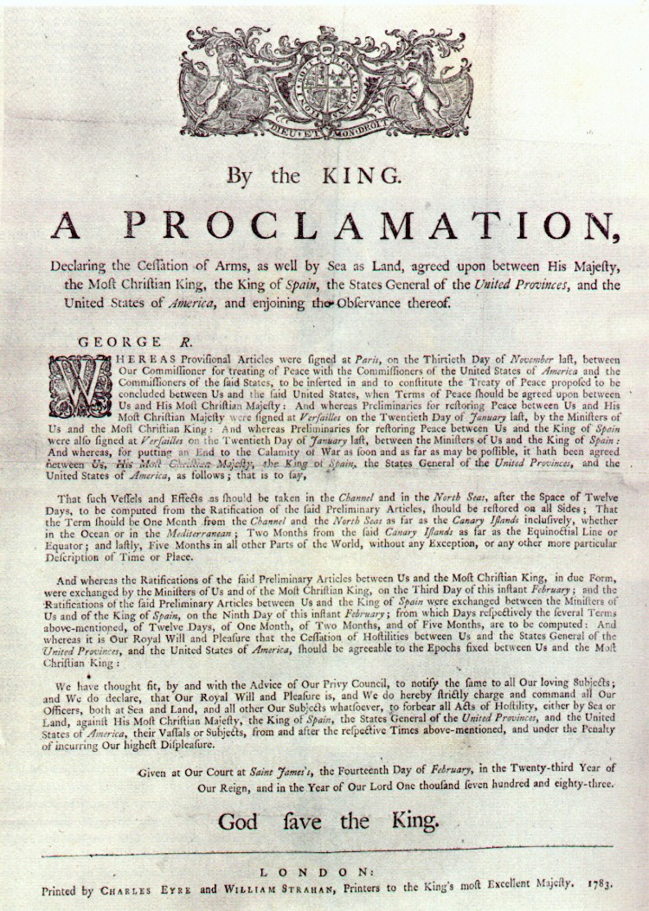
Gog Wanted To Split The USA Into 2 Parts
In the Treaty of Paris in 1763, the British ratified the treaty giving Spain hegemony over the vast area.

Slide 102
Gog Wanted To Split The USA Into 2 Parts
Here we see that Louisiana covered almost a third of the USA and even extending into Canada – hence it being the centre of political intrigues between the European powers of that day

Slide 103
Louisiana’s Many Flags Indicates Its Turbulent History
1519
Spanish Flag of Leone & Castile

Slide 104
Louisiana’s Many Flags Indicates Its Turbulent History
1682
French Fleur-de-Lis

Slide 105
Louisiana’s Many Flags Indicates Its Turbulent History
1763
British Grand Union [1763]

Slide 106
Louisiana’s Many Flags Indicates Its Turbulent History
1769
Bourbon Spain [1769]

Slide 107
Louisiana’s Many Flags Indicates Its Turbulent History
1803
The French Tricolour

Slide 108
Louisiana’s Many Flags Indicates Its Turbulent History
1810
West Florida Lone Star [1810]

Slide 109
Louisiana’s Many Flags Indicates Its Turbulent History
1861
Independent Louisiana [1861]

Slide 110
Louisiana’s Many Flags Indicates Its Turbulent History
1861 (The last flag only Lasted 2 Months!
Independent Louisiana [1861]

Slide 111
Louisiana’s Many Flags Indicates Its Turbulent History
1912
Louisiana Flag [1912] - The present flag

Slide 112
Plan To Divide The USA Thwarted
1815 Andrew Jackson defeated the British at the Battle of New Orleans and saved control of the lower Mississippi for the United States. The British troops numbered about 8,000 to Jackson's 4,000 defenders
General Jackson— the Lord's terrible swift sword— commanding his troops at the Battle of New Orleans

Slide 113
The Czar Thwarts Gog’s Plans A Second Time In The USA
Emperor Alexander sent the Russian navy to New York, Virginia and San Francisco in 1863 and their presence was a warning to France and Great Britain (The Rothschilds) to stay out of the conflict. In 1867, he sold Alaska to the U.S. for the measly sum of $7.2 million dollars. For freeing the serfs and saving the American Union, Emperor Alexander was killed by a Gog assassin in 1881.
Emperor Alexander II of Russia (1818-1881).

Slide 114
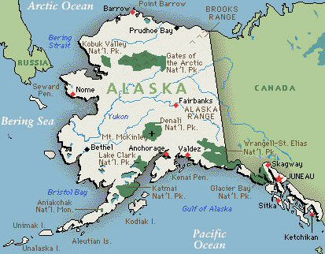
The Czar Thwarts Gog’s Plans A Second Time In The USA
…. In 1867, he sold Alaska to the U.S. for the measly sum of $7.2 million dollars. For freeing the serfs and saving the American Union, Emperor Alexander was killed by a Gog assassin in 1881.
Alaska – Formerly Russian Territory

Slide 115
The Czar Thwarts Gog’s Plans
Russian ship Osliaba arrived in Alexandria, Virginia, in 1863.
For thwarting Gog’s plans a terrible revenge would be exacted on the Czar and Russian Christians – it should be noted that people of other religions such as Islam were not harmed

Slide 116
GOG – Initiates Communism In France
Lionel de Rothschild (the de was added by the French Rothschilds) was involved with the first communist Internationale. The Mason Mazzini who helped start communism praised Rothschild, “Rothschild could be King of France if he so desired.”
Giuseppe Mazzini

Slide 117
France
We now look at events in France that would have serious repercussions for the rest of the world:
The French Revolution & the rise of Communism

Slide 118
Sir Walter Scott On The French Revolution
Sir Walter Scott publishes his nine volume set, The life of Napoleon and in volume two he states that the French Revolution was planned by the Illuminati (Adam Weishaupt) and was financed by the money changers of Europe (The Rothschilds).
Sir Walter Scott

Slide 119
First Communist (Jewish) Revolution - Paris Burns
The Masonic book A Ritual and Illustrations of Freemasonry contains the following passage, 'The Masons... originated the Revolution with the infamous Duke of Orleans at their head.'
The Duke of Orleans

Slide 120
First Communist (Jewish) Revolution - Paris Burns
The Duke of Orleans, grand master of the Grand Orient Lodge of Freemasons, who reportedly bought all the grain in 1789 and either sold it abroad or hid it away, thus creating near starvation among commoners. Galart de Montjoie, a contemporary, blamed the Revolution almost solely on the Duke of Orleans,
The Duke of Orleans

Slide 121
First Communist (Jewish) Revolution - Paris Burns
Guiseppe Balsamo, a student of the Jewish Cabala, a Freemason, and a Rosicrucian, became known as Louis XVI's court magician Caliostro. He wrote how the German Illuminati had infiltrated the French Freemason lodges for years and added, ….
Guiseppe Balsamo

Slide 122
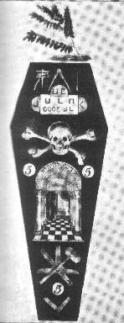
First Communist (Jewish) Revolution - Paris Burns
… "By March 1789, the 266 lodges controlled by the Grand Orient were all 'illuminized' without knowing it, for the Freemasons in general, were not told the name of the sect that brought them these mysteries, and only a very small number were really initiated into the secret.“
Logo – Grand Orient Lodge - 1776

Slide 123
First Communist (Jewish) Revolution - Paris Burns
The Marquis de Lafayette, the man who had been initiated into the Masonic fraternity by George Washington, also played an important role in the French revolutionary cause. The Jacobin Club, which was the radical nucleus of the French revolutionary movement, was founded by prominent Freemasons.
The Marquis de Lafayette

Slide 124
First Communist (Jewish) Revolution - Paris Burns
After a series of failed rebellions, the Jacobites in Scotland were finally crushed at the battle of Culloden Moor near Inverness in 1746. Their leader, Charles Edward Stuart, "Bonnie Prince Charlie,
Bonnie Prince Charlie

Slide 125
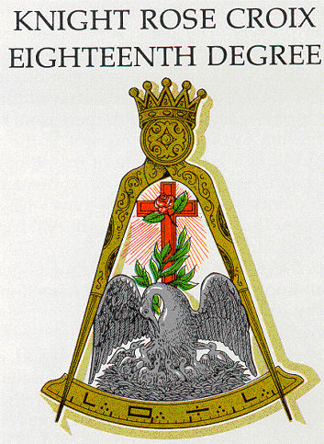
First Communist (Jewish) Revolution - Paris Burns
… the young pretender," escaped to France, taking with him Jacobites imbued with "Freemasonic ideals". A year later in Arras, France, Charles chartered a Masonic Sovereign Primordial Chapter of Rose Croix known as "Scottish Jacobite"...

Slide 126
First Communist (Jewish) Revolution - Paris Burns
French Masons were heavily involved in the political events of that day. Webster noted, "All the revolutionaries of the Constituent Assembly were initiated into the third degree" of Illuminized Masonry,
A French Masonic Symbol

Slide 127
First Communist (Jewish) Revolution - Paris Burns
including revolutionary leaders such as the Duke of Orleans, Valance, Lafayette, Mirabeau, Garat, Marat, Robespierre, Danton, and Desmoulins.
Robespierre

Slide 128
The Red Flag of The Rothschilds
The French Revolution was the first Communist influenced uprising on the Continent i.e. The Red Flag of The House of Rothschild

Slide 129
Red – Gog’s Colour
The Phrygian cap of the Mithraic mysteries, known as the Bonnet Rouge (Red Hat), became the emblem of the revolutionaries and the Masonic tenets of Equality, Liberty and Fraternity their rallying cry. Mirabeau,

Slide 130
First Communist (Jewish) Revolution - Paris Burns
Because Britain and France were the two greatest world powers in the late years of the 18th Century; Weishaupt ordered the Illuminati to foment the colonial wars, including our Revolutionary War, to weaken the British Empire and organize the French Revolution to start in 1789

Slide 131
The French Revolution
Left: 1793 - the King of France is beheaded in Paris on the square now known as the Place de la Concorde. His head was displayed to waiting mob after his execution.
The Beheading of The King of France
Notes:
The French Revolution soon took a sub-racial undertone - often it was enough to have blond hair to be declared a noble and be beheaded. This was taken to an extreme under a bloodthirsty period known as the "reign of terror" and led to civil and foreign wars for ten years.
During this period, revolutionary tribunals and commissions beheaded close on 17,000 people - when the numbers of Frenchmen who died in prison or who were shot out of hand is added in, the victims of the Reign of Terror totaled approximately 40,000.

Slide 132
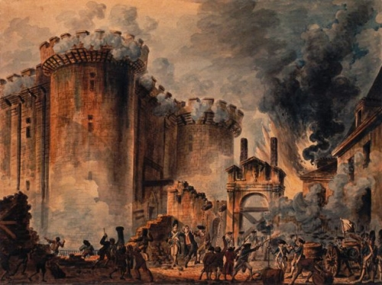
The French Revolution
Often it was enough for a person just to have had blond hair to be accused of being a nobleman - even though this was of course not always true, the French Revolution severely reduced the number of blond haired Whites in France.
Storming of the Bastille prison.

Slide 133
First Communist (Jewish) Revolution - Paris Burns
Many more devastating attacks on Christendom were to follow:-
Russia, Armenia, Ukraine, World War 1, World War 2, Rhodesia, South Africa, Serbia
1792: In the midst of the French Revolution, Jews in France are granted citizenship and full civil rights.
Notes:
Above: The world's first Communist Revolution. France's troubles did not end with the defeat of her army by the Prussians in 1871 - following the downfall of the Emperor Louis Napoleon, communists declared a 'Communistic Republic' in Paris on 28 March 1871. The French army moved to suppress the revolution and attacked Paris, but for two months the Parisians, armed with the weapons they had been issued with during the Franco-Prussian War and which they had been allowed to keep, resisted. After a series of street fights in some of the city's most well known thoroughfares, the Communists were defeated. A few stragglers however took their revenge by burning down some of the city's most famous landmarks - and they made a good job of the Tuileries Palace (the city residence of the former Kings of France, which was razed to the ground.) Here the Tuileries burns, along with other buildings in Paris, during the last hours of the world's first Communist state.

Slide 134
First Communist (Jewish) Revolution – Power Passes To The Bankers
In the French Revolution power subtlety passed to the bankers who weren't constrained by Christian niceties. Royal power was taken over by persons,

Slide 135
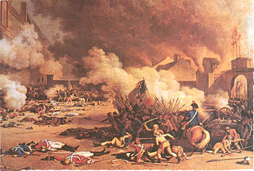
First Communist (Jewish) Revolution – Power Passes To The Bankers
…. whose moral, intellectual and cosmopolitan qualities did allow them to use it. It is clear that these were people who had never been Christians, but cosmopolitans.“

Slide 136
Gog Profits From War Between 2 Great Israelite Powers
Napoleon
Duke of Wellington
1815: The five Rothschild brothers work to supply gold to both Wellington’s army (through Nathan in England) and Napoleon’s army (through Jacob in France),

Slide 137
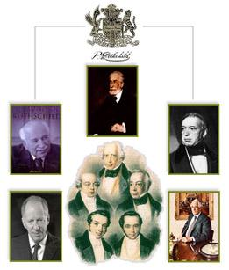
Gog Profits From War Between 2 Great Israelite Powers
… and the Rothschilds begin their policy of funding both sides in wars which they engineer.

Slide 138
Napoleon, Financed by the Rothschilds built synagogues in all major towns he conquered

Slide 139
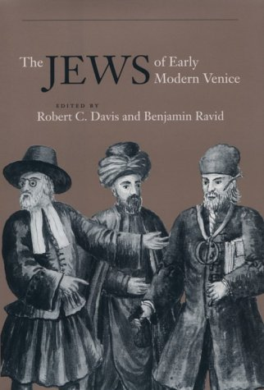
Napoleon (a Gentile Freemason)
Emancipated the Jews of Venice. In the course of his campaigns across Europe, Napoleon will replace the feudal kingdoms that he conquers with new republics,

Slide 140
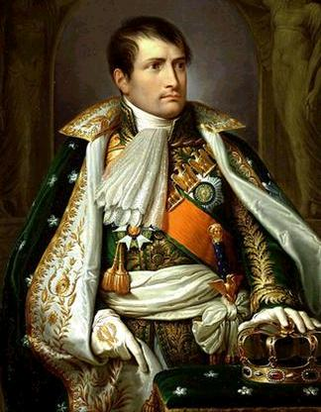
Napoleon (a Gentile Freemason)
…. and the Jews are set free from the restrictions of the ghetto which had been placed upon them. Napoleon is still honoured today as the "Emancipator of the Jews.“

Slide 141
The Serpent Disraeli Ingratiates Himself With Queen Victoria
The Westminster Review quoted Daniel O’Conner as saying: “If Disraeli’s genealogy would be traced back, he would no doubt be found to be the true heir of the impenitent thief on the cross”
Engraving Westminster Review

Slide 142
Prince Albert Was Considered A Threat To The NWO
Queen Victoria saw her duty as looking after her large family of 9 children and left the Hurley-burley of politics to Prince Albert. By his consolatory diplomacy between the 2 warring sides and Great Britain in adverting a world war, Gog saw him as an obstacle to their plans, so had to be eliminated.

Slide 143
The Trent Affair
One of the Prince's last and most notable services to his adopted country was the redrafting of a provocative British despatch at a moment of high tension in Anglo-American relations.
Prince Albert

Slide 144
The Trent Affair
The European powers were shaken by the Unexpected victory of the Confederates at the battle of Manassas in July 1861

Slide 145
The Trent Affair
This was a ruse to get the European Powers involved in the American Civil War in order to bring the plans of the Rothschilds to fruition.
The Trent Interception

Slide 146
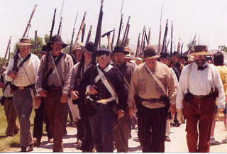
The Trent Affair
The Confederates sent 2 commissioners to London – sailing on the British Royal Mail steamer Trent (Captain Moir). However, news of their sailing plans had reached Captain Charles Wilkes of the U.S. warship San Jacinto and who decided to intercept them on the high seas.
The Confederates

Slide 147
The Trent Affair
Lord Palmerston was for strong action against the United States and instructed the Foreign Office to draft a letter to president Lincoln.
Lord Russell's draft was considered and approved by the Cabinet at its meeting on November 30th.
Lord Palmerston 1809-1865

Slide 148
The Trent Affair
Drafts of the letter arrived at Windsor Castle late that evening, and were earnestly discussed by the Queen with her husband. The Prince Consort was at this moment an already dying man.
Windsor Castle

Slide 149
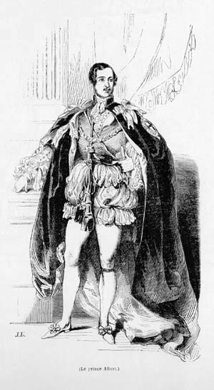
The Trent Affair
The Prince Consort’s acute Germanic brain was still active in his ailing body and, after discussing Russell's drafts with the Queen, he took them to his bedroom.
To his clear and detached mind it was apparent that Britain had nothing to lose, but, on the contrary, much to gain by preserving peace.

Slide 150
The Trent Affair
At eight o'clock he brought his Memorandum to the Queen's room, exclaiming pitiably: "Ich bin so schwach, ich habe kaum die Feder halten konnen." But his work was done; it was the last service he was to perform for his country. He had avoided war. Two weeks later he was dead (December 14th, 1861). – Murdered by Gog’s agents.

Slide 151
Prince Albert Assassinated By Poison?
Prince Albert on his death bed – supposedly from Typhoid – being a very contagious disease – no one else in the household caught it despite being so close!

Slide 152
Death Of Prince Albert
The death of Prince Albert would leave Queen Victoria open to the machinations of wily politicians
Prince Albert Memorial

Slide 153
The Serpent Disraeli Ingratiates Himself With Queen Victoria
Upon the death of Prince Albert 14 December, 1861, at the age of 42, the serpent in the form of Benjamin Disraeli moved in.
The Cartoon Alludes to Disraeli Exchanging the Crown Of England for The Empress of India Crown
Disraeli and Queen Victoria Exchanging Gifts (Punch Magazine 1876)
Notes:
Yes there is, and it’s as plain as the nose on a “Jew’s” face. To fit that criteria, the situation must return to a king’s advisor similar to Shebna, a “rolling-stone” descendant of Cain. By this yardstick, it can only be Benjamin Disraeli, Earl of Beaconsfield, sometimes called “Dizzy.” Benjamin was born 1804 and died 1881. He lived during the reign of Queen Victoria, born 1819, death 1901. She took the throne June 28, 1838. She married her first cousin, Prince Albert of Saxe-Coburg-Gotha, 10 February, 1840. Upon the death of Prince Albert 14 December, 1861, at the age of 42, the serpent in the form of Benjamin Disraeli moved in.
We cannot fully grasp the maneuvering that was developing at that time unless we understand Disraeli’s background. For that, I will give an abridged paraphrase from the book DISRAELI by André Maurois: In the year 1290, on All Saints’ Day, King Edward I expelled the “Jews” from England. It was the time of the Crusades, and the monks were crying, ‘get rid of the Infidels.’ Those “Jews” who survived that onslaught took asylum in France. There in 1306, King Philip the Fair, being pressed for money, confiscated their belongings and thrust them towards Spain. Upon the persecutions in Spain, they moved to Venice and Amsterdam, and back to France once more. After much confusion under Cromwell and the Puritans, at the close of the 17th century, a small community of Portuguese and Spanish Jews was reestablished in London. Among these returnees was the Disraeli family. Benjamin’s father, Isaac, spent most of his time at libraries and the British Museum. Upon the advice of Sharon Turner, the great Anglo-Saxon historian, Isaac, and his family were “converted to Christianity”, and “baptized.” After problems with his schoolmates, Benjamin, at the age of 15, returned home to utilize his father’s library, reading a wide variety of subjects. Vigorously, he read details on the secret societies; the Vehmgerichte, the Council of Ten, and the Jesuits, reading and rereading the life of St. Ignatius Loyola. Following a boring attempt at law practice, he reverted to writing and traveling, after which he entered politics, which his “baptism” helped to facilitate.

Slide 154
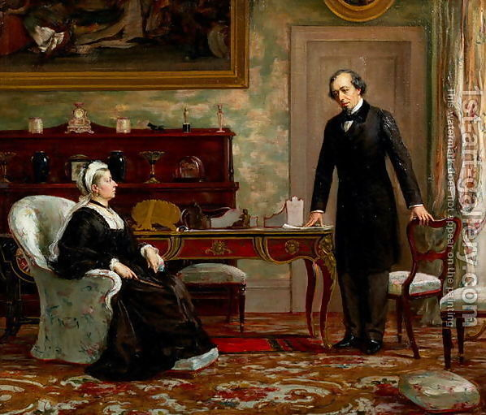
Benjamin Disraeli – Rothschild Agent
Disraeli having an audience with Queen Victoria
Benjamin Disraeli was the Rothschild’s European Banking Empire’s Representative in England.

Slide 155
Benjamin Disraeli – Rothschild Agent
In 1857 the Rothschilds and their representatives held a meeting and established a plan to divide the United States and conquer it financially. The North would revert to a British Colony and be annexed to Canada, while the South would come under the rule of Napoleon III.
Benjamin Disraeli 1804-1881
Notes:
Benjamin Disraeli, was born in London on 21st December, 1804. His father, Isaac Disraeli, was the author of several books on literature and history, including The Life and Reign of Charles I (1828). After a private education Disraeli was trained as a solicitor. Disraeli's maiden speech in the House of Commons was poorly received and after enduring a great deal of barracking ended with the words: "though I sit down now, the time will come when you will hear me." Disraeli was now a progressive Tory and advocated triennial parliaments and the secret ballot. He was sympathetic to the demands of the Chartists and in one speech argued that the "rights of labour were as sacred as the rights of property".
The Liberals defeated the Conservatives in the 1880 General Election and after William Gladstone became Prime Minister, Disraeli decided to retire from politics. Disraeli hoped to spend his retirement writing novels but soon after the publication of Endymion (1880) he became very ill. Benjamin Disraeli died on 19th April, 1881.

Slide 156
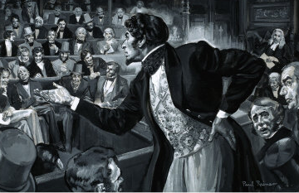
Benjamin Disraeli – Rothschild Agent
Disraeli was the first Jew to be admitted to Parliament after several attempts and opening the way for Jews and Catholics to subvert our Christian laws.

Slide 157
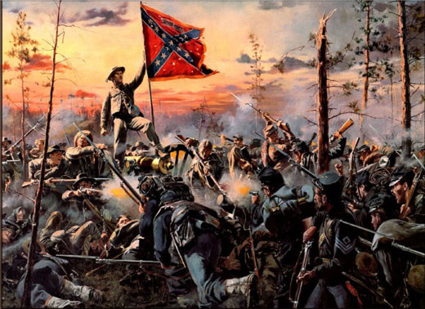
Gog Instigates Civil War In The States
In 1861, during the Civil War, Congress adjourned sine die. That term means forever, never to return. The Republic was under Martial Law….
The American Civil War

Slide 158
Gog Instigates Civil War In The States
…. and President Lincoln appointed representatives for the southern states and forced the legislature to again sit.

Slide 159
Gog Instigates Civil War In The States
The civil war was supposedly about freeing slaves in the south but was in reality about the Rothschilds gaining financial control of the south.
There was no truce, so in reality the civil war is still ongoing.

Slide 160
The People Of The USA Decide To Debar Lawyers From The Legislature
Left: SCENE IN THE HOUSE ON THE PASSAGE OF THE PROPOSITION TO AMEND THE CONSTITUTION.
The proposition to debar lawyers required that 13 States vote in favour out of 17 that were in the union at that time.

Slide 161
The People Of The USA Decide To Debar Lawyers From The Legislature
12 States had voted for the amendment by 1812. However, there was a civil war, no doubt by design, during this year, so Virginia's affirmative vote was made known by
publication and dissemination – this was ignored by Gog knowing that a corporate constitution would soon be set up.

Slide 162
Gog Acquires Washington DC
On 21st February 1871, “An Act To Provide A Government For The District Of Columbia” was passed by the 41st Congress. Why would such an act be passed for a 10 sq mile parcel of land and in defiance of the Constitution?
Washington DC

Slide 163
Gog Acquires Washington DC
The USA was virtually bankrupt after the civil wars stirred up by the Rothschilds, so no doubt pressure was applied by the usual methods. Washington DC would become the Corporate Capital of THE UNITED STATES with its own Constitution of THE UNITED STATES OF AMERICA to replace the original Constitution for the united states of America.

Slide 164
Gog Acquires Washington DC
After obtaining a foothold it would not be long before Gog took control of the whole of the USA signalled by the flying of the Stars and Stripes military version instead of
the individual state flags and the civil version of the stars and stripes with its vertical stripes.

Slide 165
Gog Acquires Washington DC
The people of the USA, just as in other Israelite nations, are enslaved to a corporate Government and given fictitious names by converting their names to all uppercase letters – look at your next communication from the Government and you will see this is the case.

Slide 166
Gog Tampers With USA Constitution
The 14th amendment was never properly ratified – 11 senators from southern states were barred from sitting to enable the amendment to be passed.
The American Constitution

Slide 167
Gog Tampers With USA Constitution
This amendment would effectively make every one a citizen and pave the way for the assimilation of non-white races.

Slide 168
Gog Tampers With USA Constitution
Proposed by Congress June 16, 1866; proclaimed adopted July 21, 1868

Slide 169
The Chicago Fire
Sunday evening, October 8, 1871 marked the beginning of one of the most devastating fires in U.S. history

Slide 170
The Chicago Fire
Between October 8 and 10, an estimated 350 people perished. The fire destroyed the homes of up to one-third of the city's population, about 1,600 stores, 60 factories, and 28 public buildings. Four square miles of the city burned to the ground.

Slide 171
The Chicago Fire
Was it a coincidence that this fire occurred in the same year Washington DC became an independent state within the union?

Slide 172
Gog Would Rebuild Chicago In His Own Image - Gigantic
The Chicago fire like the great fire of London, would be used by Gog to reconstruct the city in his image – huge skyscrapers which only the London Money Power could afford. Previously prior to the fire the buildings were no more than 2 - 3 stories high and owned by the occupiers.

Slide 173
Gog Exterminates Free Meat Supply
The London Money Power determined to control the beef trade. To do this it would be necessary to exterminate the plentiful supply of free meat namely the bison that roamed the plains. This was achieved by placing a bounty on bison hides far in excess of what they were really worth.
Some of the once plentiful Bison

Slide 174
A.T. Stewart & Co. – New York Gog’s Agent In Taking Over The Retail Trade
A.T. Stewart was a Scotsman who, for years, occupied a little narrow place on Broadway a few feet wide, where he peddled needles, and thread and tape. He suddenly bloomed out in
a palatial building, with a thousand clerks behind his counters, and twenty million dollars worth of goods upon his shelves.

Slide 175
A.T. Stewart & Co. – New York Gog’s Agent In Taking Over The Retail Trade
At the same time, there was a branch house of A.T. Stewart & Co., in Glasgow, Scotland, and another in Germany; besides establishments in Belfast, Ireland, and in Paris.
Glasgow

Slide 176
A.T. Stewart & Co. – New York Gog’s Agent In Taking Over The Retail Trade
The peculiarity of his style of business was, that he had in his House a number of departments; in the various departments, goods of every variety, of the best quality, and at the cheapest wholesale prices. and, ….
A typical Department Store

Slide 177
A.T. Stewart & Co. – New York Gog’s Agent In Taking Over The Retail Trade
…. this was the start of large department stores that would put the small trader out of business – the “Co” of Stewart & Co was The London Money Power – namely the Rothschilds or their agent banking houses.
The Rothschild Arms

Slide 178
Gog – Buys And Controls The US Rail Roads
Gog would use the power of the purse to gain control of the USA’s railways and use this as another means of wresting control of trade from the Israelites by giving rebates to his proxies while charging a premium to others.
Old Chicago Rail Marshalling Yard

Slide 179
Gog – Buys And Controls The US Rail Roads
This was how the Rockefeller / Rothschild syndicate gained control of the oil industry and would use their influence to remove competing fuel sources such as coal and thereby gain even more control
The Old Standard Oil Company

Slide 180
The US Illuminati Exposed
In 1826, Captain William Morgan, a journalist and stonemason from Batavia, New York, who was a high degree mason in a local Masonic lodge, wrote an exposé of the Masonic Order in a book called Illustrations of Masonry

Slide 181
The US Illuminati Exposed
Under the name of William Preston, which revealed many of their secrets concerning the first three degrees. Shortly afterward, he was arrested and charged with stealing and indebtedness, and put in jail.

Slide 182
The US Illuminati Exposed
Here we see a newspaper advert – blackening Morgan’s character for having exposed the secrets of the Illuminati

Slide 183
Gog Takes Control Of The USA’s Railways
Edward Henry Harriman becomes a director of the Union Pacific Railroad and goes on to take control of the Southern Pacific Railroad. This is all financed by the Rothschilds
Edward Henry Harriman

Slide 184
1895 - Gog Starts Its Plans To Seize The Holy Land
Edmond James de Rothschild the youngest son of Jacob (James) Mayer Rothschild visits Palestine and subsequently supplies the funds to found the first Jewish colonies there, this is to further their long term objective of creating a Rothschild formed country
The Temple Mount

Slide 185
1895 - Gog Starts Its Plans To Seize The Holy Land
1897: The Rothschilds found the Zionist Congress and arranged its first meeting in Munich. However due to local Jewish opposition this is re-arranged for Basle, Switzerland and takes place on 29 August.

Slide 186
1895 - Gog Starts Its Plans To Seize The Holy Land
The meeting is chaired by Theodor Herzl, who would state in his diaries,
“It is essential that the sufferings of Jews….become worse….
Theodor Herzl Lodge № 75, Raanana

Slide 187
1895 - Gog Starts Its Plans To Seize The Holy Land
…. this will assist in realization of our plans….I have an excellent idea….I shall induce anti-Semites to liquidate Jewish wealth…. The anti-Semites will assist us thereby in that they will strengthen the persecution and oppression of Jews. The anti-Semites shall be our best friends.”

Slide 188
1895 - Gog Starts Its Plans To Seize The Holy Land
Theodore Herzl is subsequently elected President of the Zionist Organisation which adopts the, “Rothschild Red Hexagram or Sign,” as the Zionist flag which 51 years later will end up as the flag of the Israeli state.
Theodore Herzl

Slide 189
GOG’s Boer War
THE SIEGE OF MAFEKING
At the turn of the 19th century there occurred a war so devastating in its consequences that the world is still feeling its effect. – This was the Boer War

Slide 190
GOG’s Boer War
Perhaps the most important result of the war is that Gog gained control of the richest gold deposits known to mankind, along with a diversity of minerals seldom found in one country.
A South African Gold Mine

Slide 191
The Boer Holocaust
2
1
Young starved victim
Killing the Boers’ sheep
The dead carcases
3

Slide 192
First Concentration Camp Was “British”
Left: The Boer Holocaust: Boer children, emaciated through disease, photographed in British concentration camps in South Africa, 1900-1902. Eventually 27,927 women and children were to die in this way.
The Boer Holocaust

Slide 193
The Boer Holocaust
Family at the beginning - newly arrived with tea and bread (British Propaganda for consumption in the UK) to make the public believe that the Boers were being accommodated in ideal conditions!
One of the British propaganda photographs

Slide 194
The First Concentration Camps Were “British” (Gog)
The inscription panel records the death of 26,370 women and children in British Concentration Camps
Bloemfontein Women’s Memorial

Slide 195
The First Concentration Camps Were “British” (Gog
English Translation of the Afrikaans legend inscribed on the war memorial
TO OUR HEROINES
AND DEAR CHILDREN
"THY WILL BE DONE"
This National Monument
was erected
in memory of the
Bloemfontein (South Africa) - Dutch Reformed Church

Slide 196
The First Concentration Camps Were “British” (Gog
English Translation of the Afrikaans legend inscribed on the war memorial
26,370 women and children
who died in the concentration
camps
and other women and children
Bloemfontein (South Africa)

Slide 197
The First Concentration Camps Were “British” (Gog
English Translation of the Afrikaans legend inscribed on the war memorial
who as a result of the war
lost their lives elsewhere
Top left panel:
"For freedom, NATION AND FATHERLAND”
Bloemfontein (South Africa)

Slide 198
The First Concentration Camps Were “British” (Gog
English Translation of the Afrikaans legend inscribed on the war memorial
Top right panel:
"I SHALL NOT FORSAKE THEE
I SHALL NOT DESERT THEE"
Bloemfontein (South Africa)

Slide 199
Gog Seizes South Africa’s Mineral Wealth
The outcome of the war was that The Oppenheimers (agents of the Rothschilds) would take control of South Africa’s mineral wealth.
Diamond Mine De Beers

Slide 200
Gog Goes On To Seize Political Control Of South Africa
Gog not satisfied with having seized South Africa’s mineral wealth goes on to plot the downfall of its white government – signalled by the assassination of Dr. Verwoerd and putting in place a white puppet, later to be followed by black puppets.
Under Dr. Verwoerd’s leadership SA prospered despite Gog’s sanctions

Slide 201
SA Now Firmly In The Control Of Gog
SACP boss, Joe Slovo
Mandela with Joe Slovo
“This terrorist Nelson Mandela is now puffed up by the controlled media as a symbol, an icon, one of the world's most famous statesmen, recognised and revered by all the deceived.

Slide 202
SA Now Firmly In The Control Of Gog
He dines with royalty, associates with the world's great leaders and his opinion is sought and valued on all weighty matters. He has achieved an almost divine status in the world, equal to that of the Pope or the late Princess Diana."

Slide 203
The Story Of Gog And Magog
A thought to leave you with
Jesus gave you a little clue on who was behind your troubles. HE said in the last days, they will deliver you to the synagogue (Town Hall) and the magistrate. And they always have one procedure. Know what that is? THE FALSE WITNESS!
NWO - BECAUSE THE UNAWARE ARE UNAWARE THAT THEY ARE UNAWARE:

Slide 204
The Story Of Gog And Magog
The End Of Part Five
To be continued …………….Gog’s World Wars 1 & 2 – Part 6

