Slide 1
The Story Of Gog And Magog
Part Four
The Rise of The House Rothschild & The Armenian Holocaust

Slide 2
The Story of Gog & Magog Will be covered in a series of 10 parts
Attila, The Rise of Islam and the Khazars
Genghis Khan, The Russians & the 3 frogs of Revelation
The Spanish Armada & Inquisition + the English revolution
The rise of the House of Rothschild & the Armenian Holocaust
The French Revolution &The Victorian Era
WW1 & WW2
Post War Situation

Slide 3
The Story of Gog & Magog Will be covered in a series of 10 parts
Gog’s covert attack on western culture, education, legal system, health, art & education.
False flag operations
Conclusion

Slide 4
Gog – Recap Parts 1 & 2
1) Ezekiel 38:15 Had important Key Words and That This Key Verse Covered Most Of The AD Period to the present day.
2) Magog=Equals Mongol.
3) Gog = Khazar = Askenazim Jew - Mongolia
Gog’s three major frontal attacks – Attila, Genghis Khan and the Moors
The rise of the 3 evil spirits (on the banner of Clovis King of the Franks) Portended Jacob’s trouble

Slide 5
Gog – Recap Parts 1 & 2
6) Gog attack on England via the Spanish Armada fails
7) Gog dispersed by the Spanish Inquisition to Mexico, Sicily and Amsterdam
8) From Amsterdam Gog is successful in gaining control of Britain’s money
9) By knowing the Illuminati’s occult numbering code one can identify false flag operations

Slide 6
Gog of The Land of Magog
The Story of
Analysis of Ezekiel 38 : 15
First half of verse
And Thou (Attila/Genghis Khan) Shalt Come From Thy Place Out Of The North Parts, Thou And Many People With Thee All Of Them Riding Upon Horses, A Great Company, And A Mighty Army

Slide 7
Thou And Many People With Thee All Of Them Riding Upon Horses, A Great Company, And A Mighty Army
The horse cavalries of Genghis Khan

Slide 8
Gog of The Land of Magog
The Story of
Second half of verse
And Thou Shalt Come Up Against My People of Israel, As A Cloud To Cover The Land: It Shall Be In The Latter Days, And I Will Bring Thee Against My Land That The Heathen May Know Me, When I Shall Be Sanctified In Thee, O Gog, Before Their Eyes.

Slide 9
Gog Deceives The Nations
We saw in part 2, that Jacob’s Trouble was signalled on the banner of Clovis (King of the Franks) by the 3 frogs (evil spirits) of Rev 16:13) and shall now look in more detail at of one of these –
Notes:
Double, Double, Toil and Trouble
"And I saw three unclean spirits like frogs.." Rev 16:13
The vial judgements are patterned after the plagues in Exodus. It is not a one to one correspondence but, the sores of the first vial, the blood of the second, the darkness of the fifth and the hail of the seventh vial establish the pattern. And after the sixth vial there were three frogs.
The plagues were directed against the gods of Egypt. The frog goddess, Hecate, was one of their principle deities. Hecate was a triple goddess. She performed her magic at crossroads, where three ways meet. As a result, the goddess of crossroads has three faces, one looking each way. The word trivial is a Roman word that refers to Hecate Tri Via (three ways). She is also represented as an equilateral triangle.
On another level, Hecate was the third stage in the life of the mother goddess. These three phases are represented by the moon. Crescent waxing, the beautiful virgin goddess. Full moon, the maid. And crescent waning, the old maid or crone. The word hag is a variant of Heka from Hecate.
Hecate was the goddess of witchcraft. She is the goddess of Halloween. When you see the witch on her broom and black hat before a waning crescent moon you are seeing a representation of this old egyptian goddess. The goddess of course is Semeramis, the goddess of a thousand names, Babylon's queen who is riding the scarlet beast. (Rev 17:3)
The fact that toads or frogs are associated with witchcraft proceeds from the old legends of the frog goddess.
The illuminati masonic pit beast is the focus of the vial judgements. And both the illuminati and masonry are based upon the ancient egyptian mysteries which point to the triple frog goddess.
E.B. Elliot discovered that the original arms of France were a banner with three black toads or frogs. Clovis, king of the Franks converted to Christianity and changed the flag from three frogs to the familiar fleur de lis. The french do not like to be called frogs so their histories of the fleur de lis don't mention this fact.
Elliott reveals that the three frogs came from an egyptian medal. This would have to be a symbolic representation of their triple frog goddess, the dark goddess, Hecate.
The Illuminati was founded by a witch and has always been involved in witchcraft. And Masonry is essentially Baal worship or satanism when the layers of symbolism are stripped away. And this end time beast emerged in France.
The three frogs then are a powerful symbol representing the end time 8th beast which emerged from a witches coven and erupted during the French Revolution. And the old witch goddess Hecate is brewing up a witches caldron where the three beasts meet in the New World Order.
Double, double toil and trouble......."Jacob's" trouble.

Slide 10
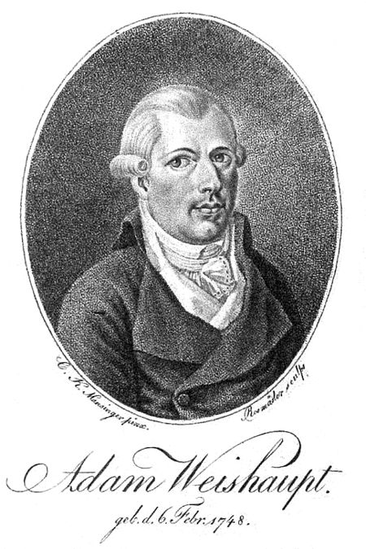
Gog Deceives The Nations
… the Rothschilds – the other 2 being Weishaupt (Illuminati) & Loyola (Jesuits).
It is believed that the Rothschilds are the most influential of the 13 controlling families.

Slide 11
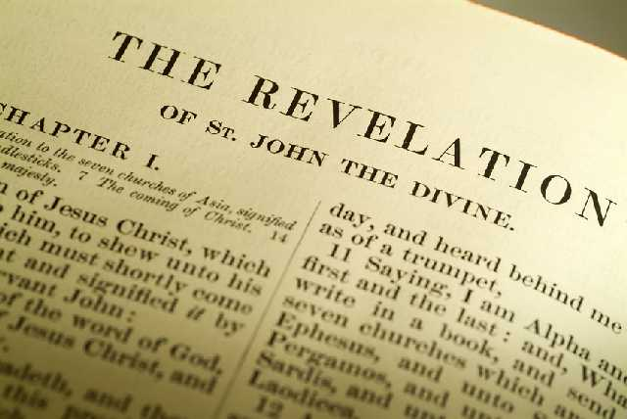
Gog Deceives The Nations
"And I saw three unclean spirits like frogs come out of the mouth of the dragon, and out of the mouth of the beast, and out of the mouth of the false prophet." Rev 16:13

Slide 12
The House of Rothschild
As Frederic Morton wrote in the preface to “The Rothschilds:” "Someone once said that the Wealth of the Rothschilds consists of the bankruptcy of nations.”
Frederic Morton

Slide 13
The House of Rothschild
In his “The Empire of the City,” E C, Knuth wrote: "The fact that the House of Rothschilds made its money in the great crashes of history and the great wars of history, the very periods when others lost their money, is beyond question.”

Slide 14
Rothschild’s Plot to Control The World
William had inherited what was purported to be among the largest fortunes in Europe and eventually came to depend substantially on Mayer for managing this fortune, particularly during and after the invasion and conquest of the area by Napoleon.
Mayer Amschel Bauer (Rothschild) (1744-1812).

Slide 15
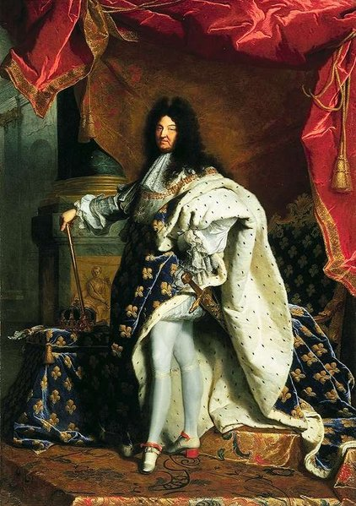
Rothschild’s Plot to Control The World
Much of the early Rothschild fortune and rise to prominence was built on business dealings with the Landgrave of Hesse-Cassel, also known as William IX
The Landgrave of Hesse-Cassel

Slide 16
Rothschild’s Plot to Control The World
Mayer Amschel Bauer began hanging out a red hexagram in front of his house – hence the name Rothschild from the German (Rot = Red & schild = shield) – The sign of the red shield.
Rot + (h) + (schild) = Rothschild

Slide 17
Gog Grovels To Achieve His Objectives
The Rothschilds like the rest of their Canaanite viper race would go on their belly or grovel as foretold in Gen. 3:14 ---
We shall see this in an example of a letter sent to a German prince to ingratiate himself into royal courts

Slide 18
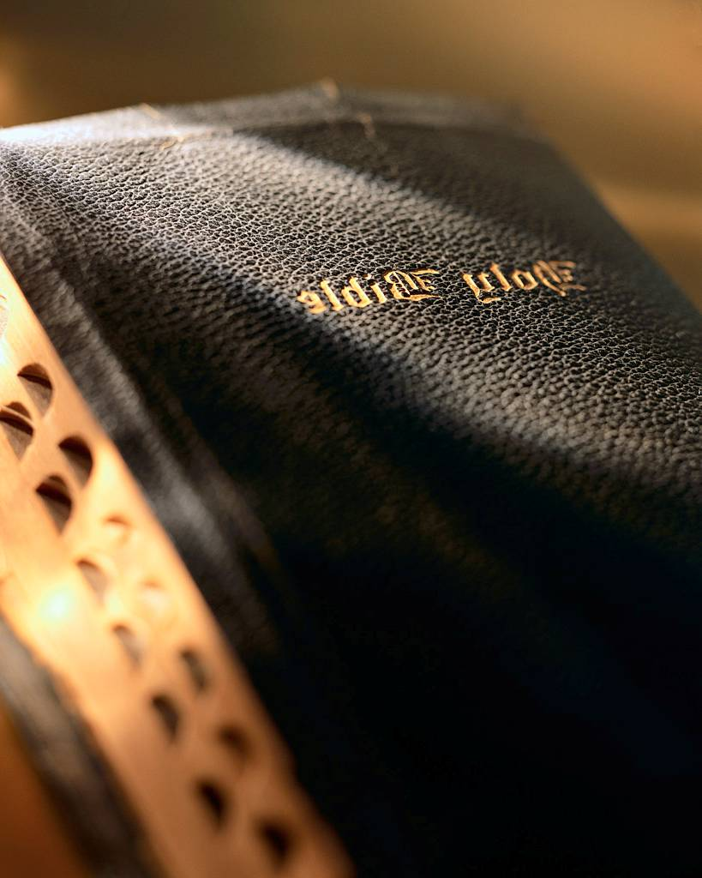
Gog Grovels To Achieve His Objectives
Gen. 3:14 --- “Because thou has done this thou are cursed above all cattle, above every beast of the field; upon thy belly shalt thou go and dust shalt thou eat all the days of thy of thy life.”

Slide 19
Gog Grovels To Achieve His Objectives – The Letter
"It has been my particular high and good fortune to serve your lofty princely Serenity at various times and to your most gracious satisfaction. I stand ready to exert all my energies and my entire fortune to serve your lofty princely serenity whenever in future it shall please you to command me.

Slide 20
Gog Grovels To Achieve His Objectives – The Letter
An especially powerful incentive to this end would be given me if your lofty princely serenity were to distinguish me with an appointment as one of your Highness' Court Factors. I am making bold to beg for this with the more confidence in the assurance that by so doing I am not giving any trouble;

Slide 21
Gog Grovels To Achieve His Objectives – The Letter
while for my part such a distinction would lift up my commercial standing and be of help to me in many other ways that I feel certain thereby to make my own way and fortune here in the city of Frankfurt."

Slide 22
Rothschild’s Plot to Control The World
Money was Rothschild’s first priority even in arranging who his sons would marry.
Mayer Amschel Bauer (Rothschild) (1744-1812).

Slide 23
Rothschild’s Plot to Control The World
Mayer Amschel Bauer’s Fortunes prospered by lending on usury to the potentates of Europe, so much so that he divided Europe between his 5 sons.
Mayer Amschel Bauer (Rothschild) (1744-1812).

Slide 24
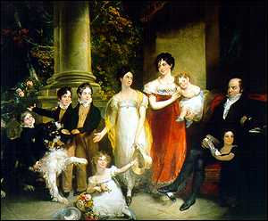
Rothschild’s Plot to Control The World
The Rothschilds would become the main coordinating force behind their fellow Gogites’ assault on Christendom and true Israel in particular.
The Rothschilds

Slide 25
The Rothschilds = “Rot” (Red) “Schild” (Shield)
Here we see Mayer Amschel Bauer’s 5 sons who would take control of Europe & eventually the world

Slide 26
Amschel Meyer Rothschild Frankfurt
This Son looked after the lending operations in Germany.
It is interesting to note that the European Central Bank is located in Frankfurt-am-Main.
It should also be noted that during the devastating allied bombing of Frankfurt – no bomb fell near the Rothschild mansion there!
Amschel Meyer Rothschild
(1773-1855)

Slide 27
Nathan Meyer Rothschild London
The son Nathan was sent to London to take control of the Rothschilds banking interests there, which with Paris would become the senior partnership because of the legal hold the Knights Templars have over the British Empire and North America.
Nathan Meyer Rothschild
(1777-1836)

Slide 28
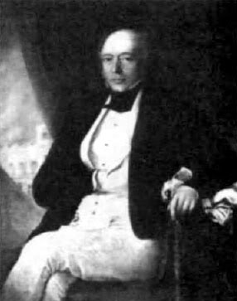
Nathan Meyer Rothschild London
There is a story that says one of Nathan’s sons asked him how many nations there were in the world and Nathan replied: ‘There are only two you need to bother about. There is the mishpoche [Yiddish for family] and there are the others.’
Nathan Meyer Rothschild
(1777-1836)

Slide 29
The Race War
Houston Stewart Chamberlain: “Saw all history as a conflict between the Aryans and the Semites”
Houston Stewart Chamberlain confirmed what Nathan Rothschild said!

Slide 30
Salomon Rothschild Vienna
Salomon was busy getting various titles. In 1801 his firm became crown agents of the Landgrave William of Hesse-Cassel. All these titles were wonderful, but most important was the Landgrave’s. The Landgrave was the richest Prince in Europe and the Rothschilds were determined to take advantage of his wealth.
Salomon Rothschild
(1774-1855)

Slide 31
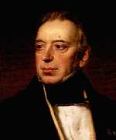
Salomon Rothschild Vienna
Salomon ‘dropped dead’. He had been placed in a coffin and, according to Jewish custom, carried into every room in the house. One of the pall bearers had stumbled, the coffin had crashed into a door and Salomon had woken up! Not for another three years was he well and truly buried.”
Salomon Rothschild
(1774-1855)

Slide 32
Kalmann (Carl) Meyer Rothschild Naples
While in Italy the Rothschild “mantle” came upon Carl and he made a series of ingenious deals with the Italian government that forced Naples to pay for its own occupation.
Kalmann (Carl) Meyer Rothschild (1792-1868)

Slide 33
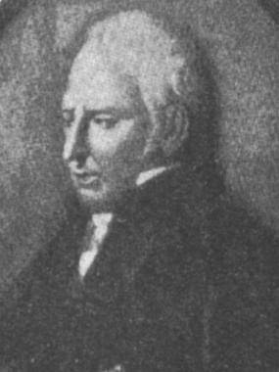
Kalmann (Carl) Meyer Rothschild Naples
He also helped Luigi de Medici of the Black Nobility to re-gain his position as finance minister of Naples, and later did business with the powerful man.
Luigi de Medici

Slide 34
Kalmann (Carl) Meyer Rothschild Naples
He became financier to the court, the “financial overlord of Italy.” Carl “...wound the Italian peninsula around his hand.” He did business with the Vatican, and when Pope Gregory XVI received him by giving him his hand rather than the customary toe to kiss, people realized the extent of his power. The Pope conferred upon him the Order of St. George
Mayer Carl Rothschild

Slide 35
Jacob (James) Meyer Rothschild Paris
This branch of the Rothschild family financed Napoleon who gained control of the Papacy and it is for this reason that the Jesuit controlling Black Pope is based in Paris.
Jacob (James) Meyer Rothschild (1792-1868)

Slide 36
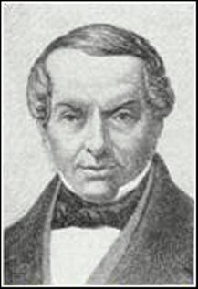
Jacob (James) Meyer Rothschild Paris
Edmond, the youngest son of James (Yakov) de Rothschild while on oil business in Southern Russia visited Gori in Georgia had an affair with a Jewish wine merchant’s servant girl who became pregnant (Stalin?)
Jacob (James) Meyer Rothschild (1792-1868)

Slide 37
The Rothschilds = “Rot” (Red) “Schild” (Shield)
The five Rothschild brothers as well as being the dominant banking family within five countries in Europe: GERMANY, FRANCE, ENGLAND, ITALY, and AUSTRIA.
Mayer Amschel Rothschild & Söhne Frankfurt
Notes:
11805

Slide 38
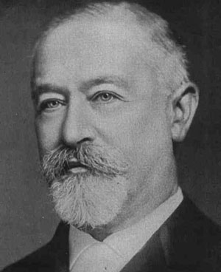
The Rothschilds = “Rot” (Red) “Schild” (Shield)
In the late 1800’s, the Rothschilds financed American Corporations through:
1 WARBURGS OF GERMANY who were partners with:
2. KUHN, LO EB CO. OF NEW YORK
Jacob Schiff of Kuhn Loeb

Slide 39
The Rothschilds Amass A Huge Fortune
The Rothschilds prospered through their skill at manipulating money and consequently could build/ buy mansions and estates to match any of the royal rulers in Europe as we shall see in the following slide.
Rothschild Bank

Slide 40
Some Of The European Homes Of The Rothschilds
Frankfurt
France
Notes:
Researcher Eustice Mullins writes that the Rothschilds took over all the financial operations of the worldwide Catholic Church in 1823

Slide 41
Some Of The European Homes Of The Rothschilds
Mentmore Towers – Buckinghamshire - England
Notes:
Researcher Eustice Mullins writes that the Rothschilds took over all the financial operations of the worldwide Catholic Church in 1823

Slide 42
Mentmore Towers
Baron Mayer, married a Cohen. Mayer built a spectacular house, Mentmore Towers. Said one woman: “I do not believe that the Medicis were ever so lodged at the height of their glory.” The Mentmore Towers were turned over to Mayer’s daughter, Hannah, when he died. Hannah married the Earl of Roseberry in 1878.
Hannah Louise de Rothschild (1850-1892).

Slide 43
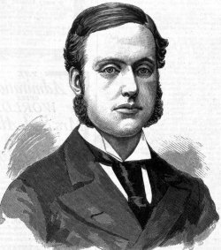
Mentmore Towers
The Earl of Roseberry became Prime Minister of England in 1894-95. The Mentmore Towers are still owned today by the son of Hannah, the current Earl of Roseberry. The Baron Mayer de Rothschild was a member of Parliament (never made a speech), and loved horse breeding and racing. He was the “sporting” member of the family
Earl of Roseberry

Slide 44
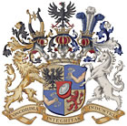
Rothschild Coat Of Arms
Only the Rothschilds had enough power and influence to be able to mimic the coat-of-arms of our Royal House – note the Zionist star between the horns of the bull (England) and the Rothschild spears pointed at the Eagle of Manasseh and the Lion of true Judah
Rothschilds coat-of-arms

Slide 45
Rothschild & Royal Coat Of Arms
The Rothschild’s Arms are based on the Royal Coat of arms – note the 6 pointed star in the horns of the Bull – Ephraim England – Engel (Bull Land)
Notes:
It is a further interesting point that about 1805, the Rothschilds usurped the main devices of the Royal Arms of Great Britain, viz. the Lion and the Unicorn supporting the crown. Further above the original crown they have superimposed three crowns, which in heraldry symbolize that the superimposed crowns have overcome the original crown of Britain. Perhaps one of the main points of the Rothschild arms is that in one of the superimposed crowns they have placed the interlaced triangles of Zionism INSIDE THE HORNS OF A BULL. Now the horns of bull is the ancient crest of the Anglo‑Saxon nation ( ENGLE Anglo‑Saxon for a bull) Engle‑land ‑ Bull land from which we get the name John Bull. This signifies that the Zionists are working inside the Anglo-Saxon nation.

Slide 46
Trinity Broadcasting Network
Note the similarity to the Rothschild’s coat-of-arms.
The Dove is pointing downwards which is a Satanic sign
TBN supports the Zionist state in Palestine

Slide 47
Rothschild’s 5 Spears (Sons)
Here we see part of the Rothschild coat of Arms – the 5 spears representing the 5 sons
Notice that the 5 spears are pointing upwards (from Hell?) pointing towards heaven to make war.

Slide 48
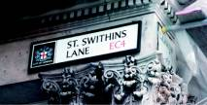
St. Swithins Lane – Global Headquarters
Who would have guessed that St. Swithins Lane, a very narrow and unassuming thoroughfare of Cannon Street, is the headquarters of the Rothschild global empire!

Slide 49
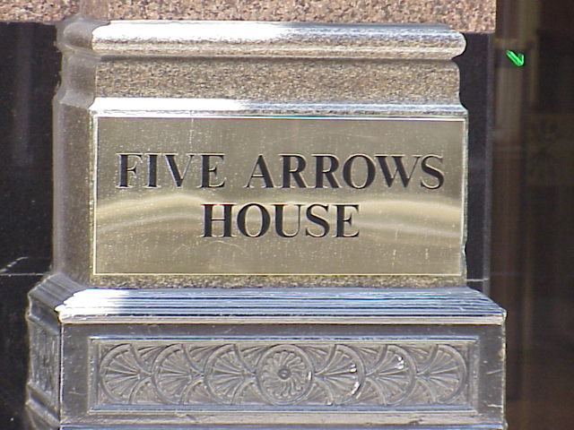
St. Swithins Lane – Global Headquarters
This is the only clue that this building is the Rothschild headquarters! (They keep a low public profile)

Slide 50
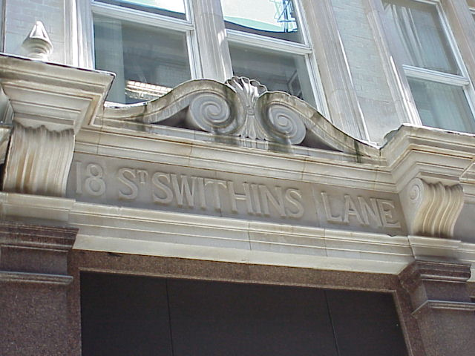
St. Swithins Lane – Global Headquarters
The lintel above Five Arrows House – notice it is No 18 (3 x 6) or 666

Slide 51
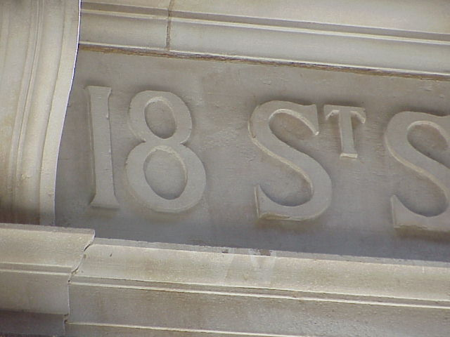
St. Swithins Lane – Global Headquarters
A Close up of the No. 18.

Slide 52
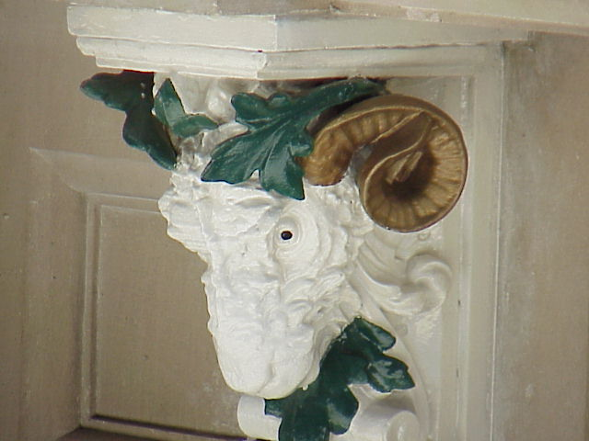
St. Swithins Lane – Global Headquarters
Appropriately the window ledge of Five Arrows House are supported by Goats’ heads – one of them is seen on the left.

Slide 53
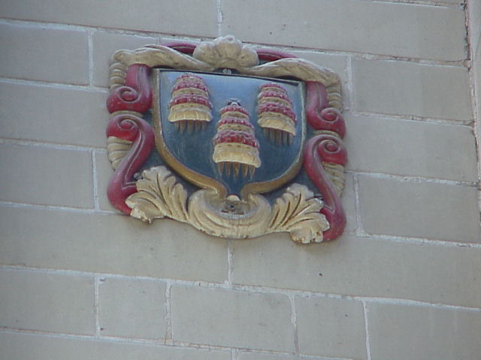
St. Swithins Lane – Global Headquarters
A small shield on the wall of Five Arrows House. Not yet identified but probably a ward boundary indicator

Slide 54
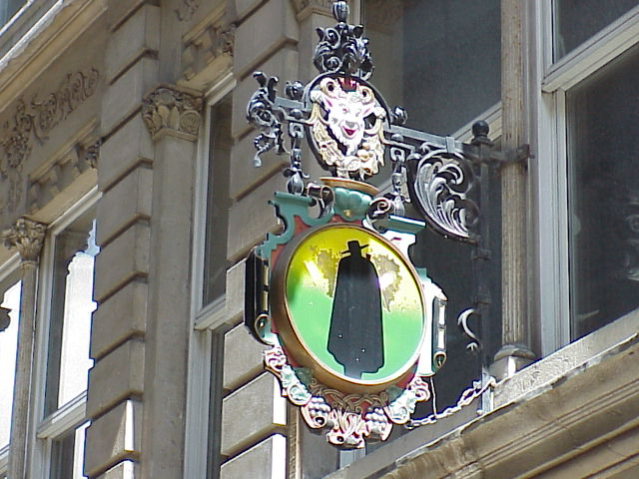
St. Swithins Lane – Global Headquarters
Is this where the Rothschilds dine? The sign of the man in black

Slide 55
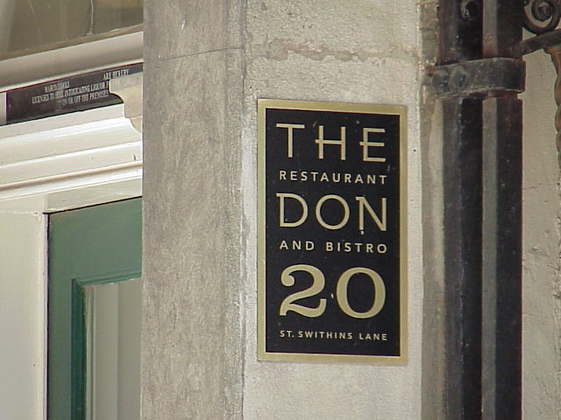
St. Swithins Lane – Global Headquarters
The Resturant is just next door to Five Arrows House!

Slide 56
Rothschilds & The Rockefellers
Mayer Amschel Bauer (Rothschild) (1744-1812).
John D. Rockefeller the 1st
We shall see in the next few slides the links between the 2 Gogite (Khazar) families the Rothschilds and the Rockefellers

Slide 57
Rothschilds Bankroll The Rockefellers
John D. Rockefeller the 1st. The worlds first billionaire, shown here in the later part of his long life. He got his big start with a loan from the Rothschild owned bank the National City and never looked back.
Rockefeller was related to the Rothschilds through the female line!
John D. Rockefeller

Slide 58
John Davison Rockefeller I Notable Sayings
“The combination is here to stay. Individualism has gone, never to return.”
“I want to own nothing and control everything.”
“Competition is a sin.”
Born 18th July 1839
Died 23rd May 1937

Slide 59
Rothschilds Bankroll The Rockefellers
John D Rockefeller the 2nd increased his fathers billions

Slide 60
Rothschilds Bankroll The Rockefellers
The third generation, John D. Rockefeller the 2nd and the brothers David, Nelson, Winthrop, Laurence and John. All founded their own Empires

Slide 61
Rothschilds Bankroll The Rockefellers
David Rockefeller, World Banker meets with retired Terrorist (rags to Riches) President Mandela

Slide 62
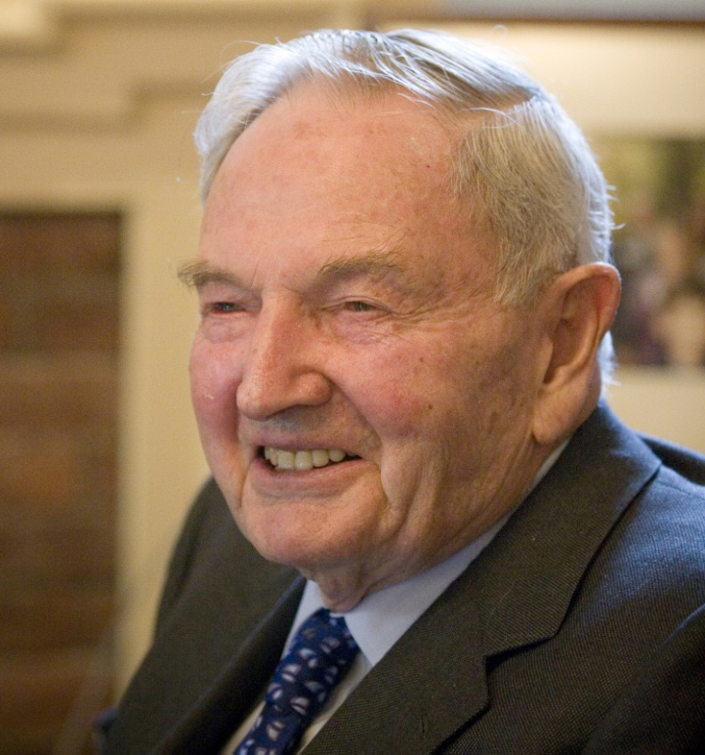
Rothschilds Bankroll The Rockefellers
Notice how the world’s 2 major controlling families founded their dynasties with 5 sons – one for each horn of the beast in Revelation.
Both the Rothschilds and the Rockefellers have red in their name (Rockefeller = Red fellow – Rothafel Rot = Red & Hafel = Fellow).
David Rockefeller

Slide 63
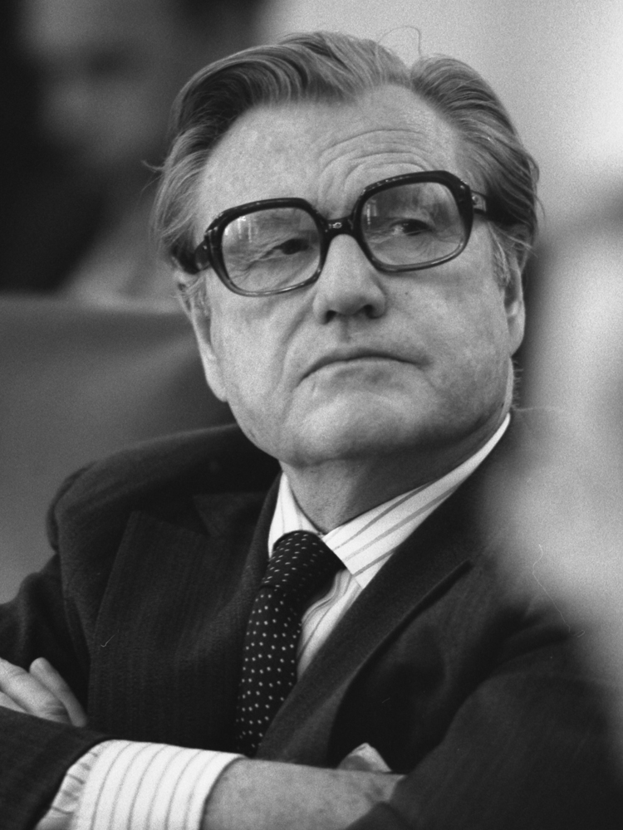
Rothschilds Bankroll The Rockefellers
Interestingly, both names begin with the letter “R” the 18th letter of the alphabet, which as we saw in part 2, 18 is the way the Illuminati disguise the No. 666!!
Nelson Rockefeller

Slide 64
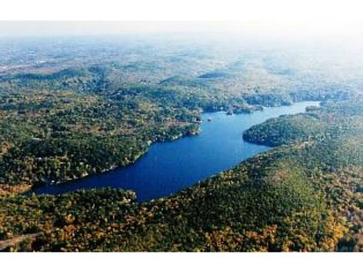
The Rockefellers NY Retreat
Part of the Rockefeller’s financial holdings consists of real estate, foremost being the 4,180 acre family estate at Pocantico Hills, north of New York City, which has 70 miles of private roads, 75 buildings,
Pocantico Hills – New York State

Slide 65
The Rockefellers NY Retreat
…. underground archives, and close to 500 servants, guards, gardeners and chauffeurs. They also maintain over 100 residences in all parts of the world. Besides investments held in personal trusts, the family also holds stock in numerous companies.
Pocantico Hills

Slide 66
Rothschild’s Involved In The Postal Service
The five Rothschild brothers, each in the five major European capitals set up their own private courier system which was faster than the regular mail. The Rothschilds had news whether political or economic faster than anyone else including the monarchs.
“Thus the Rothschilds had news before anyone else, including ministers [govt.]; they also understood how to make use of it.”

Slide 67
Rothschild’s Involved In The Postal Service
The large amounts of voluminous correspondence by Rothschild couriers attracted attention, but no one ever stopped their personal intelligence and mail services.

Slide 68
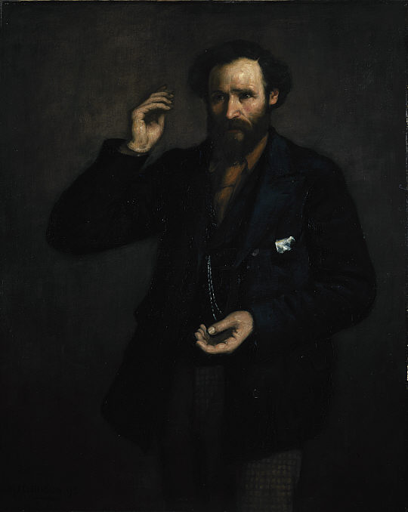
Gog Controls Criticism By Buying Into The Media
1891: The British Labour Leader makes the following statement on the subject of the Rothschilds, “This blood-sucking crew has been the cause of untold mischief and misery in Europe during the present century, and has piled up its prodigious wealth chiefly through fomenting wars between States which ought never to have quarrelled.
James Keir Hardie, 1856 - 1915. Labour leader

Slide 69
Gog Controls Criticism By Buying Into The Media
Whenever there is trouble in Europe, wherever rumours of war circulate and men’s minds are distraught with fear of change and calamity you may be sure that a hook-nosed Rothschild is at his games somewhere near the region of the disturbance.”
Comments like this worry the Rothschilds and towards the end of the 1800’s they purchase Reuters news agency so they can have some control of the media.

Slide 70
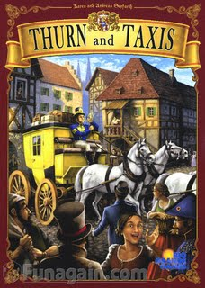
Rothschild’s Involved In The Postal Service
The German princes of Thurn and Taxis in the 16th century initiated a postal service. Mayer Amschel loaned them money. “Certainly they [the Rothschilds] discovered the latitude that the Thurn and Taxis ….
Thurn & Taxis Postal Service

Slide 71
Rothschild’s Involved In The Postal Service
….. allowed themselves in unsealing letters, possibly divulging their contents, and according to their own interests, delaying or accelerating delivery.
Karl Prinz von Thurn und Taxis

Slide 72
Rothschild’s Intelligence Gathering
B’nai B’rith was a spin-off of the Order of Zion & was organised as a covert Rothschild intelligence agency – now the B’nai B’rith is a Mossad front and are linked to the ANL & ADL.
Order of Zion

Slide 73
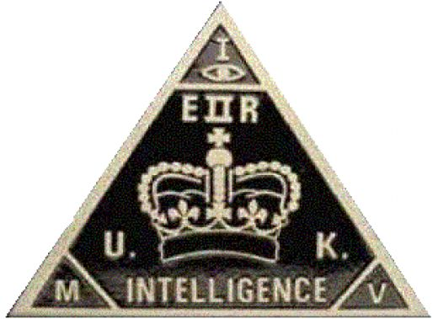
Rothschild’s Intelligence Gathering
The British Intelligence Agency MI6 is believed to be under the control of the Rothschilds – hence the 6 – code for the “Star of David” – If you are wondering about MI5 – then 5 represents the 5 pointed star of the Idumeans as seen on the old Soviet flag – Note as yet there is no MI 1,2,3 or 4!
MI5 Logo

Slide 74
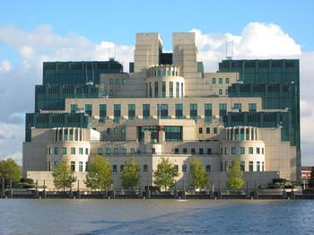
Rothschilds & The Intelligence Services
Churchill (during the war years) sacked the then patriotic head of Intelligence and it was subsequently taken over by Communist (Rothschild) agents.
Those in the know nickname it The Rothschild Intelligence service!
MI6 – Headquarters Vauxhall

Slide 75
Rothschilds & The Intelligence Services
In conjunction with their efficient postal service the Rothschilds had their own private intelligence service.
MI6 Logo

Slide 76
Rothschilds & The Intelligence Services
This building has nine sub-basements, while the legendary Lubianka KGB headquarters in Moscow has 7 – so which is the bigger police state?
MI6 – Headquarters Vauxhall

Slide 77
Rothschilds & The Intelligence Services
Note also the appellation of 5 to MI (Military Intelligence) – 5 alludes to the 5 pointed Idumean Star.
MI5 Building Opposite side of the river to MI6 – Headquarters

Slide 78
Rothschild’s Involved In The Postal Service
The Rothschild’s private postal service latterly provided a public service known as the Federal Express (FedEx) – only a Rothschild could give their company a government sounding name!

Slide 79
Satan’s Selective Breeding Program
One of the most powerful Rothschild bloodline families in America are the Springs. The Springs were originally the Springsteins when they came to America in the mid 1700s and settled in NY and NJ. They later changed their name from Springstein to Springs to hide their identity.
Nancy Hanks Lincoln

Slide 80
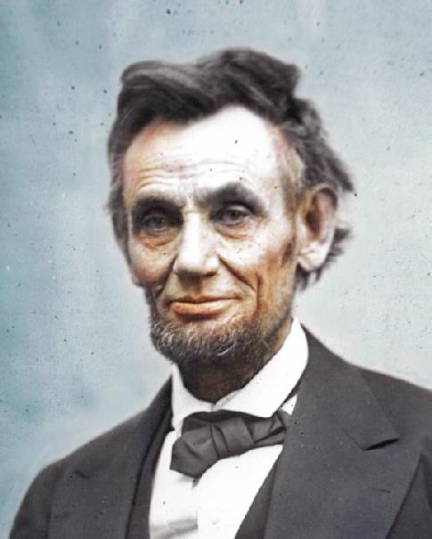
Satan’s Selective Breeding Program
A.A. Springs was the secret father of Abraham Lincoln following an affair with Nancy Hanks Lincoln
Abraham Lincoln

Slide 81
Satan’s Selective Breeding Program
On account of this, it has been suggested that Winston Churchill was not the son of Randolph but of one of Jennie's lovers and could have been a Rothschild.
Winston Churchill

Slide 82
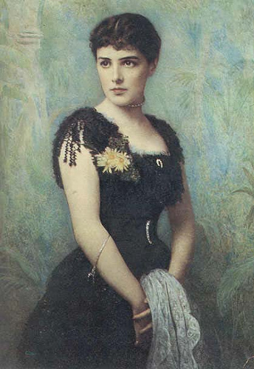
Satan’s Selective Breeding Program
According to numerous biographers, throughout her life Jennie: Left
(Churchill’s mother) was extremely promiscuous. Clive Ponting expresses it in his biography Churchill, she was “still engaging in numerous affairs.”

Slide 83
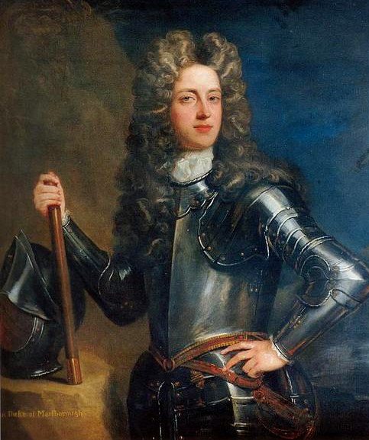
Satan’s Selective Breeding Program
If this claim is true, it would make Winston and his descendants impostors and not true descendants of the first Duke of Marlborough and heirs to his titles and estates. This, however, is open to speculation.
First Duke of Marlborough

Slide 84
Satan’s Selective Breeding Program
Joseph (Iosif) Dzhugashvili or "Soso", as his mother called him in Georgian fashion. Edmond, the youngest son of James (Yakov) de Rothschild did much of the legwork for the Paris branch of the Rothschilds --- the family's "oil experts". travelling overseas in style in the family yacht.
Joseph (Iosif) Vissarionovich Dzhugashvili
Stalin

Slide 85
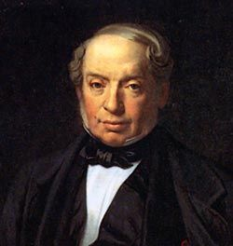
Satan’s Selective Breeding Program
From there to Baku overland where he would have visited the Jewish wine merchant in Gori where his mother worked. The Rothschilds were involved in the Oil Business in this area. Stalin’s son was named Yakov – after his secret grandfather perhaps?
Baron James (Yakov) de Rothschild

Slide 86
Satan’s Selective Breeding Program
His wife however was employed as a servant in the home of Baron Rothschild. As soon as the family discovered her pregnancy she was sent back home where Alois was born."
Adolph Hitler
Notes:
"Adolf's father, Alois Hitler, was the illegitimate son of Maria Anna Schicklgruber. It was generally supposed that the father of Alois Hitler (Schicklgruber) was Johann Georg Hiedler.There are some people who seriously doubt that Johann Georg Hiedler was the father of Alois…(an Austrian document was) prepared that proved Maria Anna Schicklgruber was living in Vienna at the time she conceived. At that time she was employed as a servant in the home of Baron Rothschild. As soon as the family discovered her pregnancy she was sent back home..where Alois was born."

Slide 87
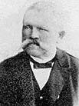
Satan’s Selective Breeding Program
"Adolf's father, Alois Hitler, was the illegitimate son of Maria Anna Schicklgruber. It was generally supposed that the father of Alois Hitler (Schicklgruber) was Johann Georg Hiedler.
Alois Schicklgruber (Hitler)

Slide 88
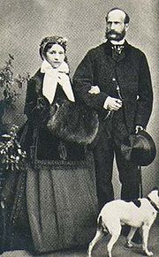
Satan’s Selective Breeding Program
Earl Mountbatten & Prince Phillip share a common Gogite ancestor – Julia Theresa von Hauke a Polish Lady in waiting to the Royal House of the Grand Duchy of Hess
Julia Hauke, Princess von Battenberg with Alexander von Hessen-Darmstadt

Slide 89
Satan’s Selective Breeding Program
Julia Theresa von Hauke.
Louis Alexander Mountbatten.
Philip Mountbatten.
Charles, Prince of Wales
Earl Mountbatten
Notes:
But Louis' second son (whose mother was the Polish Jewess) is the present Admiral Earl Mountbatten, Philip's most influential uncle and top serving Admiral in the British Navy, last Viceroy to India, close friend of socialite/intellectual Fabians ...His wife is the daughter of Lord Mount Temple (previously Mr. Wilfred Ashley, a Tory MP of 30 years ago). Ashley married the daughter of Sir Ernest Cassel, the son of a Cologne Jewish banker Cassel, and the financier of Edward VII...Princes Charles has been circumcised at Buckingham Palace by the Jewish Rabbi, Dr. Jacob Snowman, who has in the past attended other Royal Babies." (From Kingdom Identify Ministries, Box 1021, Harrison, Arkansas).

Slide 90
Satan’s Selective Breeding Program
Earl Mountbatten’s wife was the daughter of Lord Mount Temple (previously Mr. Wilfred Ashley, a Tory MP of 30 years ago). Ashley married the daughter of Sir Ernest Cassel, the son of a Cologne Jewish banker Cassel, and the financier of Edward VII
Earl Mountbatten

Slide 91
The Rothschilds = “Rot” (Red) “Schild” (Shield)
Left: The Rothschilds though their banking network control governments.
The Established Political Parties dance to their tune.
Their anthem “Keep the Red Flag Flying Here”!
They control “Booms” and “Busts” of the Economy.
Notes:
It is a further interesting point that about 1805, the Rothschilds usurped the main devices of the Royal Arms of Great Britain, viz. the Lion and the Unicorn supporting the crown. Further above the original crown they have superimposed three crowns, which in heraldry symbolize that the superimposed crowns have overcome the original crown of Britain. Perhaps one of the main points of the Rothschild arms is that in one of the superimposed crowns they have placed the interlaced triangles of Zionism INSIDE THE HORNS OF A BULL. Now the horns of bull is the ancient crest of the Anglo‑Saxon nation ( ENGLE Anglo‑Saxon for a bull) Engle‑land ‑ Bull land from which we get the name John Bull. This signifies that the Zionists are working inside the Anglo-Saxon nation.

Slide 92
The Rothschilds = “Rot” (Red) “Schild” (Shield)
By the 1820s the Rothschilds had become the dominant banking family of Europe, controlling the fastest growing banks in France, England, Austria, Italy, and Germany.
Meyer Amschel Rothschild being received by servants of a German Prince

Slide 93
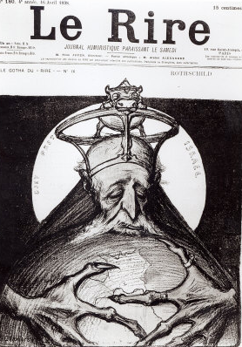
The Rothschilds = “Rot” (Red) “Schild” (Shield)
Wealthy investment bankers who allied themselves with the Rothschilds and the Masonic Order prospered through a series of financial mergers and acquisitions, which would essentially become the future pattern for how International Business would lay its framework on cross-border investments.
A French View Of The Rothschilds

Slide 94
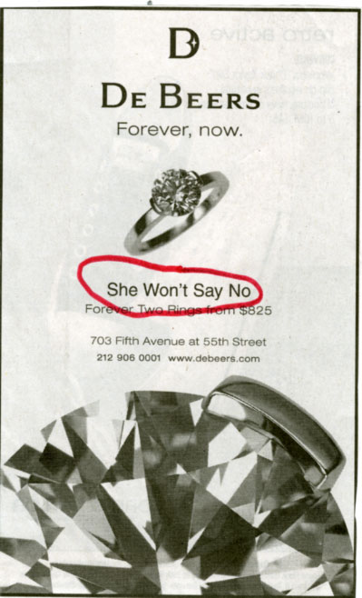
Rothschilds & South Africa
The Rothschilds supported Cecil Rhodes to form De Beers. (We shall see in a later presentation how the Rothschilds wrested the mineral wealth away from the Boers)

Slide 95
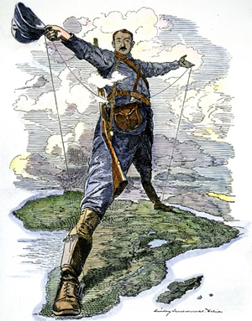
Rothschilds & South Africa
Rhodes made 7 wills to set up a secret society modelled on the Jesuits and Masons to bring in the New World Order centred on Britain – The Rhodes Scholarships and the Round-Table assisted by the Fabians
Cecil Rhodes

Slide 96
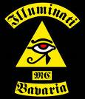
Rothschild’s Linked To The Oppenheimers
The Oppenheims and Oppenheimers. Originated from Cologne. The Oppenheimers were members of the Bavarian Illuminati. The Bund der Gerechten (League of the Just) - an illuminati front run mainly by Jews who were Satanists.

Slide 97
Rothschild’s Linked To The Oppenheimers
This Bund financed in part by the Rothschilds who paid the Satanist and Mason Karl Marx to write the Communist Manifesto. The Jew Gumpel Oppenheim was in the inner circle of the Bund.
J. Robert Oppenheimer

Slide 98
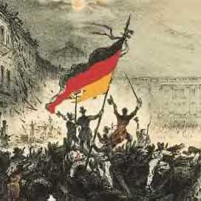
Rothschild’s Linked To The Oppenheimers
His relative Heinrich Oppenheim masterminded the communist revolution of 1848 in Germany. The Communist Party’s official histories even accept the Bund as the predecessor of Communism.
The German Revolution

Slide 99
Rothschilds Linked To The Oppenheimers
The Oppenheimers would become Rothschild’s agents for controlling the mineral wealth of South Africa and would be the manipulators ……

Slide 100
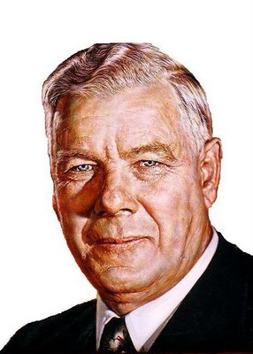
Rothschilds Linked To The Oppenheimers
…. behind the scenes resulting in the assassination of Dr. H. F. Verwoerd being instrumental in plans now successfully achieved for the overthrow of white government in SA
Dr. H. F. Verwoerd

Slide 101
Rothschilds Involved In The Round Table
Rhodes secret society consisted of an inner group set up in 1891 – Rhodes, Stead, Lord Esher (Brett) & 33º Mason Alfred Milner.
A secondary group of initiates were set up – Lord Balfour (Jew), Sir Harry Johnson, Lord Rothschild, Lord Grey and others.
Cecil Rhodes

Slide 102
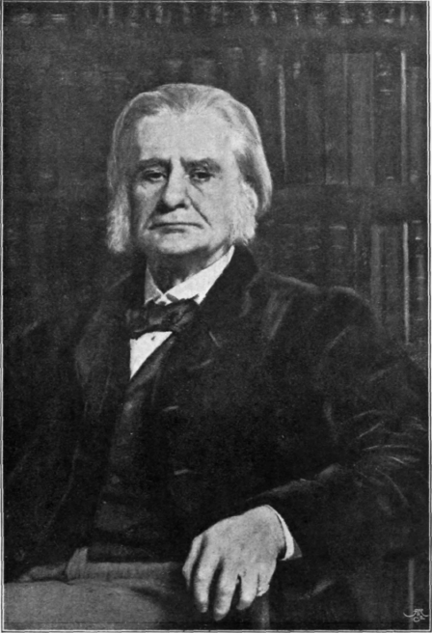
Rothschilds Involved In The Round Table
Lord Rothschild was not initially in the inner group but was represented by his son-in-law Lord Rosebury. The Round Table developed from the inner circle of the Rhodes Secret Society
Lord Rosebury

Slide 103
Rothschilds Involved In The Round Table
Today there is a Round-Table branch in most towns.
It attracts local business men, prominent people in Local Government and other public organisations.
A Local Round Table Meeting

Slide 104
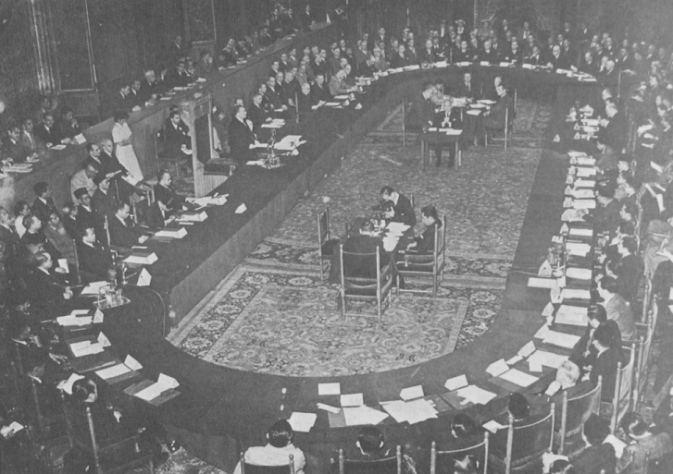
Rothschilds Involved In The Round Table
Few are aware of the powerful inner circle – The RT acts as an intelligence gathering service for what is going on at ground level – so any revolt against the NWO can be “nipped in the bud” There will be only one or two unknown people who report back to the next level.
A Round Table Conference

Slide 105
Rothschilds Involved In The Round Table
Like all Illuminati organisations – The Round Table has an impeccable front raising money for local good causes – alluding to the knights of King Arthur's Round Table seen here at Winchester.

Slide 106
Rothschilds Control The Price of Gold
The dominant role played by the House of Rothschild in the Bank of England is augmented by another peculiar duty of the firm, the daily fixing of the world price of gold.
Gold Bullion

Slide 107
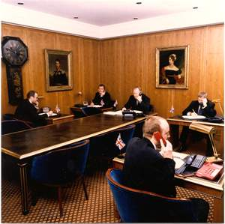
Rothschilds Control The Price of Gold
Every weekday at 11 a.m. the representatives of five firms of bullion brokers and one firm of refiners meet at the office of Messrs. Rothschild (except on Saturday) and there fix the sterling price of gold.
Gold fixing at NM Rothschild

Slide 108
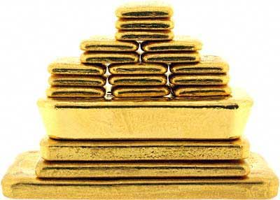
Rothschilds Control The Price of Gold
The banking houses privileged to meet with the Rothschilds to set the world price of gold are known as “the Club of Five”. In 1958, they were: N.M. Rothschild, Samuel Montagu, Mocatta and Goldsmid, Sharps Pixley, and Johnson, Matthey.

Slide 109
The Rothschilds And The Lord Mayor Of London
Since 1820 the Lord Mayors of London have been chosen by the Rothschilds

Slide 110
Rothschilds Founded Many Well Known Businesses
In the early 19th century, the Rothschilds began to consolidate their profits from government loans into various business ventures,

Slide 111
Rothschilds Founded Many Well Known Businesses
“There is the Sun Alliance life insurance company, most aristocratic of all insurance companies, founded by Nathan Rothschild in 1824; Brinco, the British Newfoundland corp., founded by the British and French Rothschilds in 1952; the Anglo-American corp.; Bowater, Rio Tinto and others.”
Sun Life Insurance Canada

Slide 112
Rothschilds Founded Many Well Known Businesses
The British firms comprising the major basis of the Rothschild fortune are: Sun Alliance Assurance, Eagle Star, DeBeers, and Rio Tinto. Eagle Star’s directors include Duncan Mackinnon, of Hambro Investment Trust;
Eagle Star Insurance

Slide 113
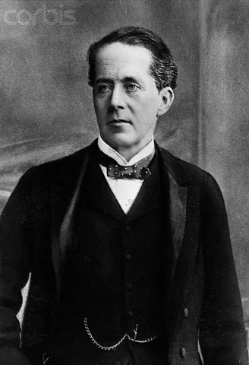
Rothschilds Founded Many Well Known Businesses
Earl Cadogan, whose mother was a Hill Samuel Co.; Marquess Linlithgow (Charles Hope) whose mother was a Milner Hambro; Sir Robert Clark,– he married Judith Baring; Evelyn de Rothschild; and Sir Ian Stewart of Brown Shipley Co., who has been parliamentary private secretary to the Chancellor of the Exchequer since 1979.
Earl Cadogan

Slide 114
The Rothschilds Enter Parliament

Slide 115
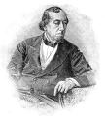
Some Of Many Rothschild Agents
Disraeli, (21 December 1804 – 19 April 1881) on the death of Prince Albert wormed his way into the confidence of Queen Victoria and persuaded her to allow Jews into Parliament
The Right Honourable Benjamin Disraeli, 1st Earl of Beaconsfield, KG PC

Slide 116
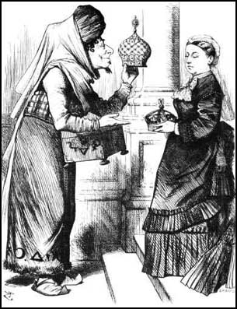
Some Of Many Rothschild Agents
… as after all they were related to Israel Britain as they were the tribe of Judah!
Obviously Queen Victoria was unaware of the Jews real racial origins.

Slide 117
Some Of Many Rothschild Agents
Duke Of Wellington
His House No1 London

Slide 118
Some Of Many Rothschild Agents
?
A biography of the Rothschilds stated that Lord Rothschild boasted of having an agent in the B.I.W.F during the last war and post war period.

Slide 119
Rothschild’s are the Vatican’s Bankers
Early in the 19th Century the Pope came to the Rothschilds to borrow money – in 1823 the Rothschilds took over the financial operations of the worldwide Catholic Church.
The Vatican

Slide 120
The Vatican – The Jesuits (Jews) Begin To Become A Major Influence
On the night of 20th February, 1798, the Pope was placed under arrest and escorted out of Rome by French soldiers.
The Vatican
Notes:
"There is no God but Allah, and Mohammed is his prophet." On the night of 20th February, 1798, the Pope was placed under arrest and escorted out of Rome by French soldiers. He was taken first to an Augustinian Convent at Sienna, but this was damaged by an earthquake during his stay and he was taken to Florence. Finally, he was escorted by way of Turin to the French fortress of Valence, where, broken by sorrow and fatigue, he died on 28th July, 1798.
Darkness was now prevailing throughout the Kingdom of the Papal Beast. The new Pope had to watch impotently, whilst Napoleon seized the crown from his hands, and crowned himself Emperor in Notre Dame Cathedral in 1804. Then, in 1809, the Papal States were formally confiscated and Pope Pius VII placed under restraint. It is of interest to note that he remained a prisoner of Napoleon until 1814, when not only did he lift the Bull of Excommunication, but on 23rd January, he agreed to reconstitute the Jesuit Order, suppressed by his forerunner, Pope Clement, a forty year generation earlier. The Jesuits had indeed been avenged on both France and the Papacy through the very Revolutionary forces spawned by Adam Weishaupt. The Pope returned to Rome, but the Papacy would be increasingly under Jesuit influence and control.
CONTINUING JUDGEMENT ON THE SEAT OF THE BEAST
The troubles and tribulations of the Papacy did not end with the downfall of Napoleon, in fact they had

Slide 121
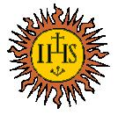
The Vatican – The Jesuits (Jews) Begin To Become A Major Influence
The Jesuits had indeed been avenged on both France and the Papacy through the very Revolutionary forces spawned by Adam Weishaupt. The Pope returned to Rome, but the Papacy would be increasingly under Jesuit influence and control.
The Jesuit Logo

Slide 122
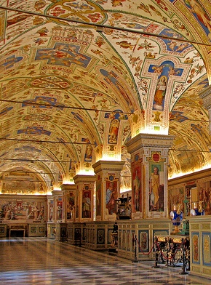
The Vatican – The Jesuits (Jews) Begin To Become A Major Influence
Today The Vatican is under almost total Jewish/Zionist control through the Jesuits and the “Black Pope” (Rothschild Agent)
The Vatican Library

Slide 123
Napoleon Bonaparte, France, was Rothschild’s agent for wresting control of the Papacy

Slide 124
God’s Bankers
God's Bankers, directed by Giuseppe Ferrara, suggests the Vatican was involved in a huge conspiracy involving drug-dealing Mafiosi, corrupt bankers and politicians, arms dealers and Freemasons.
Calvi's body was found at Blackfriars Bridge

Slide 125
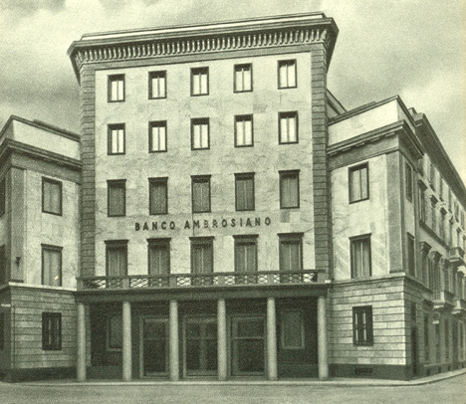
God’s Bankers
In 1981, Calvi, head of the Banco Ambrosiano, was jailed for four years and fined $11.7m (£8.2m) for illegally exporting currency.
Banco Ambrosiano

Slide 126
God’s Bankers
Although we do not know for sure – it was likely that Calvi was “suicided” for being the Vatican’s agent in trying to bypass the Rothschild’s banking network

Slide 127
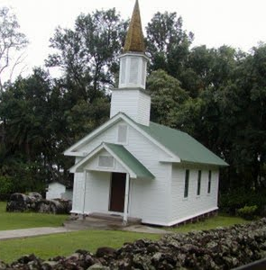
Rothschilds Also Well Connected To The Protestant Church
Besides the Roman Catholic Church – The Rothschilds also wielded much influence and power not only in Secret Societies, but also in Christendom’s Protestant churches.

Slide 128
Rothschilds Also Well Connected To The Protestant Church
The Salvation Army under the suggestion of the Rothschilds adopted the Red Shield (Roth-red)

Slide 129
The Armenian Holocaust
The Armenian Holocaust unlike as we are told in the history books – was as a consequence of powerful people seeking to gain control of the rich oil deposits in this region.

Slide 130
The Armenian Holocaust
The American oil business itself was to be mastered and monopolized by John D. Rockefeller's Standard Oil Company who was to supply the entire world's oil needs from the wells of Pennsylvania.
Standard Oil Logo

Slide 131
The Armenian Holocaust
The Rothschilds however had other ideas!

Slide 133
The Armenian Holocaust
Notice the logo of the red Crown – representing the Knights Templar “Crown” of the Inns of Court in the City of London.
Standard Oil – known here as ESSO

Slide 134
The Armenian Holocaust
Although the Rockefellers were facilitated into power by the Rothschilds through the banking connections in the states – it is believed that the Rockefellers thought they could get one better over the Rothschilds through their oil monopoly.
Rothschild’s Shell Oil

Slide 135
The Armenian Holocaust
Rockefeller was able to become the “One of the richest men in the world" by virtue of an early oil empire nestled in peaceful Pennsylvania.
Standard Oil's first bout with serious worldwide competition (The Rothschilds) would come from a region halfway around the world whose stability was far from that of Pennsylvania.
Baron Edmond de Rothschild 1845-1934

Slide 136
The Armenian Holocaust
Baku Nobel Oil Fields
The Nobel Family (of Nobel prize fame) had already established a flourishing oil business in the Baku area supplying mainly Russia and some other countries.

Slide 137
The Armenian Holocaust
The Rothschilds saw the potential of this rich area for competing with the Rockefellers for world dominance in the supply of oil. But there were 2 problems:-
Cost of transporting the oil to the nearest seaport of Batum on the Black Sea,
Unstable conditions because of the on going conflict between Christian Armenians and Muslims.

Slide 138
The Armenian Holocaust
In the 1880's, the French branch of the Rothschild family acquired interests in Russia's Baku oil fields in an effort to supply their refinery on the Adriatic with cheap Russian oil.

Slide 139
The Armenian Holocaust
In exchange for these interests they built a railroad linking Baku to the newly acquired Black Sea port of Batum. This opened up the Baku oil, a major world supply. It had previously been geographically locked in by the mountains of the Caucasus.
Baku – Batum Railroad

Slide 140
The Armenian Holocaust
[The Swedish Nobel family had been supplying internal Russia with the Baku oil by way of rivers as well as via the Caspian Sea]. With the success of the new railroad, the Rothschilds had more oil than they could actually sell. Overcoming their fear of competing with the giant Standard oil, they sought out the huge markets east of Suez.
Baku – on the Caspian Sea

Slide 141
The Armenian Holocaust
The Rothschilds sought out a man to help them penetrate these markets. His name was Marcus Samuel. Samuel had many contacts throughout the Far East.
Baron Edmond de Rothschild 1845-1934

Slide 142
The Armenian Holocaust
When the Rothschilds proposed to sell their oil to Samuel, understanding the magnitude of the opportunity, and understanding the competition with a foe like Standard oil, he set about tackling the logistics of successfully competing with the giant company.
Marcus Samuel

Slide 143
The Armenian Holocaust
Samuel understood that he needed to sell his oil at a cheaper price. In his efforts to do this he reduced transportation costs by designing bulk tankers which were safe enough to pass through the Suez Canal.
Sir Marcus Samuel

Slide 144
The Armenian Holocaust
Standard oil's costs would be much higher as they transported their oil around the tip of Africa in clipper ships that were loaded with pre-filled cans.

Slide 145
The Armenian Holocaust
In 1892, Samuel's coup would unleash forces that would shape the history of mankind. His first oil tanker picked up it's load of Baku oil from the Rothschild's Batum refinery and sailed through the Dardenelles
Royal Dutch Shell

Slide 146
The Armenian Holocaust
… and on through the Suez canal to the far east where the Shell oil company became, overnight the predominant supplier of Kerosene replacing Standard oil. The great Standard world monopoly had been busted.

Slide 147
The Armenian Holocaust
Three years after Shell joined Royal Dutch, production at Baku would come to an abrupt halt in 1905 due to the violence of the ethnic conflict between the region's Moslems and the minority population of Armenians who are Christians.
Batum – on the Black Sea

Slide 148
The Armenian Holocaust
This conflict caused the first interruption of oil to the world market. Standard oil was quick to supplant the needs of the affected markets as its source was operating under the blanket of peace and would flow until dry.

Slide 149
The Armenian Holocaust
The Port of Batum
To an all-powerful banking family like the The Royal/Dutch/Shell Group (and the Nobels) watched their Baku investments go up in flames. Ethnic conflict was at the root of the matter.

Slide 150
The Armenian Holocaust
Rothschilds, whose vast wealth bankrolled many a war, causing millions of fatalities... was the removal of a small minority like the Armenians a fair price to pay for the peace in a region so crucial to the development and investment of the Far East,
The Armenian Massacre

Slide 151
The Armenian Holocaust
Squeamish the Rothschilds were not, their line of work requires pragmatism to rule their day.

Slide 152
The Armenian Holocaust
How it could be done, so as not to reveal any plausible motive which could link the actual planners to the genocide? The scheme involved a proxy party, which was manipulated through layers of influence, providing sufficient cover for the planners.
Some Armenian Victims

Slide 153
The Armenian Holocaust
Of course, history tells us that it was the Turks, and not big business that committed the Armenian atrocities. However, if one looks closely, one would find that the Turks owed more than one favour to the French government which aided Turkey in it's recent past.

Slide 154
The Armenian Holocaust
A constant behind France's economic power was the French branch of the Rothschild family. Napoleon III was a Rothschild man. Specifically, Baron James de Rothschild's man. Baron James was, financially and hence politically, the most powerful figure in France
Baron James De Rothschild

Slide 155
The Armenian Holocaust
The question arises. Was the Armenian genocide an obligation demanded by Turkey's creditor? The Armenian massacres of 1894 and 1896 occurred merely two years after Baku oil first began to flow through the Suez Canal to the Far Eastern markets.
The Armenian Massacre

Slide 156
The Armenian Holocaust
Armenians were living within the Ottoman Empire for hundreds of years, how incredible fortuitous for the oilmen that ethnic hatred would heat up to such a pitch as to consume their population!
Coat of Arms of The Ottoman Empire

Slide 157
The Armenian Holocaust
The Armenian genocide, during World War I, brought stability to the Baku oil region. A further accomplishment of World War I was the successful demise of the Ottoman Empire.

Slide 158
The Armenian Holocaust
Turkey was heavily in debt to France behind whom was the Rothschild Bank – Turkey would have to pay their indebtedness off by eliminating the Armenians – although very few would know who the lender of last resort was!!
The Sultanate of Turkey

Slide 159
The Armenian Holocaust
“In 1895 Sultan Abdul Hamid II was ordered by the owners of Royal Dutch Shell - the Rothschilds - to exterminate the Armenians, who were all Orthodox Christian. The background for that was Shell's rivalry with the Rockefeller's Standard Oil.
Sultan Abdul Hamid II

Slide 160
The Armenian Holocaust
Shell was trying to get oil from Baku down to the Mediterranean and the Rothschilds assessed the Armenians as being a potential destabilizing factor that could affect the flow of oil.

Slide 161
The Armenian Holocaust
The Sultan refused to murder the Armenians so the Rothschilds had one of his palace officials killed and the message was not lost on the Sultan, and so he commenced to slaughter about 300,000 Armenians.

Slide 162
The Armenian Holocaust
Enver Pasha
Jamal Bey
Djemal Pasha
On April 24, 1915 the above Doenme Jew Young Turk leaders who had taken over the Ottoman Empire commenced the Genocide of the Armenians

Slide 163
The Armenian Holocaust
…. which in two years time accomplished the rape and murder of over 1.5 million Armenians and the complete depopulation of Western Armenia.

Slide 164
The Armenian Holocaust
Baku
Certainly as volatile as Baku, Palestine and the surrounding Moslem areas were susceptible to the same problems of ethnic disruption.

Slide 165
The Armenian Holocaust
Although Rothschild was by far the single most important source of funding for the Jewish settlements in Palestine, his intentions were primarily for investment purposes.

Slide 166
The Armenian Holocaust
It was slow steady growth that he looked forward to. Not the mass immigration of millions of "beggars" into an area as crucial to his oil business as the Suez Canal region.
The Suez Canal Region

Slide 167
The Armenian Holocaust
The Armenian Holocaust would pave the way for the Holocaust of WWII

Slide 168
The Rothschilds Manipulated Events To Gain Palestine
As we read in Ezekiel 18:15 God would bring Gog against His land as well as His people. It is appropriate therefore that the 6 pointed cabbalistic star is the national emblem which is also to be seen on the Gates of the Rothschild’s Frankfurt home and on their coat of arms.
Notes:
In Ezekiel 16:1-3 Yahweh says to the people of Jerusalem, "Son of man, cause Jerusalem to know her abominations, and say, thus saith Yahweh unto Jerusalem: Thy birth and nativity is of the land of Canaan: thy father was an Amorite, and thy mother an Hittite."
Ezekiel 11:14-15 where we read, "Again the word of Yahweh came unto me saying, Son of man, thy brethren, even thy brethren, the men of thy kindred, and all the house of Israel wholly, are they unto whom the inhabitants of Jerusalem have said, Get you far from Yahweh unto us is this land given in possession."

Slide 169
The Rothschilds Manipulated Events To Gain Palestine
In Ezekiel 16:1-3 Yahweh says to the people of Jerusalem, "Son of man, cause Jerusalem to know her abominations, and say, thus saith Yahweh unto Jerusalem: Thy birth and nativity is of the land of Canaan: thy father was an Amorite, and thy mother an Hittite."
Jerusalem

Slide 170
The Rothschilds Manipulated Events To Gain Palestine
Ezekiel 11:14-15 where we read, "Again the word of Yahweh came unto me saying, Son of man, thy brethren, even thy brethren, the men of thy kindred,
Jerusalem
Notes:
In Ezekiel 16:1-3 Yahweh says to the people of Jerusalem, "Son of man, cause Jerusalem to know her abominations, and say, thus saith Yahweh unto Jerusalem: Thy birth and nativity is of the land of Canaan: thy father was an Amorite, and thy mother an Hittite."
Ezekiel 11:14-15 where we read, "Again the word of Yahweh came unto me saying, Son of man, thy brethren, even thy brethren, the men of thy kindred, and all the house of Israel wholly, are they unto whom the inhabitants of Jerusalem have said, Get you far from Yahweh unto us is this land given in possession."

Slide 171
The Rothschilds Manipulated Events To Gain Palestine
And all the house of Israel wholly, are they unto whom the inhabitants of Jerusalem have said, Get you far from Yahweh unto us is this land given in possession."

Slide 172
Flag of Gog’s Stolen Real Estate In The Middle East
The Margen David, 6 pointed star – the Seal of Solomon was not considered a Jewish symbol until the Rothschilds started using it.

Slide 173
Flag of Gog’s Stolen Real Estate In The Middle East
Throughout the Middle Ages, the seal of Solomon has been used by Arab magicians, Cabalistic magicians, witches and Satanists.

Slide 174
Flag of Gog’s Stolen Real Estate In The Middle East
It was found on a 1200 year old Moslem Mosque where Tel Aviv is today

Slide 175
Flag of Gog’s Stolen Real Estate In The Middle East
Because the Rothschilds were Satanists they adopted the powerful magic symbol, The 6 pointed star, in 1822 for their coat-of-arms.
The Star of “David”

Slide 176
Flag of Gog’s Stolen Real Estate In The Middle East
In fact the progenitor of the Rothschilds – Mayer Amschel Bauer began hanging out a red hexigram in front of their house – hence the name Rothchild from the German (Rot = Red & schild = shield)
Mayer Amschel Bauer

Slide 177
The Israeli State Pays Tribute To Its Owner And Founder
Coin struck to commemorate the life of Baron Edmond De Rothschild who was instigator of the Balfoure Declaration.

Slide 178
The Israeli State Pays Tribute To Its Owner And Founder
500 Sheckle Bank Note issued to commemorate the life of Baron Edmond De Rothschild.

Slide 179
The Israeli State Pays Tribute To Its Owner And Founder
300 Sheckle postage stamp issued to commemorate the life of Baron Edmond De Rothschild.

Slide 180
Baroness Philippine de Rothschild, Opus One Winery
Recently completed “Opus One” Winery in Napa Valley USA – Specialising in blood red wines, but actually is a satanic, devil worshipping hideaway similar to Bohemian Grove, located just to the east and north of San Francisco.
Opus One – Grand Entrance

Slide 181
Baroness Philippine de Rothschild, Opus One Winery
The land for Opus One, meaning First Work, was secretly purchased in the late 1960s, its construction shrouded in secrecy
Opus One

Slide 182
Baroness Philippine de Rothschild, Opus One Winery
"Strangely, the Napa Valley Register which reports all building activity remained extremely quiet about what was being built. From the air, the construction forms a Masonic square and compass,”

Slide 183
Baroness Philippine de Rothschild, Opus One Winery
The logo of Opus One is the two-headed Janus or the spirit who divides, the symbol being an important part of Illuminati mind control.

Slide 184
Baroness Philippine de Rothschild, Opus One Winery
The opening announcement was low key and only select people and select International media types were invited.

Slide 185
Baroness Philippine de Rothschild, Opus One Winery
This opening is extremely unusual for a winery in the Napa Valley area. Private guided tours are very hard to obtain of Opus 1, in contrast to the other wineries in Napa Valley.
One of the rare tours

Slide 186
Baroness Philippine de Rothschild, Opus One Winery
An inquisitive researcher, who later had a secret spy take a tour of the compound, said the inner theme of the numbers 3 and 6 runs throughout the large Opus I pyramid building,
Aerial View of Opus One

Slide 187
Baroness Philippine de Rothschild, Opus One Winery
… as well as the number 666. He added that little circles frequently appear throughout the compound, having Illuminati significance.

Slide 188
Baroness Philippine de Rothschild, Opus One Winery
The head of Philippe de Rothschild SA, baroness Philippine de Rothschild, seen here opening an exhibition in Russia.
Baroness Philipine de Rothschild

Slide 189
Jacob Rothschild
Here we see the present head of the London branch of the Rothschild Merchant Bank – Jacob Rothschild.

Slide 190
Jacob Rothschild
California governor Arnold Schwarzenegger – seen here prior to getting the job being auditioned by Jacob Rothschild.

Slide 191
Jacob Rothschild
Lord Jacob Rothschild’s place in the sun on the Island of Corfu.

Slide 192
Jacob Rothschild
"No its not the Public Baths" Its Lord Jacob Rothschild's 100m Pool. "They want a private world not just a private pool". They can relax here while their puppets are doing their bidding back in London and elsewhere.

Slide 193
The Rothschilds Summed Up In German History
"The Rothschilds introduced the rule of money into European politics. The Rothschilds were the servants of money who undertook the reconstruction of the world as an image of money and its functions.

Slide 194
The Rothschilds Summed Up In German History
Money and the employment of wealth have become the law of European life; we no longer have nations, but economic provinces." (New York Times, Professor Wilhelm, a German historian, July 8, 1937)
Professor Wilhelm Josef Behr

Slide 195
Black Monday
Norman Lamont the Chancellor (Formerly in the employ of the Rothschilds) who presided over Britain’s hasty exit from the ERM known as the “snake” and consequent plunge in the stock markets and interest rates rocketing to a record 15%
Norman Lamont

Slide 196
Black Monday
- this enabled the Rothschilds through their proxies, to buy up for peanuts utility shares sold to a gullible public in previous years under privatisation schemes.

Slide 197
Black Monday
David Cameron assistant to Norman Lamont at the time of the ERM debacle and connections to the Rothschilds banking house was as a consequence their “blue eyed boy” to take over the leadership of the Conservative Party
David Cameron

Slide 198
The Rothschilds Summed Up In German History
"If you will look back at every war in Europe during the nineteenth century, you will see that they always ended with the establishment of a ‘balance of power.' With every re‑shuffling there was a balance of power in a new grouping around the House of Rothschild in England, France, or Austria.
Rothschild's Waddesdon Manor

Slide 199
The Rothschilds Summed Up In German History
They grouped nations so that if any king got out of line, a war would break out and the war would be decided by which way the financing went. Researching the debt positions of the warring nations will usually indicate who was to be punished." (Economist Stuart Crane)
Notes:
Rothschilds at prayer – to whom?

Slide 200
The 4 Horses Of The Apocalypse
It is reported that in the reception area of the City of London office of Lord Rothschild hangs a large painting of the 4 horses of the apocalypse. This is very appropriate has they have been responsible for unleashing the scourges represented by the 4 horses!
The four horses of the apocalypse

Slide 201
A Thought To Leave You With
"The truth is not for all men, but only for those who seek it.'' Ayn Rand. Ayn Rand was born in 1905 in St. Petersburg, Russia. Defying the death warrant of the Soviet Union, she
came to America as a temporary visitor in 1926 but remained for the rest of her life

Slide 202
The Story Of Gog And Magog
The End Of Part Four
To be continued …………Satan Bound For A 1000 Years & French & American Revolutions

