Slide 1
The Story Of Gog And Magog
Part Three
The Spanish Armada, Inquisition & English Revolution

Slide 2
The Story of Gog & Magog Will be covered in a series of 10 parts
Attila, The Rise of Islam and the Khazars
Genghis Khan, The Russians & the 3 frogs of Revelation
The Spanish Armada, Inquisition & the English revolution
The rise of the Rothschilds & the Armenian Holocaust
The Victorian Era
WW1 & WW2
WW3 – The secret war

Slide 3
The Story of Gog & Magog Will be covered in a series of 10 parts
Gog’s covert attack on western culture, education, legal system, health, art & education.
False flag operations
Conclusion

Slide 4
Gog – Recap Parts 1 & 2
1) Ezekiel 38:15 Had important Key Words and That This Key Verse Covered Most Of The AD Period to the present day.
2) Magog=Equals Mongol.
3) Gog = Khazar = Askenazim Jew
Gog’s three major frontal attacks – Attila, Genghis Khan and the Moors
The rise of the 3 evil spirit (on the banner of Clovis King of the Franks) Portended Jacob’s trouble

Slide 5
Gog of The Land of Magog
The Story of
Analysis of Ezekiel 38 : 15
First half of verse
And Thou (Attila/Genghis Khan) Shalt Come From Thy Place Out Of The North Parts, Thou And Many People With Thee All Of Them Riding Upon Horses, A Great Company, And A Mighty Army

Slide 6
Thou And Many People With Thee All Of Them Riding Upon Horses, A Great Company, And A Mighty Army
The horse cavalries of Genghis Khan

Slide 7
Gog of The Land of Magog
The Story of
Second half of verse
And Thou Shalt Come Up Against My People of Israel, As A Cloud To Cover The Land: It Shall Be In The Latter Days, And I Will Bring Thee Against My Land That The Heathen May Know Me, When I Shall Be Sanctified In Thee, O Gog, Before Their Eyes.

Slide 8
Gog’s Attack On England By Way Of The Spanish Armada Fails
The attack on England by the Spanish Armada came about through Gog’s influence within the Spanish Court. They wanted to seize England’s riches following its expanding sea power in the New World
The Spanish Armada

Slide 9
Spanish Armada - Defeated
Defeat of the Spanish Armada, 8th August 1588 by Philippe-Jacques de Loutherbourg, painted1796, depicts the battle of Gravelines.

Slide 10
Gog’s Attack On England By Way Of The Spanish Armada Fails
As an Elizabethan coin struck to commemorate the defeat stated – “God blew with his winds”
In the following slides we will see that the events leading up to the armada was Gog’s need to find a more secure base having been rumbled by the Spanish and the protracted inquisition

Slide 11
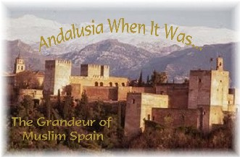
Khazars Seek Refuge In Spain -Andalusia
Professor Graetz, describing the collapse [in the second half of Tenth century A.D.] of the Jewish Khazar kingdom, states, "As though Andalusia were a Jewish state, the sons of the last chagan or king of the Khazars, like those of the exiles also sought refuge in Spain."
At this time the Moslems had not been driven out of this part of Spain where there was a colony of Sephardic Jews which had maintained contact with the Khazar kingdom.
Notes:
16952

Slide 12
Andalusia
It is interesting to note that Andalusia at this time had Gibraltar (Gib’s altar) within its territory.

Slide 13
Andalusia – Gog’s Stronghold In Spain
When Spain drove out the last of the Moors in 1492 AD , a number of Moslems and Jews both Sephardic and Ashkenazim remained in Andalusia. Some converted to Christianity in order to gain influence. This they were successful in doing and were able to persuade the court to make war with England.
Seville - Andalusia

Slide 14
Spanish Inquisition To Root Out Jews & Moslems – 2 phases
The first phase of the inquisition was to root out the Moslems and Jews particularly the most uncouth and rough Jews the Khazars (mainly in Andalusia) – forcing them to flee to Poland to their fellow Khazars who had settled there many years earlier following the overthrow of the Khazar kingdom by the Russians
Flags of Andalusia

Slide 15
Gog Decamps To Poland
When the Spanish re-conquest was completed in 1492 the [Sephardhim] Jews, as well as the Moors, were expelled, and the "centre" of Talmudic government was then transferred to Poland
A Jewish Ghetto in Krakow Poland

Slide 16
Krakow (Poland)
During the 1500's and 1600's the Jews in Poland lived under "an autonomous government", ‘the Kahal’. Krakow known for its Jewish Ghettos was within this region and part of the Hanseatic League Trading Cartel.
Krakow City Centre – Home of the Hanseatic League merchants

Slide 17
Gog’s Attack On England By Way Of The Spanish Armada Fails
Spain instigated a further purge of the Jews through the Inquisition. Many Jews fled to the Americas and Mexico in particular but many also made their way to Holland and Amsterdam – here they would re-group and consolidate for another attack on England which this time would be successful.
The Spanish Armada

Slide 18
Gog’s Attack On England By Way Of The Spanish Armada Fails
Those that fled to the Americas kept their Jewishness secret, but so they could recognise each other they changed their names to plant names such as Rose i.e. President Roosevelt
The Spanish Armada

Slide 19
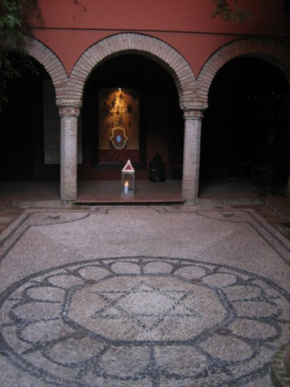
The Spanish Inquisition Spain Attempts To Expel Gog From Its Borders
The Jews were under increasing pressure from the Church because of the heresies that they were intentionally planting into the Church,

Slide 20
The Spanish Inquisition Spain Attempts To Expel Gog From Its Borders
…. as well as their excesses as tax collectors and money lenders. The Pope finally initiated what has become known as the Inquisition.

Slide 21
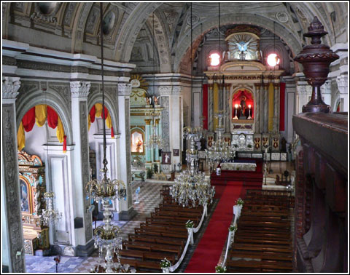
The Spanish Inquisition Spain Attempts To Expel Gog From Its Borders
It was within the Inquisition that the Catholic Church made its most terrible strategic blunder:-
A Spanish Catholic Church

Slide 22
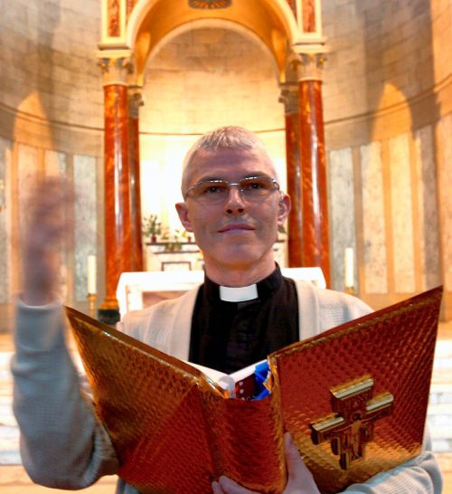
The Spanish Inquisition Spain Attempts To Expel Gog From Its Borders
As a result of this horrible blunder on the part of the Catholic Church, the Jews were now within the church like the Trojan horse, with some of them rising to the higher ranks within the Church, until 1866, when they took absolute control, and now rule the Catholic Church through the "Black Pope."
A Spanish Priest

Slide 23
The Spanish Inquisition Spain Attempts To Expel Gog From Its Borders
The final results have been that the entire Christian Kingdom of God has suffered in general and the Catholic Church has suffered in particular. What did the Catholic Church do? It gave the Jews the option of being baptized and converting to Catholicism.
The Inquisition

Slide 24
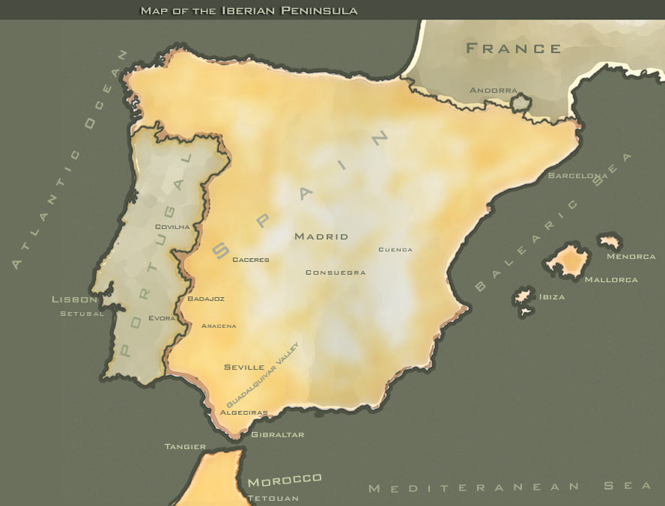
The Spanish Inquisition Spain Attempts To Expel Gog From Its Borders
The Jews of Spain and Portugal took them up on it and were baptized in wholesale numbers and joined the Church.

Slide 25
The Spanish Inquisition
They (Gog) could now even more efficiently implant their heresies. All the while that they pretended to be Christian, they still practiced their Jewish faith. The name converso, or converted, was given to the multitude of Jews who were baptized and claimed to be Christian. Within that group of conversos were the Marranos.

Slide 26
The Spanish Inquisition
They were the Jews who supposedly converted but actually remained Jews in thought and action. The problem was that nearly all, if not all, of the conversos still remained loyal to the Jewish religion and cause. As we shall see, that situation has plagued all of us to this very day.

Slide 27
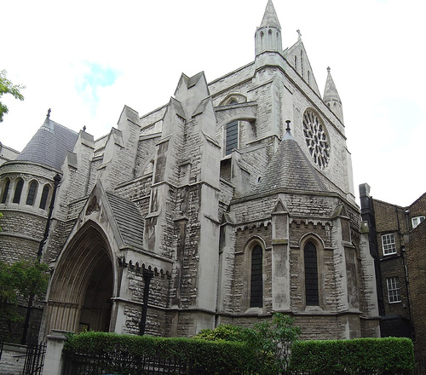
The Spanish Inquisition
When the Catholic Church finally realized its blunder, it sought out the Marrano Jews and systematically executed them by burning them at the stake. The undercover investigations to find them would have made the KGB, CIA and the FBI look like school boys.
A Spanish Church

Slide 28
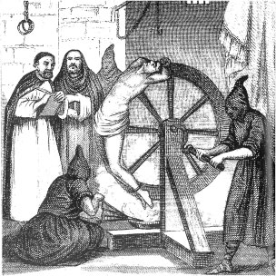
The Spanish Inquisition
They found them within the nobility and even they weren't spared. These were the circumstances in Spain

Slide 29
The Spanish Inquisition
….when Queen Isabella and King Ferdinand finally, on the 30th of March, 1492, gave the known Jews four months to leave the country. Some went to Sicily where they formed the organization we know today as the Mafia, and some went to Holland.
Queen Isabella & King Ferdinand

Slide 30
The Spanish Inquisition
We have to bear in mind that the Spanish had good reason to hate the Jews, for it was they who let the enemy (the Moors) into their cities by opening the gates while they were in
their churches praying for deliverance - as a consequence many Spaniards (Simeon) were slaughtered.
.
Nothing changes - they are doing the same today by allowing the heathen through our borders.

Slide 31
Gog’s Cowardice
When the Jews opened the gates of Spanish cities to let in the Moors, while the Spanish were in their churches praying for deliverance, they wore yellow armbands, so they could be easily identified and no doubt acted as
guides to lead the Moors to the Spanish hideouts. Is this why the colour yellow is often associated with Cowardice – yellow belly etc.?

Slide 32
The Spanish Inquisition
The conversos, of course, did not leave because they were Christians, weren't they? But the Marranos who had not yet been found out were living from day to day,

Slide 33
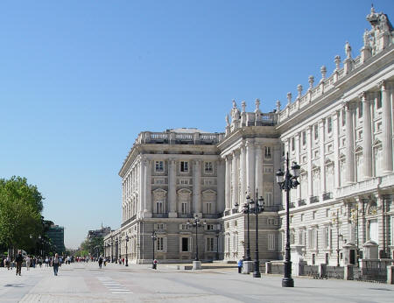
The Spanish Inquisition
… knowing that they had to leave or face the stake. In reality, all of the conversos knew that they would one day need to find a new home because of their true sympathies. Many of them were within the household of the royal family.
Spanish Royal Palace - Madrid

Slide 34
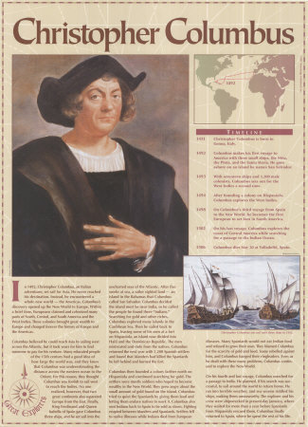
The Spanish Inquisition
The king and queen's advisors were conversos and later found out to be Marranos. The kings treasurer was a Marrano. It was this group of very powerful men who found the money to finance the voyages of Columbus. They had very personal reasons to find a way to get the thousands upon thousands of Jews out of Spain before they were executed.

Slide 35
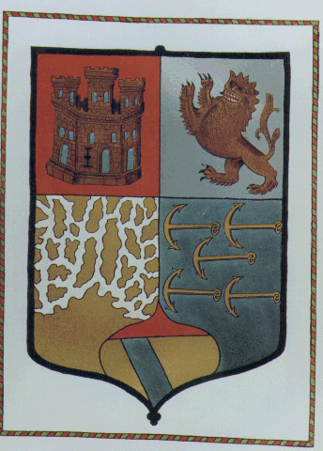
The Spanish Inquisition
It is not our purpose here to prove, one way or the other, the genealogy of Columbus. For several hundred years now that argument has flourished. The Italians claim him to be Italian. The Spanish researchers claim that he was born in Spain of a Jewish family.
Columbus Coat of Arms

Slide 36
The Spanish Inquisition The Marranos Jews Negotiate To leave Spain
The Marrano advisers had already obtained the promise of the required money from the wealthy Jews of Spain but the king and queen did not know that. These advisors tried desperately to find a way to get the Marranos out of the
country before they were found and executed. The king and queen accepted the proposals. Foremost among the Marrano advisors to the king was Luis de Santangel.

Slide 37
The Spanish Inquisition The Marranos Jews Negotiate To leave Spain
The Santangels came from a place called Calatayud, or Calatal-Yehud, one of the wealthiest Jewish communities in Spain. Because of their wealth, the Santangel family obtained high offices in the government.
The Santangels were the Rothschilds of that time. It was because of the pressing need to get the Jews out of Spain that Luis de Santangel loaned the crown 17,000 ducats, interest free, to equip Columbus' ships for the voyage.

Slide 38
The Spanish Inquisition The Marranos Jews Negotiate To leave Spain
Many went to Sicily and would become the “Italian” Mafia – as always they were careful to hide their religious/racial origin.

Slide 39
The Spanish Inquisition The Marranos Jews Negotiate To leave Spain
Many Marranos involved in money lending and usury went to Amsterdam – to milk the riches of the Dutch empire and with an eye to the British Isles.

Slide 40
The Spanish Inquisition The Marranos Jews Negotiate To leave Spain
Later the Amsterdam Jews would transfer the money lending operations to New Amsterdam – which later became New York and a financial centre 2nd only to London today

Slide 41
The Spanish Inquisition The Marranos Jews Negotiate To leave Spain
Yet others would settle in Mexico and later moving on into the U.S.A. and to rise to influential positions within the government.

Slide 42
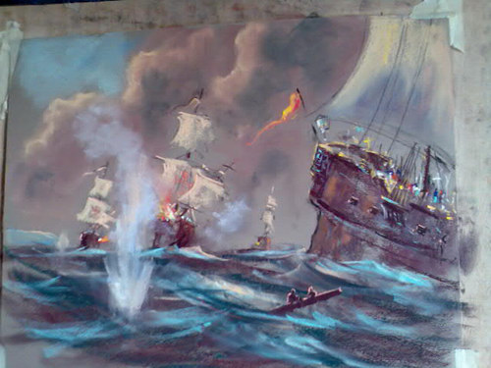
Momentous Events Were To Occur In The 1600’s
These would have profound effects on the Kingdom for both good and evil. The clash of the two great cities – New Jerusalem & Babylon
Following the defeat of the Spanish Armada and the dispersal of Gog to Holland, Sicily and Mexico – Gog’s next attack would come from Holland

Slide 43
James 1st & 6th of Scotland The Union of Jacob
In 1603, King James VI of Scotland became James I of England, as a result of which the first Union Jack was formed in 1606 by the addition of the Cross of St. Andrew which formed the background of the new flag. The name "Union Jack"

Slide 44
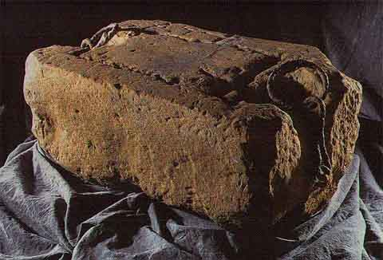
James 1st & 6th of Scotland The Union of Jacob
The Stone of Destiny comes to London – on his long march down to London he went through bunting decorated arches bearing the legend – “Union of Jacob”
The Stones of Destiny

Slide 45
James 1st & 6th of Scotland The Union of Jacob
The union of the Stone Kingdom – was a threat to Gog – therefore there were great political upheavals in this century (1600’s) as we shall see

Slide 46
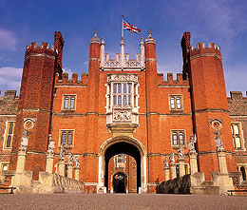
James 1st & 6th of Scotland The KJ Bible
The King James Authorized Version – can be traced back to 1604; and specifically, the Hampton Court Conference held in January of 1604.
Hampton Court Palace

Slide 47
James 1st & 6th of Scotland The KJ Bible
This means that January of 2004 was the 400th anniversary of the Hampton Court Conference in which the Authorized Version was born.
The now freely available scriptures would be another reason for Gog to go into overdrive
The KJ Bible of 1611

Slide 48
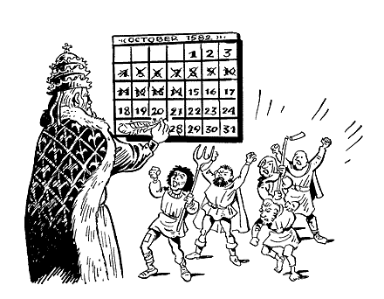
Gog – Changes The Times
New Year’s Day is changed from – March 25th to January 1st
At the time of the Hampton Court Conference Britain was still on the Julian Calendar – The continent had changed earlier. The Gregorian calendar, promulgated in 1582 by Pope Gregory XIII, subtracted thirteen days from the month of October
The New Calendar Caused Riots

Slide 49
Gog – Changes The Times
It was not until 1752 that Great Britain and its colonies shifted to the Gregorian calendar.
The Julian was more in keeping with the Hebrew Calendar with New Year’s Day being in the spring
The Julian Calendar

Slide 50
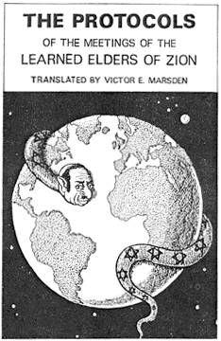
The Money Lenders of Amsterdam (Elders of Zion)
Jewish Rabbis who were the religious and political leaders of the Jewish money lenders combined their forces in a group known as the "Elders of Zion."
From 1640 to 1689, these "Elders of Zion" located in Holland plotted the English Revolution.

Slide 51
The Money Lenders of Amsterdam (Elders of Zion)
(Gog) Jewish Bankers engineered the rise to power of:-
a) Oliver Cromwell
b) William of Orange
Cromwell
William of Orange

Slide 52
Cromwell – Lord Protector
Left: Oliver Cromwell Lord Protector – Here as Uncrowned Monarch.
Under his leadership – the land was cleansed of Roman Catholic Idols

Slide 53
Cromwell – Lord Protector
It has been mentioned in a Biography of Oliver Cromwell that the reason he let the Jews in was because of his belief that Britain was Israel and obviously under the mistaken belief that the Jews were Judah
Oliver Cromwell

Slide 54
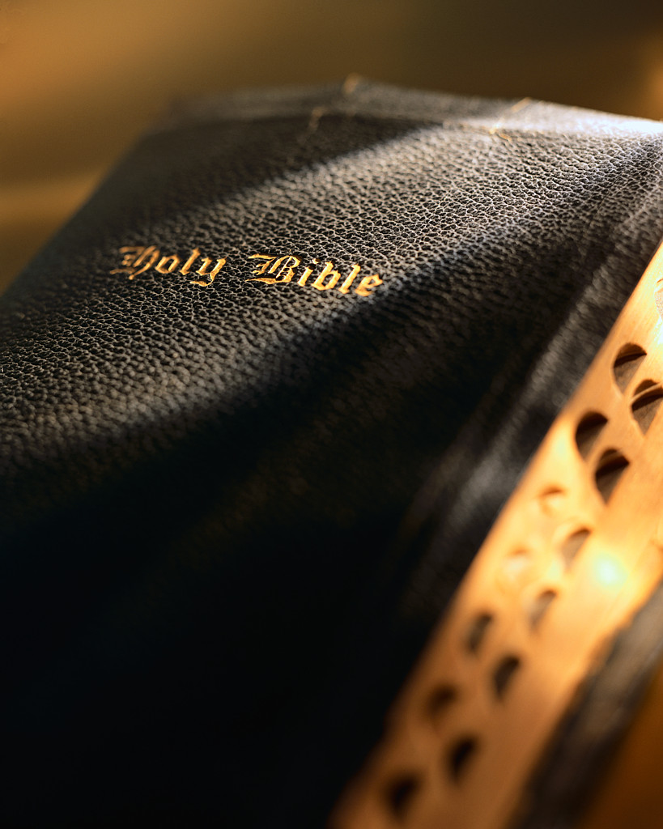
Cromwell – Lord Protector
"Receive a stranger into thine house, and he will disturb thee, and turn thee out of thine own." (Ecclesiasticus 2, 11:34)
Notes:
To prevent rebellion to his own rule he respected the prevailing prejudice against Catholics, still, he allowed the surrogates of the catholic Church, the Jews, into England (God's Law: "They shall not dwell in thy land, lest they make thee sin against me." (1 Kings 4:21‑24) "Receive a stranger into thine house, and he will disturb thee, and turn thee out of thine own." (Ecclesiasticus 2, 11:34)

Slide 55
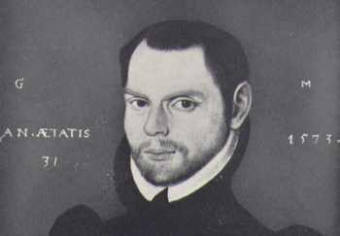
Cromwell – Lord Protector
Gregory Martin. Working at Douai between 1578 and 1581, he made a translation of the Bible for English Catholics.
To prevent rebellion to his own rule he respected the prevailing prejudice against Catholics, still, he allowed the surrogates of the catholic Church, the Jews, into England (God's Law: "They shall not dwell in thy land, lest they make thee sin against me." (1 Kings 4:21‑24)

Slide 56
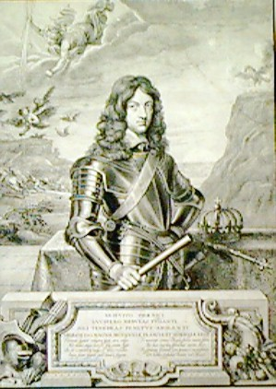
Cromwell – Lord Protector
When Cromwell died the old rulers quietly stepped back into the shoes that he had kept safe from the Presbyterian Protestants.
King Charles II restored the Anglican Episcopal Church, which he called "protestant," as the state religion.
King Charles II

Slide 57
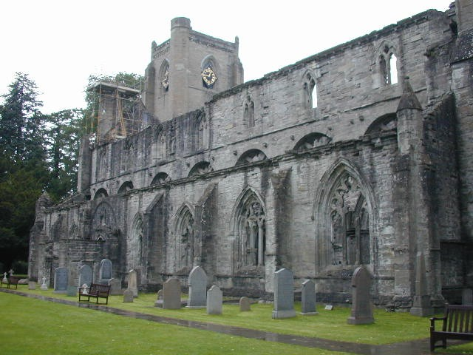
Cromwell – Lord Protector
He banned the Presbyterian Covenanters as traitors, banned Presbyterian meetings and fined, confiscated, imprisoned, transported, and executed those who were arrested attending meetings held far out in the open fields. It was called "the killing times."
Dunkeld Cathedral – Centre of resistance

Slide 58
Cromwell – Lord Protector
Cromwell's followers were allowed to keep their lands if they transferred their enfiefment obligations to the new king. The remnant who insisted "No King but Jesus" and that "We must obey God rather than men." (Acts 5:29) were outlawed.

Slide 59
Cromwell Dies 1657
1657: Death of Cromwell, Son Richard named Protector.
1659: Richard, disgusted with intrigue, resigns.
1661: Truth revealed regarding intrigue entered into by Cromwell and his cohorts Ireton, and Bradshaw, causes serious public reaction. Bodies are exhumed and hung from gallows on Tyburn Hill, London
His treachery becomes public knowledge

Slide 60
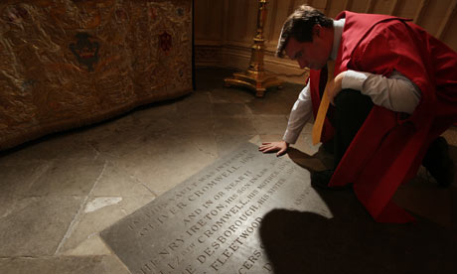
Cromwell Dies 1657
Oliver Cromwell's grave in the RAF Chapel in Westminster Abbey
Oliver Cromwell in 1657 (he died the same year!) let the Jews (Manasseh Ben Israel and Moses Carvajal) finance his war on King Charles I. The Jews gain power over the political life in England. When later, in 1689, Amsterdam Jews financed a rebellion against King James II they enlarged their power.

Slide 61
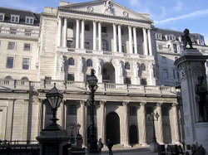
Cromwell- Dies
The chief of those Amsterdam Jews, , followed William of Orange to England. In 1694 the Jews set up the Bank of England. An act whereby the Jews, gain power over all taxes, and power over all of England.
The Bank of England

Slide 62
King Charles II
1660: General Monk occupies London. Charles II proclaimed King.
1662: Gog (through the Cabalists) engenders Religious strife to divide members of the Protestant denominations. Non‑Conformists to the established Church of England are persecuted.
1664: England is again involved in war with Holland.

Slide 63
James 2nd Gog Intrigues to Dethrone James
King Charles II died. The Duke of York became King James II of England. Immediately a campaign of L'Infamie was started against James II. The Duke of Monmouth was persuaded, or bribed, into leading an insurrection to overthrow the king.
James II

Slide 64
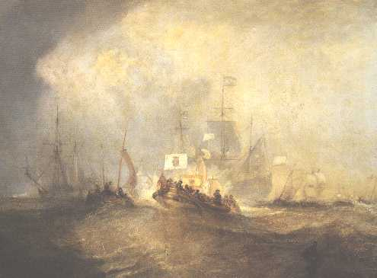
James 2nd Gog Intrigues to Dethrone James
The secret powers ordered William Prince of Orange to land in England at Torbay. This he did on November 5th. King James abdicated and fled to France.
Prince of Orange Sailing for Torbay

Slide 65
London: Year of The "Great Fire" of 1666
1665: A great depression settles over England. Unemployment, shortages of food undermine the health of the people and the Great Plague breaks out. (The outbreak of the Great Fire of London, known as "The Great Cleaner" ended the plague)

Slide 66
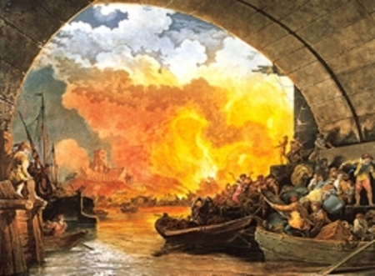
London: Year of The "Great Fire" of 1666
Used by Gog to reconstruct the City in his own image and the first step towards creating an independent state within a state.
The Great Fire

Slide 67
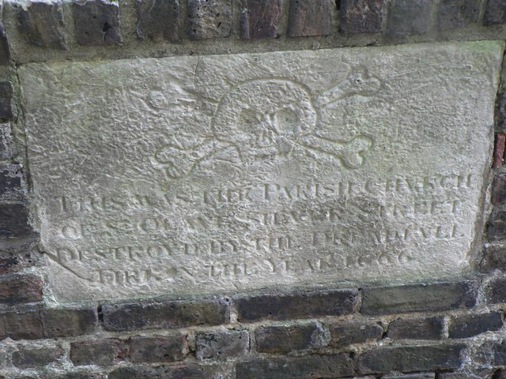
London: Year of The "Great Fire" of 1666
Note: The year ends in 666. The "Great fire of London" of 1666 levelled most of the city. This was the second "Great fire of London," with the first "Great fire" having occurred in the year 1212.
Plaque: Destruction of St. Olaves Church by the Great Fire
Notes:
City parish churches: St. Olave Silver Street (site of)
Below the skull and crossbones, this stone reads: "This was the Parish Church of St. Olave Silver Street, Destroyed by the Dreadfull Fire in the Year 1666" Situated on the corner of London Wall and Noble Street

Slide 68
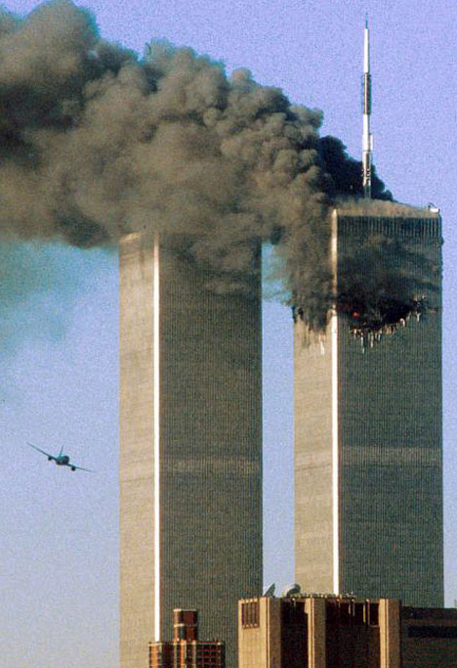
London: Year of The "Great Fire" of 1666
Note also that when allowance is made for changes in the calendar – The great fire started on September 11th
( Michael Clark - BIWF)

Slide 69
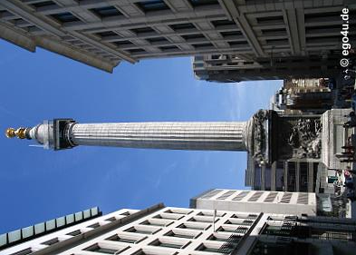
London: Year of The "Great Fire" of 1666
Note: There used to be an inscription on the monument stating that the fire was started by the Jesuits (one of the evil frogs). It was however, removed in 1830 – and the story substituted that it was started by accident in a bakery.

Slide 70
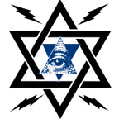
The Cabal 1667
Cabal agents start new religious and political strife. (The word Cabal is closely related to Cabala, a mysterious Jewish theosophy dating back into antiquity but which became very active during the 10th and succeeding centuries).
A Cabal Logo

Slide 71
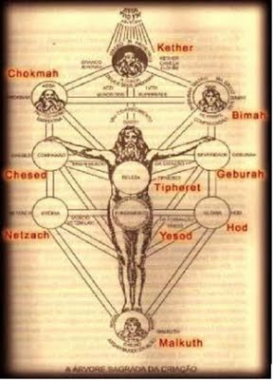
The Cabal 1667
Cabala was announced as "a special revelation" which enabled Rabbis to explain to the Jewish people the hidden meanings of the Talmud. Pear's Cyclopaedia 57th edition, page 529 says "Cabalism was later carried to great excess."
The Cabala would influence the reconstruction of London after the great fire

Slide 72
The Priory De Scion
The first International Bankers were the Knights Templar (who we will learn more of later), a secretive society created and sponsored by an even more secret society known as the "Priory De Scion" during the time of the Christian Crusades to recapture the Holy Lands from Muslim control.
The Priory De Scion - Jerusalem

Slide 73
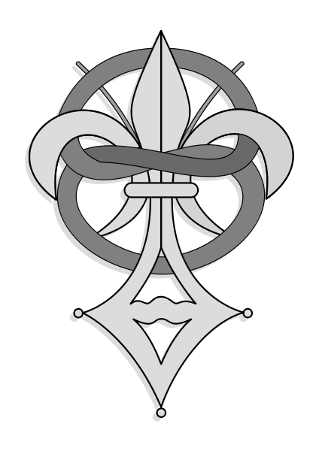
The Priory De Scion
The reason that most people have not heard of the “Priory De Scion" is that they work secretly behind the scenes. It takes its name from the Priory on Mount Zion - Jerusalem

Slide 74
The Priory De Scion
Christopher Columbus was a secret member of the "Priory De Scion" and on his voyage of discovery to the "New World," his Flag Ship had the Templar Cross emblem on the Main Sail. This was unusual because the Templars had been outlawed by that time in history.

Slide 75
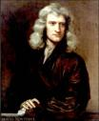
The Priory De Scion
Left: Leonardo Da Vinci
Right: Sir Isaac Newton
A list of the "Grand Masters of the Priory De Scion" would include such notables as Leonardo Da Vinci and Sir Isaac Newton. This secret organization still wields extraordinary secret power in modern Europe and has exercised a large influence in creating the present European Union

Slide 76
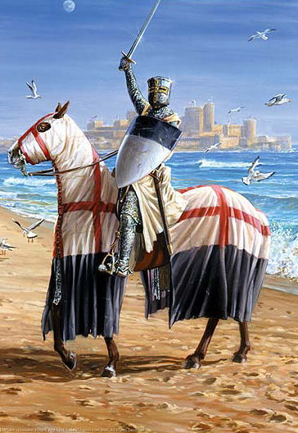
The Priory De Scion
Friday the 13th of 1307
The Templars were Outlawed by a Papal Bull which charged them with Heresy. On this unlucky day, all the Knights Templar in France were simultaneously arrested. Many were surprised by this unexpected turn of events because the Knights Templar were considered the army of the Catholic Church

Slide 77
The Priory De Scion
The King of France, Philip IV, went to considerable trouble to influence the Pope to make this declaration. Part of this effort included holding relatives of the Pope hostage to insure the declaration was made.
Philip IV of France 1268 - 1314

Slide 78
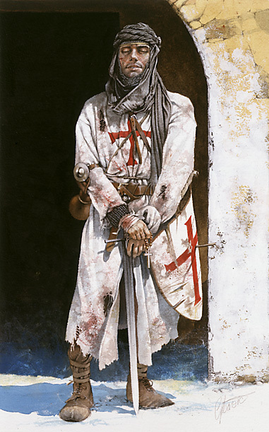
The Priory De Scion
The Priory De Scion's intelligence network had advance knowledge of the King's secret plan to have the Knights Templar outlawed and arrested. They advised the Templars to give up peacefully. They were told that they would be protected by the Church and found innocent at a later trial.

Slide 79
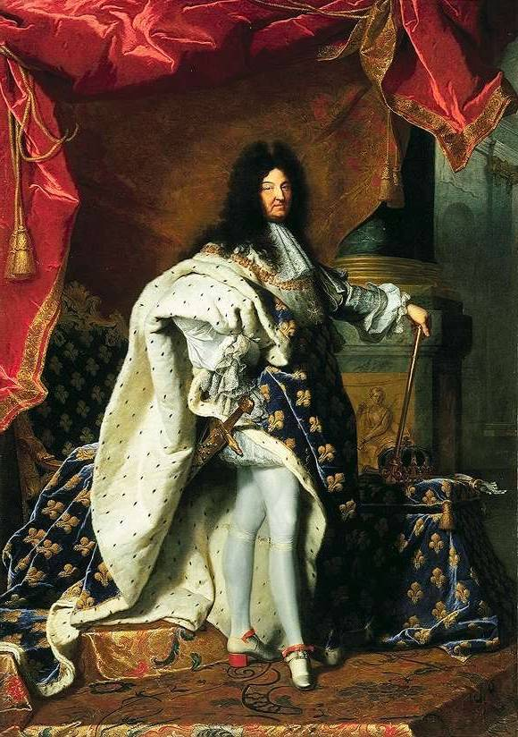
The Priory De Scion
Phillip IV had borrowed heavily from the Templar Treasury to finance his wars against England. If he could get the Templars outlawed, not only could the debt be cancelled but the Templar banks, with their treasure, could be seized.
Philip IV of France1268 - 1314

Slide 80
The Priory De Scion
The Priory De Scion had the treasure shipped to Scotland before it could be seized by the King.
While Jacques de Molay, the Templar leader of France, was imprisoned, he secretly directed the establishment of Occult or Hermetic Masonry, establishing four Lodges; one in Naples, one at Edinburgh, one at Stockholm, and one at Paris
Jacques de Molay

Slide 81
The Priory De Scion
The Templars, which were arrested, were not protected by the Church as expected. Many were horribly tortured to extract confessions of guilt. Their leader, Jacques De Molay was burned at the stake in a public square of Paris
Jacques de Molay

Slide 82
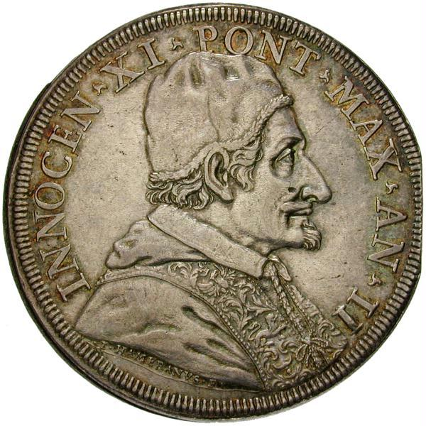
The Priory De Scion
Just before his death, De Molay placed a curse on the king of France and the Pope stating that he would see them before the throne of God before a year passes.
A Papal Coin

Slide 83
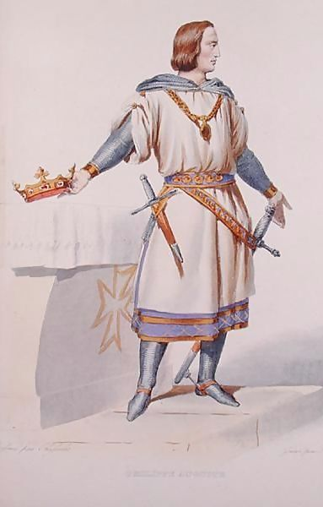
The Priory De Scion
Perhaps due to the secret influence of the Priory De Scion, the Pope and King perished within the year in a strange and sudden manner. strange and sudden manner. Squin de Florin, the chief denouncer of the Templars was assassinated.

Slide 84
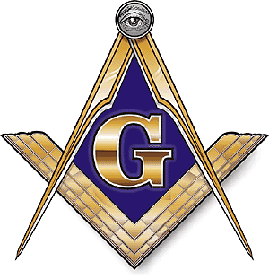
The Priory De Scion
Outlawing of the Knights Templars drove them underground as the secret order of the Free Masons throughout Europe. The Freemasons became the arch enemies of the Catholic Church, because of the perceived betrayal of the Templars by the Church, and worked behind the scenes to promote the later Protestant Reformation

Slide 85
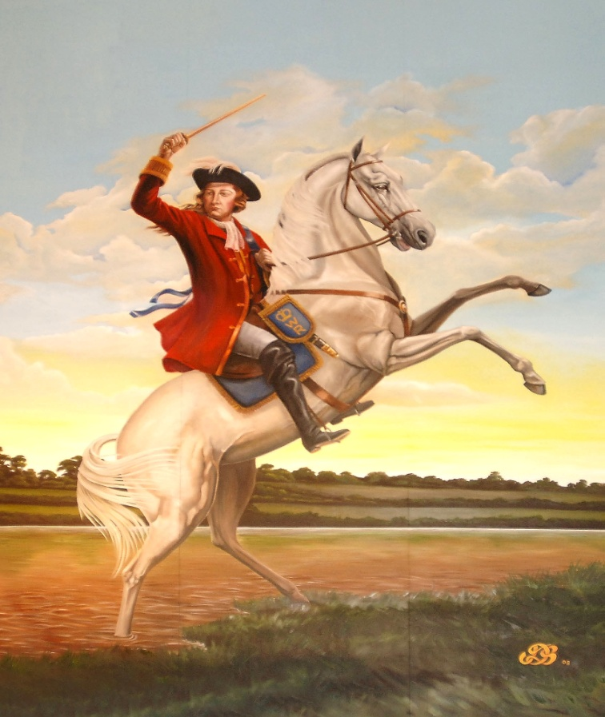
The Priory De Scion
The Templars were soon to exact revenge on the Catholic Church through their agent William of Orange’s Irish expeditions.
William of Orange

Slide 86
The Crown Temple
We saw earlier how Gog exerts his control through 2 main secret societies with the overseeing all seeing eye – the bankers – the Rothschilds and Rockefellers et al.
Lets now take a closer look at the little known Crown Temple or the Knights Templar.

Slide 87
The Templars of the Crown
The governmental and judicial systems within the United States of America & UK, at both federal and local state levels, is owned by the "Crown," which is a private foreign power. Before jumping to conclusions about the Queen of England or the Royal Families of Britain owning the U.S.A., this is a different "Crown"
The Crown

Slide 88
The Templars of the Crown
We are specifically referencing the established Templar Church, known for centuries by the world as the "Crown." From this point on, we will also refer to the Crown as the Crown Temple or Crown Templar, all three being synonymous.

Slide 89
The Temple London The Templar Church
A little historical background. The Temple Church was built by the Knights Templar in two parts: the Round and the Chancel.
The Round Church was consecrated in 1185 and modelled after the circular Church of the Holy Sepulchre in Jerusalem.
The Temple London

Slide 90
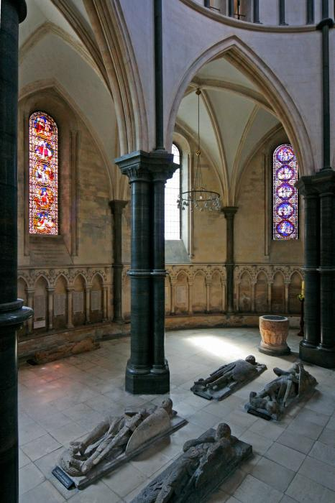
The Temple London The Templar Church
The Chancel was built in 1240. The Temple Church serves both the Inner and Middle Temples - is located between Fleet Street and Victoria Embankment at the River Thames

Slide 91
The Temple London The Templar Church
Interestingly the church is closed on Sundays!
This Temple "Church" is outside any Canonical jurisdiction. The Master of the Temple is appointed and takes his place by sealed (non-public) patent, without induction or institution.

Slide 92
The Temple London The BAR
Note: BAR, = is British Accreditation Regency; undoubtedly a private stock company, the majority of which is owned by the Bank of England and the "Crown" of the ‘the City’ of London.)
All Bar Association licensed Attorneys must keep the terms of their oath to the Crown Temple in order to be accepted or "called to the Bar" at any of the King's Inns. Their oath, pledge, and terms of allegiance are made to the Crown Temple.

Slide 93
The Temple London The BAR
All Bar Association licensed Attorneys must keep the terms of their oath to the Crown Temple in order to be accepted or "called to the Bar" at any of the King's Inns. Their oath, pledge, and terms of allegiance are made to the Crown Temple.
US Bar Association

Slide 94
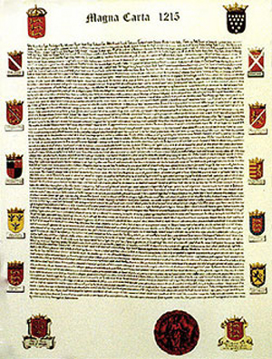
The Temple London The Templar Church
The Chancel, or Chancery, of the Crown Inner Temple Court was where King John was, in January 1215, when the English barons demanded that he confirm the rights enshrined in the Magna Carta.
Magna Carta

Slide 95
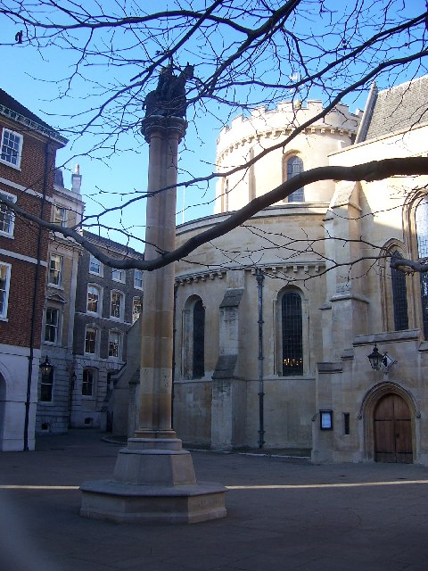
The Temple London The Templar Church
This City of London Temple was the headquarters of the Templar Knights in Great Britain where Order and Rule were first made, which became known as Code.

Slide 96
The Temple London The Templar Church
Remember all these terms, such as Crown, Temple, Templar, Knight, Chancel, Chancery, Court, Code, Order and Rule as we tie together their origins with the present British & American Temple Bar system of thievery by equity (chancery) contracts.
Inside The Temple “Church”

Slide 97
Plan of The Inns of Court to the unholy Temple

Slide 98
The Four Inns of Court to the unholy Temple
Grays Inn
Gray's Inn specializes in Taxation legalities by Rule and Code for the Crown.

Slide 99
The Four Inns of Court to the unholy Temple
Lincoln’s Inn
Like Gray's Inn Lincoln’s Inn specializes in Taxation legalities by Rule and Code for the Crown. Lincoln's Inn received its name from the Third Earl of Lincoln (circa 1300).

Slide 100
The Four Inns of Court to the unholy Temple
Inner Temple
The Inner Temple holds the legal system franchise by license to steal from Canada and Great Britain

Slide 101
The Four Inns of Court to the unholy Temple
It is the Middle Temple that has legal license to steal from America. This comes about directly via their Bar Association franchises to the Honourable Society of the Middle Temple through the Crown Temple.
Middle Temple

Slide 102
The Four Inns of Court to the unholy Temple
Middle Temple

Slide 103
The Four Inns of Court to the unholy Temple
The Crown Temple was granted Letters Patent and Charters for all the land (Colonies) of New England by the King of England, a sworn member of the Middle Temple (as the Queen is now).
Middle Temple

Slide 104
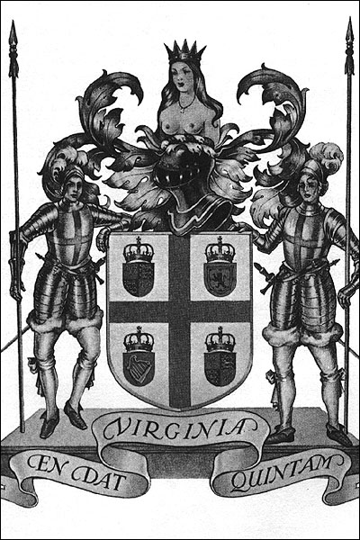
The Four Inns of Court to the unholy Temple
Since the people were giving the patent/charter corporations and Colonial Governors such a hard time, especially concerning Crown taxation, a scheme was devised to allow the Americans to believe they were being granted independence.

Slide 105
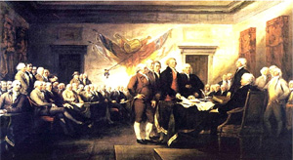
The Four Inns of Court to the unholy Temple
Remember, the Crown Templars represented both parties to the 1776 Declaration of Independence; and, as we are about to see, in the later 1787 U.S. Constitution.

Slide 106
The Four Inns of Court to the unholy Temple
Middle Temple
S.I. 1997 NO.1778 The Social Security ( United States of America) Order 1997 Made 22nd of July 1997 coming into force 1st on 1st September 1997. At the Court at Buckingham Palace the 22nd day of July 1997.
The U.S. controlled from London

Slide 107
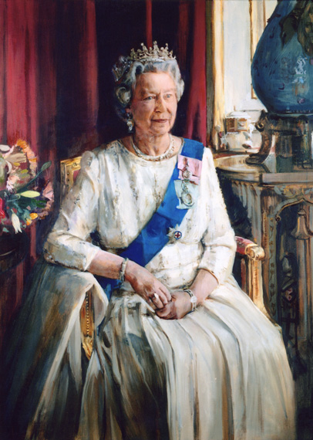
The Four Inns of Court to the unholy Temple
Now, therefore Her Majesty in pursuance of section 179 (1) (a) and (2) of the Social Security Administration Act of 1992 and all other powers enabling Her in that behalf, is pleased, by and with advice of Her privy Council, to order, and it is hereby ordered as follows:
Queen Elizabeth

Slide 108
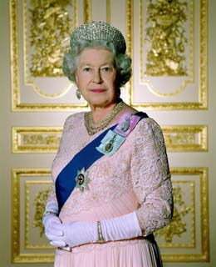
The Four Inns of Court to the unholy Temple
"This Order may be cited as the Social Security (United States of America) Order 1997 and shall come into force on 1st September 1997."

Slide 109
The Four Inns of Court to the unholy Temple
The banks Rule the Temple Church and the Attorneys carry out their Orders by controlling their victim's judiciary.
Inside the Bank of England

Slide 110
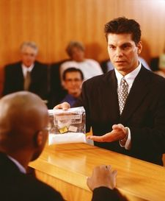
The Four Inns of Court to the unholy Temple
ATTORN [e-'tern] Anglo-French aturner to transfer (allegiance of a tenant to another lord), from Old French atorner to turn (to), arrange, from a- to + torner to turn: to agree to be the tenant of a new landlord or owner of the same property. Merriam-Webster's Dictionary of Law ©1996.
Attorney - noun

Slide 111
The Four Inns of Court to the unholy Temple
ATTORN, v.i. [L. ad and torno.] In the feudal law, to turn, or transfer homage and service from one lord to another. This is the act of feudatories, vassals or tenants, upon the alienation of the estate.-Webster's 1828
Attorney – verb intransitive

Slide 112
The City of London A State Within A State
Interestingly a dragon is on prominent display at the City’s boundary.
`The City' is not part of England. It is not subject to the Sovereign. It is not under the rule of the British Parliament. Like the Vatican in Rome, it is a separate, independent state. It is the Vatican of the commercial world.
The City of London occupies 677 acres = 666 + 11 ( As we saw in part 2 this is a powerful Illuminati number)
Temple Bar – Marks The Frontier

Slide 113
The City of London A State Within A State
The relation of this monarch of the City to the monarch of the realm [Queen] is curious and tells much.
Notice the “S” shape of the tail – which also has a striking similarity to a snake – very apt for what we know goes on in the city.
Temple Bar – Marks The Frontier

Slide 114
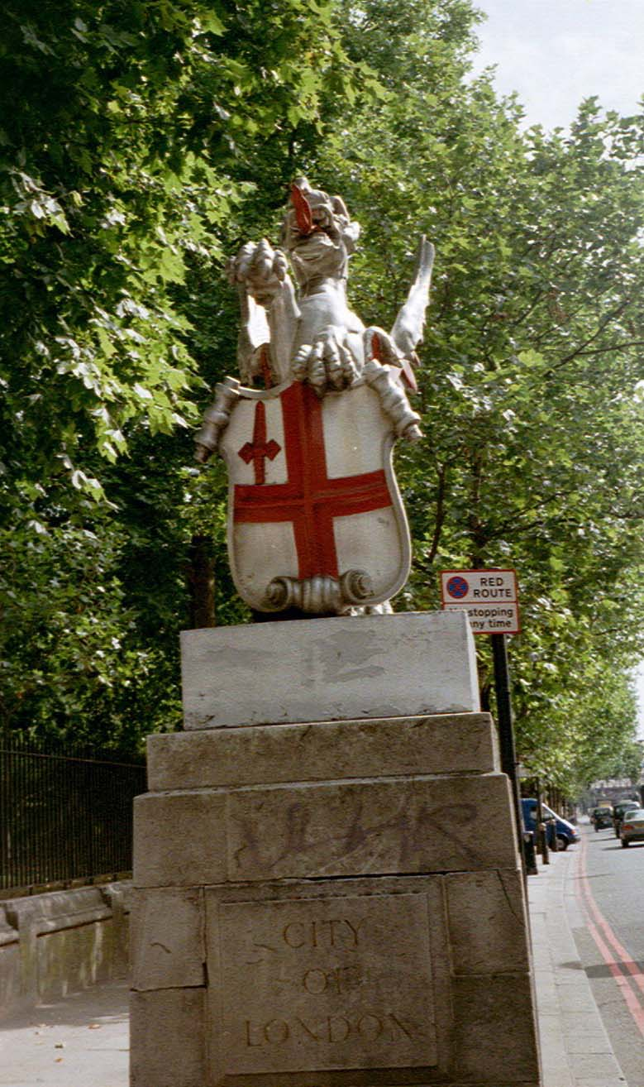
The City of London A State Within A State
The City of London is at the centre of Greater London which occupies 610 sq. miles (6 + 1 = 7) and with a population of just over 7 million
The London terrorist bombings had the stamp of a 7 & 77 – another powerful Illuminati number

Slide 115
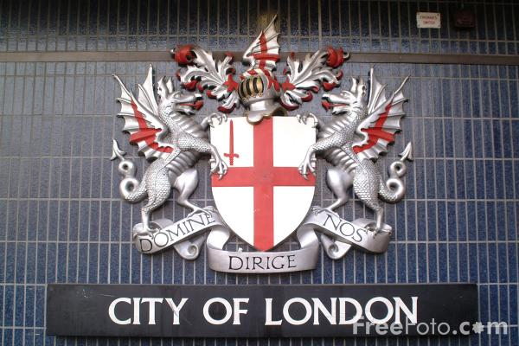
The Dragon City of London
Here we see further confirmation of The City of London’s dragon status – the 2 Dragons with the flag of England in their clutches and with a hint of red – The London Money Power or the Great Red Dragon of Revelation

Slide 116
London Has For Many Centuries Been Part Of Gog’s Global Trading Blocks
The route marked red was abandoned due to the increasing power of the Kievien Rus (Benjamin)
The Blue Blobs indicate Khazar (Gog) Settlements
The Silk Route - Note that even in those days Gog had a colony in London

Slide 117
Gog & Magog Paraded In London
That Gog and Magog is in control of the country and the City of London in particular is signalled by the parading of replicas of the Guild Hall statues during the Lord Mayor’s procession on the 11th Month of the Year (November) a good Illuminati number

Slide 118
Gog & Magog Paraded In London
According to the Lord Mayor, the giants Gog and Magog are traditional guardians of the City of London, and images of them have been carried in the Lord Mayor's Show since the days of King Henry V. The Lord Mayor's procession takes place each year on the second Saturday of November.

Slide 119
London Has For Many Centuries Been Part Of Gog’s Global Trading Blocks
The Hanseatic League

Slide 120
London Has For Many Centuries Been Part Of Gog’s Global Trading Blocks
Although the number of EU member states is in excess of 12, only 12 stars are displayed on the flag – thus correctly indicating that Europe is
the domain of the 12 tribes of Israel However, the 5 pointed stars would indicate that all 12 tribes of Israel are under Idumean control.
The Common Market

Slide 121
The Dragon City of London
Here we see a City of London’s decorative bollard replete with the Dragon Coat of Arms and in addition decorated with the Idumean 5 pointed star.
Has Gog’s control been similarly indicated in the other capital cities of Israel’s New Jerusalem in Europe?

Slide 122
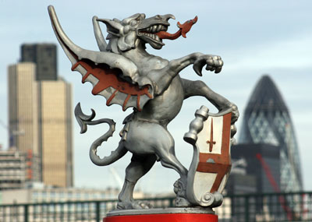
The City of London A State Within A State
When the Queen of England goes to visit the City she is met by the Lord Mayor at Temple Bar, the symbolic gate of the City. She bows and asks for permission to
enter his private sovereign state. During such state visits "the Lord Mayor in his robes and chain, and his entourage in medieval costume, …

Slide 123
The City of London A State Within A State
… outshine the royal party, which can dress up no further than service uniforms." The Lord Mayor leads the Queen into his City. The reason should be
clear. The Lord Mayor is the monarch. The Queen is his subject! The monarch always leads the way. The subject always stays a pace or two behind!

Slide 124
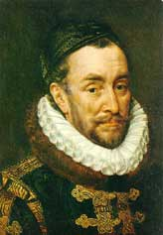
The Money Lenders of Amsterdam (Elders of Zion)
Power returned to the Jews by the Bill of Rights, 1689, "an Act Declaring the Rights and Liberties of the Subject and Settling the Succession of the Crown" when the commoner and William Stradholder of Orange, was proclaimed king of England by Jewish intrigue.
William of Orange

Slide 125
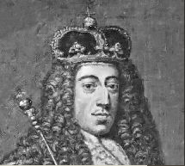
The Money Lenders of Amsterdam (Elders of Zion)
These Jewish money lenders used their influence to elevate Mr. William Stradholder to Captain General of the Dutch Forces and then to William, Prince of Orange. Then, they arranged the meeting of William Stradholder with the English Duke of York's eldest daughter, Mary.
William of Orange

Slide 126
The Money Lenders of Amsterdam (Elders of Zion)
The Duke of York was next in line to be the King of England. In 1677, Prince William of Orange married Princess Mary of York.
When the Duke of York suddenly died (Assassinated?), Prince William of Orange and Mary became the next King and Queen of England in 1689.
The Duke of York

Slide 127
Bank of England 1707
Sir Thomas Osborne was impeached by King Charles II for treasonous negotiations with King Louis XIV and imprisoned in the Tower of London from 1678 to 1684. After his release, he again became active in the conspiracy to bring in William of Orange as King of England and secured the crucial province of York for him. William then created him Duke of Leeds.
Notes:
After the incorporation of the Bank, peace and quiet returned to merry old England. No more royal heads rolled and no more civil wars. After that it didn't matter what was the religious beliefs of the monarchs. The Jesuits preferred that they were "Protestants" as they could take the blame for the wars, poverty and pauperism which inevitably followed usury and money lending.
The Threadneedle Street front of the Bank in 1797
The First Bank of the U.S., 2nd Bank of the U.S. and the "Federal" Reserve Bank are all copied from this Bank.

Slide 128
Bank of England 1707
The placing of William on the throne of England made it possible for the conspirators to implement the crucial step in their plans, setting up the Bank of England in 1694. This enabled the Amsterdam bankers to gain control of the wealth of the British Empire.
Notes:
After the incorporation of the Bank, peace and quiet returned to merry old England. No more royal heads rolled and no more civil wars. After that it didn't matter what was the religious beliefs of the monarchs. The Jesuits preferred that they were "Protestants" as they could take the blame for the wars, poverty and pauperism which inevitably followed usury and money lending.
The Threadneedle Street front of the Bank in 1797
The First Bank of the U.S., 2nd Bank of the U.S. and the "Federal" Reserve Bank are all copied from this Bank.

Slide 129
Bank of England 1707
Sir Thomas Osborne was titled, the first Duke of Leeds in 1694, who was one of the key conspirators in the overthrow of King James II and the seizure of the throne of England by William III in 1688; Osborne had made peace with Holland during the reign of King Charles II, and single-handedly promoted the marriage of Mary, daughter of the Duke of York, to William of Orange in 1677
Sir Thomas Osborne
Notes:
After the incorporation of the Bank, peace and quiet returned to merry old England. No more royal heads rolled and no more civil wars. After that it didn't matter what was the religious beliefs of the monarchs. The Jesuits preferred that they were "Protestants" as they could take the blame for the wars, poverty and pauperism which inevitably followed usury and money lending.
The Threadneedle Street front of the Bank in 1797
The First Bank of the U.S., 2nd Bank of the U.S. and the "Federal" Reserve Bank are all copied from this Bank.

Slide 130
Bank of England 1707
The Secret Power (Gog) behind the World Revolutionary Movement pulled the necessary strings and brought about "The Wars of the Spanish Succession.“ In 1701 the Duke of Marlborough was made Commander‑in‑chief of the armed forces of Holland.
The Duke of Marlborough

Slide 131
Bank of England 1707
No less an authority than the Jewish Encyclopaedia records the fact that for his many services the Duke of Marlborough received not less than £6,000 a year from the Dutch Jewish Banker, Solomon Medina.

Slide 132
William And Mary
The Dutchman William III and his Queen Mary, who was the daughter of James II, came to the throne in 1689
Khazar Jew
Royal
William was a tool of the powerful Wisselbank of Amsterdam:

Slide 133
William And Mary
The King and Queen were made to promise in a solemn "declaration" that they would never claim a "dispensing power" or try to set aside or overthrow the law and THAT THEY WOULD NEVER RAISE MONEY WITHOUT THE CONSENT OF PARLIAMENT or keep a standing army in time of peace. (The Bill of Rights)
Khazar Jew

Slide 134
William And Mary
There is probably not one Orangeman in ten thousand who knows that all the wars and rebellions fought from 1640 to 1689 were fomented by the Jewish International money‑lenders for the purpose of putting themselves in position to control British politics and economy.
Orangeman
Notes:
There is probably not one Orangeman in ten thousand who knows that all the wars and rebellions fought from 1640 to 1689 were fomented by the Jewish International money‑lenders for the purpose of putting themselves in position to control British politics and economy.

Slide 135
William And Mary
The Amsterdam bankers came down on the side of the protestants only.
The protestant work ethic would reap greater returns on investments.
Old Amsterdam

Slide 136
William And Mary
To revenge the Catholic church’s treachery in burning the Knights Templar at the stake in order to gain control of their treasure.

Slide 137
William And Mary
To weaken the Catholic Church in order to take it over – Napoleon would be their agent to achieve this end as we shall see in a later presentation (Part 5)
Napoleon

Slide 138
Bank of England 1707
Then, King William persuaded the British Treasury to borrow one and a quarter million British pounds from the Dutch bankers who had placed him in power. The terms of the loan were as follows:
Bank of England Interior
Notes:
After the incorporation of the Bank, peace and quiet returned to merry old England. No more royal heads rolled and no more civil wars. After that it didn't matter what was the religious beliefs of the monarchs. The Jesuits preferred that they were "Protestants" as they could take the blame for the wars, poverty and pauperism which inevitably followed usury and money lending.
The Threadneedle Street front of the Bank in 1797
The First Bank of the U.S., 2nd Bank of the U.S. and the "Federal" Reserve Bank are all copied from this Bank.

Slide 139
Bank of England 1707
Bank of England Charter
1
The names of the lenders be kept secret and that they be granted a charter to establish a bank of England.

Slide 140
Bank of England 1707
Bank of England Charter
2
That they be allowed to consolidate the national debt and secure amounts due as principal and interest by a direct taxation of the people.

Slide 141
Bank of England 1707
Bank of England Charter
3
The directors of said bank be granted the legal right to establish the gold standard for paper currency.

Slide 142
Bank of England 1707
Bank of England Charter
4
That they be allowed to lend out 10 pounds of paper currency for every 1 pound of gold held on deposit.

Slide 143
Bank of England 1707
Negotiations were conducted by Sir John Houblen and Mr. William Patterson on behalf of the British Government with money‑lenders whose identity remained secret.
Sir John Houblen

Slide 144
Bank of England 1707
A search of historical documents reveals that in order to maintain complete secrecy the negotiations regarding the terms of the loan were carried on in a church (The Temple?). In the days of Christ the money lenders used the Temple.
The Temple London

Slide 145
Bank of England 1707
The owners of the Bank of England are still unknown – although one can be sure that the Rothschilds are major shareholders
Baron Ferdinand de Rothschild

Slide 146
Bank of England – Hub Of Worldwide Financial Control
The Bank Of England
All Rail Roads Lead To The Bank
Notes:
None of the Stuart monarchs would grant a charter to the Bank of England!!
None of the Stuarts would grant the fervent desire of the "Bank" of Rome and charter an English national bank. That is why murder, civil war, and religious conflicts plagued their reigns. The Jesuit worked behind the scenes to get them to charter the Bank. Nothing succeeded however and finally King James II was deposed and Dutchman William of Orange was invited to take the throne. William was a tool of the powerful Wisselbank of Amsterdam:
"Central to the success of the Dutch was the Amsterdam Wisselbank, which had been founded in 1609. It provided the motive power for the Dutch economy by lending to the City of Amsterdam, the State in the form of the Province of Holland and trade in the shape of the Dutch East India Company as well as being responsible for coinage and, of course, exchange. Much later, in 1683, it was empowered to lend to private customers. Payments over a certain amount had to pass through it and it therefore was convenient for the important finance houses to hold accounts with it. Thus not only was it in a position to oversee the Dutch financial scene, it was also able to act as a stabilising influence on it" (The Bank of England).

Slide 147
Bank of England – Hub Of Worldwide Financial Control
William always short of money in his war against France, in 1694 he borrowed £1,200,000 in gold from the Jewish Money Changers at 8 per cent interest to be repaid a year later.
Statue of William of Orange in Brixham Harbour

Slide 148
Bank of England – Hub Of Worldwide Financial Control
They only agreed to lend him this money on condition that he gave his royal permission for them to establish a "Bank of England" and print for themselves an equal amount in bank notes.
The Bank Of England

Slide 149
Bank of England – Hub Of Worldwide Financial Control
Thus, he really agreed to pay them 108% interest on their original loan. William Patterson, a spokesman for the newly formed "Bank of England" declared "THE BANK HATH BENEFIT OF INTEREST ON ALL MONEY IT CREATES OUT OF NOTHING."
The Bank Of England
Notes:
None of the Stuart monarchs would grant a charter to the Bank of England!!
None of the Stuarts would grant the fervent desire of the "Bank" of Rome and charter an English national bank. That is why murder, civil war, and religious conflicts plagued their reigns. The Jesuit worked behind the scenes to get them to charter the Bank. Nothing succeeded however and finally King James II was deposed and Dutchman William of Orange was invited to take the throne. William was a tool of the powerful Wisselbank of Amsterdam:
"Central to the success of the Dutch was the Amsterdam Wisselbank, which had been founded in 1609. It provided the motive power for the Dutch economy by lending to the City of Amsterdam, the State in the form of the Province of Holland and trade in the shape of the Dutch East India Company as well as being responsible for coinage and, of course, exchange. Much later, in 1683, it was empowered to lend to private customers. Payments over a certain amount had to pass through it and it therefore was convenient for the important finance houses to hold accounts with it. Thus not only was it in a position to oversee the Dutch financial scene, it was also able to act as a stabilising influence on it" (The Bank of England).

Slide 150
Bank of England 1707
The Threadneedle Street front of the Bank in 1797
The First Bank of the U.S., 2nd Bank of the U.S. and the "Federal" Reserve Bank are all copied from this Bank.
Notes:
After the incorporation of the Bank, peace and quiet returned to merry old England. No more royal heads rolled and no more civil wars. After that it didn't matter what was the religious beliefs of the monarchs. The Jesuits preferred that they were "Protestants" as they could take the blame for the wars, poverty and pauperism which inevitably followed usury and money lending.
The Threadneedle Street front of the Bank in 1797
The First Bank of the U.S., 2nd Bank of the U.S. and the "Federal" Reserve Bank are all copied from this Bank.

Slide 151
Bank of England Charter
The Charter of the Bank of England (1694) with the Great Seal of William and Mary. The first usury central bank to be incorporated in England.
Notes:
The Charter of the Bank of England (1694) with the Great Seal of William and Mary. The first usury central bank to be incorporated in England.

Slide 152
Gog Controls The Value Of All Money
The Rothschilds meet twice daily in London to dictate to the world what the world price of gold will be. They also dictate what the “Federal Reserve System” will do with America’s finances.

Slide 153
Gog Controls The Value Of All Money
As all currencies have a notional gold value – the Rothschilds therefore dictate the value of all world currencies

Slide 154
Banks Are Enslaving Us Through Credit
Banks are working all out to bring in a cashless society – thereby having complete control over buying and selling

Slide 155
Parable Of The Rich Man
Mark 10:25 - It is easier for a camel to go through the eye of a needle than a rich man to enter into the Kingdom of God

Slide 156
Parable Of The Rich Man
The Lord in referring to it being easier for a camel to go through an eye of a needle than a rich man to gain entry into the Kingdom of Heaven was prophesying the rise of the Rothschilds (rich man) and the Bank of England in Threadneedle Street.

Slide 157
Parable Of The Rich Man
As we already have seen how that the Bank of England through secret negotiations in a church (London Temple) was set up and whose tentacles would control most of the world’s currencies. Those who are not controlled such as Libya, Syria, Iran and North Korea, were deemed the axis of evil
The Lord in turning out the money changers from the temple was foretelling that on his return the money changers at the Bank of England in Threadneedle Street would be removed – the needle in Threadneedle street would no longer be threaded!

Slide 158
Parable Of The Rich Man
Broad is the way that leadeth to destruction …. Here we see Old Broad Street that leads into Threadneedle Street – home to the Bank of England
Old Broad Street

Slide 159
Broad Is The Way That Leads To Destruction
Note Old Broad Street leads into Threadneedle Street

Slide 160
Broad Is The Way That Leads To Destruction
We saw earlier how the Temple Church was a replica of the Church in Jerusalem so this gives even more poignancy to the parable of the Rich Man and the money changers in the Temple
And of course Threadneedle Street leads to the Unholy Temple Church – The Church of The Knights Templar

Slide 161
Parable Of The Rich Man
Lord Rothschild
Note The Shield affixed to the Rothschild Mansion gates mimic the Royal Coat of Arms – Only a Rothschild could get away with this!!
The Bank of England rules the world and the Rothschilds rule the bank of England
The Rich Man

Slide 162
Sir Christopher Wren Architect of St. Paul’s Cathedral
Born: 20 Oct 1632 in East Knoyle, Wiltshire, England Died: 25 Feb 1723 in London, England.
St. Paul’s took 43 years to build and was completed 12 years before death of Christopher Wren
Wren was involved in other building works some of which were delegated to others

Slide 163
St. Paul’s Cathedral
Gog now well established in the capital engage their agent Christopher Wren to replace St. Paul’s with a Babylonian dome structure reminiscent of the Vatican and the Capitol Washington DC.
Sir Christopher Wren

Slide 164
St. Paul’s Cathedral
Sir Christopher Wren’s design attracted a huge amount of criticism – so much so that the design had to be modified and while under construction had to be hid from public view by the erection of hoardings.
Wren was believed to be a Mason

Slide 165
St. Paul’s Cathedral
Greek Cross Design
The Warrant Design
Final – As Built
Here we see the previous 2 designs and the final design

Slide 166
St. Paul’s Cathedral
As we see here the style is in keeping with The Capitol Washington DC

Slide 167
St. Paul’s Cathedral
CAPITOL. The temple of Jupiter in Rome, and a fort or castle, on the Mons Capitolinus. In this, the Senate of Rome anciently assembled; and on the same place, is still the city hall or town-house, where the conservators of the Romans hold their meetings. The same name was given to the principal temples of the Romans in their colonies.
As we see here the style is in keeping with The Capitol Washington DC

Slide 168
St. Paul’s Cathedral
As we see here the style is in keeping also with the Vatican

Slide 169
Old St. Paul’s Cathedral
Constructed in traditional Christian style unlike its modern replacement
At 498ft it was the highest spire in Europe
The third St Paul's (known as Old St Paul's), was begun by the Normans after the late Saxon cathedral suffered in a fire of 1087. Work took over two hundred years, and a great deal was lost in a fire in 1136.

Slide 170
Sir Christopher Wren Architect Delegates Some of The London Rebuilding Works
Nicholas Hawksmoor was born at East Drayton, Nottinghamshire, probably in 1661 (or, according to some authorities, 1666).
Nicholas Hawksmoor was responsible for three of the East End's best‑known churches.
There was a dramatic change in style of architecture used in rebuilding the London churches

Slide 171
Changing The Face of London
Two of the best‑known chroniclers of East End history, Ian Sinclair and Peter Ackroyd, have dug deep into the history and symbolism surrounding these churches and think there may be darker forces at work, drawing in occult practices, murder and even Jack the Ripper
St Anne's and Christ Church both have unexplained pyramids sitting in their grounds, all draw on ancient Greek and Egyptian imagery
St. Anne’s Limehouse

Slide 172
Masonic Lodges Are Infiltrated By The Illuminati
The vacancies left in the various London lodges were filled by Bankers and other professional people who changed the nature of the organisation to become a tool to further subvert this and other western governments.

Slide 173
Masonic Lodges Are Infiltrated By The Illuminati
The vacancies left in the various London lodges were filled by Bankers and other professional people who changed the nature of the organisation to become a tool to further subvert this and other western governments.

Slide 174
The Masonic Hierarchy

Slide 175
33 Degree Mason - (1809-1891)
That which we must say to the crowd is --- we worship a God, but it is the God that one adores without superstition --- To you, Sovereign Grand Inspector Generals, we say this;
Notes:
Pike designed a plan for world conquest and wrote of it in a letter to Mazzini dated August 15, 1871. He said three future world wars would prepare the world for the New World Order. In the third world war "we shall unleash the Nihilists and atheists, and we shall provoke a formidable social cataclysm which in all its horror will show clearly to the nations the effect of absolute atheism, origin of savagery and of the most bloody turmoil. Then everywhere, the citizens, obliged to defend themselves against the world minority of revolutionaries, will exterminate those destroyers of civilization, and the multitude, disillusioned with Christianity, whose deistic spirit will from that moment be without a compass (direction), anxious for an ideal, but without knowing where to render its adoration, will receive the pure light through the universal manifestation of the pure doctrine of Lucifer, brought finally out in the public view, a manifestation which will result from the general reactionary movement which will follow the destruction of Christianity and atheism, both conquered and exterminated at the same time." Des Griffin, Fourth Reich of the Rich, 71-72 (1989). pike.htm

Slide 176
33 Degree Mason - (1809-1891)
…. that you may repeat it to brothers of the 32nd, 31st, and 30th degrees --- The Masonic religion should be, by all our initiates of the high degrees, maintained in the purity of the Luciferian doctrine.
Notes:
Pike designed a plan for world conquest and wrote of it in a letter to Mazzini dated August 15, 1871. He said three future world wars would prepare the world for the New World Order. In the third world war "we shall unleash the Nihilists and atheists, and we shall provoke a formidable social cataclysm which in all its horror will show clearly to the nations the effect of absolute atheism, origin of savagery and of the most bloody turmoil. Then everywhere, the citizens, obliged to defend themselves against the world minority of revolutionaries, will exterminate those destroyers of civilization, and the multitude, disillusioned with Christianity, whose deistic spirit will from that moment be without a compass (direction), anxious for an ideal, but without knowing where to render its adoration, will receive the pure light through the universal manifestation of the pure doctrine of Lucifer, brought finally out in the public view, a manifestation which will result from the general reactionary movement which will follow the destruction of Christianity and atheism, both conquered and exterminated at the same time." Des Griffin, Fourth Reich of the Rich, 71-72 (1989). pike.htm

Slide 177
A Thought To Leave You With
"The individual is handicapped by coming face to face with a conspiracy so monstrous he cannot believe it exists”
J. Edgar Hoover, former head of the FBI.

Slide 178
The Story Of Gog And Magog
The End Of Part Three
To be continued ……………..The Rise of The House of Rothschild

