Slide 1
The Story Of Gog And Magog
Part Two
The Second Great Invasion – Genghis Khan & Start of The Covert Attack
Notes:
Newbury, Swanwick

Slide 2
The Story of Gog & Magog Will be covered in a series of 10 parts
Attila, The Rise of Islam and the Khazars
Genghis Khan, The Russians & the 3 frogs of Revelation
The Spanish Armada & Inquisition + the English revolution
The rise of the Rothschilds & the Armenian Holocaust
The French & American Revolutions
WW1 & WW2
Post War Situation

Slide 3
The Story of Gog & Magog Will be covered in a series of 10 parts
Gog’s covert attack on western culture, education, legal system, health, art & education.
False flag operations
Conclusion

Slide 4
Gog – Recap Part One
1) Ezekiel 38:15 Had important Key Words and That This Key Verse Covered Most Of The AD Period to the present day.
2) Magog=Equals Mongol.
3) Gog = Khazar = Askenazim Jew
4) Gog’s Involvement With The Rise Of Islam.
5) Khazaria Original Homeland of 92% of today’s Jews

Slide 5
Gog of The Land of Magog
The Story of
Analysis of Ezekiel 38 : 15
First half of verse
And Thou (Attila/Genghis Khan) Shalt Come From Thy Place Out Of The North Parts, Thou And Many People With Thee All Of Them Riding Upon Horses, A Great Company, And A Mighty Army

Slide 6
Thou And Many People With Thee All Of Them Riding Upon Horses, A Great Company, And A Mighty Army
The horse cavalries of Genghis Khan

Slide 7
Gog of The Land of Magog
The Story of
Second half of verse
And Thou Shalt Come Up Against My People of Israel, As A Cloud To Cover The Land : It Shall Be In The Latter Days, And I Will Bring Thee Against My Land That The Heathen May Know Me, When I Shall Be Sanctified In Thee, O Gog, Before Their Eyes.

Slide 8
Gog – Recap Part One
The second phase of the invasion would be as a cloud covereth the earth i.e.
Cover + t = Covert

Slide 9
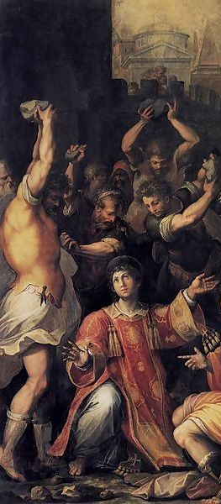
Gog – Causes Israelites to Kill One Another
1) They shall put you out of the meeting places: yea, the time cometh, that whosoever killeth you will think that he doeth God service. John 16:2
Left : The stoning of St. Steven

Slide 10
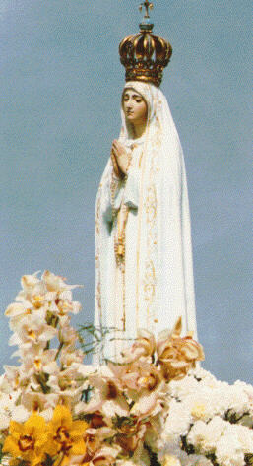
Fatima Isalm & Russia
The Fatima phenomena was a masterstroke of Gog, to unite the Islamic forces of the near east and Catholic Europe, with an eye also to the Eastern Orthodox Church – as we shall see.
The Fatima Idol

Slide 11
“Miracles” Associated With Fatima
Allah made an appearance in Fatima, Portugal, on October 13, 1917.
Allah's apparition was accompanied by a strange miracle:
Notes:
Allah made an appearance in Fatima, Portugal, on October 13, 1917.
Allah's apparition was accompanied by a strange miracle:
"The sun became pale, three times it turned speedily on itself, like a Catherine wheel . . . At the end of these convulsive revolutions it seemed to jump out of its orbit and come forward towards the people on a zig-zag course, stopped, and returned again to its normal position. This was seen by a large crowd near the children and lasted twelve minutes. The fact that the other two thousand million human beings the world over never noticed the sun agitate, rotate and jump out of its orbit did not bother the Catholic Church in the least." (Manhattan, Vietnam Why Did We Go?, p. 27).
The Fatima Crusade had to do with the conversion of Russia to Roman Catholicism!!

Slide 12
Fatima Isalm & Russia
1.The first was a vision of Hell (something well known to the modern world).
2.The second was more to the point: a reiteration that Soviet Russia would be converted to the Catholic Church.
3.The third was sealed in an envelope and put in custody of the ecclesiastical authority not to be revealed until 1960.
Fatima shrine
in Portugal.

Slide 13
Gogs Agent - Mohammed
Mohammed had his visions in a cave
Fatima, Mohammed’s only surviving daughter is the connecting link between the Vatican and Islam.
In the Koran she is called a most holy woman next to the Virgin Mary.
When Moslem armies occupied Portugal they named a little town after her.
Notes:
The connecting link between the Vatican and Islam is Fatima. Mohammad's only surviving daughter was called FATIMAH. In the Koran, she is called the most holy woman in paradise next to the Virgin Mary. When the Moslem armies occupied Portugal, they named a little town there after her.

Slide 14
“Miracles” Associated With Fatima
"The sun became pale, three times it turned speedily on itself, like a Catherine wheel . . . At the end of these convulsive revolutions it seemed to jump out of its orbit and come forward towards the people on a zig-zag course, stopped, and returned again to its normal position.

Slide 15
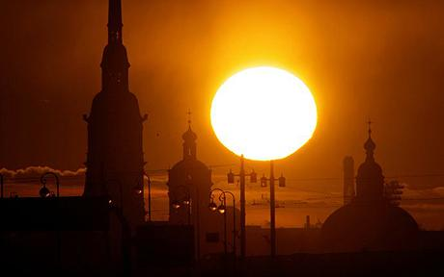
“Miracles” Associated With Fatima
No one else noticed this strange phenomenon as alleged by the Vatican!

Slide 16
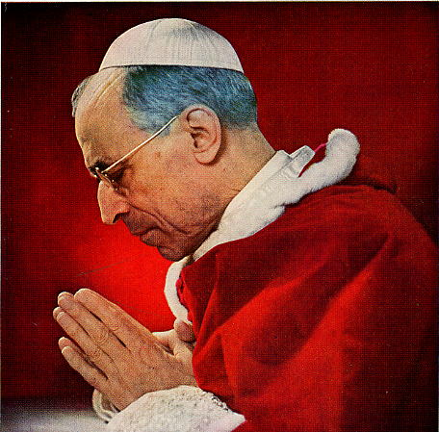
Fatima Statue Goes On Parade
With the appearance of Bolshevik Russia and world communism, the cult soon was transformed into an ideological crusade. It was used extensively in the anti-Russian ideological war carried out by Pius XII, Cardinal Spellman and John Foster Dulles
Pope Pius XII

Slide 17
Fatima Statue Goes On Parade
To whip up religious fervour – the statue was paraded around the capitals of the world including Moscow
The Fatima Crusade was part of the plot to convert Russia to Roman Catholicism!!
Notes:
Fatima statue on parade. The Fatima cult is derived from the alleged appearance of the Virgin Mary to three sickly children at Fatima, Portugal, in 1917. With the appearance of Bolshevik Russia and world communism, the cult soon was transformed into an ideological crusade. It was used extensively in the anti-Russian ideological war carried out by Pius XII, Cardinal Spellman and John Foster Dulles. The statue of the Virgin was sent on a global pilgrimage to the capitals of the world to rouse religious fervor. One of the capitals she visited was Moscow itself, under the veiled sponsorship of Western embassies led by the U.S.

Slide 18
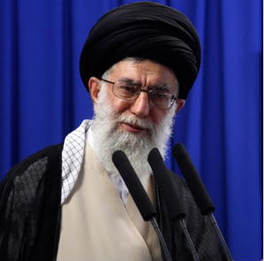
Fatima Statue Goes On Parade
While so far Gog has failed to convert Russia, there has been some success in merging Catholicism with Islam, as Mullahs are ever more frequently appearing in Catholic churches

Slide 19
Last of The Non-Whites Pushed Out Of Europe
1492 AD The Last Non-White Stronghold In Spain Surrenders To The Victorious White Army Led By King Ferdinand and Queen Isabella
Ferdinand & Isabella receiving the surrender of the Islamic forces in Spain
Notes:
Right: Monday 2 January 1492: The last non-White stronghold in Spain, the citadel of Grenada, surrenders to the victorious White army, led personally by King Ferdinand and Queen Isabella. It was the first time in 770 years that all of Spain was once again under White control.
Left: The non-White Moorish advance into Europe seemed unstoppable when in 732 AD they launched a massive invasion of present day France. The king of the leading White tribe in that country, Charles Martel of the Franks (who had their headquarters in present day Paris) mobilized a counter attack. A great race battle took place between the towns of Tours and Potiers in central France in October 732 AD. The battle was one of the most momentous in the history of the White race. Defeat would have meant that all of Western Europe might have fallen under the sway of Islam, and the mixed races from the East would have poured into continental Europe. Accounts have it that 375,000 Moors were killed - the White army was utterly victorious over the non-White army and the Moorish invasion of Europe was halted in its tracks. Charles Martel earned his name -Martel means 'hammer' - at this battle - he personally bludgeoned to death a large number of non-Whites with his favorite weapon, a mighty hammer

Slide 20
Meanwhile Gog – Attacks White Strongholds In Asia Minor and North Africa
Above: An illustration from a medieval manuscript showing Saladin wresting the cross from King Richard during the Third Crusade. (1189 - 1192 AD)
Notes:
THE AFTER EFFECTS OF THE CRUSADES
On a strict military level the Crusades were a failure and did not dislodge the Muslims from anywhere except in northern Portugal. However, this is an unfair dismissal of the efforts of the White nations who took part in the wars. The obstacles they had to overcome were formidable - vast distances, their total reliance on soldiers recruited voluntarily from mainland Europe, combined with the extremely poor communications and supply routes of the time; makes the fact that they were able to launch expeditions of this nature so far from home, a remarkable achievement all by itself.
The Crusades also had the effect of adding to the fervor to expel the Muslim non-White occupiers of Spain from the European continent - something which was finally achieved in just under 150 years after the last Crusade.
(1189 - 1192 AD)

Slide 21
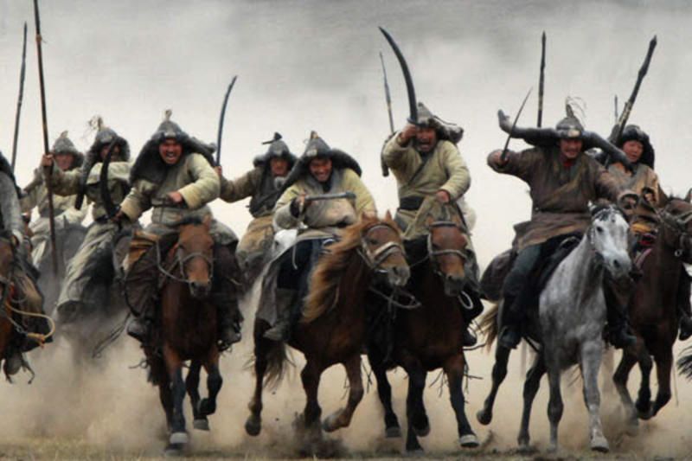
The Next Great Invasion From The Land of Gog Magog
Starting In The 14th Century Was The Second Major Onslaught Of The Mongol Hordes Under The Leadership Of Genghis Khan Into Europe and Near East.

Slide 22
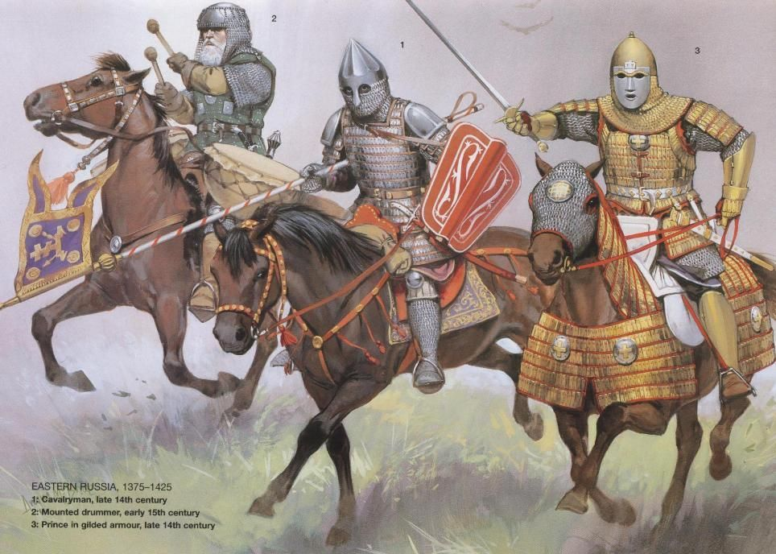
Gog – Assault on Russia
We must remember that the Rosh (the ruling elite) were Anglo-Saxons from which Russia took its name together with the Slav (Ishmael) majority who God promised would be a great (in size) country.

Slide 23
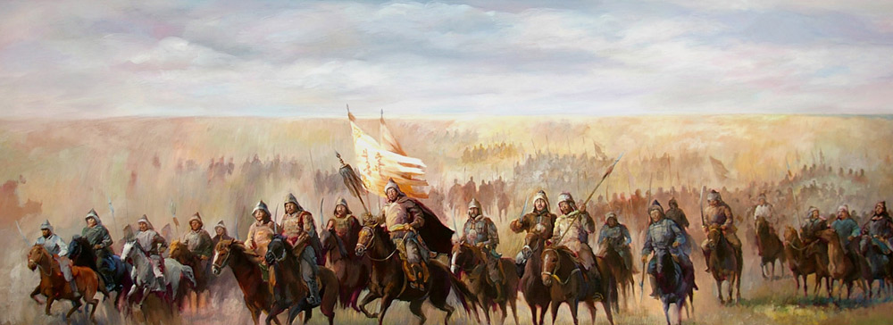
Gog – Assault on Russia
Our brethren here were the first to succumb to the sowing of tares amongst the wheat through gradual ever westward thrust instigated by Attila and Genghis Khan. At the present day all the Israel nations are in the malign grip of Gog.
Notes:
— the “Rus” were undoubtedly Norman. At this time, the story is starting to get very interesting. We know that the word “Northmen” refers to Norway. We also know that the people of Norway are from the tribe of Benjamin. We know that the symbol of Benjamin is the Wolf. We have evidence that William the Conqueror was probably of the tribe of Benjamin. The tribe of Benjamin was evidently quite active in Russia as well as in Norway and England. As a matter of fact, these Benjaminite Northmen had a big part in breaking down and causing the fall of the Empire of the Khazars of Askenazim. At this time, for a moment, we will leave the writings of Rev. W. M. H. Milner and take some excerpts from the book The Thirteenth Tribe by Arthur Koestler. .

Slide 24
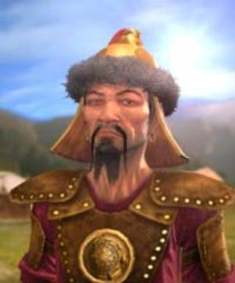
4) Gog – Second Major Onslaught From The East
GENGHIS KHAN (TEMUJIN) Unified The Mongols Circa 1206 AD. Dies - 1227 AD
Left: Genghis Khan, as portrayed by an unknown artist

Slide 25
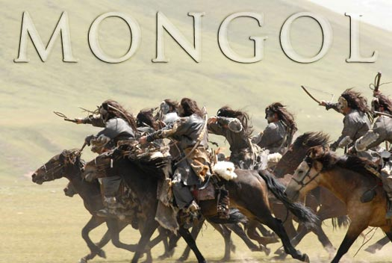
Gog – Assault on Russia
In the year A.D. 1224 Mongol hordes poured over Russia under Genghis Kahn. They came agin in 1237. Latham says they bore the specific name of “Mongol.”
Gibbon describes how they overran and devastated Russia. For more than two hundred years, to 1480 AD.

Slide 26
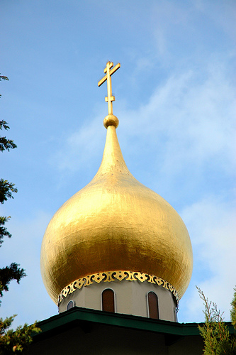
Gog – Assault on Russia
Russian Architecture – the onion domes – is based on the Mongolian Tent.
Left: Orthodox Church of All Russian Saints, Burlingame, California, USA
Notes:
— the “Rus” were undoubtedly Norman. At this time, the story is starting to get very interesting. We know that the word “Northmen” refers to Norway. We also know that the people of Norway are from the tribe of Benjamin. We know that the symbol of Benjamin is the Wolf. We have evidence that William the Conqueror was probably of the tribe of Benjamin. The tribe of Benjamin was evidently quite active in Russia as well as in Norway and England. As a matter of fact, these Benjaminite Northmen had a big part in breaking down and causing the fall of the Empire of the Khazars of Askenazim. At this time, for a moment, we will leave the writings of Rev. W. M. H. Milner and take some excerpts from the book The Thirteenth Tribe by Arthur Koestler. .

Slide 27
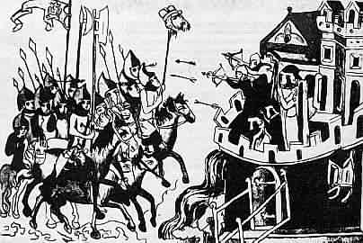
Gog’s Mighty Army of Horsemen
Above: Mongols at the gates of Leignitz in 1241, after defeating the White army of Duke Henry. They are carrying Henry's head on a lance.

Slide 28
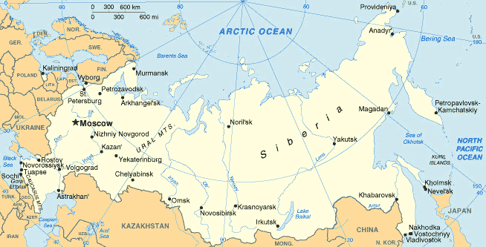
Gog – Assault on Russia
There is good evidence that at least in the European areas of Russia that racial purity was maintained until the genocide of the White Russians and Ukrainians following 1917 communist revolution.
No doubt God has ensured that a remnant remains within this vast domain of Benjamin Israelites and Ishmael.
Notes:
— the “Rus” were undoubtedly Norman. At this time, the story is starting to get very interesting. We know that the word “Northmen” refers to Norway. We also know that the people of Norway are from the tribe of Benjamin. We know that the symbol of Benjamin is the Wolf. We have evidence that William the Conqueror was probably of the tribe of Benjamin. The tribe of Benjamin was evidently quite active in Russia as well as in Norway and England. As a matter of fact, these Benjaminite Northmen had a big part in breaking down and causing the fall of the Empire of the Khazars of Askenazim. At this time, for a moment, we will leave the writings of Rev. W. M. H. Milner and take some excerpts from the book The Thirteenth Tribe by Arthur Koestler. .

Slide 29
The Extent of The Mongol Empire Prior to Expansion Under Genghis Khan.

Slide 30
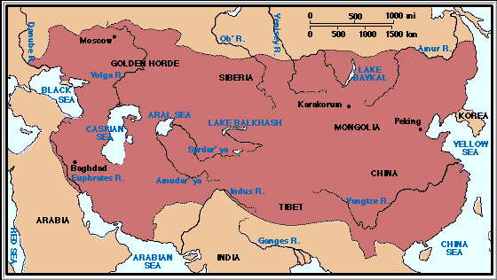
Extent of Mongol Empire 1300 A.D.
Notes:
Heinrich von Neustadt, around 1300, wrote of them as the "terrifying people of Gog and Magog." 18

Slide 31
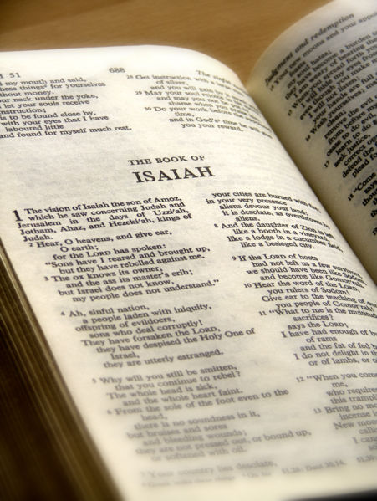
Gog – “I Will Turn Thee Back”
, Ezekiel 39:2, which reads thus in the King James Version:
And I will turn thee back, and leave but the sixth part of thee; and will cause thee to come up from the north parts, and will bring thee upon the mountains of Israel.
Notes:
There is a very interesting footnote on page 36 of Rev. W. M. H. Milner’s The Russian Chapters Of Ezekiel. It refers to the Scripture, Ezekiel 39:2, which reads thus in the King James Version: And I will turn thee back, and leave but the sixth part of thee; and will cause thee to come up from the north parts, and will bring thee upon the mountains of Israel. Now to read this footnote by Milner on page 36: In chap. xxxix. 2, the ordinary English Bibles add to “I will turn thee back” the words “and leave but the sixth part of thee.” This should be “lead thee”, which is the simple rendering of the word !::, so mysteriously rendered by the A.V., “leave but the sixth part,” “strike with six plagues.” “with a hook of six teeth;” all because :: is six! The LXX. render i"h@*0(¯@T, I “will conduct.” See Gesenius’ Hebrew Lexicon. The thing that is outstanding here is: “with a hook of six teeth.” Could it be that the hook with six teeth might represent the Star of David? If it does, it means it will be the “Jews” that will be playing a leading role in this attack.

Slide 32
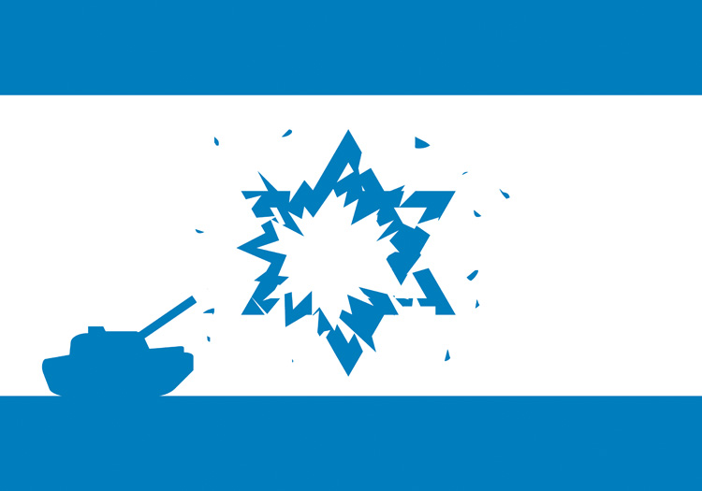
Gog – “I Will Turn Thee Back”
the ordinary English Bibles add to “I will turn thee back” the words “and leave but the sixth part of thee.” This should be “lead thee”, which is the simple rendering of the Hebrew word, so mysteriously rendered by the A.V., “leave but the sixth part,” “strike with six plagues.” “with a hook of six teeth;”
Notes:
There is a very interesting footnote on page 36 of Rev. W. M. H. Milner’s The Russian Chapters Of Ezekiel. It refers to the Scripture, Ezekiel 39:2, which reads thus in the King James Version: And I will turn thee back, and leave but the sixth part of thee; and will cause thee to come up from the north parts, and will bring thee upon the mountains of Israel. Now to read this footnote by Milner on page 36: In chap. xxxix. 2, the ordinary English Bibles add to “I will turn thee back” the words “and leave but the sixth part of thee.” This should be “lead thee”, which is the simple rendering of the word !::, so mysteriously rendered by the A.V., “leave but the sixth part,” “strike with six plagues.” “with a hook of six teeth;” all because :: is six! The LXX. render i"h@*0(¯@T, I “will conduct.” See Gesenius’ Hebrew Lexicon. The thing that is outstanding here is: “with a hook of six teeth.” Could it be that the hook with six teeth might represent the Star of David? If it does, it means it will be the “Jews” that will be playing a leading role in this attack.

Slide 33
Gog – “I Will Turn Thee Back”
The thing that is outstanding here is: “with a hook of six teeth.” Could it be that the hook with six teeth might represent the “Star of David”? If it does, it could well means that the “Jews” will be playing a leading role in this attack.
Notes:
There is a very interesting footnote on page 36 of Rev. W. M. H. Milner’s The Russian Chapters Of Ezekiel. It refers to the Scripture, Ezekiel 39:2, which reads thus in the King James Version: And I will turn thee back, and leave but the sixth part of thee; and will cause thee to come up from the north parts, and will bring thee upon the mountains of Israel. Now to read this footnote by Milner on page 36: In chap. xxxix. 2, the ordinary English Bibles add to “I will turn thee back” the words “and leave but the sixth part of thee.” This should be “lead thee”, which is the simple rendering of the word !::, so mysteriously rendered by the A.V., “leave but the sixth part,” “strike with six plagues.” “with a hook of six teeth;” all because :: is six! The LXX. render i"h@*0(¯@T, I “will conduct.” See Gesenius’ Hebrew Lexicon. The thing that is outstanding here is: “with a hook of six teeth.” Could it be that the hook with six teeth might represent the Star of David? If it does, it means it will be the “Jews” that will be playing a leading role in this attack.

Slide 34
Houston Stewart Chamberlain: “Saw all history as a conflict between the Aryans and the Semites"
The Race War
He did not understand that the Aryans were in fact true Israel and the so-called Semites were Edomites.

Slide 35
Who Are The Russians?
Notes:
— the “Rus” were undoubtedly Norman. At this time, the story is starting to get very interesting. We know that the word “Northmen” refers to Norway. We also know that the people of Norway are from the tribe of Benjamin. We know that the symbol of Benjamin is the Wolf. We have evidence that William the Conqueror was probably of the tribe of Benjamin. The tribe of Benjamin was evidently quite active in Russia as well as in Norway and England. As a matter of fact, these Benjaminite Northmen had a big part in breaking down and causing the fall of the Empire of the Khazars of Askenazim. At this time, for a moment, we will leave the writings of Rev. W. M. H. Milner and take some excerpts from the book The Thirteenth Tribe by Arthur Koestler. .

Slide 36
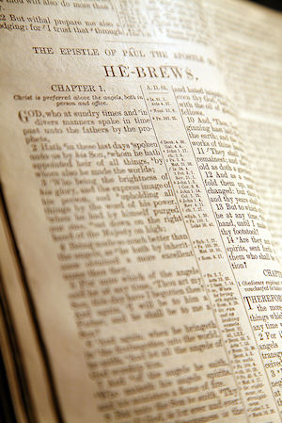
Rhos (Benjamin)
We will pause a moment to read Genesis 46:21: And the sons of Benjamin were Belah and Becher, and Ashbel, Gera, and Naaman, Ehi, and Rosh, Muppim, Huppim, and Ard.
Notes:
We have seen that Rosh was the earliest form of the Russian name. Rosh does not occur with Magog and the rest in the catalogue of the sons of Japhet in Genesis x. But the name does occur in Genesis xlvi. 21, in the line of Shem, the chosen line through Eber to Abraham, Isaac, and Jacob, being given as one of the sons of Benjamin, one of the tribes of Israel. Benjamin we British-Israelites have been in the habit of identifying as the ancestor of the Normans. If this identification be correct, and Scandinavia was largely settled by that particular Hebrew tribe, then Rosh has been an element of Israel left in Russia, first as founders and rulers of the Russian State, then as a remnant reduced to subjection by Mongolised Russia. So Gog is now prince of Rosh.
We will pause a moment to read Genesis 46:21: And the sons of Benjamin were Belah and Becher, and Ashbel, Gera, and Naaman, Ehi, and Rosh, Muppim, Huppim, and Ard. Now lets get back to W. M. H. Milner:
I had two suggestions as to the identity of Rosh as an Israelite element in modern Russia: (1) That the Scandinavian aristocracy in Finland is Rosh, and their privileges we know have been filched (stole) from them by the Tsar and his bureaucracy. (2) That the Ruthenian population of the southern part of Western Russia bordering on Galicia and Roumania are Rosh. There is a possibility that the Ruth of Ruthenia is derived from Russ of the Scandinavian founders of Russia, and they do occupy our old early European home in Arsareth.
Incidentally in this connection I may mention that about a month before the War a British-Israel lady in London wrote to me that she was coming to Penzance, and might she introduce to us a Ruthenian friend? She enclosed a pamphlet by him in which he showed that the Ruthenian population of Russia would infinitely prefer to be incorporated with the Ruthenians of Galicia under Austrian rule! You can see here that there are evidently Hebrew stock, or at least there was at the time of the writing of this booklet by Milner, in Russia.

Slide 37
Rhos (Benjamin)
Is ‘from the Swedish word “rodher”, meaning ‘rowers’. As for ‘Varangian’, it was used by the Arabs and also the Russian particular brand of Vikings ….
Varangian Rus on the Volga-Dniper route to Constantinople
Notes:
The, is ‘from the Swedish word “rodher”, meaning ‘rowers’. As for ‘Varangian’, it was used by the Arabs and also the Russian particular brand of Vikings, which the Byzantines called ‘Rhos’, were called ‘Varangian’ by the Arab chroniclers. The most probable derivation of ‘Rhos’, according to Toynbee —

Slide 38
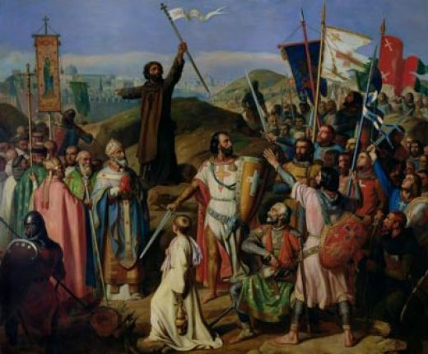
Rhos (Benjamin
… which the Byzantines called ‘Rhos’, were called ‘Varangian’ by the Arab chroniclers. The most probable derivation of ‘Rhos’, according to Toynbee
The Byzantines

Slide 39
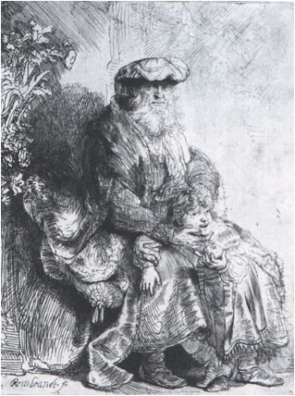
Rus (Benjamin) Caused the Fall of The Khazar (Gog) Empire
— the “Rus” were undoubtedly Norman. We know that the word “Northmen” refers to Norway. We also know that the people of Norway are from the tribe of Benjamin. We know that the symbol of Benjamin is the Wolf.
Jacob caressing Benjamin
Notes:
— the “Rus” were undoubtedly Norman. At this time, the story is starting to get very interesting. We know that the word “Northmen” refers to Norway. We also know that the people of Norway are from the tribe of Benjamin. We know that the symbol of Benjamin is the Wolf. We have evidence that William the Conqueror was probably of the tribe of Benjamin. The tribe of Benjamin was evidently quite active in Russia as well as in Norway and England. As a matter of fact, these Benjaminite Northmen had a big part in breaking down and causing the fall of the Empire of the Khazars of Askenazim. At this time, for a moment, we will leave the writings of Rev. W. M. H. Milner and take some excerpts from the book The Thirteenth Tribe by Arthur Koestler. .

Slide 40
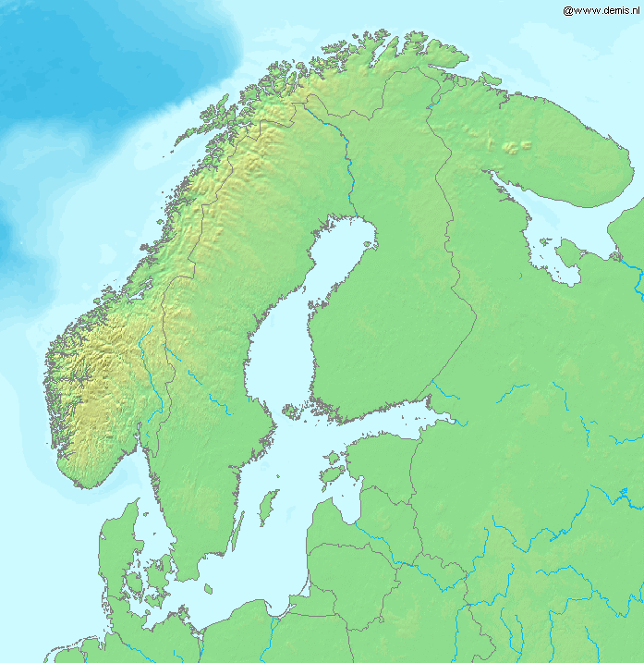
Rus (Benjamin) Caused the Fall of The Khazar (Gog) Empire
The tribe of Benjamin was evidently quite active in Russia as well as in Norway and England. As a matter of fact, these Benjaminite Northmen had a big part in breaking down and causing the fall of the Empire of the Khazars of Askenazim.

Slide 41
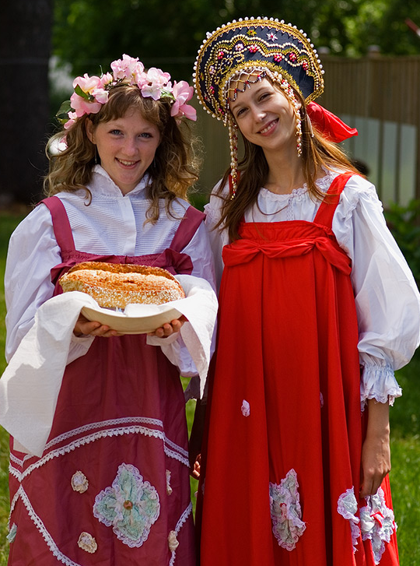
Who Are The Russians?
The Study of Gog would not be complete without knowing who the Russians are in bible prophecy.
Most Christians believe that the Russians are Gog. Although the Gogi originate within the borders of the Soviet Union, I will try and show that this is not the case.

Slide 42
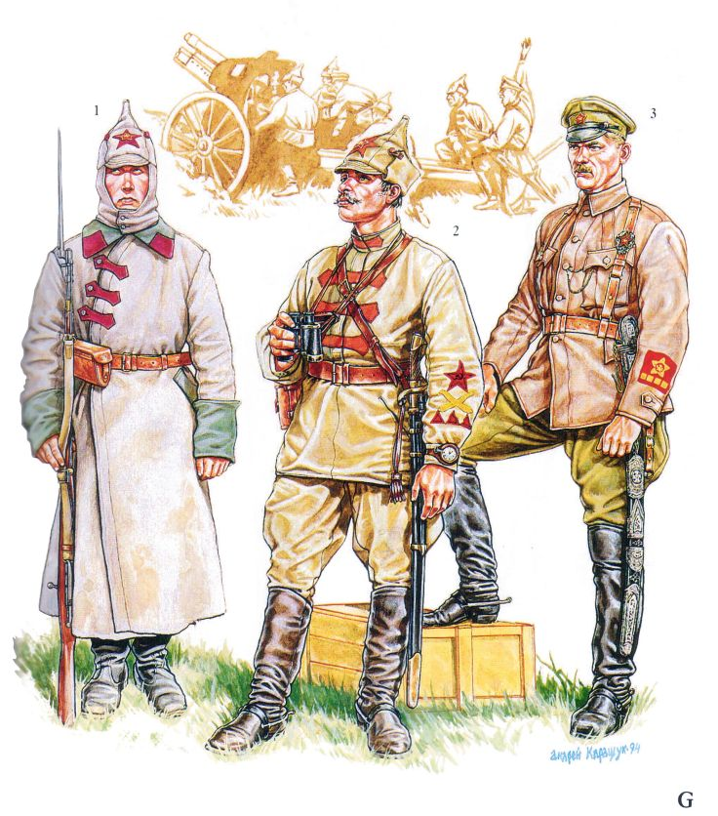
Who Are The Russians?
3. We must also distinguish between the Kievian (white) Russians and the Slavs.
4. The Gogi originating from Mongolia are Asiatics who have mongrelised with other races including the Idumeans, Canaanites and Amelek.
White Russians

Slide 43
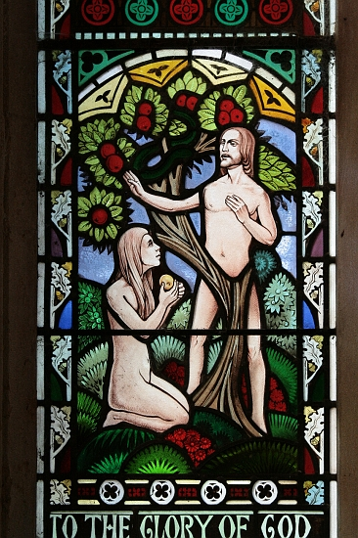
Who Are The Russians?
5. The Adamites were destined by God to rule over the heathen, so naturally one would expect to find other races within the Russian borders, as is the case in other Israelite nations!

Slide 44
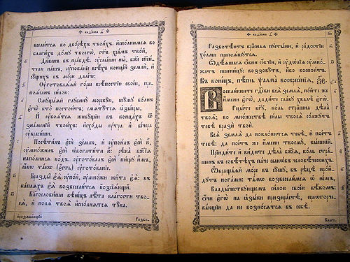
Some Surprising Facts About Russia
The Bible was available to ordinary Russians in their own Language centuries before vulgate translations were available in western Europe.
A Russian Bible

Slide 45
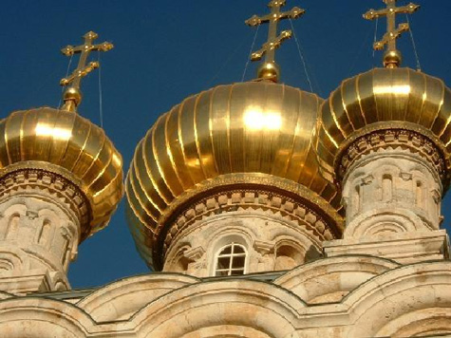
Some Surprising Facts About Russia
2. Prior to the revolution Russia was the largest Christian country in the world.
A Russian Church

Slide 46
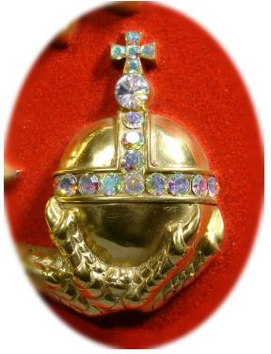
Some Surprising Facts About Russia
3. During the period of the Tzars, Russia had more gold in her banks than the value of notes in circulation.
Symbol Of The Russian Tsars

Slide 47
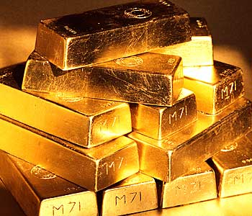
Some Surprising Facts About Russia
4. During the time of the Tzars Russia was also the largest producer of gold in the world

Slide 48
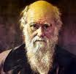
Some Surprising Facts About Russia
5. The Hymn “How Great Thou Art” was composed by a Russian to a Swedish tune.
Cibele Ferrari

Slide 49
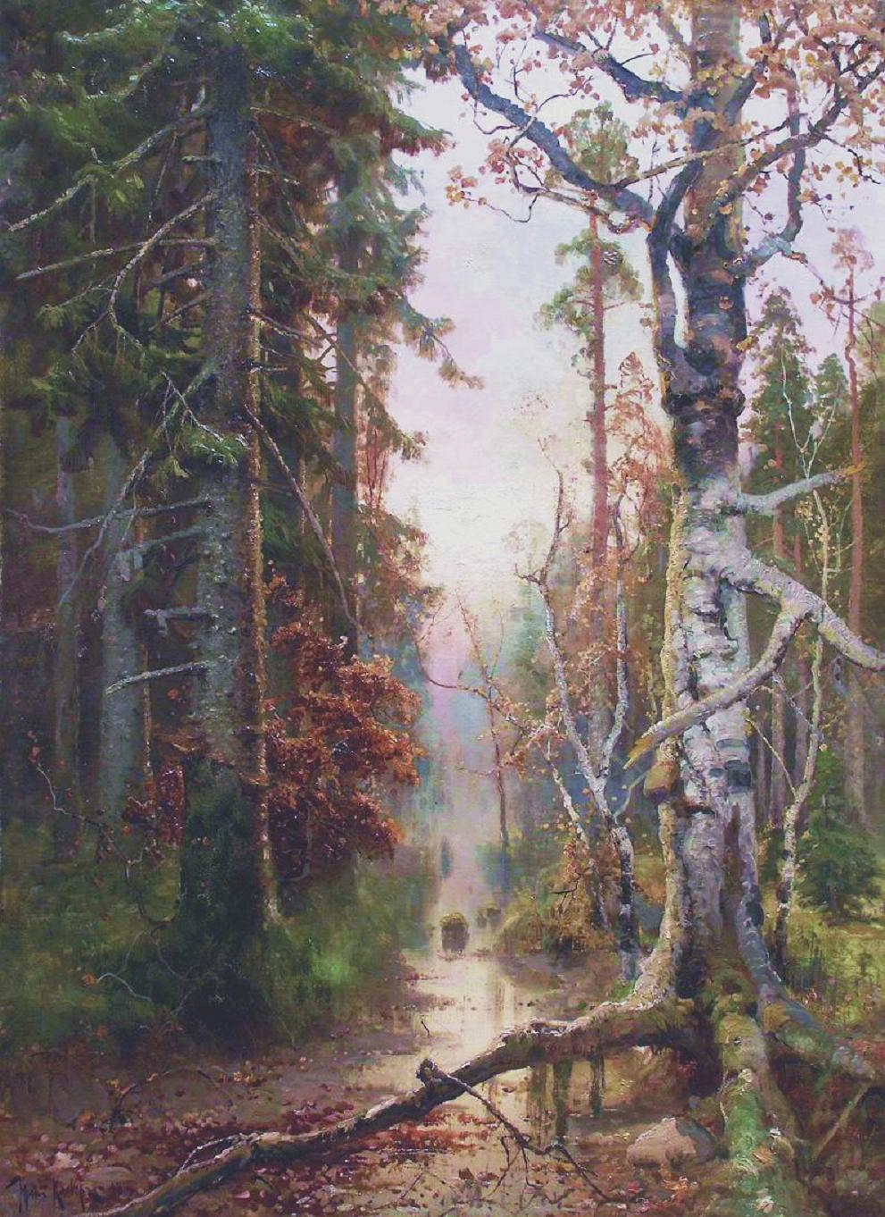
Some Surprising Facts About Russia
6. Russia has 25% of all the world’s forests

Slide 50
The Rus - Benjamin
Territory of the Rus circa 650 AD

Slide 51
Russia Today

Slide 52
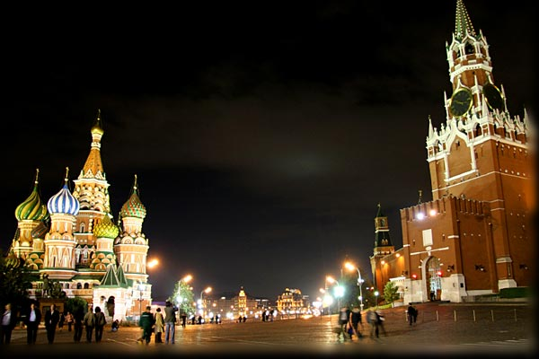
Moscow (Meshech)
Now we are going to consider the variant forms of the words “Meshech” and “Tubal”. First, Meshech: (Two syllables): Meshech, Meshek, Mesech, Mesec, Mosoch, Mosokh (One syllable): Maskh, Masch, Mesch, Misch, Moskh, Mosch, Mask, Masc, Mosc, Musc.
The names themselves, as they stand in the Hebrew text, have just one long vowel between them. “Mesech” is simply: M sh ch;
Notes:
Meshech and Tubal, as their names read in the English versions, occur together in the ethnological tables given in Gen. x. and 1 Chron. i. The Septuagint Greek version has Mosoch and Thobel. The names themselves, as they stand in the Hebrew text, have just one long vowel between them. “Mesech” is simply +:/ M sh ch; and “Tubal” is -,&( Th–bal or Thôbl, and in one place -,( Th b l. Any short vowels may be inserted — nor are the vowels only responsible for the possible differences of form. Sh before a guttural readily becomes S. It is difficult to pronounce Sh and Ch together — it is easier to say Musk and Mushk. The Ch may pass into the hard K, while the form of the Hebrew " suggest our C. Thus we get the following table of forms (out of a total of at least eighty possible transliterations) in which the name of the Japhetic Meshech may be found.
Now we are going to consider the variant forms of the words “Meshech” and “Tubal”. First, Meshech: (Two syllables): Meshech, Meshek, Mesech, Mesec, Mosoch, Mosokh (One syllable): Maskh, Masch, Mesch, Misch, Moskh, Mosch, Mask, Masc, Mosc, Musc. Second, Tubal: Thobel, Tubal, Tobal, Tobl, Tupal, Tupl, Sabar, Tabal, Tapal, Tibil, Tivol, Tifl, Tabr, Taber, Tibar, Tiber, Tever, Tibur, Tapur, Tapyr, Siber, Sibir, Sever, Bal, Bel, Bol, Bul, Bar, Val, Vol. (I got these from table #1 and #2 on page 28 of Milner’s booklet.) Right away, here, you can see that the word Siberia comes from the word Tubal, a son of Japheth. Now back to Rev. W. M. H. Milner.
While for a time the early settlements of the Tobol in Siberia represented Tubal, Tubal is specially the great migration, which produced Bulgaria. Northwards, on the Volga, in a little village is to be seen all that remains of the once powerful city of Bol-gara, named in the first chapter of Marco Polo’s Travels as being, with Sarai or Astrakhan, the seat of rule of the Mongol dominions in Russia in the middle of the thirteenth century. “The Bolgar, Bulgar, or Bulghar, here spoken of,” adds Marco Polo’s Editor (Bohn 1854, p. 4), “is the name of a town and extensive district in Tartary, lying to the eastward of the Volga, and now inhabited by the Bashkirs, sometimes distinguished from the Bulgaria on the Danube, by the appellation of the Greater Bulgaria.”

Slide 53
Russian Double Headed Eagle
Notice St. George and the Dragon on the Russian double headed eagle.
Another meaning for the prophecy of Ishmael in the "original Hebrew, which runs literally, "he shall be before the faces of all his brethren

Slide 54
Russian Double Headed Eagle
Facing west to his brethren in Europe and East to his brethren in the USA.

Slide 55
Russian Double Headed Eagle
" And he will be a wild man; his hand will be against every man, and every man's hand against him; and he shall dwell in the presence of all his brethren.

Slide 56
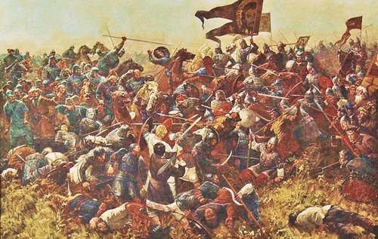
Russian Double Headed Eagle
Secular history records that the Slavs invited the Vikings to rule over them because of almost continuous internal fighting amongst themselves.

Slide 57
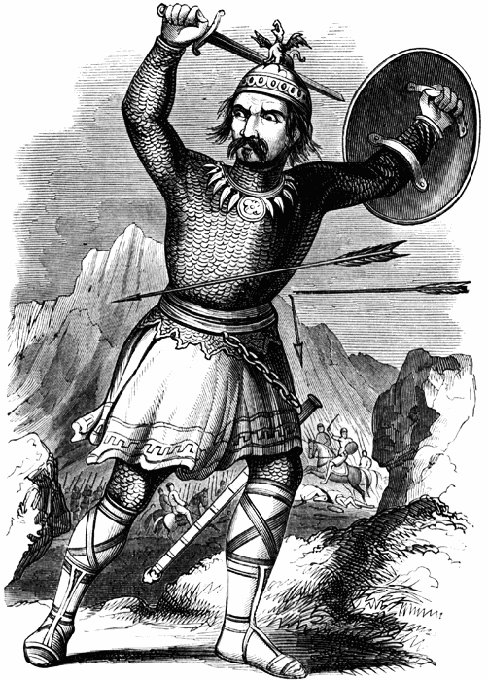
Europe Post Genghis Khan
In the following slide we shall see the political map of Europe in 1346 after the assault of Genghis Khan gradually recedes.
We see the political boundaries beginning to resemble those familiar to us today.

Slide 58
Note the princes of Ishmael

Slide 59
Political Map Of Europe 1914
Here we see the extent of the European part of the Russian Empire (at its maximum) – shortly to be decimated from within by Gog
Notes:
TSAR NICHOLAS II LAST Emperor of the Third Rome First cousin to King George V of England First cousin to Kaiser Wilhelm II of Germany TSAR NICHOLAS II LAST Emperor of the Third Rome First cousin to King George V of England First cousin to Kaiser Wilhelm II of Germany TSAR NICHOLAS II LAST Emperor of the Third Rome First cousin to King George V of England First cousin to Kaiser Wilhelm II of Germany

Slide 60
Czar Nicholas II
It must be remembered that whilst Moscow was the capital of Russia, the Czars’ court was in St. Petersburg, not Moscow which would become the power centre of Gog after the 1917 revolution.
Notes:
TSAR NICHOLAS II LAST Emperor of the Third Rome First cousin to King George V of England First cousin to Kaiser Wilhelm II of Germany TSAR NICHOLAS II LAST Emperor of the Third Rome First cousin to King George V of England First cousin to Kaiser Wilhelm II of Germany TSAR NICHOLAS II LAST Emperor of the Third Rome First cousin to King George V of England First cousin to Kaiser Wilhelm II of Germany

Slide 61
Czar & Family Flee
In August of 1917, the Royal Family fled to Tobolsk, in Siberia. They stay at the Governors house until April, 1918.
Notes:
TSAR NICHOLAS II LAST Emperor of the Third Rome First cousin to King George V of England First cousin to Kaiser Wilhelm II of Germany TSAR NICHOLAS II LAST Emperor of the Third Rome First cousin to King George V of England First cousin to Kaiser Wilhelm II of Germany TSAR NICHOLAS II LAST Emperor of the Third Rome First cousin to King George V of England First cousin to Kaiser Wilhelm II of Germany

Slide 62
Czar & Family Flee
They hoped to escape to England, where King George V who was a Romanov cousin, but he refused due to pressure from Jewish groups.
Notes:
TSAR NICHOLAS II LAST Emperor of the Third Rome First cousin to King George V of England First cousin to Kaiser Wilhelm II of Germany TSAR NICHOLAS II LAST Emperor of the Third Rome First cousin to King George V of England First cousin to Kaiser Wilhelm II of Germany TSAR NICHOLAS II LAST Emperor of the Third Rome First cousin to King George V of England First cousin to Kaiser Wilhelm II of Germany

Slide 63
Czar Nicholas II and Family
Here we see the Czar’s family just prior to being assassinated by Gog
Notes:
TSAR NICHOLAS II LAST Emperor of the Third Rome First cousin to King George V of England First cousin to Kaiser Wilhelm II of Germany TSAR NICHOLAS II LAST Emperor of the Third Rome First cousin to King George V of England First cousin to Kaiser Wilhelm II of Germany TSAR NICHOLAS II LAST Emperor of the Third Rome First cousin to King George V of England First cousin to Kaiser Wilhelm II of Germany

Slide 64
Tsar Nicholas & Family – Murdered By Gog
Left: Tsar Nicholas, his wife and one of his children. All were to be murdered by the Communists once the party had seized complete power.

Slide 65
Tsar Nicholas & Family – Murdered By Gog
Ipatyev House - Where the Romanoffs Were Butchered

Slide 66
Czar & Family Murdered
About midnight, Yurovsky woke up the Czar's family, and their party. At 1 o'clock in the night, the Czar, Czaritza, their four daughters, the maid, the doctor, the cook, ….
The Murder of the Czar
Notes:
TSAR NICHOLAS II LAST Emperor of the Third Rome First cousin to King George V of England First cousin to Kaiser Wilhelm II of Germany TSAR NICHOLAS II LAST Emperor of the Third Rome First cousin to King George V of England First cousin to Kaiser Wilhelm II of Germany TSAR NICHOLAS II LAST Emperor of the Third Rome First cousin to King George V of England First cousin to Kaiser Wilhelm II of Germany

Slide 67
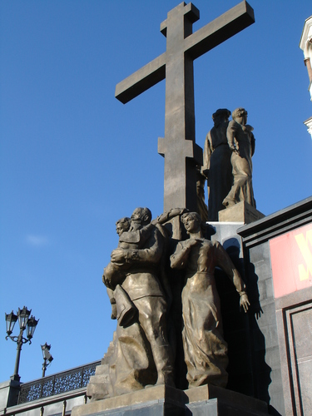
Czar & Family Murdered
… and the waiter went to the basement. The Czar carried the heir in his arms. Yurovsky, Medvedev, Nikulin, Yermakov, Vaganov, all Jewish Cheka assassins were waiting.
A memorial in Yekaterinburg where the Czar and Family were murdered

Slide 68
Czar Nicholas II (1868-1918) was the last Russian Emperor
The Mountbattens (aka Windsors ‑ QE2), who are related to the Rothschilds, led the court battles to prevent the claimants from withdrawing any of the fortune.

Slide 69
Gog Exerts Power Through Communism
The First Meeting of the Communist Party
In 1917, Rothschild directs Lenin to replace Kerensky. Lenin, joined by Trotsky and 300 Jews from New York, deposed Kerensky.
Notes:
TSAR NICHOLAS II LAST Emperor of the Third Rome First cousin to King George V of England First cousin to Kaiser Wilhelm II of Germany TSAR NICHOLAS II LAST Emperor of the Third Rome First cousin to King George V of England First cousin to Kaiser Wilhelm II of Germany TSAR NICHOLAS II LAST Emperor of the Third Rome First cousin to King George V of England First cousin to Kaiser Wilhelm II of Germany

Slide 70
Gog Exerts Power Through Communism
Kerensky steps down to be replaced by Lenin
Notes:
TSAR NICHOLAS II LAST Emperor of the Third Rome First cousin to King George V of England First cousin to Kaiser Wilhelm II of Germany TSAR NICHOLAS II LAST Emperor of the Third Rome First cousin to King George V of England First cousin to Kaiser Wilhelm II of Germany TSAR NICHOLAS II LAST Emperor of the Third Rome First cousin to King George V of England First cousin to Kaiser Wilhelm II of Germany

Slide 71
Lenin (Jew) – Real Name Vladimir Illyich Ulynaov
Left: Lenin addresses a meeting - to his right, Leon Trotsky, the principal organizer of the Communist Revolution and the real brains behind the creation of the Soviet Union
Notes:
Vladimir Illyich Ulynaov, who later adopted the name of Lenin, was born in 1870 and had become a convinced revolutionary by the age of 17, when his brother had been executed for his part in a plot to assassinate the Tsar
On his release, he fled to Western Europe and built up the radical wing of the Russian Communist Party, mainly through the publication of his famous newspaper "Iskra" (the Spark) from Switzerland. Lenin returned briefly to Russia in 1905 to take part in the abortive revolution of that year: When it failed and was suppressed, he fled once more into exile.
The February revolution of 1917 caught Lenin unprepared: he was still in Switzerland when it broke out. He immediately made an offer to the German government: if they would give him safe passage to Russia, he would endeavor to take Russia out of the war. The Germans agreed to this plan, and along with a tight group of selected revolutionaries, Lenin was put across the Russian border by the Germans in a secret operation which involved the Communists hiding in a railway truck. Lenin finally arrived in Petrograd in April 1917, with his small but tough and trained hard core group of revolutionaries.

Slide 72
1917 – Moscow Falls to Gog
Kremlin Now The Seat of Gog’s Power In The East
Russians (Ishmael) Now An Enslaved People

Slide 73
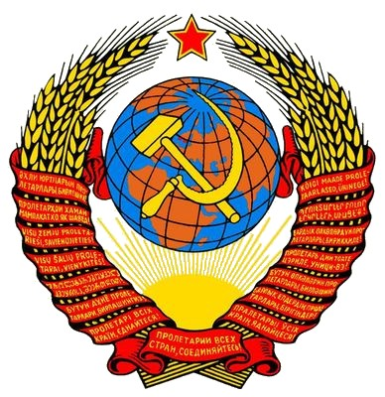
Insignia of The Soviet Union
The world is depicted as conquered by the red beast after having bound in slavery the children of the wheat – and we will see the Biblical symbolism of the Soviet Insignia …

Slide 74
Insignia of The Soviet Union
1 The Star of Idumea
1
2 The Wheat (the good seed) being bound for burning
3
The hammer and sickle of Tubal-Cain
Gathering the Israel Nations to Battle
4
5 True Israel bound in red tape – The wheat
6 The Sun Scorching the earth
Notes:
TSAR NICHOLAS II LAST Emperor of the Third Rome First cousin to King George V of England First cousin to Kaiser Wilhelm II of Germany TSAR NICHOLAS II LAST Emperor of the Third Rome First cousin to King George V of England First cousin to Kaiser Wilhelm II of Germany TSAR NICHOLAS II LAST Emperor of the Third Rome First cousin to King George V of England First cousin to Kaiser Wilhelm II of Germany

Slide 75
1917 – Moscow Falls to Gog
1 - TUBAL-CAIN. the smith (of cutting instruments) 2 – The Fallen Star – Lucifer (Satan)
3 – There was a 5 pointed star on the flag of the Idumeans
The Pentagon (USA) is a 5 pointed star!

Slide 76
KHRUSHCHEV MEETS HIS ROCKEFELLER MASTER
Khrushchev boasts that he receives secret codes, money and all "secret" reports from Rockefeller dominated CIA Quislings.
False headlines say that they met for the first time

Slide 77
1987 – Gog’s Grip on Russia Falters
1) USSR Dissolves to become the Russian Federation.
2) The Red, White & Blue Russian Tricolour flies once more.

Slide 78
Russia Clamps Down on Jewish Crooks
Putin
Mikhail Khodorkovsky
Gigantic Jewish globalists and world criminals like Mikhail Khodorkovsky (photo) in a cage whilst standing trial in Moscow.
Notes:
Gigantic Jewish globalists and world criminals like Mikhail Khodorkovsky (photo) in a cage whilst standing trial in Moscow.
The three oil executives living in Israel Leonid Nevzlin, Mikhail Brudno and Vladimir Dubov are former partners of Khodorkovsky and all are wanted by Russia on fraud charges. The men, all of whom appeared on the Forbes list of the world's billionaires in 2004, are now directors of Group Menatep, a holding company that owns 60 percent of what remains of the dismantled Yukos empire. First cousin to King George V of England First cousin to Kaiser Wilhelm II of Germany TSAR NICHOLAS II LAST Emperor of the Third Rome First cousin to King George V of England First cousin to Kaiser Wilhelm II of Germany TSAR NICHOLAS II LAST Emperor of the Third Rome First cousin to King George V of England First cousin to Kaiser Wilhelm II of Germany

Slide 79
Clovis – King of The Franks
Popular tradition, based on French royal tradition, holds that the Franks were the founders of the French nation, and that Clovis was therefore the first King of France.
Non-contemporary coin with obverse legend "Clovis Roy de France"

Slide 80
Clovis – King of The Franks
Notes:
Baphomet as a word is formed from the title reversed and abbreviated in cabalistic fashion, "Tem.ohp.ab." "Templi omnium hominum pacis abbas", or, The Father of the Temple of Universal Peace. The great two horned goat bearing between its horns the fiery torch is Nimrod or Moloch. The pentacle or five pointed star between the beast's horns stand's for the Idumeans, (the symbol of the tribe of Judah is the Lion). The right hand of the beast is raised with two fingers pointing upwards to a white moon. The white moon stands for the Children of Shem, the White Race. On the right arm is written “SOLVE” which means destroy or dis­solve. The left hand is pointing downwards with two fingers to a black moon. The black moon stands for the children of Ham. On the left arm is written "Coagula" which means Mix or combine. 'The beast sits on the world. On his stomach can be seen part of a circle which stands for the Zoroaster, the Seed of Fire. In front the circle is the apple on a pole around which are twined two serpents one white and the other black. The apple is the forbidden fruit of the tree of knowledge of good and evil. The serpent is the Aish‑Skhul‑Apis, the Man instructing serpent.
This design reveals the great secret – the great white race of the Shem is to be destroyed by intermingling it with the black races of Ham. In Causing this to be done the Idumeans and Askenazim will gain control of the world for which they have worked for more than two thousand Years. The two fingers stand for two shall be one.
Eliphas Levi whose name appears on the picture was the Abbe Alphonse Louis Constant who became a cabalist.

Slide 81
Gog Deceives The Nations
"And I saw three unclean spirits like frogs come out of the mouth of the dragon, and out of the mouth of the beast, and out of the mouth of the false prophet." Rev 16:13
Notes:
Double, Double, Toil and Trouble
"And I saw three unclean spirits like frogs.." Rev 16:13
The vial judgements are patterned after the plagues in Exodus. It is not a one to one correspondence but, the sores of the first vial, the blood of the second, the darkness of the fifth and the hail of the seventh vial establish the pattern. And after the sixth vial there were three frogs.
The plagues were directed against the gods of Egypt. The frog goddess, Hecate, was one of their principle deities. Hecate was a triple goddess. She performed her magic at crossroads, where three ways meet. As a result, the goddess of crossroads has three faces, one looking each way. The word trivial is a Roman word that refers to Hecate Tri Via (three ways). She is also represented as an equilateral triangle.
On another level, Hecate was the third stage in the life of the mother goddess. These three phases are represented by the moon. Crescent waxing, the beautiful virgin goddess. Full moon, the maid. And crescent waning, the old maid or crone. The word hag is a variant of Heka from Hecate.
Hecate was the goddess of witchcraft. She is the goddess of Halloween. When you see the witch on her broom and black hat before a waning crescent moon you are seeing a representation of this old egyptian goddess. The goddess of course is Semeramis, the goddess of a thousand names, Babylon's queen who is riding the scarlet beast. (Rev 17:3)
The fact that toads or frogs are associated with witchcraft proceeds from the old legends of the frog goddess.
The illuminati masonic pit beast is the focus of the vial judgements. And both the illuminati and masonry are based upon the ancient egyptian mysteries which point to the triple frog goddess.
E.B. Elliot discovered that the original arms of France were a banner with three black toads or frogs. Clovis, king of the Franks converted to Christianity and changed the flag from three frogs to the familiar fleur de lis. The french do not like to be called frogs so their histories of the fleur de lis don't mention this fact.
Elliott reveals that the three frogs came from an egyptian medal. This would have to be a symbolic representation of their triple frog goddess, the dark goddess, Hecate.
The Illuminati was founded by a witch and has always been involved in witchcraft. And Masonry is essentially Baal worship or satanism when the layers of symbolism are stripped away. And this end time beast emerged in France.
The three frogs then are a powerful symbol representing the end time 8th beast which emerged from a witches coven and erupted during the French Revolution. And the old witch goddess Hecate is brewing up a witches caldron where the three beasts meet in the New World Order.
Double, double toil and trouble......."Jacob's" trouble.

Slide 82
Gog Deceives The Nations
And the old witch goddess Hecate is brewing up a witches caldron where the three beasts meet in the New World Order.
Overt
Communis
Catholism
Capitalism
.
Covert
Knights Templar
Illuminati
Finance
"Double, double toil and trouble......."Jacob's" trouble. Clovis 481-511 – King of The Franks
Notes:
E.B. Elliot discovered that the original arms of France were a banner with three black toads or frogs. Clovis, king of the Franks converted to Christianity and changed the flag from three frogs to the familiar fleur de lis. The french do not like to be called frogs so their histories of the fleur de lis don't mention this fact. E.B. Elliot discovered that the original arms of France were a banner with three black toads or frogs. Clovis, king of the Franks converted to Christianity and changed the flag from three frogs to the familiar fleur de lis. The french do not like to be called frogs so their histories of the fleur de lis don't mention this fact.

Slide 83
Gog Deceives The Nations
The 3 frogs representing Gog’s covert attack on Israel is very appropriate: Frogs hide in the slim and can travel on land or in water (Jews are into organised – drugs – slave trade – the mafia etc.)
"Double, double toil and trouble......."Jacob's" trouble. Clovis 481-511 – King of The Franks
Notes:
E.B. Elliot discovered that the original arms of France were a banner with three black toads or frogs. Clovis, king of the Franks converted to Christianity and changed the flag from three frogs to the familiar fleur de lis. The french do not like to be called frogs so their histories of the fleur de lis don't mention this fact. E.B. Elliot discovered that the original arms of France were a banner with three black toads or frogs. Clovis, king of the Franks converted to Christianity and changed the flag from three frogs to the familiar fleur de lis. The french do not like to be called frogs so their histories of the fleur de lis don't mention this fact.

Slide 84
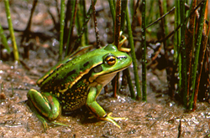
Gog Deceives The Nations
They can blend in with their surroundings so no one notices them. They hide in secret societies – Masons – Crown Temple – The Illuminati etc

Slide 85
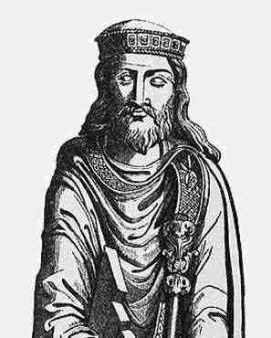
Gog Deceives The Nations
Some Additional “Frog” Banners Extant at the Time In France
King Clovis I

Slide 86
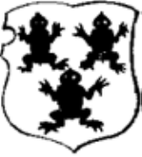
Gog Deceives The Nations
A warning to God’s Elect that that Jacob’s Trouble was brewing

Slide 87
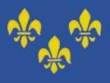
Gog Deceives The Nations
These frogs were soon replaced with Fleur de Lis as the French didn’t like being called frogs!

Slide 88
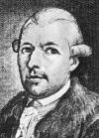
Gog Deceives The Nations
The Illuminati was founded by a witch and has always been involved in witchcraft. And Masonry is essentially Baal worship or Satanism when the layers of symbolism are stripped away. And this end time beast emerged in France.
Adam Weishaupt – who revived the Illuminati
Notes:
E.B. Elliot discovered that the original arms of France were a banner with three black toads or frogs. Clovis, king of the Franks converted to Christianity and changed the flag from three frogs to the familiar fleur de lis. The french do not like to be called frogs so their histories of the fleur de lis don't mention this fact. E.B. Elliot discovered that the original arms of France were a banner with three black toads or frogs. Clovis, king of the Franks converted to Christianity and changed the flag from three frogs to the familiar fleur de lis. The french do not like to be called frogs so their histories of the fleur de lis don't mention this fact.

Slide 89
Gog Speaks Like A Frog
Ibn Fadlan, a fastidious Arab traveller, whose journey took him to a village in Khazaria called Ardkwa whose inhabitants are called Kardals said; “their language sounds entirely like the croaking of frogs”.

Slide 90
Frogs - A Link To Egypt
The 3 Frogs of Revelation also indicate a link to Egypt – the plague of frogs – also Egyptian Gods Amon & Amonet were transformed from the frogs Niau and Naiut.
Amon

Slide 91
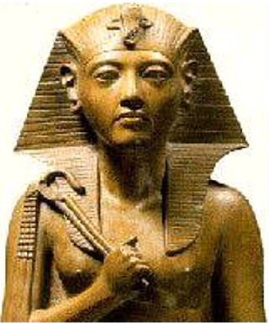
Frogs - A Link To Egypt
The magic secrets of these gods were taken to Europe following the collapse of Egypt – leaping from one continent to another for which the frog is a good analogy.

Slide 92
The 3 Principals (Frogs) Finance, Religious & Political
The overseeing eye = the Rothschild & Rockefeller Banking and Commercial conglomerates
Notes:
The Templars were recognized at Clermont in 1118. 1+1+1+8= 11. The authors of Holy Blood Holy Grail provided the definitive evidence that there were 9 original founding Templars and they first banded together in 1111 and taking no new members for 9 years. And this was the numerical basis for the 911's in this tragedy.

Slide 93
The 3 Principals (Frogs) Finance, Religious & Political
Here we see the complete diagram of Gog’s Masonic & Templar structure

Slide 94
Billy Graham (Frank) - Jew
Interestingly Billy Graham’s real name Frank originates from the land of the 3 frogs – The Kingdom of the Franks

Slide 95
Billy Graham (Frank) - Jew
Billy Graham was a major driving force towards ecumenism
He was also a 33 Degree Mason
He also had several audiences with the Pope at the Vatican
Billy Graham

Slide 96
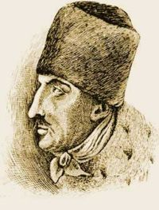
Billy Graham (Frank) - Jew
A famous member of this line was Jakob Frank, a self-confessed Satanist whose followers were called “Frankists”. Freud's sexually-obsessed theories came from Frankism. Frank taught his followers to convert to another religion and hide behind that religion to conceal their Satanism.
Jakob Frank

Slide 97
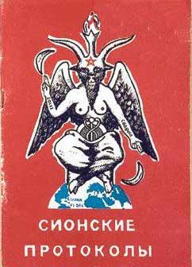
The 6 Objectives Finance, Religious & Political
1. abolition of all existing governments and the establishment of a one-world super-government,
2. abolition of inheritance,
3. abolition of private property,
4. abolition of patriotism,
5. abolition of the family,
6. abolition of freedom.
The Protocols

Slide 98
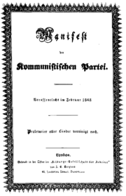
The Objectives Finance, Religious & Political
Communist Manifesto (1848), is remarkably similar to the objectives of the Illuminati..

Slide 99
The Illuminati
Origin of The Illuminati Back in 1203 B.C.:From the official printing press of the Rosicrucians – It states:-
Notes:
Origin of The Illuminati Back in 1203 B.C.: From the official printing press of the Rosicrucians, it states: "In 1203 B.C., several of the Brothers of the Order who were of the Illuminati were commissioned to go into other lands and spread the secret doctrines by the establishment of other Lodges. It was quite apparent that Egypt was to be subjected to a devastation and that its great learning might be lost. Willie Martin - Events

Slide 100
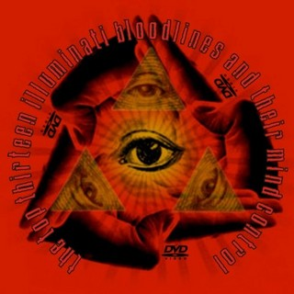
The Illuminati
Several Brothers of the Illuminati Order were commissioned to spread the secret doctrines in other lands before the invasion of Egypt and thereby prevent the extinction of the Illuminati
The Illuminati Logo

Slide 101
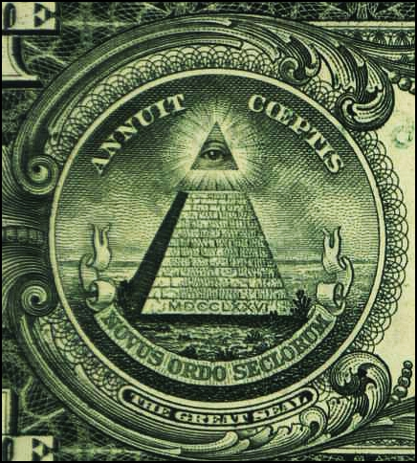
Gog Gradually Weakens The West – Ready For The Final Attack
Destruction of White Culture
Destruction of True Christianity
Destruction of White Industrial Power
Control of Money and Financial Institutions
Control of the Legal Processes and Replacing Anglo-Saxon Common Law With Civil (Roman) Law & UCC (Unified Commercial Code) in The States
Destruction of Farming
Destruction of Fishing
Reducing the Strength of Western Armies

Slide 102
The Knights Templars Banded Together in 1111
The Templars were recognized at Clermont in 1118. 1+1+1+8= 11. The authors of Holy Blood Holy Grail provided the definitive evidence that there were 9 original founding Templars

Slide 103
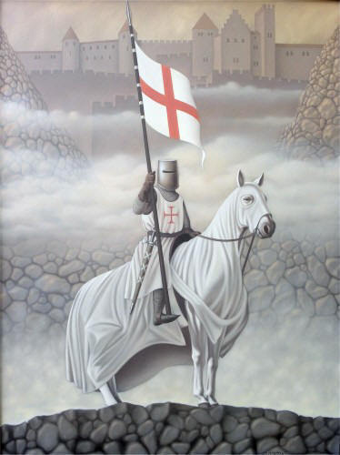
The Knights Templars Banded Together in 1111
… and they first banded together in 1111 and taking no new members for 9 years. And this was the numerical basis for the 911's in many tragedies.

Slide 104
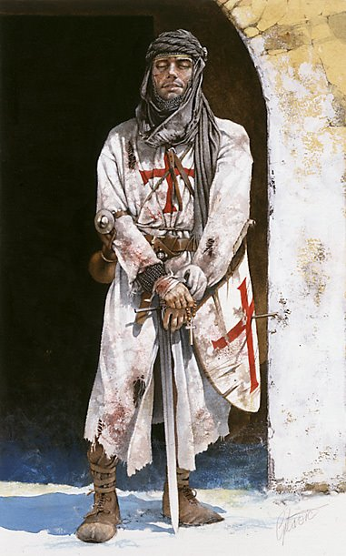
The Knights Templars Banded Together in 1111
The order was Officially founded in 1118 by the Burgundian knight Yves de Faillon, with the aim of protecting pilgrims traveling to the Holy Places. The order's official name, the "Poor Knights of Christ and of the Temple of Solomon,”
Notes:
The order was founded in 1118 by the Burgundian knight Yves de Faillon, with the aim of protecting pilgrims traveling to the Holy Places. The order's official name, the "Poor Knights of Christ and of the Temple of Solomon," comes from their place of residence - on the Temple Mount, where its members took over the el-Aqsa Mosque, known as the "Temple of Solomon" by the Crusaders.
The Templars enlarged the el-Aqsa Mosque to the west, building a refectory with three long halls there. In addition, they built partitions to divide up the mosque's prayer hall into cells. They used the vaults supporting the Temple Mount structures as stables, as described by John of Wurtzburg (1160-1170): "When you descend to the main street, there is a great gate through which one may enter the great courtyard of the Temple. On the right side, toward the south, is the palace which they say that Solomon built. Within it are stables, so huge that they can hold more than two thousand horses or 1,500 camels, and near this palace the Templar knights have many great houses and there are also the foundations of a great new church which is not yet finished. This order has enormous property and endless revenues in this region and in other places. This allows them to give alms to the poor, though not as a tithe, as the Hospitallers do. The order also has many knights for the defense of the land of the Christians."

Slide 105
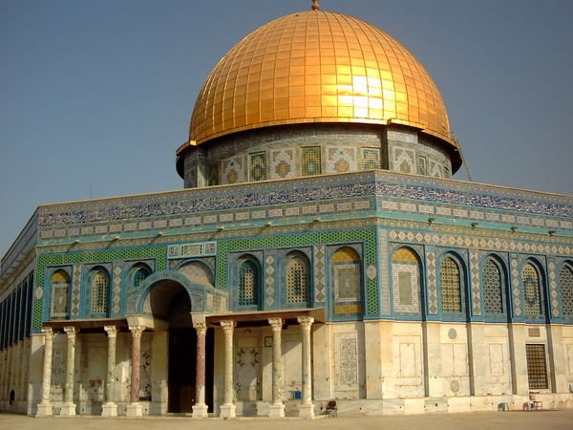
The Knights Templars Banded Together in 1111
The El-Aska Mosque
… comes from their place of residence - on the Temple Mount, where its members took over the el-Aqsa Mosque, known as the "Temple of Solomon" by the Crusaders.

Slide 106
Gogs Agents – The Rise Of The Jesuits (Catholic Jews)
Disraeli, who revealed the truth about a lot of things, declared “the first Jesuits were Jews. Now if “the first Jesuits were Jews”
Ignatius LIEola (1491 — 1556).
Notes:
In the year 1523, Ignatius LIEola, the Founder and first General of the Jesuit order, started his career of deception by going to Jerusalem and trying to covert Moslems to Roman Catholicism....He was a complete failure there and even his Superior threatened him with excommunication if he did not quit the city.
Arriving back in Europe he decided to fight the Reformation instead. About that time, Martin Luther had just finished his marvelous translation of the Bible. Millions were reading the Scriptures for themselves and awaking from the long dark night of the Dark Ages.
They realized that the great apostasy that the Apostle Paul had predicted of the Man of Sin sitting in the Temple of God was fulfilled in the Papal Dynasty:
THE ORDER OF TIME ... (70 A.D.) When the Church of the Jews was overthrown, the dragon invaded the Catholic Church, all this in the 12th chap. The dragon is bound for a 1000 years, chap 20. The dragon raiseth up the beast with seven heads, and the beast with two heads, which make havoc of the Church Catholic, and her Prophets for 1260 years after the passion of Christ, chaps. 13 & 11. (97A.D.) The seven Churches are admonished of things present, somewhat before the end of Domitian’s reign, and are forewarned of the persecution to come under Trajan for ten years, chap 2 & 3. God by word and signs provoketh the world, and sealeth the godly, chaps. 6 & 7. He showeth forth examples of his wrath upon all creatures, mankind excepted, chap. 8. (1073 A.D.) The dragon is let loose after 1000 years, and Gregory the VII being Pope, rageth against Henrie the third then Emperor, chap. 20 ...”

Slide 107
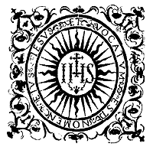
Gogs Agents – The Rise Of The Jesuits (Catholic Jews)
one can be sure they would not relinquish control to anyone else!
In fact a lot of Popes have been assassinated because they tried to remove the Jesuits
The Jesuit Logo

Slide 108
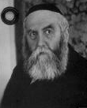
Jesuits Try To Destroy The
According to the book "To Eliminate the Opiate" (out of print) by Rabbi Antelman, the Illuminati formed a committee entitled the Biblical Destruction Group in 1776. This committee disbanded 50 years later
Rabbi Antelman

Slide 109
Jesuits Try To Destroy The Word
In 1826 the Apocrypha, (fourteen books of the Bible) was removed from the protestant editions of the King James Bible.
What were they trying to hide – Our Identity perhaps?

Slide 110
Jesuits Try To Destroy The Word
The 1540 Geneva Bible includes the Apocrypha. The 1607 version of the King James Bible includes the Apocrypha. The Apocrypha is included in the Lectern Bible of the Church of England,

Slide 111
Jesuits Try To Destroy The Word
…. and also in what is called The King's Bible on which the Coronation oath is taken. It is reported that, at the coronation of King Edward VII, a Bible Society sent a magnificently bound Bible as a coronation gift, which had to be returned as it was without the Apocrypha.

Slide 112
Jesuits Try To Destroy The Word
Have we been given a clue?
Before the Apocrypha was removed the Bible contained 80 books (8 x 10) a good scriptural number.
After removal the number of books was reduced to 66 (6 x 11) – an Illuminati occult number as we shall see later

Slide 113
Jesuits Try To Destroy The Word
The Bible on which the Coronation oath is taken always contains the Apocrypha

Slide 114
Puppet Master to The Late Pope John Paul II
Peter-Hans Kolvenbach (1928--) Jesuit General since 1983 – Jewish “Black Pope”

Slide 115
Illuminati Conspiracy, Order of the Illumined Wise Men
Most associate May 1st with dancing around the Maypole – but as we shall see, this date has more sinister connotations!

Slide 116
Illuminati Conspiracy, Order of the Illumined Wise Men
May 1, 1776, was the most important date in Freemasonry's Luciferian New World Order Plans. On that date an obscure Jesuit-trained professor of canon law …..
Adam Weishaupt

Slide 117
Illuminati Conspiracy, Order of the Illumined Wise Men
… at the University of Ingolstadt in Bavaria, Adam Weishaupt, founded a secret society called the Ancient and Illuminated Seers of Bavaria
Adam Weishaupt
Notes:
May 1, 1776, was the most important date in Freemasonry's Luciferic New World Order Plans. On that date an obscure Jesuit-trained professor of canon law at the University of Ingolstadt in Bavaria, Adam Weishaupt, founded a secret society called the Ancient and Illuminated Seers of Bavaria (AISB for short). Illuminati was founded on a mixture of Masonic secrets(--Luciferic Doctrine--), Islamic Mysticism(--Sufism--), and Jesuit mental discipline(--Hatha Yoga--). A unique and dangerous element was it's scientific use of the drug, hashish, to produce an "illuminated" state of mind--derived directly through the Knights Templar's association with the Order of the Assassins (circa 1050 AD).

Slide 118
Illuminati Conspiracy, Order of the Illumined Wise Men
In 1770, the then reorganised House of Rothschild had commisioned Weishaupt to revise the age old Protocols of Zion. This was completed in 1776 and the Illuminati were then founded –
The House of Rothschild

Slide 119
Illuminati Conspiracy, Order of the Illumined Wise Men
You now know what you are celebrating on May 1st which was fairly recently turned into a public holiday.
Notes:
May 1, 1776, was the most important date in Freemasonry's Luciferic New World Order Plans. On that date an obscure Jesuit-trained professor of canon law at the University of Ingolstadt in Bavaria, Adam Weishaupt, founded a secret society called the Ancient and Illuminated Seers of Bavaria (AISB for short). Illuminati was founded on a mixture of Masonic secrets(--Luciferic Doctrine--), Islamic Mysticism(--Sufism--), and Jesuit mental discipline(--Hatha Yoga--). A unique and dangerous element was it's scientific use of the drug, hashish, to produce an "illuminated" state of mind--derived directly through the Knights Templar's association with the Order of the Assassins (circa 1050 AD).

Slide 120
Illuminati of Bavaria, founded 1776 – Notice Rites Similar To Masons today!

Slide 121
Gog’s Baphomet
Here are the Masons Parading Baphomet of the Templars – Note the Templar Cross on its chest – indicating the fusion of the Templars into Masonry later to become known as the York Rite.

Slide 122
Gog’s Baphomet
Baphomet = "Tem.ohp.ab from the title reversed and abbreviated in cabalistic fashion which = The Father of the Temple of Universal Peace.
The great two horned goat bearing between its horns the fiery torch is Nimrod or Moloch.
Notes:
Baphomet as a word is formed from the title reversed and abbreviated in cabalistic fashion, "Tem.ohp.ab." "Templi omnium hominum pacis abbas", or, The Father of the Temple of Universal Peace. The great two horned goat bearing between its horns the fiery torch is Nimrod or Moloch. The pentacle or five pointed star between the beast's horns stand's for the Idumeans, (the symbol of the tribe of Judah is the Lion). The right hand of the beast is raised with two fingers pointing upwards to a white moon. The white moon stands for the Children of Shem, the White Race. On the right arm is written “SOLVE” which means destroy or dis­solve. The left hand is pointing downwards with two fingers to a black moon. The black moon stands for the children of Ham. On the left arm is written "Coagula" which means Mix or combine. 'The beast sits on the world. On his stomach can be seen part of a circle which stands for the Zoroaster, the Seed of Fire. In front the circle is the apple on a pole around which are twined two serpents one white and the other black. The apple is the forbidden fruit of the tree of knowledge of good and evil. The serpent is the Aish‑Skhul‑Apis, the Man instructing serpent.
This design reveals the great secret – the great white race of the Shem is to be destroyed by intermingling it with the black races of Ham. In Causing this to be done the Idumeans and Askenazim will gain control of the world for which they have worked for more than two thousand Years. The two fingers stand for two shall be one.
Eliphas Levi whose name appears on the picture was the Abbe Alphonse Louis Constant who became a cabalist.

Slide 123
Gog’s Baphomet
Eliphas Levi whose name appears on the picture was the Abbe Alphonse Louis Constant who became a cabalist.
Eliphas Levi

Slide 124
Gog’s Baphomet
The Left hand is pointing with 2 fingers down towards a black moon which stands for the black races.
On the left arm is written “COAGULA” which means mix or combine
On its stomach is a circle which stands for Zoroaster – the seed of fire.

Slide 125
Gog’s Baphomet
In front of the circle is a pole with an apple on it around which are two serpents one white and the other black. The apple representing the forbidden fruit of good and evil
The serpent is the Aish-Skhul-Apis, the man instructing serpent.
Notes:
Baphomet as a word is formed from the title reversed and abbreviated in cabalistic fashion, "Tem.ohp.ab." "Templi omnium hominum pacis abbas", or, The Father of the Temple of Universal Peace. The great two horned goat bearing between its horns the fiery torch is Nimrod or Moloch. The pentacle or five pointed star between the beast's horns stand's for the Idumeans, (the symbol of the tribe of Judah is the Lion). The right hand of the beast is raised with two fingers pointing upwards to a white moon. The white moon stands for the Children of Shem, the White Race. On the right arm is written “SOLVE” which means destroy or dis­solve. The left hand is pointing downwards with two fingers to a black moon. The black moon stands for the children of Ham. On the left arm is written "Coagula" which means Mix or combine. 'The beast sits on the world. On his stomach can be seen part of a circle which stands for the Zoroaster, the Seed of Fire. In front the circle is the apple on a pole around which are twined two serpents one white and the other black. The apple is the forbidden fruit of the tree of knowledge of good and evil. The serpent is the Aish‑Skhul‑Apis, the Man instructing serpent.
This design reveals the great secret – the great white race of the Shem is to be destroyed by intermingling it with the black races of Ham. In Causing this to be done the Idumeans and Askenazim will gain control of the world for which they have worked for more than two thousand Years. The two fingers stand for two shall be one.
Eliphas Levi whose name appears on the picture was the Abbe Alphonse Louis Constant who became a cabalist.

Slide 126
Gog’s Baphomet
The 5 pointed star between the beasts horns stands for the Idumeans.
The right hand is pointing with raised 2 fingers towards the white moon which represents the white race of Shem.
On the right arm is written “SOLVE” meaning destroy or dissolve.
Notes:
Baphomet as a word is formed from the title reversed and abbreviated in cabalistic fashion, "Tem.ohp.ab." "Templi omnium hominum pacis abbas", or, The Father of the Temple of Universal Peace. The great two horned goat bearing between its horns the fiery torch is Nimrod or Moloch. The pentacle or five pointed star between the beast's horns stand's for the Idumeans, (the symbol of the tribe of Judah is the Lion). The right hand of the beast is raised with two fingers pointing upwards to a white moon. The white moon stands for the Children of Shem, the White Race. On the right arm is written “SOLVE” which means destroy or dis­solve. The left hand is pointing downwards with two fingers to a black moon. The black moon stands for the children of Ham. On the left arm is written "Coagula" which means Mix or combine. 'The beast sits on the world. On his stomach can be seen part of a circle which stands for the Zoroaster, the Seed of Fire. In front the circle is the apple on a pole around which are twined two serpents one white and the other black. The apple is the forbidden fruit of the tree of knowledge of good and evil. The serpent is the Aish‑Skhul‑Apis, the Man instructing serpent.
This design reveals the great secret – the great white race of the Shem is to be destroyed by intermingling it with the black races of Ham. In Causing this to be done the Idumeans and Askenazim will gain control of the world for which they have worked for more than two thousand Years. The two fingers stand for two shall be one.
Eliphas Levi whose name appears on the picture was the Abbe Alphonse Louis Constant who became a cabalist.

Slide 127
The Illuminati
We see here their code for encrypting messages.
They have also a series of numbers which are particularly important to them.
It is by the use of these occult numbers they place their signature on events (Assassinations, “Terrorist” attacks and political upheavals)

Slide 128
The Illuminati & 911
Rev. 9:11 “And they had a king over them, which is the angel of the bottomless pit, whose name in the Hebrew tongue is Abaddon, but in the Greek tongue is Apollyon (That is to say destroyer)
Abbadon is the Masonic password given to those reaching the 17th Degree

Slide 129
The Illuminati & 911
Several Israelis were caught videoing this event on top of a building – obviously they had foreknowledge of this event.
This was made into music album cover
Their van in which they transported their equipment belonged to Moving Systems Incorporated

Slide 130
The Illuminati & 911
The name of their “moving company” actually contained the word MOSSAD embedded inside. Moving Systems Incorporated… MOving SyStems IncorporAteD = …….MOSSAD
Israelis were again arrested in a similar van with equipment to blow up a bridge in Washington – They were quietly deported back to Israel

Slide 131
Freemasonry
In order to get their freemasonry growing and gaining members they have always kept their hate for royalties and nobilities hidden from those groups. They have even allowed kings, dukes, lords and other nobilities to act as Master of Grades/Lodges just to get their support for freemasonry and to get members, but the real Leaders of freemasonry have been and are Jews.
Duke of Kent

Slide 132
Freemasonry
In France during the 18. century. King Louis, XV son of King Louis XIV, was against all kind of freemasonry. He even prohibited it from France in 1737. By then freemasonry had been in France since 1717.
King Louis XV
Notes:
In order to get their freemasonry growing and gaining members they have always kept their hate for royalties and nobilities hidden for those groups. They have even allowed kings, dukes, lords and other nobilities to act as Master of Grades/Lodges just to get their support for freemasonry and to get members, but the real Leaders of freemasonry have been and are Jews. France during the 18. century. King Louis, XV son of King Louis XIV, was against all kind of freemasonry. He even prohibited it from France in 1737. By then freemasonry had been in France since 1717. In order to get their freemasonry growing and gaining members they have always kept their hate for royalties and nobilities hidden for those groups. They have even allowed kings, dukes, lords and other nobilities to act as Master of Grades/Lodges just to get their support for freemasonry and to get members, but the real Leaders of freemasonry have been and are Jews. France during the 18. century. King Louis, XV son of King Louis XIV, was against all kind of freemasonry. He even prohibited it from France in 1737. By then freemasonry had been in France since 1717. In order to get their freemasonry growing and gaining members they have always kept their hate for royalties and nobilities hidden for those groups. They have even allowed kings, dukes, lords and other nobilities to act as Master of Grades/Lodges just to get their support for freemasonry and to get members, but the real Leaders of freemasonry have been and are Jews. France during the 18. century. King Louis, XV son of King Louis XIV, was against all kind of freemasonry. He even prohibited it from France in 1737. By then freemasonry had been in France since 1717. tIn order to get their freemasonry growing and gaining members they have always kept their hate for royalties and nobilities hidden for those groups. They have even allowed kings, dukes, lords and other nobilities to act as Master of Grades/Lodges just to get their support for freemasonry and to get members, but the real Leaders of freemasonry have been and are Jews. France during the 18. century. King Louis, XV son of King Louis XIV, was against all kind of freemasonry. He even prohibited it from France in 1737. By then freemasonry had been in France since 1717. In order to get their freemasonry growing and gaining members they have always kept their hate for royalties and nobilities hidden for those groups. They have even allowed kings, dukes, lords and other nobilities to act as Master of Grades/Lodges just to get their support for freemasonry and to get members, but the real Leaders of freemasonry have been and are Jews. France during the 18. century. King Louis, XV son of King Louis XIV, was against all kind of freemasonry. He even prohibited it from France in 1737. By then freemasonry had been in France since 1717.

Slide 133
Illuminati Occult Numbers
3
Is the first sacred number, the first perfect number (Westcott, p. 41)
Three represents the Pagan Trinity
33, or 333. 333 + 333 equals 666. Occultists have used 333 as the hidden symbol by which they present the more offensive number 666.
Brooke Foss Westcott
Notes:
Number 3:
Three (3) is the first sacred number, the first perfect number (Westcott, p. 41). Three represents the Pagan Trinity." (Westcott, p. 37). It is represented geo-metrically in the triangle, and spiritually as the Third Eye Of Hinduism. Occultists will multiply and add three to other sacred numbers to create new numbers. However, they also group threes in two's and threes, because they believe in the principle of "intensification", i.e., that greater power is achieved when a sacred number is grouped. In the case of three, greater intensification is achieved when it is shown as 33, or 333. 333 + 333 equals 666. Occultists have used 333 as the hidden symbol by which they present the more offensive number 666. When the details of an event are so arranged as to contain certain sacred occult numbers or numeric combinations, this is literally an occult signature on the event. Mathematically, 666 can be created when three pairs of threes are added. Thus, (3+3) + (3+3) + (3+3) = 666. Now, eliminate the parentheses and the plus sign, and you have 33 space, 33 space, 33, representing the number 666

Slide 134
Illuminati Occult Numbers
6
Is the next sacred number, representing the number of the soul of man (Westcott, p. 66). This shows the omnipotent power of God, as this belief parallels Revelation 13:18, where God assigns 666 to man and to the beast. Six is also believed to be "all-sufficient".
Notes:
Number 3:
Three (3) is the first sacred number, the first perfect number (Westcott, p. 41). Three represents the Pagan Trinity." (Westcott, p. 37). It is represented geo-metrically in the triangle, and spiritually as the Third Eye Of Hinduism. Occultists will multiply and add three to other sacred numbers to create new numbers. However, they also group threes in two's and threes, because they believe in the principle of "intensification", i.e., that greater power is achieved when a sacred number is grouped. In the case of three, greater intensification is achieved when it is shown as 33, or 333. 333 + 333 equals 666. Occultists have used 333 as the hidden symbol by which they present the more offensive number 666. When the details of an event are so arranged as to contain certain sacred occult numbers or numeric combinations, this is literally an occult signature on the event. Mathematically, 666 can be created when three pairs of threes are added. Thus, (3+3) + (3+3) + (3+3) = 666. Now, eliminate the parentheses and the plus sign, and you have 33 space, 33 space, 33, representing the number 666

Slide 135
Illuminati Occult Numbers
7
Seven (7) is a sacred number. Van Buren calls 7 "one of the most sacred of all the numbers..: the Invisible Centre, the Spirit of everything". (p. 39) Since multiplication of seven creates an even more powerful sacred number, we should not be surprised that 3 x 7, or 21, is considered powerful.
Martin Van Buren
Notes:
Seven (7) is a sacred number. Van Buren calls 7 "one of the most sacred of all the numbers...the Invisible Centre, the Spirit of everything". (p. 39) Since multiplication of seven creates an even more powerful sacred number, we should not be surprised that 3x7, or 21, is considered powerful

Slide 136
Illuminati Occult Numbers
9
Nine (9) is sacred because it is the "first cube of an odd number (3)", (Van Buren, p.40-41) The triple nine (999) is utilized to represent 666, because it is simply the inversion of 666.
Notes:
In systems such as Astrology and basic Numerology, eleven is considered to be a Master Number. Eleven can also represent sin; transgression and peril. Ten being the perfect number, eleven represents the exceeding of both. It is interesting to note that eleven when broken down (1+1=2) comprises the Two of duality. (LUCIFER tried/wanted to be equal to God) Number eleven is a master vibration and as such should not be reduced to a single number. People with this number could be both idealistic and visionary, and they are attracted to the unknown. They can be both unusual, interesting and magnetic personalities. Eleven bring the gift of spiritual inheritance, (system of the Anti-Christ) is gifted as the "Light-Bearer". (One of the names of Lucifer)

Slide 137
Illuminati Occult Numbers
Royal Arch Masonry is obsessed with bridge symbolism (Princess Diana was murdered under a covered bridge) to the same extent that the Masonic grade of Ninth degree is up to it's neck in decapitation ritual.

Slide 138
Illuminati Occult Numbers
11
Eleven when broken down (1+1=2) comprises the Two of duality. (LUCIFER tried/wanted to be equal to God)
Notes:
In systems such as Astrology and basic Numerology, eleven is considered to be a Master Number. Eleven can also represent sin; transgression and peril. Ten being the perfect number, eleven represents the exceeding of both. It is interesting to note that eleven when broken down (1+1=2) comprises the Two of duality. (LUCIFER tried/wanted to be equal to God) Number eleven is a master vibration and as such should not be reduced to a single number. People with this number could be both idealistic and visionary, and they are attracted to the unknown. They can be both unusual, interesting and magnetic personalities. Eleven bring the gift of spiritual inheritance, (system of the Anti-Christ) is gifted as the "Light-Bearer". (One of the names of Lucifer)

Slide 139
Illuminati Occult Numbers
Eleven (11) is a sacred number. When eleven is multiplied by the perfect number 3, the number 33 is produced, a number of tremendous occult importance

Slide 140
Illuminati Occult Numbers
11 - The subversion and undoing of 10; a flawed addition to that perfect order. 11 - the Antichrist/Prince is known as the 11th Horn.
Lucifer = “Light Bearer” has 11 letters!

Slide 141
Illuminati Occult Numbers
11
Interestingly the word Gog appears exactly 11 times in the whole of the Bible.
10 times in the Old Testament and once only in the New Testament. The 10 times it appears is in Ezekiel, Chapters 38 and 39.

Slide 142
Illuminati Occult Numbers
Of the 190 nationalities within the old USSR the 11th in population size was the Jews (Gog)

Slide 143
Illuminati Occult Numbers
Aquarius is the 11th sign in the Zodiac. We are since August 11, 1999 in the "Age of Aquarius" [New Christ] which ended the 2,000 year reign of Pisces [True Christ].
11

Slide 144
Illuminati Occult Numbers
The August 11th 1999 Solar Eclipse which occurred at precisely 11:11 [over Cornwall, UK]. Biblical numerology – 11 = 11th Hour – Nearing Christ’s return. To Britain??
11

Slide 145
Illuminati Occult Numbers
It is interesting to note that a mere eleven minutes after the Zionist declaration of the Palestinian partition and independence on May 14, 1948, President Truman recognized Israel as an independent Jewish State.
11
Notes:
In systems such as Astrology and basic Numerology, eleven is considered to be a Master Number. Eleven can also represent sin; transgression and peril. Ten being the perfect number, eleven represents the exceeding of both. It is interesting to note that eleven when broken down (1+1=2) comprises the Two of duality. (LUCIFER tried/wanted to be equal to God) Number eleven is a master vibration and as such should not be reduced to a single number. People with this number could be both idealistic and visionary, and they are attracted to the unknown. They can be both unusual, interesting and magnetic personalities. Eleven bring the gift of spiritual inheritance, (system of the Anti-Christ) is gifted as the "Light-Bearer". (One of the names of Lucifer)

Slide 146
Illuminati Occult Numbers
13
There are 13 references to the antichrist in the New Testament.
13 stands for - rebellion, apostasy, defection, corruption, disintegration & revolution
Gen. xiv. 4, where we read 'Twelve years they served Chedorlaomer, and the thirteenth year they REBELLED.

Slide 147
Illuminati Occult Numbers
18
6 + 6 + 6 = 18.
This another way of hiding the number 666

Slide 148
Illuminati Occult Numbers
28
The number 28 is one of the correspondences of Solomon in kabbalistic numerology; the Solomonic name assigned to 28 is "Beale."

Slide 149
Illuminati Occult Numbers
33
KKK. K is the eleventh number of the Alphabet. In other words the KKK can be represented as 11, 11, 11. 11+11+11=33.
The Klu Klux Klan

Slide 150
Illuminati Occult Numbers
33
Albert Pike created the 33rd degree of Masonry. Confessed LUCIFERIAN and founder of the K.K.K. The Ku Klux Klan
Albert Pike

Slide 151
Illuminati Occult Numbers
33
There are 33 titles to the antichrist in the Old Testament!

Slide 152
Illuminati Occult Numbers
39
Notice that the Bilderberg Group has core of 39 members who are broken into 3 groups of 13 members in each group.
Notice that the core of 39 answers to the 13 who make up the Policy Committee. Take special notice that the 13 members of the Policy Committee answer to the Round Table of Nine.

Slide 153
Illuminati Occult Numbers
39
The Constitution has 7 articles and was signed by 39 members of the Constitutional Convention. More research is to be done on this number.

Slide 154
Illuminati Occult Numbers
77
77, the mark of the revenge of Lamech. Lamech was a descendant of Cain, the first murderer, and father of Tubal-Cain, an important hero of the Clums (ancestor of Hiram Abiff). The Bible says the following about the mark of the revenge of Lamech:
Lamech

Slide 155
Illuminati Occult Numbers
"And Lamech said unto his wives, Adah and Zillah, 'Hear my voice: ye wives of Lamech, hearken unto my speech: for I have slain a man to my wounding, and a young man to my hurt. If Cain shall be avenged sevenfold, truly Lamech seventy and sevenfold." (Genesis 4: 23-24).
77

Slide 156
Illuminati Occult Numbers
The obvious of course is 11 x 7=77
77
The London Bombings on July 7th 2005, were stamped with the number 77

Slide 157
Illuminati Occult Numbers
666
Also represented as 999
We all know that 666 represents Satan and Antichrist, it will not be tattooed on people for the word says: “let him that hath understanding count the number of the beast..”
The Brussels Beast Computer tracts trade though the bar code system based on the number 666

Slide 158
Illuminati Occult Numbers
666
Hidden 666 in the Trilateral Commission Logo
However, we are all assigned the number 666 as a prefix to our identification number held in the “Beast” computers at Bruxelles and Luxemburg …

Slide 159
Illuminati Occult Numbers
666
which consists of 18 digits – (666 + 3 digit country code + 3 digit telephone area code + our 9 digit social security number) The 18 digit number is another way of expressing 666!
Battle Engagement And Symmetrical Tracking

Slide 160
Illuminati Occult Numbers
666
[Colin Powell] - "Finding the Russian scientists may be a problem being that Russia does not have a Social Security System, as here in America, that allows us to MONITOR, TRACK DOWN and CAPTURE an American (& British) citizen.”

Slide 161
Illuminati Occult Numbers
666
Colin Powell accidentally let this information slip while being interviewed by Fox News Sunday, 17/06/01.
This statement indicates that we are more highly monitored in the west than the former Soviet Union.

Slide 162
Illuminati Occult Numbers
666
Roman numerals: The sum of all classical Roman numerals, I, V, X, L, C, D (1, 5, 10, 50, 100, 500) is 666. (The numeral M, for 1000, was a later addition.)

Slide 163
Illuminati Occult Numbers
666
We are being conditioned
By Subliminal 6’s in advertising

Slide 164
Illuminati Occult Numbers
666
The City Of London – The Richest Square Mile in the world
Occupies 677 acres – which can be expressed as 666 + 11 marking The City of London as part of the Beast System.

Slide 165
Illuminati Occult Numbers

Slide 166
Flag of Gog’s Stolen Real Estate In The Middle East
666
Note the Number 666 – (6 outer triangles, 6 inner triangles and 6 points.
Note the pagan hexagram of witchcraft.
Note the pale blue imitation of the Royal Blue of real Judah
A 5 Pointed Star Was The National Emblem of The Idumeans

Slide 167
Flag of Gog’s Stolen Real Estate In The Middle East
A geometrical form based on a multiple of sixes
6 Lines forming two equilateral triangles.
6 small outer equilateral triangles
6 points, 12 outer lines 2 x 6 = 12
6 inner lines forming a central hexagon
666

Slide 168
Flag of Gog’s Stolen Real Estate In The Middle East
6, 60 degree angles of large triangles
18, 60 degree angles (6 + 6 + 6) of small outer triangles
12, 120 degree angles (60 + 60 = 120) making a total of at least 54 sixes:
666

Slide 169
Masonic Symbols – US Capitol
Notes:
In order to get their freemasonry growing and gaining members they have always kept their hate for royalties and nobilities hidden for those groups. They have even allowed kings, dukes, lords and other nobilities to act as Master of Grades/Lodges just to get their support for freemasonry and to get members, but the real Leaders of freemasonry have been and are Jews. France during the 18. century. King Louis, XV son of King Louis XIV, was against all kind of freemasonry. He even prohibited it from France in 1737. By then freemasonry had been in France since 1717. In order to get their freemasonry growing and gaining members they have always kept their hate for royalties and nobilities hidden for those groups. They have even allowed kings, dukes, lords and other nobilities to act as Master of Grades/Lodges just to get their support for freemasonry and to get members, but the real Leaders of freemasonry have been and are Jews. France during the 18. century. King Louis, XV son of King Louis XIV, was against all kind of freemasonry. He even prohibited it from France in 1737. By then freemasonry had been in France since 1717. In order to get their freemasonry growing and gaining members they have always kept their hate for royalties and nobilities hidden for those groups. They have even allowed kings, dukes, lords and other nobilities to act as Master of Grades/Lodges just to get their support for freemasonry and to get members, but the real Leaders of freemasonry have been and are Jews. France during the 18. century. King Louis, XV son of King Louis XIV, was against all kind of freemasonry. He even prohibited it from France in 1737. By then freemasonry had been in France since 1717. tIn order to get their freemasonry growing and gaining members they have always kept their hate for royalties and nobilities hidden for those groups. They have even allowed kings, dukes, lords and other nobilities to act as Master of Grades/Lodges just to get their support for freemasonry and to get members, but the real Leaders of freemasonry have been and are Jews. France during the 18. century. King Louis, XV son of King Louis XIV, was against all kind of freemasonry. He even prohibited it from France in 1737. By then freemasonry had been in France since 1717. In order to get their freemasonry growing and gaining members they have always kept their hate for royalties and nobilities hidden for those groups. They have even allowed kings, dukes, lords and other nobilities to act as Master of Grades/Lodges just to get their support for freemasonry and to get members, but the real Leaders of freemasonry have been and are Jews. France during the 18. century. King Louis, XV son of King Louis XIV, was against all kind of freemasonry. He even prohibited it from France in 1737. By then freemasonry had been in France since 1717.

Slide 170
The Illuminati Bloodlines
The Astor Bloodline.
The Bundy Bloodline.
The Collins Bloodline.
The DuPont Bloodline.
The Freeman Bloodline.
The Kennedy Bloodline.
The Li Bloodline.
The Onassis Bloodline.
The Onassis Bloodline.
The Rockefeller Bloodline.
The Rothschild Bloodline.
The Russell Bloodline.
The Van Duyn Bloodline.
The Merovingian Bloodline.
The Disney Bloodline.
The Reynolds bloodline.
Notes:
In order to get their freemasonry growing and gaining members they have always kept their hate for royalties and nobilities hidden for those groups. They have even allowed kings, dukes, lords and other nobilities to act as Master of Grades/Lodges just to get their support for freemasonry and to get members, but the real Leaders of freemasonry have been and are Jews. France during the 18. century. King Louis, XV son of King Louis XIV, was against all kind of freemasonry. He even prohibited it from France in 1737. By then freemasonry had been in France since 1717. In order to get their freemasonry growing and gaining members they have always kept their hate for royalties and nobilities hidden for those groups. They have even allowed kings, dukes, lords and other nobilities to act as Master of Grades/Lodges just to get their support for freemasonry and to get members, but the real Leaders of freemasonry have been and are Jews. France during the 18. century. King Louis, XV son of King Louis XIV, was against all kind of freemasonry. He even prohibited it from France in 1737. By then freemasonry had been in France since 1717. In order to get their freemasonry growing and gaining members they have always kept their hate for royalties and nobilities hidden for those groups. They have even allowed kings, dukes, lords and other nobilities to act as Master of Grades/Lodges just to get their support for freemasonry and to get members, but the real Leaders of freemasonry have been and are Jews. France during the 18. century. King Louis, XV son of King Louis XIV, was against all kind of freemasonry. He even prohibited it from France in 1737. By then freemasonry had been in France since 1717. tIn order to get their freemasonry growing and gaining members they have always kept their hate for royalties and nobilities hidden for those groups. They have even allowed kings, dukes, lords and other nobilities to act as Master of Grades/Lodges just to get their support for freemasonry and to get members, but the real Leaders of freemasonry have been and are Jews. France during the 18. century. King Louis, XV son of King Louis XIV, was against all kind of freemasonry. He even prohibited it from France in 1737. By then freemasonry had been in France since 1717. In order to get their freemasonry growing and gaining members they have always kept their hate for royalties and nobilities hidden for those groups. They have even allowed kings, dukes, lords and other nobilities to act as Master of Grades/Lodges just to get their support for freemasonry and to get members, but the real Leaders of freemasonry have been and are Jews. France during the 18. century. King Louis, XV son of King Louis XIV, was against all kind of freemasonry. He even prohibited it from France in 1737. By then freemasonry had been in France since 1717.

Slide 171
The (Sanhedrin) Learned Elders of Zion.
1. Inigo de Loyola (Spanish Jew)............... 1541-1556.
2. Diego Laynez (Spanish Jew).................. 1558-1565.
3. Francisco Borgia (Spanish Jew.............. 1565-1572.
4. Eberhard Mercurian (Belgin Jew)......... 1573-1580.
5. Claudio Acquaviva (Neapolitan Jew)..... 1581-1615.
6. Mutio Vitelleschi (Roman Jew)............. 1615-1645.
7. Vincenzio Caraffa (Neapolitan Jew)....... 1646-1649.
8. Francesco Piccolomini (Florentine Jew). 1649-1651.
9. Alessandro Gottofredi (Roman Jew)....... 1652.
10. Goswin Nickel (German Jew).............. 1652-1664.
Notes:
In order to get their freemasonry growing and gaining members they have always kept their hate for royalties and nobilities hidden for those groups. They have even allowed kings, dukes, lords and other nobilities to act as Master of Grades/Lodges just to get their support for freemasonry and to get members, but the real Leaders of freemasonry have been and are Jews. France during the 18. century. King Louis, XV son of King Louis XIV, was against all kind of freemasonry. He even prohibited it from France in 1737. By then freemasonry had been in France since 1717. In order to get their freemasonry growing and gaining members they have always kept their hate for royalties and nobilities hidden for those groups. They have even allowed kings, dukes, lords and other nobilities to act as Master of Grades/Lodges just to get their support for freemasonry and to get members, but the real Leaders of freemasonry have been and are Jews. France during the 18. century. King Louis, XV son of King Louis XIV, was against all kind of freemasonry. He even prohibited it from France in 1737. By then freemasonry had been in France since 1717. In order to get their freemasonry growing and gaining members they have always kept their hate for royalties and nobilities hidden for those groups. They have even allowed kings, dukes, lords and other nobilities to act as Master of Grades/Lodges just to get their support for freemasonry and to get members, but the real Leaders of freemasonry have been and are Jews. France during the 18. century. King Louis, XV son of King Louis XIV, was against all kind of freemasonry. He even prohibited it from France in 1737. By then freemasonry had been in France since 1717. tIn order to get their freemasonry growing and gaining members they have always kept their hate for royalties and nobilities hidden for those groups. They have even allowed kings, dukes, lords and other nobilities to act as Master of Grades/Lodges just to get their support for freemasonry and to get members, but the real Leaders of freemasonry have been and are Jews. France during the 18. century. King Louis, XV son of King Louis XIV, was against all kind of freemasonry. He even prohibited it from France in 1737. By then freemasonry had been in France since 1717. In order to get their freemasonry growing and gaining members they have always kept their hate for royalties and nobilities hidden for those groups. They have even allowed kings, dukes, lords and other nobilities to act as Master of Grades/Lodges just to get their support for freemasonry and to get members, but the real Leaders of freemasonry have been and are Jews. France during the 18. century. King Louis, XV son of King Louis XIV, was against all kind of freemasonry. He even prohibited it from France in 1737. By then freemasonry had been in France since 1717.

Slide 172
The (Sanhedrin) Learned Elders of Zion.
11. Giovanni Paolo Oliva (Genoese Jew)
Vicar-general and Coadjutor, 1661; General. 1664-1681.
12. Charles von Noyelle (Belgian Jew)....... 1682-1686.
13. Tirso Gonzales (Spanish Jew).............. 1687-1705.
14. Michael Angelo Tamburini (Modanese Jew).... 1706-1730.
15. Franz Retz (Bohemian Jew)................ 1730-1750.
16. Ignazio Visconti (Milanese Jew).......... 1751-1755.
17. Alessandro Centurioni (Genoese Jew).. 1755-1757.
18. Lorenzo Ricci (Florentine Jew)............ 1758-1775.
a. Stanislaus Czerniewicz (Polish Jew)..... 1782-1785.
b. Gabriel Lienkiewicz (Polish Jew)......... 1785-1798.
Notes:
In order to get their freemasonry growing and gaining members they have always kept their hate for royalties and nobilities hidden for those groups. They have even allowed kings, dukes, lords and other nobilities to act as Master of Grades/Lodges just to get their support for freemasonry and to get members, but the real Leaders of freemasonry have been and are Jews. France during the 18. century. King Louis, XV son of King Louis XIV, was against all kind of freemasonry. He even prohibited it from France in 1737. By then freemasonry had been in France since 1717. In order to get their freemasonry growing and gaining members they have always kept their hate for royalties and nobilities hidden for those groups. They have even allowed kings, dukes, lords and other nobilities to act as Master of Grades/Lodges just to get their support for freemasonry and to get members, but the real Leaders of freemasonry have been and are Jews. France during the 18. century. King Louis, XV son of King Louis XIV, was against all kind of freemasonry. He even prohibited it from France in 1737. By then freemasonry had been in France since 1717. In order to get their freemasonry growing and gaining members they have always kept their hate for royalties and nobilities hidden for those groups. They have even allowed kings, dukes, lords and other nobilities to act as Master of Grades/Lodges just to get their support for freemasonry and to get members, but the real Leaders of freemasonry have been and are Jews. France during the 18. century. King Louis, XV son of King Louis XIV, was against all kind of freemasonry. He even prohibited it from France in 1737. By then freemasonry had been in France since 1717. tIn order to get their freemasonry growing and gaining members they have always kept their hate for royalties and nobilities hidden for those groups. They have even allowed kings, dukes, lords and other nobilities to act as Master of Grades/Lodges just to get their support for freemasonry and to get members, but the real Leaders of freemasonry have been and are Jews. France during the 18. century. King Louis, XV son of King Louis XIV, was against all kind of freemasonry. He even prohibited it from France in 1737. By then freemasonry had been in France since 1717. In order to get their freemasonry growing and gaining members they have always kept their hate for royalties and nobilities hidden for those groups. They have even allowed kings, dukes, lords and other nobilities to act as Master of Grades/Lodges just to get their support for freemasonry and to get members, but the real Leaders of freemasonry have been and are Jews. France during the 18. century. King Louis, XV son of King Louis XIV, was against all kind of freemasonry. He even prohibited it from France in 1737. By then freemasonry had been in France since 1717.

Slide 173
The (Sanhedrin) Learned Elders of Zion.
c. Franciscus Xavier Kareu (Polish Jew)
(General in Russia, March 7th, 1801)..... 1799-1802.
d. Gabriel Gruber (German Jew)............. 1802-1805.
19. Thaddaeus Brzozowiski (Polish Jew).... 1805-1820.
20. Aloysio Fortis (Veronese Jew).............. 1820-1829.
21. Johannes Roothaan (Dutch Jew).......... 1829-1853.
22. Peter Johannes Beckx (Belgian Jew)..... 1853-1887.
23. Antoine Marie Anderledy (Swiss Jew).... 1887-1892.
24. Louis Martin (Spanish Jew).................. 1892-1906.
25. Francis Xavier Warnz (German Jew)..... 1906-1914.
26. Vladimir Ledochowski (Polish Jew)....... 1915-.
The Generals of the Jesuits have always been Jews, there has never been a general that was not Jewish and under the absolute control of the Illuminati which, is in turn, under the total control of the Learned Elders of Zion.
Notes:
In order to get their freemasonry growing and gaining members they have always kept their hate for royalties and nobilities hidden for those groups. They have even allowed kings, dukes, lords and other nobilities to act as Master of Grades/Lodges just to get their support for freemasonry and to get members, but the real Leaders of freemasonry have been and are Jews. France during the 18. century. King Louis, XV son of King Louis XIV, was against all kind of freemasonry. He even prohibited it from France in 1737. By then freemasonry had been in France since 1717. In order to get their freemasonry growing and gaining members they have always kept their hate for royalties and nobilities hidden for those groups. They have even allowed kings, dukes, lords and other nobilities to act as Master of Grades/Lodges just to get their support for freemasonry and to get members, but the real Leaders of freemasonry have been and are Jews. France during the 18. century. King Louis, XV son of King Louis XIV, was against all kind of freemasonry. He even prohibited it from France in 1737. By then freemasonry had been in France since 1717. In order to get their freemasonry growing and gaining members they have always kept their hate for royalties and nobilities hidden for those groups. They have even allowed kings, dukes, lords and other nobilities to act as Master of Grades/Lodges just to get their support for freemasonry and to get members, but the real Leaders of freemasonry have been and are Jews. France during the 18. century. King Louis, XV son of King Louis XIV, was against all kind of freemasonry. He even prohibited it from France in 1737. By then freemasonry had been in France since 1717. tIn order to get their freemasonry growing and gaining members they have always kept their hate for royalties and nobilities hidden for those groups. They have even allowed kings, dukes, lords and other nobilities to act as Master of Grades/Lodges just to get their support for freemasonry and to get members, but the real Leaders of freemasonry have been and are Jews. France during the 18. century. King Louis, XV son of King Louis XIV, was against all kind of freemasonry. He even prohibited it from France in 1737. By then freemasonry had been in France since 1717. In order to get their freemasonry growing and gaining members they have always kept their hate for royalties and nobilities hidden for those groups. They have even allowed kings, dukes, lords and other nobilities to act as Master of Grades/Lodges just to get their support for freemasonry and to get members, but the real Leaders of freemasonry have been and are Jews. France during the 18. century. King Louis, XV son of King Louis XIV, was against all kind of freemasonry. He even prohibited it from France in 1737. By then freemasonry had been in France since 1717.

Slide 174
Concealment Behind “Reputable Organisations
"The great strength of our Order lies in its concealment; let it never appear in any place in its own name, but always covered by another name, and another occupation".

Slide 175
Concealment Behind “Reputable Organisations
"Of all the means I know to lead men, the most effectual is a concealed mystery. The hankering of the mind is irresistible;" Adam Weishaupt (code-name Spartacus)
Gog Hides in the Shadows

Slide 177
THE MASONIC ABDICATION OF KING GEORGE VI
The Sovereign is the "Fountain of all Honour;" even if he dispenses honours at the advice of a party politician, he still does so in virtue of his own exclusive power.
King George VI by accepting a Masonic degree was in effect abdicating his Sovereignty
Notes:
In order to get their freemasonry growing and gaining members they have always kept their hate for royalties and nobilities hidden for those groups. They have even allowed kings, dukes, lords and other nobilities to act as Master of Grades/Lodges just to get their support for freemasonry and to get members, but the real Leaders of freemasonry have been and are Jews. France during the 18. century. King Louis, XV son of King Louis XIV, was against all kind of freemasonry. He even prohibited it from France in 1737. By then freemasonry had been in France since 1717. In order to get their freemasonry growing and gaining members they have always kept their hate for royalties and nobilities hidden for those groups. They have even allowed kings, dukes, lords and other nobilities to act as Master of Grades/Lodges just to get their support for freemasonry and to get members, but the real Leaders of freemasonry have been and are Jews. France during the 18. century. King Louis, XV son of King Louis XIV, was against all kind of freemasonry. He even prohibited it from France in 1737. By then freemasonry had been in France since 1717. In order to get their freemasonry growing and gaining members they have always kept their hate for royalties and nobilities hidden for those groups. They have even allowed kings, dukes, lords and other nobilities to act as Master of Grades/Lodges just to get their support for freemasonry and to get members, but the real Leaders of freemasonry have been and are Jews. France during the 18. century. King Louis, XV son of King Louis XIV, was against all kind of freemasonry. He even prohibited it from France in 1737. By then freemasonry had been in France since 1717. tIn order to get their freemasonry growing and gaining members they have always kept their hate for royalties and nobilities hidden for those groups. They have even allowed kings, dukes, lords and other nobilities to act as Master of Grades/Lodges just to get their support for freemasonry and to get members, but the real Leaders of freemasonry have been and are Jews. France during the 18. century. King Louis, XV son of King Louis XIV, was against all kind of freemasonry. He even prohibited it from France in 1737. By then freemasonry had been in France since 1717. In order to get their freemasonry growing and gaining members they have always kept their hate for royalties and nobilities hidden for those groups. They have even allowed kings, dukes, lords and other nobilities to act as Master of Grades/Lodges just to get their support for freemasonry and to get members, but the real Leaders of freemasonry have been and are Jews. France during the 18. century. King Louis, XV son of King Louis XIV, was against all kind of freemasonry. He even prohibited it from France in 1737. By then freemasonry had been in France since 1717.

Slide 178
THE MASONIC ABDICATION OF KING GEORGE VI
King George VI by accepting a Masonic degree was in effect abdicating his Sovereignty
The Masonic Square and Compass The "G" stands for "God" (Lucifer), but could equally stand for Gog!!

Slide 179
The Story Of Gog And Magog
A thought to leave you with
“Military men are ‘dumb stupid animals’ to be used as pawns for foreign policy” – Traitor – Henry Kissinger
Howbeit no man spake openly of him for fear of the Jews. (John 7:13)

Slide 180
The Story Of Gog And Magog
The End Of Part Two
To be continued at another Session ……Part 3 The Spanish Armada

