Slide 1
The Story Of Gog And Magog
Part One
Attila, The Rise of Islam and the Khazars
Notes:
Newbury, Gravesend, Swanwick, Durham,Plymouth

Slide 2
The Story of Gog & Magog Will be covered in a series of 10 parts
Attila, The Rise of Islam and the Khazars
Genghis Khan, The Russians & the 3 frogs of Revelation
The Spanish Armada & Inquisition + the English revolution
The rise of the Rothschilds & the French Revolution
The Victorian Era
WW1 & WW2
Post War Situation

Slide 3
The Story of Gog & Magog Will be covered in a series of 10 parts
Gog’s covert attack on western culture, education, legal system, health, art & education.
False flag operations
Conclusion

Slide 4
Time For Truth As We Near The Midnight Hour

Slide 5
The Truth is Carefully Hidden From Us
Study to shew thyself approved unto God, a workman that needeth not to be ashamed, rightly dividing the word of truth. (2 timothy 2:15)
And ye shall know the truth and the truth shall make you free (John 8:32)
Notes:
TSAR NICHOLAS II LAST Emperor of the Third Rome First cousin to King George V of England First cousin to Kaiser Wilhelm II of Germany TSAR NICHOLAS II LAST Emperor of the Third Rome First cousin to King George V of England First cousin to Kaiser Wilhelm II of Germany TSAR NICHOLAS II LAST Emperor of the Third Rome First cousin to King George V of England First cousin to Kaiser Wilhelm II of Germany

Slide 6
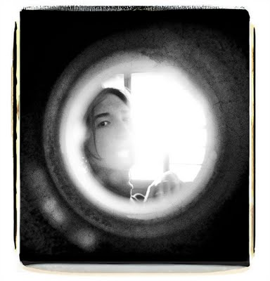
The Truth is Carefully Hidden From Us
For now we see through a glass darkly
( 1 Corinthians 13:12)

Slide 7
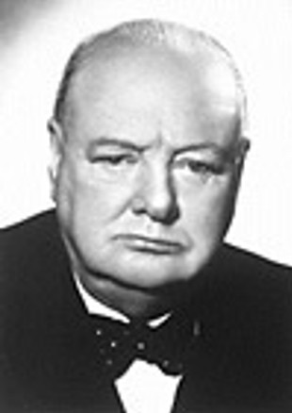
The Truth is Carefully Hidden From Us
"Men stumble over the truth from time to time, but most pick themselves up and hurry off as if nothing happened."
Winston Churchill
Notes:
TSAR NICHOLAS II LAST Emperor of the Third Rome First cousin to King George V of England First cousin to Kaiser Wilhelm II of Germany TSAR NICHOLAS II LAST Emperor of the Third Rome First cousin to King George V of England First cousin to Kaiser Wilhelm II of Germany TSAR NICHOLAS II LAST Emperor of the Third Rome First cousin to King George V of England First cousin to Kaiser Wilhelm II of Germany

Slide 8
An alien power has usurped authority both in Great Britain, the US and in other Western countries

Slide 9
The British ‘Bobby’
Our Police were once famed around the world for being unarmed and both fair and helpful.
They were also renowned for being incorruptible – applying the law of the land without fear or favour.
All this has now changed!
Dixon of Dock Green Photo courtesy of BBC

Slide 10
We are now fast becoming a Police State

Slide 11
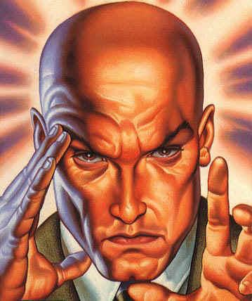
Gog – A Covert Assault Enables A Great Spoil To Be Taken
If you were extremely clever and worldly wise and you wished to invade another country and gain control of that Nation's wealth, what would be the most effective way to accomplish that end?

Slide 12
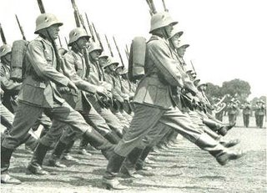
Gog – A Covert Assault Enables A Great Spoilt To Be Taken
A military invasion is too crude:
1St, the country may be largely destroyed and it's wealth generating productivity severely impaired.

Slide 13
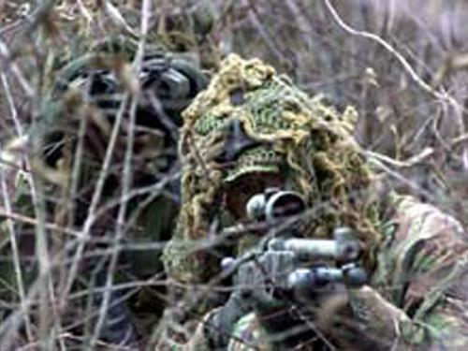
Gog – A Covert Assault Enables A Great Spoilt To Be Taken
2nd an occupation army would be expensive to maintain and would spend most of it's time fighting national patriot guerrilla armies.

Slide 14
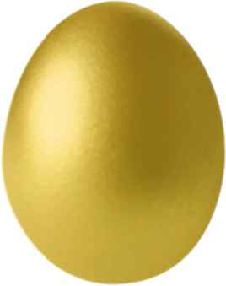
Gog – A Covert Assault Enables A Great Spoilt To Be Taken
…. This continual fighting would further diminish the wealth generating ability of the conquered Nation. The military approach would be like killing the goose that laid the golden egg.

Slide 15
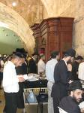
Gog – A Covert Assault Enables A Great Spoilt To Be Taken
The best invasion is one that no one is aware has taken place! If you could quietly infiltrate your agents into the target country and place them in positions to tap that country's wealth unbeknown to that country's citizens, you could carry out a gigantic hold up with out firing a shot.

Slide 16
This Alien Influence Is Recognised Subconsciously
People, when talking, have a subconscious awareness of this alien influence by referring to it as “them & they” in conversation about things they are not happy with i.e.. “They” have raised the rent, taxes etc. What extra “they” give us in benefits we have to give it back to “them” as tax.

Slide 17
“They” Are Watching You!
The code word for “they” in the Media is “The Establishment”

Slide 18
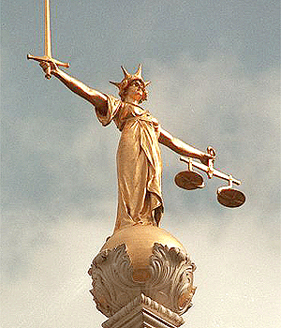
Gog – A Covert Assault Enables A Great Spoilt To Be Taken
Recent years has seen an insidious influence and impenetration, that by stealth is increasingly
supplanting our Common Law with Talmudic

Slide 19
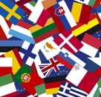
Gog – A Covert Assault Enables A Great Spoilt To Be Taken
We shall see as we progress through this series – this is precisely what has been achieved by Gog working by stealth over many centuries when they now have almost 100% control of all the Israelite and Adamic nations.

Slide 20
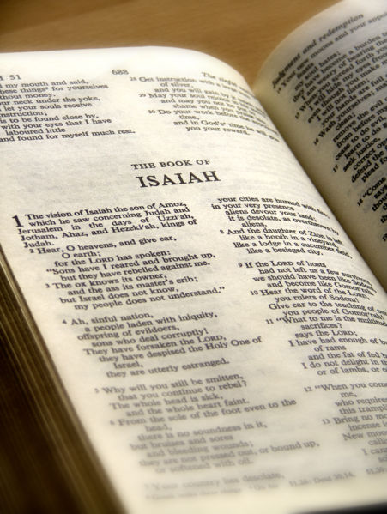
Gog – A Covert Assault Enables A Great Spoilt To Be Taken
We have the assurance of the Word that this conspiracy will be brought to nought.

Slide 21
Government Of The Israel Nations Over many Centuries Has In Varying Degrees Been Rooted In Divine law
In consequence of which our nation has declined Morally, spiritually and physically.
This presentation will seek to unmask the alien influence responsible for our decline.

Slide 22
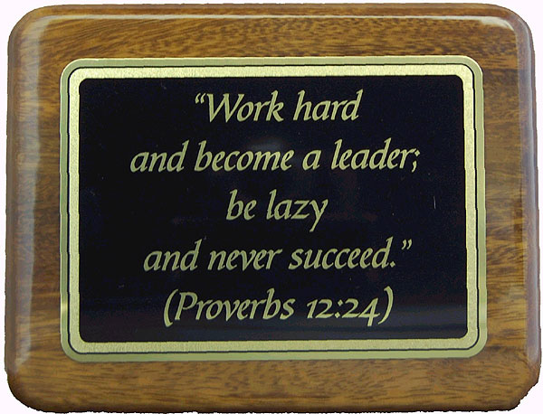
God Conceals (As Well Reveals)
It is the glory of God to conceal a thing, but the glory of kings to search out a matter. Proverbs 25 : I.
We need to study the Scriptures diligently including historical documents in order to see how prophecy has, is and will be fulfilled.

Slide 23
Scripture Is Largely About Government

Slide 24
Gog of The Land of Magog
Introduction
The Story of
As Foretold By God Through His Prophets
And Recorded in The Holy Scriptures

Slide 25
Gog of The Land of Magog
This is The Story of
His Prolonged Assault on The Christian West (Israel - The New Jerusalem in the West) Over Many Centuries during The Latter Days

Slide 26
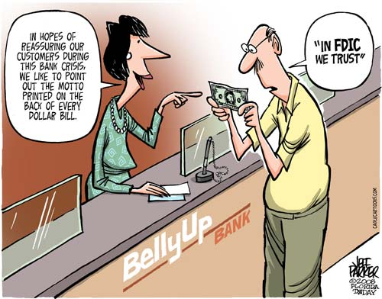
Gog of The Land of Magog
The Story of
This is a Story of Deception on a Grand Scale
Destroying the Countries in which they Settled Like Parasites and Assigning Their Crimes to The Nationals of Those Countries

Slide 27
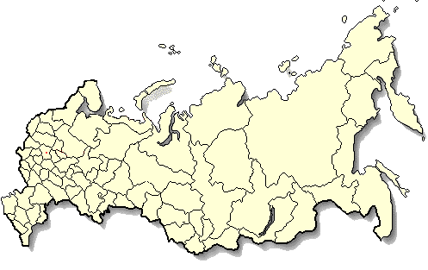
Gog of The Land of Magog
This is The Story of
There are extant today various interpretations of this prophecy of the so-called Russian chapter of Ezekiel with most projecting it into the future with Russia and all nations attacking “Israel” in the Middle East culminating in Armageddon. (Land of the re-gathered) Moreover, this is seen as a single event over a relatively short period of time.

Slide 28
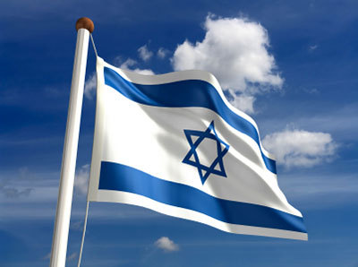
This is The Story of Gog of The Land of Magog
That it has and is being fulfilled under our very noses through clever manipulators and false flag operations carried out over many centuries.
In the following presentation I will endeavour to show that there is another more sinister interpretation to this prophecy.

Slide 29
This is The Story of Gog of The Land of Magog
Much of the information given in this presentation has been gleaned from stalwart Bible and BI expositors more learned than myself. All I have done is fit the jigsaw pieces together to form the overall picture as I see it, and this is being shared with you now.

Slide 30
Gog of The Land of Magog
This is The Story of
I would take this opportunity to acknowledge with grateful thanks to those listed below for their diligent research on matters appertaining to this prophecy which has enabled this presentation to be made.

Slide 31
Gog of The Land of Magog
This is The Story of
Frank Dowsett ( Covenant Vision Ministries – Australia)
The Late Jack Mohr (America’s Promise Ministries – USA )
Clifton Emahiser (Bible Teaching Ministries)
Rev. William P.Gale (Children of Yahweh)
The Late Willie Martin
Orange Street Congregational Church Library
The Late Harold Stough

Slide 32
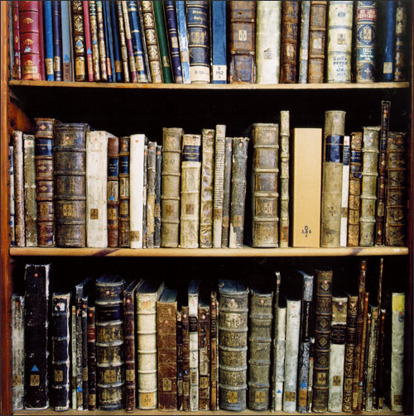
This is The Story of Gog of The Land of Magog
This acknowledgement in no way infers their acceptance of this interpretation.

Slide 33
Gog of The Land of Magog
The Story of
Analysis of Ezekiel 38 : 15
First half of verse
And Thou (Attila/Genghis Khan) Shalt Come From Thy Place Out Of The North Parts, Thou And Many People With Thee All Of Them Riding Upon Horses, A Great Company, And A Mighty Army

Slide 34
Thou And Many People With Thee All Of Them Riding Upon Horses, A Great Company, And A Mighty Army
The horse cavalries of Genghis Khan

Slide 35
Gog of The Land of Magog
The Story of
Second half of verse
And Thou Shalt Come Up Against My People of Israel, As A Cloud To Cover The Land: It Shall Be In The Latter Days, And I Will Bring Thee Against My Land That The Heathen May Know Me, When I Shall Be Sanctified In Thee, O Gog, Before Their Eyes.

Slide 36
Gog of The Land of Magog
The Story of
This verse indicates an assault in two phases (over many centuries):-
First Phase – Frontal and in the open
Second Phase – Covertly and under cover

Slide 37
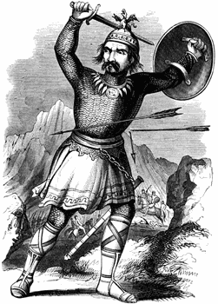
This is The Story of Gog of The Land of Magog
The first part of this prophecy has, I believe, been fulfilled by the savage incursions of the fierce wild and cruel armies of horse cavalries of Attila and Genghis Khan

Slide 38
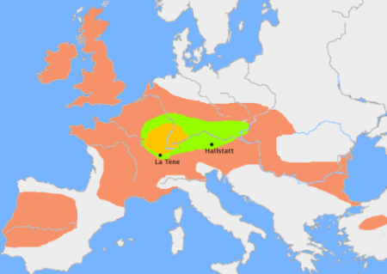
This is The Story of Gog of The Land of Magog
These incursions coincided with the migrations of the “lost tribes” of Israel and probably had the effect of speeding and forcing the tribes westward to the strongholds of their brethren.
The First Wave of Celts (Israelites)

Slide 39
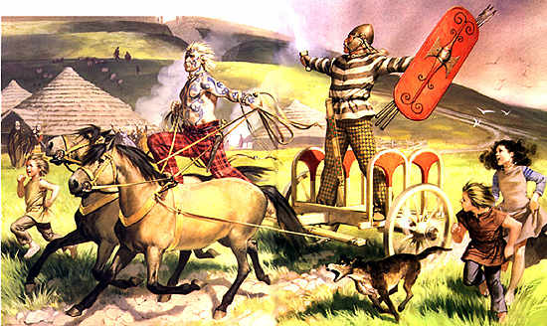
This is The Story of Gog of The Land of Magog
We shall see in the next slide most of Europe was home to the tribes of Israel under various new names.

Slide 40
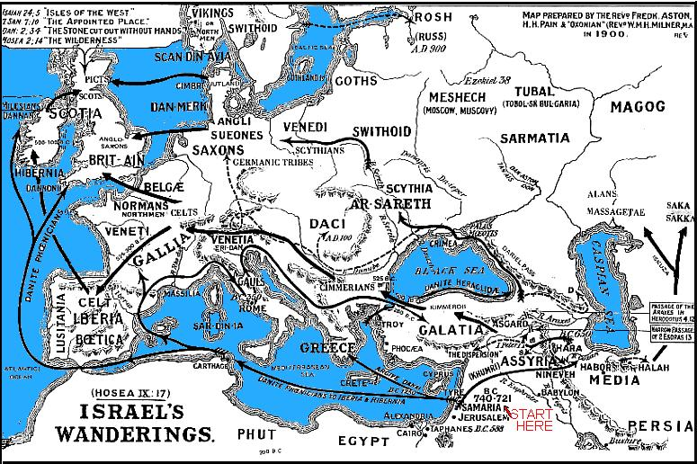
Western & Eastern Europe Filled With Migrating Israel

Slide 41
Western & Eastern Europe Filled With Migrating Israel
Here we see another depiction from secular sources of the “Lost Tribes” migration into Europe – the 10 horns of the Beast of Revelation (that is the beast people were controlling the horns of Israel Government)

Slide 42
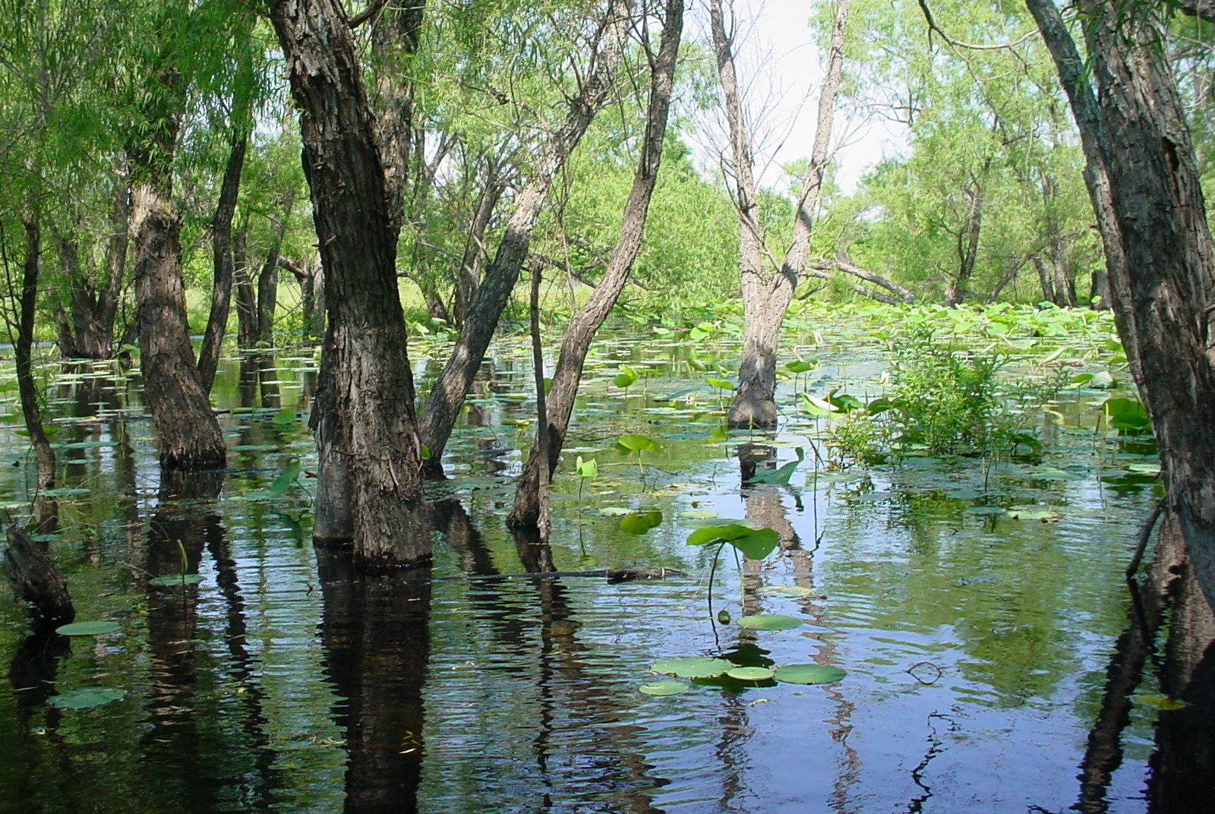
Western & Eastern Europe Filled With Migrating Israel
It should also be noted that during the period Israel was in Egypt – Europe was cut off by swamps and water from Asia, and was a wilderness – it was possible in those days to sail from the Black Sea to the Baltic

Slide 43
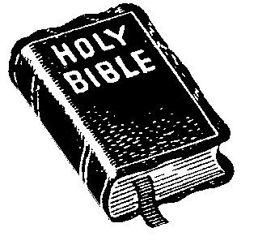
Decoding Ezekiel 38 : 15
To discover what this encrypted prophecy really means, we need to study a number of key words in this verse:-
1) Magog
2) Gog
3) Latter Days
4) Up as a cloud
5) To cover the earth
6) My Land
7) My People
Notes:
In order to get their freemasonry growing and gaining members they have always kept their hate for royalties and nobilities hidden for those groups. They have even allowed kings, dukes, lords and other nobilities to act as Master of Grades/Lodges just to get their support for freemasonry and to get members, but the real Leaders of freemasonry have been and are Jews. France during the 18. century. King Louis, XV son of King Louis XIV, was against all kind of freemasonry. He even prohibited it from France in 1737. By then freemasonry had been in France since 1717. In order to get their freemasonry growing and gaining members they have always kept their hate for royalties and nobilities hidden for those groups. They have even allowed kings, dukes, lords and other nobilities to act as Master of Grades/Lodges just to get their support for freemasonry and to get members, but the real Leaders of freemasonry have been and are Jews. France during the 18. century. King Louis, XV son of King Louis XIV, was against all kind of freemasonry. He even prohibited it from France in 1737. By then freemasonry had been in France since 1717. In order to get their freemasonry growing and gaining members they have always kept their hate for royalties and nobilities hidden for those groups. They have even allowed kings, dukes, lords and other nobilities to act as Master of Grades/Lodges just to get their support for freemasonry and to get members, but the real Leaders of freemasonry have been and are Jews. France during the 18. century. King Louis, XV son of King Louis XIV, was against all kind of freemasonry. He even prohibited it from France in 1737. By then freemasonry had been in France since 1717. tIn order to get their freemasonry growing and gaining members they have always kept their hate for royalties and nobilities hidden for those groups. They have even allowed kings, dukes, lords and other nobilities to act as Master of Grades/Lodges just to get their support for freemasonry and to get members, but the real Leaders of freemasonry have been and are Jews. France during the 18. century. King Louis, XV son of King Louis XIV, was against all kind of freemasonry. He even prohibited it from France in 1737. By then freemasonry had been in France since 1717. In order to get their freemasonry growing and gaining members they have always kept their hate for royalties and nobilities hidden for those groups. They have even allowed kings, dukes, lords and other nobilities to act as Master of Grades/Lodges just to get their support for freemasonry and to get members, but the real Leaders of freemasonry have been and are Jews. France during the 18. century. King Louis, XV son of King Louis XIV, was against all kind of freemasonry. He even prohibited it from France in 1737. By then freemasonry had been in France since 1717.

Slide 44
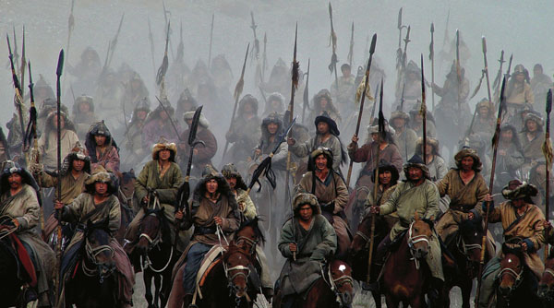
Decoding Ezekiel 38 : 15 The Name Magog
MAGOG is synonymous with MONGOL
MONGOU in India (from Mogh-ul-Mgg) i.e. The Mogul Empire.
These words are derived from the root – Mgg & Mng (Ming)
Famous historian Gibbon noted this derivation of the word Mongol

Slide 45
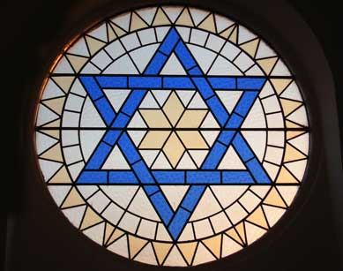
The Name - Gog (We have been given a clue!)
Decoding Ezekiel 38
Synagogue
Syna (Synod) = Assembly
Gogue = Gogii = a people from Mongolia/Russia.
Therefore synagogue means an assembly of Gog’s People.
Notes:
The masters of the Temple in Jerusalem even changed the name of the local temples to a synagogue, which was totally wrong, because "gogue" (or Gog) was an offshoot of Asia and was a name applied to the areas of Russia, and the Russian steppes. And "syna," from which the word synod is derived, refers to an assembly. So when they say synagogue they mean an assembly of Gogites. But considering the racial background of the Shamah Pharisees (the false Pharisee) and the Sadducees, who controlled the Temple in Jerusalem at that time, you can understand why they changed the name of the temples of Israel to synagogues.

Slide 46
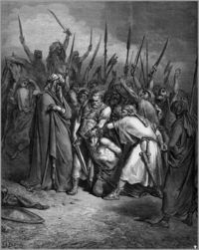
Decoding Ezekiel 38 The Name - Gog
Death of King Agag
A number of Bible versions refer to Agag King of the Amalekites as either Agog or Gog which further associates the name with Amalek-Edom or modern day Jewry whom Yahweh would have war with from generation to generation. Exodus 17:16
The Hebrew word for Gog is “Gowg” means "roof, covering, or mountain." As we shall see later under coming up as a cloud means covert or in secret. Mountain would also tie up with the other biblical name for Edom, that is mount Sier

Slide 47
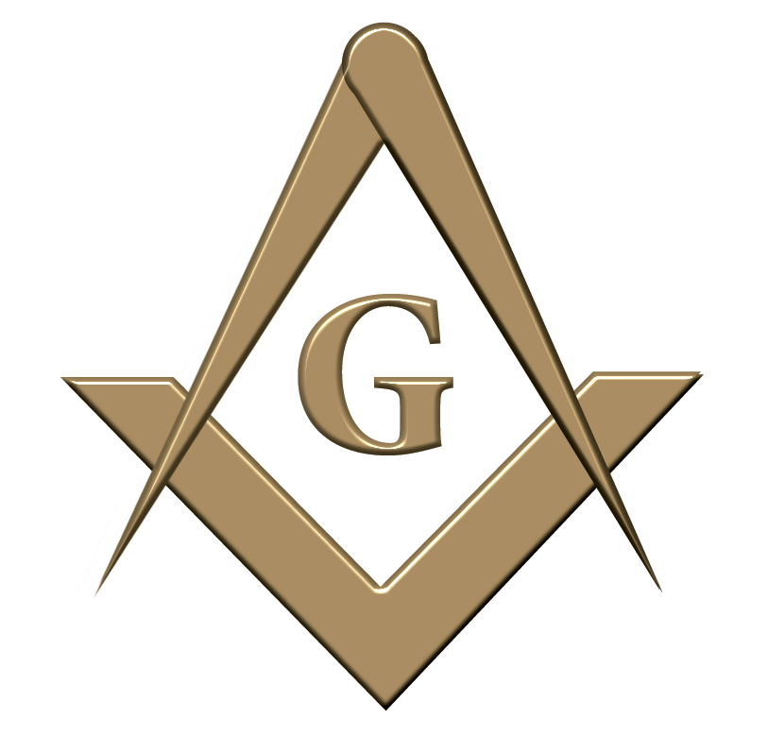
Decoding Ezekiel 38 The Name - Gog
The Hebrew word for Gog is “Gowg” means "roof, covering, or mountain." As we shall see later under coming up as a cloud means covert or in secret. Mountain would also tie up with the other biblical name for Edom, that is mount Sier

Slide 48
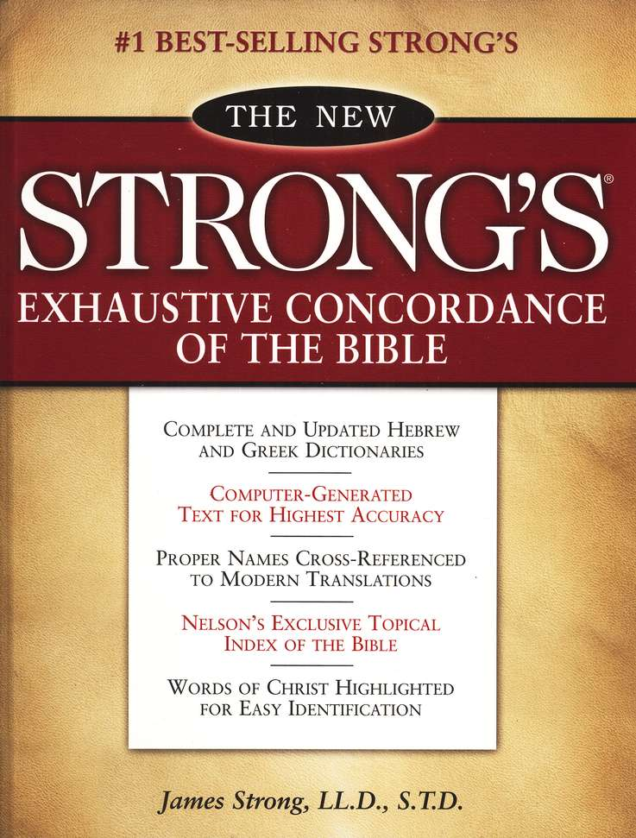
Synagogue = Town Hall
Synagogue is a word which appears often in the Greek New Testament. It is not a Hebrew word, a Yiddish word, nor a Jewish word. It is a Greek word. It is #4864 in Strong's Greek Concordance

Slide 49
Synagogue = Town Hall
-- pronounced syn-a-go-gay. It simply means "an assembly" or what would equate to our town hall or administrative centre from which the law would be
administered by the elders (Aldermen) and officials – the Gogue Edomites had taken control of these institutions in Christ’s time hence the derivation of the name as we saw earlier.

Slide 50
Names Associated With Gog
TUBAL-CAIN - the smith (of cutting instruments) - Nelson’s Ilustrated Bible Dictionary [tubal = tumult] --- H8423 offspring of Cain (outflow of Cain)
A 5 Pointed Star Was The National Emblem of The Idumeans
Interestingly Tubal-Cain is the password for 9th degree Masons!
Red Stands for Edom (Esau) – “Big Brother” – Hence the saying big brother is watching you!

Slide 51
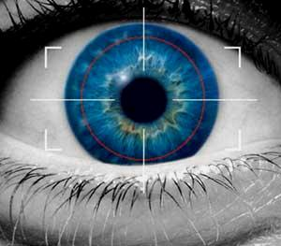
The Cloud Of Ezekiel 38
These words can imply to “hide”, “conceal” or “to act covertly”. Covertly means something done in secret. Undercover and in concealment” in the 9th and 16th verses of Ezekiel 38.
These two verses only reinforce the idea that this invasion will be done undercover rather than in the open.

Slide 52
The Cloud
Decoding Ezekiel 38
Now let’s take a look at the Hebrew meanings for these two words, “cloud” and “cover”: (1) cloud: #6051, aw-nawn’; from 6049; a cloud (as covering the sky),
Undercover
As Mist Fills a Valley
Notes:
Note: You will notice that I did not quote Ezekiel 38:9, 16 “like a cloud to cover the land” or “as a cloud to cover the land” as you find in most Bibles. Even The Interlinear Bible, Hebrew-Greek-English, by Hendrickson, translates these two verses that way. After some research on the words “cloud” and “cover”, I discovered these words can imply to “hide”, “conceal” or “to act covertly”. Covertly means something done in secret. From the meanings of these two words, you can see why I chose to use the words, “hiding under concealment” and “hiding undercover and in concealment” in the 9th and 16th verses of Ezekiel 38. These two verses only reinforce the idea that this invasion will be done undercover rather than in the open.
Now let’s take a look at the Hebrew meanings for these two words, “cloud” and “cover”: (1) cloud: #6051, aw-nawn’; from 6049; a cloud (as covering the sky), i.e. the nimbus or thundercloud: - cloud (y).
In order to understand this one, we are going to have to find out what #6049 means. #6049: aw-nan’; a primitive root: to cover over; figuratively to act covertly, i.e. practice magic: X bring enchanter, Meonemin, observe (-r of) times, soothsayer, sorcerer.
Now we will consider, cover, #3680: kaw-saw’; a prime root; properly to plump, i.e. fill up hollows; by implication to cover (for clothing or security):- clad self, close, clothe, conceal, cover (self), (flee to) hide, overwhelm.
From the study of the Hebrew meanings of the above words, it is obvious that there can be more than one meaning for them. We could take it as meaning, because of the great number involved, that they would literally cover the entire surface of the United States but I believe, in this case, it is speaking about one great big covert (undercover) operation.

Slide 53
Gog – As A Cloud
The second phase of the invasion would be as a cloud covereth the earth i.e.
Cover + t = Covert

Slide 54
The Cloud
Decoding Ezekiel 38
A typical mountain scene of mist climbing ever higher from the valley bottoms to eventually to cover the highest mountain tops – as described in Ezekiel 39

Slide 55
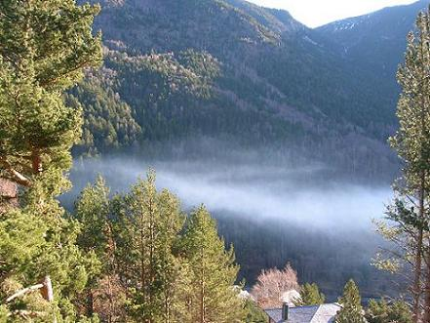
Decoding Ezekiel 38 The Cloud
As well as an undercover operation – this verse could well describe the means of assault.
It is like an autumn mist, which starts at the lowest point of a valley – maybe just 1ft high – it then gradually gets higher and higher until all the valley is enveloped and nothing can be seen at all!
A typical mist rising in the valley

Slide 56
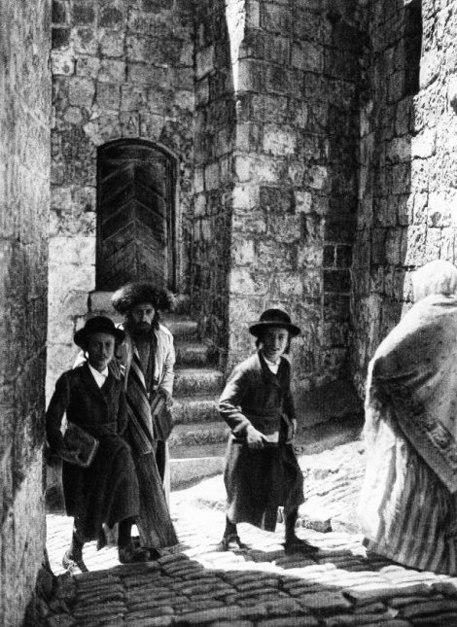
The Cloud
Decoding Ezekiel 38
This is how the Jews (GOG) infiltrated the West – first in small numbers in menial jobs, and then by hard work and a zeal for wealth domination in greater numbers and in, becoming very wealthy by changing their names to blend in with the native population, thus were no longer visible as aliens.

Slide 57
An important event took place in Constantinople in 1492 AD

Slide 58
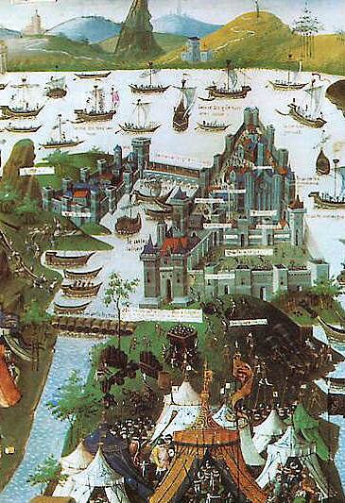
The Cloud Of Ezekiel 38
Decoding Ezekiel 38
We shall now look at this particular event that took place in Constantinople in the year 1492 AD after the Jews were expelled from their last European stronghold of power and wealth in Spain

Slide 59
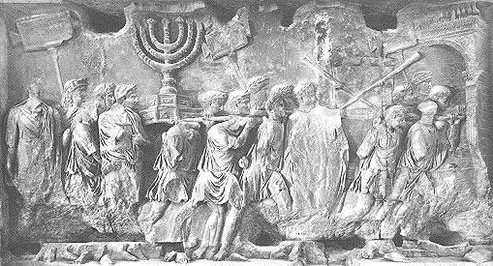
Gog – Grand Edict of 1492
A Potent Stimulus To Re-Colonise The West.
One notorious example is the response to the chief rabbi of Spain by the Grand Sanhedrin in Constantinople in 1492, following the general expulsion of Jews by Ferdinand. The Grand Satraps and Rabbis issued (condensed) six-point protocol for Jews who wished to remain in Spain:-

Slide 60
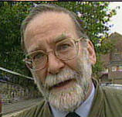
Gog – Grand Edict of 1492
1). Convert to Christianity;
2). Become merchants and take the Christians' property from them;
3). Become doctors and apothecaries and kill Christians medically;
Doctor Harold Shipman (Jew) – Killed several hundred of his patients

Slide 61
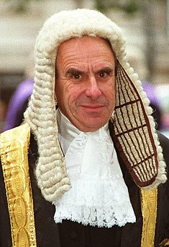
Gog – Grand Edict of 1492
4). Become priests and destroy the Church from within;
5). Become lawyers, mix in affairs of State and by putting Christians under your yoke you may dominate the world and be avenged;
Senior Law Lord, Lord Hoffmann

Slide 62
Gog – Grand Edict of 1492
6). Do not swerve from this order and you will reach the actuality of power.

Slide 63
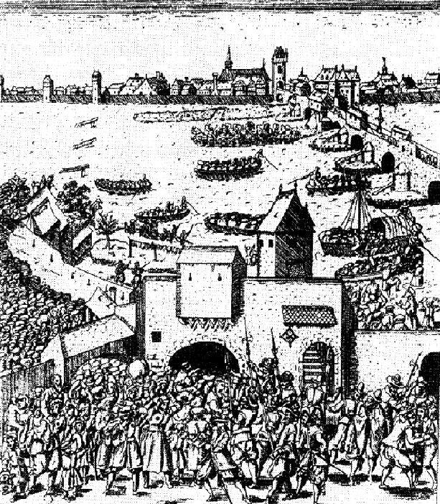
Decoding Ezekiel 38 Up ….. As A Cloud To Cover The Land
After the Jews expulsion from most European nations during the period 1100 AD to 1300 AD. They gradually started to filter back, taking very lowly positions such as rag merchants. Just like mist starting to rise in the valley.
Jews being expelled

Slide 64
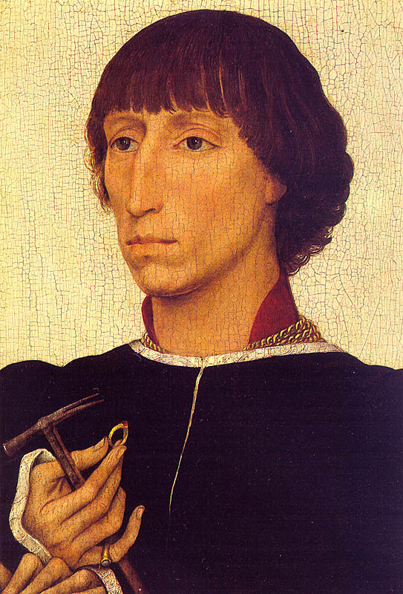
Decoding Ezekiel 38 Up ….. As A Cloud To Cover The Land
These were followed jewellery (artefacts of Jews) merchants and usurers.

Slide 65
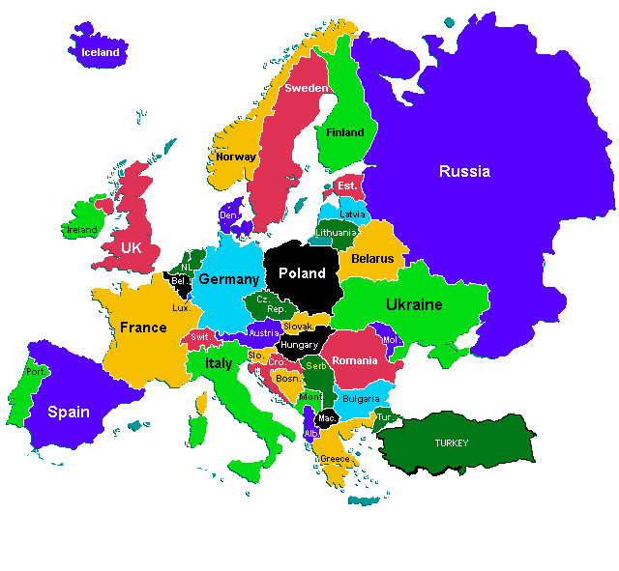
Up ….. As A Cloud To Cover The Land
Decoding Ezekiel 38
After the political upheavals in eastern Europe, they flooded into Poland and thence into the heartlands of Anglo-Saxondom of Germany, Scandinavia, France, Britain and The United States

Slide 66
My Land Gog’s Grand Deception
“It’s a Lie – Israeli” – has deceived the majority of Judeo-Christians that they are the re-gathered Holy People instead of the abomination of desolation as foretold in the Scriptures
Notes:
In Ezekiel 16:1-3 Yahweh says to the people of Jerusalem, "Son of man, cause Jerusalem to know her abominations, and say, thus saith Yahweh unto Jerusalem: Thy birth and nativity is of the land of Canaan: thy father was an Amorite, and thy mother an Hittite."
Ezekiel 11:14-15 where we read, "Again the word of Yahweh came unto me saying, Son of man, thy brethren, even thy brethren, the men of thy kindred, and all the house of Israel wholly, are they unto whom the inhabitants of Jerusalem have said, Get you far from Yahweh unto us is this land given in possession."

Slide 67
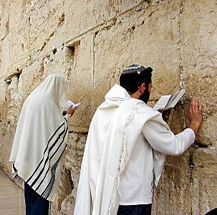
My Land Gog’s Grand Deception
“My Land” is now occupied by the enemy – The Edomite Khazar Jews

Slide 68
Decoding Ezekiel Latter Days
This in the sense of our use in speech of former & latter i.e. Before Christ BC & After Christ AD (latter days).
Christians have over the centuries been indicating this fact in correspondence but most have been blind to its import vis-à-vis bible prophecy.
A B.C. Calendar

Slide 69
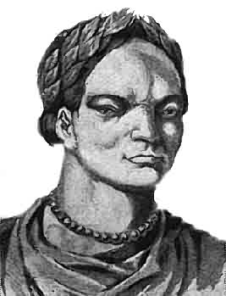
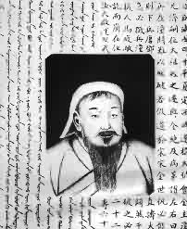
Decoding Ezekiel Latter Days
This is one reason Attila & Genghis Khan were not seen as fulfilling part of Ezekiel 38.
The other reason was that the true identity of God’s people or extent of their domain was unknown to all but a few
Attila
Genghis Khan

Slide 70
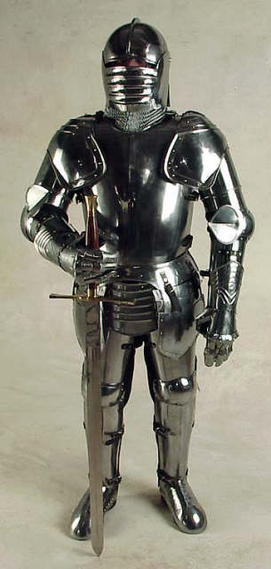
Gog’s Phased Attack on The West
1) 372 AD Attila The Hun & Others Routed in 500 AD by the Germans
2) 570/600 AD Islam starts to grow in power in the south and at about the same time the Khazars become an influential power in the east
3) 1066 AD Norman Invasion ( brought Jewish credit agreement -- shetar, or starr where a person’s home and lands could be taken in lieu of debt).
4) 1221 AD Genghis Khan

Slide 71
Gog’s Phased Attack on The West
5) Cromwell – Civil War ( Drives out the Catholics but lets in the Jews)
6) French Revolution.
7) Overthrow of The Papacy By Napoleon
8) The Russian Revolution
9) World War 1
10) World War 2
11) Korean War
12) Vietnam War
13) Gulf War
14) Serbia/Kosovo
15) Afghanistan War.
16) Iraq War

Slide 72
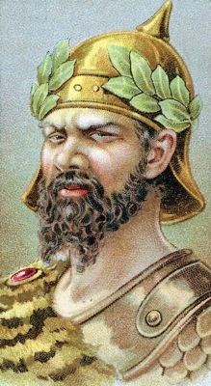
Gog’s Swathe of Death and Destruction
Part 1 – The Frontal Attack
In this Section we shall see how the first part of Ezekiel's prophecy has been fulfilled by Gog’s Gigantic armies of Horse Calvary led by Attila and Genghis Khan almost succeeding in destroying and overwhelming Christendom and Civilisation in Europe and the Near East which at that time were strongholds of Aryan Culture.
Attila

Slide 73
1) GOG - Attila the Hun. 372 AD
Attila the Hun. Leader of an Asiatic terror which swept across White Europe with such fury and cruelty that his name has remained to this day a byword for tyranny.
Image – After a Roman Depiction
Notes:
Above: Atilla the Hun. Leader of an Asiatic terror which swept across White Europe with such fury and cruelty that his name has remained to this day a byword for tyranny. After a Roman depiction

Slide 74
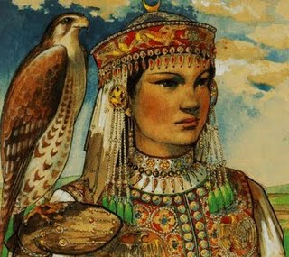
Alans – First White Tribe To Fall to Gog
This group was closely related to the ancient Medes, Persians and Aryans, all of whom had penetrated southwards and had slowly become mixed with the darker inhabitants of the regions they had conquered
A Lady In Alan Costume

Slide 75
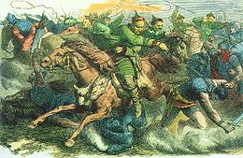
Alans – First White Tribe To Fall to Gog
In the year 372 AD, the easternmost White peoples in what is today Russia were the Sarmatians, or Alans.

Slide 76
The Alans Attacked
Asiatics, known as Huns, attacked the easternmost White tribes, the Alans, in 372 AD. Quickly annihilating the Alans, ….
Notes:
Above: The non-White terror: Asiatics, known as Huns, attacked the easternmost White tribes, the Alans, in 372 AD. Quickly annihilating the Alans, they marched east forcing the squabbling Whites - Romans, Germans and Goths - in Europe to unite and face the communal racial threat. An overt race war, fought across Europe, then followed, with the Huns being defeated at Troyes in central France and at Nedao in Central Europe. White Europe was nearly extinguished by this threat - above is a depiction of a scene which befell hundreds of thousands of Whites - a raiding non-White party attack a Roman villa, killing the males and carrying off the White women for sexual slavery.

Slide 77
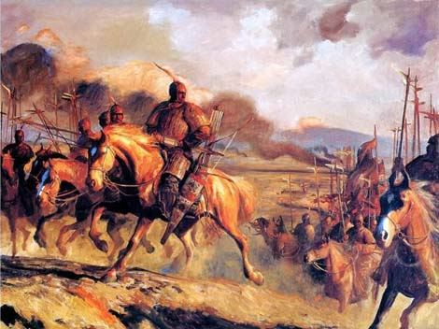
The Alans Attacked
…. they marched east forcing the squabbling Whites - Romans, Germans and Goths to unite to fight this invasion from the east.

Slide 78
Gog’s Swathe of Death and Destruction 372 – 500 AD
Left: The path of destruction waged by the first Mongol incursion in their rampage through Europe led by Attila. Untold thousands of Whites (Israelites?) perished at this time.
Starting Against The Alans The Most Easterly of The White Tribes in 372 AD

Slide 79
The Extent Of Attila's (Gog) Onslaught Against The West
Right: Europe under the non-White Huns: The dark area shows the extent of the Asiatic invasion. In addition to this, the Huns also launched attacks into France, Italy and into northern Greece.
372 AD Plan Showing Maximum Incursion into the West

Slide 80
Another Perspective Of Attila's (Gog) Assault Against The West
The black lines show deeper forays into the west

Slide 81
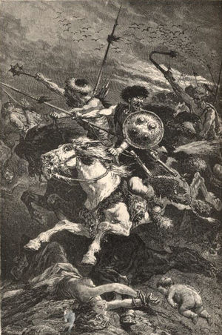
Germans Save Europe From The Hun (Gog)
The battle of Nedao became one of the most significant battles in White history, for without it Europe would most likely have been completely overrun by Asiatics before 500 AD.

Slide 82
The Hun (Gog) Retreats Circa 500AD
Nedao
Notes:
Suffering total defeat at the hands of the Germans, the vast majority of the surviving Asiatic Huns then fled back into the Far East, to the Sea of Azov in Russia - fearing the retribution by the Whites that would follow (a fear which was fully justified, as the enraged and victorious Whites mercilessly put to death any bands of Hun stragglers they found).

Slide 83
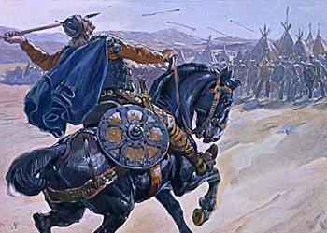
Germans Save Europe From The Hun (Gog)
The Germans, as victors over the Huns, became famous amongst their Indo-European racial cousins, with the Icelandic word for German to this day translating literally as "peoples' defender".
Notes:
Located in Bosnia

Slide 84
The Hun (Gog) Retreats Circa 500AD
Suffering total defeat at the hands of the Germans in the battle of Nedao, the surviving Huns fled back into the Far East, to the Sea of Azov in Russia.
Here they changed their name and became known as the Bulgars
Notes:
Suffering total defeat at the hands of the Germans, the vast majority of the surviving Asiatic Huns then fled back into the Far East, to the Sea of Azov in Russia - fearing the retribution by the Whites that would follow (a fear which was fully justified, as the enraged and victorious Whites mercilessly put to death any bands of Hun stragglers they found).

Slide 85
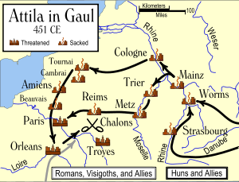
No Peace During The Two Major Hun Invasions
During this period from the retreat of Attila until the next great invasion from the east under Genghis Khan, Christendom would come under pressure from Gog via the south – Islam, Saladin and the Moors.
The extent of Attilia’s incursion before retreat

Slide 86
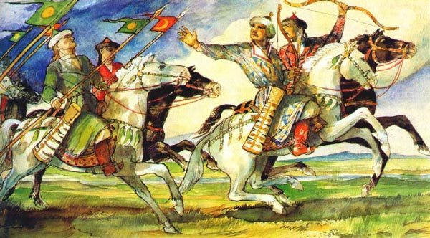
No Peace During The Two Major Hun Invasions
Although the major invasion of the Huns from the east had been routed – other incursions on a smaller scale continued; of particular note were the Magyars.

Slide 87
The Scourge Of The Magyars
Right: Magyar raiders set fire to a German homestead. The Magyars were eventually defeated, but small traces of their gene pool remain in a minority of the Slavic population today. This is particularly evident in modern south-eastern Russia.

Slide 88
Below: Magyars raiding a White settlement
An Asiatic race who burst over the Danube river at the close of the 10th Century, ravaging wide areas of central Europe.
Notes:
Above: Magyars raiding a White settlement. The Magyars were an Asiatic race who burst over the Danube river at the close of the 10th Century, ravaging wide areas of central Europe. Although they were to be ultimately driven out, a small number of their genes remained behind in the areas they subjugated - the origin of the small number of slightly Asiatic looking southern Slavs. This process was by no means complete, and of course huge numbers of Slavs retain the characteristics of their Indo-European forebears. Nonetheless, the impact of the Magyars was so great that in the Hungarian language to this day, the name for Hungary and Hungarian is still Magyar - although the original Asiatic Magyars have long since vanished.

Slide 89
The Defeat Of The Magyars
The destruction of the Magyars marked the end of the second great Asian invasion.
The next would occur in 1221 AD when an even more cruel leader would establish a reign of terror in Eastern and central Europe so terrible his name is a byword for tyranny today – Genghis Khan
Notes:
The defeat and dissolution of the Magyars marks the end of the second great Asian invasion - the next would occur in 1221, when an even more cruel Mongol leader would establish a reign of terror in eastern and central Europe so terrible his name is still a byword for tyranny today - Genghis Khan

Slide 90
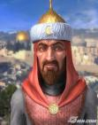
After The Retreat Of The Huns
Islam And Judaism Start To Grow In Power
Islam Arises In The Arabian Peninsular.
Islam a Force That Would Push Up From The South To Harass Israel and Force Further Consolidation.

Slide 91
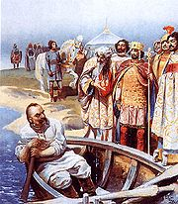
After The Retreat Of The Huns
Islam And Judaism Start To Grow In Power
The Kingdom of The Khazars Comes onto The Stage of World History – Probably a Residue of The Retreating Huns.
The Rise of the Khazars and Islam occurred within a short period of each other.
The Khazars

Slide 92
Following The Defeat of The Magyars
An even more deadly foe was arising from the ashes of the Mongol Empire – THE KHAZARS.
They would become the scourge of the West and Israel in particular.
Their satanic objective to destroy the white race and Christendom

Slide 93
Gog – The Rise Of The Khazars AD 576
A New Fierce Force of Mixed Race , Calling Themselves Khazars Invaded from the East and Forced The Bulgars into Bulgaria.
Khazars were made up of Mongolian, Arab and Old European Elements and began by Occupying Land East of the Dniester River by 650 AD.
Notes:
KHAZARS - FORCE BULGARS INTO BULGARIA
In 576 AD, a new force invaded from the east - a mixed race grouping calling themselves Khazars, occupied territory on the northwestern shore of the Caspian Sea in southern Russia.
Originally from Asia Minor (Turkey), the Khazars were the product of the integration process which had taken place in the Middle and Near East over a process of centuries. Made up of Old European, Semitic and Mongolian elements, the Khazars physically closely resembled many other peoples in that region.
The Khazars began to expand their territory westwards, occupying the land east of the Dniester River by 650 AD. In this process they drove the Bulgar Huns from the territory around the Sea of Azov, forcing them on into modern Bulgaria which they ruled for about 150 years and which bears their name to this day.

Slide 94
Gog – The Rise Of The Khazars
A bust of a Khazar warrior circa 800 - 1000 AD. This is a remarkably accurate statue, with the Asiatic influence being particularly marked with the eye shape and the protruding lower lip.
Did they always have their
eyebrows in the "angry" position?

Slide 95
Moslem Scholar Confirms Origin Of Gog & Magog
The great Muslim scholar, Ibn Kathir, stated that ‘Yajuj wa Ma’juj’ (Gog and Magog) – were the people who traditionally inhabited the area between the Black Sea and the Caspian Sea, which is where the Khazar Kingdom was originally situated -
Abu'l-Abbas Ahmad ibn Muhammad ibn Kathir al-Farghani Circa 833-900AD
Notes:
16952

Slide 96
Moslem Scholar Confirms Origin Of Gog & Magog
…. in his historical work, Al-Bidayah wa'l-Nihayah (The Beginning and the End), specifically states that "Gog and Magog” are two groups of Mongols/Turks

Slide 97
Khazaria – would become established: 350 – 627 A.D.
The area was well chosen – being on the cross roads of the major trade routes - it would be difficult to circumvent the Khazars 10% tribute on all goods passing through their territory.

Slide 98
Khazaria – Pre-History 350 – 627 A.D.
This Map shows The Ancient Major Trade Routes between Europe / China / India / Middle East and Africa converge on the area between the Black and Caspian Seas.
This is where the Khazaria (Jews) Kingdom was set up, in order to exact tribute from passing caravans.

Slide 100
The Extent of The Khazar Kingdom & Trade Routes 700 – 1016 AD
Notes:
Pollock believes the traditional Russian anti Semitism probably stems from that epoch when Hebrew‑speaking Khozar raiders. attacked Russian villages, killed the men folk, abducted women, forcibly converted them to Judaism and married them in full‑fledged religious ceremonies. This also would explain why so many European Jews are blond and blue‑eyed, with a slight Mongol slant to their eyes, as we'll as the total absence of Semitic features among many Israelis of European descent

Slide 101
The Khazar Empire In Relation To Europe
From this map one can appreciate Gog’s gigantic size relative to the European powers

Slide 102
Gog As Always Controls Trade
Each Camel Train coming into Khazaria would consist of 5000 camels carrying silk and other precious goods from China
A Camel Train

Slide 103
Gog As Always Controls Trade
Hosea 12:7, "He is a merchant, the balances of deceit are in his hand: he loveth to oppress". This verse records the merchant is a Kenaan, a merchant or Canaanite the terms are interchangeable

Slide 104
Nations neighbouring The Khazars

Slide 105
Khazars Outposts & Trade Routes
Map on left shows the Khazar trade routes and settlements.
Note that like today the Khazars had an outpost and settlement in London!
The Khazars – European Trade Routes

Slide 106
Khazars Outposts & Trade Routes
After the overthrow of the Khazar Empire, the Khazars reformed their north-western settlements into a domineering trading group - The Hanseatic League

Slide 107
Khazars Outposts & Trade Routes
The fortress of Birka at Borg in Sweden

Slide 108
Khazars Outposts & Trade Routes
A model of Birka, made by Swedish Television

Slide 109
The Pagan Khazars Convert To Judaism
In about 740AD, a stunning event took place. The Khazars had been under continual pressure from their Byzantine and Moslem neighbours to adopt Christianity or Islam, but the Khazar ruler, called the Khakan, had heard of a third religion called JUDAISM.

Slide 110
The Pagan Khazars Convert To Judaism
Apparently for political reasons of independence, the Khakan announced that the Khazars were adopting Judaism as their religion. Overnight an entirely new group of people, the warlike Khazars, suddenly proclaimed themselves Jews - adoptive Jews.

Slide 111
The Pagan Khazars Convert To Judaism
The Khazar kingdom began to be described as the 'Kingdom of the Jews' by historians of the day. Succeeding Khazar rulers took Jewish names, and during the late 9th Century the Khazar kingdom became a haven for Jews of other lands

Slide 112
Khazar Slave Traders ORIGIN OF THE WORD SLAVE
With The Khazar Conversion to Judaism The Slave Trade Became Firmly Established in the East.
Nothing Changes!! – Tel-Aviv is the Capital of the so-called White Slave Trade today!!
Notes:
KHAZAR SLAVE TRADERS - ORIGIN OF THE WORD SLAVE
Even before their conversion to Judaism, the Khazars, like the Huns and other Asiatics, were active slave traders. The Slavs however bore the brunt of the Khazar slave catching expeditions - so much so that the word slave was to derive from the word Slav - and with the Khazar conversion to Judaism, an association of Judaism with slave trade in the east became firmly established. This was the origin of the association of Jews with slave trading - an allegation which had some basis in fact at this stage in history.

Slide 113
Khazar Slave Traders ORIGIN OF THE WORD SLAVE
The Slavs bore the brunt of the Khazar slave catching expeditions - so much so that the word slave was to derive from the word Slav.
Don Quixote releases slaves

Slide 114
The Story of
A Khazar Capturing a Slav for Their Slave Trade

Slide 115
Surnames Associated With The Khazar Kingdom
Karagn-Hargan, King Bulans Chief Minister - Halperin, Alpert, Galpern etc., Kaplan, Caplon, Koppel and the Like are Positive proof of Khazar Descent. Kogan, Kagen, Hargan Show Aristocratic descent.
Notes:
How can one find out If he is a Khozar Jew" or a Hebrew Jew? According to Pollock, whose parents came from Poland, if your name is Halperin, Alpert, Halpern, Galpern, etc... you are a 100 percent Khozar. Alper means “brave knight” in the Khosar tougne, and the name was granted by the King to the most distinguished warriors. Names like Kaplan, Caplon, Koppel, and the like are positive proof of Khosar descent, according to the scholar. “Kaplan” means “fierce hawk” in the Khosar language. Kogan, Kagan, Kaganovich show aristocratic descent from Kagan-Hargan, King Bulan’s chief minister.

Slide 116
Destruction Of The Khazars - 965 AD
964 AD, Oleg's grandson, Svyatoslav, became ruler of the Rus.
He was a fierce warrior who adhered strictly to his Scandinavian upbringing.
He set his first task as the destruction of the Jewish Khazar Empire in the south.
Svyatoslav
Notes:
DESTRUCTION OF THE KHAZARS - 965 AD
In 964 AD, Oleg's grandson, Svyatoslav, became ruler of the Rus. A fierce warrior who adhered strictly to his Scandinavian upbringing - even refusing to become a Christian after his mother had converted - Svyatoslav set as his first task the destruction of the Jewish Khazar empire in the south.
In 965, the Rus army under Svyatoslav, crashed through the Khazar borders and utterly defeated the Jewish slave trading empire forever. The Khazars who survived this great assault were scattered throughout the region, with many moving west into what became western Russia and Poland. There they re-established Jewish communities and absorbed some Nordic elements (mainly through marrying Jewish women to non-Jewish men; Jewish law dictating that only persons born of a Jewish mother can be classified as a Jew), creating the basic stock of today's modern European Jews, known as the Ashkenazim.

Slide 117
Destruction Of The Khazars - 965 AD
Jewish Ghetto - Warsaw
Svyatoslav utterly defeated the Jewish slave trading empire forever.
The Khazars who survived this great assault were scattered throughout the region, with many moving west into what became western Russia and Poland.
They re-established Jewish communities in these lands.
Notes:
DESTRUCTION OF THE KHAZARS - 965 AD
In 964 AD, Oleg's grandson, Svyatoslav, became ruler of the Rus. A fierce warrior who adhered strictly to his Scandinavian upbringing - even refusing to become a Christian after his mother had converted - Svyatoslav set as his first task the destruction of the Jewish Khazar empire in the south.
In 965, the Rus army under Svyatoslav, crashed through the Khazar borders and utterly defeated the Jewish slave trading empire forever. The Khazars who survived this great assault were scattered throughout the region, with many moving west into what became western Russia and Poland. There they re-established Jewish communities and absorbed some Nordic elements (mainly through marrying Jewish women to non-Jewish men; Jewish law dictating that only persons born of a Jewish mother can be classified as a Jew), creating the basic stock of today's modern European Jews, known as the Ashkenazim.

Slide 118
Destruction Of The Khazars - 965 AD
The Jews absorbed some Nordic elements mainly through marrying Jewish women to non-Jewish men.
Jewish law dictates that only persons born of a Jewish mother can be classified as a Jew.
This mongrelised people became the basic stock of today's modern European Jews, known as the Ashkenazim.
Notes:
DESTRUCTION OF THE KHAZARS - 965 AD
In 964 AD, Oleg's grandson, Svyatoslav, became ruler of the Rus. A fierce warrior who adhered strictly to his Scandinavian upbringing - even refusing to become a Christian after his mother had converted - Svyatoslav set as his first task the destruction of the Jewish Khazar empire in the south.
In 965, the Rus army under Svyatoslav, crashed through the Khazar borders and utterly defeated the Jewish slave trading empire forever. The Khazars who survived this great assault were scattered throughout the region, with many moving west into what became western Russia and Poland. There they re-established Jewish communities and absorbed some Nordic elements (mainly through marrying Jewish women to non-Jewish men; Jewish law dictating that only persons born of a Jewish mother can be classified as a Jew), creating the basic stock of today's modern European Jews, known as the Ashkenazim.

Slide 119
Gog’s Breeding Programme
The Gogi are now almost indistinguishable from true Israelites/Adamites
This can be demonstrated in the House of Rothschild
Jacob Rothschild 1990 – could now pass for a typical English squire
Meyer Bauer founder of the Rothschild dynasty 1790
The House of Rothschild will be studied in greater detail in part 4 of this presentation

Slide 120
Origin of the Jews
They were originally Khazars a warlike tribe who lived in the land of Magog. An area deep in the heart of Asia.

Slide 121
Origin of the Jews
Not many know that the word "jewish" only shows up ONE TIME in the entire text of the BIBLE. Use any concordance. The only time it shows up is right here in:

Slide 122
Origin of the Jews
Titus 1:14 "Not giving heed to Jewish fables, and commandments of men, that turn from the truth."

Slide 123
Gog & Zionism
Rabbi Teitelbaum: "Zionism, an invention of Satan."
Zionists actively promote their political aims in the countries in which they have settled

Slide 124
Gog & Zionism
Rev. 2:9 "I KNOW YOUR WORKS, AND TRIBULATION AND POVERTY, (BUT YOU ARE RICH) AND I KNOW THE BLASPHEMY OF THEM WHICH SAY THEY ARE (Israel) AND ARE NOT, BUT ARE THE SYNAGOGUE OF SATAN
An Assembly of Jews

Slide 125
The Gogi Worship A different God
As part of the deception of True Israel, and contrary to the teachings of the Bible, Judaism forbids the use of God’s name, Yahweh.

Slide 126
The Gogi Worship A different God
Christians have to ask: “Why would God’s purported ‘chosen people’ disobey their own God by refusing to use His name at all? Well, since the Jews aren’t God’s people, it is easy to understand why they don’t use His name.

Slide 127
The Gogi Worship A different God
The Gogi removed the Sacred Name from the Bible and substituted titles instead - like God and Lord instead of the sacred name “YHWH” – this would pave the way for future infiltration into and the eventual takeover of the Christian Churches of all denominations.

Slide 128
The Gogi Worship A different God
They could now masquerade as true Christians without breaking their sacred rule of not uttering the name of the creator of all things - YHWH

Slide 129
The Gogi Worship A different God
True Israel made the fatal mistake of engaging Jewish Rabbis to help with the translation of the word for their supposed knowledge of Hebrew.

Slide 130
Gog’s Holy Book Is Not The Bible
It is the Babylonian Talmud, which after long labours by many hands had been completed on December 2, 499. AD which Christ referred to as The Tradition Of The Elders

Slide 131
Some Of Gog’s Agents Who Have Infiltrated The Church
Billy Graham (Jew) – real name Frank
John Calvin (Jew) – real name Cohen
Dr. C. I. Scofield (Jew)

Slide 132
Some Of Gog’s Agents Who Have Infiltrated The Church
Isaiah 56:9-11
10 His watchmen are blind: they are all ignorant, they are all dumb dogs, they cannot bark; sleeping, lying down, loving to slumber.

Slide 133
Some Of Gog’s Agents Who Have Infiltrated The Church
Isaiah 56:9-11
11 Yea, they are greedy dogs which can never have enough, and they are shepherds that cannot understand: they all look to their own way, every one for his gain, from his quarter.

Slide 134
Some Of Gog’s Agents Who Have Infiltrated The Church
Scriptures refer to these false shepherds as DUMB DOGS. Those who qualify after attending a theological college append DD (Doctor of Divinity) to their names, which equally could stand for “dumb dogs”
Appropriately they also wear “dog collars”, as above. (A UK nickname)

Slide 135
Some Of Gog’s Agents Who Have Infiltrated The Church
By calling the false shepherds dogs, this is telling us who they are! Namely, the Canaanites who were referred to as dogs in the scriptures. They have been busy infiltrating our centres of learning including theological colleges over the centuries.
Dumb Dog

Slide 136
Some Of Gog’s Agents Who Have Infiltrated The Church
Interestingly, even today the Latin name for the dog family is CANIS pronounced - cain-is

Slide 137
Origin of the Jews
92% of the world’s population of people who call themselves Jews were originally Khazars.

Slide 138
Origin of the Jews
As we have seen they set up a large Khazar Kingdom covering some 800,000 sq Miles in southwest Asia.
They were so warlike that even the Asiatics drove them out into Eastern Europe.
Russ prince Svyatoslav of Kiev Who destroyed the Khazar Kingdom

Slide 139
Origin of the Jews
The Hebrews called the descendents of Shelah “yehudi” – The cursed ones who had mongrelised with descendents of Esau who had taken Canaanite wives.
Notes:
They were called by the Israelites in their Hebrew language “Yehudi”. The name in Hebrew meant “the cursed ones”. These people were the descendents of Shelah, a mongrelized son of Judah by Shua from centuries previous when Judah had left his father’s land and had committed the adultery. They were joined with the mongrelized descendents of Esau who had taken Canaanite wives in the days of Jacob and all were called “Yehudi”. The “Yehudi” lived in Southern Judea by and to themselves. They were not permitted in Northern Judea or in Jerusalem nor to mix with the Israelites because they were descendents of Cain with whom the Israelites from Ancient times had been told not to mix. After many years, the ten tribes known as the nation of Israel were taken into captivity to the North by the Assyrians (Yehudi).

Slide 140
Origin of the Jews
One can see how Yehudi – Jew – Judah are phonetically close.
The Yehudi lived in Southern Judea and weren’t allowed into Northern Judea

Slide 141
Jews Not Israel!
False Prophets Exposed By Arthur Koestler In His Book “The Thirteenth Tribe”

Slide 142
Nothing Changes!! Communists (Jews) Still Kill and Imprison Christians
In AD. 864 a monk wrote "there exists a people under the sky in regions where no Christians can be found, whose name is Gog and Magog, and who are Huns; among them is one called Gazari [Khazari?], who are circumcised and observe Judaism in its entirety.” Koestler quoted another source that Christians were prisoners of these Jews.

Slide 143
What Happened to True Judah
Ireland & Scotland
Germany
Eire & Spain

Slide 144
The Rise Of Islam
We next look briefly at the rise of Islam.
How there were strong connections to Gog and the Vatican.
Islam was to become one of the 3 prongs of Satan’s attack on Israel in the West.
It should be noted that Gog has agents in all religions to manipulate them to his own ends.

Slide 145
2) Gog's Agent - Mohammed
Mohammed and his wife Kadijah (Jew & a Catholic Nun).
Notes:
It is easy for the Vatican to control Islam and create brainwashed Islamic "terrorists" because they founded that false religion.
Mohammed was 25 years old when he married the 40 year old widow Kadijah. Kadijah was a Roman Catholic and a wealthy widow. She left her money to the "church" and retired to a convent. While there, her superior sent her back out into the world and told her to find a handsome, charismatic man with leadership ability. She found Mohammad and married him.
The Koran even features Jesus Christ, only differing with Christianity by saying that Christ was not the son of God but just another prophet like the others mentioned in the Old Testament. It is presumed, but unproven, that Mohammed gained his knowledge of Judaism and Christianity from his Jewish wife.
Started by an Arab, Mohammed, (570 AD - 632 AD

Slide 146
2) Gog's Agent - Mohammed
It is presumed, but unproven, that Mohammed (570 AD – 632 AD) gained his knowledge of Judaism and Christianity from his Jewish wife

Slide 147
Gogs Agent - Mohammed
Sister Kadijah as a NUN
Notes:
After his marriage, Mohammad retired to a cave and began to see visions. His wife had a Roman Catholic cousin named Maraquah. Maraquah began to interpret the visions for Mohammed. He gave a very prominent place to the Virgin Mary in the visions which eventually ended up as the Moslem holy book or the Koran.

Slide 148
Babylonian Moon God Called SIN or Isthar
The name of the moon god in Arabia was ALLAH!!
All over the Middle East statues of this moon god Allah can be found. Another name of the moon god was SIN. This is where the word SINai comes from or the Wilderness of Sin.

Slide 149
The Moors Invade Spain & France
Left: The non-White Moorish advance into Europe seemed unstoppable when in 732 AD they launched a massive invasion deep into present day France.
The picture shows Charles Martel of the Franks, who had their headquarters in Paris, mobilising a counter attack.
Notes:
The non-White Moorish advance into Europe seemed unstoppable when in 732 AD they launched a massive invasion of present day France. The king of the leading White tribe in that country, Charles Martel of the Franks (who had their headquarters in present day Paris) mobilized a counter attack. A great race battle took place between the towns of Tours and Potiers in central France in October 732 AD. The battle was one of the most momentous in the history of the White race. Defeat would have meant that all of Western Europe might have fallen under the sway of Islam, and the mixed races from the East would have poured into continental Europe. Accounts have it that 375,000 Moors were killed - the White army was utterly victorious over the non-White army and the Moorish invasion of Europe was halted in its tracks. Charles Martel earned his name -Martel means 'hammer' - at this battle - he personally bludgeoned to death a large number of non-Whites with his favorite weapon, a mighty hammer.

Slide 150
Spain Falls To The Moors
A Dramatic Painting Showing The Fall Of A White Spanish Town 711 AD

Slide 151
The Story of
The Advance and Retreat of The Moors
An Islamic Power The Moors Invade from The South Making Forays Into France Beyond The Pyrenees

Slide 152
3) Our Norman Cousins Fight Their Way Into The British Isles
Left: William of Normandy in action at the Battle of Hastings, 1066. William was a direct descendant of Rollo the Viking, who settled in France at the invitation of the French in an attempt to stave off further Viking attacks.
Notes:
Right: William of Normandy in action at the Battle of Hastings, 1066. William was a direct descendant of Rollo the Viking, who settled in France at the invitation of the French in an attempt to stave off further Viking attacks. Due to a series of family links, William ended up being a claimant for the English throne when the reigning English King Edward, died heiress. Leading a Norman, French speaking, army across the English channel, he landed in southeast England and at the battle of Hastings, defeated the English claimant to the throne, Harold of Essex. In this way a Viking descendant became King of England. The depiction of the battle scene follows the accurate detail of the Normans having long shields, as opposed to the round ones the Britons carried

Slide 153
3) Our Norman Cousins Fight Their Way Into The British Isles
Dr. Wesley Swift – The Normans were the true Israelites that vacated Palestine just prior to the fall of Jerusalem
Dr. Wesley Swift & His Wife

Slide 154
The Normans Invade Bringing Changes To Our Common Law
Left: Norman cavalrymen from the Bayeux Tapestry, celebrating the Norman invasion of England, 1066. The Norsemen all still wore the traditional Viking dress,
Bayeux Tapestry

Slide 155
The Normans Invade Bringing Changes To Our Common Law
… and Harold Hardraada would have been similarly clad in his adventures across the known world.
Harold Hardraada

Slide 156
The Doomsday Book The Normans Record Ownership Of All Real Estate Within The Realm
Under Norman Rule It was now possible to seize a person’s house or lands for unpaid debts (Credit agreement – shetar or Starr)
Norman law had been corrupted by the Jews while on the continent.

Slide 157
The Doomsday Book The Normans Record Ownership Of All Real Estate Within The Realm
The Start of a Government Data Base to bring all property within their control for which they would eventually charge the “owners” a rent disguised as rates for the privilege for living in their own property.
The Doomsday Book indeed sealed our doom!!
Notes:
After the conquest of 1066, the Normans imposed on the English an efficiently organized social system that crowded out many Anglo-Saxon traditions. Jews, whom the Normans brought to England in their turn contributed to the changing English society. The Jews brought a refined system of commercial law: their own form of commerce and a system of rules to facilitate and govern it. These rules made their way into the developing structure of English law.
Several elements of historical Jewish legal practice have been integrated into the English legal system. Notable among these is the written credit agreement -- shetar, or starr, as it appears in English documents. . . Under Jewish law, the shetar permitted a creditor to proceed against all the goods and land of the defaulting debtor. Both "movable and immovable" property . . .
The Crusades of the twelfth century opened an era of change in feudal England. To obtain funds from Jews, nobles offered their land as collateral. . . The law of shetar, developed and elaborated by 500AD, in the Babylonian Talmud, antedates the Norman Conquest by six centuries.

Slide 158
The Story Of Gog And Magog
A thought to leave you with
“If you want to know where the power lies, then ask whom you cannot criticize” - Kevin Alfred Strom, Revisionist Historian
Howbeit no man spake openly of him for fear of the Jews. (John 7:13)

Slide 159
The Story Of Gog And Magog
The End Of Part One
To be continued …………The Second Great Invasion – Genghis Khan…..

