Slide 1
The Story Of Gog And Magog
A PREVIEW OF THIS
PRESENTION
COMPRISING 10 SECTIONS
Tracing the covert war against the white Adamic race and Christendom in particular which has been going on for many centuries

Slide 2
The Story Of Gog And Magog
and unmasks the hidden force that seeks to destroy us

Slide 3
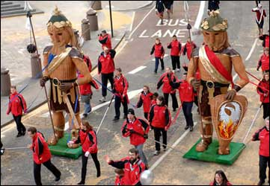
The Story Of Gog And Magog
Gog and Magog on parade at the Lord Mayors show in the City of London.
The conspiracy of Gog and Magog is so vast that it has only be possible to give an insight into some of the major aspects of the assault on true Israel. It is to be hoped that viewers will be encouraged to conduct their own research using the information given.

Slide 4
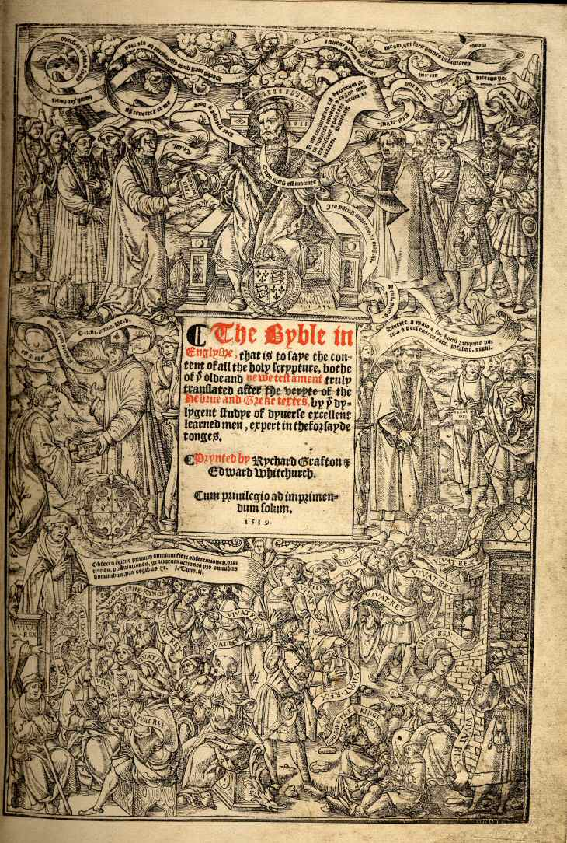
The Story Of Gog And Magog
This assault in its various phases was foretold long ago in the scriptures – The Book of Our Race!
The enemy through its control of the media and infiltration into the church has thereby been able to keep the people from knowing who and where this enemy is located.

Slide 5
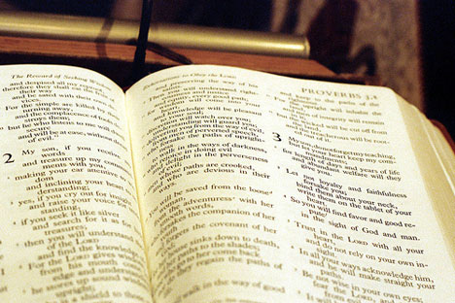
Gog of The Land of Magog
The following verses of scripture give an overall summary of Gog’s attack while subsequent verses, chapters and books of the Bible go into greater detail about the various aspects of the attack and upon which the presentation is based.

Slide 6
Gog of The Land of Magog
The Story of
Analysis of Ezekiel 38 : 15
First half of verse
And Thou (Attila/Genghis Khan) Shalt Come From Thy Place Out Of The North Parts, Thou And Many People With Thee All Of Them Riding Upon Horses, A Great Company, And A Mighty Army

Slide 7
Gog of The Land of Magog
The Story of
Second half of verse
And Thou Shalt Come Up Against My People of Israel, As A Cloud To Cover The Land: It Shall Be In The Latter Days, And I Will Bring Thee Against My Land That The Heathen May Know Me, When I Shall Be Sanctified In Thee, O Gog, Before Their Eyes.

Slide 8
Gog - A Short Recap Gog’s Attack - In 2 Phases
Overt
Attila & Genghis Khan
Covert
Secret Societies – The Illuminati, Freemasons etc.

Slide 9
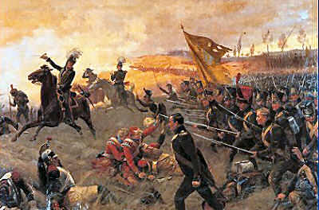
Gog’s Attack - In 2 Phases
Under the covert phase Gog would engineer devastating wars between the Israelite tribes (now European nation states) to finally culminate in Armageddon.

Slide 10
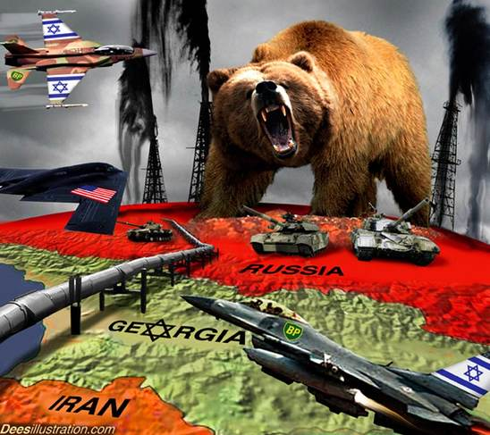
One of the latest examples

Slide 11
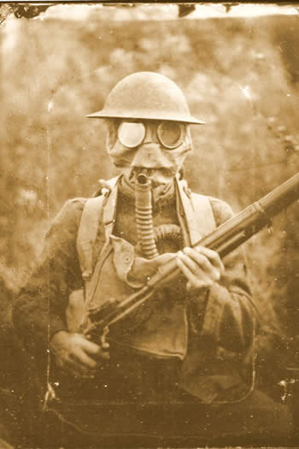
Gog’s Attack - In 2 Phases
In the series to follow we will look into some of these major wars and discover how they were all stepping stones to seize global power and to steal the wealth of Yahweh’s people Israel.

Slide 12
Gog - A Short Recap Gog’s Attack - In 2 Phases
The presentation starts by looking at the frontal attacks against Christendom (Israel) in the west by, namely; Attila, Islam’s attack from the south and a further attack from the east and north by Genghis Khan.
Above: Attila
Right: Genghis Khan.
Left: Mohamed

Slide 13
Gog - A Short Recap Gog’s Attack - In 2 Phases
In the presentations to follow, it will be shown that as well as attacking Israel through Islam, they infiltrated all religions and in particular the Catholic church, the Orthodox church and even the Protestant church and twisting these into their Talmudic precepts.
Mohamed

Slide 14
Islam - Jewish
Islam is Jewish – that is it was conceived by Jewish minds and a man with a charismatic personality having a vision and “being in touch with God” and being instructed to write another “holy” book.
Mohamed had a vision

Slide 15
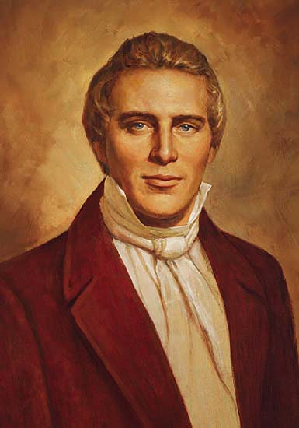
Islam - Jewish
Interestingly Joseph Smith – a Rothschild agent also had a vision some 1260 years after Mohamed and produced the book of Mormon just as Mohamed wrote (purportedly) the Koran.
Joseph Smith

Slide 16
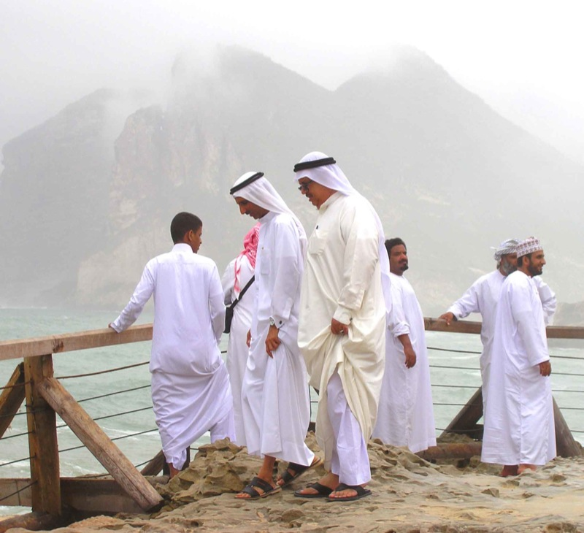
Islam - Jewish
Once the Arabs had been indoctrinated, this would be used as a means to attack the infidels (Christians) and drive them together west and northwards with the rest of the white civilisation out of Asia Minor and North Africa.
Most Arabs converted to Islam

Slide 17
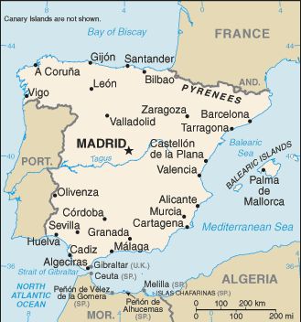
Islam - Jewish
They would later mobilise to attack the strongholds of Christendom in Europe via Spain.

Slide 18
Islam - Jewish
While the attack on and occupation of Spain was eventually repulsed, the forces of Islam are yet again regrouping within our borders and we have seen the devastation caused by the rioting in France.

Slide 19
Islam - Jewish
By all accounts Mohamed was illiterate. That he should be influenced by a Rabbi is no surprise as he was married to a rich Catholic Jew - Khadija
The Koran

Slide 20
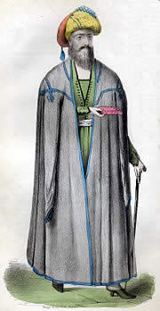
Islam - Jewish
Tradition has it that the Koran was drawn up by a Persian Jew, one Rabbi Warada Ibu Newsal and a Nestorian monk.
A Nestorian Monk

Slide 21
Islam - Jewish
The Jewish input into the Koran, is confirmed by its reference to the 1st 5 books of the bible (the Torah) and the Psalms, just as the Jews claim to follow to day but just like the Talmud (referred to by Jesus as the Traditions of Men) the Koran was a perversion of God’s law.

Slide 22
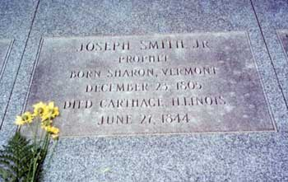
Islam - Jewish
The similarity between Joseph Smith and Mohamed continues in that they both met untimely deaths, no doubt due to passing on secrets of their Jewish masters. – Mohamed died on June 7th, 632 in Medina. Note the good Illuminati numbers in the date of his death (6 + 7 = 13 & 6 + 3 + 2 = 11 & 1 + 3 + 1 + 1 = 6)
The Grave of Joseph Smith

Slide 23
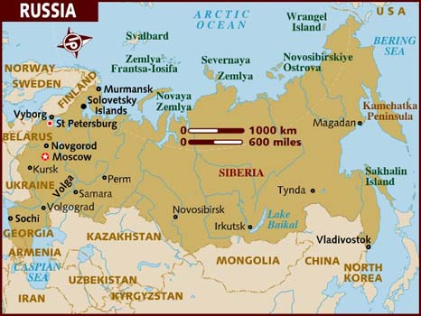
Who Is Gog?
Many say that Russia is Gog. The presentation will show that this is not the case, although at one time an element of Gog was within the present boundaries of Russia.

Slide 24
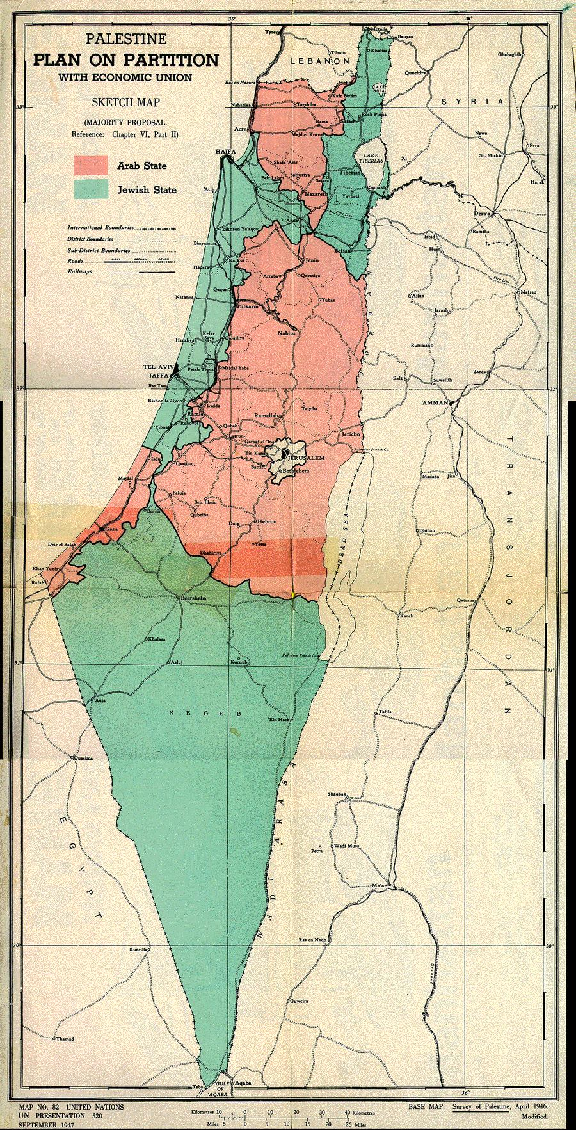
Who Is Gog?
Judeo-Christians see the prophecy of Gog as that of Russia coming over the Caucasus to attack Israel in Palestine, but ignore the fact that the scriptures say that Gog will come against my people and my land. There would have been no need to mention my land as well as my people if Israel was in the Middle East!

Slide 25
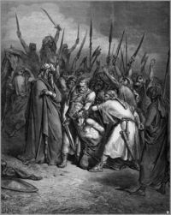
The Name - Gog
A number of Bible versions refer to Agag King of the Amalekites as either Agog or Gog which further associates the name with Amalek-Edom or modern day Jewry whom Yahweh would have war with from generation to generation. Exodus 17:16
Death of King Agag

Slide 26
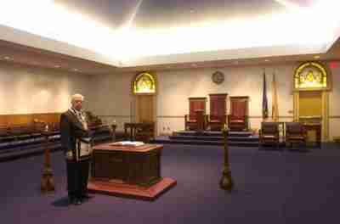
The Name - Gog
Masons operate under cover
The Hebrew word for Gog is “Gowg” means "roof, covering, or mountain." As we shall see later under coming up as a cloud means covert or in secret. Mountain would also tie up with the other biblical name for Edom, that is mount Seir

Slide 27
Who Is Gog?
It will be shown that the Amalekites had contacts with their relatives in Khazaria referred to on old maps as “Land of Magog”

Slide 28
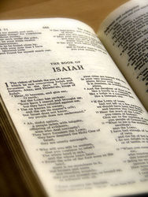
Who Is Gog?
Exodus 17:16: “For he said, Because the LORD hath sworn that the LORD will have war with Amalek from generation to generation”.
It will be shown that Gog, Amalek, Jew, Khazar and Canaanite are just different manifestations of the same people.

Slide 29
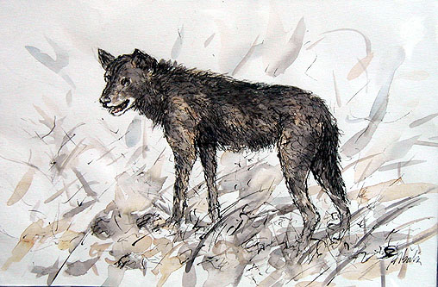
Who Is Gog?
In the Scriptures Canaanites are referred to as dogs and to this day the Latin name for Dog is Cainis.

Slide 30
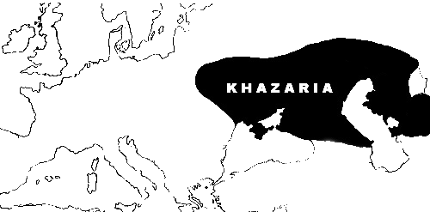
The Khazar Empire In Relation To Europe
From this map one can appreciate Gog’s gigantic size relative to the European powers

Slide 31
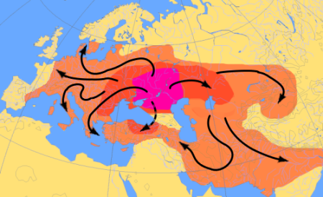
Rise Of The Ashkenazi Jews
A New Menace Arises In The East
The Rise of Khazaria following the expulsion of the Khazars from Asia would be the base from which the west would be infiltrated.
The area chosen was ideally situated as it straddled the trade routes between China, Europe, the Middle East and Africa. The map above shows their tentacles reaching far into Europe and the Middle East.

Slide 32
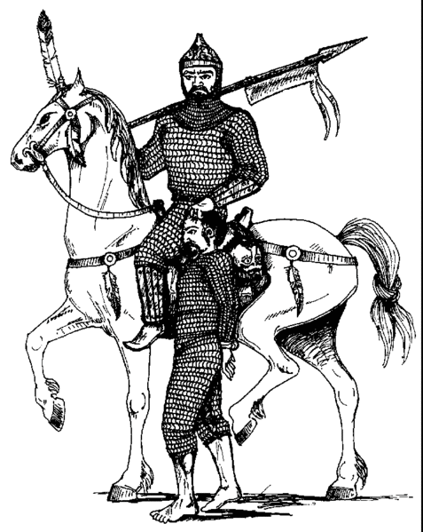
Rise Of The Ashkenazi Jews
They Were Ruthless
They controlled the Volga passes between the Black and Caspian seas. They butchered and killed more people than the Black Plague.
The only people They didn’t get the better of were the Vikings

Slide 33
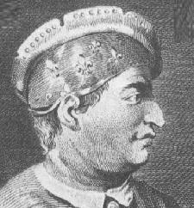
Rise Of The Ashkenazi Jews
The Sephardics
They had them convert to Judaism following representations from the Babylonian Sephardic Jews in approximately 874 AD.
A Sephardic Jew

Slide 34
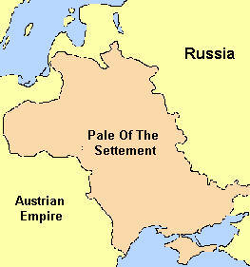
Rise Of The Ashkenazi Jews
The Khazars Were Always Confined
(Until the end of the 1000 years when “Satan” would be loosed)
The Sephardics had their army, but Russia and Germany wanted no part of these foul creatures

Slide 35
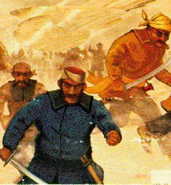
Rise Of The Ashkenazi Jews
They Were Ruthless
They controlled the Volga passes between the Black and Caspian seas. They butchered and killed more people than the Black Plague.

Slide 36
Destruction Of The Khazar Kingdom - 965 AD
964 AD, Oleg's grandson, Svyatoslav, became ruler of the Rus.
He was a fierce warrior who adhered strictly to his Scandinavian upbringing.
He set his first task as the destruction of the Jewish Khazar Empire in the south.
Svyatoslav
Notes:
DESTRUCTION OF THE KHAZARS - 965 AD
In 964 AD, Oleg's grandson, Svyatoslav, became ruler of the Rus. A fierce warrior who adhered strictly to his Scandinavian upbringing - even refusing to become a Christian after his mother had converted - Svyatoslav set as his first task the destruction of the Jewish Khazar empire in the south.
In 965, the Rus army under Svyatoslav, crashed through the Khazar borders and utterly defeated the Jewish slave trading empire forever. The Khazars who survived this great assault were scattered throughout the region, with many moving west into what became western Russia and Poland. There they re-established Jewish communities and absorbed some Nordic elements (mainly through marrying Jewish women to non-Jewish men; Jewish law dictating that only persons born of a Jewish mother can be classified as a Jew), creating the basic stock of today's modern European Jews, known as the Ashkenazim.

Slide 37
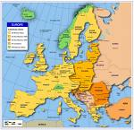
Destruction Of The Khazar Kingdom - 965 AD
The destruction of the Khazar Kingdom resulting in the Khazars first fleeing to eastern Europe, Russia, Poland and thence to Spain, and subsequently on to Holland, America and England.

Slide 38
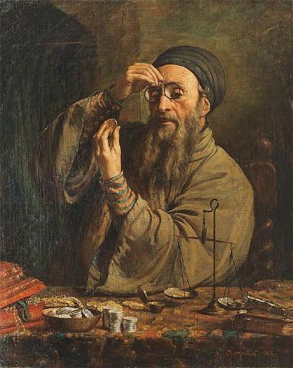
Destruction Of The Khazar Kingdom - 965 AD
We shall see that they acted as a cohesive force in secretly subduing those countries where they settled through their control of finance by usury
Jewish Money Lender

Slide 39
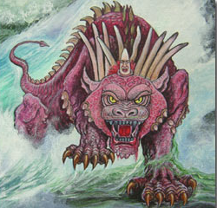
Khazar = Gog = The Little Horn
The Collapse of Khazaria would result in the rise of the little horn in the midst of the 10 horns (Israel) – the horns represent sovereignties - called a little horn because the Khazar Jews were numerically inferior to the Israelites.
The Little Horn

Slide 40
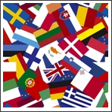
Khazar = Gog = The Little Horn
We shall see in subsequent presentations how these Jews fleeing into the Israelite lands of western Europe would take control of the Israel nations and take a great spoil

Slide 41
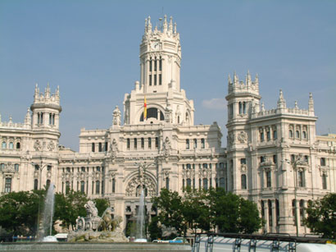
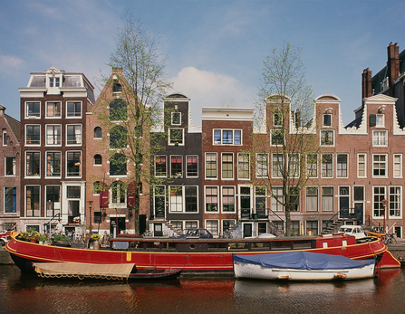
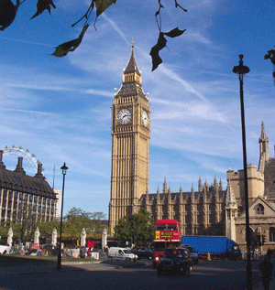
Khazar = Gog = The Little Horn
Madrid
Amsterdam
London
We shall trace Gog’s control centres from Spain to Holland and finally London to become the London money power or the Great Red Dragon of Revelation

Slide 42
Gog Is Identified as The Little Horn
It can be shown from the scriptures and numerical values that the little horn can be identified as the Jews and Khazar Jews in particular

Slide 43
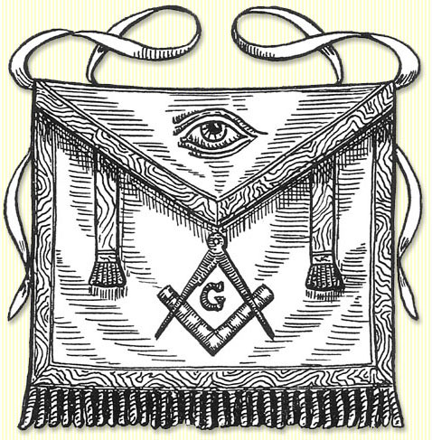
Khazar = Gog = The Little Horn
Daniel 7:8 I considered the horns, and, behold, there Came Up among them another little horn, before whom there were three of the first horns plucked up by the roots: and, behold, in this horn were eyes like the eyes of man, and a mouth speaking great things.
A Masonic Apron

Slide 44
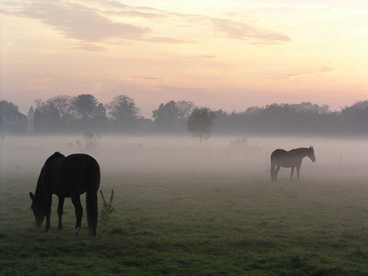
Khazar = Gog = The Little Horn
And Thou Shalt Come Up Against My People of Israel, As A Cloud To Cover The Land

Slide 45
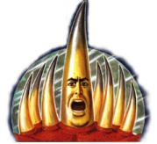
Khazar = Gog = The Little Horn
Daniel 7:8 I considered the horns, and, behold, there came up among them another little horn, before whom there were three of the first horns plucked up by the roots: and, behold, in this horn were eyes like the eyes of man, and a mouth speaking great things
The Little Horn

Slide 46
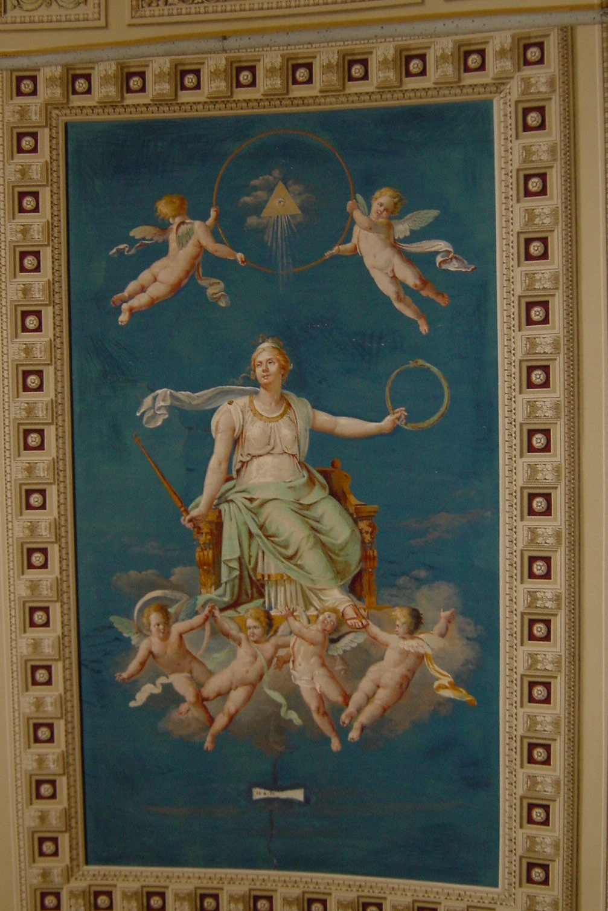
Khazar = Gog = The Little Horn
Tapestry in the Vatican with the all seeing eye
The Vatican is only part of the Little Horn, but is not the Little Horn as some commentators say nor is the Pope. The Little Horn was a power (Jewish) like the other 10 horn sovereignties.

Slide 47
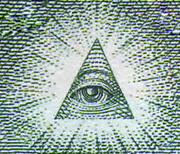
Khazar = Gog = The Little Horn
The all seeing eye depicted on the Vatican picture shows that the Vatican was part of the “Little Horn Power”

Slide 48
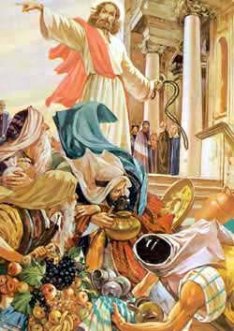
Khazar = Gog = The Little Horn
2 Thessalonians 2:4 Who opposeth and exalteth himself above all that is called God, or that is worshipped; so that he as God sitteth in the temple of God, shewing himself that he is God.
Christ Chasing out the money lenders

Slide 49
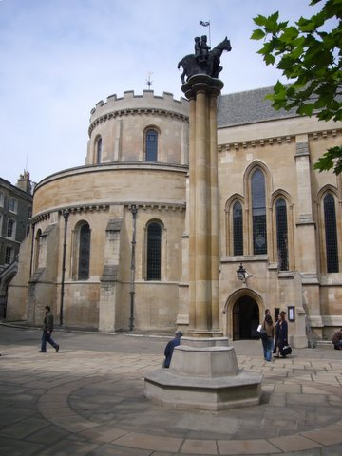
Khazar = Gog = The Little Horn
… There is a double allegory here. Left we see the church modelled on the temple in Jerusalem and where the plan to set up a central bank was plotted that would eventually enslave the whole world.
The Temple – London & monument to the Knights Templar

Slide 50
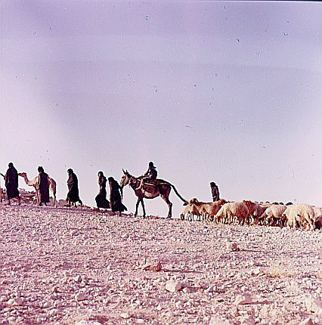
Khazar = Gog = The Little Ho
The presentation will show that Gog has had a foothold in London since ancient times and was one of the control centres for the silk route.

Slide 51
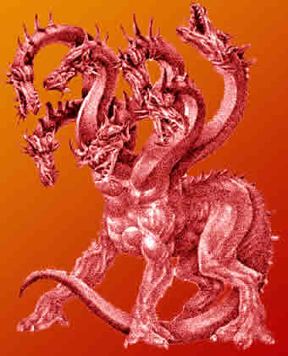
Khazar = Gog = The Little Horn
The City of London is full of dragons, on the boundary posts and the coat of arms, even the Queen of England is not sovereign in the City of London.

Slide 52
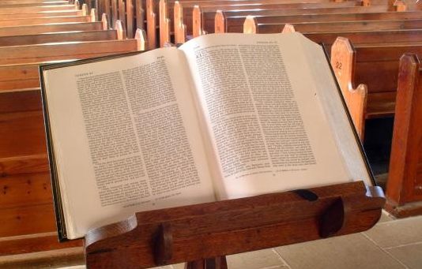
Khazar = Gog = The Little Horn
Notice the similarity of the 2 verses describing this power as coming up in the midst of the Israel nations. Christ said ye (Israel) are the Temple.
The scriptures also say that the Anti_Christ would be in the midst of the Temple (Israel). These references only occur once, but together they fulfil the requirement of being in the mouth of 2 or 3 witnesses!

Slide 53
The Numerology Of The Little Horn
On the basis of A = 1, B = 2 etc.
Khazar = 11 + 8 + 1 + 26 + 1 + 18 = 65 = 6 + 5 = 11
Gog = 7 + 15 + 7 = 29 = 2 + 9 = 11
Jew = 10 + 5 + 23 = 38 = 3 + 8 = 11
This gives us 33 (11+11+11) = The number of Masonic degrees!

Slide 54
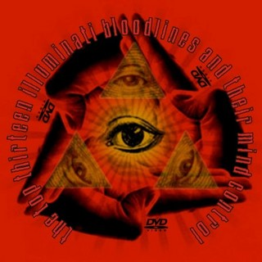
The Numerology Of The Little Horn
One of the secret forces of Gog was the Illuminati and as we shall see was formed, or to be more correct, re-constituted, on a very significant date. The Illuminati would be at the centre of the octopus’s many tentacles that would entrap true Israel.
The Illuminati

Slide 55
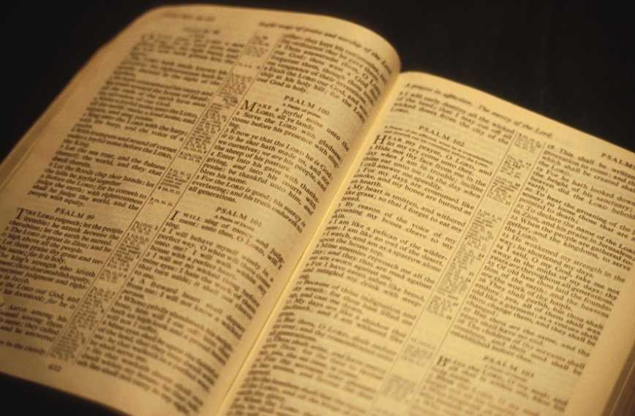
The Numerology Of The Little Horn
The word Gog is mentioned exactly 11 times in the Holy Scriptures

Slide 56
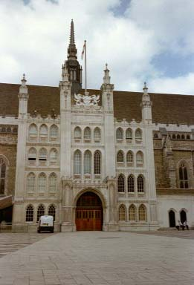
The Numerology Of The Little Horn
The ancient walled City of London covers an area of 677 acres which is the number of the beast (666) plus the number of Gog (11). Which is very appropriate as it is Gog’s headquarters in the administrative and premier capital of the Israel nations
London Guildhall guarded by 2 dragons!

Slide 57
The Knights Templars Banded Together in 1111
The Templars were recognized at Clermont in 1118. 1+1+1+8= 11. The authors of Holy Blood Holy Grail provided the definitive evidence that there were 9 original founding Templars ….

Slide 58
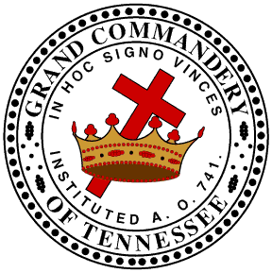
The Knights Templars Banded Together in 1111
…. and they first banded together in 1111 and taking no new members for 9 years. And this was the numerical basis for the 911's in many tragedies.
The Logo of The Knights Templar

Slide 59
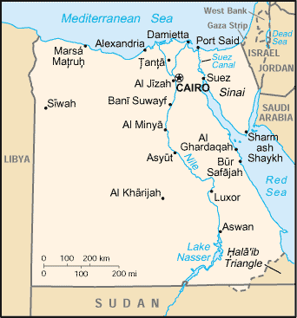
The Knights Templars Banded Together in 1111
The Templars were in possession of the occult secrets of the serpent seed that made its way to Europe from Egypt. After the overt demise of the Knights Templar,

Slide 60
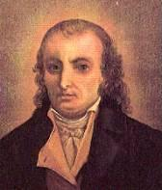
The Knights Templars Banded Together in 1111
…. this organisation would be resurrected and reinvigorated as a secret society known as the Illuminati by Adam Weishaupt on May 1, 1776, - 666 year later bar 1
Adam Weishaupt

Slide 61
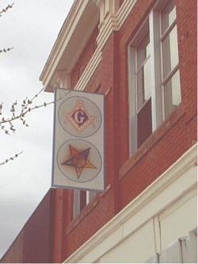
Khazar = Gog = The Little
The word Gog literally means "roof, covering, or a mountain." Which is another confirmation that Gog, the little horn, is associated with Masonry and secrecy under cover of the Masonic lodges - coming up as a cloud!
Left: Note the 5 pointed star of Amalek (Gog)
Lodge - Downtown Douglas, Arizona

Slide 62
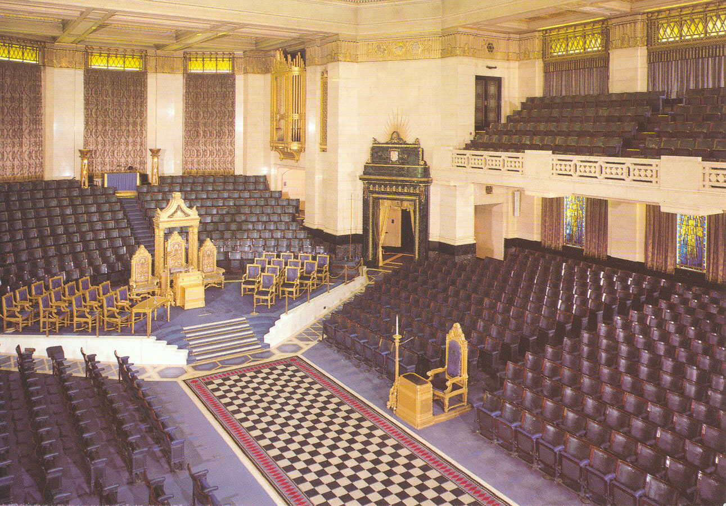
The Masonic Hall London Kingsway

Slide 63
Khazar = Gog = The Little
It is therefore appropriate that the leading Israelite tribe of the 10 horns should have its Prime Minister's residence at number ten Downing St.!

Slide 64
Khazar = Gog = The Little
It is equally appropriate that the “the great red dragon or the London money power” – that is Gog, whose number is 11, should be occupying 11 Downing Street and exercising control over the affairs of the leading tribe through No. 10 Downing Street by dictating monetary policy via the Treasury.

Slide 65
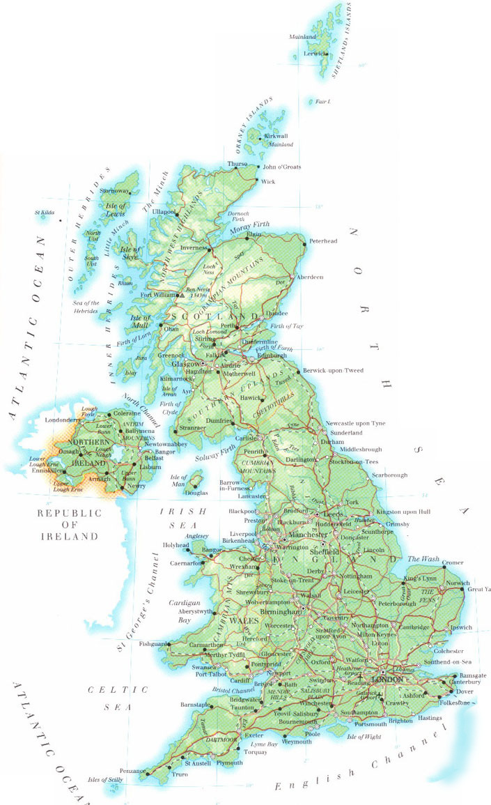
William "the Conqueror"
Although the presentation is mainly from a UK perspective, it does cover Gog’s attack on other Israelite nations such as USA, SA and Germany, but because of the vastness of the conspiracy, it is not possible to do each country justice, so apologies if your country is not included or covered in full.

Slide 66
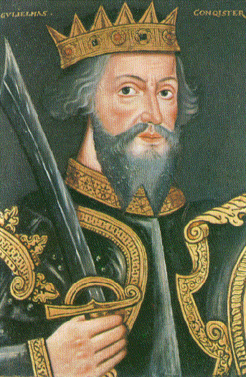
William "the Conqueror"
With William the Conqueror (plunderer) came a retinue of Jews who were influential in causing the Doomsday book to be written so that all property could be taken into state control and used as security for debts to the Jews.

Slide 67
William "the Conqueror"
Under Norman Rule It was now possible to seize a person’s house or lands for unpaid debts (Credit agreement – shetar or Starr)
Page out of the Doomsday Book

Slide 68
William "the Conqueror"
With William the Conqueror’s invasion of England came the start of a slippery slope of decline that would lead us into the present situation that we now find ourselves!

Slide 69
Gog’s Plan – Evil Thought
An important event took place in Constantinople in 1492 AD

Slide 70
Which has had repercussions up to this day

Slide 71
Gog’s Plan – Evil Thought
After being expelled from nearly every country in Europe, it was the 6 point plan to gain the ascendancy issued by the Grand Satrap and Rabbis of Constantinople, as follows:
The Grand Satrap

Slide 72
Gog’s Plan – Evil Thought
1). Convert to Christianity;
2). Become merchants and take the Christians' property from them;
3). Become doctors and apothecaries and kill Christians medically;
Jew – Billy Graham

Slide 73
Gog’s Plan – Evil Thought
4). Become priests and destroy the Church from within;
5). Become lawyers, mix in affairs of State and by putting Christians under your yoke you may dominate the world and be avenged;
6). Do not swerve from this order and you will reach the actuality of power.

Slide 74
Gog’s Plan – Evil Thought
A Rothschild Courier was struck down by lightning in Bavaria on whom were found documents for acquiring control of all western governments

Slide 75
Gog’s Plan – Evil Thought
Bavaria warned all the governments, but their warnings were ignored. These documents were probably the basis for the protocols.
Frauenkirche (München),

Slide 76
Gog – Conceives An Evil Thought
Ezekiel 38: 10-12; Thus sayeth the Lord God: It shall also come to pass, that at the same time shall things come into thy mind, and thou shalt think (conceive / plan) an evil thought:
And thou shalt say, I will go up to the land of unwalled villages: I will go to them that are at rest, that dwell safely, all of them dwelling without walls, and having neither bars nor gates, to take a spoil and to take a prey.
The evil plan

Slide 77
Gog’s Plan – Evil Thought Convert To Christianity
Many Jews converted and rose to high position in the Church and became known as Marranos. Too late, the Spanish realised their mistake – once a Jew always a Jew.
A Marrano Jew

Slide 78
Gog’s Plan – Evil Thought Convert To Christianity
This gave rise to the Spanish Armada against England and the Spanish Inquisition whose primary purpose was to root out secret Jews not protestants as we have been led to believe, but undoubtedly some protestants were affected.

Slide 79
The Spanish Inquisition
They were the Jews who supposedly converted but actually remained Jews in thought and action. The problem was that nearly all, if not all, of the conversos still remained loyal to the Jewish religion and cause. As we shall see, that situation has plagued all of us to this very day.

Slide 80
Gog’s Plan – Evil Thought Merchants
The presentation will show how a great spoil has been taken by Gog’s corporate giants.

Slide 81
Gog’s Plan – Evil Thought Merchants
Even now we are seeing the consequences of this evil policy.

Slide 82
Gog’s Control Through Banks
Bank Of England
The presentation will show how Gog has taken a great spoil through its central banking system and the issue of fiat money.
Bank Of England’s American Branch – The Federal Reserve

Slide 83
Gog’s Plan – Evil Thought Doctors And Apothecaries
Harold Shipment was just one example of Gog’s use of the medical profession to kill Christians and it will be shown how the Pharmaceutical industry and abortion clinics have been used to kill us under the guise of keeping us well!
Harold Shipman

Slide 85
Gog Culling Our Old People With Drugs
Scandal of the Alzheimer’s victims given ‘zombie’ drugs
Many elderly people only mildly affected by dementia but prescribed anti-psychotic drugs are reduced to a "zombified" state by them, says the Alzheimer's Society, which has demanded an end to their blanket use.

Slide 86
Gog’s Plan – Evil Thought The Church
The presentation will show how Gog’s agents have infiltrated the church

Slide 87
Some Of Gog’s Agents Who Have Infiltrated The Church
Billy Graham (Jew) – real name Frank
John Calvin (Jew) – real name Cohen
Dr. C. I. Scofield (Jew)

Slide 88
Gog’s Plan – Evil Thought The Legal Profession
The legal profession is perhaps the most infiltrated of all and uses the BAR to ensure loyalty to the crown – not the royal crown, but the Knights Templar Crown in their inns of court in the City of London.
The presentation will show how the BAR controls the US legal system as well.

Slide 94
Gog’s Plan – Evil Thought You Will Reach The Actuality Of Power
The Actuality of Power has nearly been achieved – the presentation, however, shows that Yahweh will thwart their plans

Slide 95
Gog’s Plan – Evil Thought The Rothschilds
The financial power of the House of Rothschild was the driving force of Gog during the last 2 centuries – the presentation will cover the House of Rothschild.
Mayer Amschel Bauer (Rothschild) (1744-1812).

Slide 96
The Rothschild Family Tree

Slide 97
Gog’s Plan – Evil Thought Palestine
The presentation will show that the Israeli state in Palestine is a private estate of the Rothschilds used to deceive Yahweh’s true Israel into thinking that they the Jews are God’s chosen.

Slide 98
Gog’s Plan – Evil Thought Palestine
The Hexagram (note Hexa in German means witch) on the Israeli flag is a pictorial representation of 666 as well as being the logo of the House of Rothschild.

Slide 99
Rothschilds Profit From Opium And European Wars
The Rothschilds make huge profits from the battle of Waterloo and ensured that Wellington would win because …
Battle of Waterloo

Slide 100
Rothschilds Profit From Opium And European Wars
Napoleon had served his purpose by freeing the Jews from the Ghettoes and removing the Pope’s restriction on usury.
Napoleon

Slide 101
Gog’s Great Fires
Left: We see Rome on fire following Nero’s Jewish wife persuading him to do this, in order that it can be blamed on the Christians causing the remaining Pagan population to rise up and kill them as the Jews were worried at the speed with which Christianity was taking hold in the Roman Empire.

Slide 102
Gog’s Great Fires
Left: The Reichstag Fire.
Down through the ages Gog has used fire as a means of subjugating true Israel.

Slide 103
London: Year of The "Great Fire" of 1666

Slide 104
London: Year of The "Great Fire" of 1666
1665: A great depression settles over England. Unemployment, shortages of food undermine the health of the people and the Great Plague breaks out. (The outbreak of the Great Fire of London, known as "The Great Cleaner" ended the plague)

Slide 105
London: Year of The "Great Fire" of 1666
It was used by Gog to reconstruct the City in his own image and the first step towards creating an independent state within a state.
The Great Fire

Slide 106
London: Year of The "Great Fire" of 1666
Note: The year ends in 666. The "Great fire of London" of 1666 levelled most of the city. This was the second "Great fire of London," with the first "Great fire" having occurred in the year 1212.
London 1666

Slide 107
London: Year of The "Great Fire" of 1666
Note also that when allowance is made for changes in the calendar – The great fire started on September 11th ( Michael Clark)

Slide 108
London: Year of The "Great Fire" of 1666
Note: There used to be an inscription on the monument stating that the fire was started by the Jesuits (one of the evil frogs). It was however, removed in 1830 – and the story substituted that it was started by accident in a bakery.

Slide 109
The Chicago Fire
Sunday evening, October 8, 1871 marked the beginning of one of the most devastating fires in U.S. history

Slide 110
The Chicago Fire
Between October 8 and 10, an estimated 350 people perished. The fire destroyed the homes of up to one-third of the city's population, about 1,600 stores, 60 factories, and 28 public buildings. Four square miles of the city burned to the ground.

Slide 111
The Chicago Fire
Was it a coincidence that this fire occurred in the same year Washington DC became an independent state within the union?
Washington DC

Slide 112
Gog Would Rebuild Chicago In His Own Image - Gigantic
The Chicago fire like the great fire of London, would be used by Gog to reconstruct the city in his image – huge skyscrapers which only the London Money Power could afford. Previously prior to the fire the buildings were no more than 2 - 3 stories high and owned by the occupiers.

Slide 113
Gog’s Great Fires
Like the twin towers the “terrorist attack” on the Reichstag was faked to make the population accept a draconian “security” clamp down

Slide 114
Gog’s Great Fires
More recently the fires in California were a means of getting insurance payment on properties with irrecoverable mortgage debt from German insurance companies who were heavily involved in the California housing market

Slide 115
Public Heroes?? Or Gog’s Agents
Cromwell
William of Orange
Churchill
Or instigators of Britain’s three greatest disasters? Find out in the presentations to follow.

Slide 116
The Story Of Gog And Magog
Winston Churchill: "You must understand that this war is not against Hitler or National Socialism, but against the strength of the German people, which is to be smashed once and for all, regardless of whether it is in the hands of Hitler or a Jesuit priest. "Emrys Hughes, Winston Churchill - His Career in War and Peace, p. 145

Slide 117
Public Heroes?? Or Gog’s Agents
Was it just Hitler who was a war criminal? Find out in the following presentations

Slide 118
The Story Of Gog And Magog
Knut Hamsun - Norwegian writer and Nobel Prize-winner, Knut Hamsun, upon the death of Adolf Hitler, Aftenposten, 1 May 1945

Slide 119
The Story Of Gog And Magog
"Adolf Hitler was a warrior for mankind“ (Knut Hamsun)
"I am not worthy to speak aloud of Adolf Hitler, and his life and work do not invite sentimental words.
"He was a warrior for mankind and a herald of the gospel of justice for all nations. He was a reformative figure of the highest rank,

Slide 120
The Story Of Gog And Magog
"Adolf Hitler was a warrior for mankind"
. ..and it was his historic fate that he had to work in a time of unprecedented baseness, which in the end brought him down.
"Thus, I suppose, must the ordinary West European look upon Adolf Hitler. And we, his close followers, now bow our heads before his mortal shroud."

Slide 121
Silent Weapons For Quiet Wars
Microwave Oven
In the presentations to follow we see how Gog is using modern technology to disable and even kill us
Cell Phone

Slide 123
Gog’s Occult Societies
Gog uses occult and pagan practices within its secret societies, such as the masons, Scull & Bones, Illuminati and Knights Templar.
The presentation will give examples of buildings and cities built on occult principles.

Slide 124
Gog Uses Drugs To Subdue
It is no coincidence that the poppy is used to represent the fallen of the last 2 world wars

Slide 125
Sassoon - Jewish
It is interesting to note that the Jews of Bombay in India controlled the drug trade and especially the Chinese opium trade, their chiefs took the name Sassoon which was no doubt taken from the pagan Sassonades who ruled Persia

Slide 126
Gog Uses Drugs To Subdue
One of the reasons for the war in Afghanistan was to safeguard the opium trade after the Taliban refused to supply after big pharmacy declined to give them an increase of price.
Afghanistan

Slide 127
Gog Uses Drugs To Subdue
Opium is the basis for many medical drugs as well as street drugs. A small amount of opium is added to tobacco to keep users “hooked”.

Slide 128
Gog’s Three Control Centre
London
The Vatican
Washington DC

Slide 129
Gog’s Control Of US Presidents
Gog has been in control of most USA presidents. Those who did not follow orders were assassinated such as Abraham Lincoln and J. F. Kennedy. The presentation will go into more details and show how the US is controlled from the City of London.

Slide 130
Gog’s Control Of US Presidents
Today because of the power of the Jewish lobby, modern US presidents count it as good PR to flout their Jewishness!

Slide 131
Gog’s Control Of US Presidents
However corrupt or however low in the opinion poll ratings a government is, Gog, with its control of the media can always ensure that the chosen candidate reaches the actuality of power!

Slide 132
This Alien Rule is Signalled By Subtle Changes to National Insignias
We Shall now look at some of these changes

Slide 133
The Crown’s & Gog’s Coat of Arms
Spot the Difference!!
The Genuine Arms
The “Counterfeit” Arms

Slide 134
The True Flag Of The USA?
By 1951 The Civil Flag Flown by US Customs was completely phased out.

Slide 135
Gog’s False Flag Operations
Some of Gog’s more recent false flag operations will be looked into in detail such as 911 and why these happen on special dates. For instance when one makes allowance for calendar adjustments the great fire of London also occurred on the 11th September

Slide 136
Gog’s False Flag Operations
The Government’s misinformation regarding the perpetuators of the London bombings on 7th July, 2005 will be looked into in some detail in the presentations to follow.

Slide 137
911 Used To Remove Freedoms
False flag operations such as 911 have and are being used to curtail our freedoms

Slide 138
Gog Destroying Africa
Having seized the gold and diamonds in South Africa Gog would accelerate plans for the elimination of the white race in Africa.

Slide 139
Gog Seizes Palestine
The seizure of Palestine was essential in order to deceive the gullible Christians into believing that the Jews are God’s chosen people.

Slide 140
Gog Seizes Palestine
British Mandate
To the Zionists gaining control of Palestine was essential for at least two reasons:
To pass themselves off as God’s chosen.

Slide 141
Gog Seizes Palestine
2) To be in a pivotal position to control the oil wealth of the Middle East

Slide 142
Gog Seizes Palestine
Having used General Allenby as their tool to seize Palestine from the Turks, Gog’s priority now was to expel the British – this would be done by terror with many atrocities blamed on the Arabs.

Slide 143
Gog Seizes Palestine
Gog’s Terror – 2 British soldiers hang and their bodies bobby trapped – blamed on the Arabs.

Slide 144
Gog Seizes Palestine
He was the hangman, and nailed this note to their chests.
We hung two British spies for their "criminal anti-Hebrew activities" on the following charges:
Sholmo Kaplan

Slide 145
Gog Seizes Palestine
1. Illegal entry into the Hebrew homeland.
2. Membership of a British criminal terrorist organisation known as the Army of Occupation which was responsible for the torture, murder, deportation, and denying the Hebrew people the right to live.
British Occupation of Palestine

Slide 146
Gog Seizes Palestine
3. Illegal possession of arms.
4. Anti-Jewish spying in civilian clothes.
5. Premeditated hostile designs against the underground. Found guilty of these charges
British Occupation of Palestine

Slide 147
Gog Seizes Palestine
… they have been sentenced to hang and their appeal for clemency dismissed. This is not a reprisal for the execution of three Jews but a "routine judicial fact."
British Palestine Currency

Slide 148
Gog Seizes Palestine
British Authorities issue a wanted list of Jews although the media blamed it on the Arabs.
Many of these terrorists would go on to become Prime Ministers of the Israeli state

Slide 149
Gog Seizes Palestine
Menachen Begin Of The Irgun
He later became the Prime Minister of Israel
Menachen Begin

Slide 150
Gog Seizes Palestine
Massacre At Deir Yassin
At least a hundred heavily armed Jews massacred a little village of 200 Arabs. They raped the women and children, then crushed their heads with rocks.

Slide 151
The Time Of Jacobs Trouble
The taking of Jerusalem was a signal that the Fullness of the Gentiles (the Israelite Nations) had reached their maximum development – from this point on the European nations would loose their empires and colonies ….

Slide 152
The Time Of Jacobs Trouble
Russia being first to fall. - This will be gone into in more detail in the presentation

Slide 153
Gog Attacks Royalty
Queen visits mosque at Bursa Turkey on 14th May 2008, and listens to reading from the Koran.
The “time of Jacob’s trouble” would see an unprecedented attack on the house of David European monarchies.

Slide 154
Gog’s Destruction
The presentation will show that there is light at the end of the tunnel – the horns ( the Israel nations ) will burn the whore.

Slide 155
Gog/Babylon - Destroyed
Ezekiel 39:3; And I will smite thy bow out of thy left hand and will cause thine arrows to fall out of thy right hand.

Slide 156
Gog/Babylon - Destroyed
Here we see the logo of one of the Rothschild Banks with arrows taken from the coat of arms of the house of Rothschild – Interestingly the large R could refer to the Right Hand and the J & C to judgment coming!
Rothschild Logo

Slide 157
Gog/Babylon - Destroyed
Malachi 4:1 For, behold, the day cometh, that shall burn as an oven; and all the proud, yea, and all that do wickedly, shall be stubble:
and the day that cometh shall burn them up, saith the LORD of hosts, that it shall leave them neither root nor branch.

Slide 158
Gog/Babylon - Destroyed
Obadiah 1:18
And the house of Jacob shall be a fire, and the house of Joseph a flame, and the house of Esau for stubble, and they shall kindle in them, and devour them; and there shall not be any remaining of the house of Esau; for the LORD hath spoken it.
Of course the term House of Jacob is used because all the tribes of Israel will rise up and destroy Gog

Slide 159
Gog/Babylon - Destroyed
Revelation 17:16
And the ten horns which thou sawest upon the beast, these shall hate the Whore and make her desolate and naked, and shall eat her flesh, and burn her with fire.

Slide 160
Gog/Babylon - Destroyed
The previous 2 slides of bible verses confirm that the horns of the beast are the Israelite nations.

Slide 161
Gog/Babylon - Destroyed
We must also give consideration to the little horn, which of course makes 11 horns – the number of Gog! The other horns are the tribes of Israel, therefore the little horn must be a race small in number,
The little horn makes 11 horns

Slide 162
Gog/Babylon - Destroyed
…... this is of course the Jews. The crown on the small horn indicates that although numerically inferior to the 10 tribes they exercise power over them!!

Slide 163
Their machinations will come to naught!

Slide 164
The Story Of Gog And Magog
A thought to leave you with
"Whenever the legislators endeavour to take away and destroy the property of the people, or to reduce them to slavery under arbitrary power, they put themselves into a state of war with the people, who are thereupon absolved from any further obedience ... " John Locke (1632-1704),
Howbeit no man spake openly of him for fear of the Jews. (John 7:13)

Slide 165
The Story Of Gog And Magog
The End Of Preview
To be continued ….. Part One Attila, The Rise of Islam and the Khazars

