Slide 1
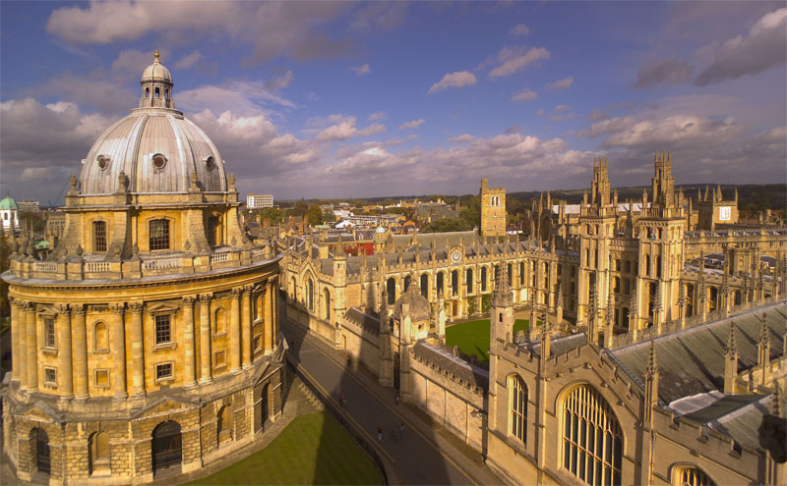
The Hebrews
And The
English Language
Oxford University

Slide 2
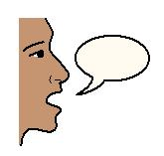
The Ancient British Language
Isaiah 28:11 says, "For with stammering lips and another tongue will he speak to this people” (Israel)

Slide 3
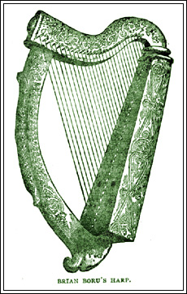
The Ancient British Language
The Hebrew word for "stammering" here is "LAEG" reading right to left but English reads left to right so it would be pronounced GAEL in English.

Slide 4
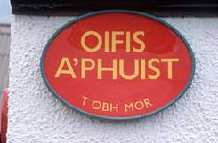
The Ancient British Language
GAELIC is not only the foundation of the English language, but is still spoken in its primitive simplicity in many places in Wales, Scotland and the north of Ireland. God does speak to us through the English Bible (Isaiah 28:13).

Slide 5
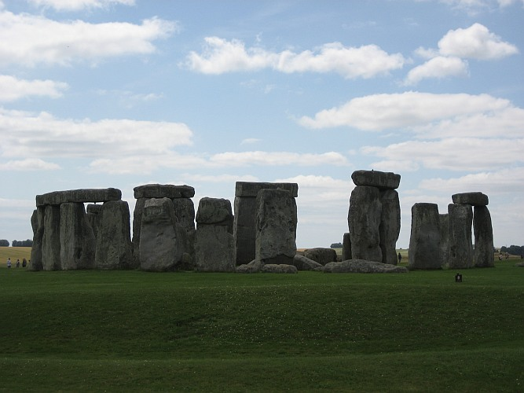
The Ancient British Language
The language spoken by the ancient Britons (Hebrews) can be dated back at least 4000 years. It now only survives in Wales and Brittany in France, although efforts are being made to revive the Cornish language, another branch of what is known as the Brythonic languages.

Slide 6
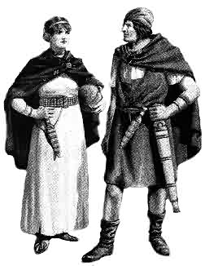
The Ancient British Language
Left: Ancient Britons who were the early Hebrew settlers. Every detail on this reconstruction of the dress and equipment of a man and a woman of 2,000 BC is based upon contemporary material remains.

Slide 7
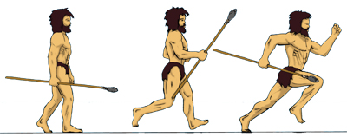
The Ancient British Language
But the history books would have you believe that the inhabitants of the British Isles prior to the Roman invasions were savages!

Slide 8
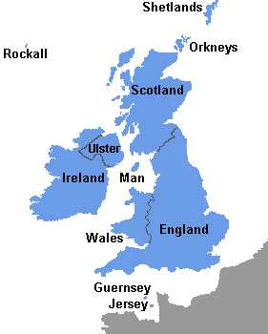
The Ancient British Language
"A comparison of the various languages spoken in Britain, Ireland and Gaul in the time of Caesar, in so far as their elements are now ascertainable leads to the conclusion that those tribes and "nations", who spoke them, though torn asunder by dissension, and widely separated by locality, constituted substantially but one people.” (Professor T. Nicholas.)
Notes:
The Various Languages Spoken In Britain, Ire­land And Gaul
Professor T. Nicholas
(Harold Stough Notes)
"A comparison of the various languages spoken in Britain, Ire­land and Gaul in the time of Caesar, in so far as their elements are now ascertainable leads to the conclusion that those tribes and "nations", who spoke them, though torn asunder by dissension, and widely separated by locality, constituted substantially but one people."
(Professor T. Nicholas, Prof. of Biblical Literature/in the Presbyterian College, Carmarthen: Welsh Antiquary and Governor of the University of Wales; in "The Pedigree of the English People" pp 27.28.)
Presbyterian College, Carmarthen

Slide 9
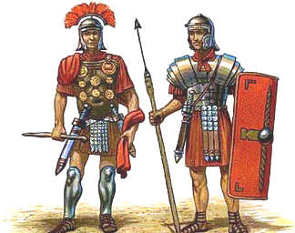
The Ancient British Language
With the Roman Invasion in 43AD onwards, the Brythonic language survived alongside Latin, and some Latin words were added to the language.
Roman Soldiers

Slide 10
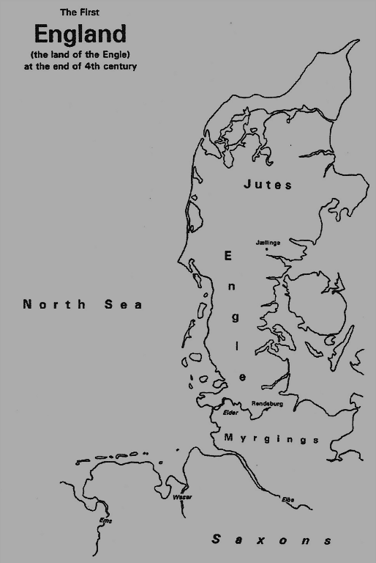
The Ancient British Language
The Brythonic language (Welsh) survived alongside Latin for many centuries until the ever increasing invasion of Angles and Saxons from Jutland would have consequences for the Brythonic language speakers. The language spoken by the Anglo-Saxons was also related to Hebrew, it had become changed while in Assyrian captivity.
The Jutland Peninsular

Slide 11
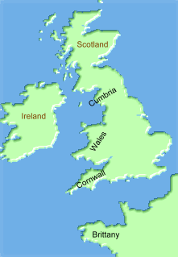
The Ancient British Language
These invasions caused the indigenous Britons to be pushed both north and west and similarly on the continent into Brittany. They became isolated from one another and evolved into 4 separate languages known as Cumbrian, Welsh, Cornish and Bretton.

Slide 12
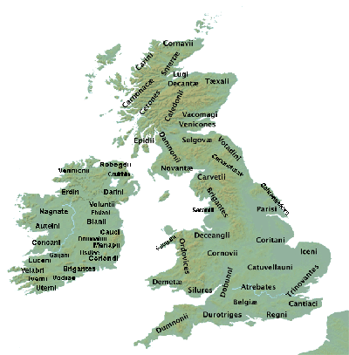
The Ancient British Language
From then the Brythonic language developed separately in Wales, Cornwall, Brittany and Cumbria, and the Welsh language was born.
Tribes of Britain during the Roman occupation

Slide 13
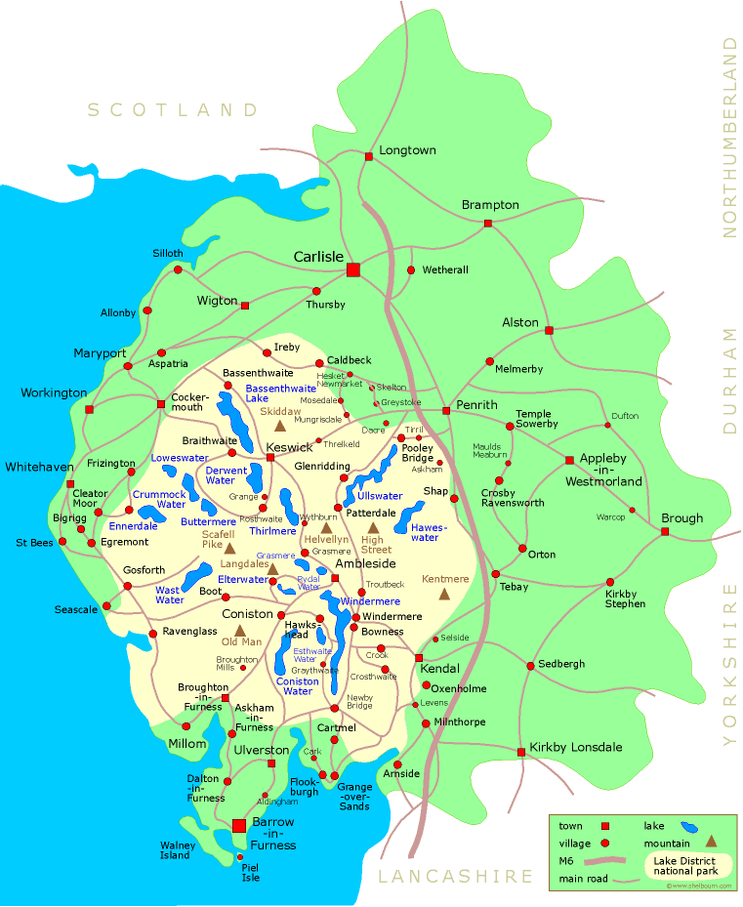
The Ancient British Language
The Celtic language in Cumbria died out in the 14th century.
Cumbria

Slide 14
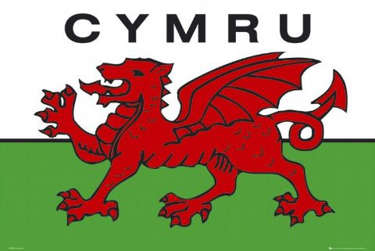
The Ancient British Language
The Welsh language was born from the old Brythonic language and it is still spoken today in parts of Wales

Slide 15
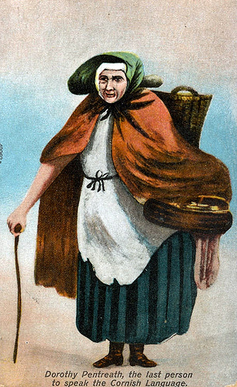
The Ancient British Language
Cornish having nearly died out is now experiencing a revival. Left: is Dolly Pentreath the last person to speak the Cornish language.
Dolly Pentreath (1685-1778)

Slide 16
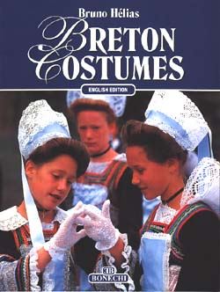
The Ancient British Language
Breton is still widely spoken in the area of Brittany in Northwest France.

Slide 17
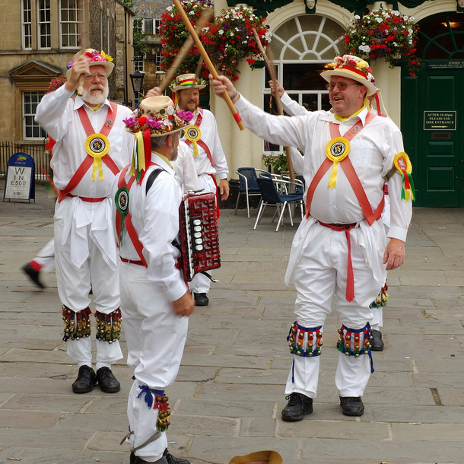
The Ancient British Language
Yahweh determined that English would be the tongue of the 2 most powerful Israelite nations, namely Britain and the USA.
English Morris Dancers maintaining the traditions of ancient Britain

Slide 18
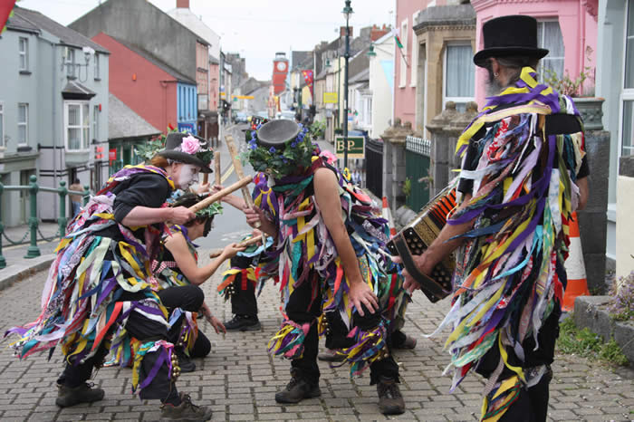
The Ancient British Language
No doubt Yahweh also ensured that there would be a remnant speaking the ancient tongues more closely related to Hebrew as a witness to our origins!

Slide 19
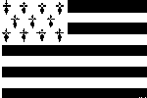
The Ancient British Language
English Saesneg | Welsh Cymraeg | Cornish Cernyweg | Breton Llydaweg
short arm a rock a sheep a swallow a lamb | byr braich carreg dafad gwennol oen | bear breh carrack davas gwennol oan | berr brec'h karreg danvad gwennel oan
The similarities between the languages can be seen from the examples above

Slide 20
The Ancient British Language
Dr.Jones notes that the term, ‘Welsh’, has Saxon origins and comes from a word meaning ‘foreigner’. However, the Welsh word for itself, Cymraeg, means ‘language of the kinsmen’ Cymraeg is a Celtic language in a Indo-European lineage.
Dr R Brinley Jones CBE MA DPhil FSA,

Slide 21
The Ancient British Language
It belongs to the Insular Celtic languages rather than the Continental Celtic languages and it is, ‘a branch of the Brittonic group’ (akin to Cornish and Breton) rather than Goidelic (referring to Irish, Gaelic and Manx)

Slide 22
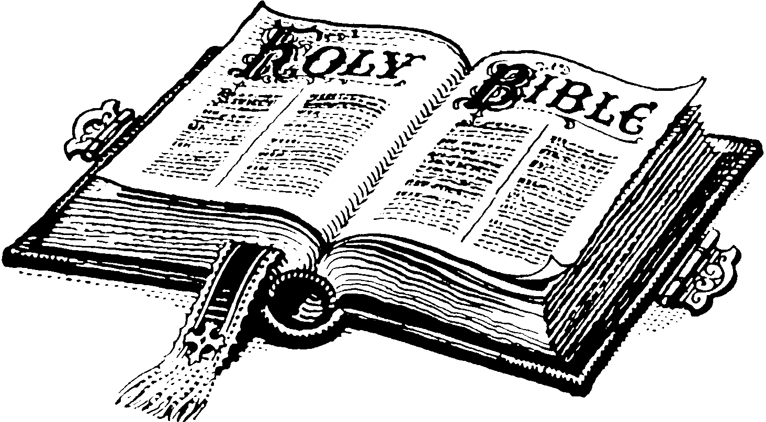
The Ancient British Language
It is interesting that the language of Welsh is referred to by themselves as the language of the kinsmen, because the word gentile means precisely that from its Latin origin, so where the KJV Bible uses gentile instead of people or nation in many instances it is referring to the Celtic-Germanic-Anglo-Saxon peoples!

Slide 23
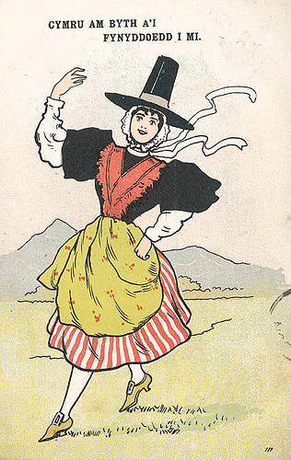
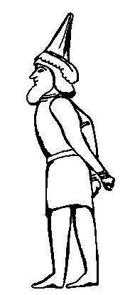
The Ancient British Language
Not only is the language similar but so is the Scythian custom of wearing pointed hats like those worn by welsh ladies.
Sakan king Of The Skuka

Slide 24
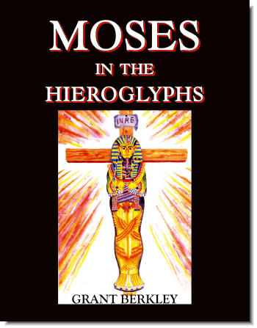
The Ancient British Language
Grant Berkley, the author of the book “Moses In The Hieroglyphs” shows how the Welsh language can be used to decipher Egyptian cartouches and consequently that the generally accepted chronology of the pharaohs is in error.

Slide 25
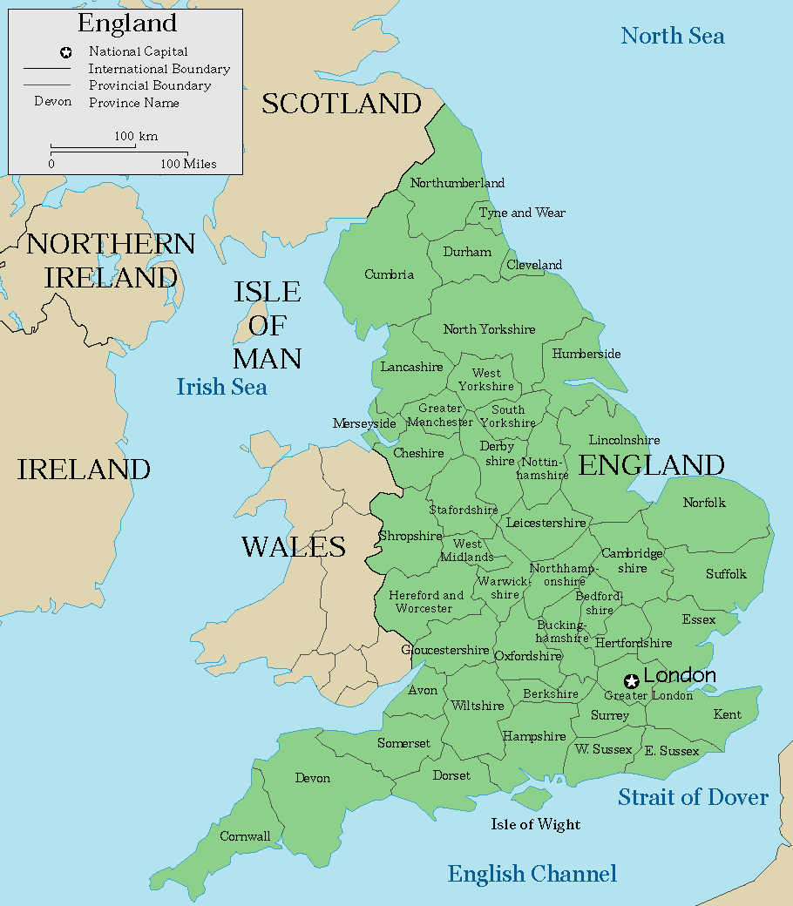
The Ancient British Language
The pre-Anglo-Saxon ‘England’ would have been the Kingdom of Lloegria and it is interesting to note that the modern Welsh for England is Lloegr
England

Slide 26
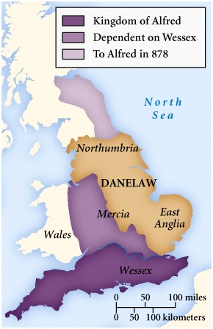
The Ancient British Language
With the expansion of English power over many formerly Brythonic speaking areas steps would be taken to try and eradicate these competing languages.
England

Slide 27
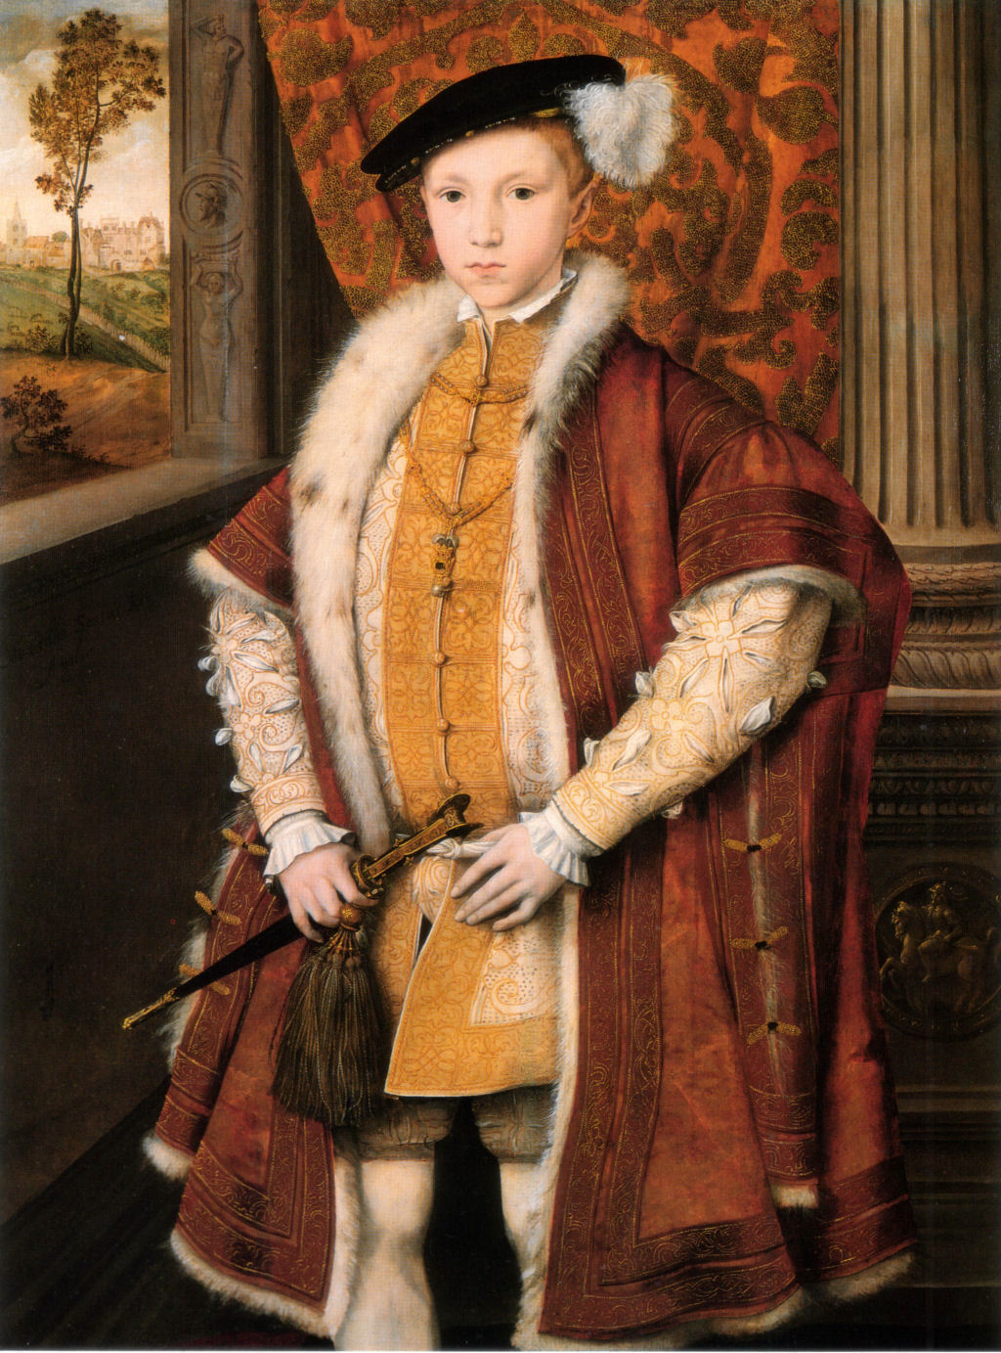
The Ancient British Language
The first major pressure on Welsh and other non English tongues came in 1549 Edward VI passed the Act of Uniformity, which came into law in 1552 and required all acts of public worship to be conducted in English instead of Latin.

Slide 28
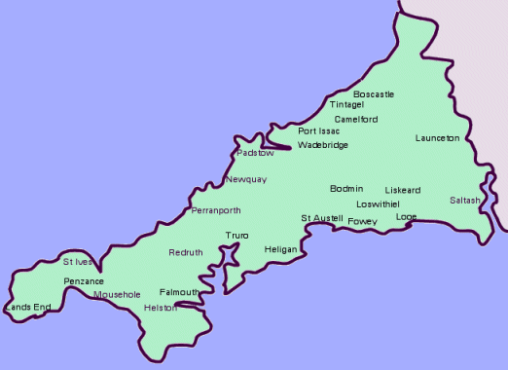
The Ancient British Language
In Cornwall the act caused a rebellion among Cornish speakers which resulted in thousands of deaths. Wales escaped similar suffering, yet the act seemed to signal the end for the language.

Slide 29
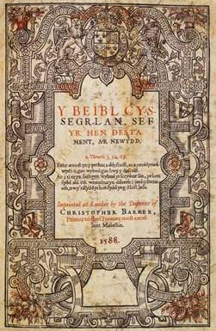
The Ancient British Language
Nonetheless, in 1563 Elizabeth I introduced legislation which appeared to contradict the 1549 act. It required all churches in Wales by 1567 to have Welsh translations of the Book of Common Prayer and the Bible alongside the English versions.

Slide 30
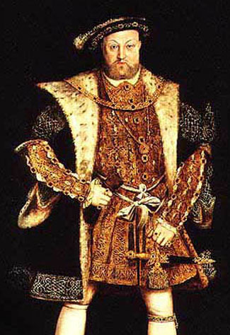
The Ancient British Language
Under his son, Henry VIII of England, the Laws in Wales Acts 1535-1542 were passed, annexing Wales to England in legal terms, abolishing the Welsh legal system, and banning the Welsh language from any official role or status.
King Henry VIII

Slide 31
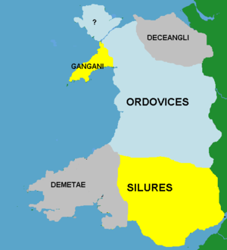
The Ancient British Language
For the first time the England-Wales border was defined. They also abolished any legal distinction between the Welsh and the English, thereby effectively ending the Penal Code although this was not formally repealed.
The Welsh Tribes

Slide 32
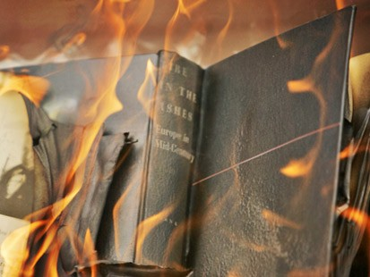
The Ancient British Language
Banning the Welsh language from any official role or status was used as an excuse for destroying all official records written in the “Welsh” and as a consequence much of our ancient history has been lost.
The destruction of official records

Slide 33
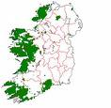
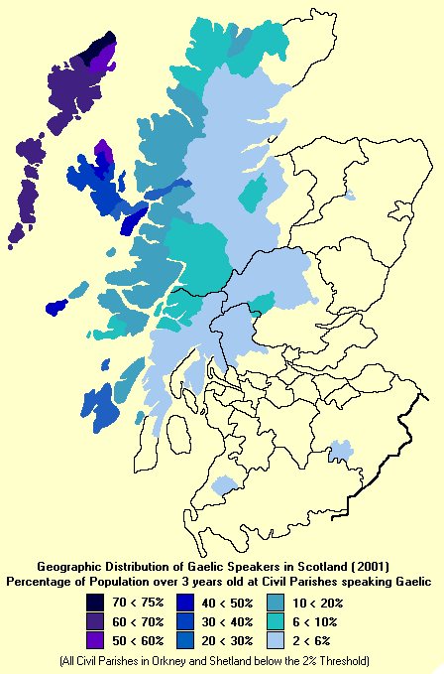
The Ancient British Language
The other distinctive branch of the Brythonic language is Gaelic and is spoken in Scotland, Ireland and the Isle of Man (Manx)

Slide 34
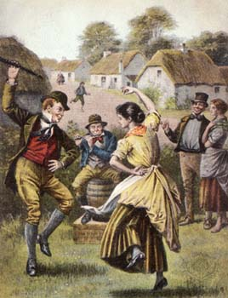
The Ancient British Language
The HEBREW word for Festival is "MOED." The annual Scottish Gaelic musical festival is known as the "MOD." Another HEBREW word for Festival is "CHAG." The Scotch and Gaelic dance is called a "JIG."
Advert for a Scottish MOD
Irish villagers dancing a jig

Slide 35
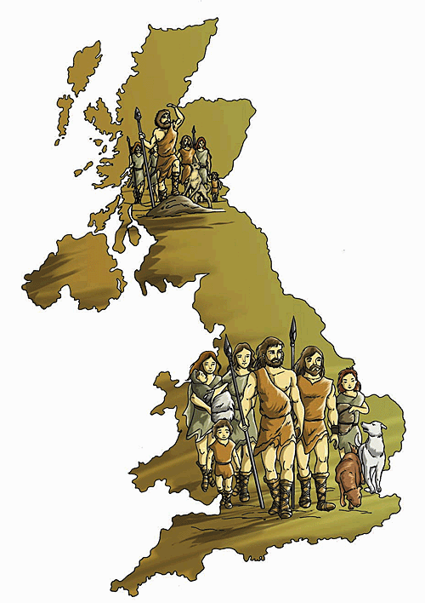
The Ancient British Language
The Celtic language in the British Isles consisted of two distinct groups; Giodelic (Gaelic or Q-Celtic) and Brythonic (British or P-Celtic). Gaelic was spoken in Ireland, the Highlands and Islands of Scotland, and the Isle of Man. The rest of Britain including Wales spoke Brythonic.

Slide 36
The Ancient British Language
Interestingly, the 2 branches of the Celtic language relate to 2 major migrations of Hebrews from the east.
The very earliest migration of Hebrew people is represented by the Brythonic speaking Celts in the southern part of the UK.

Slide 37
The Ancient British Language
The later migration of Hebrews who came from Egypt prior to the Exodus spoke in the Giodelic (Gaelic) tongue. The Hebrew had evolved while in Goshen.

Slide 38
The Ancient British Language
That this later migration were Hebrews is confirmed following the discovery of a rare book “Ancient History of Caledonia” by John Maclaren giving a detailed description of their journey via Troy, Carthage, Sicily, Gaul, Spain and eventually landing at Montrose in Scotland.
Ancient History Of Caledonia
Notes:
There were only 2 copies of the book “Ancient History of Caledonia” by John Maclaren, published in 1879 known to Bibliography, one being in the Westminster museum in Canada.
Then a 3rd copy turned up which was discovered by Frank Gibb McIntyre of Possilpark, Glasgow, in the bookcase of Frank Wills of Balquhidder, Argyllshire about 1905 and sent to John McIntyre, Calgary, Alberta, Canada, by Frank Wills Jr., school Principal at Bellfield, Lanarkshire about March, 1938.

Slide 39
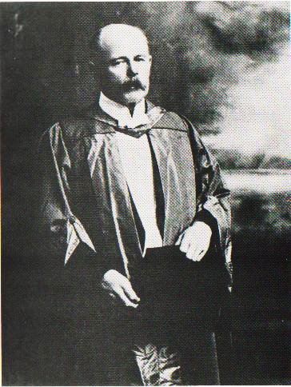
The Ancient British Language
But of course this book has been dismissed as fairy tales by academia! However, this book is still being researched by Dr. Alan Patterson of Newcastle . This is a colossal undertaking so any assistance would be welcome. The facts in this book are proving to be correct …..
Notes:
PROFESSOR W H WARREN,

Slide 40
The Ancient British Language
Those in identity are familiar with the stone of destiny having come to Britain, but not of the fact that it came with a marble chair (throne) as described in the book.

Slide 41
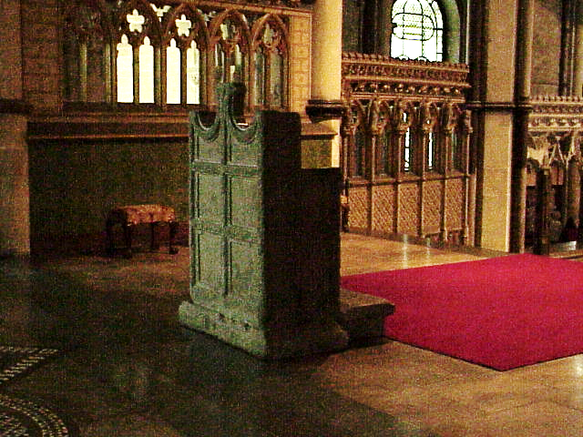
The Ancient British Language
It’s a long story, but it was traced to Canterbury Cathedral, where it is known as “St. Augustine's Chair”, although he never sat in it!

Slide 42
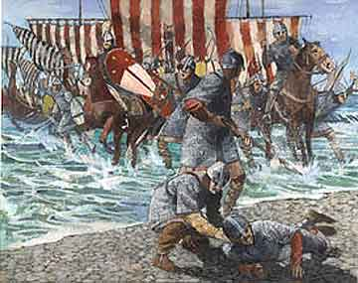
The Ancient British Language
The last major influence in moulding the English language into what it is today was the Norman invasion of England in 1066

Slide 43
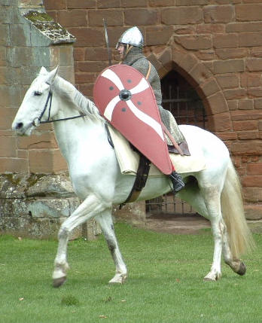
The Ancient British Language
According to the late Dr. Wesley Swift, the Normans were the descendents of the Galileans of Christ's day whom were given a special dispensation to leave prior to the sacking of Jerusalem.

Slide 44
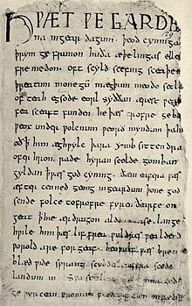
The Ancient British Language
The English spoken by the common people until the Norman invasion was very close to that spoken by our Germanic cousins on the Continent as well as the Gothic script used in written documents.

Slide 45
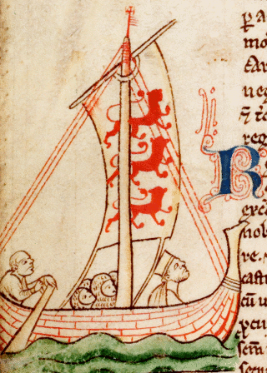
The Ancient British Language
The original Normans spoke a Romance language of northern Gaul which has now been replaced by French to which it is related but it is still spoken in parts of Normandy as a second language.
A Norman Ship

Slide 46
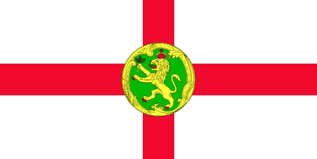
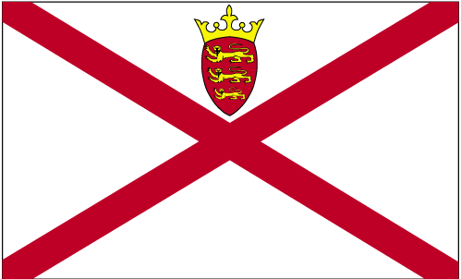
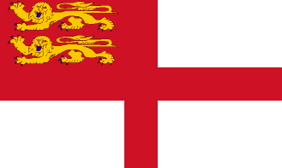
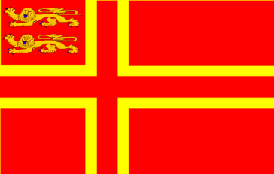
The Ancient British Language
Guernsey
Alderney
Jersey
Sark
A form of the old Norman language still lingers on in the Channel Islands where English is predominant and in Normandy where French is predominant.
Normandy
Notes:
Langues d'oïl is the linguistic and historical designation of the Gallo-Romance languages originating from the northern territories of Roman Gaul, which today make up northern France, part of Belgium, and the Channel Islands. These languages have all been replaced by Standard French (an oïl variety itself) as the official and predominant language in their territories, except in the Channel Islands, where English is the predominant language.

Slide 47
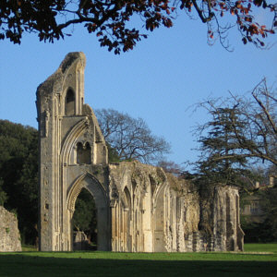
The Ancient British Language
The Normans were renowned for being builders of cathedrals and other fine buildings. One such, was the famous Glastonbury Abbey, now in ruins seen here on the left.
Glastonbury Abbey

Slide 48
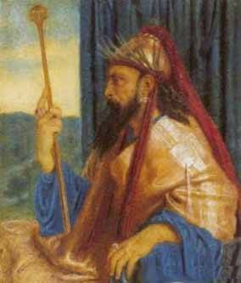
The Ancient British Language
Jewish, Hebrew Scholar of the last century, Dr. Moses Margoliouth, made the following comment: “A small remnant of Solomon’s subjects remained in Cornwall since that time (the time of the building of his Temple).
King Solomon

Slide 49
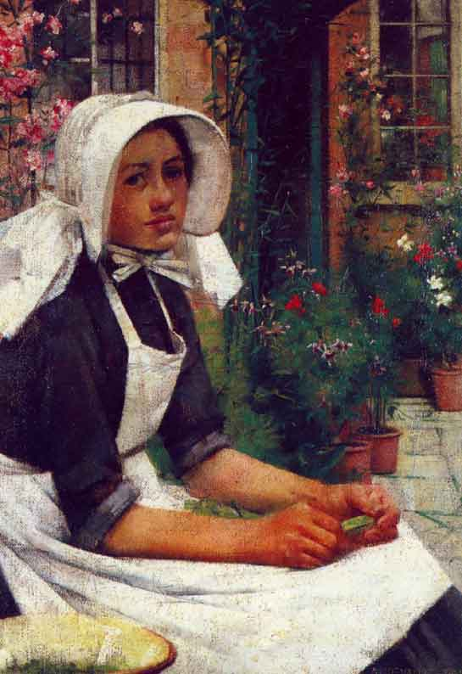
The Ancient British Language
I have traced that remnant by the paths of philology, and the byways of nomenclature. I might adduce an array of whole sentences, exactly alike in the languages of Hebrew and the ancient Cornish.
Cornish Costume

Slide 50
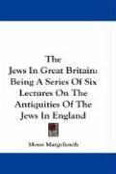
The Ancient British Language
I might adduce some of the proper names which prevailed among the aboriginal Britons long before they knew anything of Christianity, such as Adam, Abraham, Asaph, …Daniel, Solomon…(The Hebrews In East Anglia [1870], Margoliouth).’

Slide 51
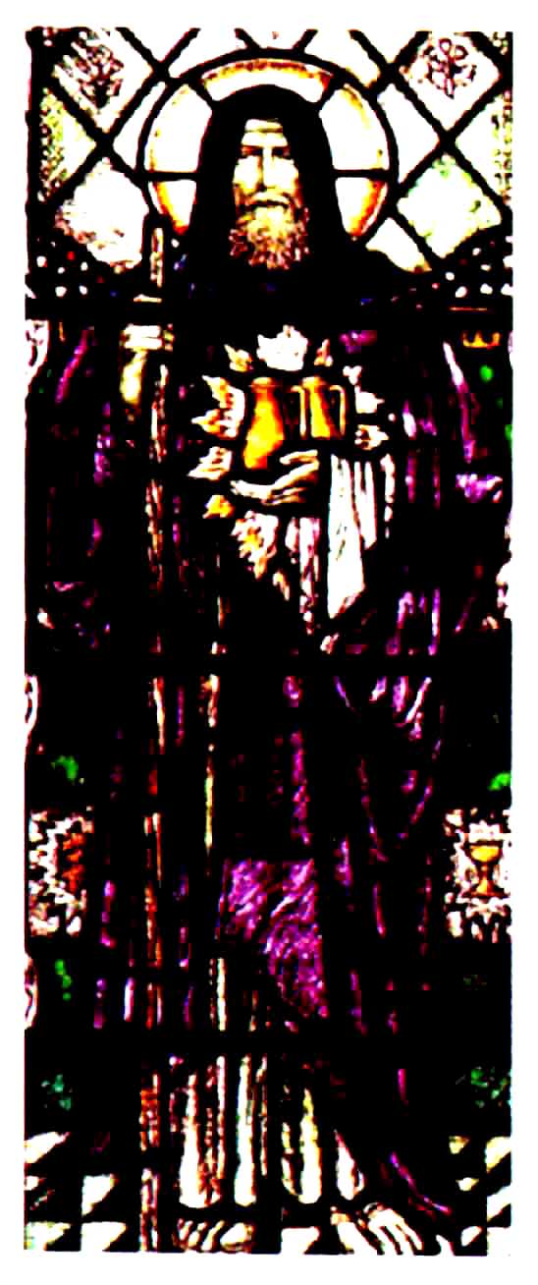
The Ancient British Language
That there were Hebrew colonies in Cornwall, England, is not surprising to those who realise that Yahshua’s uncle, Joseph of Arimathea, was a Roman Decurio,
Joseph of Arimathea

Slide 52
The Ancient British Language
…. having supervision over the tin mining (and probably mining generally, whether iron, copper or tin). He is remembered in song by miners and residents of that area still in the song: “Joseph Was A Tin Man.”
A Cornish Tin Mine

Slide 53
The Ancient British Language
Judges 12:6 says the Ephraimites had trouble pronouncing the aspirate "h" in Shibboleth. In Britain today, especially the Cockney, can't pronounce it either. You still hear, "Don't be so oggish with your horanges."
Cockney Pearly King & Queen

Slide 54
The Ancient British Language
Likewise Germans are unable to pronounce “h” in th such as “the” which becomes “der” and the famous German poet, Johann Wolfgang von Goethe, whose surname is pronounced “gerta” – thus this is another mark of the Hebrew ancestry of the German people and language.
Johann Wolfgang von Goethe

Slide 55
The Ancient British Language
This concludes the overview of how the 4 major waves of Hebrew migrants have influenced the English language as spoken today.
The 4 waves were:
The brython speaking Hebrews.
The Caledonians (Chaldeans) from Egypt.
The Anglo-Saxons post captivity Hebrews.
The Normans – the Hebrews from Galilee and Judea.
2
3
1
4

Slide 56
The Ancient British Language
That the ancient British languages are closely related to the Hebrew language is attested to by many secular sources.
Notes:
The great Dr. M' Gregor, pioneer evangelist and poet of Nova Scotia, his biographer tells us, wrote a book, now unfortunately unobtainable, on the relation between the Gaelic and Hebrew languages

Slide 57
The Ancient British Language
The biography of the great Dr. MacGregor, pioneer evangelist and poet of Nova Scotia mentions that: Now, you can take any sentence in Hebrew and change it into Gaelic, word for word, without altering the order of a single word or particle, and you will have the correct Gaelic idiom in every case.

Slide 58
The Ancient British Language
You cannot do that with any other language in Europe. Every boy who speaks Gaelic as his mother-tongue, and who enters upon the study of Hebrew, is at once impressed by this fact."

Slide 59
The Ancient British Language
Hew B. Colquhoun, in his work Our Descent from Israel (1940) states: "Ga-el = Goi-el (Hebrew), signifying 'Nation of God'
An Old Gaelic Blessing

Slide 60
The Ancient British Language
The Highland Society's Dictionary of the Gaelic language, in four large volumes ....gives cognate Hebrew roots for approximately one-half of all the roots in the Gaelic language.

Slide 61
The Ancient British Language
Lochcarron.
Rev. Lachlan Mackenzie, of Lochcarron.... held strongly that the ancestors of the Kelts, when they reached the shores of Britain, spoke the Hebrew language.

Slide 62
The Ancient British Language
According to Vallencey, 'the language of the early inhabitants of Ireland was a compound of Hebrew and Phoenician,’

Slide 63
The Ancient British Language
Entire sentences of archaic Hebraisms are similarly to be found in the now obsolete Cornish language, and there are 'several thousand words of Hebrew origin' in the Erse or Gaelic.

Slide 64
The Ancient British Language
and this statement would appear to be substantiated by the curious fact that in 1827, the Bible Societies presented Hebrew Bibles to the native Irish in preference to those printed in English, as it was found that the Irish peasants understood Hebrew more readily than English....

Slide 65
The Ancient British Language
The Isle Of Canna - Scotland
A possible Hebrew/Aramaic and Celtic/Gaelic link is revealed, for example, in such names as Isa and Iosa, Cana (Galilee) and Canna (a western Isle of Scotland),

Slide 66
The Ancient British Language
Hebrew and Hebrides and the Hebrew word Ath in Athol, Scotland. The Hebrew prefix ATH figures in a number of Celtic place names throughout the British Isles and Ireland
8th Duke of Athol

Slide 67
The Ancient British Language
In Godfrey Higgins classic work The Celtic Druids published in 1829, he comments on the western isles of Scotland, saying: "The language of the islands was a dialect of the Hebrew, or of the same language as the Hebrew,

Slide 68
The Ancient British Language
…. and in it the word Iona was found to mean dove." According to Jacob Bryant in his New System of Ancient Mythology, both Antioch in Asia Minor, and Gaza in Palestine, were originally called Jonah' (Dove).
Isle Of Iona (Jonah)

Slide 69
The Ancient British Language
Interestingly, Tertullianus, one of the most celebrated of the Latin Fathers, who embraced the Christian faith during the 2nd century A.D., refers to the early Christian Church as Columbus Domus, the House of the Dove.

Slide 70
The Ancient British Language
Caledonia, another name for Scotland, is derived from Chaldean - Abraham was a Chaldean
The Arms Of The Caledonian Railway Company

Slide 71
The Ancient British Language
These people, the Chaldeans. were the followers of wisdom, and thus the Goddess Cali, whom we have found near Cape Comorin was Wisdom;
Cape Comorin S. India

Slide 72
The Ancient British Language
… and the Calidei of Iona or Columkill were followers of wisdom; and the language of these people was Hebrew, which was Celtic, which was the Gael, of Scotland ….
A Rock Carving Of Chaldean Soldiers

Slide 73
The Ancient British Language
…. the learned Celt or Hebrew, the language of Abraham, of South India, and of the Chaldeans; and this, at last, brings us almost to a conclusion, to which we have come by a variety of other ways,
Abraham And Isaac

Slide 74
The Ancient British Language
… that the Hebrew was the sacred language, and was probably the first language into which the mythos was written. Whence CALedonia?

Slide 75
The Ancient British Language
Other writers give the derivation as from the Hebrew Derussim, or Drussim, which means `contemplators.' .....Another explanation given is that it is an old Celtic word, druis, formed from trowis, or truwis, meaning 'a doctor of the faith.' Trowis, in German, means 'a revealer of truth'."
A British Druid

Slide 76
The Ancient British Language
Dudley Wright, who says. "The Celtic meaning of the word Druid is 'to enclose within a circle' and the word was used in the sense of `prophet' or 'one admitted into the mysteries of the inner circle.'

Slide 77
The Ancient British Language
However, Jews who claim to be Israel do not speak Hebrew. Yiddish is their language. It is an amalgam of Asiatic, Polish and German languages; such Hebrew words that may be in Yiddish would have been assimilated from European tongues that were derived from Hebrew.
New York Jews

Slide 78
The Ancient British Language
Dr. Van Dyck: I need not tell you that Yiddish, the language spoken by the Jews throughout the world to-day, is an Aryan language,
Dr. Van Dyck

Slide 79
The Ancient British Language
a mixture of German and Polish, with only a few Hebrew words mixed in, but disguised by being written in Hebrew characters. Outside of that, it has far less affinity with Hebrew than Keltic has."
Yiddish

Slide 80
The Ancient British Language
An event would take place in Hampton Court in 1604 that would have a profound effect upon the English language

Slide 81
The Ancient British Language
The beginnings of what many consider to be the "noblest monument of English prose" or the "word of God in English" – the King James Authorized Version – can be traced back to 1604; and specifically, the Hampton Court Conference held in January of 1604.

Slide 82
The Ancient British Language
Wrought iron gates to Hampton Court Palace
The owners of the land upon which the Palace now stands can be traced back to before the Norman Conquest of 1066.

Slide 83
The Ancient British Language
For hundreds of years the large tract of land contained a manor house and fields for grazing and farming. King Henry VII (1457–1509) and his wife spent time at Hampton Court during his quarter-century reign (1485–1509) before it became a king’s palace.
King Henry VII

Slide 84
The Ancient British Language
The King James Bible would be instrumental in preserving a uniformity of language in the English speaking countries and colonies until eventually it would displace French as the international language of diplomacy and commerce.

Slide 85
The Ancient British Language
The King James Authorised Bible besides being read in the Anglican church and those of other denominations throughout the English speaking world ….

Slide 86
The Ancient British Language
The King James Bible was also used in schools throughout the English speaking world to teach English besides just for religious instruction.

Slide 87
The Ancient British Language
… Consequently there has been little deviation from the original language and with continued emigration from the homeland the language of the various settlements evolved together, so today we can still converse with each other.

Slide 88
The Ancient British Language
The Bible has an inbuilt dictionary where difficult words are explained. Many of these were actually used in the original Webster’s Dictionary. Hence the Bible was an ideal textbook for teaching reading and English.

Slide 89
The Ancient British Language
Like a good school textbook the first book of the scriptures namely Genesis, the reading is fairly easy.
The story is told of a man with a low reading ability who was given a Bible and having read it through had a top grade when tested again.

Slide 90
The Ancient British Language
Having progressed from Genesis to the final book of Revelation, the reader is now in the section with the most difficult language and having mastered this will become proficient in the English language. The Bible is the lynch pin of the English language.

Slide 91
The Ancient British Language
While the “King James Bible” is one of the better editions, scholars are well aware of its many translational errors. No doubt Yahweh used this Bible for a twofold purpose, namely, to bind his people together but also allowed in errors in order to put his people under a strong delusion because of their disobedience.

Slide 92
The Ancient British Language
People of the other Israelite nations in Europe speaking other languages, increasingly have English as their second language.
The English language is the one that is uniting his people scattered around the world.

Slide 93
The Ancient British Language
The enemy is only just now realising the unifying effect and power of the English language and is working overtime to destroy it.
They are doing this by stealth, by substituting other languages along side English.
Above the sign that greets passengers alighting at Southall railway station!

Slide 94
The Ancient British Language
The English language is being further attacked by encouraging the resurgence of the old Celtic languages where previously they had been ruthlessly suppressed.

Slide 95
The Ancient British Language
Despite these attacks English is the world’s most widespread language

Slide 96
The Ancient British Language
Likewise in the USA, Spanish is being introduced alongside English and in many towns in the southern States, English is no longer the predominant language.
One of many multi-lingual signs popping up in America.

Slide 97
The Ancient British Language
Through the ages, the learned and rulers, communicated with each other in a common language from Egyptian to Greek, Latin and finally English.
The Ancient Library of Alexandria

Slide 98
The Ancient British Language
In the 19th and early 20th centuries there were 3 competing international languages with English – Latin in the Catholic church and Universities, French as an international diplomatic language and German as international scientific language. However English prevailed

Slide 99
The Ancient British Language
When a vote was taken to decide what would be the common language of the USA, English won by only one vote over the German language. This was another deciding factor on English becoming the international language of the world.

Slide 100
The Ancient British Language
However, the enemy as always tried to thwart Yahweh's plans by substituting their own international language – namely Esperanto, but this was a dismal failure. Note the Idumean 5 pointed star on the Esperanto logo.

Slide 101
The Ancient British Language
Oxford University whose origins can be traced back to the great centres of learning in Greece, has been guardian of the English language by producing definitive dictionaries. Oxford University Press also prints and distributes the KJV Bible. The Greeks of course were Israelites.

Slide 102
The Ancient British Language
Oxford University produces a variety of dictionaries from relatively small ones up to the Greater Oxford Dictionary - GOD. The smaller one – the Concise Oxford Dictionary is known as COD

Slide 103
The Ancient British Language
The intermediate one – the shorter Oxford Dictionary is know as SOD.

Slide 104
The Ancient British Language
The definitive Greater Oxford Dictionary of all English words runs into several volumes as English has one of the largest vocabularies. And is known as GOD.

Slide 105
The Ancient British Language
Dr. Wesley Swift made reference to the great centres of learning being in On in Egypt, thence to Alexandria, Greece and Great Britain.
Model of ancient Jerusalem

Slide 106
The Ancient British Language
The ancient city of Athens was built to replicate the city of Jerusalem, with centres of learning and great libraries.

Slide 107
The Ancient British Language
Edinburgh known as “The Athens Of The North”, also laid out to replicate Jerusalem and a famous centre of learning.

Slide 108
The Ancient British Language
John Britton F.R.A in his “Historical
Topographical And Antiquarian
Sketches Of Wiltshire”, 1814, states; In a tract intituled Historiola Oxoniensis it is affirmed that a University was established here by the Britons,
Cricklade
Notes:
Concerning the origin of this place much diversity of opinion has prevailed among antiquaries and historians. William of Worcester relates that it was formerly called Chelysworth, and constituted part of an ancient parish of that name, extending six miles in circumference.¹ In a tract intituled Historiola Oxoniensis, it is affirmed that a University was established here by the Britons, over which several Greek philosophers presided; and that this seminary was afterwards translated to Oxford by the Saxons. The authenticity of this account, however, though confirmed; is some writers think by the etymology of the term Cricklade, they conceive to be a corruption for Greeklade,

Slide 109
The Ancient British Language
----over which several Greek philosophers presided; and that this seminary was afterwards translated to Oxford by the Saxons. The authenticity of this account, however, though confirmed; is some writers think by the etymology of the term Cricklade, they conceive to be a corruption for Greeklade,
A Painting Of Cricklade

Slide 110
The Ancient British Language
Oxford like all great centres of learning in the Israelite nations has been infiltrated and taken over by the Edomites and no longer proclaim Christian values on which they were founded.

Slide 111
The Ancient British Language
On November 14, 1996, Prince Charles’ 48th Birthday, the stone of destiny was removed from Westminster Abbey, London to Edinburgh Castle, Scotland.
The Stone of Destiny or Jacob’s Pillow

Slide 112
The Ancient British Language
Could it be that the “Stone of Destiny” was preordained to be returned to Judah’s Scottish territory’s capital, Edinburgh, modelled on old Jerusalem in readiness for Yashua’s return as King over his people Israel?

Slide 113
The Ancient British Language
“Salvation shall come to the tents of Judah first”

Slide 114
The Hebrews
And The
English Language
The End

